Slide 1

25 GPU Model
Peter H. Chen

Slide 2
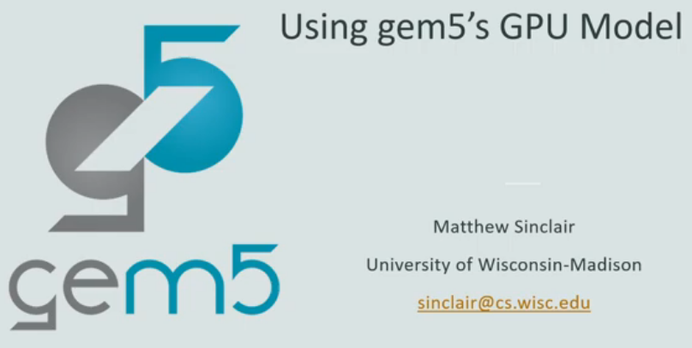
25 GPU Model
https://www.youtube.com/watch?v=Kjd1hTFOI44&list=PL_hVbFs_loVR_8ntTTmmG6YEq3Po_4snu&index=25
GPU Model (0:00 - 0:10/2:01:30)
We discuss how to use Gem5 GPU Model.
Slides are made by Professor Matthew Sinclair, University of Wisconsin-Madison, sinclair@cs.wisc.edu.

Slide 3
25.0 Topics

Slide 4
25.0 Topics
https://www.youtube.com/watch?v=Kjd1hTFOI44&list=PL_hVbFs_loVR_8ntTTmmG6YEq3Po_4snu&index=25
GPU Model (0:10 - 0:15/2:01:30)
Topics:
1. Accelerator: GPU is transformed from Graphic Display Accelerator
2. GPU Threads vs CPU Memory Latency: GPU uses Parallel Threads vs. CPU Caches to handle Memory latency
2. Compare GPU Component in CUDA/HIP and OpenCL: Thread, Warp, Thread Block, and Kernel
3. GPGPU Programming Model: GPU offload the CPU in different phase (kernel).
4. GPU Hardware: GPU, Shared L2 Cache; Thread/SIMT runs inside Core with private L1 Cache, register, and DDR/HBM memory.

Slide 5
25.1 Disclaim/Contributor

Slide 6
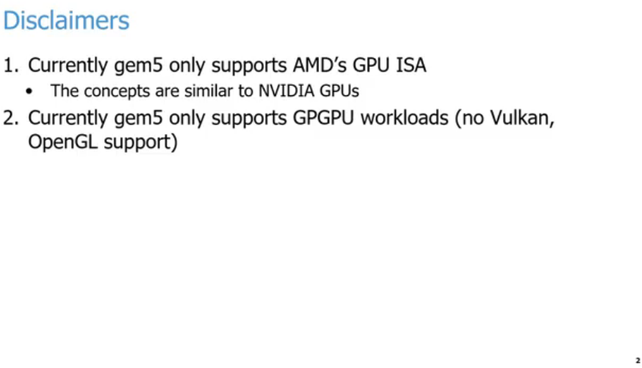
25.1 Disclaim/Contributor
https://www.youtube.com/watch?v=Kjd1hTFOI44&list=PL_hVbFs_loVR_8ntTTmmG6YEq3Po_4snu&index=25
Disclaim: AMD GPU ISA (0:16 - 2:14/2:01:30)
Right now, Gem5 only support AMD GPU/ISA and a little to ARM. But mostly in AMD GPU.
The concepts are similar to other companies, such as, NVIDIA GPU.
We also talks about the general purpose GPU or GPGPU workloads. There is no support for OpenGL or Vulcan.
If you are trying to run the true Graphics workloads. We are not going to talk that today,

Slide 7
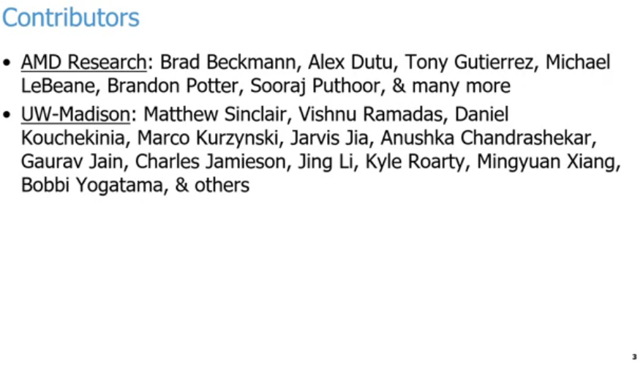
25.1 Disclaim/Contributor
https://www.youtube.com/watch?v=Kjd1hTFOI44&list=PL_hVbFs_loVR_8ntTTmmG6YEq3Po_4snu&index=25
Contributor (0:16 - 2:15/2:01:30)
Right now, Gem5 only support AMD GPU/ISA and a little to ARM. But mostly in AMD GPU.
The concepts are similar to other companies, such as, NVIDIA GPU.
We also talks about the general purpose GPU or GPGPU workloads. There is no support for OpenGL or Vulcan.
If you are trying to run the true Graphics workloads. We are not going to talk that today,

Slide 8
25.2 Setup Docker

Slide 9
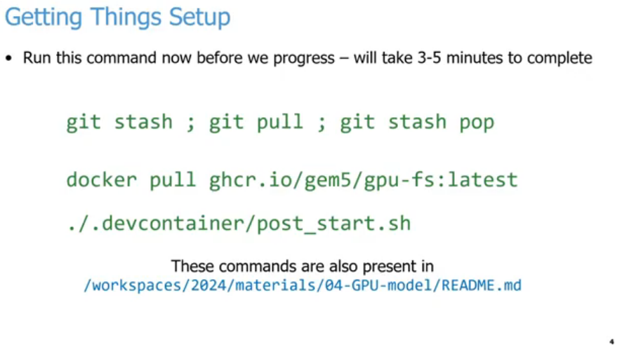
25.2 Setup Docker
https://www.youtube.com/watch?v=Kjd1hTFOI44&list=PL_hVbFs_loVR_8ntTTmmG6YEq3Po_4snu&index=25
Setup Docker (2:16 - 4:30/2:01:30)
Below is the commands to setup docker image code to run the code.

Slide 10
25.3 Programmability vs Efficiency

Slide 11
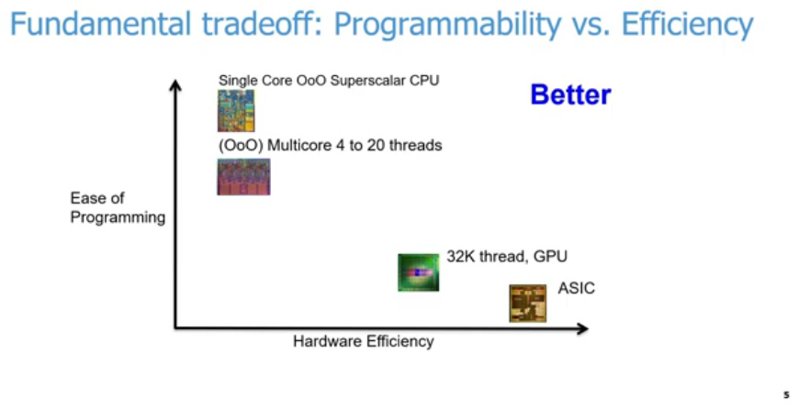
25.3 Programmability vs Efficiency
https://www.youtube.com/watch?v=Kjd1hTFOI44&list=PL_hVbFs_loVR_8ntTTmmG6YEq3Po_4snu&index=25
Programmability vs Efficiency (4:31-6:00/2:01:30)
Below diagram, we have trade-off of easy program in y-axis versus hardware efficiency in x-axis. We want to have both as much as possible but not always in agreement.
1. We have single CPU with OoO (out of order) core is the superscalar processor is easier to write our code. The compiler will compile it and run on X86, AMD, ARM, etc. We don’t need to specify optimization to get result easily. The easy of programming is very high. It is a general purpose of hardware system. We can run it for a lot of hardware. but the efficiency is low.
1
3
4
2

Slide 12
25.3 Programmability vs Efficiency
https://www.youtube.com/watch?v=Kjd1hTFOI44&list=PL_hVbFs_loVR_8ntTTmmG6YEq3Po_4snu&index=25
Programmability vs Efficiency (6:01-6:30/2:01:30)
2. On the other end of the spectrum, we have ASIC ( A specific IC). We design ASIC for specific functionality with specific hardware. The hardware efficiency is good but very difficult to write the program. The easy of programming will be very low. We have to write assembly (simpler if provided) or analog accelerator to tune up hardware wires (very complicated).
1
3
4
2

Slide 13
25.3 Programmability vs Efficiency
https://www.youtube.com/watch?v=Kjd1hTFOI44&list=PL_hVbFs_loVR_8ntTTmmG6YEq3Po_4snu&index=25
Programmability vs Efficiency (6:31-6:50/2:01:30)
3. In the middle of the spectrum is OoO (Out of Order) Multicore CPUs with 4 to 20 threads. Now, we have to write the CPU code to harness for parallelism. We have better hardware efficiency tan single threaded core OoO CPU in code parallelism.
1
3
4
2

Slide 14
25.3 Programmability vs Efficiency
https://www.youtube.com/watch?v=Kjd1hTFOI44&list=PL_hVbFs_loVR_8ntTTmmG6YEq3Po_4snu&index=25
Programmability vs Efficiency (6:51-7:40/2:01:30)
4. GPUs fall at somewhere on the other end of below diagram. We can have thousands, millions, billions, etc. of threads running in parallel. The hardware efficiency is better than those CU based solutions but they will not reach the level of ASIC. The programming of GPUs will be harder than a CPU.
In GPUs. we need to think of thousands, millions, billions, etc. threads.
In the CPU, the threads is only at maximum of 64 threads.
In GPUs, we have more magnitude or more concurrency to think than CPU. The trade off is between the harder of write code and better hardware efficiency.
1
3
4
2

Slide 15
25.4 Accelerator

Slide 16
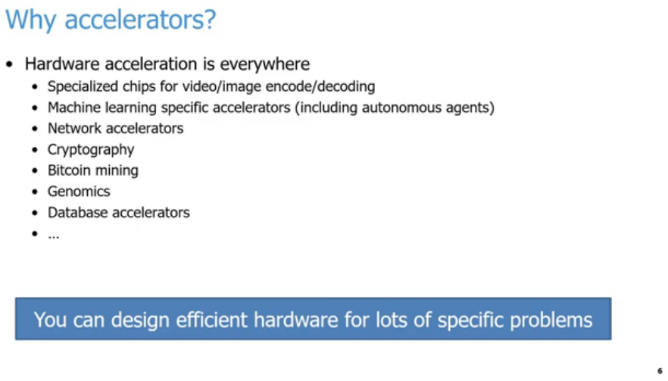
25.4 Accelerator
https://www.youtube.com/watch?v=Kjd1hTFOI44&list=PL_hVbFs_loVR_8ntTTmmG6YEq3Po_4snu&index=25
Accelerator (7:41-8:10/2:01:30)
In modern day, hardware accelerators is everywhere, especially in encoding and decoding in video, image, cryptography, bitcoin, mining, genomics, database accelerator, network accelerator, machine learning accelerator, deep learning accelerator, Large Language Model accelerator, etc. This is the first reason why we use accelerators.
Computer Architecture: A Quantitative Approach”, John L. Hennessy and David A. Patterson: “We are in golden age of architecture where we can design efficient hardware for lots of specific problems.”

Slide 17
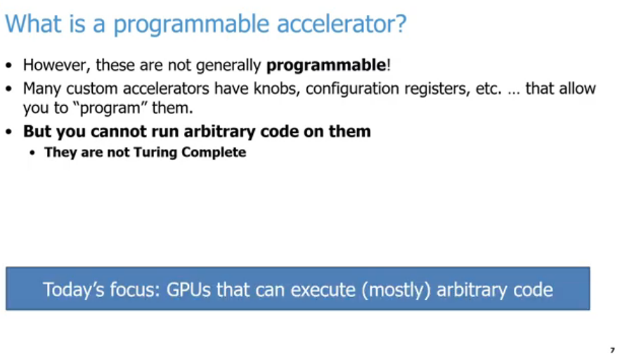
25.4 Accelerator
https://www.youtube.com/watch?v=Kjd1hTFOI44&list=PL_hVbFs_loVR_8ntTTmmG6YEq3Po_4snu&index=25
Accelerator (8:11-8:40/2:01:30)
In general, most of the accelerators are not programmable.
These accelerators programming includes custom knobs, configurations registers, etc. that allow you to program them in some abstract sense.
In general, the accelerators will not run arbitrary code.
Today, we focus a special kind of accelerator, CPUs. We focus on how to run mostly arbitrary code on accelerator, GPUs.

Slide 18
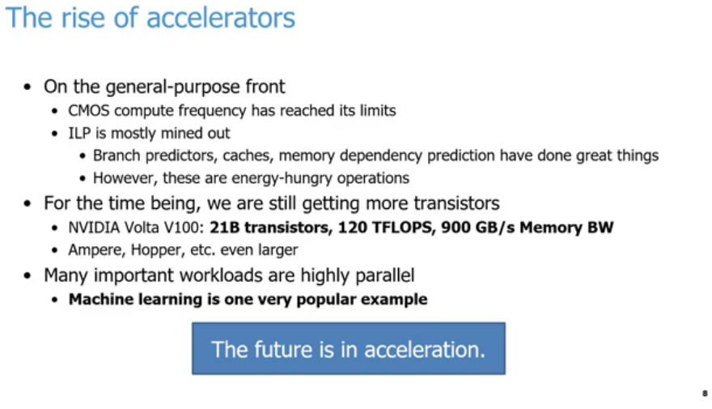
25.4 Accelerator
https://www.youtube.com/watch?v=Kjd1hTFOI44&list=PL_hVbFs_loVR_8ntTTmmG6YEq3Po_4snu&index=25
Accelerator (8:41-9:40/2:01:30)
The second reason why accelerators are becoming so prominent.
1. On the general purpose front end CPU, CMOS compute frequency has reached its limit. We don’t see Intel and AMD really can scaling frequency anymore in the past 10-20 years. The CPU frequency is 1, 2, 4 GHz. They cannot run faster.
2. ILP (Instruction Level Parallelism) is almost dig out their capability for CPU to improve the performance. ILP does a lot of jobs, such as, branch predictors, cache, memory dependency prediction, etc. ILP is a wide variety of techniques to help CPU performance. ILP have done great jobs but ILP are also energy hungry operations.
1
2
3
4
5

Slide 19
25.4 Accelerator
https://www.youtube.com/watch?v=Kjd1hTFOI44&list=PL_hVbFs_loVR_8ntTTmmG6YEq3Po_4snu&index=25
Accelerator (9:41-10:20/2:01:30)
3. Now, we are still get more transistors for Moore’s law. We have NVIDIA GPU continue to grow in billions of transistors, Tera FLOPS of performance, and Terabyte of bandwidth per second.
4. The reason why workloads are highly parallel
5. The reason why accelerator works so well is the workloads are matrix computation. The matrix computation can be paralleled by high speed hardware logic (such as, adder, subtractor, multiplier, and divider) to replace slow software matrix computation. Machine learning, deep learning, and LLM (Large Language Model) are primary reason in recent years.
1
2
3
4
5

Slide 20
25.5 GPU

Slide 21
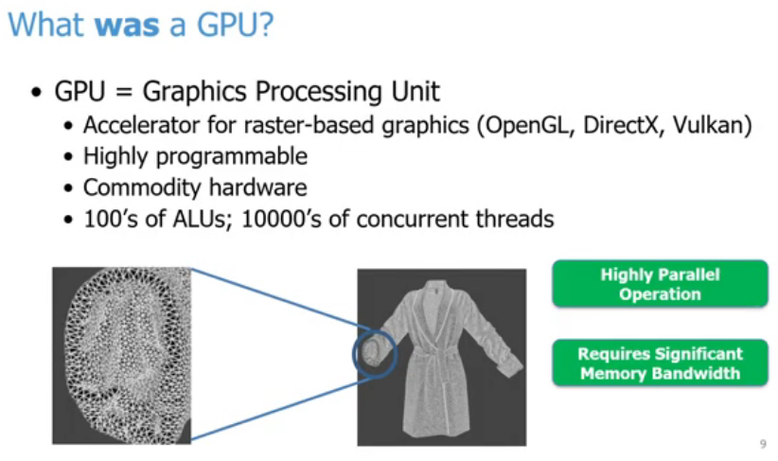
25.5 GPU
https://www.youtube.com/watch?v=Kjd1hTFOI44&list=PL_hVbFs_loVR_8ntTTmmG6YEq3Po_4snu&index=25
GPU (10:21-11:10/2:01:30)
Machine learning began in the 1950s, the commercial GPU was launched in 1999 by NVIDIA GeForce 256, and combining them started around 2004–2006.
In 2012, a famous image-recognition computer model called AlexNet used GPUs to win a major contest. This big win proved how well GPUs worked for deep learning and started the modern AI boom.

Slide 22
25.5 GPU
https://www.youtube.com/watch?v=Kjd1hTFOI44&list=PL_hVbFs_loVR_8ntTTmmG6YEq3Po_4snu&index=25
GPU (11:01-12:15/2:01:30)
GPU (Graphics Processing Unit) is original designed for accelerator for raster based graphics, such as, OpenGL, Direct, Vulkan, etc.
GPU is highly programmable and can use commodity (商品) hardware
GPU is different from CPU. GPU is dedicated for hardware logic computation with hundreds of ALU and tens of thousands of concurrent threads. CPU allows us in game, Pixar, and movie.
For example, in 1990s, we started to draw independent and highly parallel triangle with big bandwidth of memory for any objects. The movie Toy Story uses a lot of rasterization for image and pictures.

Slide 23
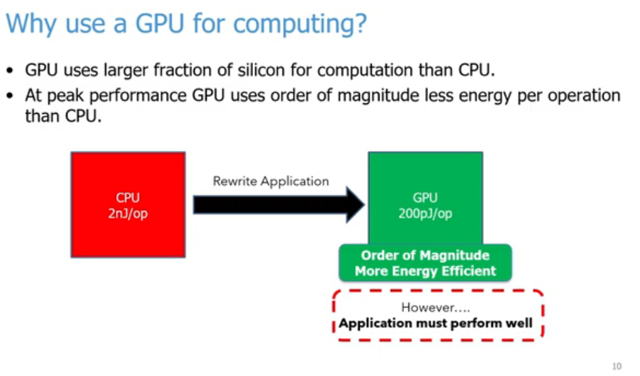
25.5 GPU
https://www.youtube.com/watch?v=Kjd1hTFOI44&list=PL_hVbFs_loVR_8ntTTmmG6YEq3Po_4snu&index=25
Why Use GPU for Computing? (12:16 - 13:30/2:01:30)
GPU implement silicon hardware (adder, subtractor, multiplier, divider) computation to replace CPU software computation.
1. GPU has larger hardware silicon for computation than CPU.
2. GPU has less energy consumption than CPU.
3. We have to rewrite the code from CPU to GPU.

Slide 24
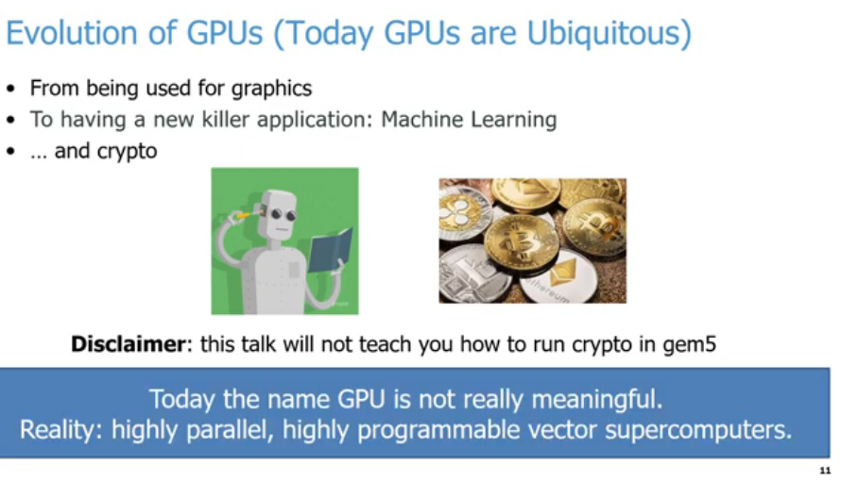
25.5 GPU
https://www.youtube.com/watch?v=Kjd1hTFOI44&list=PL_hVbFs_loVR_8ntTTmmG6YEq3Po_4snu&index=25
Evolution (13:31-15:50/2:01:30)
Today, GPU are Ubiquitous (existed everywhere). GPU is switched from graphics processing into killer AI applications, such as, Mathematical ML (Machine Learning), Neural Network DL (Deep Learning), LLM (Large Language Model), Crypto, Bitcom mining, etc.
In gem5, we will not talk about how to run ML, DL, LLM, Crypto, etc.
Nowadays, GPU are widely used in highly parallel, highly programmable vector computations in entire AI worlds.

Slide 25
25.6 Objective and Outline

Slide 26
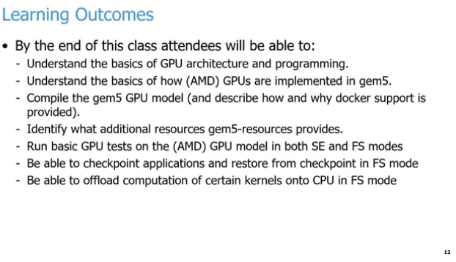
25.6 Objective and Outline
https://www.youtube.com/watch?v=Kjd1hTFOI44&list=PL_hVbFs_loVR_8ntTTmmG6YEq3Po_4snu&index=25
Objective (15:51-16:50/2:01:30)
We will discuss:
1. GPU architecture and GPU programming
2. AMD GPUs implemented in Gem5.
3. Compile Gem5 GPUs Model
4. Gem5 resources
5. GPU Model in SE (Standard edition) and FS (Full System) mode.
6. Checkpoint for applications and restore
7. Offload computation of kernels on CPU.
Using FS (Full System) mode, we can run MNIST (Modified National Institute Standard and Technology) or Nano-GPT (Generative Pre-Trained Transformer) Simulation in GPU model.

Slide 27
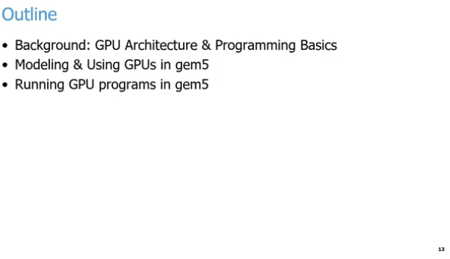
25.6 Objective and Outline
https://www.youtube.com/watch?v=Kjd1hTFOI44&list=PL_hVbFs_loVR_8ntTTmmG6YEq3Po_4snu&index=25
Outline (15:51-17:00/2:01:30)
We discuss the following:
1. GPU Architecture and Programming
2. Gem5 GPU modeling
3. Run Gem5 GPU program

Slide 28
25.7 Parallelism

Slide 29
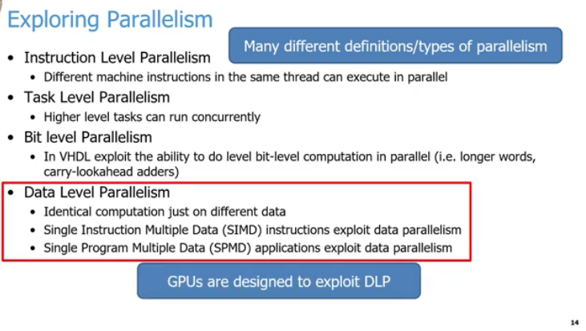
25.7 Parallelism
https://www.youtube.com/watch?v=Kjd1hTFOI44&list=PL_hVbFs_loVR_8ntTTmmG6YEq3Po_4snu&index=25
Parallelism Type (17:01-18:15/2:01:30)
Instruction parallelism is very popular in CPU.
1. Instruction Level Parallelism: If we have different instructions (usually assembly or machine code instructions) are running in the same thread but can be executed in parallel without affecting the correctness of our program. This is Intel, AMD, ARM, etc have been exploiting for 30 years.
2. Task Level Parallelism: We have several tasks running in parallel at the same time. This is Microsoft, Google, etc. do their different queries, such as, when users take a food picture in restaurant and ask to translate a menu. The requests running concurrently for more efficiency in the cloud and figure out the users want.
5
1
2
3
4
6

Slide 30
25.7 Parallelism
https://www.youtube.com/watch?v=Kjd1hTFOI44&list=PL_hVbFs_loVR_8ntTTmmG6YEq3Po_4snu&index=25
Parallelism Type (19:46 - 19:55/2:01:30)
3. Bit Level Parallelism: For Verilog (Verification and Logic) or VHDL (Very High Speed IC Hardware Description Language), we can run bits computation for parallel. We can do the parallel for longer word pr carry look-ahead in adders.
4. Data Level Parallelism: When we do the same computation across many different threads with different data for each of the threads. For example, we can have thread A and thread B to do the addition, each thread add different address from memory. We can load these addresses concurrently and then add them concurrently. We have Data Level Parallelism for SIMD (Single Instruction Multiple Data), SIMT (Single Instruction Multiple Threads) for GPU, or SPMD (Single Program Multiple Data). No matter SIMD or SIMT, the data can be operated in concurrent instructions identically. They just need to instruction fetching and instruction decoding and run parallel in threads to do the addition.
5
1
2
3
4
6

Slide 31
25.7 Parallelism
https://www.youtube.com/watch?v=Kjd1hTFOI44&list=PL_hVbFs_loVR_8ntTTmmG6YEq3Po_4snu&index=25
Parallelism Type (18:16 - 19:45/2:01:30)
5. There are many different definitions/types of parallelism.
6. Among the parallelism types, the most important is DLP (Data Level Parallelism).
Key point of GPUs are design to exploit DLP (Data Level Parallelism): SIMD (Single Instruction Multiple Data), SIMT (Single Instruction Multiple Threads), SPMD (Single Program Multiple Data).
5
1
2
3
4
6

Slide 32
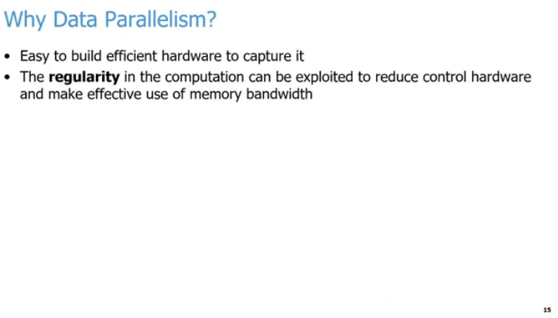
25.7 Parallelism
https://www.youtube.com/watch?v=Kjd1hTFOI44&list=PL_hVbFs_loVR_8ntTTmmG6YEq3Po_4snu&index=25
Data Parallelism (19:46 - 20:30/2:01:30)
We might wonder why mention the Data Paralleism?
When we done with fetching and decoding instructions, it is easy to build efficient hardware for compute the same data.
We don’t need to fetched and decode the instructions again and again.
We do the same fetched/decoded instructions for different data for parallelism.
We can reduce the logic for the regularity of computation. We need for fetching, decoding, logic controlling, logic branches, etc. We can uses more resources, for example, more memory bandwidth, more ALUs, etc. to process more data computation.

Slide 33
25.8 Parallelism Execution Model

Slide 34
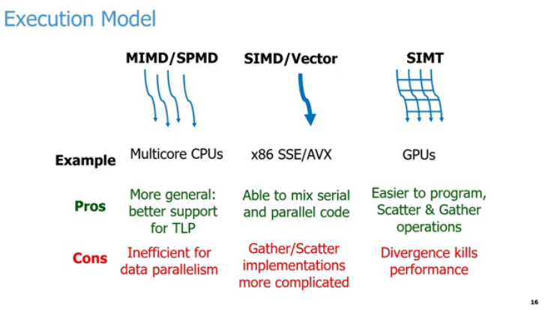
25.8 Parallelism Execution Model
https://www.youtube.com/watch?v=Kjd1hTFOI44&list=PL_hVbFs_loVR_8ntTTmmG6YEq3Po_4snu&index=25
Parallelism Execution Model (20:31-20:32/2:01:30)
Below, we compares three parallel computing execution models by their examples, advantages, and disadvantages.
1. MIMD / SPMD Example: Multicore
  a. CPUs. Pro: Better support for Thread-Level Parallelism (TLP).
  b. Con: Inefficient for data parallelism.
2. SIMD / Vector Example: x86 SSE (Streaming SIMD Extension)/AVX (Advanced Vector Extension) extensions:
  a. Pro: Blends serial and parallel code execution easily.
  b. Con: Complicated Gather and Scatter hardware implementations.
3. SIMT (Single Instruction Multiple Threads) Example: Graphics Processing Units (GPUs).
  a. Pro: Built-in support for Gather and Scatter operations.
  b. Con: Thread divergence heavily degrades performance.

Slide 35
25.8 Parallelism Execution Model
https://www.youtube.com/watch?v=Kjd1hTFOI44&list=PL_hVbFs_loVR_8ntTTmmG6YEq3Po_4snu&index=25
Terminology: Thread Divergence (20:33-20:34/2:01:30)
Thread divergence occurs in SIMT (GPUs) when threads inside the same execution block (warp or wavefront) take different paths during a conditional statement (if-else).
Because hardware executes the exact same instruction across all threads simultaneously, it cannot run different paths at the same time.
1. How It Works?
  a. The Problem: An if-else branch splits the threads.
  b. The Execution: The GPU serializes the execution paths.
  c. The Penalty: It runs the if path while disabling else threads.
  d. The Flip: It runs the else path while disabling if threads.
  e. The Impact: Total execution time doubles, cutting efficiency in half.
2. Visual Example: Imagine 4 threads executing a conditional block:
> If (thread_id % 2 == 0) {
> Do Path A;
> } else {
> Do Path B;
> }
3. Use code with caution.
  a. Step 1: Threads 0 and 2 execute Path A. Threads 1 and 3 sit idle.
  b. Step 2: Threads 1 and 3 execute Path B. Threads 0 and 2 sit idle.
4. How to Fix It?
  a. Avoid branching: Minimize deep if-else structures inside GPU kernels.
  b. Sort data: Group similar data together so adjacent threads take identical paths.
  c. Use math: Replace branches with mathematical operations or predication when possible.

Slide 36
25.8 Parallelism Execution Model
https://www.youtube.com/watch?v=Kjd1hTFOI44&list=PL_hVbFs_loVR_8ntTTmmG6YEq3Po_4snu&index=25
Terminology: Gather and Scatter (20:35-20:36/2:01:30)
1. Gather and Scatter are memory operations used in parallel computing to handle data that is scattered across different, non-contiguous locations in memory. They allow parallel processors to read or write multiple data points simultaneously using an array of pointers or offsets.
2. The Two Operations:
  a. Gather (Read): Fetches data from multiple separate memory addresses and packages them into a single, contiguous register.
  b. Scatter (Write): Takes data from a contiguous register and writes it out to multiple separate memory addresses.
3. Conceptual Example: Imagine processing a sparse matrix or a list of specific indices (e.g., pulling only the even-indexed elements from a large array).
  a. Standard Memory Access: Expects data to be sequential (Index 0, then 1, then 2).
  b. Gather Operation: Can read Index 4, Index 12, and Index 97 all in a single vectorized step using an index vector [4, 12, 97].
4. Architectural Differences:
  a. SIMD / Vector (x86 SSE/AVX): Implementing Gather/Scatter in hardware is highly complex. Older or simpler SIMD extensions have to emulate these operations by generating multiple traditional serial memory requests, which creates a performance bottleneck.
  b. SIMT (GPUs): GPUs are explicitly designed with massively parallel memory controllers. They natively handle highly irregular memory addresses via "coalescing" hardware logic, making Gather/Scatter operations much more efficient.

Slide 37
25.8 Parallelism Execution Model
https://www.youtube.com/watch?v=Kjd1hTFOI44&list=PL_hVbFs_loVR_8ntTTmmG6YEq3Po_4snu&index=25
Parallelism Execution Model (21:37-23:20/2:01:30)
Below, we executed four threads. The threads can be thousands, millions, etc. with level of parallelism:
1. Multicore CPUs: MIMD (Multiple Instruction Multiple Data)/SPMD (Single Program Multiple Data):
  a. Advantage: more general and better support for TLP (Thread Level Parallelism).
  b. Disadvantage: insufficient for data parallelism.
2. Intel x86 SSE (Streaming SIMD Extension)/AVX (Advanced Vector Extension): SIMD (Single Instruction Multiple Data)/Vector:
  a. Advantage: can mix serial and parallel code for thick threads (128 or 256 bits/bytes).
  b. Disadvantage: too complicate for Gather (memory read) and Scatter (memory write) implementation for thick thread (128 or 250 bit/bytes).
3. GPUs: SIMT (Single Instruction Multiple threads):
  a. Advantage: easy to program and easy to do Gather (memory read) and Scatter (memory write) operation for thick threads.
  b. Disadvantage: hardware cannot run divergence (logic in different paths) at the same time. The performance will go down.

Slide 38
25.9 GPU Thread vs Memory Latency

Slide 39
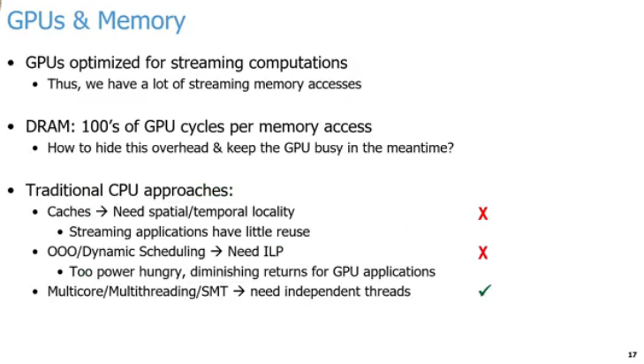
25.9 GPU Thread vs CPU Memory Latency
https://www.youtube.com/watch?v=Kjd1hTFOI44&list=PL_hVbFs_loVR_8ntTTmmG6YEq3Po_4snu&index=25
GPU Thread vs CPU Memory Latency (23:21-24:20/2:01:30)
1. GPUs use a lot of efficient hardware resource to do tasks in parallel.
The concurrent tasks are optimized for streaming computation.
There a lot of memory accesses going through the memory subsystem at the same time.
2. The main memory or DRAM will take hundreds of CPU cycles to do the memory access.
The CPU will wait of cycles for GPU to finish their work and data to come back.
1
2
3
a
b
c

Slide 40
25.9 GPU Thread vs CPU Memory Latency
https://www.youtube.com/watch?v=Kjd1hTFOI44&list=PL_hVbFs_loVR_8ntTTmmG6YEq3Po_4snu&index=25
GPU Thread vs CPU Memory Latency (24:21-25:50/2:01:30)
3. Traditional CPU vs GPU approaches:
  a. The CPU has problem in cache, The cache need spatial (空間的) or temporal (時間的) locality. The problem of these workloads for GPUs are streaming meaning that they are not reuse data. GPU does not have spatial and temporal locality. So cache in the CPU does not work.
  b. CPU use OOO (Out of Order) or Dynamic Scheduling to exploit ILP (Instruction Level Parallelism): CPU identify the independent instruction within a thread that can reorder to help hide that delay. GPU does not have a lot of independent instructions to reorder and implement this kind of behavior. The CPU reorder need power hungry and does not work for GPU task.
1
2
3
a
b
c

Slide 41
25.9 GPU Thread vs CPU Memory Latency
https://www.youtube.com/watch?v=Kjd1hTFOI44&list=PL_hVbFs_loVR_8ntTTmmG6YEq3Po_4snu&index=25
GPU Thread vs CPU Memory Latency (24:21-25:50/2:01:30)
3. Traditional CPU vs GPU approaches:
  c. GPU uses Multicore, SMT (Simultaneously Multi-threading), or Multi-threading: GPU run multi-thread in the same time and let long latency operation. At that point, GPU switch to another thread to do the work. That work very well since the GPU has thousand or million of threads. The thread with long memory latency have no big deal since the rest of 999,999 threads will find one of them to do the rest tasks. So millions of threads will hide the memory latency.
1
2
3
a
b
c

Slide 42
25.10 Multicore/Multithreading/SMT

Slide 43
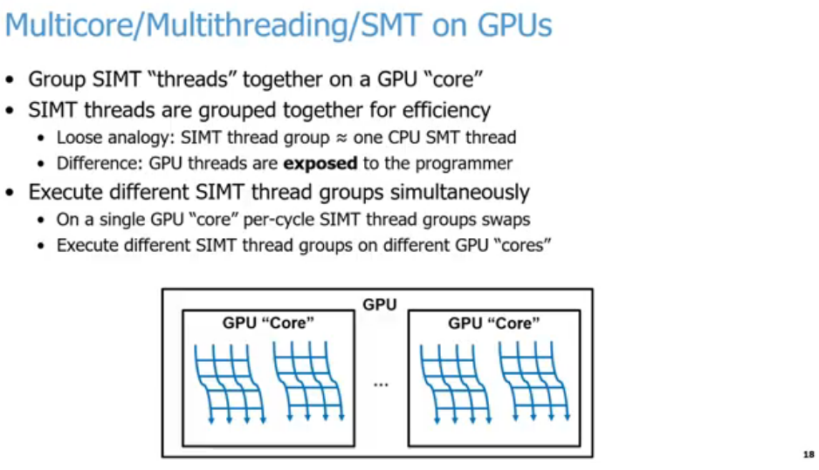
25.10 Multicore/Multithreading/SMT
https://www.youtube.com/watch?v=Kjd1hTFOI44&list=PL_hVbFs_loVR_8ntTTmmG6YEq3Po_4snu&index=25
Multicore/Multithreading/SMT (25:51-25:52/2:01:30)
Core Aggregation:
  Multiple SIMT "threads" are bundled together to run on a single physical GPU "core" (Streaming Multiprocessor).
CPU vs. GPU SMT:
  A GPU SIMT thread group functions roughly like a single CPU SMT thread.
  Unlike CPU hardware threads, GPU SIMT threads are explicitly exposed to the programmer (e.g., as warps or wavefronts).
Simultaneous Execution:
  Intra-core: A single GPU core can context-switch or swap SIMT thread groups every clock cycle to hide latency.
  Inter-core: Different SIMT thread groups run across completely different physical GPU cores concurrently.

Slide 44
25.10 Multicore/Multithreading/SMT
https://www.youtube.com/watch?v=Kjd1hTFOI44&list=PL_hVbFs_loVR_8ntTTmmG6YEq3Po_4snu&index=25
Multicore/Multithreading/SMT (25:53-26:30/2:01:30)
We design architecture around the threads parallelism idea.
1. We can group those millions of threads into subgroups to run on GPU. Each subgroup is called a GPU “core”. We will discuss more GPU “core” later on. The CPU core and GPU “core” are different. Their behavior are different.
2. One group of SIMT (Single Instruction Multiple Threads) running on GPU is approximately equal to one SMT (Simultaneously Multi-Thread) running on CPU.
For example, CPU with four cores. Each core can run two threads. We can running 8 thread concurrently on our CPU. Any one of the eight threads is loosely (not exactly, CPU is heavy weight and GPU is light weight) logically equivalent to one thread group run on GPU.
The key difference is GPU threads are exposed to the programmer. We can see a single one of them run on GPU.
1
2
3

Slide 45
25.10 Multicore/Multithreading/SMT
https://www.youtube.com/watch?v=Kjd1hTFOI44&list=PL_hVbFs_loVR_8ntTTmmG6YEq3Po_4snu&index=25
Multicore/Multithreading/SMT (26:31-27:40/2:01:30)
3. The programmer can run CPU SIMT (Single Instruction Multiple Threads) in GPU thread group simultaneously.
In Thread groups, we can switch between those thread groups at per cycle basis.
We also can start CPU SIMT in GPU thread group on different GPU “core”.
Below, we have two GPU “Core” to run CPU SIMT or GPU SMT in the thread groups.
1
2
3

Slide 46
25.11 GPU Component

Slide 47
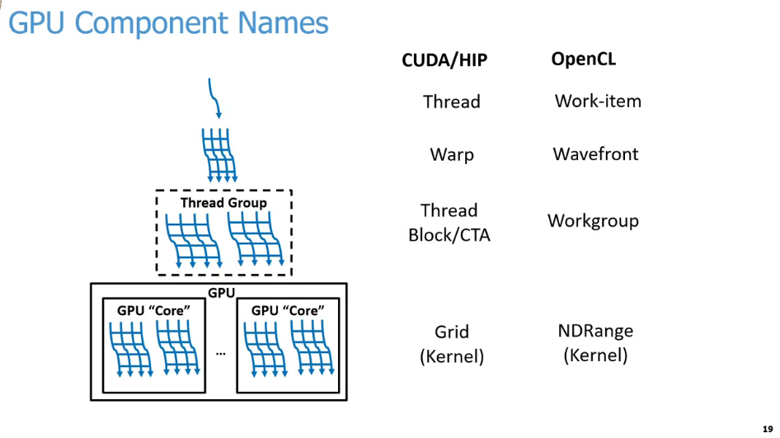
25.11 GPU Component
https://www.youtube.com/watch?v=Kjd1hTFOI44&list=PL_hVbFs_loVR_8ntTTmmG6YEq3Po_4snu&index=25
GPU Component (27:41-27:42/2:01:30)
Below is a comparison terminology between NVIDIA CUDA (Compute Unified Device Architecture), AMD HIP (Heterogeneous Interface for Portability), and Google OpenCL (Open Computing Language).
CUDA or HIP | OpenCL | Description
Thread | Work-Item | 1. The smallest unit of execution. 2. Executes a single instance of a kernel.
Warp | Wavefront | 1. A collection of threads/work-items executed physically in lockstep. 2. Typically consists of 32 threads in CUDA or 32/64 work-items in OpenCL.
Thread Block/ CTA (Cooperative Thread Array) | Workgroup | 1. A logical grouping of threads/work-items. 2. Executes on a single GPU compute unit, SM 9streaming Multi-process or CU (Compute Unit). 3. Shares local memory and synchronization resources.
Grid [Kernel] | NDRange (N-Dimensional Range) [Kernel] | 1. The entire execution space for a given program launch. 2. Encompasses all blocks/workgroups scheduled across the entire GPU.

Slide 48
25.11 GPU Component
https://www.youtube.com/watch?v=Kjd1hTFOI44&list=PL_hVbFs_loVR_8ntTTmmG6YEq3Po_4snu&index=25
GPU Component (27:43-28:30/2:01:30)
Below, we assign the name of each GPU components for GPU Programming Language, such as, CUDA, HIP, or OpenCL.
1. A single Thread within those SIMT threads: In CUDA and HIP, the SIMT threads are calls a thread. OpenCL calls a Work-Item.
2. A group of SIMT threads: In CUDA and Hip, the group SIMT threads call Warp. OpenCL calls Wavefront.
3. Multiple groups of threads that logically run together: CUDA and HIP call Thread Block/CTA (Cooperate Thread Array). OpenCL calls Workgroup.
1
2
3
4

Slide 49
25.11 GPU Component
https://www.youtube.com/watch?v=Kjd1hTFOI44&list=PL_hVbFs_loVR_8ntTTmmG6YEq3Po_4snu&index=25
GPU Component (28:31-28:50/2:01:30)
4. All those groups of threads running across all of the cords concurrently: CUDA and HP call Grid running (launched with) a kernel. OpenCL calls NDRange (D-Dimensional Range) running (launched with) a kernel.
Note: When Grid launch with kernel, the Grid contains the parent and child relationship.
In GPU programming, when people talk about Thread, Warp, Thread Block/CTA, Grid, etc. They talk those abstract concept which mapping to the hardware architecture in specific documentation.
1
2
3
4

Slide 50
25.12 GPU Programming

Slide 51
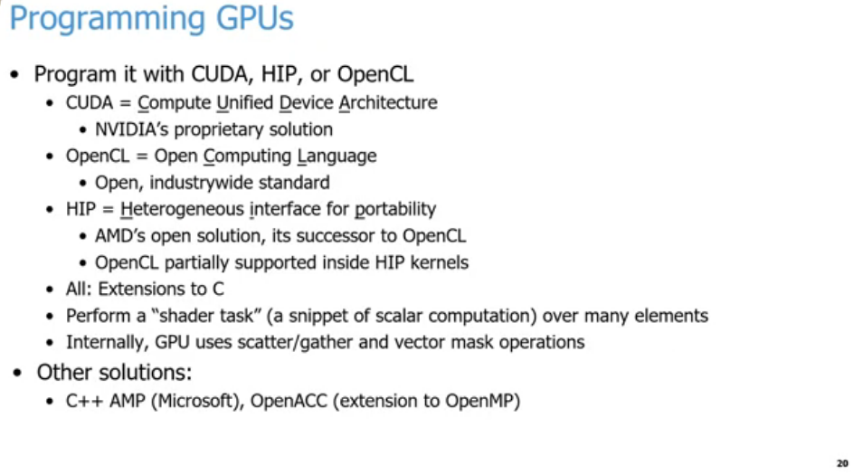
25.12 GPU Programming
https://www.youtube.com/watch?v=Kjd1hTFOI44&list=PL_hVbFs_loVR_8ntTTmmG6YEq3Po_4snu&index=25
GPU Programming (28:51-29:40/2:01:30)
Program GPU:
1. NVIDIA provides CUDA (Compute Unified Device Architecture). CUDA is NVIDIA’s GPU programming language.
2. AMD provides HIP (Heterogeneous Interface for Portability). HIP is equivalent to CUDA.
3. Google provide OpenCL (google Open Computing Language). OpenCL is partially supported inside HIP. OpenCL is wide industry-wide standard that is technically run by Apple.
1
2
3
4
5
6
7

Slide 52
25.12 GPU Programming
https://www.youtube.com/watch?v=Kjd1hTFOI44&list=PL_hVbFs_loVR_8ntTTmmG6YEq3Po_4snu&index=25
GPU Programming (29:41 - 3 0:15/2:01:30)
4. CUDA, HIP, and OpenCL use high level programming language. They have extensions to C/C++. We can run them with C/C++ style code with vector extension to run lots of threads concurrently.
5. CUDA, HIP, and OpenCL perform a “Shader Task” or a Snippet of computation across many elements.
6. Internally, GPU uses scatter and gather and vector mask operation for every thread. The GPU will do the same thing for all the threads at a given time no matter the thread want or not.
7. We also have other solutions, such as, OpenACC and C++ Amp from Microsoft. They are not so popular today but they are around if you are interested.
1
2
3
4
5
6
7

Slide 53
25.13 GPGPU Programming Model

Slide 54
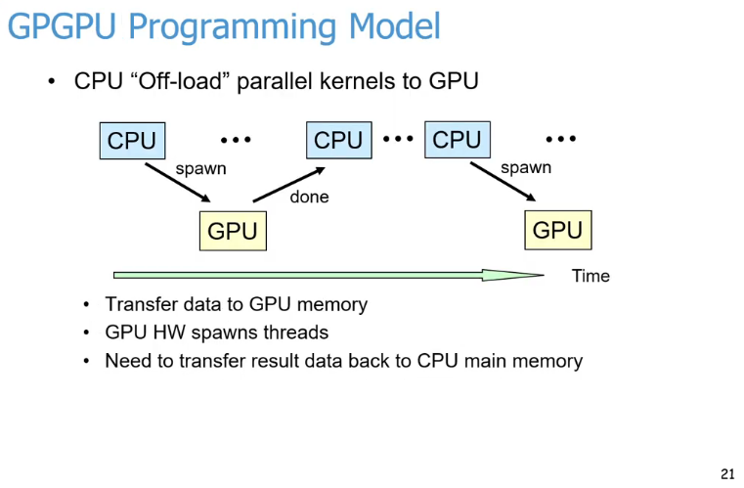
25.13 GPGPU Programming Model
https://www.youtube.com/watch?v=Kjd1hTFOI44&list=PL_hVbFs_loVR_8ntTTmmG6YEq3Po_4snu&index=25
GPGPU Programming Model (30:16-31:40/2:01:30)
What is the practice in GPU to run a program?
1. When we run a program, we offload some highly parallel piece of work from CPU to GPU.
2. We spawn this highly parallel piece of work, offload from CPU, and pass it to GPU. When GPU done the work,
3. the result come back to CPU.
4
5
6
1
2
3

Slide 55
25.13 GPGPU Programming Model
https://www.youtube.com/watch?v=Kjd1hTFOI44&list=PL_hVbFs_loVR_8ntTTmmG6YEq3Po_4snu&index=25
GPGPU Programming Model (30:41 - 3 1:15/2:01:30)
4. In the below diagram, we have CPU do some more work, and spawn another parallel piece of work, offload from CPU, and pass it to GPU, etc.
5. We have many threads need to spawn, to pass/transfer data to GPU. When GPU are done, we need to transfer all the results back to CPU.
6. What is Kernel?
Each phases of work that we offload to GPU to run. We call a Kernel. In the below diagram, each yellow box is a different kernel or a different phase of our program.
4
5
6
1
2
3

Slide 56
25.14 GPU Hardware Overview

Slide 57
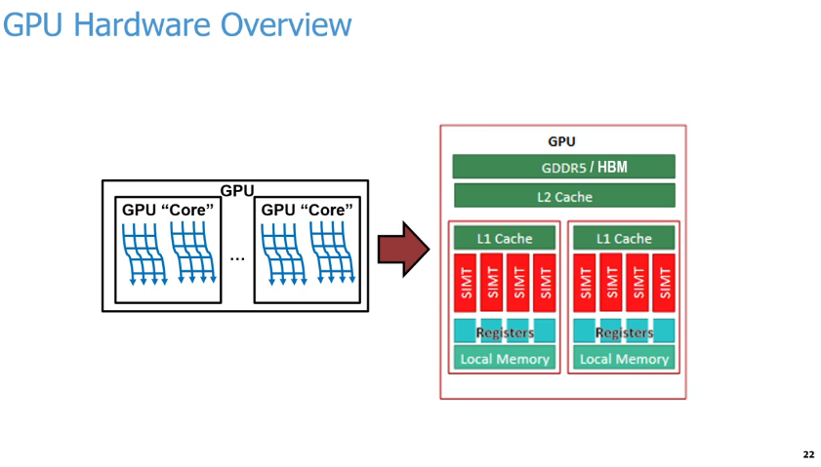
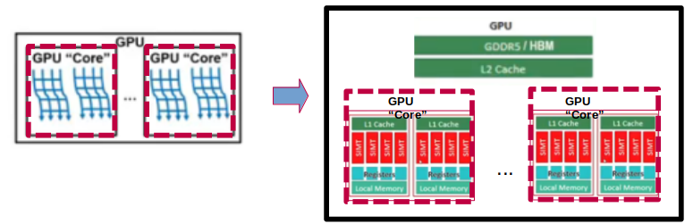
25.14 GPU Hardware Overview
https://www.youtube.com/watch?v=Kjd1hTFOI44&list=PL_hVbFs_loVR_8ntTTmmG6YEq3Po_4snu&index=25
GPU Hardware Overview (31:16-31:17/2:01:30)
Below diagram abstracts GPU processing units to their physical hardware layout.
Hardware layout Breakdown
1. GPU "Core" (Left): Represents a Streaming Multiprocessor (SM) or compute unit that executes many parallel threads simultaneously (wavy blue lines).
2. Memory Hierarchy (Right): Shows the breakdown of memory from fastest/smallest to slowest/largest:
  a. Registers & Local Memory: Dedicated directly to individual execution units.
  b. L1 Cache: Shared within a single GPU "Core" cluster.L2 Cache: Shared across all compute units on the GPU.
  c. GDDR5/HBM: The high-capacity global device memory.
3. SIMT (Single Instruction, Multiple Threads): The red blocks highlight the execution lanes that process parallel instructions.

Slide 58
25.14 GPU Hardware Overview
https://www.youtube.com/watch?v=Kjd1hTFOI44&list=PL_hVbFs_loVR_8ntTTmmG6YEq3Po_4snu&index=25
GPU Hardware Overview (31:18-32:15/2:01:30)
In GPU, we have a lot of logical cores. Each of cores runs many groups of SIMT threads concurrently.
GPU have multiple levels of memory: DDR (Double Data Rate) or HBM (High Bandwidth Memory),
CPU also have multiple levels of Cache:
L2 Shared cache across all of the compute units or cores,
L1 cache: Locally within each one of the GPU “core” that run and used by multiple ALUs. These ALUs designed to run on SIMT with very wide vectors and below picture.
We have one CPU core. Each GPU “core” have two Warps. Each Warp has one L1 Cache and four threads (SIMT).
Each GPU “Core” have a bunch of registers and local memory to run the tasks.

Slide 59
25.15 CU (Compute Unit): GPU Core

Slide 60
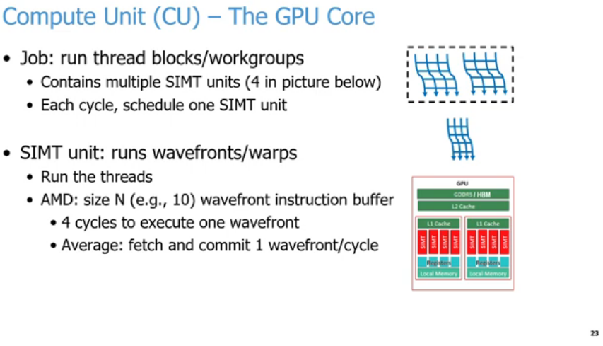

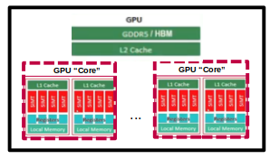
25.15 CU (Compute Unit): GPU Core
https://www.youtube.com/watch?v=Kjd1hTFOI44&list=PL_hVbFs_loVR_8ntTTmmG6YEq3Po_4snu&index=25
CU (Computer Unit): GPU Core (32:16-32:17/2:01:30)
Below slide explains the internal architecture of a Compute Unit (CU), which functions as the core of a Graphics Processing Unit (GPU).
1. Responsibilities of a Compute Unit (CU)
  a. Thread Execution: The primary job of a CU is to execute thread blocks (NVIDIA terminology) or workgroups (AMD/OpenCL terminology).
  b. Internal Components: A single CU contains multiple SIMT units (the provided diagram illustrates 4 SIMT units per CU).
  c. Scheduling: The hardware schedules exactly one SIMT unit per clock cycle.

Slide 61
25.15 CU (Compute Unit): GPU Core
https://www.youtube.com/watch?v=Kjd1hTFOI44&list=PL_hVbFs_loVR_8ntTTmmG6YEq3Po_4snu&index=25
CU (Computer Unit): GPU Core (32:18-32:19/2:01:30)
2. How a SIMT Unit Operates
  a. Target Workloads: SIMT units are responsible for running groups of threads known as wavefronts (AMD) or warps (NVIDIA).
  b. Instruction Buffering: In AMD architectures, the unit utilizes a wavefront instruction buffer of size N (e.g., capable of holding 10 instructions).
  c. Execution Latency: It requires 4 clock cycles to fully execute a single wavefront.
  d. Throughput Efficiency: Despite the 4-cycle execution latency, pipelining allows the hardware to achieve an average throughput of fetching and committing 1 wavefront per cycle.

Slide 62
25.15 CU (Compute Unit): GPU Core
https://www.youtube.com/watch?v=Kjd1hTFOI44&list=PL_hVbFs_loVR_8ntTTmmG6YEq3Po_4snu&index=25
CU (Computer Unit): GPU Core (32:20-33:00/2:01:30)
We will talk GPU components one by one. We use GPU “Core” (in quote) because it is very different from CPU Core. That is why we call GPU “Core” a computer unit. NVIDIA call GPU “Core” a SM (Streaming Multi-processor).
Regardless what terminology we use, the job to run those thread blocks or work groups in parallel on GPU “Core” underline hardware. GPU “Core” run SIMT (Single Instruction Multiple Thread) units. Every cycle will schedule something to run each one of those SIMT units.
Assume we have enough work groups. Every SIMT units job will be run in a wavefront or a warp.

Slide 63
25.15 CU (Compute Unit): GPU Core
https://www.youtube.com/watch?v=Kjd1hTFOI44&list=PL_hVbFs_loVR_8ntTTmmG6YEq3Po_4snu&index=25
CU (Computer Unit): GPU Core (33:01 - 3 3:25/2:01:30)
Every thread in the wavefront or warp to run.
AMD has size 10 of the buffer to hold the threads to run the instructions.
We assume that threads take at least 10 cycles to run inside the wavefront.
The goal to fetch and commit with average 1 wavefront/cycle to run through 1 SIMT unit.

Slide 64
25.16 Address Coalescing

Slide 65
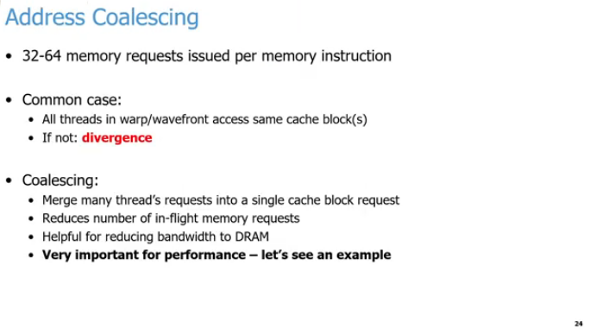
25.16 Address Coalescing
https://www.youtube.com/watch?v=Kjd1hTFOI44&list=PL_hVbFs_loVR_8ntTTmmG6YEq3Po_4snu&index=25
Address Coalescing (33:26-33:27/2:01:30)
This slide covers Address Coalescing, a critical optimization technique used by GPUs to maximize memory bandwidth during SIMT execution.
1. Memory Requests
  High Volume: A single memory instruction can issue between 32 to 64 memory requests simultaneously across a warp or wavefront.
1
2
3

Slide 66
25.16 Address Coalescing
https://www.youtube.com/watch?v=Kjd1hTFOI44&list=PL_hVbFs_loVR_8ntTTmmG6YEq3Po_4snu&index=25
Address Coalescing (33:26-33:27/2:01:30)
The Ideal Scenario vs. Divergence
  a. Common Case: Ideally, all threads within a single warp or wavefront access the exact same cache block or contiguous blocks.
  b. Memory Divergence: When threads within a warp look for widely different, scattered memory locations, it creates divergence. This forces the GPU to make multiple slow, serial memory fetches.
1
2
3

Slide 67
25.16 Address Coalescing
https://www.youtube.com/watch?v=Kjd1hTFOI44&list=PL_hVbFs_loVR_8ntTTmmG6YEq3Po_4snu&index=25
Address Coalescing (33:26-33:27/2:01:30)
Benefits of Coalescing
  a. Request Merging: It combines the independent memory demands of many individual threads into one single cache block request.
  b. Traffic Reduction: This significantly reduces the total number of in-flight memory requests actively hitting the hardware.
  c. Bandwidth Optimization: It saves massive amounts of DRAM bandwidth, making it absolutely vital for achieving high GPU performance.
1
2
3

Slide 68
25.16 Address Coalescing
https://www.youtube.com/watch?v=Kjd1hTFOI44&list=PL_hVbFs_loVR_8ntTTmmG6YEq3Po_4snu&index=25
Address Coalescing (33:28-34:20/2:01:30)
Second GPU Component here is called Address Coalescing.
Because we have same instruction to access different data, when we run those waves or run those warps, the GPU will issue a whole bunch of memory requests.
We will have thousands or millions of threads. If all of the threads issue a memory request concurrently. It will be overwhelm the memory system no matter how hard we try.
The threads in the same wavefront or in the same warp will access data in cache line over and over again.
1. Normally, the thread make 32 or 64 requests in parallel a the same time. If the threads request data is in the cache line, the thread is satisfied.
1
2
3

Slide 69
25.16 Address Coalescing
https://www.youtube.com/watch?v=Kjd1hTFOI44&list=PL_hVbFs_loVR_8ntTTmmG6YEq3Po_4snu&index=25
Address Coalescing (34:21 - 3 5:20/2:01:30)
2. If requests cannot access data cache line, we call Divergence.
3. The process we send requests for many data in parallel is called coalescing.
The job of many threads requests as many as possible in the warp or wavefront into a single cache block request. This greatly reduce the number of in-flight memory. That will save bandwidth of the DRAM that actually need it. It is very important for performance.
1
2
3

Slide 70
25.17 Memory Access

Slide 71
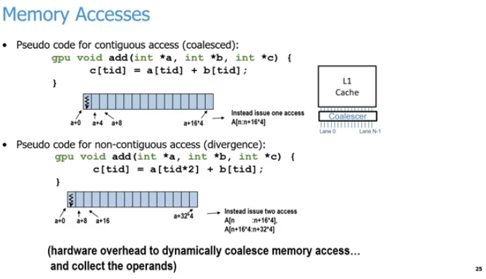
25.17 Memory Access
https://www.youtube.com/watch?v=Kjd1hTFOI44&list=PL_hVbFs_loVR_8ntTTmmG6YEq3Po_4snu&index=25
Memory Access (35:21 - 3 5:22/2:01:30)
Here is the explanation for each numbered region marked on the slide:
1. Memory Accesses: How parallel threads retrieve data from global memory.
2. L1 Cache and Coalescer Hardware:
  a. The hardware intercepts memory requests from thread lanes (Lane 0 to N-1),
  b. Combine the memory data in thread lanes (Lane 0 to Lane N-1),
  c. Put data into the cache.
1
3
2
4
5

Slide 72
25.17 Memory Access
https://www.youtube.com/watch?v=Kjd1hTFOI44&list=PL_hVbFs_loVR_8ntTTmmG6YEq3Po_4snu&index=25
Memory Access (35:23-35:24/2:01:30)
3. Contiguous (Coalesced) Access:
  a. Contiguous (Coalesced) access is the optimal execution
  b. The data is in neighboring threads.
  c. The threads access neighboring memory addresses (a+0, a+4, a+8), resulting in a single memory transaction.
1
3
2
4
5

Slide 73
25.17 Memory Access
https://www.youtube.com/watch?v=Kjd1hTFOI44&list=PL_hVbFs_loVR_8ntTTmmG6YEq3Po_4snu&index=25
Memory Access (35:25-35:26/2:01:30)
4. Non-Contiguous (Strided) Access:
  a. Non-Contiguous (Strided) Access is the non-optimal execution
  b. The thread index multipliers (tid*2) cause memory gaps (a+0, a+8, a+16)
  c. The threads splitting the request into multiple memory transactions.
1
3
2
4
5

Slide 74
25.17 Memory Access
https://www.youtube.com/watch?v=Kjd1hTFOI44&list=PL_hVbFs_loVR_8ntTTmmG6YEq3Po_4snu&index=25
Memory Access (35:27-35:28/2:01:30)
5. Hardware Penalty Note:
  Highlights the cost of poor alignment, as the GPU must use extra hardware cycles to dynamically merge spread-out requests and assemble the necessary operands.
1
3
2
4
5

Slide 75
25.17 Memory Access
https://www.youtube.com/watch?v=Kjd1hTFOI44&list=PL_hVbFs_loVR_8ntTTmmG6YEq3Po_4snu&index=25
Memory Access (35:29-38:20/2:01:30)
Below is the pseudo code that we add on GPU.
We pass in three arrays a, b, and c. They are all integers. At each tid (thread id) index, we access data of array a and array b at that tid index. Then, we add the data together and store in array c in tid index. We can see the data at tid index = 0 of arrays a, b, and c.
For coalesced case, the memory location is contiguous, integer is 4 bytes, a+0, a+4, a+8, etc. for integer array. The array elements are continuous. Thread requests take minimum cycles to access the array elements. The coalesced is efficient and has much better performance.
For divergence case, the memory has gap, he memory location is non-contiguous, a =0, a + 8, a +16, etc. There are extra 4 bytes gap in the array elements. Thread requests take longer cycles to access the array elements.
1
3
2
4
5

Slide 76
25.18 SIMT Pipeline

Slide 77
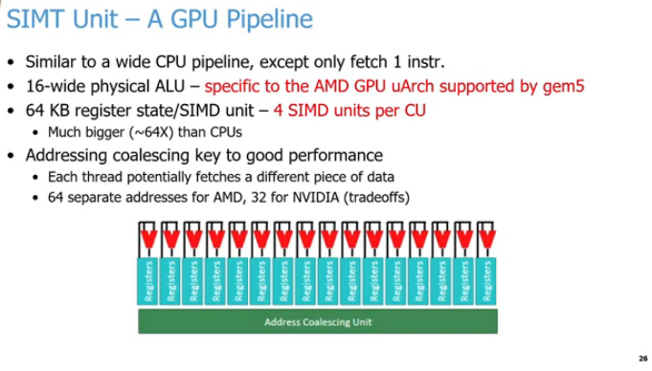
25.18 SIMT Pipeline
https://www.youtube.com/watch?v=Kjd1hTFOI44&list=PL_hVbFs_loVR_8ntTTmmG6YEq3Po_4snu&index=25
SIMT Pipeline (38:21 - 3 9:00/2:01:30)
1. SIMT Pipeline Definition
  The SIMT (Single Instruction, Multiple Threads) Unit is the core execution pipeline of a modern GPU architecture.
2. Instruction Fetch Mechanics
  a. Unlike a standard superscalar CPU pipeline that fetches multiple unique instructions per cycle, a GPU pipeline is wide but only fetches one instruction at a time.
  b. This single instruction is subsequently broadcasted down the pipeline to all active executing threads.
1
2
3
4
5
6

Slide 78
25.18 SIMT Pipeline
https://www.youtube.com/watch?v=Kjd1hTFOI44&list=PL_hVbFs_loVR_8ntTTmmG6YEq3Po_4snu&index=25
SIMT Pipeline (39:01 - 3 9:30/2:01:30)
3. ALU Execution Width
  a. All active components within the execution block operate concurrently on that same broadcasted instruction.
  b. The underlying physical execution layer relies on a 16-wide physical ALU array (specifically based on the AMD microarchitecture parameters used in gem5).
  c. The 16 physical ALUs simultaneously compute unique pieces of data in parallel across distinct vector lanes or data channels.
1
2
3
4
5
6

Slide 79
25.18 SIMT Pipeline
https://www.youtube.com/watch?v=Kjd1hTFOI44&list=PL_hVbFs_loVR_8ntTTmmG6YEq3Po_4snu&index=25
SIMT Pipeline (39:31 - 40:00/2:01:30)
4. Massive Register Capacity
  a. To ensure execution pipelines stay saturated without needing complex out-of-order CPU scheduling, each SIMD unit contains 64 KB of register state allocation.
  b. Even though conceptual hardware diagrams might only show a handful of visual registers (like 16) for simplicity, the physical storage is massive.
  c. This total storage capacity per Compute Unit (CU) is roughly 64 times larger than what is provisioned inside a traditional CPU core.
1
2
3
4
5
6

Slide 80
25.18 SIMT Pipeline
https://www.youtube.com/watch?v=Kjd1hTFOI44&list=PL_hVbFs_loVR_8ntTTmmG6YEq3Po_4snu&index=25
SIMT Pipeline (40:01 - 40:35/2:01:30)
5. Address Coalescing Functionality
  a. When an entire thread grouping executes a memory load or store command, the GPU attempts to process multiple requests at once.
  b. The AMD microarchitecture handles a wavefront of 64 threads (addresses) simultaneously, while NVIDIA handles a warp of 32 threads (addresses) concurrently.
  c. The Address Coalescing Unit automatically groups these 32 or 64 distinct memory addresses into a single combined memory block transaction.
  d. Maximizing coalescing is a primary goal in GPU programming because it prevents slow, serialized, unaligned memory accesses, significantly improving overall calculation throughput and performance.
1
2
3
4
5
6

Slide 81
25.19 L1 Cache

Slide 82
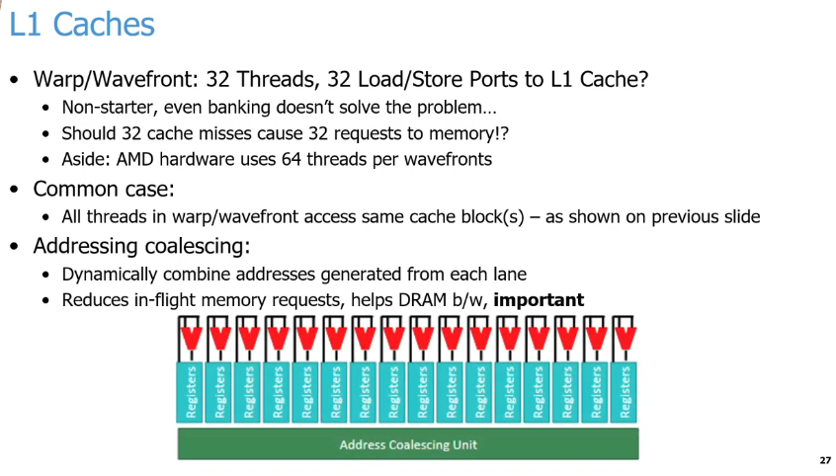
25.19 L1 Cache
https://www.youtube.com/watch?v=Kjd1hTFOI44&list=PL_hVbFs_loVR_8ntTTmmG6YEq3Po_4snu&index=25
L1 Cache (40:36 - 40:40/2:01:30)
1. L1 Caches Challenge:
  Caches are an excellent latency solution for standard CPUs, but they face severe architectural limitations in GPUs due to the massive number of parallel requests generated simultaneously.
1
2
3
4
5

Slide 83
25.19 L1 Cache
https://www.youtube.com/watch?v=Kjd1hTFOI44&list=PL_hVbFs_loVR_8ntTTmmG6YEq3Po_4snu&index=25
L1 Cache (40:41 - 41:00/2:01:30)
2. The Port Bottleneck & Cache Miss Storm
  a. The Problem: A standard GPU execution group features dozens of concurrent threads (32 for an NVIDIA warp, 64 for an AMD wavefront).
  b. Why it fails: Building 32 unique physical Load/Store ports to an L1 Cache to handle every thread at once is a hardware "non-starter" (行不通的, it takes up too much chip space and wiring overhead). Even dividing the cache into memory banks cannot solve this structural bottleneck.
  c. The Risk: If 32 threads encounter an L1 cache miss at the exact same moment, sending 32 individual, isolated requests out to external memory would completely flood the system.
1
2
3
4
5

Slide 84
25.19 L1 Cache
https://www.youtube.com/watch?v=Kjd1hTFOI44&list=PL_hVbFs_loVR_8ntTTmmG6YEq3Po_4snu&index=25
L1 Cache (41:01 - 41:30/2:01:30)
3. The Exploited Design Optimization (Common Case)
  a. To bypass the port bottleneck, GPU hardware explicitly exploits the common case.
  b. Programs are optimized so that threads within a warp or wavefront typically access data located inside the exact same local cache block.
1
2
3
4
5

Slide 85
25.19 L1 Cache
https://www.youtube.com/watch?v=Kjd1hTFOI44&list=PL_hVbFs_loVR_8ntTTmmG6YEq3Po_4snu&index=25
L1 Cache (40:31 - 41:45/2:01:30)
4. Hardware Coalescing Layer (Diagram)
  The hardware diagram visually depicts how separate parallel thread execution lanes and register data (the vertical blocks) are intercepted and funneled (漏斗狀的輸送) directly into a unified Address Coalescing Unit (the green horizontal block) before touching the main memory infrastructure.
1
2
3
4
5

Slide 86
25.20 Matrix Core Engines (AMD) / TensorCores (NVIDIA)

Slide 87
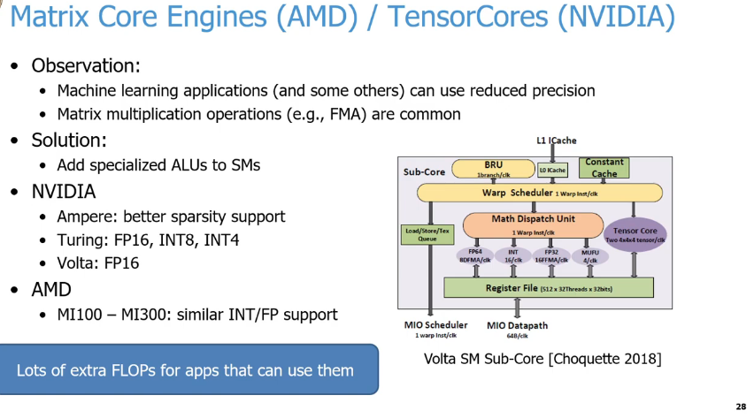
25.20 Matrix Core Engines (AMD) / TensorCores (NVIDIA)
https://www.youtube.com/watch?v=Kjd1hTFOI44&list=PL_hVbFs_loVR_8ntTTmmG6YEq3Po_4snu&index=25
Matrix Core Engines (AMD) / TensorCores (NVIDIA) (41:46 - 42:00/2:01:30)
1. Key Drivers for Specialization:
  a. Reduced Precision: Machine learning models (LLMs, Neural Networks) often do not require high-precision FP64 math. Lower precision (FP16, INT8, INT4) drastically increases throughput and reduces memory bandwidth requirements.
  b. Algorithmic Patterns: These workloads heavily rely on matrix multiplications and Fused Multiply-Add (FMA) operations (e.g., D = A x B + C).
2. Architectural Solution:
Specialized Hardware: Instead of relying on general-purpose ALUs, vendors integrated dedicated hardware blocks inside the Compute Units (AMD) and Streaming Multiprocessors (NVIDIA)
  a. Dedicated Silicon: Offloads matrix math from standard ALUs.
  b. SM Integration: Placed directly inside the GPU execution datapath.
1
2
6
3
4
5

Slide 88
25.20 Matrix Core Engines (AMD) / TensorCores (NVIDIA)
https://www.youtube.com/watch?v=Kjd1hTFOI44&list=PL_hVbFs_loVR_8ntTTmmG6YEq3Po_4snu&index=25
Matrix Core Engines (AMD) / TensorCores (NVIDIA) (42:01 - 43:00/2:01:30)
3. NVIDIA Tensor Cores:
  a. Volta Era: Introduced dedicated FP16 TensorCores.
  b. Turing Era: Added tighter precision limits (INT8/INT4).
  c. Ampere Era: Native 2:4 structured sparsity acceleration.
4. AMD Matrix Core Engines:
  a. Hardware Matrix: Matrix Core Engines deployed in Instinct MI100–MI300.
  b. Feature Parity: Delivers matching deep-learning INT/FP data formats.
1
2
6
3
4
5

Slide 89
25.20 Matrix Core Engines (AMD) / TensorCores (NVIDIA)
https://www.youtube.com/watch?v=Kjd1hTFOI44&list=PL_hVbFs_loVR_8ntTTmmG6YEq3Po_4snu&index=25
Matrix Core Engines (AMD) / TensorCores (NVIDIA) (43:01 - 43:45/2:01:30)
5. Efficiency Gains (Footer in Slide):
  a. Instruction Collapse: Replaces dozens of scalar instructions with one warp instruction.
  b. FLOPS Density: Packs massive compute capability into localized silicon.
6. Sub-Core Datapath Execution (Diagram in Slide)
  a. Warp Scheduler: Issues one warp instruction per clock cycle.
  b. Math Dispatch Unit: Directs the workload down to parallel execution units.
  c. Tensor Core (Purple Block): Processes 4 x 4 x 4 matrix dots over multiple cycles.
  d. Register File (Green Block): Provides a high-bandwidth 512 x 32-threads}x 32-bit lane.
1
2
6
3
4
5

Slide 90
25.21 Memory System Optimization

Slide 91
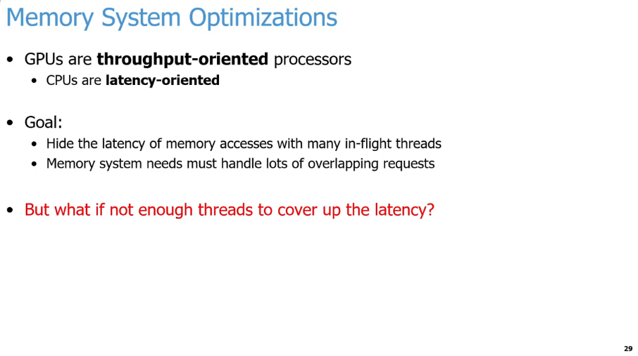
25.21 Memory System Optimization
https://www.youtube.com/watch?v=Kjd1hTFOI44&list=PL_hVbFs_loVR_8ntTTmmG6YEq3Po_4snu&index=25
Memory System Optimization (43:46 - 43:50/2:01:30)
GPUs re throughput-oriented processors
CPUs are latency-oriented processors,
Our goal for GPUs is
1. GPUs need to hide the latency of memory with a lot of in-flight threads.
2. GPUs Memory system need to handle a lot overlapping request
Conclusion:
In GPUs, we need a lot of threads to cover the memory latency.

Slide 92
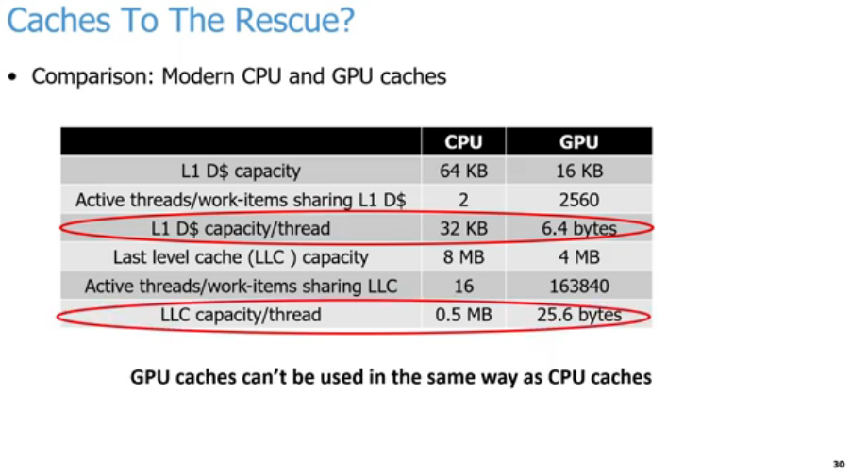
25.21 Memory System Optimization
https://www.youtube.com/watch?v=Kjd1hTFOI44&list=PL_hVbFs_loVR_8ntTTmmG6YEq3Po_4snu&index=25
Memory System Optimization (43:51 - 45:00/2:01:30)
We heard many times that we don’t use caches in the same way in CPUs and GPUs.
Below examples shows different sizes cache of CPU and GPU.
1. L1 D$ (Data Cache) in a CPU is about 64KB. CPU is 16KB (In real world, it is around 16 KB to to 32KB).
2. Number of threads/work-items that are sharing L1 D$ (Data Cache) that is huge different. For example, on a Intel/AMD/ARM CPU, we have two threads that are sharing those 64 KB L1 Cache. That means each thread get 32 KB roughly for each L1 Data Cache. In the GPU, we have 2560 threads that are running concurrently on our CU (Compute Unit).
1
2
3
4
5
6
7

Slide 93
25.21 Memory System Optimization
https://www.youtube.com/watch?v=Kjd1hTFOI44&list=PL_hVbFs_loVR_8ntTTmmG6YEq3Po_4snu&index=25
Memory System Optimization (45:01 - 45:40/2:01:30)
3. For each threads, we get 32KB in L1 Cache for CPU and 6.4 byes L1 Cache for GPU.
4. In the LLC (Last Level Cache), CPU has 8 MB and GPU has 4 MB.
5. For example, in CPUs, we have 16 threads per CPU core. In GPS, we have 32 GPU cores and 163840 threads per LLC (Last Level Cache). Each GPU core average is 5120 threads/core (= 163840/32)
6. In CPUs, if we have 8 cores and 16 threads, we have 2 thread of each core and 0.5MB [= 8 MB / (8 cores x 2 threads/core)] for each thread in the LLC. In GPUs, if we have 32 CU (Compute Unit) and 5120 threads fro each CU, we have 25.6 bytes/thread [= 4 MB / (32 CU x 5120 threads/CU) = 4 x 1048.576/163840 = 25.6 bytes/thread]
1
2
3
4
5
6
7

Slide 94
25.21 Memory System Optimization
https://www.youtube.com/watch?v=Kjd1hTFOI44&list=PL_hVbFs_loVR_8ntTTmmG6YEq3Po_4snu&index=25
Memory System Optimization (45:41 - 46:00/2:01:30)
7. From the table, we see why we cannot use L1 Cache from CPU to GPU.
  In point 3. GPU has too many threads run concurrently. We cannot keep all the threads in the caches as we traditional do in the CPUs. In stead, GPUs are designed to maximize throughput, not latency. Because GPUs do not have any locality to exploit, we only have 6.4 bytes/thread. In GPUs, we only access in the Warp once. In CPU, we have all threads to get the 32 KB/thread data in one time before somebody kick it. In GPUs, we only have 6.4 bytes/thread, we use coalescing to reduce the number of requests when we send to DRAM.
  In point 6, In the LLC (Last Level of Cache or L2 Cache), the GPUs have 25.6 bytes/threads. L1 is the staging buffer with a little bit of reuse.
1
2
3
4
5
6
7

Slide 95
25.22 GPU Cache

Slide 96
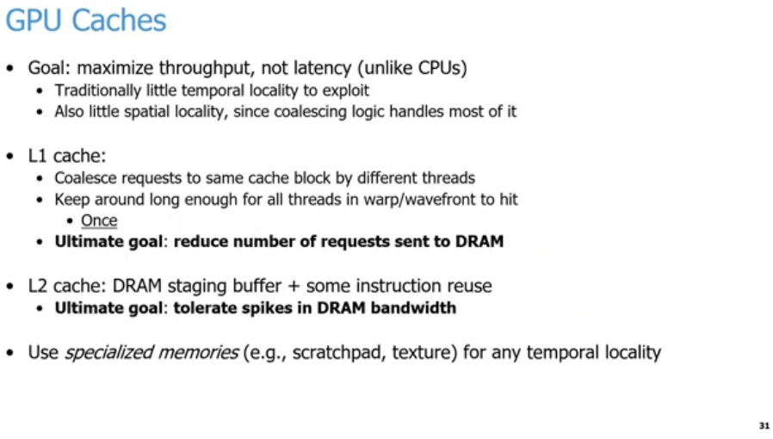
25.22 GPU Cache
https://www.youtube.com/watch?v=Kjd1hTFOI44&list=PL_hVbFs_loVR_8ntTTmmG6YEq3Po_4snu&index=25
GPU Cache (46:01 - 47:15/2:01:30)
1. GPU Cache goal is to Maximize throughput (not like CPUs cache is to minimize memory latency). In the previous slide, we know the GPUs only have 6.4 bytes per thread for Data Cache (L1 D$). There is very little or no locality to exploit. Also, we do not have spatial locality since the coalescing logic handles most of it.
2. We want to keep the data around in the cache long enough for all the threads in our warp or wavefront to access it once, not like access many times in CPUs. We want all 32 or 64 of those threads to get the data. GPUs cache just need one time before somebody else kicks it out of it and GPUs L1 Data cache need 6.4 bytes. BY doing so, especially by exploiting coalescing that allows us to reduce the number of request the we send to DRAM.
3. L2 Cache: The last level of cache in the GPU tends to be L2 Cache. This goal is basically to act as a staging buffer with a little bit in instruction reuse. The goal is to tolerate spikes in DRAM bandwidth.
4. But not ALL Is Lost here, GPUs also add specialize memories, such as, scratch pads and textures that allows us to exploit, such as, spatial and locality in these specialized memories. The programmer control what should be in there, for example, scratch pad.
1
2
3
4

Slide 97
25.23 Case 1: APU (Accelerated Process Unit)

Slide 98
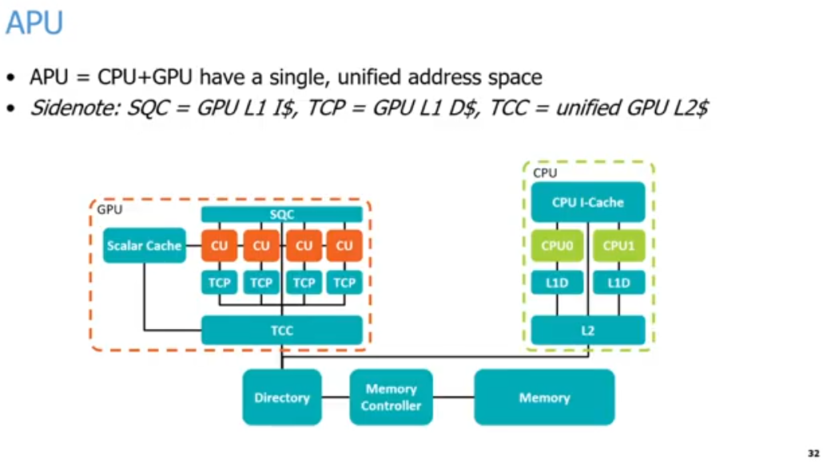
25.23 Case 1: APU (Accelerated Process Unit)
https://www.youtube.com/watch?v=Kjd1hTFOI44&list=PL_hVbFs_loVR_8ntTTmmG6YEq3Po_4snu&index=25
APU (Accelerated Process Unit) (47:16 - 47:17/2:01:30)
Chrome AI Summary:
1. APU (Accelerated Process Unit) = CPU + GPU
2. SQC (Sequencer Instruction Cache) = CPU L1 I$ (Instruction Cache), TCP (Texture Cache per Pipe) = GPU L1 D$ (Data Cache), TCC (Texture Cache per Channel) = unified GPU L2$ (Cache).
3. Cache Hierarchy Breakdown
  3.1. GPU Side (Left Orange Box)
    3.1.a. SQC (L1 I$): Shared across multiple Compute Units (CU) for instructions.
    3.1.b. Scalar Cache: Handles scalar data read-only operations for the CUs.
    3.1.c. TCP (L1 D$): Dedicated locally to individual Compute Units for data caching.
    3.1.d. TCC (Unified L2$): Aggregates data from the TCP caches and the Scalar Cache before communicating with the memory system
  3.2 CPU Side (Right Green Box)
    3.2.a. CPU I-Cache: Unified L1 Instruction Cache shared by the cores.
    3.2.b. L1D: Dedicated L1 Data Caches individual to each core (CPU0 and CPU1).
    3.2.c. L2: Shared L2 Cache supporting both CPU cores.
  3.3. Shared Memory System
    3.3.a. Directory: Manages cache coherence between the distinct CPU and GPU cache subsystems.
    3.2.b. Memory Controller: Controls data flow to and from the physical System Memory.
    3.3.c. Memory: The main unified memory storage pool shared by both processors.
1
2
3

Slide 99
25.23 Case 1: APU (Accelerated Process Unit)
https://www.youtube.com/watch?v=Kjd1hTFOI44&list=PL_hVbFs_loVR_8ntTTmmG6YEq3Po_4snu&index=25
Case 1: APU (Accelerated Process Unit) (47:18-47:19/2:01:30)
Chrome AI Mode Summary for case 1 use (APU):
Use Case 1: APU (Accelerated Processing Unit)
  a. Unified Memory Structure: The CPU and GPU share a single, unified address space and a single physical pool of system memory.
  b. No Copy Overhead: Because they share identical memory addresses, data does not need to be copied back and forth between separate CPU and GPU memory banks.
  c. Hardware Coherency: A dedicated Directory connects the CPU and GPU address spaces, maintaining cache coherency and allowing seamless data access between components.
  d. Shared Memory Controller: The directory routes requests through a unified memory controller directly into the main system memory.
1
2
3

Slide 100
25.23 Case 1: APU (Accelerated Process Unit)
https://www.youtube.com/watch?v=Kjd1hTFOI44&list=PL_hVbFs_loVR_8ntTTmmG6YEq3Po_4snu&index=25
Case 1: APU (Accelerated Process Unit) (47:20 - 47:21/2:01:30)
Chrome AI Mode Summary for case 1 use (APU):
AMD Cache Hierarchy & Nomenclature
  a. SQC (Sequencer Instruction Cache): Acts as the L1 Instruction Cache, shared across a group of Compute Units (CUs).
  b. TCP (Texture Cache per Pipe): Acts as the L1 Data Cache. Each individual Compute Unit gets its own separate TCP.
  c. TCC (Texture Cache per Channel): A unified L2 Cache handling both instruction (I) and data (D) lines for the GPU side.
  d. Scalar Cache: A specialized cache holding uniform constants or data. It supplies identical instructions/variables (like a universal bias term) to all threads in a warp or wavefront simultaneously.
1
2
3

Slide 101
25.23 Case 1: APU (Accelerated Process Unit)
https://www.youtube.com/watch?v=Kjd1hTFOI44&list=PL_hVbFs_loVR_8ntTTmmG6YEq3Po_4snu&index=25
Case 1: APU (Accelerated Process Unit) (47:22-48:00/2:01:30)
We will talk two common uses of GPUs with examples.
The first use is APU (Accelerated Processing Unit).
1. APU is CPU and GPU are used together in a single unified address space with coherent caches and a single set of memory. APU have the same address for CPU and GPU. APU don’t need to copy data back and forth between the CPU and GPU.
2. AMD Cache name: SQC (Sequencer Instruction Cache) = L1 Instruction Cache, TCP (Texture Cache per Pipe) = L1 Data Cache, TCC (Texture Cache per Channel) = Unified L2 Cache.
1
2
3

Slide 102
25.23 Case 1: APU (Accelerated Process Unit)
https://www.youtube.com/watch?v=Kjd1hTFOI44&list=PL_hVbFs_loVR_8ntTTmmG6YEq3Po_4snu&index=25
Case 1: APU (Accelerated Process Unit) (48:01 - 50:35/2:01:30)
3. Below is AMD APU diagram, GPU on the left and CPU on the right.
On the right, we have two CPU cores with two levels of cache (L1 and L2).We share caches between CPU and GPU. On the left, we have four CU (Compute Unit).
AMD uses weird name for their caches, SQC is the L1 Instruction Cache, TCP is L1 Data Cache. TCC is he unified L2 Cache. CPU and GPU share the caches across groups of our compute units.
Those compute units get a separate L1 data cache and they share a single unified L2 Cache for both I and D cache. AMD also have a specialized type of ache called a scaler cache. The scaler cache is for Vector operation, such as, multiple every thread by the same bias term for multiplication operations or normalize all the data into 0 to 1. All the warp or wavefront across all threads.
AMD’s APU use 2 level of cache and use a single unified address space. They have the directory to connect CPU and GPU address and allow us to access data back and forth between CPU and GPU.
The Directory connect to memory controller and finally in the memory.
The APU has only one system memory. There is no separate GPU memory and CPU memory.
1
2
3

Slide 103
25.24 Case 2: dGPU (Discrete GPU)

Slide 104
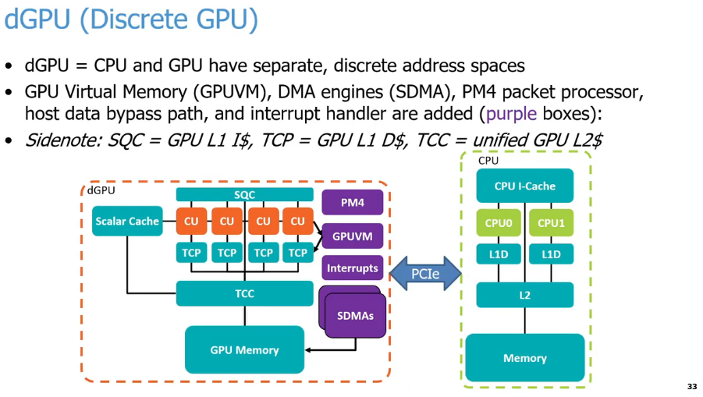
25.24 Case 2: dGPU (Discrete GPU)
https://www.youtube.com/watch?v=Kjd1hTFOI44&list=PL_hVbFs_loVR_8ntTTmmG6YEq3Po_4snu&index=25
Case 2: dGPU (Discrete GPU) (50:36 - 51:35/2:01:30)
Q: What is difference of dGPU (Discrete Process Unit) and APU (Accelerated Process Unit)?
Ans:
APU (Accelerated Processing Unit) combines both the CPU and GPU (Graphics process Unit) onto a single silicon chip, while a dGPU (Dedicated/Discrete Graphics Processing Unit) is a separate graphics IO card.
Description | APU (Accelerated Process Unit) | dGPU (Dedicated/Discrete GPU)
External Outlook | Combined on the CPU chip | Standalone PCIe expansion card
Video Memory (VRAM) | Share standard system DRAM | GPU has standalone/Dedicated very fast VRAM
Performance | Entry to mid level | Extremely fast
Price | Cheap | Very expensive
Power/Heat | High efficient, very cool | High power, require heavy cooling
Upgrade | Cannot upgrade | Easy to remove and add new graphic card

Slide 105
25.24 Case 2: dGPU (Discrete GPU)
https://www.youtube.com/watch?v=Kjd1hTFOI44&list=PL_hVbFs_loVR_8ntTTmmG6YEq3Po_4snu&index=25
Case 2: dGPU (Discrete GPU) (50:38 - 51:30/2:01:30)
1. APU (Accelerated Process Unit) have single/same address spaces on the mother board. dGPU (dedicated/discrete GPU) have separated address spaces external IO/PCIe card.
2. All the purple color boxes are extra components for GPU memory (Video RAM). GPU have its own Packet Processor PM4 (AMD Packet Mode 4), Virtual Memory GPUVM (GPU Virtual Memory), interrupt handlers, DMA/SDMA (Direct Memory Access/System Direct Memory Access), etc.
3. GPU uses the PCIe (Peripheral Component Interconnect Express) for discrete interface, such as, NVLink (NVIDIA Link) or XGM (ASUS Xtreme Graphics Mobile). In dGPU, we have to copy the data back and forth across the PCIe or other connection between the GPU memory and CPU memory. The bandwidth of the GPU memory and CPU memory are different.
1
2
3

Slide 106
25.25 Run GPU App in Gem5

Slide 107
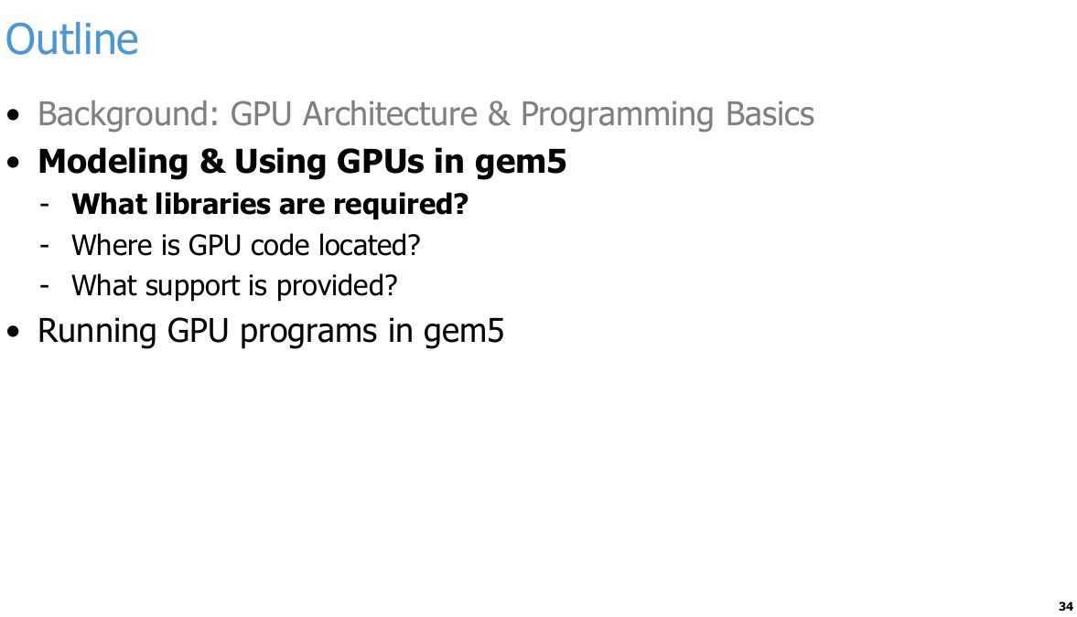
25.25 Run GPU App in Gem5
https://www.youtube.com/watch?v=Kjd1hTFOI44&list=PL_hVbFs_loVR_8ntTTmmG6YEq3Po_4snu&index=25
Run GPU App in Gem5 (51:31 - 51:32/2:01:30)

Slide 108
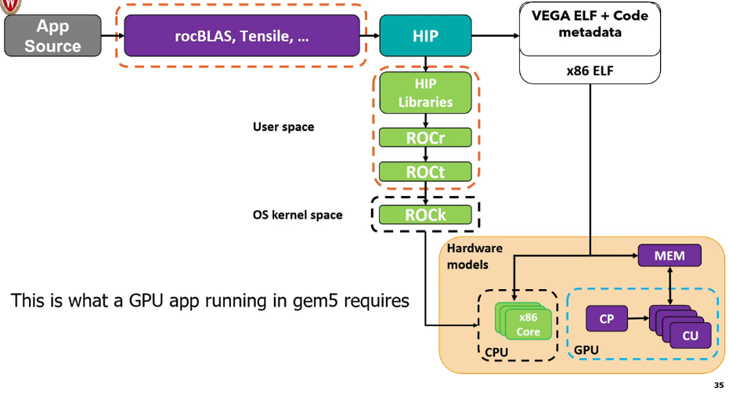
25.25 Run GPU App in Gem5
https://www.youtube.com/watch?v=Kjd1hTFOI44&list=PL_hVbFs_loVR_8ntTTmmG6YEq3Po_4snu&index=25
Run GPU App in Gem5 (51:33 - 51:34/2:01:30)
Chrome AI Mode Summary:
Below is AMD ROCm software stack and hardware components required to simulate a GPU application inside the gem5 architectural simulator.
1. Software Stack (User Space)
  a. App Source: The user-provided GPU application source code.
  b. Libraries: Core math and optimization libraries like rocBLAS and Tensile. HIP: AMD's portable C++ runtime and programming model interface.
  c. HIP Libraries: High-level libraries built on top of the runtime layer.
  d. ROCr (ROCm Runtime): Interacts directly with user-level software and manages system resources.
  e. ROCt (ROCm Thunk): The low-level user-space library interfacing directly with the kernel driver.
2. Driver & Kernel (OS Kernel Space)
  ROCk (ROCm Kernel): The open-source kernel driver (amdgpu) managing GPU hardware resources.
3. Hardware Simulation Models
  a. x86 Core (CPU): Simulates host CPU execution alongside binaries like x86 ELF.
  b. CP (Command Processor): Schedules and dispatches commands inside the simulated GPU.
  c. CU (Compute Units): Executes the actual parallel GPU compute workloads.
  d. MEM (Memory): Shared or dedicated memory hierarchy interconnecting the simulated CPU and GPU.
1
2
3
4
5
6
7

Slide 109
25.25 Run GPU App in Gem5
https://www.youtube.com/watch?v=Kjd1hTFOI44&list=PL_hVbFs_loVR_8ntTTmmG6YEq3Po_4snu&index=25
Run GPU App in Gem5 (51:35 - 54:15/2:01:30)
Below diagram shows Running a GPU app in Gem5.
1. We have a GPU application in the top/left in gray color of below diagram.
2. The application will go through multiple levels of user framework/libraries in purple color: rocBLAS (Basic Linear Algebra Subprogram) is math library for Linear Algebra and AMD Tensile (Open-source and code generator).
3. The application will go through the HIP (Heterogeneous-compute Interface for Portability) framework: HIP is the Runtime API Library and Kernel language.
4. The AMD Tensile will generate Vega (織女星, star name in Constellation Lyra) GPUs ELF (Executable and Link Format) code with meta data. GCC/Clang generates x86 ELF. They will be passed into the Gem5 simulator.
5. HIP framework runs in user space and OS kernel space. The user space includes HIP library, ROCr (Radeon Open Compute runtime), and ROCt (Thunk).
6. The OS kernel space includes ROCk (Kernel driver). ROCk is the Linux driver stack for GPU passed into the Hardware Models.
7. Hardware Models: contains x86 CPU cores and an AMD GPU architecture where the CP (Command Processor) receives commands from the CPU and dispatches them to the GPU's CUs (Compute Units).
Note: gem5 has AMD and ARM GPU but not NVIDIA GPU.
1
2
3
4
5
6
7

Slide 110
25.26 AMD ROCm Stack

Slide 111
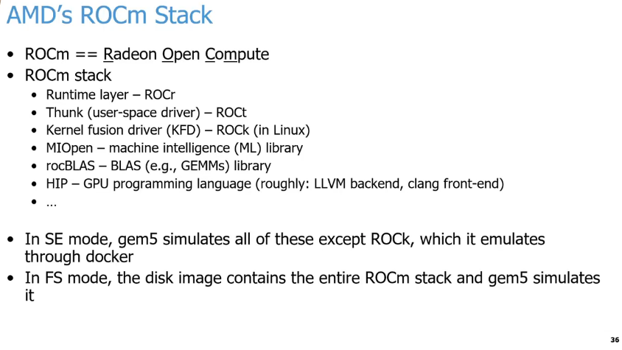
25.26 AMD ROCm Stack
https://www.youtube.com/watch?v=Kjd1hTFOI44&list=PL_hVbFs_loVR_8ntTTmmG6YEq3Po_4snu&index=25
AMD ROCm Stack (54:16 - 54:17/2:01:30)
Chrome AI Mode Summary:
gem5 handles AMD's ROCm (Radeon Open Compute) stack in its two main simulation modes:
1. SE Mode (Syscall Emulation)
  a. Partial simulation: gem5 directly simulates almost all layers of the ROCm stack (ROCr, ROCt, MIOpen, rocBLAS, and HIP).
  b. Exception (ROCk): It does not simulate the Kernel fusion driver (ROCK).
  c. Docker workaround: The ROCk driver is instead emulated through a Docker container.
2. FS Mode (Full System)
  a. Complete simulation: The simulation relies on a full disk image containing the entire, intact ROCm stack.
  b. Hardware-level handling: gem5 simulates the entire stack end-to-end without bypassing any layers.

Slide 112
25.26 AMD ROCm Stack
https://www.youtube.com/watch?v=Kjd1hTFOI44&list=PL_hVbFs_loVR_8ntTTmmG6YEq3Po_4snu&index=25
AMD ROCm Stack (54:18 - 56:00/2:01:30)
1. AMD provides the ROCm (Radeon Open Compute) stack for gem5.
2. ROCm stands for Radeon Open Compute. Radeon is an AMD brand name derived from "radio + electron".
3. AMD ROCm supports all layers of software:
a. ROCr (ROCm runtime): Runtime layer
b. ROCt (ROC thunk): User-space driver
c. ROCk (ROC Linux kernel): KFD (Kernel Fusion Driver) integrated into the Linux kernel.
d. MIOpen (Machine Intelligence Open Library): Machine Learning library
e. rocBLAS (ROC Basic Linear Algebra Subprograms): Linear Algebra library
f. HIP (Heterogeneous-compute Interface for Portability): GPGPU programming language, compilers with LLVM (Low Level Virtual Machine) backend, and Clang frontend for AMD GPGPU.
5. In SE (System-call Emulation) mode, gem5 supports all ROCm layers for simulation except ROCk. ROCk is emulated through Docker.
6. In FS (Full System) mode, the gem5 disk image contains the entire ROCm stack, and gem5 simulates it entirely, including system commands and syscalls (system calls).
1
2
3
4
5

Slide 113
25.27 GPU Programming

Slide 114
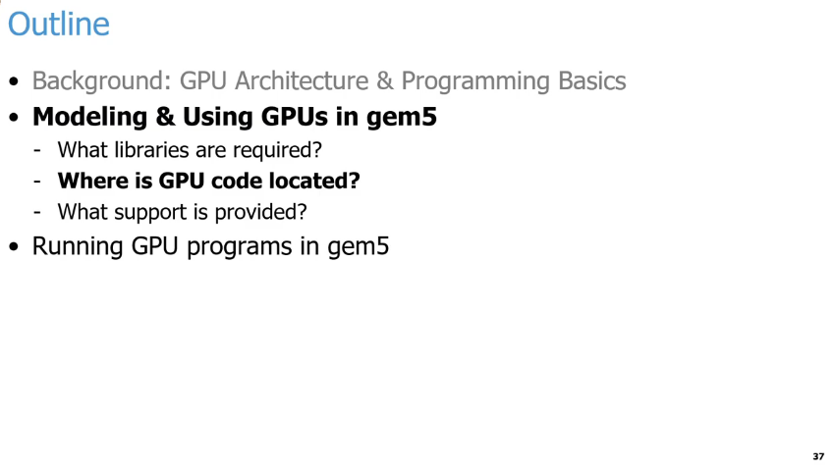
25.27 GPU Programming
https://www.youtube.com/watch?v=Kjd1hTFOI44&list=PL_hVbFs_loVR_8ntTTmmG6YEq3Po_4snu&index=25
GPU Programming (56:01 - 56:05/2:01:30)
Below is the outline of GPU Programming Basics:
1. gem5 GPU Model:
  a. GPU Libraries
  b. gem5 GPU Code location
  c. gem5 support
2. Run GPU program in gem5.

Slide 115
25.28 GPU Model Codebase

Slide 116
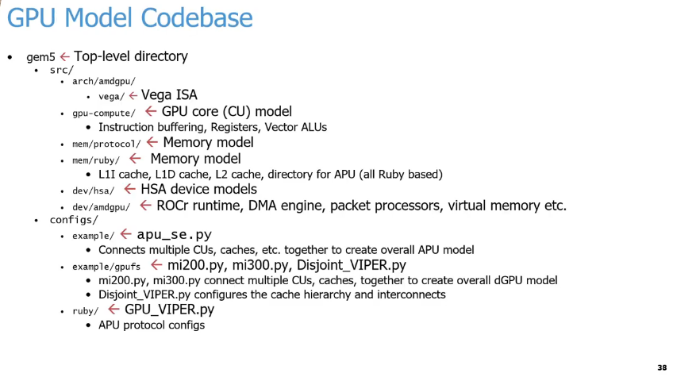
25.28 GPU Model Codebase
https://www.youtube.com/watch?v=Kjd1hTFOI44&list=PL_hVbFs_loVR_8ntTTmmG6YEq3Po_4snu&index=25
GPU Model Codebase (56:06 - 56:07/2:01:30)
Below is a structured summary of the GPU Model Codebase directories and configurations:
1. Source Directory (src/)
  a. arch/amdgpu/vega/: Contains the Vega (織女星) Instruction Set Architecture (ISA).
  b. gpu-compute/: Houses the GPU core (Compute Unit) model, managing instruction buffering, registers, and vector ALUs.
  c. mem/protocol/: Handles part of the memory model implementation.
  d. mem/ruby/: Implements the Ruby-based memory model, including L1I, L1D, and L2 caches, as well as the APU directory.
  e. dev/hsa/: Contains the Heterogeneous System Architecture (HSA) device models.
  f. dev/amdgpu/: Manages ROCr runtime simulation, DMA engines, packet processors, and virtual memory.
2. Configuration Files (configs/)
  a. example/apu_se.py: Connects multiple CUs and caches to assemble the overall APU model.
  b. example/gpufs/: Contains scripts for discrete GPU (dGPU) and interconnect configuration.
    b.1. mi200.py, mi300.py: Connects CUs and caches together for full dGPU models.
    b.2 Disjoint_VIPER.py: Configures the cache hierarchy and system interconnects.
  c. ruby/GPU_VIPER.py: Defines the cache coherence protocol configurations for the APU.

Slide 117
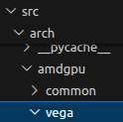
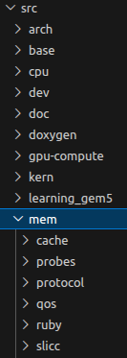
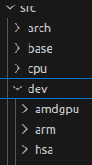
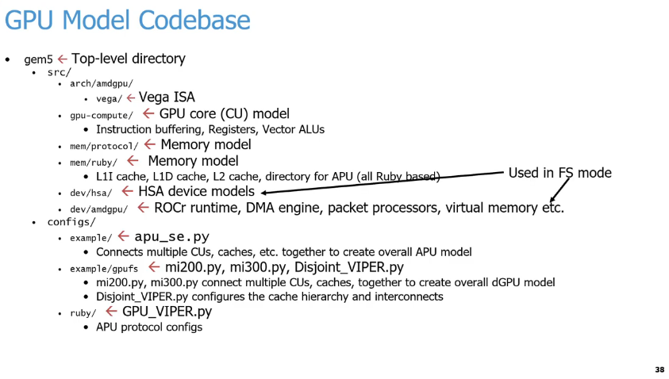
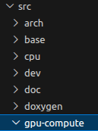
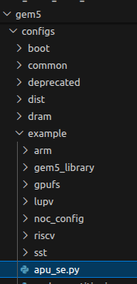
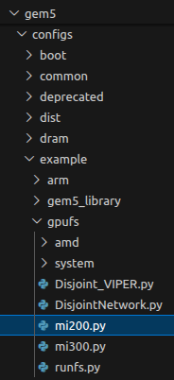
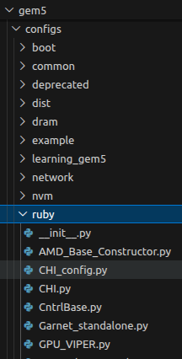
25.28 GPU Model Codebase
https://www.youtube.com/watch?v=Kjd1hTFOI44&list=PL_hVbFs_loVR_8ntTTmmG6YEq3Po_4snu&index=25
GPU Model Codebase (56:08 - 56:55/2:01:30)
Below are the libraries required by AMD GPU in gem5. The codes are located under gem5/src folder.
1.a: arch/amdgpu/vega: Contains the AMD GPU ISA (Instruction Set Architecture)
1.b: gpu-cpmpute: Contains the GPU core CU (Compute Unit) model, including instruction buffer, register, and Vector ALUs.
1.c, 1.d: mem/protocol and mem/ruby: contains the ruby based protocol for memory coherence and memory consistency.
1.e dev/hsa contains HSA (Heterogeneous System Architecture) device model.
1.f dev/amdgpu contains ROCr runtime, DMA engine, packet processors, virtual memory, etc.
1.a
1.f
1.e
1
1.a
1.b
1.c
1.c
1.d
1.d
1.e
1.b
1.f
2
2.a
2.b
2.c
2.b
2.a
2.c

Slide 118
25.28 GPU Model Codebase
https://www.youtube.com/watch?v=Kjd1hTFOI44&list=PL_hVbFs_loVR_8ntTTmmG6YEq3Po_4snu&index=25
GPU Model Codebase (56:56 - 57:10/2:01:30)
In the configs side, we have configurations for SE (System Call Emulation) mode and FS (Full system) mode.
The files in dev/hsa and dev/amdgpu are used in FS mode only.
2.a example: apu_se.py contains the connection of multiple CUs (Compute Units) and caches to create the APU (Accelerate Processing Unit) model.
2.b example/gpufs: mi200.py and mi300.py connect multiple CUs and caches to create dGPU (Discrete GPU) model. Disjoint_VIPER.py configures the cache hierarchy and interconnects (VIPER name is a poison snake).
2.c ruby: GPU_VIPER.py configure APU protocol.
1.a
1.f
1.e
1
1.a
1.b
1.c
1.c
1.d
1.d
1.e
1.b
1.f
2
2.a
2.b
2.c
2.b
2.a
2.c

Slide 119
25.29 GPU Kernel

Slide 120
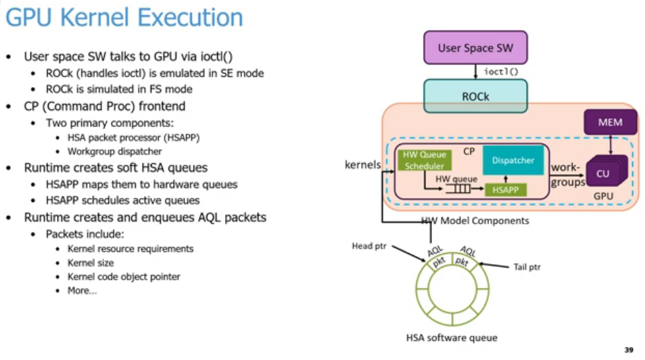
25.29 GPU Kernel
https://www.youtube.com/watch?v=Kjd1hTFOI44&list=PL_hVbFs_loVR_8ntTTmmG6YEq3Po_4snu&index=25
GPU Kernel (57:11 - 57:12/2:01:30)
Summary of the GPU kernel execution process shown in the slide:
1. Driver Communication: User Space Interaction: User space software communicates with the GPU using ioctl().
  1.1. SE Mode Emulation: The ROCK driver handles ioctl() and is emulated in Syscall Emulation mode.
  1.1. FS Mode Simulation: The ROCK driver is simulated in Full System mode.
2. CP Frontend Components: Two Core Components: The Command Processor frontend consists of an HSAPP and a Workgroup dispatcher.
3. Queue & Packet Lifecycle: Soft Queue Creation: The runtime creates soft HSA queues.
  3.1 Hardware Queue Mapping: The HSAPP (Heterogeneous System Architecture Packet Processor) maps these soft HSA queues to hardware queues.
  3.2 Active Queue Scheduling: The HSAPP handles the scheduling of active queues.
4. Packet Generation: The runtime creates and enqueues AQL packets.
  4.1 Packet Contents: These packets include kernel resource requirements, kernel size, and the kernel code object pointer.
5
1
2
6
7
3
4
9
8

Slide 121
25.29 GPU Kernel
https://www.youtube.com/watch?v=Kjd1hTFOI44&list=PL_hVbFs_loVR_8ntTTmmG6YEq3Po_4snu&index=25
GPU Kernel (57:13 - 57:14/2:01:30)
Explained the Diagram:
5.User Space SW initiates a GPU command.
6. Driver Communication: User Space SW sends an ioctl() command down to the kernel-level driver (ROCK).
7. Command Processor (CP) Frontend:
  7.1 Gatekeeper: The CP acts as the gatekeeper inside the GPU (the light orange box).
  7.2 Scheduling: It contains the HW Queue Scheduler, which manages incoming tasks.
  7.3 Queueing: Commands move from the scheduler into a hardware queue (HW queue).
8. Queue Management
  8.1 HSA Queue: The circular ring represents the HSA software queue.
  8.2 Packet Generation: The runtime environment generates and enqueues AQL packets (Architected Queue Language) packets containing kernel data.
  8.3 Head Pointer: Points to the execution start.
  8.4 Tail Pointer: Points to where new packets are added.
  8.5 Feedback Loop: These packets feed directly back into the hardware model components (kernels).
9. Hardware Processing & Execution
  9.1 Queue Processing: The HSAPP (HSA Packet Processor) processes the active queues.
  9.2 Work-Group Release: The CP signals the Dispatcher to release the work-groups.
  9.3 Parallel Dispatch: The Dispatcher sends these work-groups to the CU (Compute Unit) for parallel execution.
  9.4 Memory Access: The CU interacts directly with the GPU memory (MEM) to read and write data during execution.
5
1
2
6
7
3
4
9
8

Slide 122
25.29 GPU Kernel
https://www.youtube.com/watch?v=Kjd1hTFOI44&list=PL_hVbFs_loVR_8ntTTmmG6YEq3Po_4snu&index=25
GPU Kernel (57:15 - 59:20/2:01:30)
1. If we have some code (user space software) offload the Linux kernel and run on GPU, we need to use ioctl(). We need the ROCk comes in to do that.
We emulate that in SE mode or FS mode. We use the command processor in frontend to offload our kernel to the GPU command processor.
Execution Step-by-Step Flow
1. User space software communicates with the GPU driver via ioctl() system calls.
2. The Radeon Open Compute Kernel (ROCK) driver handles these calls (emulated in SE mode or simulated in FS mode).
3. The Command Processor (CP) frontend manages the offloading using two main components:HSAPP (Heterogeneous System Processor Packet Processor):
  3.1 Maps software queues to hardware queues.
  3.2 Workgroup Dispatcher: Dispatches workgroups to the Compute Units.
4. The runtime creates soft HSA queues (64K circular queues in memory heap).
5. The runtime creates and enqueues AQL Packets (Architected Queue Language) containing:
  5.1 Kernel resource requirements
  5.2 Kernel dimensions and sizes
  5.3 Kernel code object pointers
1
1
2
2
3
3
4
4
5
5

Slide 123
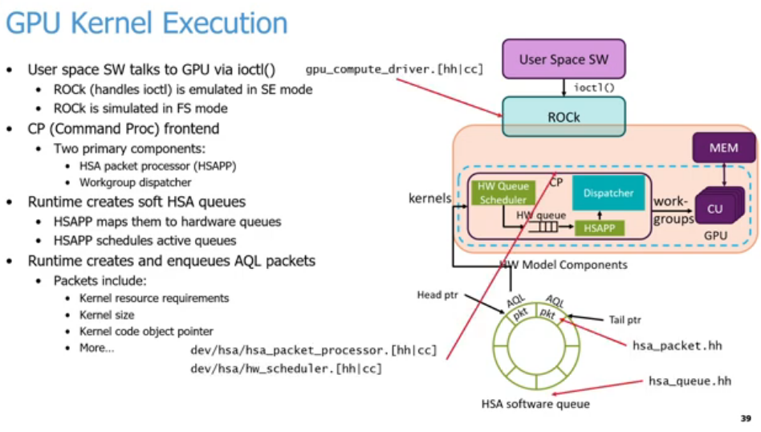


25.29 GPU Kernel
https://www.youtube.com/watch?v=Kjd1hTFOI44&list=PL_hVbFs_loVR_8ntTTmmG6YEq3Po_4snu&index=25
GPU Kernel (59:20 - 59:30/2:01:30)
We have five places to look at gem5 AMD/GPU.
1. src/gpu-compute/gpu_compute_driver.{hh|cc}:
  1.1. Implements the ROCK (Radeon Open Compute Kernel) driver emulation.
  1.2. Handles the ioctl() system calls initiated by User Space SW.
2. dev/hsa/hsa_packet_processor.{hh|cc}:
  2.1. Implements the HSAPP (Heterogeneous System Processor Packet Processor) logic.
  2.2. Responsible for mapping software HSA queues to hardware queues.
3. src/dev/hsa/hw_scheduler.{hh|cc}:
  3.1 Implements the HW Queue Scheduler component within the Command Processor (CP).
  3.2 Schedules active queues onto the execution hardware.
4. src/dev/hsa/hsa_packet.hh: Defines the structures and layouts for AQL packets (Architected Queue Language).
5. src/dev/hsa/hsa_queue.hh: Defines the structure and management of the HSA software queue (the ring buffer with head and tail pointers).
1
2
4
5
2
4
3
3
5
1

Slide 124

25.29 GPU Kernel
https://www.youtube.com/watch?v=Kjd1hTFOI44&list=PL_hVbFs_loVR_8ntTTmmG6YEq3Po_4snu&index=25
GPU Kernel (59:31 - 59:33/2:01:30)
Summary (Skip below slide because these came up in the questions before execution pipeline)
GPU Dispatcher schedules work-groups (WGs) to Compute Units (CUs) during kernel execution.
1. Core Concepts
  1.1. Resource Limits: Work-groups are mapped directly to hardware Compute Units based on availability.
  1.2 Status Tracking: The dispatcher tracks all running or pending kernels.
  1.3. Queueing: If resources are full, unmapped WGs wait in a queue.
  1.4. Host Notification: The dispatcher frees resources and alerts the host CPU once all WGs finish.
2. Dispatcher Workflow
  2.1. Continuous Check: Attempts to dispatch WGs on every hardware cycle.
  2.2. FIFO Selection: Selects the oldest AQL packet with remaining unexecuted WGs.
  2.3. Resource Verification: Dispatches WGs only if three conditions are met:
    2.3.1. Available Wavefront (WF) slots.
    2.3.2. Sufficient GPRs (General Purpose Registers).
    2.3.3. Adequate LDS (Local Data Share) space.

Slide 125
25.30 GPU Execution Pipeline

Slide 126

25.30 GPU Execution Pipeline
https://www.youtube.com/watch?v=Kjd1hTFOI44&list=PL_hVbFs_loVR_8ntTTmmG6YEq3Po_4snu&index=25
GPU Execution Pipeline (59:34 - 59:35/2:01:30)
Summary
structural pipeline stages of a GPU hardware simulator, breaking down how Wavefronts (WFs) flow through execution and memory stages.
1. Core Pipeline Stages
  1.1. Fetch: Retrieves instructions for dispatched WFs.
  1.2 Scoreboard: Checks dependencies to determine which WFs are ready.
  1.3. Schedule: Selects an execution-ready WF from the available pool.
  1.4. Execute: Runs the selected WF on the hardware execution resources.
2. Memory Pipeline Subsystems: The memory stage handles three distinct operations:
  2.1. Local Memory (LDS): Data operations utilizing the Local Data Share.
  2.2. Global Memory (TCP): Main GPU memory operations.
  2.3. Scalar Memory: Specialized handling for uniform scalar data.

Slide 127
25.30 GPU Execution Pipeline
https://www.youtube.com/watch?v=Kjd1hTFOI44&list=PL_hVbFs_loVR_8ntTTmmG6YEq3Po_4snu&index=25
GPU Execution Pipeline (59:36 - 1:00:55/2:01:30)
In gem5, we have roughly five pipeline stages. There is more in a real GPU. In gem5, this is how we model it.
1. Fetch: We fetch the WFs (Wavefronts) that we dispatched to the GPU which are implemented in the fetch stage and fetch unit.
2. Scoreboard: We check which Wavefronts are ready.
3. Schedule: Select a Wavefront from the ones that are ready. In every cycle, we keep track of Schedule and Scoreboard information. For example, Is wavefront 0 get ready to go, wavefront 1 get ready to go, etc. Whatever the wavefronts are ready to go, schedule grabs those and starts sending that work out to the later stages in the pipeline.
4. Execute: Execute is the most important. Execute can be ALU operations and different memory operations.
5. Memory Pipeline: When we execute the ALU operations and memory pipeline, the operations can be local memory operation, global memory operation, or scalar memory operation.
1
2
3
4
5

Slide 128
25.31 AMD/GPU Support

Slide 129

25.31 AMD/GPU Support
https://www.youtube.com/watch?v=Kjd1hTFOI44&list=PL_hVbFs_loVR_8ntTTmmG6YEq3Po_4snu&index=25
AMD/GPU Support (1:00:56 - 1:00:57/2:01:30)
The last topic before we do the GPU example: “What is AMD/GPU Support gem5?”

Slide 130

25.31 AMD/GPU Support
https://www.youtube.com/watch?v=Kjd1hTFOI44&list=PL_hVbFs_loVR_8ntTTmmG6YEq3Po_4snu&index=25
AMD/GPU Support (1:00:57 - 1:03:40/2:01:30)
1. ROCm supports gem5: In FS mode, gem5 supports the latest version ROCm v6.1. In SE Mode, gem5 support ROCm v4.0.
2. gem5 supports a number of AMD/GPUs:
  a. gem5 supports AMD Vega class GPUs for dGPU (discrete GPUs) with library gfx (Graphics) 900 and APU (Accelerated Processing Unit = CPU + GPU) with library gfx 902. Vega are used in gaming.
  b. gem5 supports AMD GPUs MI200 (gfx90a) and MI300 (gfx942). These MI (Machine Intelligence) products are all dGPUs and used for generative AI. In AMD gfx9xx, gfx is Graphics, 9 is the series number and xx is the version ID.
  c. In MI200 and MI300, gem5 supports the Matrix Core Engines. These tensor cores were introduced when shifting from Vega ISA to CDNA (Compute DNA).
  d. Currently, MI200 is better tested than MI300.
1
2
a
b
c
d
e
f
3
4
5
6

Slide 131
25.31 AMD/GPU Support
https://www.youtube.com/watch?v=Kjd1hTFOI44&list=PL_hVbFs_loVR_8ntTTmmG6YEq3Po_4snu&index=25
AMD/GPU Support (1:03:41 - 1:05:50/2:01:30)
2. gem5 supports a number of AMD/GPUs (Cont):
  e. If we want to run Vega, MI200, or MI300 in gem5, we need to compile applications for appropriate gfx9* model, for example, if we want to run code for MI200 model, we need to compile the code for gfx90a. If we want to run code for MI300, we need to compile the code for gfx942, etc. If we do not compile with the right architecture, the compilation will fail.
  f. Only official gfx9* GPUs can be run on gem5 Full System mode with real driver.
3. Currently, gem5 does not support GPU standard library yet. Right now, gem5 only use apu_se.py, mi200.py, mi300.py for testing instead.
4. Currently, gem5 only supports Ruby GPU.
5. For APU, gem5 strongly recommends use GPU FS mode instead of GPU SE mode.
6. When AMD releases new ROCm (Radeon Open Compute) Libraries, AMD only fully supports GPU FS mode and does not provide full testing for the gfx libraries in Vega/MI300 for GPU SE Mode.
1
2
a
b
c
d
e
f
3
4
5
6

Slide 132
25.32 GPU Full System Simulation

Slide 133

25.32 GPU Full System Simulation
https://www.youtube.com/watch?v=Kjd1hTFOI44&list=PL_hVbFs_loVR_8ntTTmmG6YEq3Po_4snu&index=25
GPU Full System Simulation (1:05:51 - 1:05:52/2:01:30)
Summary
1. Core Definitions
  a. SE Mode: Simulates an Accelerated Processing Unit (APU).
  b. GPUFS Mode: Simulates applications running on a discrete GPU (dGPU).
2. Caveats & Constraints (as of gem5 24.0)
  a. Supported CPUs: Only X86 KVM CPU and Atomic CPU are supported.
  b. Host Requirement: Using KVM CPU requires an X86 host machine with KVM support.
  c. Future Work: Support for other hardware models is currently in progress.
3. Main Differences (GPUFS vs. SE Mode)
  a. Driver Handling: ROCk (Linux kernel driver) is fully simulated rather than emulated.
  b. Hardware Modeling: GPU DMA engines and packet processors are actively modeled in GPUFS.
  c. Memory: GPU virtual memory support is fully available in GPUFS.
  d. Performance: Simulation speeds are faster due to the use of simpler CPU models.
1
2
3

Slide 134
25.32 GPU Full System Simulation
https://www.youtube.com/watch?v=Kjd1hTFOI44&list=PL_hVbFs_loVR_8ntTTmmG6YEq3Po_4snu&index=25
GPU Full System Simulation (1:05:53 - 1:07:25/2:01:30)
1. The gem5 SE (System call Emulation) mode simulates application in the APU (= CPU + GPU).
The gem5 FS (Full system) mode simulates application in both APU (= CPU + GPU) and dGPU (Discrete GPU).
2. gem5 24.0 only supports x86 KVM (Kernel-based Virtual Machine) CPU and Atomic Mode (原子模式, an atomic action/one single, uninterrupted function call) CPU with GPU FS Mode.
  When using KVM CPU, the host machine must have X86 with KVM support.
  In all the demo examples, we use a flag to disable the host X86 requirement that allow gem5 to run AMD, multi-GPU, Multi-chipset devices.
3. The main differences between GPU FS and GPU SE Mode:
  In GPU FS Mode, ROCk (Radeon Open Compute Kernel Driver) performs Full System Simulation. GPU SE mode uses System Call Emulation.
  In GPU FS mode, GPU DMA engines and packet processor are modeled. GPU SE mode does not model DMA engine and packet processor.
  In GPU FS mode, GPU Virtual memory is modeled. GPU SE mode does not model GPU Virtual Memory.
  In GPU FS mode, we have simpler CU model for fast simulation through phases of the program. GPU SE mode is slower.
1
2
3

Slide 135
25.33 gem5 Docker

Slide 136

25.33 gem5 Docker
https://www.youtube.com/watch?v=Kjd1hTFOI44&list=PL_hVbFs_loVR_8ntTTmmG6YEq3Po_4snu&index=25
gem5 Docker (1:07:26 - 1:07:27/2:01:30)
Summary:
The Docker containers provide reliable, portable environments for gem5 simulator workflows involving AMD ROCm software stacks.
Core Infrastructure
  Docker Containers: Handle the proper installation of the ROCm software stack.
  Dual-Mode Compilation: The environments support compiling target applications for both System Call Emulation (SE) mode and Full System (FS) mode.
Availability & Integration
  Official Repository: Integrated directly into the main gem5 repository.
  Resource Inclusion: Benchmarks and documentation are added to the gem5-resources repository.
  CI/CD Integration: Utilized in continuous integration pipelines to enforce stable GPU support.
  Recommended Practice: Developers are strongly encouraged to use Docker for building ROCm-dependent applications.
Hands-On Experiment Support
  gcn-gpu:v24-0: Image used for executing gem5 v24.0 in SE mode.
  gpu-fs:latest: Image used to compile applications for gem5 v24.0 in FS mode.
  Workshop Note: These local Docker pulls are unnecessary for the current session because the provided cloud Codespace already comes pre-configured with all required GPUFS dependencies.
1
2
3

Slide 137
25.33 gem5 Docker
https://www.youtube.com/watch?v=Kjd1hTFOI44&list=PL_hVbFs_loVR_8ntTTmmG6YEq3Po_4snu&index=25
gem5 Docker (1:07:28 – 1:08:55/2:01:30)
1. To compile/link different with different versions of AMD/GPUs library, and setting up driver stacks for running are very complicated and challenging.
To avoid complication of compiling, linking, and setting, we do all of these through the Docker support, i.e., Docker has done these for us.
Docker use “docker pull” command to download the docker image and “docker run” to run the downloaded image.
2. Docker hub is a public web server that collect different versions of pre-built images for us to download (docker pull).
3. Below, we have two different docker pull commands for download SE Mode image and FS Mode image, respectively.
a. For gem5 SE mode (v24.0)
> docker pull ghcr.io/gem5/gcn-gpu:v24-0
b. For gem5 FS Mode (v24.0)
> docker pull ghcr.io/gem5/gpu-fs:latest
Note: The command “gpu-fs” is not explicitly needed since Docker puts all of them together.
1
2
3

Slide 138
25.34 Run GPU/SE Mode

Slide 139

25.34 Run GPU/SE Mode
https://www.youtube.com/watch?v=Kjd1hTFOI44&list=PL_hVbFs_loVR_8ntTTmmG6YEq3Po_4snu&index=25
Run GPU/SE Mode (1:08:56 – 1:10:30/2:01:30)
We will go through four types of example
1. GPU in SE Mode
2. GPU in FS Mode
3. GPU checkpoint and restoration
4. How do we run PyTorch in gem5?
5. How do we run ML (Machine Learning) workloads in PyTorch in gem5?
6. How do we create and checkpoints to make gem5 run faster?

Slide 140
25.35 Running Square: GPU Vector Addition

Slide 141

25.35 Running Square: GPU Vector Addition
https://www.youtube.com/watch?v=Kjd1hTFOI44&list=PL_hVbFs_loVR_8ntTTmmG6YEq3Po_4snu&index=25
Running Square: GPU Vector Addition (1:10:31 – 1:12:05/2:01:30)
1. What is the Square program?
  a. Square is a simple vector addition program where each thread calculates C[i] = A[i] + B[i].
  b. Hardware: It is a perfectly parallel application designed to run on a GPU.
  c. This demo will not work inside a standard bootcamp codespace environment.
The example below shows how to pull the Docker image and compile the gem5 binary with AMD/GPU libraries.
2. Pull the Docker image:
> docker pull ghcr.io/gem5/gcn-gpu:v24-0
3. Go to the work directory.
> cd gem5-resources/src/gpu/square
4. Clean up the work directory and compile the Square program.
> docker run --rm -v ${PWD}:${PWD} -w ${PWD} ghcr.io/gem5/gcn-gpu:v24-0 make
5. Go to the gem5 directory.
> cd gem5
6. Build gem5 with AMD X86/VEGA libraries.
> docker run --volume $(pwd):$(pwd) -w $(pwd) ghcr.io/gem5/gcn-gpu:v24-0 scons build/VEGA_X86/gem5.opt -j <num cores>
1
2
3
4
5
6

Slide 142

25.35 Running Square: GPU Vector Addition
https://www.youtube.com/watch?v=Kjd1hTFOI44&list=PL_hVbFs_loVR_8ntTTmmG6YEq3Po_4snu&index=25
Running Square: GPU Vector Addition (1:12:06 – 1:12:30/2:01:30)
We have built gem5 with AMD/GPUs. How do we get AMD/GPU gem5 to run square? Below is the command to run AMD/GPU gem5:
> docker run --volume $(pwd):$(pwd) -w $(pwd) ghcr.io/gem5/gcn-gpu:v24-0 gem5/build/VEGA_X86/gem5.opt gem5/configs/example/apu_se.py -n 3 --gpu --gfx-version=gfx900 -c gem5-resources/src/gpu/square/bin/square
Command Flags Explanation:
1. Docker Flags
  a. run: Creates and starts a new container instance from the specified image.
  b. --volume $(pwd):$(pwd): Mounts your current working directory ($(pwd)) from your host machine into the exact same path inside the container. This allows the container to access and save files directly to your host machine.
  c. -w $(pwd): Sets the working directory inside the container to your current host directory path, ensuring the command executes from that folder.
  d. ghcr.io/gem5/gcn-gpu:v24-0: The specific Docker container image being downloaded and run, which comes pre-configured with a gem5 GPU development environment.
2. gem5 Binary & Configuration
  a. gem5/build/VEGA_X86/gem5.opt: The compiled gem5 simulator executable, optimized for performance (.opt), simulating an AMD Vega x86 architecture.
  b. gem5/configs/example/apu_se.py: The Python configuration script that defines the hardware layout (Accelerated Processing Unit) to run in Syscall Emulation (se) mode.
3. gem5 Simulation Flags
  a. -n 3: Configures the simulation to use 3 CPU cores.
  b. --gpu: Enables the simulation of the GPU component within the system architecture.
  c. --gfx-version=gfx900: Specifies the exact AMD GPU instruction set architecture version to simulate (gfx900 corresponds to AMD Vega 10 / MI25).
  d. -c gem5-resources/src/gpu/square/bin/square: Specifies the path to the compiled workload/binary (square) that the simulated system will execute.

Slide 143




25.35 Running Square: GPU Vector Addition
https://www.youtube.com/watch?v=Kjd1hTFOI44&list=PL_hVbFs_loVR_8ntTTmmG6YEq3Po_4snu&index=25
Running Square: GPU Vector Addition (1:12:31 – 1:13:00/2:01:30)
Below image shows Professor Sinclair commands:
1. open power shell
2. remote connect with secure shell
> ssh sinclair@eldin.cs.wisc.edu
3. push Docker image
4. Change to his working directory
> cd /nobackup2/sinclair
3
1
4
2

Slide 144

25.35 Running Square: GPU Vector Addition
https://www.youtube.com/watch?v=Kjd1hTFOI44&list=PL_hVbFs_loVR_8ntTTmmG6YEq3Po_4snu&index=25
Running Square: GPU Vector Addition (1:13:01 – 1:15:50/2:01:30)
After compilation finishes in the Docker environment, we are ready to run the Square binary under the Docker environment.
1. --volume $(pwd):$(pwd): Mounts your current working directory ($(pwd)) from your host machine into the exact same path inside the container. This allows the container to access and save files directly to your host machine.
2. -w $(pwd): Sets the working directory inside the container to your current host directory path, ensuring the command executes from that folder.
3. ghcr.io/gem5/gcn-gpu:v24-0: The specific Docker container image being downloaded and run, which comes pre-configured with a gem5 GPU development environment.
4. gem5/build/VEGA_X86/gem5.opt: The compiled gem5 simulator in AMD Vega/X86 Architecture. It is an opt (optimized for performance) binary.
5. gem5/configs/example/apu_se.py: The Python configuration script that defines the hardware layout (Accelerated Processing Unit) to run in SE (Syscall Emulation) mode.
6. -n 3: Specifies 3 threads for ROCm (Radeon Open Compute) for the multiprocessors to run the program.
7. --dgpu: Enables the simulation of the GPU component within the system architecture.
8. --gfx-version=gfx900: Specifies the AMD GPU gfx (Graphics) instruction set architecture version to simulate (gfx900 corresponds to AMD Vega 10 / MI25). This model is for AMD discrete GPU.
9. -c <path>: Passes the binary of the square program.
1
2
3
4
6
7
8
9
5

Slide 145


25.35 Running Square: GPU Vector Addition
https://www.youtube.com/watch?v=Kjd1hTFOI44&list=PL_hVbFs_loVR_8ntTTmmG6YEq3Po_4snu&index=25
Running Square: GPU Vector Addition (1:13:01 – 1:18:10/2:01:30)
Under the work directory, type command:
> docker run --volume $(pwd):$(pwd) -w $(pwd) ghcr.io/gem5/gcn-gpu:v24-0 gem5/build/VEGA_X86/gem5.opt gem5/configs/example/apu_se.py -n 3 --gpu --gfx-version=gfx900 -c gem5-resources/src/gpu/square/bin/square
> … <running now>
If we passed the wrong version of gfs, we will get the execution error.

Slide 146
25.36 Running Square: Output Statistics

Slide 147

25.36 Running Square: Output Statistics
https://www.youtube.com/watch?v=Kjd1hTFOI44&list=PL_hVbFs_loVR_8ntTTmmG6YEq3Po_4snu&index=25
Running Square: Output Statistics (1:18:11 – 1:18:12/2:01:30)
The primary statistical differences between CPUs and GPUs stem from their architectural goals: CPUs track sequential latency, while GPUs track parallel throughput.
Performance Metric | CPU Counters | GPU Counters
Execution Focus | Latency minimization | Throughput maximization
Instruction Tracking | Instructions Per Cycle (IPC) | Thread/Wavefront Occupancy
Core Activity | Active clock cycles | shaderActiveTicks / Execution time
Memory Monitoring | L1/L2/L3 cache hit/miss rates | Memory coalescing (coalsrLineAddresses)
Control Flow | Branch mispredictions | Predicated threads / Masked lanes
Arithmetic Type | Scalar / SIMD instructions | Vector (VALU) vs. Scalar (SALU) tracking
Key Differences Explained
Core Tracking: CPU stats measure individual core efficiency. GPU stats track collective compute unit activation across thousands of smaller processing cores.
Memory Architecture: CPU metrics focus on caching hierarchy latency. GPU metrics focus on memory bandwidth utilization and memory instruction coalescing.
Branch Handling: CPUs aggressively monitor branch predictors. GPUs monitor thread diverging where masking registers temporarily disable execution lanes.

Slide 148
25.36 Running Square: Output Statistics
https://www.youtube.com/watch?v=Kjd1hTFOI44&list=PL_hVbFs_loVR_8ntTTmmG6YEq3Po_4snu&index=25
Running Square: Output Statistics (1:18:13 – 1:19:12/2:01:30)
The highlighted on the screen is shaderActiveTicks. shaderActiveTicks tells us how many ticks in the compute unit in the program. This case takes 1.1 Billion ticks.
Metric Name: system.cpu3.shaderActiveTicksValue: 1,151,851,409
Description: # Total ticks that any CU attached to this shader is active (Unspecified)
In gem5, a "tick" is usually measured in picoseconds (ps) by default (1 tick = 10^(-12) seconds).
1,151,851,409 ticks = 1,151,851,409 x 10^(-12) second = 1,151,851 x 10^(-9) second = 1,151,851 nanoseconds = 1,151.85 us = 1.15ms about of active Compute Unit runtime.

Slide 149


25.36 Running Square: Output Statistics
https://www.youtube.com/watch?v=Kjd1hTFOI44&list=PL_hVbFs_loVR_8ntTTmmG6YEq3Po_4snu&index=25
Running Square: Output Statistics (1:18:13 – 1:20:10/2:01:30)
Below highlight is the shaderActiveTicks 10,061,999 tick = 10,061,999 ps = 10,061.999 ns = 10 us = 0.01 ms = 0.00001 sec
CU takes 10 million ticks.
So, different program running results are different.

Slide 150


25.36 Running Square: Output Statistics
https://www.youtube.com/watch?v=Kjd1hTFOI44&list=PL_hVbFs_loVR_8ntTTmmG6YEq3Po_4snu&index=25
Running Square: Output Statistics (1:20:11 – 1:20:25/2:01:30)
If we remove the gfx900 (discrete GPU) flags and run again.
Then, we can see it runs failed.

Slide 151

25.36 Running Square: Output Statistics
https://www.youtube.com/watch?v=Kjd1hTFOI44&list=PL_hVbFs_loVR_8ntTTmmG6YEq3Po_4snu&index=25
Running Square: Output Statistics (1:20:26 – 1:21:20/2:01:30)
We need –dgpu and --gfx-version=gfx900 discrete GPU library to run it.
It should take less 5 minutes to run gem5 discrete GPU mode.

Slide 152

25.36 Running Square: Output Statistics
https://www.youtube.com/watch?v=Kjd1hTFOI44&list=PL_hVbFs_loVR_8ntTTmmG6YEq3Po_4snu&index=25
Running Square: Output Statistics (1:21:21 – 1:21:40/2:01:30)
Below is the GPU example of CU (Compute Unit).
1. For L1 Cache. we can see there are
  a. Cache hits and misses.
  b. tcp_cntrli (TCP Controller I): Here, i is the Compute Unit number.
  c. m_demand_misses/m-demand_hits: Here, m Demand Hits and m Demand missed under the L1 Cache.
2. For L2 Cache, we can look at the tcc m_demand_hits and misses
1
2
3

Slide 153
25.36 Running Square: Output Statistics
https://www.youtube.com/watch?v=Kjd1hTFOI44&list=PL_hVbFs_loVR_8ntTTmmG6YEq3Po_4snu&index=25
Running Square: Output Statistics (1:21:41 – 1:22:20/2:01:30)
3. For the scratchpads or LDS (Local Data Share), AMD calls the scratchpad LDS. We can look at the Bank Conflicts and how many accesses are coalesced using “Number of coalesced accesses.”
Q1. What is LDS?
Ans:
  a. LDS (Local Data Share) is a fast, on-chip scratchpad memory located inside each compute unit.
  b. LDS allows threads in the same workgroup or block to share data quickly.
  c. LDS offers much lower latency than global device memory (DRAM).
  d. LDS is managed by the programmer to optimize high-performance kernels.
Q2: What is LDS Bank Conflict?
An LDS bank conflict occurs when multiple threads in a wavefront (or warp) try to access different data addresses that reside within the same memory bank at the exact same time.
To achieve high bandwidth, Local Data Share (LDS) is divided into equally sized memory modules called banks (typically 32 banks). Each bank can service only one request per clock cycle.
  a. No Conflict: If 32 threads access 32 different banks, the requests are processed simultaneously (1 cycle).
  b. Bank Conflict: If two or more threads try to access different memory addresses within the same bank, the hardware must serialize the requests. This causes a stall, degrading performance.
1
2
3

Slide 154

25.36 Running Square: Output Statistics
https://www.youtube.com/watch?v=Kjd1hTFOI44&list=PL_hVbFs_loVR_8ntTTmmG6YEq3Po_4snu&index=25
Running Square: Output Statistics (1:22:21 – 1:22:40/2:01:30)
Below are the compiled error messages:
> /HIP/rocclr/hip_code_object.cpp:120: guarantee(false && "hipErrorNoBinaryForGpu: Coudn't find binary for current devices!")
>> “Couldn’t” is a typo of “Couldn’t”
This error tells us the ROCm/HIP (Heterogeneous-compute Interface for Portability) application was compiled for a different GPU architecture than the one being simulated or used.

Slide 155
25.37 GPU Configuration Parameters

Slide 156

25.37 GPU Configuration Parameters
https://www.youtube.com/watch?v=Kjd1hTFOI44&list=PL_hVbFs_loVR_8ntTTmmG6YEq3Po_4snu&index=25
GPU Configuration Parameters (1:22:41 – 1:22:42/2:01:30)
Left column code:
> parser.add_argument ( "-u", "--num-compute-units",
> type=int, default=4, help="number of GPU compute units", ),
>
> parser.add_argument ("--mem-req-latency", type=int, default=50,
> help="Latency for requests from the cu to ruby.", )
>
> parser.add_argument ("--mem-resp-latency", type=int, default=50,
> help="Latency for responses from ruby to the cu.",)
Right column Codes:
> parser.add_argument ("--vreg-file-size", type=int, default=2048,
> help="number of physical vector registers per SIMD",)
>
> parser.add_argument ("--vreg-min-alloc", type=int, default=4,
> help="Minimum number of registers that can be allocated "
> "from the VRF. The total number of registers will be "
> "aligned to this value.",)
>
> parser.add_argument ("--sreg-file-size", type=int, default=2048,
> help="number of physical vector registers per SIMD",)
>
> parser.add_argument ("--sreg-min-alloc", type=int, default=4,
> help="Minimum number of registers that can be allocated "
> "from the SRF. The total number of registers will be "
> "aligned to this value.",)
1
4
5
2
6
3
7

Slide 157
25.37 GPU Configuration Parameters
https://www.youtube.com/watch?v=Kjd1hTFOI44&list=PL_hVbFs_loVR_8ntTTmmG6YEq3Po_4snu&index=25
GPU Configuration Parameters (1:22:43 – 1:23:00/2:01:30)
In GPUs SE (Syscall Emulation) Mode, gem5 has a large number of parameters to setup, for example, we can control:
1. the number of compute-units of GPUs,
2. the amount of latency of memory requests, the latency unit is “ticks”;
3. the amount of latency of requests and responses of memory, the latency unit is “tick”;
4. how big of register per SIMD (Single Instruction, Multiple Data) unit, the unit is the total number of vector registers (physical entry per SIMD unit); the size of each register is = 64 lanes x 4 bytes = 256 bytes;
5. the minimum number of registers allocated from VRF (Vector Register File), the VRF handles independent data for every single lane/thread in a wavefront;
6. the number of scalar registers per SIMD,
7. the minimum number of registers allocated from SRF (Scalar Register File), the SRF handles data that is uniform across the entire wavefront.
1
4
5
2
6
3
7

Slide 158

25.37 GPU Configuration Parameters
https://www.youtube.com/watch?v=Kjd1hTFOI44&list=PL_hVbFs_loVR_8ntTTmmG6YEq3Po_4snu&index=25
GPU Configuration Parameters (1:23:01 – 1:23:15/2:01:30)
8. We can look at the example in
> gem5/configs/example/apu_se.py
For example, the code on the right is to use the num-compute-units, we can call parser.add_argument (…) as below:
> parser.add_argument ("-u", "--num-compute-units", type=int, default=4,
> help="number of GPU compute units",),
Here the compute unit is set to default = 4.
9. We can change to 20 compute units with Linux Shell command.
1
4
5
2
6
3
7
8
9

Slide 159

25.37 GPU Configuration Parameters
https://www.youtube.com/watch?v=Kjd1hTFOI44&list=PL_hVbFs_loVR_8ntTTmmG6YEq3Po_4snu&index=25
GPU Configuration Parameters (1:23:16 – 1:23:16/2:01:30)
Left Column Code:
> parser.add_argument ("--num-tccs", type=int,default=1, help="number of TCC banks in the GPU",)
> parser.add_argument ("--sqc-size", type=str, default="32kB", help="SQC cache size")
> parser.add_argument ("--sqc-assoc", type=int, default=8, help="SQC cache assoc")
> parser.add_argument ("--WB_L2", action="store_true", default=False, help="writeback L2")
> parser.add_argument ("--TCP_latency", type=int, default=4, help="In combination with the number of banks for the "
"TCP, this determines how many requests can happen " "per cycle (i.e., the bandwidth)",)
> parser.add_argument ("--mandatory_queue_latency", type=int,default=1,help="Hit latency for TCP",)
> parser.add_argument ("--TCC_latency", type=int, default=16, help="TCC latency")
> parser.add_argument("--tcc-size", type=str, default="256kB", help="aggregate tcc size")
> parser.add_argument("--tcc-assoc", type=int, default=16, help="tcc assoc")
> parser.add_argument("--tcp-size", type=str, default="16kB", help="tcp size")

Slide 160
25.37 GPU Configuration Parameters
https://www.youtube.com/watch?v=Kjd1hTFOI44&list=PL_hVbFs_loVR_8ntTTmmG6YEq3Po_4snu&index=25
GPU Configuration Parameters (1:23:17 – 1:23:17/2:01:30)
Right Column Code:
> parser.add_argument ("--glc-atomic-latency", type=int, default=1, help="GLC Atomic Latency")
> parser.add_argument("--atomic-alu-latency", type=int, default=8, help="Atomic ALU Latency")
> parser.add_argument("--tcc-num-atomic-alus", type=int,default=64, help="Number of atomic ALUs in the TCC",)
> parser.add_argument("--tcc-num-banks", type=int,default=16, help="Num of banks in l1 cache",)
> parser.add_argument("--tcc-num-banks", type=int,default=16,help="Num of banks in l2 cache",)
> parser.add_argument("--tcc-tag-access-latency", type=int,default=2, help="Tag access latency in L2 cache",)
> parser.add_argument("--tcc-data-access-latency", type=int,default=8,help="Data access latency in L2 cache",)
Bottom Right Note:
And many more ingem5/configs/ruby/GPU_VIPER.py

Slide 161

25.37 GPU Configuration Parameters
https://www.youtube.com/watch?v=Kjd1hTFOI44&list=PL_hVbFs_loVR_8ntTTmmG6YEq3Po_4snu&index=25
GPU Configuration Parameters (1:23:18 – 1:23:20/2:01:30)
Below, in ruby/GPU_VIPER.py, we have the configurations for the GPU cache and memory protocol.
Q. What is the difference between apu_se.py and GPU_VIPER.py?
Ans:
1. apu_se.py is a top-level system configuration script. It configures HIP (Heterogeneous-compute Interface for Portability) for a heterogeneous APU (Accelerated Processing Unit) simulation environment, managing high-level orchestration, such as Compute Units (CUs), setting up the ROCm parameters, and orchestrating overall simulation options in Syscall Emulation (SE) mode.
2. GPU_VIPER.py is a subsystem-specific cache protocol script. It configures detailed cache hierarchy and memory coherence mechanisms in the GPU Viper Protocol.

Slide 162
25.38 Run GPU in FS Mode

Slide 163

25.38 Run GPU in FS Mode
https://www.youtube.com/watch?v=Kjd1hTFOI44&list=PL_hVbFs_loVR_8ntTTmmG6YEq3Po_4snu&index=25
Run GPU in FS Mode (1:23:21 – 1:23:22/2:01:30)

Slide 164

25.38 Run GPU in FS Mode
https://www.youtube.com/watch?v=Kjd1hTFOI44&list=PL_hVbFs_loVR_8ntTTmmG6YEq3Po_4snu&index=25
Run GPU in FS Mode (1:23:23 – 1:23:25/2:01:30)
This slide outlines the necessary steps and file links for Creating GPUFS (GPU Full System) Resources when setting up gem5 Full System GPU models. It breaks down the environments needed to build and execute machine learning or GPU workloads under architectural simulation.
1. Docker Container
  a. Contains a complete installation of the AMD ROCm software stack.
  b. Acts as the development environment used to build applications and compile binaries before deploying them into the simulator.
2. Disk Image & Linux Kernel: To run a Full System (FS) simulation, gem5 requires an isolated virtual kernel and OS filesystem:
  a. Linux Kernel: Downloadable via vmlinux-gpu-ml.gz.
  b. Disk Image: Downloadable via x86-ubuntu-gpu-ml.gz.
  c. Purpose: Provides a packaged version of Linux and ROCm tailored natively to execute target machine learning binaries during simulation.
  d. Environment: These files are pre-downloaded inside the /workspaces/2024 directory for bootcamp/tutorial environments.🛠
3. Manual Configuration
  a. Custom disk images can be built manually to test newer kernel versions or updated ROCm software stacks.01

Slide 165

25.38 Run GPU in FS Mode
https://www.youtube.com/watch?v=Kjd1hTFOI44&list=PL_hVbFs_loVR_8ntTTmmG6YEq3Po_4snu&index=25
Run GPU in FS Mode (1:23:26 – 1:24:45/2:01:30)
1. Gem5 support ROCm 6.1 and Simulate ROCm stack. The Docker container contains an installation of ROCm software stack. We can use ROCm Stack to build the application that we are going to run our GPUFS simulation.
2. There are two important parts: Linux Kernel and disk image. We can download the disk image or Linux kernel
  a. Linux Kernel: Downloadable via vmlinux-gpu-ml.gz.
  b. Disk Image: Downloadable via x86-ubuntu-gpu-ml.gz.
  c. There are version of Linux and ROCm for full simulation.
  d. In the gem5-resource and material. There are GPU examples run and make GPU model.
  > bootcamp/gem5-resources/src/gpu/square
  > bootcamp/materials/04-GPU-model/Makefile
1
2

Slide 166
25.39 Build Square for GPU-FS

Slide 167

25.39 Build Square for GPU-FS
https://www.youtube.com/watch?v=Kjd1hTFOI44&list=PL_hVbFs_loVR_8ntTTmmG6YEq3Po_4snu&index=25
Run GPU in FS Mode (1:24:46 – 1:25:47/2:01:30)
2. Build GPU-FS”
a. Go to Square work director
> cd gem5-resource/src/gpu/square
b. Copy Makefile to wok directory
> cp materials/04-GPU-model/Makefile .
c. Remove previous docker run environment in workspace-path and re-recreate latest docker run environment.
Note:
a. ghcr (GitHub Container Register) store the latest Gem5’s image.
b. The command ghcr.io/gem5/gpu-fs:latest compile applications for gem5’s pre-built Docker container image to run in GPU Full-System (GPUFS)
> docker run --rm -v <workspace-path> -w ${PWD} ghcr.io/gem5/gpu-fs:latest make
1
2

Slide 168



25.39 Build Square for GPU-FS
https://www.youtube.com/watch?v=Kjd1hTFOI44&list=PL_hVbFs_loVR_8ntTTmmG6YEq3Po_4snu&index=25
Run GPU in FS Mode (1:24:48 – 1:26:00/2:01:30)
Now, we take the exact same application Square that we run in GPU-SE (Syscall Emulation).
We will run it in GPU-FS (Full System).
1. Compile the m5ops (m5/gem5 opcodes) binary for gem5 from m5 project (FS Mode has different binary from SE mode.
> cd gem5/util/m5
> scons build/x86/out/m5 # build the gem5/util/build/x86/out/[libm5.a, m5] binary
> cd build/x86/out
> ls -l
>> libm5.a # m5 binary library compiled for C++ static C library
>> m5 # m5 binary for command utility, such as, m5 exit, m5 checkpoint in guest terminal
1
2

Slide 169
25.39 Build Square for GPU-FS
https://www.youtube.com/watch?v=Kjd1hTFOI44&list=PL_hVbFs_loVR_8ntTTmmG6YEq3Po_4snu&index=25
Run GPU in FS Mode (1:24:48 – 1:25:30/2:01:30)
2. We run square in gem5-resources/src/gpu/square with docker run
a. change to working directory (gem5-resources/src/gpu/square)
> cd ~/gem5-resources/src/gpu/square
b. Copy GPU-FS Makefile from bootcamp directory (~bootcamp/materials/04-GPU-model/Makefile) to working directory (cd ~/gem5-resources/src/gpu/square)
> cp ~bootcamp/materials/04-GPU-model/Makefile .
c. Use docker run command to generate and run
> docker run --rm -v <workspace-path> -w ${PWD} ghcr.io/gem5/gpu-fs:latest make
Note:
c.1 --rm -v <workspace-path>: Remove previous docker run environment in workspace-path
c.2 ghcr.io (GitHub Container Registry): Get the latest gem5 image from GitHub.
c.3 make: Recreate the new docker environment
1
2

Slide 170


25.39 Build Square for GPU-FS
https://www.youtube.com/watch?v=Kjd1hTFOI44&list=PL_hVbFs_loVR_8ntTTmmG6YEq3Po_4snu&index=25
Run GPU in FS Mode (1:25:31 – 1:25:50/2:01:30)
1. Modify README.md file
2. Generate m5ops
1
2

Slide 171


25.39 Build Square for GPU-FS
https://www.youtube.com/watch?v=Kjd1hTFOI44&list=PL_hVbFs_loVR_8ntTTmmG6YEq3Po_4snu&index=25
Run GPU in FS Mode (1:25:51 – 1:27:50/2:01:30)
4. Change to gpu square application working directory
5. Copy Makefile to working directory
6. Use “docker run” command to run application.
7. Running.,.,
4
5
6
7

Slide 172
25.40 Run GPU-FS Without Docker

Slide 173

25.40 Run GPU-FS Without Docker
https://www.youtube.com/watch?v=Kjd1hTFOI44&list=PL_hVbFs_loVR_8ntTTmmG6YEq3Po_4snu&index=25
Run GPU-FS Without Docker (1:27:51 – 1:27:52/2:01:30)
Docker environment is easier for user to run gem5. This is the recommended way.
If we compile without error, we can run GPU-FS without docker.
Parameter Breakdown:
a. --app: Path to the target binary application.
b. --disk-image: Simulated operating system storage image file.
c. --kernel: Pre-built Linux kernel vmlinux file.
d. --no-kvm-perf: Performance tracking flag configuration.

Slide 174
25.40 Run GPU-FS Without Docker
https://www.youtube.com/watch?v=Kjd1hTFOI44&list=PL_hVbFs_loVR_8ntTTmmG6YEq3Po_4snu&index=25
Run GPU-FS Without Docker (1:27:53 – 1:28:00/2:01:30)
1. In GPU-SE mode, we technically can only use Docker pre-built image due to complicated ROCm stack.
2. In GPU-FS mode, can run both without and with Docker pre-built image. The user most likely compiles the benchmark by himself. The libraries are part of the disk image.
> /usr/local/bin/gem5-vega gem5/configs/example/gpufs/mi200.py --app ./gem5-resources/src/gpu/square/bin/square --disk-image ./x86-ubuntu-gpu-ml-isca --kernel ./vmlinux-gpu-ml-isca --no-kvm-perf

Slide 175
25.40 Run GPU-FS Without Docker
https://www.youtube.com/watch?v=Kjd1hTFOI44&list=PL_hVbFs_loVR_8ntTTmmG6YEq3Po_4snu&index=25
Run GPU-FS Without Docker (1:28:01 – 1:28:20/2:01:30)
For GPU-FS mode,
a. Once we download the disk image, we can run the following in the command line without any Docker.
b. We just need to download the disk image before we run.
c. We have pre-built Vega, therefore, we do not need to run scons to build. gem5-Vega is in the user/local/bin.
d. We have config file mi200.py.
e. We are still running application Square which is compiled previously.
> /usr/local/bin/gem5-vega gem5/configs/example/gpufs/mi200.py --app ./gem5-resources/src/gpu/square/bin/square --disk-image ./x86-ubuntu-gpu-ml-isca --kernel ./vmlinux-gpu-ml-isca --no-kvm-perf

Slide 176
25.40 Run GPU-FS Without Docker
https://www.youtube.com/watch?v=Kjd1hTFOI44&list=PL_hVbFs_loVR_8ntTTmmG6YEq3Po_4snu&index=25
Run GPU-FS Without Docker (1:28:21 – 1:29:25/2:01:30)
f. Now, we have flags for disk image and kernel. These two files are used to run container. The kernel will bring in ROCm 6.1 stack.
g. The last flag is “--no-kvm-perf”. This flag does decouple the application from host machine with KVM support. We don’t need to update the KVM hardware.
> /usr/local/bin/gem5-vega gem5/configs/example/gpufs/mi200.py --app ./gem5-resources/src/gpu/square/bin/square --disk-image ./x86-ubuntu-gpu-ml-isca --kernel ./vmlinux-gpu-ml-isca --no-kvm-perf

Slide 177


25.40 Run GPU-FS Without Docker
https://www.youtube.com/watch?v=Kjd1hTFOI44&list=PL_hVbFs_loVR_8ntTTmmG6YEq3Po_4snu&index=25
Run GPU-FS Without Docker (1:29:26 – 1:30:40/2:01:30)
Below
> cd <work directory>
Run command:
> /usr/local/bin/gem5-vega gem5/configs/example/gpufs/mi200.py --app ./gem5-resources/src/gpu/square/bin/square --disk-image ./x86-ubuntu-gpu-ml-isca --kernel ./vmlinux-gpu-ml-isca –no-kvm-perf
It takes a couple of minutes to run.

Slide 178

25.40 Run GPU-FS Without Docker
https://www.youtube.com/watch?v=Kjd1hTFOI44&list=PL_hVbFs_loVR_8ntTTmmG6YEq3Po_4snu&index=25
Run GPU-FS Without Docker (1:30:41 – 1:31:15/2:01:30)
The results are in m5out/system.pc.com_1.device

Slide 179
25.41 Compile MFMA Operations in GPUFS

Slide 180


25.41 Compile MFMA Operations in GPUFS
https://www.youtube.com/watch?v=Kjd1hTFOI44&list=PL_hVbFs_loVR_8ntTTmmG6YEq3Po_4snu&index=25
Compile MFMA Operations in GPUFS (1:31:16 – 1:31:17/2:01:30)
Q. What is difference between the Square and MFMA (Matrix Fused Multiply-Add)
Ans: Square only do C = A x B. MFMA does D = A x B + C.

Slide 181
25.41 Compile MFMA Operations in GPUFS
https://www.youtube.com/watch?v=Kjd1hTFOI44&list=PL_hVbFs_loVR_8ntTTmmG6YEq3Po_4snu&index=25
Compile MFMA Operations in GPUFS (1:31:16 – 1:32:35/2:01:30)
Run MFMA (Matrix Fused Multiply-Add) operations in the gem5 GPU Full-System simulation.
Below, we use mi200.py to do MFMA (D = A x B + C) calculation for 32 bits operation. Everything else are very similar to Square before.
1. Navigate to the working directory
> cd /workspaces/2024/
2. Copy the source materials into the gem5-resources directory
> cp -r materials/04-GPU-model/mfma_fp32/ gem5-resources/src/gpu/mfma_fp32
3. Move into the copied directory
> cd gem5-resources/src/gpu/mfma_fp32
4. Compile the MFMA source code using the gem5 GPU Docker container
> docker run --rm -v /workspaces/2024:/workspaces/2024 -w ${PWD} ghcr.io/gem5/gpu-fs:latest make
5. Return to the main workspace root
> cd /workspaces/2024/
6. Run the gem5 full-system simulation targeting an AMD MI200 GPU
> /usr/local/bin/gem5-vega -d mfma_out1 gem5/configs/example/gpufs/mi200.py
> --kernel ./vmlinux-gpu-ml-isca --disk-image ./x86-ubuntu-gpu-ml-isca
> --app ./gem5-resources/src/gpu/mfma_fp32/mfma_fp32_32x32x2fp32 --no-kvm-perf

Slide 182


25.41 Compile MFMA Operations in GPUFS
https://www.youtube.com/watch?v=Kjd1hTFOI44&list=PL_hVbFs_loVR_8ntTTmmG6YEq3Po_4snu&index=25
Compile MFMA Operations in GPUFS (1:31:16 – 1:32:30/2:01:30)
In mfma_fp32_32x32x2fp32.cp, we call __builtin_amdgcn_mfma_f32_32x32x2f32(a, b, d, 0, 0, 0)
Amdgcn (AMD Graphic Core Next) is software tool to generate code for AMD GPUs (Graphic Processing Units).
> ~materials/04-GPU-model/mfma_f32/src/mfma_f32_32x32x2fp32.cpp

Slide 183

25.41 Compile MFMA Operations in GPUFS
https://www.youtube.com/watch?v=Kjd1hTFOI44&list=PL_hVbFs_loVR_8ntTTmmG6YEq3Po_4snu&index=25
Compile MFMA Operations in GPUFS (1:32:31 - 1:32:50/2:01:30)
In the massive “N x M problem” (N programming languages and M types of hardware chips, we need LLVM (Low Level Virtual machine).
LLVM is a universal, modular middle man. LLVM shared a universal language called LLVM IR (Intermediate Representation). LLVM translates the IR into machine code for any hardware chip.

Slide 184

25.41 Compile MFMA Operations in GPUFS
https://www.youtube.com/watch?v=Kjd1hTFOI44&list=PL_hVbFs_loVR_8ntTTmmG6YEq3Po_4snu&index=25
Compile MFMA Operations in GPUFS (1:32:51 - 1:33:30/2:01:30)
Here, we are using the __built_amdgcn_mfma_f32_32x32x2f32() function to perform the LLVM (Low Level Virtual Machine) for matrix calculation for different machines.
This call is for AMD GCN (Graphic Core Next), MFMA (Matrix Fused Multiply-Add), f32 (Accumulator/Output, Floating point 32 bits), 32 x 32 x 2 (M x N x K, A = 32 x2 , B = 2 x 32, C = 32 x 32), f32 (Input 32 bit floating point)

Slide 185


25.41 Compile MFMA Operations in GPUFS
https://www.youtube.com/watch?v=Kjd1hTFOI44&list=PL_hVbFs_loVR_8ntTTmmG6YEq3Po_4snu&index=25
Compile MFMA Operations in GPUFS (1:33:31 - 1:36:25/2:01:30)
> cd <work directory>
> cp -r <code> # Copy code from materials to gem5-resources/gpu/mfma_fp32
> cd <mfma_fp32> # Change to mfma_fp32 directory
> docker run … make # Compile mi200 for MFMA (Matrix Fused Multiply-Add)

Slide 186
25.42 Run MFMA Operations in GPUFS

Slide 187



25.42 Run MFMA Operations in GPUFS
https://www.youtube.com/watch?v=Kjd1hTFOI44&list=PL_hVbFs_loVR_8ntTTmmG6YEq3Po_4snu&index=25
Run MFMA Operations in GPUFS (1:36:26 - 1:37:00/2:01:30)
GPU model has a wide variety of different configuration operations.
Below, we have MFMA test with different register allocators for GPU model. We have
1. simple register model run one wavefront at a time on a given computer unit.
2. dynamic register that uses all the resource at the same time.

Slide 188
End

