Slide 1

26 SST Integration
Peter H. Chen

Slide 2

26 SST Integration
https://www.youtube.com/watch?v=ciSLhURk6OU&list=PL_hVbFs_loVR_8ntTTmmG6YEq3Po_4snu&index=26
SST Integration (0:00 - 0:30/2:01:30)
Gem5 is an useful simulator but not the best for all cases. There are lots of other simulators as well. Gem5 can integrate other simulators, such as, SST, DRAM, etc.

Slide 3
26.1 Install SST
https://www.youtube.com/watch?v=ciSLhURk6OU&list=PL_hVbFs_loVR_8ntTTmmG6YEq3Po_4snu&index=26
Install SST (0:31 – 1:30/2:01:30)
We will run docker to do the SST (Structured Simulation Toolkit). SST is an event simulator but we run in a Single Thread SST and a parallel discrete event simulator. SST is developed at CIA National Labs.
SST is used for doing very large scale simulation. SST can run a lot of Network Level Simulations in Super computer.
We create interfaces between gem5 and SST.
SST is made up of a bunch of components in the system. gem5 is used as one of those components in SST system.

Slide 4
26.0 Topics

Slide 5
26.0 Topics
https://www.youtube.com/watch?v=ciSLhURk6OU&list=PL_hVbFs_loVR_8ntTTmmG6YEq3Po_4snu&index=26
Topics (1:31 – 1:32/2:01:30)
Topics:
1. SST:

Slide 6
26.1 Install SST

Slide 7
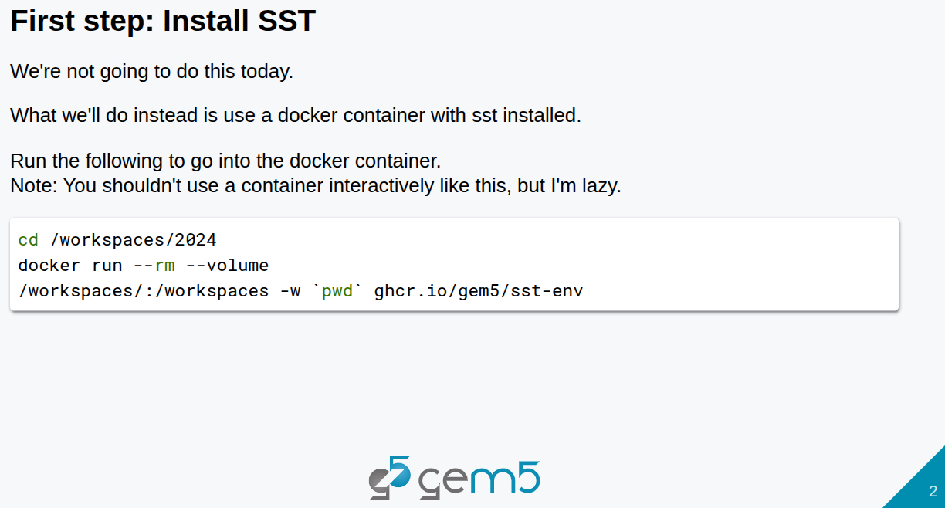
26.1 Install SST
https://www.youtube.com/watch?v=ciSLhURk6OU&list=PL_hVbFs_loVR_8ntTTmmG6YEq3Po_4snu&index=26
Install SST (1:33 – 1:45/2:01:30)
Below shows how to setup and run SST example.
But we said before, we are not going to install SST.
So, we skip the below installation.

Slide 8
26.2 SST Uses gem5 as a Library

Slide 9
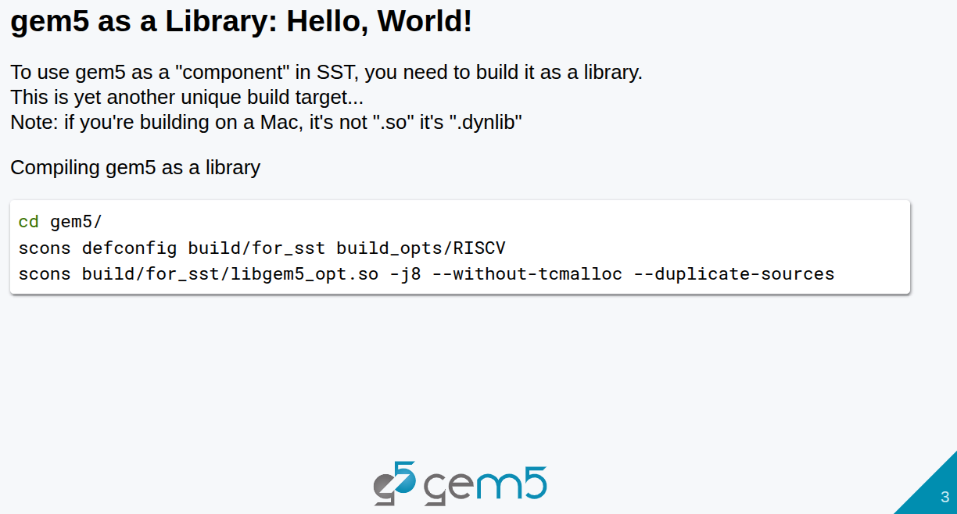
26.2 SST Uses gem5 as a Library
https://www.youtube.com/watch?v=ciSLhURk6OU&list=PL_hVbFs_loVR_8ntTTmmG6YEq3Po_4snu&index=26
SST Uses gem5 as a Library (1:33 – 1:45/2:01:30)
Below, we use gem5 as a library

Slide 10
26.2 gem5 as a Library

Slide 11
26.2 gem5 as a Library
https://www.youtube.com/watch?v=ciSLhURk6OU&list=PL_hVbFs_loVR_8ntTTmmG6YEq3Po_4snu&index=26
gem5 as a Library (1:46 – 2:45/2:01:30)
We use gem5 as a Component in SST.
SST loads in components dynamically as libraries.
Below, SST loads the gem5 library as a SST component.
> scons build/for_set/libgem5_opt.so -j8 –wihout-tcmalloc –duplcate-sources
We can use fast or opt of gem5.

Slide 12
26.3 Build gem5 Component

Slide 13
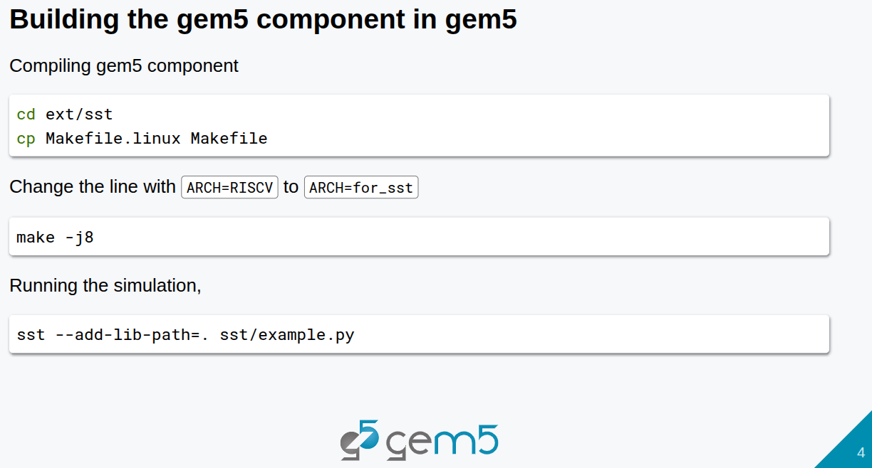
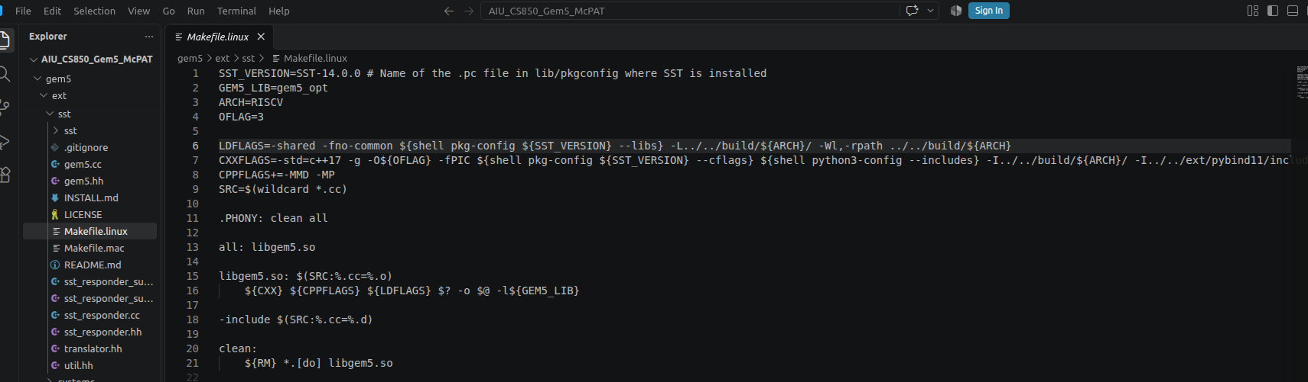
26.3 Build gem5 Component
https://www.youtube.com/watch?v=ciSLhURk6OU&list=PL_hVbFs_loVR_8ntTTmmG6YEq3Po_4snu&index=26
Build gem5 Component (2:46 – 3:45/2:01:30)
1. We need to build gem5 component.
> ~/gem5/ext/sst/Makefile.linux
2. Change ARCH=RISCV to ARCH=for_sst
2
1

Slide 14
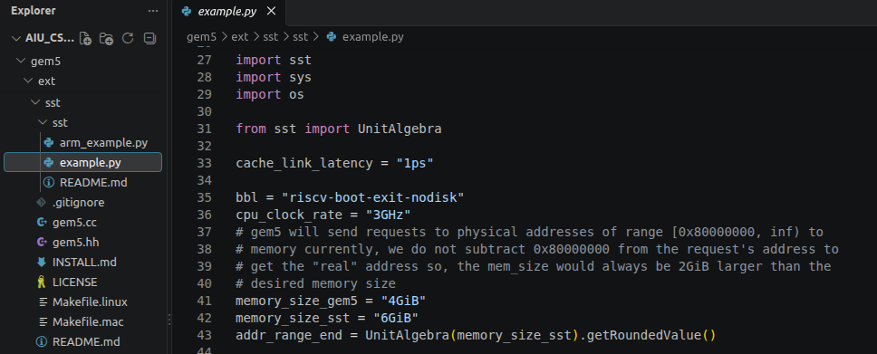
26.3 Build gem5 Component
https://www.youtube.com/watch?v=ciSLhURk6OU&list=PL_hVbFs_loVR_8ntTTmmG6YEq3Po_4snu&index=26
Build gem5 Component (3:46 – 4:10/2:01:30)
3. Build sst
> make -j8
4. Run sst/example.py
> sst –add-lib-path=. sst/example.py
5. ~gem5/ext/sst/sst/example.py
5
3
4

Slide 15
26.4 gem5 Library Component Instantiation

Slide 16
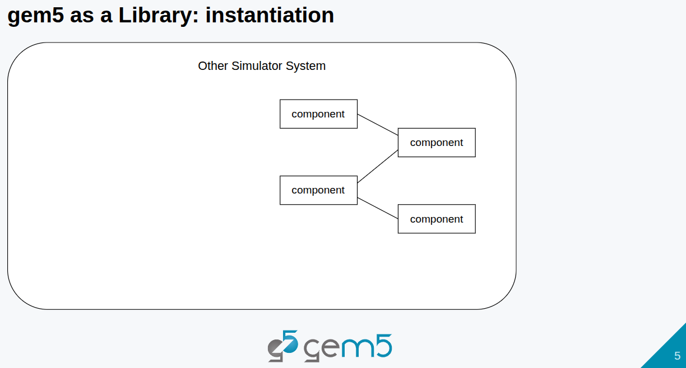
6.4 gem5 Library Component Instantiation
https://www.youtube.com/watch?v=ciSLhURk6OU&list=PL_hVbFs_loVR_8ntTTmmG6YEq3Po_4snu&index=26
gem5 Library Component Instantiation (3:46 – 4:25/2:01:30)
Below, sst has a bunch of components components.

Slide 17
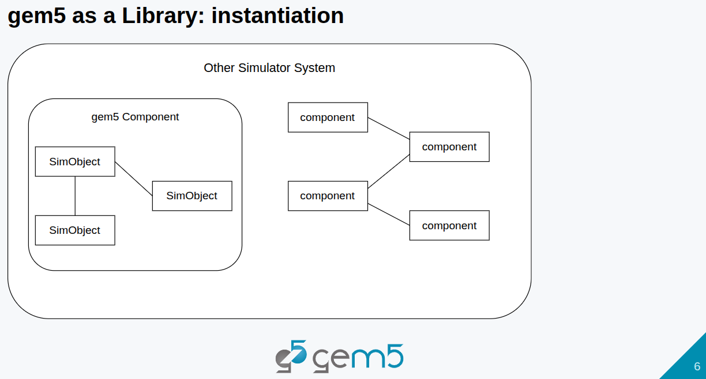
6.4 gem5 Library Component Instantiation
https://www.youtube.com/watch?v=ciSLhURk6OU&list=PL_hVbFs_loVR_8ntTTmmG6YEq3Po_4snu&index=26
gem5 Library Component Instantiation (4:26 – 4:30/2:01:30)
gem5 is a component which has a bunch of SimObjects.

Slide 18

6.4 gem5 Library Component Instantiation
https://www.youtube.com/watch?v=ciSLhURk6OU&list=PL_hVbFs_loVR_8ntTTmmG6YEq3Po_4snu&index=26
gem5 Library Component Instantiation (4:31 – 4:40/2:01:30)
We create a bridge between the SimObjects and sst component.
The gem5 SimObject to send and receive data from sst components.

Slide 19
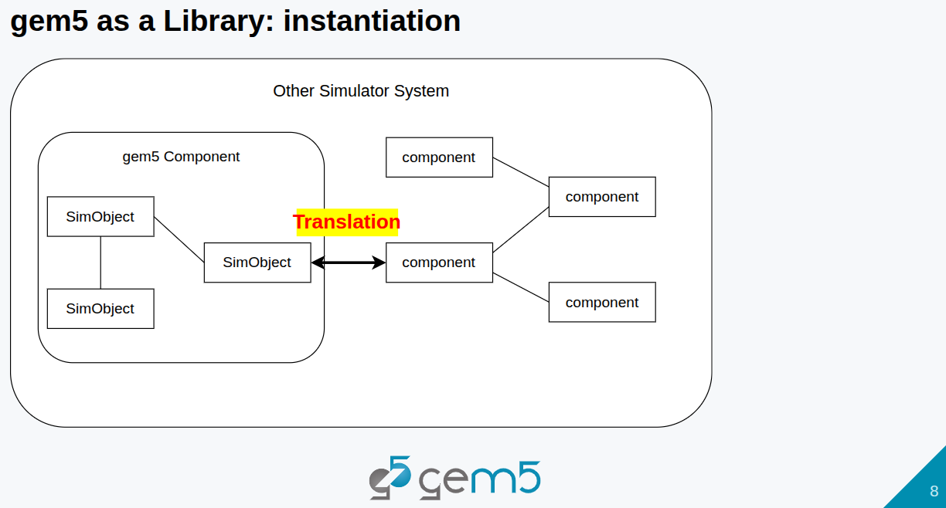
6.4 gem5 Library Component Instantiation
https://www.youtube.com/watch?v=ciSLhURk6OU&list=PL_hVbFs_loVR_8ntTTmmG6YEq3Po_4snu&index=26
gem5 Library Component Instantiation (4:41 – 5:15/2:01:30)
The bridge is implemented across gem5 port interfaces.
We can convert SimObjects data into sst component.

Slide 20
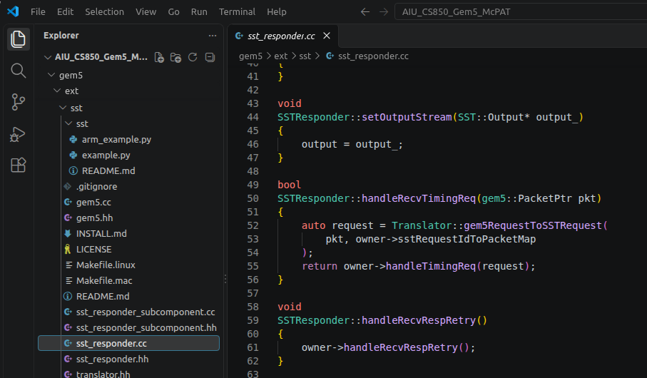
6.4 gem5 Library Component Instantiation
https://www.youtube.com/watch?v=ciSLhURk6OU&list=PL_hVbFs_loVR_8ntTTmmG6YEq3Po_4snu&index=26
gem5 Library Component Instantiation (5:16 – 5:30/2:01:30)
Below ~gem5/ext/sst/sst_responder.cc is the sst side with sst responder.
We can set request from gem5 int sst. sst will respond.
SSTRepomder::handleRecvTimingReq () will respond to gem5 side.

Slide 21
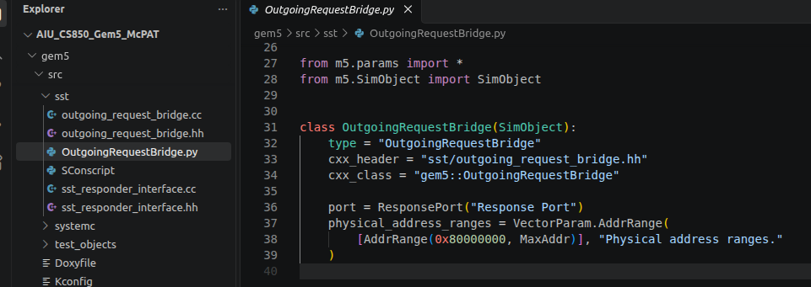
6.4 gem5 Library Component Instantiation
https://www.youtube.com/watch?v=ciSLhURk6OU&list=PL_hVbFs_loVR_8ntTTmmG6YEq3Po_4snu&index=26
gem5 Library Component Instantiation (5:32 – 6:05/2:01:30)
Below ~gem5/src/sst/OutgoingRequestBridge.py will contact sst SimObject.

Slide 22
26.5 gem5 as a Library

Slide 23
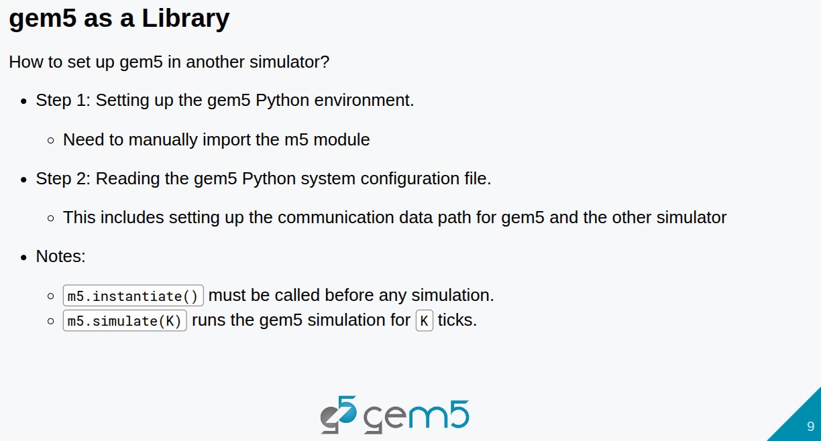
26.5 gem5 as a Library
https://www.youtube.com/watch?v=ciSLhURk6OU&list=PL_hVbFs_loVR_8ntTTmmG6YEq3Po_4snu&index=26
gem5 as a Library (6:06 – 6:30/2:01:30)
Setup gem5 in another simulator.

Slide 24
End

