Slide 1

18.1 Debug: Slides
Peter H. Chen

Slide 2

18.1 Debug: Slides
https://gem5bootcamp.github.io/2024/#03-Developing-gem5-models/02-debugging-gem5
Debug: Slides

Slide 3
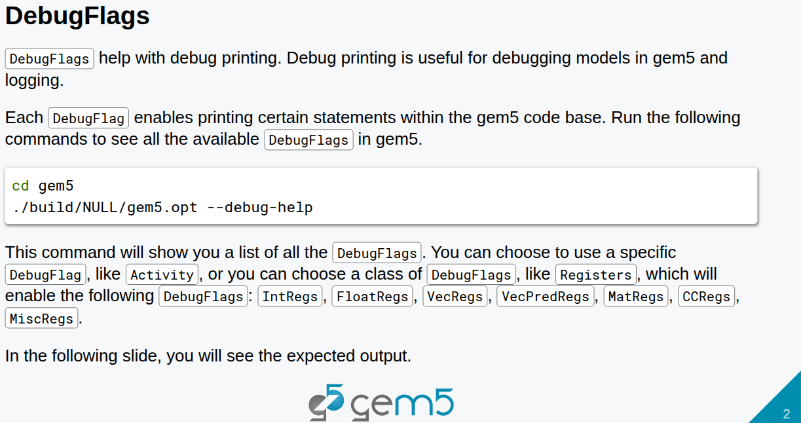
18.1 Debug: Slides
https://gem5bootcamp.github.io/2024/#03-Developing-gem5-models/02-debugging-gem5
Debug: Slides

Slide 4
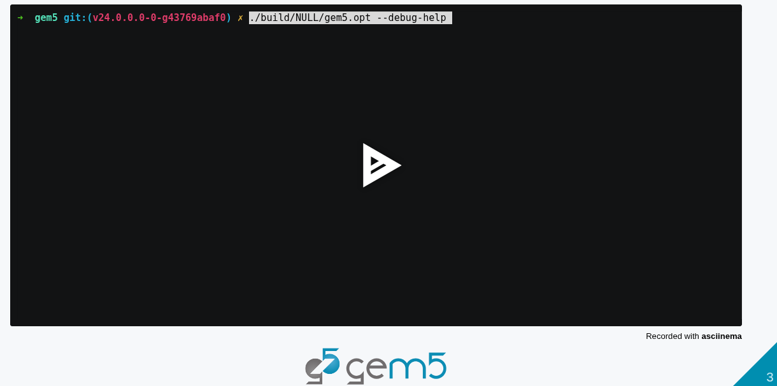
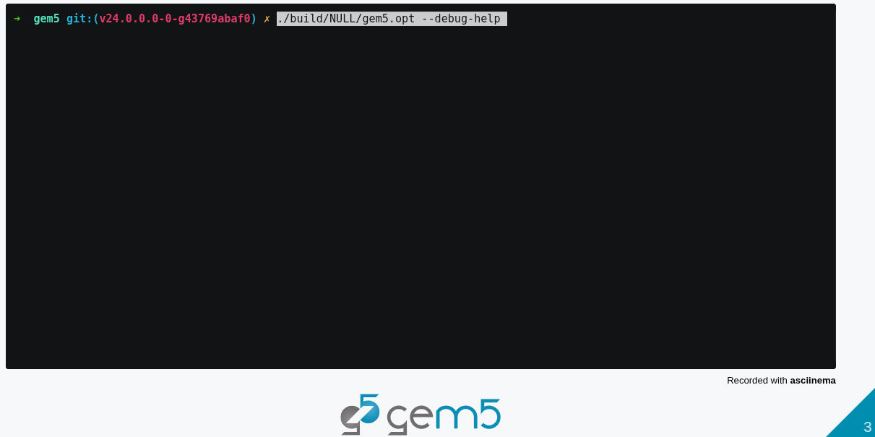
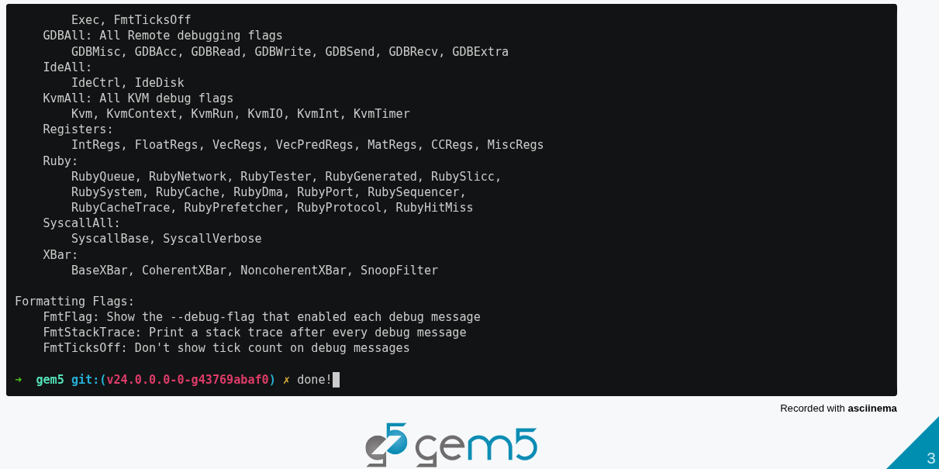
18.1 Debug: Slides
https://gem5bootcamp.github.io/2024/#03-Developing-gem5-models/02-debugging-gem5
Debug: Slides

Slide 5
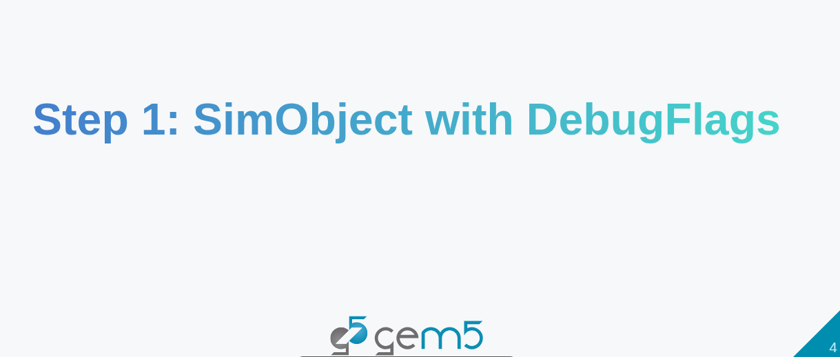
18.1 Debug: Slides
https://gem5bootcamp.github.io/2024/#03-Developing-gem5-models/02-debugging-gem5
Debug: Slides

Slide 6
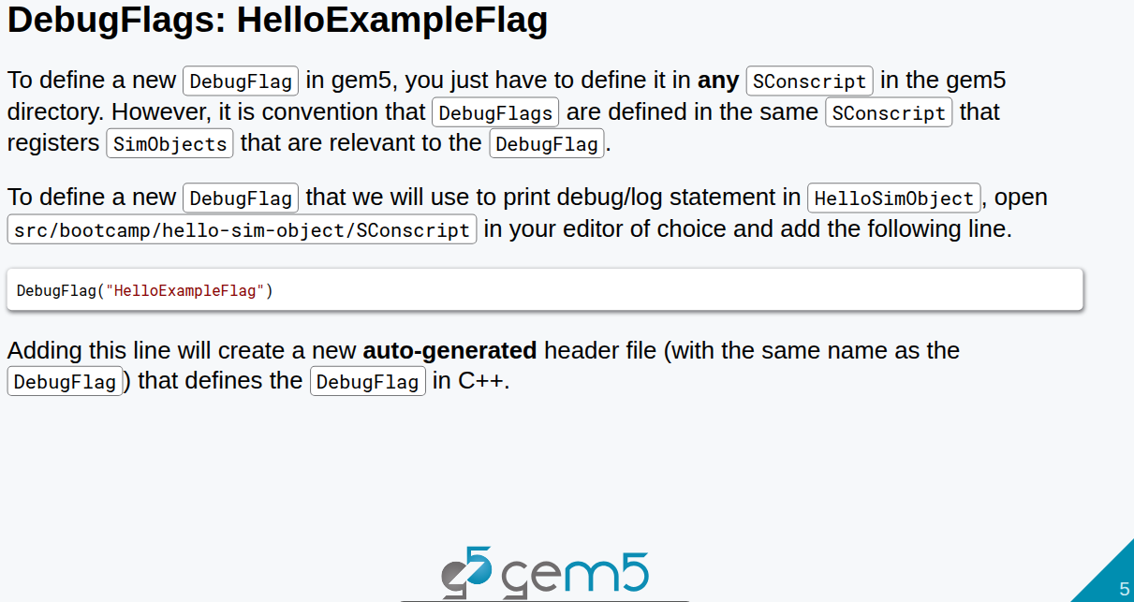
18.1 Debug: Slides
https://gem5bootcamp.github.io/2024/#03-Developing-gem5-models/02-debugging-gem5
Debug: Slides

Slide 7
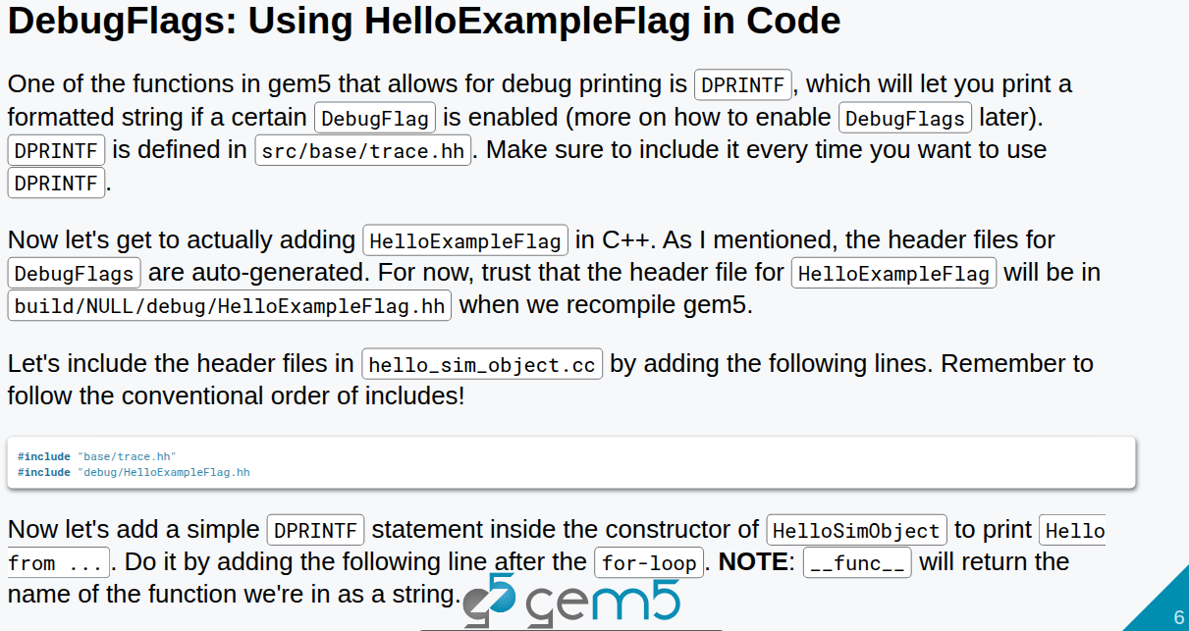
18.1 Debug: Slides
https://gem5bootcamp.github.io/2024/#03-Developing-gem5-models/02-debugging-gem5
Debug: Slides

Slide 8
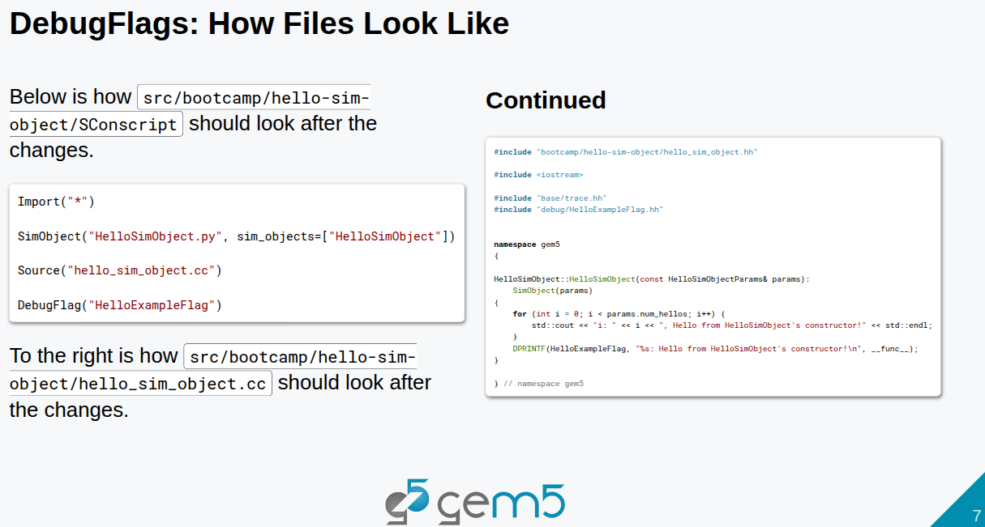
18.1 Debug: Slides
https://gem5bootcamp.github.io/2024/#03-Developing-gem5-models/02-debugging-gem5
Debug: Slides

Slide 9
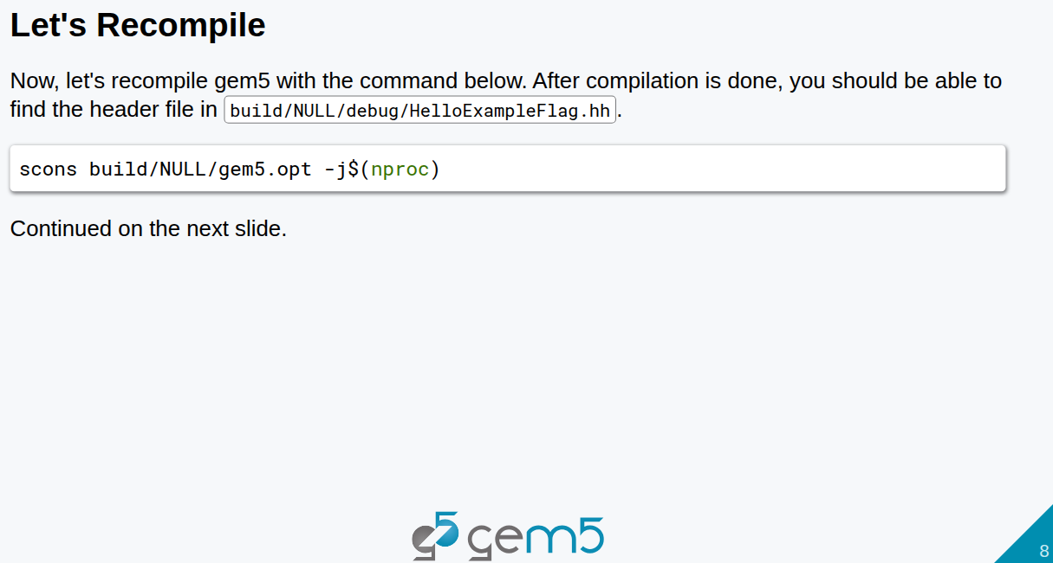
18.1 Debug: Slides
https://gem5bootcamp.github.io/2024/#03-Developing-gem5-models/02-debugging-gem5
Debug: Slides

Slide 10
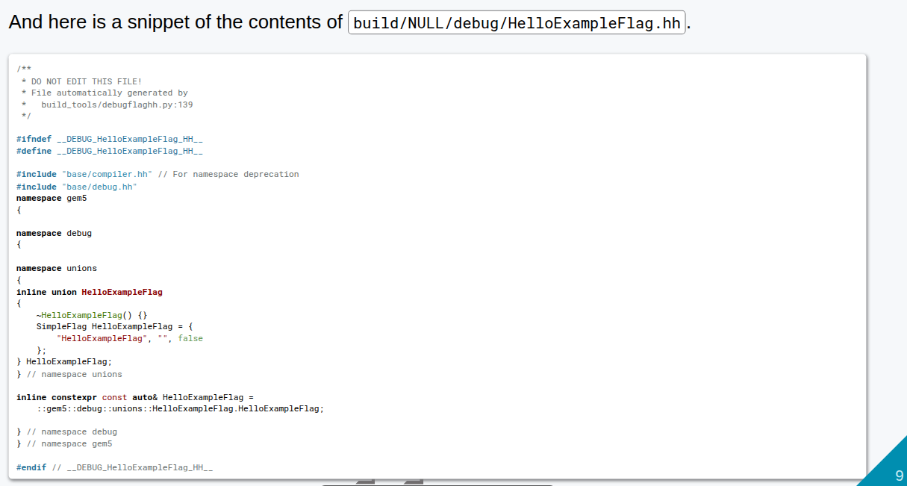
18.1 Debug: Slides
https://gem5bootcamp.github.io/2024/#03-Developing-gem5-models/02-debugging-gem5
Debug: Slides

Slide 11
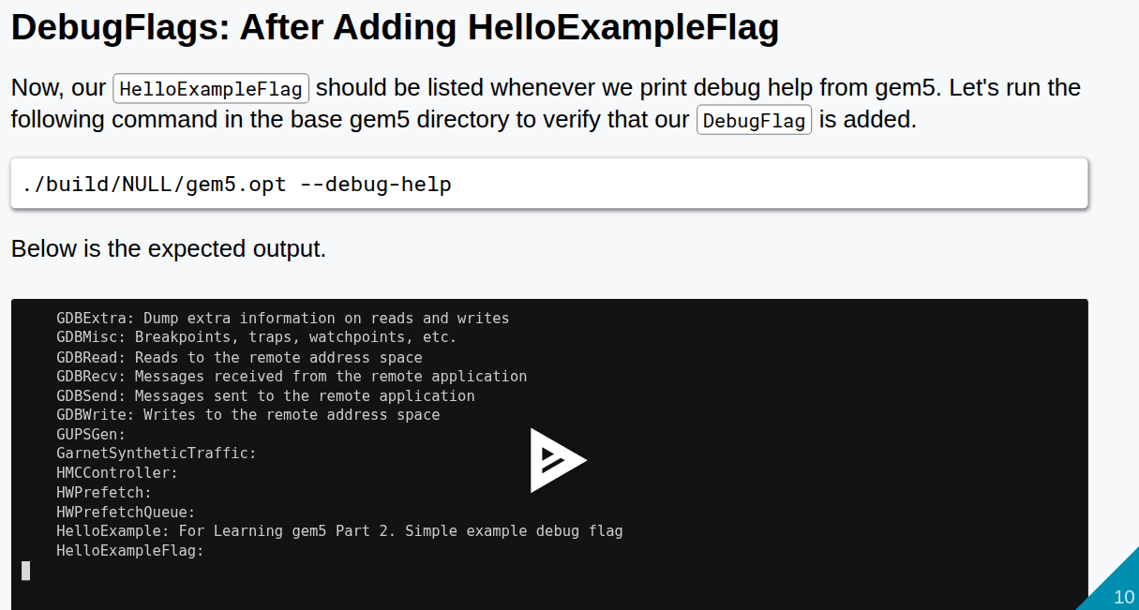
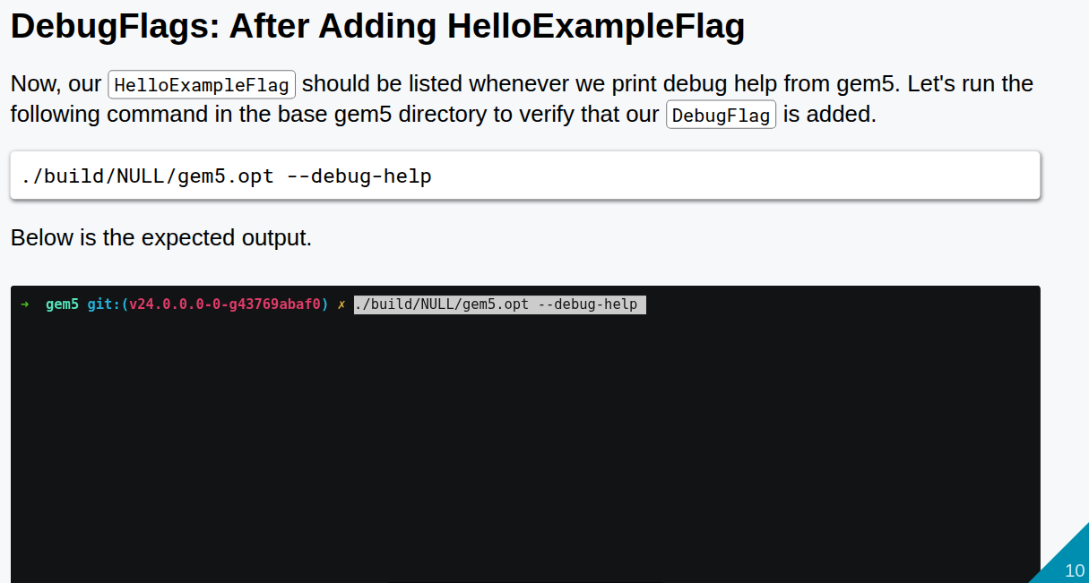
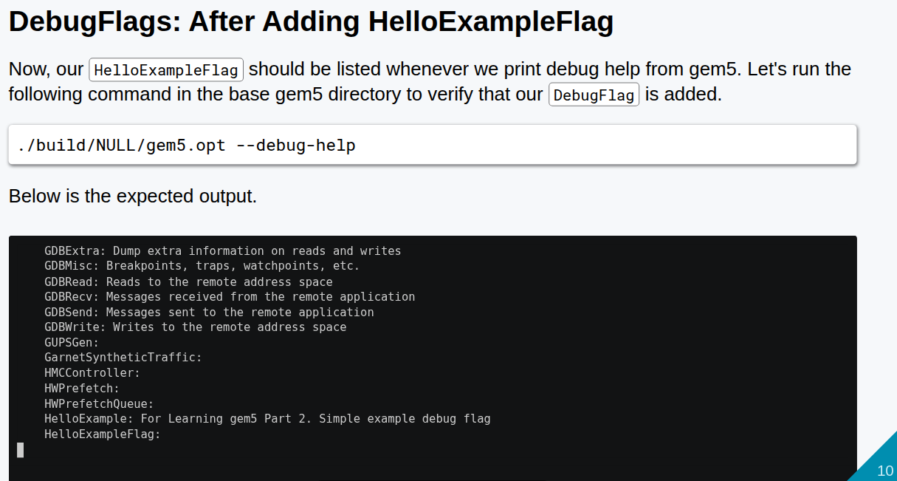
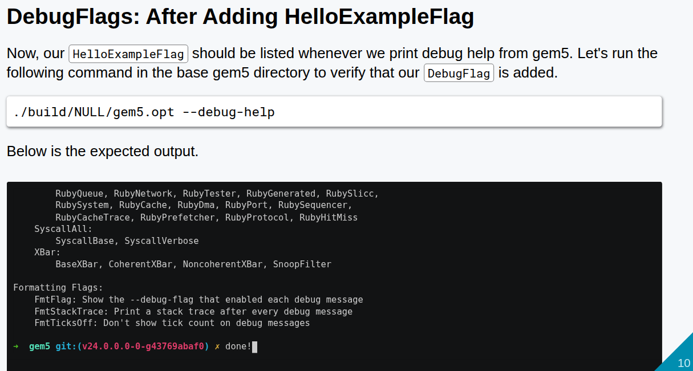
18.1 Debug: Slides
https://gem5bootcamp.github.io/2024/#03-Developing-gem5-models/02-debugging-gem5
Debug: Slides

Slide 12
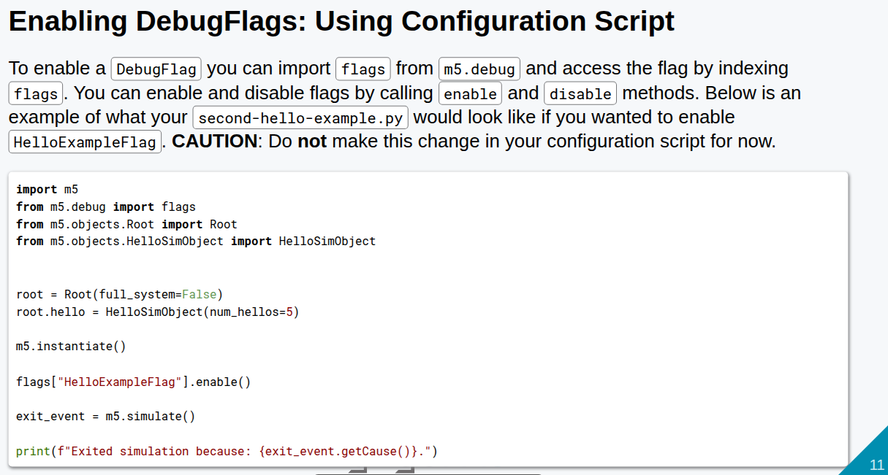
18.1 Debug: Slides
https://gem5bootcamp.github.io/2024/#03-Developing-gem5-models/02-debugging-gem5
Debug: Slides

Slide 13
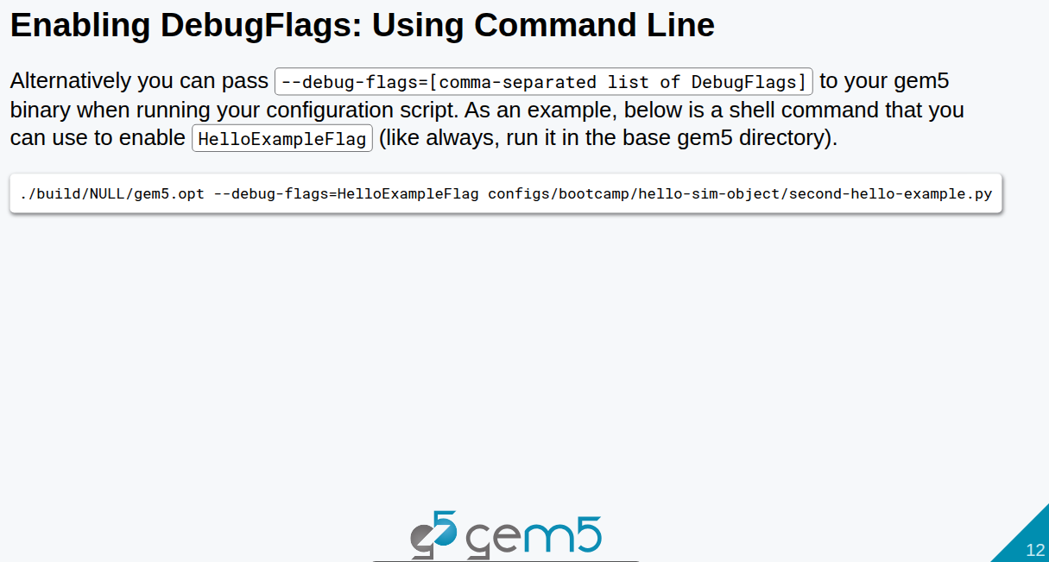
18.1 Debug: Slides
https://gem5bootcamp.github.io/2024/#03-Developing-gem5-models/02-debugging-gem5
Debug: Slides

Slide 14
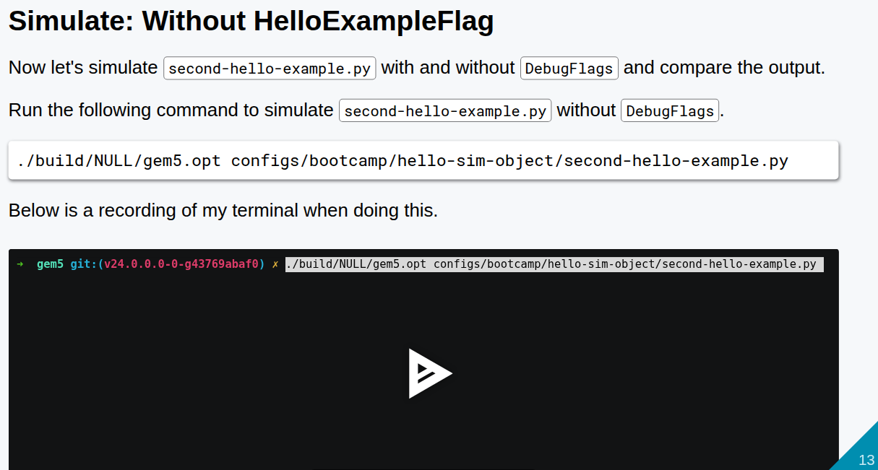
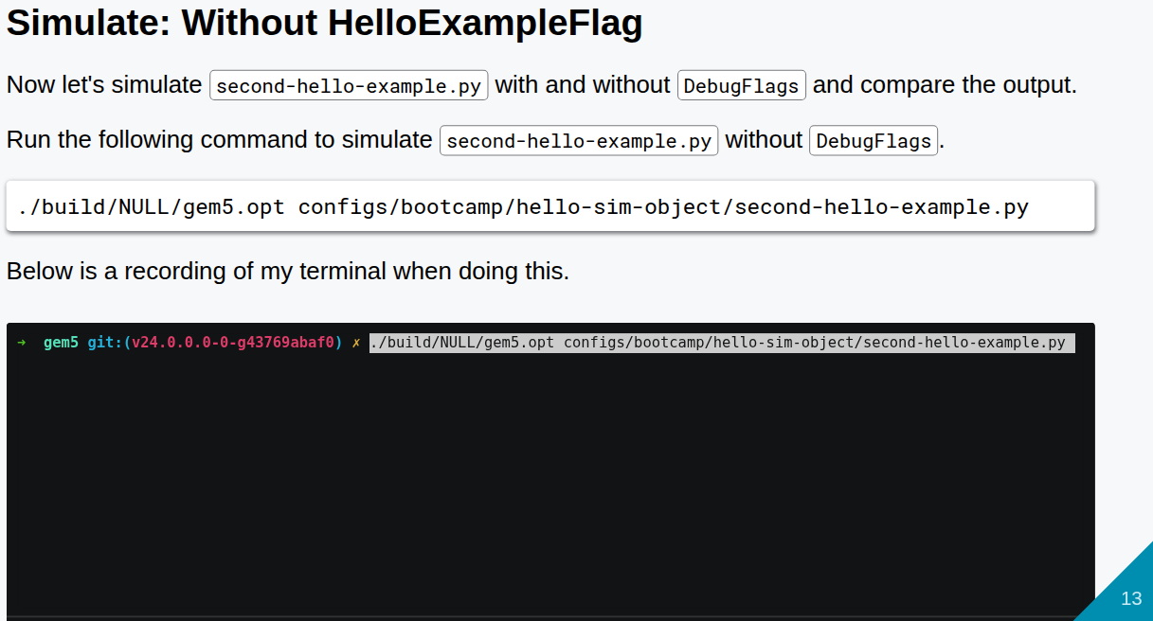
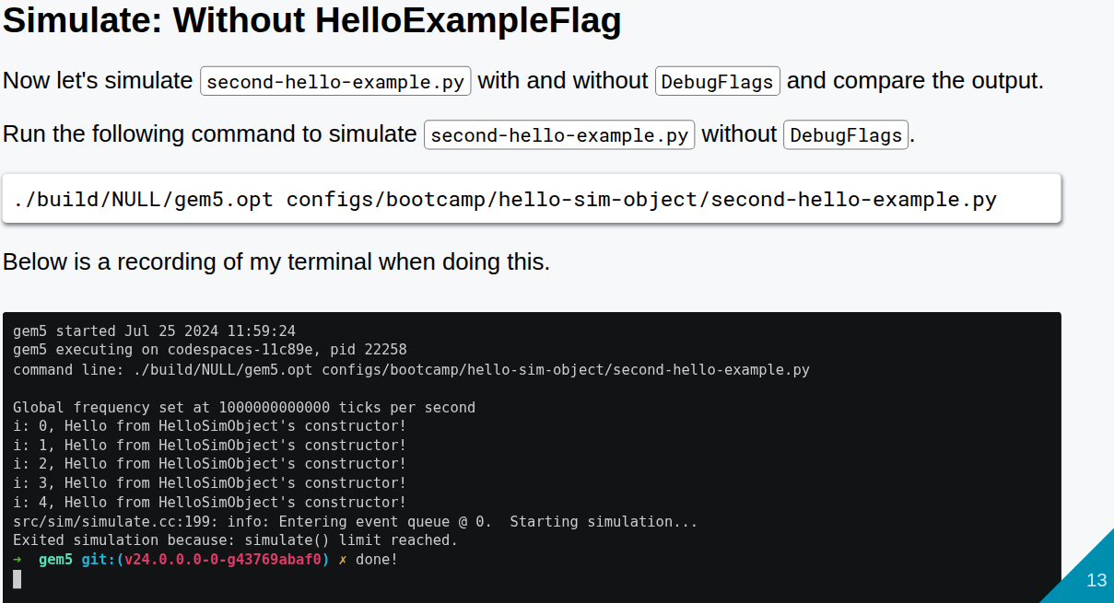
18.1 Debug: Slides
https://gem5bootcamp.github.io/2024/#03-Developing-gem5-models/02-debugging-gem5
Debug: Slides

Slide 15
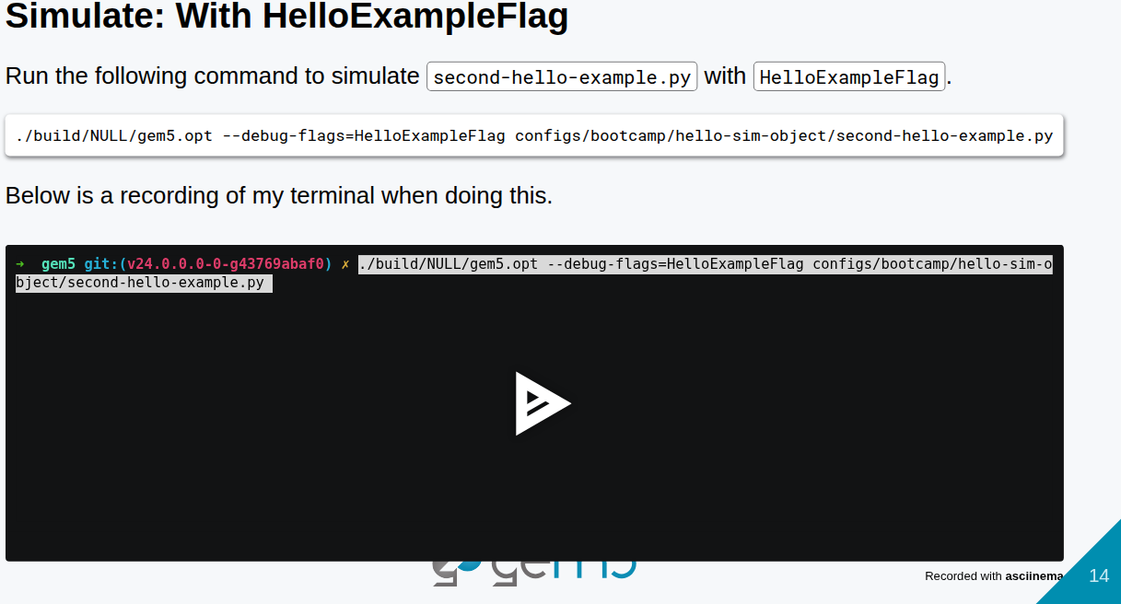
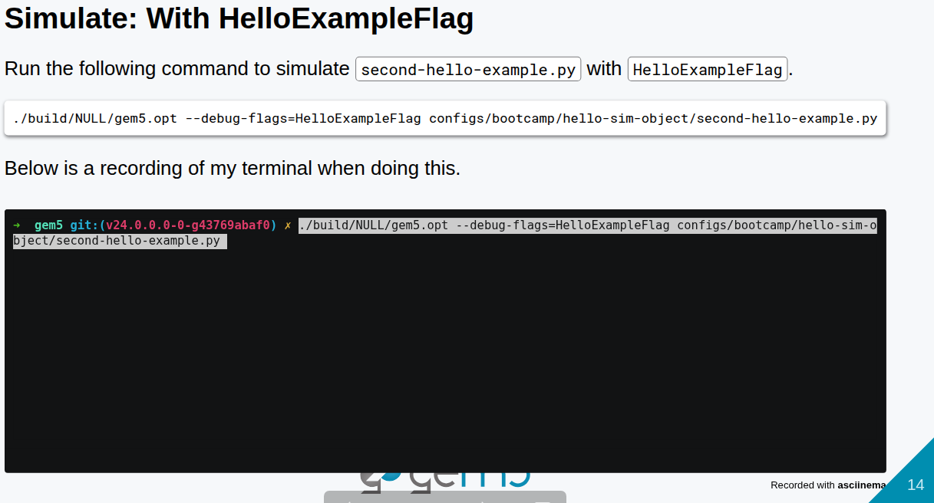
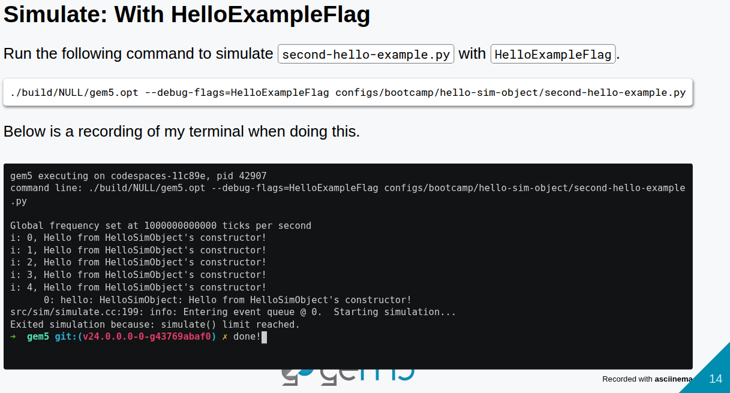
18.1 Debug: Slides
https://gem5bootcamp.github.io/2024/#03-Developing-gem5-models/02-debugging-gem5
Debug: Slides

Slide 16
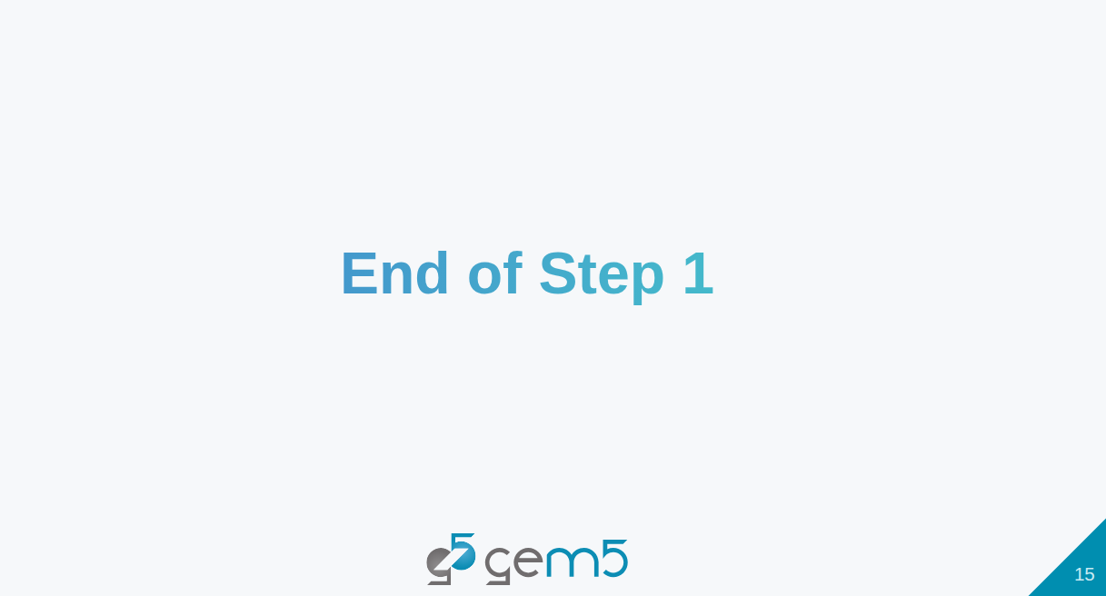
18.1 Debug: Slides
https://gem5bootcamp.github.io/2024/#03-Developing-gem5-models/02-debugging-gem5
Debug: Slides

Slide 17
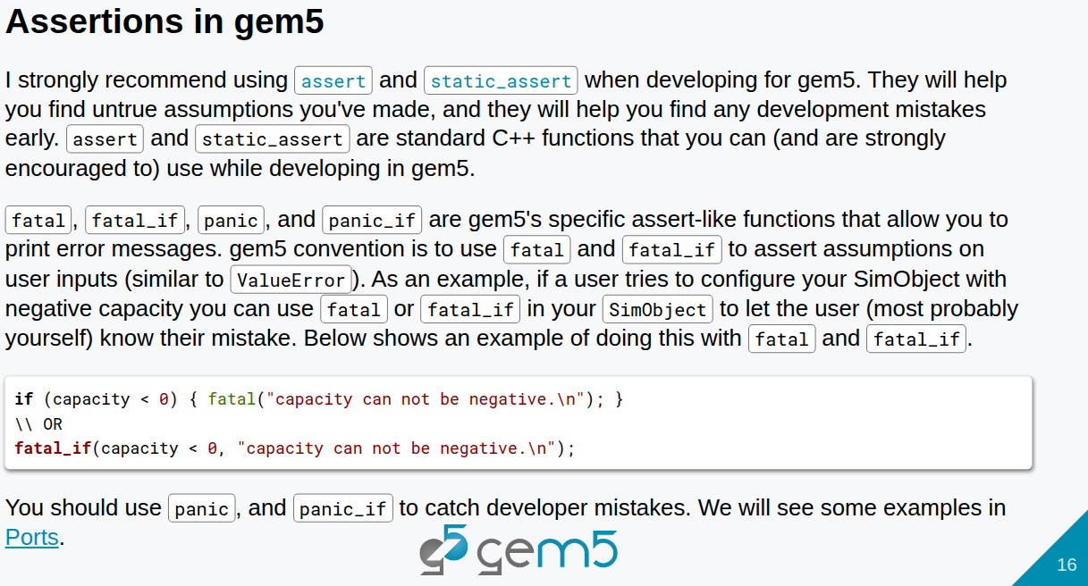
18.1 Debug: Slides
https://gem5bootcamp.github.io/2024/#03-Developing-gem5-models/02-debugging-gem5
Debug: Slides

Slide 18
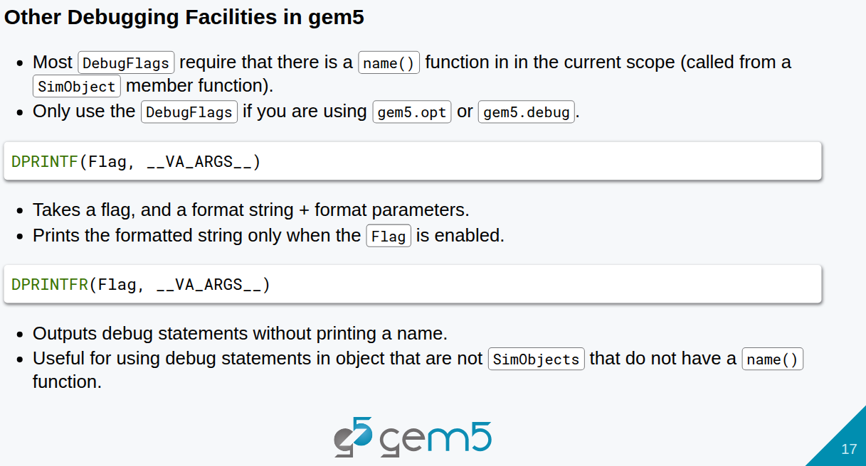
18.1 Debug: Slides
https://gem5bootcamp.github.io/2024/#03-Developing-gem5-models/02-debugging-gem5
Debug: Slides

Slide 19
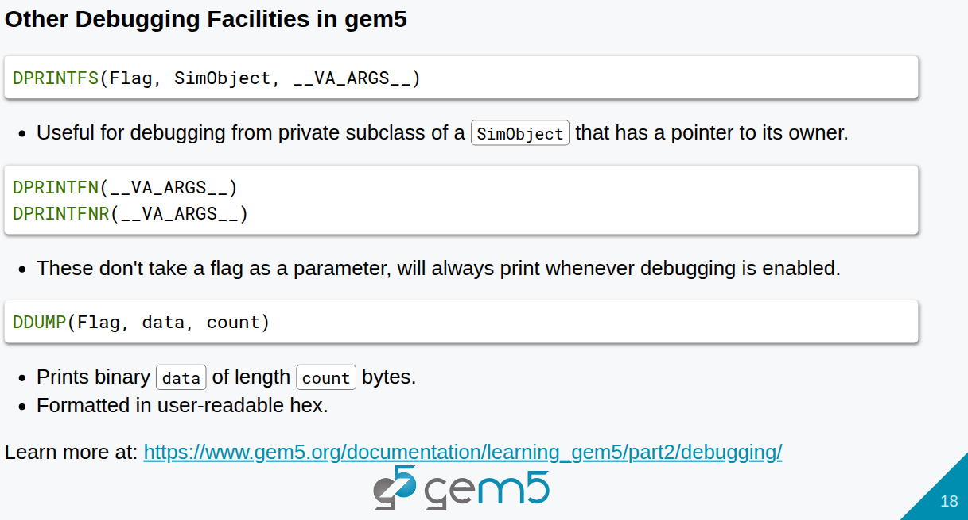
18.1 Debug: Slides
https://gem5bootcamp.github.io/2024/#03-Developing-gem5-models/02-debugging-gem5
Debug: Slides

Slide 20
End

