Slide 1

16.1 SimObjects (Part 1): Slides
Peter H. Chen

Slide 2

16.1 SimObjects (Part 1): Slides
https://gem5bootcamp.github.io/2024/#03-Developing-gem5-models/01-sim-objects-intro
SimObjects (Part 1): Slides

Slide 3
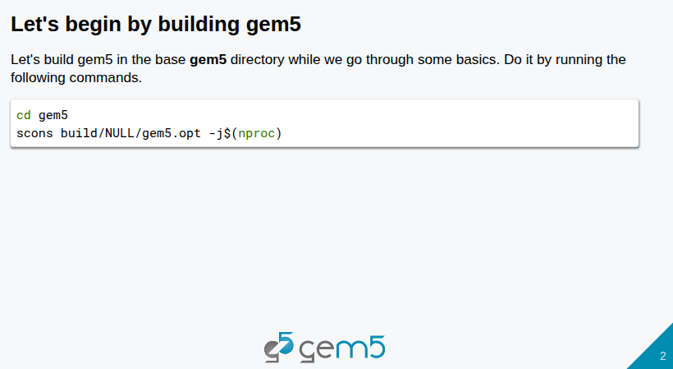
16.1 SimObjects (Part 1): Slides
https://gem5bootcamp.github.io/2024/#03-Developing-gem5-models/01-sim-objects-intro
SimObjects (Part 1): Slides

Slide 4
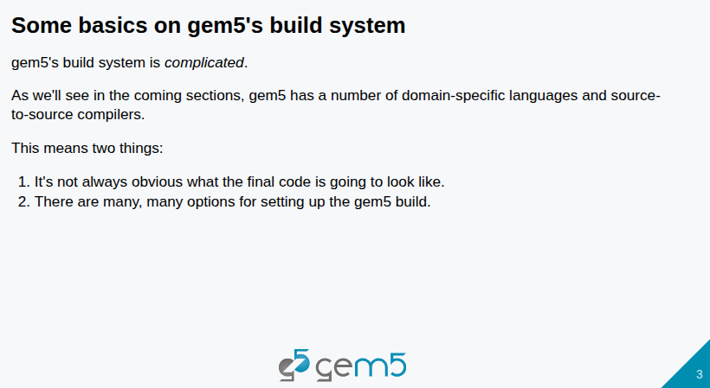
16.1 SimObjects (Part 1): Slides
https://gem5bootcamp.github.io/2024/#03-Developing-gem5-models/01-sim-objects-intro
SimObjects (Part 1): Slides

Slide 5
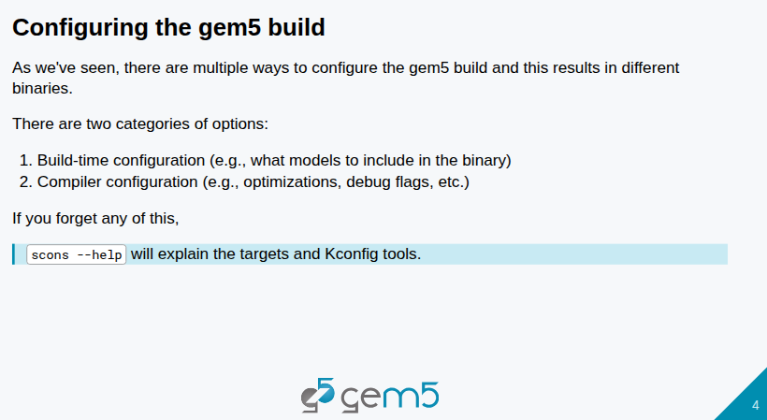
16.1 SimObjects (Part 1): Slides
https://gem5bootcamp.github.io/2024/#03-Developing-gem5-models/01-sim-objects-intro
SimObjects (Part 1): Slides

Slide 6
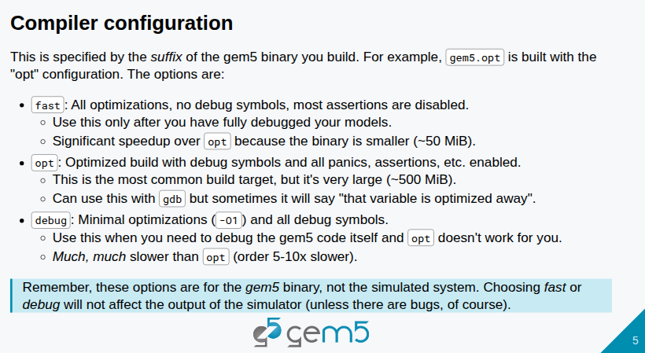
16.1 SimObjects (Part 1): Slides
https://gem5bootcamp.github.io/2024/#03-Developing-gem5-models/01-sim-objects-intro
SimObjects (Part 1): Slides

Slide 7
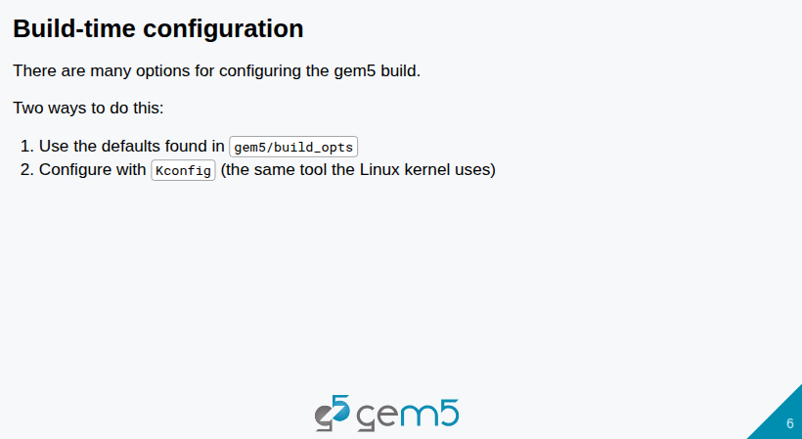
16.1 SimObjects (Part 1): Slides
https://gem5bootcamp.github.io/2024/#03-Developing-gem5-models/01-sim-objects-intro
SimObjects (Part 1): Slides

Slide 8
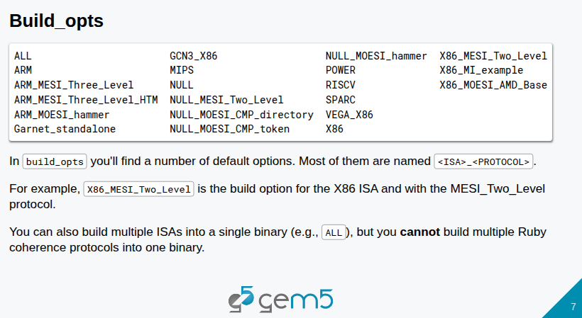
16.1 SimObjects (Part 1): Slides
https://gem5bootcamp.github.io/2024/#03-Developing-gem5-models/01-sim-objects-intro
SimObjects (Part 1): Slides

Slide 9
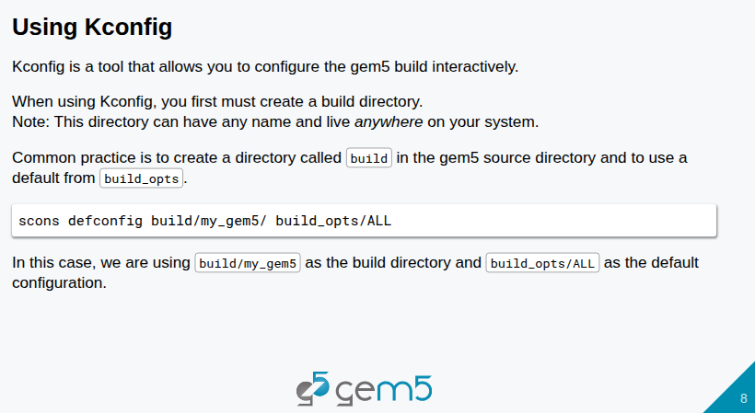
16.1 SimObjects (Part 1): Slides
https://gem5bootcamp.github.io/2024/#03-Developing-gem5-models/01-sim-objects-intro
SimObjects (Part 1): Slides

Slide 10
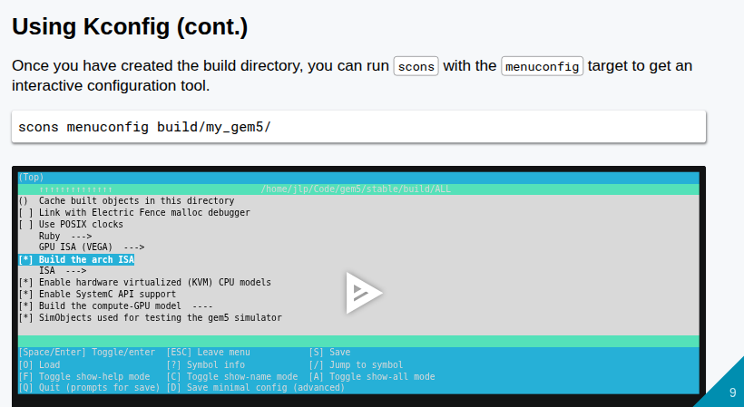
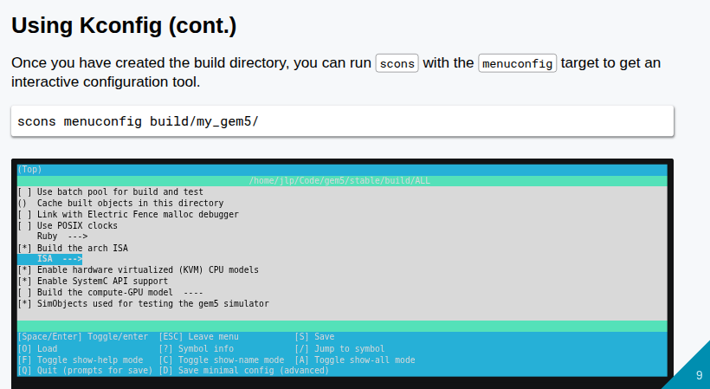
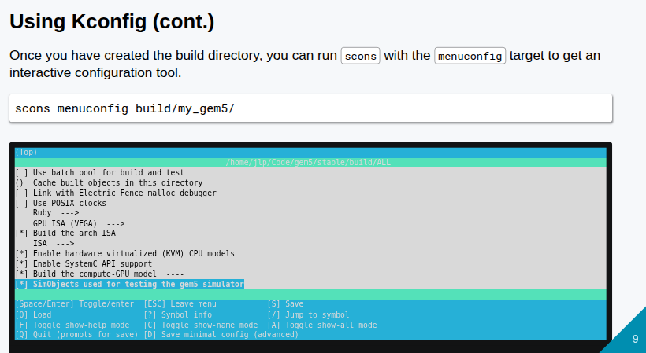
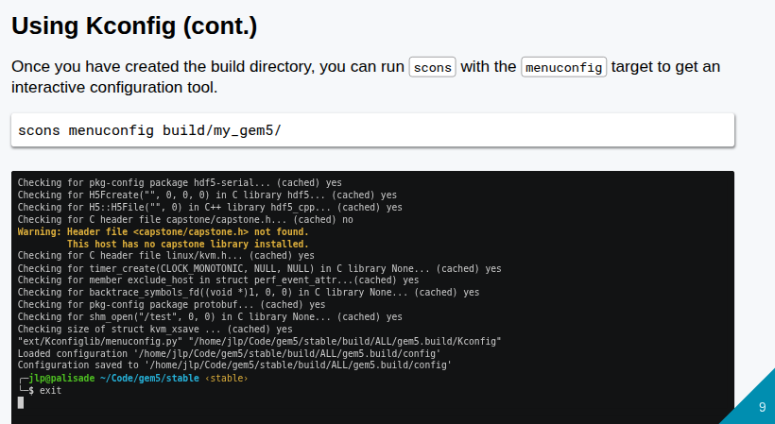
16.1 SimObjects (Part 1): Slides
https://gem5bootcamp.github.io/2024/#03-Developing-gem5-models/01-sim-objects-intro
SimObjects (Part 1): Slides

Slide 11
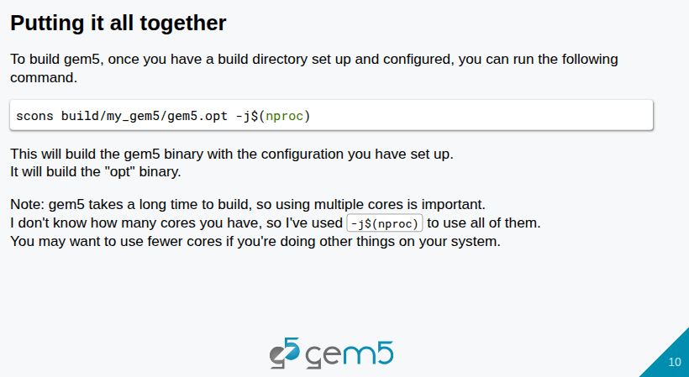
16.1 SimObjects (Part 1): Slides
https://gem5bootcamp.github.io/2024/#03-Developing-gem5-models/01-sim-objects-intro
SimObjects (Part 1): Slides

Slide 12
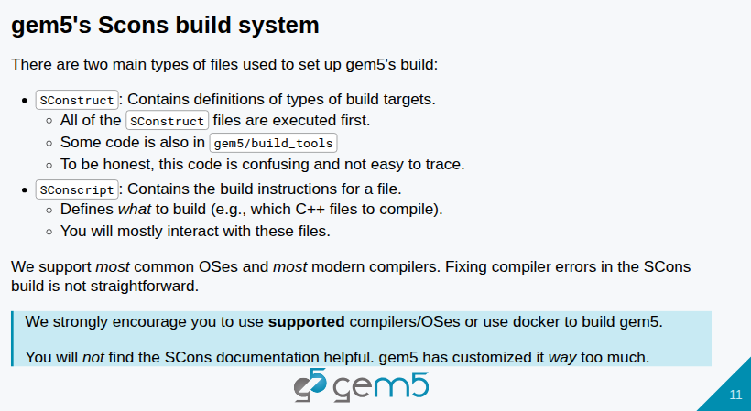
16.1 SimObjects (Part 1): Slides
https://gem5bootcamp.github.io/2024/#03-Developing-gem5-models/01-sim-objects-intro
SimObjects (Part 1): Slides

Slide 13
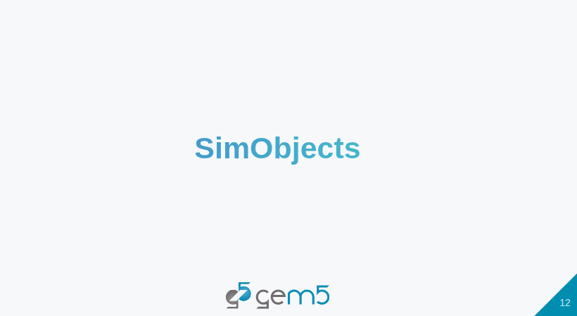
16.1 SimObjects (Part 1): Slides
https://gem5bootcamp.github.io/2024/#03-Developing-gem5-models/01-sim-objects-intro
SimObjects (Part 1): Slides

Slide 14
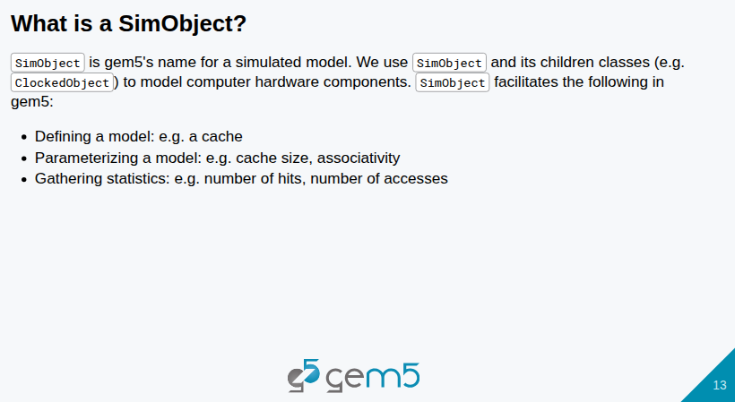
16.1 SimObjects (Part 1): Slides
https://gem5bootcamp.github.io/2024/#03-Developing-gem5-models/01-sim-objects-intro
SimObjects (Part 1): Slides

Slide 15
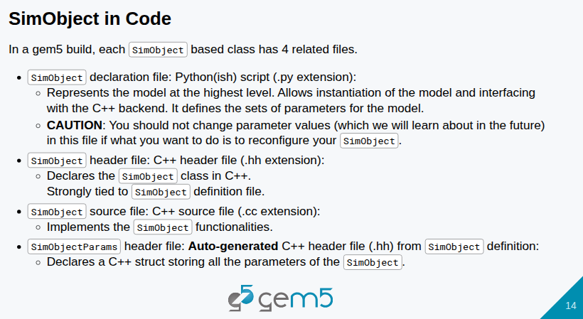
16.1 SimObjects (Part 1): Slides
https://gem5bootcamp.github.io/2024/#03-Developing-gem5-models/01-sim-objects-intro
SimObjects (Part 1): Slides

Slide 16
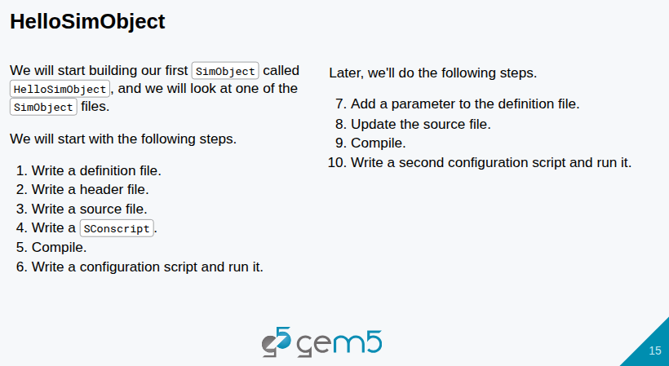
16.1 SimObjects (Part 1): Slides
https://gem5bootcamp.github.io/2024/#03-Developing-gem5-models/01-sim-objects-intro
SimObjects (Part 1): Slides

Slide 17
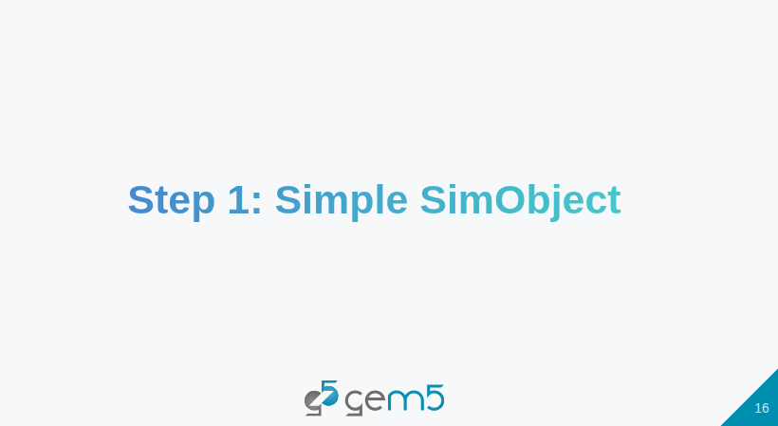
16.1 SimObjects (Part 1): Slides
https://gem5bootcamp.github.io/2024/#03-Developing-gem5-models/01-sim-objects-intro
SimObjects (Part 1): Slides

Slide 18
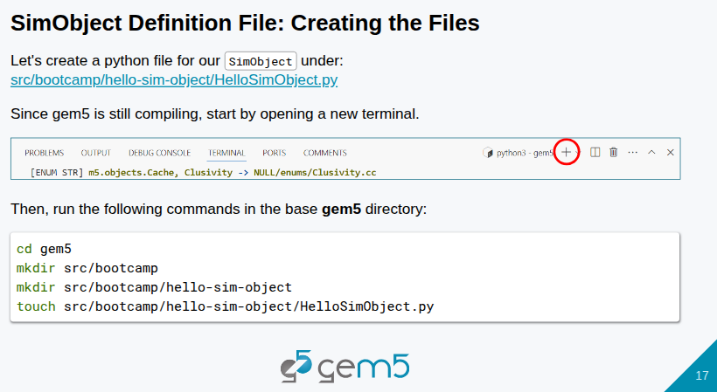
16.1 SimObjects (Part 1): Slides
https://gem5bootcamp.github.io/2024/#03-Developing-gem5-models/01-sim-objects-intro
SimObjects (Part 1): Slides

Slide 19
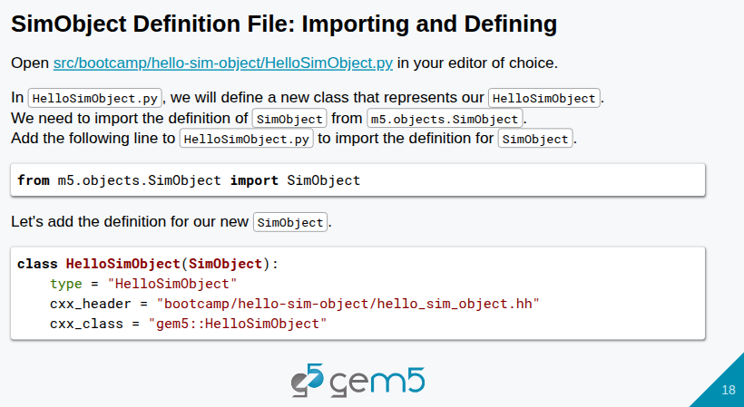
16.1 SimObjects (Part 1): Slides
https://gem5bootcamp.github.io/2024/#03-Developing-gem5-models/01-sim-objects-intro
SimObjects (Part 1): Slides

Slide 20
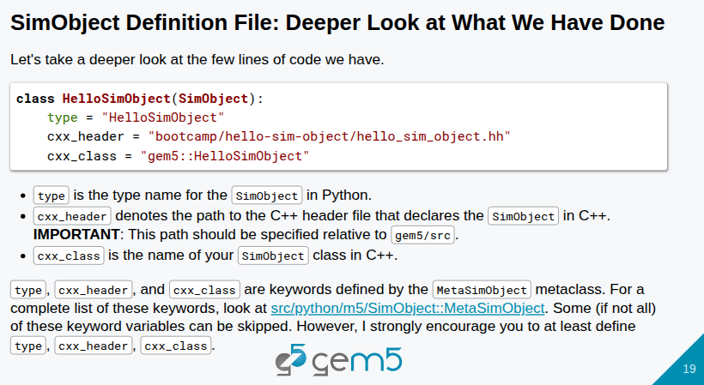
16.1 SimObjects (Part 1): Slides
https://gem5bootcamp.github.io/2024/#03-Developing-gem5-models/01-sim-objects-intro
SimObjects (Part 1): Slides

Slide 21
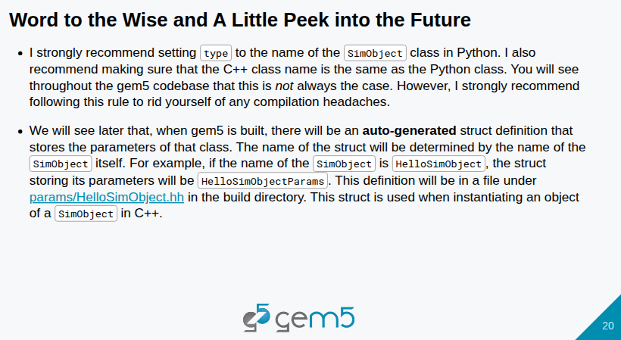
16.1 SimObjects (Part 1): Slides
https://gem5bootcamp.github.io/2024/#03-Developing-gem5-models/01-sim-objects-intro
SimObjects (Part 1): Slides

Slide 22
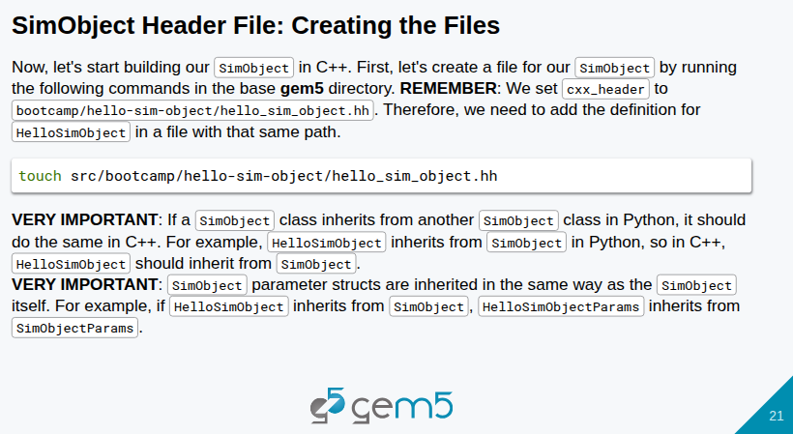
16.1 SimObjects (Part 1): Slides
https://gem5bootcamp.github.io/2024/#03-Developing-gem5-models/01-sim-objects-intro
SimObjects (Part 1): Slides

Slide 23
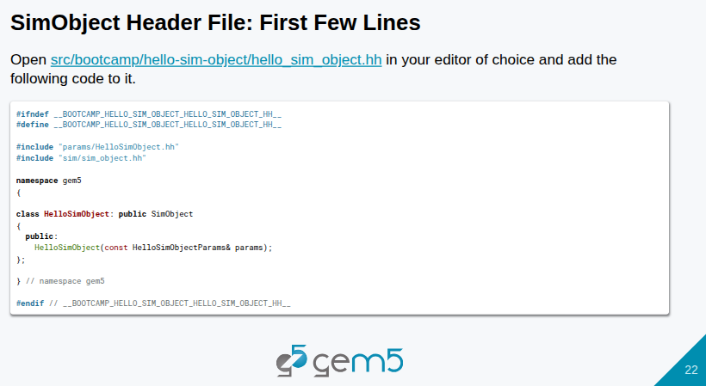
16.1 SimObjects (Part 1): Slides
https://gem5bootcamp.github.io/2024/#03-Developing-gem5-models/01-sim-objects-intro
SimObjects (Part 1): Slides

Slide 24
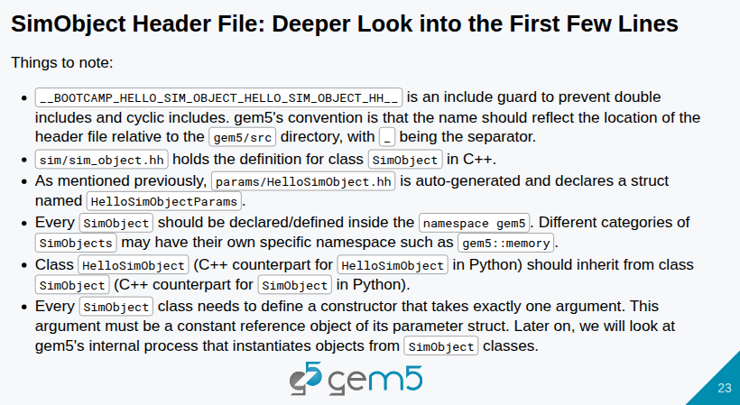
16.1 SimObjects (Part 1): Slides
https://gem5bootcamp.github.io/2024/#03-Developing-gem5-models/01-sim-objects-intro
SimObjects (Part 1): Slides

Slide 25
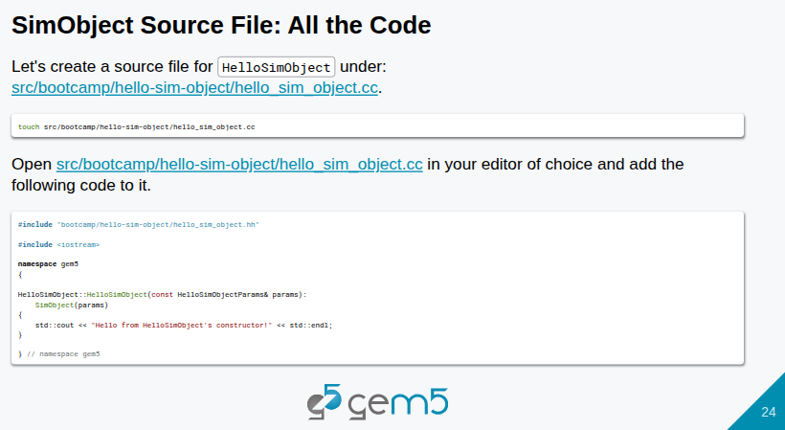
16.1 SimObjects (Part 1): Slides
https://gem5bootcamp.github.io/2024/#03-Developing-gem5-models/01-sim-objects-intro
SimObjects (Part 1): Slides

Slide 26
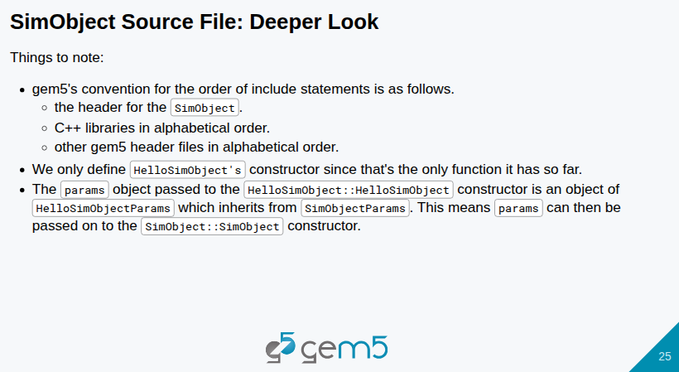
16.1 SimObjects (Part 1): Slides
https://gem5bootcamp.github.io/2024/#03-Developing-gem5-models/01-sim-objects-intro
SimObjects (Part 1): Slides

Slide 27
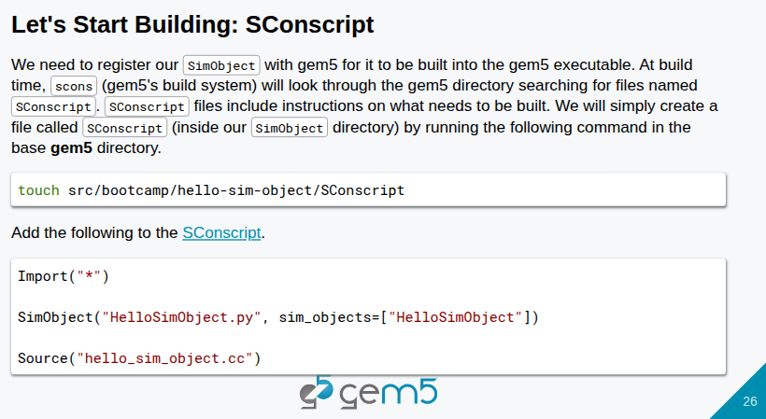
16.1 SimObjects (Part 1): Slides
https://gem5bootcamp.github.io/2024/#03-Developing-gem5-models/01-sim-objects-intro
SimObjects (Part 1): Slides

Slide 28
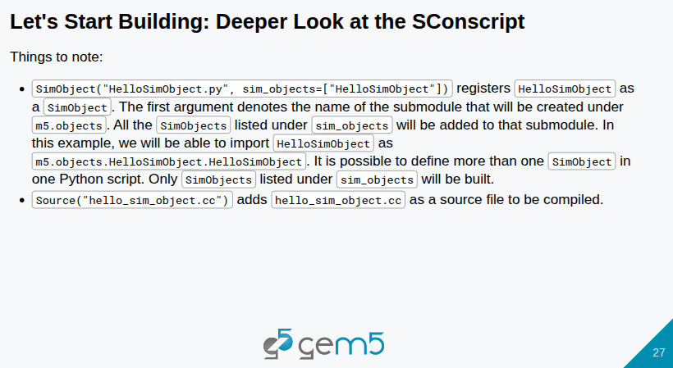
16.1 SimObjects (Part 1): Slides
https://gem5bootcamp.github.io/2024/#03-Developing-gem5-models/01-sim-objects-intro
SimObjects (Part 1): Slides

Slide 29
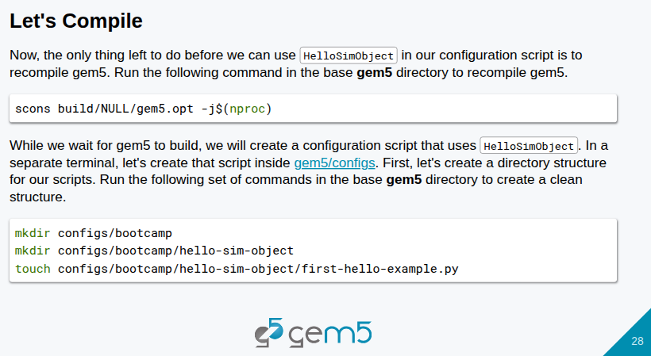
16.1 SimObjects (Part 1): Slides
https://gem5bootcamp.github.io/2024/#03-Developing-gem5-models/01-sim-objects-intro
SimObjects (Part 1): Slides

Slide 30
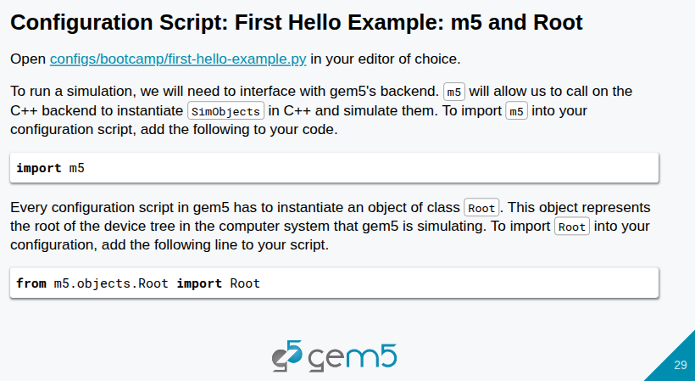
16.1 SimObjects (Part 1): Slides
https://gem5bootcamp.github.io/2024/#03-Developing-gem5-models/01-sim-objects-intro
SimObjects (Part 1): Slides

Slide 31
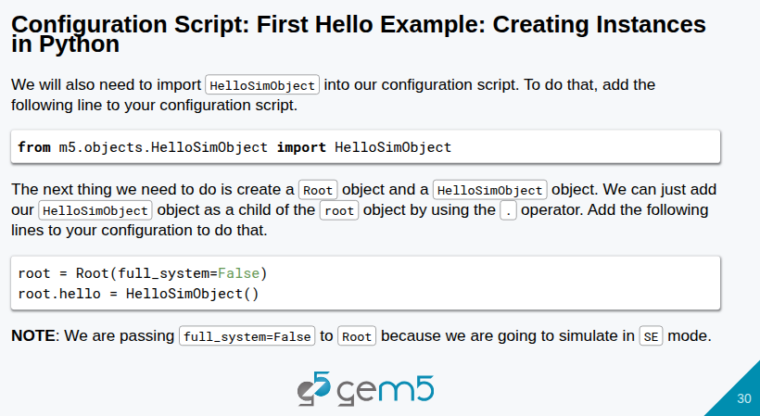
16.1 SimObjects (Part 1): Slides
https://gem5bootcamp.github.io/2024/#03-Developing-gem5-models/01-sim-objects-intro
SimObjects (Part 1): Slides

Slide 32
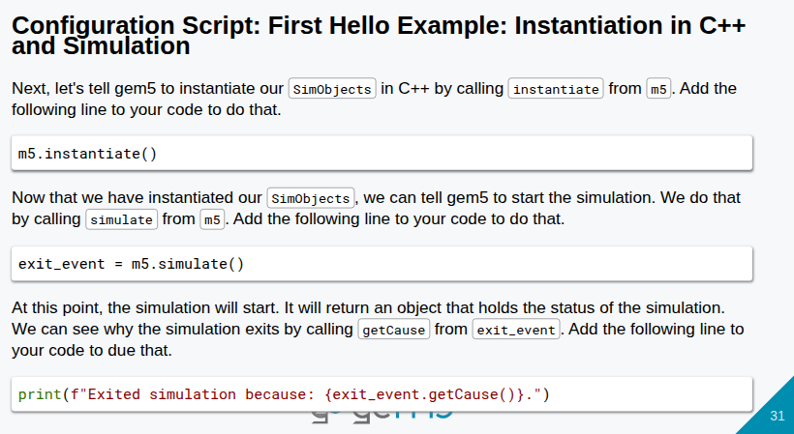
16.1 SimObjects (Part 1): Slides
https://gem5bootcamp.github.io/2024/#03-Developing-gem5-models/01-sim-objects-intro
SimObjects (Part 1): Slides

Slide 33
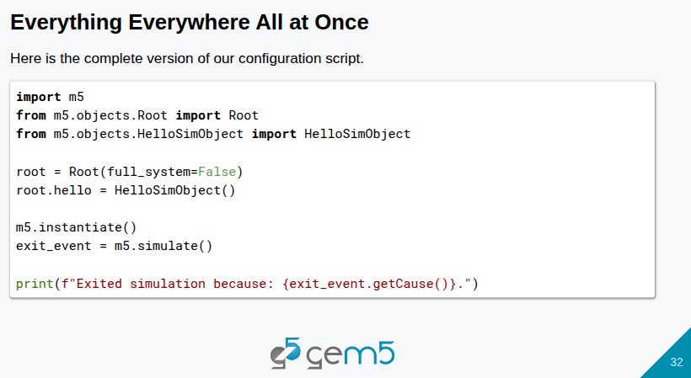
16.1 SimObjects (Part 1): Slides
https://gem5bootcamp.github.io/2024/#03-Developing-gem5-models/01-sim-objects-intro
SimObjects (Part 1): Slides

Slide 34
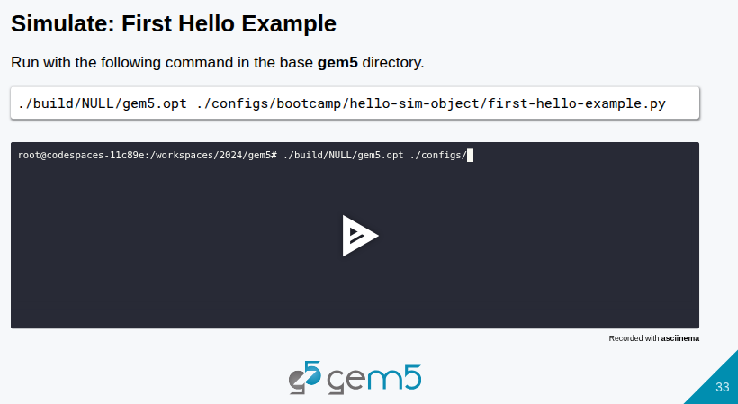
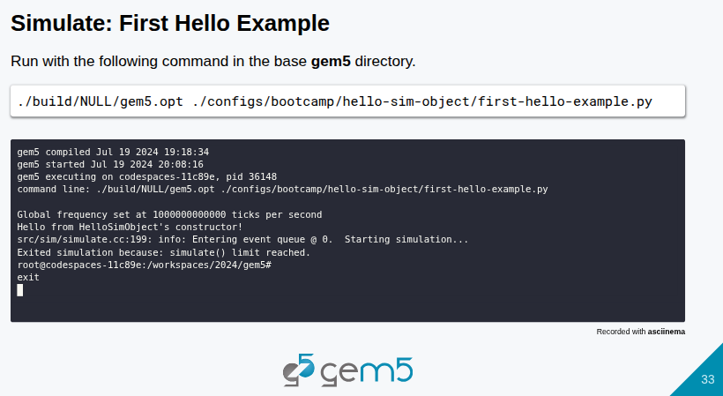
16.1 SimObjects (Part 1): Slides
https://gem5bootcamp.github.io/2024/#03-Developing-gem5-models/01-sim-objects-intro
SimObjects (Part 1): Slides

Slide 35

16.1 SimObjects (Part 1): Slides
https://gem5bootcamp.github.io/2024/#03-Developing-gem5-models/01-sim-objects-intro
SimObjects (Part 1): Slides

Slide 36
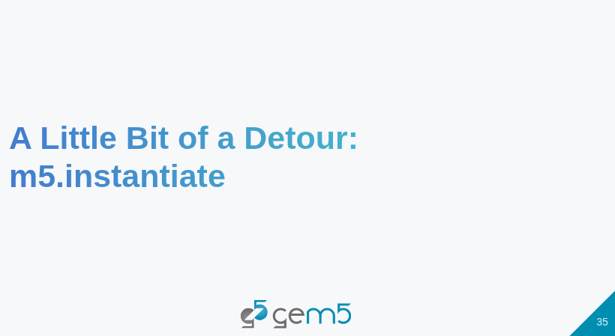
16.1 SimObjects (Part 1): Slides
https://gem5bootcamp.github.io/2024/#03-Developing-gem5-models/01-sim-objects-intro
SimObjects (Part 1): Slides

Slide 37
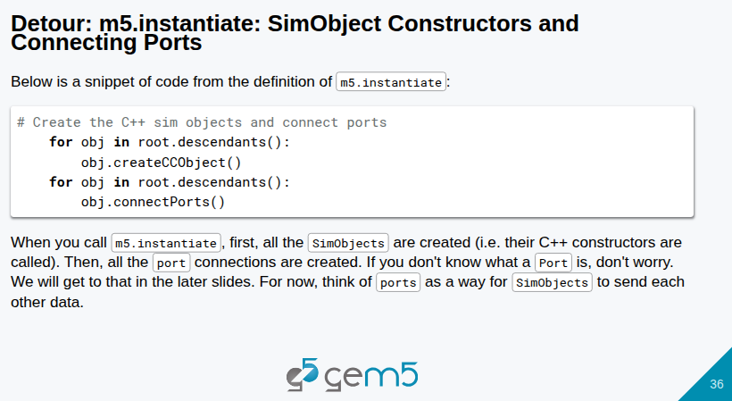
16.1 SimObjects (Part 1): Slides
https://gem5bootcamp.github.io/2024/#03-Developing-gem5-models/01-sim-objects-intro
SimObjects (Part 1): Slides

Slide 38
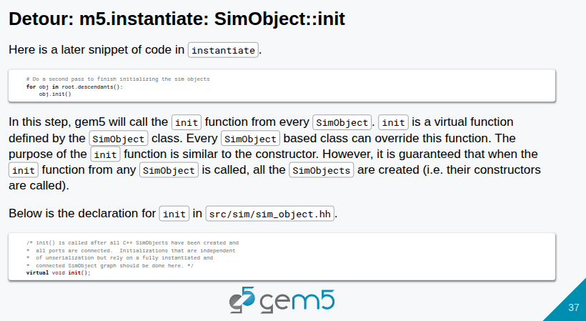
16.1 SimObjects (Part 1): Slides
https://gem5bootcamp.github.io/2024/#03-Developing-gem5-models/01-sim-objects-intro
SimObjects (Part 1): Slides

Slide 39
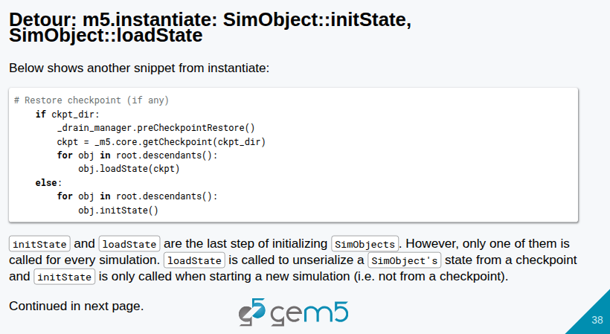
16.1 SimObjects (Part 1): Slides
https://gem5bootcamp.github.io/2024/#03-Developing-gem5-models/01-sim-objects-intro
SimObjects (Part 1): Slides

Slide 40
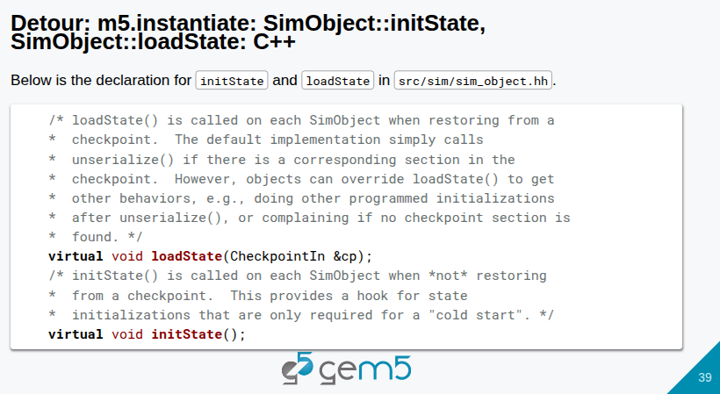
16.1 SimObjects (Part 1): Slides
https://gem5bootcamp.github.io/2024/#03-Developing-gem5-models/01-sim-objects-intro
SimObjects (Part 1): Slides

Slide 41
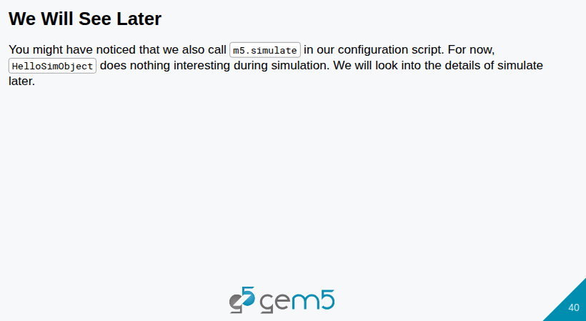
16.1 SimObjects (Part 1): Slides
https://gem5bootcamp.github.io/2024/#03-Developing-gem5-models/01-sim-objects-intro
SimObjects (Part 1): Slides

Slide 42

16.1 SimObjects (Part 1): Slides
https://gem5bootcamp.github.io/2024/#03-Developing-gem5-models/01-sim-objects-intro
SimObjects (Part 1): Slides

Slide 43
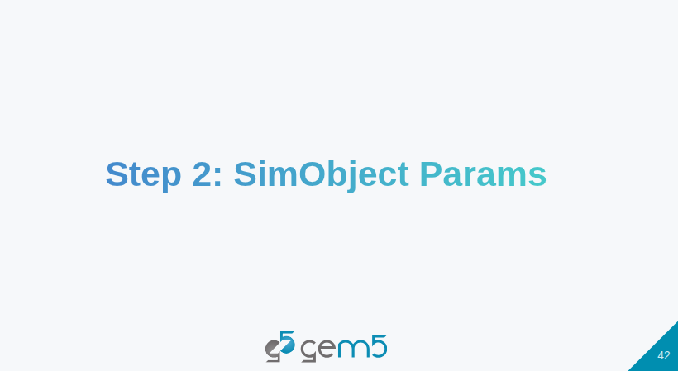
16.1 SimObjects (Part 1): Slides
https://gem5bootcamp.github.io/2024/#03-Developing-gem5-models/01-sim-objects-intro
SimObjects (Part 1): Slides

Slide 44
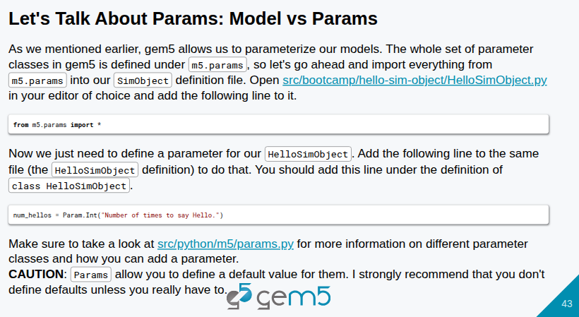
16.1 SimObjects (Part 1): Slides
https://gem5bootcamp.github.io/2024/#03-Developing-gem5-models/01-sim-objects-intro
SimObjects (Part 1): Slides

Slide 45
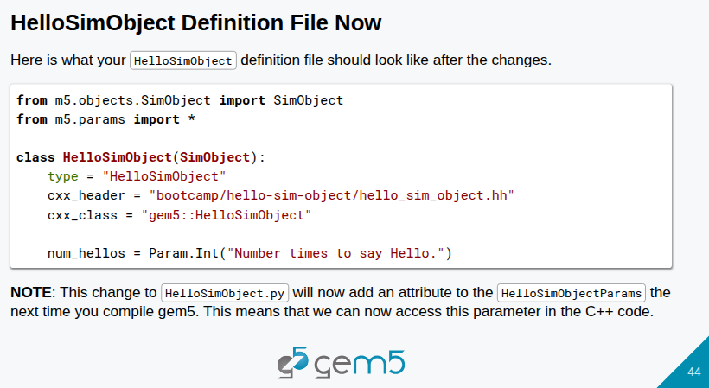
16.1 SimObjects (Part 1): Slides
https://gem5bootcamp.github.io/2024/#03-Developing-gem5-models/01-sim-objects-intro
SimObjects (Part 1): Slides

Slide 46
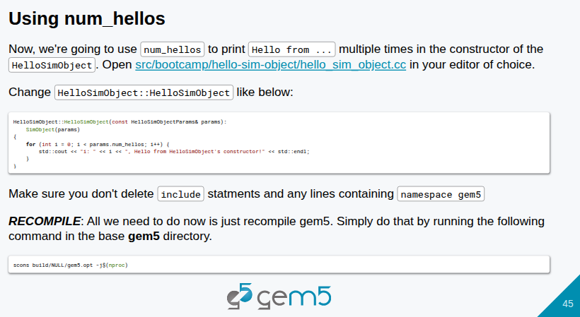
16.1 SimObjects (Part 1): Slides
https://gem5bootcamp.github.io/2024/#03-Developing-gem5-models/01-sim-objects-intro
SimObjects (Part 1): Slides

Slide 47
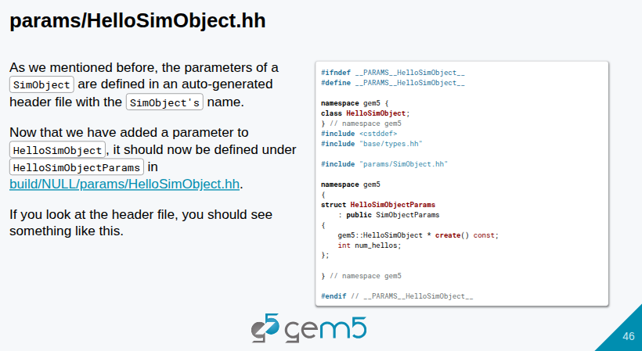
16.1 SimObjects (Part 1): Slides
https://gem5bootcamp.github.io/2024/#03-Developing-gem5-models/01-sim-objects-intro
SimObjects (Part 1): Slides

Slide 48
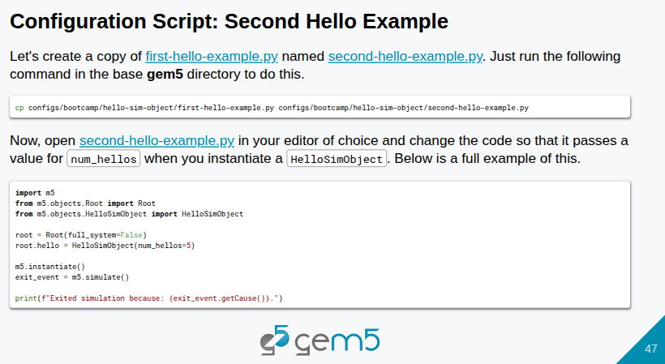
16.1 SimObjects (Part 1): Slides
https://gem5bootcamp.github.io/2024/#03-Developing-gem5-models/01-sim-objects-intro
SimObjects (Part 1): Slides

Slide 49
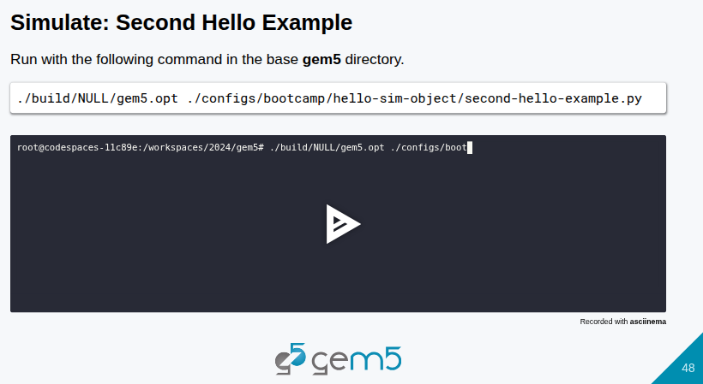
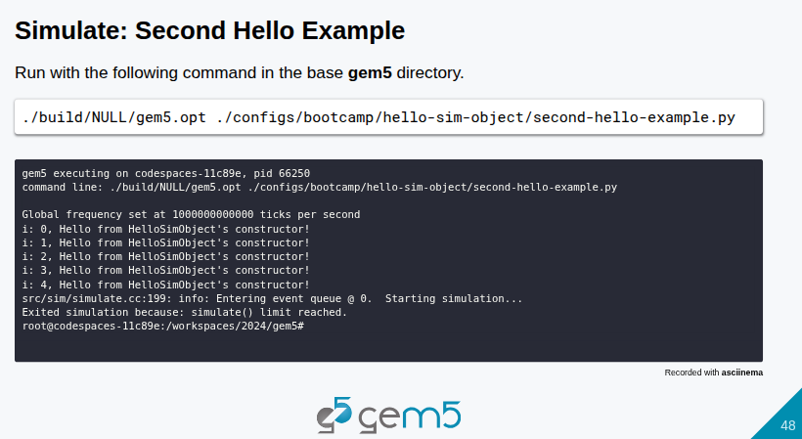

16.1 SimObjects (Part 1): Slides
https://gem5bootcamp.github.io/2024/#03-Developing-gem5-models/01-sim-objects-intro
SimObjects (Part 1): Slides

Slide 50

16.1 SimObjects (Part 1): Slides
https://gem5bootcamp.github.io/2024/#03-Developing-gem5-models/01-sim-objects-intro
SimObjects (Part 1): Slides

Slide 51

16.1 SimObjects (Part 1): Slides
https://gem5bootcamp.github.io/2024/#03-Developing-gem5-models/01-sim-objects-intro
SimObjects (Part 1): Slides

Slide 52
End

