Slide 1

1.1 McPAT-Calib Lab
Peter H. Chen

Slide 2
1.1 McPAT-Calib Lab
https://github.com/zhaijw18/mcpat-calib-public
McPAT-Calib Lab
Abstract:
What is McPAT-Calib?
1. McPAT-Calib is a Power Model framework for RISC-V Boom (Berkeley Out-Of-Order Machine) for Micro-Multi-Core Microelectronic Architecture.
2. McPAT-Calib improves the McPAT to fast power modeling to McPAT-7nm for RISC-V BOOM Core.
3. Currently, McPAT-Calib uses ML (Machine Learning) with mathematic/regression to construct Power Model.
4. McPAT-Calib uses AL (Active Learning) sampling algorithm to reduce the huge samples. Therefore, cut the run-time to construct ML power model.
5. Note that current McPAT-Calib is in ML (Machine Learning) which is based on Math/Statistics Regression, not yet in DL (Deep Learning) which is based on NN (Neural Network.
5.1 McPAT-Calib can be improved from ML (Machine Learning)/Math/Statistics into DL (Deep Learning)/NN (Neural Network) to construct Power Model.
5.2 The linear combination of Neurons can improve accuracy and avoid overfitting problem in high-order regression in ML (Machine Learning).

Slide 3
1.2 Introduction

Slide 4
1.2 Introduction
https://github.com/zhaijw18/mcpat-calib-public
Introduction
1. Below, the McPAT-Calib in for ML (Machine Learning) only, not for NN (Neural Network).
2. The ML modeling flow of McPAT-Calib can be divided into three parts:
3. Microarchitecture Simulation: Use the microarchitecture simulator (gem5) to complete the simulation of the given BOOM microarchitecture configuration and benchmark.
4. McPAT Power Modeling: Convert gem5 simulation results to the XML input file required for McPAT, and then use McPAT to complete preliminary power analysis.
5. ML Modeling: The leakage power and dynamic power are modeled separately using the ML-based power model, and summed to obtain the total power.
6. Due to large number of samples (generated by design space exploration), some of them are important and some of them maybe useless/redundant. In order to save time, we need to make the decision to discard some samples and only select some of samples for simulation.
7. In the data acquisition stage of constructing the power model, more valuable samples can be selected to label using our proposed AL (Active Learning) sampling method (i.e., PowerGS) to reduce the run-time.

Slide 5
1.3 Download McPAT-Calib

Slide 6
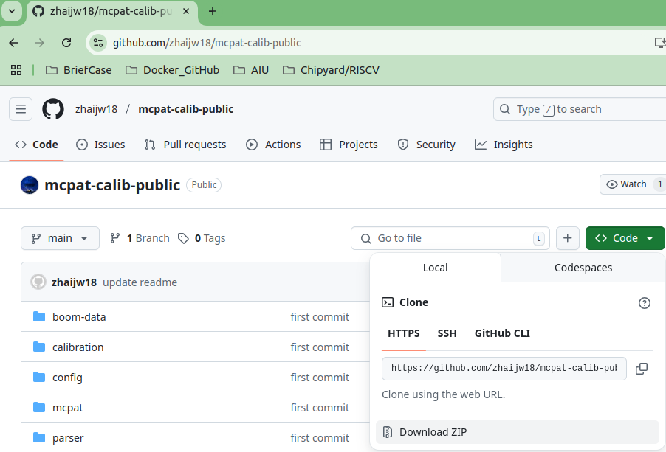
1.3 Download McPAT-Calib
https://github.com/zhaijw18/mcpat-calib-public
Download McPAT-Calib
1. Under the github/zhaijw18/mcpat-calib-public,
2. select <> Code > Download ZIP

Slide 7
1.4 Move McPAT-Calib to Work Folder

Slide 8
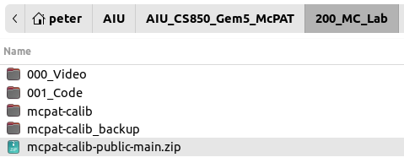
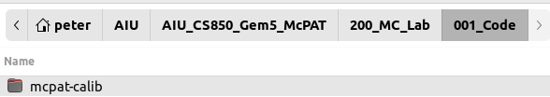
1.4 Move McPAT-Calib to Work Folder
https://github.com/zhaijw18/mcpat-calib-public
Move McPAT-Calib to Work folder
1. Save the mcpat-calib-publuc-main.zip
2. Unzip and rename to “mcpat-calib” and copy into “001_Code”
1
2

Slide 9
1.5 Compile mcpat

Slide 10
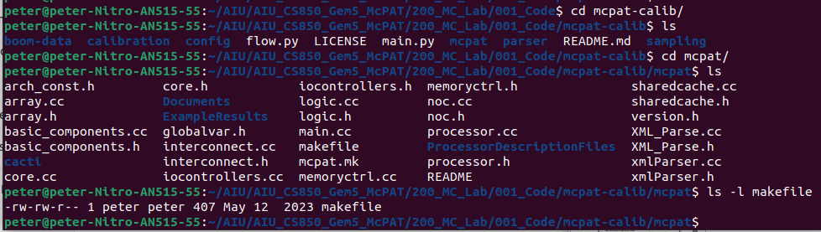
1.5 Compile mcpat
https://github.com/zhaijw18/mcpat-calib-public
Compile mcpat
1. > cd mcpat-lib
2. > ls
3. > cd mcpat
4. > ls
5. > ls -l makefile
1
3
5

Slide 11
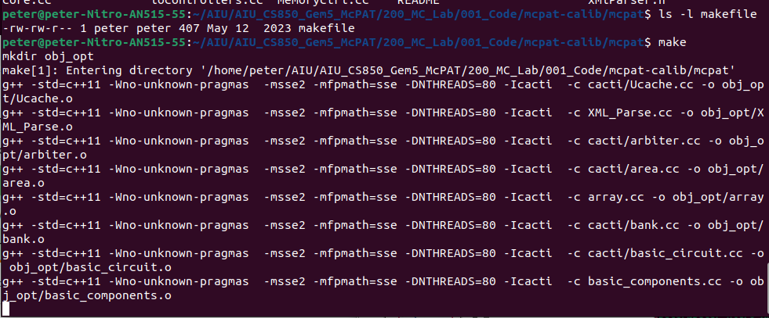
1.5 Compile mcpat
https://github.com/zhaijw18/mcpat-calib-public
Compile mcpat
1. > make
The command “make” will try to find the files in order to compile: GNUmakefile, makefile, and Makefile.

Slide 12
1.6 Run mcpat

Slide 13
1.6 Run mcpat
https://github.com/zhaijw18/mcpat-calib-public
Run mcpat
After compiled, we get the compiled today’s executable “mcpat”
1. > ls -l mcpat
>> -rwxrwx … Jun 15 21:46 mcpat
2. > ./mcpat
>> How to use McPAT:
>> Mcpat -infile <input file name> print_level <...> -opt_foe_clk ...
1
2

Slide 14
1.7 Check Python main.py

Slide 15
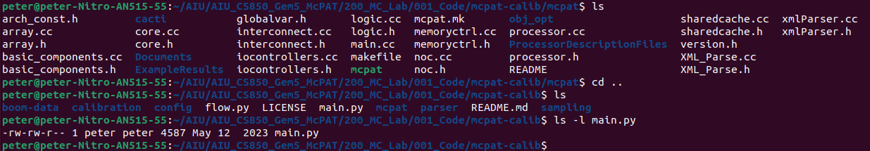
1.7 Check Python main.py
https://github.com/zhaijw18/mcpat-calib-public
Check Python main.py
1. > cd ..
We are in the mcpat-calib directory
2. ls
3. Check python main program main.py.
> ls -l main.py
>> -rwxrwx … May 12 2023 main.py
3

Slide 16
1.8 Install Machine Learning Framework

Slide 17
1.8 Install Machine Learning Framework
https://github.com/zhaijw18/mcpat-calib-public
Install Machine Learning Framework
1. Numerical Python
> pip install numpy
2. Install scikit-learn
> pip install scikit-learn
3. Install Panel Data
> pip install pandas
4. Math Plot Library
> pip install matplotlib
5. Machine Learning Extension
> pip install mlxtend
6. Statistic Model
> pip install statsmodels
7. Extreme Gradient Boosting
> pip install xgboost
8. Progress bar
> pip install progressbar

Slide 18
1.8 Run McPAT-Calib

Slide 19
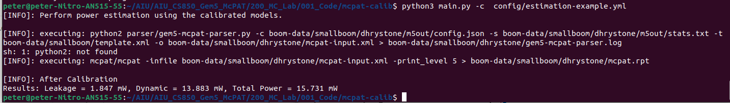
1.8 Run McPAT-Calib
https://github.com/zhaijw18/mcpat-calib-public
Run McPAT-Calib
Run McPAT-Calib with configuration yaml file.
> python3 main.py -c config/estimation-example.yml

Slide 20
1.9 Train New ML CPU Model

Slide 21
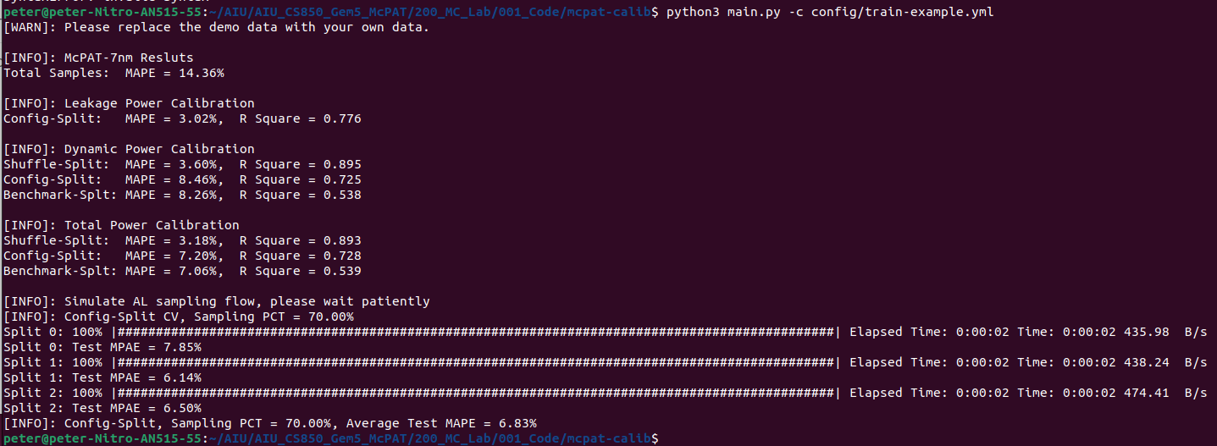
1.9 Train New ML CPU Model
https://github.com/zhaijw18/mcpat-calib-public
Train New CPU Model
Train new CPU Model.
> python3 main.py -c config/train-example.yml

Slide 22
End

