Slide 1

3.1 SimObject: Slides
Peter H. Chen

Slide 2

4.1 Standard Library: Slides
https://gem5bootcamp.github.io/2024/#02-Using-gem5/01-stdlib
Standard Library: Slides

Slide 3
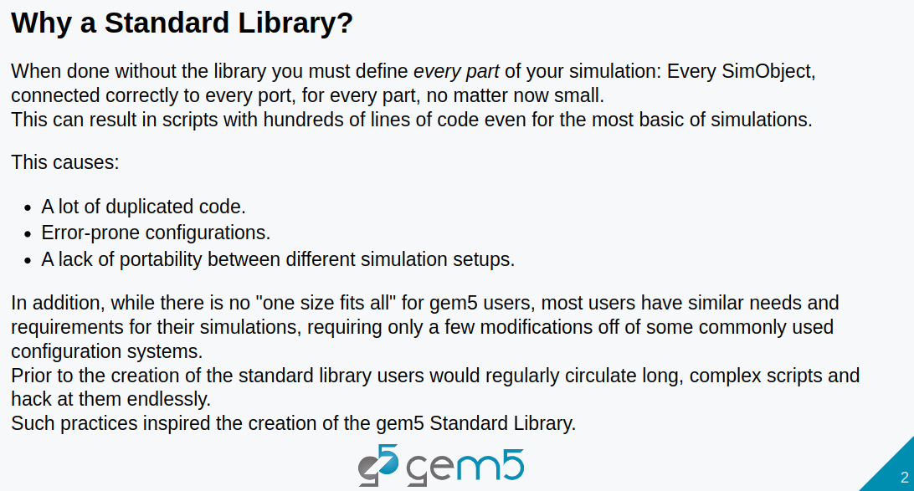
4.1 Standard Library: Slides
https://gem5bootcamp.github.io/2024/#02-Using-gem5/01-stdlib
Standard Library: Slides

Slide 4
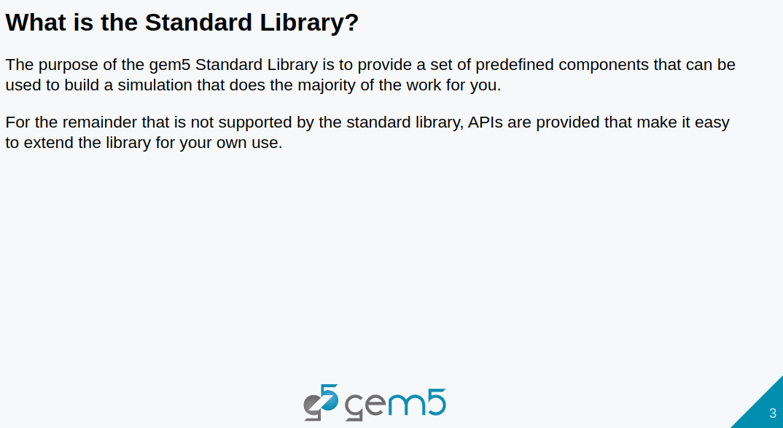
4.1 Standard Library: Slides
https://gem5bootcamp.github.io/2024/#02-Using-gem5/01-stdlib
Standard Library: Slides

Slide 5
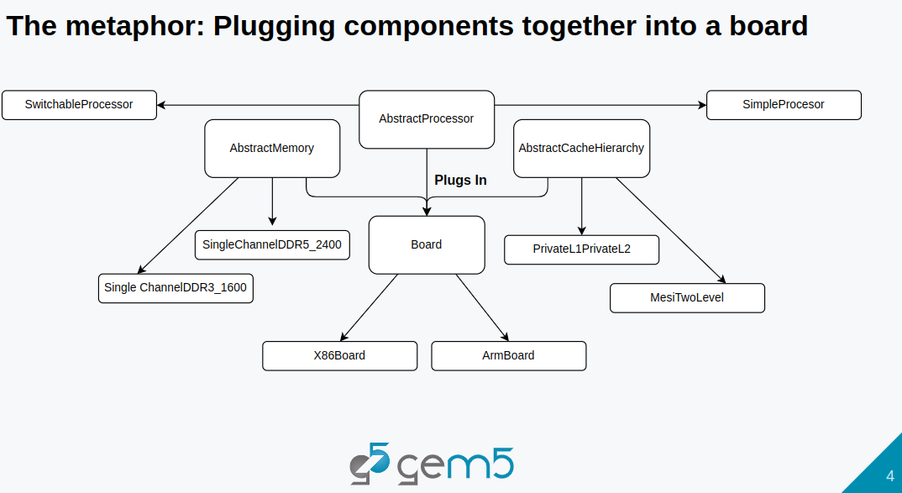
4.1 Standard Library: Slides
https://gem5bootcamp.github.io/2024/#02-Using-gem5/01-stdlib
Standard Library: Slides

Slide 6
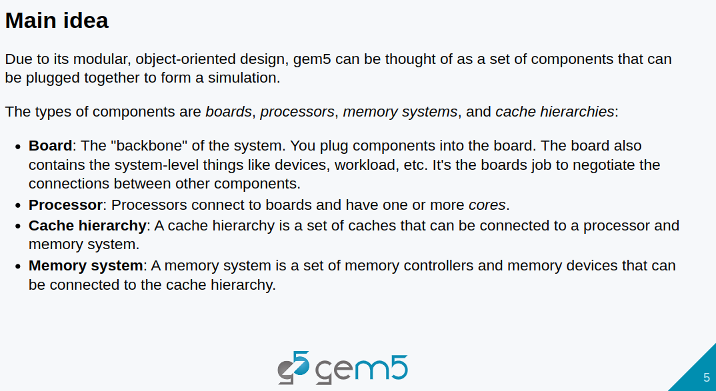
4.1 Standard Library: Slides
https://gem5bootcamp.github.io/2024/#02-Using-gem5/01-stdlib
Standard Library: Slides

Slide 7
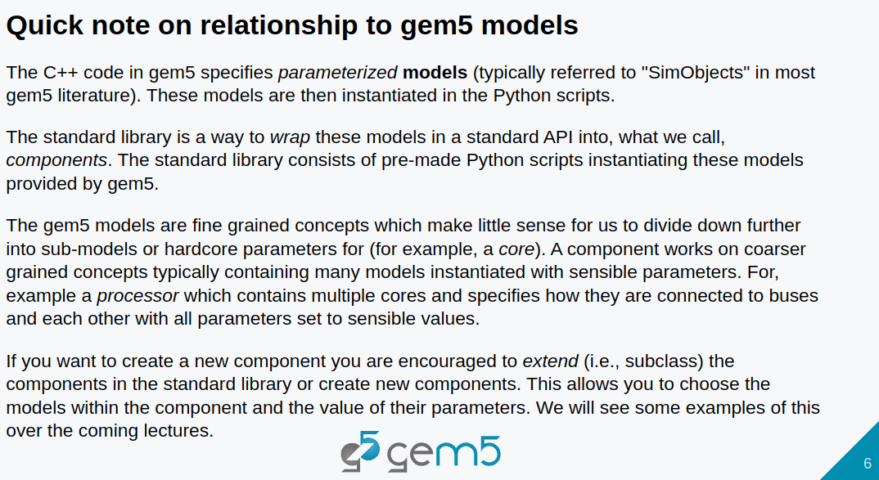
4.1 Standard Library: Slides
https://gem5bootcamp.github.io/2024/#02-Using-gem5/01-stdlib
Standard Library: Slides

Slide 8
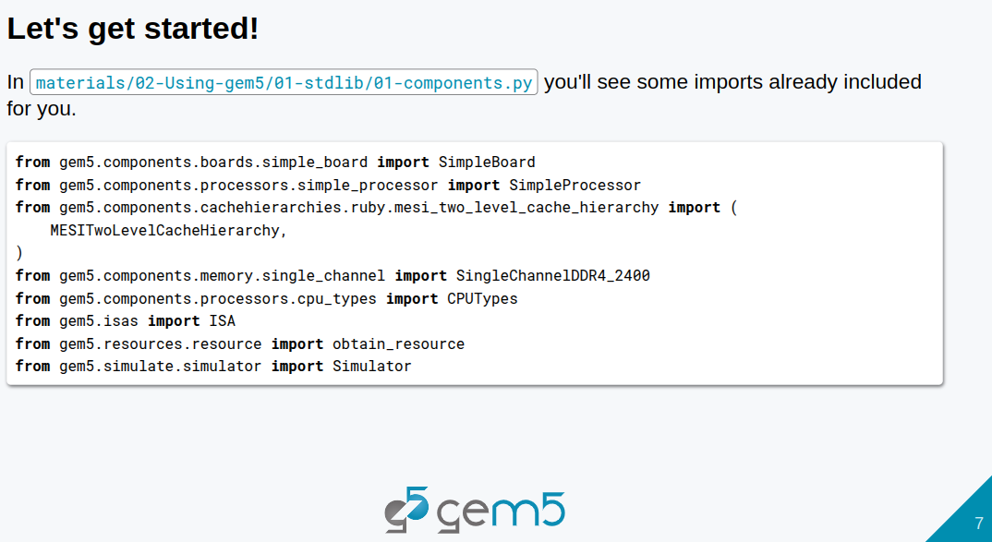
4.1 Standard Library: Slides
https://gem5bootcamp.github.io/2024/#02-Using-gem5/01-stdlib
Standard Library: Slides

Slide 9
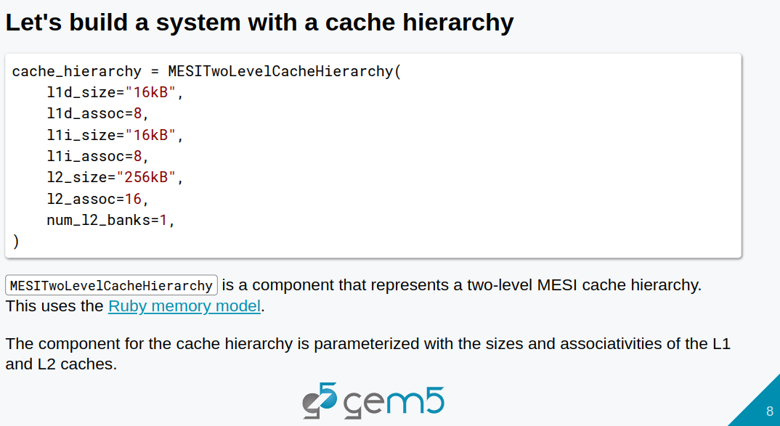
4.1 Standard Library: Slides
https://gem5bootcamp.github.io/2024/#02-Using-gem5/01-stdlib
Standard Library: Slides

Slide 10
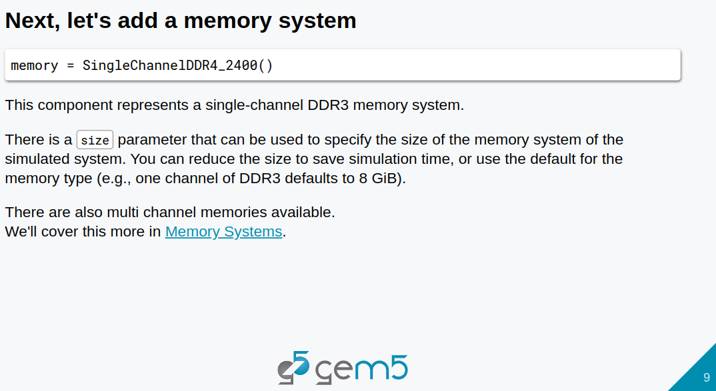
4.1 Standard Library: Slides
https://gem5bootcamp.github.io/2024/#02-Using-gem5/01-stdlib
Standard Library: Slides

Slide 11
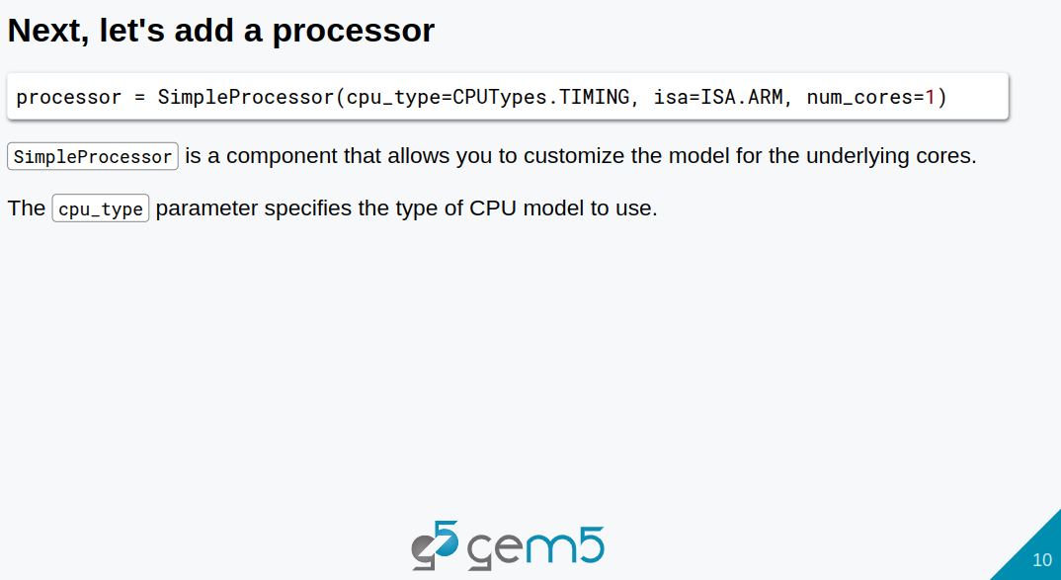
4.1 Standard Library: Slides
https://gem5bootcamp.github.io/2024/#02-Using-gem5/01-stdlib
Standard Library: Slides

Slide 12
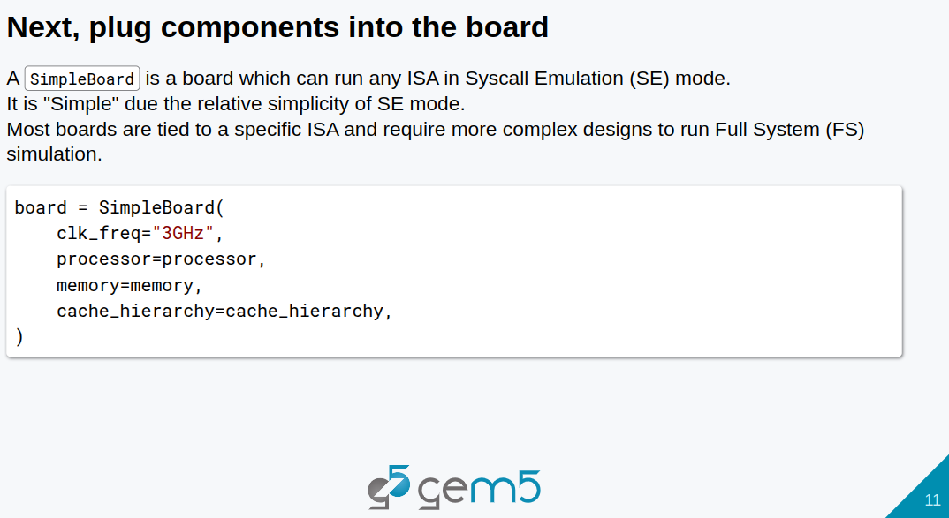
4.1 Standard Library: Slides
https://gem5bootcamp.github.io/2024/#02-Using-gem5/01-stdlib
Standard Library: Slides

Slide 13
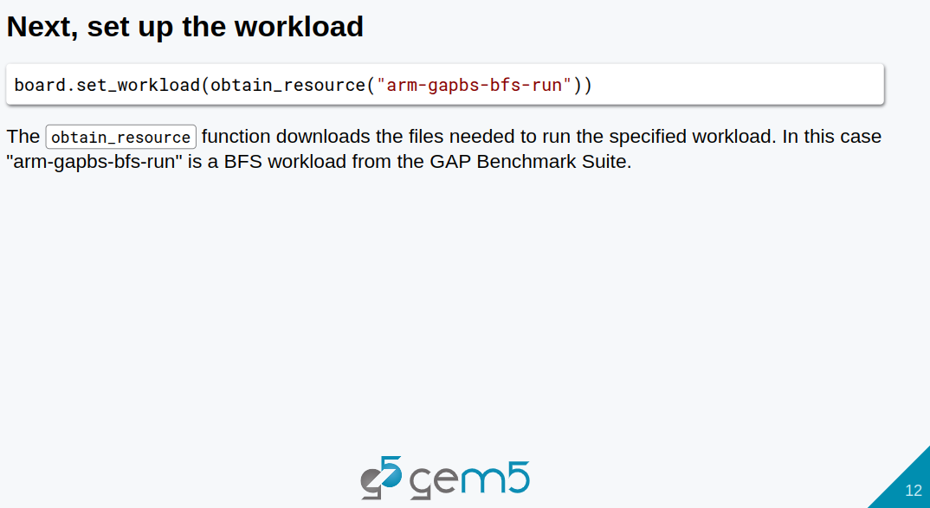
4.1 Standard Library: Slides
https://gem5bootcamp.github.io/2024/#02-Using-gem5/01-stdlib
Standard Library: Slides

Slide 14
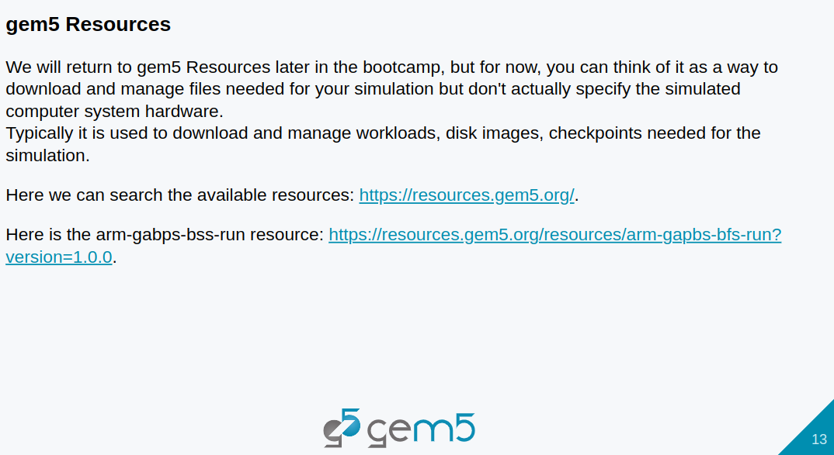
4.1 Standard Library: Slides
https://gem5bootcamp.github.io/2024/#02-Using-gem5/01-stdlib
Standard Library: Slides

Slide 15
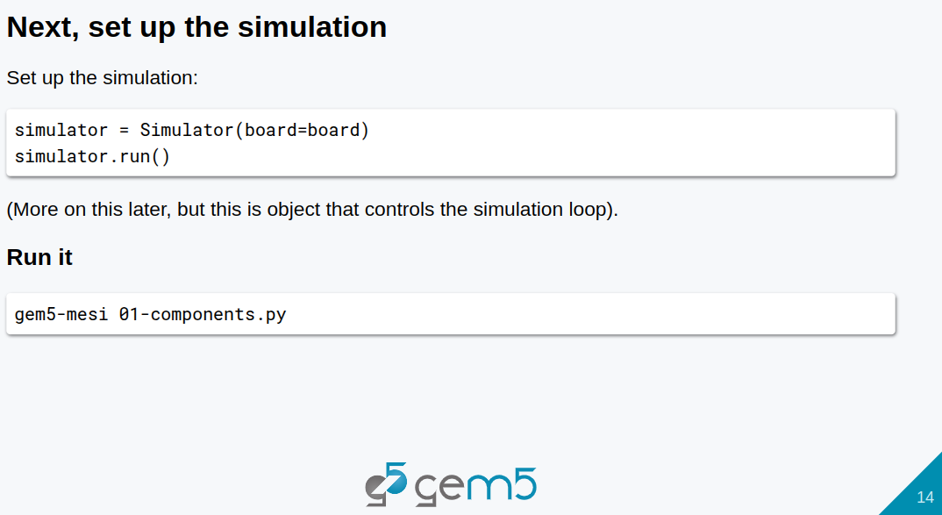
4.1 Standard Library: Slides
https://gem5bootcamp.github.io/2024/#02-Using-gem5/01-stdlib
Standard Library: Slides

Slide 16
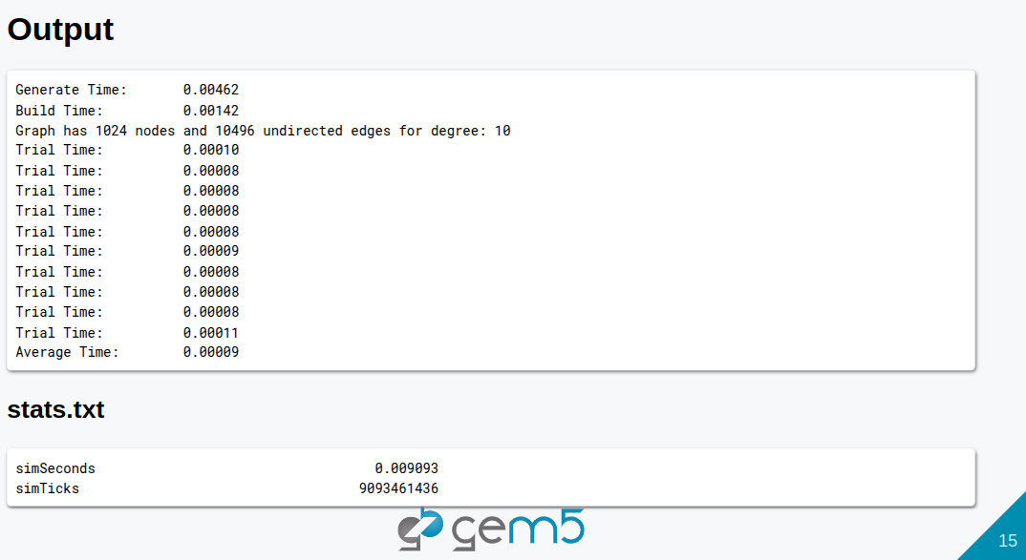
4.1 Standard Library: Slides
https://gem5bootcamp.github.io/2024/#02-Using-gem5/01-stdlib
Standard Library: Slides

Slide 17
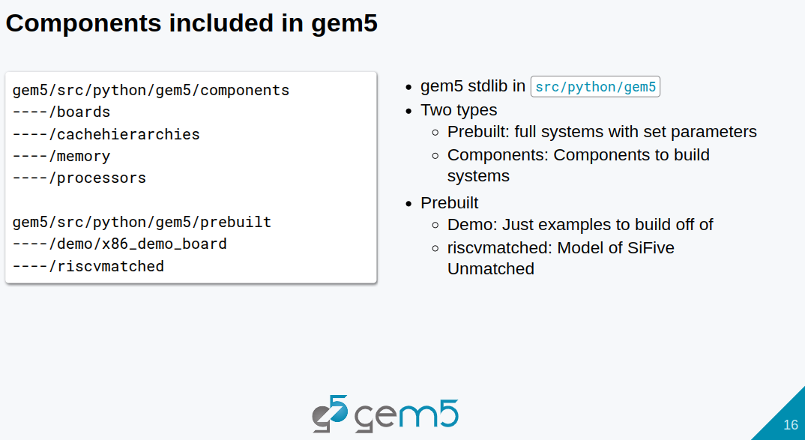
4.1 Standard Library: Slides
https://gem5bootcamp.github.io/2024/#02-Using-gem5/01-stdlib
Standard Library: Slides

Slide 18
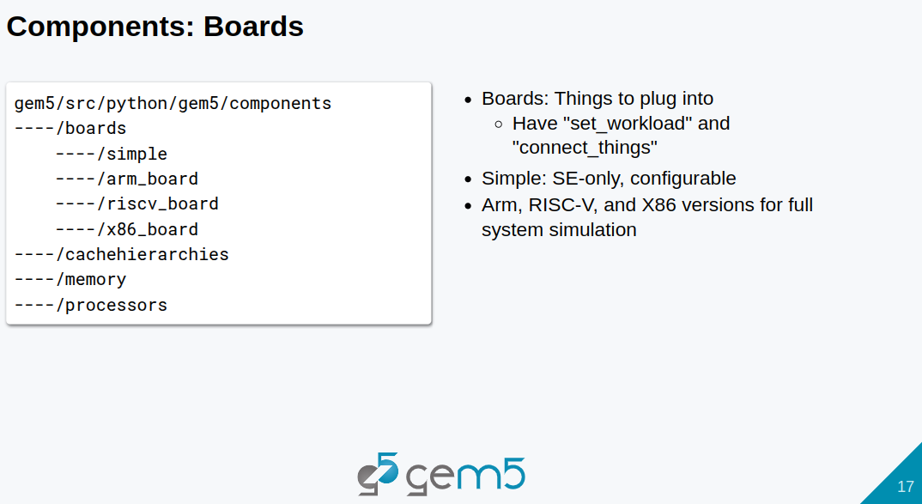
4.1 Standard Library: Slides
https://gem5bootcamp.github.io/2024/#02-Using-gem5/01-stdlib
Standard Library: Slides

Slide 19
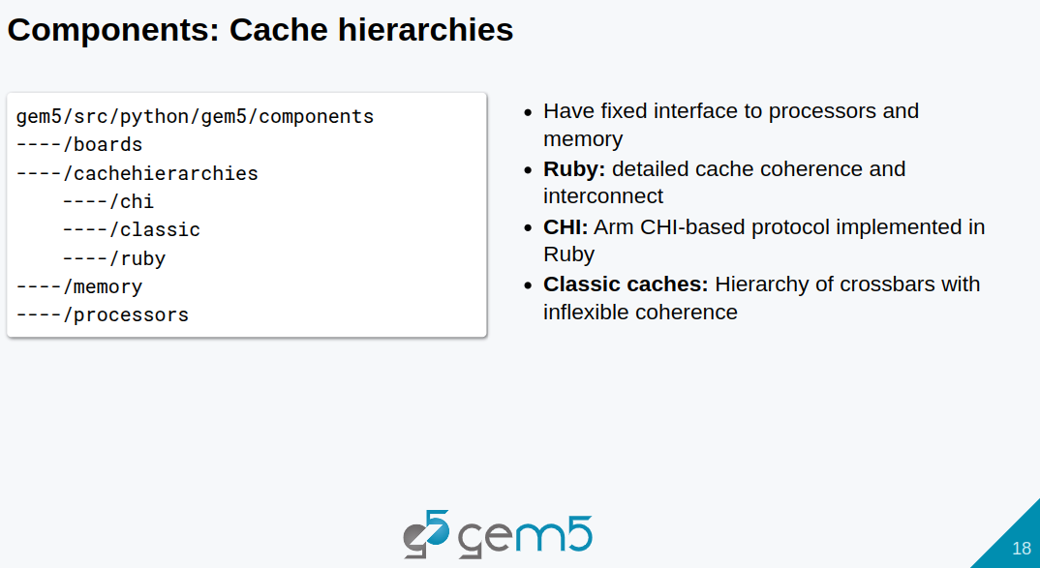
4.1 Standard Library: Slides
https://gem5bootcamp.github.io/2024/#02-Using-gem5/01-stdlib
Standard Library: Slides

Slide 20
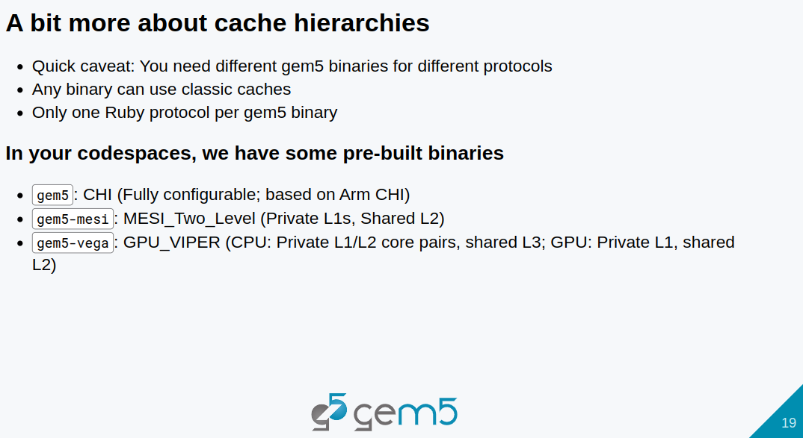
4.1 Standard Library: Slides
https://gem5bootcamp.github.io/2024/#02-Using-gem5/01-stdlib
Standard Library: Slides

Slide 21
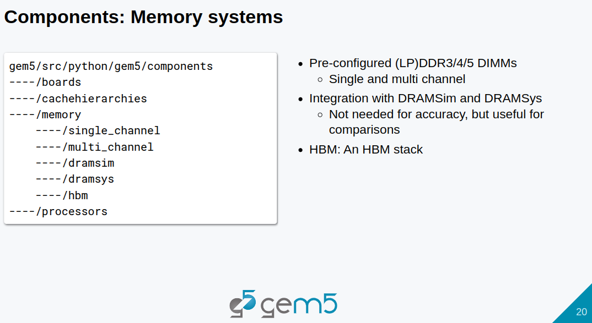
4.1 Standard Library: Slides
https://gem5bootcamp.github.io/2024/#02-Using-gem5/01-stdlib
Standard Library: Slides

Slide 22
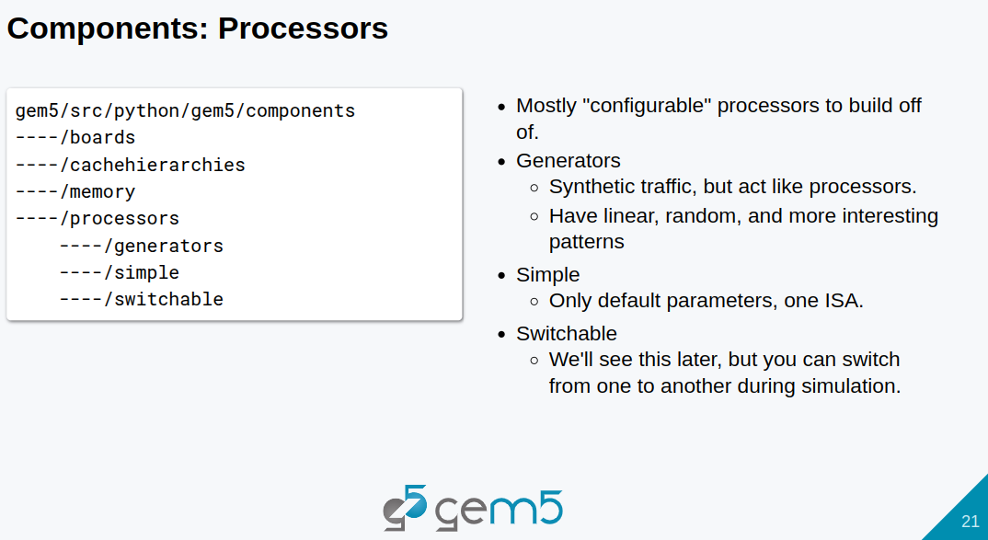
4.1 Standard Library: Slides
https://gem5bootcamp.github.io/2024/#02-Using-gem5/01-stdlib
Standard Library: Slides

Slide 23
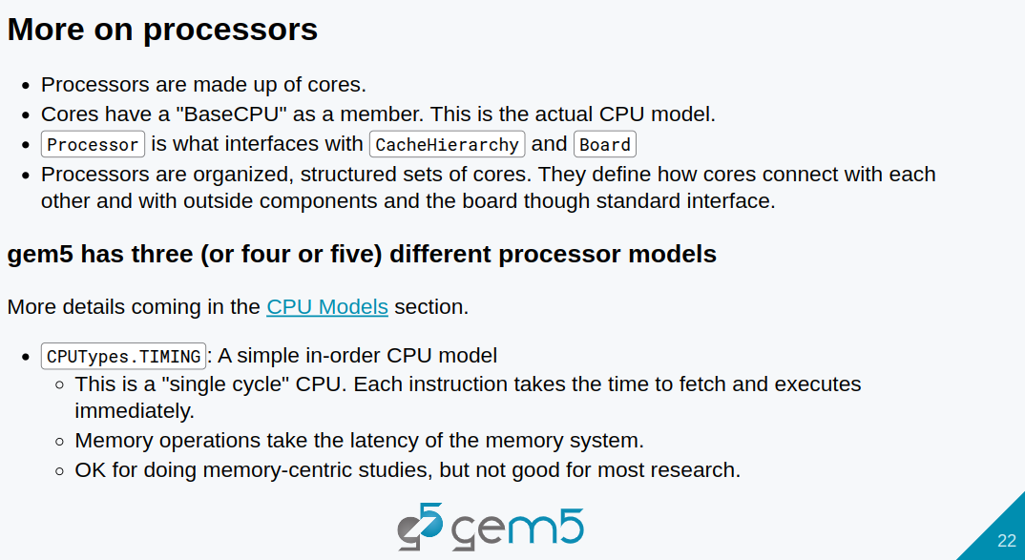
4.1 Standard Library: Slides
https://gem5bootcamp.github.io/2024/#02-Using-gem5/01-stdlib
Standard Library: Slides

Slide 24
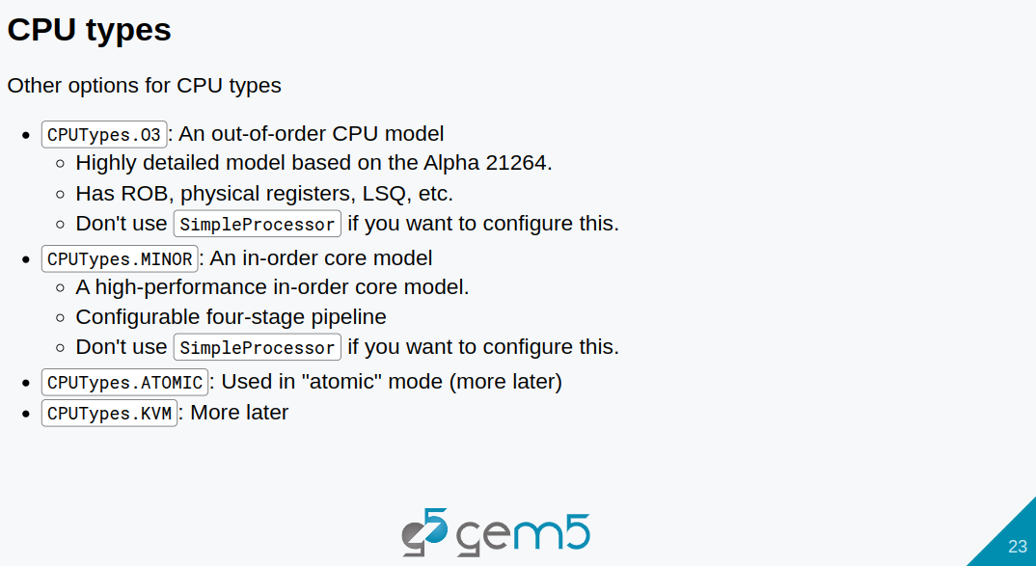
4.1 Standard Library: Slides
https://gem5bootcamp.github.io/2024/#02-Using-gem5/01-stdlib
Standard Library: Slides

Slide 25
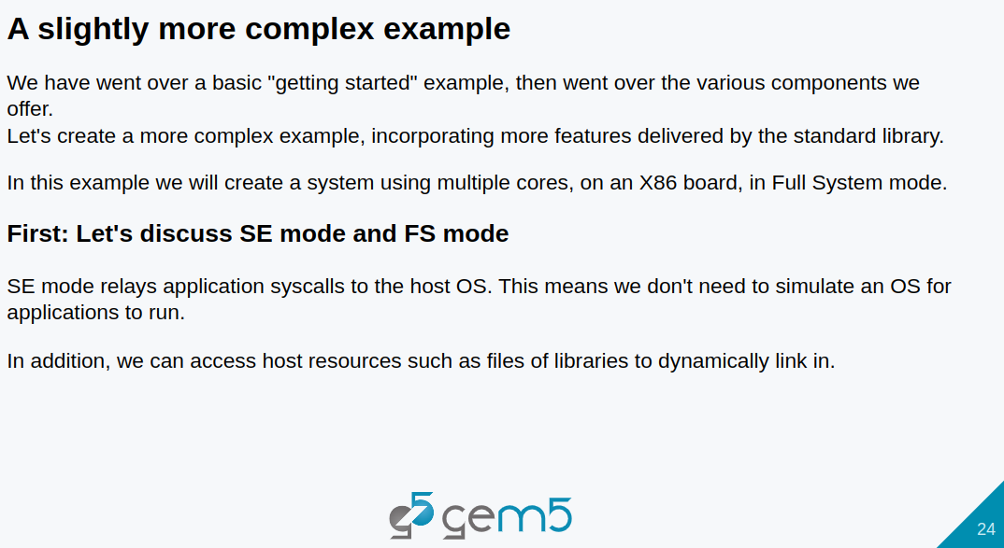
4.1 Standard Library: Slides
https://gem5bootcamp.github.io/2024/#02-Using-gem5/01-stdlib
Standard Library: Slides

Slide 26
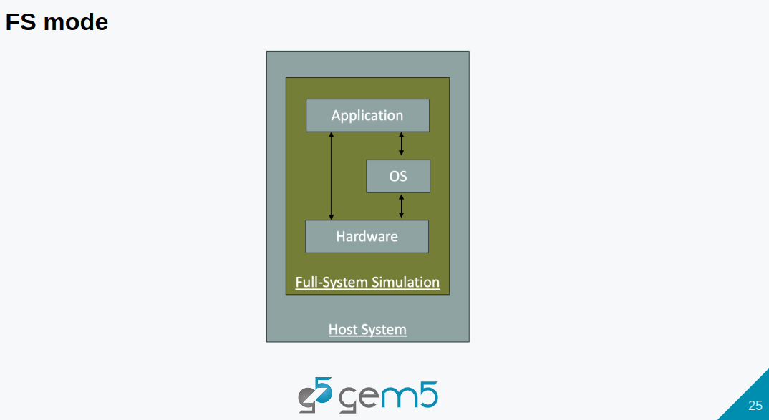
4.1 Standard Library: Slides
https://gem5bootcamp.github.io/2024/#02-Using-gem5/01-stdlib
Standard Library: Slides

Slide 27
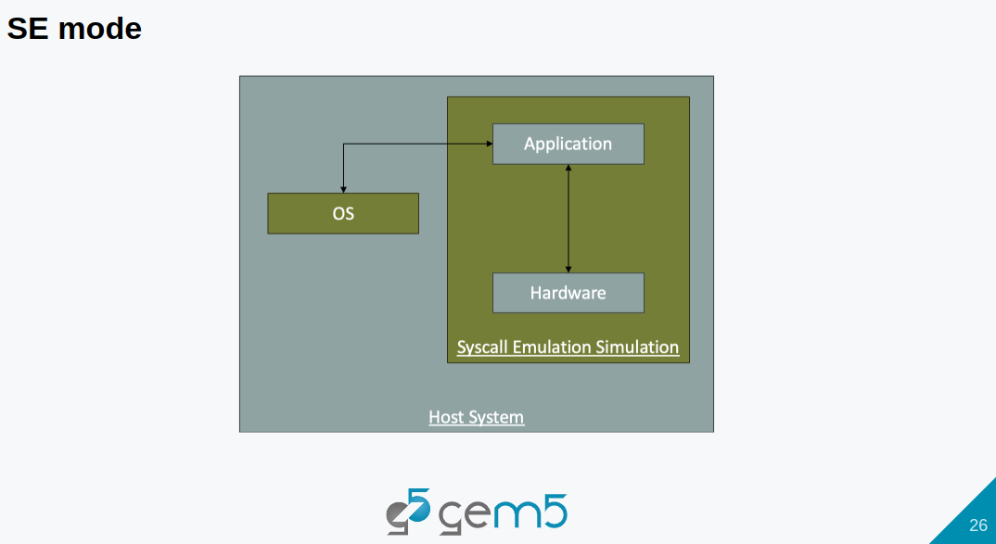
4.1 Standard Library: Slides
https://gem5bootcamp.github.io/2024/#02-Using-gem5/01-stdlib
Standard Library: Slides

Slide 28
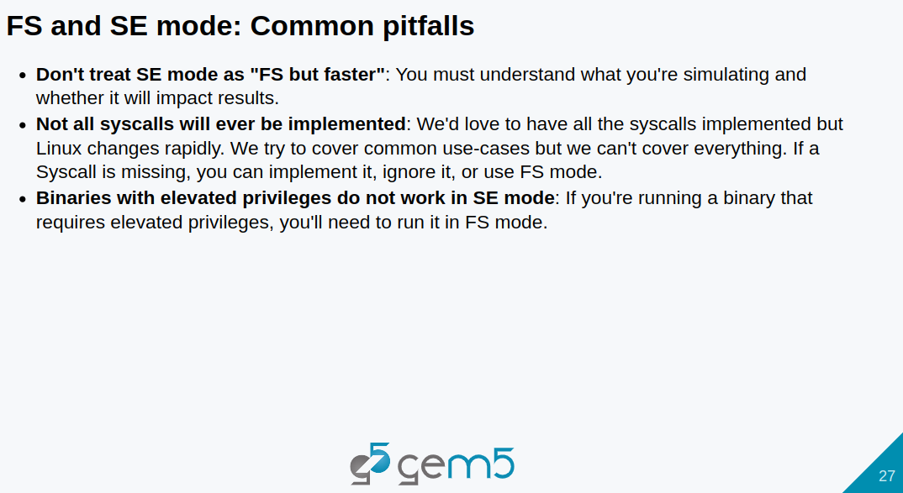
4.1 Standard Library: Slides
https://gem5bootcamp.github.io/2024/#02-Using-gem5/01-stdlib
Standard Library: Slides

Slide 29
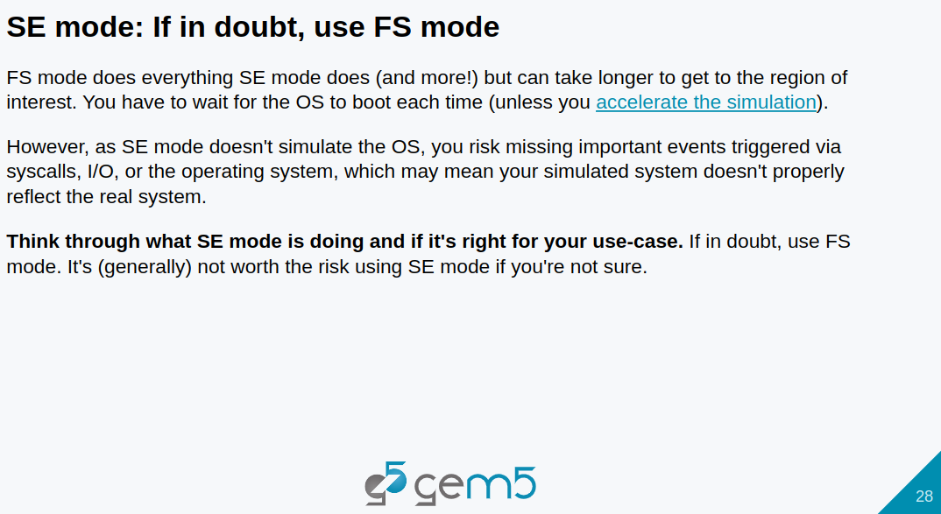
4.1 Standard Library: Slides
https://gem5bootcamp.github.io/2024/#02-Using-gem5/01-stdlib
Standard Library: Slides

Slide 30
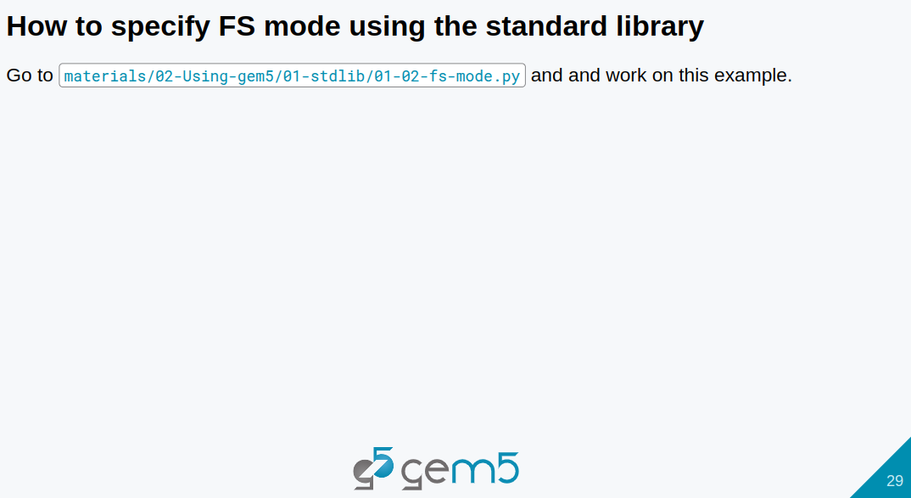
4.1 Standard Library: Slides
https://gem5bootcamp.github.io/2024/#02-Using-gem5/01-stdlib
Standard Library: Slides

Slide 31
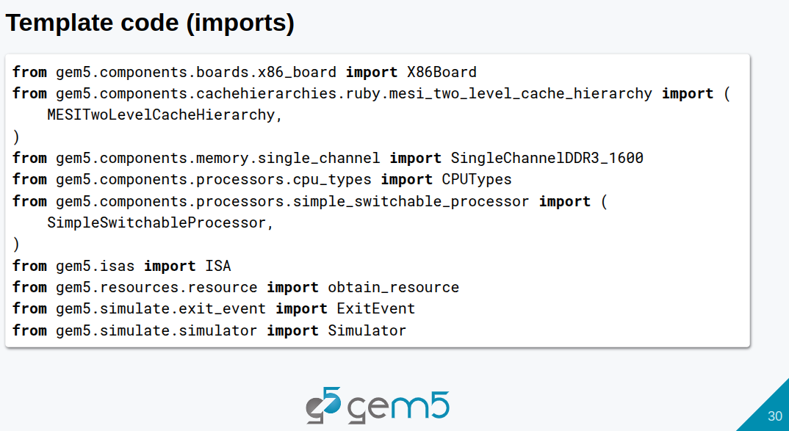
4.1 Standard Library: Slides
https://gem5bootcamp.github.io/2024/#02-Using-gem5/01-stdlib
Standard Library: Slides

Slide 32
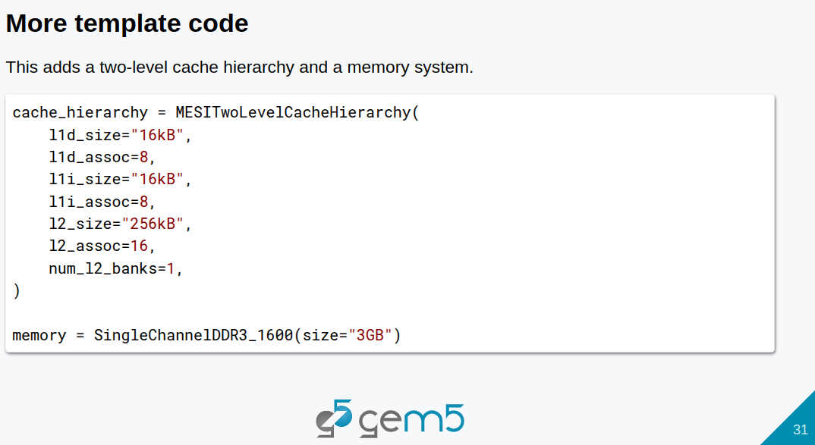
4.1 Standard Library: Slides
https://gem5bootcamp.github.io/2024/#02-Using-gem5/01-stdlib
Standard Library: Slides

Slide 33
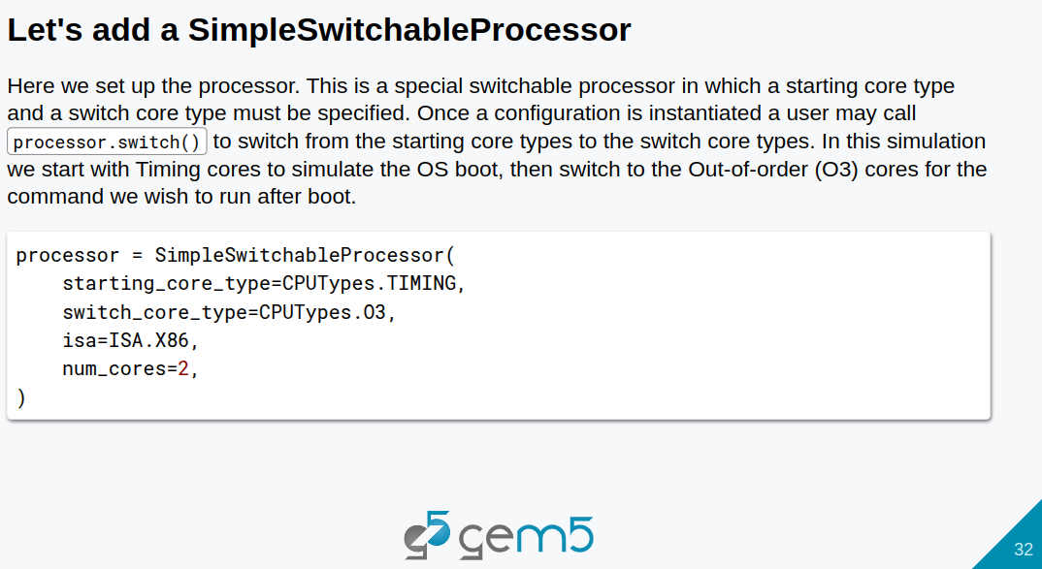
4.1 Standard Library: Slides
https://gem5bootcamp.github.io/2024/#02-Using-gem5/01-stdlib
Standard Library: Slides

Slide 34
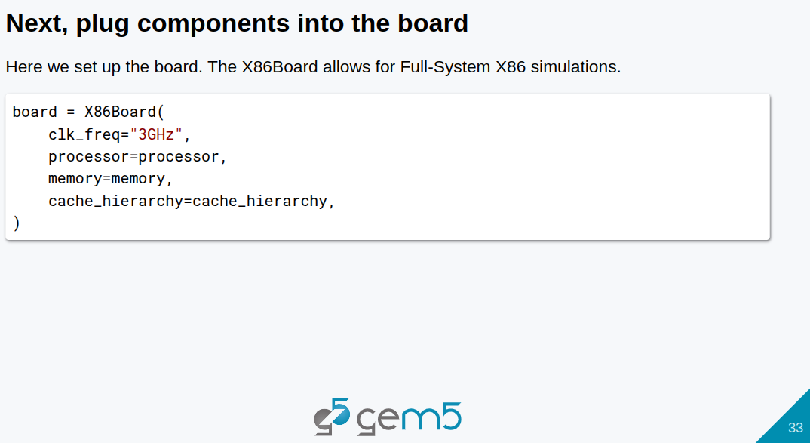
4.1 Standard Library: Slides
https://gem5bootcamp.github.io/2024/#02-Using-gem5/01-stdlib
Standard Library: Slides

Slide 35
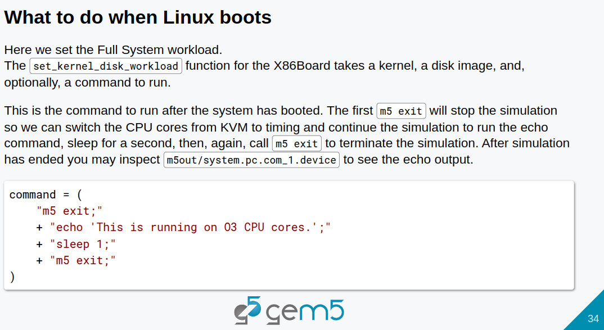
4.1 Standard Library: Slides
https://gem5bootcamp.github.io/2024/#02-Using-gem5/01-stdlib
Standard Library: Slides

Slide 36
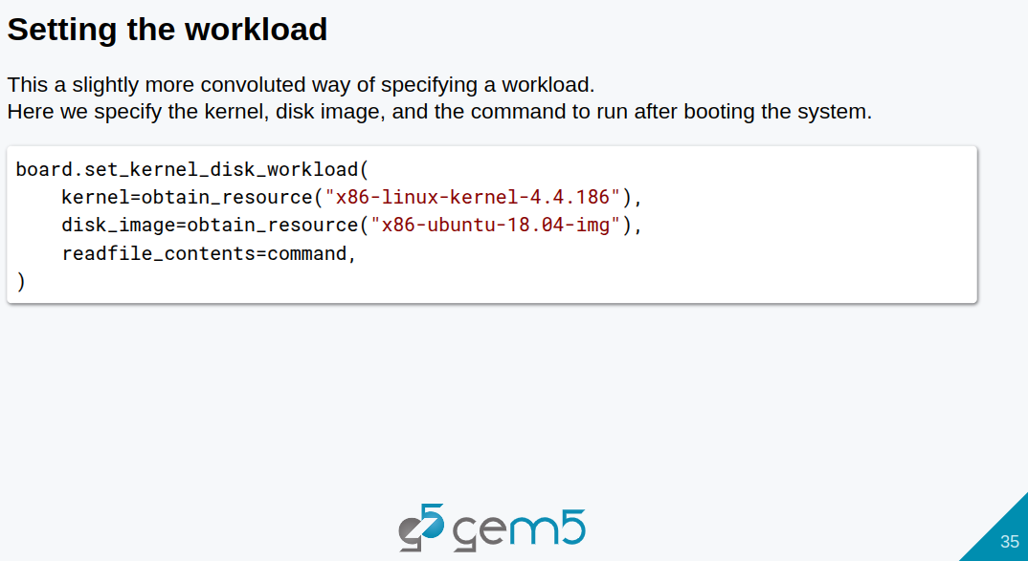
4.1 Standard Library: Slides
https://gem5bootcamp.github.io/2024/#02-Using-gem5/01-stdlib
Standard Library: Slides

Slide 37
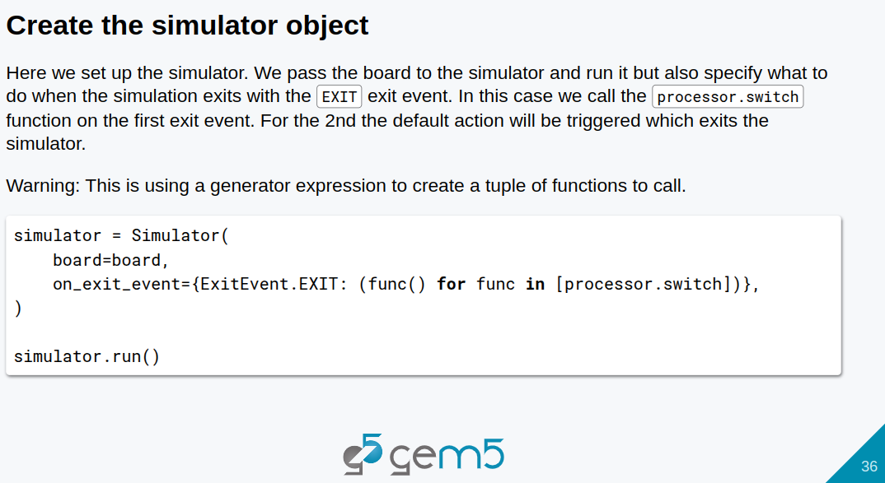
4.1 Standard Library: Slides
https://gem5bootcamp.github.io/2024/#02-Using-gem5/01-stdlib
Standard Library: Slides

Slide 38
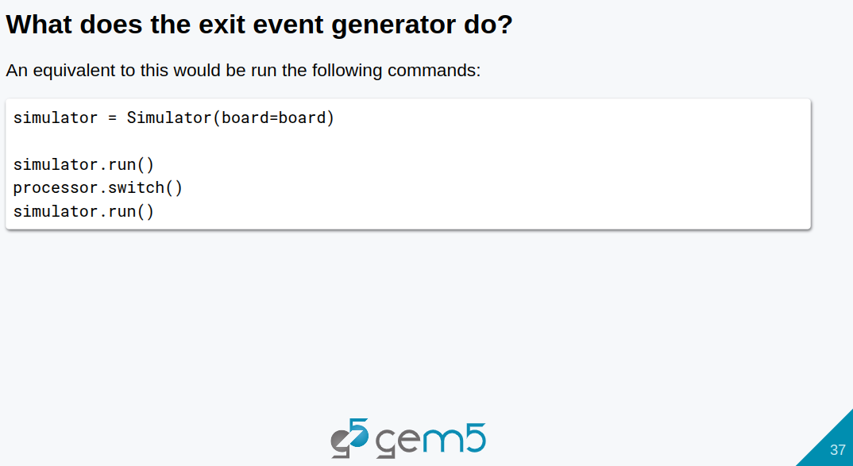
4.1 Standard Library: Slides
https://gem5bootcamp.github.io/2024/#02-Using-gem5/01-stdlib
Standard Library: Slides

Slide 39
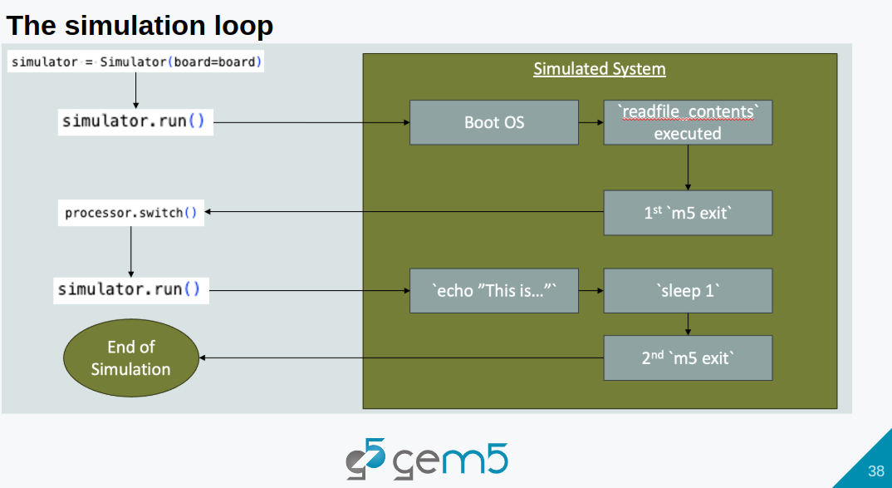
4.1 Standard Library: Slides
https://gem5bootcamp.github.io/2024/#02-Using-gem5/01-stdlib
Standard Library: Slides

Slide 40
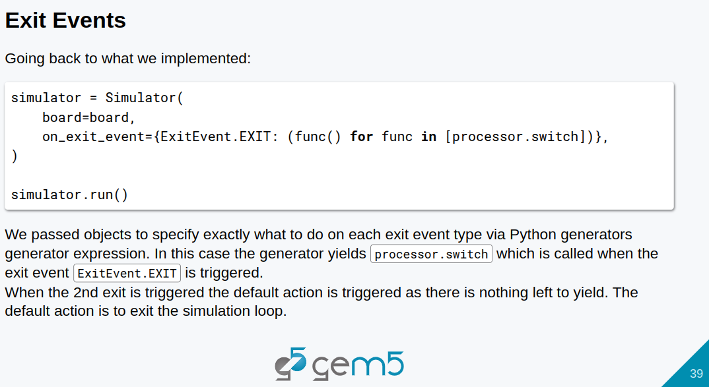
4.1 Standard Library: Slides
https://gem5bootcamp.github.io/2024/#02-Using-gem5/01-stdlib
Standard Library: Slides

Slide 41
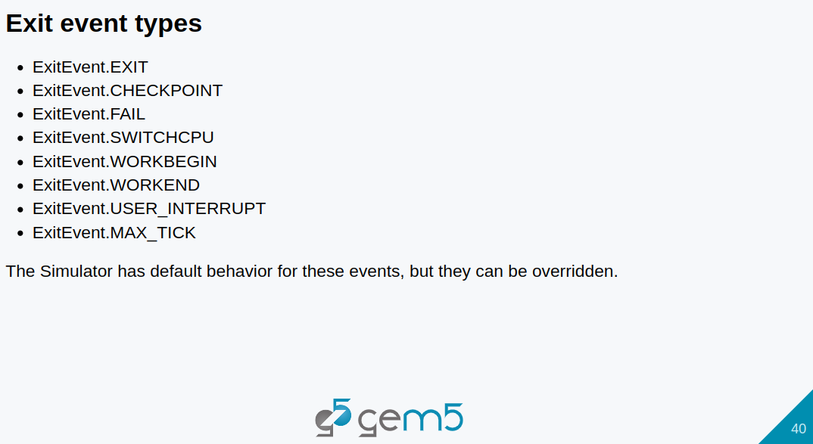
4.1 Standard Library: Slides
https://gem5bootcamp.github.io/2024/#02-Using-gem5/01-stdlib
Standard Library: Slides

Slide 42
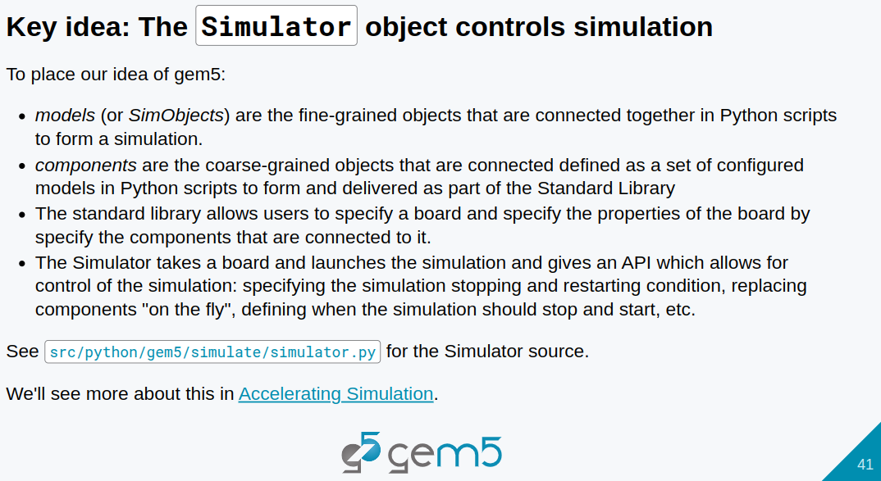
4.1 Standard Library: Slides
https://gem5bootcamp.github.io/2024/#02-Using-gem5/01-stdlib
Standard Library: Slides

Slide 43
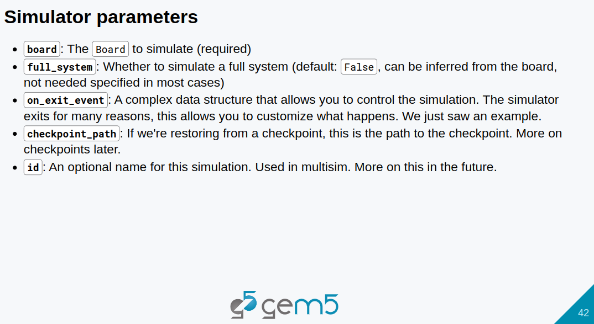
4.1 Standard Library: Slides
https://gem5bootcamp.github.io/2024/#02-Using-gem5/01-stdlib
Standard Library: Slides

Slide 44
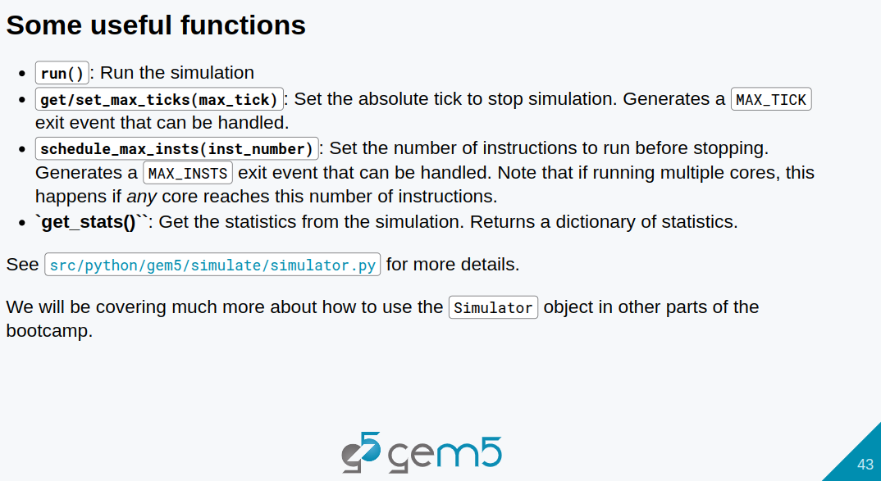
4.1 Standard Library: Slides
https://gem5bootcamp.github.io/2024/#02-Using-gem5/01-stdlib
Standard Library: Slides

Slide 45
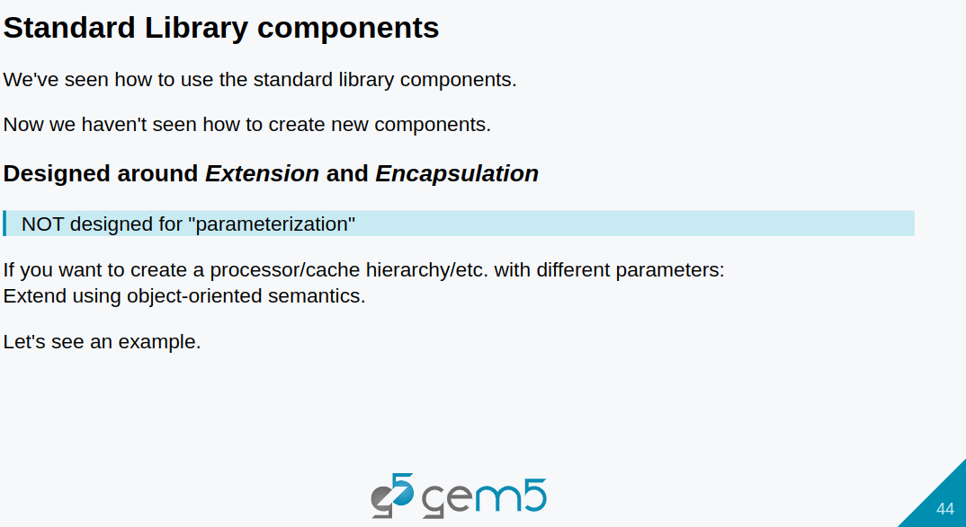
4.1 Standard Library: Slides
https://gem5bootcamp.github.io/2024/#02-Using-gem5/01-stdlib
Standard Library: Slides

Slide 46
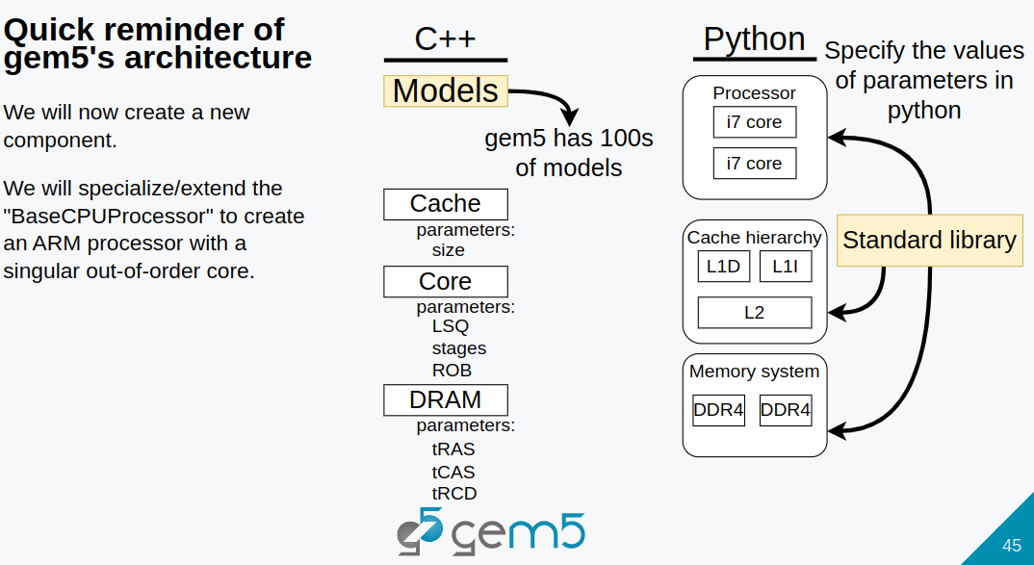
4.1 Standard Library: Slides
https://gem5bootcamp.github.io/2024/#02-Using-gem5/01-stdlib
Standard Library: Slides

Slide 47
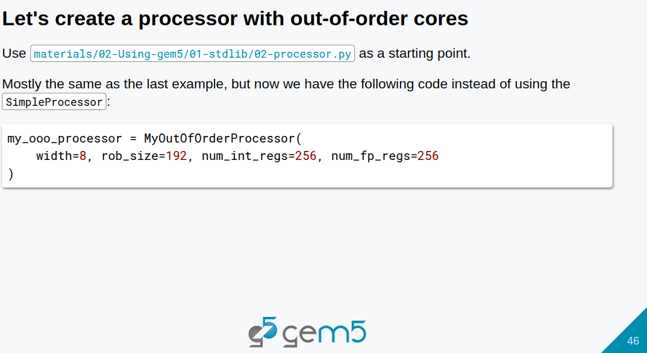
4.1 Standard Library: Slides
https://gem5bootcamp.github.io/2024/#02-Using-gem5/01-stdlib
Standard Library: Slides

Slide 48
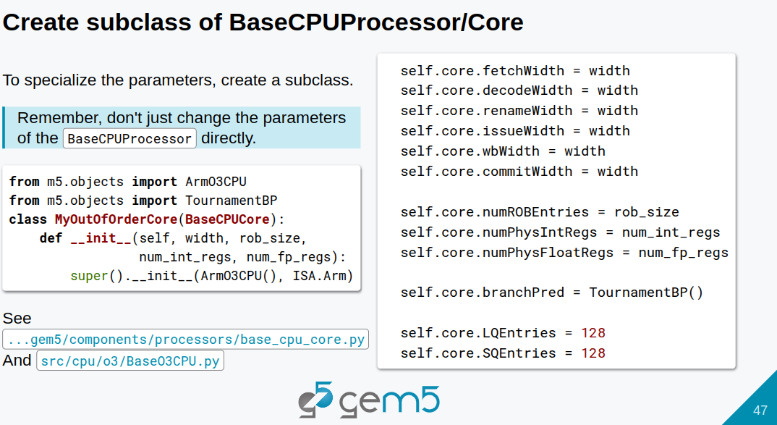
4.1 Standard Library: Slides
https://gem5bootcamp.github.io/2024/#02-Using-gem5/01-stdlib
Standard Library: Slides

Slide 49
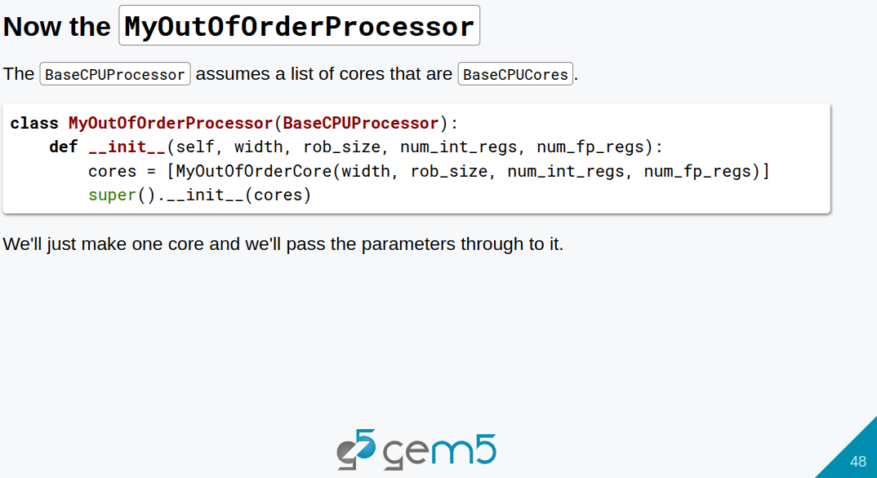
4.1 Standard Library: Slides
https://gem5bootcamp.github.io/2024/#02-Using-gem5/01-stdlib
Standard Library: Slides

Slide 50
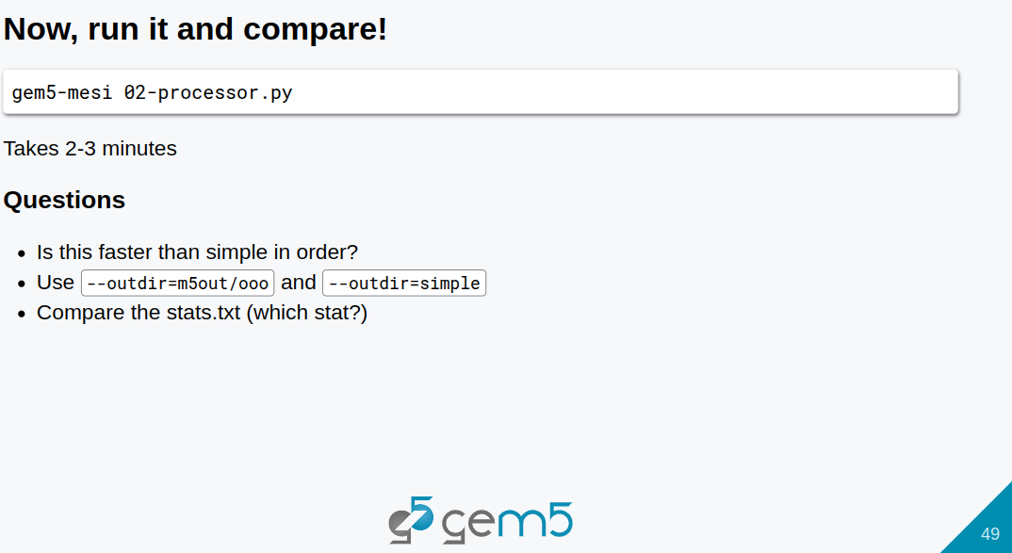
4.1 Standard Library: Slides
https://gem5bootcamp.github.io/2024/#02-Using-gem5/01-stdlib
Standard Library: Slides

Slide 51
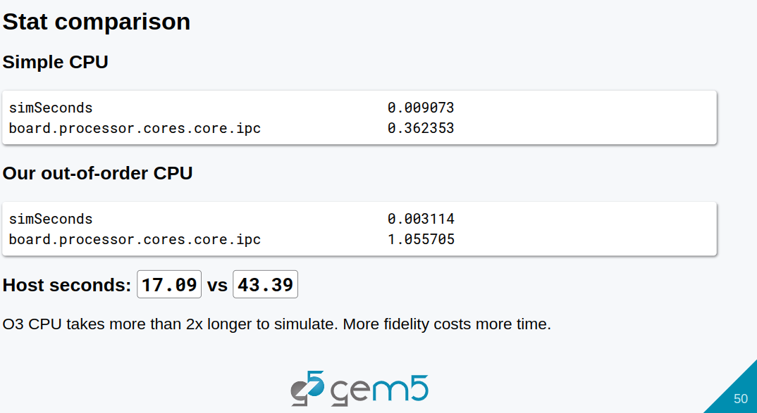
4.1 Standard Library: Slides
https://gem5bootcamp.github.io/2024/#02-Using-gem5/01-stdlib
Standard Library: Slides

Slide 52
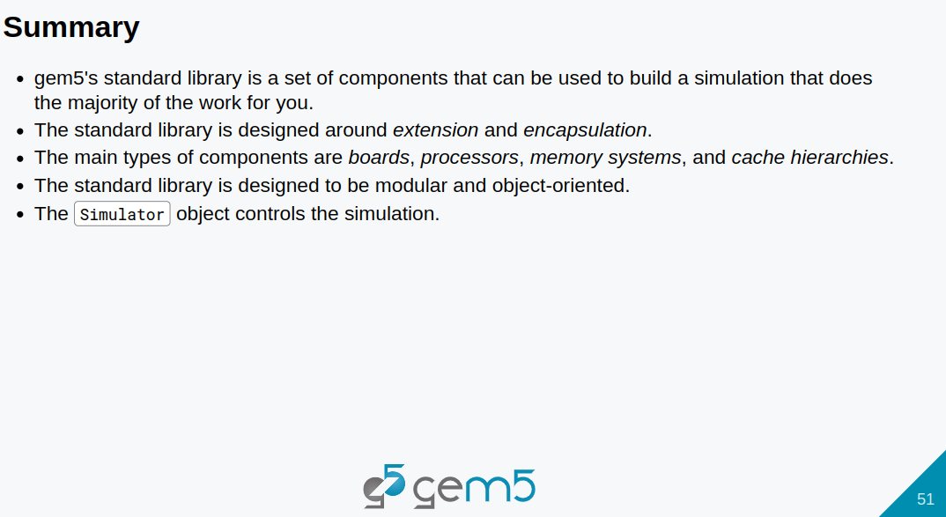
4.1 Standard Library: Slides
https://gem5bootcamp.github.io/2024/#02-Using-gem5/01-stdlib
Standard Library: Slides

Slide 53
End

