Slide 1

12.1 Gem5 Checkpoint: Slides
Peter H. Chen

Slide 2
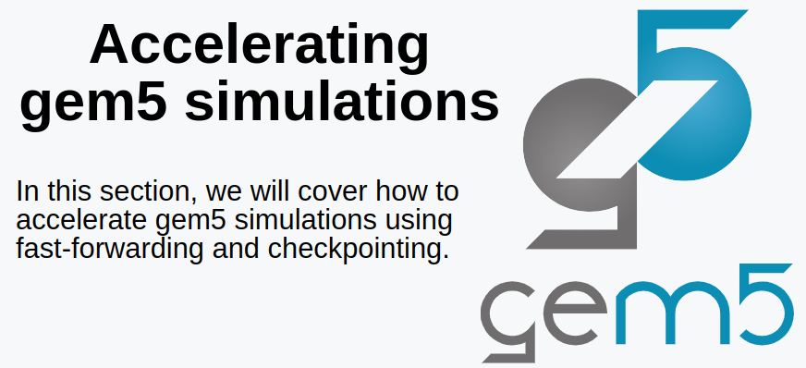
12.1 Gem5 Checkpoint: Slides
https://gem5bootcamp.github.io/2024/#02-Using-gem5/08-accelerating-simulation
Gem5 Checkpoint: Slides
These slides are used in 11 Accelerate Gem5 Simulation and 12 Gem5 Checkpoint.

Slide 3
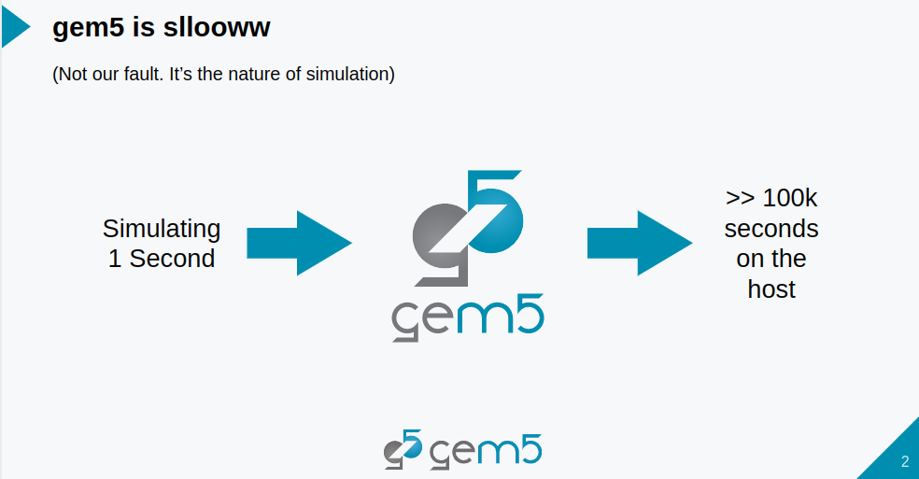
12.1 Gem5 Checkpoint: Slides
https://gem5bootcamp.github.io/2024/#02-Using-gem5/08-accelerating-simulation
Gem5 Checkpoint: Slides

Slide 4
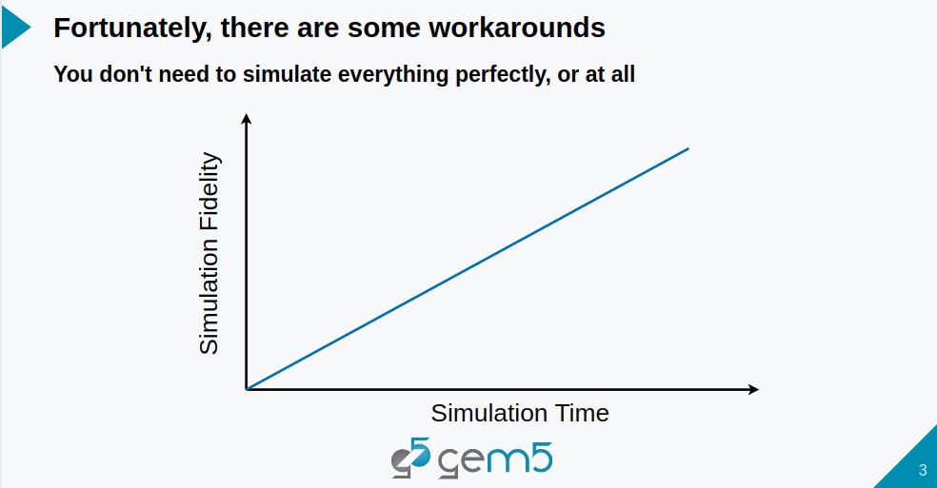
12.1 Gem5 Checkpoint: Slides
https://gem5bootcamp.github.io/2024/#02-Using-gem5/08-accelerating-simulation
Gem5 Checkpoint: Slides

Slide 5
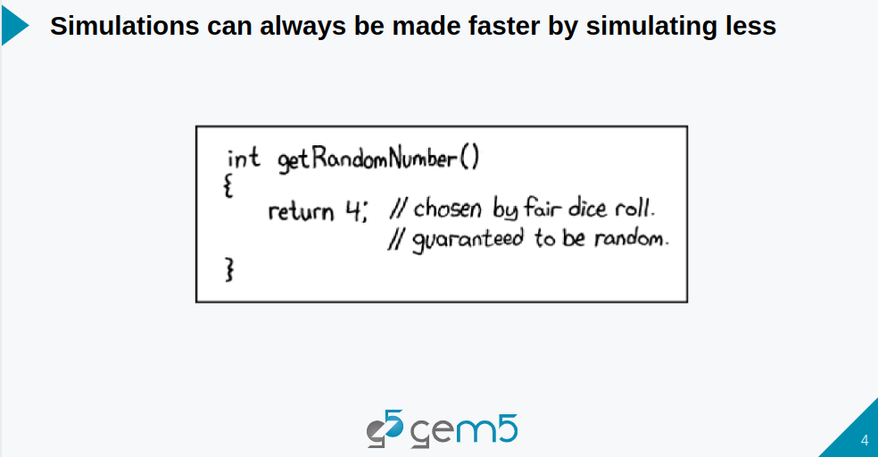
12.1 Gem5 Checkpoint: Slides
https://gem5bootcamp.github.io/2024/#02-Using-gem5/08-accelerating-simulation
Gem5 Checkpoint: Slides

Slide 6
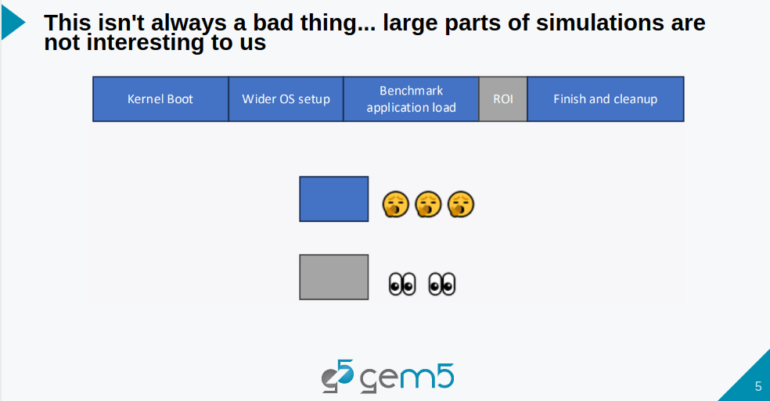
12.1 Gem5 Checkpoint: Slides
https://gem5bootcamp.github.io/2024/#02-Using-gem5/08-accelerating-simulation
Gem5 Checkpoint: Slides

Slide 7
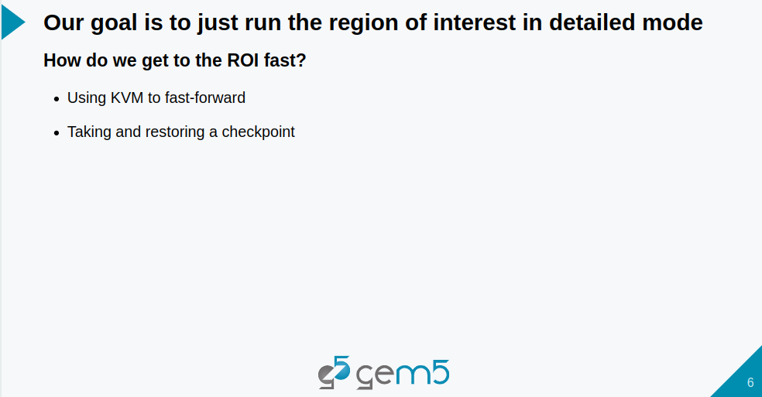
12.1 Gem5 Checkpoint: Slides
https://gem5bootcamp.github.io/2024/#02-Using-gem5/08-accelerating-simulation
Gem5 Checkpoint: Slides

Slide 8
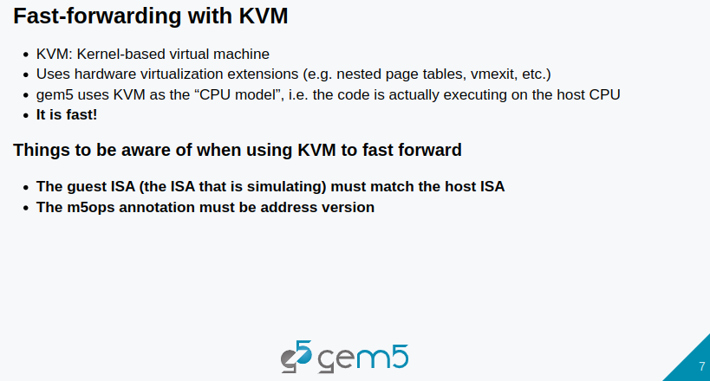
12.1 Gem5 Checkpoint: Slides
https://gem5bootcamp.github.io/2024/#02-Using-gem5/08-accelerating-simulation
Gem5 Checkpoint: Slides

Slide 9
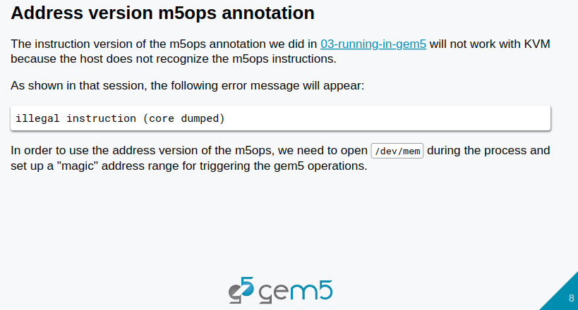
12.1 Gem5 Checkpoint: Slides
https://gem5bootcamp.github.io/2024/#02-Using-gem5/08-accelerating-simulation
Gem5 Checkpoint: Slides

Slide 10
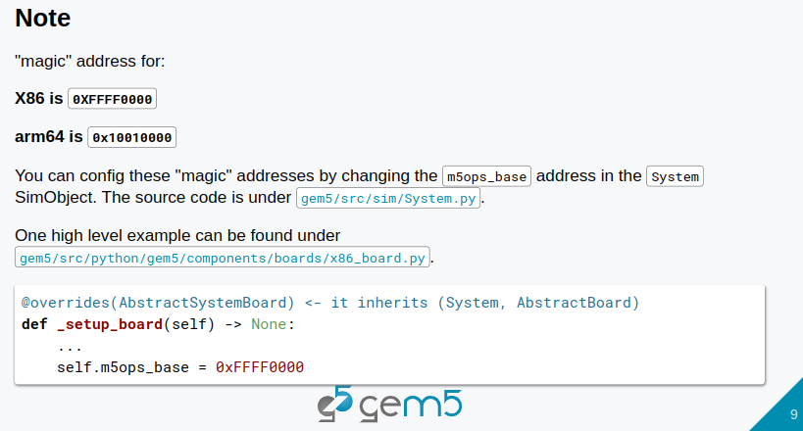
12.1 Gem5 Checkpoint: Slides
https://gem5bootcamp.github.io/2024/#02-Using-gem5/08-accelerating-simulation
Gem5 Checkpoint: Slides

Slide 11
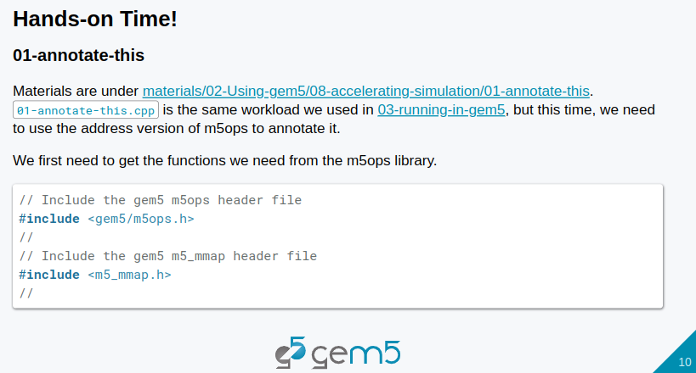
12.1 Gem5 Checkpoint: Slides
https://gem5bootcamp.github.io/2024/#02-Using-gem5/08-accelerating-simulation
Gem5 Checkpoint: Slides

Slide 12
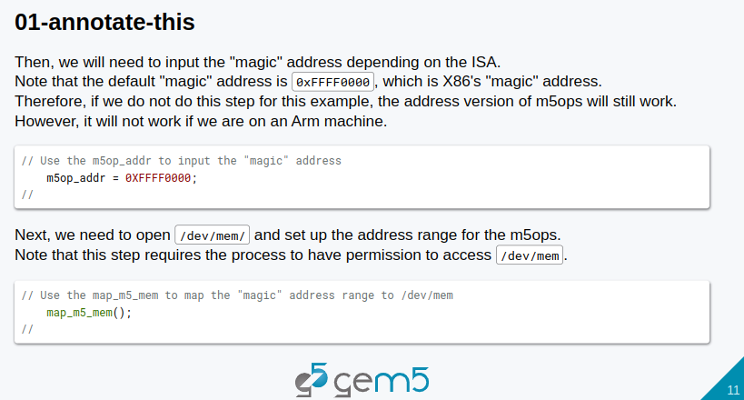
12.1 Gem5 Checkpoint: Slides
https://gem5bootcamp.github.io/2024/#02-Using-gem5/08-accelerating-simulation
Gem5 Checkpoint: Slides

Slide 13
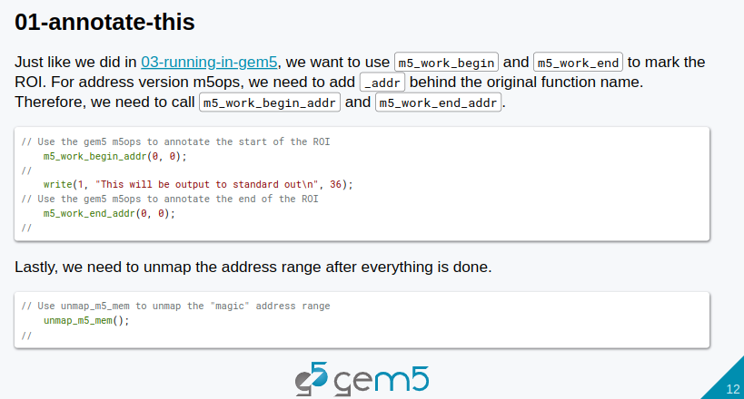
12.1 Gem5 Checkpoint: Slides
https://gem5bootcamp.github.io/2024/#02-Using-gem5/08-accelerating-simulation
Gem5 Checkpoint: Slides

Slide 14
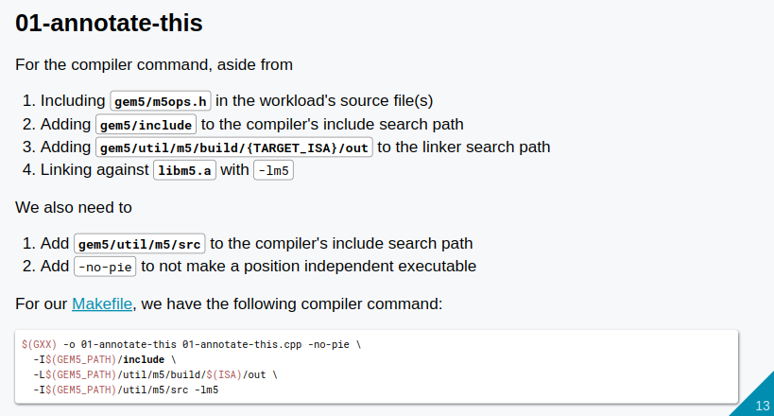
12.1 Gem5 Checkpoint: Slides
https://gem5bootcamp.github.io/2024/#02-Using-gem5/08-accelerating-simulation
Gem5 Checkpoint: Slides

Slide 15
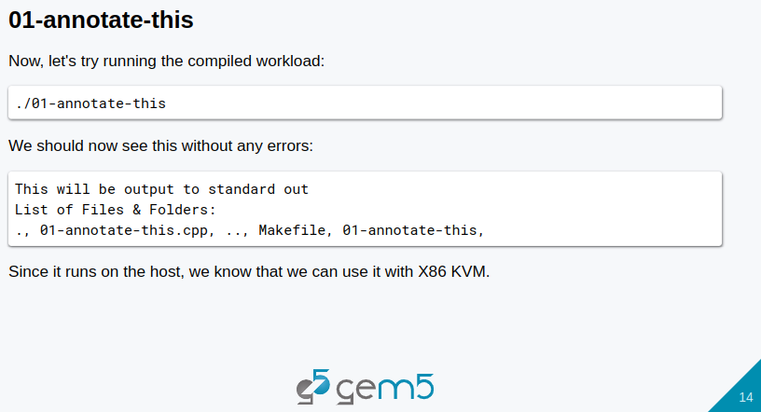
12.1 Gem5 Checkpoint: Slides
https://gem5bootcamp.github.io/2024/#02-Using-gem5/08-accelerating-simulation
Gem5 Checkpoint: Slides

Slide 16
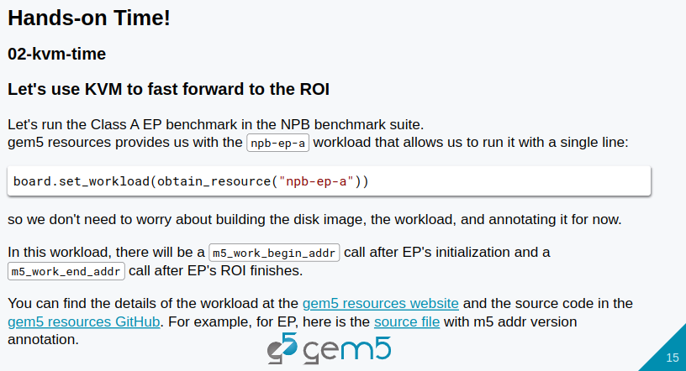
12.1 Gem5 Checkpoint: Slides
https://gem5bootcamp.github.io/2024/#02-Using-gem5/08-accelerating-simulation
Gem5 Checkpoint: Slides

Slide 17
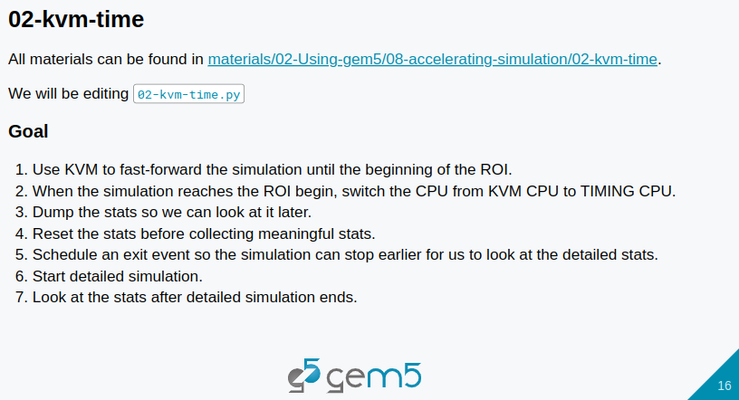
12.1 Gem5 Checkpoint: Slides
https://gem5bootcamp.github.io/2024/#02-Using-gem5/08-accelerating-simulation
Gem5 Checkpoint: Slides

Slide 18
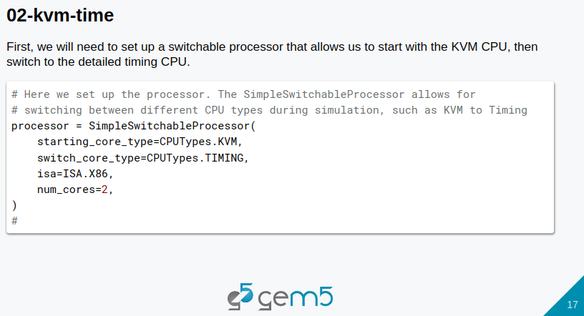
12.1 Gem5 Checkpoint: Slides
https://gem5bootcamp.github.io/2024/#02-Using-gem5/08-accelerating-simulation
Gem5 Checkpoint: Slides

Slide 19
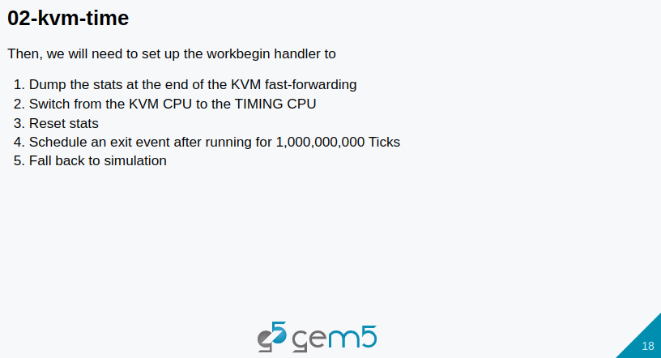
12.1 Gem5 Checkpoint: Slides
https://gem5bootcamp.github.io/2024/#02-Using-gem5/08-accelerating-simulation
Gem5 Checkpoint: Slides

Slide 20
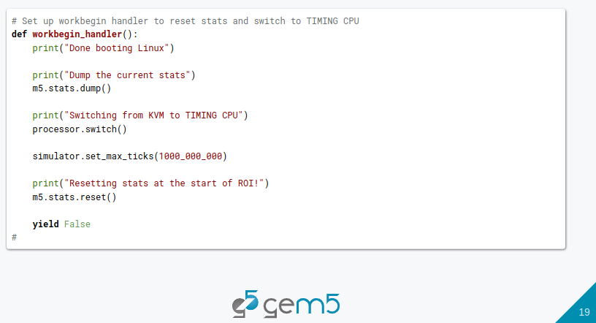
12.1 Gem5 Checkpoint: Slides
https://gem5bootcamp.github.io/2024/#02-Using-gem5/08-accelerating-simulation
Gem5 Checkpoint: Slides

Slide 21
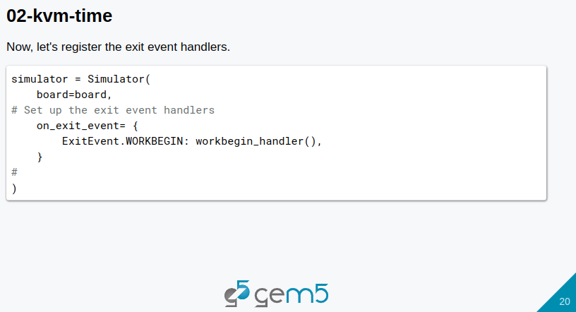
12.1 Gem5 Checkpoint: Slides
https://gem5bootcamp.github.io/2024/#02-Using-gem5/08-accelerating-simulation
Gem5 Checkpoint: Slides

Slide 22
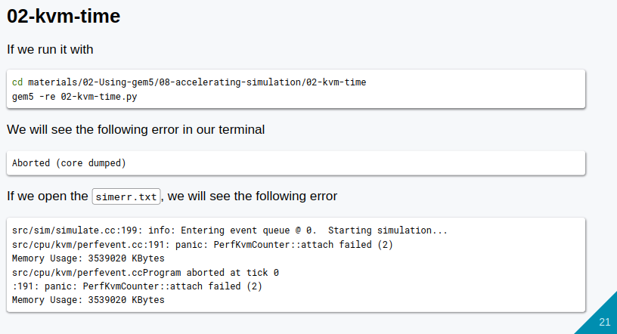
12.1 Gem5 Checkpoint: Slides
https://gem5bootcamp.github.io/2024/#02-Using-gem5/08-accelerating-simulation
Gem5 Checkpoint: Slides

Slide 23
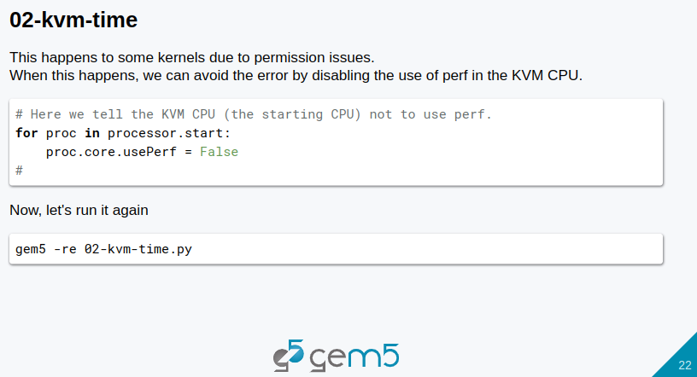
12.1 Gem5 Checkpoint: Slides
https://gem5bootcamp.github.io/2024/#02-Using-gem5/08-accelerating-simulation
Gem5 Checkpoint: Slides

Slide 24
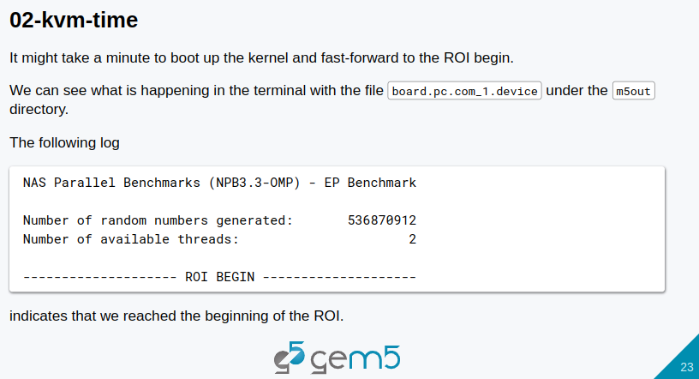
12.1 Gem5 Checkpoint: Slides
https://gem5bootcamp.github.io/2024/#02-Using-gem5/08-accelerating-simulation
Gem5 Checkpoint: Slides

Slide 25
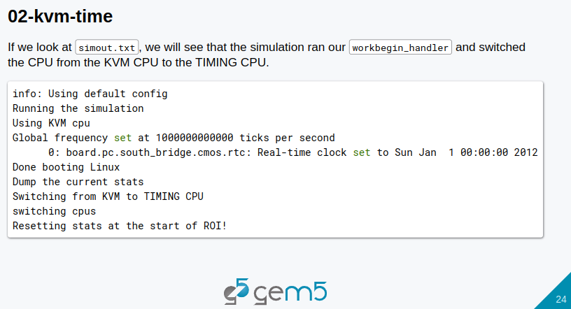
12.1 Gem5 Checkpoint: Slides
https://gem5bootcamp.github.io/2024/#02-Using-gem5/08-accelerating-simulation
Gem5 Checkpoint: Slides

Slide 26
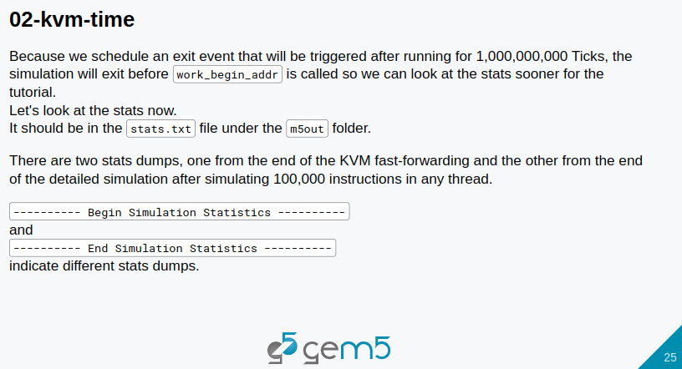
12.1 Gem5 Checkpoint: Slides
https://gem5bootcamp.github.io/2024/#02-Using-gem5/08-accelerating-simulation
Gem5 Checkpoint: Slides

Slide 27
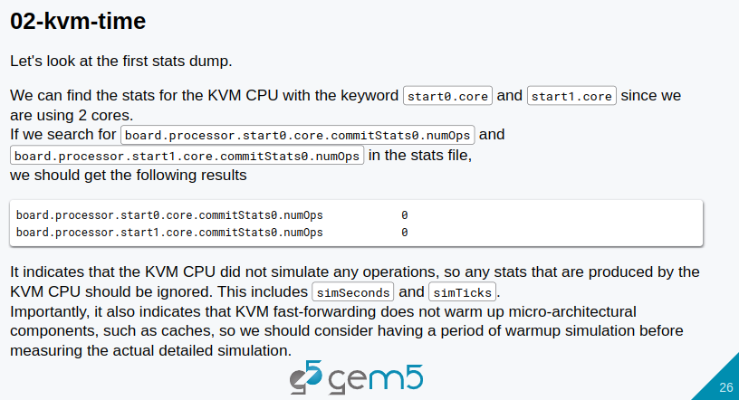
12.1 Gem5 Checkpoint: Slides
https://gem5bootcamp.github.io/2024/#02-Using-gem5/08-accelerating-simulation
Gem5 Checkpoint: Slides

Slide 28
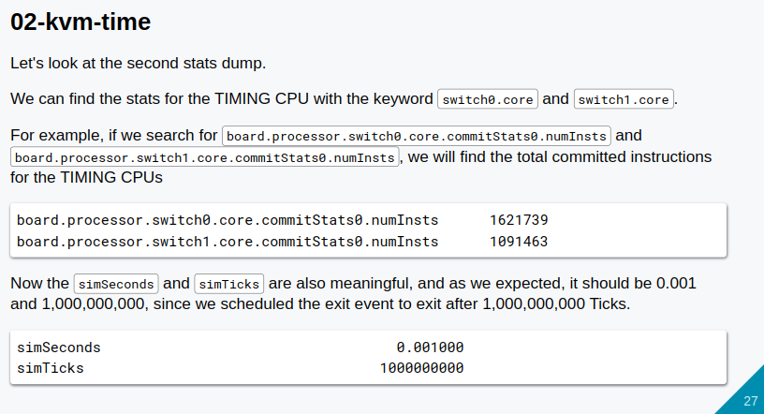
12.1 Gem5 Checkpoint: Slides
https://gem5bootcamp.github.io/2024/#02-Using-gem5/08-accelerating-simulation
Gem5 Checkpoint: Slides

Slide 29
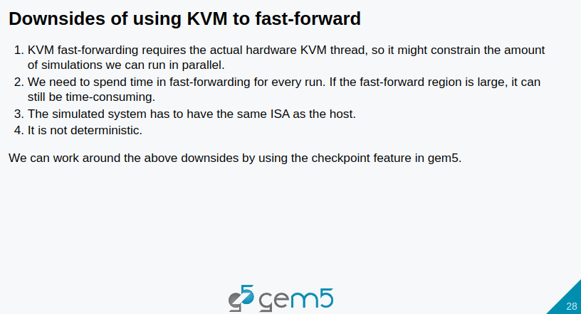
12.1 Gem5 Checkpoint: Slides
https://gem5bootcamp.github.io/2024/#02-Using-gem5/08-accelerating-simulation
Gem5 Checkpoint: Slides

Slide 30

12.1 Gem5 Checkpoint: Slides
https://gem5bootcamp.github.io/2024/#02-Using-gem5/08-accelerating-simulation
Gem5 Checkpoint: Slides

Slide 31
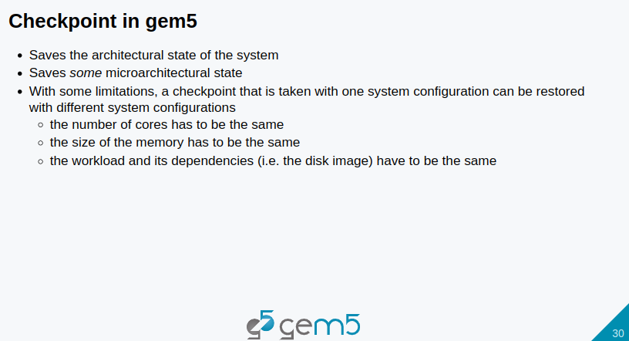
12.1 Gem5 Checkpoint: Slides
https://gem5bootcamp.github.io/2024/#02-Using-gem5/08-accelerating-simulation
Gem5 Checkpoint: Slides

Slide 32
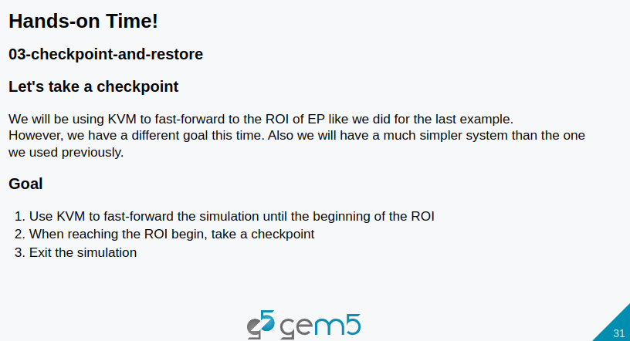
12.1 Gem5 Checkpoint: Slides
https://gem5bootcamp.github.io/2024/#02-Using-gem5/08-accelerating-simulation
Gem5 Checkpoint: Slides

Slide 33
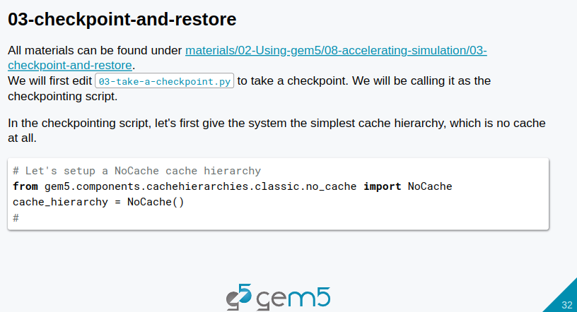
12.1 Gem5 Checkpoint: Slides
https://gem5bootcamp.github.io/2024/#02-Using-gem5/08-accelerating-simulation
Gem5 Checkpoint: Slides

Slide 34
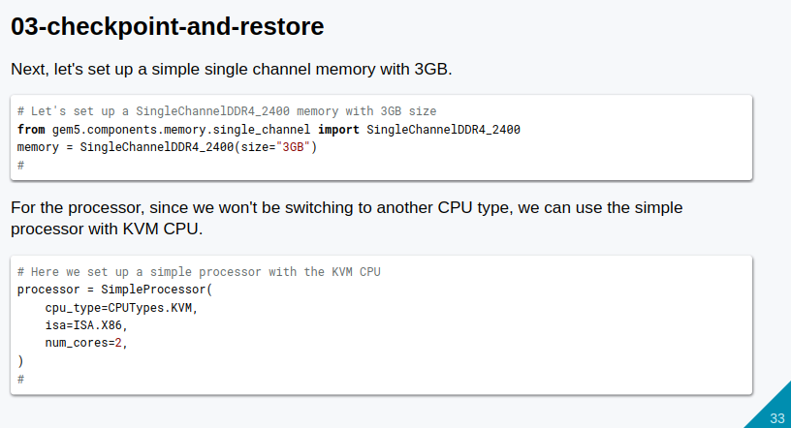
12.1 Gem5 Checkpoint: Slides
https://gem5bootcamp.github.io/2024/#02-Using-gem5/08-accelerating-simulation
Gem5 Checkpoint: Slides

Slide 35
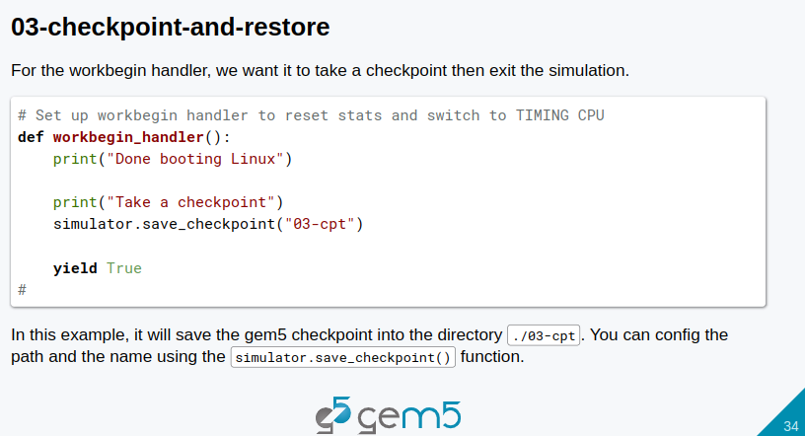
12.1 Gem5 Checkpoint: Slides
https://gem5bootcamp.github.io/2024/#02-Using-gem5/08-accelerating-simulation
Gem5 Checkpoint: Slides

Slide 36
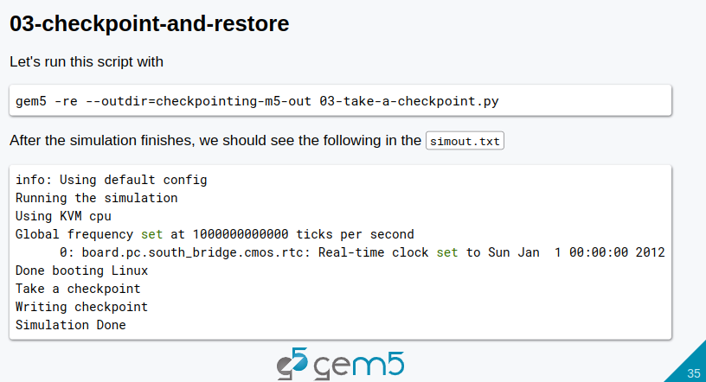
12.1 Gem5 Checkpoint: Slides
https://gem5bootcamp.github.io/2024/#02-Using-gem5/08-accelerating-simulation
Gem5 Checkpoint: Slides

Slide 37
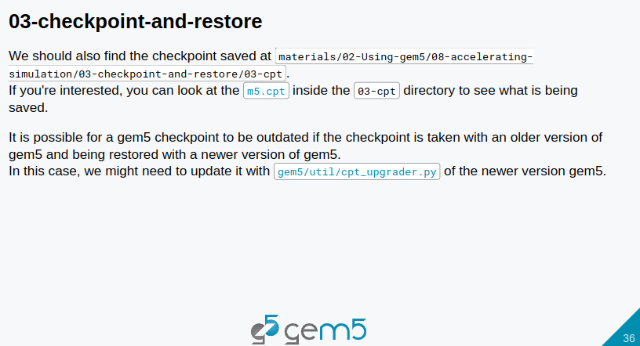
12.1 Gem5 Checkpoint: Slides
https://gem5bootcamp.github.io/2024/#02-Using-gem5/08-accelerating-simulation
Gem5 Checkpoint: Slides

Slide 38
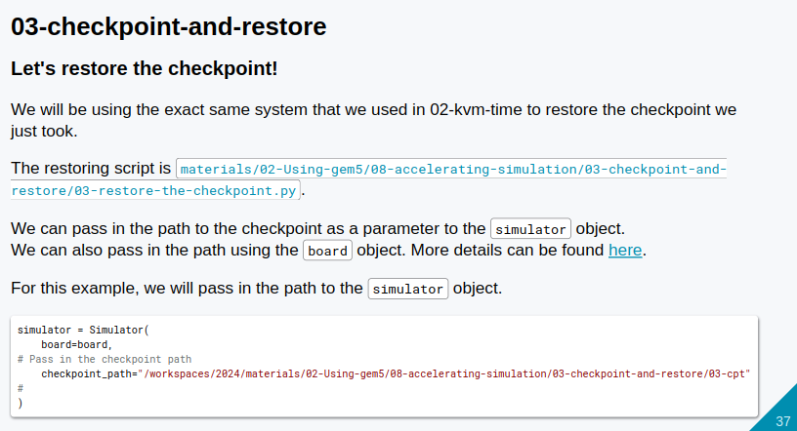
12.1 Gem5 Checkpoint: Slides
https://gem5bootcamp.github.io/2024/#02-Using-gem5/08-accelerating-simulation
Gem5 Checkpoint: Slides

Slide 39
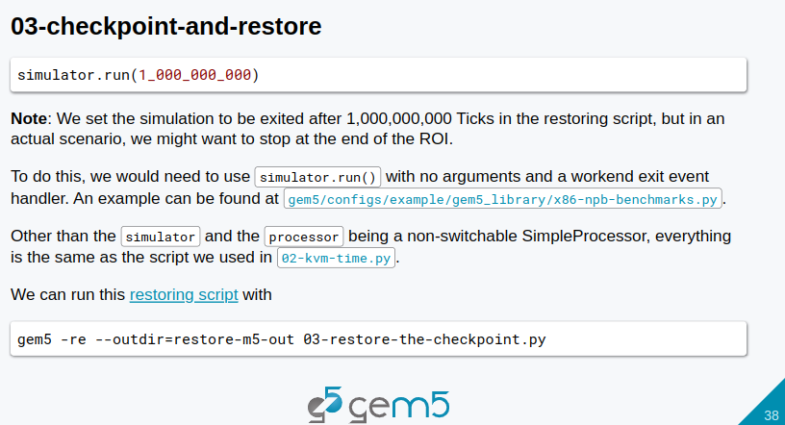
12.1 Gem5 Checkpoint: Slides
https://gem5bootcamp.github.io/2024/#02-Using-gem5/08-accelerating-simulation
Gem5 Checkpoint: Slides

Slide 40
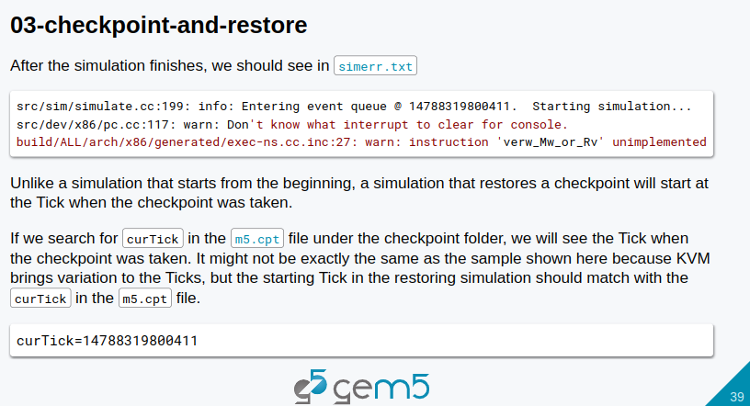
12.1 Gem5 Checkpoint: Slides
https://gem5bootcamp.github.io/2024/#02-Using-gem5/08-accelerating-simulation
Gem5 Checkpoint: Slides

Slide 41
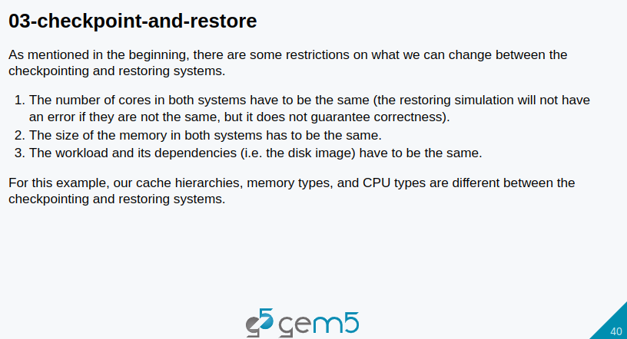
12.1 Gem5 Checkpoint: Slides
https://gem5bootcamp.github.io/2024/#02-Using-gem5/08-accelerating-simulation
Gem5 Checkpoint: Slides

Slide 42
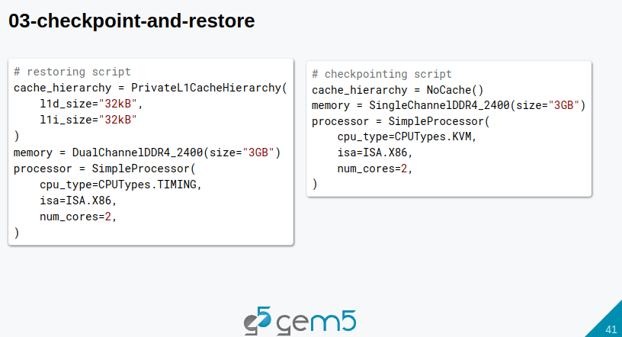
12.1 Gem5 Checkpoint: Slides
https://gem5bootcamp.github.io/2024/#02-Using-gem5/08-accelerating-simulation
Gem5 Checkpoint: Slides

Slide 43
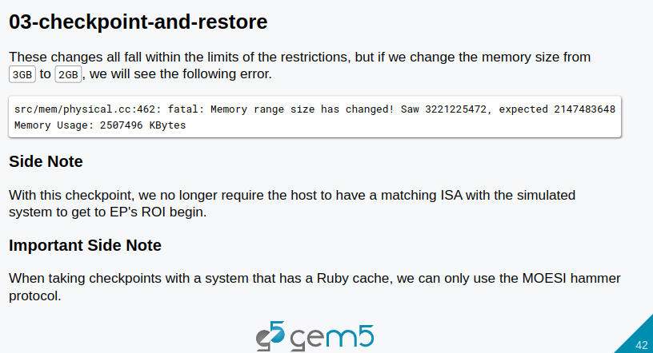
12.1 Gem5 Checkpoint: Slides
https://gem5bootcamp.github.io/2024/#02-Using-gem5/08-accelerating-simulation
Gem5 Checkpoint: Slides

Slide 44
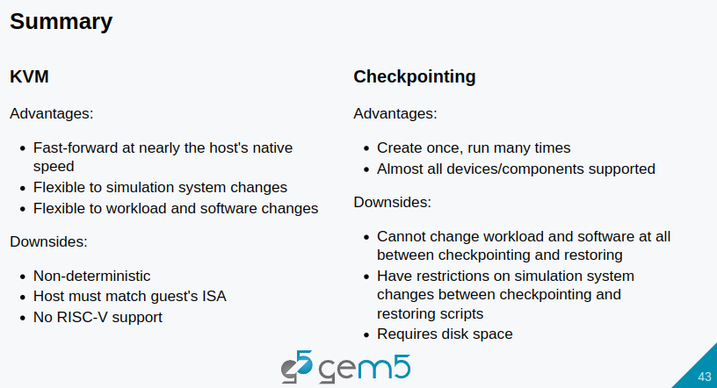
12.1 Gem5 Checkpoint: Slides
https://gem5bootcamp.github.io/2024/#02-Using-gem5/08-accelerating-simulation
Gem5 Checkpoint: Slides

Slide 45
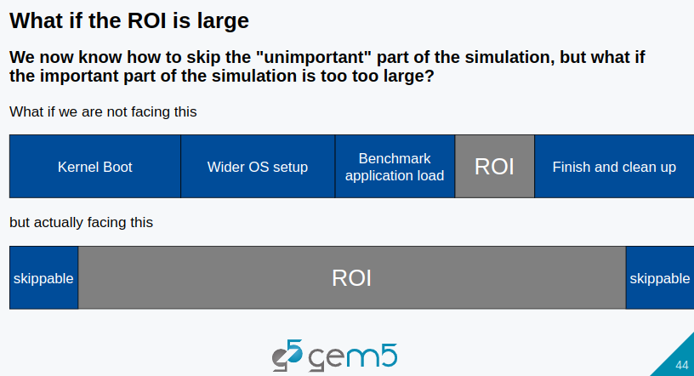
12.1 Gem5 Checkpoint: Slides
https://gem5bootcamp.github.io/2024/#02-Using-gem5/08-accelerating-simulation
Gem5 Checkpoint: Slides

Slide 46
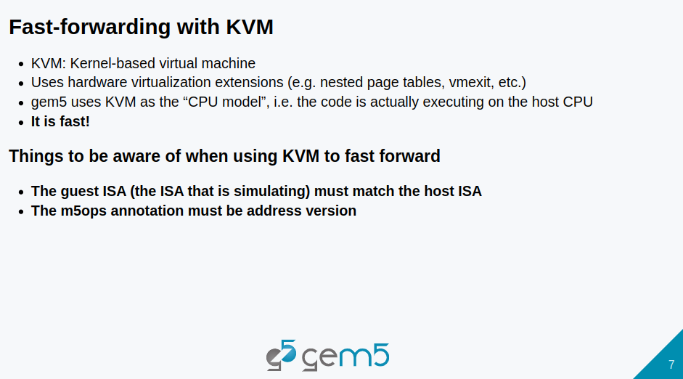
12.1 Gem5 Checkpoint: Slides
https://gem5bootcamp.github.io/2024/#02-Using-gem5/08-accelerating-simulation
Gem5 Checkpoint: Slides

Slide 47
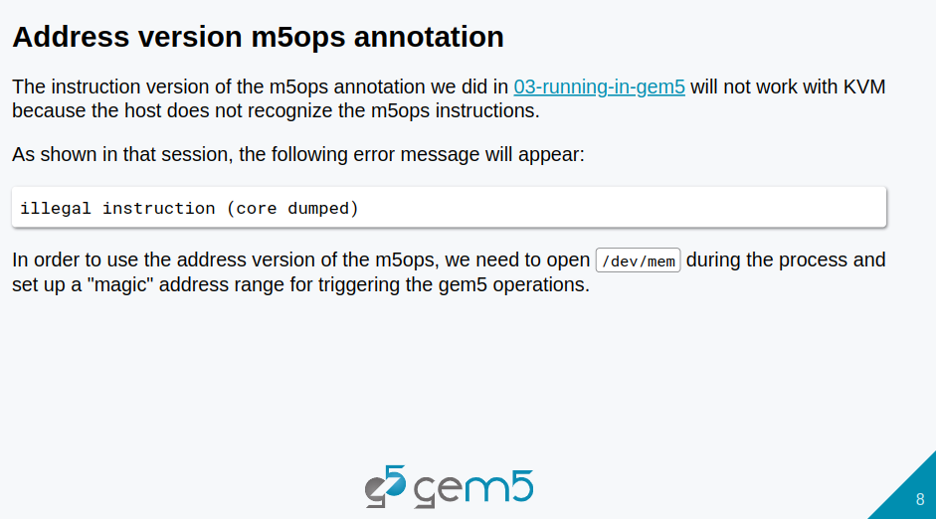
12.1 Gem5 Checkpoint: Slides
https://gem5bootcamp.github.io/2024/#02-Using-gem5/08-accelerating-simulation
Gem5 Checkpoint: Slides

Slide 48
End

