Slide 1

3 SimObject
Peter H. Chen

Slide 2
3.0 SimObject Topics
https://www.youtube.com/watch?v=xl89tA-LnuQ&list=PL_hVbFs_loVR_8ntTTmmG6YEq3Po_4snu&index=3
SimObject Topics (0:00-0:01/16:37)
1. Gem5 has high level interface is Python and low-level library in C++.
2. Both Python and C++ are Object-Oriented Programming Languages.
3. Gem5 has a lot of built in libraries.
4. Gem5 contains Objects to model components of a computer System
5. Gem5 Parameters are objects to connect computer system components.

Slide 3
3.1 SimObject OOD

Slide 4
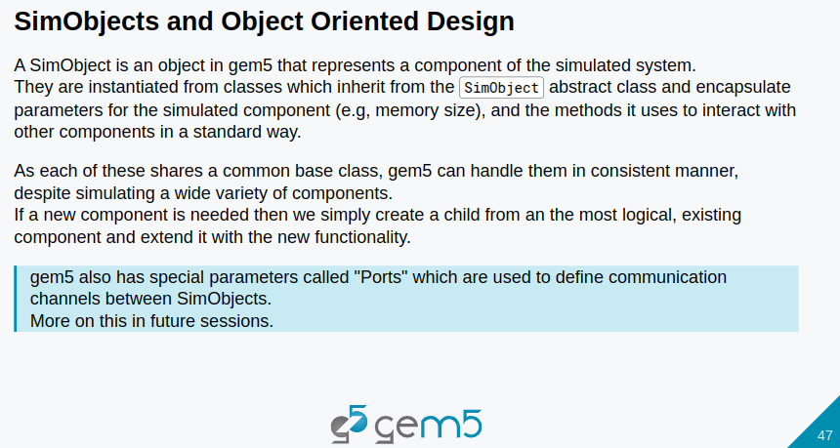
3.1 SimObject OOD
https://www.youtube.com/watch?v=xl89tA-LnuQ&list=PL_hVbFs_loVR_8ntTTmmG6YEq3Po_4snu&index=3
SimObject OOD (0:02-0:30/16:37)
We started at page 47: SimObjects and Object Oriented Design.

Slide 5
3.1 SimObject OOD
https://www.youtube.com/watch?v=xl89tA-LnuQ&list=PL_hVbFs_loVR_8ntTTmmG6YEq3Po_4snu&index=3
SimObject (0:31-1:00/16:37)
1. SimObject is an object in Gem5. SimObject represents our component in the Simulated system.
2, Gem5 are not very consistent with terminology. Gem5 object, sometimes called models, sometimes refer to SimObject. Both Models and SimObject are components in Gem5.

Slide 6
3.1 SimObject OOD
https://www.youtube.com/watch?v=xl89tA-LnuQ&list=PL_hVbFs_loVR_8ntTTmmG6YEq3Po_4snu&index=3
SimObject (1:01-2:00/16:37)
3.SimObject are components from Gem5 classes. They are used to encapsulate the data and methods of SimObject which are used in Gem5 Simulator to simulate architectural system.
4. For example, we have cache SimObject. It has cache parameter, such as, size in the CU (Computer Unit).

Slide 7
3.1 SimObject OOD
https://www.youtube.com/watch?v=xl89tA-LnuQ&list=PL_hVbFs_loVR_8ntTTmmG6YEq3Po_4snu&index=3
SimObject (2:01-2:23/16:37)
5. We pass in parameter to the component SimObject. SimObject has the common SimObject base class.
6. All the class derived from SimObject class has the same manner of the abstract base class,
7. The parameters defined communication between the sub objects,.

Slide 8
3.2 SimObject Example

Slide 9
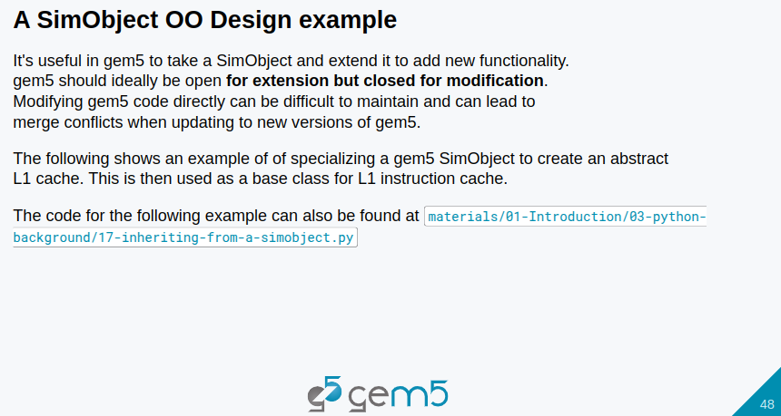
3.2 SimObject Example
https://www.youtube.com/watch?v=xl89tA-LnuQ&list=PL_hVbFs_loVR_8ntTTmmG6YEq3Po_4snu&index=3
SimObject Example (2:24-2:56/16:37)
1. In Gem5, it is useful to take a SimObject ane extend it to add new functionality to Gem5.
2. The OOD (Object Oriented Design) philosophy give us to add functionality to the inherited class without modifying the base class.

Slide 10
3.2 SimObject Example
https://www.youtube.com/watch?v=xl89tA-LnuQ&list=PL_hVbFs_loVR_8ntTTmmG6YEq3Po_4snu&index=3
SimObject Example (2:57-3:24/16:37)
1. We create a new class which inherit from the base class.
2. We make changes whatever we want to do.

Slide 11
3.2 SimObject Example
https://www.youtube.com/watch?v=xl89tA-LnuQ&list=PL_hVbFs_loVR_8ntTTmmG6YEq3Po_4snu&index=3
SimObject Example (3:25-3:50/16:37)
1. For example, we create a new class called myCache base on class Cache. We will only modify the class myCache. We will not modify the base class Cache.

Slide 12
3.3 SimObject Code: __init__()

Slide 13
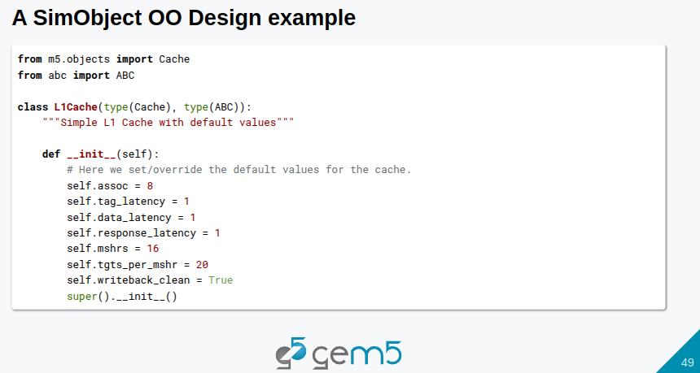
3.3 SimObject Code: __init__()
https://www.youtube.com/watch?v=xl89tA-LnuQ&list=PL_hVbFs_loVR_8ntTTmmG6YEq3Po_4snu&index=3
SimObject Code: __init__() (3:51-4:44/16:37)
1. Below, we define the new Python abstract base class called L1Cache().
2. In Python, we inherit (by argument passing) two classes: class Cache and base class ABC.

Slide 14
3.3 SimObject Code: __init__()
https://www.youtube.com/watch?v=xl89tA-LnuQ&list=PL_hVbFs_loVR_8ntTTmmG6YEq3Po_4snu&index=3
SimObject Code: __init__() (4:45-5:20/16:37)
1. Here, we have a new class L1Cache.
2. We have new class L1Cache() with properties of the parent base class Cache and based class ABC.

Slide 15
3.3 SimObject Code: __init__()
https://www.youtube.com/watch?v=xl89tA-LnuQ&list=PL_hVbFs_loVR_8ntTTmmG6YEq3Po_4snu&index=3
SimObject Code: __init__() (5:21-5:30/16:37)
1. The constructor __init__() overwrite the values of the base class Cache and base class ABC.

Slide 16
3.3 SimObject Code: __init__()
https://www.youtube.com/watch?v=xl89tA-LnuQ&list=PL_hVbFs_loVR_8ntTTmmG6YEq3Po_4snu&index=3
SimObject Code: __init__() (5:31-5:32/16:37)
1. The override properties are assoc, tag latency, date latency, response latency, mshrs, targets per mshr.
Q: What is MSHRS in Gem5?
Ans: MSHRS (Miss Status Handling Registers)
Q: What is tgts in Gem5?
Ans: tgts (Targets)

Slide 17
3.3 SimObject Code: __init__()
https://www.youtube.com/watch?v=xl89tA-LnuQ&list=PL_hVbFs_loVR_8ntTTmmG6YEq3Po_4snu&index=3
SimObject Code: __init__() (5:33-5:40/16:37)
Finally, we call parent __init__() by super().__init__()
1. to inherit parent class into child class and
2. the override the parent data into child data.

Slide 18
3.4 Extend Functionality

Slide 19
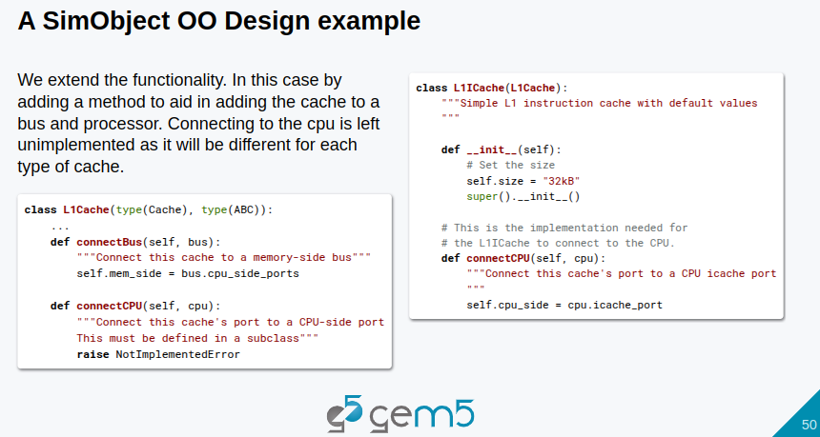
3.4 Extend Functionality
https://www.youtube.com/watch?v=xl89tA-LnuQ&list=PL_hVbFs_loVR_8ntTTmmG6YEq3Po_4snu&index=3
Extend Functionality (5:41-7:32/16:37)
1. We extend the functionality in the inherited class,
2. Below, we add cache for bus and processor.
3. Since the cache need to connect CPU and Bus, we add the methods connectCPU () and connectBus () to L1Cache class..

Slide 20
3.5 Module m5

Slide 21
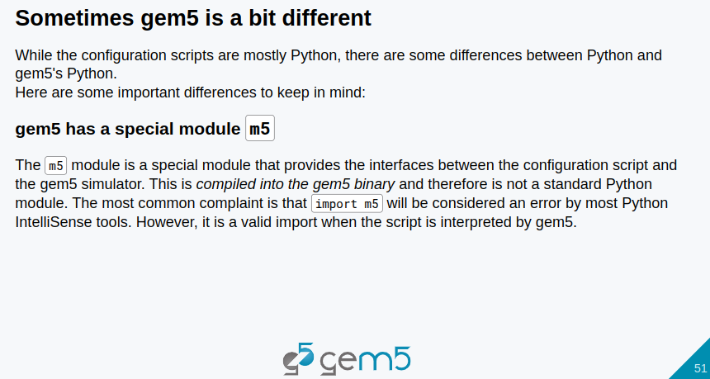
3.5 Module m5
https://www.youtube.com/watch?v=xl89tA-LnuQ&list=PL_hVbFs_loVR_8ntTTmmG6YEq3Po_4snu&index=3
Module m5 (7:33-8:53/16:37)
In Gem5 code, first, we import gem5 m5.
Gem5 has a special module m5 which provide the interface between the environment configuration and gem5 simulator.
The m5 module is not a standard python module. The Python will complain with error if the gem5 modules are not there.

Slide 22
3.6 SimObject Parameter

Slide 23
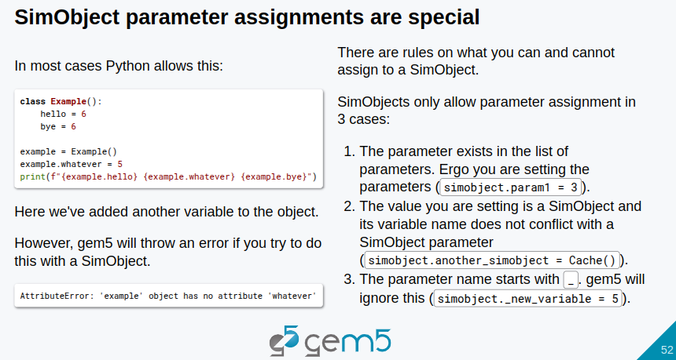
3.6 SimObject Parameter
https://www.youtube.com/watch?v=xl89tA-LnuQ&list=PL_hVbFs_loVR_8ntTTmmG6YEq3Po_4snu&index=3
SimObject Parameter (8:54-11:29/16:37)
Gem5 object parameter assignment is similar to Python parameter assignment.
1. Assign value object: For exmaple. simobject.param1 = 3
2. Assign method object: For example, simobject.param2 = Cache()
3. Gem5 ignore private parameter (_parameter) assignment: simobject._private_param3 = 5 will not assign.

Slide 24
3.7 SimObject Port

Slide 25
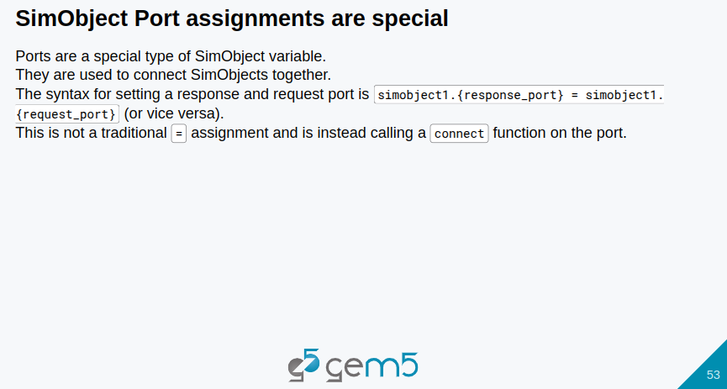
3.7 SimObject Port
https://www.youtube.com/watch?v=xl89tA-LnuQ&list=PL_hVbFs_loVR_8ntTTmmG6YEq3Po_4snu&index=3
SimObject Port (11:30-13:25/16:37)
1. Port are special type of SImObject variable.
2. Port are used to connect SimObjects together. Port Xs are connected to Port Ys.
3. Syntax: simobject1.{response_port} = simobject1{request_port}

Slide 26
3.8 SimObject Vector

Slide 27
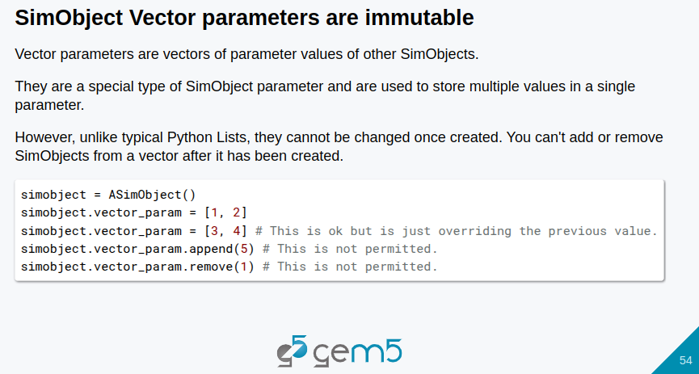
3.8 SimObject Vector
https://www.youtube.com/watch?v=xl89tA-LnuQ&list=PL_hVbFs_loVR_8ntTTmmG6YEq3Po_4snu&index=3
SimObject Vector (13:26-14:01/16:37)
1. SimObject Vector Parameters are immutable.
2. Vector parameters are vector of parameter values of other SimObjects.
3. Vector Parameters are immutable. We cannot not use append and remove to change the vector parameters.

Slide 28
3.9 Immutable Vector Parameter

Slide 29
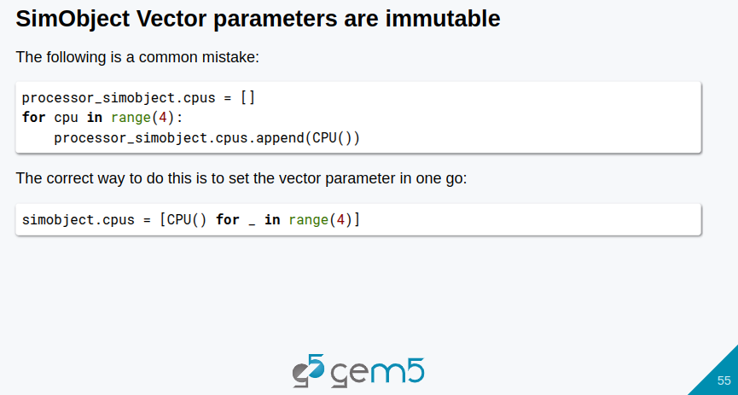
3.9 Immutable Vector Parameter
https://www.youtube.com/watch?v=xl89tA-LnuQ&list=PL_hVbFs_loVR_8ntTTmmG6YEq3Po_4snu&index=3
Immutable Vector Parameter (14:02-14:40/16:37)
1. We can loop the Vector Parameter
2. We cannot change the vector parameter.

Slide 30
3.10 Immutable SimObject

Slide 31
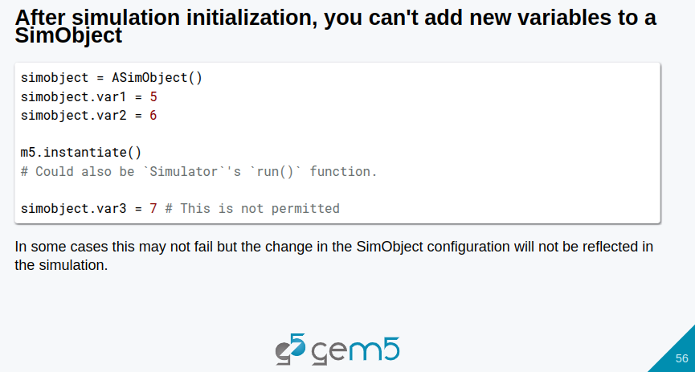
3.10 Immutable SimObject
https://www.youtube.com/watch?v=xl89tA-LnuQ&list=PL_hVbFs_loVR_8ntTTmmG6YEq3Po_4snu&index=3
Immutable SimObject (14:41-15:55/16:37)
1. SimObject is immutable.
2. After initialization, we cannot add new variable.

Slide 32
3.11 Summary

Slide 33
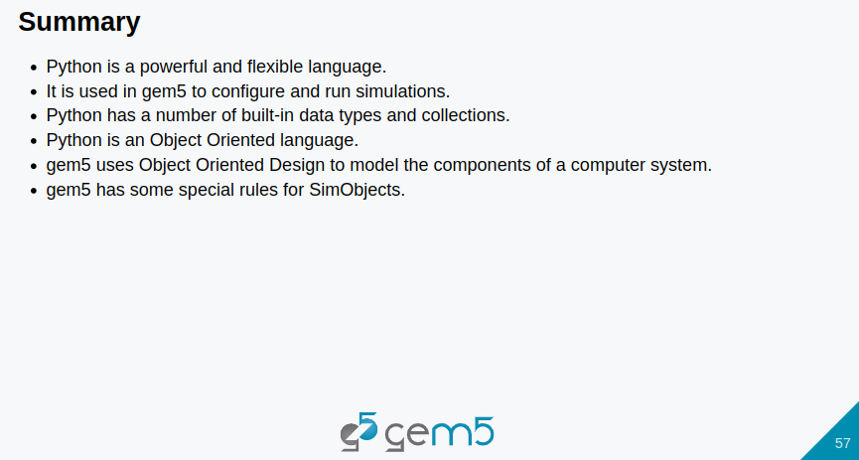
3.11 Summary
https://www.youtube.com/watch?v=xl89tA-LnuQ&list=PL_hVbFs_loVR_8ntTTmmG6YEq3Po_4snu&index=3
Summary (15:56-16:37/16:37)
1. Gem5 has high level interface is Python and low-level library in C++.
2. Both Python and C++ are Object-Oriented Programming Languages.
3. Gem5 has a lot of built in libraries.
4. Gem5 contains Objects to model components of a computer System
5. Gem5 Parameters are objects to connect computer system components.

Slide 34
End

