Slide 1

20 Model Core
Peter H. Chen

Slide 2
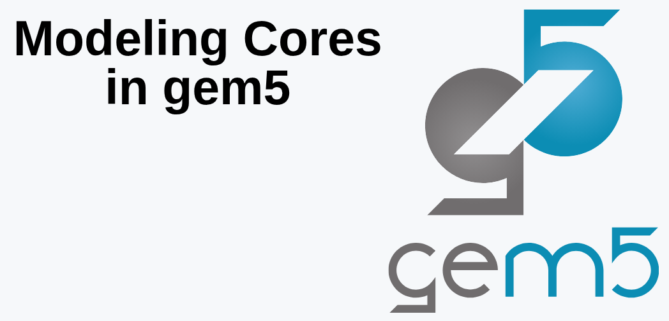
20 Model Core
https://www.youtube.com/watch?v=eM8FHTuu80c&list=PL_hVbFs_loVR_8ntTTmmG6YEq3Po_4snu&index=20
Model Core (0:00-1:00/1:15:39)
We talk about the Model Core.
We will talk how to implement ISA (Instruction Set Architecture) instructions and how we model some of CPU cores (Not model all of CPU core) in Gem5. To model CPU cores are a complicated tasks. We only provide the enough information for you to do CPU Core modeling.

Slide 3
20.0 Topics

Slide 4
20.0 Topics
https://www.youtube.com/watch?v=eM8FHTuu80c&list=PL_hVbFs_loVR_8ntTTmmG6YEq3Po_4snu&index=20
Model Core (1:01-1:05/1:15:39)
1. Introduction of CPU Core Modeling implementation
2. What is ISA (Instruction Set Architecture)?

Slide 5
20.1 What is ISA?

Slide 6
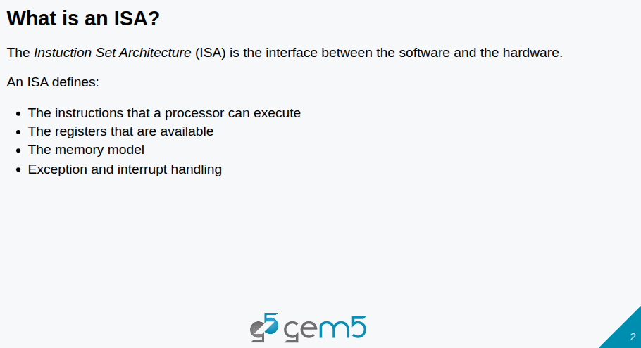
20.1 What is ISA?
https://www.youtube.com/watch?v=eM8FHTuu80c&list=PL_hVbFs_loVR_8ntTTmmG6YEq3Po_4snu&index=20
What is ISA (1:06-1:45/1:15:39)
1. What is ISA (Instruction Set Architecture)? ISA defines:
  Instructions for CPU execution
  Registers
  Memory Model
  Exception and Interrupt handling.
2. We are going to focus on implementation of Gem5.

Slide 7
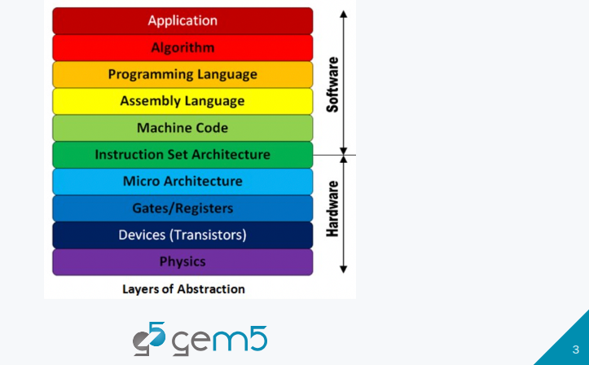
20.1 What is ISA?
https://www.youtube.com/watch?v=eM8FHTuu80c&list=PL_hVbFs_loVR_8ntTTmmG6YEq3Po_4snu&index=20
What is ISA (1:46-1:50/1:15:39)
Below, we have Layers of Abstraction from Hardware to Software. We will talk later on.

Slide 8
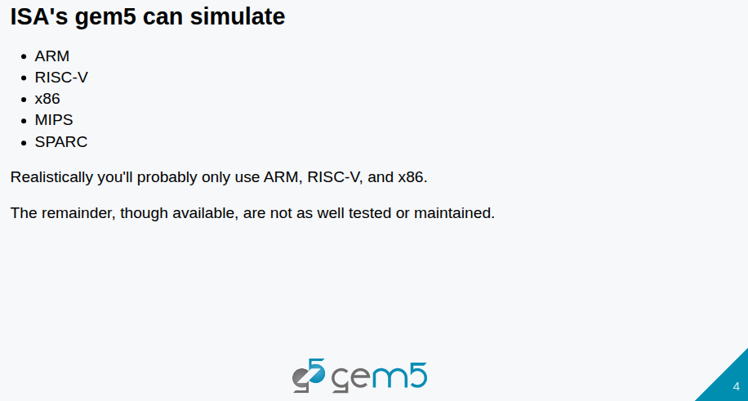
20.1 What is ISA?
https://www.youtube.com/watch?v=eM8FHTuu80c&list=PL_hVbFs_loVR_8ntTTmmG6YEq3Po_4snu&index=20
What is ISA (1:51-2:35/1:15:39)
In Gem5, we simulate the ARM ISA, RISC-V ISA,X86 ISA, MIPS ISA, and SPARC ISA.
In real world, we only use ARM ISA, RISC-V ISA, and X86 ISA.
Others, such as, MIPS ISA and SPARC ISA are not well implemented, tested, and maintained.

Slide 9
20.2 ISA/CPU Independence

Slide 10
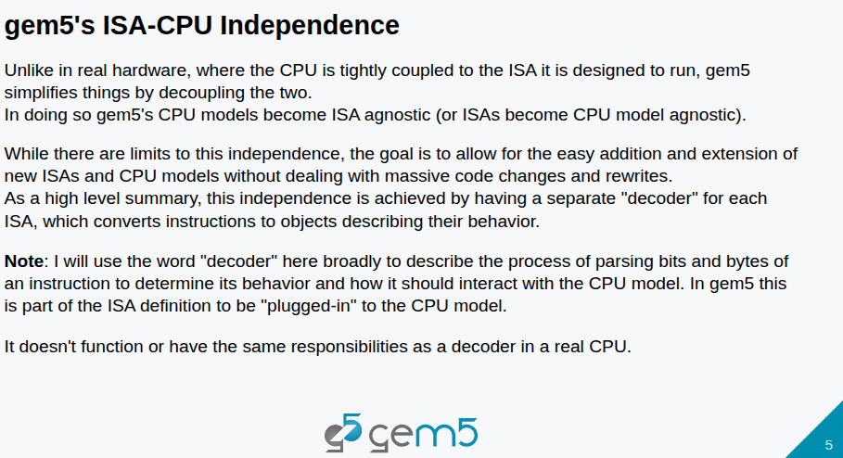
20.2 ISA/CPU Independence
https://www.youtube.com/watch?v=eM8FHTuu80c&list=PL_hVbFs_loVR_8ntTTmmG6YEq3Po_4snu&index=20
ISA/CPU Independence (2:36-4:50/1:15:39)
In real word, CPU and ISA are tightly coupled together.
In Gem5, ISA and CPU are completely decoupled concepts.
When we pick up the ISA. We have to pick CPU is 3O (Out-of -Order). CPU and ISA are totally agnostic each other. The totally don’t know each other.
For each ISA (Instruction Set Architecture), they are decoders. Gem5 converts instructions to objects to describes the instruction behavior.
The ISA is defined, we plug the ISA into the CPU Model.

Slide 11
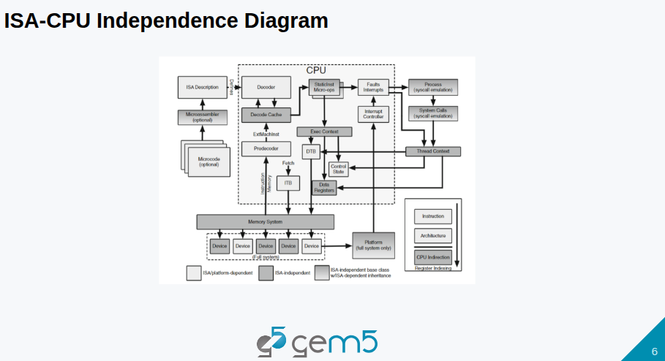
20.2 ISA/CPU Independence
https://www.youtube.com/watch?v=eM8FHTuu80c&list=PL_hVbFs_loVR_8ntTTmmG6YEq3Po_4snu&index=20
ISA/CPU Independence (4:51-5:20/1:15:39)
Below is ISA and CPU Independence Diagram. It is very complicated diagram.
1. In the diagram, we implement the decoder at the top based on ISA (Instruction Set Architecture) description and other functions are derived from the top ISA.
1

Slide 12
20.2 ISA/CPU Independence
https://www.youtube.com/watch?v=eM8FHTuu80c&list=PL_hVbFs_loVR_8ntTTmmG6YEq3Po_4snu&index=20
ISA/CPU Independence (5:21-5:40/1:15:39)
2. The static instructions will be derived and implemented into the detailed decoder functions. Then, we plug in the decoder into our CPU.
That is how we create a X-86, RISC-V, or ARM CPU model.
2

Slide 13
20.2 ISA/CPU Independence
https://www.youtube.com/watch?v=eM8FHTuu80c&list=PL_hVbFs_loVR_8ntTTmmG6YEq3Po_4snu&index=20
ISA/CPU Independence (5:31-6:05/1:15:39)
3. From here, we have Gem5 that we can process instructions simulation for the real world hardware.
3

Slide 14
20.3 StaticInst and DynamicInst

Slide 15
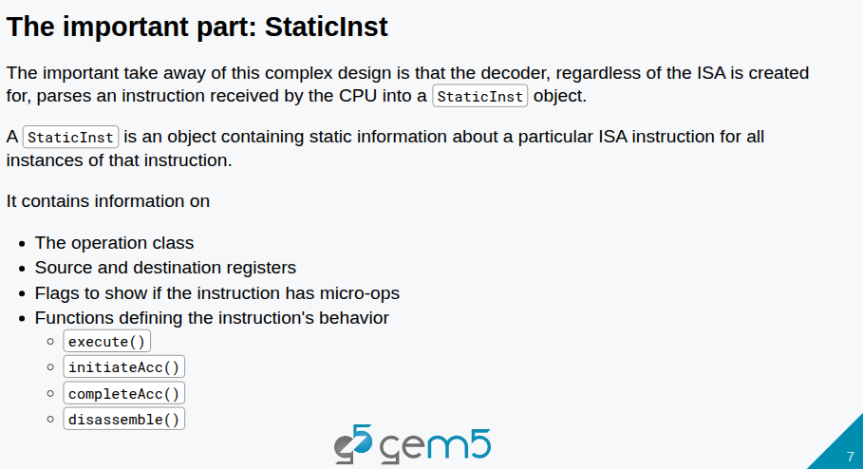
20.3 StaticInst and DynamicInst
https://www.youtube.com/watch?v=eM8FHTuu80c&list=PL_hVbFs_loVR_8ntTTmmG6YEq3Po_4snu&index=20
StaticInst and DynamicInst (6:06-6:30/1:15:39)
No matter what kind of ISA crated, we parses the instructions received by CPU into a static instruction object.
1. The instruction is an object containing starting information about a particular ISA instruction.
1

Slide 16
20.3 StaticInst and DynamicInst
https://www.youtube.com/watch?v=eM8FHTuu80c&list=PL_hVbFs_loVR_8ntTTmmG6YEq3Po_4snu&index=20
StaticInst and DynamicInst (6:31-7:20/1:15:39)
2. For all instances of that instruction contains information on
  the operation class
  Source and destination registers
  Flags for Micro operation
  Functions for instruction behavior, such as as execute(), initiateAcc(), completeAcc(), and disassemble()
2

Slide 17
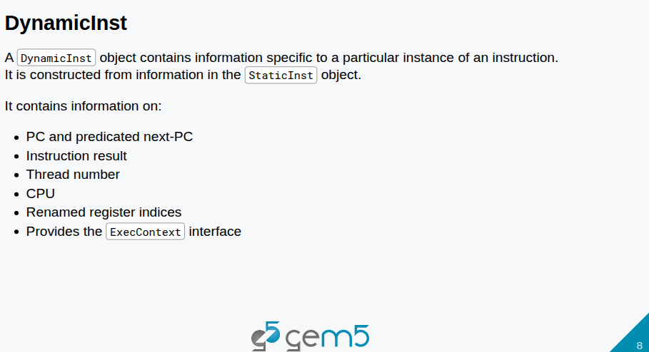
20.3 StaticInst and DynamicInst
https://www.youtube.com/watch?v=eM8FHTuu80c&list=PL_hVbFs_loVR_8ntTTmmG6YEq3Po_4snu&index=20
StaticInst and DynamicInst (7:21-7:45/1:15:39)
The class DynamicInst is implement for Dynamic Instruction Objects.
The dynamic object contains information for a particular instance.
These objects are constructed from information in the static instruction objects and they contain information on
1. PC and predicated next-PC.
2. instruction result
3. thread number
4. CPU
5. Renamed registers indices
6. Provides the ExecContext interface.

Slide 18
20.4 ExecContext

Slide 19
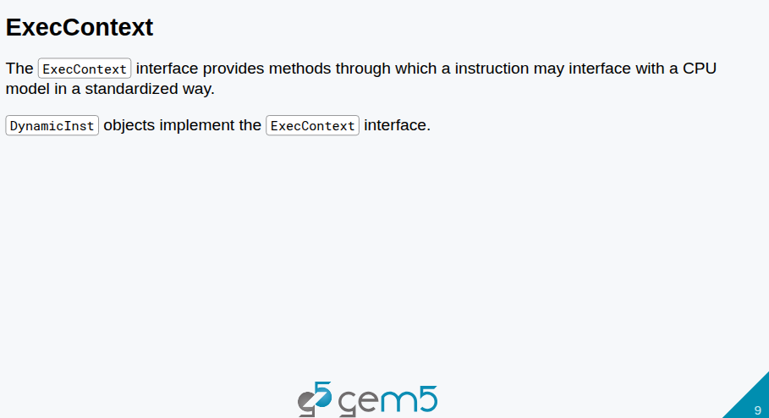
20.4 ExecContext
https://www.youtube.com/watch?v=eM8FHTuu80c&list=PL_hVbFs_loVR_8ntTTmmG6YEq3Po_4snu&index=20
ExecContext (7:46-8:50/1:15:39)
The ExecContext Interface provides methods to interface CPU Model in a standardized way.
The DynamicInst Object implement the interface for ExecContext().
When CPU received an instruction, the instruction is decoded into a static instruction. From there, there is a chain of events we can do to eventually execute our instructions in a standardized way.
The decoder chain is completely ISA agnostic (completely unknown by ISA). Every ISA received by the CPU can be cast into the static instruction object.
The ExecContext provides a standardized interface to the CPU model.

Slide 20
20.5 ISA Example

Slide 21
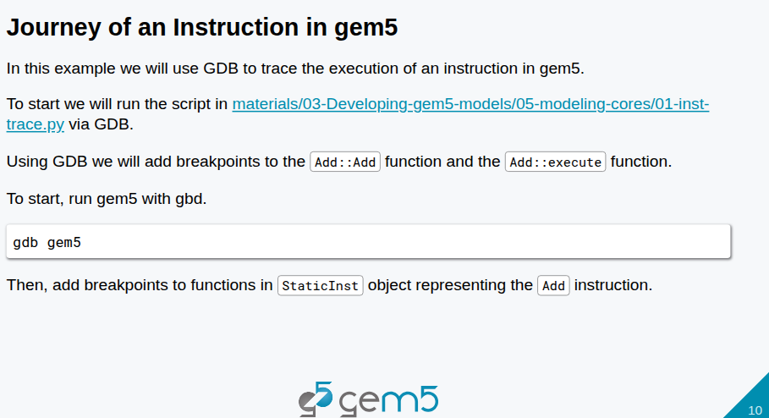
20.5 ISA Example
https://www.youtube.com/watch?v=eM8FHTuu80c&list=PL_hVbFs_loVR_8ntTTmmG6YEq3Po_4snu&index=20
ISA Example (8:51-9:30/1:15:39)
We will go through an ISA Example. In this example, we will use
> gdb gem5

Slide 22
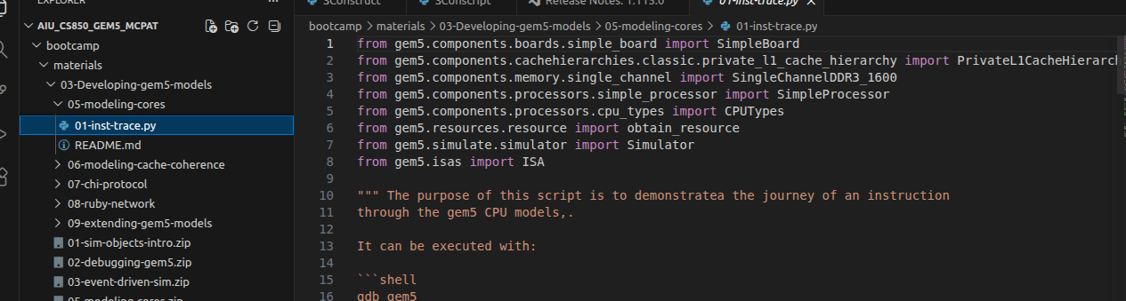
20.5 ISA Example
https://www.youtube.com/watch?v=eM8FHTuu80c&list=PL_hVbFs_loVR_8ntTTmmG6YEq3Po_4snu&index=20
ISA Example (9:31-9:35/1:15:39)
To trace the execution of an instruction in gem5. We look at
> ~materials.03-Developing-gem5-models/05-modeling-cores/01-inst-trace.py

Slide 23
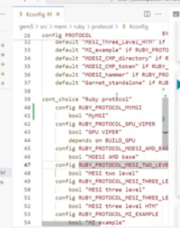
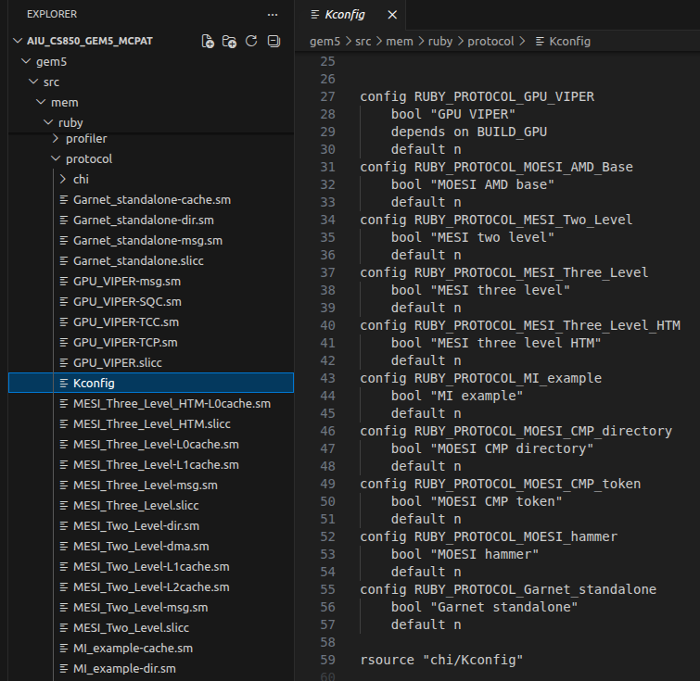
20.5 ISA Example
https://www.youtube.com/watch?v=eM8FHTuu80c&list=PL_hVbFs_loVR_8ntTTmmG6YEq3Po_4snu&index=20
ISA Example (9:36-9:40/1:15:39)
To trace the execution of an instruction in gem5. We look at
> ~gem5/src/mem/ruby/protocol/Kconfig
Kconfig (Kernel Configuration) Is Gem5 Kernel Configuration.
These are all configurations of gem5 for “RUBY_PROTOCOL_MESI_Two_Level”, “RUBY_PROTOCOL_MESI_Three_Level”, “RUBY_PROTOCOL_MESI_Three_Level_HTM”, etc.
MESI (Modified Exclusive Shred Invalid), HTM (Hardware Transactional Memory)

Slide 24
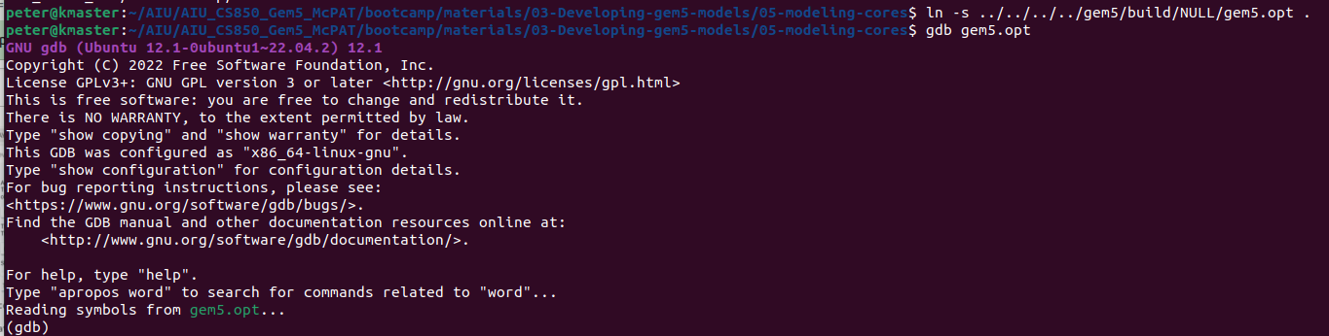
20.5 ISA Example
https://www.youtube.com/watch?v=eM8FHTuu80c&list=PL_hVbFs_loVR_8ntTTmmG6YEq3Po_4snu&index=20
ISA Example (9:41-10:00/1:15:39)
>cd ~materials.03-Developing-gem5-models/05-modeling-cores/
> ln -s <path>/gem5/build/NULL/gem5.opt .
> gdb gem5.opt
# “gem5.opt” is the optimized version without debugging symbols. We need to compiled with symbolic debugger information.

Slide 25
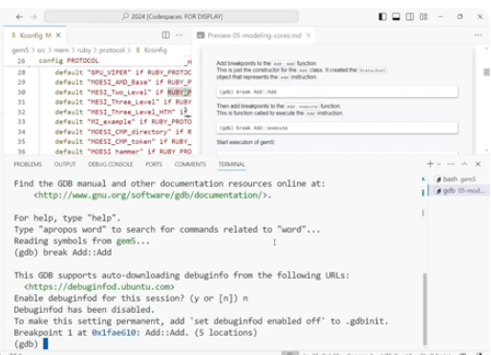
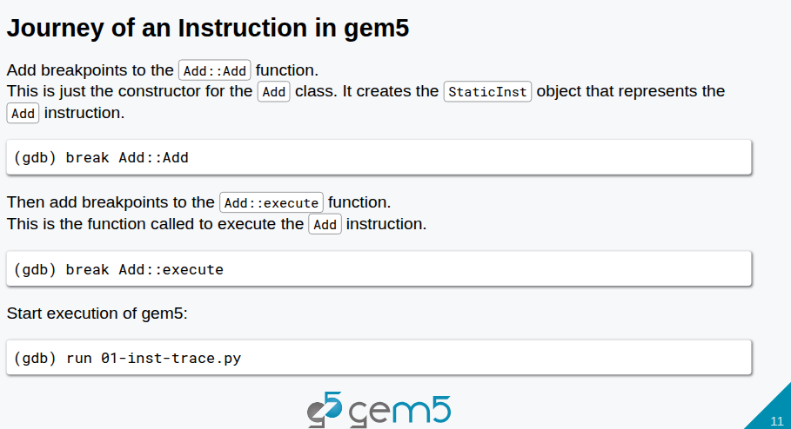
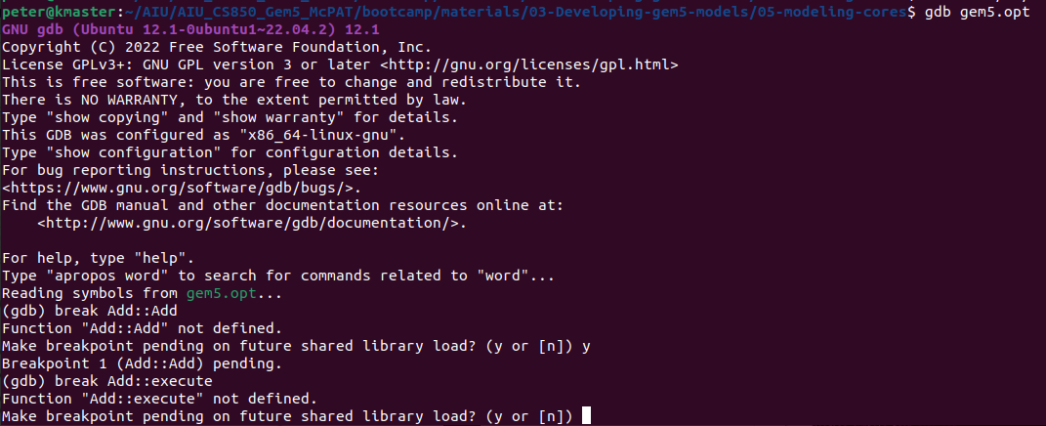
20.5 ISA Example
https://www.youtube.com/watch?v=eM8FHTuu80c&list=PL_hVbFs_loVR_8ntTTmmG6YEq3Po_4snu&index=20
ISA Example (10:01-12:00/1:15:39)
>cd ~materials.03-Developing-gem5-models/05-modeling-cores
> break Add::Add
> break Add::execute

Slide 26
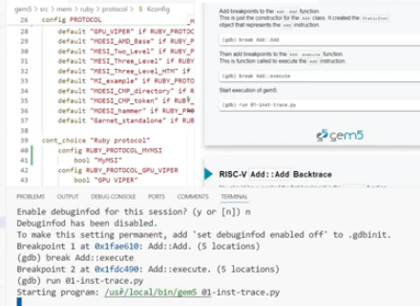
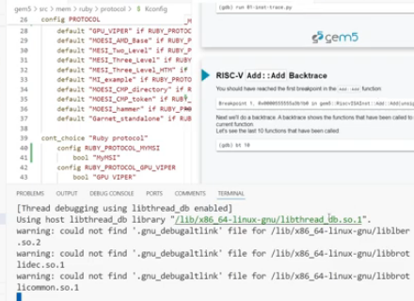
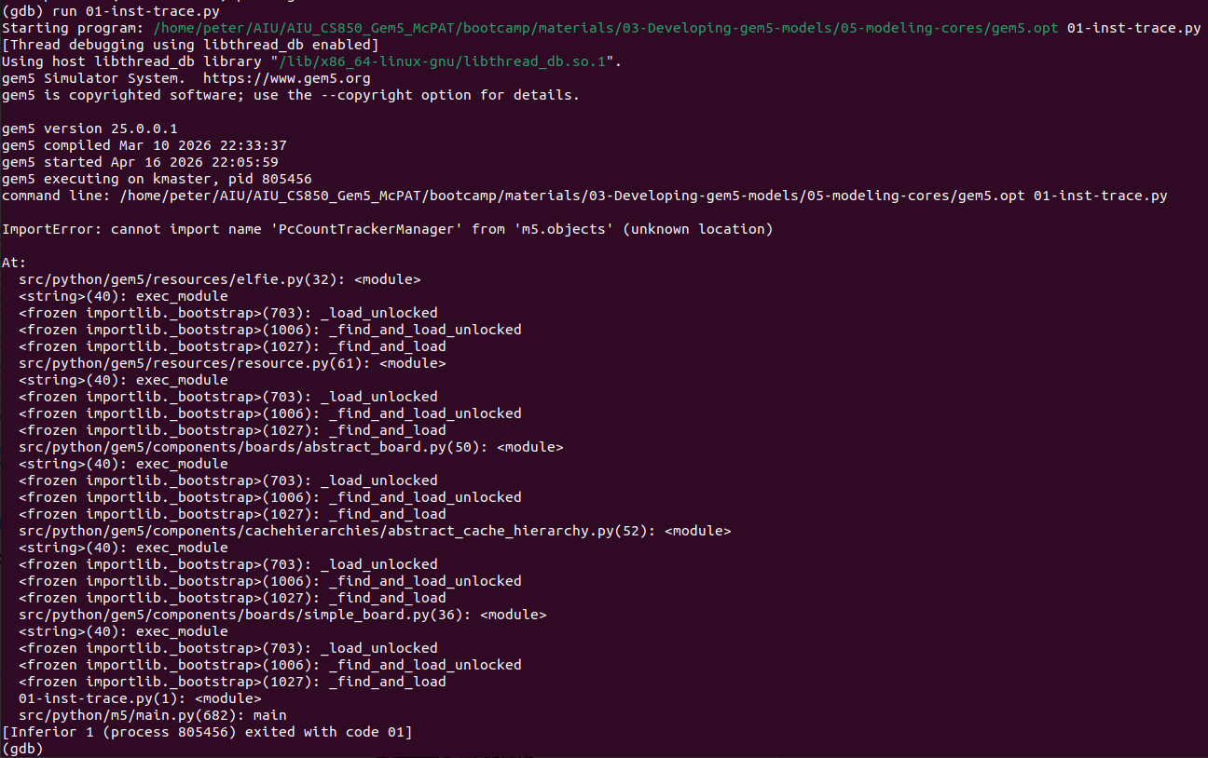
20.5 ISA Example
https://www.youtube.com/watch?v=eM8FHTuu80c&list=PL_hVbFs_loVR_8ntTTmmG6YEq3Po_4snu&index=20
ISA Example (12:01-12:30/1:15:39)
>cd ~materials.03-Developing-gem5-models/05-modeling-cores
> run 01-inst-trace.py

Slide 27
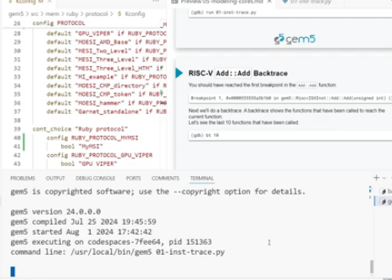
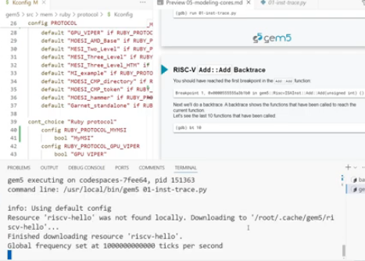
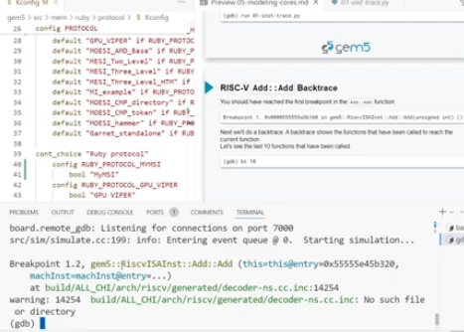
20.5 ISA Example
https://www.youtube.com/watch?v=eM8FHTuu80c&list=PL_hVbFs_loVR_8ntTTmmG6YEq3Po_4snu&index=20
ISA Example (12:31-12:45/1:15:39)
>cd ~materials.03-Developing-gem5-models/05-modeling-cores
> run 01-inst-trace.py

Slide 28
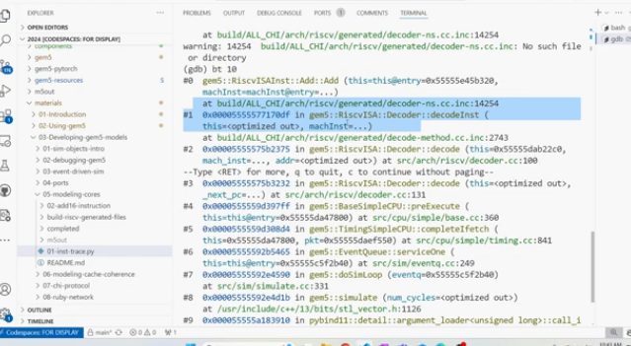
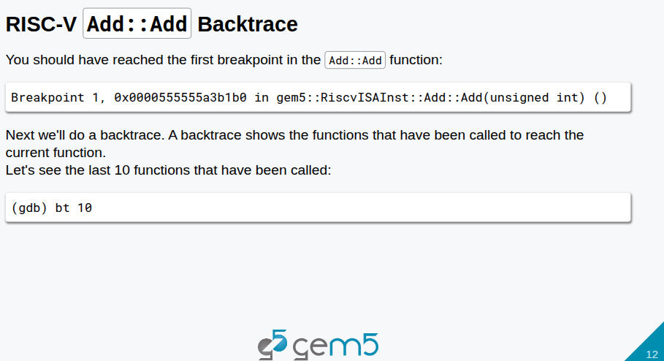
20.5 ISA Example
https://www.youtube.com/watch?v=eM8FHTuu80c&list=PL_hVbFs_loVR_8ntTTmmG6YEq3Po_4snu&index=20
ISA Example (12:46-15:00/1:15:39)
>cd ~materials.03-Developing-gem5-models/05-modeling-cores
> bt 10 # Display back-trace of 10 last functions
Back-Trace #1: Decoder constructor
Back-Trace #2: Decoder start
Back-Trace #3: Decoder RISC-V
Back-Trace #4: pre-execution
Back-Trace #5: Instruction Fetch
Back-Trace #5: Service one
Back-Trace #6: Do Simulation

Slide 29
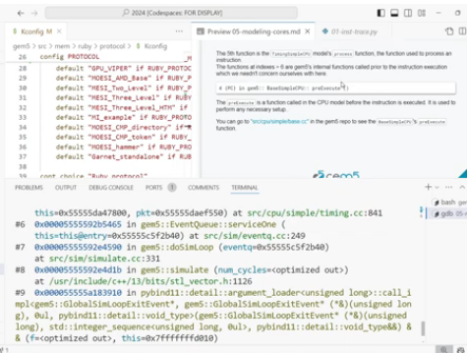
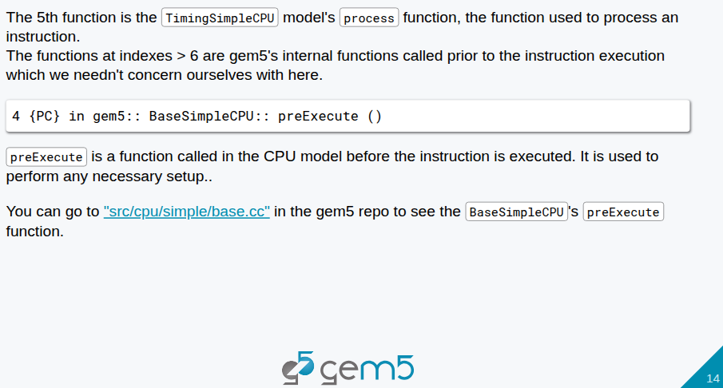
20.5 ISA Example
https://www.youtube.com/watch?v=eM8FHTuu80c&list=PL_hVbFs_loVR_8ntTTmmG6YEq3Po_4snu&index=20
ISA Example (15:01-15:20/1:15:39)
>cd ~materials.03-Developing-gem5-models/05-modeling-cores
The 5th function preExecute()

Slide 30
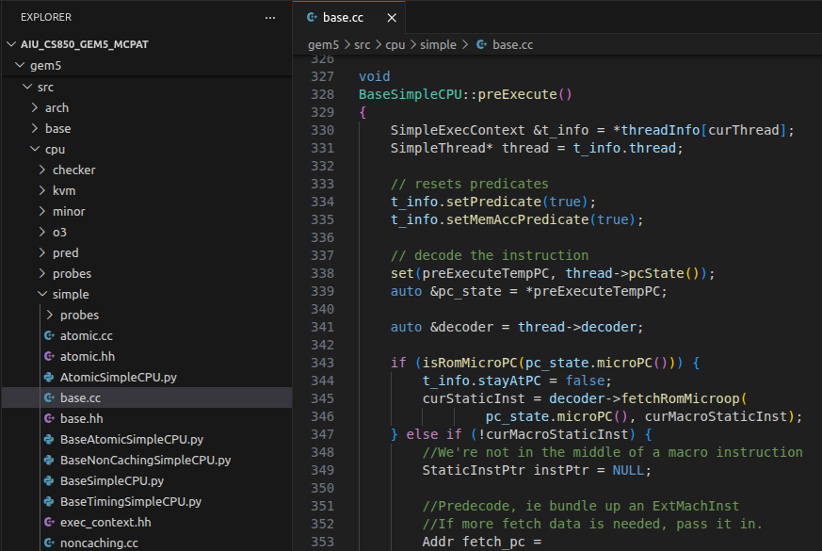
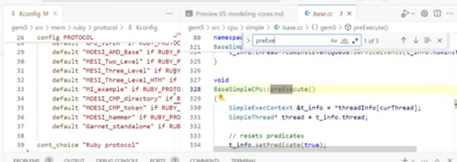
20.5 ISA Example
https://www.youtube.com/watch?v=eM8FHTuu80c&list=PL_hVbFs_loVR_8ntTTmmG6YEq3Po_4snu&index=20
ISA Example (15:21-16:20/1:15:39)
>cd ~gem/src/cpu/base.cc
We look inside the base.cc. The function preExcute() was called.
preExecute() is Back-Trace #4 before decoding in CPU Model.

Slide 31
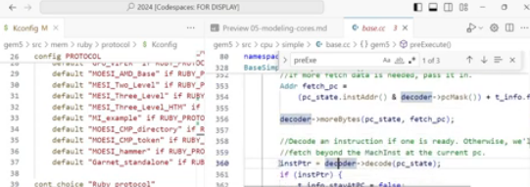
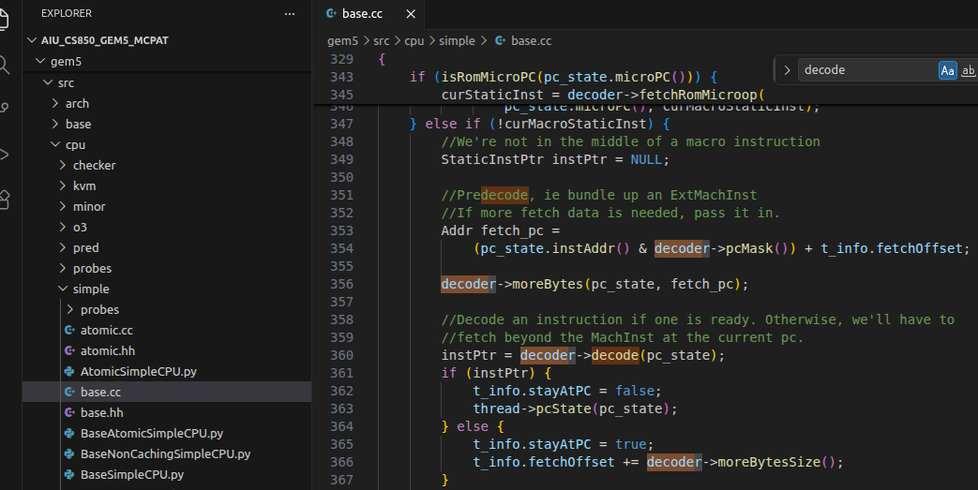
20.5 ISA Example
https://www.youtube.com/watch?v=eM8FHTuu80c&list=PL_hVbFs_loVR_8ntTTmmG6YEq3Po_4snu&index=20
ISA Example (16:21-17:00/1:15:39)
>cd ~gem/src/cpu/base.cc
Line #361 is the entry of decoder call.
> instrPtr = decoder->decode(pc)state);

Slide 32
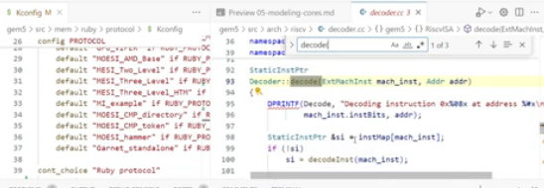
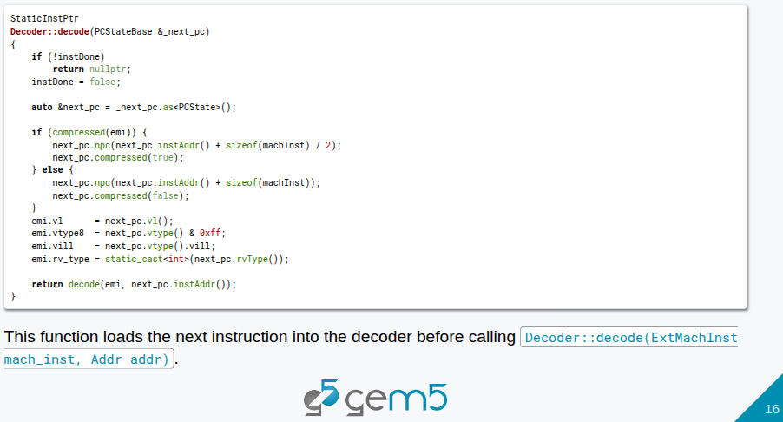
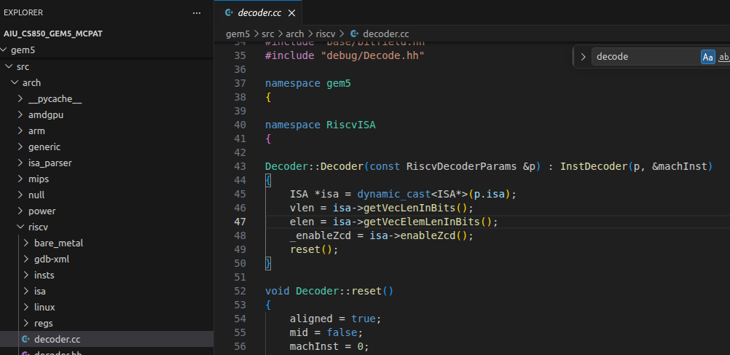
20.5 ISA Example
https://www.youtube.com/watch?v=eM8FHTuu80c&list=PL_hVbFs_loVR_8ntTTmmG6YEq3Po_4snu&index=20
ISA Example (17:01-22:00/1:15:39)
>cd ~gem/src/arch/riscv/decoder.cc
The code jumped from Back-Trace #5 to Back-Trace #2.
Decoder::decoder()

Slide 33
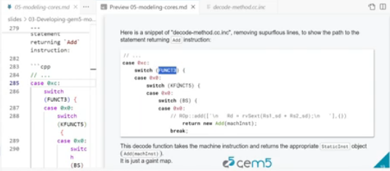
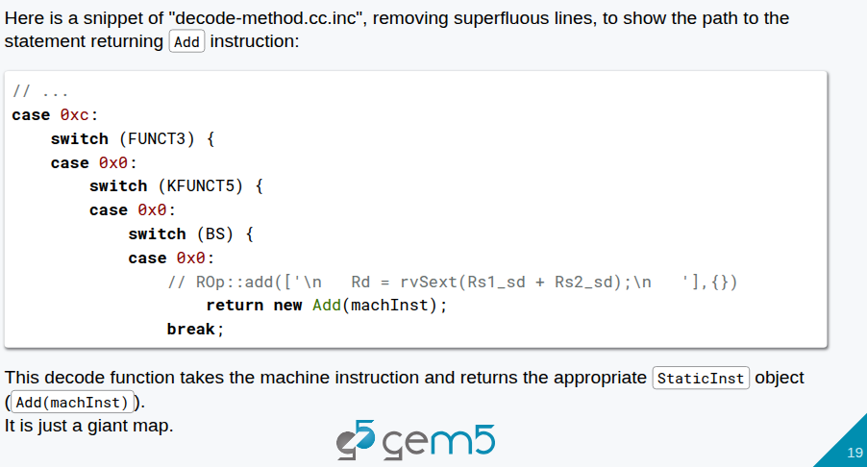
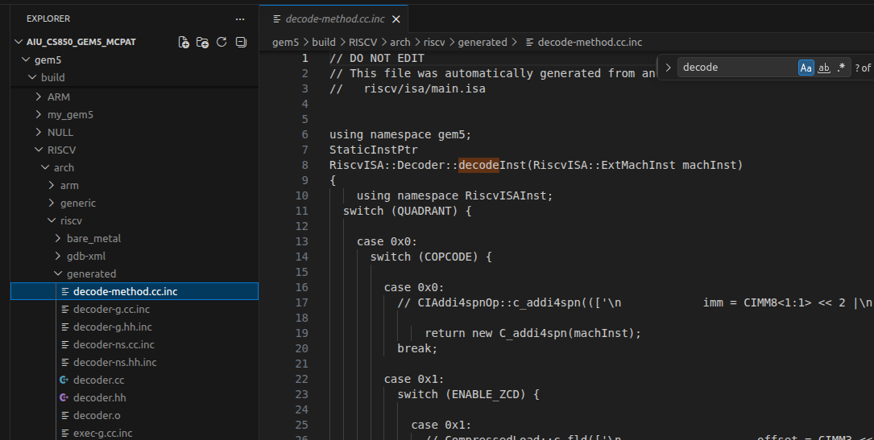
20.5 ISA Example
https://www.youtube.com/watch?v=eM8FHTuu80c&list=PL_hVbFs_loVR_8ntTTmmG6YEq3Po_4snu&index=20
ISA Example (22:01-22:40/1:15:39)
>cd ~gem/build/[ARCH/RISCV]/arch/[arch_name/riscv]/generated/decode-method.cc.inc
In decode-method.cc.inc, we call the Add(machine-Instruction) function
> RiscvISA::Decoder::decodeInst()

Slide 34
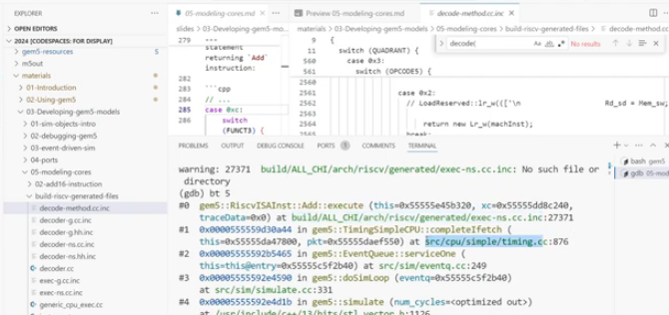
20.5 ISA Example
https://www.youtube.com/watch?v=eM8FHTuu80c&list=PL_hVbFs_loVR_8ntTTmmG6YEq3Po_4snu&index=20
ISA Example (22:41-23:30/1:15:39)
>cd ~gem/build/[ARCH/RISCV]/arch/[arch_name/riscv]/generated/decode-method.cc.inc
The decode-method.cc.inc is generated at Back-Trace #0.

Slide 35
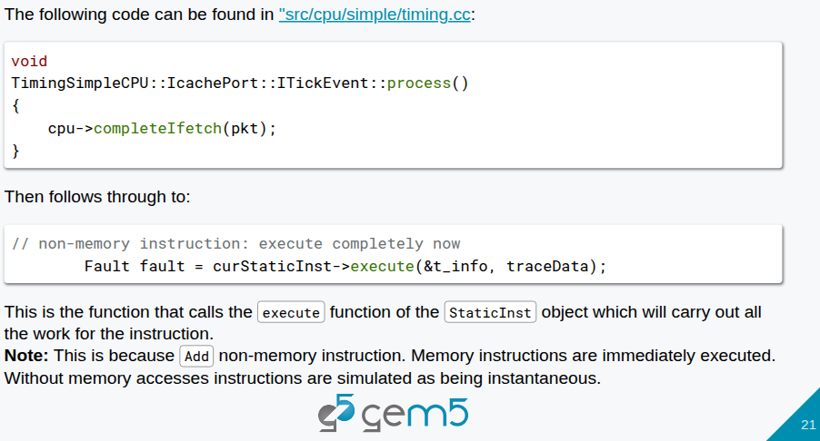
20.5 ISA Example
https://www.youtube.com/watch?v=eM8FHTuu80c&list=PL_hVbFs_loVR_8ntTTmmG6YEq3Po_4snu&index=20
ISA Example (22:41-23:30/1:15:39)
>cd ~gem/src/cpu/simple/timing.cc
At Back-Trace #1: gem5/src/cpu/simple/timing.cc.

Slide 36
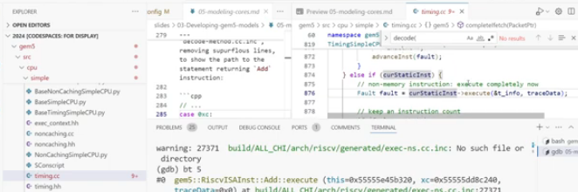
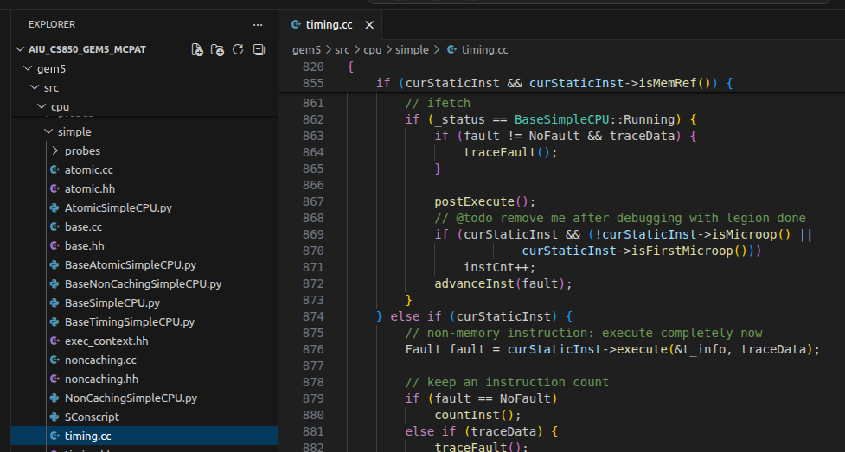
20.5 ISA Example
https://www.youtube.com/watch?v=eM8FHTuu80c&list=PL_hVbFs_loVR_8ntTTmmG6YEq3Po_4snu&index=20
ISA Example (23:31-24:50/1:15:39)
>cd ~gem/src/cpu/simple/timing.cc
In gem5/src/cpu/simple/timing.cc,
> Line #876: fault fault = curStaticInst -> execute ()
We execute the instruction. There are some logic here.

Slide 37
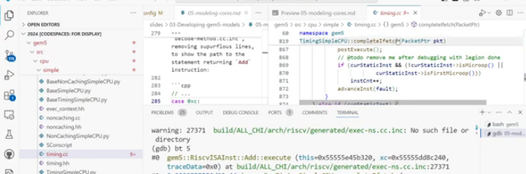
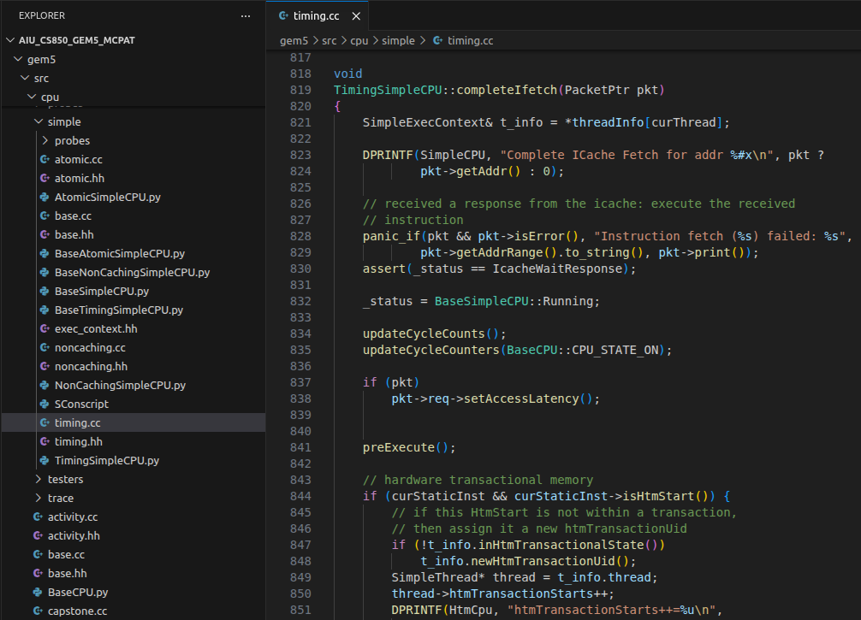
20.5 ISA Example
https://www.youtube.com/watch?v=eM8FHTuu80c&list=PL_hVbFs_loVR_8ntTTmmG6YEq3Po_4snu&index=20
ISA Example (25:51-25:00/1:15:39)
>cd ~gem/src/cpu/simple/timing.cc
In gem5/src/cpu/simple/timing.cc,
> Line #819: TimingSimpleCPU::completeIftetch ()
When we execute in the previous page, we have the complete Instruction fetch function.
> Line #873: It will generate the exec-ns.cc.inc and decode-method.cc.inc.

Slide 38
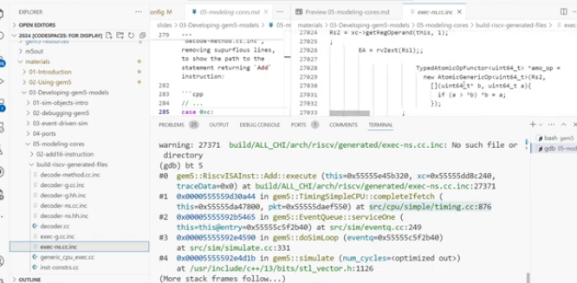
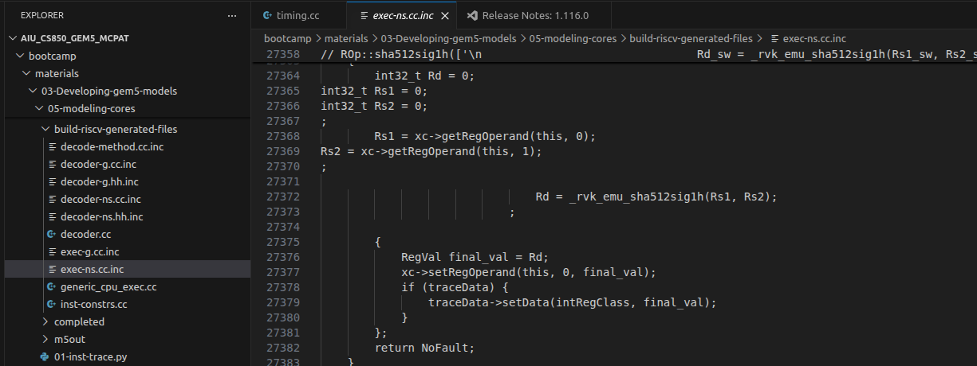
20.5 ISA Example
https://www.youtube.com/watch?v=eM8FHTuu80c&list=PL_hVbFs_loVR_8ntTTmmG6YEq3Po_4snu&index=20
ISA Example (25:01-25:40/1:15:39)
>cd ~material/03-Developing/gem5-gem5-models.05-modeling-cores/exec-ns.cc.inc
In exec-ns.cc.inc, LINE#27368:
> RS1 = xc->getRegOperand (this, 0);

Slide 39
End

