Slide 1

17.1 SimObjects (Part 2): Slides
Peter H. Chen

Slide 2

17.1 SimObjects (Part 2): Slides
https://gem5bootcamp.github.io/2024/#03-Developing-gem5-models/01-sim-objects-intro
SimObjects (Part 2): Slides

Slide 3
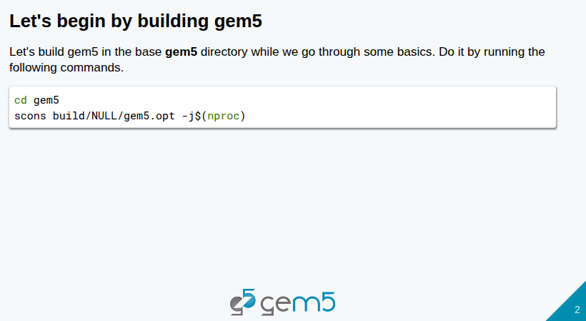
17.1 SimObjects (Part 2): Slides
https://gem5bootcamp.github.io/2024/#03-Developing-gem5-models/01-sim-objects-intro
SimObjects (Part 2): Slides

Slide 4
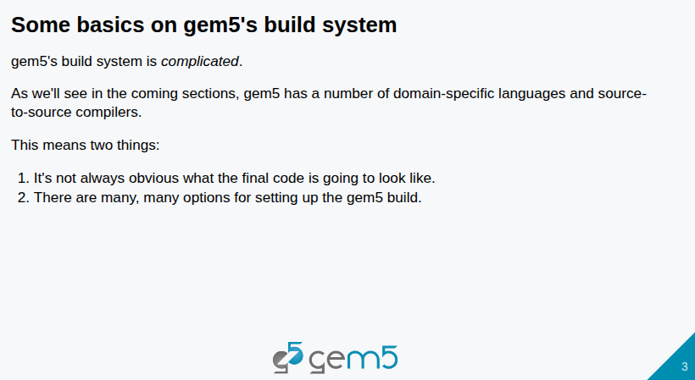
17.1 SimObjects (Part 2): Slides
https://gem5bootcamp.github.io/2024/#03-Developing-gem5-models/01-sim-objects-intro
SimObjects (Part 2): Slides

Slide 5
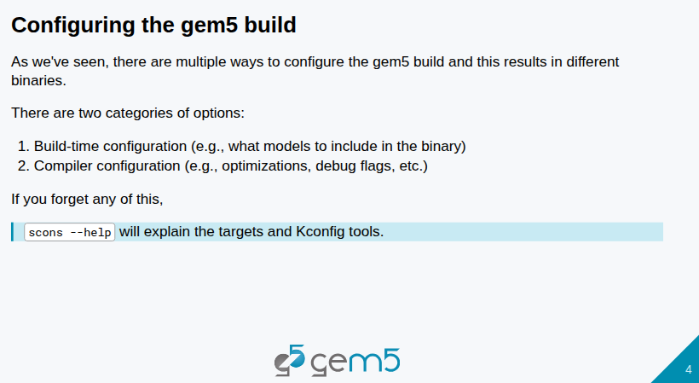
17.1 SimObjects (Part 2): Slides
https://gem5bootcamp.github.io/2024/#03-Developing-gem5-models/01-sim-objects-intro
SimObjects (Part 2): Slides

Slide 6
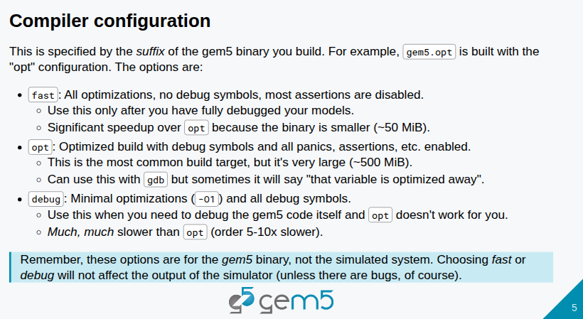
17.1 SimObjects (Part 2): Slides
https://gem5bootcamp.github.io/2024/#03-Developing-gem5-models/01-sim-objects-intro
SimObjects (Part 2): Slides

Slide 7
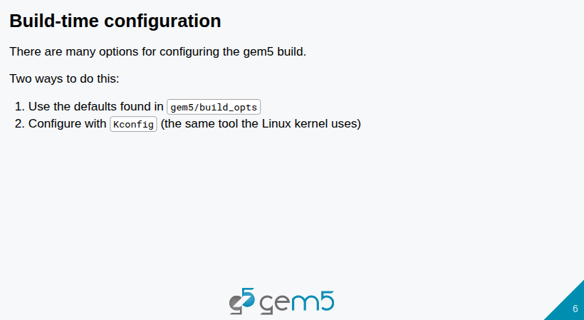
17.1 SimObjects (Part 2): Slides
https://gem5bootcamp.github.io/2024/#03-Developing-gem5-models/01-sim-objects-intro
SimObjects (Part 2): Slides

Slide 8
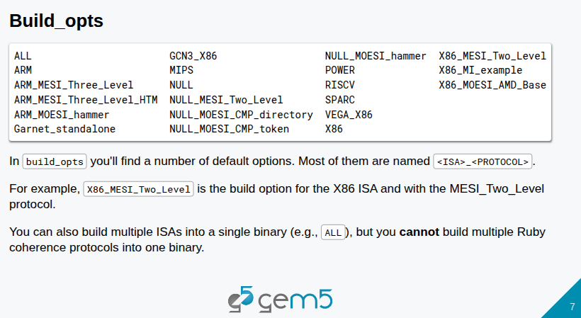
17.1 SimObjects (Part 2): Slides
https://gem5bootcamp.github.io/2024/#03-Developing-gem5-models/01-sim-objects-intro
SimObjects (Part 2): Slides

Slide 9
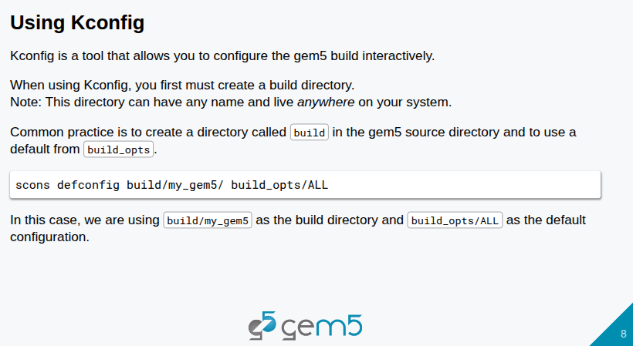
17.1 SimObjects (Part 2): Slides
https://gem5bootcamp.github.io/2024/#03-Developing-gem5-models/01-sim-objects-intro
SimObjects (Part 2): Slides

Slide 10
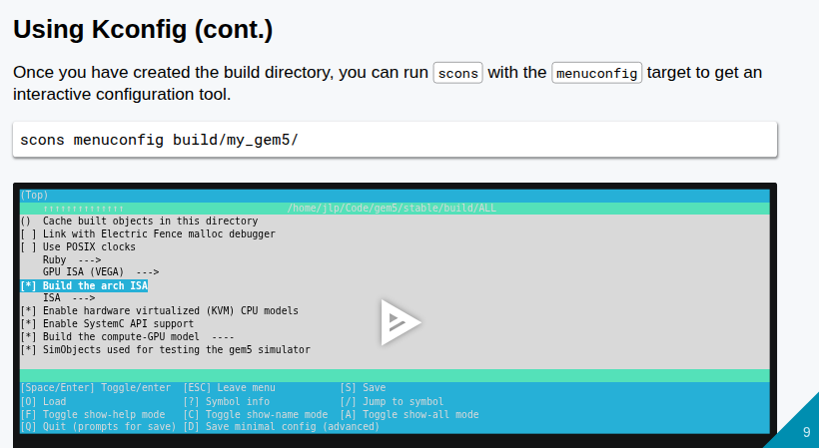
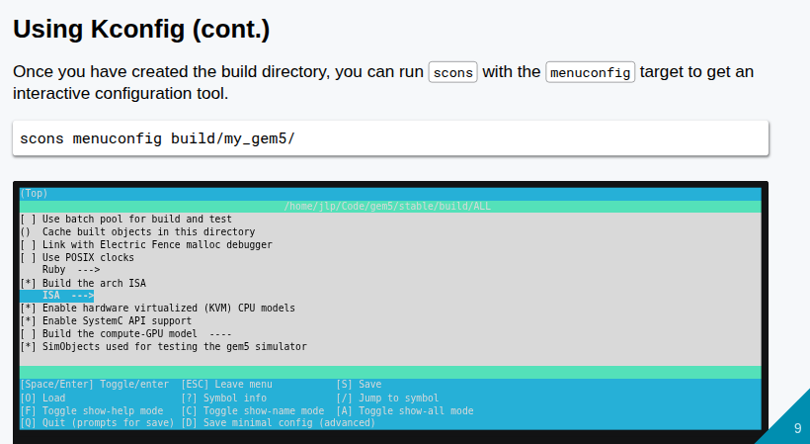
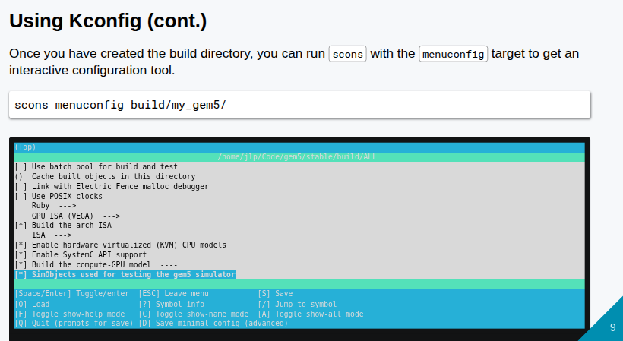
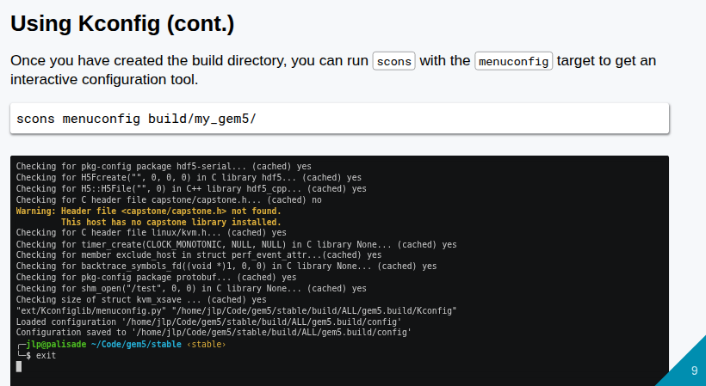
17.1 SimObjects (Part 2): Slides
https://gem5bootcamp.github.io/2024/#03-Developing-gem5-models/01-sim-objects-intro
SimObjects (Part 2): Slides

Slide 11
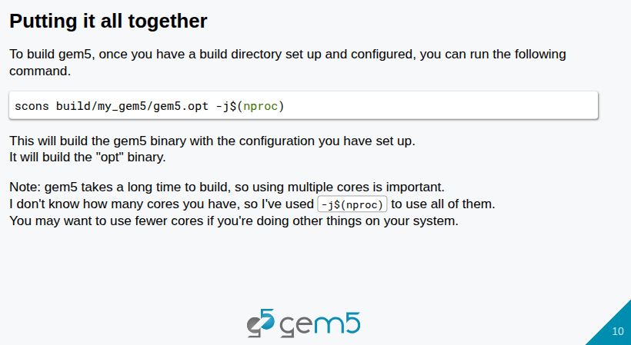
17.1 SimObjects (Part 2): Slides
https://gem5bootcamp.github.io/2024/#03-Developing-gem5-models/01-sim-objects-intro
SimObjects (Part 2): Slides

Slide 12
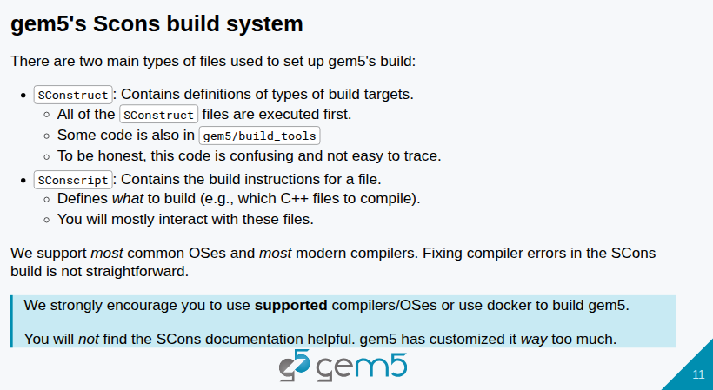
17.1 SimObjects (Part 2): Slides
https://gem5bootcamp.github.io/2024/#03-Developing-gem5-models/01-sim-objects-intro
SimObjects (Part 2): Slides

Slide 13
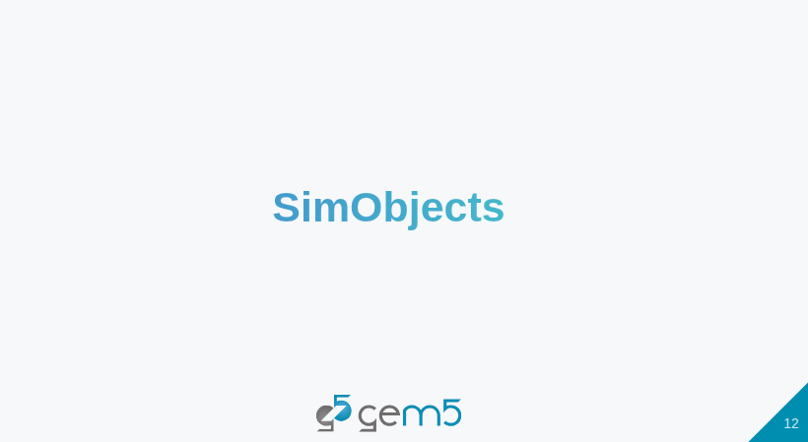
17.1 SimObjects (Part 2): Slides
https://gem5bootcamp.github.io/2024/#03-Developing-gem5-models/01-sim-objects-intro
SimObjects (Part 2): Slides

Slide 14
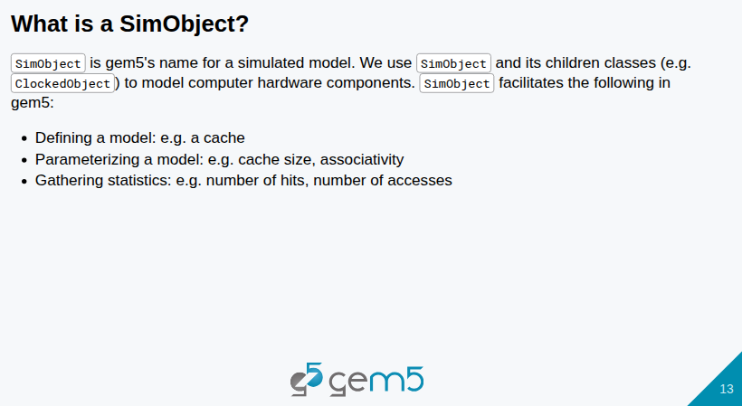
17.1 SimObjects (Part 2): Slides
https://gem5bootcamp.github.io/2024/#03-Developing-gem5-models/01-sim-objects-intro
SimObjects (Part 2): Slides

Slide 15
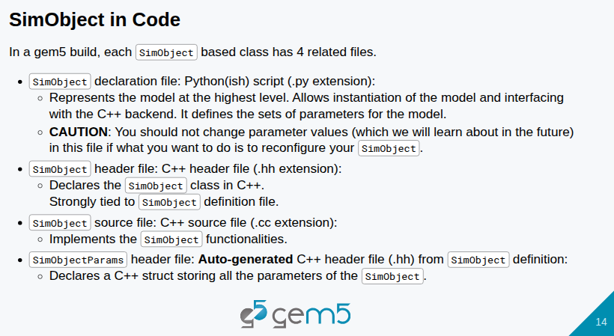
17.1 SimObjects (Part 2): Slides
https://gem5bootcamp.github.io/2024/#03-Developing-gem5-models/01-sim-objects-intro
SimObjects (Part 2): Slides

Slide 16
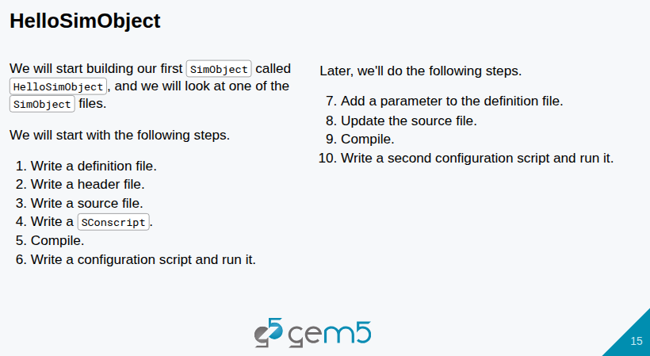
17.1 SimObjects (Part 2): Slides
https://gem5bootcamp.github.io/2024/#03-Developing-gem5-models/01-sim-objects-intro
SimObjects (Part 2): Slides

Slide 17
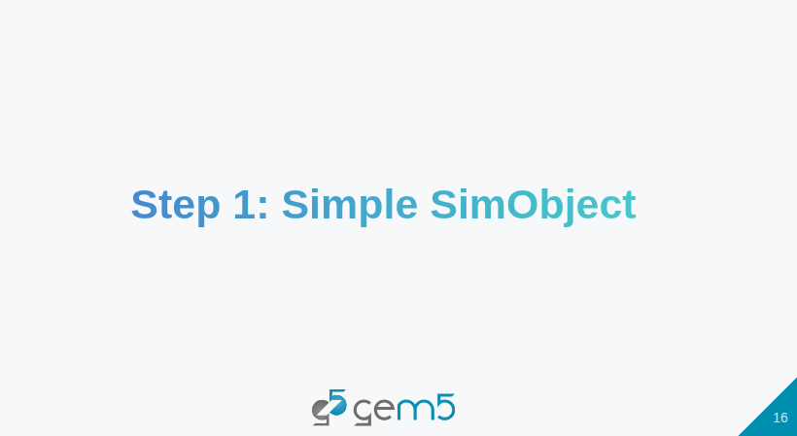
17.1 SimObjects (Part 2): Slides
https://gem5bootcamp.github.io/2024/#03-Developing-gem5-models/01-sim-objects-intro
SimObjects (Part 2): Slides

Slide 18
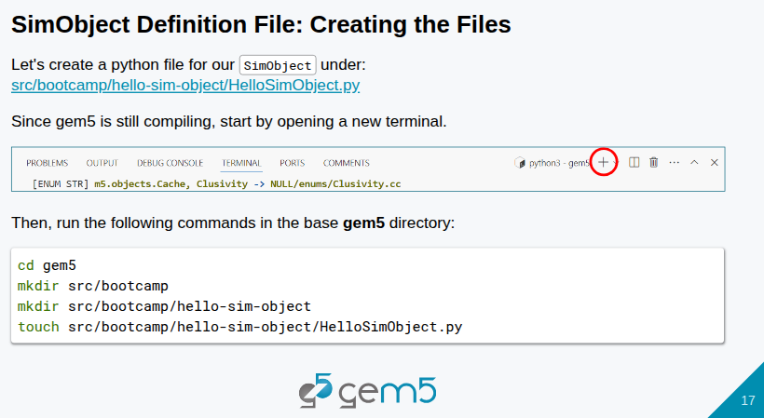
17.1 SimObjects (Part 2): Slides
https://gem5bootcamp.github.io/2024/#03-Developing-gem5-models/01-sim-objects-intro
SimObjects (Part 2): Slides

Slide 19
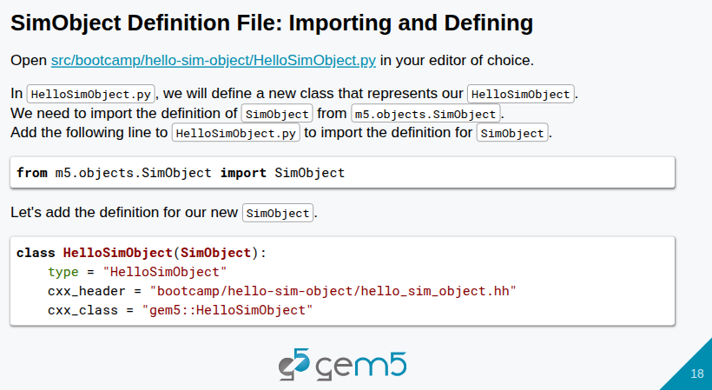
17.1 SimObjects (Part 2): Slides
https://gem5bootcamp.github.io/2024/#03-Developing-gem5-models/01-sim-objects-intro
SimObjects (Part 2): Slides

Slide 20
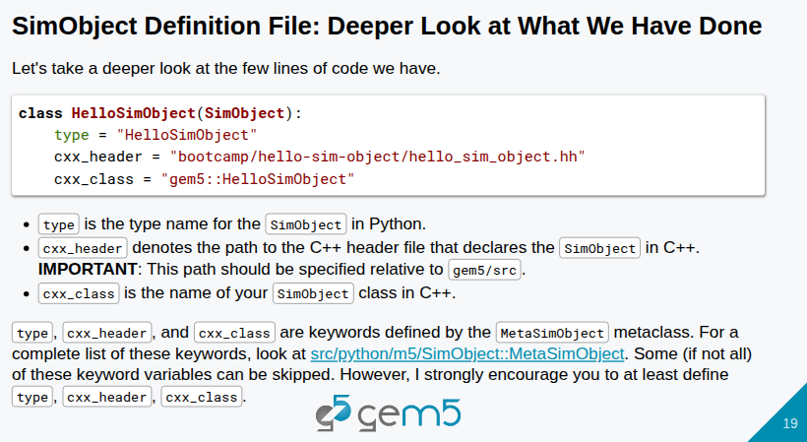
17.1 SimObjects (Part 2): Slides
https://gem5bootcamp.github.io/2024/#03-Developing-gem5-models/01-sim-objects-intro
SimObjects (Part 2): Slides

Slide 21
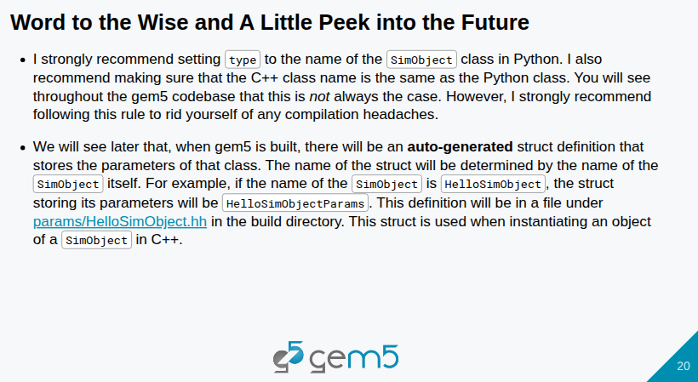
17.1 SimObjects (Part 2): Slides
https://gem5bootcamp.github.io/2024/#03-Developing-gem5-models/01-sim-objects-intro
SimObjects (Part 2): Slides

Slide 22
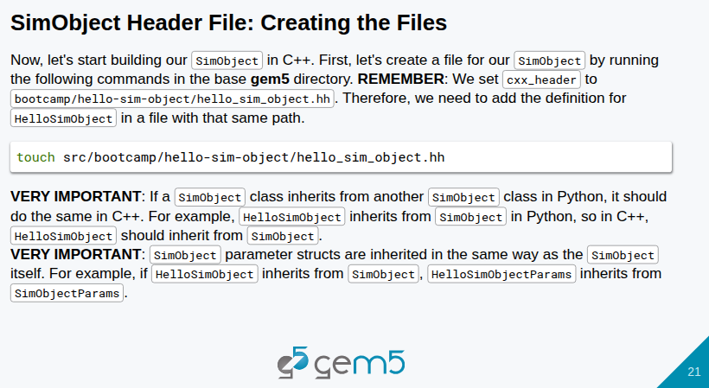
17.1 SimObjects (Part 2): Slides
https://gem5bootcamp.github.io/2024/#03-Developing-gem5-models/01-sim-objects-intro
SimObjects (Part 2): Slides

Slide 23
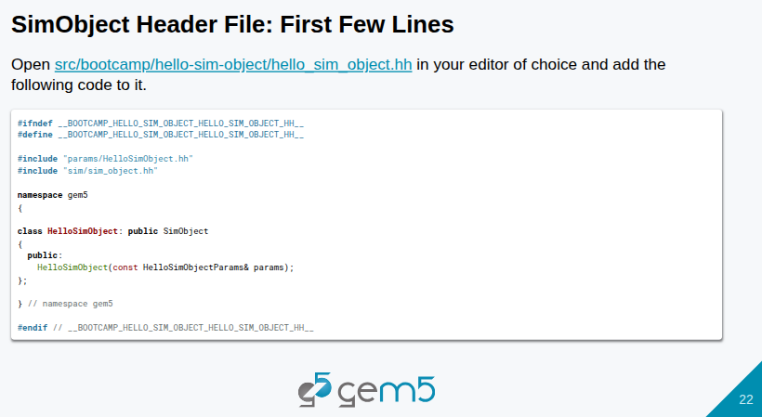
17.1 SimObjects (Part 2): Slides
https://gem5bootcamp.github.io/2024/#03-Developing-gem5-models/01-sim-objects-intro
SimObjects (Part 2): Slides

Slide 24
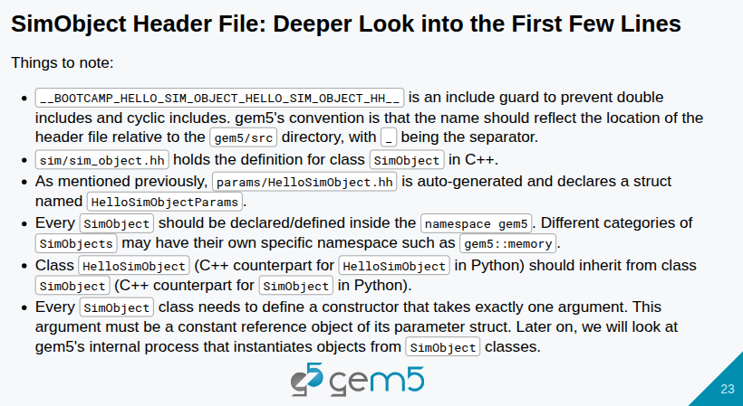
17.1 SimObjects (Part 2): Slides
https://gem5bootcamp.github.io/2024/#03-Developing-gem5-models/01-sim-objects-intro
SimObjects (Part 2): Slides

Slide 25
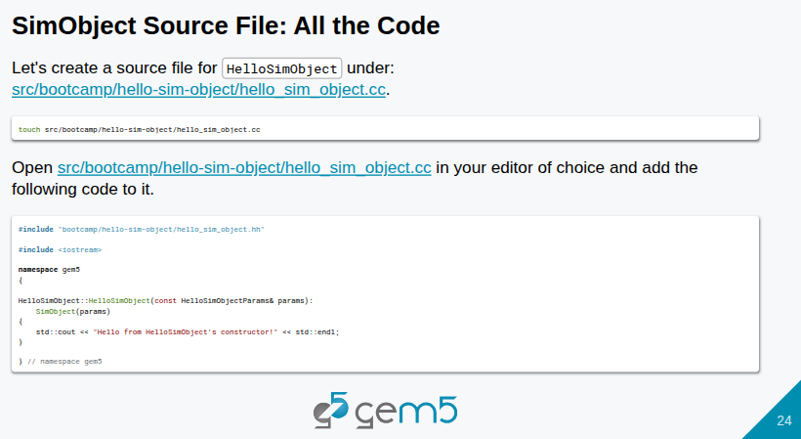
17.1 SimObjects (Part 2): Slides
https://gem5bootcamp.github.io/2024/#03-Developing-gem5-models/01-sim-objects-intro
SimObjects (Part 2): Slides

Slide 26
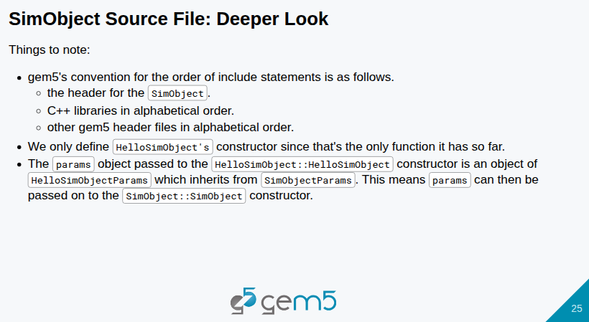
17.1 SimObjects (Part 2): Slides
https://gem5bootcamp.github.io/2024/#03-Developing-gem5-models/01-sim-objects-intro
SimObjects (Part 2): Slides

Slide 27
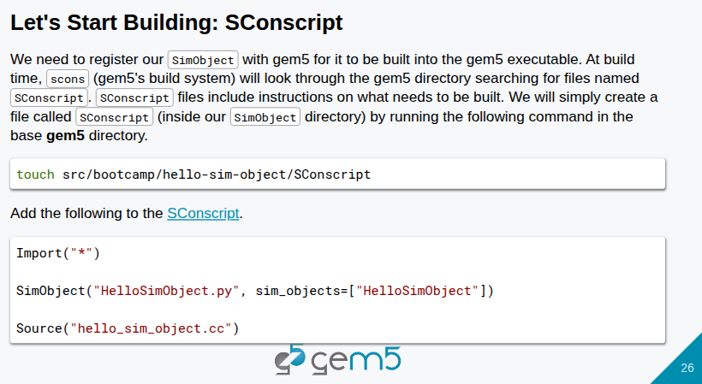
17.1 SimObjects (Part 2): Slides
https://gem5bootcamp.github.io/2024/#03-Developing-gem5-models/01-sim-objects-intro
SimObjects (Part 2): Slides

Slide 28
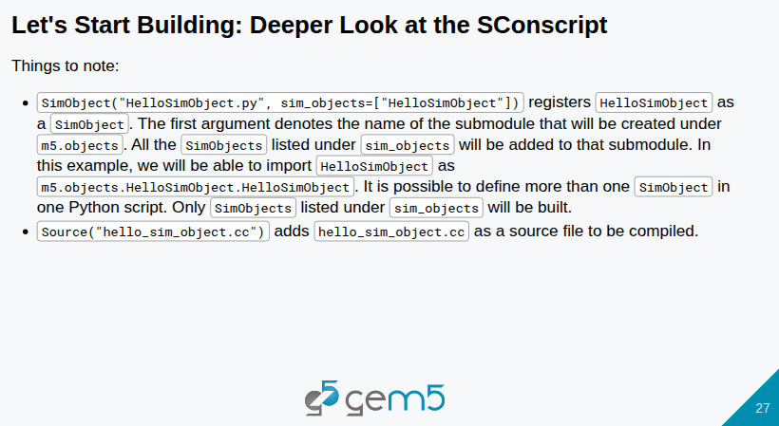
17.1 SimObjects (Part 2): Slides
https://gem5bootcamp.github.io/2024/#03-Developing-gem5-models/01-sim-objects-intro
SimObjects (Part 2): Slides

Slide 29
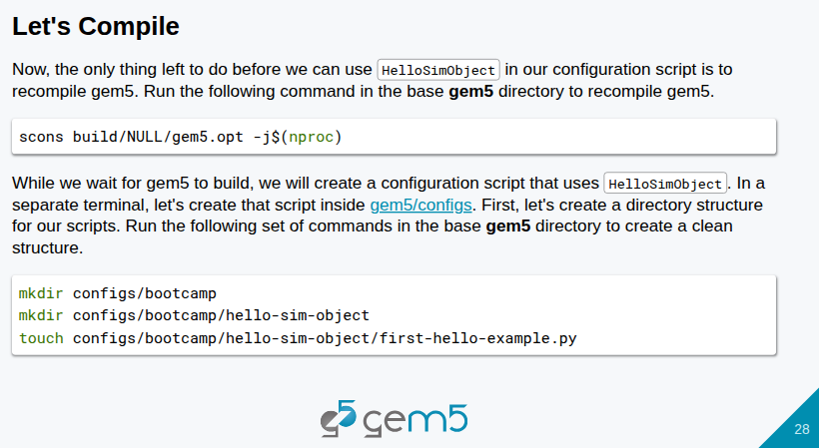
17.1 SimObjects (Part 2): Slides
https://gem5bootcamp.github.io/2024/#03-Developing-gem5-models/01-sim-objects-intro
SimObjects (Part 2): Slides

Slide 30
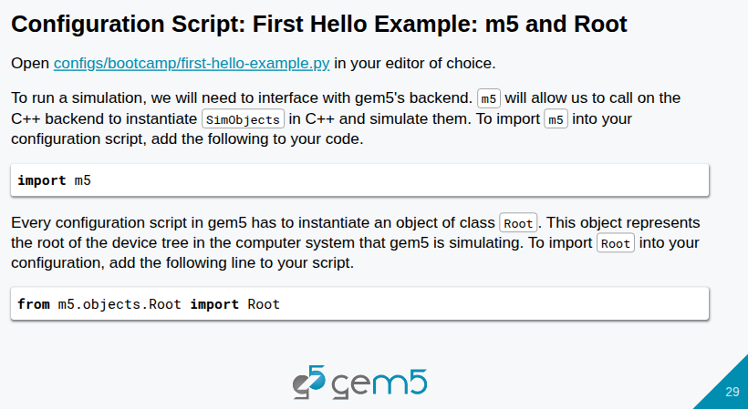
17.1 SimObjects (Part 2): Slides
https://gem5bootcamp.github.io/2024/#03-Developing-gem5-models/01-sim-objects-intro
SimObjects (Part 2): Slides

Slide 31
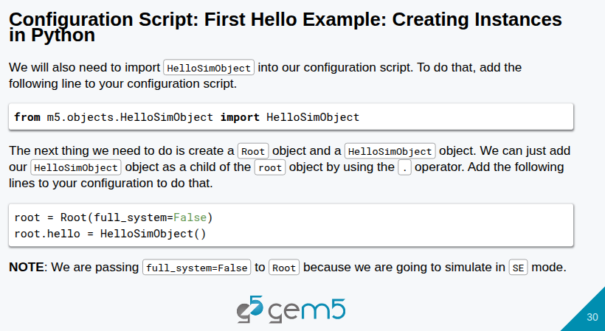
17.1 SimObjects (Part 2): Slides
https://gem5bootcamp.github.io/2024/#03-Developing-gem5-models/01-sim-objects-intro
SimObjects (Part 2): Slides

Slide 32
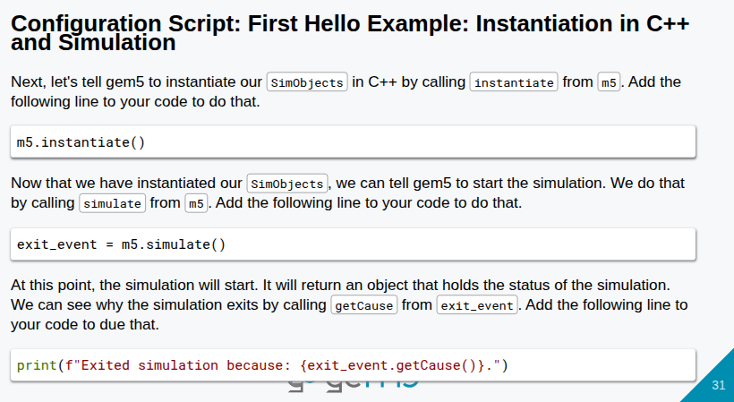
17.1 SimObjects (Part 2): Slides
https://gem5bootcamp.github.io/2024/#03-Developing-gem5-models/01-sim-objects-intro
SimObjects (Part 2): Slides

Slide 33
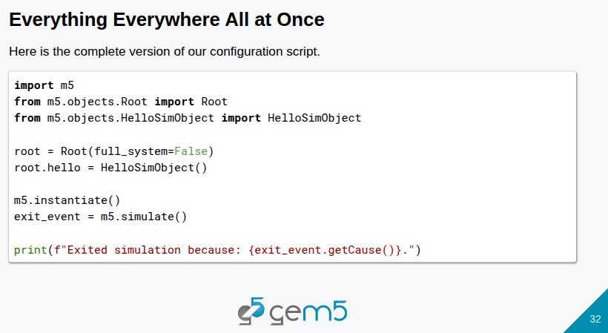
17.1 SimObjects (Part 2): Slides
https://gem5bootcamp.github.io/2024/#03-Developing-gem5-models/01-sim-objects-intro
SimObjects (Part 2): Slides

Slide 34
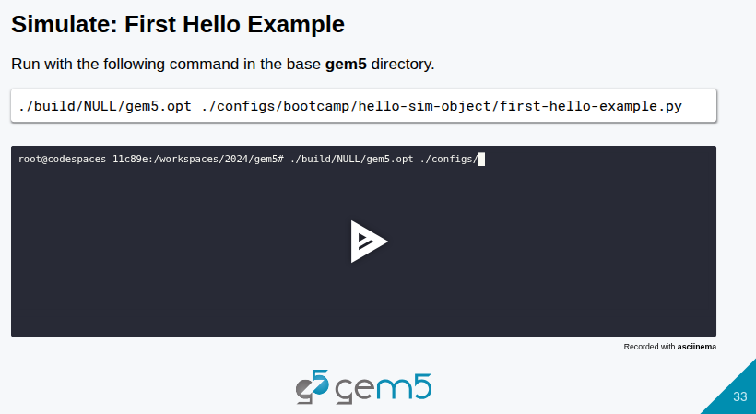
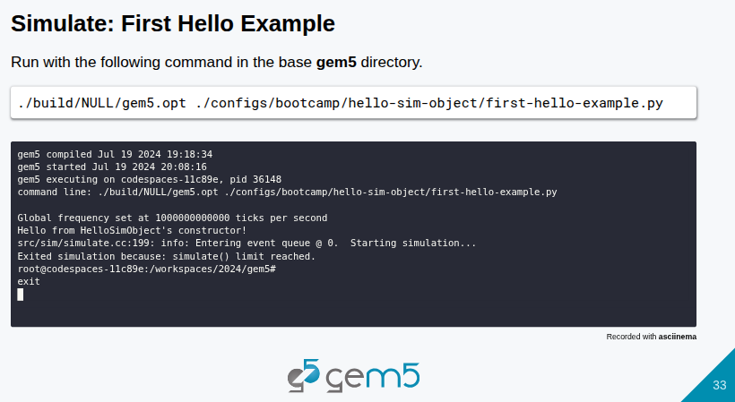
17.1 SimObjects (Part 2): Slides
https://gem5bootcamp.github.io/2024/#03-Developing-gem5-models/01-sim-objects-intro
SimObjects (Part 2): Slides

Slide 35

17.1 SimObjects (Part 2): Slides
https://gem5bootcamp.github.io/2024/#03-Developing-gem5-models/01-sim-objects-intro
SimObjects (Part 2): Slides

Slide 36
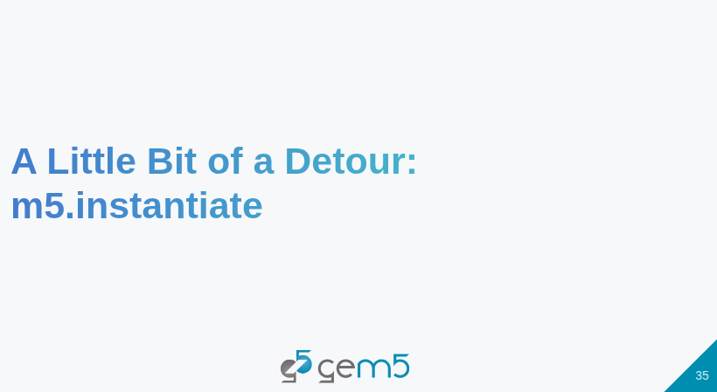
17.1 SimObjects (Part 2): Slides
https://gem5bootcamp.github.io/2024/#03-Developing-gem5-models/01-sim-objects-intro
SimObjects (Part 2): Slides

Slide 37
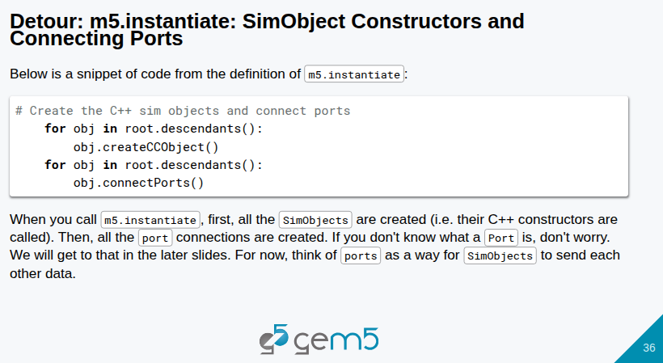
17.1 SimObjects (Part 2): Slides
https://gem5bootcamp.github.io/2024/#03-Developing-gem5-models/01-sim-objects-intro
SimObjects (Part 2): Slides

Slide 38
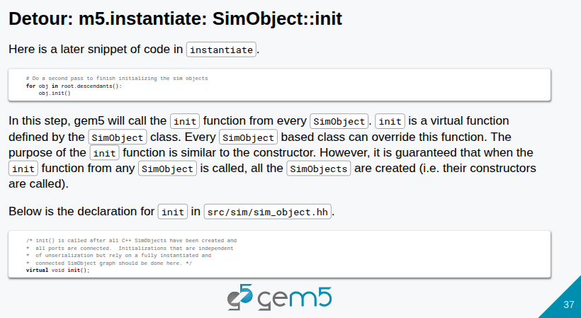
17.1 SimObjects (Part 2): Slides
https://gem5bootcamp.github.io/2024/#03-Developing-gem5-models/01-sim-objects-intro
SimObjects (Part 2): Slides

Slide 39
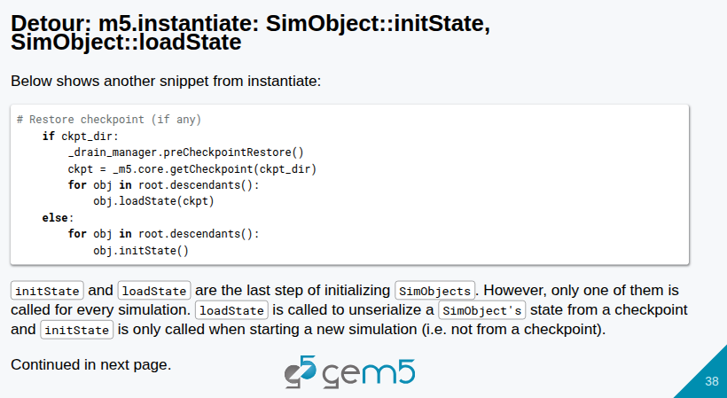
17.1 SimObjects (Part 2): Slides
https://gem5bootcamp.github.io/2024/#03-Developing-gem5-models/01-sim-objects-intro
SimObjects (Part 2): Slides

Slide 40
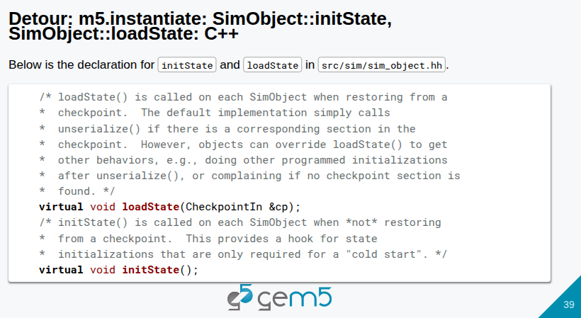
17.1 SimObjects (Part 2): Slides
https://gem5bootcamp.github.io/2024/#03-Developing-gem5-models/01-sim-objects-intro
SimObjects (Part 2): Slides

Slide 41
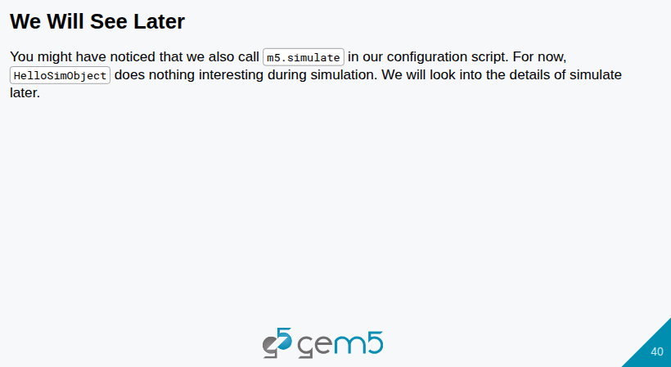
17.1 SimObjects (Part 2): Slides
https://gem5bootcamp.github.io/2024/#03-Developing-gem5-models/01-sim-objects-intro
SimObjects (Part 2): Slides

Slide 42

17.1 SimObjects (Part 2): Slides
https://gem5bootcamp.github.io/2024/#03-Developing-gem5-models/01-sim-objects-intro
SimObjects (Part 2): Slides

Slide 43
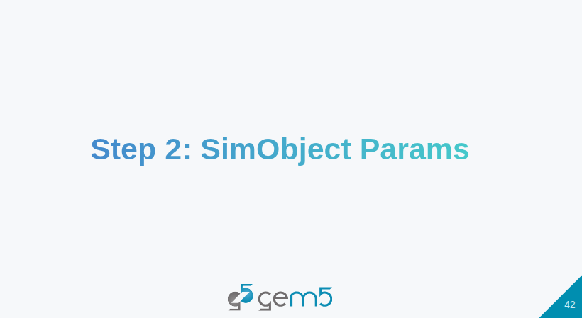
17.1 SimObjects (Part 2): Slides
https://gem5bootcamp.github.io/2024/#03-Developing-gem5-models/01-sim-objects-intro
SimObjects (Part 2): Slides

Slide 44
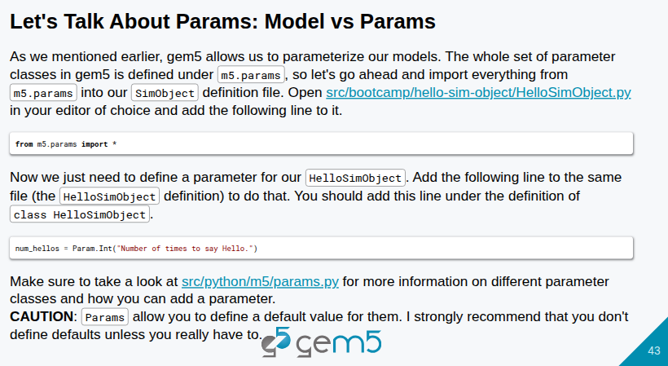
17.1 SimObjects (Part 2): Slides
https://gem5bootcamp.github.io/2024/#03-Developing-gem5-models/01-sim-objects-intro
SimObjects (Part 2): Slides

Slide 45
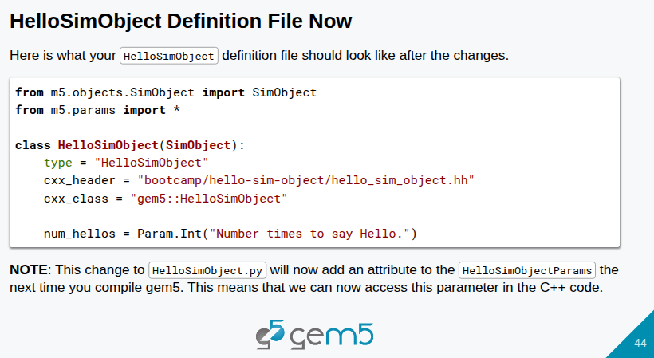
17.1 SimObjects (Part 2): Slides
https://gem5bootcamp.github.io/2024/#03-Developing-gem5-models/01-sim-objects-intro
SimObjects (Part 2): Slides

Slide 46
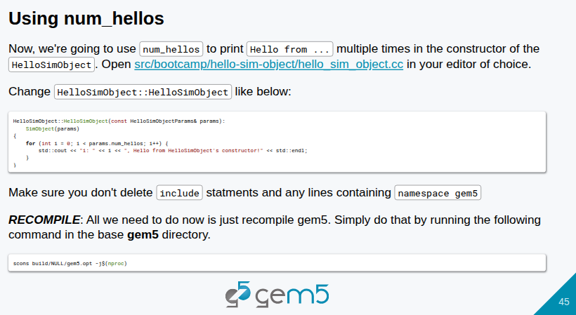
17.1 SimObjects (Part 2): Slides
https://gem5bootcamp.github.io/2024/#03-Developing-gem5-models/01-sim-objects-intro
SimObjects (Part 2): Slides

Slide 47
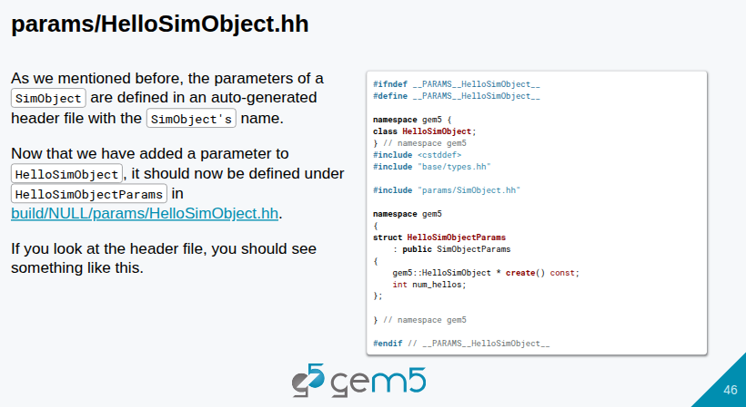
17.1 SimObjects (Part 2): Slides
https://gem5bootcamp.github.io/2024/#03-Developing-gem5-models/01-sim-objects-intro
SimObjects (Part 2): Slides

Slide 48
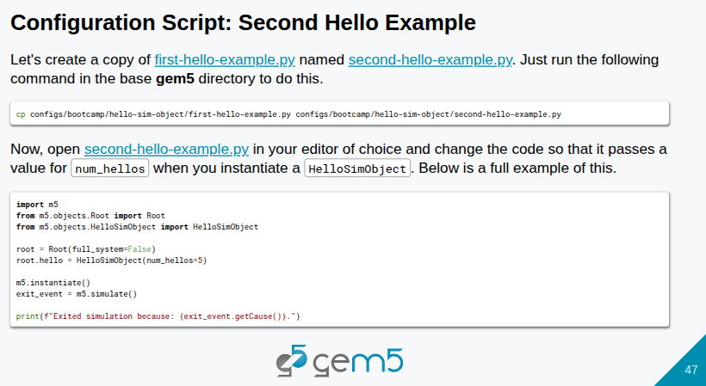
17.1 SimObjects (Part 2): Slides
https://gem5bootcamp.github.io/2024/#03-Developing-gem5-models/01-sim-objects-intro
SimObjects (Part 2): Slides

Slide 49
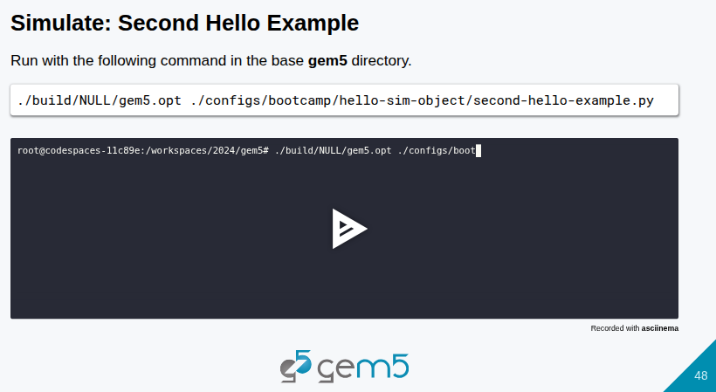
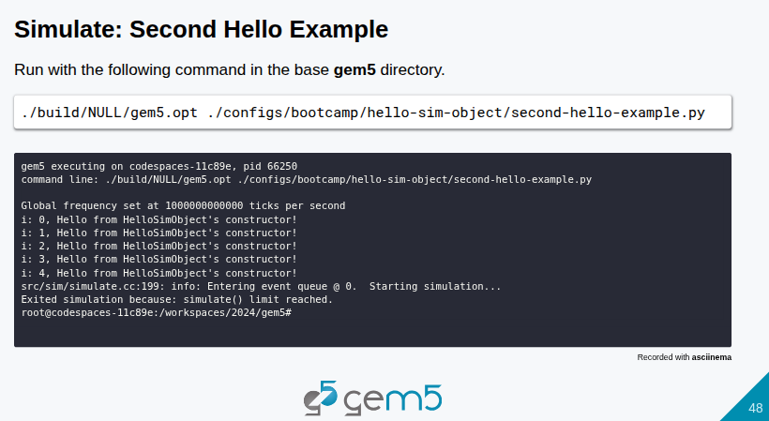

17.1 SimObjects (Part 2): Slides
https://gem5bootcamp.github.io/2024/#03-Developing-gem5-models/01-sim-objects-intro
SimObjects (Part 2): Slides

Slide 50

17.1 SimObjects (Part 2): Slides
https://gem5bootcamp.github.io/2024/#03-Developing-gem5-models/01-sim-objects-intro
SimObjects (Part 2): Slides

Slide 51

17.1 SimObjects (Part 2): Slides
https://gem5bootcamp.github.io/2024/#03-Developing-gem5-models/01-sim-objects-intro
SimObjects (Part 2): Slides

Slide 52
End

