Slide 1

6.1 Run Gem5: Slides
Peter H. Chen

Slide 2
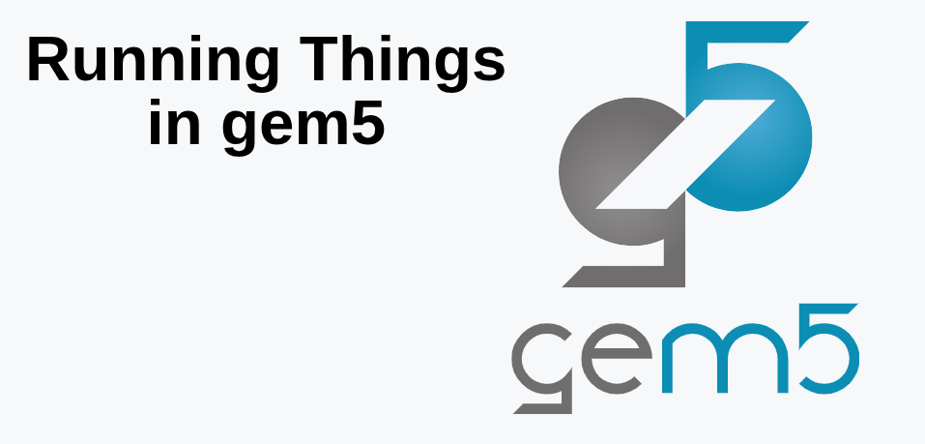
6.1 Run Gem5: Slides
https://gem5bootcamp.github.io/2024/#02-Using-gem5/03-running-in-gem5
Run Gem5: Slides

Slide 3
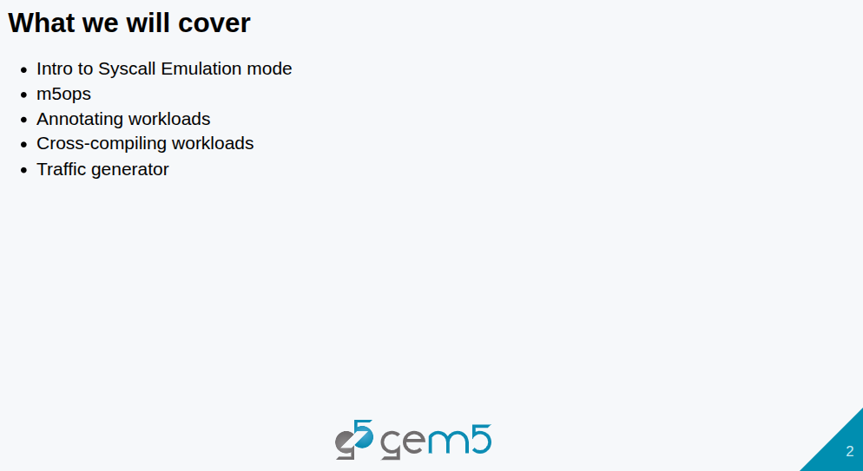
6.1 Run Gem5: Slides
https://gem5bootcamp.github.io/2024/#02-Using-gem5/03-running-in-gem5
Run Gem5: Slides

Slide 4
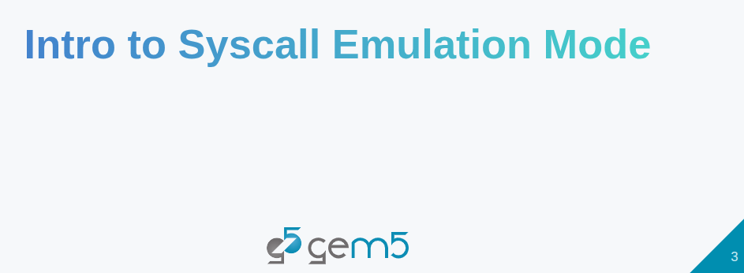
6.1 Run Gem5: Slides
https://gem5bootcamp.github.io/2024/#02-Using-gem5/03-running-in-gem5
Run Gem5: Slides

Slide 5
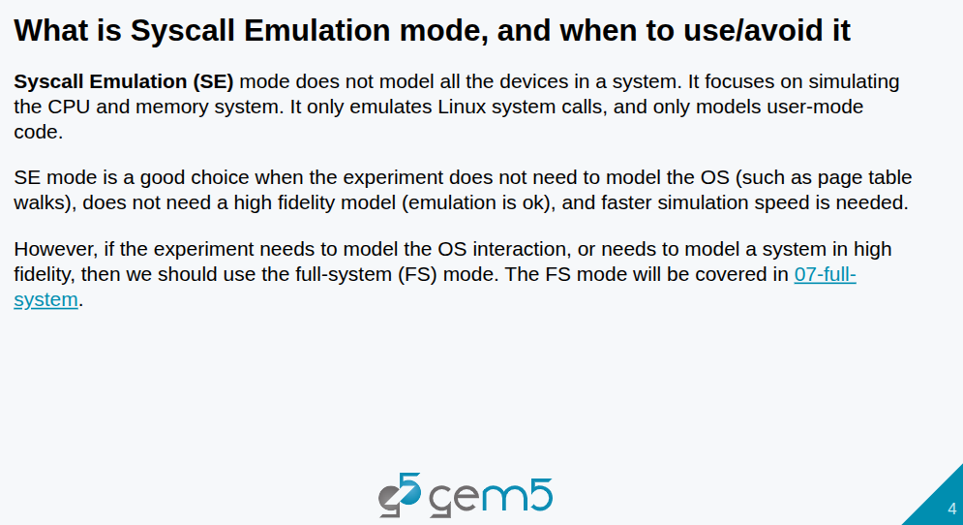
6.1 Run Gem5: Slides
https://gem5bootcamp.github.io/2024/#02-Using-gem5/03-running-in-gem5
Run Gem5: Slides

Slide 6
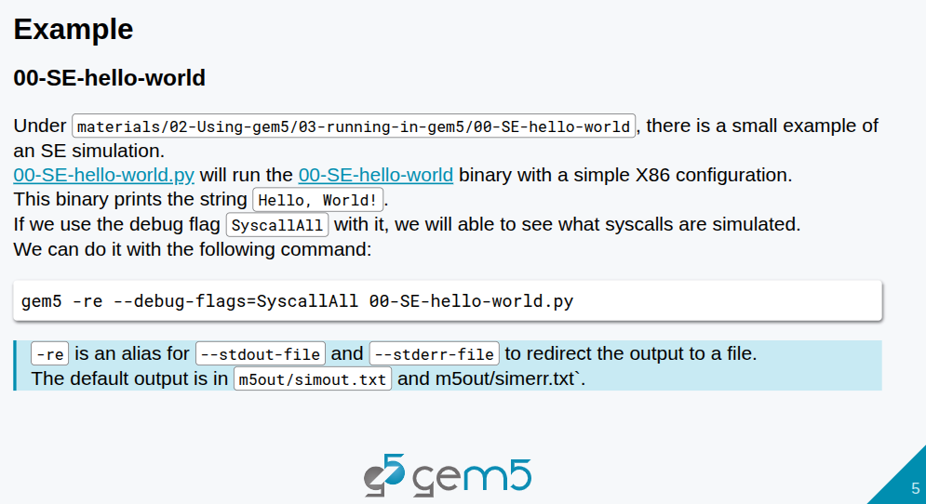
6.1 Run Gem5: Slides
https://gem5bootcamp.github.io/2024/#02-Using-gem5/03-running-in-gem5
Run Gem5: Slides

Slide 7
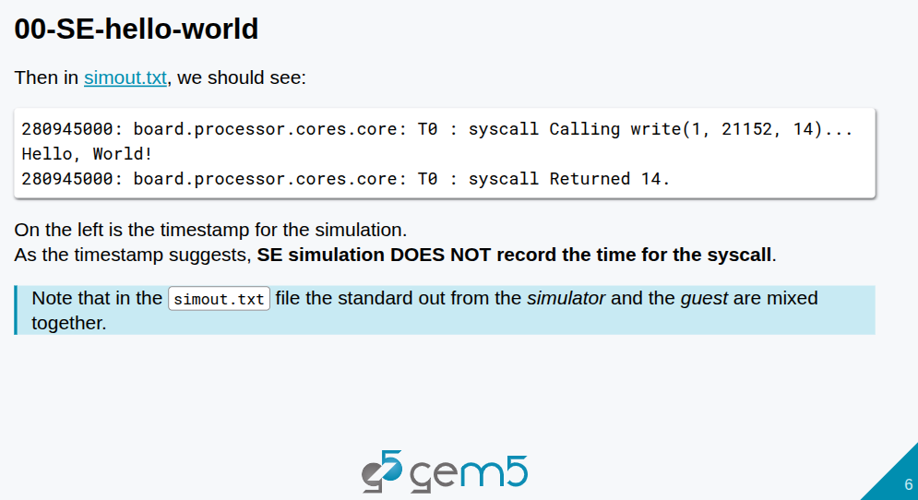
6.1 Run Gem5: Slides
https://gem5bootcamp.github.io/2024/#02-Using-gem5/03-running-in-gem5
Run Gem5: Slides

Slide 8

6.1 Run Gem5: Slides
https://gem5bootcamp.github.io/2024/#02-Using-gem5/03-running-in-gem5
Run Gem5: Slides

Slide 9
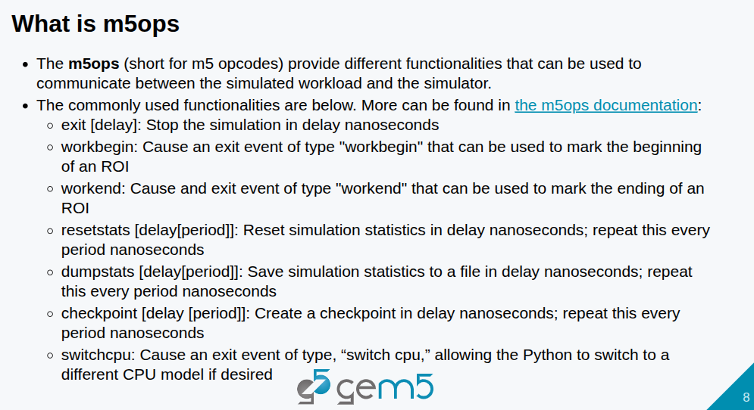
6.1 Run Gem5: Slides
https://gem5bootcamp.github.io/2024/#02-Using-gem5/03-running-in-gem5
Run Gem5: Slides

Slide 10
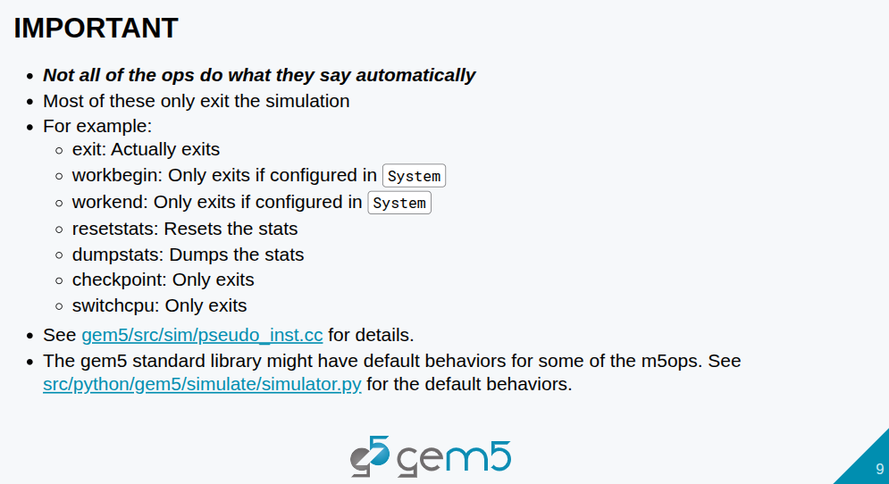
6.1 Run Gem5: Slides
https://gem5bootcamp.github.io/2024/#02-Using-gem5/03-running-in-gem5
Run Gem5: Slides

Slide 11
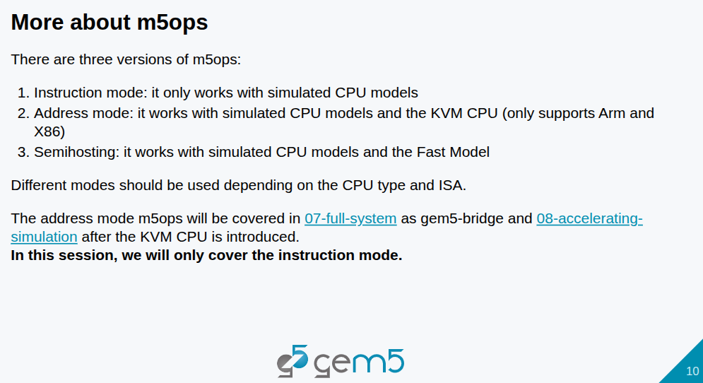
6.1 Run Gem5: Slides
https://gem5bootcamp.github.io/2024/#02-Using-gem5/03-running-in-gem5
Run Gem5: Slides

Slide 12
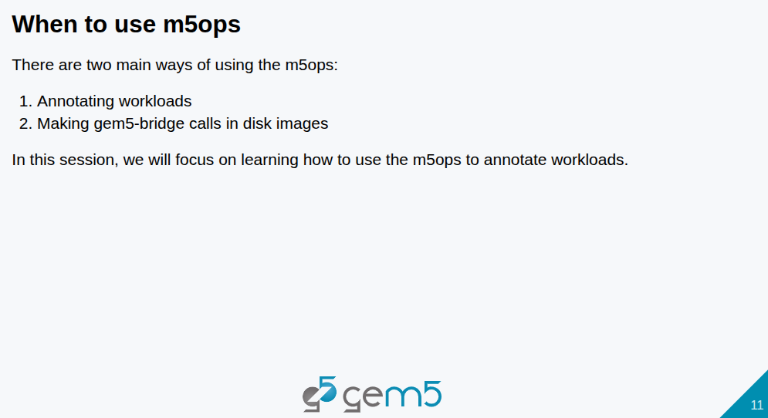
6.1 Run Gem5: Slides
https://gem5bootcamp.github.io/2024/#02-Using-gem5/03-running-in-gem5
Run Gem5: Slides

Slide 13
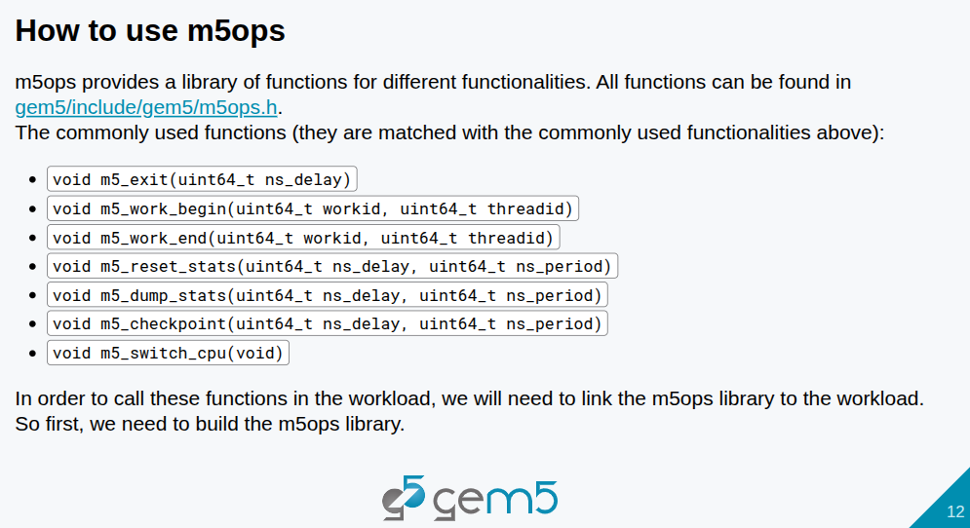
6.1 Run Gem5: Slides
https://gem5bootcamp.github.io/2024/#02-Using-gem5/03-running-in-gem5
Run Gem5: Slides

Slide 14
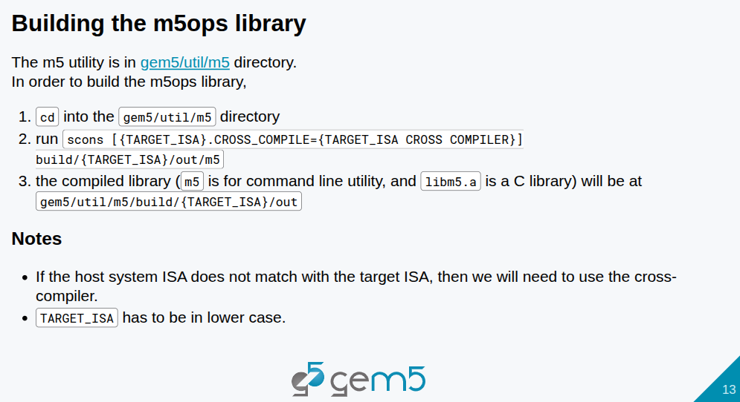
6.1 Run Gem5: Slides
https://gem5bootcamp.github.io/2024/#02-Using-gem5/03-running-in-gem5
Run Gem5: Slides

Slide 15
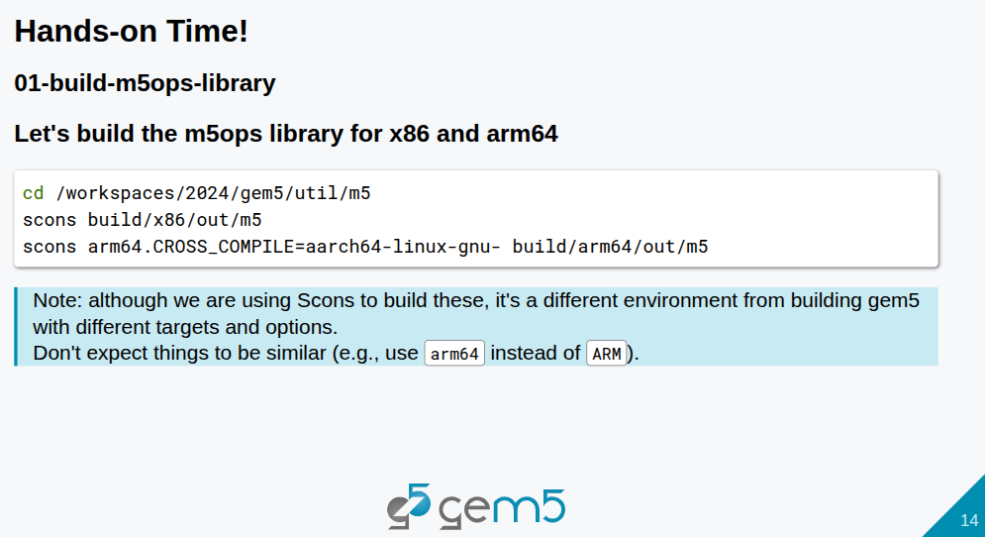
6.1 Run Gem5: Slides
https://gem5bootcamp.github.io/2024/#02-Using-gem5/03-running-in-gem5
Run Gem5: Slides

Slide 16
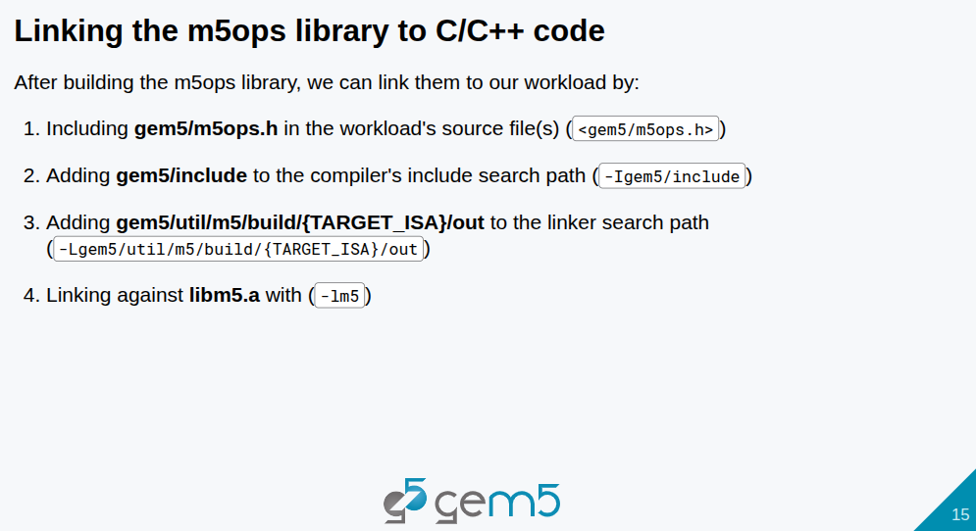
6.1 Run Gem5: Slides
https://gem5bootcamp.github.io/2024/#02-Using-gem5/03-running-in-gem5
Run Gem5: Slides

Slide 17
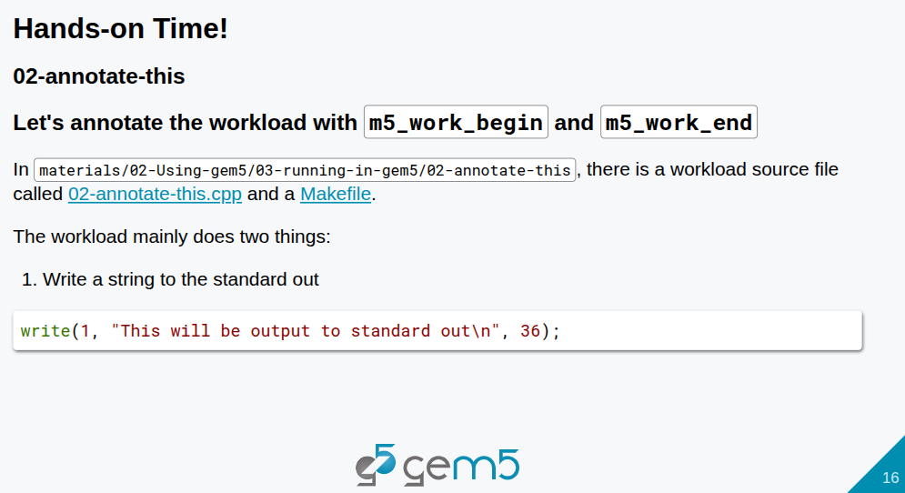
6.1 Run Gem5: Slides
https://gem5bootcamp.github.io/2024/#02-Using-gem5/03-running-in-gem5
Run Gem5: Slides

Slide 18
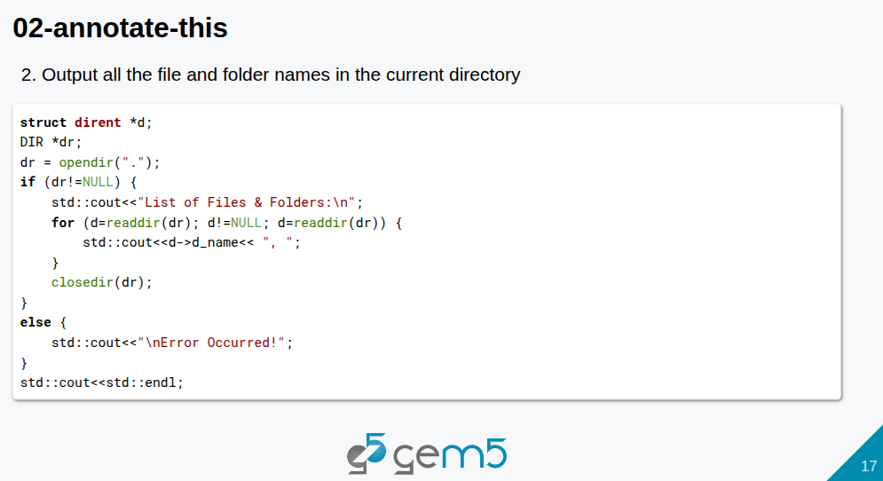
6.1 Run Gem5: Slides
https://gem5bootcamp.github.io/2024/#02-Using-gem5/03-running-in-gem5
Run Gem5: Slides

Slide 19
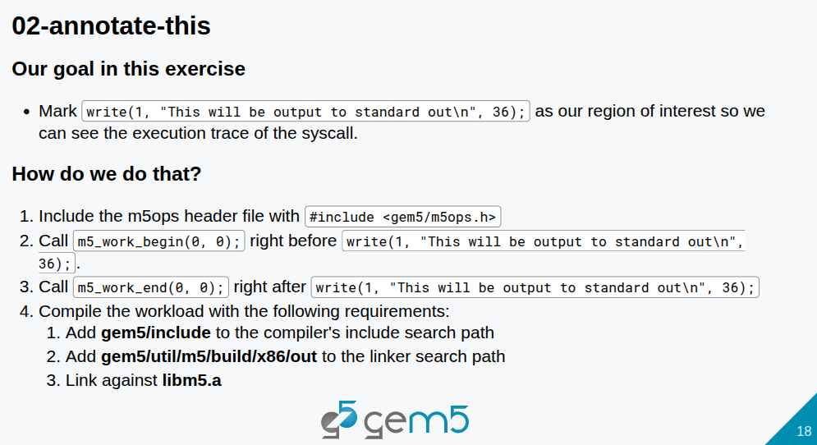
6.1 Run Gem5: Slides
https://gem5bootcamp.github.io/2024/#02-Using-gem5/03-running-in-gem5
Run Gem5: Slides

Slide 20
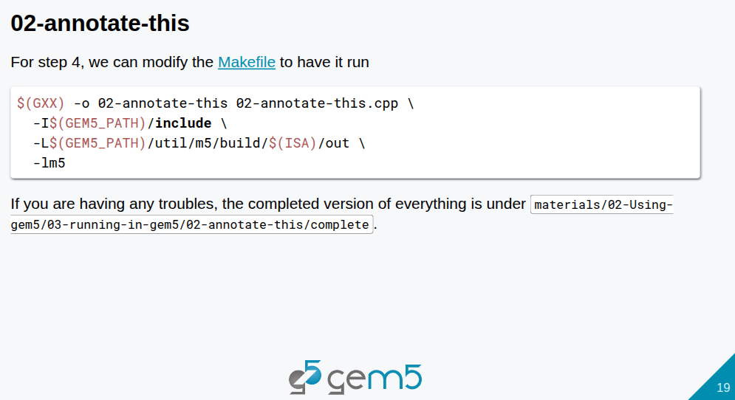
6.1 Run Gem5: Slides
https://gem5bootcamp.github.io/2024/#02-Using-gem5/03-running-in-gem5
Run Gem5: Slides

Slide 21
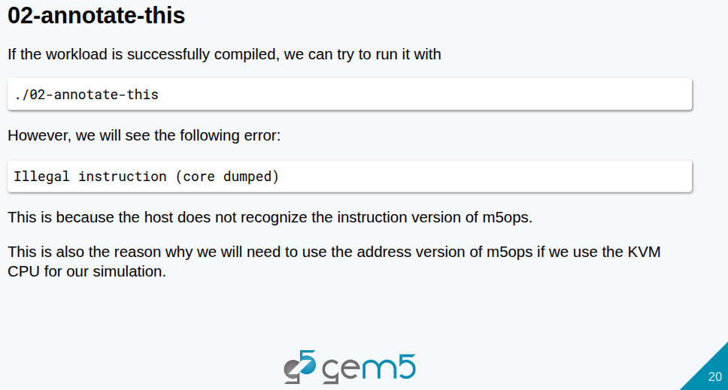
6.1 Run Gem5: Slides
https://gem5bootcamp.github.io/2024/#02-Using-gem5/03-running-in-gem5
Run Gem5: Slides

Slide 22
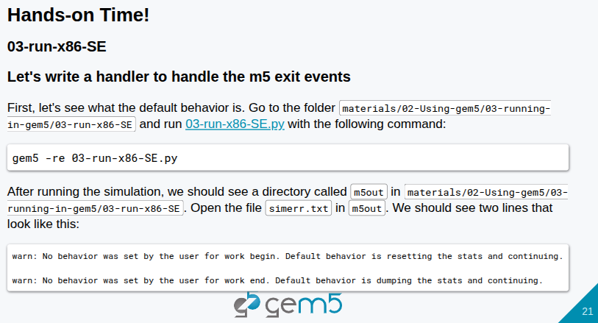
6.1 Run Gem5: Slides
https://gem5bootcamp.github.io/2024/#02-Using-gem5/03-running-in-gem5
Run Gem5: Slides

Slide 23
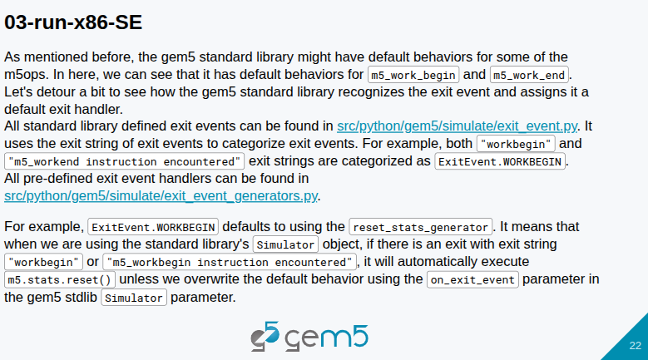
6.1 Run Gem5: Slides
https://gem5bootcamp.github.io/2024/#02-Using-gem5/03-running-in-gem5
Run Gem5: Slides

Slide 24
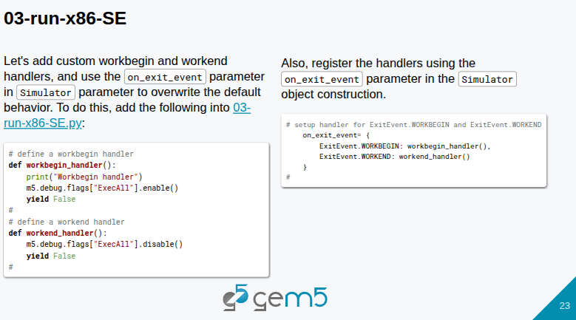
6.1 Run Gem5: Slides
https://gem5bootcamp.github.io/2024/#02-Using-gem5/03-running-in-gem5
Run Gem5: Slides

Slide 25
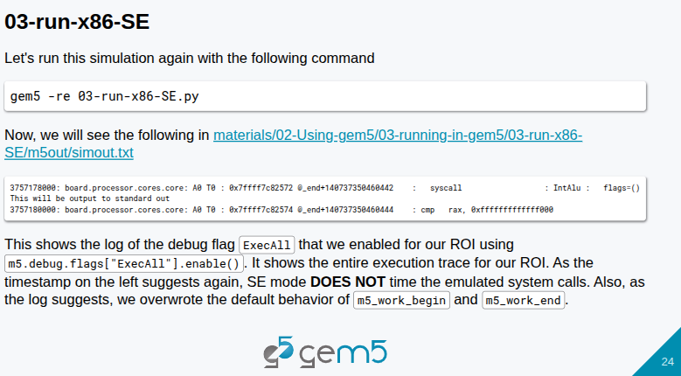
6.1 Run Gem5: Slides
https://gem5bootcamp.github.io/2024/#02-Using-gem5/03-running-in-gem5
Run Gem5: Slides

Slide 26
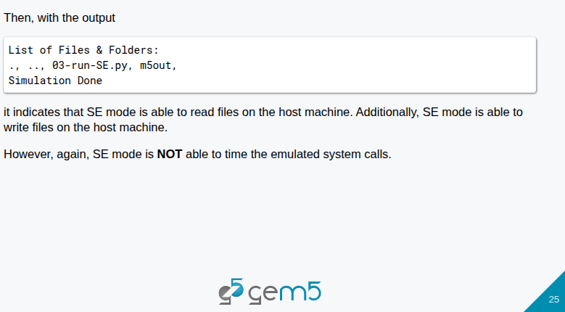
6.1 Run Gem5: Slides
https://gem5bootcamp.github.io/2024/#02-Using-gem5/03-running-in-gem5
Run Gem5: Slides

Slide 27
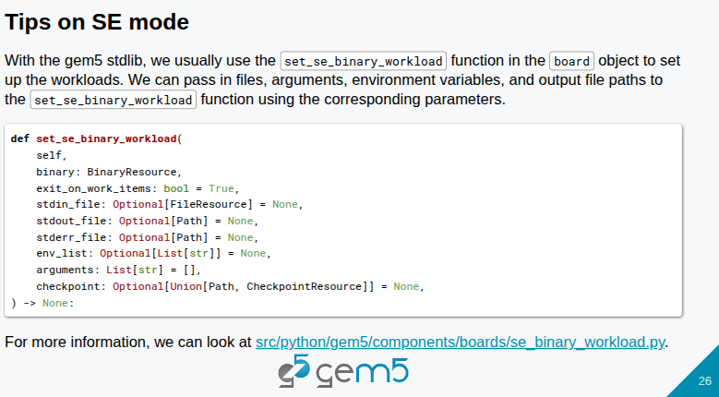
6.1 Run Gem5: Slides
https://gem5bootcamp.github.io/2024/#02-Using-gem5/03-running-in-gem5
Run Gem5: Slides

Slide 28
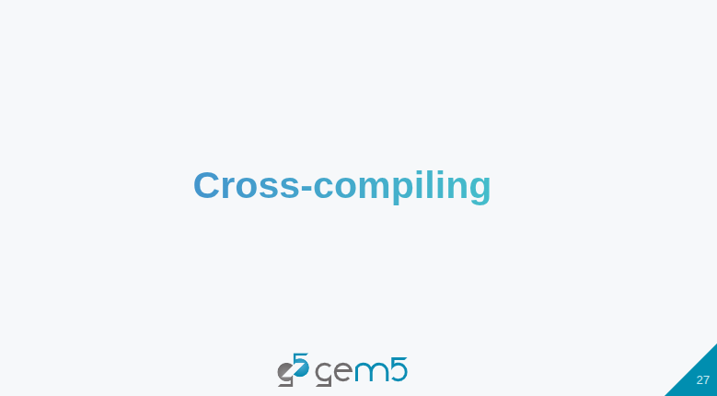
6.1 Run Gem5: Slides
https://gem5bootcamp.github.io/2024/#02-Using-gem5/03-running-in-gem5
Run Gem5: Slides

Slide 29
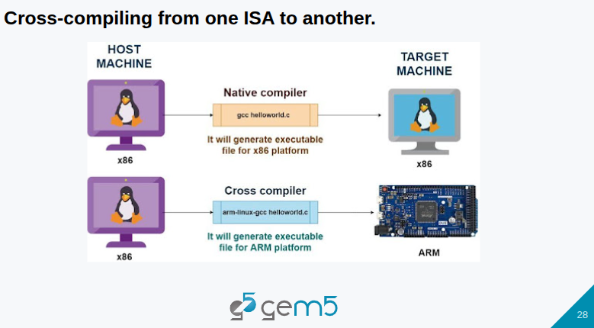
6.1 Run Gem5: Slides
https://gem5bootcamp.github.io/2024/#02-Using-gem5/03-running-in-gem5
Run Gem5: Slides

Slide 30
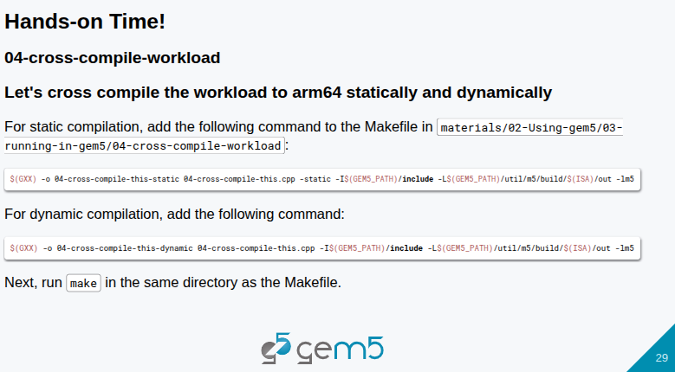
6.1 Run Gem5: Slides
https://gem5bootcamp.github.io/2024/#02-Using-gem5/03-running-in-gem5
Run Gem5: Slides

Slide 31
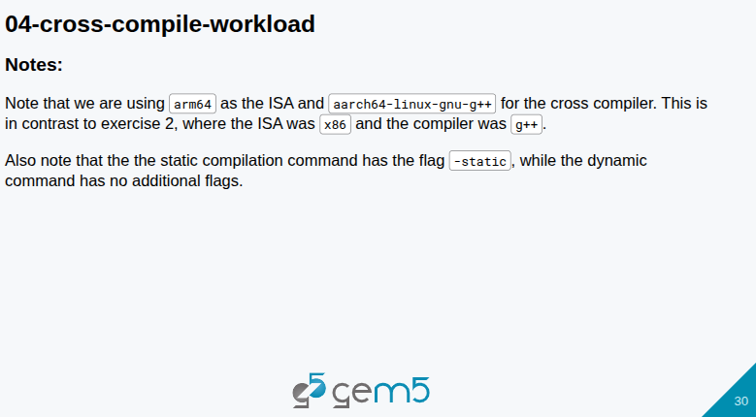
6.1 Run Gem5: Slides
https://gem5bootcamp.github.io/2024/#02-Using-gem5/03-running-in-gem5
Run Gem5: Slides

Slide 32
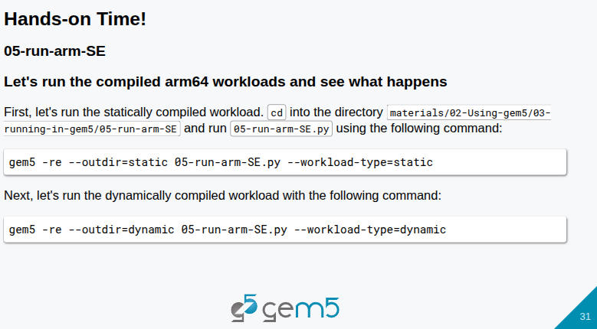
6.1 Run Gem5: Slides
https://gem5bootcamp.github.io/2024/#02-Using-gem5/03-running-in-gem5
Run Gem5: Slides

Slide 33
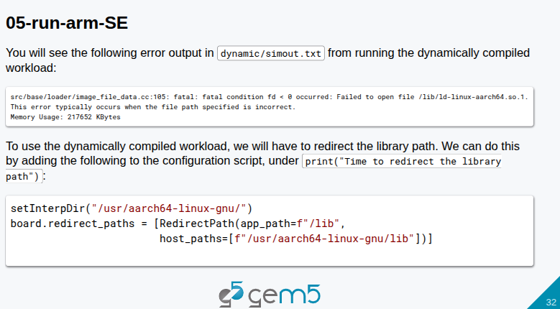
6.1 Run Gem5: Slides
https://gem5bootcamp.github.io/2024/#02-Using-gem5/03-running-in-gem5
Run Gem5: Slides
c

Slide 34
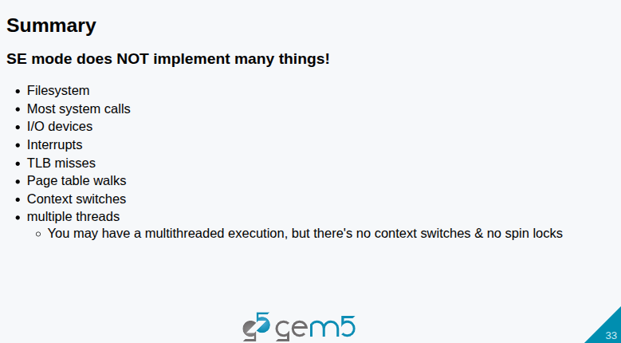
6.1 Run Gem5: Slides
https://gem5bootcamp.github.io/2024/#02-Using-gem5/03-running-in-gem5
Run Gem5: Slides

Slide 35
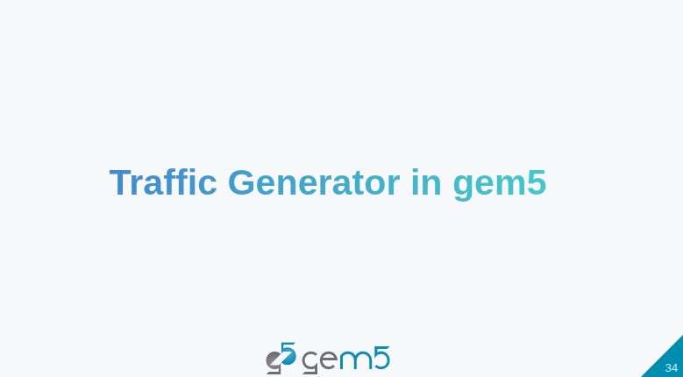
6.1 Run Gem5: Slides
https://gem5bootcamp.github.io/2024/#02-Using-gem5/03-running-in-gem5
Run Gem5: Slides

Slide 36
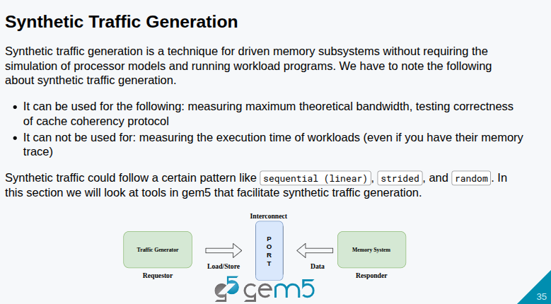
6.1 Run Gem5: Slides
https://gem5bootcamp.github.io/2024/#02-Using-gem5/03-running-in-gem5
Run Gem5: Slides

Slide 37
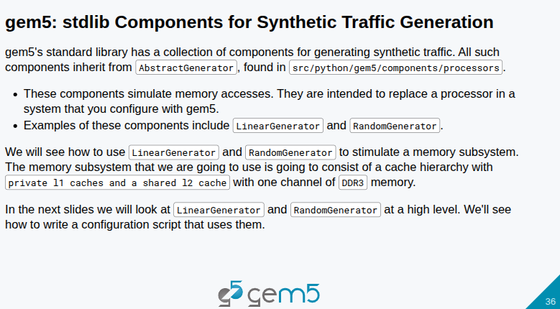
6.1 Run Gem5: Slides
https://gem5bootcamp.github.io/2024/#02-Using-gem5/03-running-in-gem5
Run Gem5: Slides

Slide 38
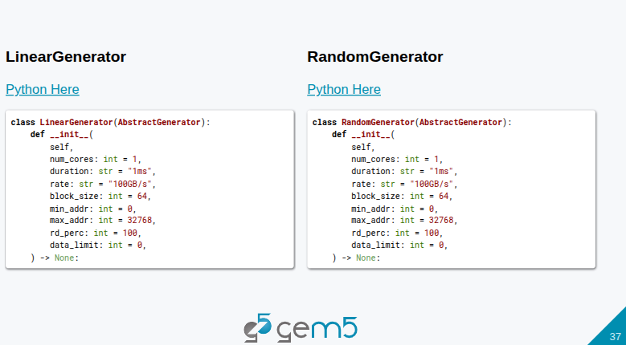
6.1 Run Gem5: Slides
https://gem5bootcamp.github.io/2024/#02-Using-gem5/03-running-in-gem5
Run Gem5: Slides

Slide 39
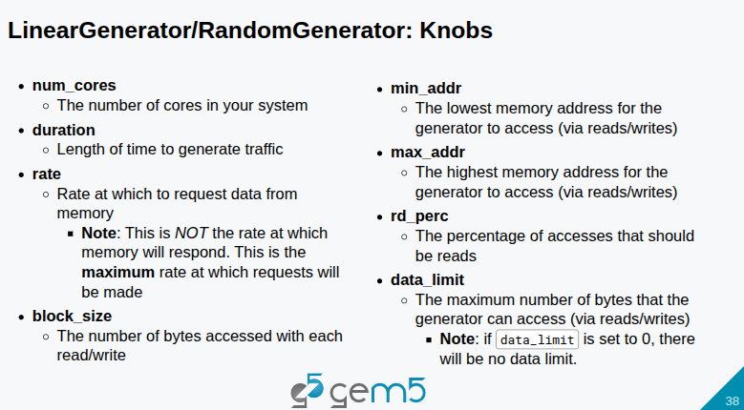
6.1 Run Gem5: Slides
https://gem5bootcamp.github.io/2024/#02-Using-gem5/03-running-in-gem5
Run Gem5: Slides

Slide 40
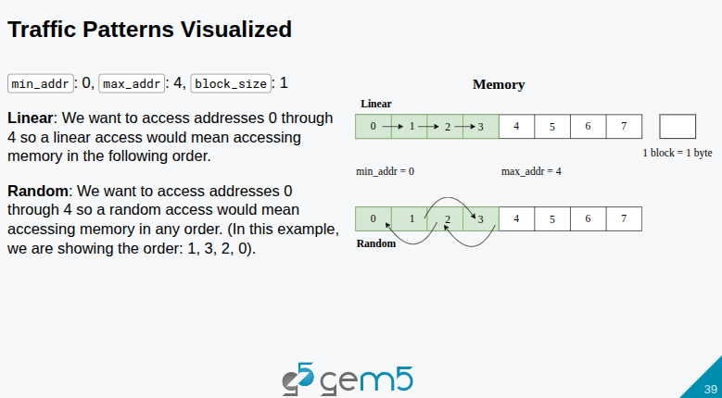
6.1 Run Gem5: Slides
https://gem5bootcamp.github.io/2024/#02-Using-gem5/03-running-in-gem5
Run Gem5: Slides

Slide 41
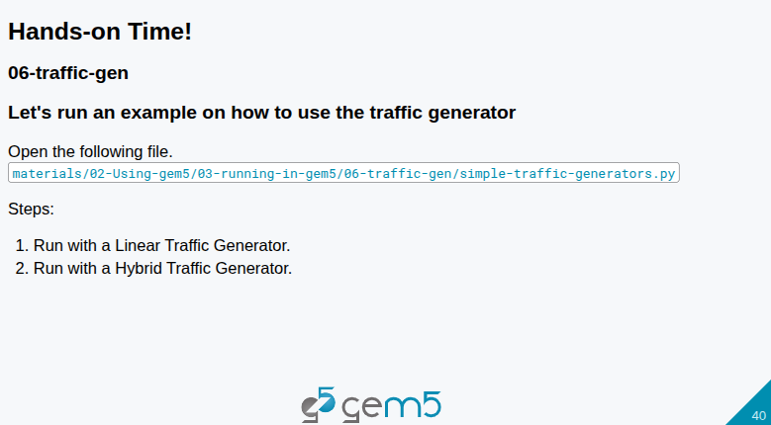
6.1 Run Gem5: Slides
https://gem5bootcamp.github.io/2024/#02-Using-gem5/03-running-in-gem5
Run Gem5: Slides

Slide 42
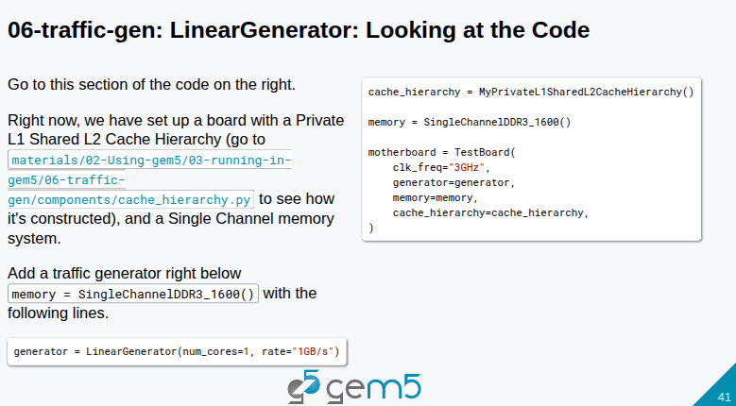
6.1 Run Gem5: Slides
https://gem5bootcamp.github.io/2024/#02-Using-gem5/03-running-in-gem5
Run Gem5: Slides

Slide 43
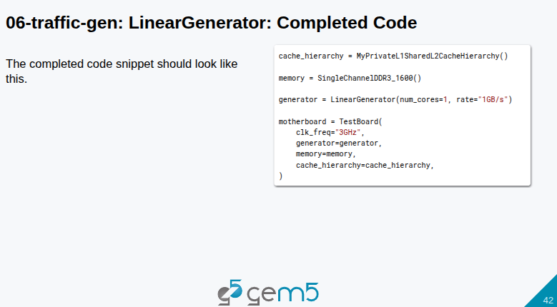
6.1 Run Gem5: Slides
https://gem5bootcamp.github.io/2024/#02-Using-gem5/03-running-in-gem5
Run Gem5: Slides

Slide 44
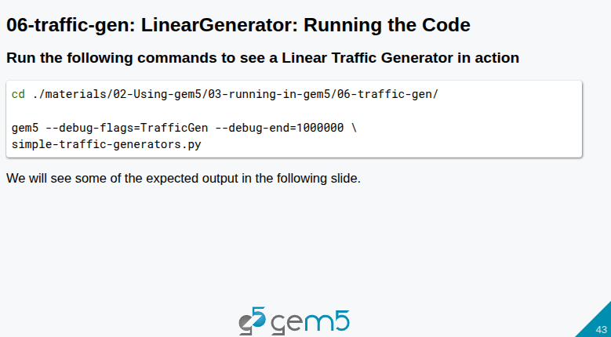
6.1 Run Gem5: Slides
https://gem5bootcamp.github.io/2024/#02-Using-gem5/03-running-in-gem5
Run Gem5: Slides

Slide 45
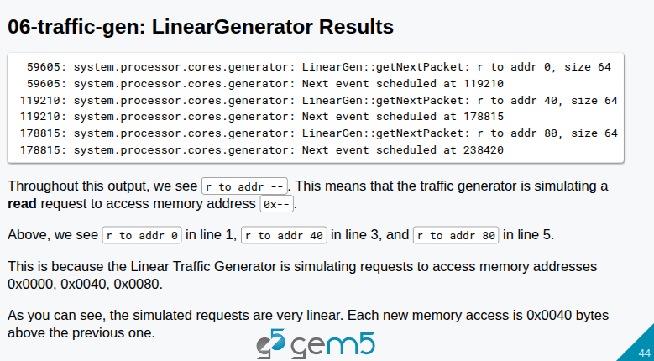
6.1 Run Gem5: Slides
https://gem5bootcamp.github.io/2024/#02-Using-gem5/03-running-in-gem5
Run Gem5: Slides

Slide 46
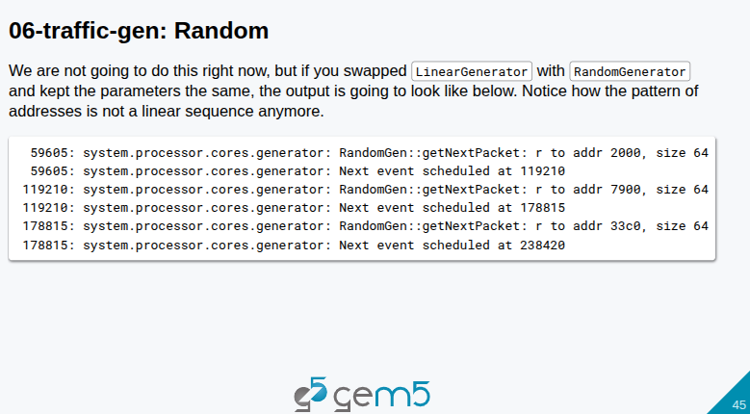
6.1 Run Gem5: Slides
https://gem5bootcamp.github.io/2024/#02-Using-gem5/03-running-in-gem5
Run Gem5: Slides

Slide 47
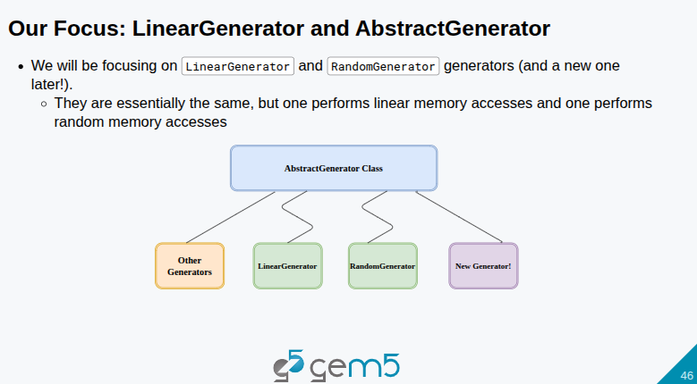
6.1 Run Gem5: Slides
https://gem5bootcamp.github.io/2024/#02-Using-gem5/03-running-in-gem5
Run Gem5: Slides

Slide 48
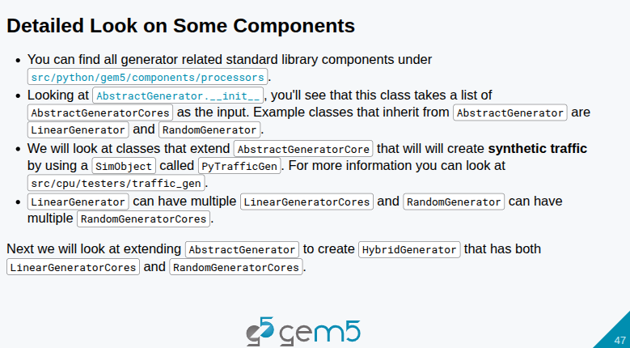
6.1 Run Gem5: Slides
https://gem5bootcamp.github.io/2024/#02-Using-gem5/03-running-in-gem5
Run Gem5: Slides

Slide 49
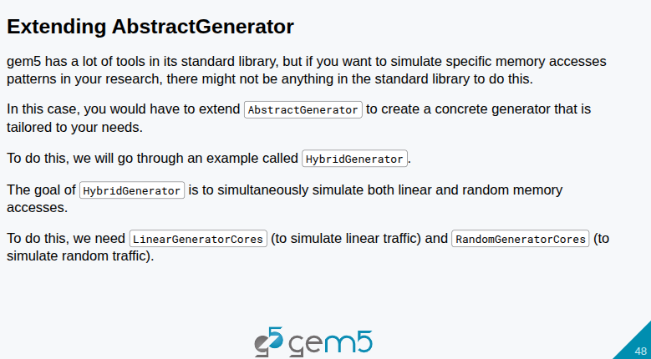
6.1 Run Gem5: Slides
https://gem5bootcamp.github.io/2024/#02-Using-gem5/03-running-in-gem5
Run Gem5: Slides

Slide 50
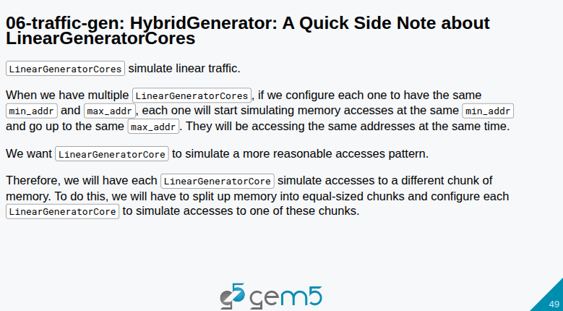
6.1 Run Gem5: Slides
https://gem5bootcamp.github.io/2024/#02-Using-gem5/03-running-in-gem5
Run Gem5: Slides

Slide 51
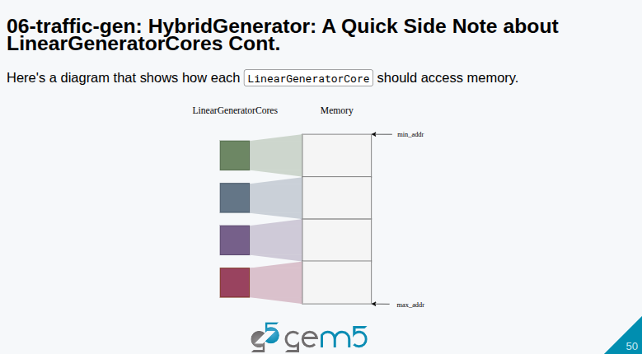
6.1 Run Gem5: Slides
https://gem5bootcamp.github.io/2024/#02-Using-gem5/03-running-in-gem5
Run Gem5: Slides

Slide 52
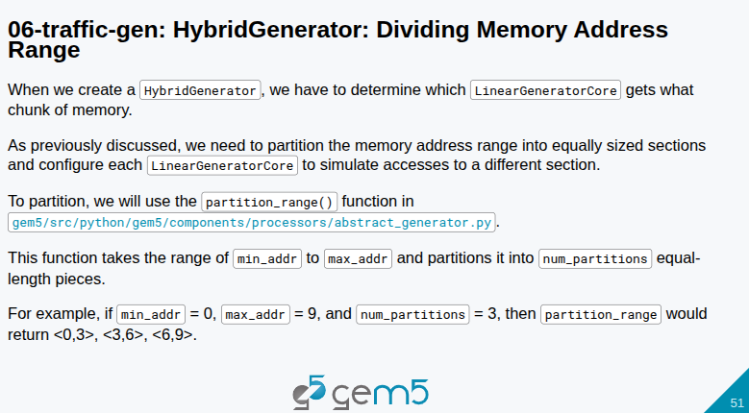
6.1 Run Gem5: Slides
https://gem5bootcamp.github.io/2024/#02-Using-gem5/03-running-in-gem5
Run Gem5: Slides

Slide 53

6.1 Run Gem5: Slides
https://gem5bootcamp.github.io/2024/#02-Using-gem5/03-running-in-gem5
Run Gem5: Slides

Slide 54

6.1 Run Gem5: Slides
https://gem5bootcamp.github.io/2024/#02-Using-gem5/03-running-in-gem5
Run Gem5: Slides

Slide 55

6.1 Run Gem5: Slides
https://gem5bootcamp.github.io/2024/#02-Using-gem5/03-running-in-gem5
Run Gem5: Slides

Slide 56

6.1 Run Gem5: Slides
https://gem5bootcamp.github.io/2024/#02-Using-gem5/03-running-in-gem5
Run Gem5: Slides

Slide 57

6.1 Run Gem5: Slides
https://gem5bootcamp.github.io/2024/#02-Using-gem5/03-running-in-gem5
Run Gem5: Slides

Slide 58

6.1 Run Gem5: Slides
https://gem5bootcamp.github.io/2024/#02-Using-gem5/03-running-in-gem5
Run Gem5: Slides

Slide 59

6.1 Run Gem5: Slides
https://gem5bootcamp.github.io/2024/#02-Using-gem5/03-running-in-gem5
Run Gem5: Slides

Slide 60

6.1 Run Gem5: Slides
https://gem5bootcamp.github.io/2024/#02-Using-gem5/03-running-in-gem5
Run Gem5: Slides

Slide 61

6.1 Run Gem5: Slides
https://gem5bootcamp.github.io/2024/#02-Using-gem5/03-running-in-gem5
Run Gem5: Slides

Slide 62

6.1 Run Gem5: Slides
https://gem5bootcamp.github.io/2024/#02-Using-gem5/03-running-in-gem5
Run Gem5: Slides

Slide 63

6.1 Run Gem5: Slides
https://gem5bootcamp.github.io/2024/#02-Using-gem5/03-running-in-gem5
Run Gem5: Slides

Slide 64

6.1 Run Gem5: Slides
https://gem5bootcamp.github.io/2024/#02-Using-gem5/03-running-in-gem5
Run Gem5: Slides

Slide 65

6.1 Run Gem5: Slides
https://gem5bootcamp.github.io/2024/#02-Using-gem5/03-running-in-gem5
Run Gem5: Slides

Slide 66

6.1 Run Gem5: Slides
https://gem5bootcamp.github.io/2024/#02-Using-gem5/03-running-in-gem5
Run Gem5: Slides

Slide 67

6.1 Run Gem5: Slides
https://gem5bootcamp.github.io/2024/#02-Using-gem5/03-running-in-gem5
Run Gem5: Slides

Slide 68

6.1 Run Gem5: Slides
https://gem5bootcamp.github.io/2024/#02-Using-gem5/03-running-in-gem5
Run Gem5: Slides

Slide 69

6.1 Run Gem5: Slides
https://gem5bootcamp.github.io/2024/#02-Using-gem5/03-running-in-gem5
Run Gem5: Slides

Slide 70

6.1 Run Gem5: Slides
https://gem5bootcamp.github.io/2024/#02-Using-gem5/03-running-in-gem5
Run Gem5: Slides

Slide 71

6.1 Run Gem5: Slides
https://gem5bootcamp.github.io/2024/#02-Using-gem5/03-running-in-gem5
Run Gem5: Slides

Slide 72

6.1 Run Gem5: Slides
https://gem5bootcamp.github.io/2024/#02-Using-gem5/03-running-in-gem5
Run Gem5: Slides

Slide 73
End

