Slide 1

12 Gem5 Checkpoint
Peter H. Chen

Slide 2

12 Gem5 Checkpoint
https://www.youtube.com/watch?v=JeOq90oDsPc&list=PL_hVbFs_loVR_8ntTTmmG6YEq3Po_4snu&index=12
Gem5 Checkpoint (0:00-0:01/13.32)
We talk Gem5checkpoint.

Slide 3
12.1 Topics

Slide 4
12.1 Topics
https://www.youtube.com/watch?v=JeOq90oDsPc&list=PL_hVbFs_loVR_8ntTTmmG6YEq3Po_4snu&index=12
Topics (0:01-0:02/13.32)
Topics:
1. Review of KVM Fast-Forward
2. Gem5 Checkpoint
3. Checkpoint and Restore
4. KVM
4.1 KVM advantage
a. It is fast-forward at nearly the host native speed.
b. It is flexible to simulation system change
c. It is flexible to workload and software changes.
4.2 KVM disadvantage
a. It is Non-deterministic
b. The host must match the guest ISA (Instruction Set Architecture)
c. Currently, we do not have the RISCV support for KVM.
5. Checkpoint
5.1 Checkpoint advantage
a. We can create one and run it many times and may have different system
b. Almost all devices and components are supported.
5.2 Checkpoint disadvantage
a. It cannot change workload and software at all between the checkpointing and restoring.
b. Checkpoint have restrictions on simulation system changes between checkpoint and restore script.
c. Checkpoint require disk space.

Slide 5
12.2 Review KVM Fast-Forward

Slide 6
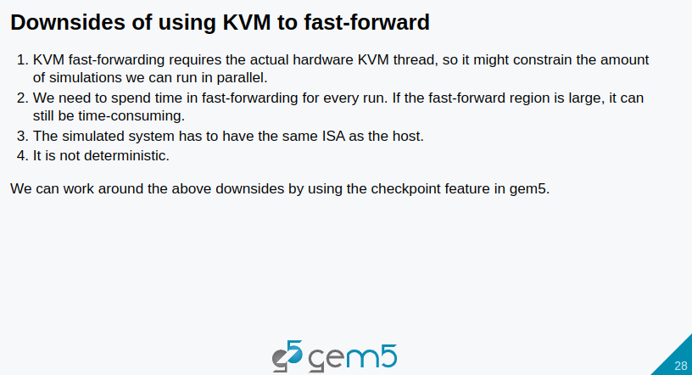
12.2 Review KVM Fast-Forward
https://www.youtube.com/watch?v=JeOq90oDsPc&list=PL_hVbFs_loVR_8ntTTmmG6YEq3Po_4snu&index=12
Review KVM Fast-Forward (0:03-0:56/13.32)
Before we talk about the checkpoint, we want to recap the downside of KVM Fast-Forward.
1. KVM requires actual hardware for KVM threads to fast-forward.
2. We need to spend time in fast forwarding. If the fast forward region is large, the KVM is very slow.
3. The simulated system have to be the same ISA as the host.
4. The KVM is not deterministic.
Checkpoint have work around for some of the downside that listed above.
5. However, the KVM is very useful if we need to frequently change our software. For checkpoint, we need to retake the checkpoint if we change any bit of our software. Therefore, If we need to change the software frequently, then KVM is better than the check point.

Slide 7
12.3 Gem5 Checkpoint

Slide 8
12.3 Gem5 Checkpoint
https://www.youtube.com/watch?v=JeOq90oDsPc&list=PL_hVbFs_loVR_8ntTTmmG6YEq3Po_4snu&index=12
Checkpoint(0:57-1:00/13.32)
Let us move on Gem5 checkpoint.

Slide 9
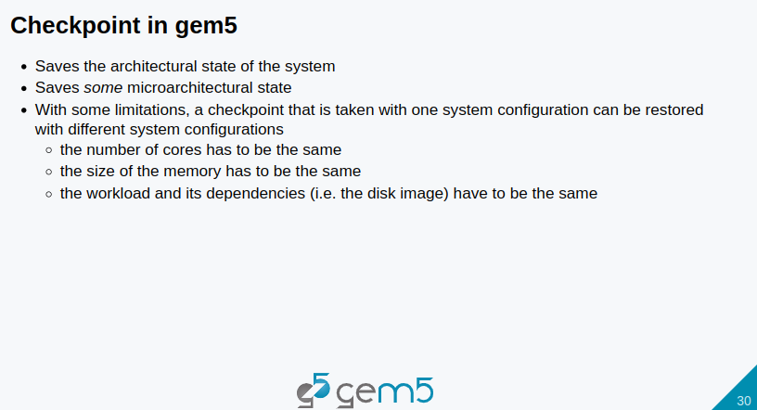
12.3 Gem5 Checkpoint
https://www.youtube.com/watch?v=JeOq90oDsPc&list=PL_hVbFs_loVR_8ntTTmmG6YEq3Po_4snu&index=12
Checkpoint (1:01-1:31/13.32)
1. Gem5 checkpoint saves the architectural state of the system.
2. Gem5 checkpoint also some micro-architectural state
3. With some limitation, a checkpoint that is taken with one system configuration can be restored with different system configurations.
The limitation
  3.1 includes the number of codes has to be the same.
  3.2 The size of memory has to be the same
  3.3 The workload and its dependencies, including the disk image, have to be the same.

Slide 10
12.4 Checkpoint and Restore

Slide 11
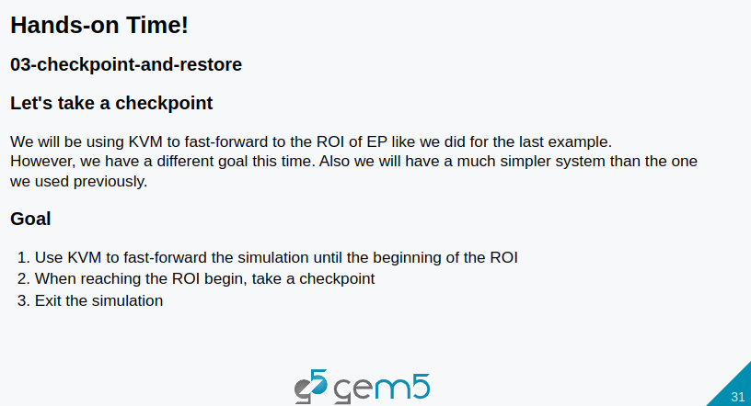
12.4 Checkpoint and Restore
https://www.youtube.com/watch?v=JeOq90oDsPc&list=PL_hVbFs_loVR_8ntTTmmG6YEq3Po_4snu&index=12
Checkpoint and Restore (1:32-2:10/13:32)
1. In the previous KVM discussion, we used KVM for fast-forwarding to the ROI (Region of Interest) of the EP (Execution Point) and Workload.
2. In the checkpoint, we will use the same KVM with different goal and we will use a much simpler system than we used in the KVM example.
3. Our goal here is to:
  3.1 Use KVM to fast forward the simulation until the beginning of ROI.
  3.2 When reaching the ROI begin, we would take a checkpoint
  3.3 Then, we exit the simulation.

Slide 12
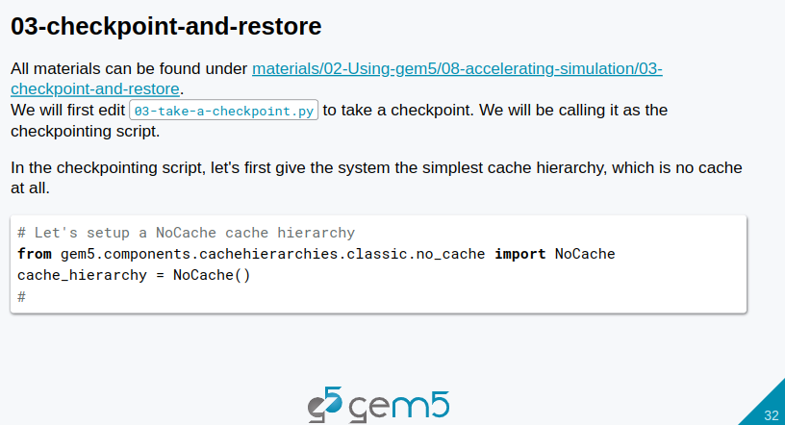
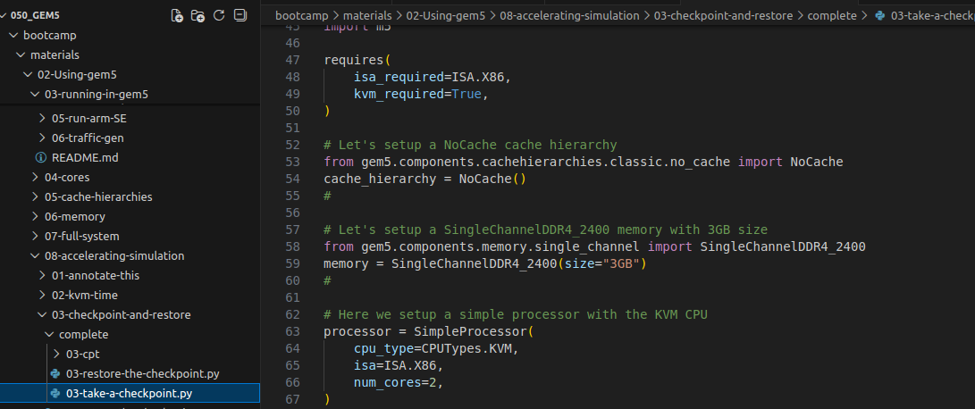
12.4 Checkpoint and Restore
https://www.youtube.com/watch?v=JeOq90oDsPc&list=PL_hVbFs_loVR_8ntTTmmG6YEq3Po_4snu&index=12
Checkpoint and Restore (2:11-3:00/13:32)
1. All the codes can be found under ~bootcamp/materials/02-Using-gem5/08-accelerating-simulation/03-checkpoint-and-restore/complete directory.
2. We look at 03-take-a-checkpoint.py

Slide 13
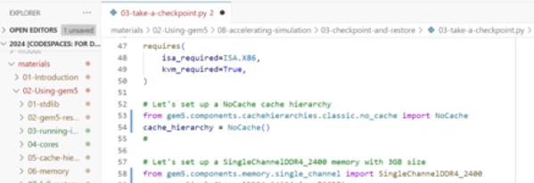
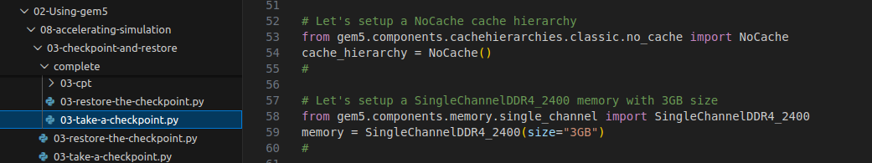
12.4 Checkpoint and Restore
https://www.youtube.com/watch?v=JeOq90oDsPc&list=PL_hVbFs_loVR_8ntTTmmG6YEq3Po_4snu&index=12
Checkpoint and Restore (3:01-4:10/13:32)
1. First, we setup the NoCache Cache Hierarchy for memory.
Since we can restore, our checkpoint is different from the checkpointing system.
We can use a simple gem5/components/cache hierarchies/no cache for fast simulation speed
> from gem5.components.cachehierarchies.no_cache import NoCache
> cache_hierarchy = NoCache ()

Slide 14
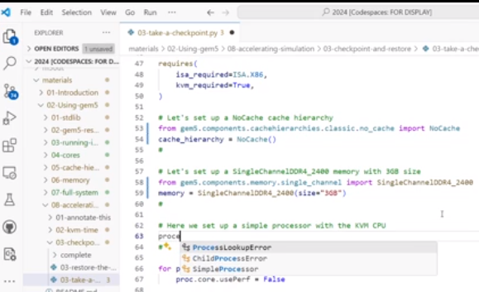
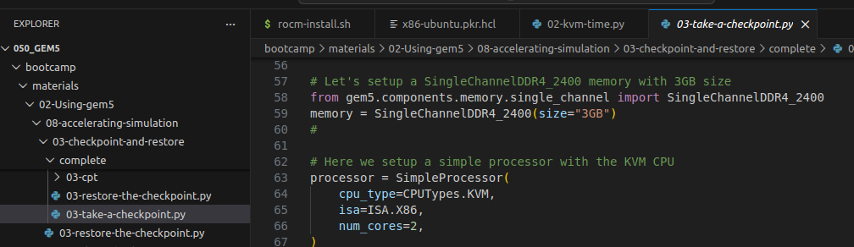
12.4 Checkpoint and Restore
https://www.youtube.com/watch?v=JeOq90oDsPc&list=PL_hVbFs_loVR_8ntTTmmG6YEq3Po_4snu&index=12
Checkpoint and Restore (4:11-4:45/13:32)
2. Second, we import the memory library and set memory size 3GB
> from gem5.components.memory import DualChannelDDR4_2400
> memory = DualChannelDDR4_2400 (size = “3GB”)

Slide 15
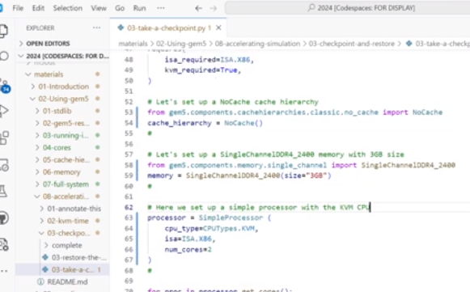
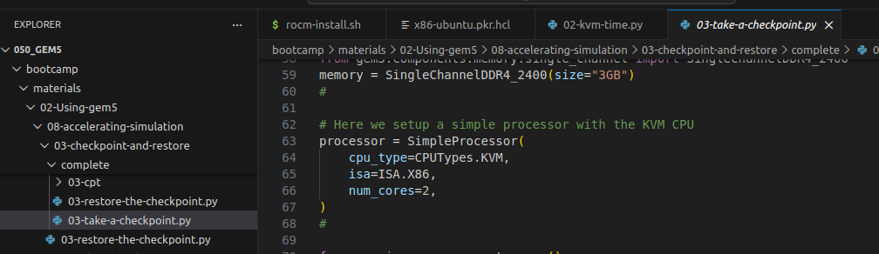
12.4 Checkpoint and Restore
https://www.youtube.com/watch?v=JeOq90oDsPc&list=PL_hVbFs_loVR_8ntTTmmG6YEq3Po_4snu&index=12
Checkpoint and Restore (4:11-5:10/13:32)
3. Third, we set set the processor.
>processor = SimpleProcessor (
> # We use the Simple Processor.
> cpu_type = CPUTypes.KVM
> # For CUP Types, we use KVM
> num_cores = 2)

Slide 16
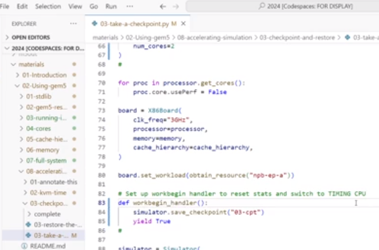
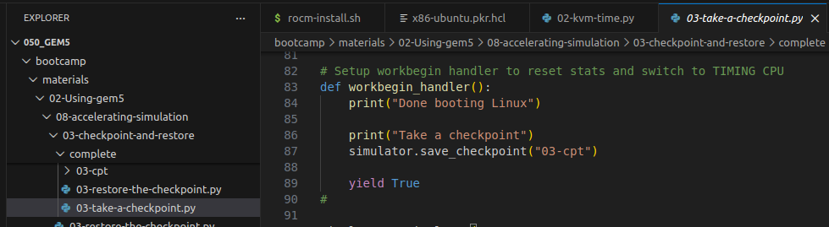
12.4 Checkpoint and Restore
https://www.youtube.com/watch?v=JeOq90oDsPc&list=PL_hVbFs_loVR_8ntTTmmG6YEq3Po_4snu&index=12
Checkpoint and Restore (5:11-5:30/13:32)
4. Fourth, we define the word begin handler.
> We use simulator.save_checkpoint () function and save with the folder name “03-cpt”
> Then, we use “yield” to exit the checkpoint afterward.
> we print the message inside the checkpoint function.

Slide 17
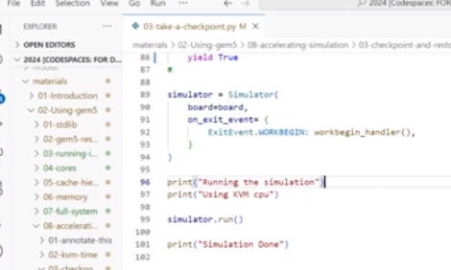
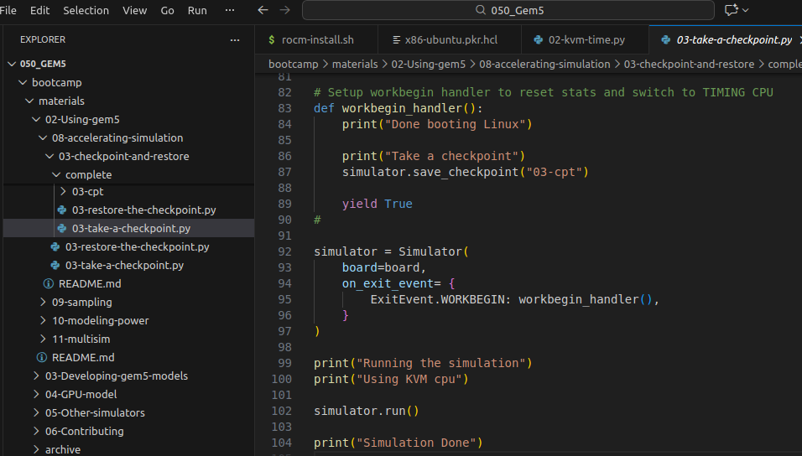
12.4 Checkpoint and Restore
https://www.youtube.com/watch?v=JeOq90oDsPc&list=PL_hVbFs_loVR_8ntTTmmG6YEq3Po_4snu&index=12
Checkpoint and Restore (5:31-6:19/13:32)
5. Fifth, we print the message after the simulation.
That is the script for the checkpoint.

Slide 18
12.4 Checkpoint and Restore
https://www.youtube.com/watch?v=JeOq90oDsPc&list=PL_hVbFs_loVR_8ntTTmmG6YEq3Po_4snu&index=12
Checkpoint and Restore (6:20-7:20/13:32)
Now, let’s run the script
> cd ~/<bootcamp>/materials/02-Using-gem5/08-accelerating/03-checkpoint-and-restore/complete
> ln -s <gem5-path>/build/ALL/gem5.opt .
> ./gem5.opt -re --outdir=checkpointing-m5-out 03-take-a-checkpoint.py
>> It will take a while (10 to 20 min) to finish.

Slide 19
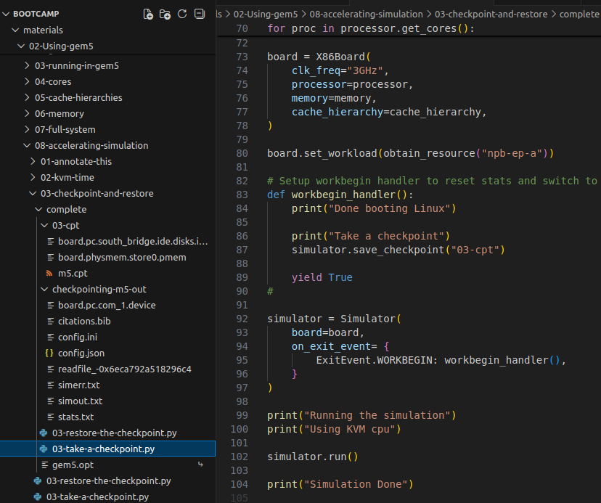
12.4 Checkpoint and Restore
https://www.youtube.com/watch?v=JeOq90oDsPc&list=PL_hVbFs_loVR_8ntTTmmG6YEq3Po_4snu&index=12
Checkpoint and Restore (7:21-07:30/13:32)
We can see directory “checkpointing-m5-out” and “03-cpt” are generated.
In checkpoint-m5-out
There are files: board.pc.com_1.device, citataion.bib, config.ini, config.json, simerr.txt, simout.txt, stats.txt.

Slide 20
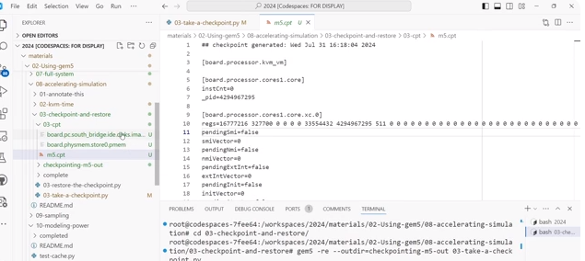
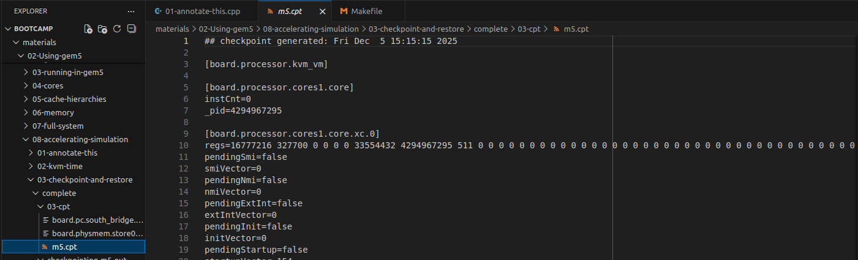
12.4 Checkpoint and Restore
https://www.youtube.com/watch?v=JeOq90oDsPc&list=PL_hVbFs_loVR_8ntTTmmG6YEq3Po_4snu&index=12
Checkpoint and Restore (07:31-08:00/13:32)
In 03-cpt (checkpoint timer) directory, we have m5.cpt file which record all the saved information.
The file contains the memory, image disk,
Here, we restore this checkpoint.

Slide 21
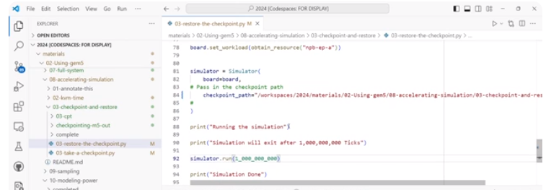
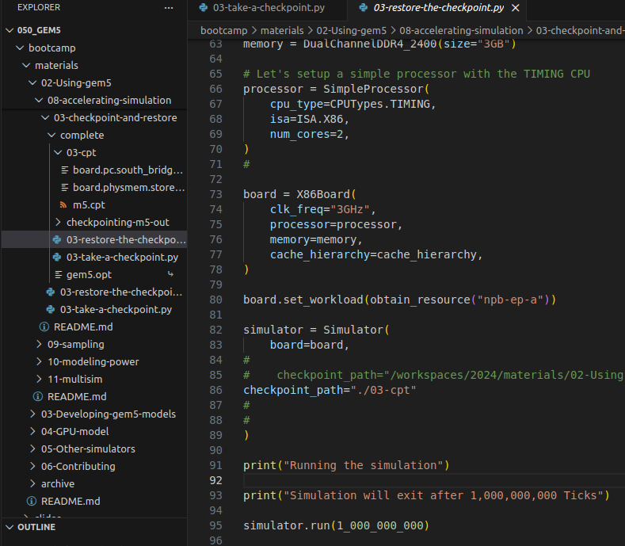
12.4 Checkpoint and Restore
https://www.youtube.com/watch?v=JeOq90oDsPc&list=PL_hVbFs_loVR_8ntTTmmG6YEq3Po_4snu&index=12
Checkpoint and Restore (08:01-08:55/13:32)
In the 03-restore-the-checkpont.py,
1. we passed in the path “./03_cpt”
2. We set run time to 1 ms (1_000_000_000). Gem5 time unit (tick) is 1 ps (10^-12). 10^9 x 10^-12 = 10^-3 sec = 1 ms.

Slide 22
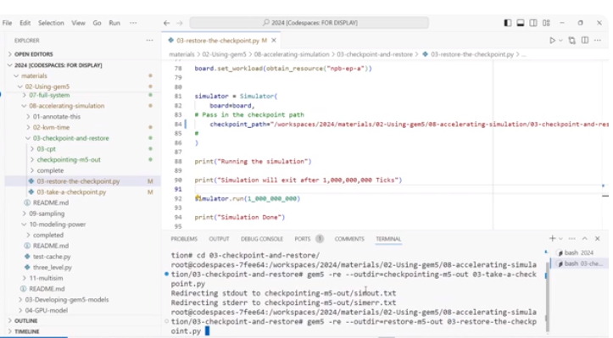
12.4 Checkpoint and Restore
https://www.youtube.com/watch?v=JeOq90oDsPc&list=PL_hVbFs_loVR_8ntTTmmG6YEq3Po_4snu&index=12
Checkpoint and Restore (08:56-09:20/13:32)
We run the restore.
> ./gem5.opt -re --outdir=restore-m5-out 03-restore-the-checkpoint.py

Slide 23
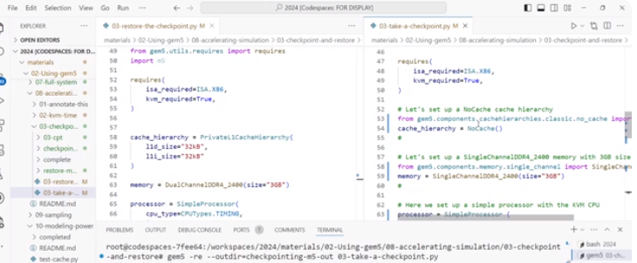
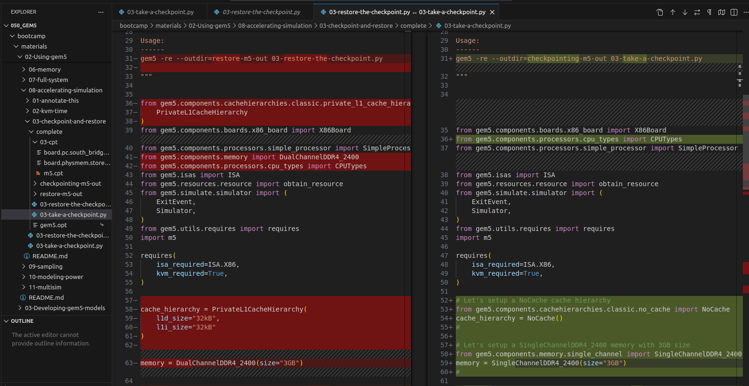
12.4 Checkpoint and Restore
https://www.youtube.com/watch?v=JeOq90oDsPc&list=PL_hVbFs_loVR_8ntTTmmG6YEq3Po_4snu&index=12
Checkpoint and Restore (09:21-09:20/13:32)
Compare the left: 03-restore-the-checkpoint.py and right: 03-take-a-checkpoint.py

Slide 24
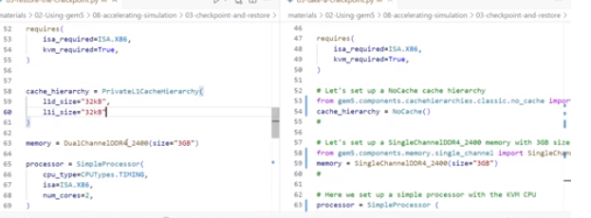
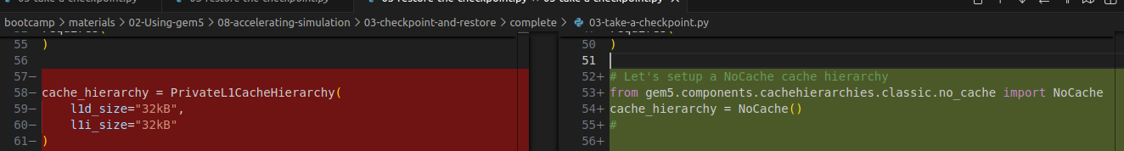
12.4 Checkpoint and Restore
https://www.youtube.com/watch?v=JeOq90oDsPc&list=PL_hVbFs_loVR_8ntTTmmG6YEq3Po_4snu&index=12
Checkpoint and Restore (09:21-09:50/13:32)
1. left: 03-restore-the-checkpoint.py; Hierarchy we use is a private cache L1D= 32KB, L1I = 32KB.
2. right: 03-take-a-checkpoint.py; We have no cache in take a checkpoint script.

Slide 25
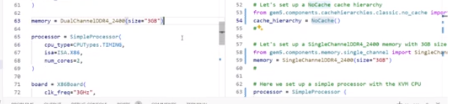
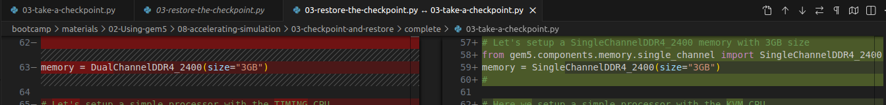
12.4 Checkpoint and Restore
https://www.youtube.com/watch?v=JeOq90oDsPc&list=PL_hVbFs_loVR_8ntTTmmG6YEq3Po_4snu&index=12
Checkpoint and Restore (09:51-10:00/13:32)
1. left: 03-restore-the-checkpoint.py; We use dual channel DDR4 Memory
2. right: 03-take-a-checkpoint.py; We use single channel DDR4 memory.

Slide 26
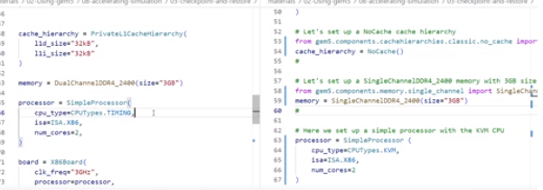
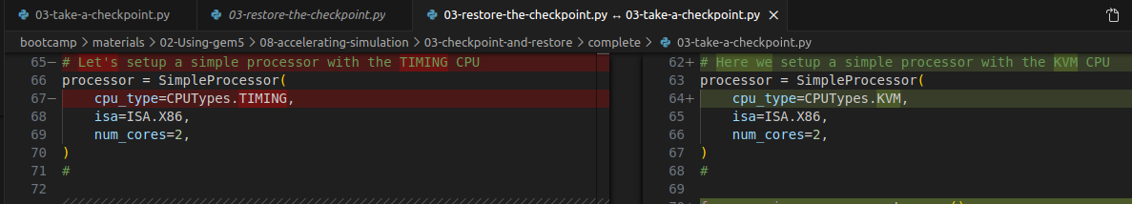
12.4 Checkpoint and Restore
https://www.youtube.com/watch?v=JeOq90oDsPc&list=PL_hVbFs_loVR_8ntTTmmG6YEq3Po_4snu&index=12
Checkpoint and Restore (10:01-10:10/13:32)
1. left: 03-restore-the-checkpoint.py; We used Timing CPU.
2. right: 03-take-a-checkpoint.py; We use KVM CPU.

Slide 27
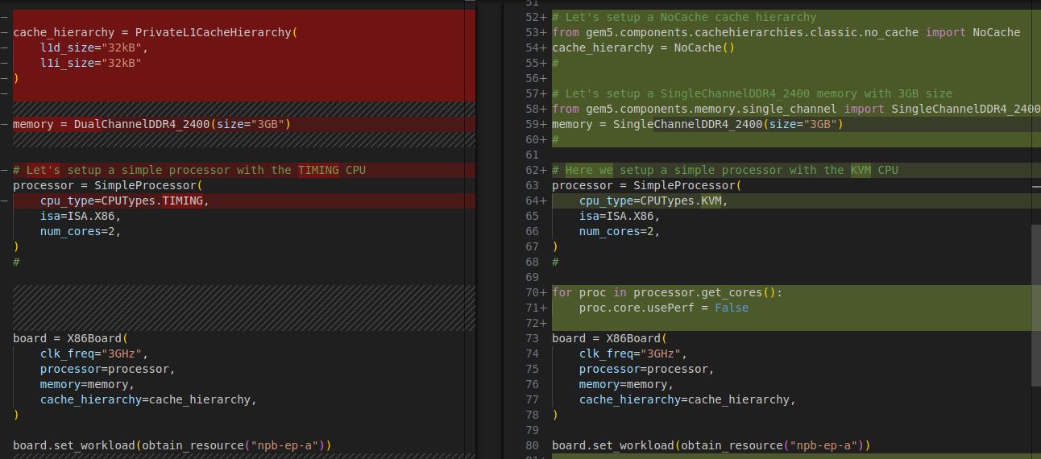
12.4 Checkpoint and Restore
https://www.youtube.com/watch?v=JeOq90oDsPc&list=PL_hVbFs_loVR_8ntTTmmG6YEq3Po_4snu&index=12
Checkpoint and Restore (10:11-10:22/13:32)
1. Number of core = 2
2. Memory = 3GB
3. workload (Simulation benchmark) = “npb-ep-a)
are exactly the same in both restore checkpoint and take a checkpoint.
2
1
3

Slide 28
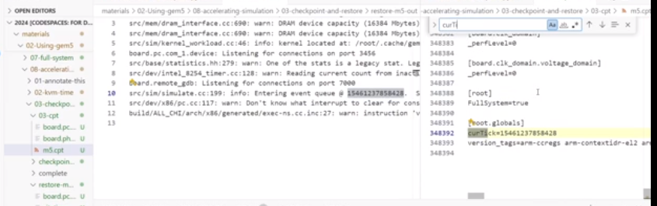
12.4 Checkpoint and Restore
https://www.youtube.com/watch?v=JeOq90oDsPc&list=PL_hVbFs_loVR_8ntTTmmG6YEq3Po_4snu&index=12
Checkpoint and Restore (10:23-11:15/13:32)
We have finished restore checkpoint and take a checkpoint.
First, we look at the output of simerr.txt of the restore.
In the restore/simerr.txt, we can see the simulation start from this tick instead of zero.
If we look o3_cpt/m5.cpt (checkpoint), we can see the simulation start from our restore script.

Slide 29
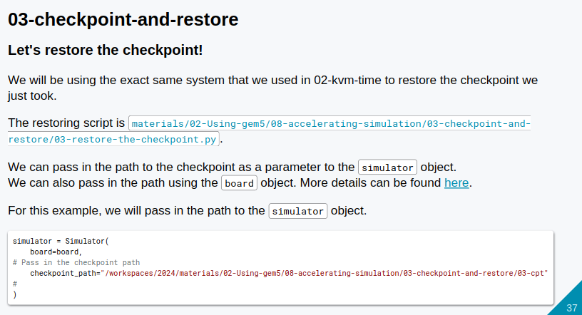
12.4 Checkpoint and Restore
https://www.youtube.com/watch?v=JeOq90oDsPc&list=PL_hVbFs_loVR_8ntTTmmG6YEq3Po_4snu&index=12
Checkpoint and Restore (11:16-11:17/13:32)
We are almost done with checkpoint here.

Slide 30
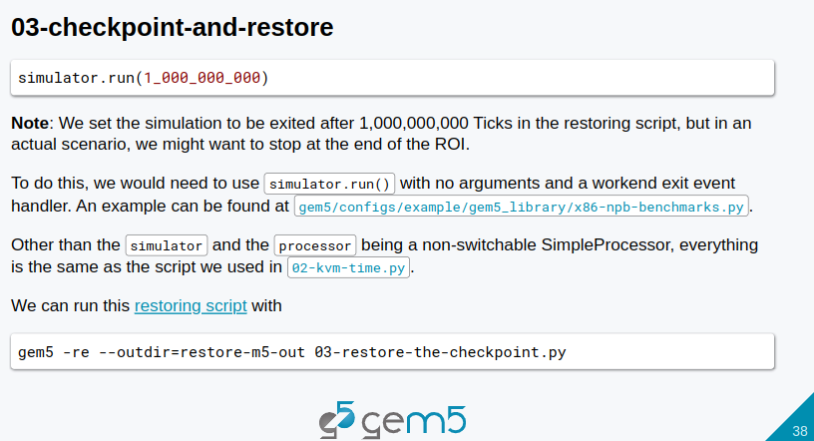
12.4 Checkpoint and Restore
https://www.youtube.com/watch?v=JeOq90oDsPc&list=PL_hVbFs_loVR_8ntTTmmG6YEq3Po_4snu&index=12
Checkpoint and Restore (11:18-12:19/13:32)
We are almost done with checkpoint here.

Slide 31
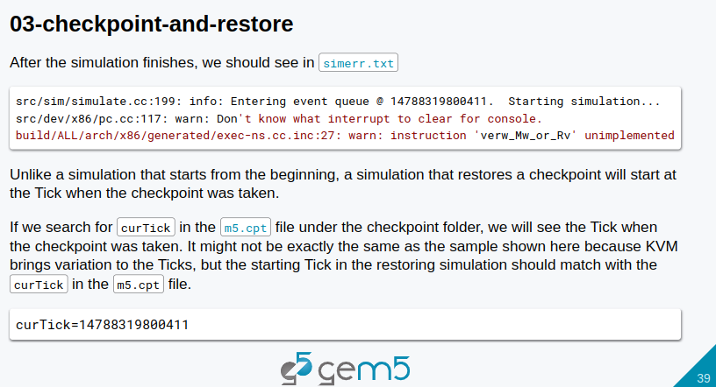
12.4 Checkpoint and Restore
https://www.youtube.com/watch?v=JeOq90oDsPc&list=PL_hVbFs_loVR_8ntTTmmG6YEq3Po_4snu&index=12
Checkpoint and Restore (11:20-12:21/13:32)
We are almost done with checkpoint here.

Slide 32
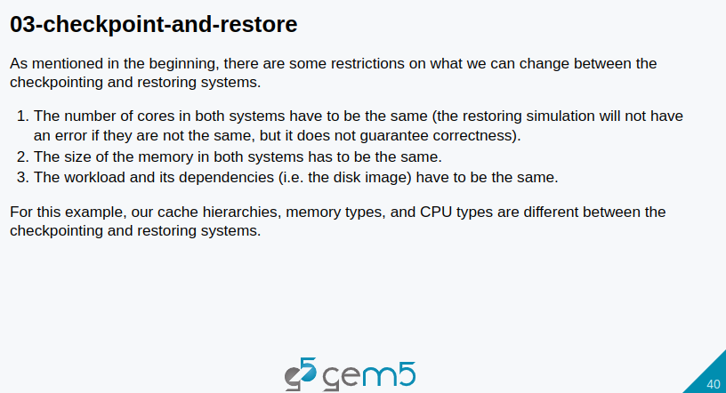
12.4 Checkpoint and Restore
https://www.youtube.com/watch?v=JeOq90oDsPc&list=PL_hVbFs_loVR_8ntTTmmG6YEq3Po_4snu&index=12
Checkpoint and Restore (11:22-12:23/13:32)
We are almost done with checkpoint here.

Slide 33
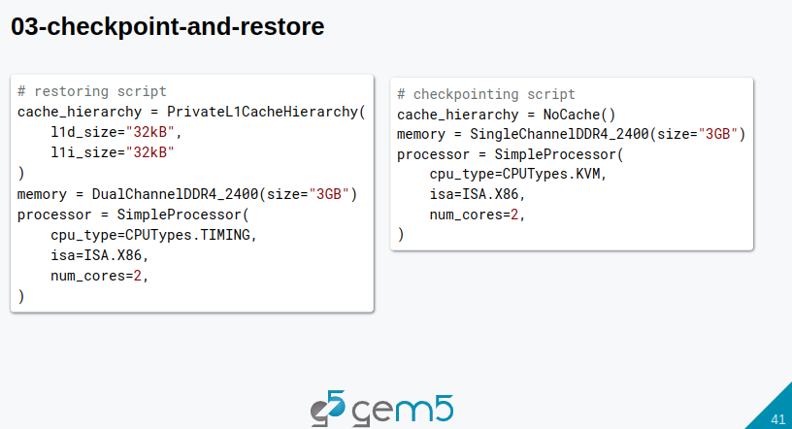
12.4 Checkpoint and Restore
https://www.youtube.com/watch?v=JeOq90oDsPc&list=PL_hVbFs_loVR_8ntTTmmG6YEq3Po_4snu&index=12
Checkpoint and Restore (11:24-12:25/13:32)
We are almost done with checkpoint here.

Slide 34
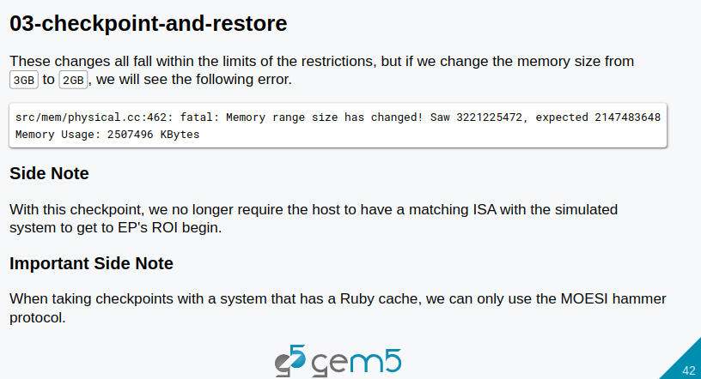
12.4 Checkpoint and Restore
https://www.youtube.com/watch?v=JeOq90oDsPc&list=PL_hVbFs_loVR_8ntTTmmG6YEq3Po_4snu&index=12
Checkpoint and Restore (11:26-12:20/13:32)
The last thing is the changes we make between the restoring and checkpoint script is falling within the limit of restriction.
If we change memory size in the restore script from 3 GB to 2 GB. Then, we will encounter the following error message.
With checkpoint, we no longer need the host to match ISA (Instruction Set Architecture) with the simulated system to get to EP (Exit Point)’s ROI (Region of Interest) begin.
When the checkpoint with a system that has a Ruby cache, we can only use the MOESI (Modified Owned, Exclusive, Shared, and Invalid) hammer protocol. That is a limitation of using Ruby cache Hierarchy.

Slide 35
12.5 Summary

Slide 36
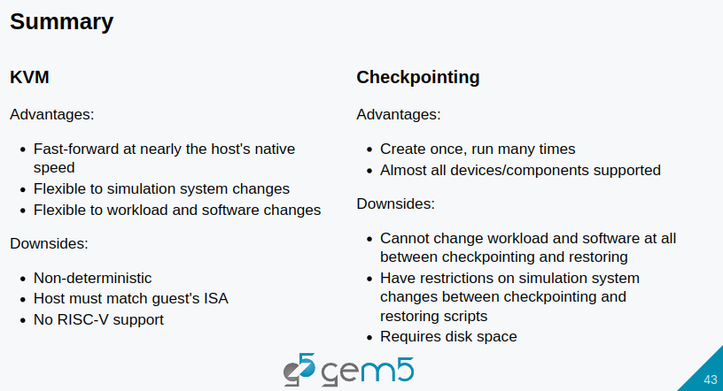
12.5 Summary
https://www.youtube.com/watch?v=JeOq90oDsPc&list=PL_hVbFs_loVR_8ntTTmmG6YEq3Po_4snu&index=12
Summary (12:21-12:47/13:32)
KVM advantage
1. It is fast-forward at nearly the host native speed.
2. It is flexible to simulation system change
3. It is flexible to workload and software changes.
KVM disadvantage
1. It is Non-deterministic
2. The host must match the guest ISA (Instruction Set Architecture)
3. Currently, we do not have the RISCV support for KVM.

Slide 37
12.5 Summary
https://www.youtube.com/watch?v=JeOq90oDsPc&list=PL_hVbFs_loVR_8ntTTmmG6YEq3Po_4snu&index=12
Summary (12:48-13:10/13:32)
Checkpoint advantage
1. We can create one and run it many times and may different system
2. Almost all devices and components are supported.
Checkpoint disadvantage
1. It cannot change workload and software at all between the checkpointing and restoring.
2. Checkpoint have restrictions on simulation system changes between checkpoint and restore script.
3. Checkpoint require disk space.

Slide 38
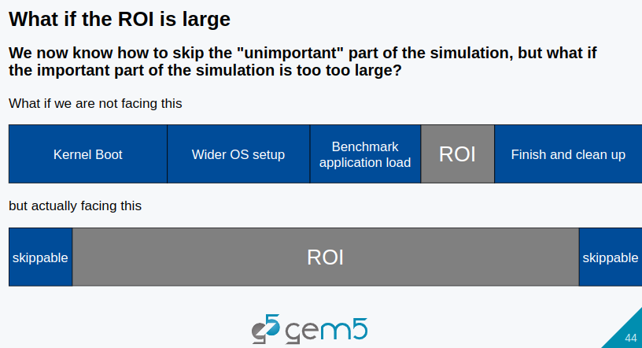
12.5 Summary
https://www.youtube.com/watch?v=JeOq90oDsPc&list=PL_hVbFs_loVR_8ntTTmmG6YEq3Po_4snu&index=12
Summary (13:11-13:32/13:32)
What if the ROI (Region of Interest) is too large?
We know that we can skip the in-important part of simulation.
What if the important port of the simulation is too large?
We will discuss this issue later on.

Slide 39
End

