Slide 1

23.1 Cache: Slides
Peter H. Chen

Slide 2

23.1 Cache: Slides
https://gem5bootcamp.github.io/2124/#03-Developing-gem5-models/04-ports
Cache (2 Level): Slides

Slide 3
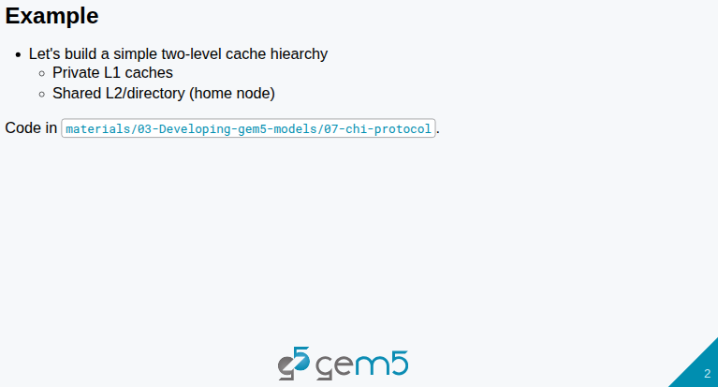
23.1 Cache: Slides
https://gem5bootcamp.github.io/2124/#03-Developing-gem5-models/04-ports
Cache (2 Level): Slides

Slide 4
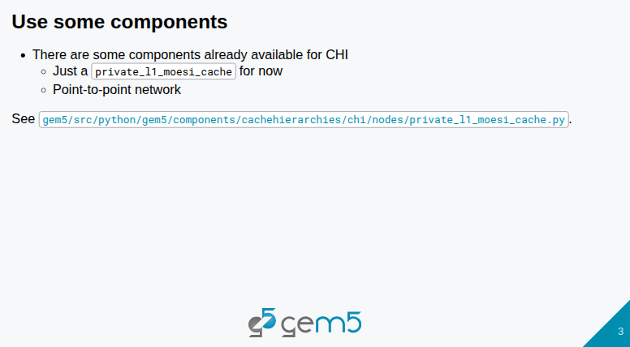
23.1 Cache: Slides
https://gem5bootcamp.github.io/2124/#03-Developing-gem5-models/04-ports
Cache (2 Level): Slides

Slide 5
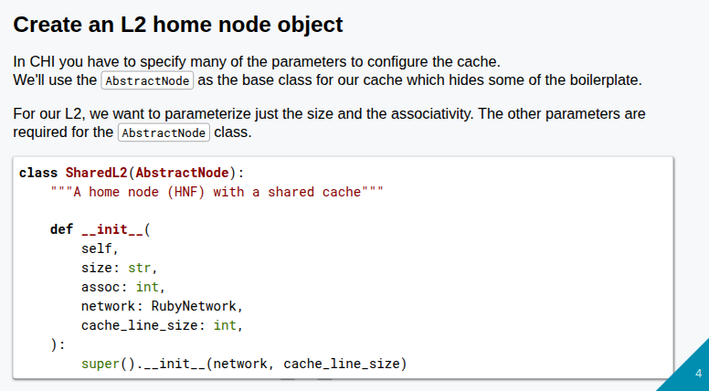
23.1 Cache: Slides
https://gem5bootcamp.github.io/2124/#03-Developing-gem5-models/04-ports
Cache (2 Level): Slides

Slide 6
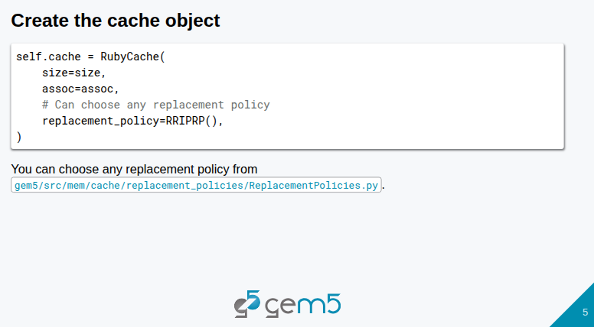
23.1 Cache: Slides
https://gem5bootcamp.github.io/2124/#03-Developing-gem5-models/04-ports
Cache (2 Level): Slides

Slide 7
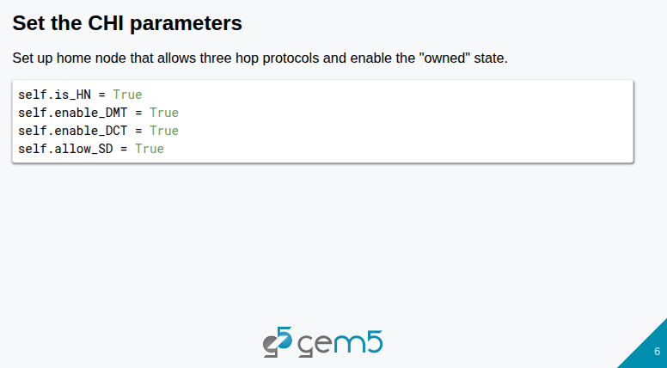
23.1 Cache: Slides
https://gem5bootcamp.github.io/2124/#03-Developing-gem5-models/04-ports
Cache (2 Level): Slides

Slide 8
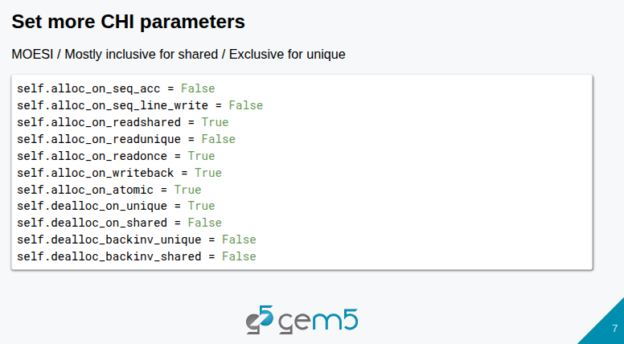
23.1 Cache: Slides
https://gem5bootcamp.github.io/2124/#03-Developing-gem5-models/04-ports
Cache (2 Level): Slides

Slide 9
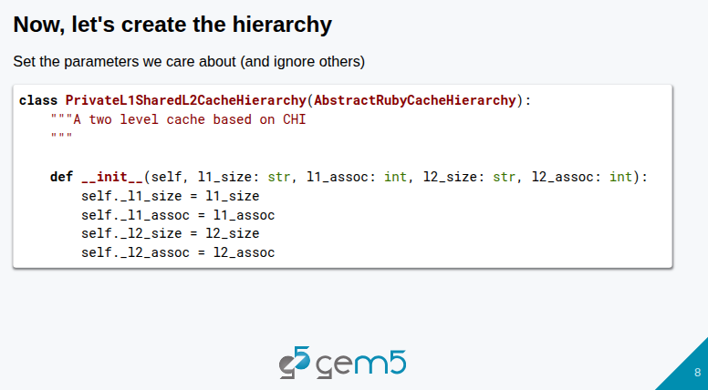
23.1 Cache: Slides
https://gem5bootcamp.github.io/2124/#03-Developing-gem5-models/04-ports
Cache (2 Level): Slides

Slide 10
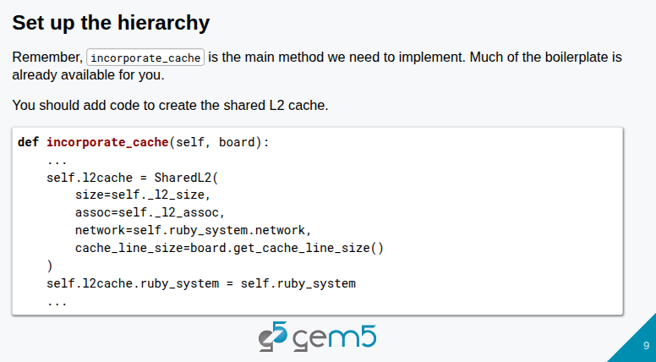
23.1 Cache: Slides
https://gem5bootcamp.github.io/2124/#03-Developing-gem5-models/04-ports
Cache (2 Level): Slides

Slide 11
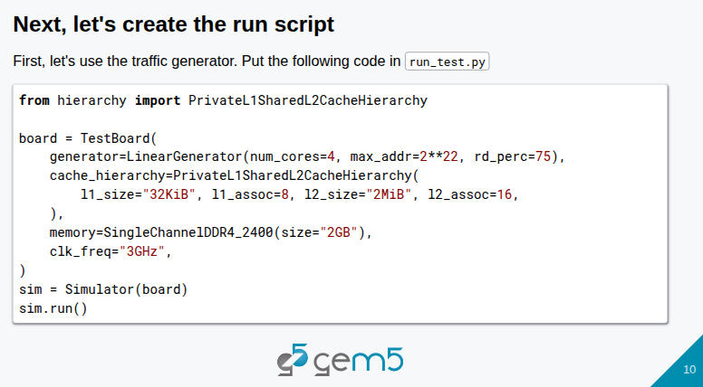
23.1 Cache: Slides
https://gem5bootcamp.github.io/2124/#03-Developing-gem5-models/04-ports
Cache (2 Level): Slides

Slide 12
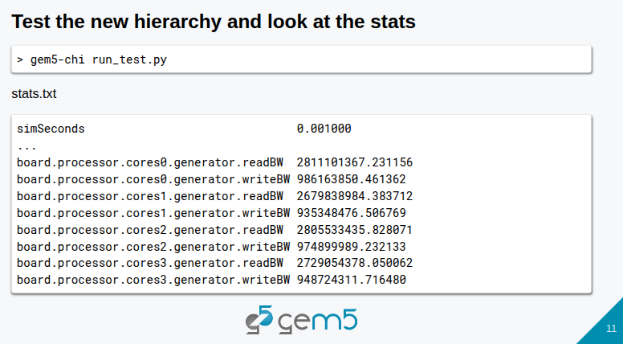
23.1 Cache: Slides
https://gem5bootcamp.github.io/2124/#03-Developing-gem5-models/04-ports
Cache (2 Level): Slides

Slide 13
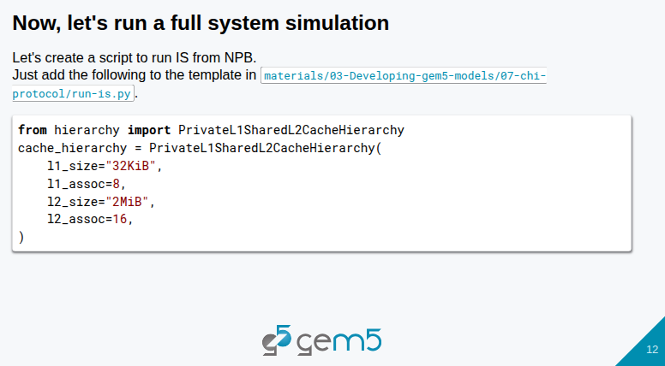
23.1 Cache: Slides
https://gem5bootcamp.github.io/2124/#03-Developing-gem5-models/04-ports
Cache (2 Level): Slides

Slide 14
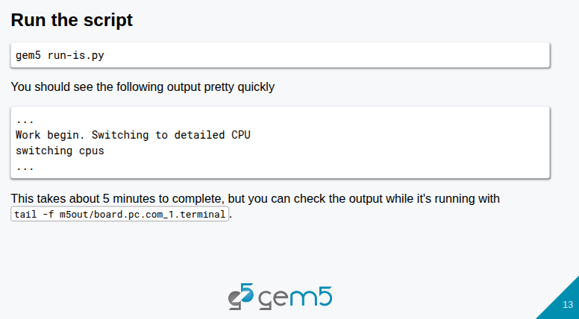
23.1 Cache: Slides
https://gem5bootcamp.github.io/2124/#03-Developing-gem5-models/04-ports
Cache (2 Level): Slides

Slide 15
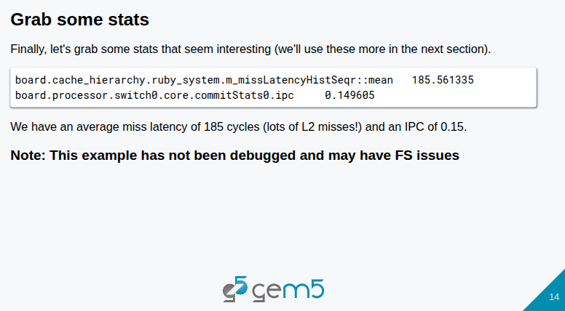
23.1 Cache: Slides
https://gem5bootcamp.github.io/2124/#03-Developing-gem5-models/04-ports
Cache (2 Level): Slides

Slide 16
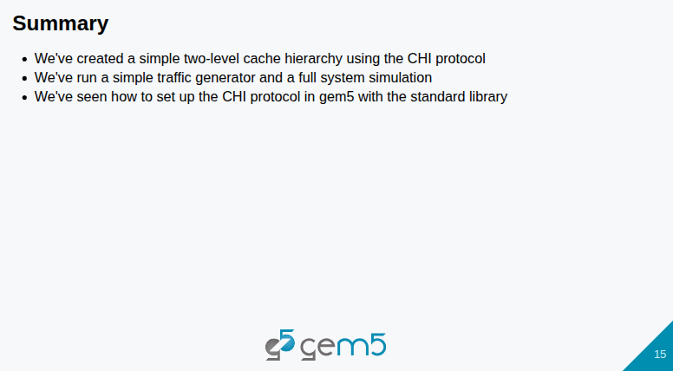
23.1 Cache: Slides
https://gem5bootcamp.github.io/2124/#03-Developing-gem5-models/04-ports
Cache (2 Level): Slides

Slide 17
End

