Slide 1

4 Standard Library
Peter H. Chen

Slide 2
4.0 Topics
https://www.youtube.com/watch?v=I8UUqyXWz_g&list=PL_hVbFs_loVR_8ntTTmmG6YEq3Po_4snu&index=4
Topics (0:00-0:01/50:45)
1.

Slide 3
4.1 Gem5 Standard Library

Slide 4

4.1 Gem5 Standard Library
https://www.youtube.com/watch?v=I8UUqyXWz_g&list=PL_hVbFs_loVR_8ntTTmmG6YEq3Po_4snu&index=4
Gem5 Standard Library (0:02-0:18/50:45)
We talk about Gem5 standard Library.

Slide 5
4.2 Why Standard Library?

Slide 6
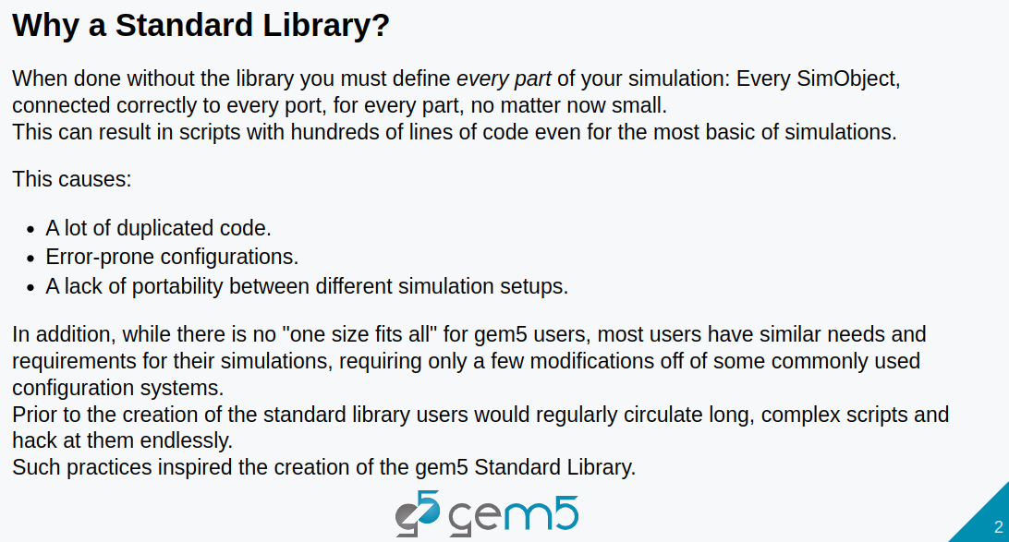
4.2 Why Standard Library?
https://www.youtube.com/watch?v=I8UUqyXWz_g&list=PL_hVbFs_loVR_8ntTTmmG6YEq3Po_4snu&index=4
Why Standard Library (0:19-3:28/50:45)
Gem5 standard library is a C++ library.
We have common useful code in the gem5 standard library shared by all developer.

Slide 7
4.3 What is Standard Library?

Slide 8
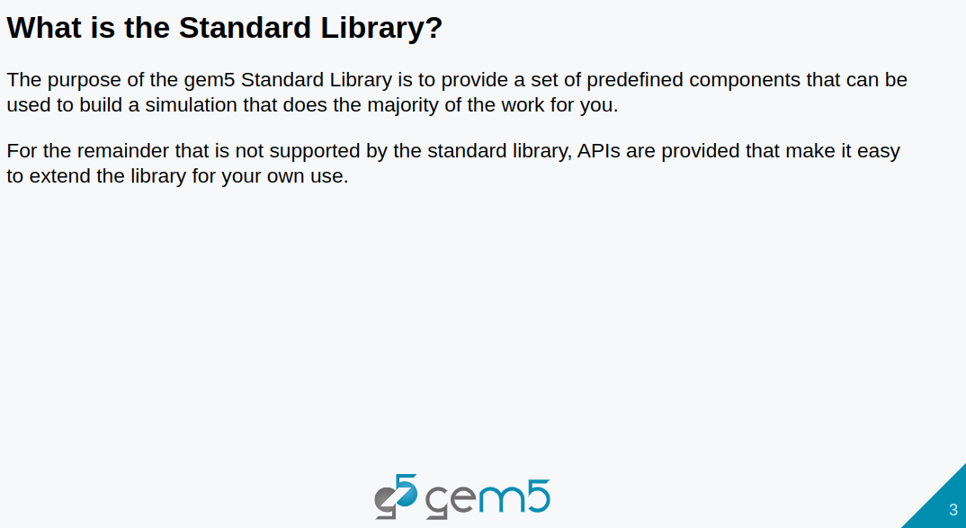
4.3 What is Standard Library?
https://www.youtube.com/watch?v=I8UUqyXWz_g&list=PL_hVbFs_loVR_8ntTTmmG6YEq3Po_4snu&index=4
What is Standard Library (3:29-3:31/50:45)
We have predefined components in the standard library.
We use API to call the Standard Library.

Slide 9
4.4 Combine Components into Board

Slide 10
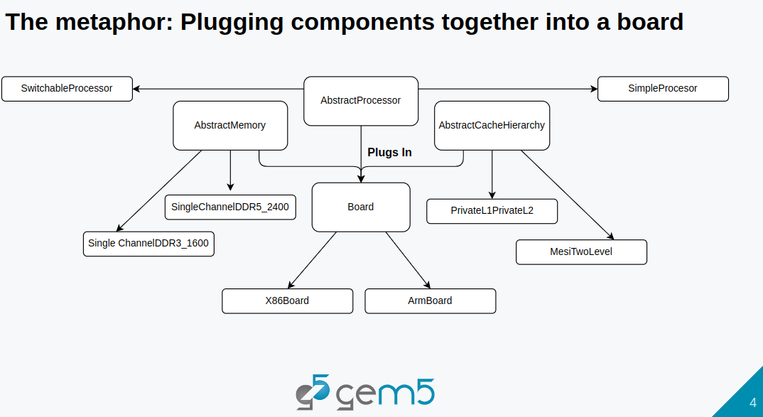
4.4 Combine Components into Board
https://www.youtube.com/watch?v=I8UUqyXWz_g&list=PL_hVbFs_loVR_8ntTTmmG6YEq3Po_4snu&index=4
Combine Components into Board (3:32-6:49/50:45)
We have board (X86 board/Arm board) contains the components: Processor (Abstract/Switchable/SImple), memory (DDR3, DDR5, etc), Cache (L1, L2).
We use interface to plug all components together.

Slide 11
4.5 Component

Slide 12
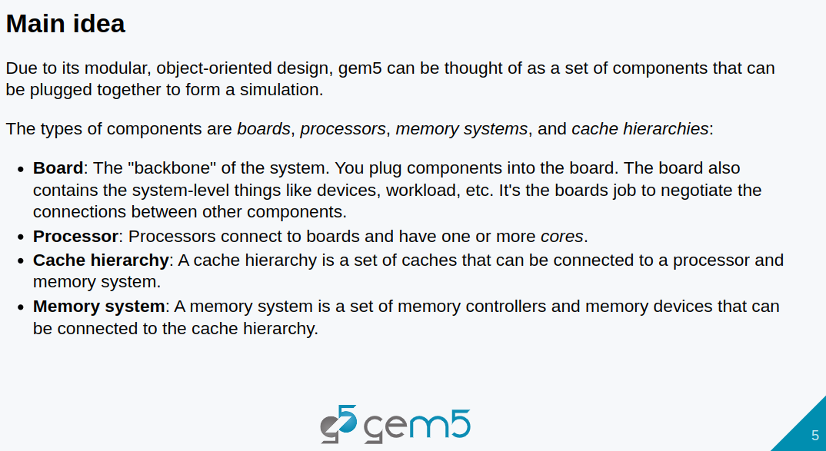
4.5 Component
https://www.youtube.com/watch?v=I8UUqyXWz_g&list=PL_hVbFs_loVR_8ntTTmmG6YEq3Po_4snu&index=4
Component (6:50-7:00/50:45)
1. We divide Components into Board, Processor, Cache Hierarchy, and Memory System.
2. Boards are the main backbone of the system. We plug components into the board,
3. The board also contain system- level components, such as, devices, workload, etc,
4. The boards are used to connect between components.

Slide 13
4.5 Component
https://www.youtube.com/watch?v=I8UUqyXWz_g&list=PL_hVbFs_loVR_8ntTTmmG6YEq3Po_4snu&index=4
Component (7:01-7:10/50:45)
5. Processors are connected to the boards and have one or more cores.
6. Cache hierarchy is a set of caches that can be connected to a processor and memory system.

Slide 14
4.5 Component
https://www.youtube.com/watch?v=I8UUqyXWz_g&list=PL_hVbFs_loVR_8ntTTmmG6YEq3Po_4snu&index=4
Component (7:10-7:14/50:45)
7. Memory system is a set of memory controllers and memory devices that can be connected to the Cache hierarchy.

Slide 15
4.6 Gem5 Model

Slide 16
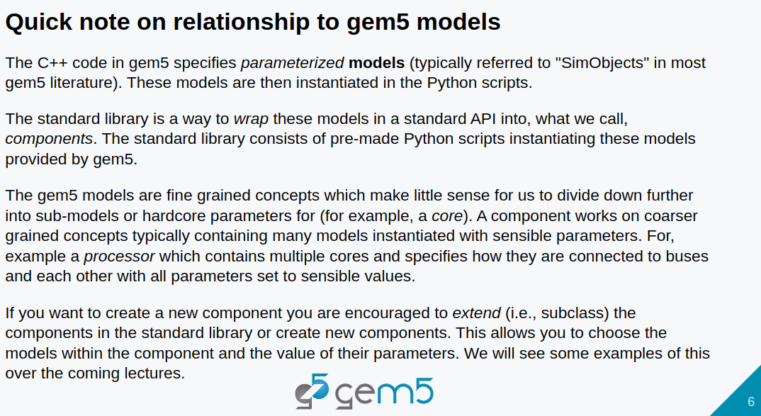
4.6 Gem5 Model
https://www.youtube.com/watch?v=I8UUqyXWz_g&list=PL_hVbFs_loVR_8ntTTmmG6YEq3Po_4snu&index=4
Gem5 Model (7:15-7:32/50:45)
1. Models are SimObjects in Gem5.
2. C++ Code in Gem5 specifies the Parameters for Models (SimObjects).

Slide 17
4.6 Gem5 Model
https://www.youtube.com/watch?v=I8UUqyXWz_g&list=PL_hVbFs_loVR_8ntTTmmG6YEq3Po_4snu&index=4
Gem5 Model (7:33-7:44/50:45)
3. Models are instantiated in Python scripts to wrap the models with standard API to call the components.
4. The standard library are pre-made with Python scripts
5. These models are instantiated and provided by Gem5.

Slide 18
4.6 Gem5 Model
https://www.youtube.com/watch?v=I8UUqyXWz_g&list=PL_hVbFs_loVR_8ntTTmmG6YEq3Po_4snu&index=4
Gem5 Model (7:45-9:03/50:45)
6. Gem5 Models are fine grained concepts. We don’t need to divide down more into the sub-models.
7. Components are coarse grained concepts. Components contain many models with passing parameters.
8. For example, X86 Processor contains multiple cores specified by parameters and connected to busses.

Slide 19
4.7 Started StdLib Coding

Slide 20
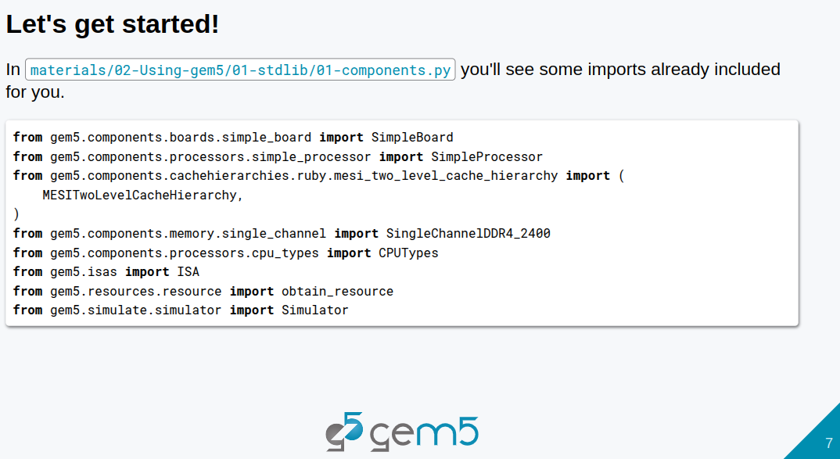
4.7 Started StdLib Coding
https://www.youtube.com/watch?v=I8UUqyXWz_g&list=PL_hVbFs_loVR_8ntTTmmG6YEq3Po_4snu&index=4
Started StdLib Coding (9:04-09:05/50:45)
1. We started the components with standard library.
https://github.com/gem5bootcamp/bootcamp/tree/main/materials/02-Using-gem5/01-stdlib

Slide 21
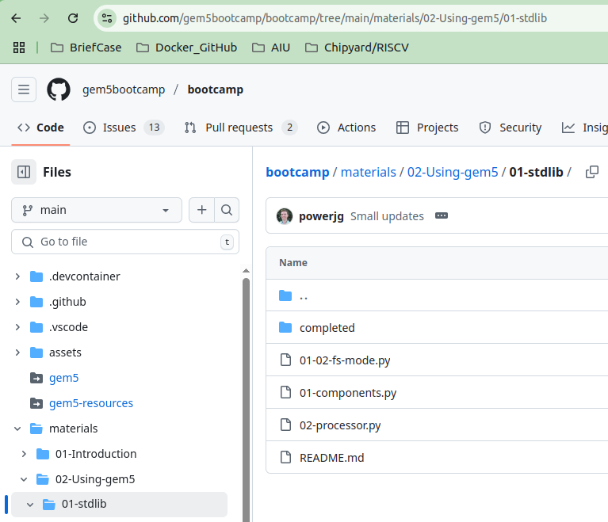
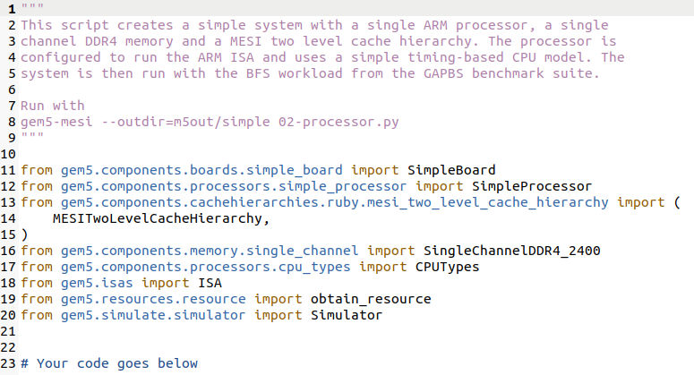
4.7 Started StdLib Coding
https://www.youtube.com/watch?v=I8UUqyXWz_g&list=PL_hVbFs_loVR_8ntTTmmG6YEq3Po_4snu&index=4
Started StdLib Coding (9:04-09:35/50:45)
Below, we go to materials/02-Using-gem5/01-stdlib/01-components.py for startup gem5 code
https://github.com/gem5bootcamp/bootcamp/tree/main/materials/02-Using-gem5/01-stdlib/01-components.py

Slide 22
4.8 Complete StdLib Coding

Slide 23
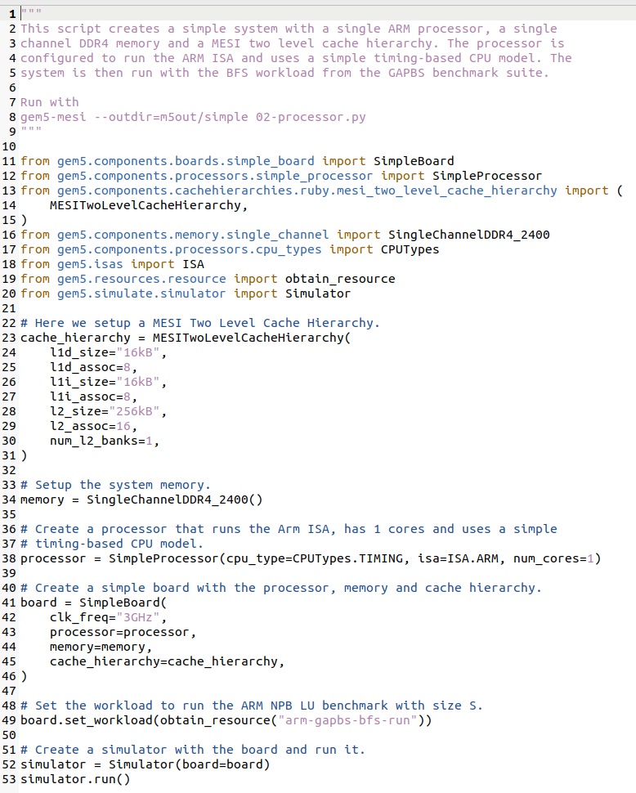
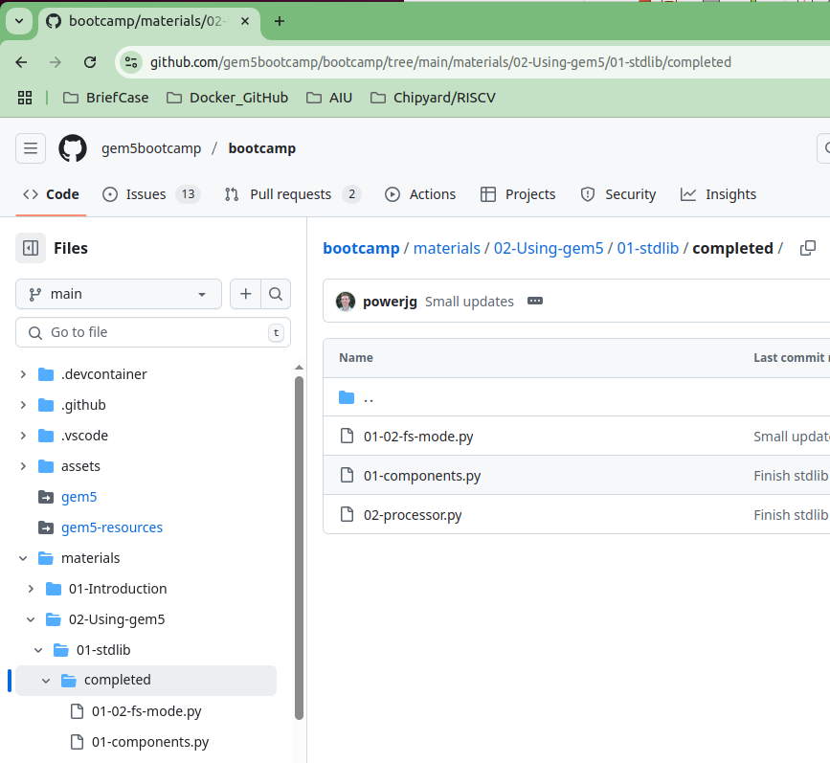
4.8 Complete StdLib Coding
https://www.youtube.com/watch?v=I8UUqyXWz_g&list=PL_hVbFs_loVR_8ntTTmmG6YEq3Po_4snu&index=4
Complete StdLib Coding (9:36-9:37/50:45)
Below, we can go to materials/02-Using-gem5/01-stdlib/completed/01-components.py for the completed code.
https://github.com/gem5bootcamp/bootcamp/tree/main/materials/02-Using-gem5/01-stdlib/completed

Slide 24
4.9 Run StdLib on Bootcamp Cloud

Slide 25
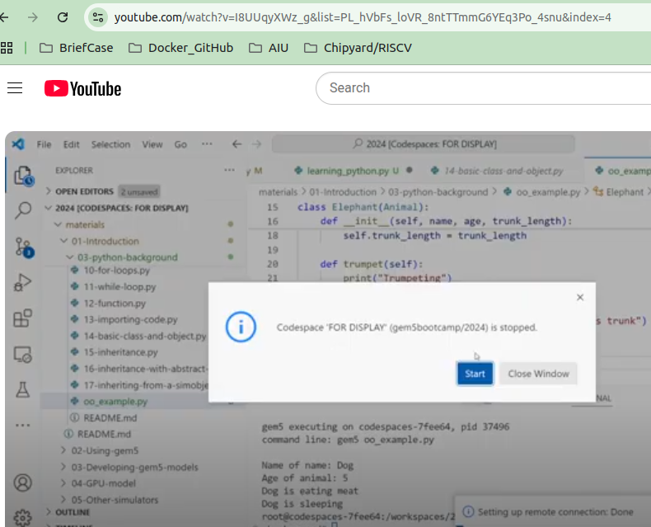
4.9 Run StdLib on Bootcamp Cloud
https://www.youtube.com/watch?v=I8UUqyXWz_g&list=PL_hVbFs_loVR_8ntTTmmG6YEq3Po_4snu&index=4
Run StdLib on Bootcamp Cloud (9:38-9:39/50:45)
We can run the code in bootcamp cloud.

Slide 26
4.10 Run StdLib on Local gem5.opt

Slide 27
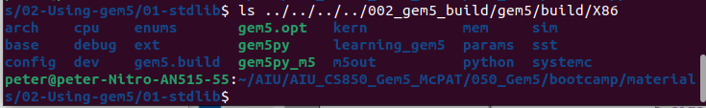
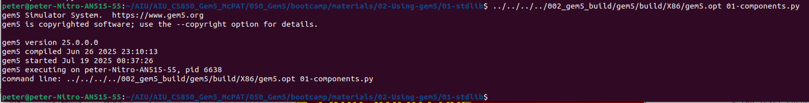
4.10 Run StdLib on Local gem5.opt
https://www.youtube.com/watch?v=I8UUqyXWz_g&list=PL_hVbFs_loVR_8ntTTmmG6YEq3Po_4snu&index=4
Run StdLib on Local gem5.opt (9:40-10:38/50:45)
We have built gem5.opt in the 002_gem5_build/gem5/X86/gem5.opt folder.
> <path>/002_gem5_build/gem5/build/X86/gem5.opt 01-components.py
Result as below:
>>peter@peter-Nitro-AN515-55:~/AIU/AIU_CS850_Gem5_McPAT/050_Gem5/bootcamp/materials/02-Using-gem5/01-stdlib$ ../../../../002_gem5_build/gem5/build/X86/gem5.opt 01-components.py
>>> gem5 Simulator System. https://www.gem5.org
>>> gem5 is copyrighted software; use the --copyright option for details.
>>>
>>> gem5 version 25.0.0.0
>>> gem5 compiled Jun 26 2025 23:10:13
>>> gem5 started Jul 19 2025 08:37:26
>>> gem5 executing on peter-Nitro-AN515-55, pid 6638
>>> command line: ../../../../002_gem5_build/gem5/build/X86/gem5.opt 01-components.py

Slide 28
4.11 01-components.py

Slide 29
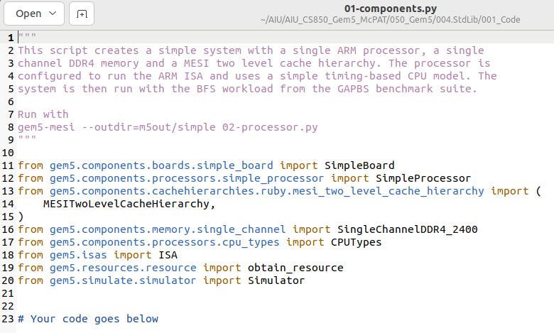
4.11 01-components.py
https://www.youtube.com/watch?v=I8UUqyXWz_g&list=PL_hVbFs_loVR_8ntTTmmG6YEq3Po_4snu&index=4
01-components.py (10:39-10:51/50:45)
We start the code in the 01-components.py

Slide 30
4.12 Setup Cache Hierarchy

Slide 31
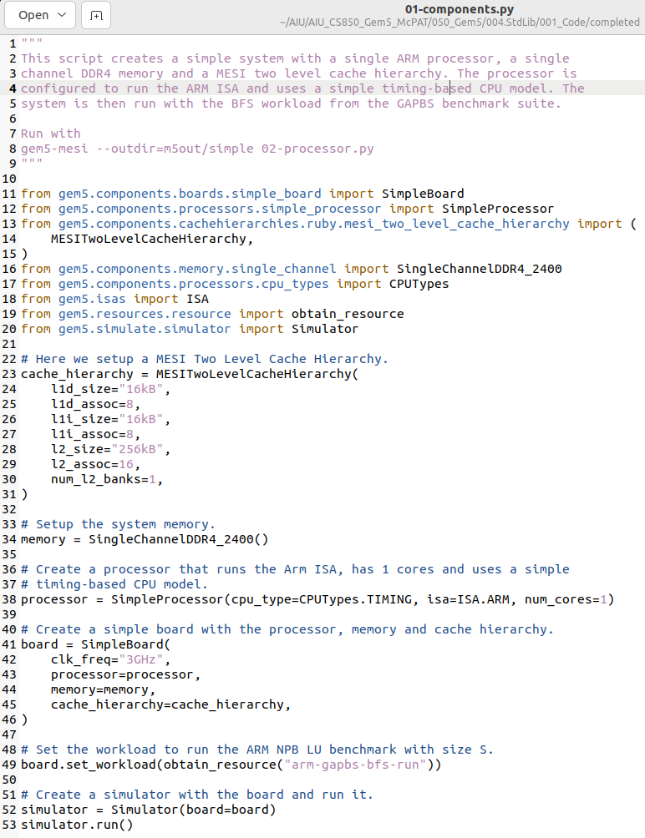
4.12 Setup Cache Hierarchy
https://www.youtube.com/watch?v=I8UUqyXWz_g&list=PL_hVbFs_loVR_8ntTTmmG6YEq3Po_4snu&index=4
Setup Cache Hierarchy (10:52-13:00/50:45)
In 01-components.py, first, we create the cache_hierarchy
We use library for MESI (Modified, Exclusive, Shared, Invalid) Two Level Cache Hierarchy.
The parameters, L1D size = 16KB, L1D associate = 8, L1I size = 16KB, L1I associate = 8, L2 Size = 256KB, L2 Associate = 16, number of L2 banks = 1. L1D is Level 1 Data Cache. L1I is Level 1 Instruction Cache.

Slide 32
4.13 Setup System Memory

Slide 33
4.13 Setup System Memory
https://www.youtube.com/watch?v=I8UUqyXWz_g&list=PL_hVbFs_loVR_8ntTTmmG6YEq3Po_4snu&index=4
Setup System Memory (13:01-14:07/50:45)
In 01-components.py, second, setup system memory with Signal Channel DDR4 2400.
If we want to change to other size, we can pass in size parameter:
> memory = SignalChannelDDR4_2400 (size = “1GB”)
Here, we use default size:
> memory = SignalChannelDDR4_2400 ()

Slide 34
4.14 Create Processor

Slide 35
4.14 Create Processor
https://www.youtube.com/watch?v=I8UUqyXWz_g&list=PL_hVbFs_loVR_8ntTTmmG6YEq3Po_4snu&index=4
Create Processor (14:08-17:17/50:45)
In 01-components.py, third, we create the processor.
We use type of Simple Processor.
1. CPU type is TIMING to model the CPU.
2. We choose ARM for ISA (Instruction Set Architecture).
We can choose isa = ISA.X86 for X86 Instruction Set Architecture.
3. Number of cire = 1

Slide 36
4.15 Plug Components into Board

Slide 37
4.15 Plug Components into Board
https://www.youtube.com/watch?v=I8UUqyXWz_g&list=PL_hVbFs_loVR_8ntTTmmG6YEq3Po_4snu&index=4
Plug Components into Board (17:18-18:30/50:45)
In 01-components.py, fourth, we plug the components into Simple Board.
1. > board = SimpleBoard ()
2. Setup clock frequency = 3 GHz
3. Setup Processor
4. Setup memory
5. Setup Cache Hierarchy

Slide 38
4.16 Setup Workload

Slide 39
4.16 Setup Workload
https://www.youtube.com/watch?v=I8UUqyXWz_g&list=PL_hVbFs_loVR_8ntTTmmG6YEq3Po_4snu&index=4
Setup Workload (18:31-22:18/50:45)
In 01-components.py, fifth, we setup the workload.
1. > board.set_workload()
2. Obtain resource “arm-graphs-bfs-run”.
BFS (Breath First Search) is used for the bench mark.

Slide 40
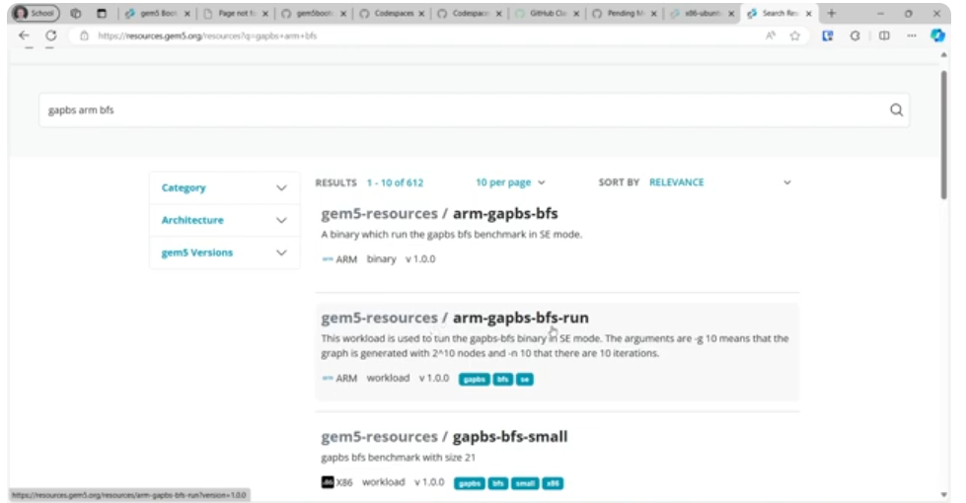
4.16 Setup Workload
https://www.youtube.com/watch?v=I8UUqyXWz_g&list=PL_hVbFs_loVR_8ntTTmmG6YEq3Po_4snu&index=4
Setup Workload (22:19-23:30/50:45)
We can search for gem5 graphs arm bfs resources.

Slide 41
4.17 Setup Simulator

Slide 42
4.17 Setup Simulator
https://www.youtube.com/watch?v=I8UUqyXWz_g&list=PL_hVbFs_loVR_8ntTTmmG6YEq3Po_4snu&index=4
Setup Simulator (23:31-24:12/50:45)
In 01-components.py, fifth, we setup the simulator.
1. > simulator = Simulator (board=board)
We setup the simulator with all components on board

Slide 43
4.18 Simulator.run

Slide 44
4.18 Simulator.run
https://www.youtube.com/watch?v=I8UUqyXWz_g&list=PL_hVbFs_loVR_8ntTTmmG6YEq3Po_4snu&index=4
Simulator.run (24:14-25:30/50:45)
In 01-components.py, sixth, we run the simulator.
1. > simulator.run()
It will run until simulator is exit.
We can pass in parameter to limited run time.
Here, we exit at 100,000, 000 ticks.
> simulator.run (100_000_000)
That is the entire gem5 simulation.
We can easily write less than 400 lines of Python codes the gem5 simulation with standard library.
There are a lot of simObjects to connect behind the scene.

Slide 45
4.19 Run Simulation on Terminal

Slide 46
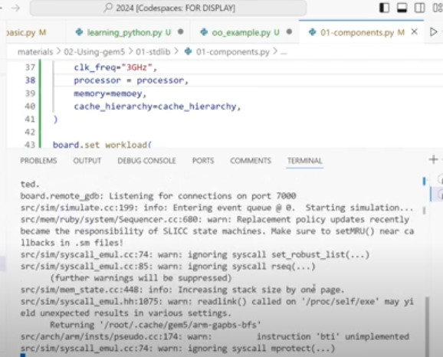
4.19 Run Simulation on Terminal
https://www.youtube.com/watch?v=I8UUqyXWz_g&list=PL_hVbFs_loVR_8ntTTmmG6YEq3Po_4snu&index=4
Run Simulation on Terminal (25:31-26:50/50:45)
> scons build/ALL/gem5-mesi
build/ALL/: This specifies the build directory where the compiled files and the final gem5 executable will be located. "ALL" signifies that all supported ISAs (like ARM, MIPS, POWER, RISCV, SPARC, and X86) will be included in the compiled binary.
gem5.opt: This indicates that you want to build the optimized version of the gem5 binary. This version has optimizations enabled and debugging functionality compiled out for better performance. Other variants include gem5.debug (for debugging with tools like gdb) and gem5.fast (for peak performance without run-time error checking).
https://www.google.com/search?q=scons+build%2FALL%2Fgem5.opt&oq=scons+build%2FALL%2Fgem5.opt&gs_lcrp=EgZjaHJvbWUyBggAEEUYOdIBCTE1NjY5ajBqNKgCALACAQ&sourceid=chrome&ie=UTF-8

Slide 47
4.20 Check Simulation Results

Slide 48
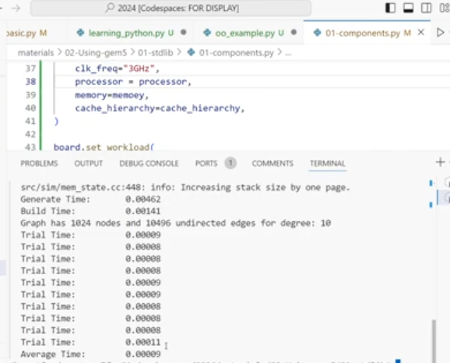
4.20 Check Simulation Results
https://www.youtube.com/watch?v=I8UUqyXWz_g&list=PL_hVbFs_loVR_8ntTTmmG6YEq3Po_4snu&index=4
Check Simulation Results (26:51-28:30/50:45)

Slide 49
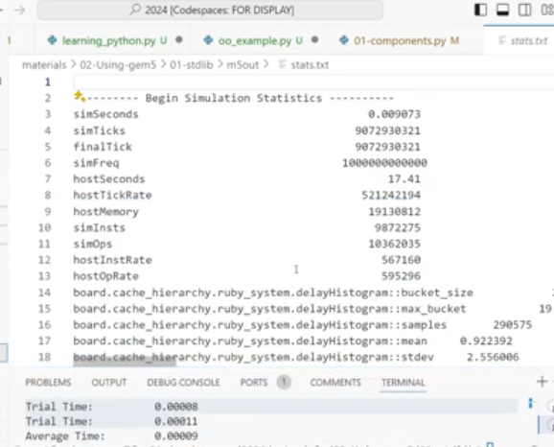
4.20 Check Simulation Results
https://www.youtube.com/watch?v=I8UUqyXWz_g&list=PL_hVbFs_loVR_8ntTTmmG6YEq3Po_4snu&index=4
Check Simulation Results (28:31-29:30/50:45)

Slide 50
4.21 Gem5 Folder

Slide 51
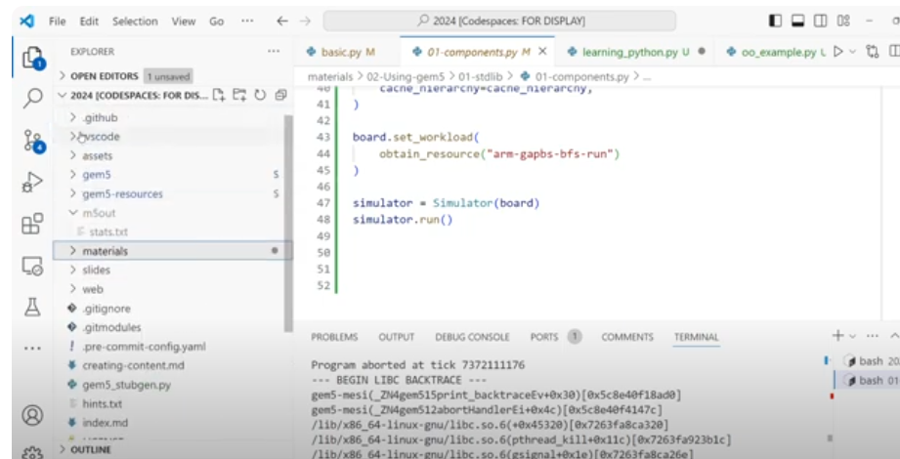
4.21 Gem5 Folder
https://www.youtube.com/watch?v=I8UUqyXWz_g&list=PL_hVbFs_loVR_8ntTTmmG6YEq3Po_4snu&index=4
Gem5 Folder (25:31-26:50/50:45)
We see the Gem5 materials folder.

Slide 52
4.22 Python Folder

Slide 53
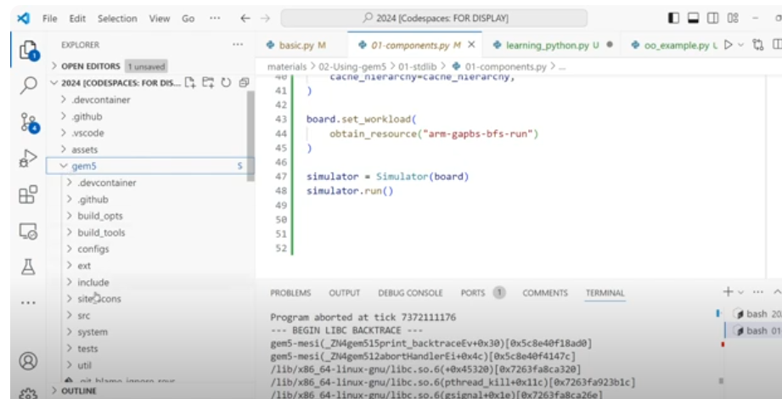
4.22 Python Folder
https://www.youtube.com/watch?v=I8UUqyXWz_g&list=PL_hVbFs_loVR_8ntTTmmG6YEq3Po_4snu&index=4
Python Folder (26:51-30:00/50:45)
We see the Gem5 folders: src/python/gem5/

Slide 54
4.22 Python Gem5 Folder

Slide 55
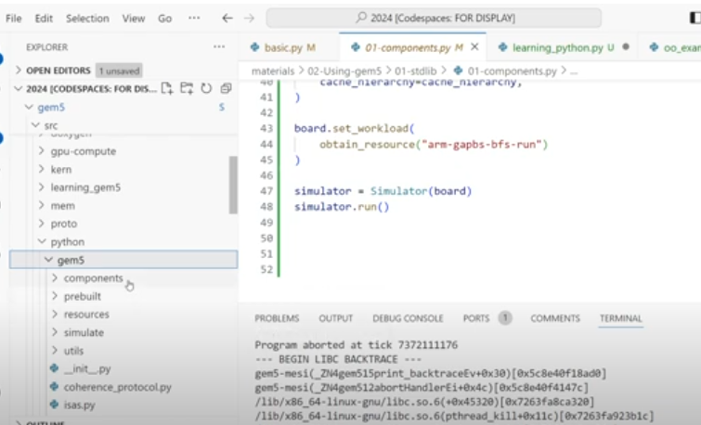
4.22 Python Gem5 Folder
https://www.youtube.com/watch?v=I8UUqyXWz_g&list=PL_hVbFs_loVR_8ntTTmmG6YEq3Po_4snu&index=4
Python Gem5 Folder (30:01-30:10/50:45)
gem5/src/python/gem5[components, prebuilt. Resources, simulate, utils]

Slide 56
4.23 Components Folder

Slide 57
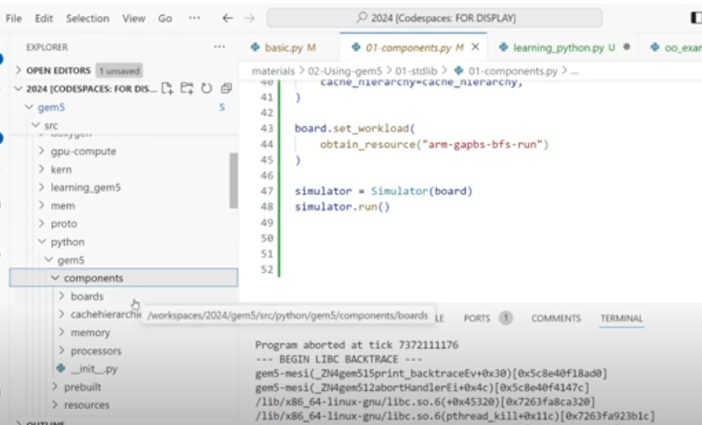
4.23 Components Folder
https://www.youtube.com/watch?v=I8UUqyXWz_g&list=PL_hVbFs_loVR_8ntTTmmG6YEq3Po_4snu&index=4
Components Folder (30:13-30:25/50:45)
Components: boards, cachehierarchies, memory, processors

Slide 58
4.24 Boards Folder

Slide 59
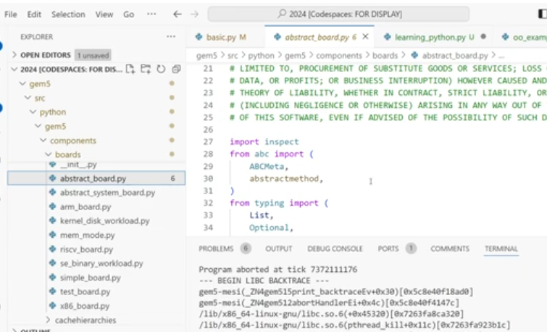
4.24 Boards Folder
https://www.youtube.com/watch?v=I8UUqyXWz_g&list=PL_hVbFs_loVR_8ntTTmmG6YEq3Po_4snu&index=4
Boards Folder (30:26-31:00/50:45)
boards: abstract_board.py, abstract_system_board.py, simple_board.py, arm_board.py,

Slide 60
4.25 Cachehierarchies Folder

Slide 61
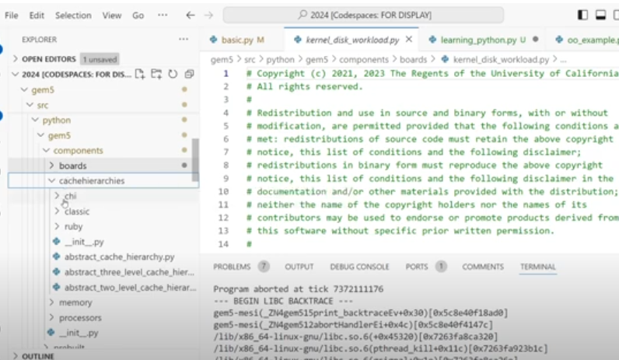
4.25 Cachehierarchies Folder
https://www.youtube.com/watch?v=I8UUqyXWz_g&list=PL_hVbFs_loVR_8ntTTmmG6YEq3Po_4snu&index=4
Cachehierarchies Folder (31:01-32:10/50:45)
Cachehierarchies: chi, classic, ruby

Slide 62
4.26 Memory Folder

Slide 63
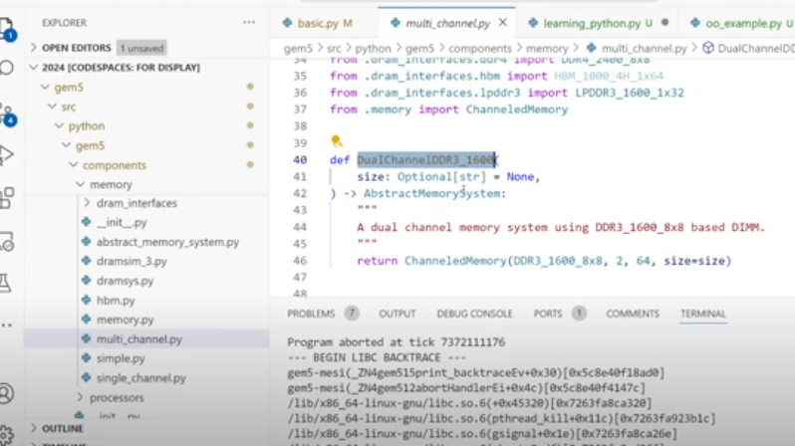
4.26 Memory Folder
https://www.youtube.com/watch?v=I8UUqyXWz_g&list=PL_hVbFs_loVR_8ntTTmmG6YEq3Po_4snu&index=4
Memory Folder (31:01-32:10/50:45)
multi_channel.py: def dualChannelDDR3_1600K, etc.

Slide 64
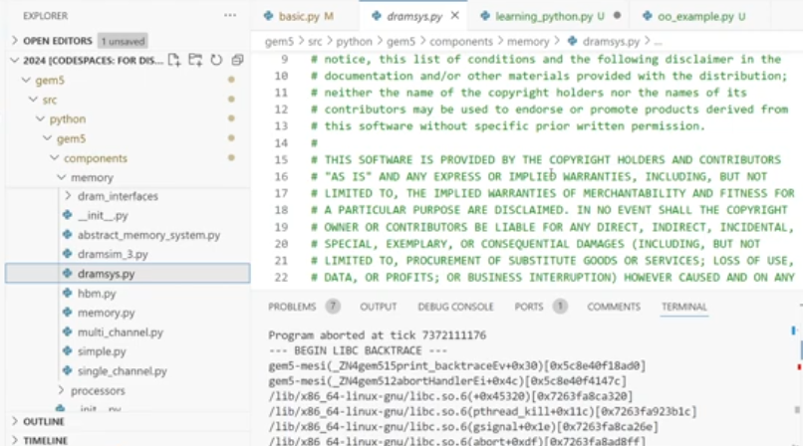
4.26 Memory Folder
https://www.youtube.com/watch?v=I8UUqyXWz_g&list=PL_hVbFs_loVR_8ntTTmmG6YEq3Po_4snu&index=4
Memory Folder (32:11-32:37/50:45)
dramsys.py: Memory controller.

Slide 65
4.27 Processors Folder

Slide 66
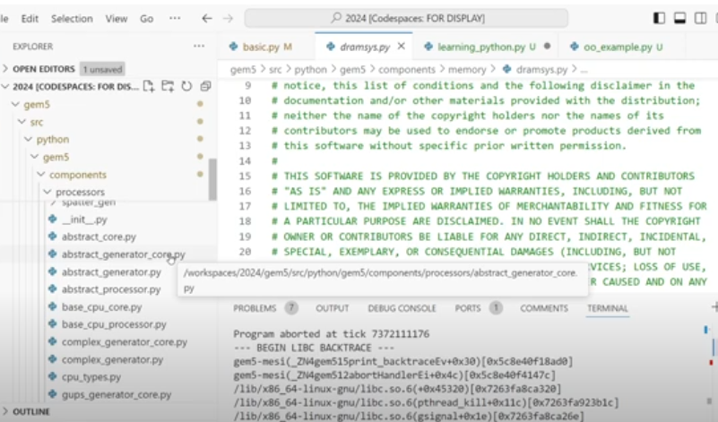
4.27 Processors Folder
https://www.youtube.com/watch?v=I8UUqyXWz_g&list=PL_hVbFs_loVR_8ntTTmmG6YEq3Po_4snu&index=4
Processors Folder (32:28-33:20/50:45)
abstract_generator_core.py: Generator core can replace the processing core for testing.

Slide 67
4.28 Prebuilt Folder

Slide 68
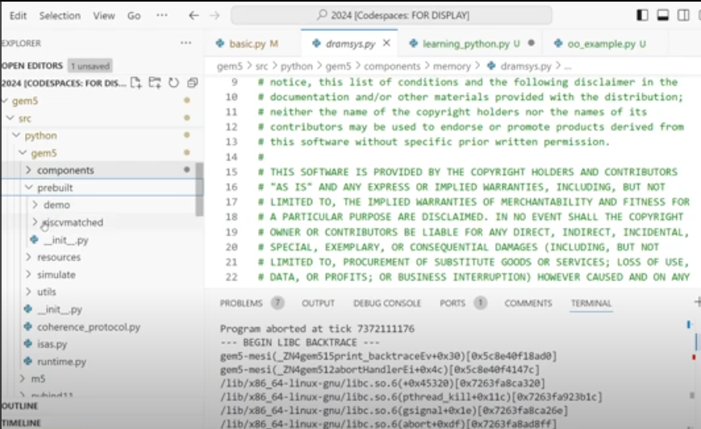
4.28 Prebuilt Folder
https://www.youtube.com/watch?v=I8UUqyXWz_g&list=PL_hVbFs_loVR_8ntTTmmG6YEq3Po_4snu&index=4
Prebuilt Folder (32:28-33:20/50:45)
In prebuilt folder, we have demo, resivmatched, and viper

Slide 69
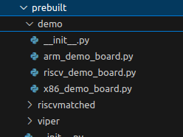
4.28 Prebuilt Folder
https://www.youtube.com/watch?v=I8UUqyXWz_g&list=PL_hVbFs_loVR_8ntTTmmG6YEq3Po_4snu&index=4
Prebuilt Folder (32:28-33:20/50:45)
In demo folder, we have arm_demo_board.py, riscv_demo_board.py, x86_demo_board.py,

Slide 70
End

