Slide 1

1.1 Gem5 vs. McPAT
Peter H. Chen

Slide 2
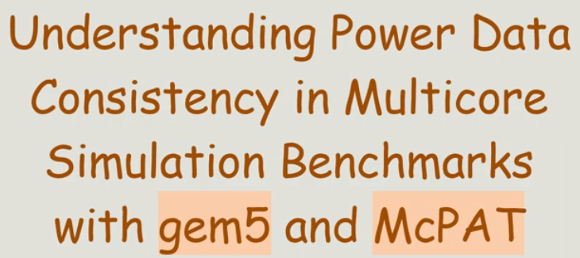
1.1 Gem5 vs. McPAT
https://www.youtube.com/watch?v=8eMvUNHiB30
Gem5 vs. McPAT (0:00-0:07/1:12)
Gem5 Cycle-Accuracy Timing vs. McPAT (Multi-Core Power/Area/Rough Timing)

Slide 3
1.2 Gem5 Power Consumption

Slide 4
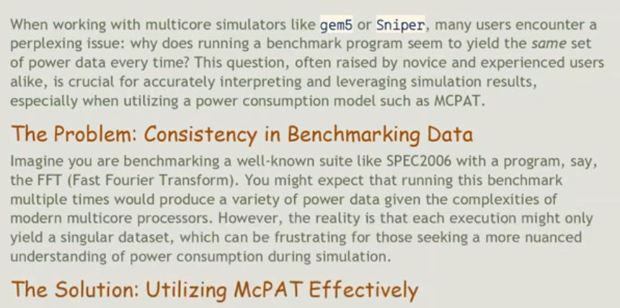
1.2 Gem5 Power Consumption
https://www.youtube.com/watch?v=8eMvUNHiB30
Gem5 Power Consumption (0:08-0:22/1:12)
Gem5 is good at cycle accuracy timing, however, Gem5 get the same power consumption with different configuration.

Slide 5
1.3 Gem5 Output to McPAT

Slide 6
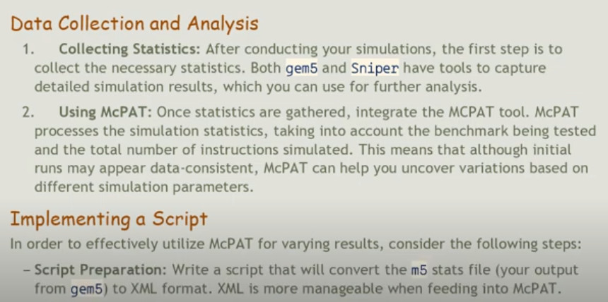
1.3 Gem5 Output to McPAT
https://www.youtube.com/watch?v=8eMvUNHiB30
Gem5 Output to McPAT (0:23-0:37/1:12)
1. Gem5: Cycle accuracy timing. Convert m5 stats file into XML format and feed into McPAT
2. McPAT: Power, Area, Timing.

Slide 7
1.4 McPAT Result

Slide 8
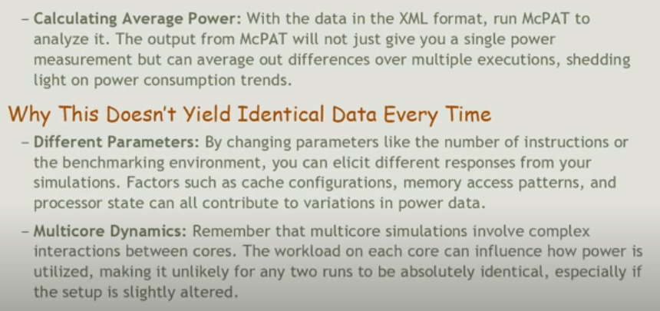
1.4 McPAT Result
https://www.youtube.com/watch?v=8eMvUNHiB30
McPAT Result (0:38-0:55/1:12)
1. Convert Gem5 m5 output into XML format.
2. Input XML different parameters to McPAT and output Power, Area, and Timing

Slide 9
1.5 Conclusion

Slide 10
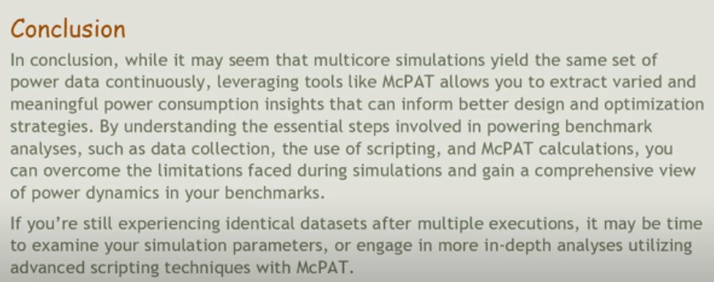
1.5 Conclusion
https://www.youtube.com/watch?v=8eMvUNHiB30
McPAT Result (0:56-1:12/1:12)
We need to process different input parameters and output different Power, Area, and Timing result.

Slide 11
End

