Slide 1

18 Debug Gem5
Peter H. Chen

Slide 2
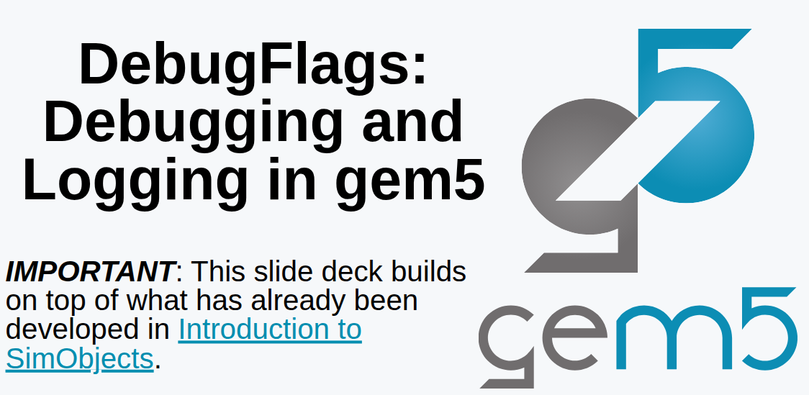
18 Debug Gem5
https://www.youtube.com/watch?v=DDlSLCi5Nmk&list=PL_hVbFs_loVR_8ntTTmmG6YEq3Po_4snu&index=18
Debug Gem5 (0:00-0:07/15:02)
We talk about the debug of Gem5.Debugging in Gem5 is very straight forward.

Slide 3
18.0 Topics

Slide 4
18.0 Topics
https://www.youtube.com/watch?v=DDlSLCi5Nmk&list=PL_hVbFs_loVR_8ntTTmmG6YEq3Po_4snu&index=18
Topic (0:07-0:08/15:02)
1. Debug Flags: Gem5 provide DebugFlags to print the register and memory information for debugging.
2. SimObject DebugFlags: We add configuration in SConscript, Debug information in python code, C++ header/Code.
3. In Gem5, we recommend to use assertion for run-time logic error checking instead of debugging print.
  3.1 panic to catch developer mistake.
  3.2 fatal to prevent user mistakes.

Slide 5
18.1 DebugFlags

Slide 6
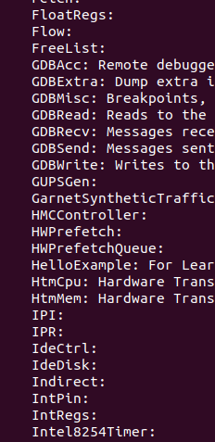
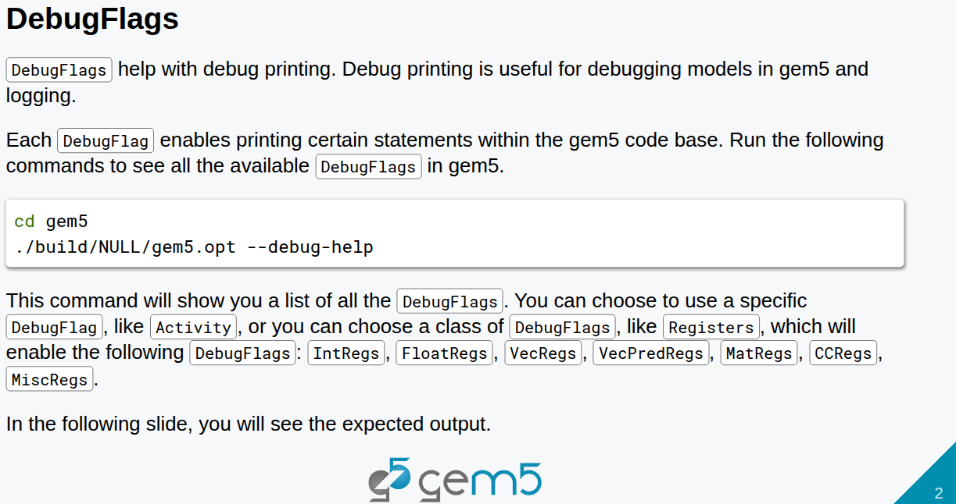
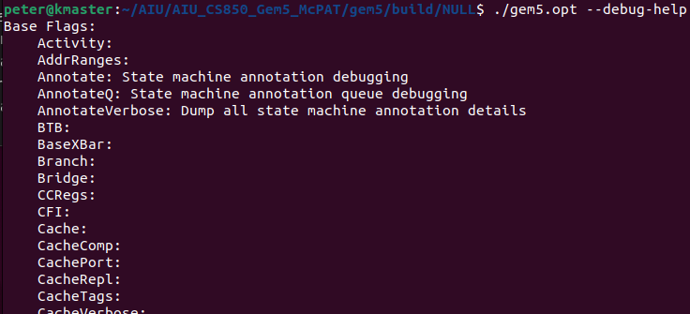
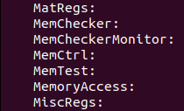

18.1 DebugFlags
https://www.youtube.com/watch?v=DDlSLCi5Nmk&list=PL_hVbFs_loVR_8ntTTmmG6YEq3Po_4snu&index=18
DebugFlags (0:09-0:50/15:02)
Gem5 has class DebugFlags, We have enable several print statements for entire your codes.
We can put print statement inside the development code whenever we developing our SimObject.
There is a macros called DPRINTF. In Gem5, DPRINTF is the most commonly used debugging function,
In Gem5, we use DebugFlags (IntRegs, FloatRegs, etc.) to specify what prints to be displayed,

Slide 7
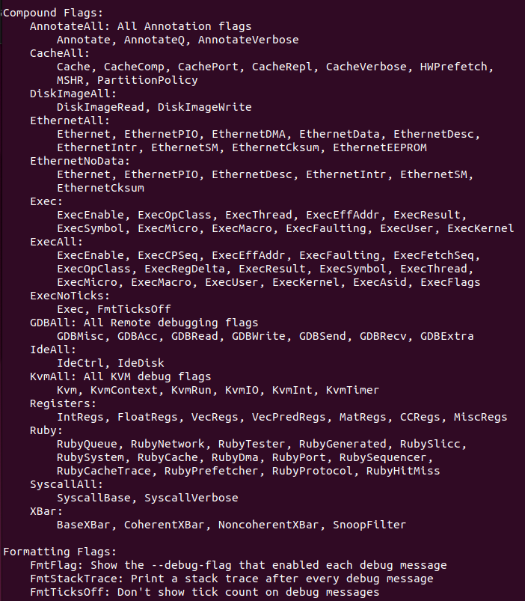
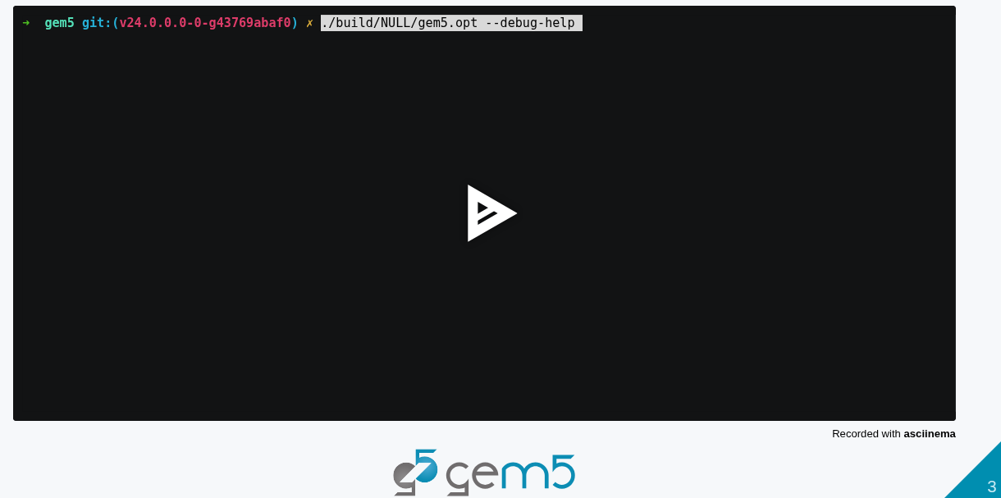
18.1 DebugFlags
https://www.youtube.com/watch?v=DDlSLCi5Nmk&list=PL_hVbFs_loVR_8ntTTmmG6YEq3Po_4snu&index=18
DebugFlags (0:51-1:40/15:02)
In Gem5, we have command
> ./build/NULL/gem5.opt --debug-help

Slide 8
18.2 Step 1: SimObject with DebugFlags

Slide 9
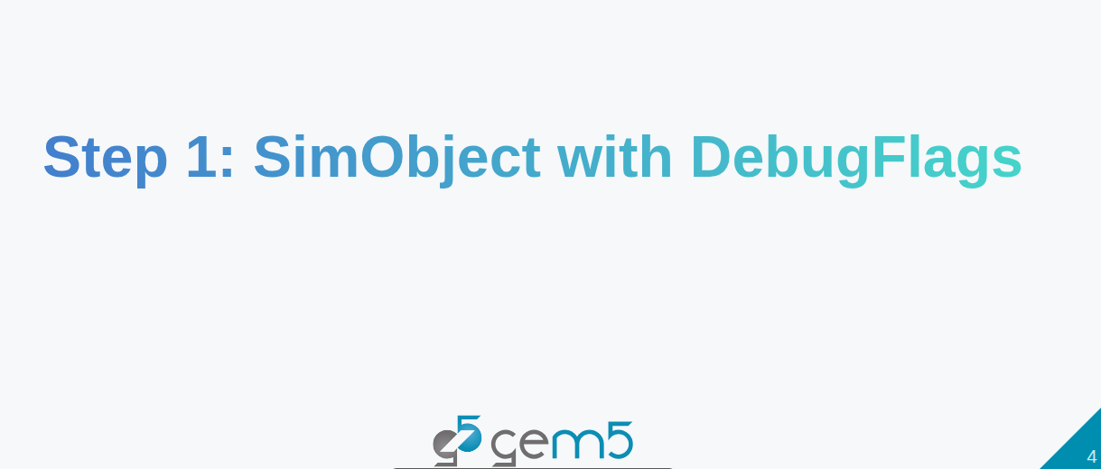
18.2 Step 1: SimObject with DebugFlags
https://www.youtube.com/watch?v=DDlSLCi5Nmk&list=PL_hVbFs_loVR_8ntTTmmG6YEq3Po_4snu&index=18
Step1: SimObject with DebugFlags (1:41-1:45/15:02)
DebugFlags is not related to any specific SimObject.

Slide 10
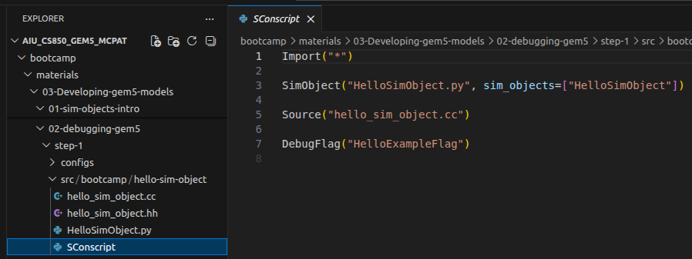
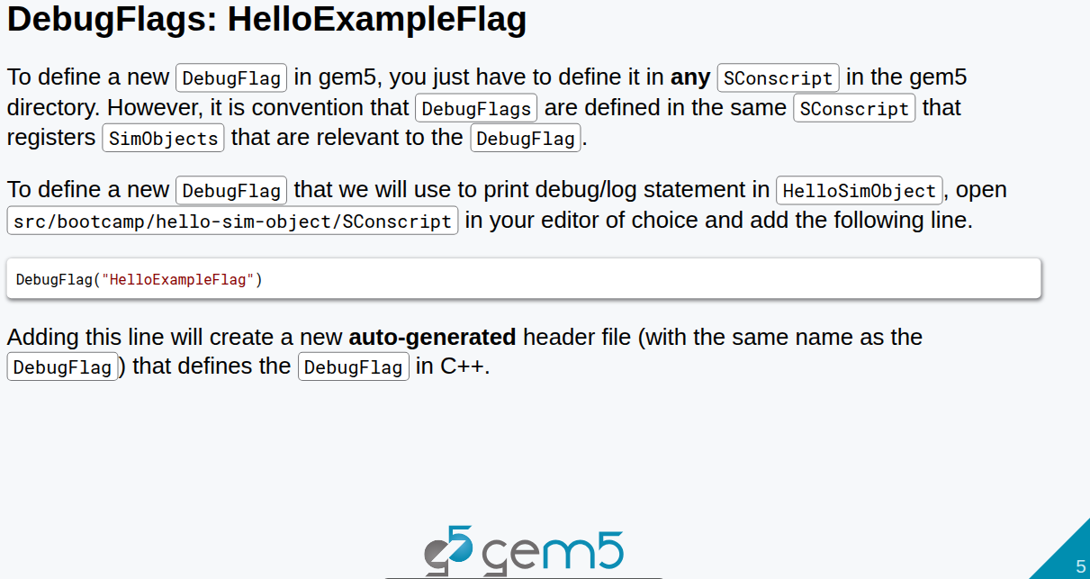
18.2 Step 1: SimObject with DebugFlags
https://www.youtube.com/watch?v=DDlSLCi5Nmk&list=PL_hVbFs_loVR_8ntTTmmG6YEq3Po_4snu&index=18
Step1: SimObject with DebugFlags (1:46-1:47/15:02)
DebugFlags is not related to any specific SimObject.
We can define DebugFlags in any SConscript in Gem5 directory. For example, for HelloSimObject project.
We open
> code ~/material/03-Developing-gem5-models/-2-debugging-gem5/src/bootcamp/hello-sim-object/SConscript
>> DebugFlag (“HelloExampleFlag”)

Slide 11
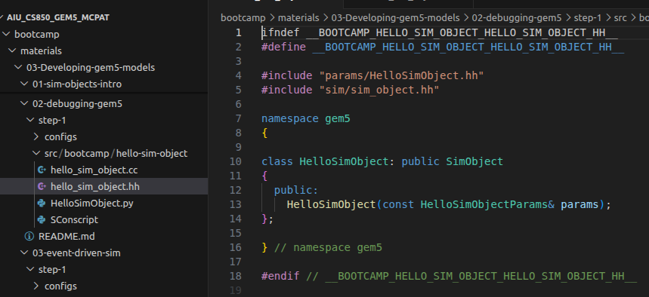
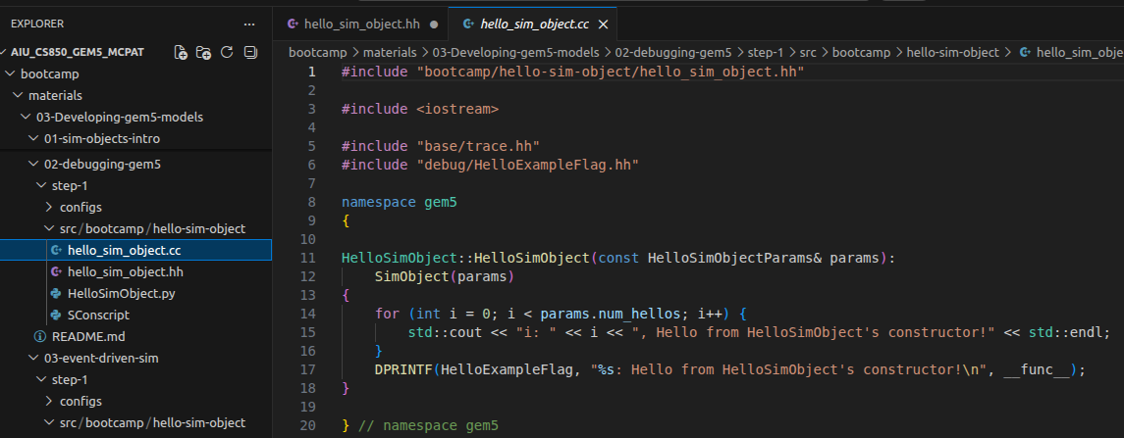
18.2 Step 1: SimObject with DebugFlags
https://www.youtube.com/watch?v=DDlSLCi5Nmk&list=PL_hVbFs_loVR_8ntTTmmG6YEq3Po_4snu&index=18
Step1: SimObject with DebugFlags (1:48-2:40/15:02)
> code ~/material/03-Developing-gem5-models/-2-debugging-gem5/src/bootcamp/hello-sim-object/hello_sim_object.[hh, cc]
>> DebugFlag (“HelloExampleFlag”)
Add this, when we run gem5 and gem5 will create a auto-generated header file (hh) and cc file that defines the DebugFlags in C++.

Slide 12
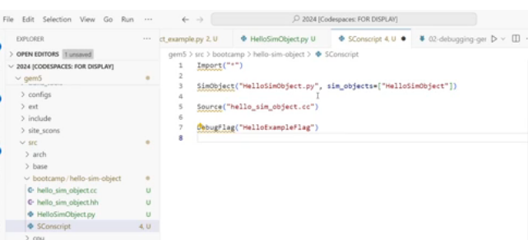
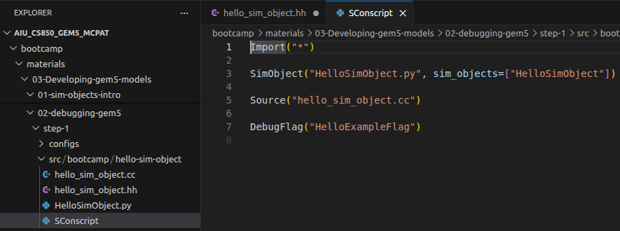
18.2 Step 1: SimObject with DebugFlags
https://www.youtube.com/watch?v=DDlSLCi5Nmk&list=PL_hVbFs_loVR_8ntTTmmG6YEq3Po_4snu&index=18
Step1: SimObject with DebugFlags (2:41-4:00/15:02)
> code ~/material/03-Developing-gem5-models/-2-debugging-gem5/src/bootcamp/hello-sim-object/SConscript
>> SimObject(“HelloSimObject.py”, sim_objects=[“HelloSimObject”])
>> Source (“hello_sim_object.cc”)
>> DebugFlag (“HelloExampleFlag”)

Slide 13
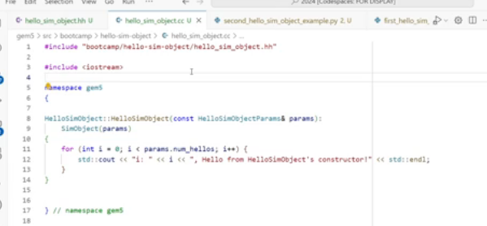
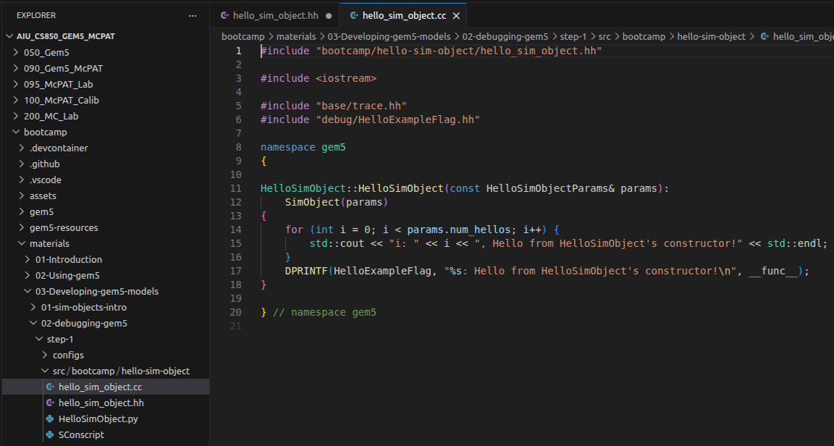
18.2 Step 1: SimObject with DebugFlags
https://www.youtube.com/watch?v=DDlSLCi5Nmk&list=PL_hVbFs_loVR_8ntTTmmG6YEq3Po_4snu&index=18
Step1: SimObject with DebugFlags (4:01-4:20/15:02)
> code ~/material/03-Developing-gem5-models/-2-debugging-gem5/src/bootcamp/hello-sim-object/hello_sim_object.cc
We go to c++ file and add code.

Slide 14
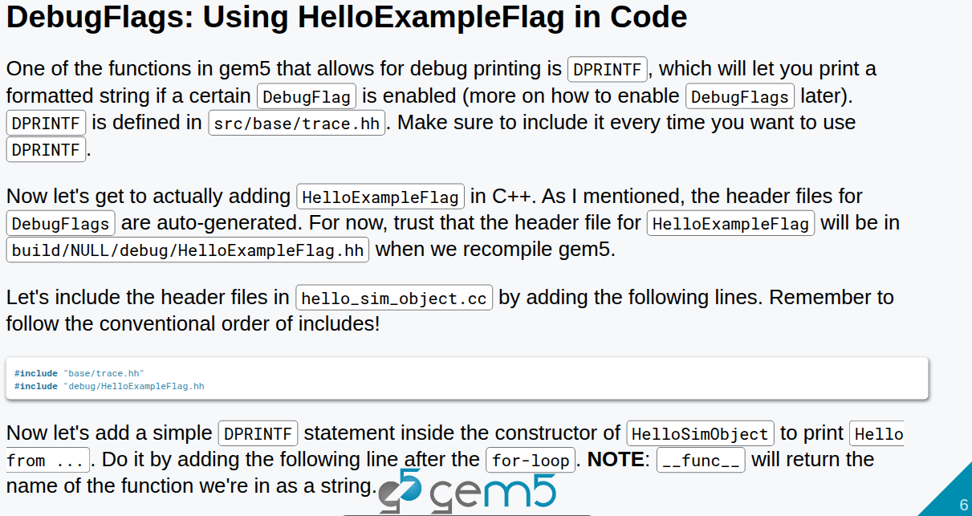
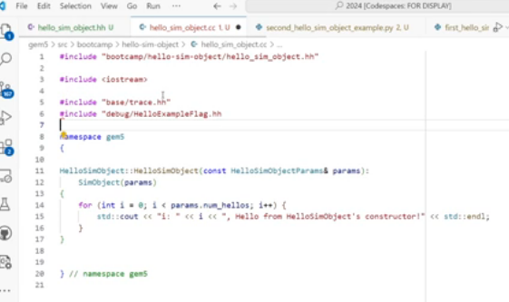
18.2 Step 1: SimObject with DebugFlags
https://www.youtube.com/watch?v=DDlSLCi5Nmk&list=PL_hVbFs_loVR_8ntTTmmG6YEq3Po_4snu&index=18
Step1: SimObject with DebugFlags (4:21-5:00/15:02)
> code ~/material/03-Developing-gem5-models/-2-debugging-gem5/src/bootcamp/hello-sim-object/hello_sim_object.cc
We add
1. “base/tracehh” in
2. “HelloExampleFlag.hh”
The gem5 simulator will generate the
1. “gem5/build/NULL/base.hh”
2. “gem5/build/NULL/debug/HelloExampleFlag.hh”

Slide 15
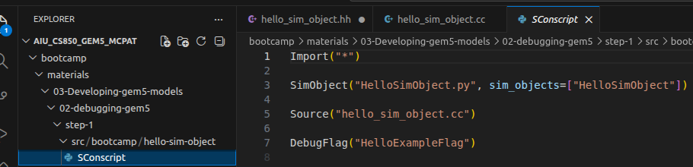
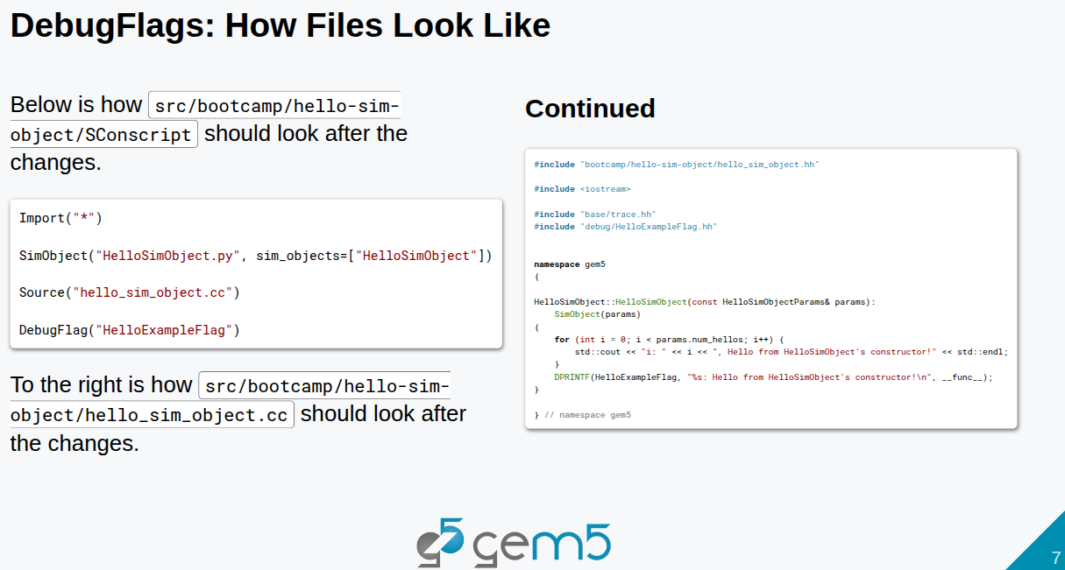
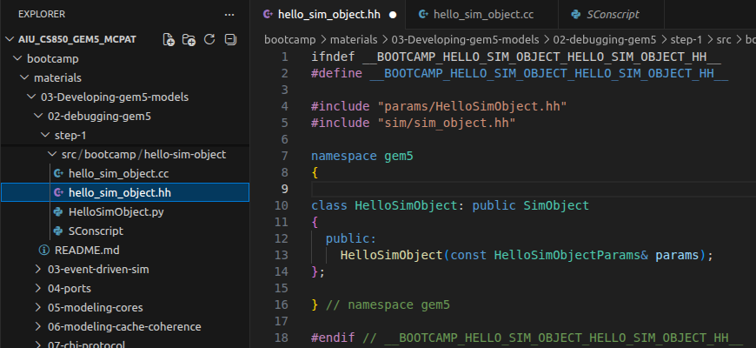
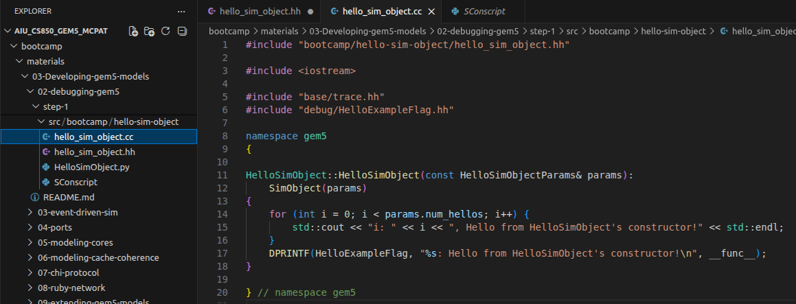
18.2 Step 1: SimObject with DebugFlags
https://www.youtube.com/watch?v=DDlSLCi5Nmk&list=PL_hVbFs_loVR_8ntTTmmG6YEq3Po_4snu&index=18
Step1: SimObject with DebugFlags (4:21-6:30/15:02)
> code ~/material/03-Developing-gem5-models/-2-debugging-gem5/src/bootcamp/hello-sim-object/[SConscript, hello_sim_obect.hh, hello_sim_object.cc]
The finale files should look like:
1. SConscript
2. hello_sim_object.hh
3. hello_sim_object.cc
1
2
3

Slide 16
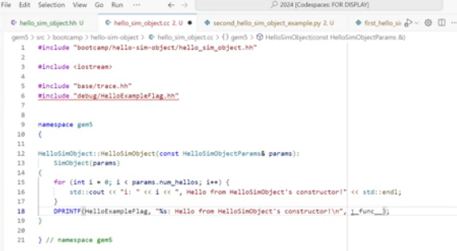
18.2 Step 1: SimObject with DebugFlags
https://www.youtube.com/watch?v=DDlSLCi5Nmk&list=PL_hVbFs_loVR_8ntTTmmG6YEq3Po_4snu&index=18
Step1: SimObject with DebugFlags (6:31-7:30/15:02)
> code ~/material/03-Developing-gem5-models/-2-debugging-gem5/src/bootcamp/hello-sim-object/[SConscript, hello_sim_obect.hh, hello_sim_object.cc]
Whenever the DebugFlags is enable, we can use DPRINTF() to print string and formatted string.
The _func__ is the name of the function in our debug print.

Slide 17
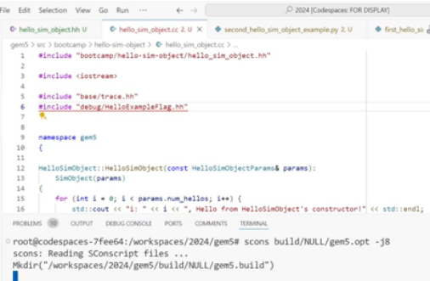
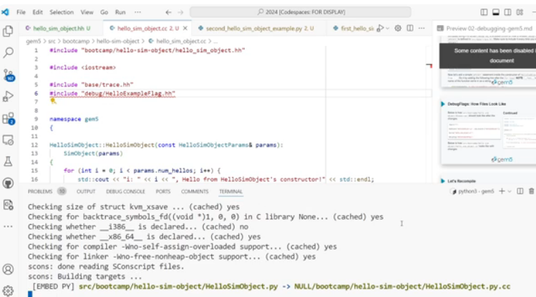
18.2 Step 1: SimObject with DebugFlags
https://www.youtube.com/watch?v=DDlSLCi5Nmk&list=PL_hVbFs_loVR_8ntTTmmG6YEq3Po_4snu&index=18
Step1: SimObject with DebugFlags (7:31-7:40/15:02)
> code ~/material/03-Developing-gem5-models/-2-debugging-gem5/src/bootcamp/hello-sim-object/[SConscript, hello_sim_obect.hh, hello_sim_object.cc]
> scons build/NULL/gem5.opt -j8
We need to copy all above files to gem5 directory. SConscript will guide compile the compilation.
src/bootcamp/help-sim-objet/HelloSimObject.py -> NULL/bootcamp/hello-sim-object/HelloSimObject.py.cc

Slide 18
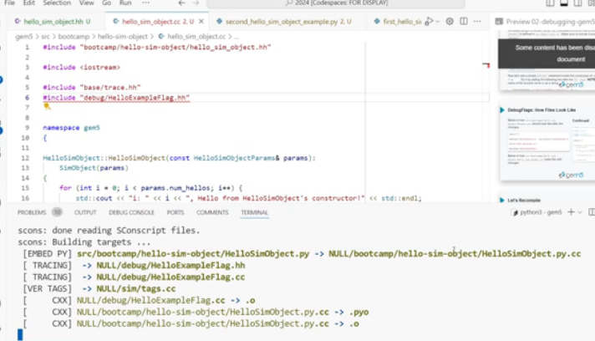
18.2 Step 1: SimObject with DebugFlags
https://www.youtube.com/watch?v=DDlSLCi5Nmk&list=PL_hVbFs_loVR_8ntTTmmG6YEq3Po_4snu&index=18
Step1: SimObject with DebugFlags (7:41-8:40/15:02)
> code ~/material/03-Developing-gem5-models/-2-debugging-gem5/src/bootcamp/hello-sim-object/[SConscript, hello_sim_obect.hh, hello_sim_object.cc]
src/bootcamp/help-sim-objet/HelloSimObject.py -> NULL/bootcamp/hello-sim-object/HelloSimObject.py.cc
-> NULL/debug/HelloExampleFlag.hh
-> NULL/debug/HelloExampleFlag.cc
→ NULL/sim/tags.cc

Slide 19
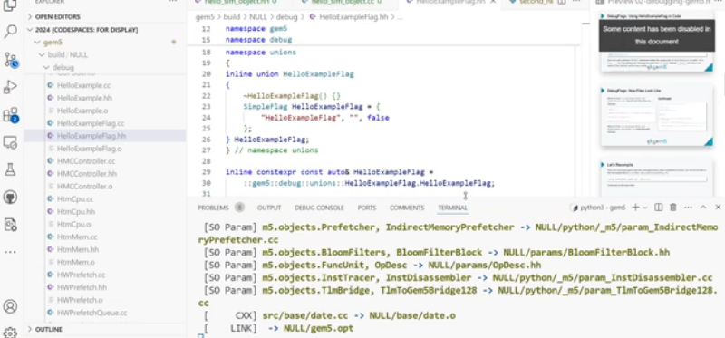
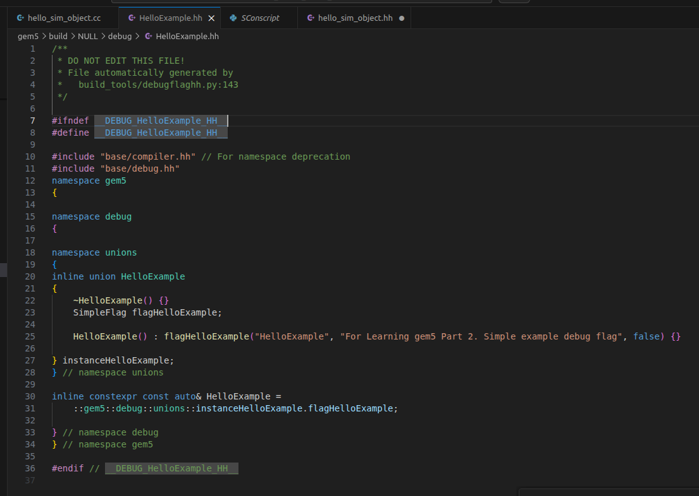
18.2 Step 1: SimObject with DebugFlags
https://www.youtube.com/watch?v=DDlSLCi5Nmk&list=PL_hVbFs_loVR_8ntTTmmG6YEq3Po_4snu&index=18
Step1: SimObject with DebugFlags (7:41-8:40/15:02)
> code ~/material/03-Developing-gem5-models/-2-debugging-gem5/src/bootcamp/hello-sim-object/[SConscript, hello_sim_obect.hh, hello_sim_object.cc]
We should see the generated HelloExampleFlag.hh.

Slide 20
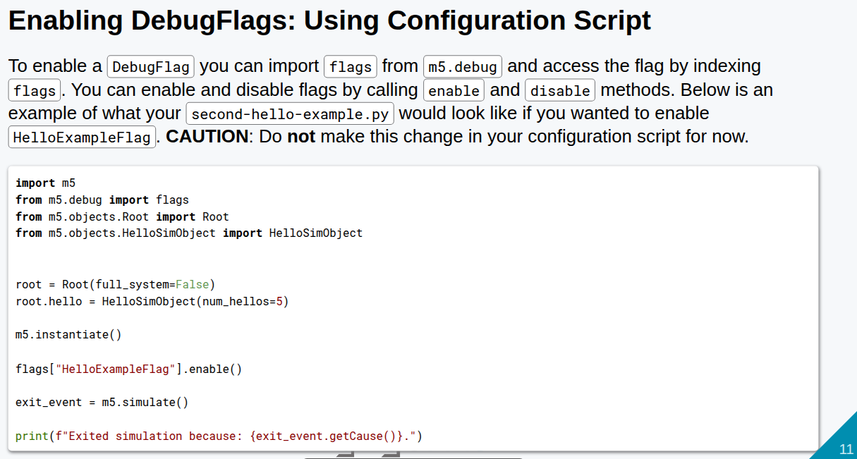
18.2 Step 1: SimObject with DebugFlags
https://www.youtube.com/watch?v=DDlSLCi5Nmk&list=PL_hVbFs_loVR_8ntTTmmG6YEq3Po_4snu&index=18
Step1: SimObject with DebugFlags (8:41-9:50/15:02)
There are two ways to enable the debug print.
1. enable print on Python script: There are gem5/src/SConscript
> from m5.debug import flags

Slide 21
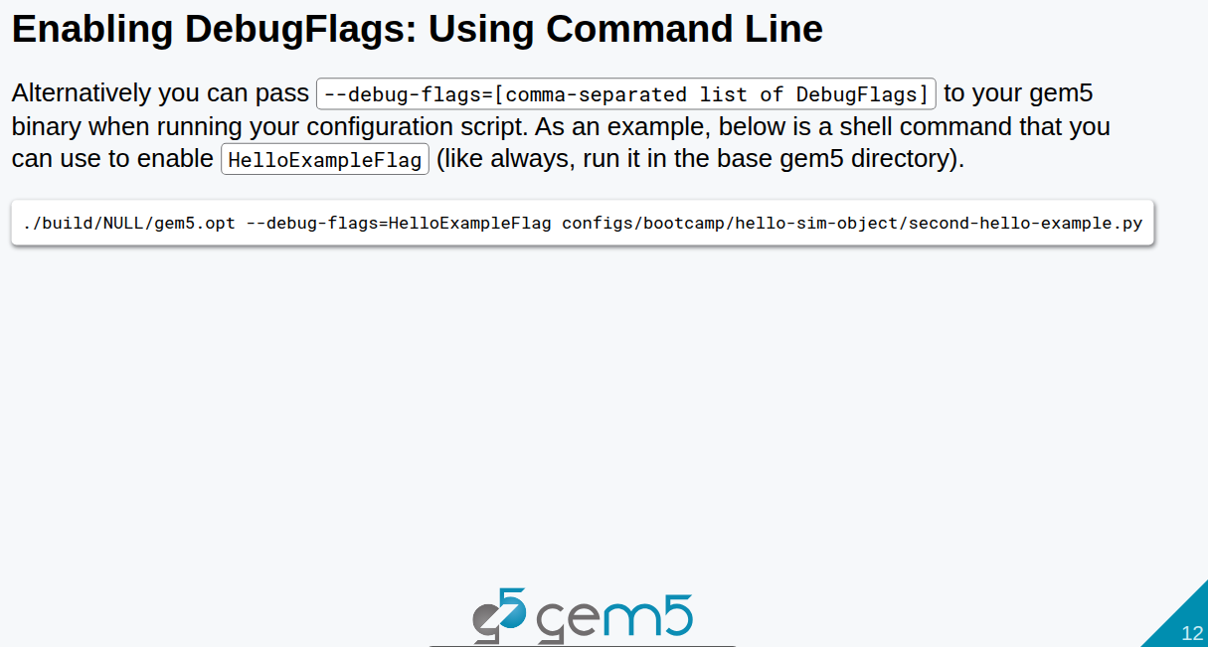
18.2 Step 1: SimObject with DebugFlags
https://www.youtube.com/watch?v=DDlSLCi5Nmk&list=PL_hVbFs_loVR_8ntTTmmG6YEq3Po_4snu&index=18
Step1: SimObject with DebugFlags (9:51-10:50/15:02)
2. The second way is to enable the DebugFlags is to use command line.
> ./build/NULL/gem5.opt –debug-flags=HelloExampleFlag configs/bootcamp/hello-sim-object/second-hello-example.py
It is better to use the debug flags in Python. We have more control over where to print and not to print.
When you run the simulation, we want to print the debug information.

Slide 22
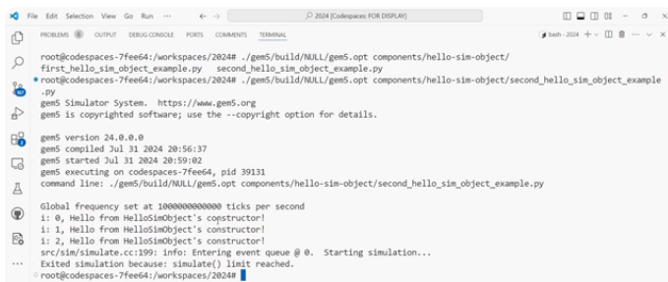
18.2 Step 1: SimObject with DebugFlags
https://www.youtube.com/watch?v=DDlSLCi5Nmk&list=PL_hVbFs_loVR_8ntTTmmG6YEq3Po_4snu&index=18
Step1: SimObject with DebugFlags (10:51-11:50/15:02)
> ~/gem5/build/NULL/gem5.opt first_hello_sim_object_example.py second_hello_sim_object_example.py
We see the
1. First hello example does not have debug print.
2. Second hello example has three debug print.

Slide 23
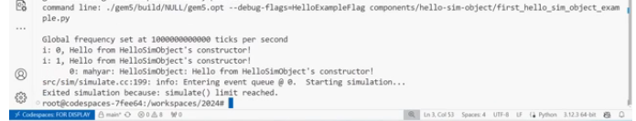
18.2 Step 1: SimObject with DebugFlags
https://www.youtube.com/watch?v=DDlSLCi5Nmk&list=PL_hVbFs_loVR_8ntTTmmG6YEq3Po_4snu&index=18
Step1: SimObject with DebugFlags (11:51-12:20/15:02)
> ~/gem5/build/NULL/gem5.opt --debug-flags=HelloExampleFlag first_hello_sim_object_example.py second_hello_sim_object_example.py
We see the enable debug flags.
Now we see there is a print at the tick 0 from the SimObject named mahyar inside the hello sim object function that print the statement.

Slide 24
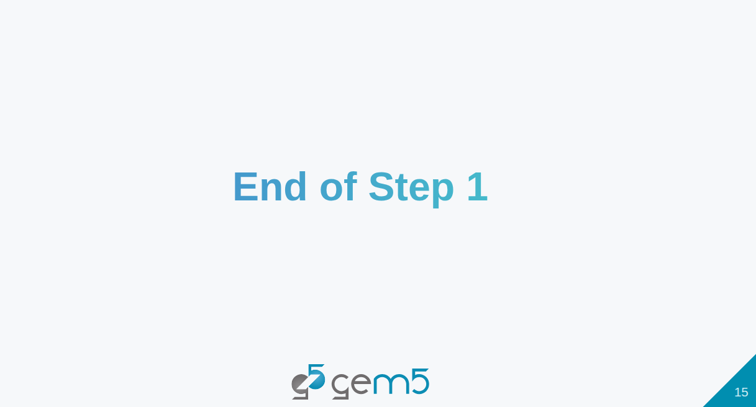
18.2 Step 1: SimObject with DebugFlags
https://www.youtube.com/watch?v=DDlSLCi5Nmk&list=PL_hVbFs_loVR_8ntTTmmG6YEq3Po_4snu&index=18
Step1: SimObject with DebugFlags (12:21-12:25/15:02)
We finish the Step 1: SimObject with DebugFlags

Slide 25
18.3 Gem5 Assertion

Slide 26
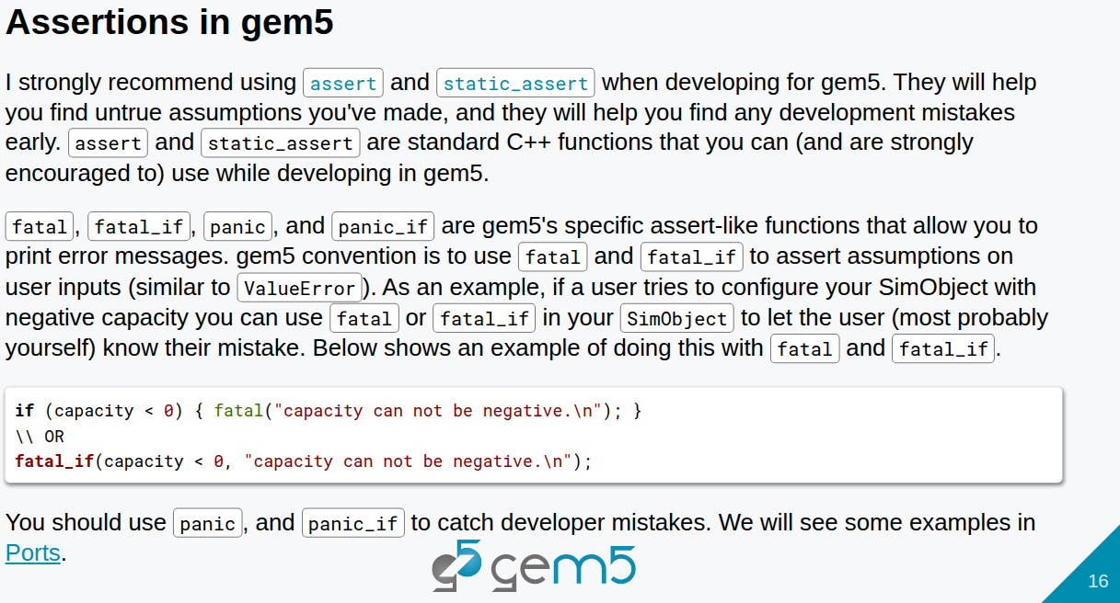
18.3 Gem5 Assertion
https://www.youtube.com/watch?v=DDlSLCi5Nmk&list=PL_hVbFs_loVR_8ntTTmmG6YEq3Po_4snu&index=18
Gem5 Assertion (12:26-14:25/15:02)
Now, we move to Assertion in Gem5.
We strongly encourage to use Assertion instead of debug print.
The assertion will prevent the development mistakes in run-time.
In Gem5, we use
1. panic to catch developer mistake.
2. fatal to prevent user mistakes.

Slide 27
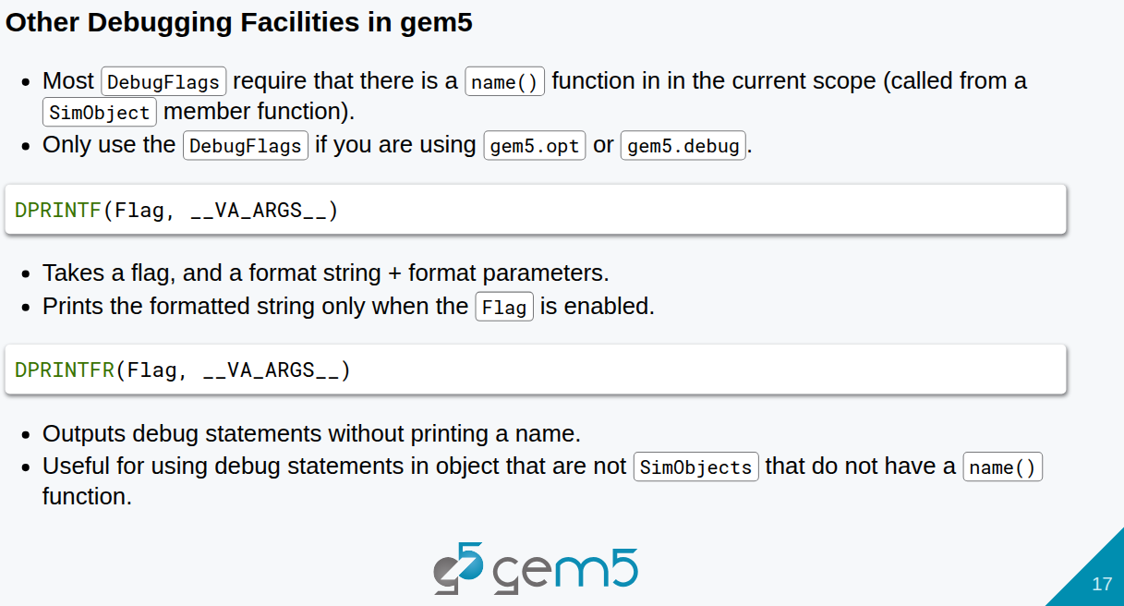
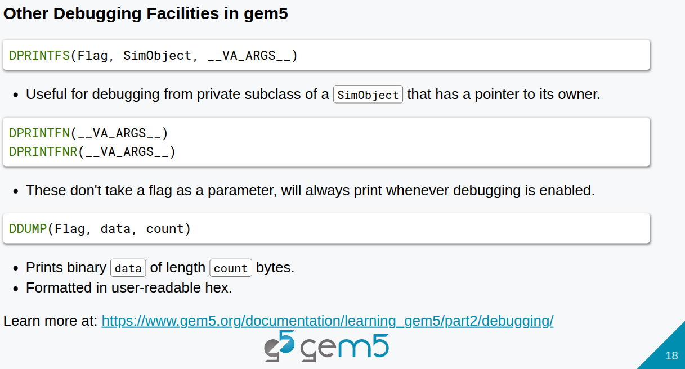
18.3 Gem5 Assertion
https://www.youtube.com/watch?v=DDlSLCi5Nmk&list=PL_hVbFs_loVR_8ntTTmmG6YEq3Po_4snu&index=18
Gem5 Assertion (14:26-14:50/15:02)
There are debugging functions in gem5: DPRINTF (), DPRINTFR(), DPRINTTFS(), DPRINTFN(), DPRINTFNR(), and DUMP() .

Slide 28
18.3 Gem5 Assertion
https://www.youtube.com/watch?v=DDlSLCi5Nmk&list=PL_hVbFs_loVR_8ntTTmmG6YEq3Po_4snu&index=18
Gem5 Assertion (14:51-15:02/15:02)
There are more debug functions: DPRINTTFS(), DPRINTFN(), DPRINTFNR(), DUMP()

Slide 29
End

