Slide 1

8 Gem5 Cache Model
Peter H. Chen

Slide 2
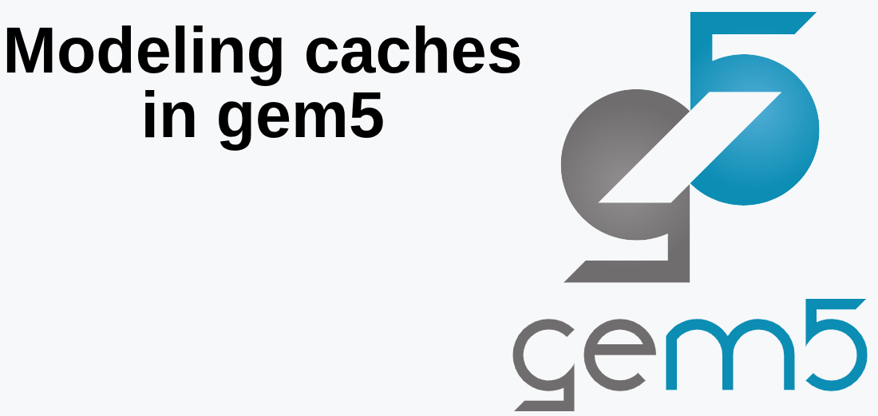
8 Gem5 Cache Model
https://www.youtube.com/watch?v=H6K0hE_zrfY&list=PL_hVbFs_loVR_8ntTTmmG6YEq3Po_4snu&index=8
Gem5 Cache Model (0:00-0:02/41:31)
We talk how to model the Cache in Gem5.

Slide 3
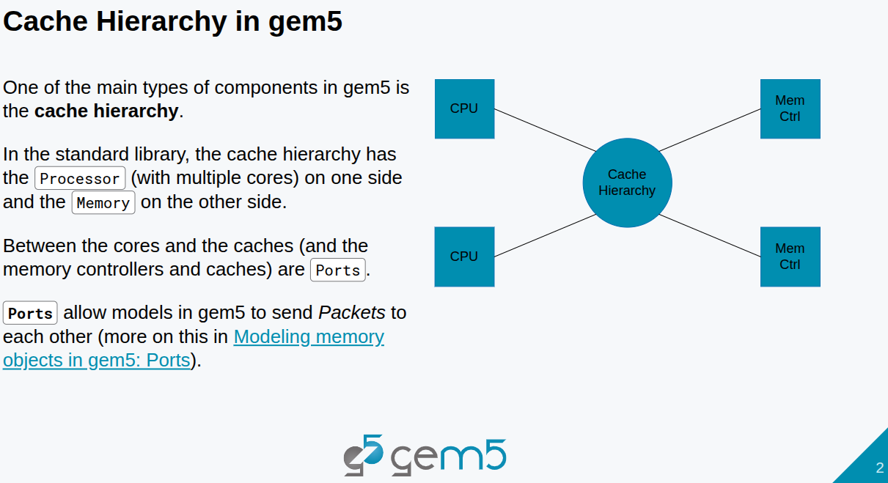
8 Gem5 Cache Model
https://www.youtube.com/watch?v=H6K0hE_zrfY&list=PL_hVbFs_loVR_8ntTTmmG6YEq3Po_4snu&index=8
Gem5 Cache Model (0:03-0:46/41:31)
One of the main types of components in gem5 is the Cache hierarchy.
The cache hierarchy is the components that sits between the CPU and Memory.
The job for cache hierarchy is to make sire all the CPUs have coherent access to memory.
Between the CPU Cores and Cache Hierarchy is a set of ports.
Between the cache hierarchy and the memory controller is a set of ports. In the classic caches. There are also ports that connect the caches together. We will see how to use ports for the objects.

Slide 4
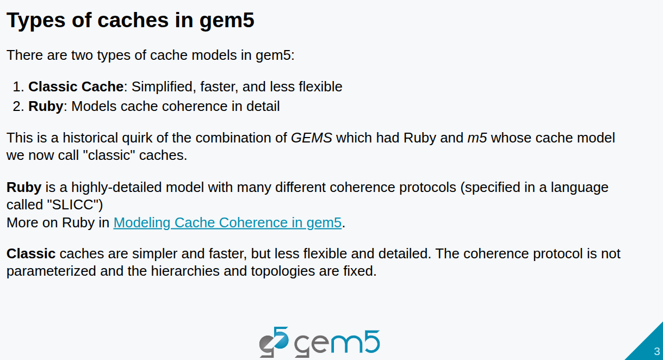
8 Gem5 Cache Model
https://www.youtube.com/watch?v=H6K0hE_zrfY&list=PL_hVbFs_loVR_8ntTTmmG6YEq3Po_4snu&index=8
Gem5 Cache Model (0:47-3:08/41:31)
There are two types of cache models in Gem5.
Gem5 combines the Gems and m5. Gems has its cache model called “Ruby” and m5 has its cache model.
When Gems and m5 combines,
1. Classic Cache: The m5 cache model rename into “Classic Cache” model.
2. Ruby: Keep the Ruby cache model, very highly-detailed model with different coherent protocols. The protocols are implemented in a domain specific language for specified cache coherent protocols called SLICC (Specification Language Including Cache Coherence). Note: Ruby is not the Ruby Programming Language.
Note:
1. Class Cache is faster but less flexible. In Class Cache, the topology is fixed but hierarchy is parameterized.
2. Ruby specify the hierarchy but not specify the topology.

Slide 5
8.1 Topics

Slide 6
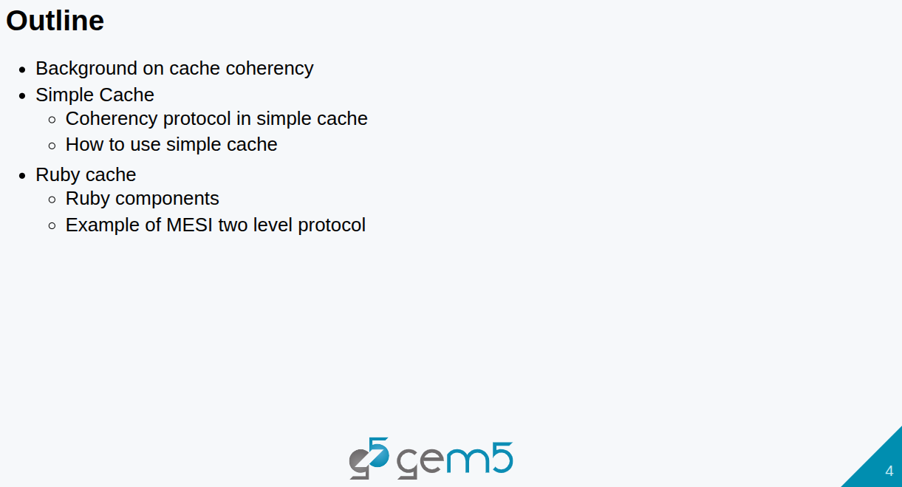
8.1 Topics
https://www.youtube.com/watch?v=H6K0hE_zrfY&list=PL_hVbFs_loVR_8ntTTmmG6YEq3Po_4snu&index=8
Topics (3:09-3:37/41:31)
1. Background of Cache Coherency
2. Code in Simple cache Protocol
3. Code in Ruby Cache Components

Slide 7
8.2 Coherency

Slide 8
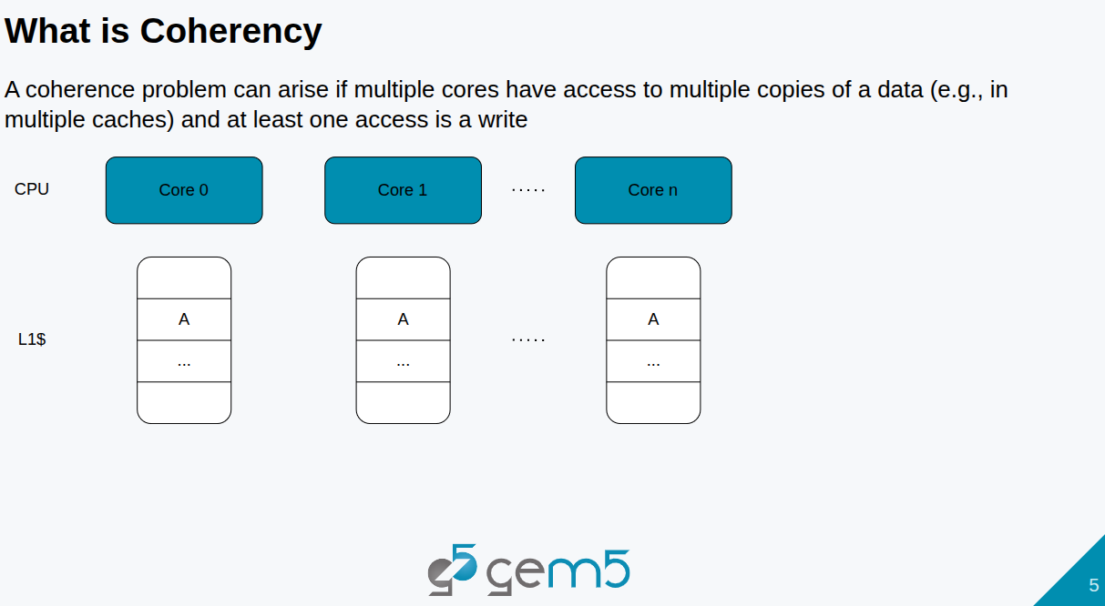
8.2 Coherency
https://www.youtube.com/watch?v=H6K0hE_zrfY&list=PL_hVbFs_loVR_8ntTTmmG6YEq3Po_4snu&index=8
Coherency (3:38-4:01/41:31)
What is Coherency?
We have a bunch of cores. Each core has some private caches. They might be sharing this block A.
This cache protocol is called SWMR (Single-Writer, Multiple-Reader) invariant.
In this case, we could have multiple cores that can all read A at the same time.
What is SWMR invariant?
The single-writer, multiple-reader (SWMR) invariant specifies that for any single memory location at any given time, one of two conditions must be true:
1. One writer: A single core has a private, read-write copy of the data. All other caches have either an invalid or no copy.
2. Multiple readers: Multiple cores can have a shared, read-only copy of the data. These multiple cores do not have writable copy.
The "variants" mentioned are the various cache coherence protocols that implement this rule.

Slide 9

8.2 Coherency
https://www.youtube.com/watch?v=H6K0hE_zrfY&list=PL_hVbFs_loVR_8ntTTmmG6YEq3Po_4snu&index=8
Coherency (4:02-4:13/41:31)
If core n writes A, we need to invalid the write of all the other cores, i.e., only core n can write. Other cores can only read.

Slide 10
8.3 Classic Cache

Slide 11
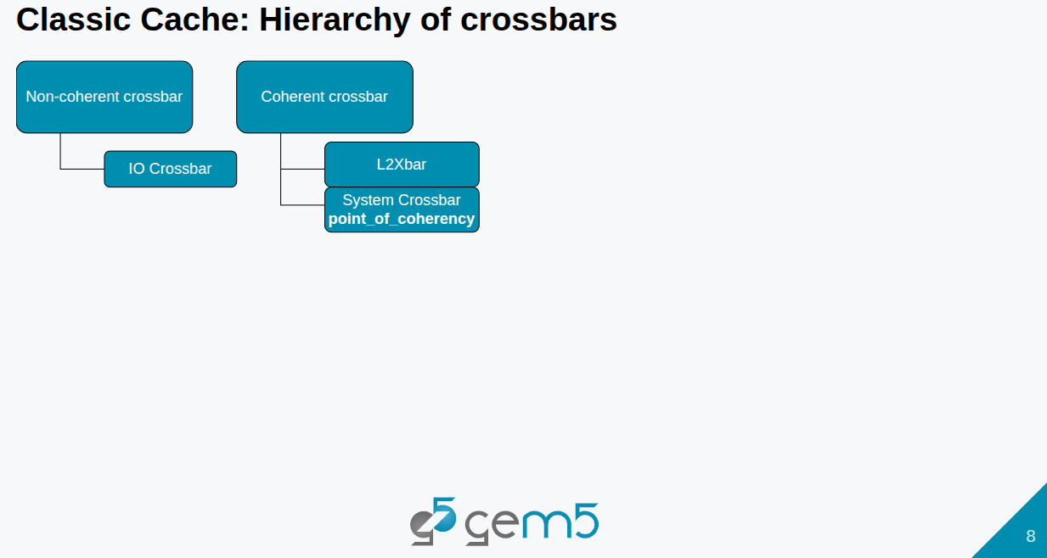
8.3 Classic Cache
https://www.youtube.com/watch?v=H6K0hE_zrfY&list=PL_hVbFs_loVR_8ntTTmmG6YEq3Po_4snu&index=8
Classic Cache (4:14-5:16/41:31)
Classic caches implement their Coherence Protocol by a Hierarchy of crossbars.
The classic caches is the only kind of coherence we can improve.
There are two types of crossbars: the classic caches and non-coherent crossbars.
1. The non-coherent crossbars has subclass IO crossbars
2. The Coherent Crossbar has L2Xbar and system Crossbar.
The coherent crossbar and non-coherent crossbar are the model in the simObjects.
The IO crossbar, L2Xbar, and system crossbar are the standard library instance or specifications.

Slide 12
8.4 Classic Cache: Coherent Crossbar

Slide 13
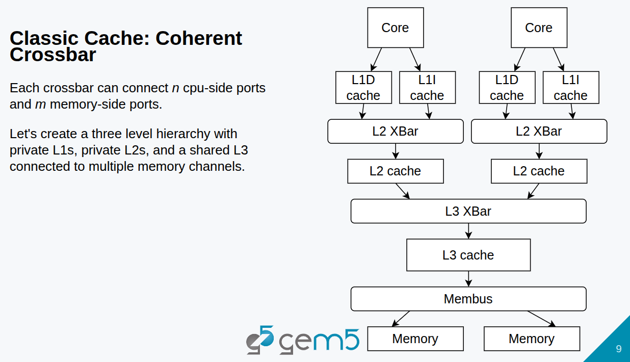
8.4 Classic Cache: Coherent Crossbar
https://www.youtube.com/watch?v=H6K0hE_zrfY&list=PL_hVbFs_loVR_8ntTTmmG6YEq3Po_4snu&index=8
Classic Cache: Coherent Crossbar (5:17-6:16/41:31)

Slide 14
End

