Slide 1

21.1 Model Port (01): Slides
Peter H. Chen

Slide 2
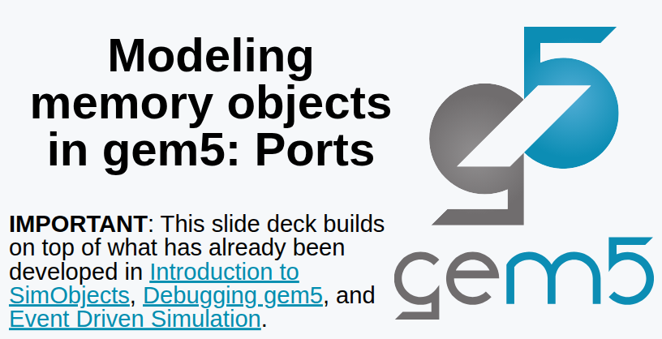
21.1 Model Port (01): Slides
https://gem5bootcamp.github.io/2124/#03-Developing-gem5-models/04-ports
Model Port (01): Slides

Slide 3
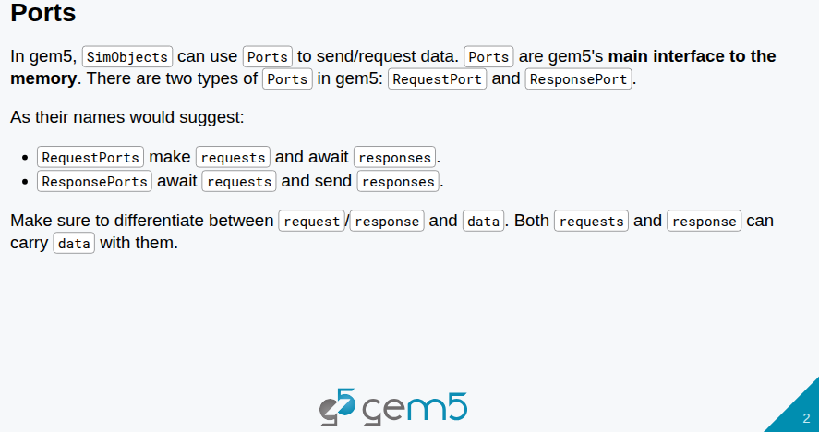
21.1 Model Port (01): Slides
https://gem5bootcamp.github.io/2124/#03-Developing-gem5-models/04-ports
Model Port (01): Slides

Slide 4
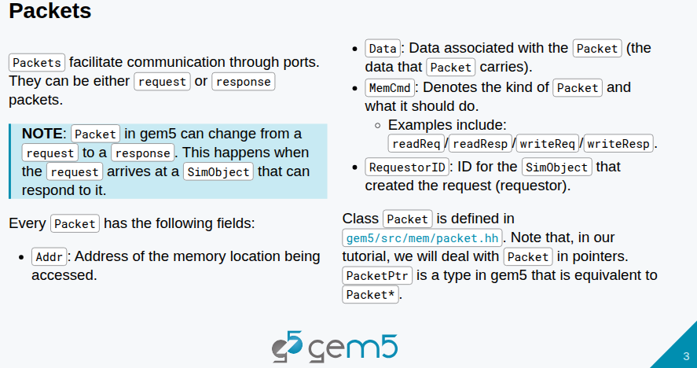
21.1 Model Port (01): Slides
https://gem5bootcamp.github.io/2124/#03-Developing-gem5-models/04-ports
Model Port (01): Slides

Slide 5
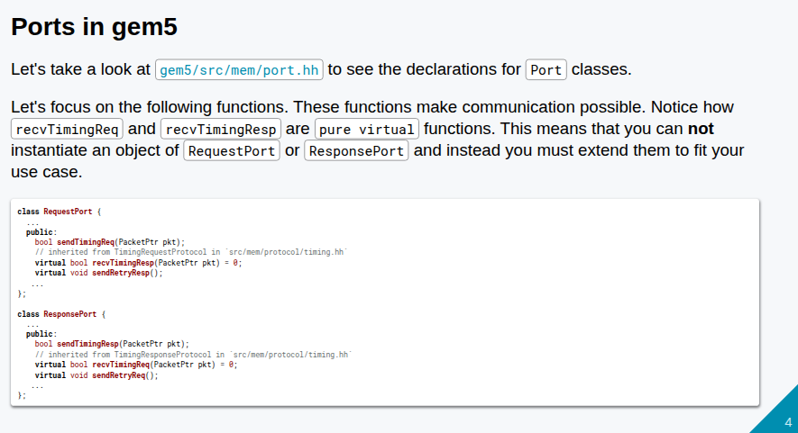
21.1 Model Port (01): Slides
https://gem5bootcamp.github.io/2124/#03-Developing-gem5-models/04-ports
Model Port (01): Slides

Slide 6
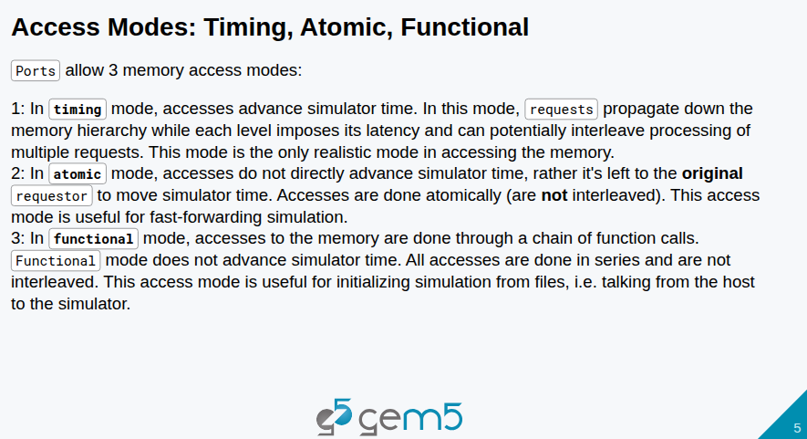
21.1 Model Port (01): Slides
https://gem5bootcamp.github.io/2124/#03-Developing-gem5-models/04-ports
Model Port (01): Slides

Slide 7
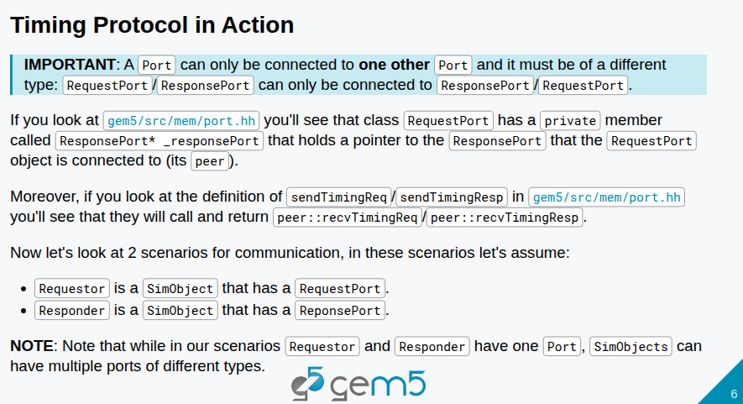
21.1 Model Port (01): Slides
https://gem5bootcamp.github.io/2124/#03-Developing-gem5-models/04-ports
Model Port (01): Slides

Slide 8
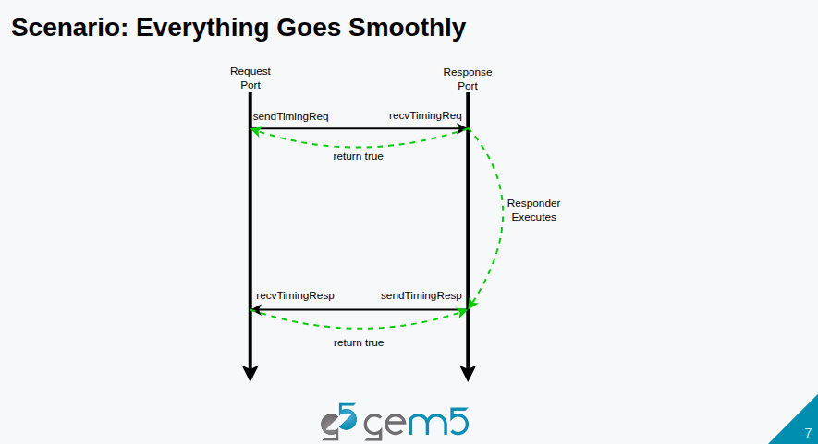
21.1 Model Port (01): Slides
https://gem5bootcamp.github.io/2124/#03-Developing-gem5-models/04-ports
Model Port (01): Slides

Slide 9
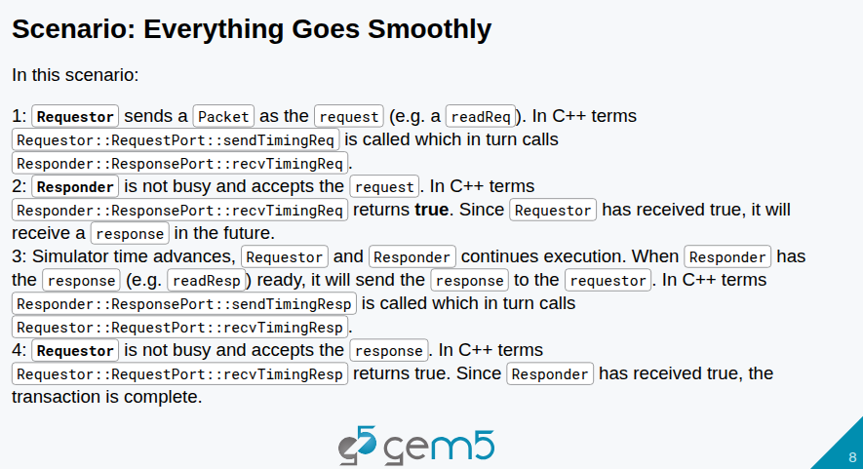
21.1 Model Port (01): Slides
https://gem5bootcamp.github.io/2124/#03-Developing-gem5-models/04-ports
Model Port (01): Slides

Slide 10
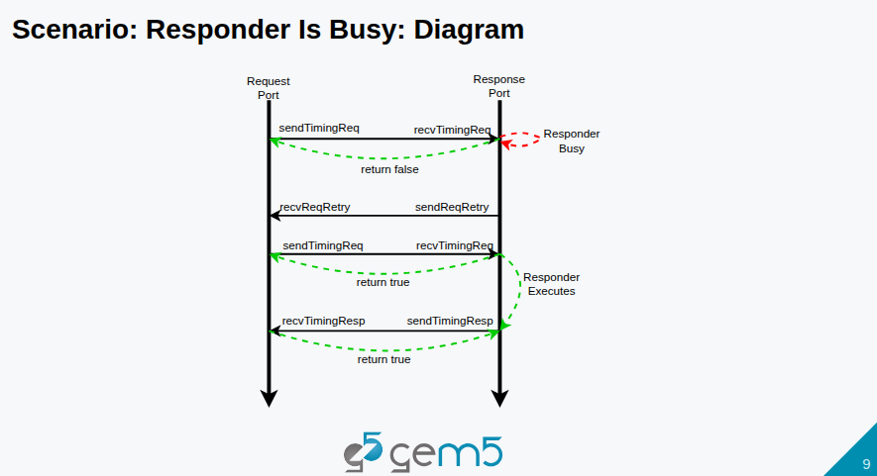
21.1 Model Port (01): Slides
https://gem5bootcamp.github.io/2124/#03-Developing-gem5-models/04-ports
Model Port (01): Slides

Slide 11
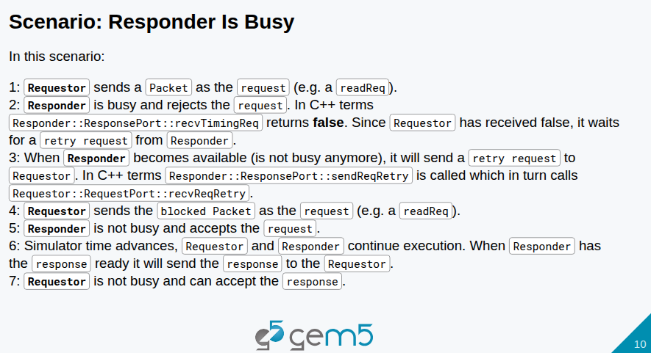
21.1 Model Port (01): Slides
https://gem5bootcamp.github.io/2124/#03-Developing-gem5-models/04-ports
Model Port (01): Slides

Slide 12
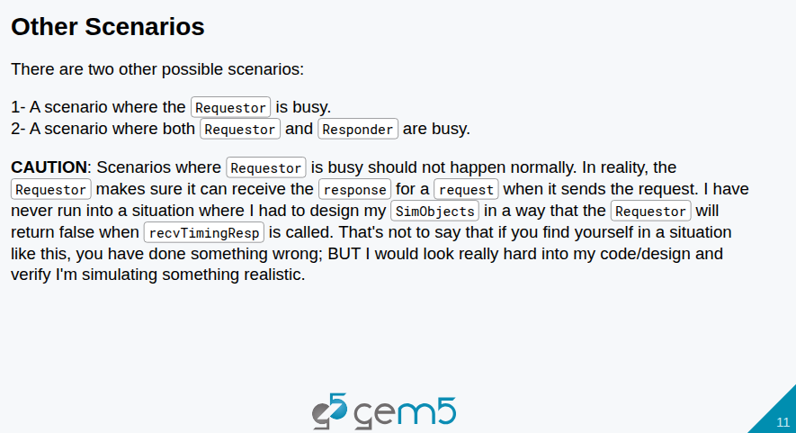
21.1 Model Port (01): Slides
https://gem5bootcamp.github.io/2124/#03-Developing-gem5-models/04-ports
Model Port (01): Slides

Slide 13
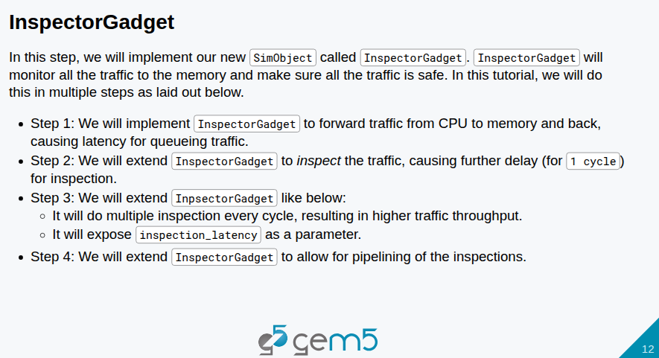
21.1 Model Port (01): Slides
https://gem5bootcamp.github.io/2124/#03-Developing-gem5-models/04-ports
Model Port (01): Slides

Slide 14
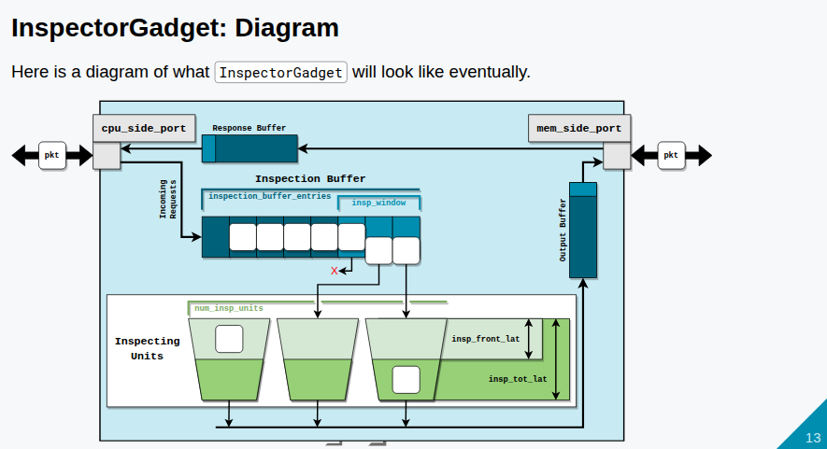
21.1 Model Port (01): Slides
https://gem5bootcamp.github.io/2124/#03-Developing-gem5-models/04-ports
Model Port (01): Slides

Slide 15
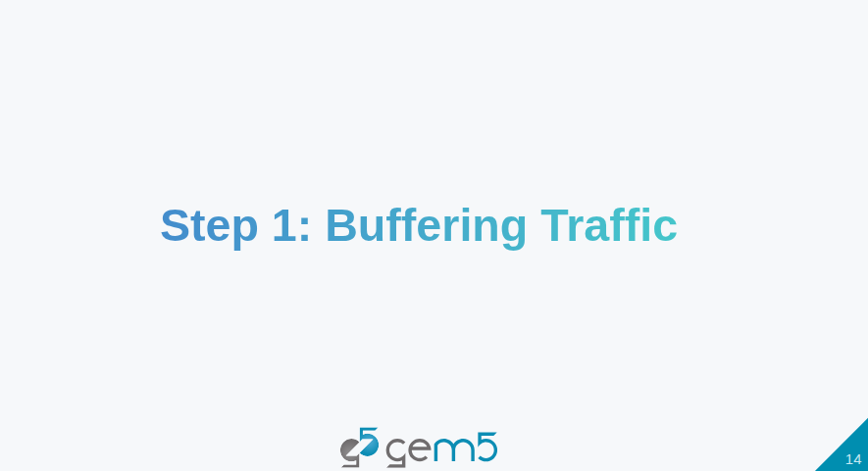
21.1 Model Port (01): Slides
https://gem5bootcamp.github.io/2124/#03-Developing-gem5-models/04-ports
Model Port (01): Slides

Slide 16
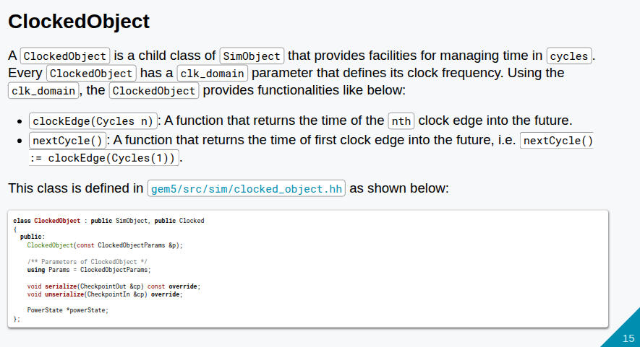
21.1 Model Port (01): Slides
https://gem5bootcamp.github.io/2124/#03-Developing-gem5-models/04-ports
Model Port (01): Slides

Slide 17
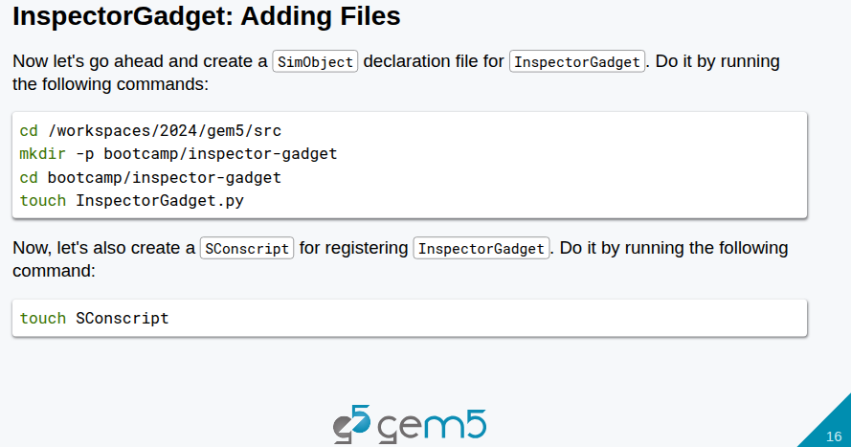
21.1 Model Port (01): Slides
https://gem5bootcamp.github.io/2124/#03-Developing-gem5-models/04-ports
Model Port (01): Slides

Slide 18
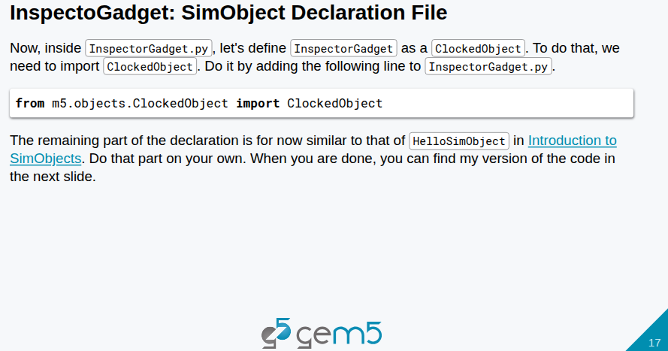
21.1 Model Port (01): Slides
https://gem5bootcamp.github.io/2124/#03-Developing-gem5-models/04-ports
Model Port (01): Slides

Slide 19
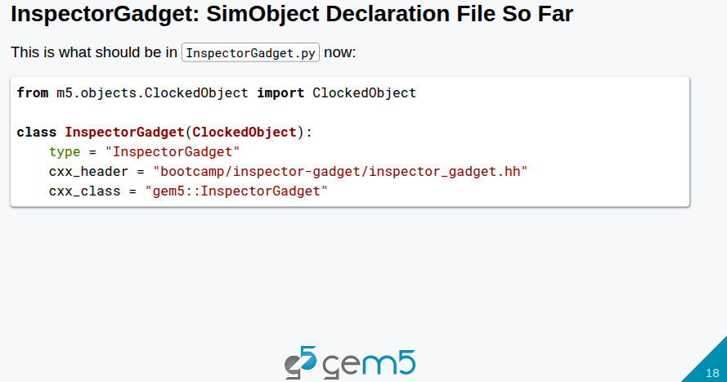
21.1 Model Port (01): Slides
https://gem5bootcamp.github.io/2124/#03-Developing-gem5-models/04-ports
Model Port (01): Slides

Slide 20
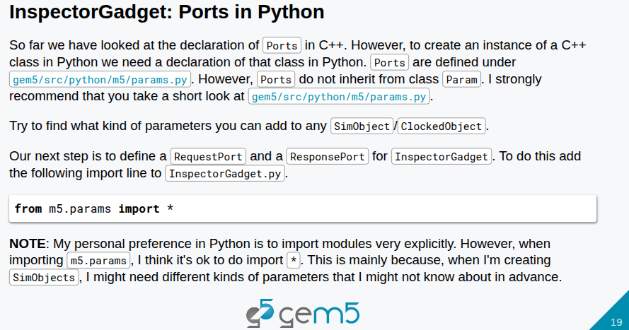
21.1 Model Port (01): Slides
https://gem5bootcamp.github.io/2124/#03-Developing-gem5-models/04-ports
Model Port (01): Slides

Slide 21
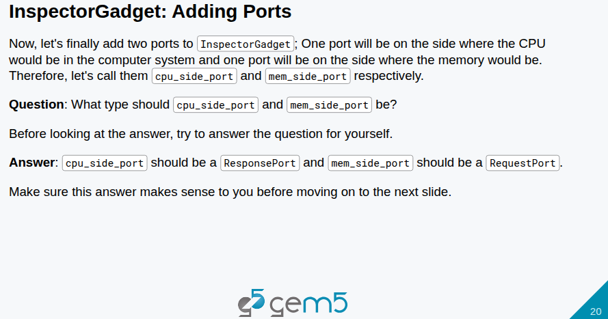
21.1 Model Port (01): Slides
https://gem5bootcamp.github.io/2124/#03-Developing-gem5-models/04-ports
Model Port (01): Slides

Slide 22
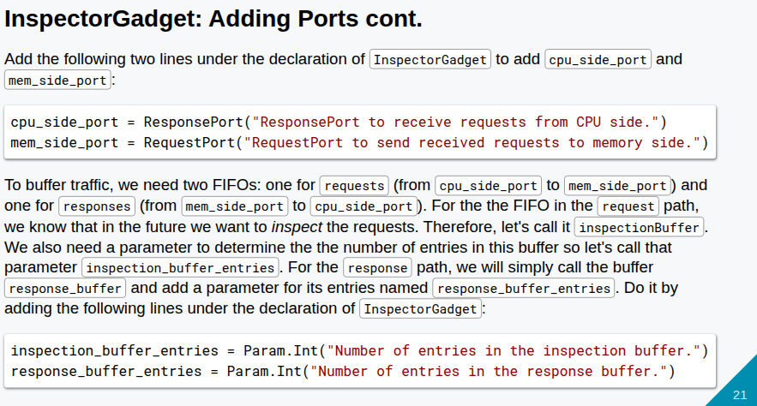
21.1 Model Port (01): Slides
https://gem5bootcamp.github.io/2124/#03-Developing-gem5-models/04-ports
Model Port (01): Slides

Slide 23
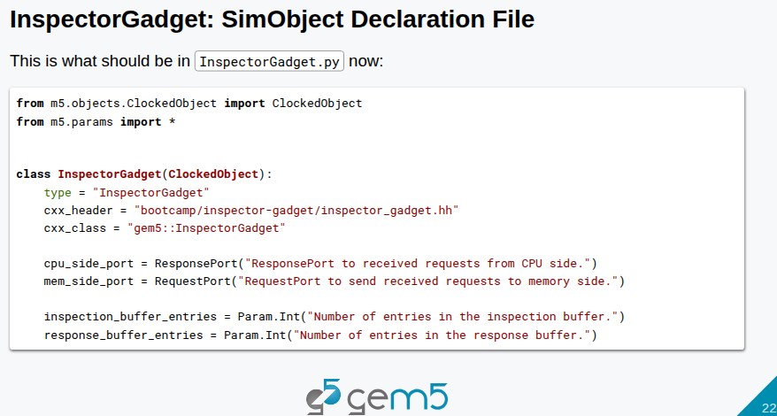
21.1 Model Port (01): Slides
https://gem5bootcamp.github.io/2124/#03-Developing-gem5-models/04-ports
Model Port (01): Slides

Slide 24
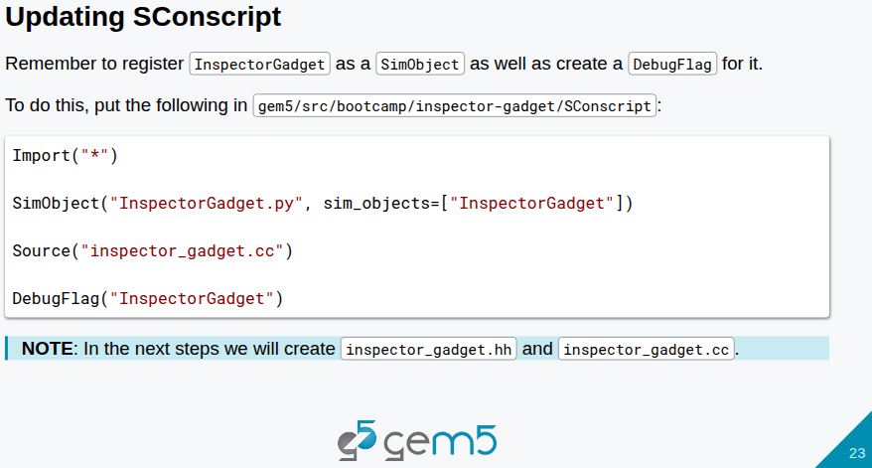
21.1 Model Port (01): Slides
https://gem5bootcamp.github.io/2124/#03-Developing-gem5-models/04-ports
Model Port (01): Slides

Slide 25
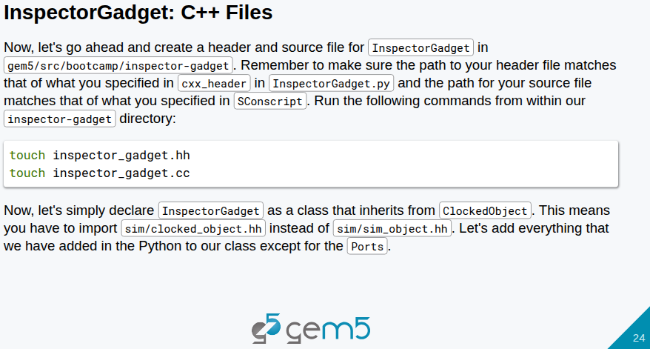
21.1 Model Port (01): Slides
https://gem5bootcamp.github.io/2124/#03-Developing-gem5-models/04-ports
Model Port (01): Slides

Slide 26
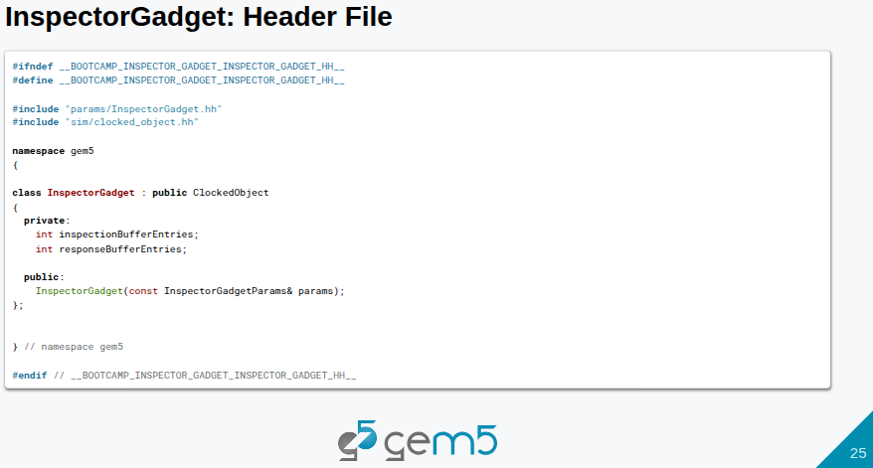
21.1 Model Port (01): Slides
https://gem5bootcamp.github.io/2124/#03-Developing-gem5-models/04-ports
Model Port (01): Slides

Slide 27
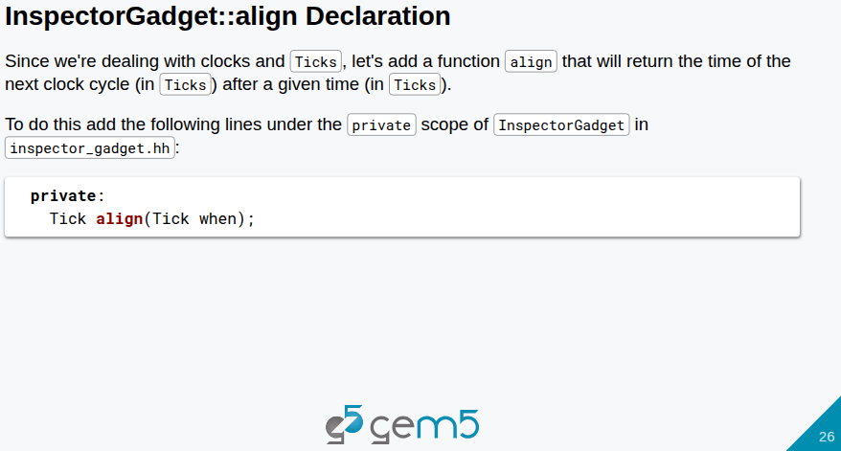
21.1 Model Port (01): Slides
https://gem5bootcamp.github.io/2124/#03-Developing-gem5-models/04-ports
Model Port (01): Slides

Slide 28
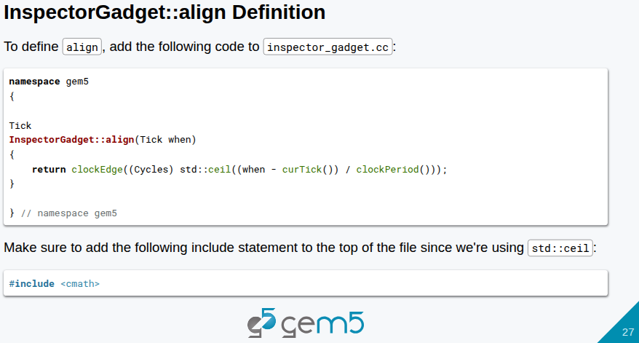
21.1 Model Port (01): Slides
https://gem5bootcamp.github.io/2124/#03-Developing-gem5-models/04-ports
Model Port (01): Slides

Slide 29
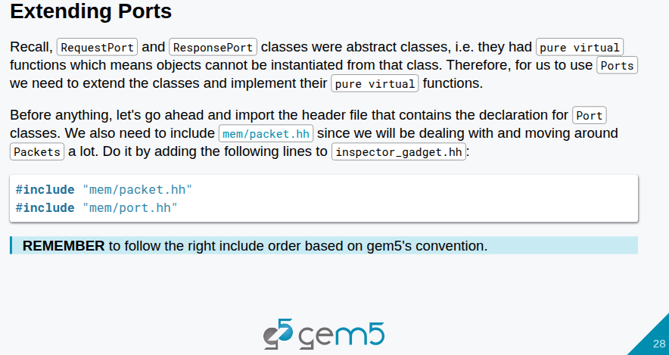
21.1 Model Port (01): Slides
https://gem5bootcamp.github.io/2124/#03-Developing-gem5-models/04-ports
Model Port (01): Slides

Slide 30
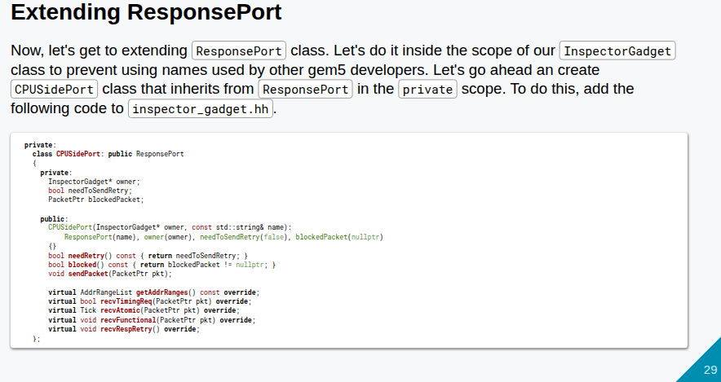
21.1 Model Port (01): Slides
https://gem5bootcamp.github.io/2124/#03-Developing-gem5-models/04-ports
Model Port (01): Slides

Slide 31
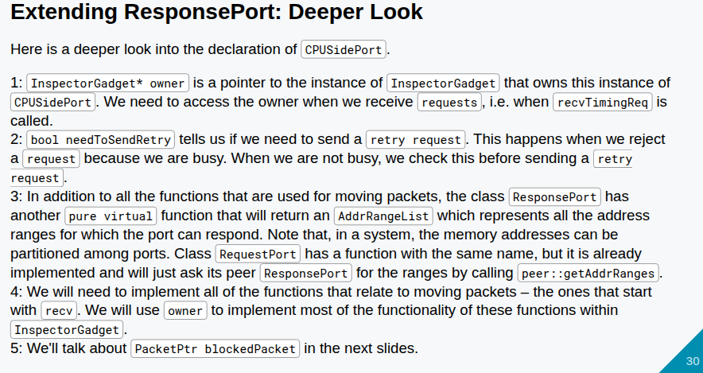
21.1 Model Port (01): Slides
https://gem5bootcamp.github.io/2124/#03-Developing-gem5-models/04-ports
Model Port (01): Slides

Slide 32
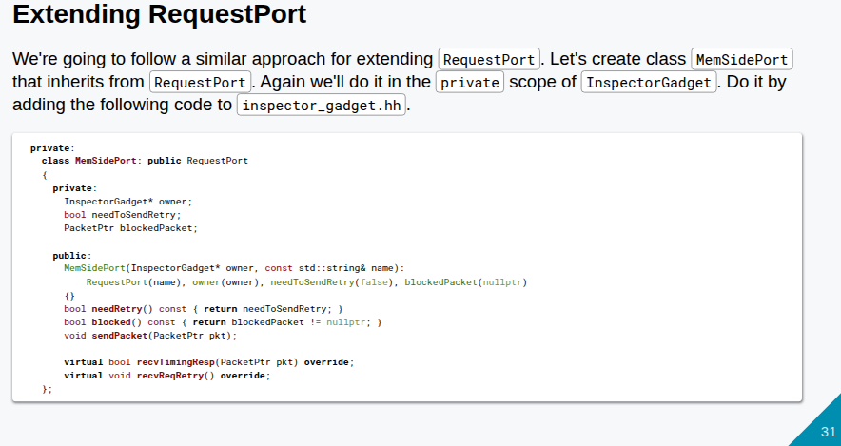
21.1 Model Port (01): Slides
https://gem5bootcamp.github.io/2124/#03-Developing-gem5-models/04-ports
Model Port (01): Slides

Slide 33
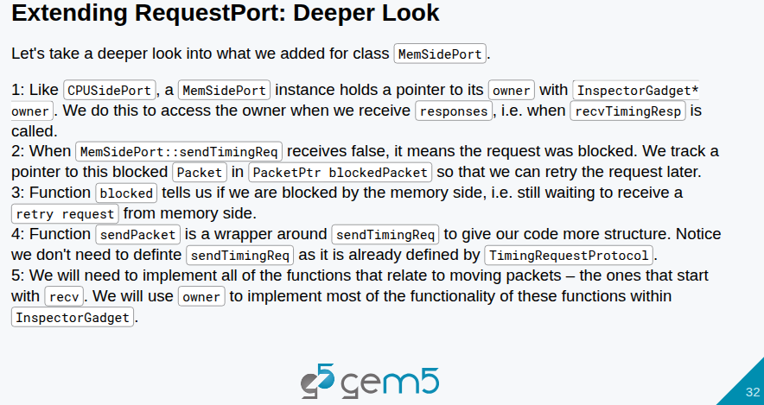
21.1 Model Port (01): Slides
https://gem5bootcamp.github.io/2124/#03-Developing-gem5-models/04-ports
Model Port (01): Slides

Slide 34
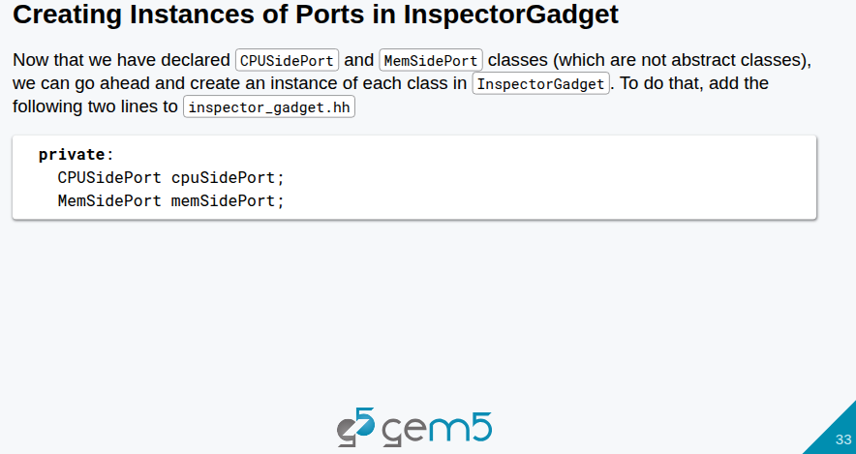
21.1 Model Port (01): Slides
https://gem5bootcamp.github.io/2124/#03-Developing-gem5-models/04-ports
Model Port (01): Slides

Slide 35
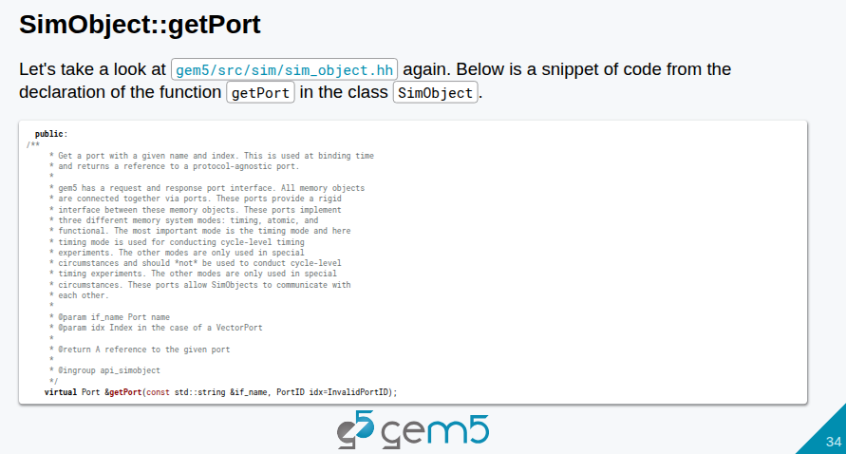
21.1 Model Port (01): Slides
https://gem5bootcamp.github.io/2124/#03-Developing-gem5-models/04-ports
Model Port (01): Slides

Slide 36
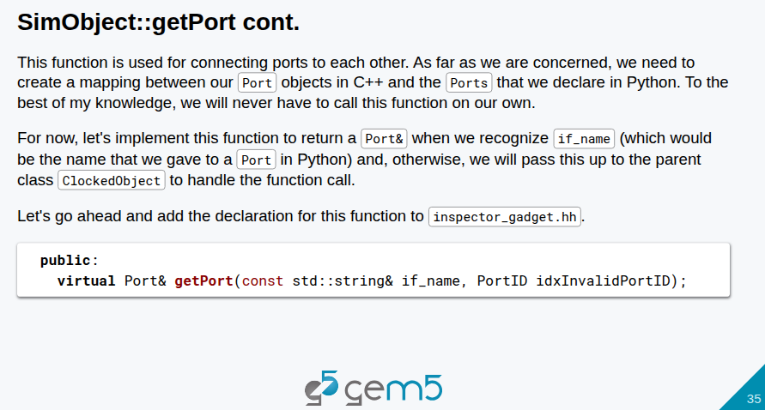
21.1 Model Port (01): Slides
https://gem5bootcamp.github.io/2124/#03-Developing-gem5-models/04-ports
Model Port (01): Slides

Slide 37
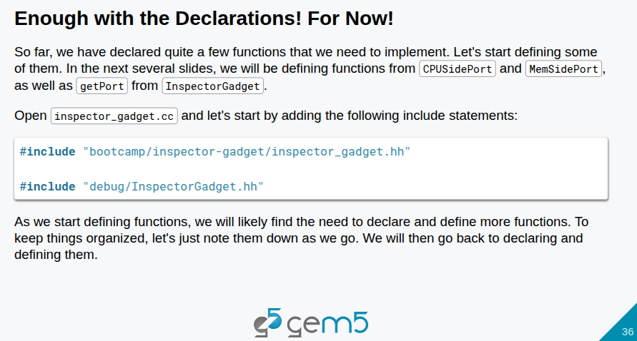
21.1 Model Port (01): Slides
https://gem5bootcamp.github.io/2124/#03-Developing-gem5-models/04-ports
Model Port (01): Slides

Slide 38
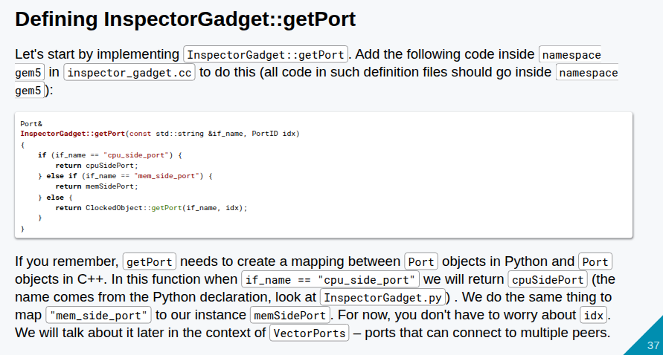
21.1 Model Port (01): Slides
https://gem5bootcamp.github.io/2124/#03-Developing-gem5-models/04-ports
Model Port (01): Slides

Slide 39
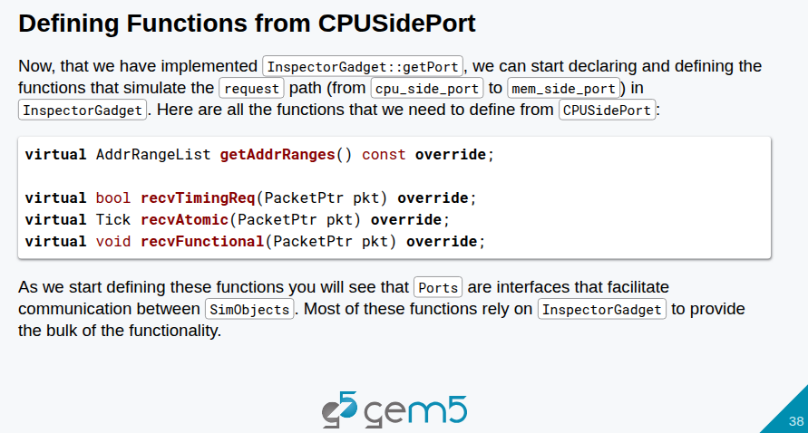
21.1 Model Port (01): Slides
https://gem5bootcamp.github.io/2124/#03-Developing-gem5-models/04-ports
Model Port (01): Slides

Slide 40
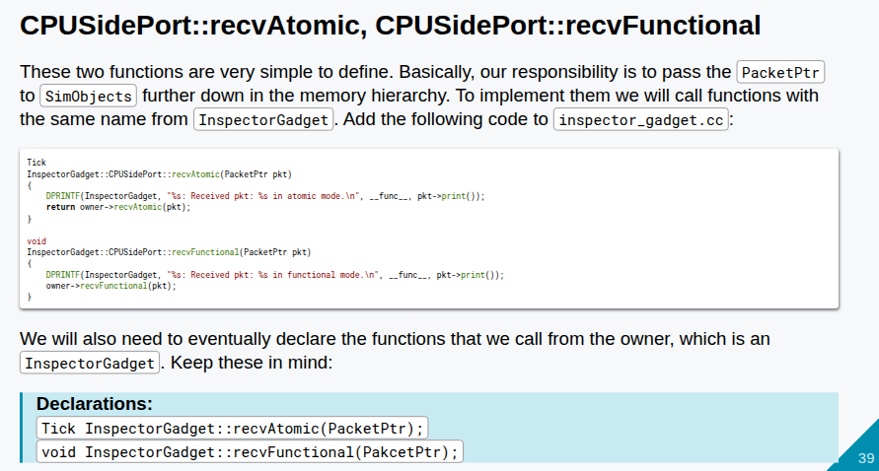
21.1 Model Port (01): Slides
https://gem5bootcamp.github.io/2124/#03-Developing-gem5-models/04-ports
Model Port (01): Slides

Slide 41
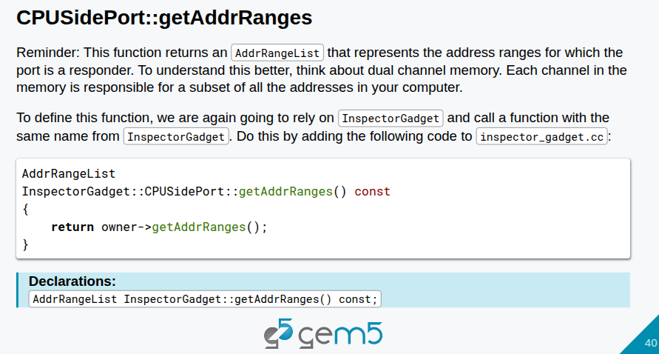
21.1 Model Port (01): Slides
https://gem5bootcamp.github.io/2124/#03-Developing-gem5-models/04-ports
Model Port (01): Slides

Slide 42
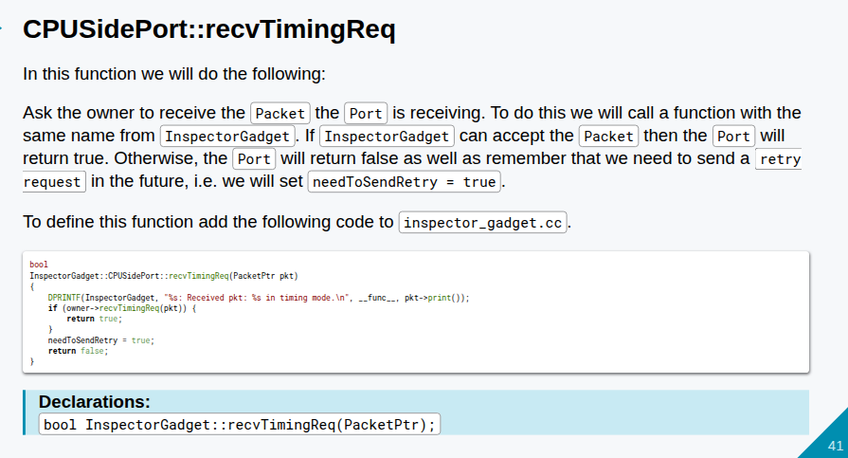
21.1 Model Port (01): Slides
https://gem5bootcamp.github.io/2124/#03-Developing-gem5-models/04-ports
Model Port (01): Slides

Slide 43
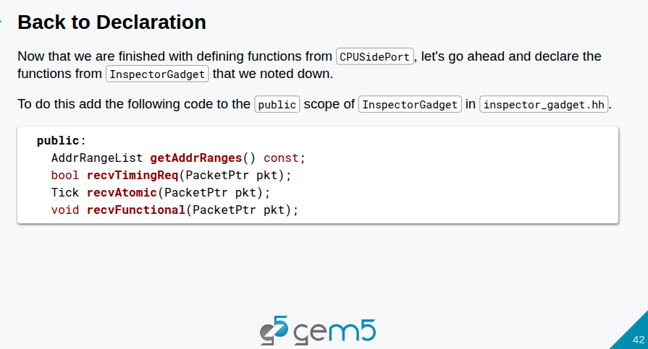
21.1 Model Port (01): Slides
https://gem5bootcamp.github.io/2124/#03-Developing-gem5-models/04-ports
Model Port (01): Slides

Slide 44
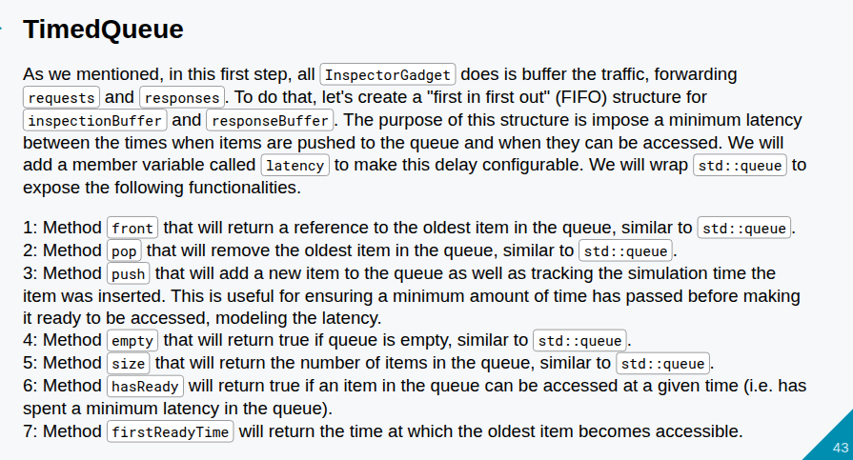
21.1 Model Port (01): Slides
https://gem5bootcamp.github.io/2124/#03-Developing-gem5-models/04-ports
Model Port (01): Slides

Slide 45
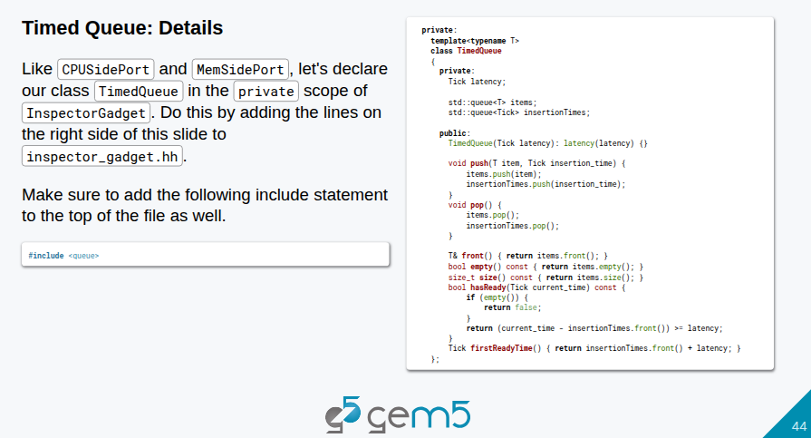
21.1 Model Port (01): Slides
https://gem5bootcamp.github.io/2124/#03-Developing-gem5-models/04-ports
Model Port (01): Slides

Slide 46
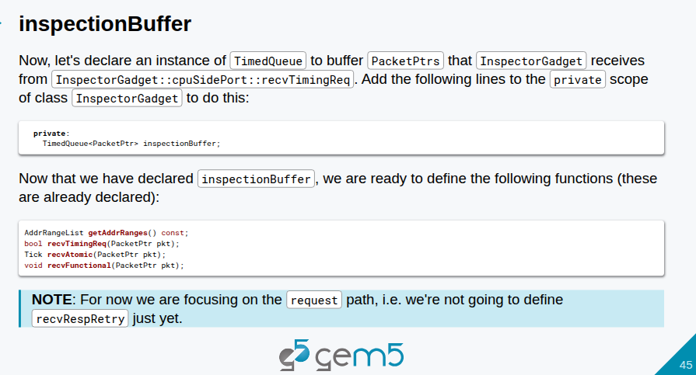
21.1 Model Port (01): Slides
https://gem5bootcamp.github.io/2124/#03-Developing-gem5-models/04-ports
Model Port (01): Slides

Slide 47
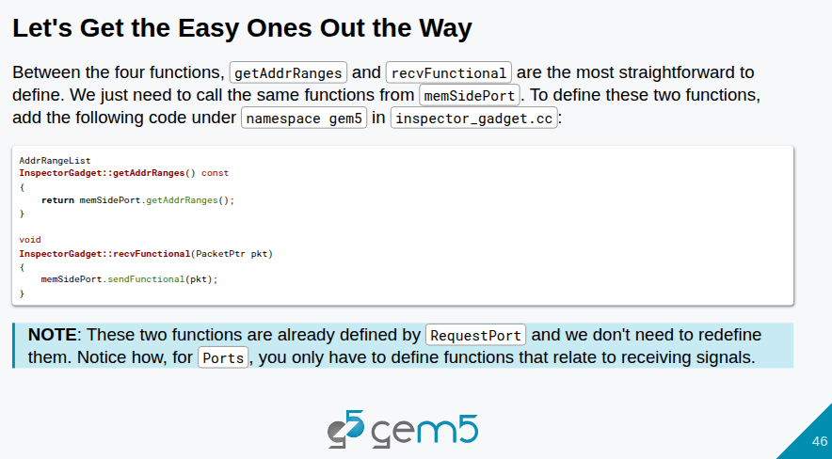
21.1 Model Port (01): Slides
https://gem5bootcamp.github.io/2124/#03-Developing-gem5-models/04-ports
Model Port (01): Slides

Slide 48
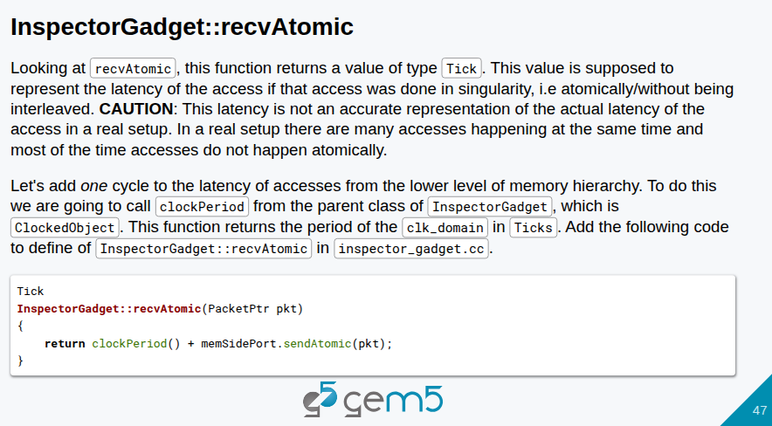
21.1 Model Port (01): Slides
https://gem5bootcamp.github.io/2124/#03-Developing-gem5-models/04-ports
Model Port (01): Slides

Slide 49
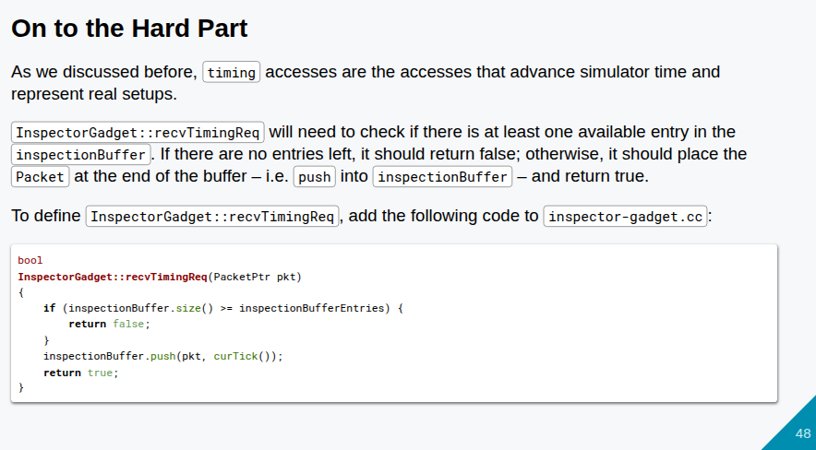
21.1 Model Port (01): Slides
https://gem5bootcamp.github.io/2124/#03-Developing-gem5-models/04-ports
Model Port (01): Slides

Slide 50
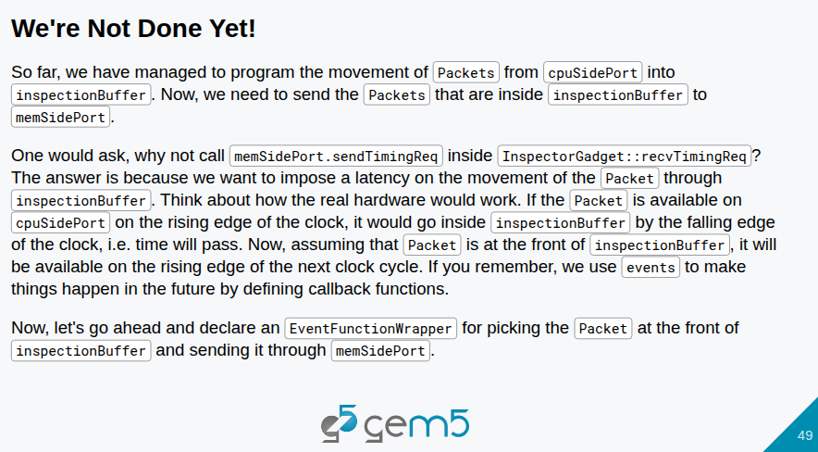
21.1 Model Port (01): Slides
https://gem5bootcamp.github.io/2124/#03-Developing-gem5-models/04-ports
Model Port (01): Slides

Slide 51
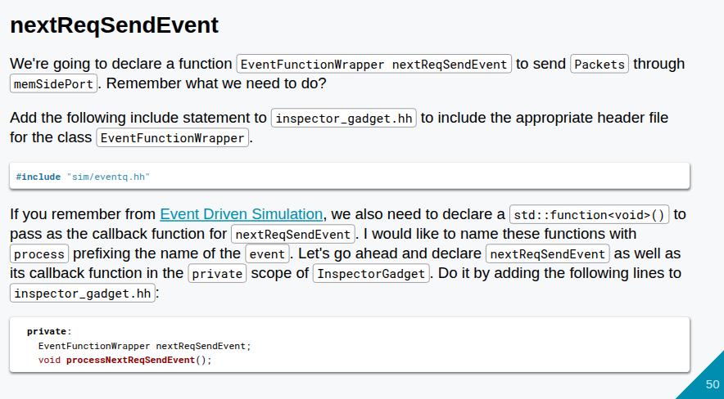
21.1 Model Port (01): Slides
https://gem5bootcamp.github.io/2124/#03-Developing-gem5-models/04-ports
Model Port (01): Slides

Slide 52

21.1 Model Port (01): Slides
https://gem5bootcamp.github.io/2124/#03-Developing-gem5-models/04-ports
Model Port (01): Slides

Slide 53

21.1 Model Port (01): Slides
https://gem5bootcamp.github.io/2124/#03-Developing-gem5-models/04-ports
Model Port (01): Slides

Slide 54

21.1 Model Port (01): Slides
https://gem5bootcamp.github.io/2124/#03-Developing-gem5-models/04-ports
Model Port (01): Slides

Slide 55

21.1 Model Port (01): Slides
https://gem5bootcamp.github.io/2124/#03-Developing-gem5-models/04-ports
Model Port (01): Slides

Slide 56

21.1 Model Port (01): Slides
https://gem5bootcamp.github.io/2124/#03-Developing-gem5-models/04-ports
Model Port (01): Slides

Slide 57

21.1 Model Port (01): Slides
https://gem5bootcamp.github.io/2124/#03-Developing-gem5-models/04-ports
Model Port (01): Slides

Slide 58

21.1 Model Port (01): Slides
https://gem5bootcamp.github.io/2124/#03-Developing-gem5-models/04-ports
Model Port (01): Slides

Slide 59

21.1 Model Port (01): Slides
https://gem5bootcamp.github.io/2124/#03-Developing-gem5-models/04-ports
Model Port (01): Slides

Slide 60

21.1 Model Port (01): Slides
https://gem5bootcamp.github.io/2124/#03-Developing-gem5-models/04-ports
Model Port (01): Slides

Slide 61

21.1 Model Port (01): Slides
https://gem5bootcamp.github.io/2124/#03-Developing-gem5-models/04-ports
Model Port (01): Slides

Slide 62

21.1 Model Port (01): Slides
https://gem5bootcamp.github.io/2124/#03-Developing-gem5-models/04-ports
Model Port (01): Slides

Slide 63

21.1 Model Port (01): Slides
https://gem5bootcamp.github.io/2124/#03-Developing-gem5-models/04-ports
Model Port (01): Slides

Slide 64

21.1 Model Port (01): Slides
https://gem5bootcamp.github.io/2124/#03-Developing-gem5-models/04-ports
Model Port (01): Slides

Slide 65

21.1 Model Port (01): Slides
https://gem5bootcamp.github.io/2124/#03-Developing-gem5-models/04-ports
Model Port (01): Slides

Slide 66

21.1 Model Port (01): Slides
https://gem5bootcamp.github.io/2124/#03-Developing-gem5-models/04-ports
Model Port (01): Slides

Slide 67

21.1 Model Port (01): Slides
https://gem5bootcamp.github.io/2124/#03-Developing-gem5-models/04-ports
Model Port (01): Slides

Slide 68

21.1 Model Port (01): Slides
https://gem5bootcamp.github.io/2124/#03-Developing-gem5-models/04-ports
Model Port (01): Slides

Slide 69

21.1 Model Port (01): Slides
https://gem5bootcamp.github.io/2124/#03-Developing-gem5-models/04-ports
Model Port (01): Slides

Slide 70

21.1 Model Port (01): Slides
https://gem5bootcamp.github.io/2124/#03-Developing-gem5-models/04-ports
Model Port (01): Slides

Slide 71

21.1 Model Port (01): Slides
https://gem5bootcamp.github.io/2124/#03-Developing-gem5-models/04-ports
Model Port (01): Slides

Slide 72

21.1 Model Port (01): Slides
https://gem5bootcamp.github.io/2124/#03-Developing-gem5-models/04-ports
Model Port (01): Slides

Slide 73
End

