Slide 1

13.1 Gem5 Sample Simulation: Slides
Peter H. Chen

Slide 2

13.1 Gem5 Sample Simulation: Slides
https://gem5bootcamp.github.io/2024/#02-Using-gem5/09-sampling
Gem5 Sample Simulation: Slides

Slide 3
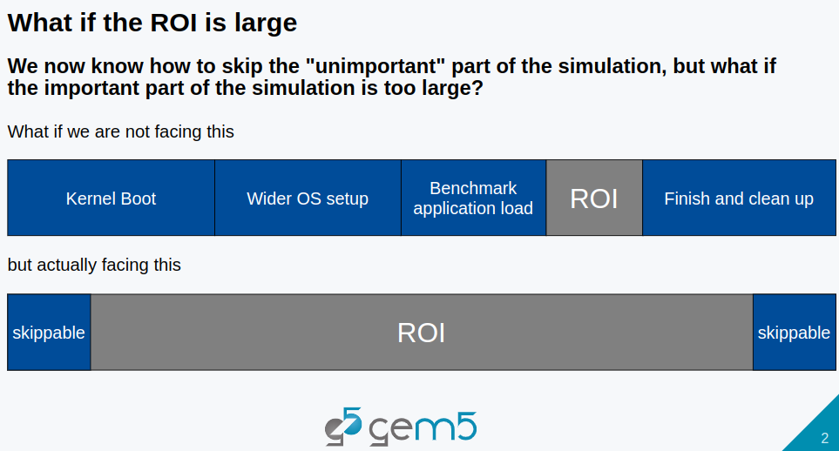
13.1 Gem5 Sample Simulation: Slides
https://gem5bootcamp.github.io/2024/#02-Using-gem5/09-sampling
Gem5 Sample Simulation: Slides

Slide 4
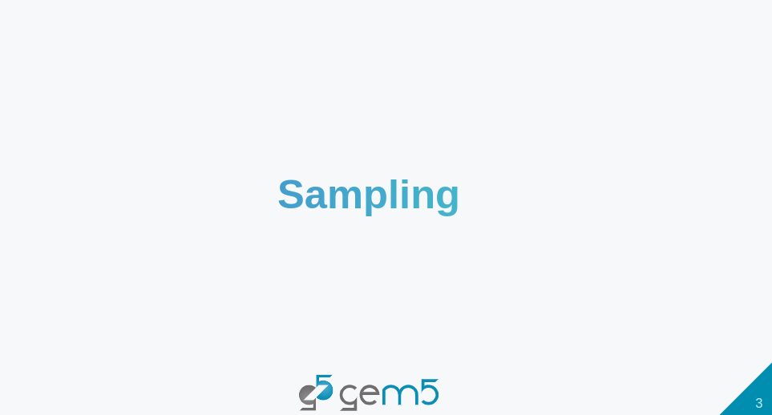
13.1 Gem5 Sample Simulation: Slides
https://gem5bootcamp.github.io/2024/#02-Using-gem5/09-sampling
Gem5 Sample Simulation: Slides

Slide 5
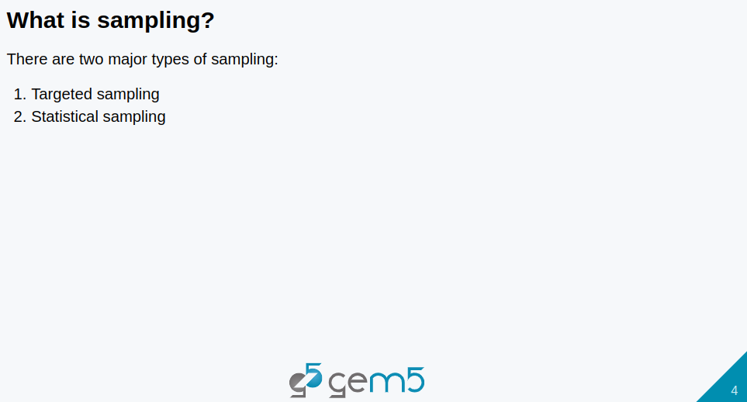
13.1 Gem5 Sample Simulation: Slides
https://gem5bootcamp.github.io/2024/#02-Using-gem5/09-sampling
Gem5 Sample Simulation: Slides

Slide 6
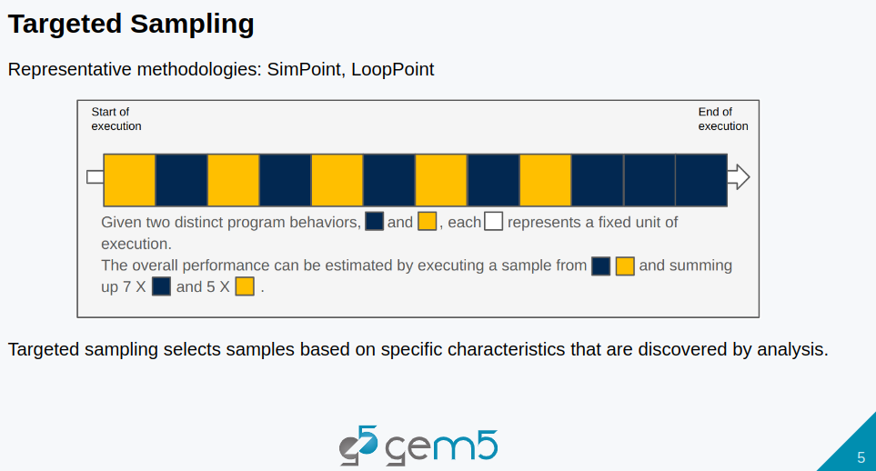
13.1 Gem5 Sample Simulation: Slides
https://gem5bootcamp.github.io/2024/#02-Using-gem5/09-sampling
Gem5 Sample Simulation: Slides

Slide 7
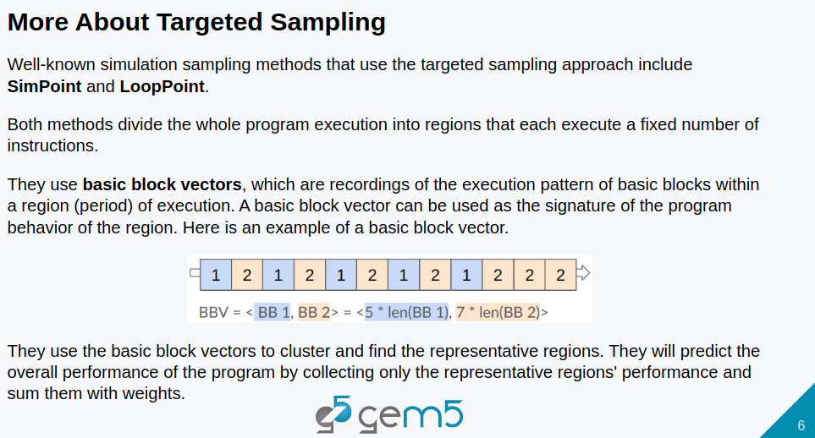
13.1 Gem5 Sample Simulation: Slides
https://gem5bootcamp.github.io/2024/#02-Using-gem5/09-sampling
Gem5 Sample Simulation: Slides

Slide 8
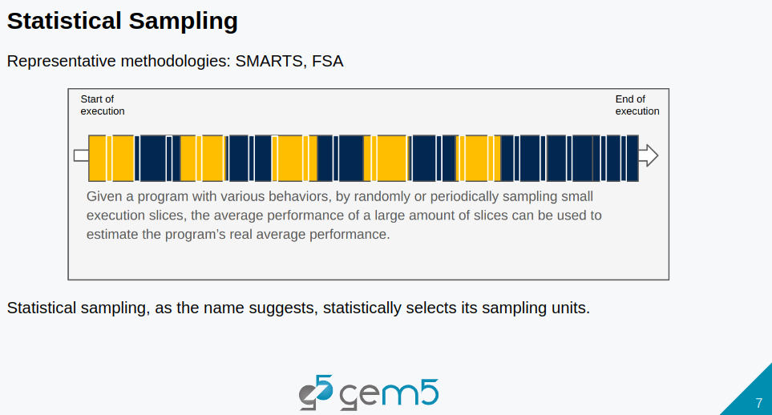
13.1 Gem5 Sample Simulation: Slides
https://gem5bootcamp.github.io/2024/#02-Using-gem5/09-sampling
Gem5 Sample Simulation: Slides

Slide 9
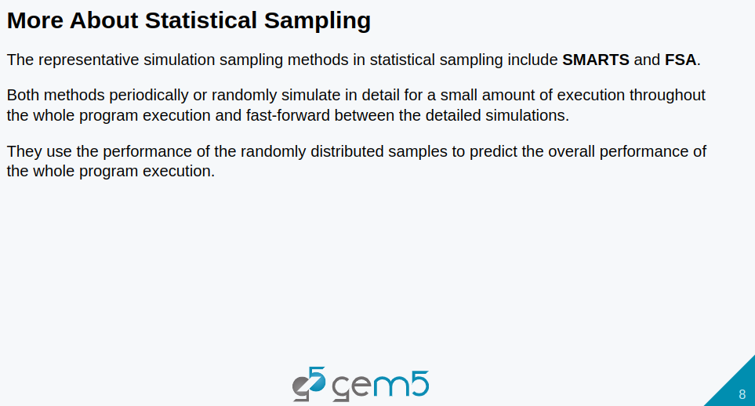
13.1 Gem5 Sample Simulation: Slides
https://gem5bootcamp.github.io/2024/#02-Using-gem5/09-sampling
Gem5 Sample Simulation: Slides

Slide 10
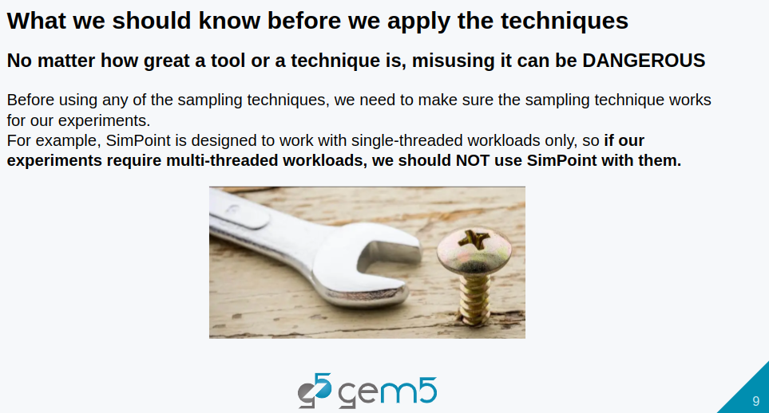
13.1 Gem5 Sample Simulation: Slides
https://gem5bootcamp.github.io/2024/#02-Using-gem5/09-sampling
Gem5 Sample Simulation: Slides

Slide 11
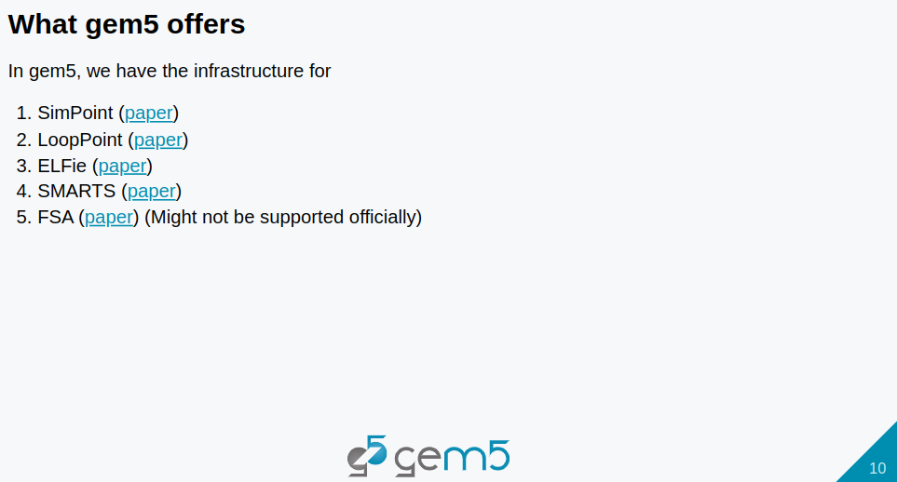
13.1 Gem5 Sample Simulation: Slides
https://gem5bootcamp.github.io/2024/#02-Using-gem5/09-sampling
Gem5 Sample Simulation: Slides

Slide 12
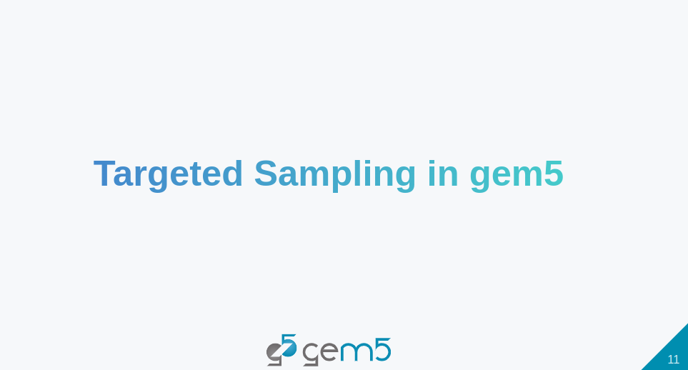
13.1 Gem5 Sample Simulation: Slides
https://gem5bootcamp.github.io/2024/#02-Using-gem5/09-sampling
Gem5 Sample Simulation: Slides

Slide 13
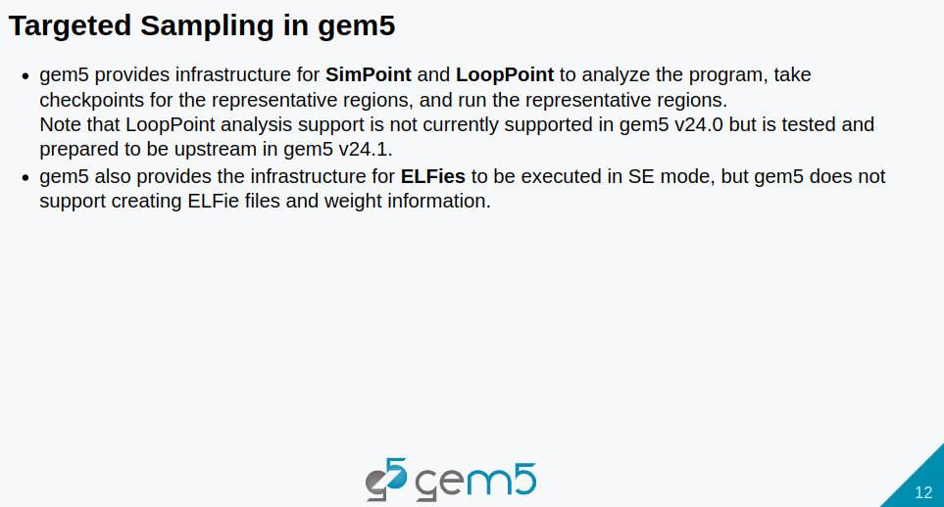
13.1 Gem5 Sample Simulation: Slides
https://gem5bootcamp.github.io/2024/#02-Using-gem5/09-sampling
Gem5 Sample Simulation: Slides

Slide 14
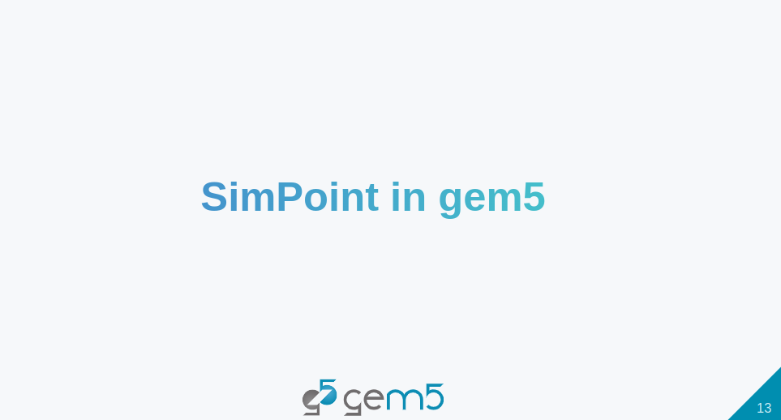
13.1 Gem5 Sample Simulation: Slides
https://gem5bootcamp.github.io/2024/#02-Using-gem5/09-sampling
Gem5 Sample Simulation: Slides

Slide 15
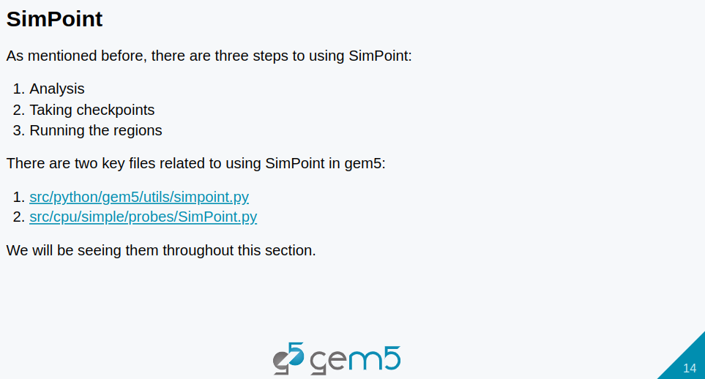
13.1 Gem5 Sample Simulation: Slides
https://gem5bootcamp.github.io/2024/#02-Using-gem5/09-sampling
Gem5 Sample Simulation: Slides

Slide 16
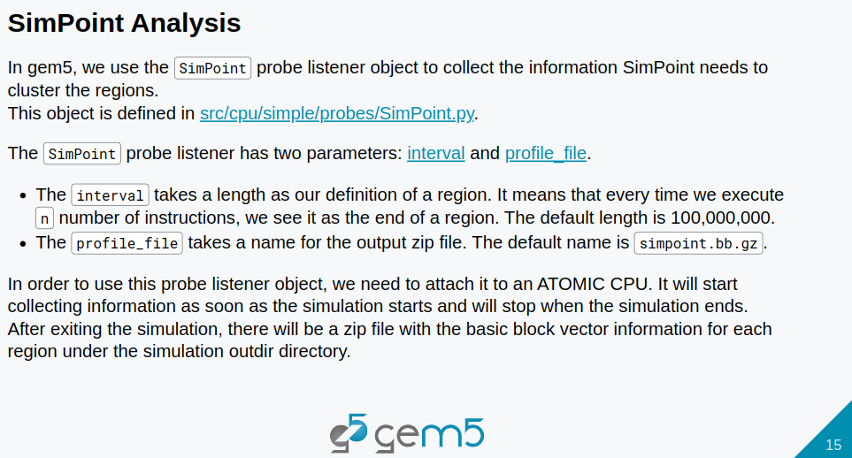
13.1 Gem5 Sample Simulation: Slides
https://gem5bootcamp.github.io/2024/#02-Using-gem5/09-sampling
Gem5 Sample Simulation: Slides

Slide 17
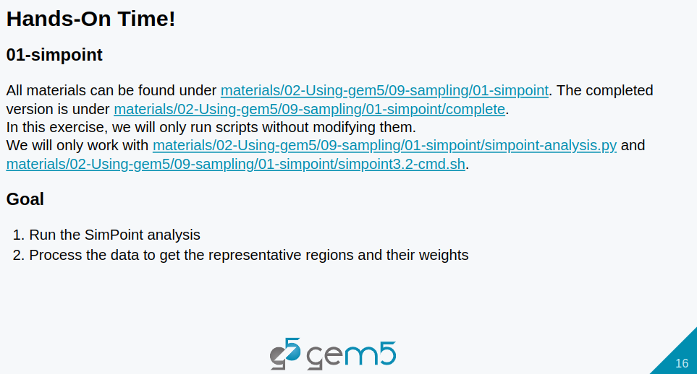
13.1 Gem5 Sample Simulation: Slides
https://gem5bootcamp.github.io/2024/#02-Using-gem5/09-sampling
Gem5 Sample Simulation: Slides

Slide 18
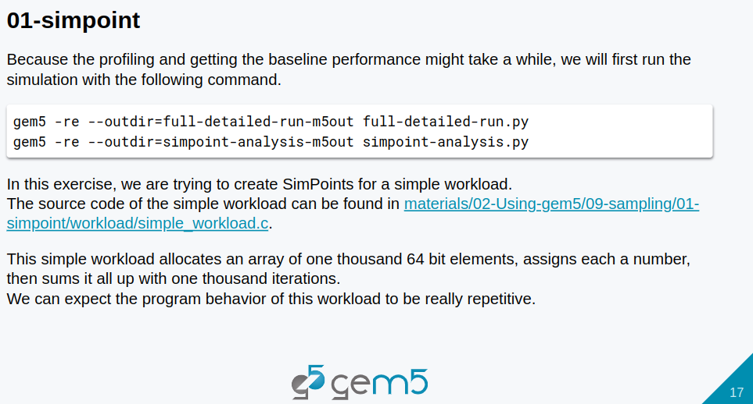
13.1 Gem5 Sample Simulation: Slides
https://gem5bootcamp.github.io/2024/#02-Using-gem5/09-sampling
Gem5 Sample Simulation: Slides

Slide 19
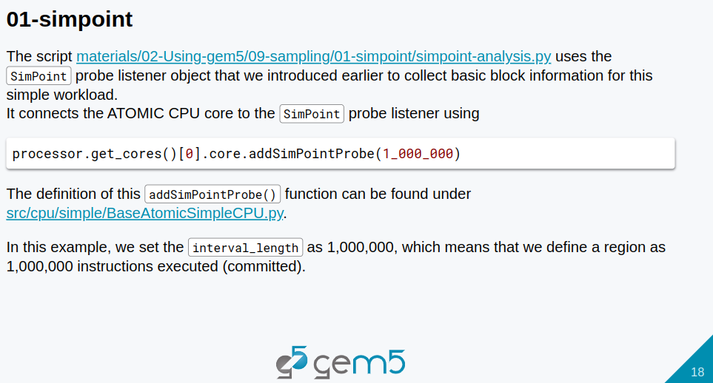
13.1 Gem5 Sample Simulation: Slides
https://gem5bootcamp.github.io/2024/#02-Using-gem5/09-sampling
Gem5 Sample Simulation: Slides

Slide 20
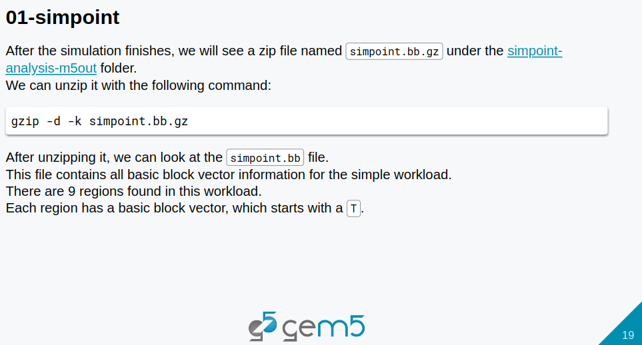
13.1 Gem5 Sample Simulation: Slides
https://gem5bootcamp.github.io/2024/#02-Using-gem5/09-sampling
Gem5 Sample Simulation: Slides

Slide 21
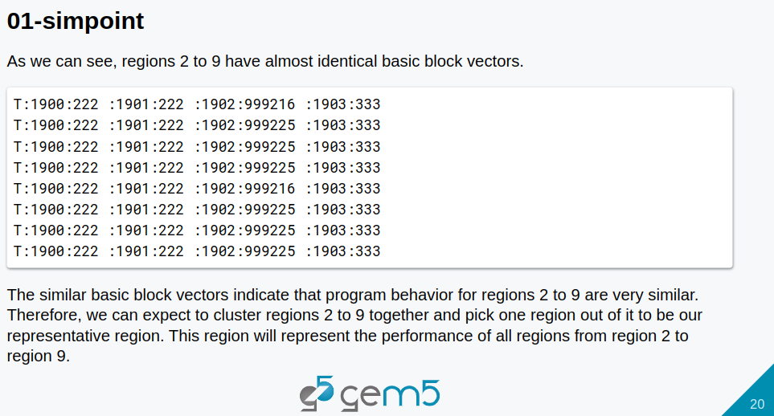
13.1 Gem5 Sample Simulation: Slides
https://gem5bootcamp.github.io/2024/#02-Using-gem5/09-sampling
Gem5 Sample Simulation: Slides

Slide 22
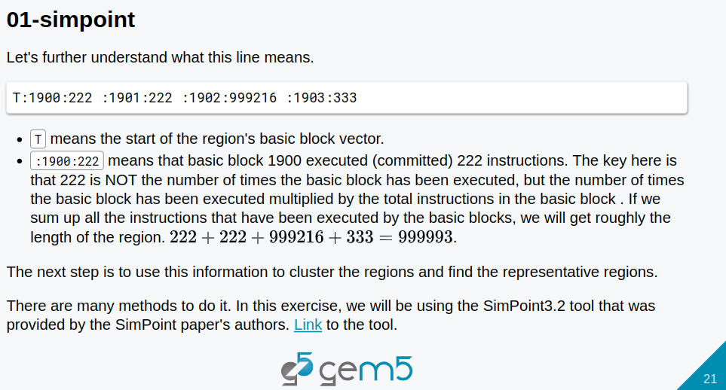
13.1 Gem5 Sample Simulation: Slides
https://gem5bootcamp.github.io/2024/#02-Using-gem5/09-sampling
Gem5 Sample Simulation: Slides

Slide 23
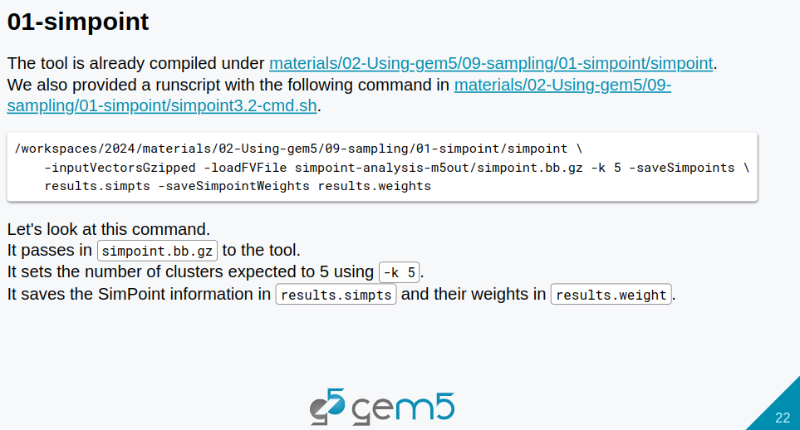
13.1 Gem5 Sample Simulation: Slides
https://gem5bootcamp.github.io/2024/#02-Using-gem5/09-sampling
Gem5 Sample Simulation: Slides

Slide 24
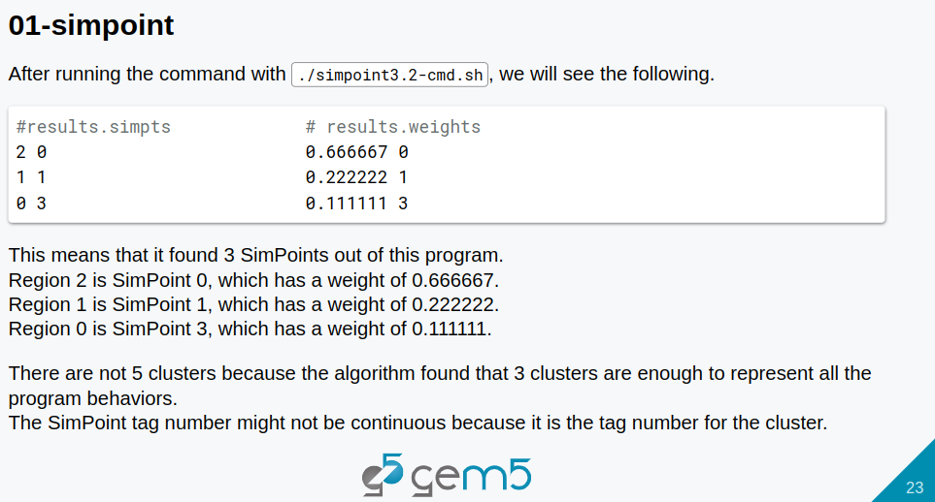
13.1 Gem5 Sample Simulation: Slides
https://gem5bootcamp.github.io/2024/#02-Using-gem5/09-sampling
Gem5 Sample Simulation: Slides

Slide 25
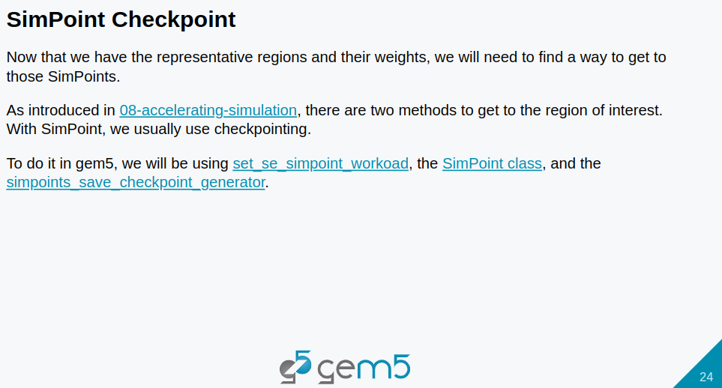
13.1 Gem5 Sample Simulation: Slides
https://gem5bootcamp.github.io/2024/#02-Using-gem5/09-sampling
Gem5 Sample Simulation: Slides

Slide 26
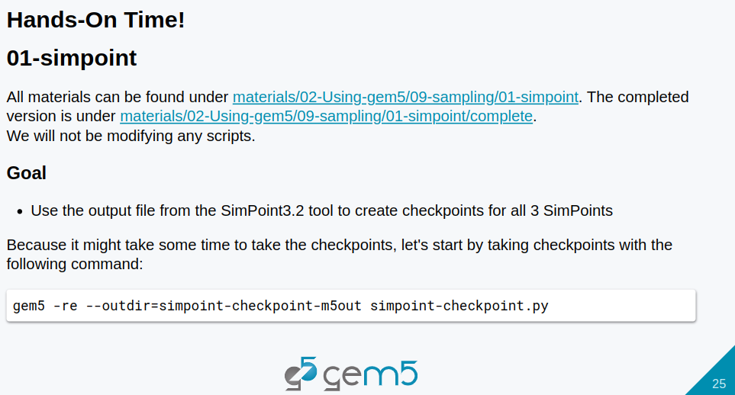
13.1 Gem5 Sample Simulation: Slides
https://gem5bootcamp.github.io/2024/#02-Using-gem5/09-sampling
Gem5 Sample Simulation: Slides

Slide 27
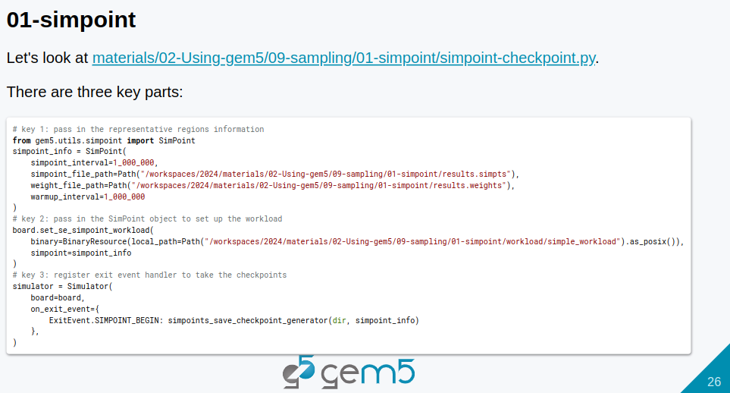
13.1 Gem5 Sample Simulation: Slides
https://gem5bootcamp.github.io/2024/#02-Using-gem5/09-sampling
Gem5 Sample Simulation: Slides

Slide 28
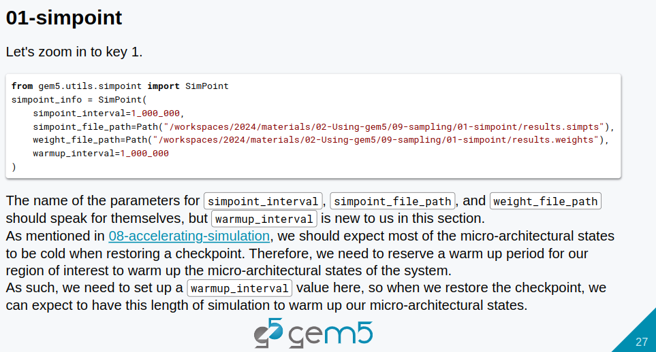
13.1 Gem5 Sample Simulation: Slides
https://gem5bootcamp.github.io/2024/#02-Using-gem5/09-sampling
Gem5 Sample Simulation: Slides

Slide 29
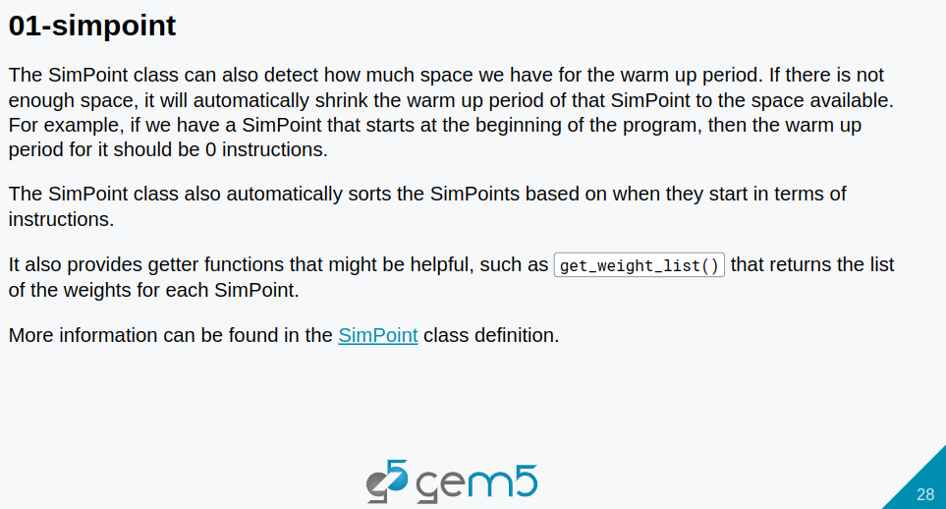
13.1 Gem5 Sample Simulation: Slides
https://gem5bootcamp.github.io/2024/#02-Using-gem5/09-sampling
Gem5 Sample Simulation: Slides

Slide 30
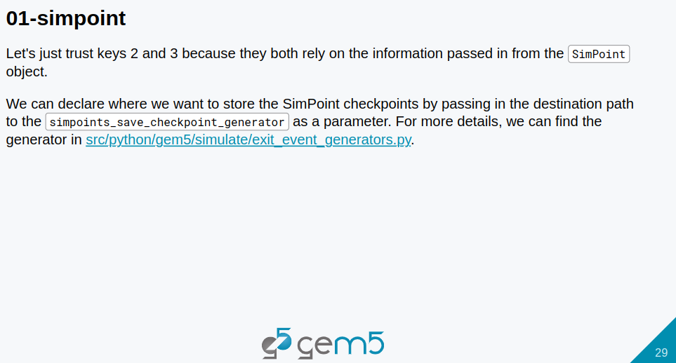
13.1 Gem5 Sample Simulation: Slides
https://gem5bootcamp.github.io/2024/#02-Using-gem5/09-sampling
Gem5 Sample Simulation: Slides

Slide 31
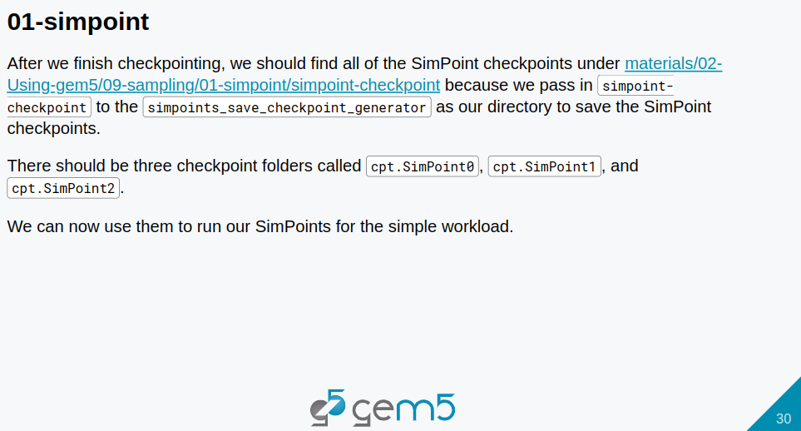
13.1 Gem5 Sample Simulation: Slides
https://gem5bootcamp.github.io/2024/#02-Using-gem5/09-sampling
Gem5 Sample Simulation: Slides

Slide 32
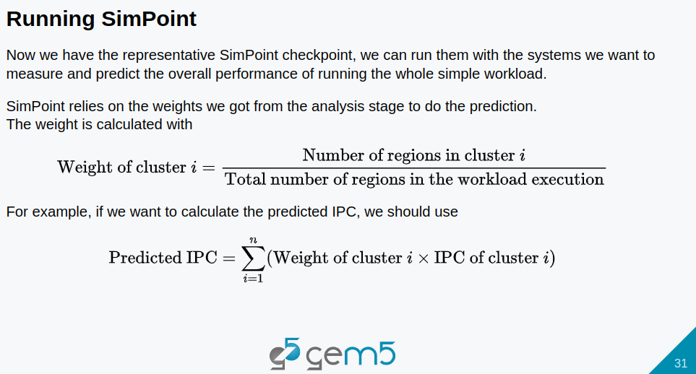
13.1 Gem5 Sample Simulation: Slides
https://gem5bootcamp.github.io/2024/#02-Using-gem5/09-sampling
Gem5 Sample Simulation: Slides

Slide 33
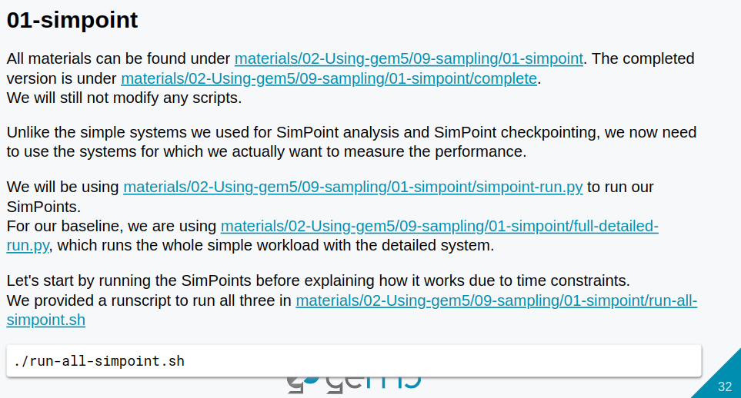
13.1 Gem5 Sample Simulation: Slides
https://gem5bootcamp.github.io/2024/#02-Using-gem5/09-sampling
Gem5 Sample Simulation: Slides

Slide 34
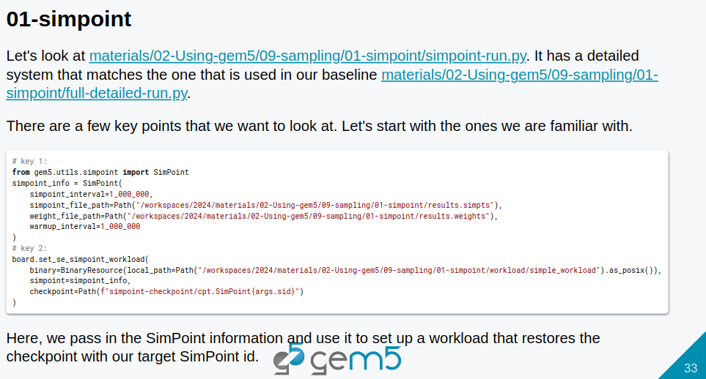
13.1 Gem5 Sample Simulation: Slides
https://gem5bootcamp.github.io/2024/#02-Using-gem5/09-sampling
Gem5 Sample Simulation: Slides

Slide 35
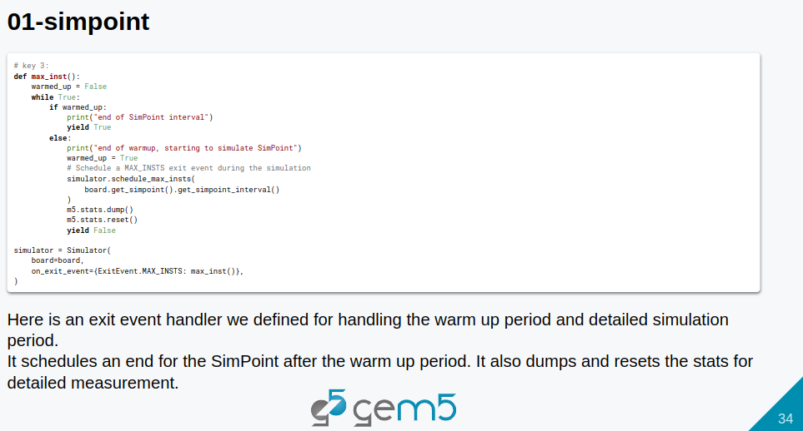
13.1 Gem5 Sample Simulation: Slides
https://gem5bootcamp.github.io/2024/#02-Using-gem5/09-sampling
Gem5 Sample Simulation: Slides

Slide 36
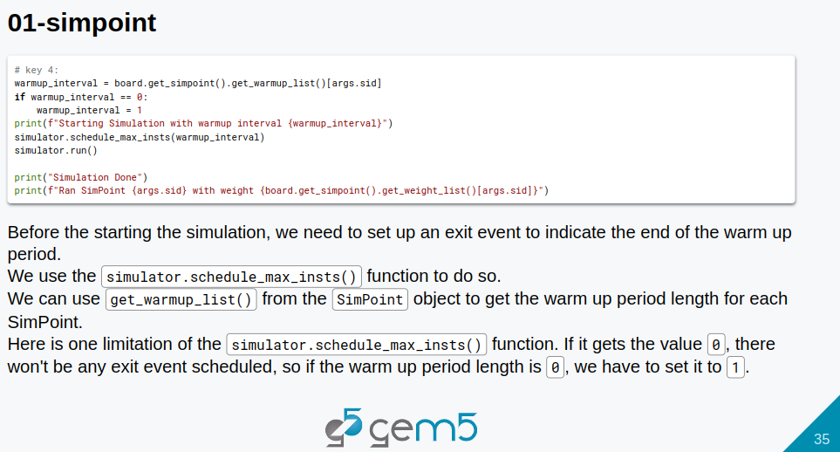
13.1 Gem5 Sample Simulation: Slides
https://gem5bootcamp.github.io/2024/#02-Using-gem5/09-sampling
Gem5 Sample Simulation: Slides

Slide 37
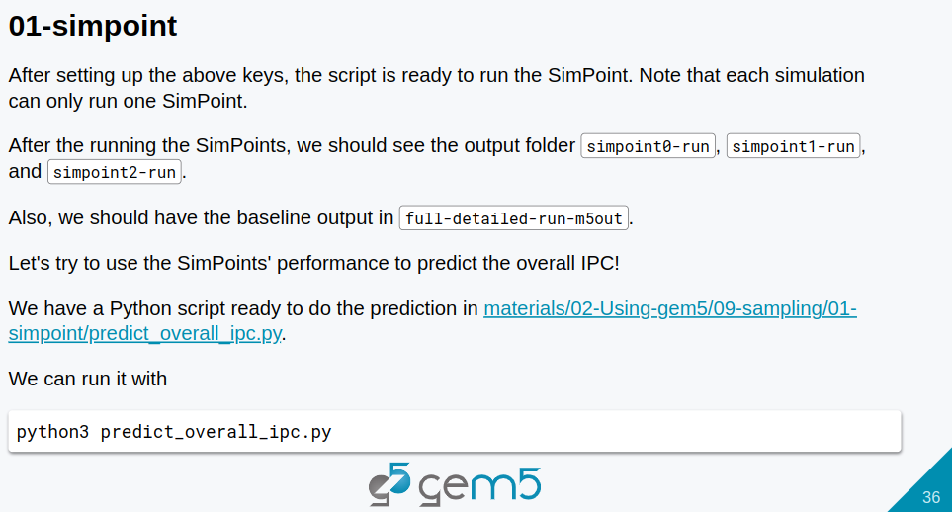
13.1 Gem5 Sample Simulation: Slides
https://gem5bootcamp.github.io/2024/#02-Using-gem5/09-sampling
Gem5 Sample Simulation: Slides

Slide 38
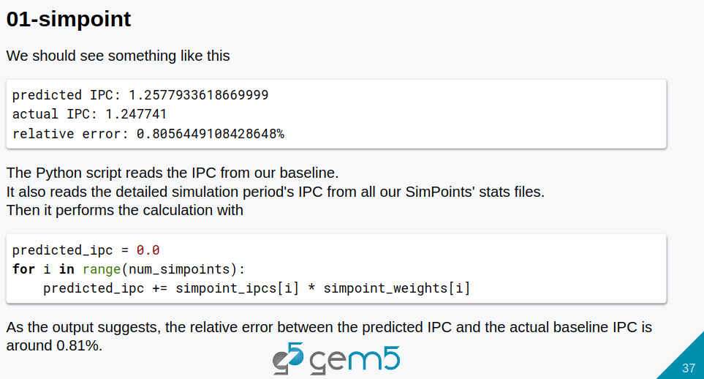
13.1 Gem5 Sample Simulation: Slides
https://gem5bootcamp.github.io/2024/#02-Using-gem5/09-sampling
Gem5 Sample Simulation: Slides

Slide 39
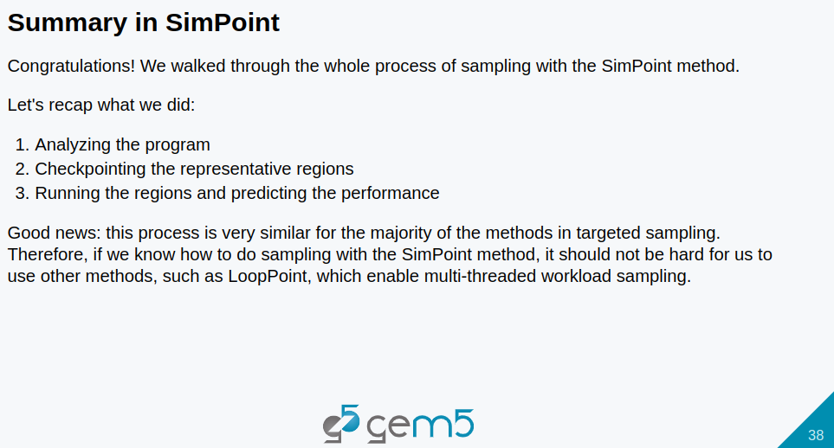
13.1 Gem5 Sample Simulation: Slides
https://gem5bootcamp.github.io/2024/#02-Using-gem5/09-sampling
Gem5 Sample Simulation: Slides

Slide 40
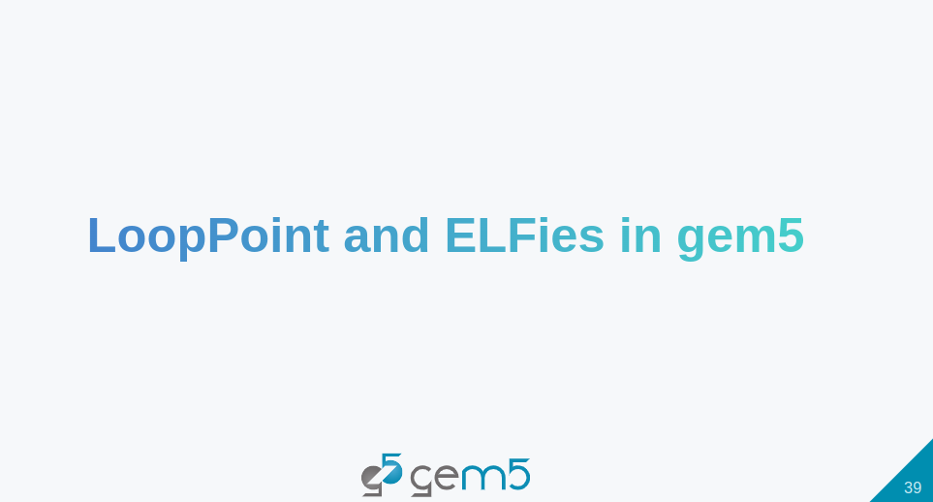
13.1 Gem5 Sample Simulation: Slides
https://gem5bootcamp.github.io/2024/#02-Using-gem5/09-sampling
Gem5 Sample Simulation: Slides

Slide 41
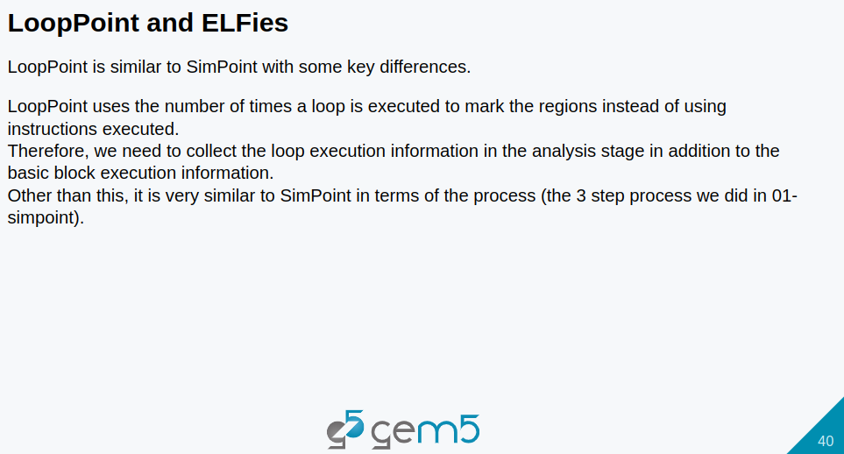
13.1 Gem5 Sample Simulation: Slides
https://gem5bootcamp.github.io/2024/#02-Using-gem5/09-sampling
Gem5 Sample Simulation: Slides

Slide 42
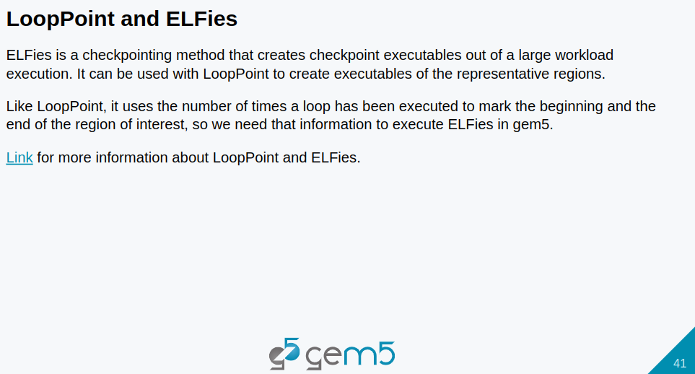
13.1 Gem5 Sample Simulation: Slides
https://gem5bootcamp.github.io/2024/#02-Using-gem5/09-sampling
Gem5 Sample Simulation: Slides

Slide 43
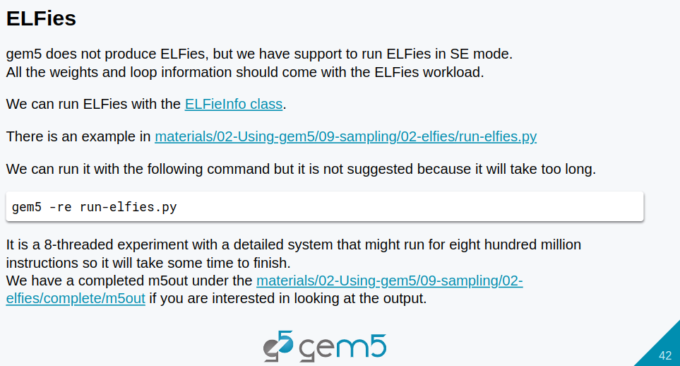
13.1 Gem5 Sample Simulation: Slides
https://gem5bootcamp.github.io/2024/#02-Using-gem5/09-sampling
Gem5 Sample Simulation: Slides

Slide 44
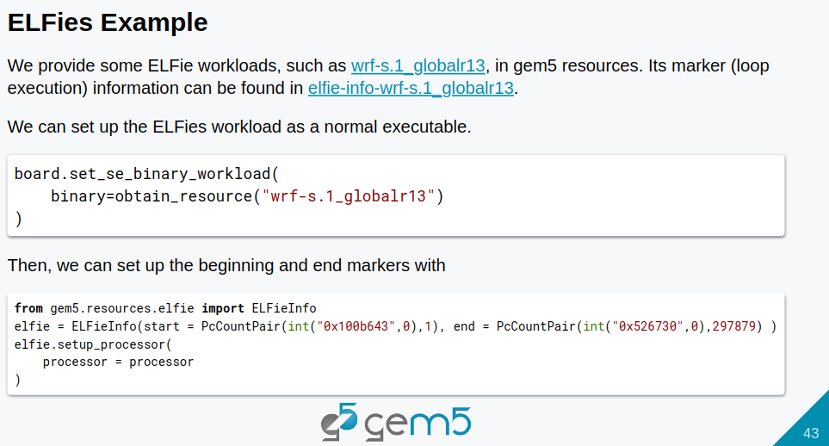
13.1 Gem5 Sample Simulation: Slides
https://gem5bootcamp.github.io/2024/#02-Using-gem5/09-sampling
Gem5 Sample Simulation: Slides

Slide 45
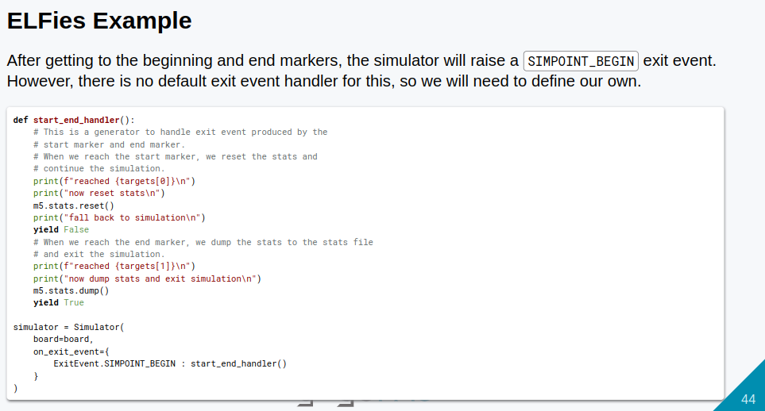
13.1 Gem5 Sample Simulation: Slides
https://gem5bootcamp.github.io/2024/#02-Using-gem5/09-sampling
Gem5 Sample Simulation: Slides

Slide 46
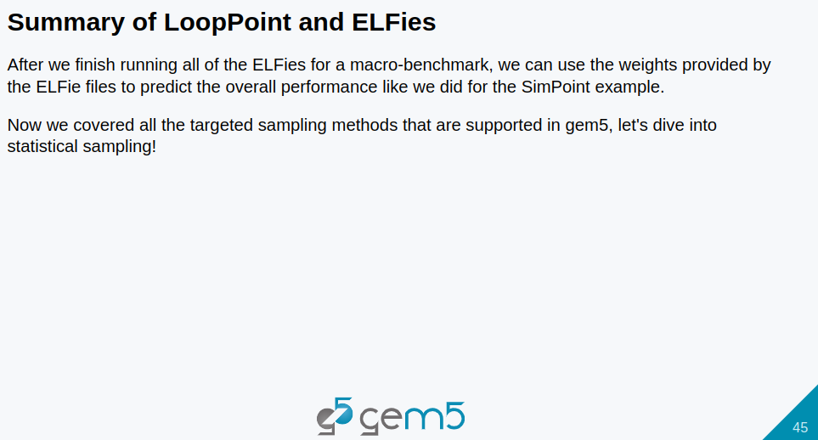
13.1 Gem5 Sample Simulation: Slides
https://gem5bootcamp.github.io/2024/#02-Using-gem5/09-sampling
Gem5 Sample Simulation: Slides

Slide 47

13.1 Gem5 Sample Simulation: Slides
https://gem5bootcamp.github.io/2024/#02-Using-gem5/09-sampling
Gem5 Sample Simulation: Slides

Slide 48
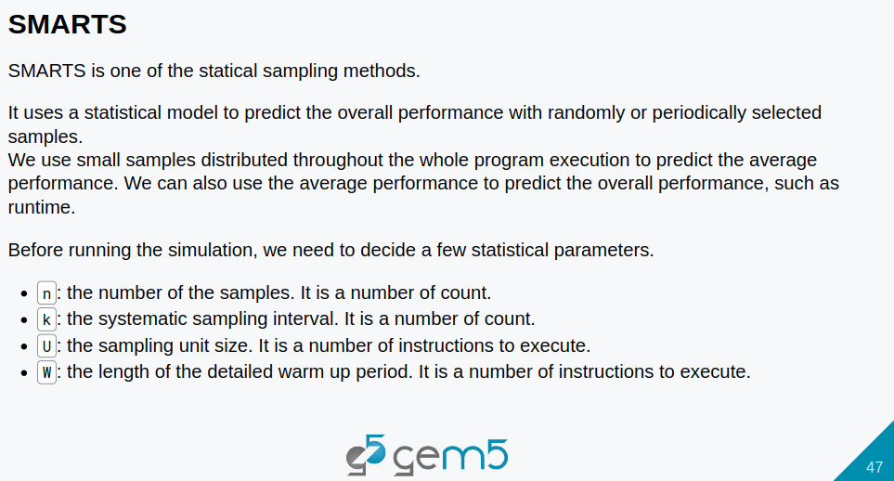
13.1 Gem5 Sample Simulation: Slides
https://gem5bootcamp.github.io/2024/#02-Using-gem5/09-sampling
Gem5 Sample Simulation: Slides

Slide 49
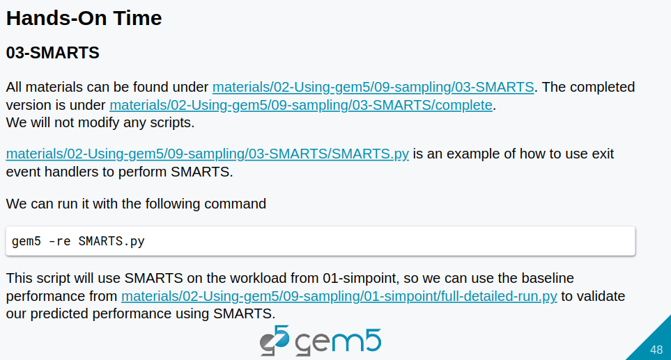
13.1 Gem5 Sample Simulation: Slides
https://gem5bootcamp.github.io/2024/#02-Using-gem5/09-sampling
Gem5 Sample Simulation: Slides

Slide 50
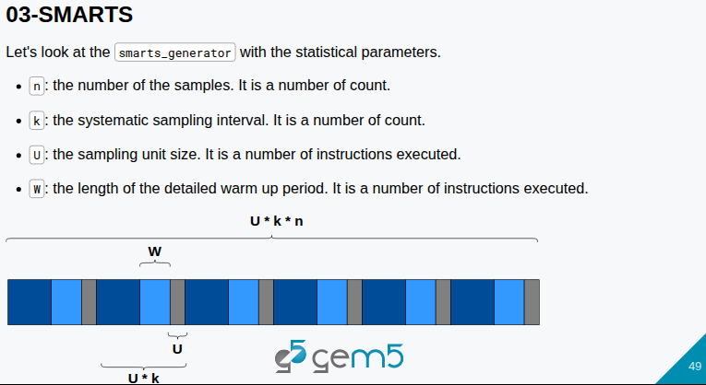
13.1 Gem5 Sample Simulation: Slides
https://gem5bootcamp.github.io/2024/#02-Using-gem5/09-sampling
Gem5 Sample Simulation: Slides

Slide 51
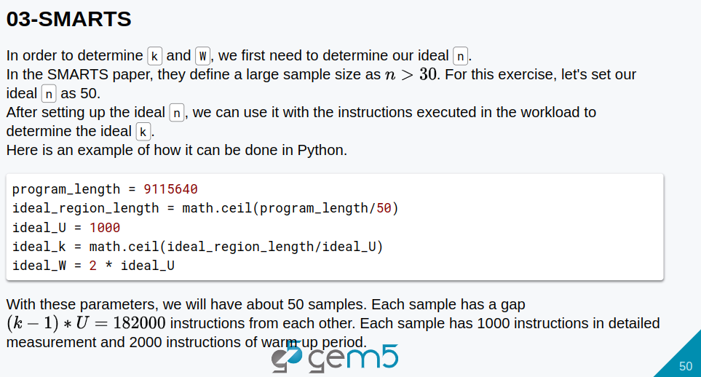
13.1 Gem5 Sample Simulation: Slides
https://gem5bootcamp.github.io/2024/#02-Using-gem5/09-sampling
Gem5 Sample Simulation: Slides

Slide 52
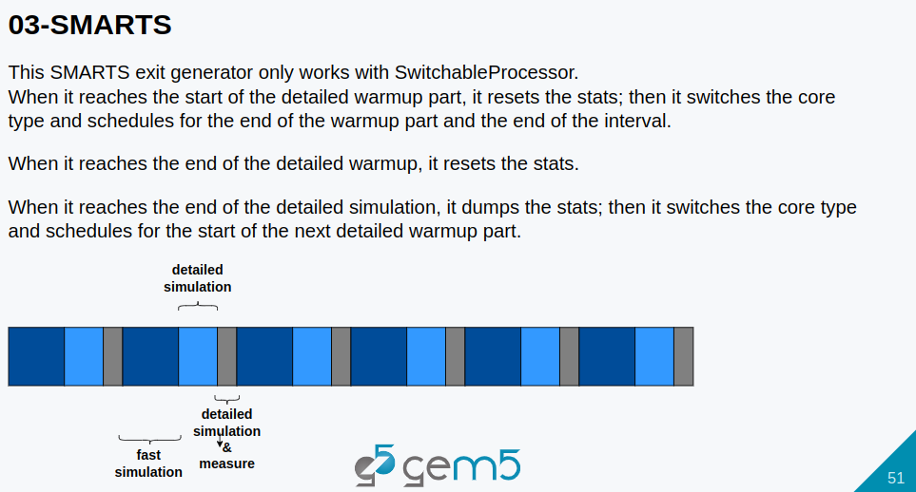
13.1 Gem5 Sample Simulation: Slides
https://gem5bootcamp.github.io/2024/#02-Using-gem5/09-sampling
Gem5 Sample Simulation: Slides

Slide 53
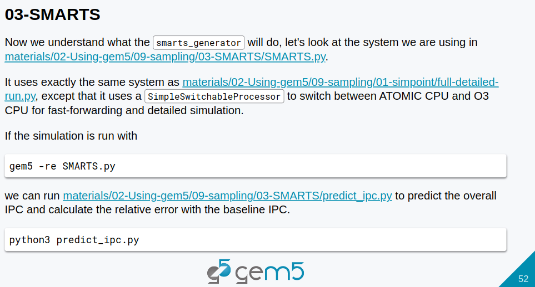
13.1 Gem5 Sample Simulation: Slides
https://gem5bootcamp.github.io/2024/#02-Using-gem5/09-sampling
Gem5 Sample Simulation: Slides

Slide 54

13.1 Gem5 Sample Simulation: Slides
https://gem5bootcamp.github.io/2024/#02-Using-gem5/09-sampling
Gem5 Sample Simulation: Slides

Slide 55

13.1 Gem5 Sample Simulation: Slides
https://gem5bootcamp.github.io/2024/#02-Using-gem5/09-sampling
Gem5 Sample Simulation: Slides

Slide 56

13.1 Gem5 Sample Simulation: Slides
https://gem5bootcamp.github.io/2024/#02-Using-gem5/09-sampling
Gem5 Sample Simulation: Slides

Slide 57
End

