Slide 1

12 Gem5 Checkpoint
Peter H. Chen

Slide 2

12 Gem5 Checkpoint
https://www.youtube.com/watch?v=JeOq90oDsPc&list=PL_hVbFs_loVR_8ntTTmmG6YEq3Po_4snu&index=12
Gem5 Checkpoint (0:00-0:01/13.32)
We talk Gem5checkpoint.

Slide 3
12.1 Topics

Slide 4
12.1 Topics
https://www.youtube.com/watch?v=JeOq90oDsPc&list=PL_hVbFs_loVR_8ntTTmmG6YEq3Po_4snu&index=12
Topics (0:01-0:02/13.32)
Topics:
1. Review of KVM Fast-Forward
2. Gem5 Checkpoint

Slide 5
12.2 Review KVM Fast-Forward

Slide 6
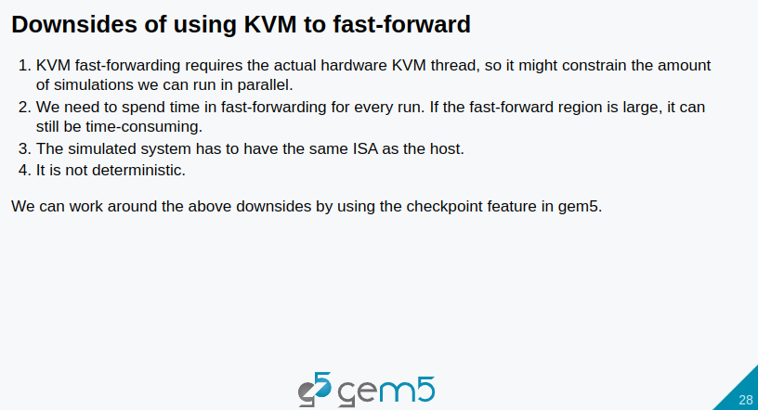
12.2 Review KVM Fast-Forward
https://www.youtube.com/watch?v=JeOq90oDsPc&list=PL_hVbFs_loVR_8ntTTmmG6YEq3Po_4snu&index=12
Review KVM Fast-Forward (0:03-0:56/13.32)
Before we talk about the checkpoint, we want to recap the downside of KVM Fast-Forward.
1. KVM requires actual hardware for KVM threads to fast-forward.
2. We need to spend time in fast forwarding. If the fast forward region is large, the KVM is very slow.
3. The simulated system have to be the same ISA as the host.
4. The KVM is not deterministic.
Checkpoint have work around for some of the downside that listed above.
5. However, the KVM is very useful if we need to frequently change our software. For checkpoint, we need to retake the checkpoint if we change any bit of our software. Therefore, If we need to change the software frequently, then KVM is better than the check point.

Slide 7
12.3 Gem5 Checkpoint

Slide 8
12.3 Gem5 Checkpoint
https://www.youtube.com/watch?v=JeOq90oDsPc&list=PL_hVbFs_loVR_8ntTTmmG6YEq3Po_4snu&index=12
Checkpoint(0:57-1:00/13.32)
Let us move on Gem5 checkpoint.

Slide 9
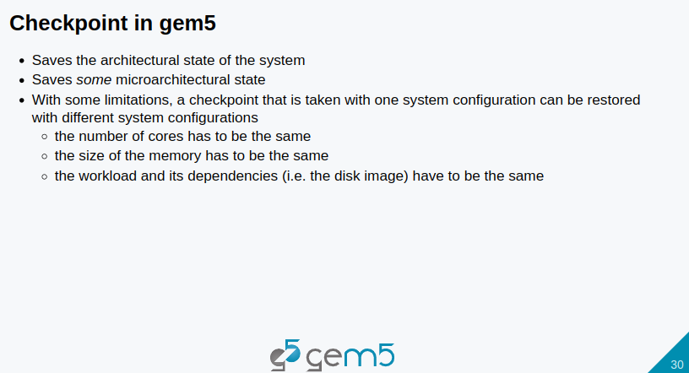
12.3 Gem5 Checkpoint
https://www.youtube.com/watch?v=JeOq90oDsPc&list=PL_hVbFs_loVR_8ntTTmmG6YEq3Po_4snu&index=12
Checkpoint (1:01-1:31/13.32)
1. Gem5 checkpoint saves the architectural state of the system.
2. Gem5 checkpoint also some micro-architectural state
3. With some limitation, a checkpoint that is taken with one system configuration can be restored with different system configurations.
The limitation
  3.1 includes the number of codes has to be the same.
  3.2 The size of memory has to be the same
  3.3 The workload and its dependencies, including the disk image, have to be the same.

Slide 10
12.4 Checkpoint and Restore

Slide 11
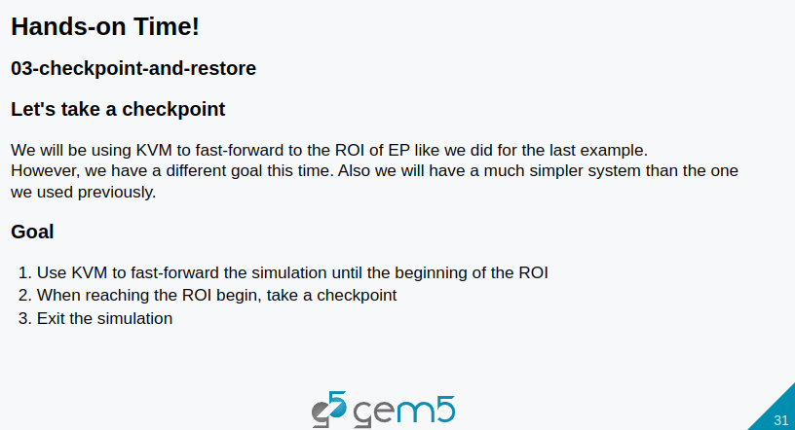
12.4 Checkpoint and Restore
https://www.youtube.com/watch?v=JeOq90oDsPc&list=PL_hVbFs_loVR_8ntTTmmG6YEq3Po_4snu&index=12
Checkpoint and Restore (1:32-2:10/13:32)
1. In the previous KVM discussion, we used KVM for fast-forwarding to the ROI (Region of Interest) of the EP (Execution Point) and Workload.
2. In the checkpoint, we will use the same KVM with different goal and we will use a much simpler system than we used in the KVM example.
3. Our goal here is to:
  3.1 Use KVM to fast forward the simulation until the beginning of ROI.
  3.2 When reaching the ROI begin, we would take a checkpoint
  3.3 Then, we exit the simulation.

Slide 12
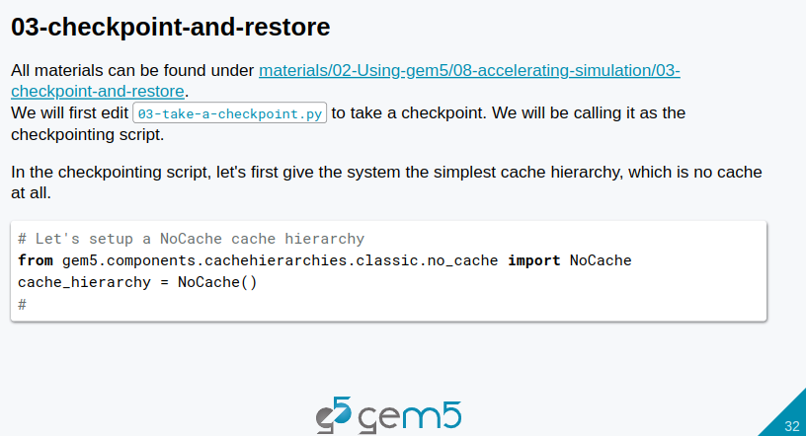
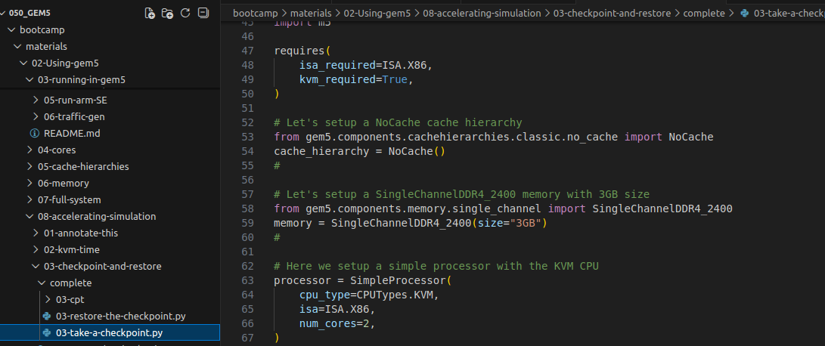
12.4 Checkpoint and Restore
https://www.youtube.com/watch?v=JeOq90oDsPc&list=PL_hVbFs_loVR_8ntTTmmG6YEq3Po_4snu&index=12
Checkpoint and Restore (2:11-3:00/13:32)
1. All the codes can be found under ~bootcamp/materials/02-Using-gem5/08-accelerating-simulation/03-checkpoint-and-restore/complete directory.
2. We look at 03-take-a-checkpoint.py

Slide 13
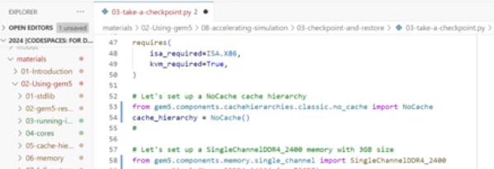
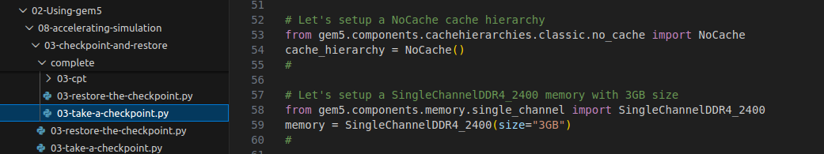
12.4 Checkpoint and Restore
https://www.youtube.com/watch?v=JeOq90oDsPc&list=PL_hVbFs_loVR_8ntTTmmG6YEq3Po_4snu&index=12
Checkpoint and Restore (3:01-4:10/13:32)
1. First, we setup the NoCache Cache Hierarchy for memory.
Since we can restore, our checkpoint is different from the checkpointing system.
We can use a simple gem5/components/cache hierarchies/no cache for fast simulation speed
> from gem5.components.cachehierarchies.no_cache import NoCache
> cache_hierarchy = NoCache ()

Slide 14
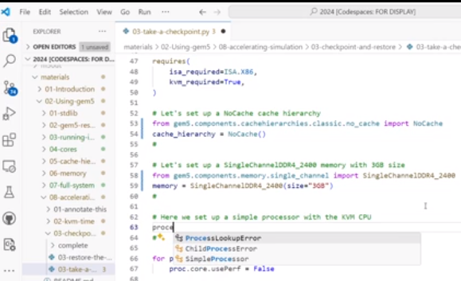
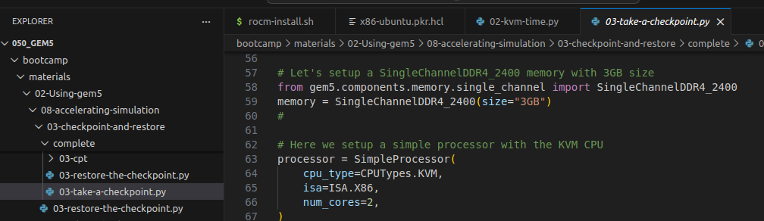
12.4 Checkpoint and Restore
https://www.youtube.com/watch?v=JeOq90oDsPc&list=PL_hVbFs_loVR_8ntTTmmG6YEq3Po_4snu&index=12
Checkpoint and Restore (4:11-4:45/13:32)
2. Second, we import the memory library and set memory size 3GB
> from gem5.components.memory import DualChannelDDR4_2400
> memory = DualChannelDDR4_2400 (size = “3GB”)

Slide 15
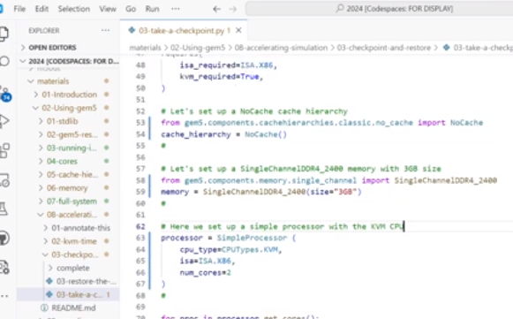
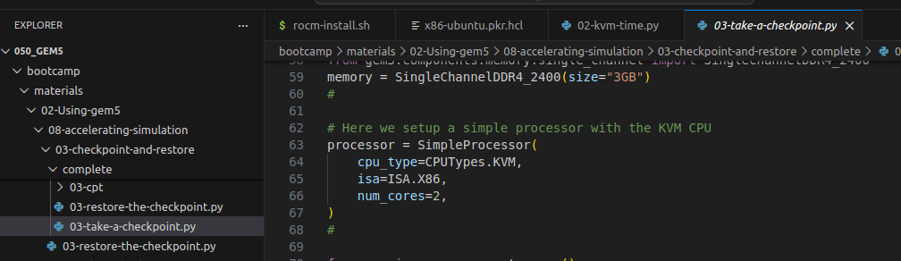
12.4 Checkpoint and Restore
https://www.youtube.com/watch?v=JeOq90oDsPc&list=PL_hVbFs_loVR_8ntTTmmG6YEq3Po_4snu&index=12
Checkpoint and Restore (4:11-5:10/13:32)
3. Third, we set set the processor.
>processor = SimpleProcessor (
> # We use the Simple Processor.
> cpu_type = CPUTypes.KVM
> # For CUP Types, we use KVM
> num_cores = 2)

Slide 16
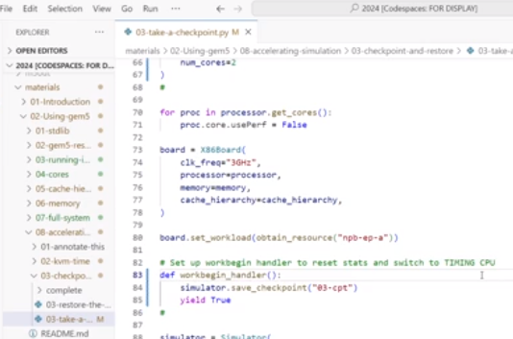
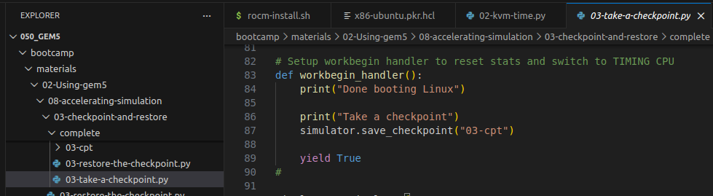
12.4 Checkpoint and Restore
https://www.youtube.com/watch?v=JeOq90oDsPc&list=PL_hVbFs_loVR_8ntTTmmG6YEq3Po_4snu&index=12
Checkpoint and Restore (5:11-5:30/13:32)
4. Fourth, we define the word begin handler.
> We use simulator.save_checkpoint () function and save with the folder name “03-cpt”
> Then, we use “yield” to exit the checkpoint afterward.
> we print the message inside the checkpoint function.

Slide 17
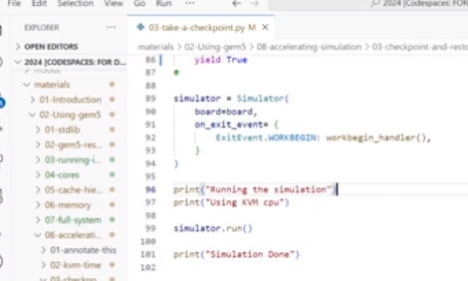
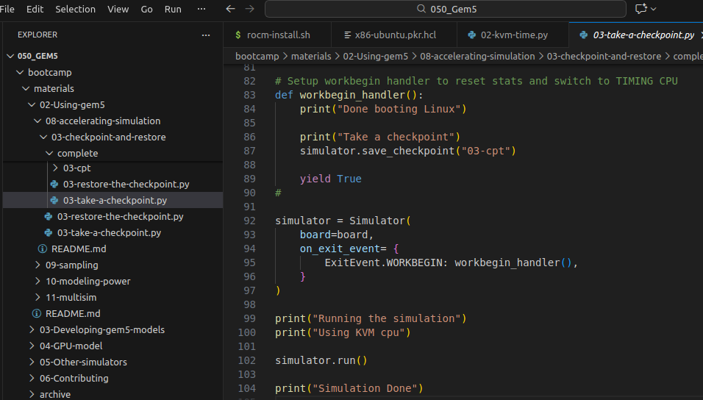
12.4 Checkpoint and Restore
https://www.youtube.com/watch?v=JeOq90oDsPc&list=PL_hVbFs_loVR_8ntTTmmG6YEq3Po_4snu&index=12
Checkpoint and Restore (5:31-6:19/13:32)
5. Fifth, we print the message after the simulation.
That is the script for the checkpoint.

Slide 18
12.4 Checkpoint and Restore
https://www.youtube.com/watch?v=JeOq90oDsPc&list=PL_hVbFs_loVR_8ntTTmmG6YEq3Po_4snu&index=12
Checkpoint and Restore (6:20-7:20/13:32)
Now, let’s run the script
> cd ~/<bootcamp>/materials/02-Using-gem5/08-accelerating/03-checkpoint-and-restore/complete
> ln -s <gem5-path>/build/ALL/gem5.opt .
> ./gem5.opt -re --outdir=checkpointing-m5-out 03-take-a-checkpoint.py
>> It will take a while (10 to 20 min) to finish.

Slide 19
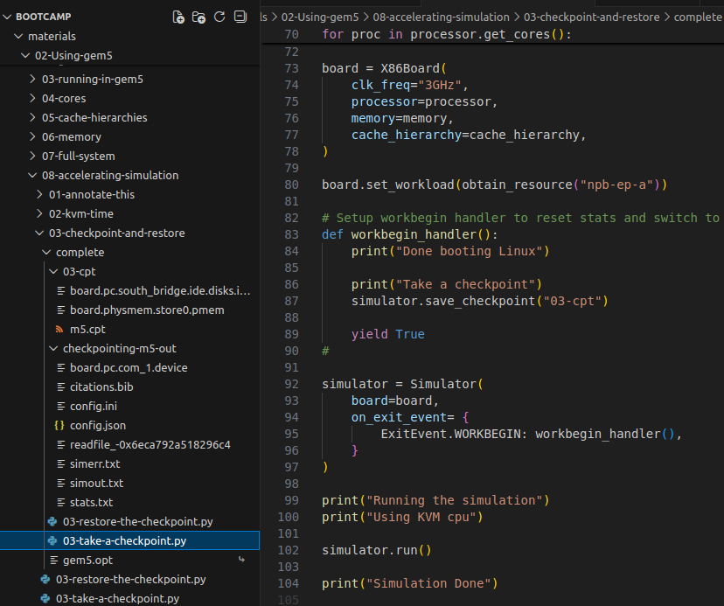
12.4 Checkpoint and Restore
https://www.youtube.com/watch?v=JeOq90oDsPc&list=PL_hVbFs_loVR_8ntTTmmG6YEq3Po_4snu&index=12
Checkpoint and Restore (7:21-07:30/13:32)
We can see directory “checkpointing-m5-out” and “03-cpt” are generated.
In checkpoint-m5-out
There are files: board.pc.com_1.device, citataion.bib, config.ini, config.json, simerr.txt, simout.txt, stats.txt.

Slide 20
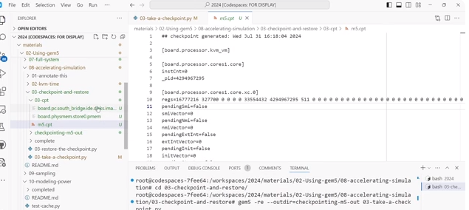
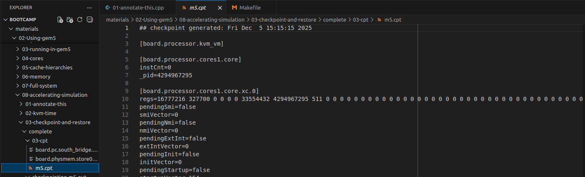
12.4 Checkpoint and Restore
https://www.youtube.com/watch?v=JeOq90oDsPc&list=PL_hVbFs_loVR_8ntTTmmG6YEq3Po_4snu&index=12
Checkpoint and Restore (07:31-08:00/13:32)
In 03-cpt (checkpoint timer) directory, we have m5.cpt file which record all the saved information.
The file contains the memory, image disk,
Here, we restore this checkpoint.

Slide 21
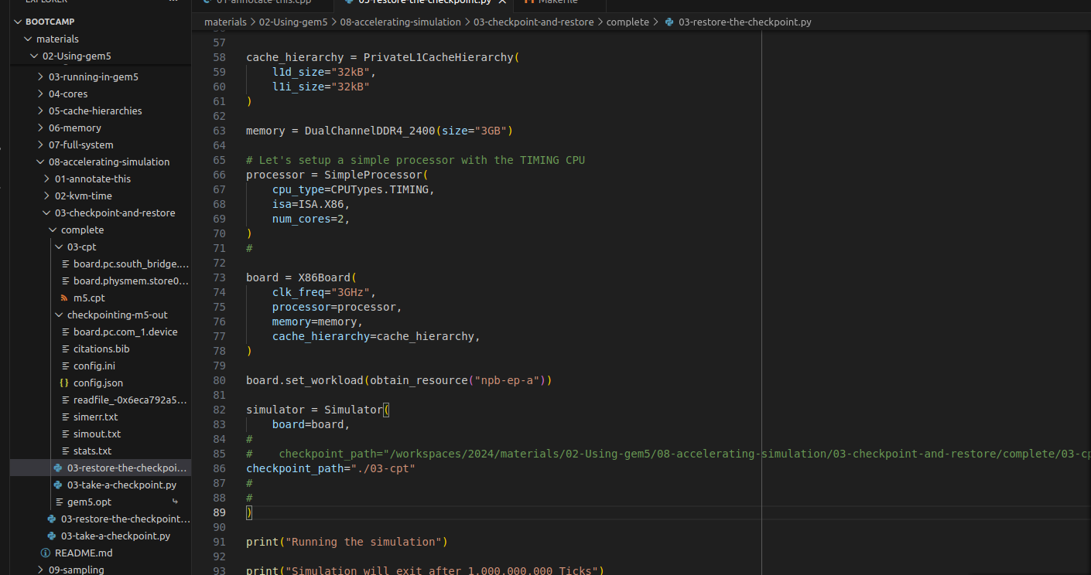
12.4 Checkpoint and Restore
https://www.youtube.com/watch?v=JeOq90oDsPc&list=PL_hVbFs_loVR_8ntTTmmG6YEq3Po_4snu&index=12
Checkpoint and Restore (08:01-08:15/13:32)
In the 03-restore-the-checkpont.py, we passed in the path “./03_cpt”

Slide 22
End

