Slide 1

21.1 Model Port (01): Slides
Peter H. Chen

Slide 2
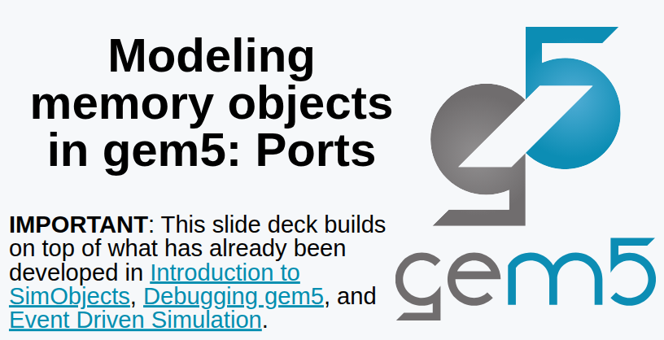
21.1 Model Port (01): Slides
https://gem5bootcamp.github.io/2124/#03-Developing-gem5-models/04-ports
Model Port (01): Slides

Slide 3
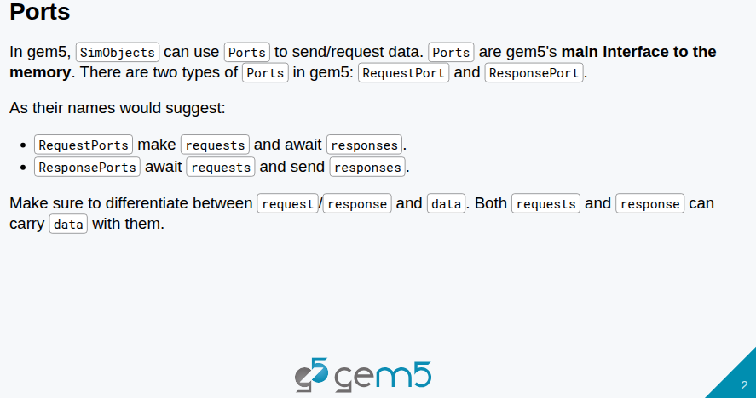
21.1 Model Port (01): Slides
https://gem5bootcamp.github.io/2124/#03-Developing-gem5-models/04-ports
Model Port (01): Slides

Slide 4
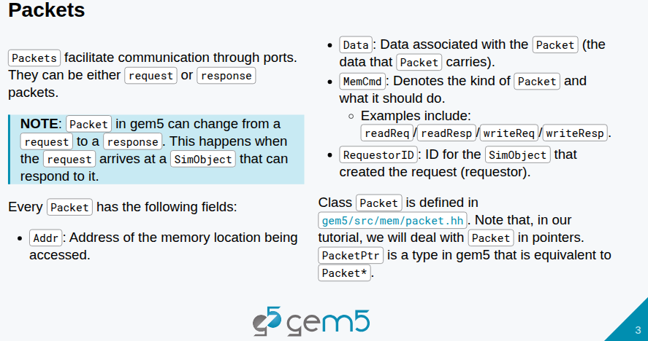
21.1 Model Port (01): Slides
https://gem5bootcamp.github.io/2124/#03-Developing-gem5-models/04-ports
Model Port (01): Slides

Slide 5
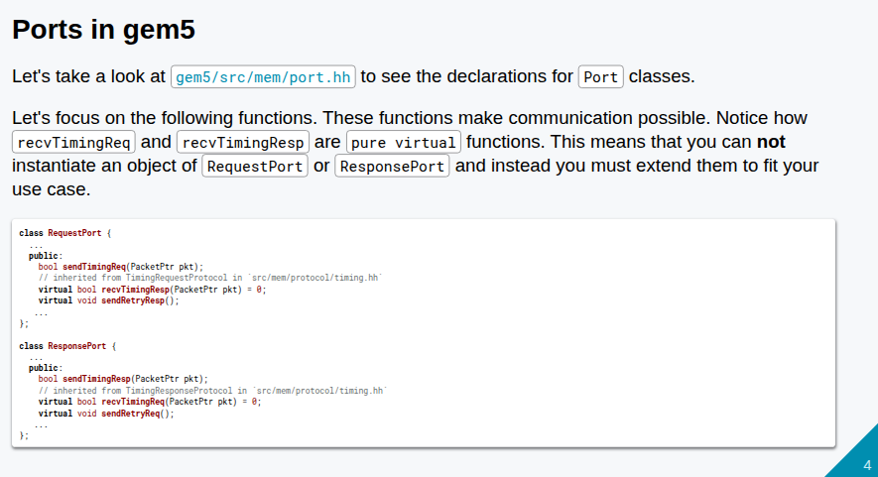
21.1 Model Port (01): Slides
https://gem5bootcamp.github.io/2124/#03-Developing-gem5-models/04-ports
Model Port (01): Slides

Slide 6
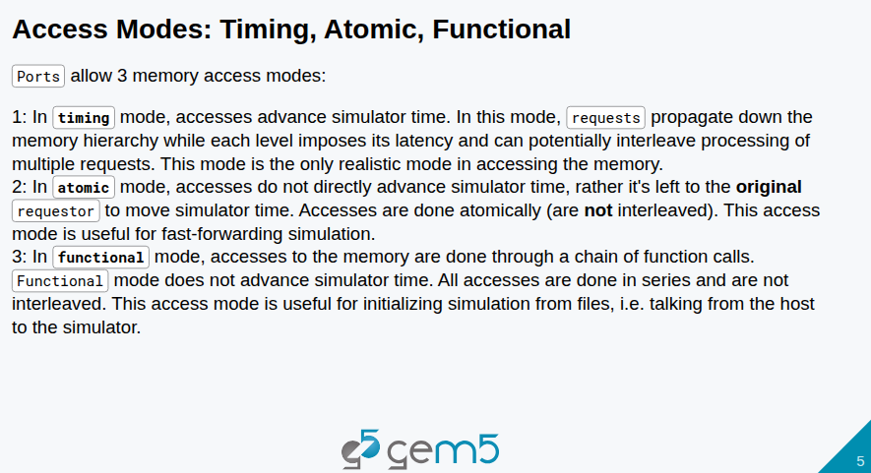
21.1 Model Port (01): Slides
https://gem5bootcamp.github.io/2124/#03-Developing-gem5-models/04-ports
Model Port (01): Slides

Slide 7
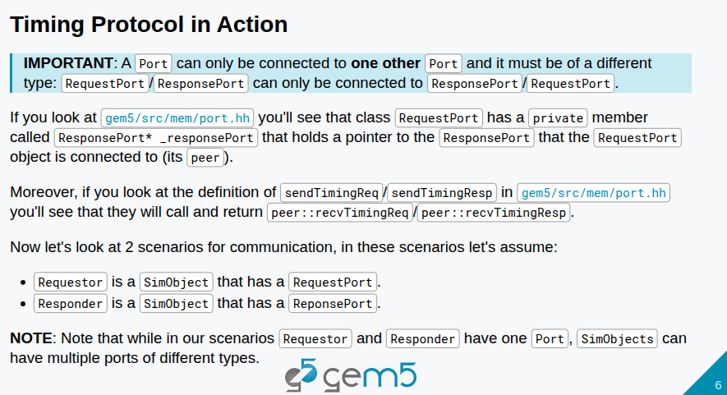
21.1 Model Port (01): Slides
https://gem5bootcamp.github.io/2124/#03-Developing-gem5-models/04-ports
Model Port (01): Slides

Slide 8
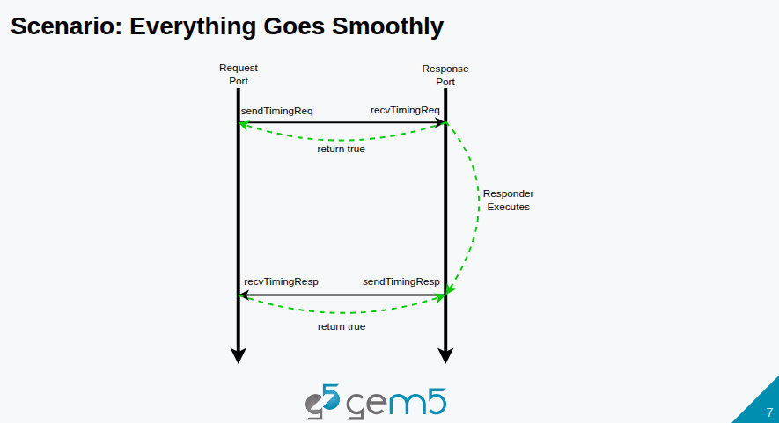
21.1 Model Port (01): Slides
https://gem5bootcamp.github.io/2124/#03-Developing-gem5-models/04-ports
Model Port (01): Slides

Slide 9
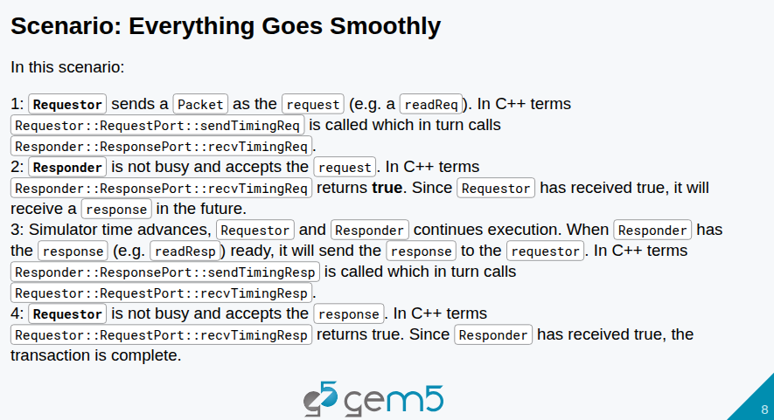
21.1 Model Port (01): Slides
https://gem5bootcamp.github.io/2124/#03-Developing-gem5-models/04-ports
Model Port (01): Slides

Slide 10
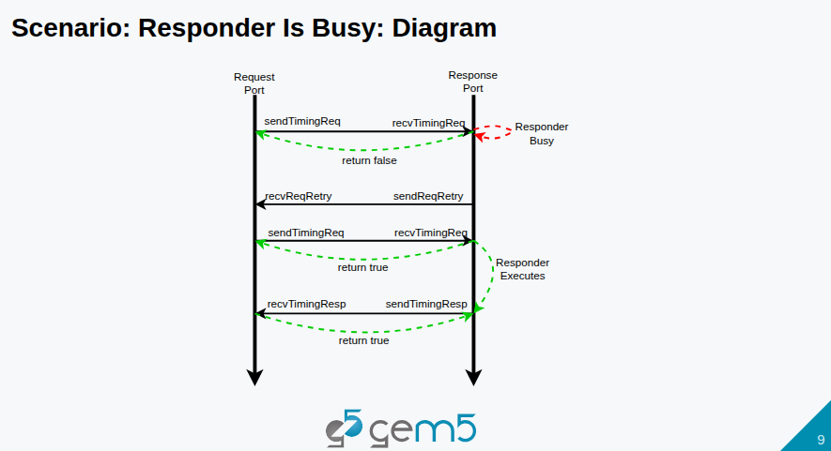
21.1 Model Port (01): Slides
https://gem5bootcamp.github.io/2124/#03-Developing-gem5-models/04-ports
Model Port (01): Slides

Slide 11
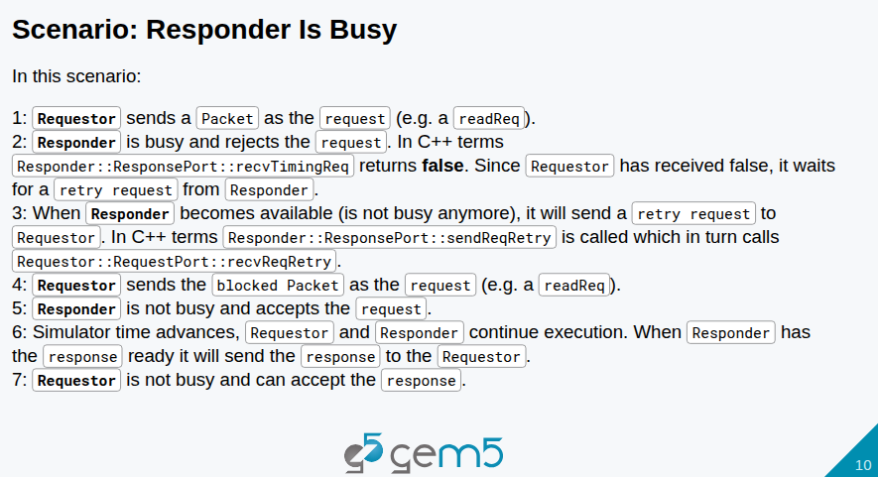
21.1 Model Port (01): Slides
https://gem5bootcamp.github.io/2124/#03-Developing-gem5-models/04-ports
Model Port (01): Slides

Slide 12
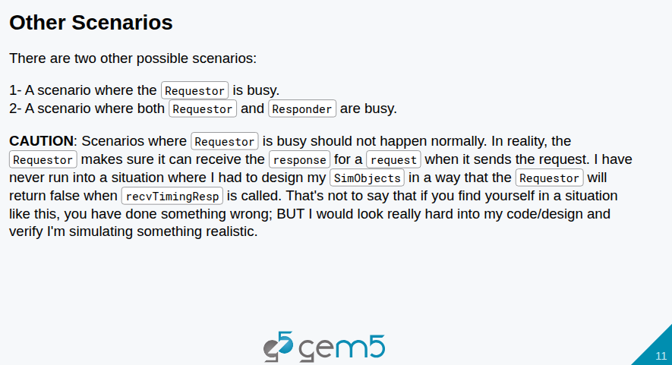
21.1 Model Port (01): Slides
https://gem5bootcamp.github.io/2124/#03-Developing-gem5-models/04-ports
Model Port (01): Slides

Slide 13
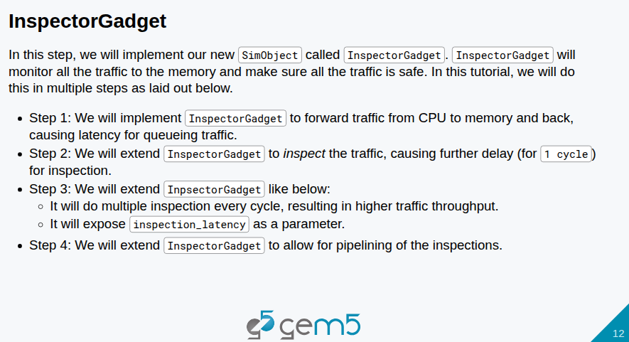
21.1 Model Port (01): Slides
https://gem5bootcamp.github.io/2124/#03-Developing-gem5-models/04-ports
Model Port (01): Slides

Slide 14
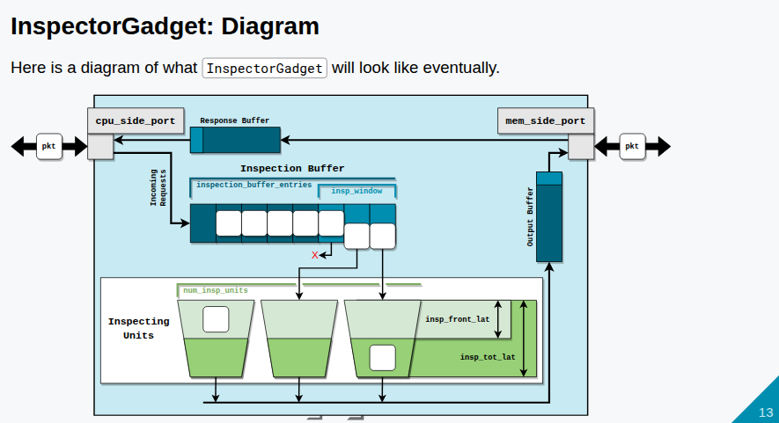
21.1 Model Port (01): Slides
https://gem5bootcamp.github.io/2124/#03-Developing-gem5-models/04-ports
Model Port (01): Slides

Slide 15
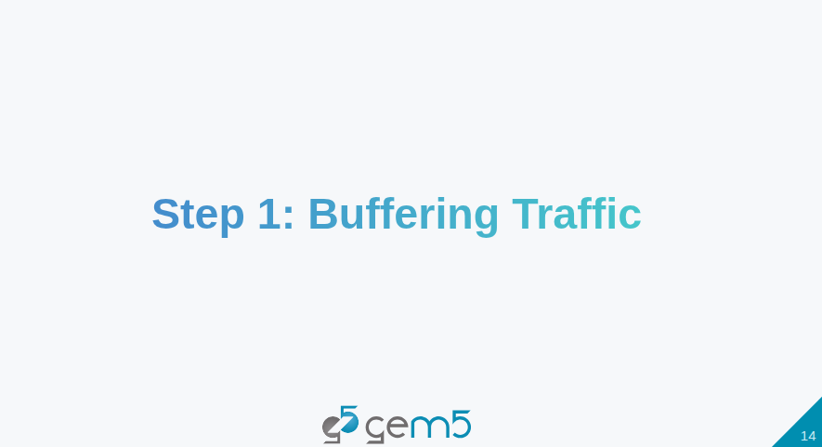
21.1 Model Port (01): Slides
https://gem5bootcamp.github.io/2124/#03-Developing-gem5-models/04-ports
Model Port (01): Slides

Slide 16
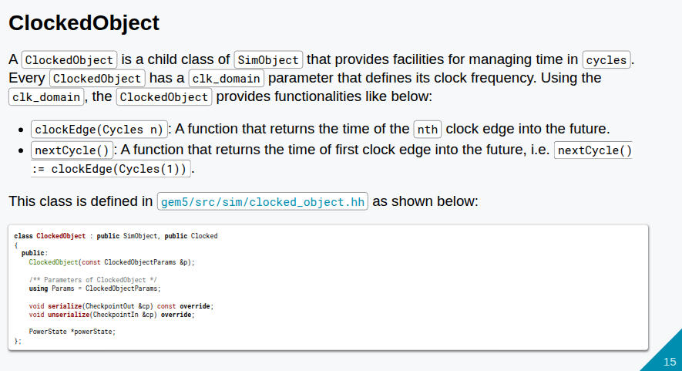
21.1 Model Port (01): Slides
https://gem5bootcamp.github.io/2124/#03-Developing-gem5-models/04-ports
Model Port (01): Slides

Slide 17
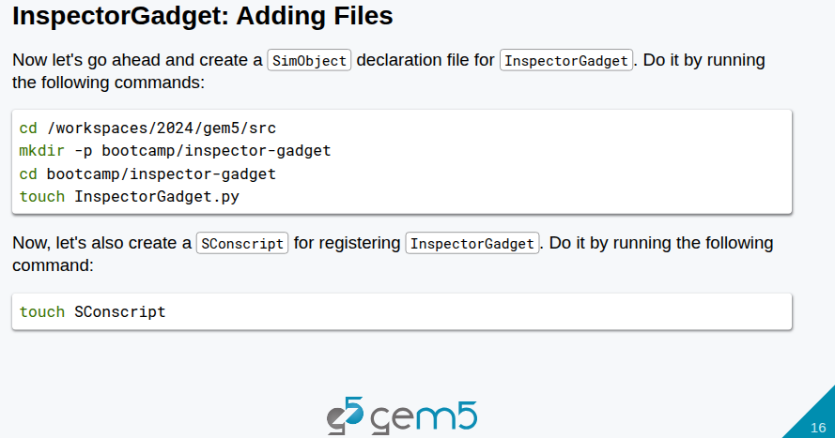
21.1 Model Port (01): Slides
https://gem5bootcamp.github.io/2124/#03-Developing-gem5-models/04-ports
Model Port (01): Slides

Slide 18
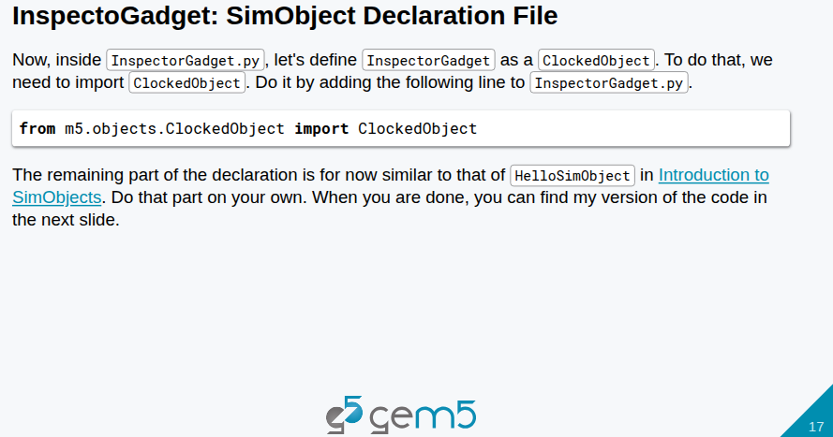
21.1 Model Port (01): Slides
https://gem5bootcamp.github.io/2124/#03-Developing-gem5-models/04-ports
Model Port (01): Slides

Slide 19
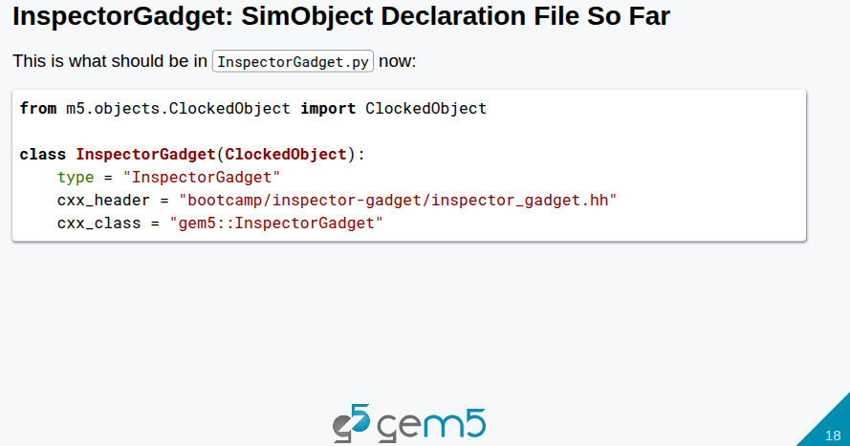
21.1 Model Port (01): Slides
https://gem5bootcamp.github.io/2124/#03-Developing-gem5-models/04-ports
Model Port (01): Slides

Slide 20
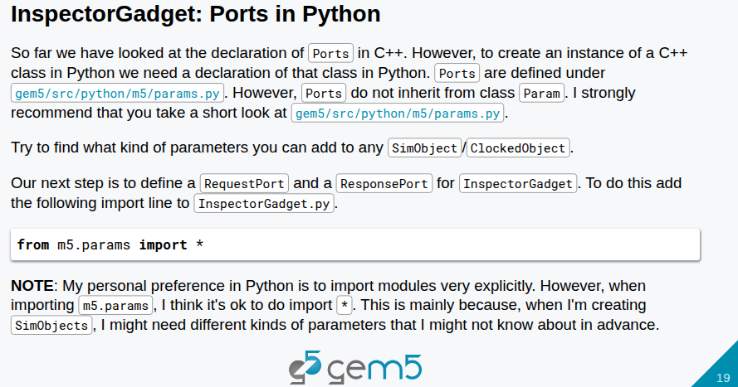
21.1 Model Port (01): Slides
https://gem5bootcamp.github.io/2124/#03-Developing-gem5-models/04-ports
Model Port (01): Slides

Slide 21
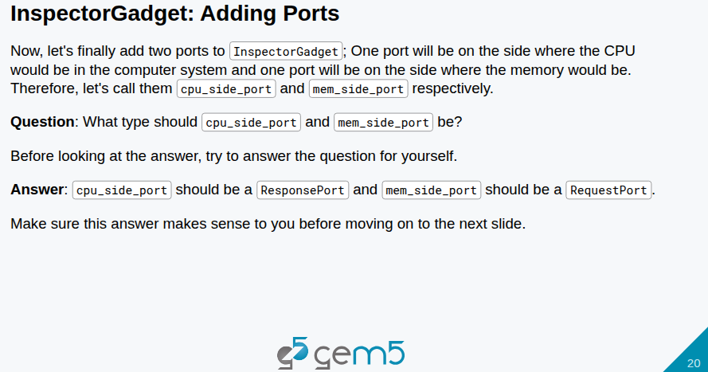
21.1 Model Port (01): Slides
https://gem5bootcamp.github.io/2124/#03-Developing-gem5-models/04-ports
Model Port (01): Slides

Slide 22
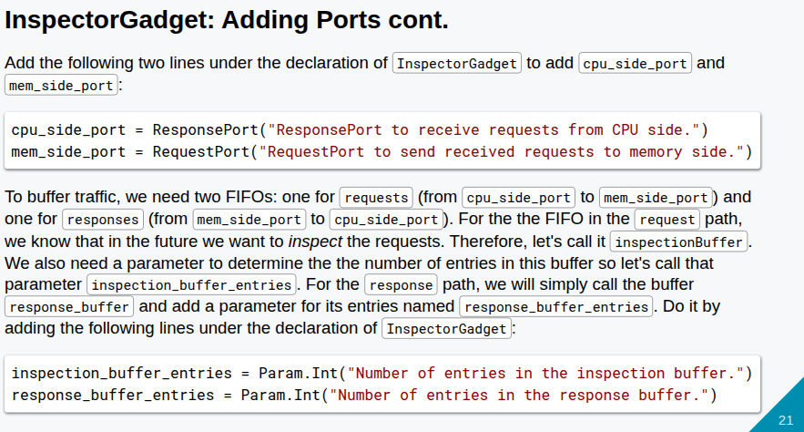
21.1 Model Port (01): Slides
https://gem5bootcamp.github.io/2124/#03-Developing-gem5-models/04-ports
Model Port (01): Slides

Slide 23
End

