Slide 1

21.1 Model Port (01): Slides
Peter H. Chen

Slide 2
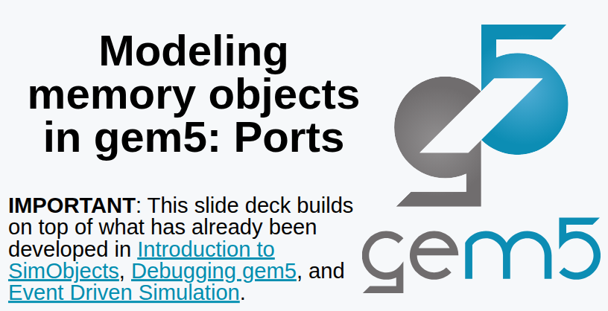
21.1 Model Port (01): Slides
https://gem5bootcamp.github.io/2024/#03-Developing-gem5-models/04-ports
Model Port (01): Slides

Slide 3
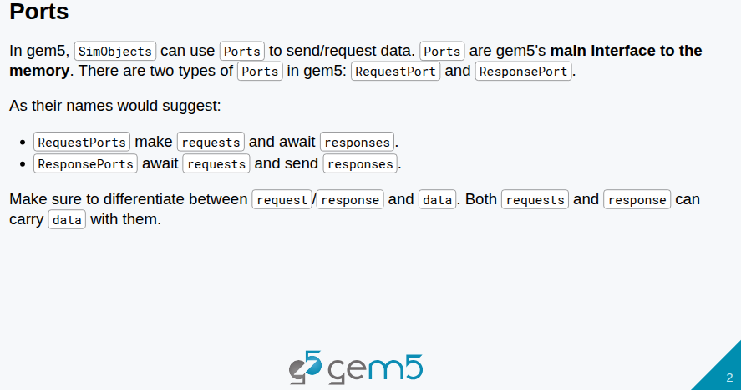
21.1 Model Port (01): Slides
https://gem5bootcamp.github.io/2024/#03-Developing-gem5-models/04-ports
Model Port (01): Slides

Slide 4
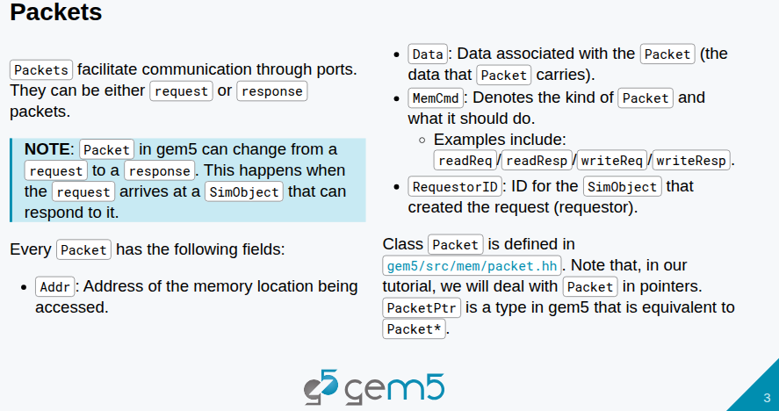
21.1 Model Port (01): Slides
https://gem5bootcamp.github.io/2024/#03-Developing-gem5-models/04-ports
Model Port (01): Slides

Slide 5
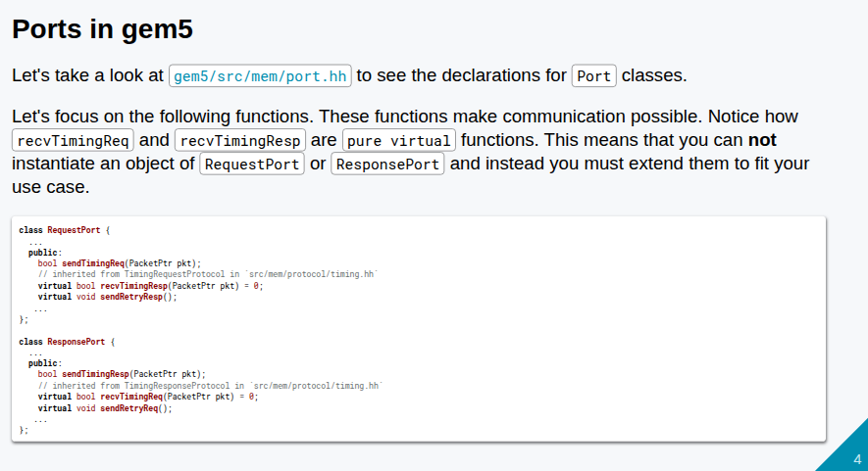
21.1 Model Port (01): Slides
https://gem5bootcamp.github.io/2024/#03-Developing-gem5-models/04-ports
Model Port (01): Slides

Slide 6
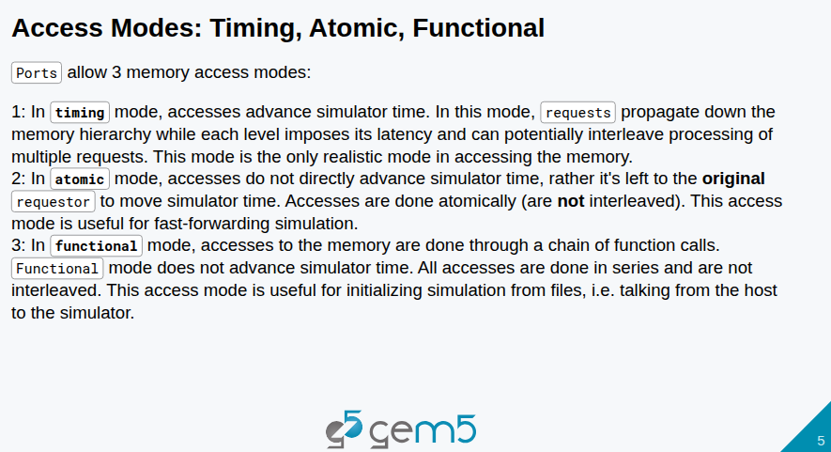
21.1 Model Port (01): Slides
https://gem5bootcamp.github.io/2024/#03-Developing-gem5-models/04-ports
Model Port (01): Slides

Slide 7
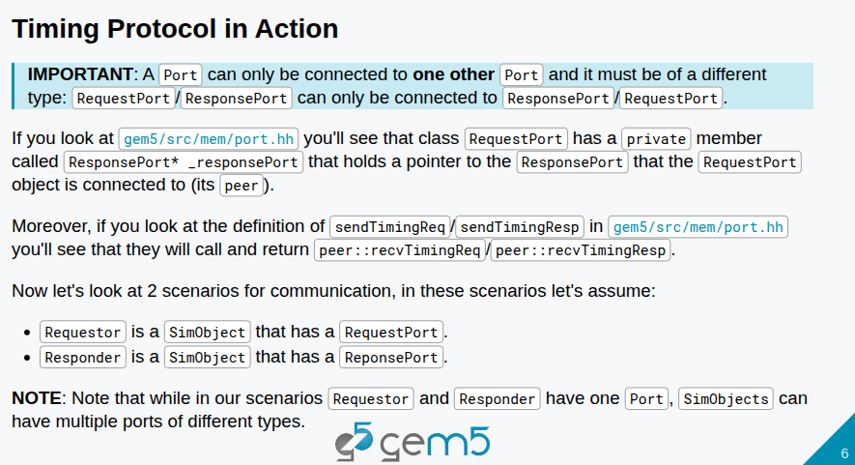
21.1 Model Port (01): Slides
https://gem5bootcamp.github.io/2024/#03-Developing-gem5-models/04-ports
Model Port (01): Slides

Slide 8
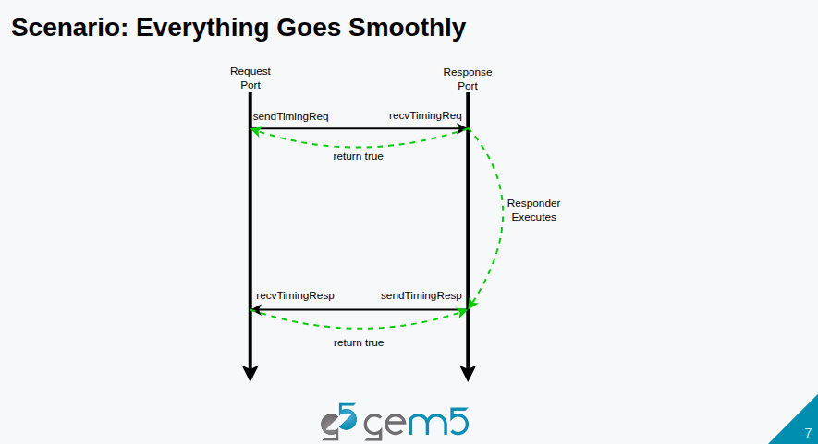
21.1 Model Port (01): Slides
https://gem5bootcamp.github.io/2024/#03-Developing-gem5-models/04-ports
Model Port (01): Slides

Slide 9
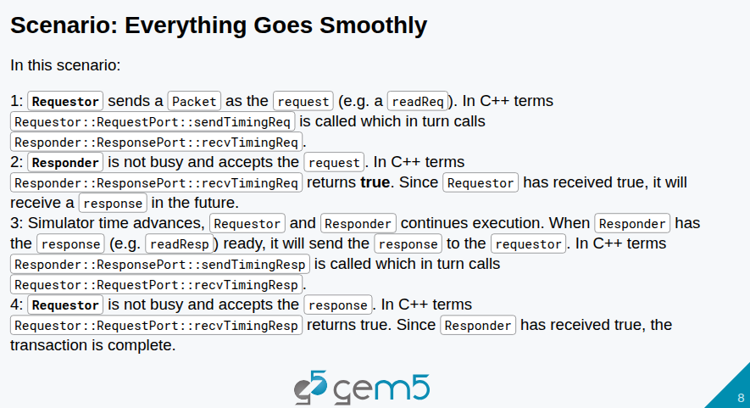
21.1 Model Port (01): Slides
https://gem5bootcamp.github.io/2024/#03-Developing-gem5-models/04-ports
Model Port (01): Slides

Slide 10
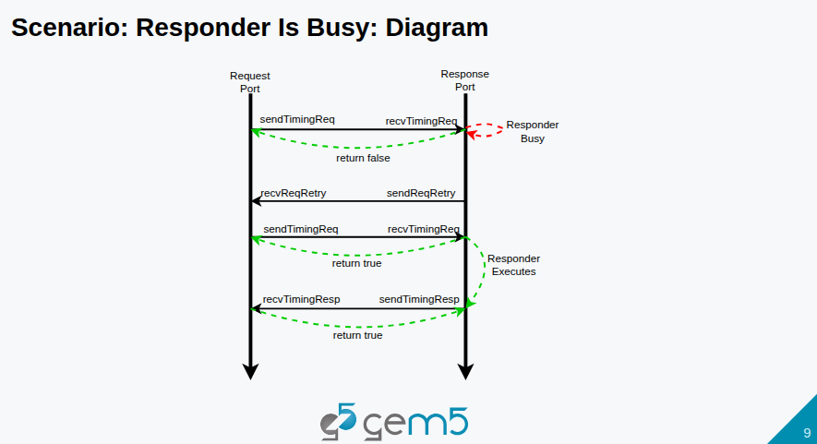
21.1 Model Port (01): Slides
https://gem5bootcamp.github.io/2024/#03-Developing-gem5-models/04-ports
Model Port (01): Slides

Slide 11
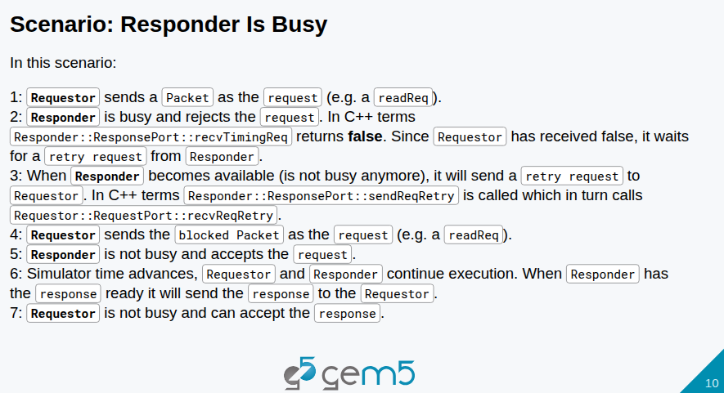
21.1 Model Port (01): Slides
https://gem5bootcamp.github.io/2024/#03-Developing-gem5-models/04-ports
Model Port (01): Slides

Slide 12
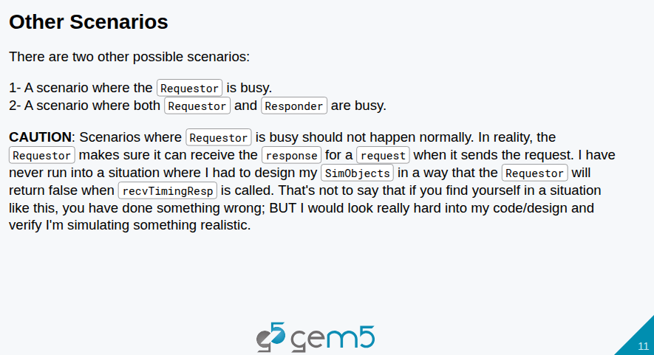
21.1 Model Port (01): Slides
https://gem5bootcamp.github.io/2024/#03-Developing-gem5-models/04-ports
Model Port (01): Slides

Slide 13
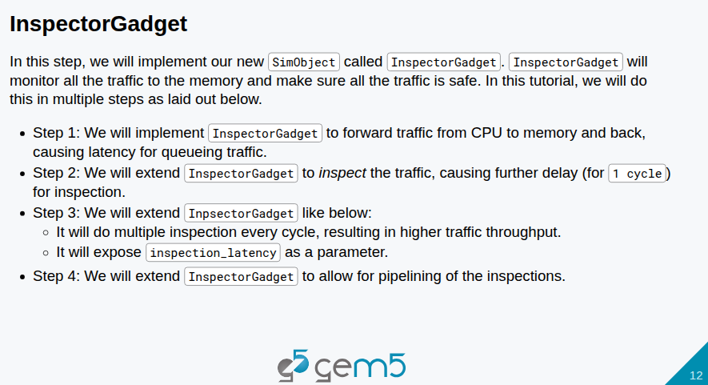
21.1 Model Port (01): Slides
https://gem5bootcamp.github.io/2024/#03-Developing-gem5-models/04-ports
Model Port (01): Slides

Slide 14
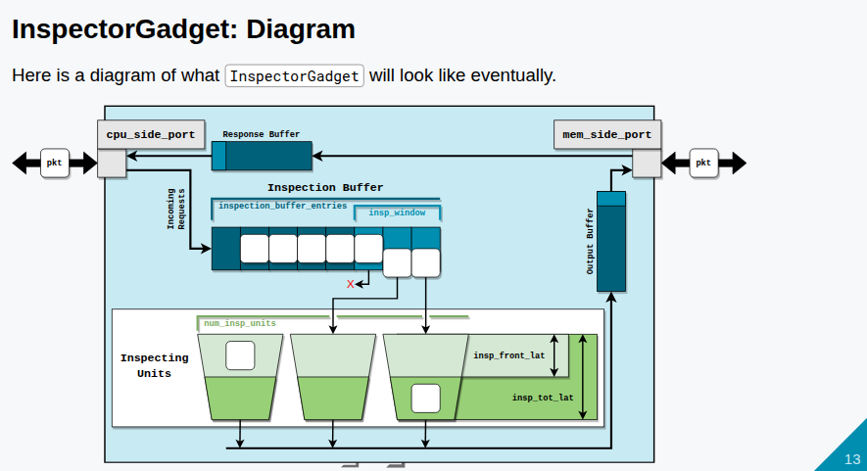
21.1 Model Port (01): Slides
https://gem5bootcamp.github.io/2024/#03-Developing-gem5-models/04-ports
Model Port (01): Slides

Slide 15
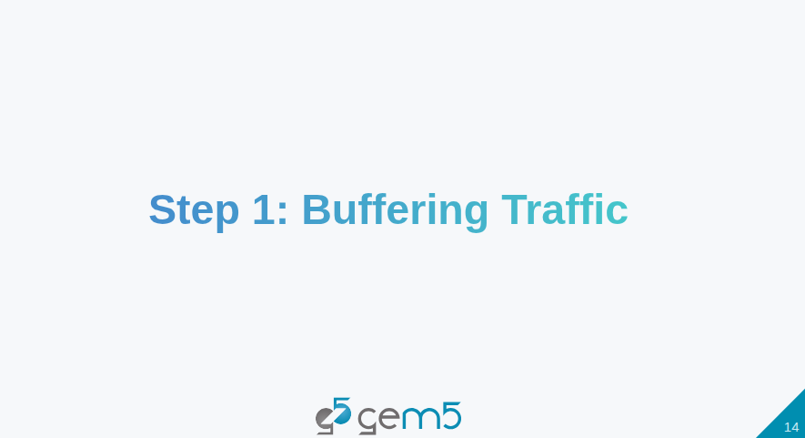
21.1 Model Port (01): Slides
https://gem5bootcamp.github.io/2024/#03-Developing-gem5-models/04-ports
Model Port (01): Slides

Slide 16
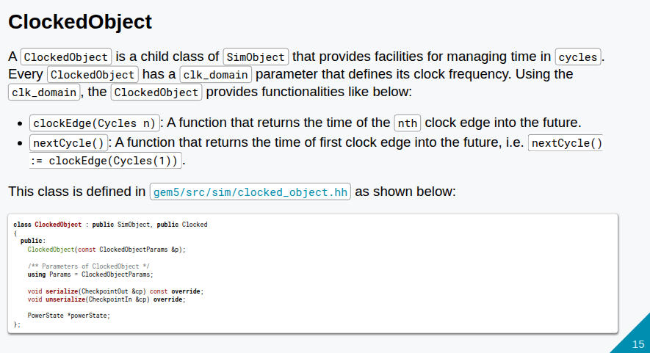
21.1 Model Port (01): Slides
https://gem5bootcamp.github.io/2024/#03-Developing-gem5-models/04-ports
Model Port (01): Slides

Slide 17
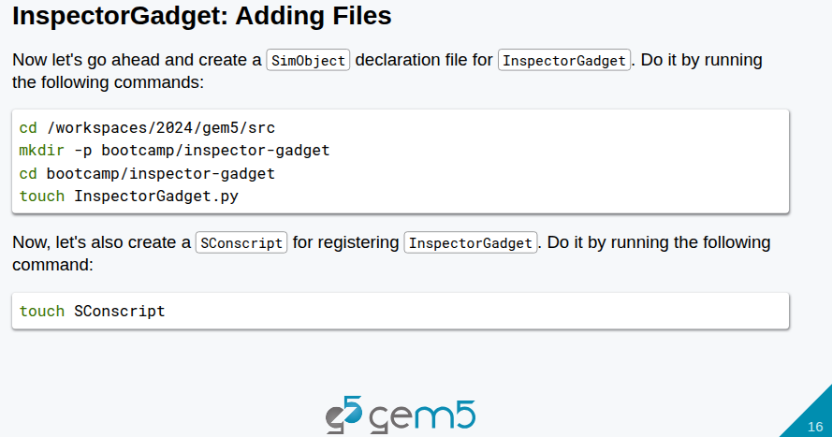
21.1 Model Port (01): Slides
https://gem5bootcamp.github.io/2024/#03-Developing-gem5-models/04-ports
Model Port (01): Slides

Slide 18
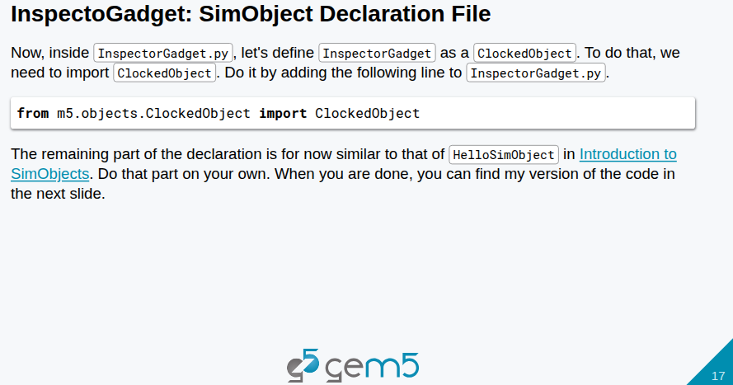
21.1 Model Port (01): Slides
https://gem5bootcamp.github.io/2024/#03-Developing-gem5-models/04-ports
Model Port (01): Slides

Slide 19
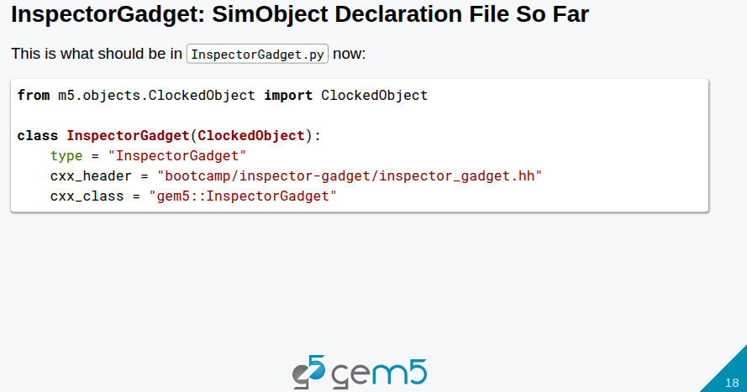
21.1 Model Port (01): Slides
https://gem5bootcamp.github.io/2024/#03-Developing-gem5-models/04-ports
Model Port (01): Slides

Slide 20
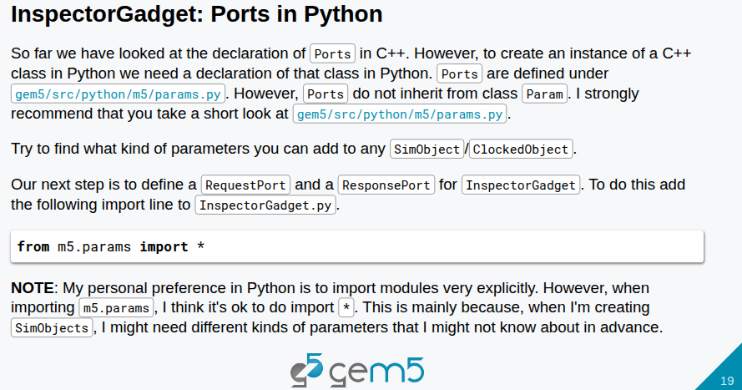
21.1 Model Port (01): Slides
https://gem5bootcamp.github.io/2024/#03-Developing-gem5-models/04-ports
Model Port (01): Slides

Slide 21
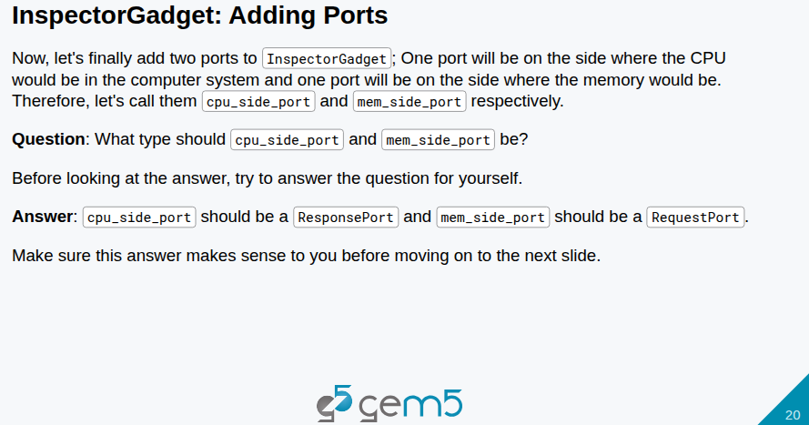
21.1 Model Port (01): Slides
https://gem5bootcamp.github.io/2024/#03-Developing-gem5-models/04-ports
Model Port (01): Slides

Slide 22
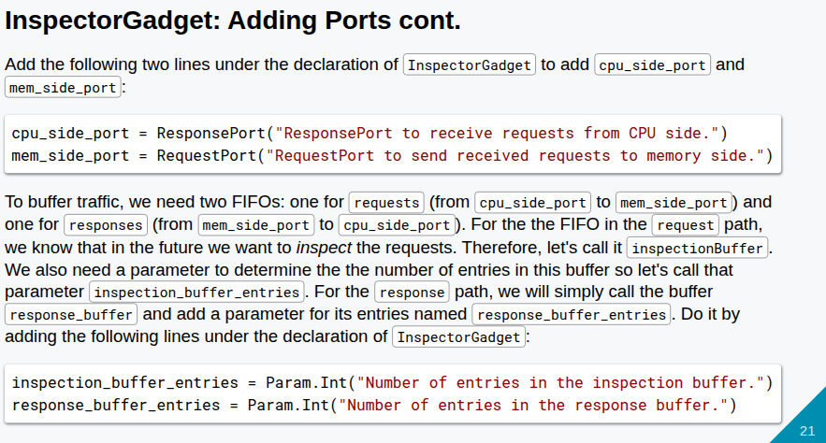
21.1 Model Port (01): Slides
https://gem5bootcamp.github.io/2024/#03-Developing-gem5-models/04-ports
Model Port (01): Slides

Slide 23
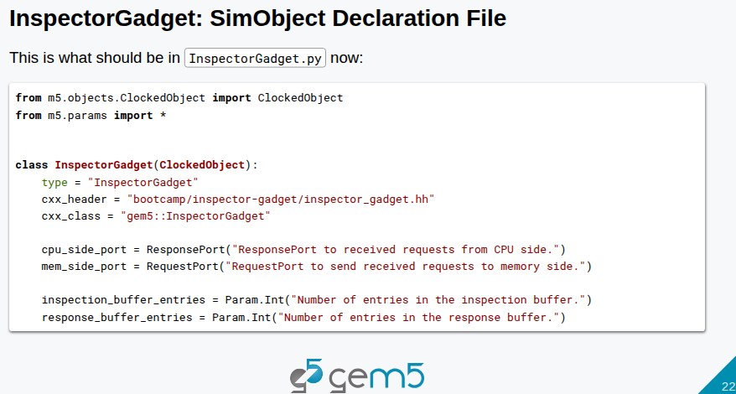
21.1 Model Port (01): Slides
https://gem5bootcamp.github.io/2024/#03-Developing-gem5-models/04-ports
Model Port (01): Slides

Slide 24
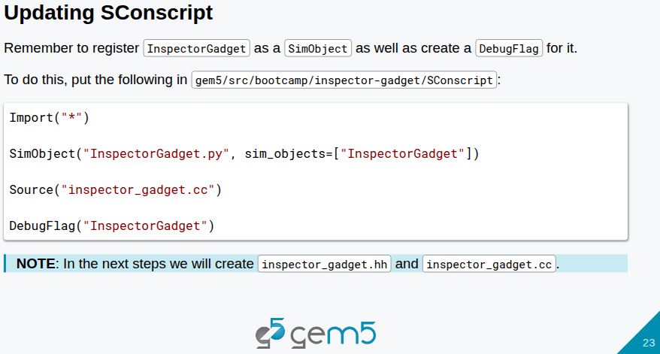
21.1 Model Port (01): Slides
https://gem5bootcamp.github.io/2024/#03-Developing-gem5-models/04-ports
Model Port (01): Slides

Slide 25
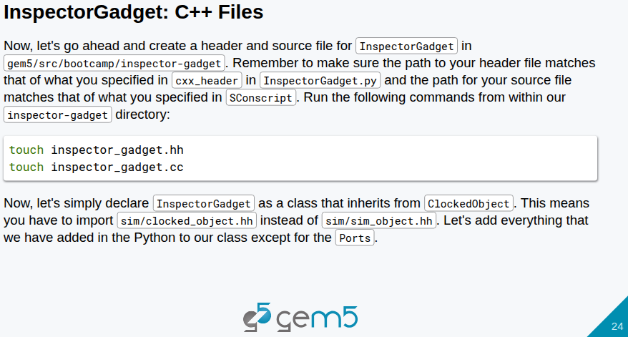
21.1 Model Port (01): Slides
https://gem5bootcamp.github.io/2024/#03-Developing-gem5-models/04-ports
Model Port (01): Slides

Slide 26
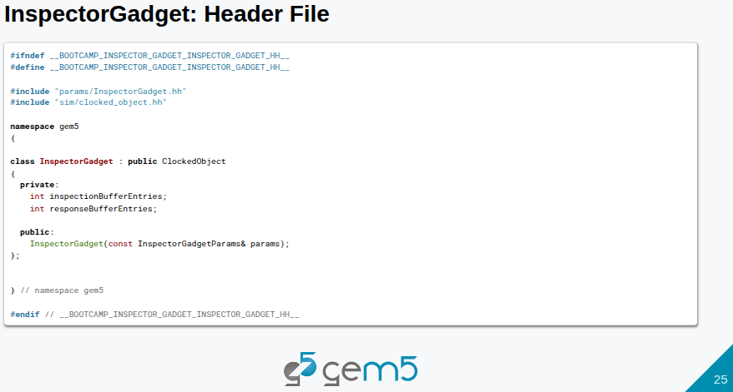
21.1 Model Port (01): Slides
https://gem5bootcamp.github.io/2024/#03-Developing-gem5-models/04-ports
Model Port (01): Slides

Slide 27
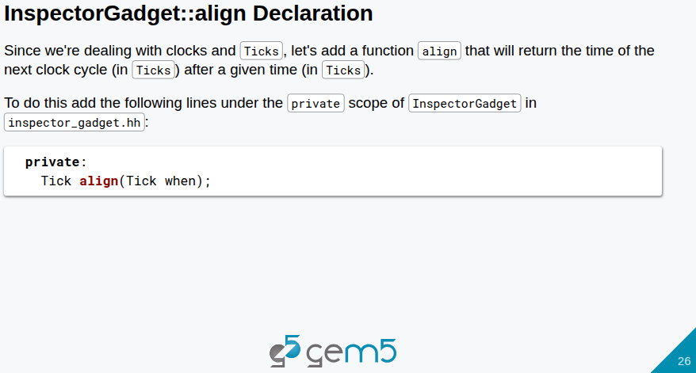
21.1 Model Port (01): Slides
https://gem5bootcamp.github.io/2024/#03-Developing-gem5-models/04-ports
Model Port (01): Slides

Slide 28
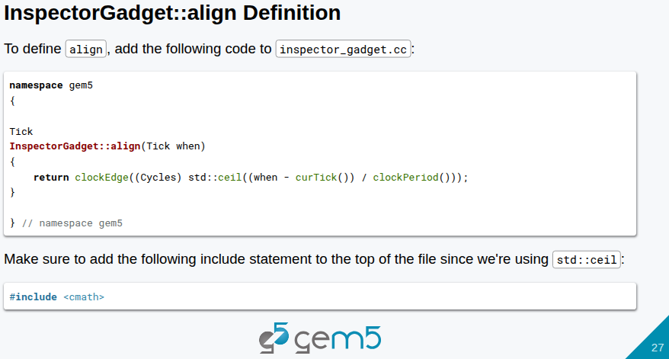
21.1 Model Port (01): Slides
https://gem5bootcamp.github.io/2024/#03-Developing-gem5-models/04-ports
Model Port (01): Slides

Slide 29
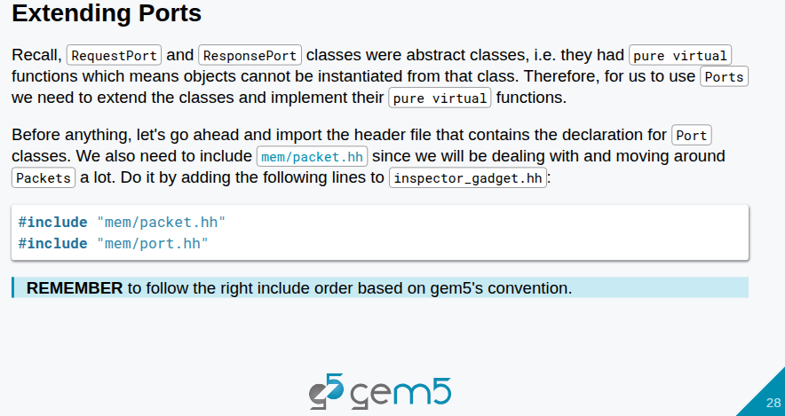
21.1 Model Port (01): Slides
https://gem5bootcamp.github.io/2024/#03-Developing-gem5-models/04-ports
Model Port (01): Slides

Slide 30
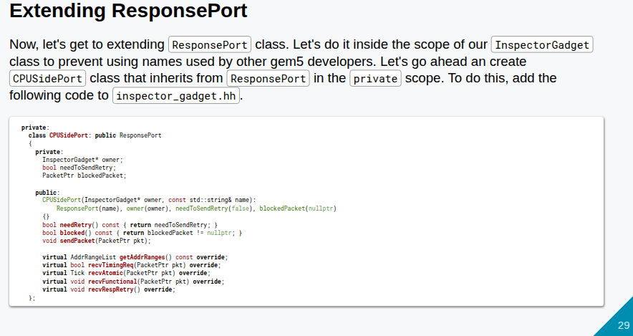
21.1 Model Port (01): Slides
https://gem5bootcamp.github.io/2024/#03-Developing-gem5-models/04-ports
Model Port (01): Slides

Slide 31
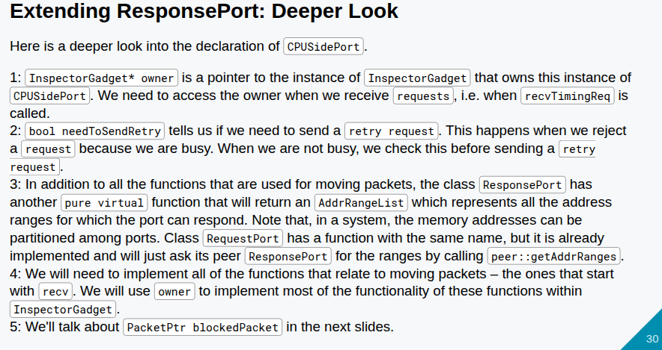
21.1 Model Port (01): Slides
https://gem5bootcamp.github.io/2024/#03-Developing-gem5-models/04-ports
Model Port (01): Slides

Slide 32
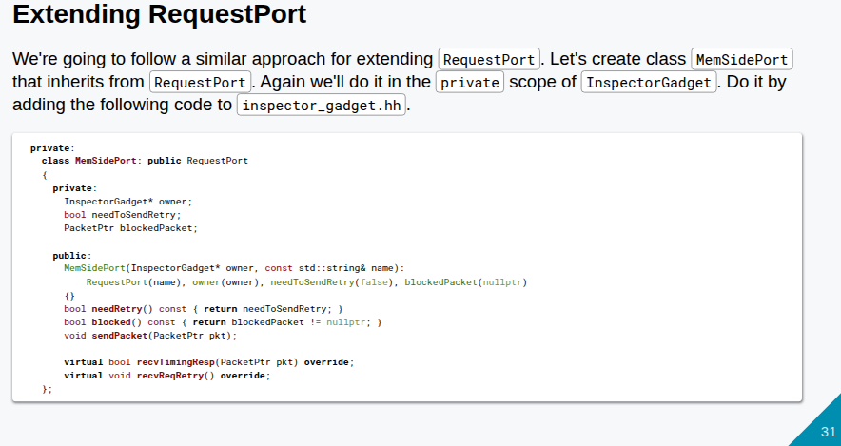
21.1 Model Port (01): Slides
https://gem5bootcamp.github.io/2024/#03-Developing-gem5-models/04-ports
Model Port (01): Slides

Slide 33
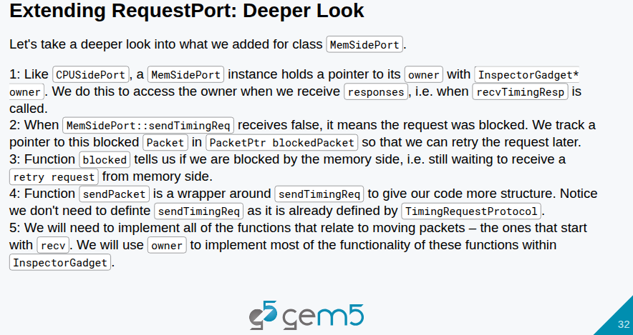
21.1 Model Port (01): Slides
https://gem5bootcamp.github.io/2024/#03-Developing-gem5-models/04-ports
Model Port (01): Slides

Slide 34
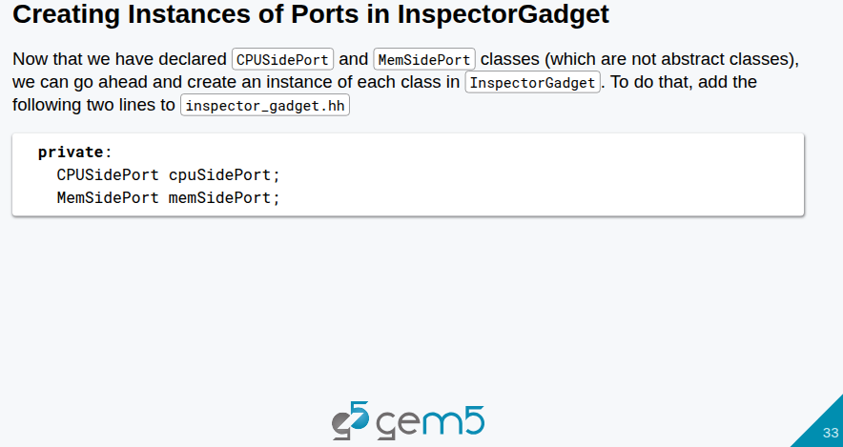
21.1 Model Port (01): Slides
https://gem5bootcamp.github.io/2024/#03-Developing-gem5-models/04-ports
Model Port (01): Slides

Slide 35
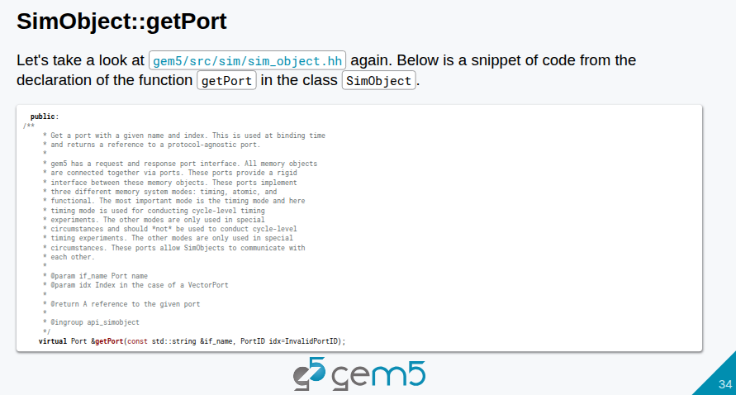
21.1 Model Port (01): Slides
https://gem5bootcamp.github.io/2024/#03-Developing-gem5-models/04-ports
Model Port (01): Slides

Slide 36
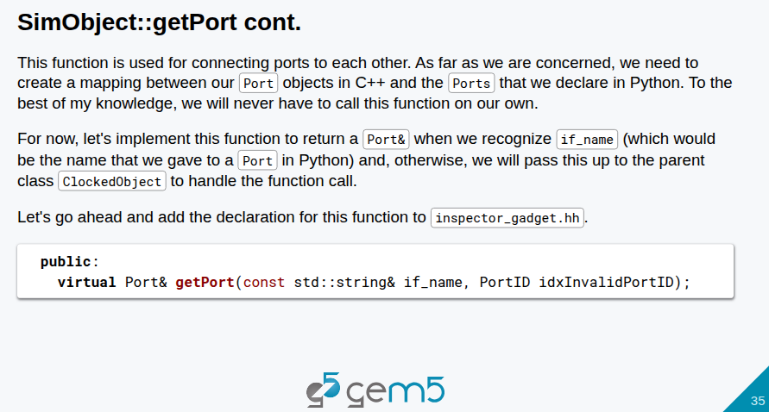
21.1 Model Port (01): Slides
https://gem5bootcamp.github.io/2024/#03-Developing-gem5-models/04-ports
Model Port (01): Slides

Slide 37
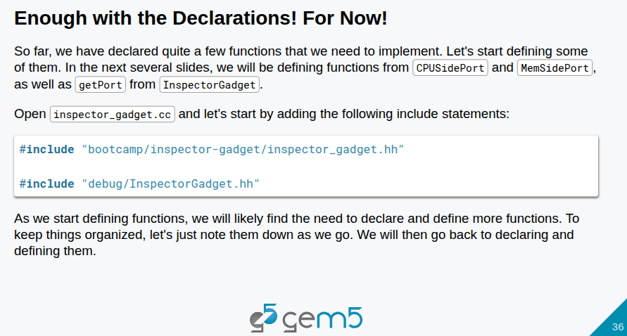
21.1 Model Port (01): Slides
https://gem5bootcamp.github.io/2024/#03-Developing-gem5-models/04-ports
Model Port (01): Slides

Slide 38
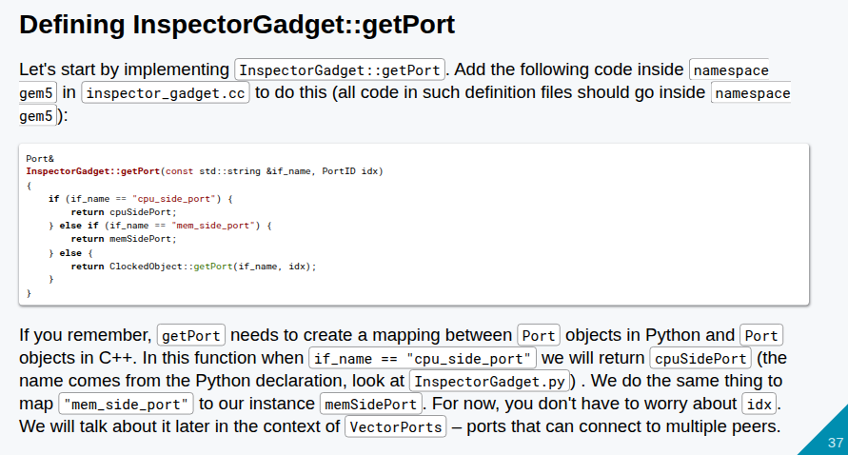
21.1 Model Port (01): Slides
https://gem5bootcamp.github.io/2024/#03-Developing-gem5-models/04-ports
Model Port (01): Slides

Slide 39
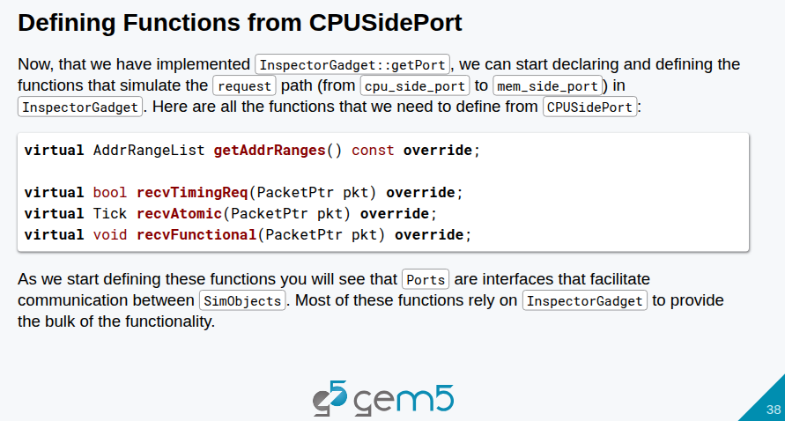
21.1 Model Port (01): Slides
https://gem5bootcamp.github.io/2024/#03-Developing-gem5-models/04-ports
Model Port (01): Slides

Slide 40
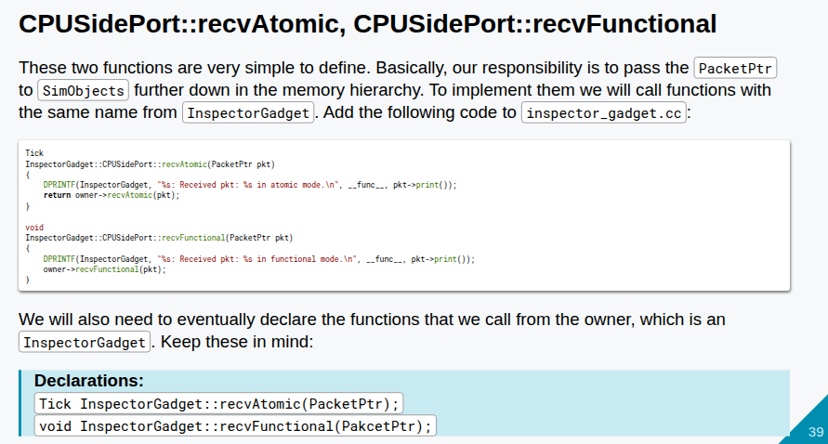
21.1 Model Port (01): Slides
https://gem5bootcamp.github.io/2024/#03-Developing-gem5-models/04-ports
Model Port (01): Slides

Slide 41
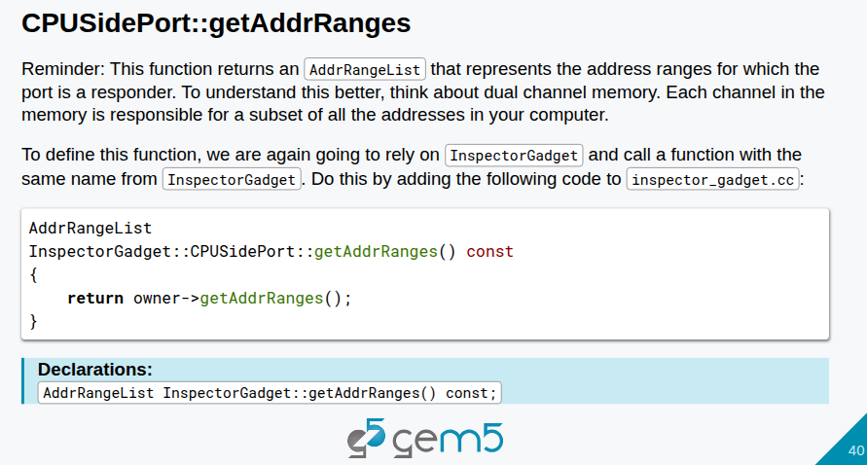
21.1 Model Port (01): Slides
https://gem5bootcamp.github.io/2024/#03-Developing-gem5-models/04-ports
Model Port (01): Slides

Slide 42
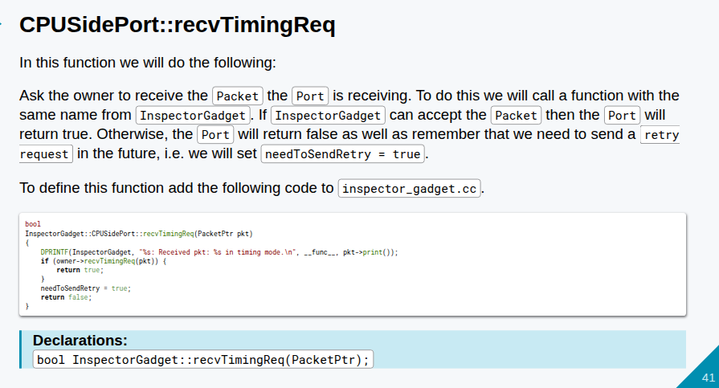
21.1 Model Port (01): Slides
https://gem5bootcamp.github.io/2024/#03-Developing-gem5-models/04-ports
Model Port (01): Slides

Slide 43
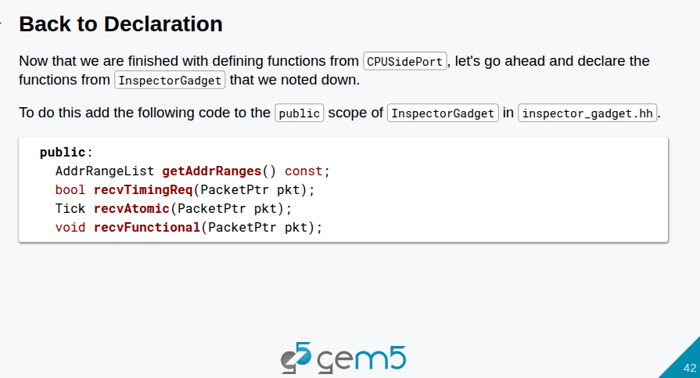
21.1 Model Port (01): Slides
https://gem5bootcamp.github.io/2024/#03-Developing-gem5-models/04-ports
Model Port (01): Slides

Slide 44
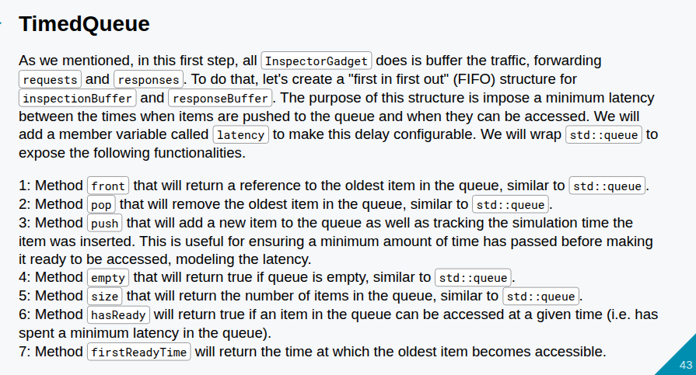
21.1 Model Port (01): Slides
https://gem5bootcamp.github.io/2024/#03-Developing-gem5-models/04-ports
Model Port (01): Slides

Slide 45
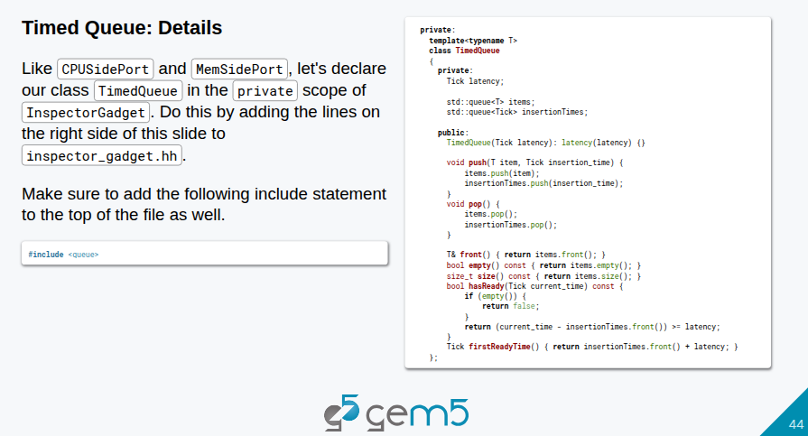
21.1 Model Port (01): Slides
https://gem5bootcamp.github.io/2024/#03-Developing-gem5-models/04-ports
Model Port (01): Slides

Slide 46
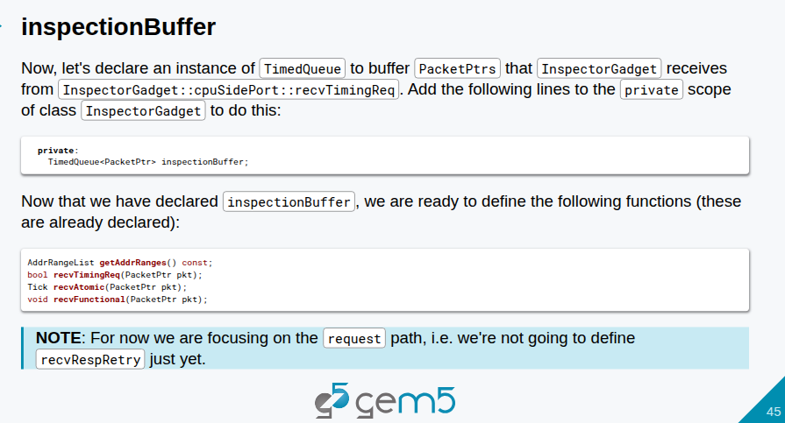
21.1 Model Port (01): Slides
https://gem5bootcamp.github.io/2024/#03-Developing-gem5-models/04-ports
Model Port (01): Slides

Slide 47
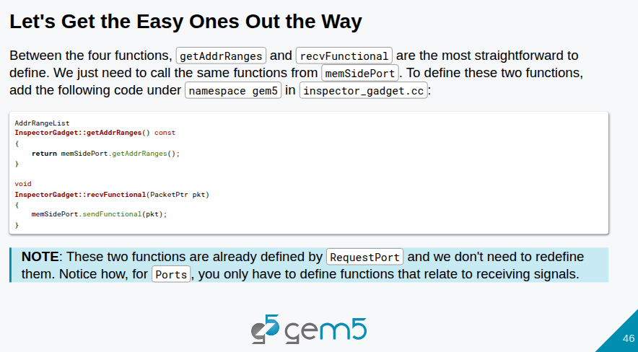
21.1 Model Port (01): Slides
https://gem5bootcamp.github.io/2024/#03-Developing-gem5-models/04-ports
Model Port (01): Slides

Slide 48
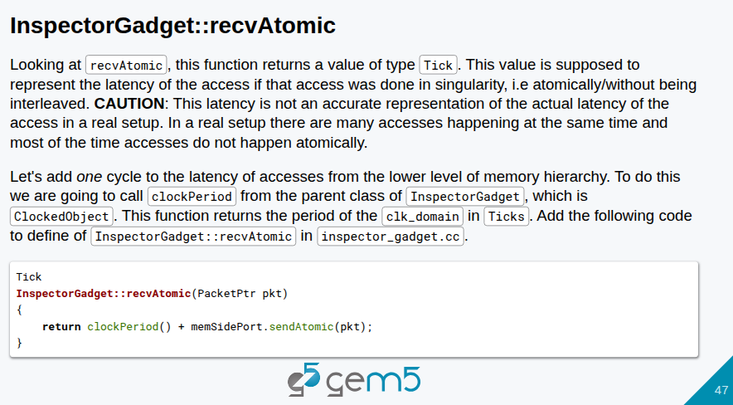
21.1 Model Port (01): Slides
https://gem5bootcamp.github.io/2024/#03-Developing-gem5-models/04-ports
Model Port (01): Slides

Slide 49
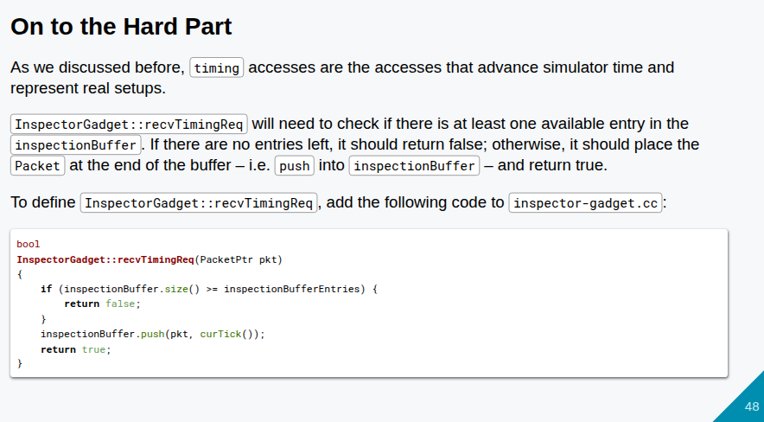
21.1 Model Port (01): Slides
https://gem5bootcamp.github.io/2024/#03-Developing-gem5-models/04-ports
Model Port (01): Slides

Slide 50
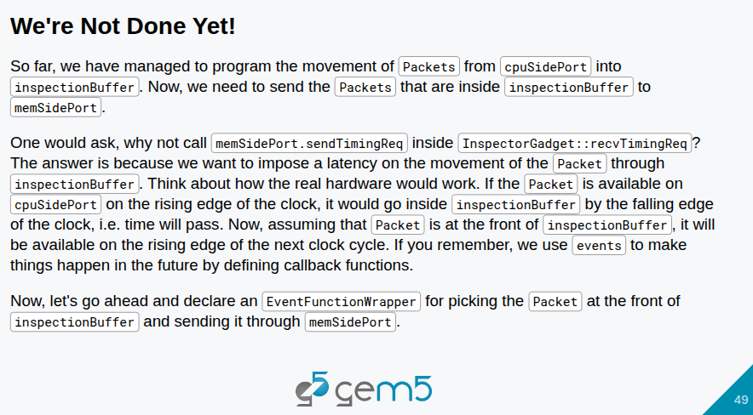
21.1 Model Port (01): Slides
https://gem5bootcamp.github.io/2024/#03-Developing-gem5-models/04-ports
Model Port (01): Slides

Slide 51
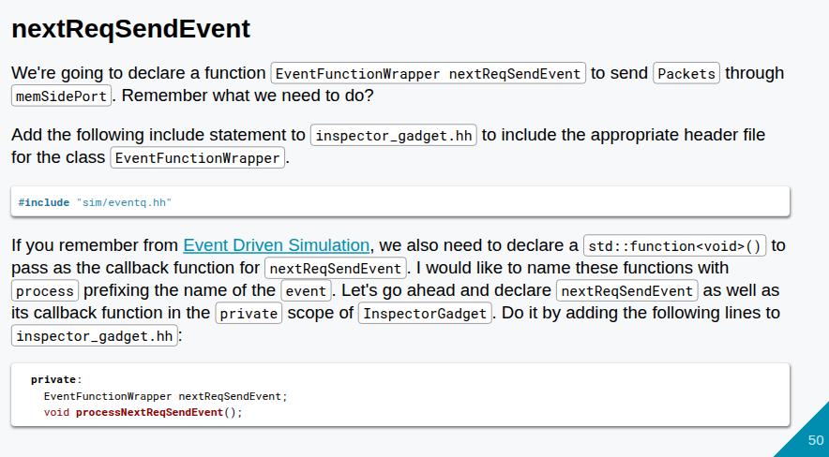
21.1 Model Port (01): Slides
https://gem5bootcamp.github.io/2024/#03-Developing-gem5-models/04-ports
Model Port (01): Slides

Slide 52

21.1 Model Port (01): Slides
https://gem5bootcamp.github.io/2024/#03-Developing-gem5-models/04-ports
Model Port (01): Slides

Slide 53

21.1 Model Port (01): Slides
https://gem5bootcamp.github.io/2024/#03-Developing-gem5-models/04-ports
Model Port (01): Slides

Slide 54

21.1 Model Port (01): Slides
https://gem5bootcamp.github.io/2024/#03-Developing-gem5-models/04-ports
Model Port (01): Slides

Slide 55

21.1 Model Port (01): Slides
https://gem5bootcamp.github.io/2024/#03-Developing-gem5-models/04-ports
Model Port (01): Slides

Slide 56

21.1 Model Port (01): Slides
https://gem5bootcamp.github.io/2024/#03-Developing-gem5-models/04-ports
Model Port (01): Slides

Slide 57

21.1 Model Port (01): Slides
https://gem5bootcamp.github.io/2024/#03-Developing-gem5-models/04-ports
Model Port (01): Slides

Slide 58

21.1 Model Port (01): Slides
https://gem5bootcamp.github.io/2024/#03-Developing-gem5-models/04-ports
Model Port (01): Slides

Slide 59

21.1 Model Port (01): Slides
https://gem5bootcamp.github.io/2024/#03-Developing-gem5-models/04-ports
Model Port (01): Slides

Slide 60

21.1 Model Port (01): Slides
https://gem5bootcamp.github.io/2024/#03-Developing-gem5-models/04-ports
Model Port (01): Slides

Slide 61

21.1 Model Port (01): Slides
https://gem5bootcamp.github.io/2024/#03-Developing-gem5-models/04-ports
Model Port (01): Slides

Slide 62

21.1 Model Port (01): Slides
https://gem5bootcamp.github.io/2024/#03-Developing-gem5-models/04-ports
Model Port (01): Slides

Slide 63

21.1 Model Port (01): Slides
https://gem5bootcamp.github.io/2024/#03-Developing-gem5-models/04-ports
Model Port (01): Slides

Slide 64

21.1 Model Port (01): Slides
https://gem5bootcamp.github.io/2024/#03-Developing-gem5-models/04-ports
Model Port (01): Slides

Slide 65

21.1 Model Port (01): Slides
https://gem5bootcamp.github.io/2024/#03-Developing-gem5-models/04-ports
Model Port (01): Slides

Slide 66

21.1 Model Port (01): Slides
https://gem5bootcamp.github.io/2024/#03-Developing-gem5-models/04-ports
Model Port (01): Slides

Slide 67

21.1 Model Port (01): Slides
https://gem5bootcamp.github.io/2024/#03-Developing-gem5-models/04-ports
Model Port (01): Slides

Slide 68

21.1 Model Port (01): Slides
https://gem5bootcamp.github.io/2024/#03-Developing-gem5-models/04-ports
Model Port (01): Slides

Slide 69

21.1 Model Port (01): Slides
https://gem5bootcamp.github.io/2024/#03-Developing-gem5-models/04-ports
Model Port (01): Slides

Slide 70

21.1 Model Port (01): Slides
https://gem5bootcamp.github.io/2024/#03-Developing-gem5-models/04-ports
Model Port (01): Slides

Slide 71

21.1 Model Port (01): Slides
https://gem5bootcamp.github.io/2024/#03-Developing-gem5-models/04-ports
Model Port (01): Slides

Slide 72

21.1 Model Port (01): Slides
https://gem5bootcamp.github.io/2024/#03-Developing-gem5-models/04-ports
Model Port (01): Slides

Slide 73



21.1 Model Port (01): Slides
https://gem5bootcamp.github.io/2024/#03-Developing-gem5-models/04-ports
Model Port (01): Slides

Slide 74

21.1 Model Port (01): Slides
https://gem5bootcamp.github.io/2024/#03-Developing-gem5-models/04-ports
Model Port (01): Slides

Slide 75

21.1 Model Port (01): Slides
https://gem5bootcamp.github.io/2024/#03-Developing-gem5-models/04-ports
Model Port (01): Slides

Slide 76

21.1 Model Port (01): Slides
https://gem5bootcamp.github.io/2024/#03-Developing-gem5-models/04-ports
Model Port (01): Slides

Slide 77

21.1 Model Port (01): Slides
https://gem5bootcamp.github.io/2024/#03-Developing-gem5-models/04-ports
Model Port (01): Slides

Slide 78

21.1 Model Port (01): Slides
https://gem5bootcamp.github.io/2024/#03-Developing-gem5-models/04-ports
Model Port (01): Slides

Slide 79

21.1 Model Port (01): Slides
https://gem5bootcamp.github.io/2024/#03-Developing-gem5-models/04-ports
Model Port (01): Slides

Slide 80

21.1 Model Port (01): Slides
https://gem5bootcamp.github.io/2024/#03-Developing-gem5-models/04-ports
Model Port (01): Slides

Slide 81

21.1 Model Port (01): Slides
https://gem5bootcamp.github.io/2024/#03-Developing-gem5-models/04-ports
Model Port (01): Slides

Slide 82

21.1 Model Port (01): Slides
https://gem5bootcamp.github.io/2024/#03-Developing-gem5-models/04-ports
Model Port (01): Slides

Slide 83

21.1 Model Port (01): Slides
https://gem5bootcamp.github.io/2024/#03-Developing-gem5-models/04-ports
Model Port (01): Slides

Slide 84

21.1 Model Port (01): Slides
https://gem5bootcamp.github.io/2024/#03-Developing-gem5-models/04-ports
Model Port (01): Slides

Slide 85

21.1 Model Port (01): Slides
https://gem5bootcamp.github.io/2024/#03-Developing-gem5-models/04-ports
Model Port (01): Slides

Slide 86

21.1 Model Port (01): Slides
https://gem5bootcamp.github.io/2024/#03-Developing-gem5-models/04-ports
Model Port (01): Slides

Slide 87

21.1 Model Port (01): Slides
https://gem5bootcamp.github.io/2024/#03-Developing-gem5-models/04-ports
Model Port (01): Slides

Slide 88

21.1 Model Port (01): Slides
https://gem5bootcamp.github.io/2024/#03-Developing-gem5-models/04-ports
Model Port (01): Slides

Slide 89

21.1 Model Port (01): Slides
https://gem5bootcamp.github.io/2024/#03-Developing-gem5-models/04-ports
Model Port (01): Slides

Slide 90

21.1 Model Port (01): Slides
https://gem5bootcamp.github.io/2024/#03-Developing-gem5-models/04-ports
Model Port (01): Slides

Slide 91

21.1 Model Port (01): Slides
https://gem5bootcamp.github.io/2024/#03-Developing-gem5-models/04-ports
Model Port (01): Slides

Slide 92

21.1 Model Port (01): Slides
https://gem5bootcamp.github.io/2024/#03-Developing-gem5-models/04-ports
Model Port (01): Slides

Slide 93

21.1 Model Port (01): Slides
https://gem5bootcamp.github.io/2024/#03-Developing-gem5-models/04-ports
Model Port (01): Slides

Slide 94

21.1 Model Port (01): Slides
https://gem5bootcamp.github.io/2024/#03-Developing-gem5-models/04-ports
Model Port (01): Slides

Slide 95

21.1 Model Port (01): Slides
https://gem5bootcamp.github.io/2024/#03-Developing-gem5-models/04-ports
Model Port (01): Slides

Slide 96

21.1 Model Port (01): Slides
https://gem5bootcamp.github.io/2024/#03-Developing-gem5-models/04-ports
Model Port (01): Slides

Slide 97

21.1 Model Port (01): Slides
https://gem5bootcamp.github.io/2024/#03-Developing-gem5-models/04-ports
Model Port (01): Slides

Slide 98

21.1 Model Port (01): Slides
https://gem5bootcamp.github.io/2024/#03-Developing-gem5-models/04-ports
Model Port (01): Slides

Slide 99

21.1 Model Port (01): Slides
https://gem5bootcamp.github.io/2024/#03-Developing-gem5-models/04-ports
Model Port (01): Slides

Slide 100

21.1 Model Port (01): Slides
https://gem5bootcamp.github.io/2024/#03-Developing-gem5-models/04-ports
Model Port (01): Slides

Slide 101

21.1 Model Port (01): Slides
https://gem5bootcamp.github.io/2024/#03-Developing-gem5-models/04-ports
Model Port (01): Slides

Slide 102

21.1 Model Port (01): Slides
https://gem5bootcamp.github.io/2024/#03-Developing-gem5-models/04-ports
Model Port (01): Slides

Slide 103

21.1 Model Port (01): Slides
https://gem5bootcamp.github.io/2024/#03-Developing-gem5-models/04-ports
Model Port (01): Slides

Slide 104

21.1 Model Port (01): Slides
https://gem5bootcamp.github.io/2024/#03-Developing-gem5-models/04-ports
Model Port (01): Slides

Slide 105

21.1 Model Port (01): Slides
https://gem5bootcamp.github.io/2024/#03-Developing-gem5-models/04-ports
Model Port (01): Slides

Slide 106

21.1 Model Port (01): Slides
https://gem5bootcamp.github.io/2024/#03-Developing-gem5-models/04-ports
Model Port (01): Slides

Slide 107

21.1 Model Port (01): Slides
https://gem5bootcamp.github.io/2024/#03-Developing-gem5-models/04-ports
Model Port (01): Slides

Slide 108

21.1 Model Port (01): Slides
https://gem5bootcamp.github.io/2024/#03-Developing-gem5-models/04-ports
Model Port (01): Slides

Slide 109

21.1 Model Port (01): Slides
https://gem5bootcamp.github.io/2024/#03-Developing-gem5-models/04-ports
Model Port (01): Slides

Slide 110

21.1 Model Port (01): Slides
https://gem5bootcamp.github.io/2024/#03-Developing-gem5-models/04-ports
Model Port (01): Slides

Slide 111
End

