Slide 1

22.1 Model Port (02): Slides
Peter H. Chen

Slide 2
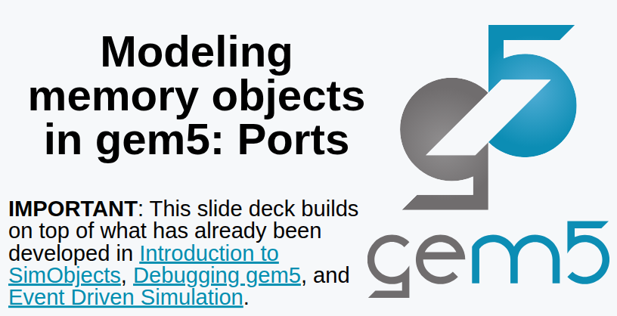
22.1 Model Port (02): Slides
https://gem5bootcamp.github.io/2024/#03-Developing-gem5-models/04-ports
Model Port (02): Slides

Slide 3
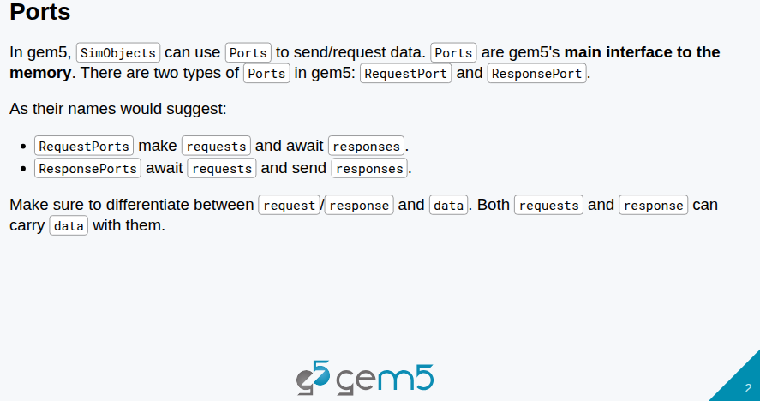
22.1 Model Port (02): Slides
https://gem5bootcamp.github.io/2024/#03-Developing-gem5-models/04-ports
Model Port (02): Slides

Slide 4
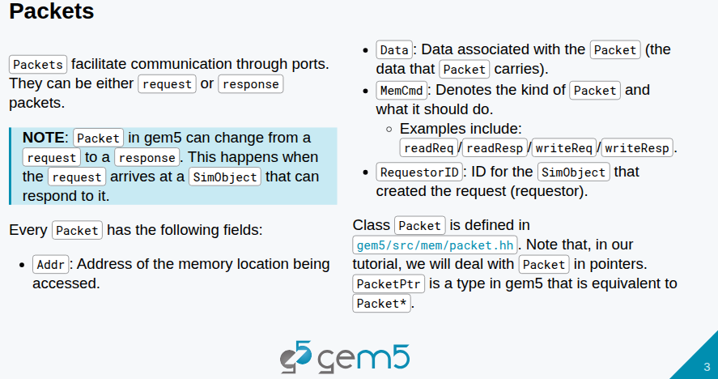
22.1 Model Port (02): Slides
https://gem5bootcamp.github.io/2024/#03-Developing-gem5-models/04-ports
Model Port (02): Slides

Slide 5
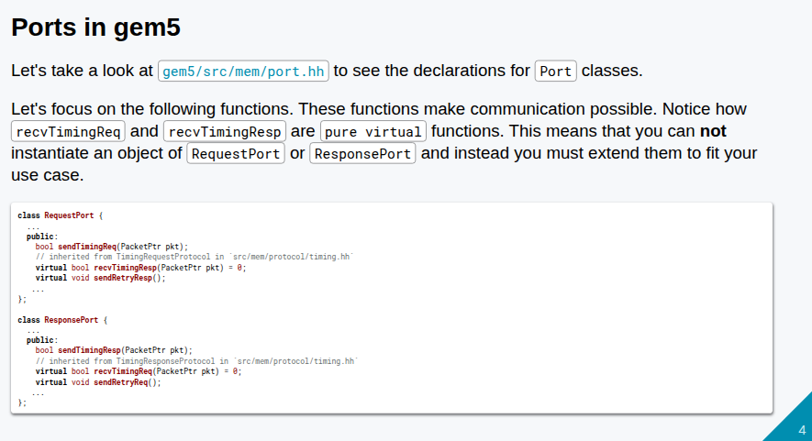
22.1 Model Port (02): Slides
https://gem5bootcamp.github.io/2024/#03-Developing-gem5-models/04-ports
Model Port (02): Slides

Slide 6
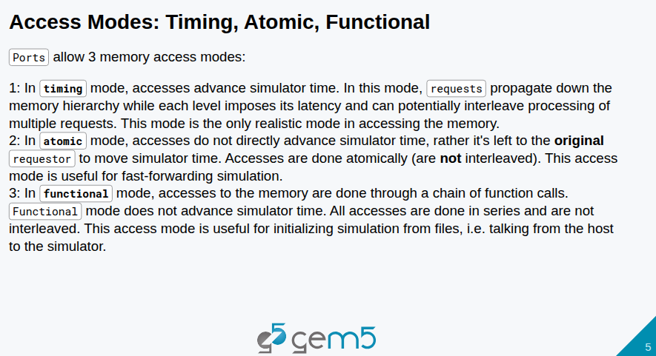
22.1 Model Port (02): Slides
https://gem5bootcamp.github.io/2024/#03-Developing-gem5-models/04-ports
Model Port (02): Slides

Slide 7
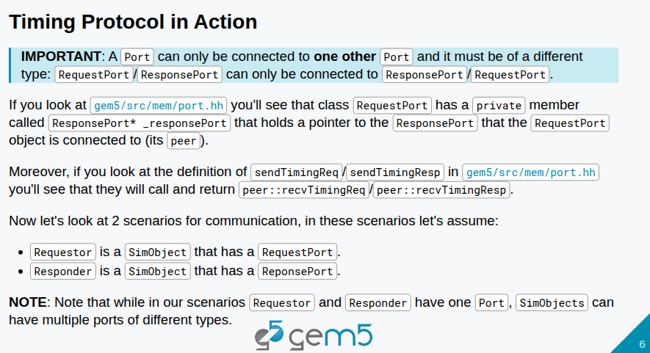
22.1 Model Port (02): Slides
https://gem5bootcamp.github.io/2024/#03-Developing-gem5-models/04-ports
Model Port (02): Slides

Slide 8
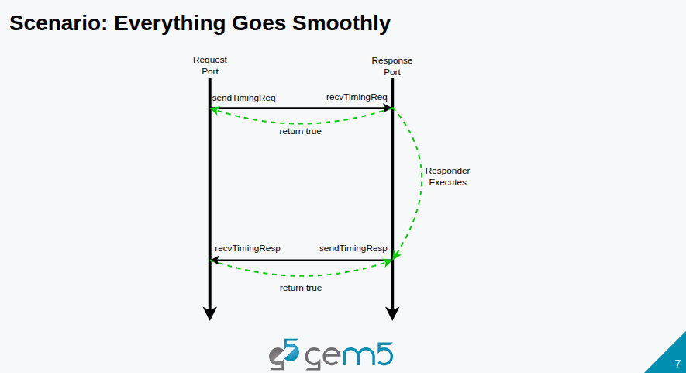
22.1 Model Port (02): Slides
https://gem5bootcamp.github.io/2024/#03-Developing-gem5-models/04-ports
Model Port (02): Slides

Slide 9
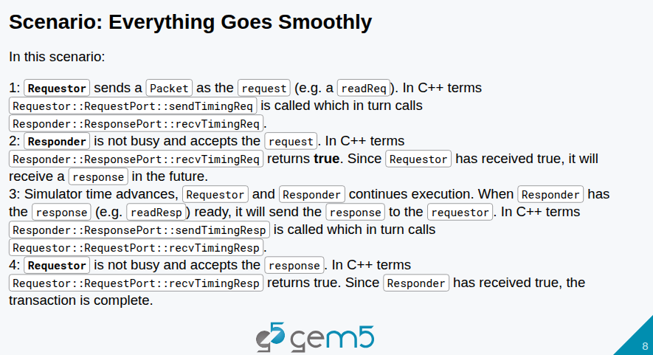
22.1 Model Port (02): Slides
https://gem5bootcamp.github.io/2024/#03-Developing-gem5-models/04-ports
Model Port (02): Slides

Slide 10
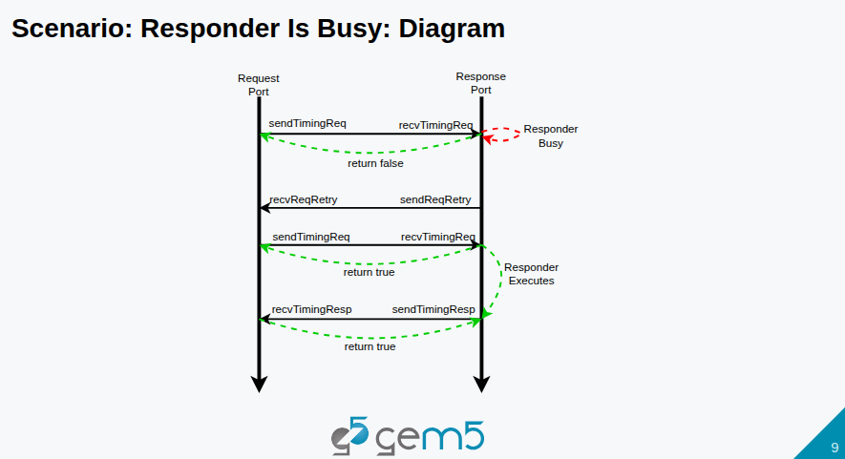
22.1 Model Port (02): Slides
https://gem5bootcamp.github.io/2024/#03-Developing-gem5-models/04-ports
Model Port (02): Slides

Slide 11
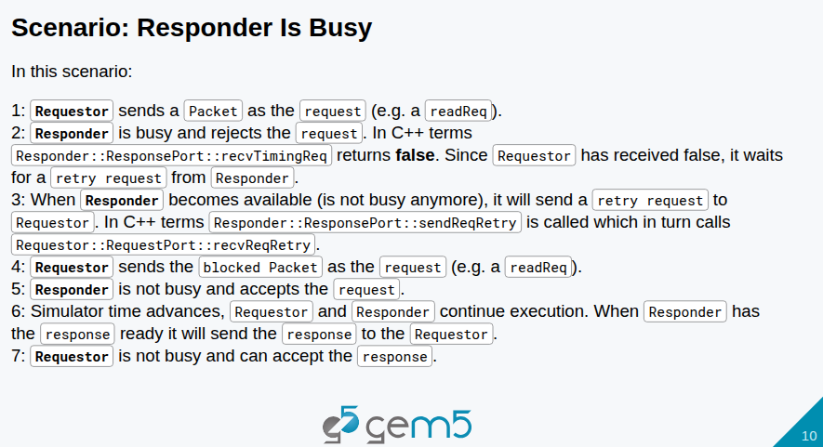
22.1 Model Port (02): Slides
https://gem5bootcamp.github.io/2024/#03-Developing-gem5-models/04-ports
Model Port (02): Slides

Slide 12
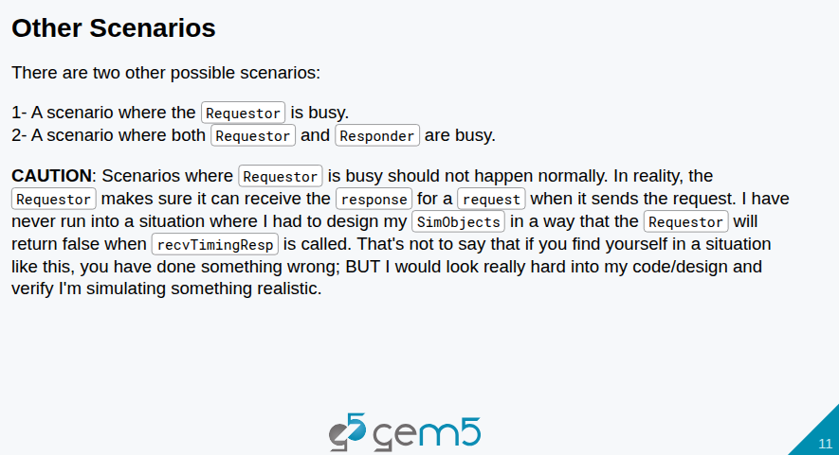
22.1 Model Port (02): Slides
https://gem5bootcamp.github.io/2024/#03-Developing-gem5-models/04-ports
Model Port (02): Slides

Slide 13
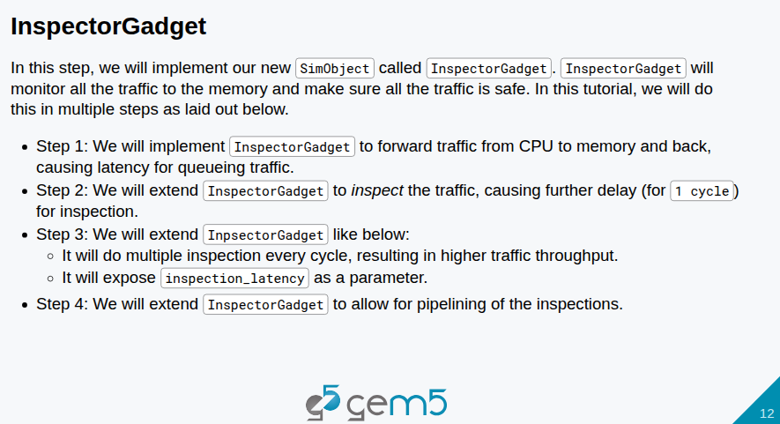
22.1 Model Port (02): Slides
https://gem5bootcamp.github.io/2024/#03-Developing-gem5-models/04-ports
Model Port (02): Slides

Slide 14
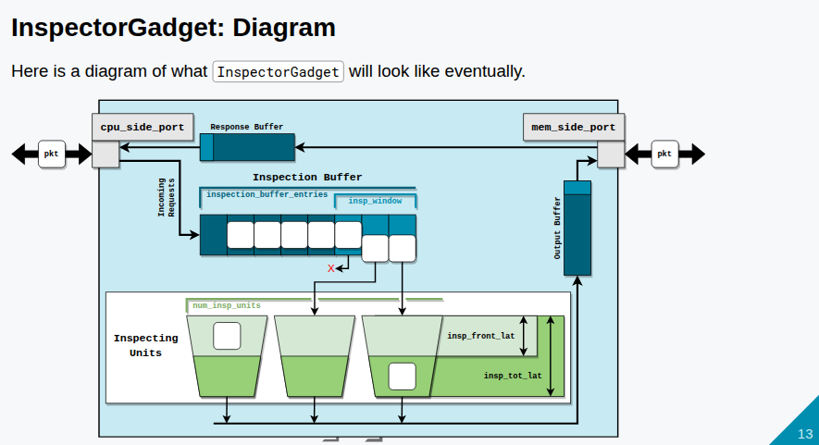
22.1 Model Port (02): Slides
https://gem5bootcamp.github.io/2024/#03-Developing-gem5-models/04-ports
Model Port (02): Slides

Slide 15
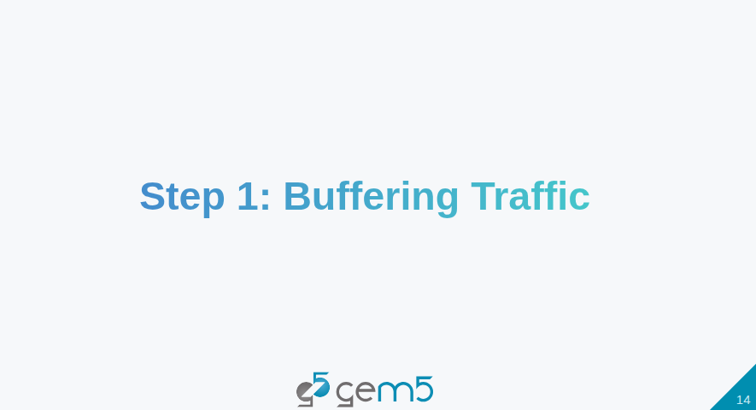
22.1 Model Port (02): Slides
https://gem5bootcamp.github.io/2024/#03-Developing-gem5-models/04-ports
Model Port (02): Slides

Slide 16
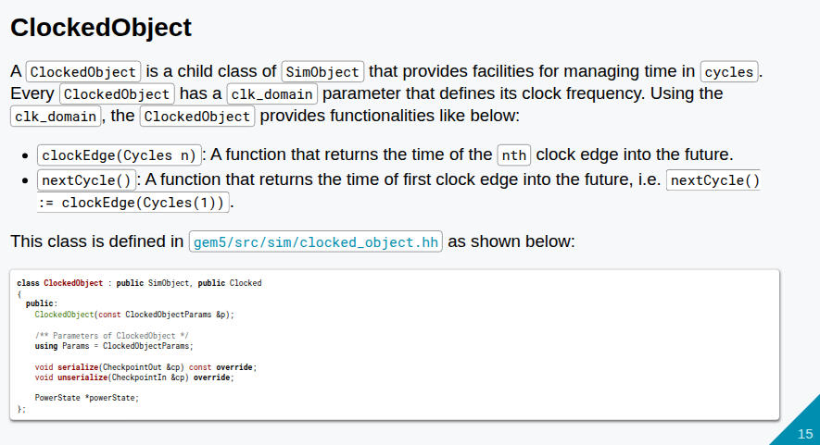
22.1 Model Port (02): Slides
https://gem5bootcamp.github.io/2024/#03-Developing-gem5-models/04-ports
Model Port (02): Slides

Slide 17
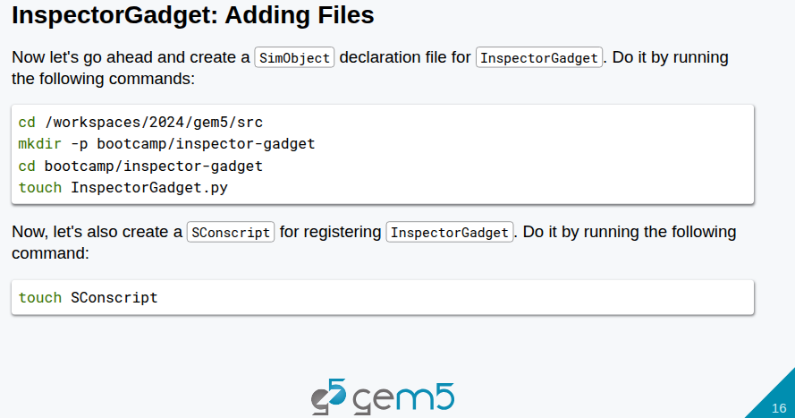
22.1 Model Port (02): Slides
https://gem5bootcamp.github.io/2024/#03-Developing-gem5-models/04-ports
Model Port (02): Slides

Slide 18
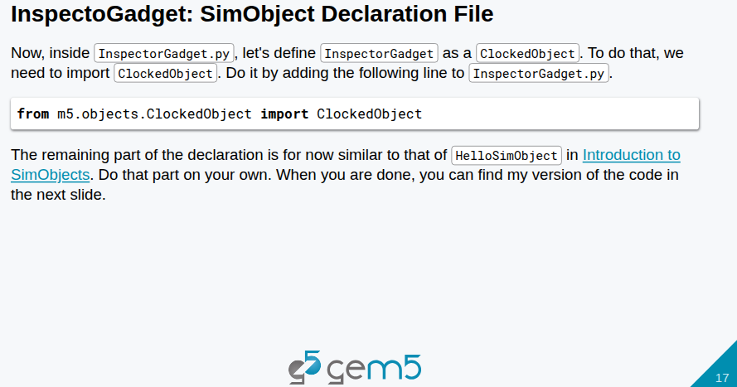
22.1 Model Port (02): Slides
https://gem5bootcamp.github.io/2024/#03-Developing-gem5-models/04-ports
Model Port (02): Slides

Slide 19
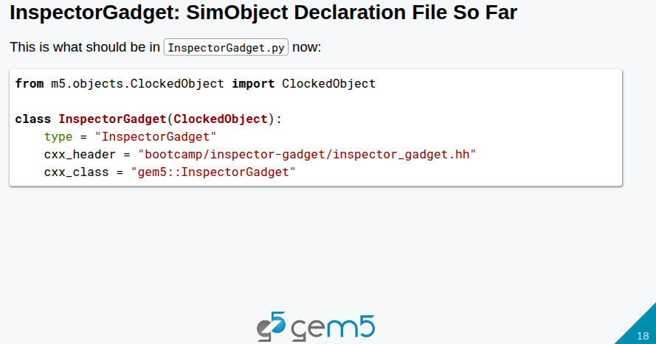
22.1 Model Port (02): Slides
https://gem5bootcamp.github.io/2024/#03-Developing-gem5-models/04-ports
Model Port (02): Slides

Slide 20
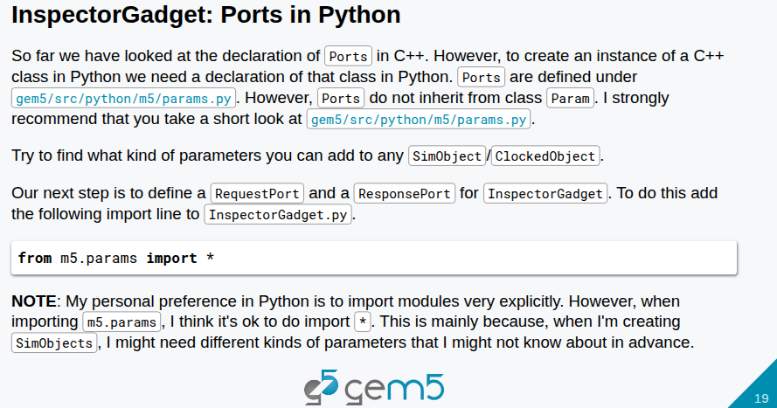
22.1 Model Port (02): Slides
https://gem5bootcamp.github.io/2024/#03-Developing-gem5-models/04-ports
Model Port (02): Slides

Slide 21
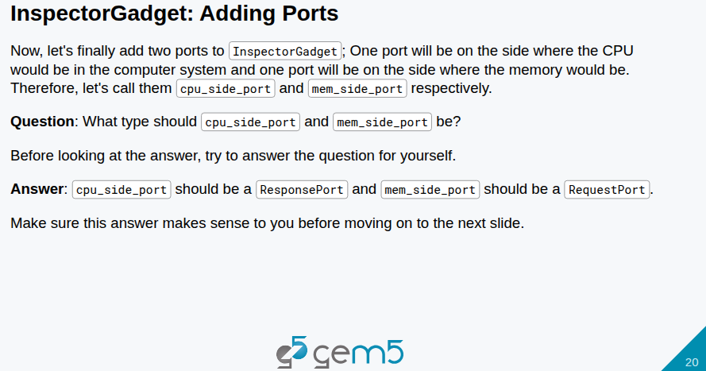
22.1 Model Port (02): Slides
https://gem5bootcamp.github.io/2024/#03-Developing-gem5-models/04-ports
Model Port (02): Slides

Slide 22
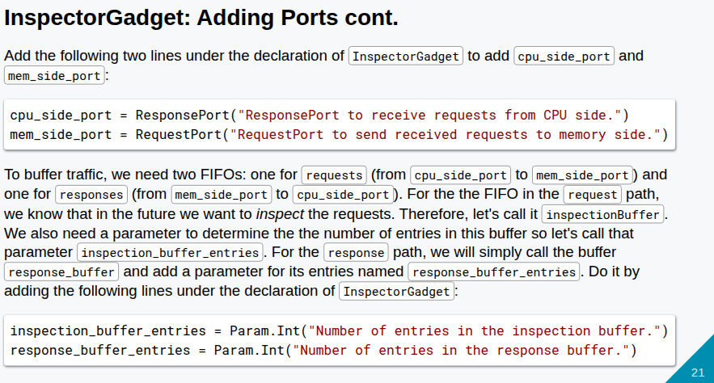
22.1 Model Port (02): Slides
https://gem5bootcamp.github.io/2024/#03-Developing-gem5-models/04-ports
Model Port (02): Slides

Slide 23
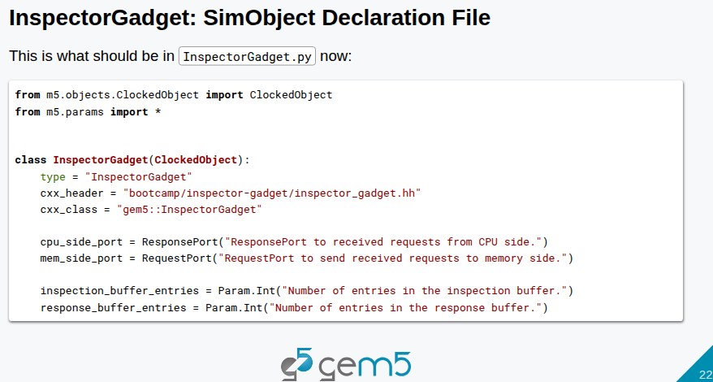
22.1 Model Port (02): Slides
https://gem5bootcamp.github.io/2024/#03-Developing-gem5-models/04-ports
Model Port (02): Slides

Slide 24
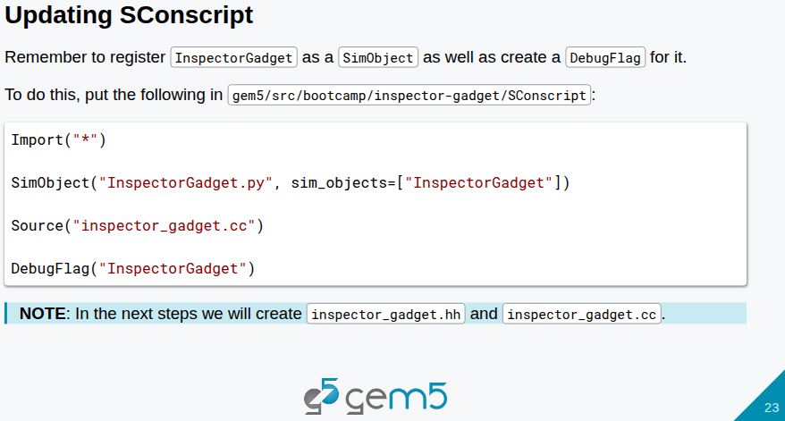
22.1 Model Port (02): Slides
https://gem5bootcamp.github.io/2024/#03-Developing-gem5-models/04-ports
Model Port (02): Slides

Slide 25
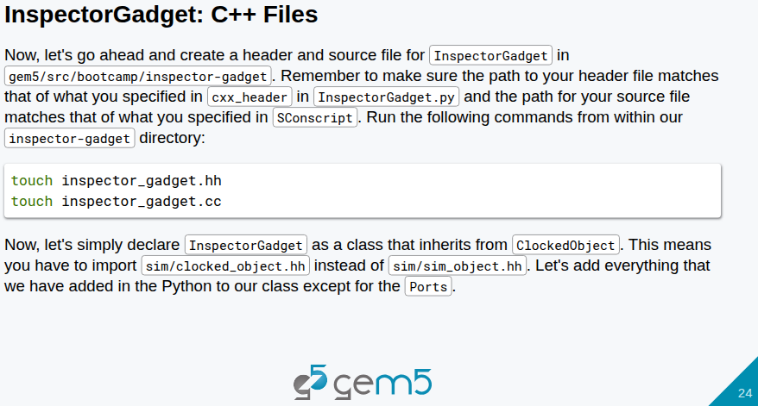
22.1 Model Port (02): Slides
https://gem5bootcamp.github.io/2024/#03-Developing-gem5-models/04-ports
Model Port (02): Slides

Slide 26
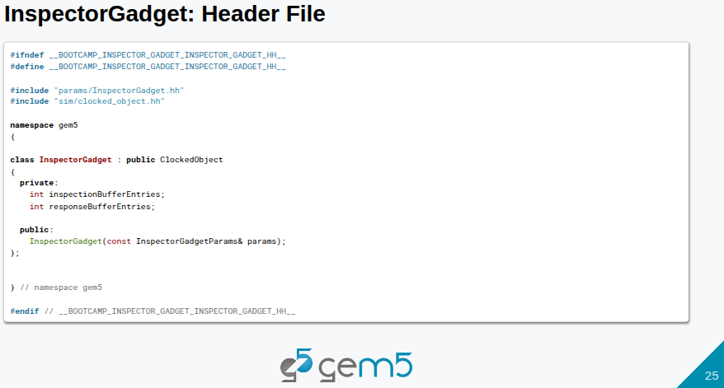
22.1 Model Port (02): Slides
https://gem5bootcamp.github.io/2024/#03-Developing-gem5-models/04-ports
Model Port (02): Slides

Slide 27
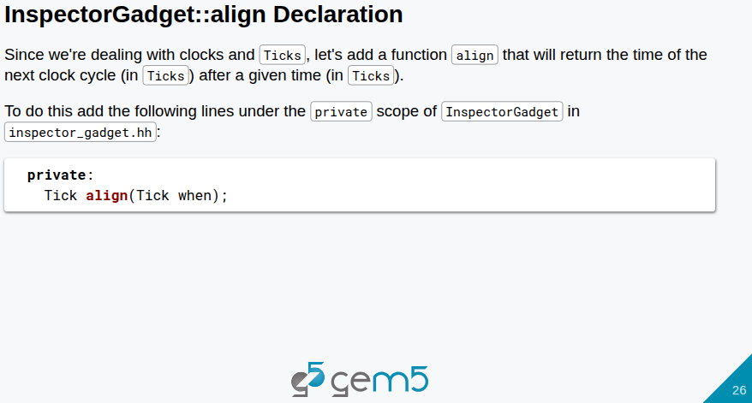
22.1 Model Port (02): Slides
https://gem5bootcamp.github.io/2024/#03-Developing-gem5-models/04-ports
Model Port (02): Slides

Slide 28
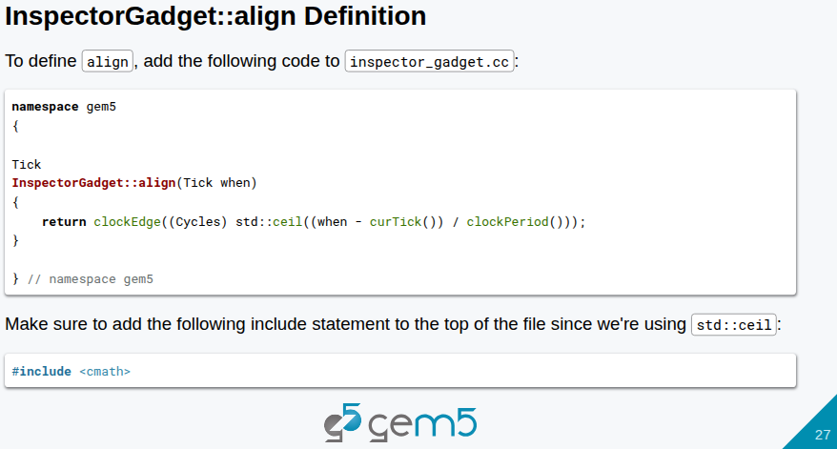
22.1 Model Port (02): Slides
https://gem5bootcamp.github.io/2024/#03-Developing-gem5-models/04-ports
Model Port (02): Slides

Slide 29
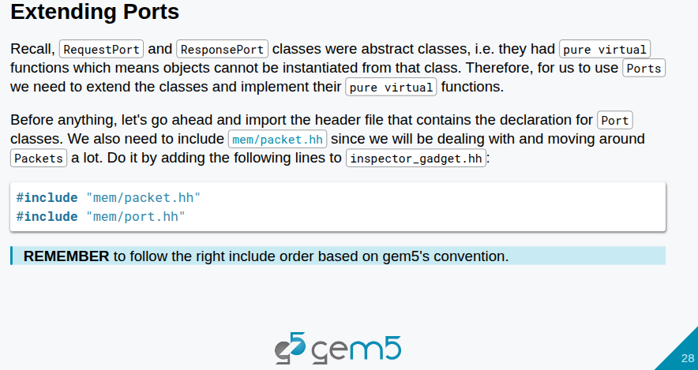
22.1 Model Port (02): Slides
https://gem5bootcamp.github.io/2024/#03-Developing-gem5-models/04-ports
Model Port (02): Slides

Slide 30
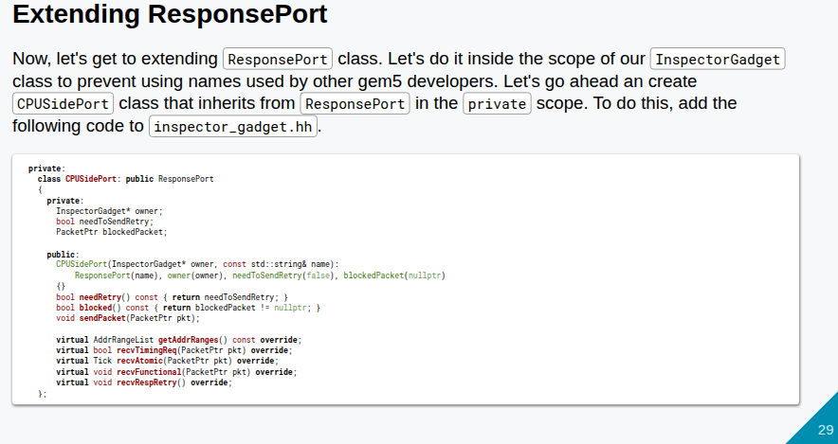
22.1 Model Port (02): Slides
https://gem5bootcamp.github.io/2024/#03-Developing-gem5-models/04-ports
Model Port (02): Slides

Slide 31
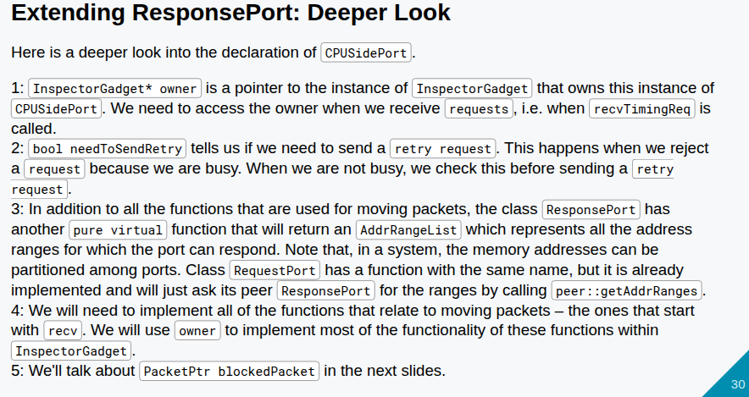
22.1 Model Port (02): Slides
https://gem5bootcamp.github.io/2024/#03-Developing-gem5-models/04-ports
Model Port (02): Slides

Slide 32
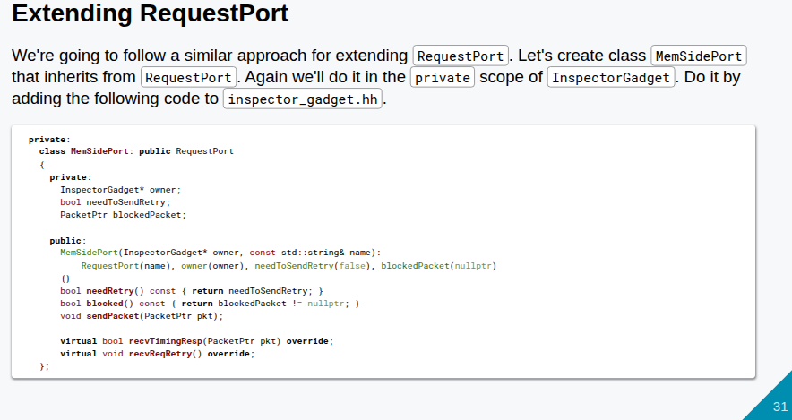
22.1 Model Port (02): Slides
https://gem5bootcamp.github.io/2024/#03-Developing-gem5-models/04-ports
Model Port (02): Slides

Slide 33
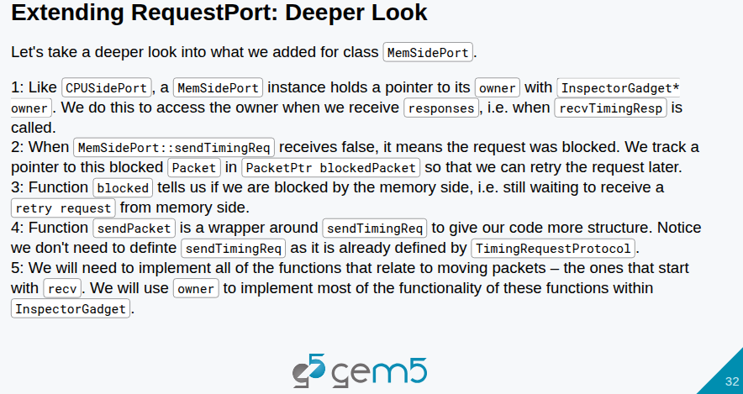
22.1 Model Port (02): Slides
https://gem5bootcamp.github.io/2024/#03-Developing-gem5-models/04-ports
Model Port (02): Slides

Slide 34
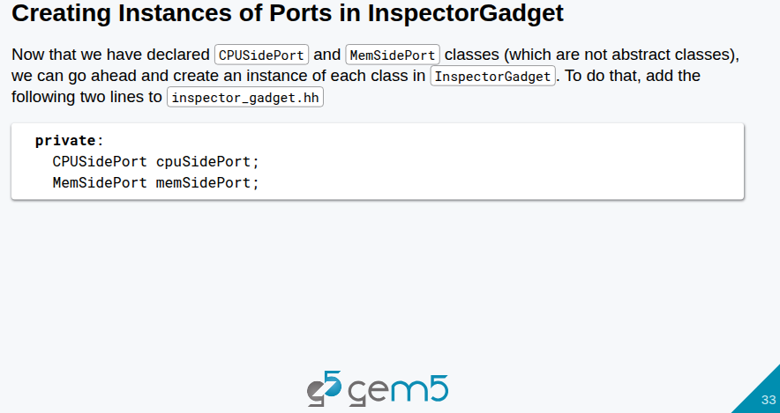
22.1 Model Port (02): Slides
https://gem5bootcamp.github.io/2024/#03-Developing-gem5-models/04-ports
Model Port (02): Slides

Slide 35
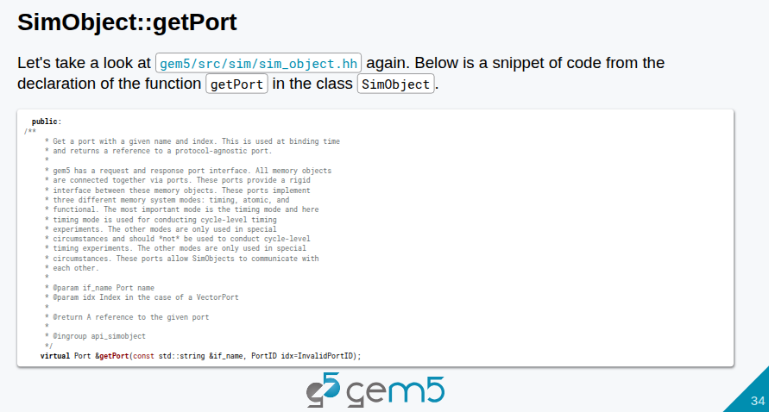
22.1 Model Port (02): Slides
https://gem5bootcamp.github.io/2024/#03-Developing-gem5-models/04-ports
Model Port (02): Slides

Slide 36
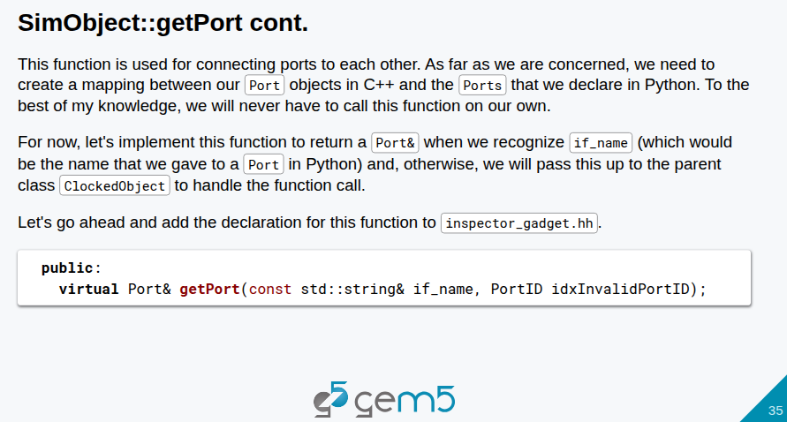
22.1 Model Port (02): Slides
https://gem5bootcamp.github.io/2024/#03-Developing-gem5-models/04-ports
Model Port (02): Slides

Slide 37
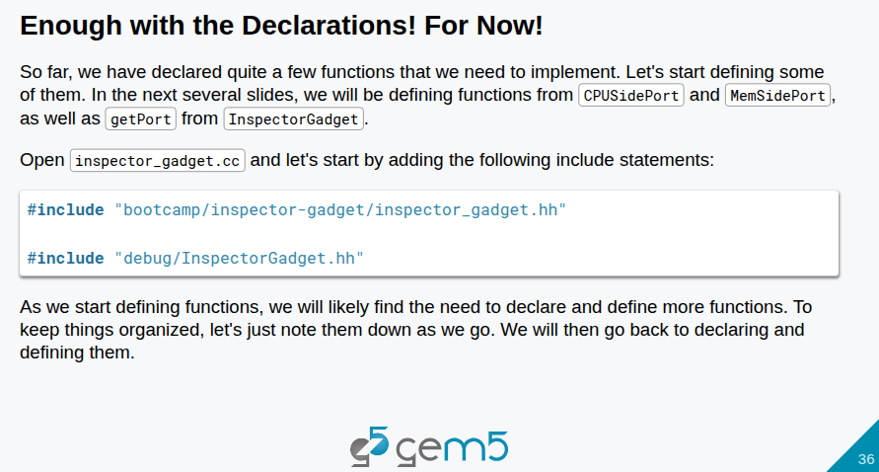
22.1 Model Port (02): Slides
https://gem5bootcamp.github.io/2024/#03-Developing-gem5-models/04-ports
Model Port (02): Slides

Slide 38
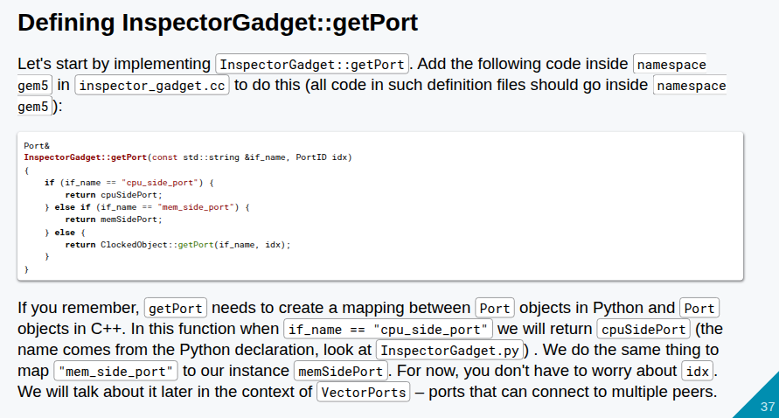
22.1 Model Port (02): Slides
https://gem5bootcamp.github.io/2024/#03-Developing-gem5-models/04-ports
Model Port (02): Slides

Slide 39
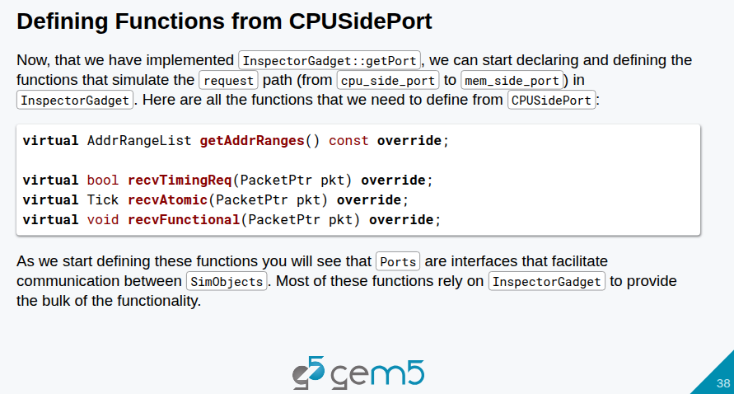
22.1 Model Port (02): Slides
https://gem5bootcamp.github.io/2024/#03-Developing-gem5-models/04-ports
Model Port (02): Slides

Slide 40
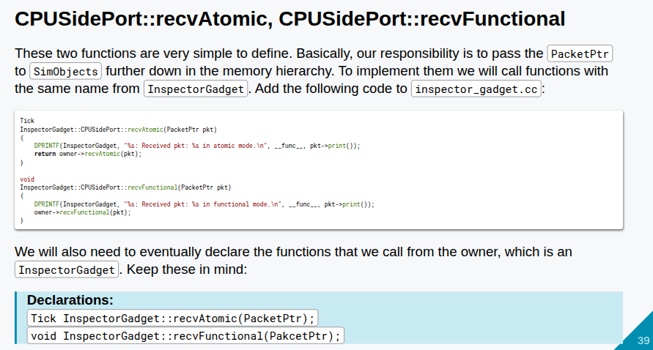
22.1 Model Port (02): Slides
https://gem5bootcamp.github.io/2024/#03-Developing-gem5-models/04-ports
Model Port (02): Slides

Slide 41
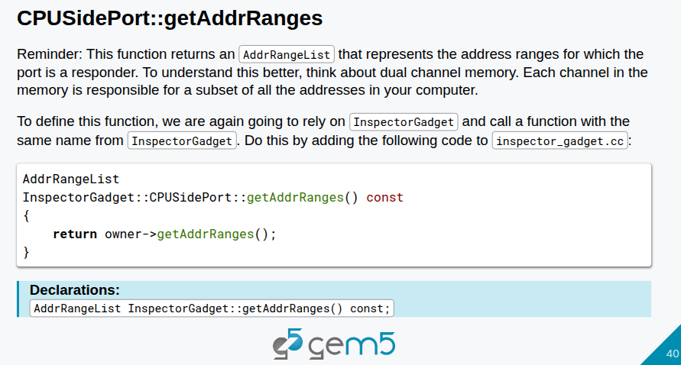
22.1 Model Port (02): Slides
https://gem5bootcamp.github.io/2024/#03-Developing-gem5-models/04-ports
Model Port (02): Slides

Slide 42
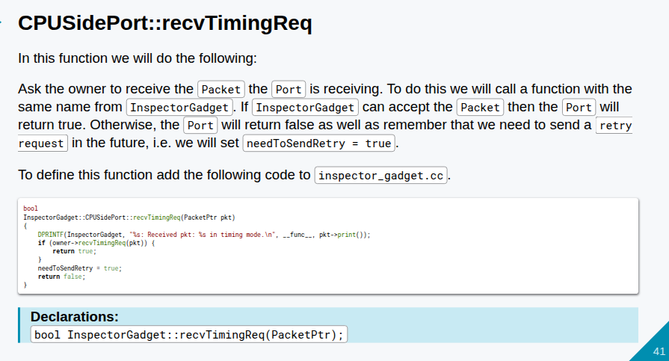
22.1 Model Port (02): Slides
https://gem5bootcamp.github.io/2024/#03-Developing-gem5-models/04-ports
Model Port (02): Slides

Slide 43
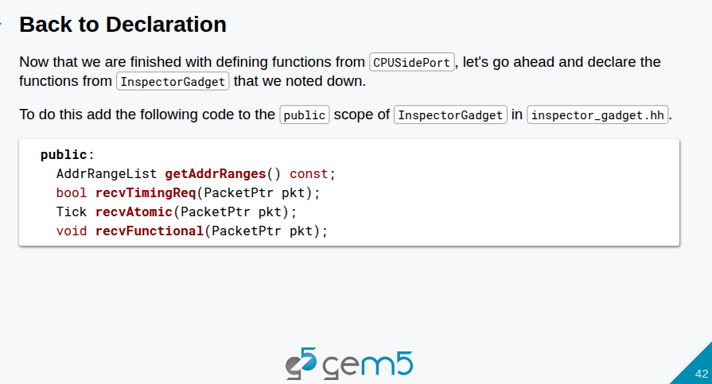
22.1 Model Port (02): Slides
https://gem5bootcamp.github.io/2024/#03-Developing-gem5-models/04-ports
Model Port (02): Slides

Slide 44
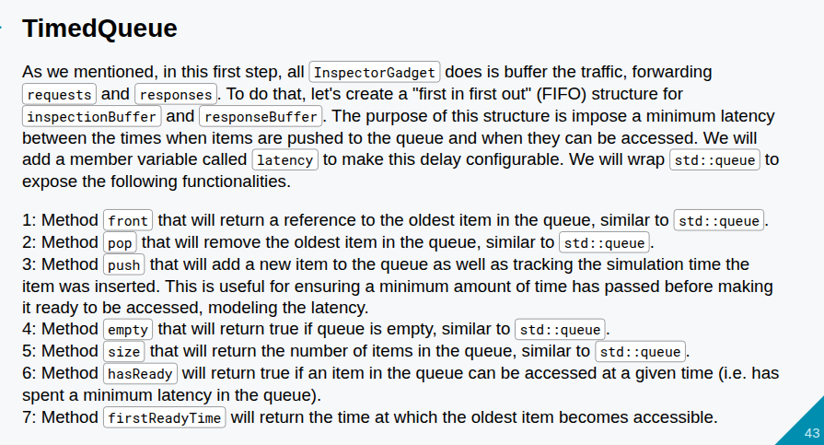
22.1 Model Port (02): Slides
https://gem5bootcamp.github.io/2024/#03-Developing-gem5-models/04-ports
Model Port (02): Slides

Slide 45
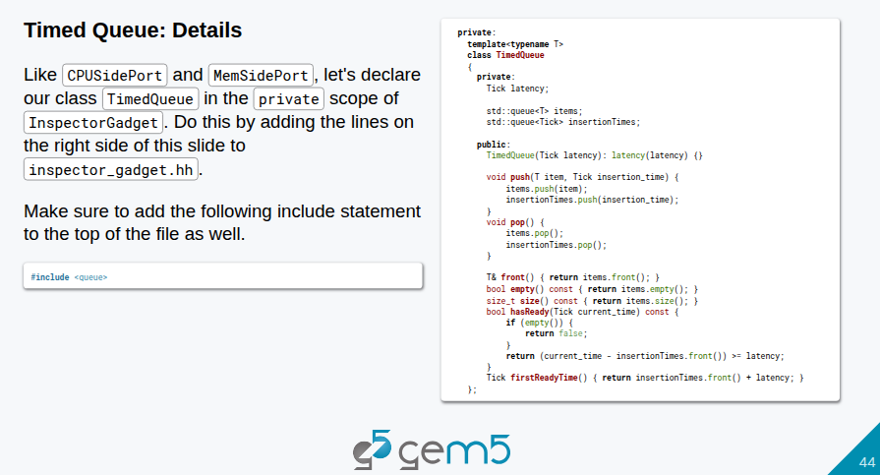
22.1 Model Port (02): Slides
https://gem5bootcamp.github.io/2024/#03-Developing-gem5-models/04-ports
Model Port (02): Slides

Slide 46
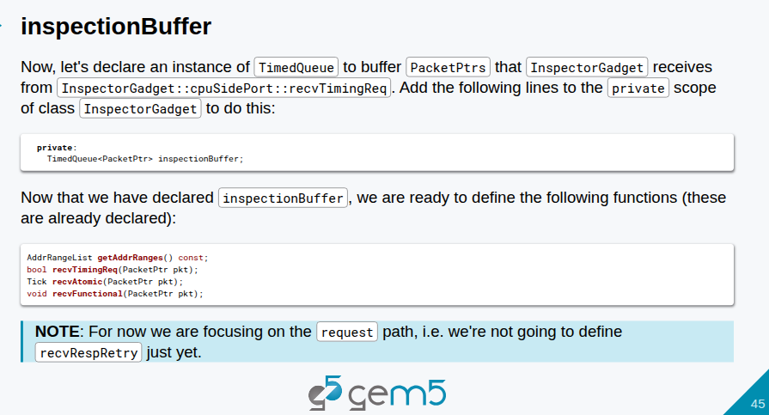
22.1 Model Port (02): Slides
https://gem5bootcamp.github.io/2024/#03-Developing-gem5-models/04-ports
Model Port (02): Slides

Slide 47
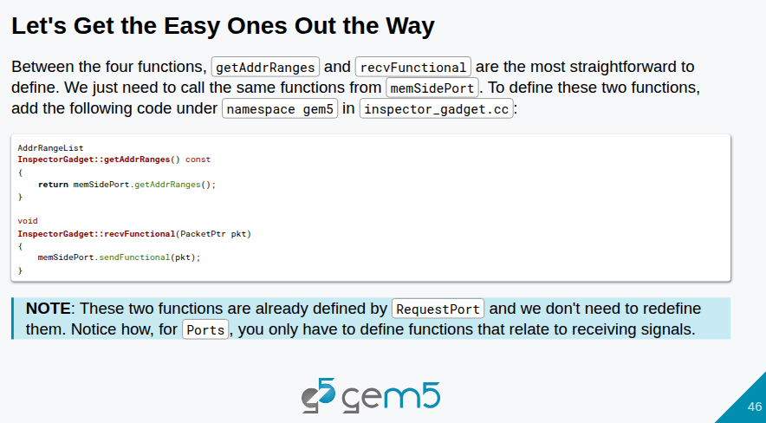
22.1 Model Port (02): Slides
https://gem5bootcamp.github.io/2024/#03-Developing-gem5-models/04-ports
Model Port (02): Slides

Slide 48
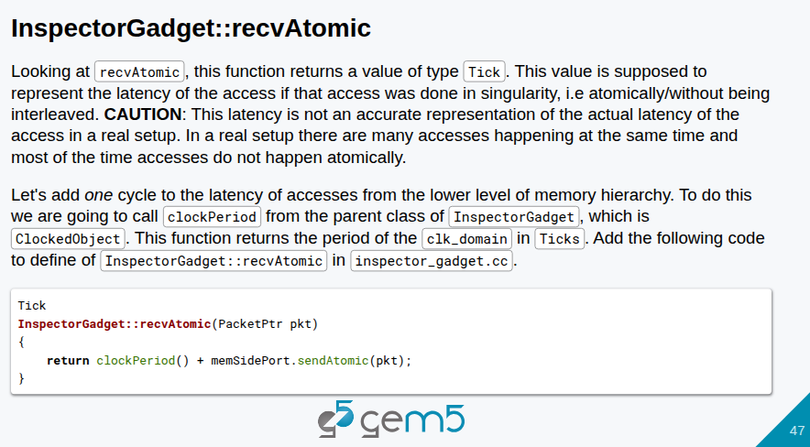
22.1 Model Port (02): Slides
https://gem5bootcamp.github.io/2024/#03-Developing-gem5-models/04-ports
Model Port (02): Slides

Slide 49
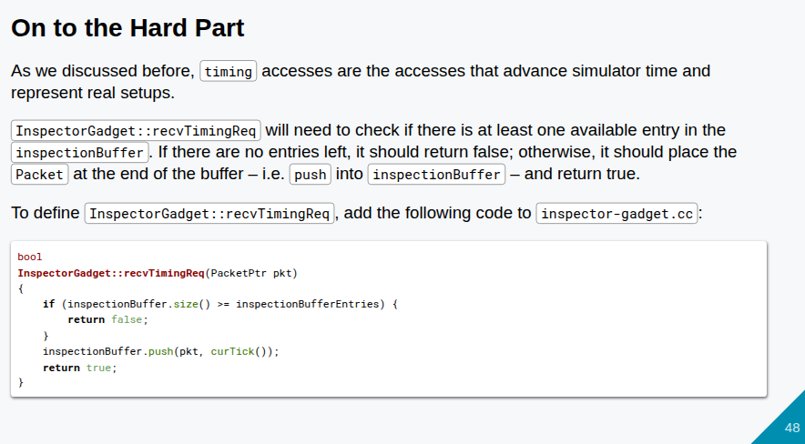
22.1 Model Port (02): Slides
https://gem5bootcamp.github.io/2024/#03-Developing-gem5-models/04-ports
Model Port (02): Slides

Slide 50
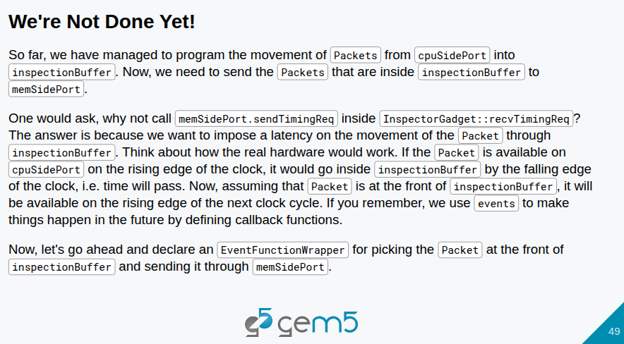
22.1 Model Port (02): Slides
https://gem5bootcamp.github.io/2024/#03-Developing-gem5-models/04-ports
Model Port (02): Slides

Slide 51
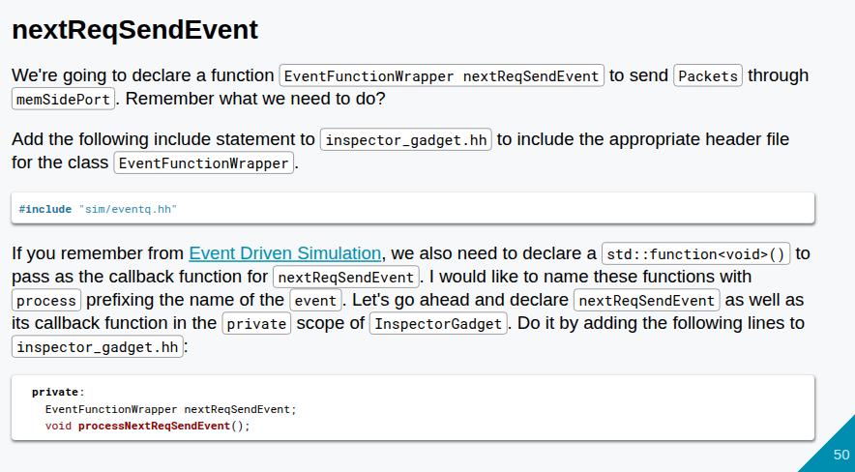
22.1 Model Port (02): Slides
https://gem5bootcamp.github.io/2024/#03-Developing-gem5-models/04-ports
Model Port (02): Slides

Slide 52

22.1 Model Port (02): Slides
https://gem5bootcamp.github.io/2024/#03-Developing-gem5-models/04-ports
Model Port (02): Slides

Slide 53

22.1 Model Port (02): Slides
https://gem5bootcamp.github.io/2024/#03-Developing-gem5-models/04-ports
Model Port (02): Slides

Slide 54

22.1 Model Port (02): Slides
https://gem5bootcamp.github.io/2024/#03-Developing-gem5-models/04-ports
Model Port (02): Slides

Slide 55

22.1 Model Port (02): Slides
https://gem5bootcamp.github.io/2024/#03-Developing-gem5-models/04-ports
Model Port (02): Slides

Slide 56

22.1 Model Port (02): Slides
https://gem5bootcamp.github.io/2024/#03-Developing-gem5-models/04-ports
Model Port (02): Slides

Slide 57

22.1 Model Port (02): Slides
https://gem5bootcamp.github.io/2024/#03-Developing-gem5-models/04-ports
Model Port (02): Slides

Slide 58

22.1 Model Port (02): Slides
https://gem5bootcamp.github.io/2024/#03-Developing-gem5-models/04-ports
Model Port (02): Slides

Slide 59

22.1 Model Port (02): Slides
https://gem5bootcamp.github.io/2024/#03-Developing-gem5-models/04-ports
Model Port (02): Slides

Slide 60

22.1 Model Port (02): Slides
https://gem5bootcamp.github.io/2024/#03-Developing-gem5-models/04-ports
Model Port (02): Slides

Slide 61

22.1 Model Port (02): Slides
https://gem5bootcamp.github.io/2024/#03-Developing-gem5-models/04-ports
Model Port (02): Slides

Slide 62

22.1 Model Port (02): Slides
https://gem5bootcamp.github.io/2024/#03-Developing-gem5-models/04-ports
Model Port (02): Slides

Slide 63

22.1 Model Port (02): Slides
https://gem5bootcamp.github.io/2024/#03-Developing-gem5-models/04-ports
Model Port (02): Slides

Slide 64

22.1 Model Port (02): Slides
https://gem5bootcamp.github.io/2024/#03-Developing-gem5-models/04-ports
Model Port (02): Slides

Slide 65

22.1 Model Port (02): Slides
https://gem5bootcamp.github.io/2024/#03-Developing-gem5-models/04-ports
Model Port (02): Slides

Slide 66

22.1 Model Port (02): Slides
https://gem5bootcamp.github.io/2024/#03-Developing-gem5-models/04-ports
Model Port (02): Slides

Slide 67

22.1 Model Port (02): Slides
https://gem5bootcamp.github.io/2024/#03-Developing-gem5-models/04-ports
Model Port (02): Slides

Slide 68

22.1 Model Port (02): Slides
https://gem5bootcamp.github.io/2024/#03-Developing-gem5-models/04-ports
Model Port (02): Slides

Slide 69

22.1 Model Port (02): Slides
https://gem5bootcamp.github.io/2024/#03-Developing-gem5-models/04-ports
Model Port (02): Slides

Slide 70

22.1 Model Port (02): Slides
https://gem5bootcamp.github.io/2024/#03-Developing-gem5-models/04-ports
Model Port (02): Slides

Slide 71

22.1 Model Port (02): Slides
https://gem5bootcamp.github.io/2024/#03-Developing-gem5-models/04-ports
Model Port (02): Slides

Slide 72

22.1 Model Port (02): Slides
https://gem5bootcamp.github.io/2024/#03-Developing-gem5-models/04-ports
Model Port (02): Slides

Slide 73



22.1 Model Port (02): Slides
https://gem5bootcamp.github.io/2024/#03-Developing-gem5-models/04-ports
Model Port (02): Slides

Slide 74

22.1 Model Port (02): Slides
https://gem5bootcamp.github.io/2024/#03-Developing-gem5-models/04-ports
Model Port (02): Slides

Slide 75

22.1 Model Port (02): Slides
https://gem5bootcamp.github.io/2024/#03-Developing-gem5-models/04-ports
Model Port (02): Slides

Slide 76

22.1 Model Port (02): Slides
https://gem5bootcamp.github.io/2024/#03-Developing-gem5-models/04-ports
Model Port (02): Slides

Slide 77

22.1 Model Port (02): Slides
https://gem5bootcamp.github.io/2024/#03-Developing-gem5-models/04-ports
Model Port (02): Slides

Slide 78

22.1 Model Port (02): Slides
https://gem5bootcamp.github.io/2024/#03-Developing-gem5-models/04-ports
Model Port (02): Slides

Slide 79

22.1 Model Port (02): Slides
https://gem5bootcamp.github.io/2024/#03-Developing-gem5-models/04-ports
Model Port (02): Slides

Slide 80

22.1 Model Port (02): Slides
https://gem5bootcamp.github.io/2024/#03-Developing-gem5-models/04-ports
Model Port (02): Slides

Slide 81

22.1 Model Port (02): Slides
https://gem5bootcamp.github.io/2024/#03-Developing-gem5-models/04-ports
Model Port (02): Slides

Slide 82

22.1 Model Port (02): Slides
https://gem5bootcamp.github.io/2024/#03-Developing-gem5-models/04-ports
Model Port (02): Slides

Slide 83

22.1 Model Port (02): Slides
https://gem5bootcamp.github.io/2024/#03-Developing-gem5-models/04-ports
Model Port (02): Slides

Slide 84

22.1 Model Port (02): Slides
https://gem5bootcamp.github.io/2024/#03-Developing-gem5-models/04-ports
Model Port (02): Slides

Slide 85

22.1 Model Port (02): Slides
https://gem5bootcamp.github.io/2024/#03-Developing-gem5-models/04-ports
Model Port (02): Slides

Slide 86

22.1 Model Port (02): Slides
https://gem5bootcamp.github.io/2024/#03-Developing-gem5-models/04-ports
Model Port (02): Slides

Slide 87

22.1 Model Port (02): Slides
https://gem5bootcamp.github.io/2024/#03-Developing-gem5-models/04-ports
Model Port (02): Slides

Slide 88

22.1 Model Port (02): Slides
https://gem5bootcamp.github.io/2024/#03-Developing-gem5-models/04-ports
Model Port (02): Slides

Slide 89

22.1 Model Port (02): Slides
https://gem5bootcamp.github.io/2024/#03-Developing-gem5-models/04-ports
Model Port (02): Slides

Slide 90

22.1 Model Port (02): Slides
https://gem5bootcamp.github.io/2024/#03-Developing-gem5-models/04-ports
Model Port (02): Slides

Slide 91

22.1 Model Port (02): Slides
https://gem5bootcamp.github.io/2024/#03-Developing-gem5-models/04-ports
Model Port (02): Slides

Slide 92

22.1 Model Port (02): Slides
https://gem5bootcamp.github.io/2024/#03-Developing-gem5-models/04-ports
Model Port (02): Slides

Slide 93

22.1 Model Port (02): Slides
https://gem5bootcamp.github.io/2024/#03-Developing-gem5-models/04-ports
Model Port (02): Slides

Slide 94

22.1 Model Port (02): Slides
https://gem5bootcamp.github.io/2024/#03-Developing-gem5-models/04-ports
Model Port (02): Slides

Slide 95

22.1 Model Port (02): Slides
https://gem5bootcamp.github.io/2024/#03-Developing-gem5-models/04-ports
Model Port (02): Slides

Slide 96

22.1 Model Port (02): Slides
https://gem5bootcamp.github.io/2024/#03-Developing-gem5-models/04-ports
Model Port (02): Slides

Slide 97

22.1 Model Port (02): Slides
https://gem5bootcamp.github.io/2024/#03-Developing-gem5-models/04-ports
Model Port (02): Slides

Slide 98

22.1 Model Port (02): Slides
https://gem5bootcamp.github.io/2024/#03-Developing-gem5-models/04-ports
Model Port (02): Slides

Slide 99

22.1 Model Port (02): Slides
https://gem5bootcamp.github.io/2024/#03-Developing-gem5-models/04-ports
Model Port (02): Slides

Slide 100

22.1 Model Port (02): Slides
https://gem5bootcamp.github.io/2024/#03-Developing-gem5-models/04-ports
Model Port (02): Slides

Slide 101

22.1 Model Port (02): Slides
https://gem5bootcamp.github.io/2024/#03-Developing-gem5-models/04-ports
Model Port (02): Slides

Slide 102

22.1 Model Port (02): Slides
https://gem5bootcamp.github.io/2024/#03-Developing-gem5-models/04-ports
Model Port (02): Slides

Slide 103

22.1 Model Port (02): Slides
https://gem5bootcamp.github.io/2024/#03-Developing-gem5-models/04-ports
Model Port (02): Slides

Slide 104

22.1 Model Port (02): Slides
https://gem5bootcamp.github.io/2024/#03-Developing-gem5-models/04-ports
Model Port (02): Slides

Slide 105

22.1 Model Port (02): Slides
https://gem5bootcamp.github.io/2024/#03-Developing-gem5-models/04-ports
Model Port (02): Slides

Slide 106

22.1 Model Port (02): Slides
https://gem5bootcamp.github.io/2024/#03-Developing-gem5-models/04-ports
Model Port (02): Slides

Slide 107

22.1 Model Port (02): Slides
https://gem5bootcamp.github.io/2024/#03-Developing-gem5-models/04-ports
Model Port (02): Slides

Slide 108

22.1 Model Port (02): Slides
https://gem5bootcamp.github.io/2024/#03-Developing-gem5-models/04-ports
Model Port (02): Slides

Slide 109

22.1 Model Port (02): Slides
https://gem5bootcamp.github.io/2024/#03-Developing-gem5-models/04-ports
Model Port (02): Slides

Slide 110

22.1 Model Port (02): Slides
https://gem5bootcamp.github.io/2024/#03-Developing-gem5-models/04-ports
Model Port (02): Slides

Slide 111
End

