Slide 1

27.2 Test: Slides
Peter H. Chen

Slide 2

27.2 Test: Slides
https://gem5bootcamp.github.io/2024/#06-Contributing/02-testing
Test: Slides

Slide 3
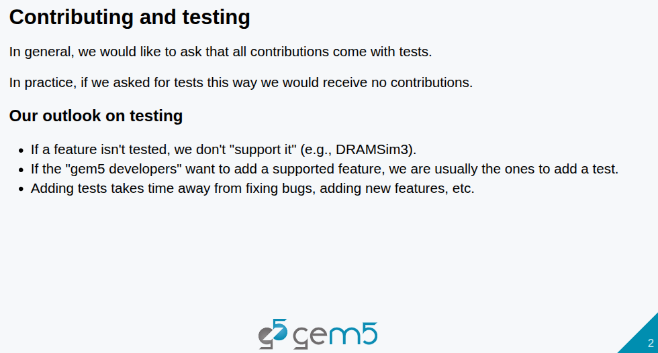
27.2 Test: Slides
https://gem5bootcamp.github.io/2024/#06-Contributing/02-testing
Test: Slides

Slide 4
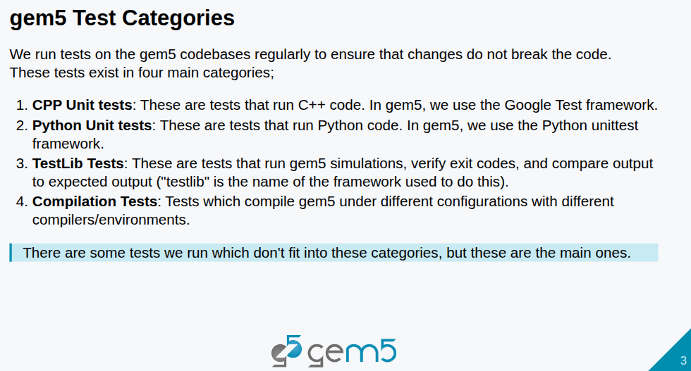
27.2 Test: Slides
https://gem5bootcamp.github.io/2024/#06-Contributing/02-testing
Test: Slides

Slide 5
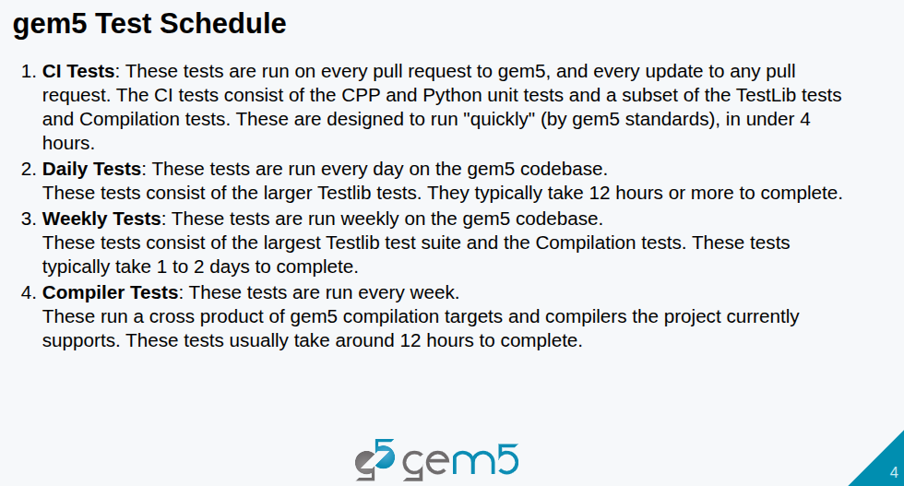
27.2 Test: Slides
https://gem5bootcamp.github.io/2024/#06-Contributing/02-testing
Test: Slides

Slide 6
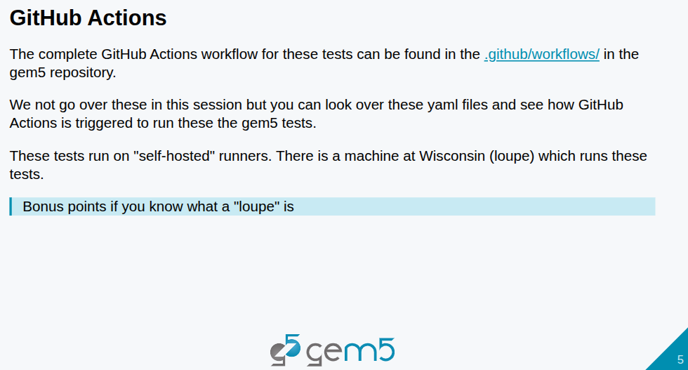
27.2 Test: Slides
https://gem5bootcamp.github.io/2024/#06-Contributing/02-testing
Test: Slides

Slide 7
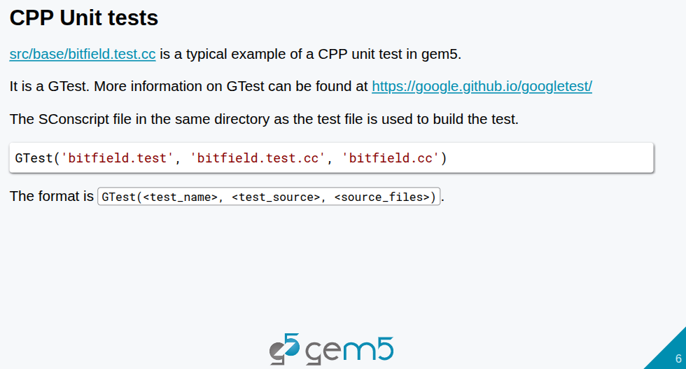
27.2 Test: Slides
https://gem5bootcamp.github.io/2024/#06-Contributing/02-testing
Test: Slides

Slide 8
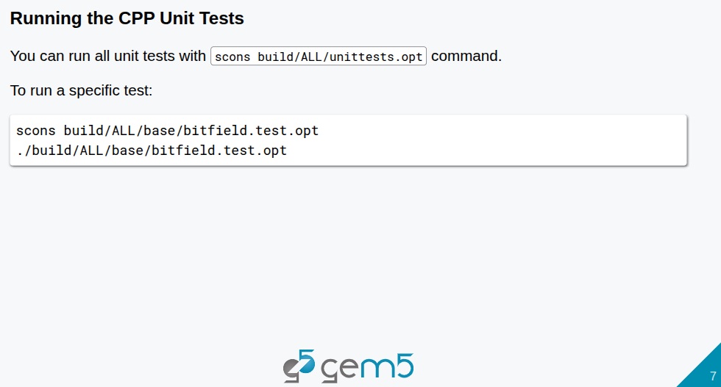
27.2 Test: Slides
https://gem5bootcamp.github.io/2024/#06-Contributing/02-testing
Test: Slides

Slide 9
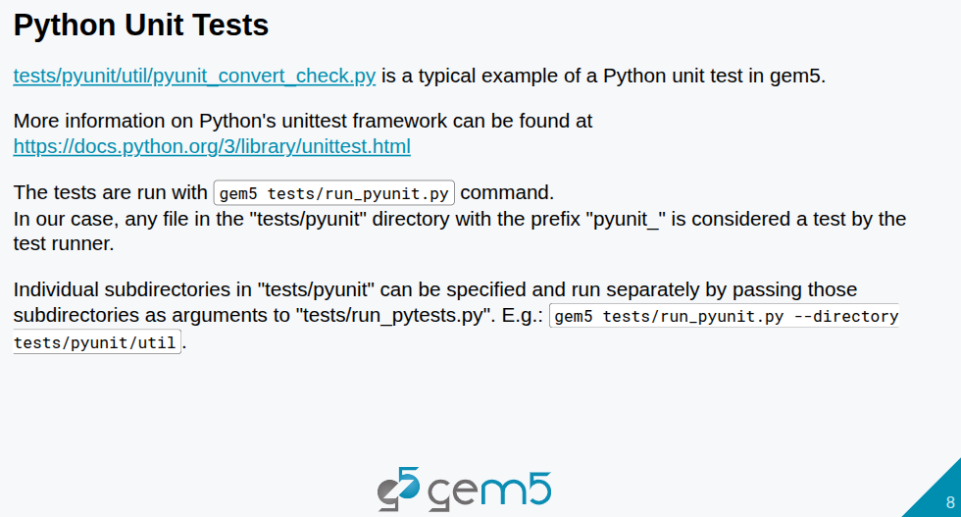
27.2 Test: Slides
https://gem5bootcamp.github.io/2024/#06-Contributing/02-testing
Test: Slides

Slide 10
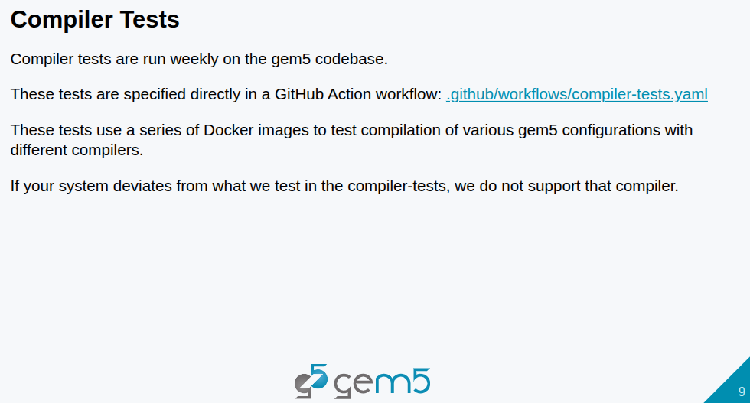
27.2 Test: Slides
https://gem5bootcamp.github.io/2024/#06-Contributing/02-testing
Test: Slides

Slide 11
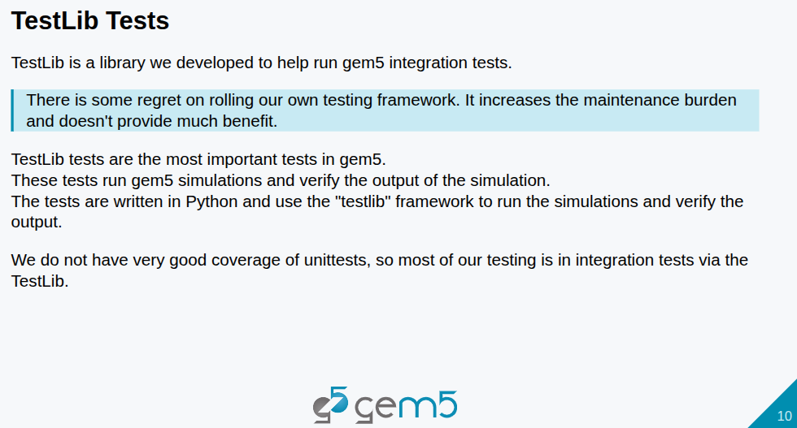
27.2 Test: Slides
https://gem5bootcamp.github.io/2024/#06-Contributing/02-testing
Test: Slides

Slide 12
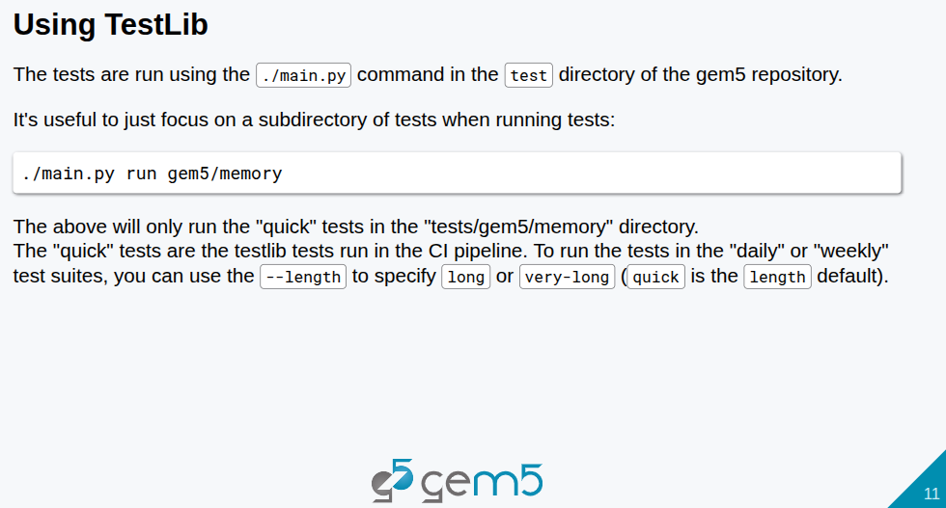
27.2 Test: Slides
https://gem5bootcamp.github.io/2024/#06-Contributing/02-testing
Test: Slides

Slide 13
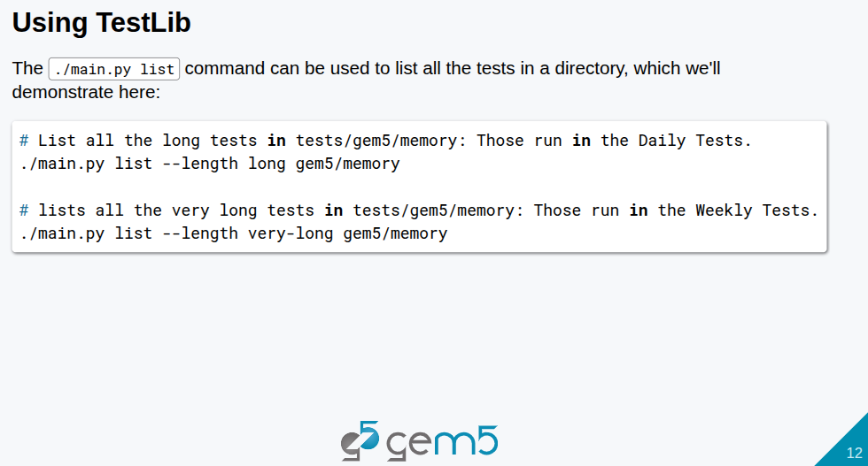
27.2 Test: Slides
https://gem5bootcamp.github.io/2024/#06-Contributing/02-testing
Test: Slides

Slide 14
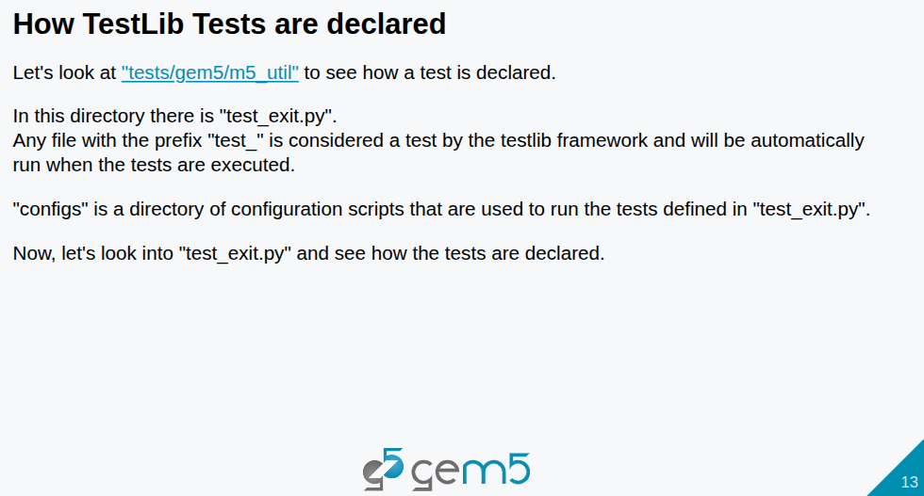
27.2 Test: Slides
https://gem5bootcamp.github.io/2024/#06-Contributing/02-testing
Test: Slides

Slide 15
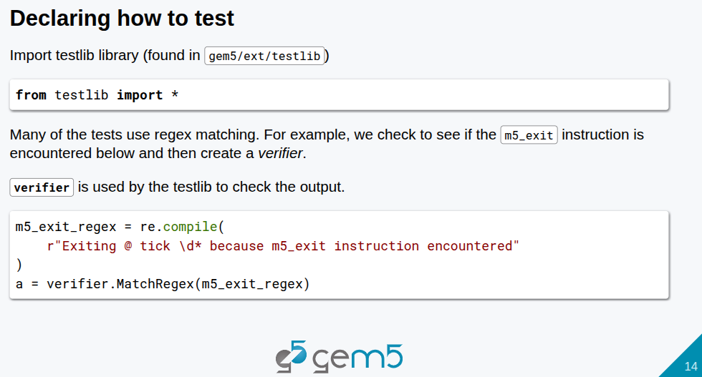
27.2 Test: Slides
https://gem5bootcamp.github.io/2024/#06-Contributing/02-testing
Test: Slides

Slide 16
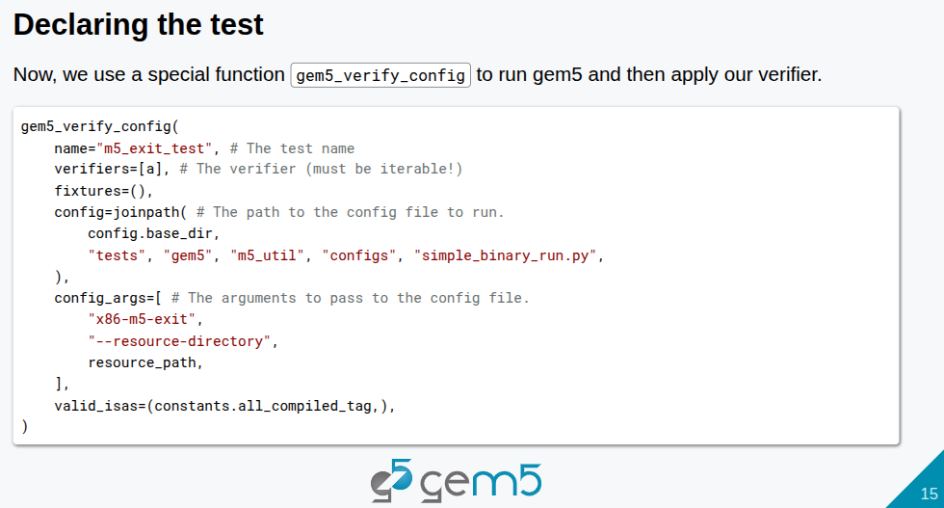
27.2 Test: Slides
https://gem5bootcamp.github.io/2024/#06-Contributing/02-testing
Test: Slides

Slide 17
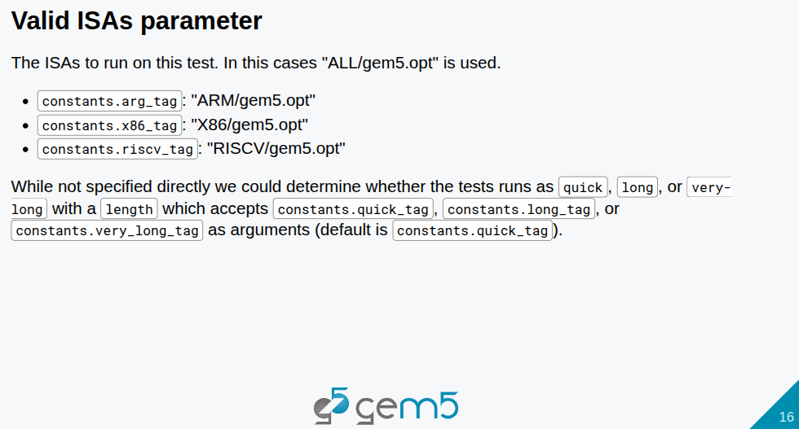
27.2 Test: Slides
https://gem5bootcamp.github.io/2024/#06-Contributing/02-testing
Test: Slides

Slide 18
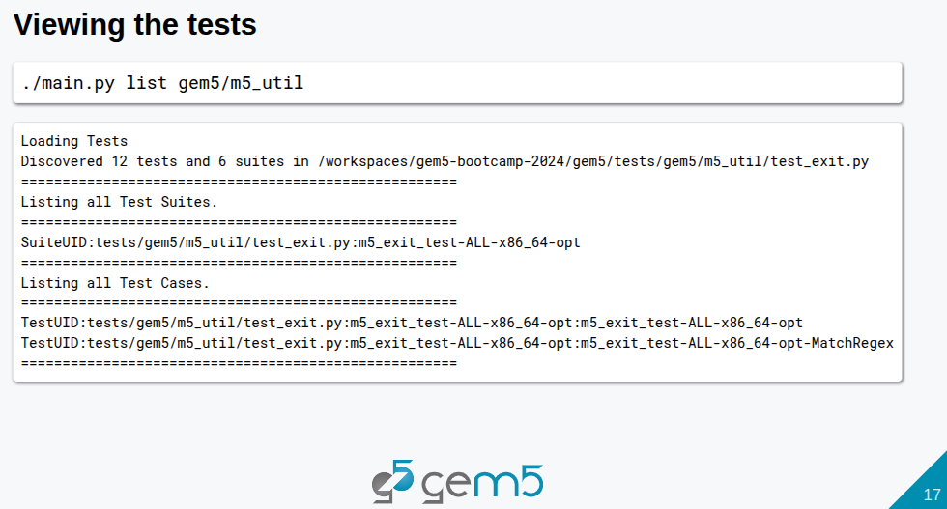
27.2 Test: Slides
https://gem5bootcamp.github.io/2024/#06-Contributing/02-testing
Test: Slides

Slide 19
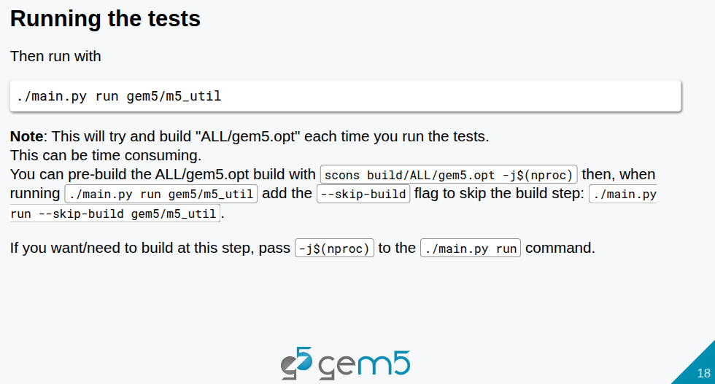
27.2 Test: Slides
https://gem5bootcamp.github.io/2024/#06-Contributing/02-testing
Test: Slides

Slide 20
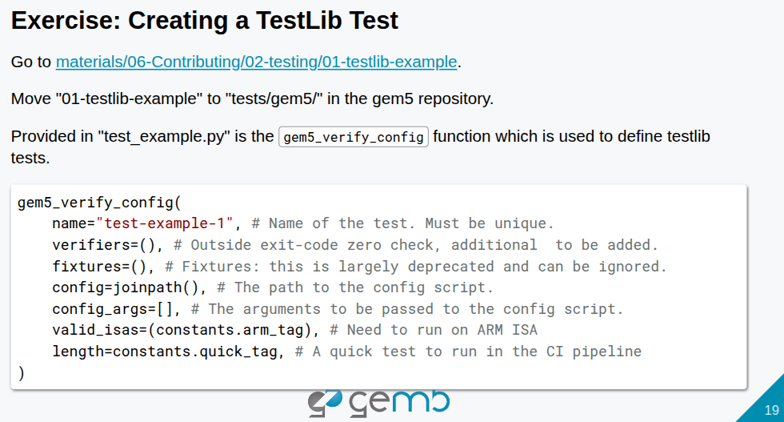
27.2 Test: Slides
https://gem5bootcamp.github.io/2024/#06-Contributing/02-testing
Test: Slides

Slide 21
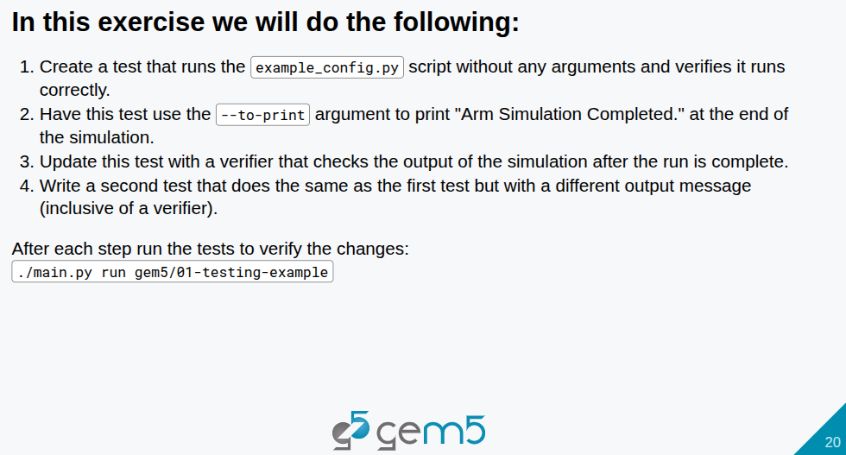
27.2 Test: Slides
https://gem5bootcamp.github.io/2024/#06-Contributing/02-testing
Test: Slides

Slide 22
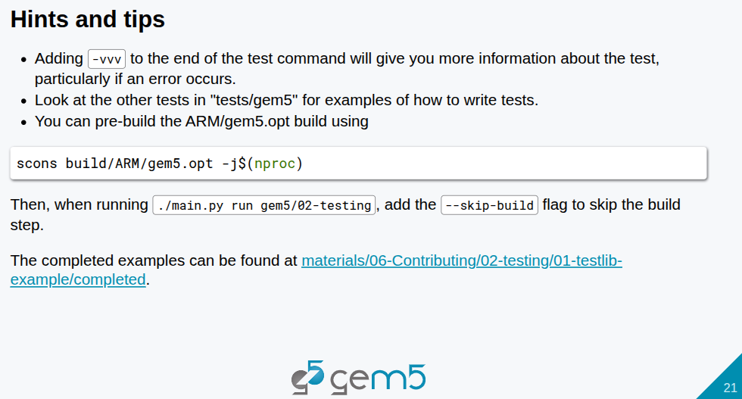
27.2 Test: Slides
https://gem5bootcamp.github.io/2024/#06-Contributing/02-testing
Test: Slides

Slide 23
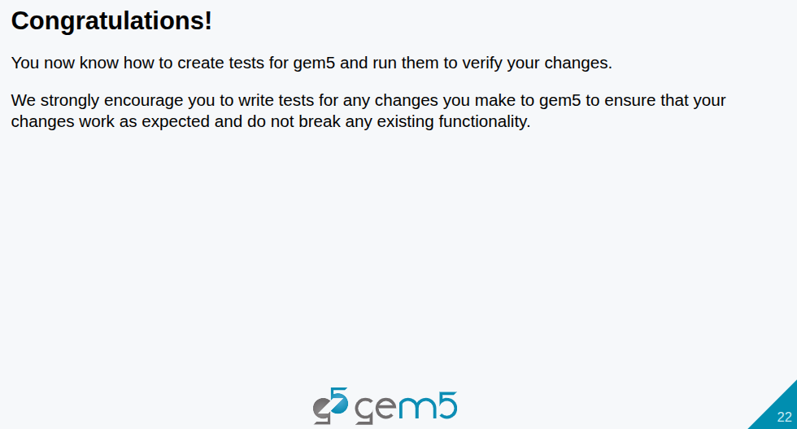
27.2 Test: Slides
https://gem5bootcamp.github.io/2024/#06-Contributing/02-testing
Test: Slides

Slide 24
End

