Slide 1

27.3 gem5 Home/Work/School: Slides
Peter H. Chen

Slide 2

27.3 gem5 Home/Work/School: Slides
https://gem5bootcamp.github.io/2024/#06-Contributing/03-gem5-at-home
Test: Slides

Slide 3
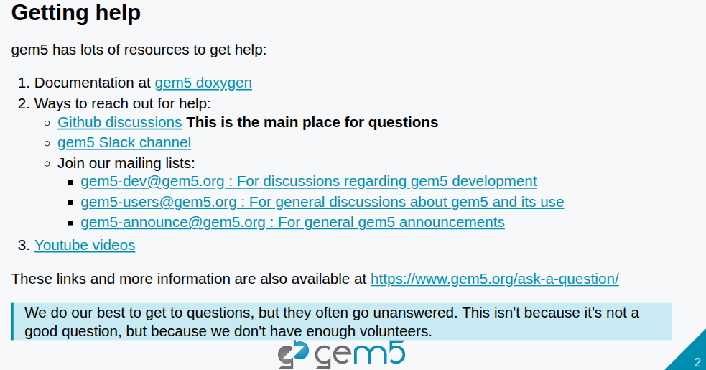
27.3 gem5 Home/Work/School: Slides
https://gem5bootcamp.github.io/2024/#06-Contributing/03-gem5-at-home
Test: Slides

Slide 4
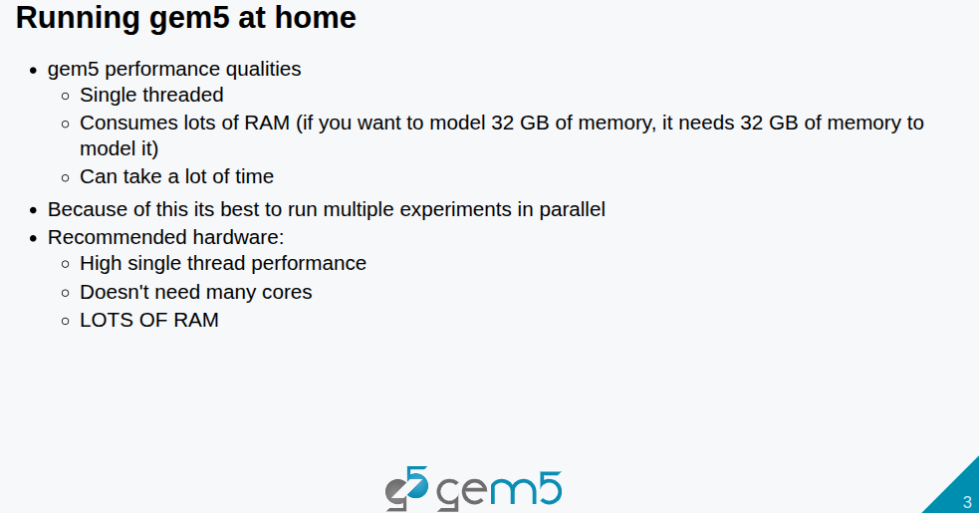
27.3 gem5 Home/Work/School: Slides
https://gem5bootcamp.github.io/2024/#06-Contributing/03-gem5-at-home
Test: Slides

Slide 5
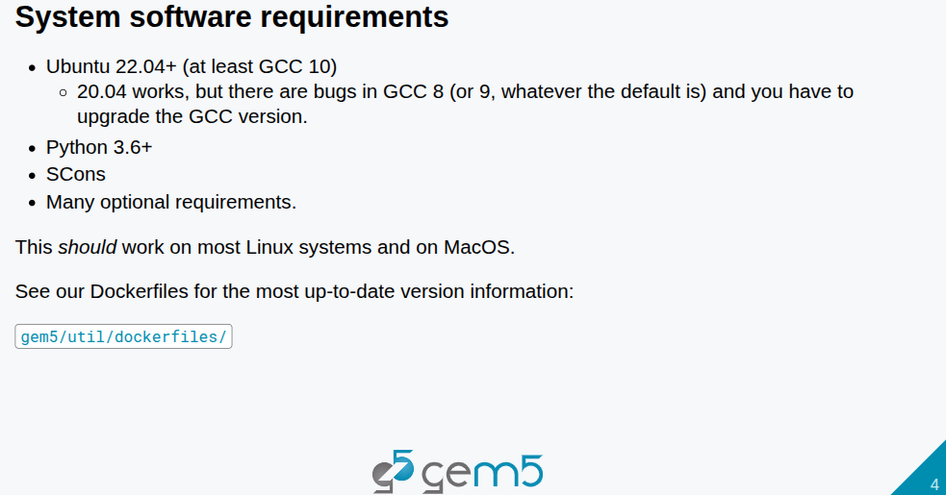
27.3 gem5 Home/Work/School: Slides
https://gem5bootcamp.github.io/2024/#06-Contributing/03-gem5-at-home
Test: Slides

Slide 6
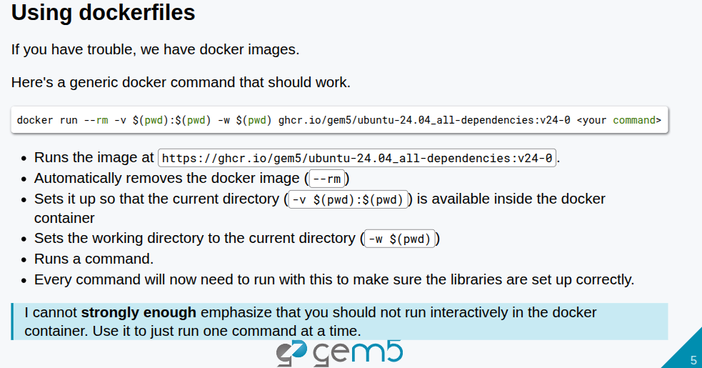
27.3 gem5 Home/Work/School: Slides
https://gem5bootcamp.github.io/2024/#06-Contributing/03-gem5-at-home
Test: Slides

Slide 7
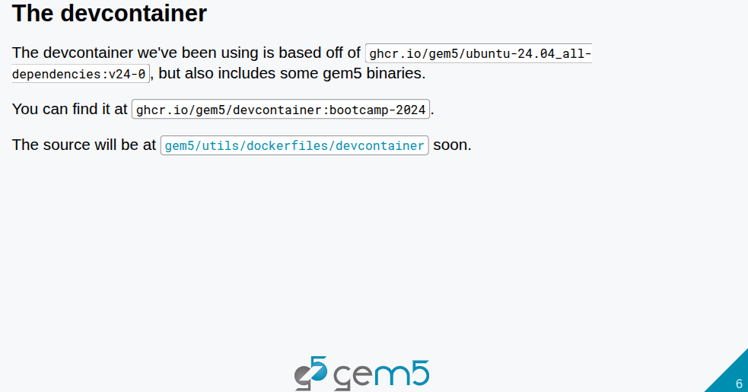
27.3 gem5 Home/Work/School: Slides
https://gem5bootcamp.github.io/2024/#06-Contributing/03-gem5-at-home
Test: Slides

Slide 8
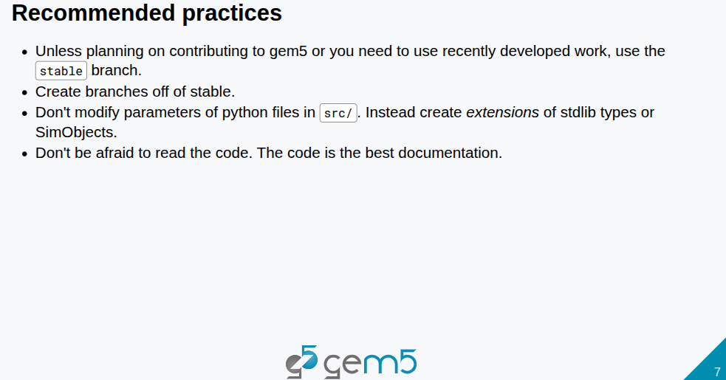
27.3 gem5 Home/Work/School: Slides
https://gem5bootcamp.github.io/2024/#06-Contributing/03-gem5-at-home
Test: Slides

Slide 9

27.3 gem5 Home/Work/School: Slides
https://gem5bootcamp.github.io/2024/#06-Contributing/03-gem5-at-home
Test: Slides

Slide 10
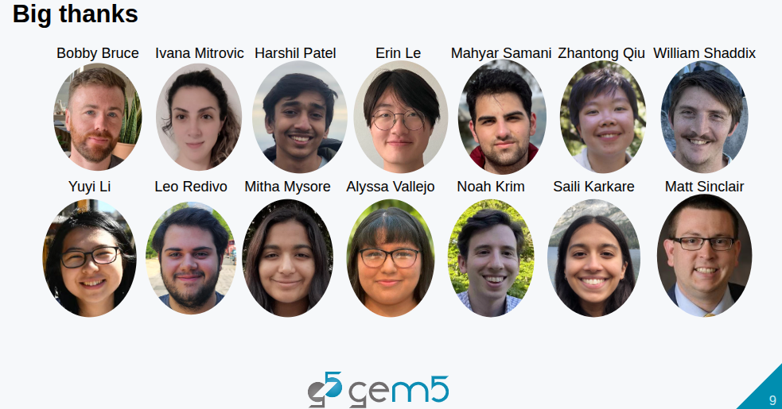
27.3 gem5 Home/Work/School: Slides
https://gem5bootcamp.github.io/2024/#06-Contributing/03-gem5-at-home
Test: Slides

Slide 11
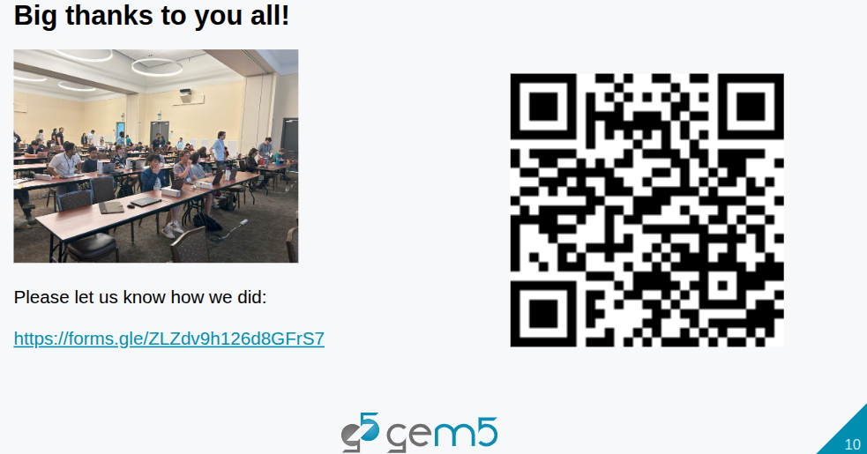
27.3 gem5 Home/Work/School: Slides
https://gem5bootcamp.github.io/2024/#06-Contributing/03-gem5-at-home
Test: Slides

Slide 12
End

