Slide 1

5.1 Gem5 Resource: Slides
Peter H. Chen

Slide 2

5.1 Gem5 Resource: Slides
https://gem5bootcamp.github.io/2024/#02-Using-gem5/02-gem5-resources
Gem5 Resource: Slides

Slide 3
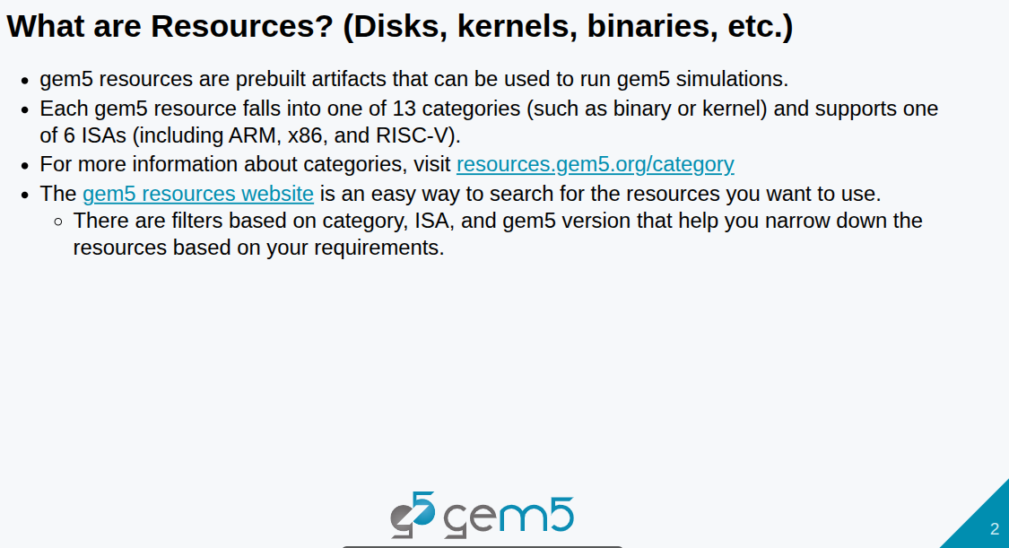
5.1 Gem5 Resource: Slides
https://gem5bootcamp.github.io/2024/#02-Using-gem5/02-gem5-resources
Gem5 Resource: Slides

Slide 4
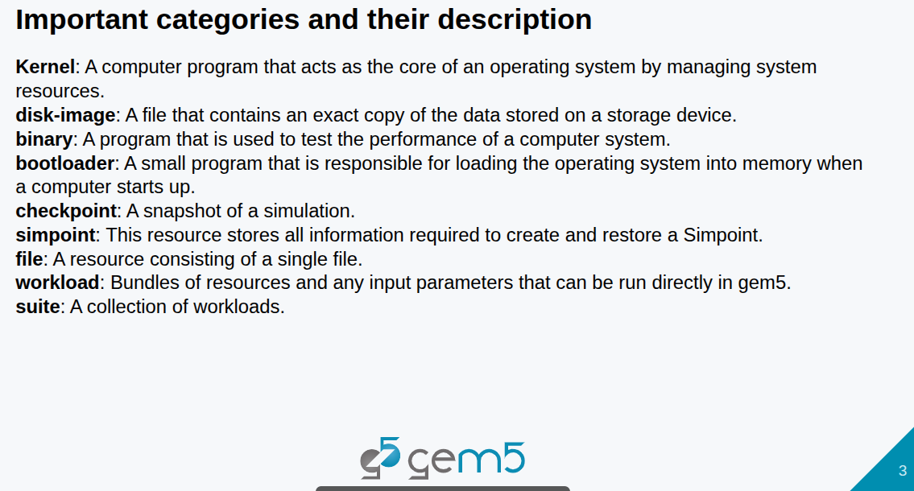
5.1 Gem5 Resource: Slides
https://gem5bootcamp.github.io/2024/#02-Using-gem5/02-gem5-resources
Gem5 Resource: Slides

Slide 5
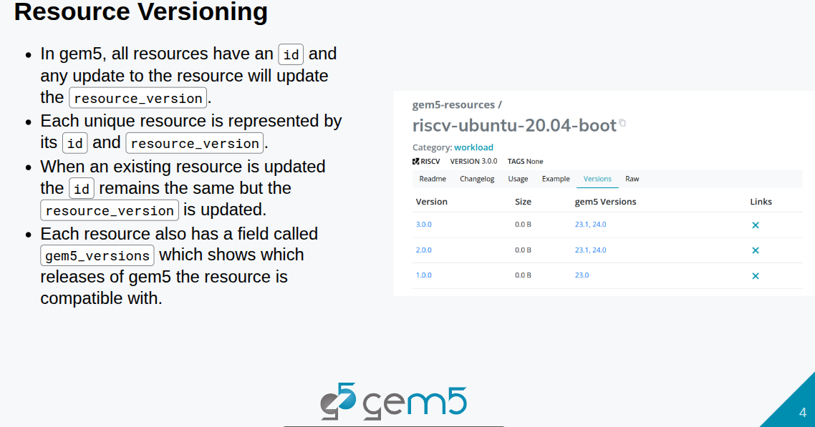
5.1 Gem5 Resource: Slides
https://gem5bootcamp.github.io/2024/#02-Using-gem5/02-gem5-resources
Gem5 Resource: Slides

Slide 6
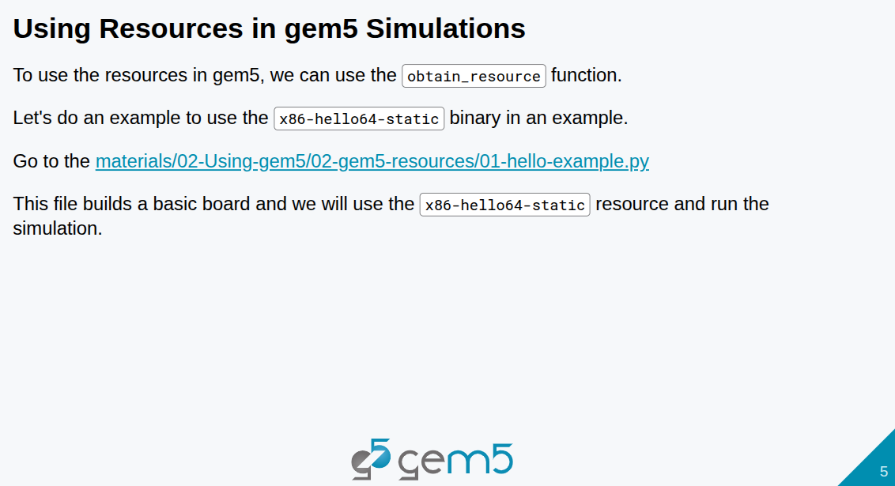
5.1 Gem5 Resource: Slides
https://gem5bootcamp.github.io/2024/#02-Using-gem5/02-gem5-resources
Gem5 Resource: Slides

Slide 7
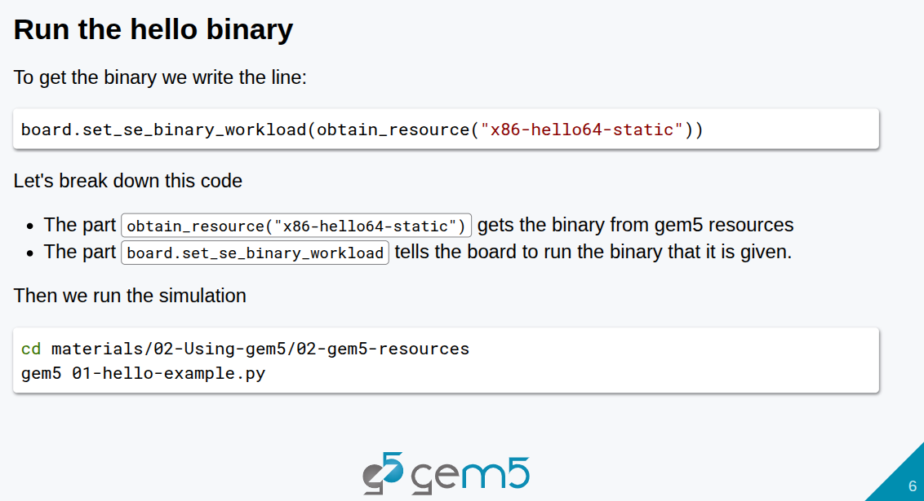
5.1 Gem5 Resource: Slides
https://gem5bootcamp.github.io/2024/#02-Using-gem5/02-gem5-resources
Gem5 Resource: Slides

Slide 8
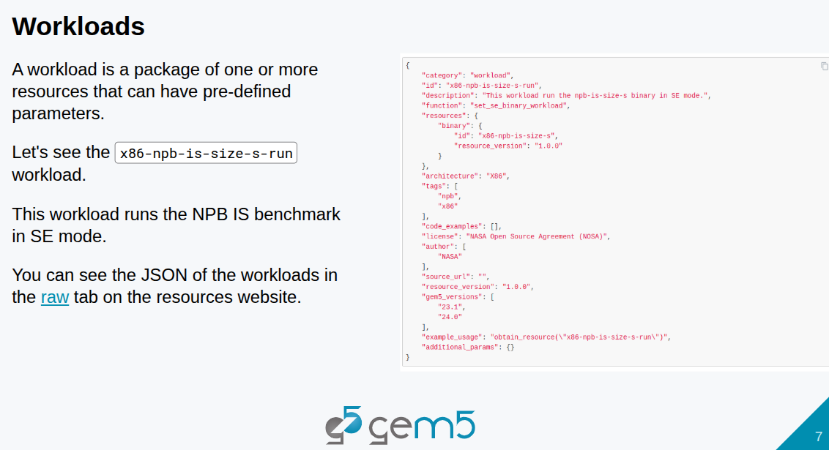
5.1 Gem5 Resource: Slides
https://gem5bootcamp.github.io/2024/#02-Using-gem5/02-gem5-resources
Gem5 Resource: Slides

Slide 9
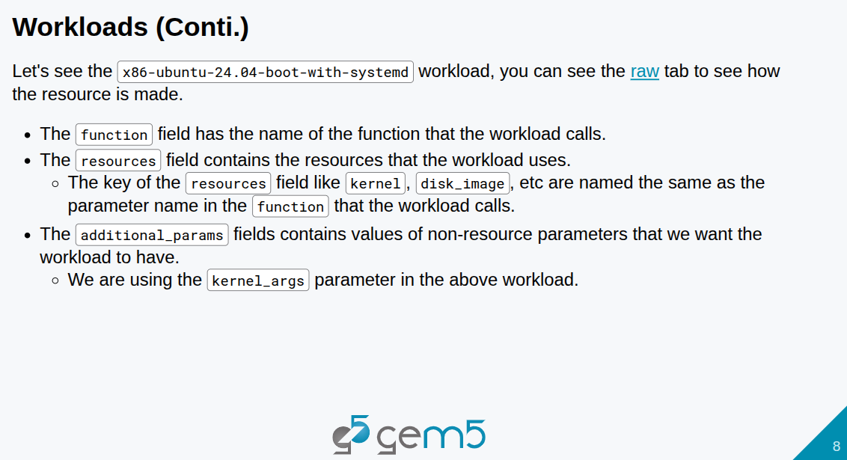
5.1 Gem5 Resource: Slides
https://gem5bootcamp.github.io/2024/#02-Using-gem5/02-gem5-resources
Gem5 Resource: Slides

Slide 10
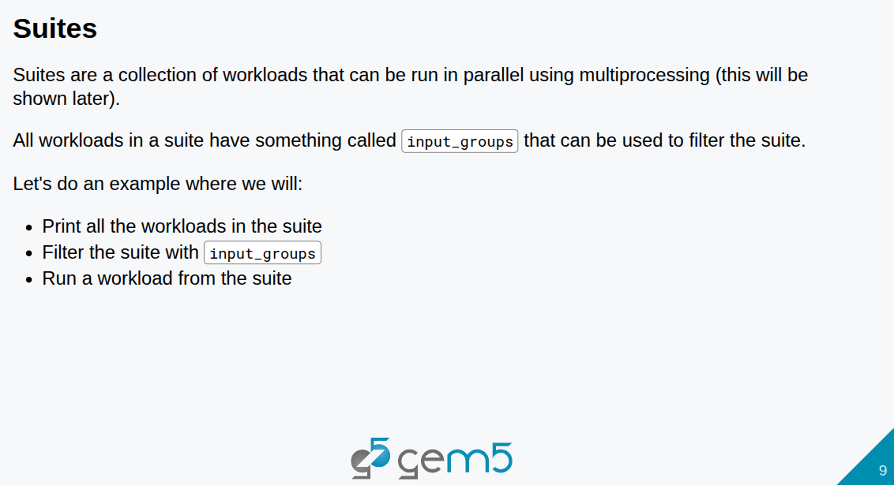
5.1 Gem5 Resource: Slides
https://gem5bootcamp.github.io/2024/#02-Using-gem5/02-gem5-resources
Gem5 Resource: Slides

Slide 11
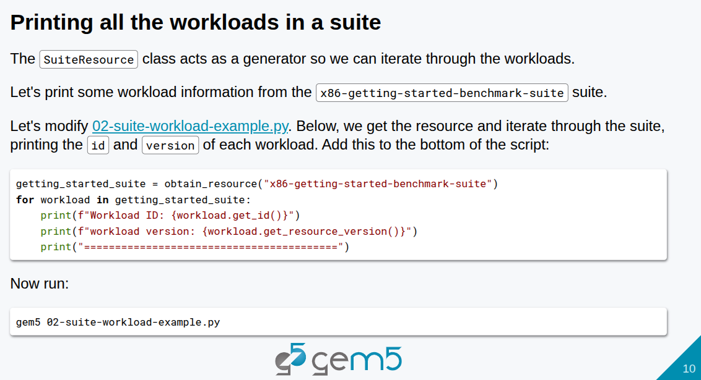
5.1 Gem5 Resource: Slides
https://gem5bootcamp.github.io/2024/#02-Using-gem5/02-gem5-resources
Gem5 Resource: Slides

Slide 12
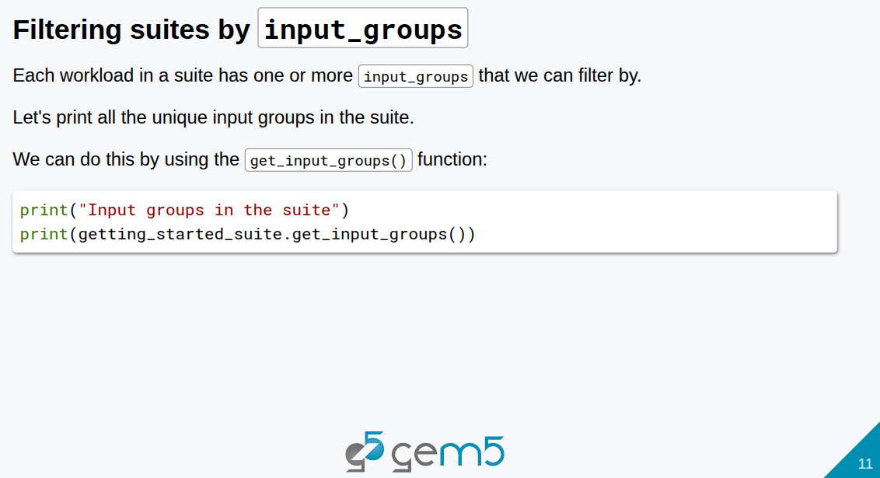
5.1 Gem5 Resource: Slides
https://gem5bootcamp.github.io/2024/#02-Using-gem5/02-gem5-resources
Gem5 Resource: Slides

Slide 13
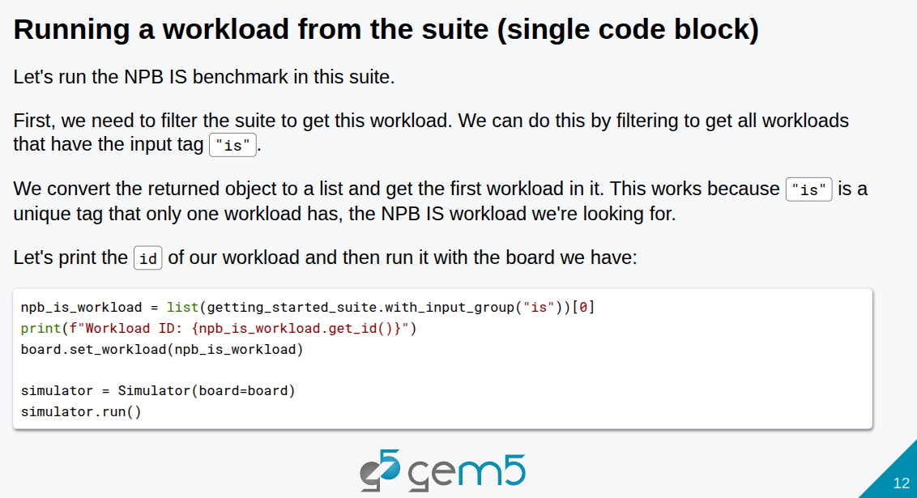
5.1 Gem5 Resource: Slides
https://gem5bootcamp.github.io/2024/#02-Using-gem5/02-gem5-resources
Gem5 Resource: Slides

Slide 14
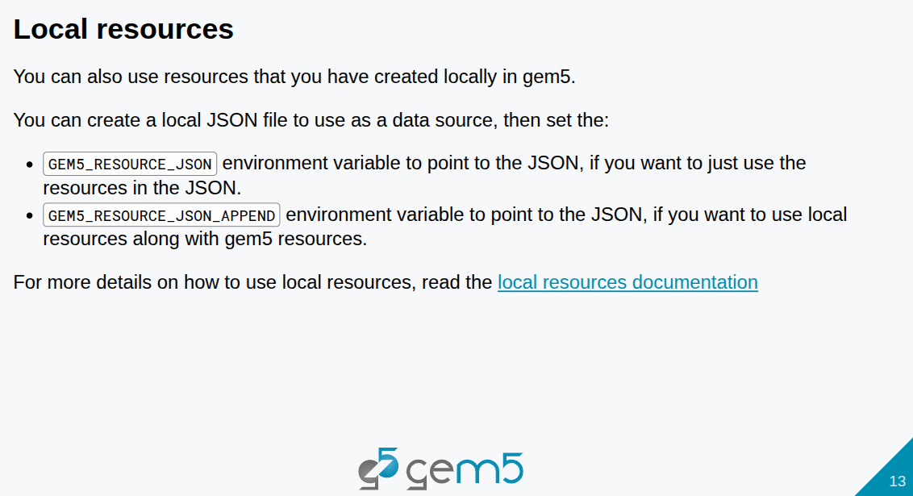
5.1 Gem5 Resource: Slides
https://gem5bootcamp.github.io/2024/#02-Using-gem5/02-gem5-resources
Gem5 Resource: Slides

Slide 15
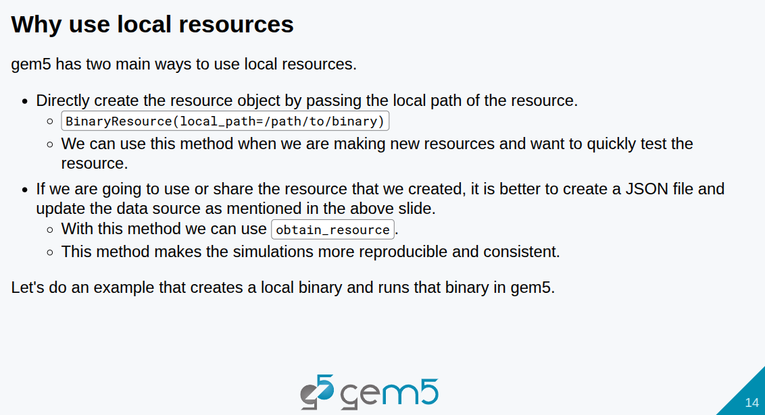
5.1 Gem5 Resource: Slides
https://gem5bootcamp.github.io/2024/#02-Using-gem5/02-gem5-resources
Gem5 Resource: Slides

Slide 16
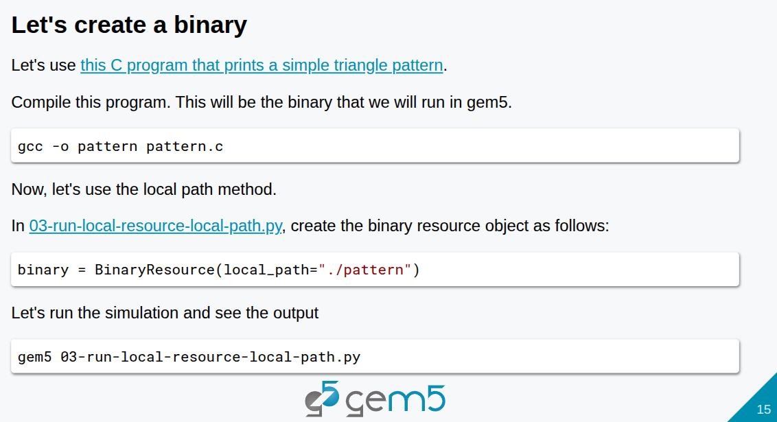
5.1 Gem5 Resource: Slides
https://gem5bootcamp.github.io/2024/#02-Using-gem5/02-gem5-resources
Gem5 Resource: Slides

Slide 17
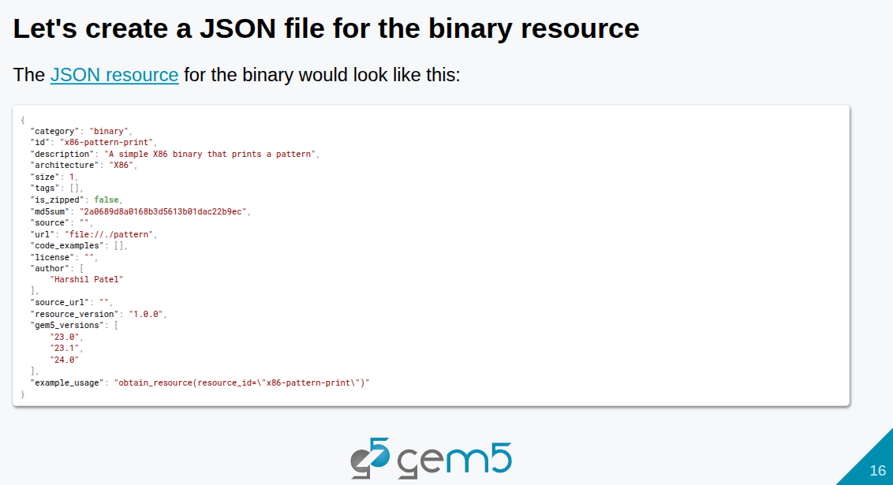
5.1 Gem5 Resource: Slides
https://gem5bootcamp.github.io/2024/#02-Using-gem5/02-gem5-resources
Gem5 Resource: Slides

Slide 18
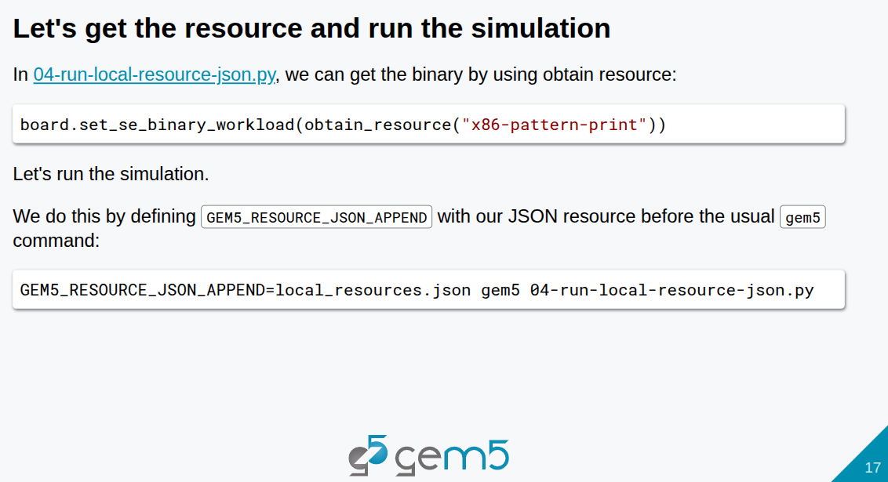
5.1 Gem5 Resource: Slides
https://gem5bootcamp.github.io/2024/#02-Using-gem5/02-gem5-resources
Gem5 Resource: Slides

Slide 19
End

