Slide 1

6 Run Gem5
Peter H. Chen

Slide 2

6 Run on Gem5
https://www.youtube.com/watch?v=pGp_41V0xf4&list=PL_hVbFs_loVR_8ntTTmmG6YEq3Po_4snu&index=6
Run on Gem5 (0:02-0:04/23:39)
We talk about Running Things on Gem5.

Slide 3
6.1 Topics

Slide 4
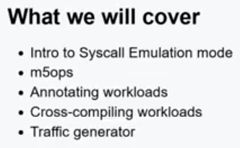
6.1 Topics
https://www.youtube.com/watch?v=pGp_41V0xf4&list=PL_hVbFs_loVR_8ntTTmmG6YEq3Po_4snu&index=6
Topics (0:05-0:42/1:10:12)
1. Syscall Emulation Mode
2. m5ops
3. Annotate Workloads
4. Cross-Compile workloads
5. Traffic Generator

Slide 5
6.2 Syscall Emulation Mode

Slide 6
6.2 Syscall Emulation Mode
https://www.youtube.com/watch?v=pGp_41V0xf4&list=PL_hVbFs_loVR_8ntTTmmG6YEq3Po_4snu&index=6
Syscall Emulation Mode (0:43-0:44/1:10:12)
First, Syscall Emulation Mode

Slide 7
6.3 What is Syscall Emulation Mode?

Slide 8
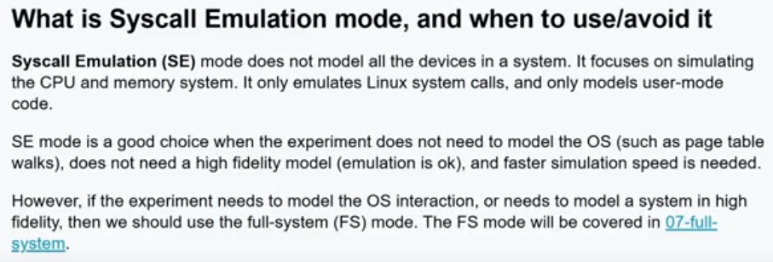
6.3 What is Syscall Emulation Mode?
https://www.youtube.com/watch?v=pGp_41V0xf4&list=PL_hVbFs_loVR_8ntTTmmG6YEq3Po_4snu&index=6
What is Syscall Emulation Mode? (0:45-1:44/1:10:12)
1. SE (Syscall Emulation) Mode does not model all the devices in a system.
2. SE only emulates CPU and memory system
3. SE only emulates Linux system calls
4. SE only for user-mode.
5. SE is a good choice without OS model, such as, Page Table Walk.
6. SE is not accurate model.
7. SE is for very fast simulation.
8. If we need to model OS interaction or high accuracy, then we need FS (Full System) mode.

Slide 9
6.4 SE Hello World

Slide 10
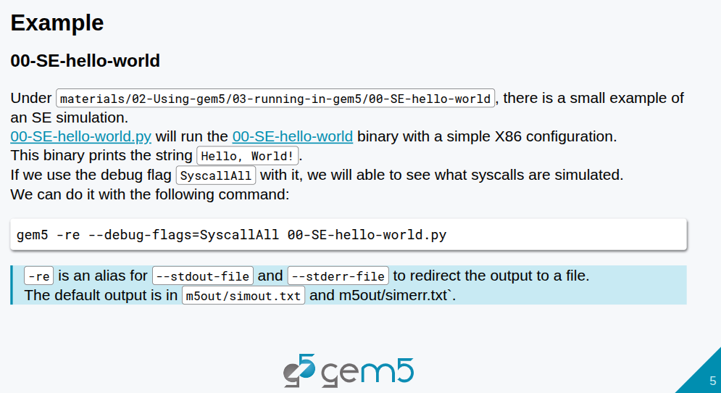
6.4 SE Hello World
https://www.youtube.com/watch?v=pGp_41V0xf4&list=PL_hVbFs_loVR_8ntTTmmG6YEq3Po_4snu&index=6
SE Hello World (1:45-1:55/1:10:12)
We run SE mode example in materials/02-using-gem5/03-running-in-gem5/00-SE-hello-world.py

Slide 11
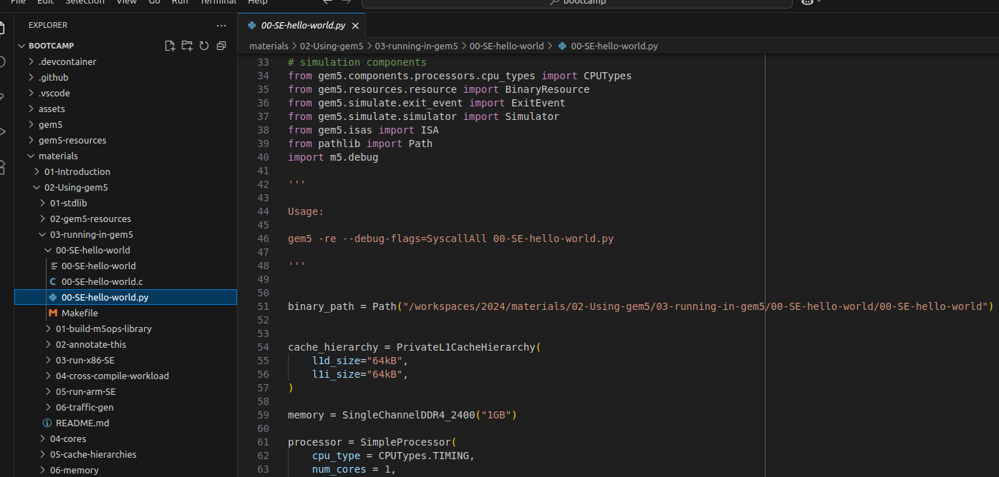
6.4 SE Hello World
https://www.youtube.com/watch?v=pGp_41V0xf4&list=PL_hVbFs_loVR_8ntTTmmG6YEq3Po_4snu&index=6
SE Hello World (1:56-3:20/1:10:12)
Example in materials/02-using-gem5/03-running-in-gem5/00-SE-hello-world.py
This example will run Hello World in X86 configuration.

Slide 12
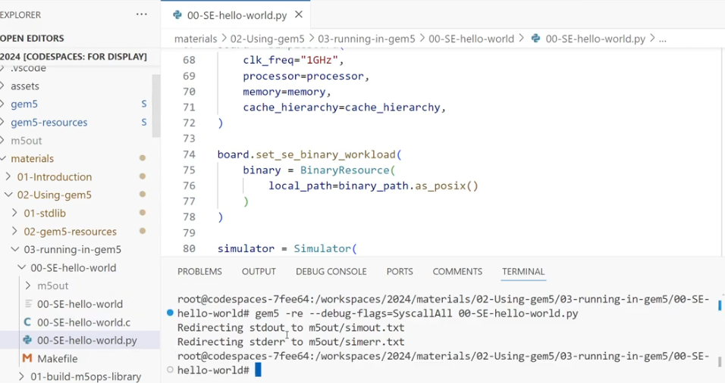
6.4 SE Hello World
https://www.youtube.com/watch?v=pGp_41V0xf4&list=PL_hVbFs_loVR_8ntTTmmG6YEq3Po_4snu&index=6
SE Hello World (3:21-5:10/1:10:12)
We run the SE mode hello world in Python.
> gem5 -re --debug-flags=SyscallAll 00-SE-hello-world.py

Slide 13
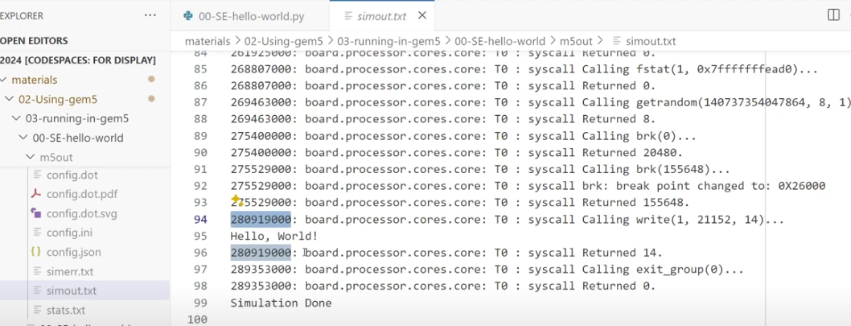
6.4 SE Hello World
https://www.youtube.com/watch?v=pGp_41V0xf4&list=PL_hVbFs_loVR_8ntTTmmG6YEq3Po_4snu&index=6
SE Hello World (5:11-5:59/1:10:12)
We check the simout.txt file.
We can see all the syscall messages in simout.txt
We can find “Hello, World!”

Slide 14
6.5 m5ops

Slide 15

6.5 m5ops
https://www.youtube.com/watch?v=pGp_41V0xf4&list=PL_hVbFs_loVR_8ntTTmmG6YEq3Po_4snu&index=6
m5ops (6:00-6:01/1:10:12)
Now, we talk m5ops

Slide 16
6.6 What is m5ops?

Slide 17
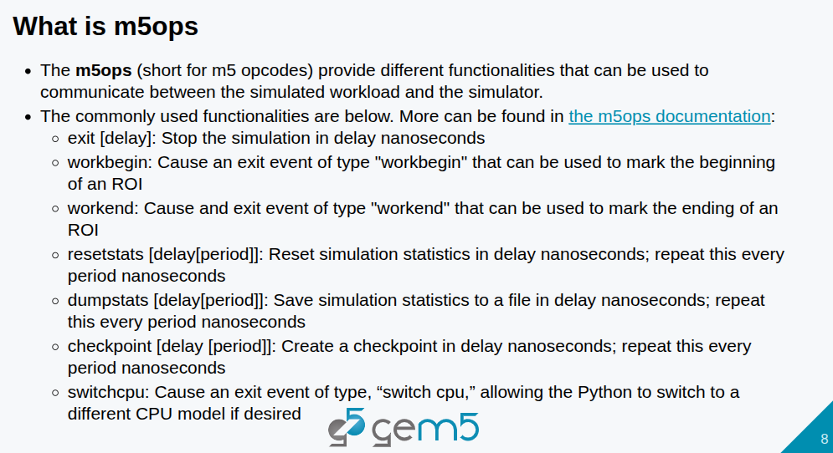
6.6 What is m5ops?
https://www.youtube.com/watch?v=pGp_41V0xf4&list=PL_hVbFs_loVR_8ntTTmmG6YEq3Po_4snu&index=6
What is m5ops? (6:02-7:00/1:10:12)
1. The m5ops means “m5 opcodes”. The m5 means gem5 simulator.
2. The m5ops provide different functions that communicate between workload and simulator.
3. Some common m5ops functions: exit, workbegin, workend, resetstats, dumpstats, checkpoint, switchcpu.

Slide 18
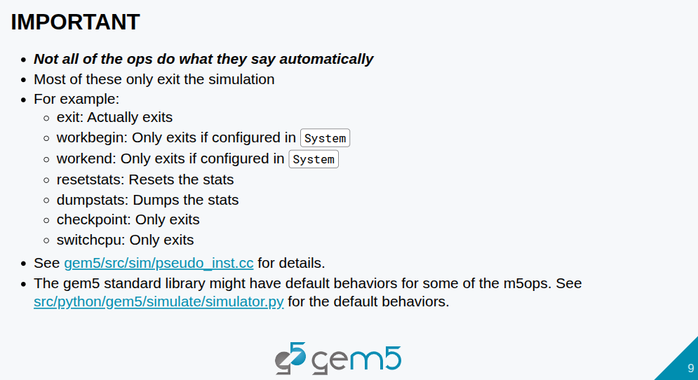
6.6 What is m5ops?
https://www.youtube.com/watch?v=pGp_41V0xf4&list=PL_hVbFs_loVR_8ntTTmmG6YEq3Po_4snu&index=6
What is m5ops? (7:01-8:07/1:10:12)
1. Not all of the ops do what that says. Most of them only do exit the simulation.
2. for example, exit is exit automatically. The workbegin and workend only exit if configured in System.
3. The resetstats and dumpstats do what they said.
4. The checkpoint and switchcpu only exit.
5. We can find gem5 standard library default behavior for some of m5ops.

Slide 19
6.7 m5ops Versions

Slide 20
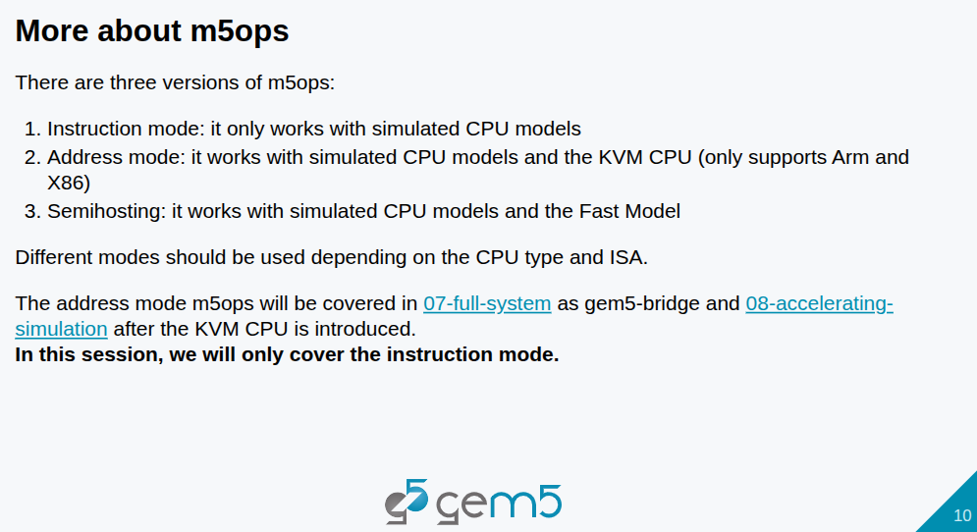
6.7 m5ops Versions
https://www.youtube.com/watch?v=pGp_41V0xf4&list=PL_hVbFs_loVR_8ntTTmmG6YEq3Po_4snu&index=6
m5ops Version (8:08-8:32/1:10:12)
There are three different version of m5ops.
1. The instruction mode that is only work with simulated CPU models, such as, Atomic CPU (Sequence of instruction cannot be interrupted), timing CPU (actual time CPU spend), O3CPU (Out-Of-Order in code executing) inside gem5.

Slide 21
6.7 m5ops Versions
https://www.youtube.com/watch?v=pGp_41V0xf4&list=PL_hVbFs_loVR_8ntTTmmG6YEq3Po_4snu&index=6
m5ops Version (8:33-9:00/1:10:12)
2. for the address mode, it work with the simulated CPU models and KVM (Kernel-based Virtual Machine) CPU. For now, gem5 only support the ARM and X86 KVM.
3. The last one is less commonly used. It is the Fast Model that we will not discuss.

Slide 22
6.7 m5ops Versions
https://www.youtube.com/watch?v=pGp_41V0xf4&list=PL_hVbFs_loVR_8ntTTmmG6YEq3Po_4snu&index=6
m5ops Version (9:01-9:13/1:10:12)
Different modes are used in different CPU type and ISA.
After KVM CPU, we discuss the address mode in section 07-full-system as gem5-bridge and section 08-accelerating simulation.
In this section, we only discuss the instruction mode.

Slide 23
6.8 When to use m5ops?

Slide 24
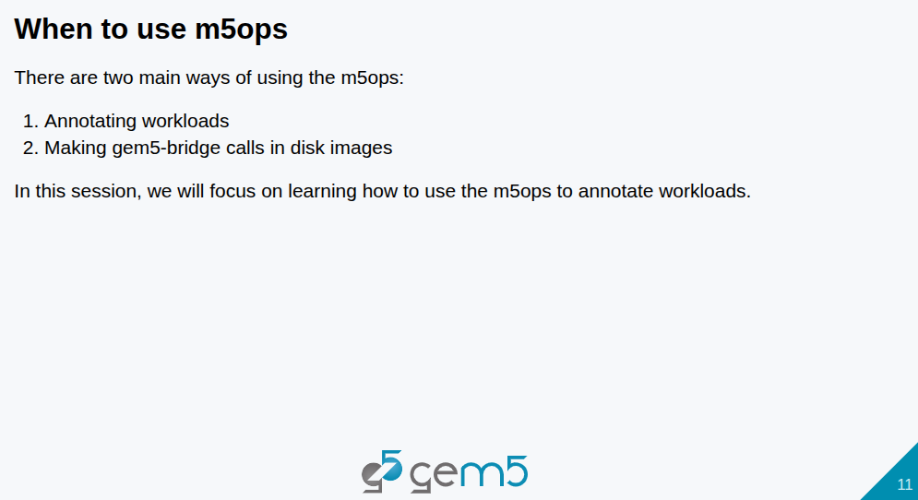
6.8 When to use m5ops?
https://www.youtube.com/watch?v=pGp_41V0xf4&list=PL_hVbFs_loVR_8ntTTmmG6YEq3Po_4snu&index=6
When to Use m5ops? (9:14-10:13/1:10:12)
Why do we use gem5 ops (or m5ops)?

Slide 25
End

