Slide 1

24.1 Network: Slides
Peter H. Chen

Slide 2

24.1 Network: Slides
https://gem5bootcamp.github.io/2024/#03-Developing-gem5-models/08-ruby-network
Network: Slides

Slide 3
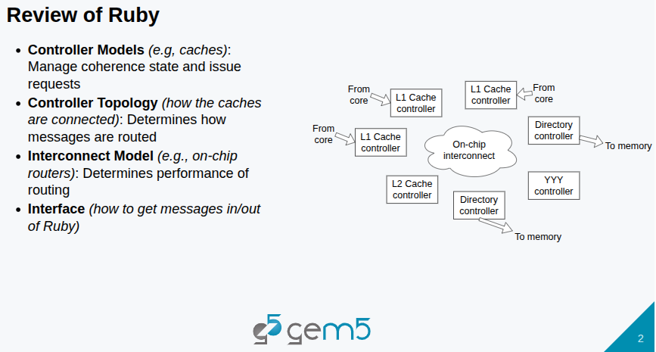
24.1 Network: Slides
https://gem5bootcamp.github.io/2024/#03-Developing-gem5-models/08-ruby-network
Network: Slides

Slide 4
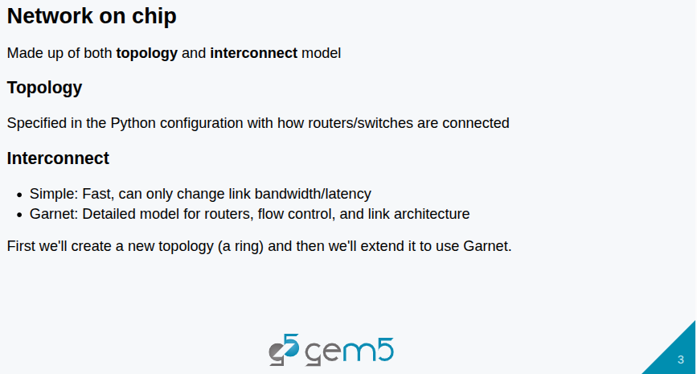
24.1 Network: Slides
https://gem5bootcamp.github.io/2024/#03-Developing-gem5-models/08-ruby-network
Network: Slides

Slide 5
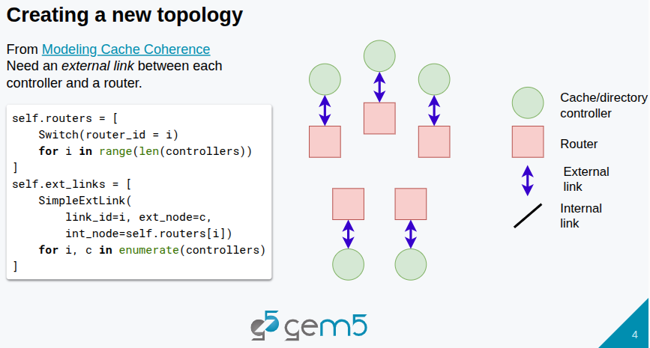
24.1 Network: Slides
https://gem5bootcamp.github.io/2024/#03-Developing-gem5-models/08-ruby-network
Network: Slides

Slide 6
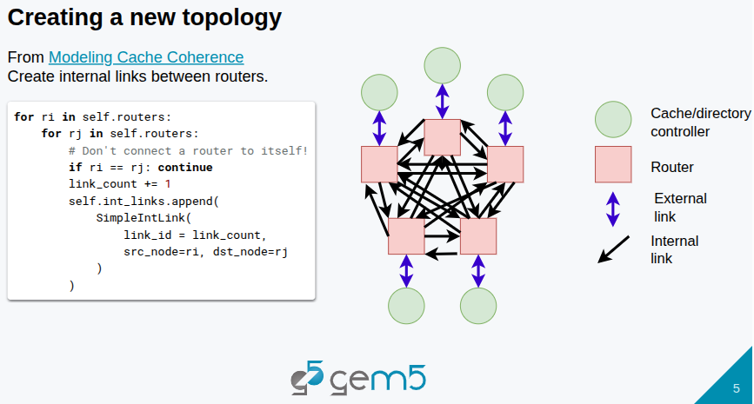
24.1 Network: Slides
https://gem5bootcamp.github.io/2024/#03-Developing-gem5-models/08-ruby-network
Network: Slides

Slide 7
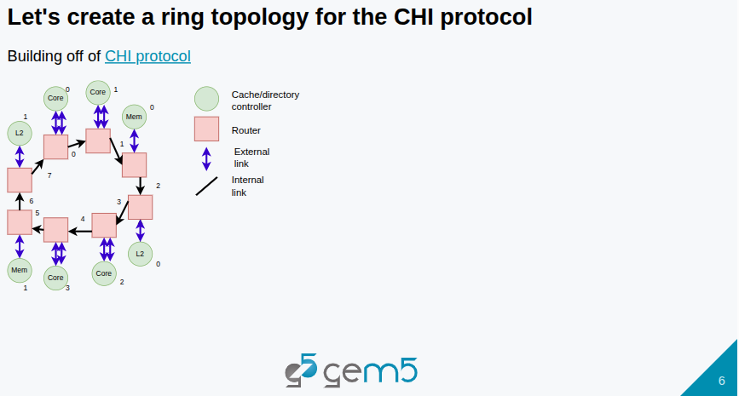
24.1 Network: Slides
https://gem5bootcamp.github.io/2024/#03-Developing-gem5-models/08-ruby-network
Network: Slides

Slide 8
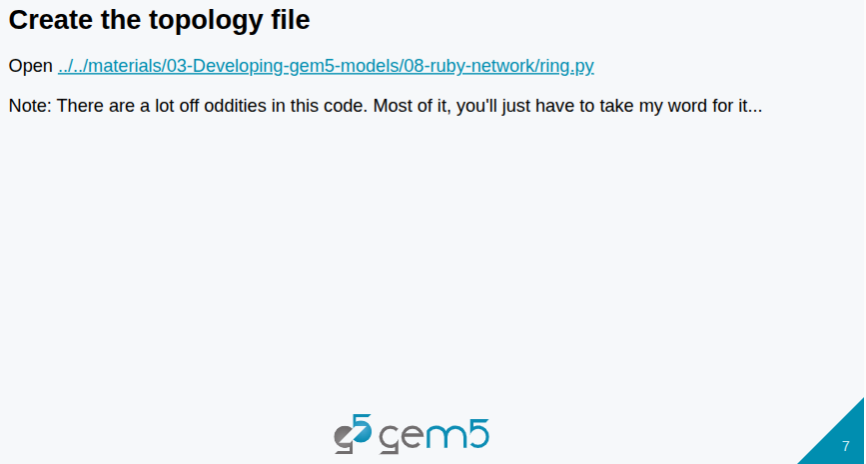
24.1 Network: Slides
https://gem5bootcamp.github.io/2024/#03-Developing-gem5-models/08-ruby-network
Network: Slides

Slide 9
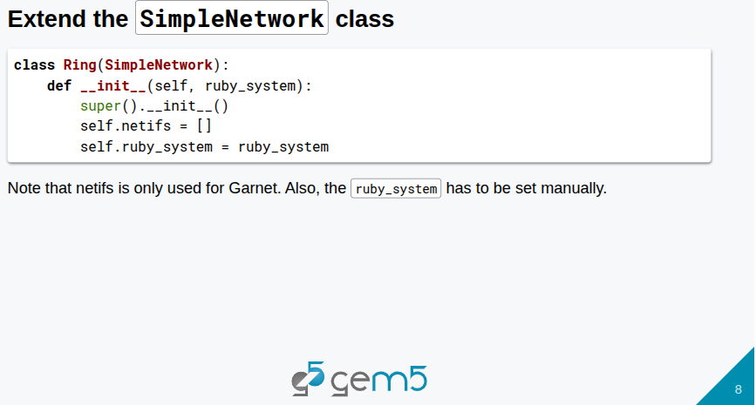
24.1 Network: Slides
https://gem5bootcamp.github.io/2024/#03-Developing-gem5-models/08-ruby-network
Network: Slides

Slide 10
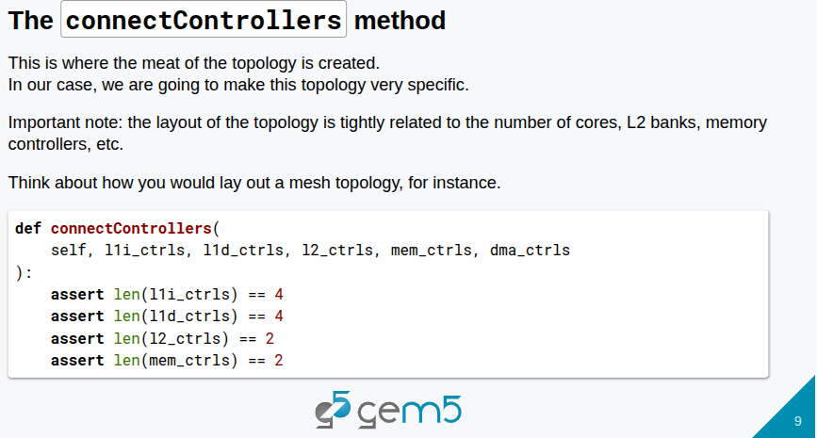
24.1 Network: Slides
https://gem5bootcamp.github.io/2024/#03-Developing-gem5-models/08-ruby-network
Network: Slides

Slide 11
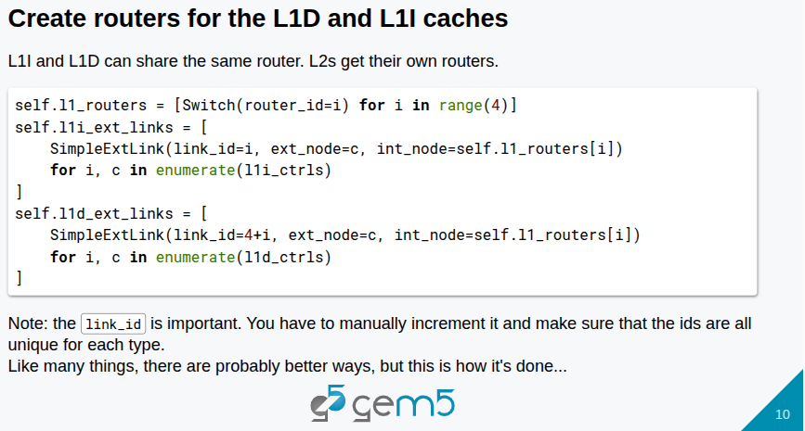
24.1 Network: Slides
https://gem5bootcamp.github.io/2024/#03-Developing-gem5-models/08-ruby-network
Network: Slides

Slide 12
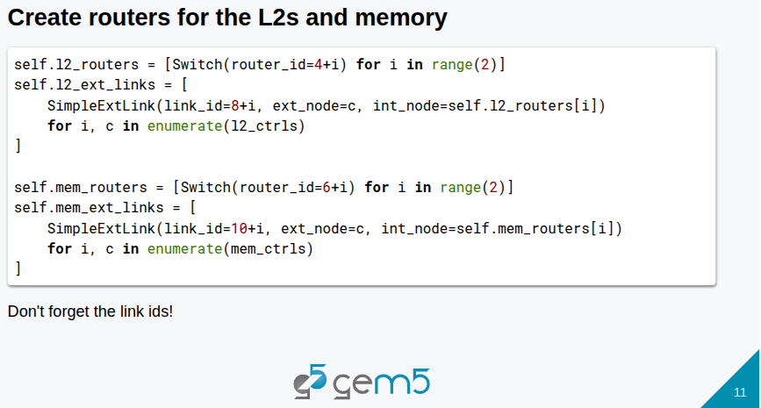
24.1 Network: Slides
https://gem5bootcamp.github.io/2024/#03-Developing-gem5-models/08-ruby-network
Network: Slides

Slide 13
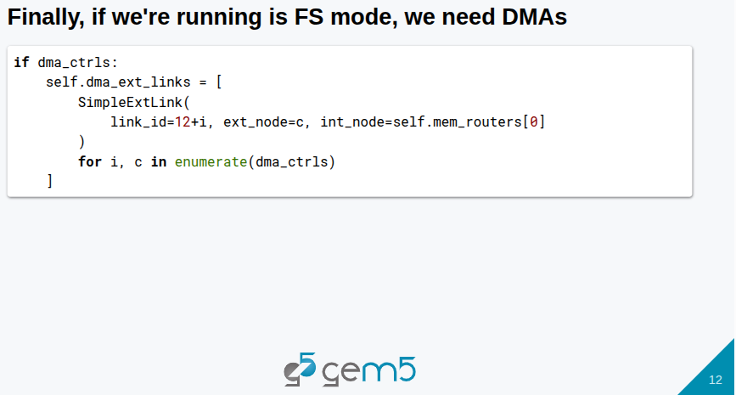
24.1 Network: Slides
https://gem5bootcamp.github.io/2024/#03-Developing-gem5-models/08-ruby-network
Network: Slides

Slide 14
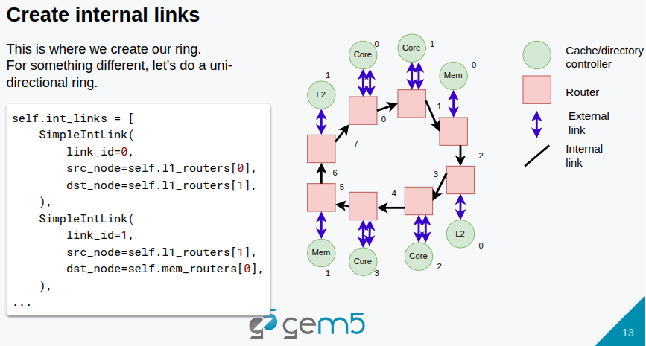
24.1 Network: Slides
https://gem5bootcamp.github.io/2024/#03-Developing-gem5-models/08-ruby-network
Network: Slides

Slide 15
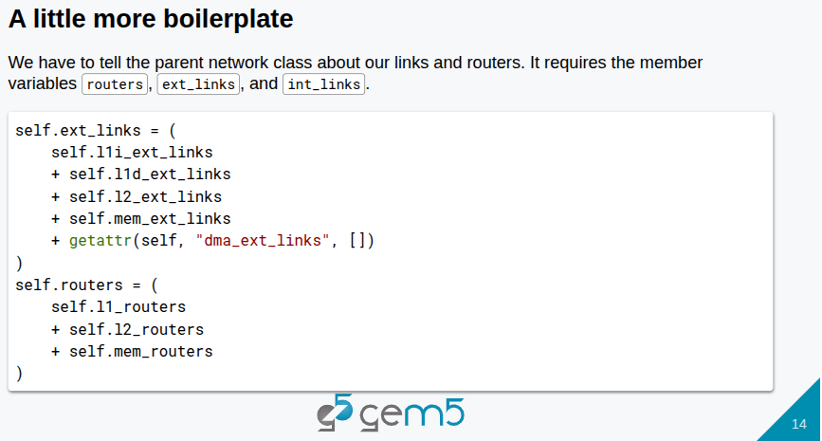
24.1 Network: Slides
https://gem5bootcamp.github.io/2024/#03-Developing-gem5-models/08-ruby-network
Network: Slides

Slide 16
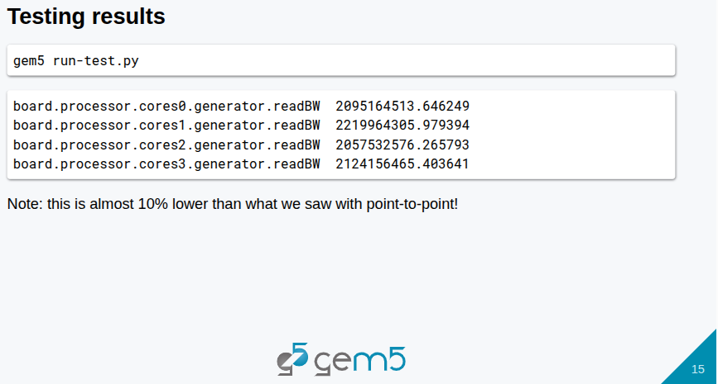
24.1 Network: Slides
https://gem5bootcamp.github.io/2024/#03-Developing-gem5-models/08-ruby-network
Network: Slides

Slide 17
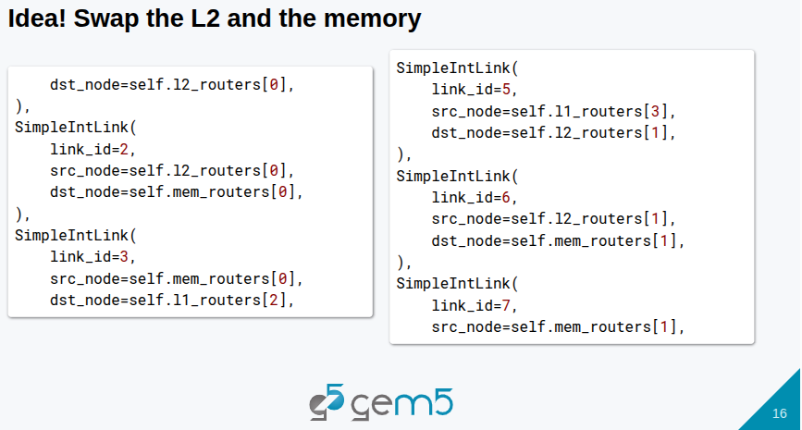
24.1 Network: Slides
https://gem5bootcamp.github.io/2024/#03-Developing-gem5-models/08-ruby-network
Network: Slides

Slide 18
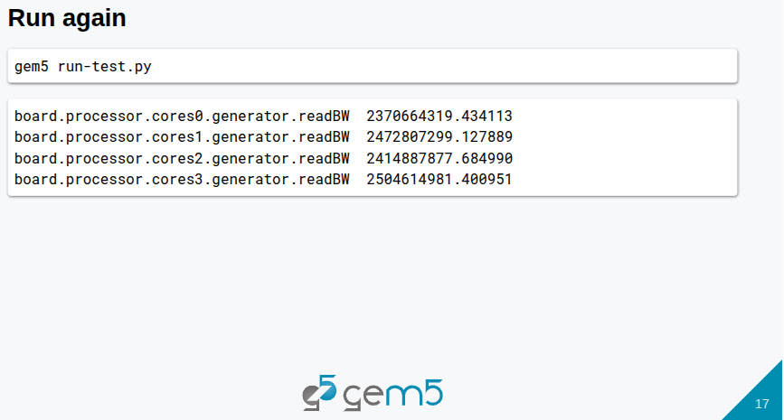
24.1 Network: Slides
https://gem5bootcamp.github.io/2024/#03-Developing-gem5-models/08-ruby-network
Network: Slides

Slide 19
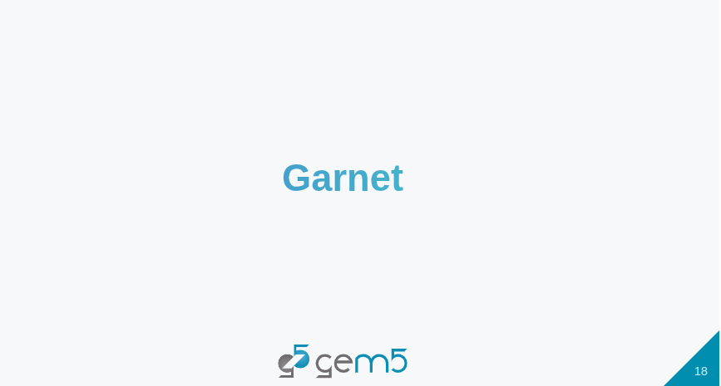
24.1 Network: Slides
https://gem5bootcamp.github.io/2024/#03-Developing-gem5-models/08-ruby-network
Network: Slides

Slide 20
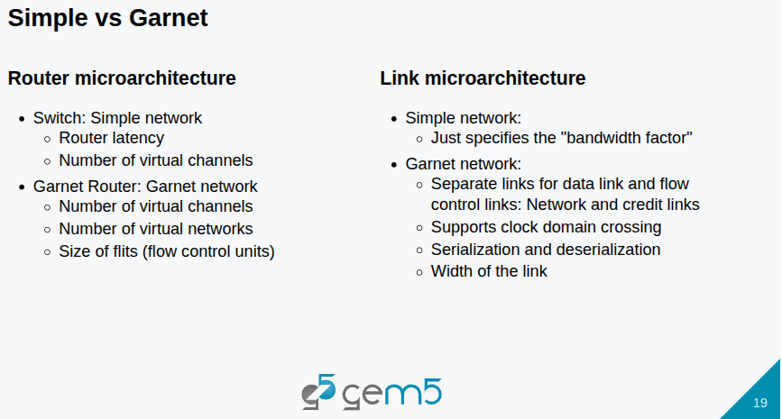
24.1 Network: Slides
https://gem5bootcamp.github.io/2024/#03-Developing-gem5-models/08-ruby-network
Network: Slides

Slide 21
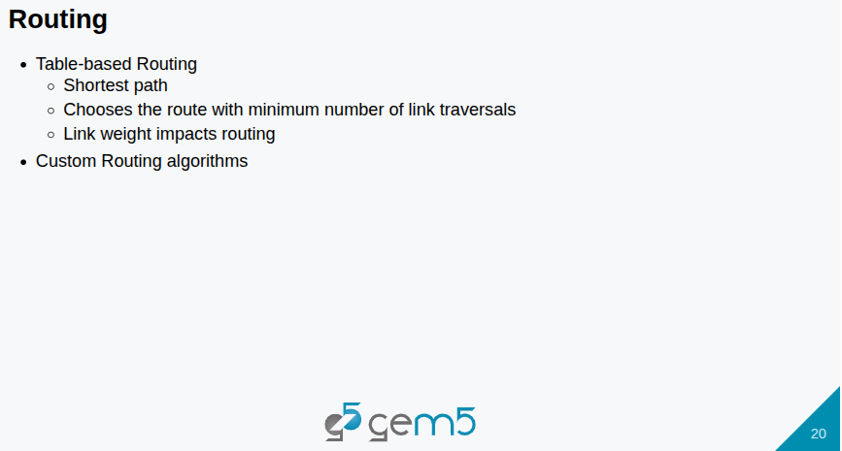
24.1 Network: Slides
https://gem5bootcamp.github.io/2024/#03-Developing-gem5-models/08-ruby-network
Network: Slides

Slide 22
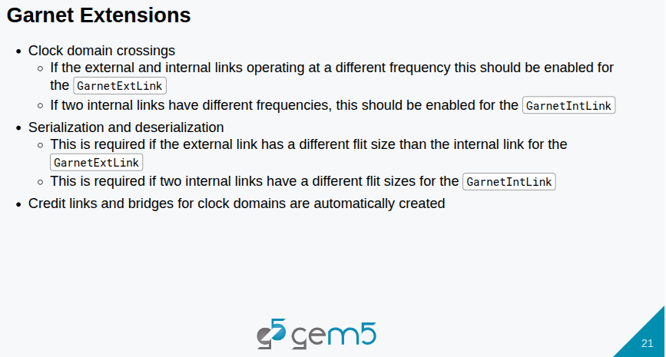
24.1 Network: Slides
https://gem5bootcamp.github.io/2024/#03-Developing-gem5-models/08-ruby-network
Network: Slides

Slide 23
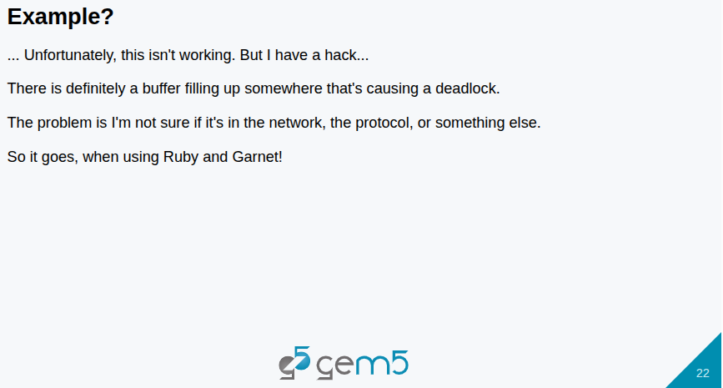
24.1 Network: Slides
https://gem5bootcamp.github.io/2024/#03-Developing-gem5-models/08-ruby-network
Network: Slides

Slide 24
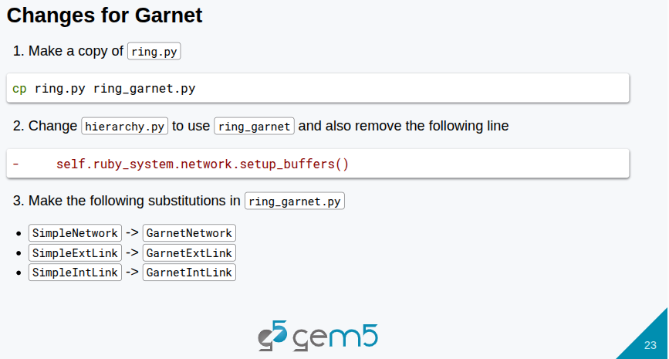
24.1 Network: Slides
https://gem5bootcamp.github.io/2024/#03-Developing-gem5-models/08-ruby-network
Network: Slides

Slide 25
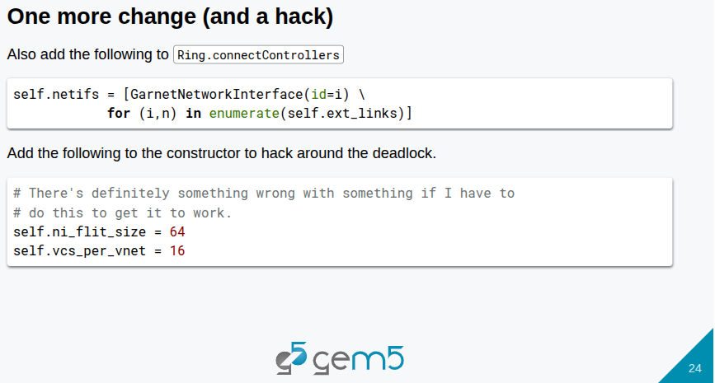
24.1 Network: Slides
https://gem5bootcamp.github.io/2024/#03-Developing-gem5-models/08-ruby-network
Network: Slides

Slide 26
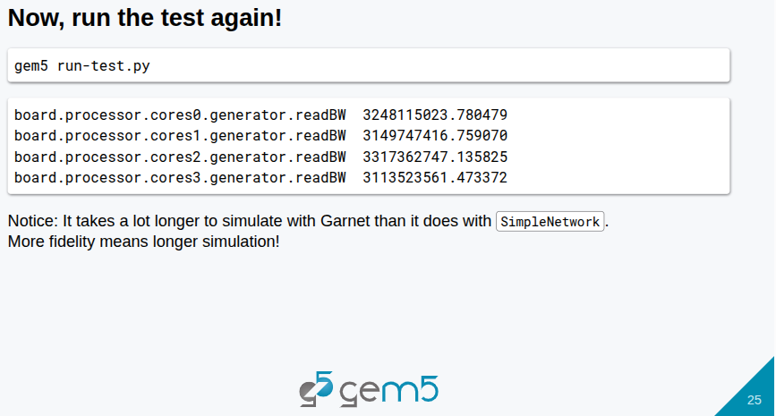
24.1 Network: Slides
https://gem5bootcamp.github.io/2024/#03-Developing-gem5-models/08-ruby-network
Network: Slides

Slide 27
End

