Slide 1

4 Standard Library
Peter H. Chen

Slide 2
4.0 Topics
https://www.youtube.com/watch?v=I8UUqyXWz_g&list=PL_hVbFs_loVR_8ntTTmmG6YEq3Po_4snu&index=4
Topics (0:00-0:01/50:45)
1.

Slide 3
4.1 Gem5 Standard Library

Slide 4
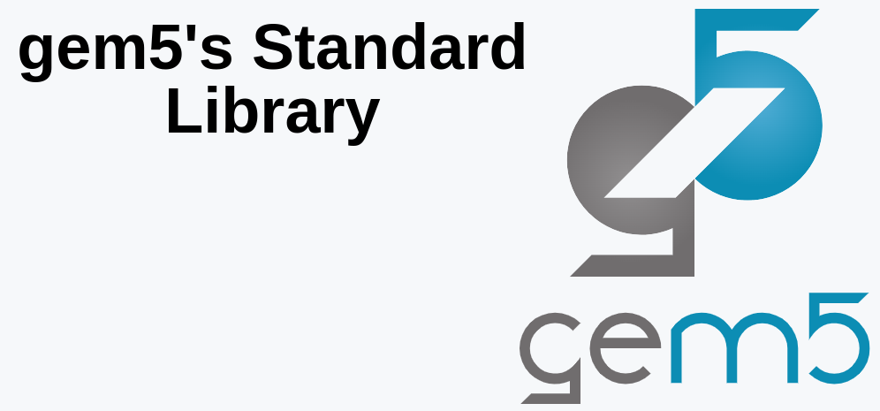
4.1 Gem5 Standard Library
https://www.youtube.com/watch?v=I8UUqyXWz_g&list=PL_hVbFs_loVR_8ntTTmmG6YEq3Po_4snu&index=4
Gem5 Standard Library (0:02-0:18/50:45)
We talk about Gem5 standard Library.

Slide 5
4.2 Why Standard Library?

Slide 6
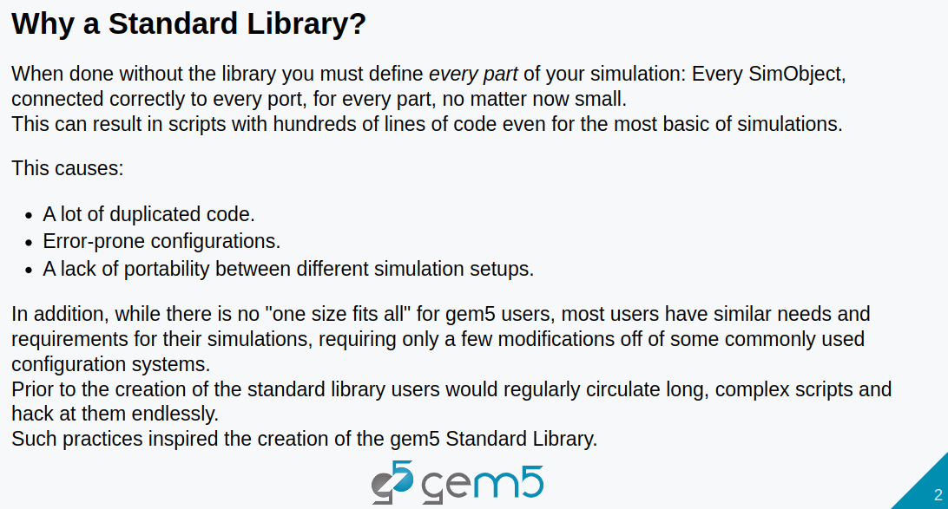
4.2 Why Standard Library?
https://www.youtube.com/watch?v=I8UUqyXWz_g&list=PL_hVbFs_loVR_8ntTTmmG6YEq3Po_4snu&index=4
Why Standard Library (0:19-3:28/50:45)
Gem5 standard library is a C++ library.
We have common useful code in the gem5 standard library shared by all developer.

Slide 7
4.3 What is Standard Library?

Slide 8
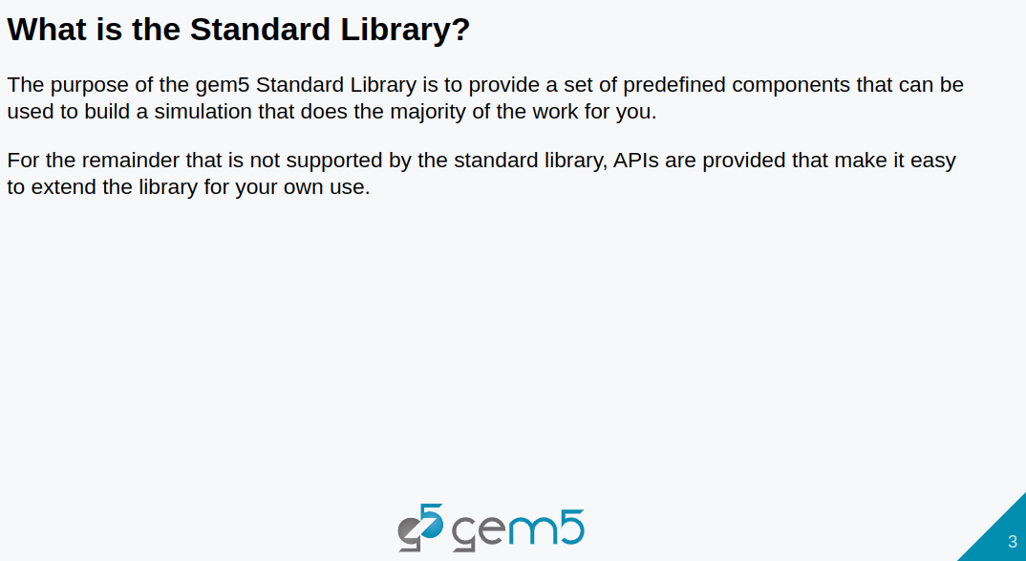
4.3 What is Standard Library?
https://www.youtube.com/watch?v=I8UUqyXWz_g&list=PL_hVbFs_loVR_8ntTTmmG6YEq3Po_4snu&index=4
What is Standard Library (3:29-3:31/50:45)
We have predefined components in the standard library.
We use API to call the Standard Library.

Slide 9
4.4 Combine Components into Board

Slide 10
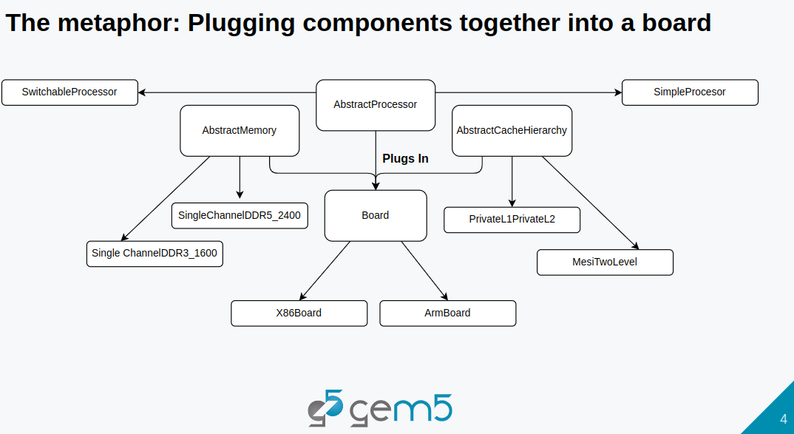
4.4 Combine Components into Board
https://www.youtube.com/watch?v=I8UUqyXWz_g&list=PL_hVbFs_loVR_8ntTTmmG6YEq3Po_4snu&index=4
Combine Components into Board (3:32-6:49/50:45)
We have board (X86 board/Arm board) contains the components: Processor (Abstract/Switchable/SImple), memory (DDR3, DDR5, etc), Cache (L1, L2).
We use interface to plug all components together.

Slide 11
4.5 Component

Slide 12
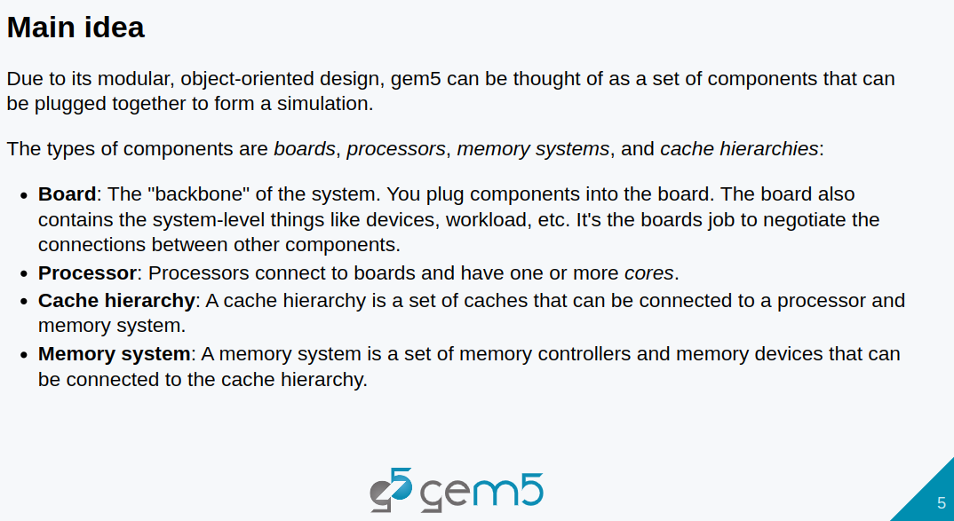
4.5 Component
https://www.youtube.com/watch?v=I8UUqyXWz_g&list=PL_hVbFs_loVR_8ntTTmmG6YEq3Po_4snu&index=4
Component (6:50-7:00/50:45)
1. We divide Components into Board, Processor, Cache Hierarchy, and Memory System.
2. Boards are the main backbone of the system. We plug components into the board,
3. The board also contain system- level components, such as, devices, workload, etc,
4. The boards are used to connect between components.

Slide 13
4.5 Component
https://www.youtube.com/watch?v=I8UUqyXWz_g&list=PL_hVbFs_loVR_8ntTTmmG6YEq3Po_4snu&index=4
Component (7:01-7:10/50:45)
5. Processors are connected to the boards and have one or more cores.
6. Cache hierarchy is a set of caches that can be connected to a processor and memory system.

Slide 14
4.5 Component
https://www.youtube.com/watch?v=I8UUqyXWz_g&list=PL_hVbFs_loVR_8ntTTmmG6YEq3Po_4snu&index=4
Component (7:10-7:14/50:45)
7. Memory system is a set of memory controllers and memory devices that can be connected to the Cache hierarchy.

Slide 15
4.6 Gem5 Model

Slide 16
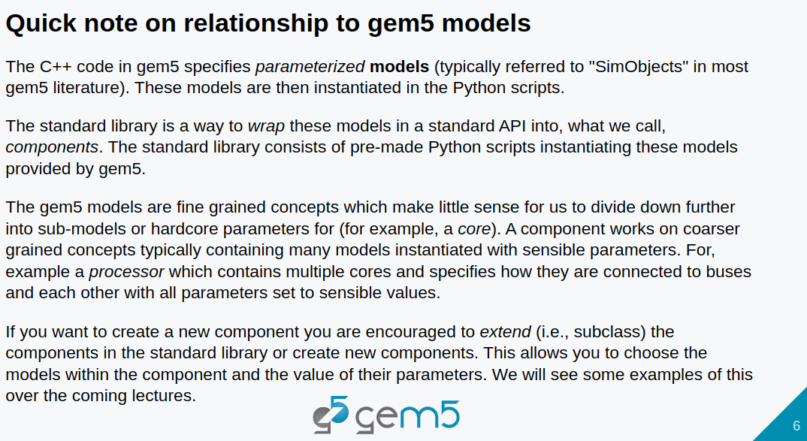
4.6 Gem5 Model
https://www.youtube.com/watch?v=I8UUqyXWz_g&list=PL_hVbFs_loVR_8ntTTmmG6YEq3Po_4snu&index=4
Gem5 Model (7:15-7:32/50:45)
1. Models are SimObjects in Gem5.
2. C++ Code in Gem5 specifies the Parameters for Models (SimObjects).

Slide 17
4.6 Gem5 Model
https://www.youtube.com/watch?v=I8UUqyXWz_g&list=PL_hVbFs_loVR_8ntTTmmG6YEq3Po_4snu&index=4
Gem5 Model (7:33-7:44/50:45)
3. Models are instantiated in Python scripts to wrap the models with standard API to call the components.
4. The standard library are pre-made with Python scripts
5. These models are instantiated and provided by Gem5.

Slide 18
4.6 Gem5 Model
https://www.youtube.com/watch?v=I8UUqyXWz_g&list=PL_hVbFs_loVR_8ntTTmmG6YEq3Po_4snu&index=4
Gem5 Model (7:45-9:03/50:45)
6. Gem5 Models are fine grained concepts. We don’t need to divide down more into the sub-models.
7. Components are coarse grained concepts. Components contain many models with passing parameters.
8. For example, X86 Processor contains multiple cores specified by parameters and connected to busses.

Slide 19
4.7 Started StdLib Coding

Slide 20
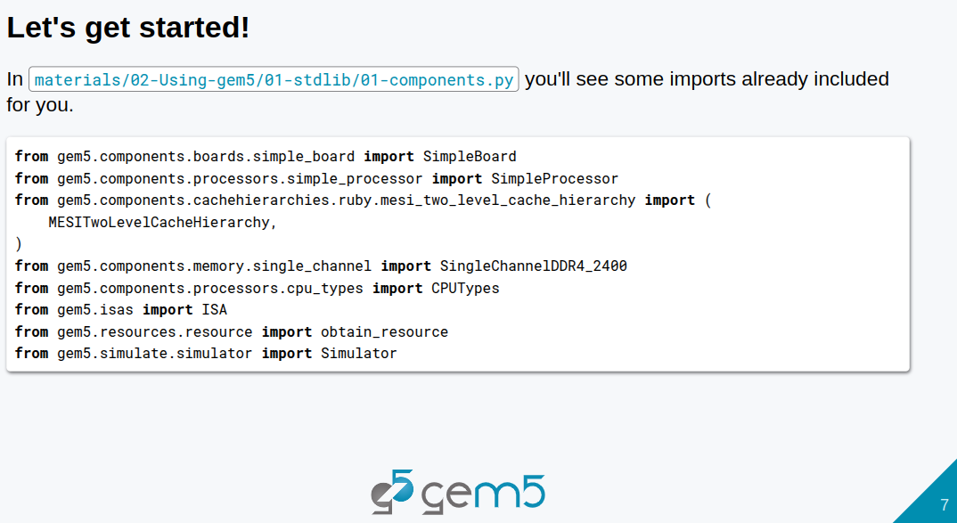
4.7 Started StdLib Coding
https://www.youtube.com/watch?v=I8UUqyXWz_g&list=PL_hVbFs_loVR_8ntTTmmG6YEq3Po_4snu&index=4
Started StdLib Coding (9:04-09:05/50:45)
1. We started the components with standard library.
https://github.com/gem5bootcamp/bootcamp/tree/main/materials/02-Using-gem5/01-stdlib

Slide 21
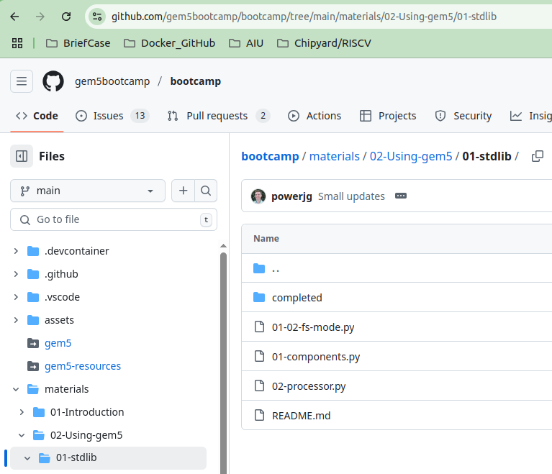
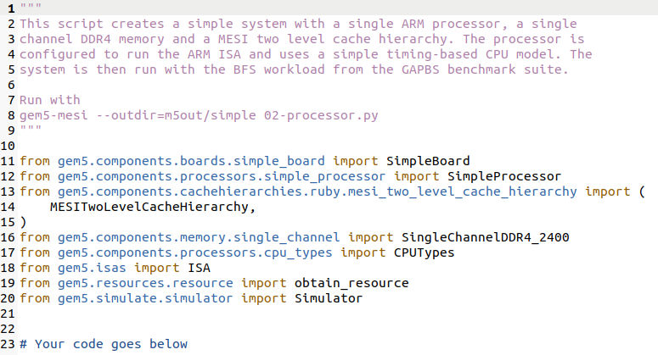
4.7 Started StdLib Coding
https://www.youtube.com/watch?v=I8UUqyXWz_g&list=PL_hVbFs_loVR_8ntTTmmG6YEq3Po_4snu&index=4
Started StdLib Coding (9:04-09:35/50:45)
Below, we go to materials/02-Using-gem5/01-stdlib/01-components.py for startup gem5 code
https://github.com/gem5bootcamp/bootcamp/tree/main/materials/02-Using-gem5/01-stdlib/01-components.py

Slide 22
4.8 Complete StdLib Coding

Slide 23
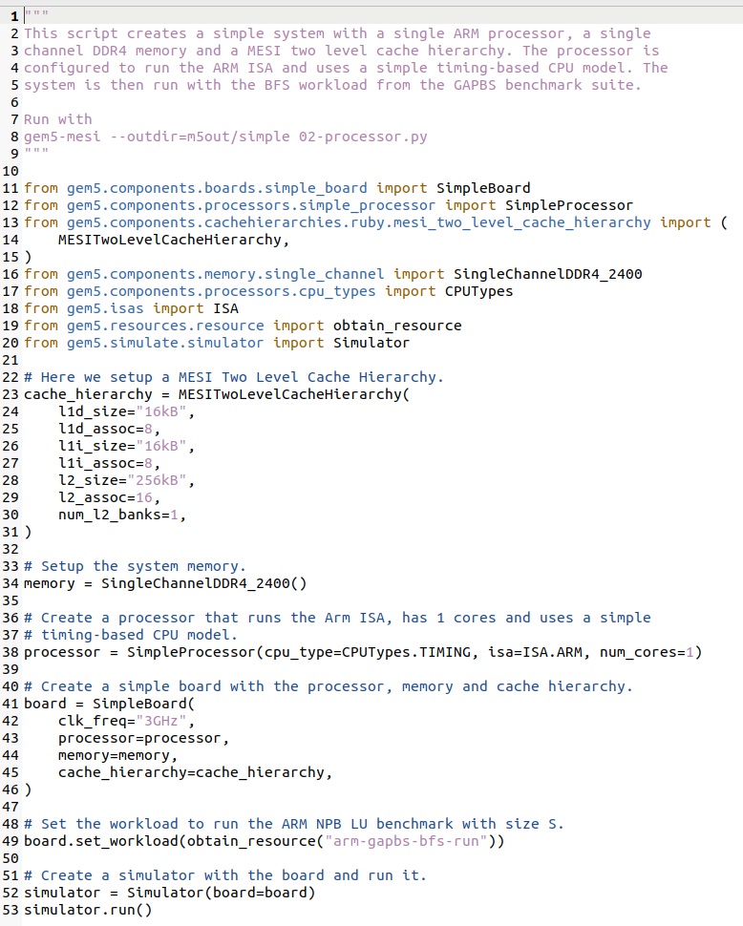
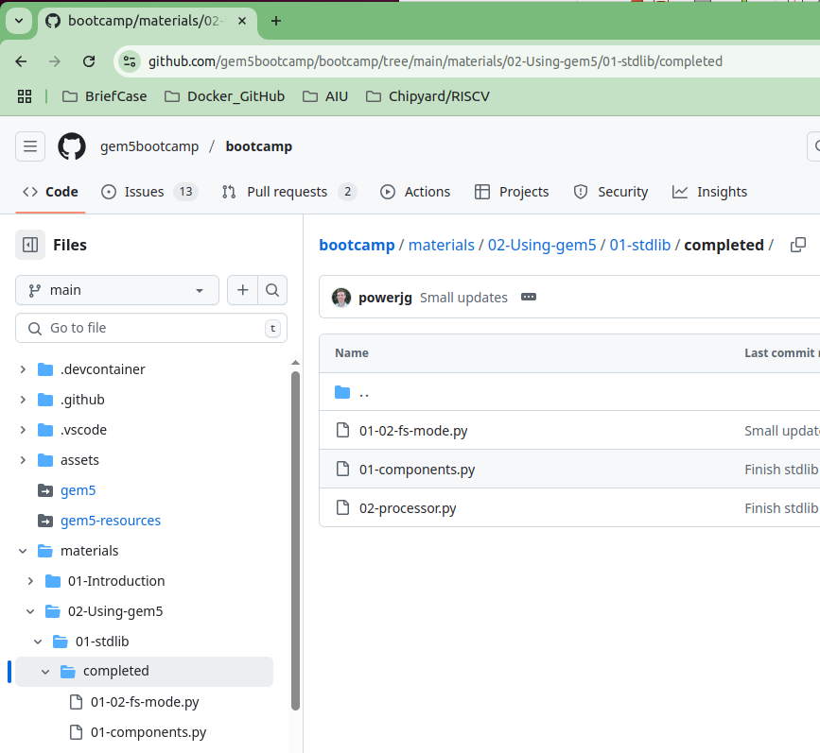
4.8 Complete StdLib Coding
https://www.youtube.com/watch?v=I8UUqyXWz_g&list=PL_hVbFs_loVR_8ntTTmmG6YEq3Po_4snu&index=4
Complete StdLib Coding (9:36-9:37/50:45)
Below, we can go to materials/02-Using-gem5/01-stdlib/completed/01-components.py for the completed code.
https://github.com/gem5bootcamp/bootcamp/tree/main/materials/02-Using-gem5/01-stdlib/completed

Slide 24
4.9 Run StdLib on Bootcamp Cloud

Slide 25
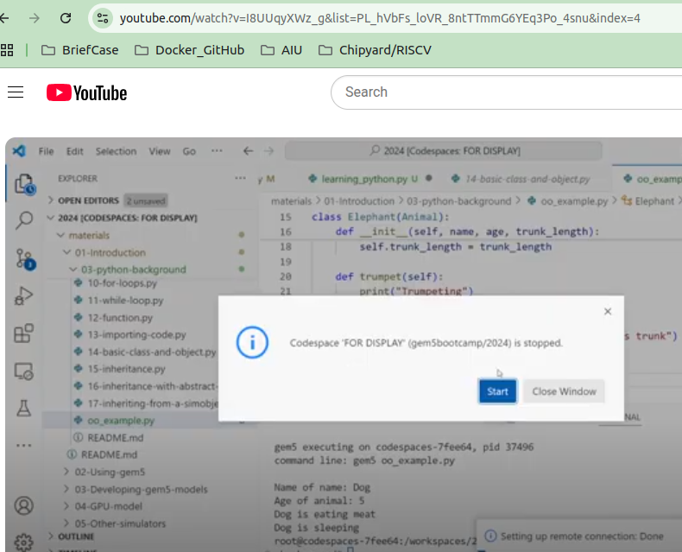
4.9 Run StdLib on Bootcamp Cloud
https://www.youtube.com/watch?v=I8UUqyXWz_g&list=PL_hVbFs_loVR_8ntTTmmG6YEq3Po_4snu&index=4
Run StdLib on Bootcamp Cloud (9:38-9:39/50:45)
We can run the code in bootcamp cloud.

Slide 26
4.10 Run StdLib on Local gem5.opt

Slide 27
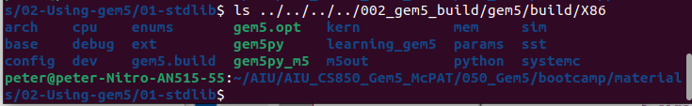
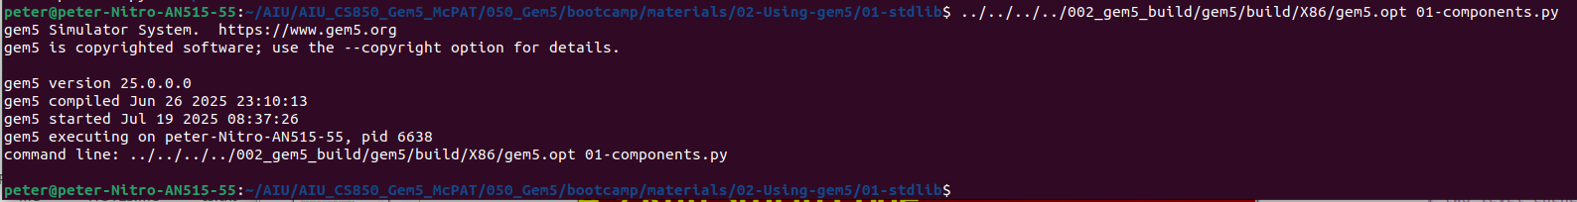
4.10 Run StdLib on Local gem5.opt
https://www.youtube.com/watch?v=I8UUqyXWz_g&list=PL_hVbFs_loVR_8ntTTmmG6YEq3Po_4snu&index=4
Run StdLib on Local gem5.opt (9:40-10:03/50:45)
We have built gem5.opt in the 002_gem5_build/gem5/X86/gem5.opt folder.
> <path>/002_gem5_build/gem5/build/X86/gem5.opt 01-components.py
Result as below:
>>peter@peter-Nitro-AN515-55:~/AIU/AIU_CS850_Gem5_McPAT/050_Gem5/bootcamp/materials/02-Using-gem5/01-stdlib$ ../../../../002_gem5_build/gem5/build/X86/gem5.opt 01-components.py
>>> gem5 Simulator System. https://www.gem5.org
>>> gem5 is copyrighted software; use the --copyright option for details.
>>>
>>> gem5 version 25.0.0.0
>>> gem5 compiled Jun 26 2025 23:10:13
>>> gem5 started Jul 19 2025 08:37:26
>>> gem5 executing on peter-Nitro-AN515-55, pid 6638
>>> command line: ../../../../002_gem5_build/gem5/build/X86/gem5.opt 01-components.py

Slide 28
End

