Slide 1

14.1 Gem5 Power Model: Slides
Peter H. Chen

Slide 2
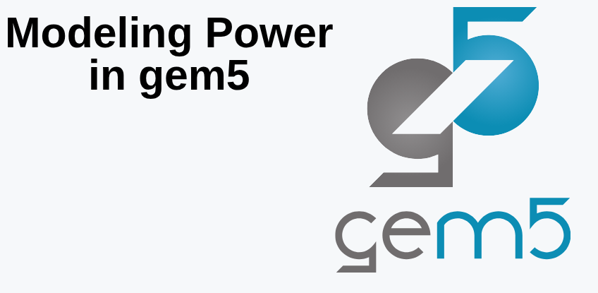
14.1 Gem5 Power Model: Slides
https://gem5bootcamp.github.io/2024/#02-Using-gem5/10-modeling-power
Gem5 Power Model: Slides

Slide 3
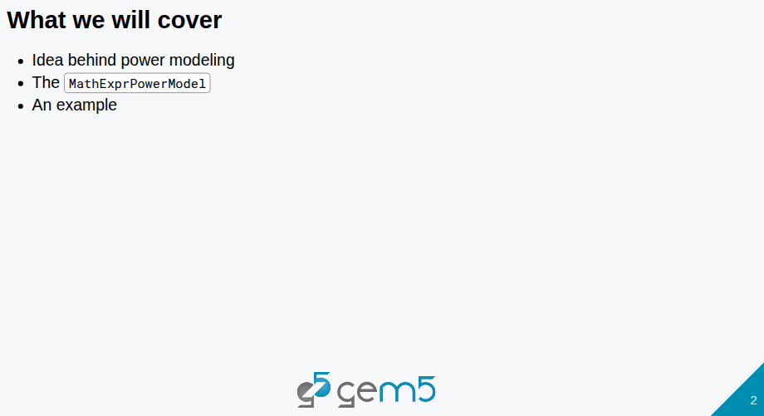
14.1 Gem5 Power Model: Slides
https://gem5bootcamp.github.io/2024/#02-Using-gem5/10-modeling-power
Gem5 Power Model: Slides

Slide 4
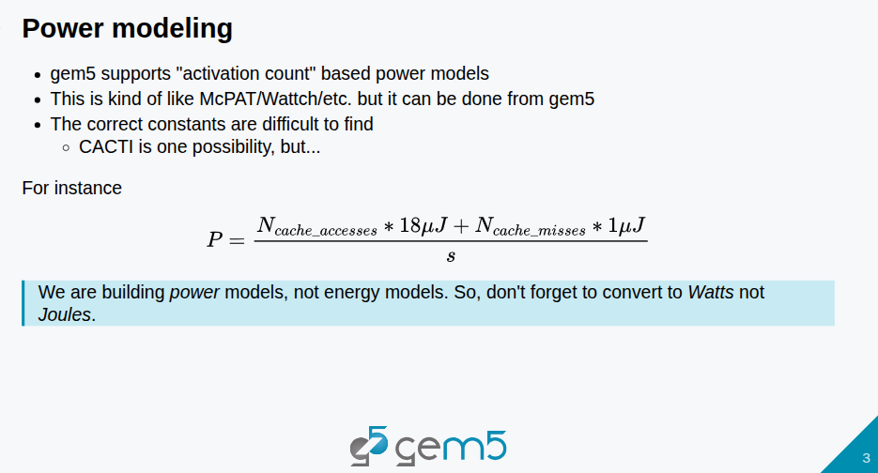
14.1 Gem5 Power Model: Slides
https://gem5bootcamp.github.io/2024/#02-Using-gem5/10-modeling-power
Gem5 Power Model: Slides

Slide 5
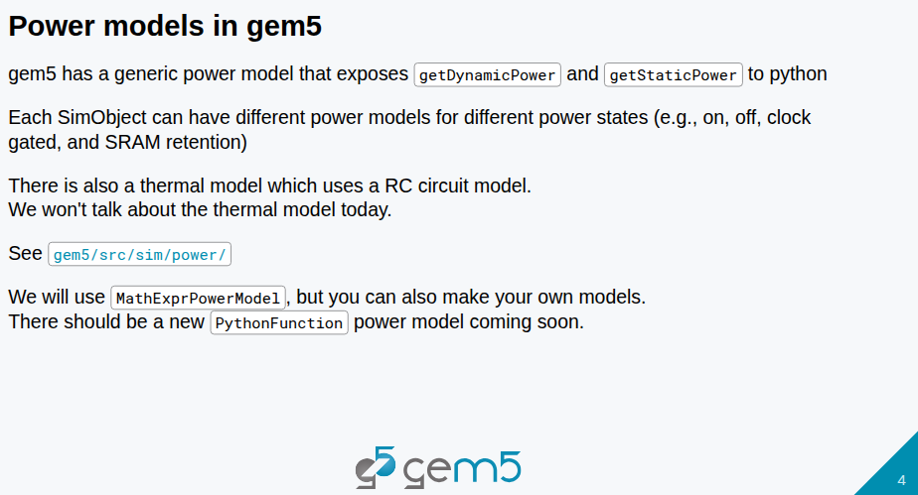
14.1 Gem5 Power Model: Slides
https://gem5bootcamp.github.io/2024/#02-Using-gem5/10-modeling-power
Gem5 Power Model: Slides

Slide 6
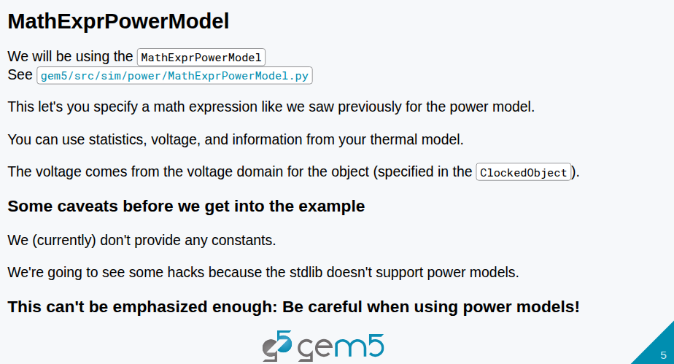
14.1 Gem5 Power Model: Slides
https://gem5bootcamp.github.io/2024/#02-Using-gem5/10-modeling-power
Gem5 Power Model: Slides

Slide 7
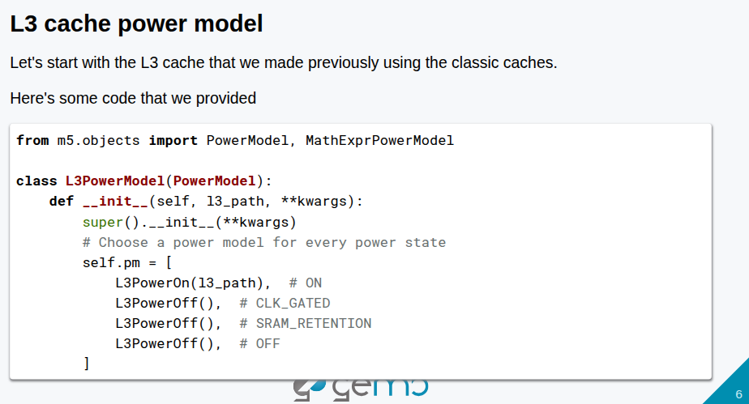
14.1 Gem5 Power Model: Slides
https://gem5bootcamp.github.io/2024/#02-Using-gem5/10-modeling-power
Gem5 Power Model: Slides

Slide 8
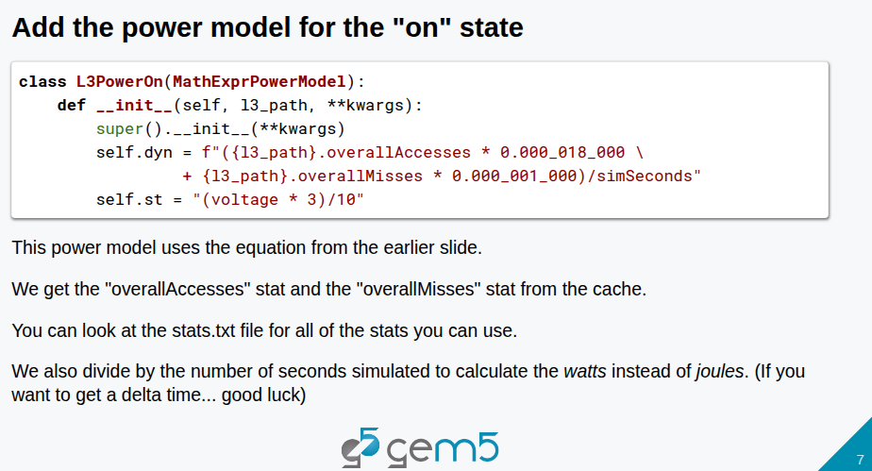
14.1 Gem5 Power Model: Slides
https://gem5bootcamp.github.io/2024/#02-Using-gem5/10-modeling-power
Gem5 Power Model: Slides

Slide 9
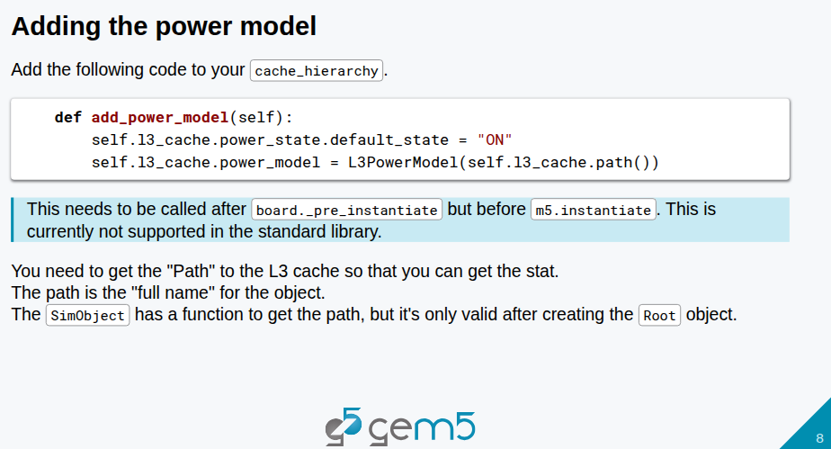
14.1 Gem5 Power Model: Slides
https://gem5bootcamp.github.io/2024/#02-Using-gem5/10-modeling-power
Gem5 Power Model: Slides

Slide 10
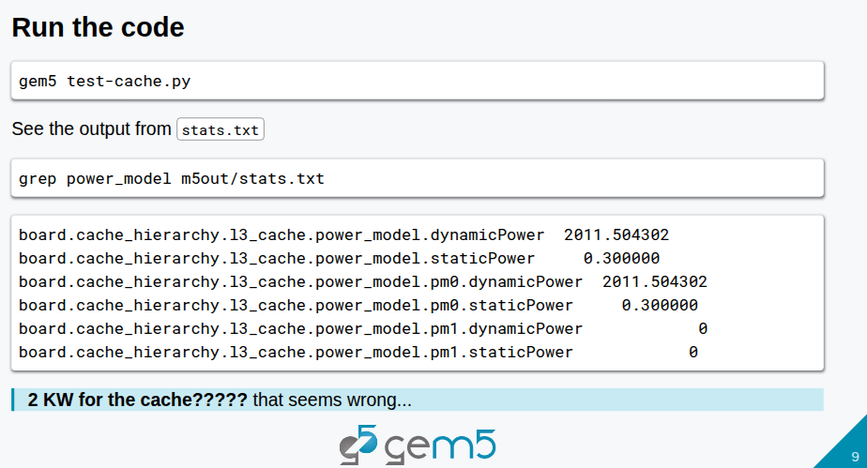
14.1 Gem5 Power Model: Slides
https://gem5bootcamp.github.io/2024/#02-Using-gem5/10-modeling-power
Gem5 Power Model: Slides

Slide 11
End

