Slide 1

2.1 Get Started
Peter H. Chen

Slide 2
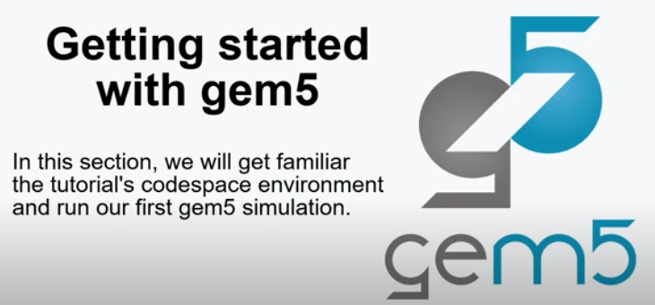
2.1 Get Started
https://www.youtube.com/watch?v=ExwHz4Z5bXc&list=PL_hVbFs_loVR_8ntTTmmG6YEq3Po_4snu&index=2
Get Started (0:00-0:27/18:47)
We talked about how to start Gem5 simulator. We share the environment with users.
We start with Python Programming.

Slide 3
2.2 Topics

Slide 4
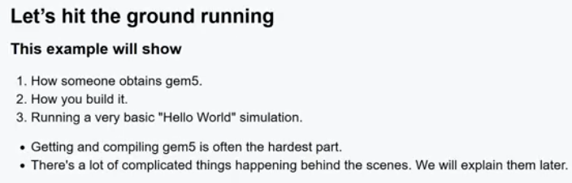
1.2 Topics
https://www.youtube.com/watch?v=ExwHz4Z5bXc&list=PL_hVbFs_loVR_8ntTTmmG6YEq3Po_4snu&index=2
Topics (0:28-0:57/18:47)
1. Gem5 is a Python interpreter
2. The Python script to interface gem5
3. Gem5 contains many Python Libraries: CPU Model, Cache Model, standard library
4. Output of Gem5 in folder m5out: Configuration, other outputs, Statistics output
5. Download Gem5 simulator.
6. Compile Gem5 into simulator gem5.opt: Optimized version).
7. Run example “Hello World” and basic.py with gem5.opt.

Slide 5
2.3 Download Gem5

Slide 6
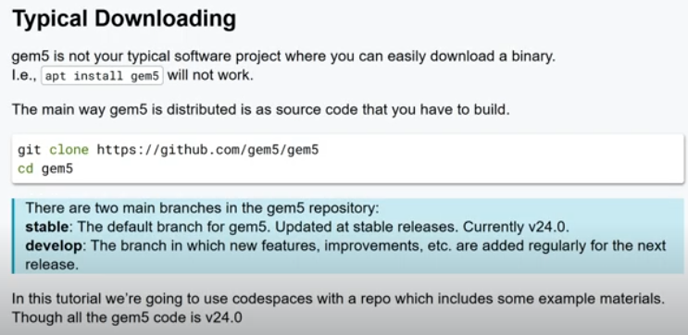
2.3 Download Gem5
https://www.youtube.com/watch?v=ExwHz4Z5bXc&list=PL_hVbFs_loVR_8ntTTmmG6YEq3Po_4snu&index=2
Download Gem5 (0:58-2:38/18:47)
Gem5 is a distributed source code. There are two branches in the Gem5 repository.
Compiled Gem5 is very difficult. Gem5 needs to be improved in future.
There is a stable version (version 24) on GitHub. We use stable version all the time.
Develop branch has new features.

Slide 7
2.4 Gem5 Version

Slide 8
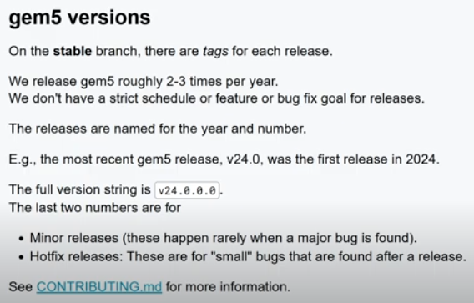
2.4 Gem5 Version
https://www.youtube.com/watch?v=ExwHz4Z5bXc&list=PL_hVbFs_loVR_8ntTTmmG6YEq3Po_4snu&index=2
Gem5 Version (2:39-3:55/18:47)
Gem5 is a distributed source code. There are two branches in the Gem5 repository.
Compiled Gem5 is very difficult. Gem5 needs to be improved in future.
There is a stable version (version 24) on GitHub. We use stable version all the time.
Develop branch has new features.
Release with four digits:
1. first: major,
2. Second: Minor
3. Third: Patch/bug fixes.
4. Fourth: Build for Revision.

Slide 9
2.5 Codespace 1

Slide 10
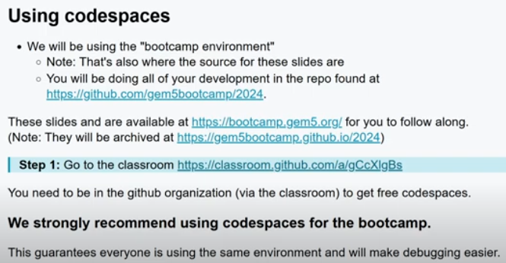
2.5 Codespace 1
https://www.youtube.com/watch?v=ExwHz4Z5bXc&list=PL_hVbFs_loVR_8ntTTmmG6YEq3Po_4snu&index=2
Codespace 1 (3:57-4:52/18:47)
1. Codespace is a cloud-based development environment that is pre-configured for developers to code, build, test, and debug applications directly within their web browser or a supported IDE like Visual Studio Code.
2. Codespace provides a virtual machine in the cloud, it pre-configured with the necessary tools and dependencies for a specific project, therefore, it eliminates the complex of local setups.

Slide 11
2.6 Github Classroom

Slide 12
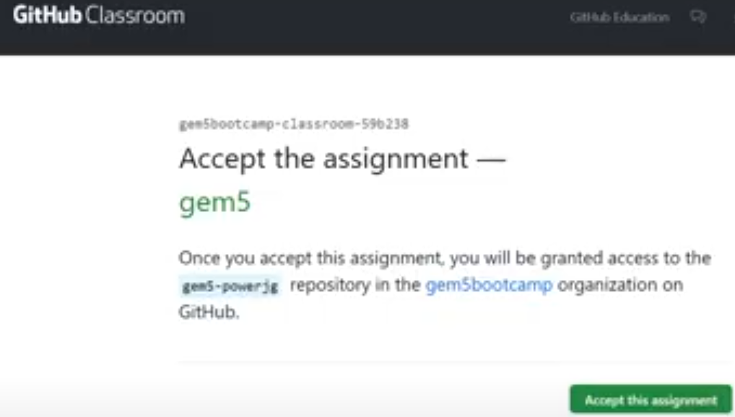
2.6 Github Classroom
https://www.youtube.com/watch?v=ExwHz4Z5bXc&list=PL_hVbFs_loVR_8ntTTmmG6YEq3Po_4snu&index=2
Github Classroom (4:53-4:59/18:47)
Class is pre-configured with Github environment.

Slide 13
2.7 Create Codespace

Slide 14
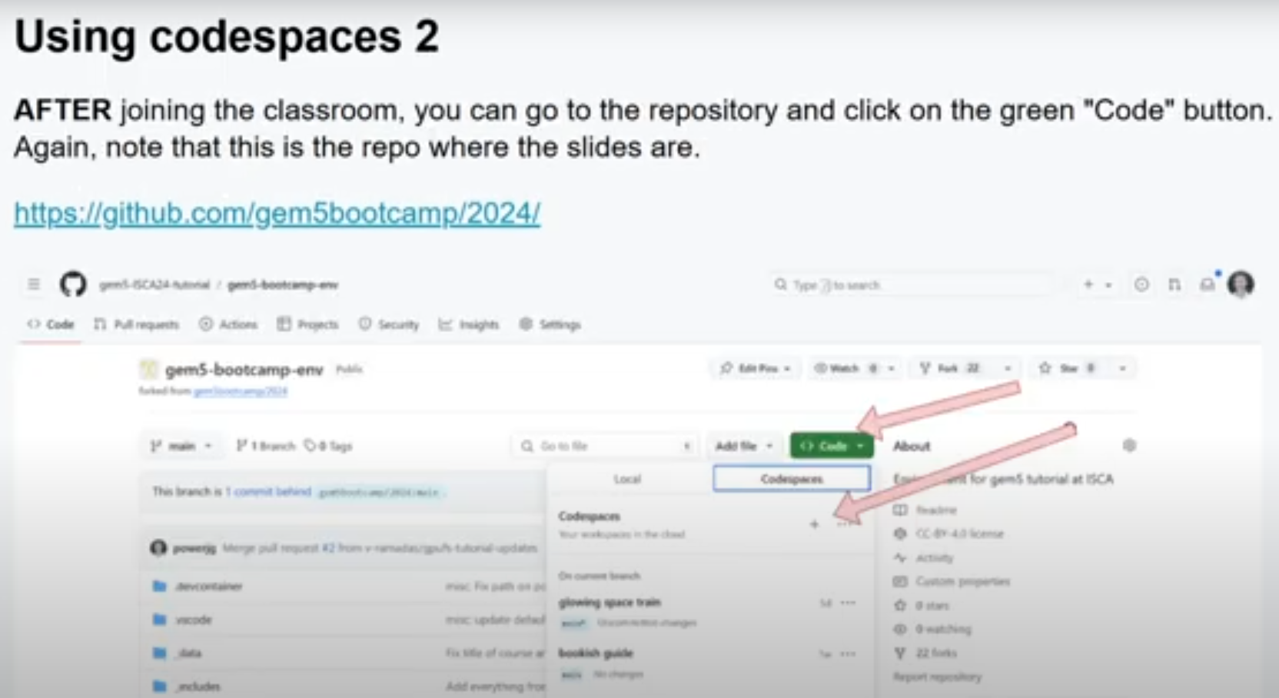
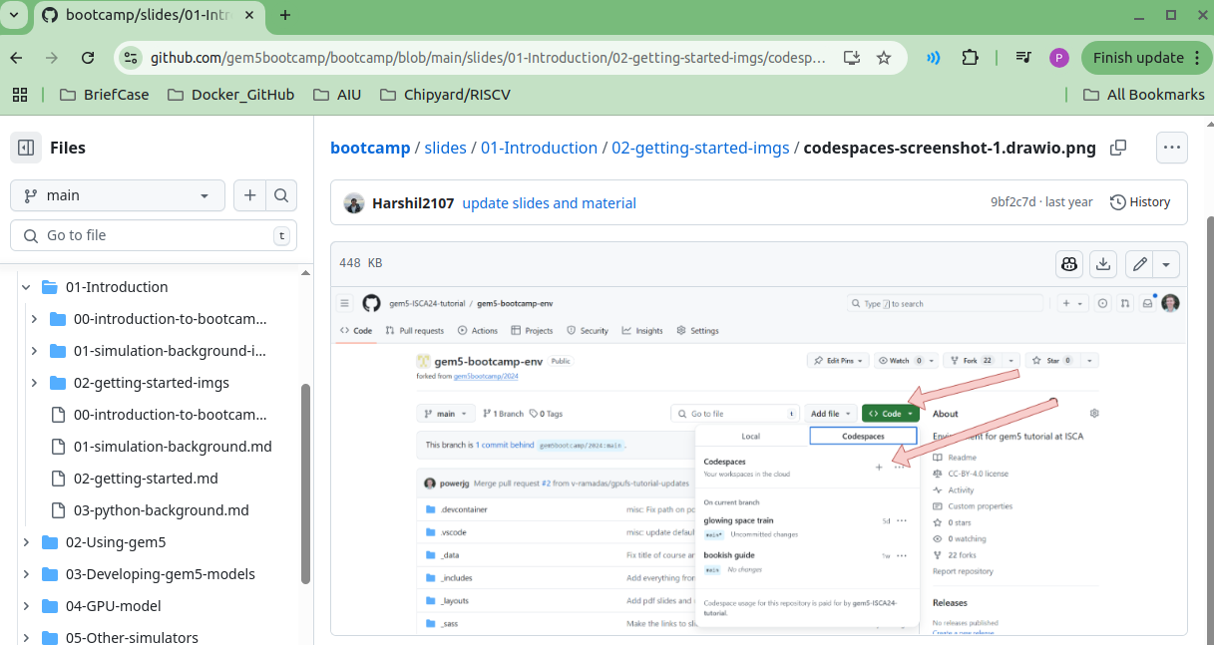
2.7 Create Codespace
https://www.youtube.com/watch?v=ExwHz4Z5bXc&list=PL_hVbFs_loVR_8ntTTmmG6YEq3Po_4snu&index=2
Create Codespace (5:00-5:54/18:47)
Click <> Code and Select “+” to create the Codespace on Github.

Slide 15
2.8 Gem5 Bootcamp Repository

Slide 16
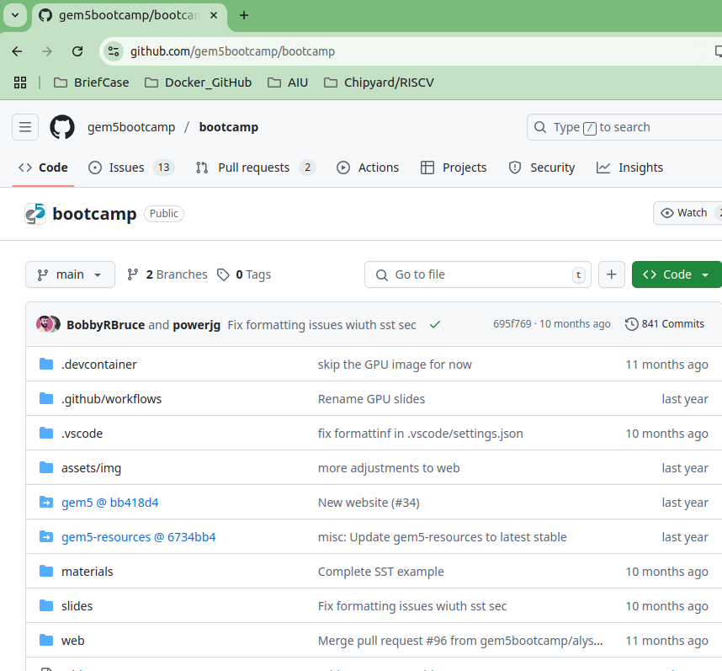
2.8 Gem5 Bootcamp Repository
https://www.youtube.com/watch?v=ExwHz4Z5bXc&list=PL_hVbFs_loVR_8ntTTmmG6YEq3Po_4snu&index=2
Gem5 bootcamp Repository (5:55-6:00/18:47)
We search “gem5 github bootcamp” and select “bootcamp and tutorial.”
Browse the Gem5 repository directory structure.
First, we look at the slides and materials folders.
https://github.com/gem5bootcamp/bootcamp

Slide 17
2.9 Slides Folder

Slide 18
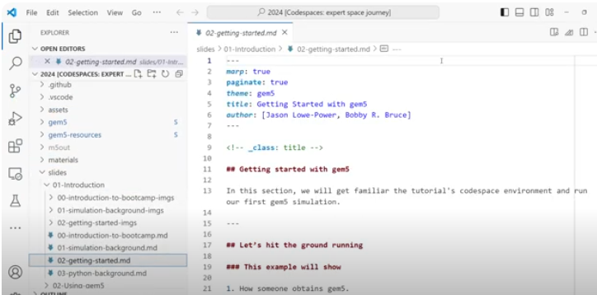
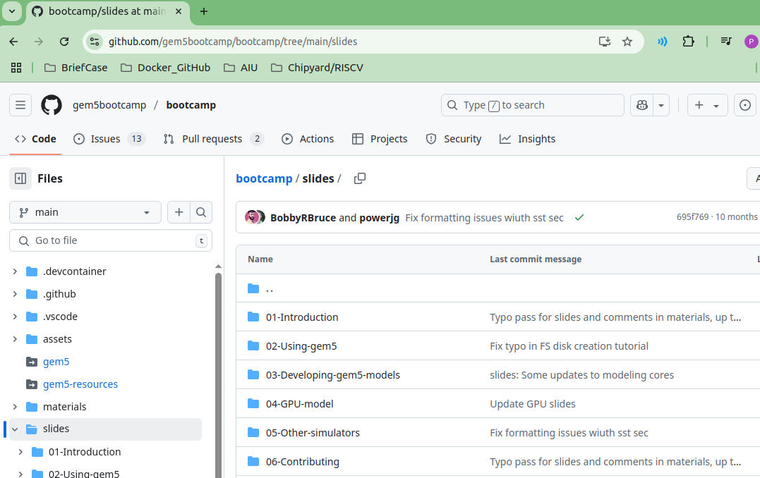
2.9 Slides Folder
https://www.youtube.com/watch?v=ExwHz4Z5bXc&list=PL_hVbFs_loVR_8ntTTmmG6YEq3Po_4snu&index=2
Slides Folder (6:01-6:30/18:47)
Sliders folder contains all the documents for gem5 users.
Slides show how to build and use gem5.
https://github.com/gem5bootcamp/bootcamp/tree/main/slides

Slide 19
2.10 Materials Folder

Slide 20
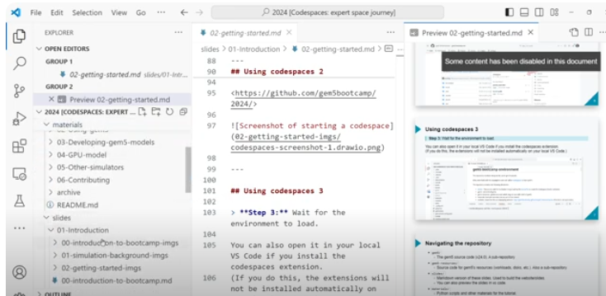
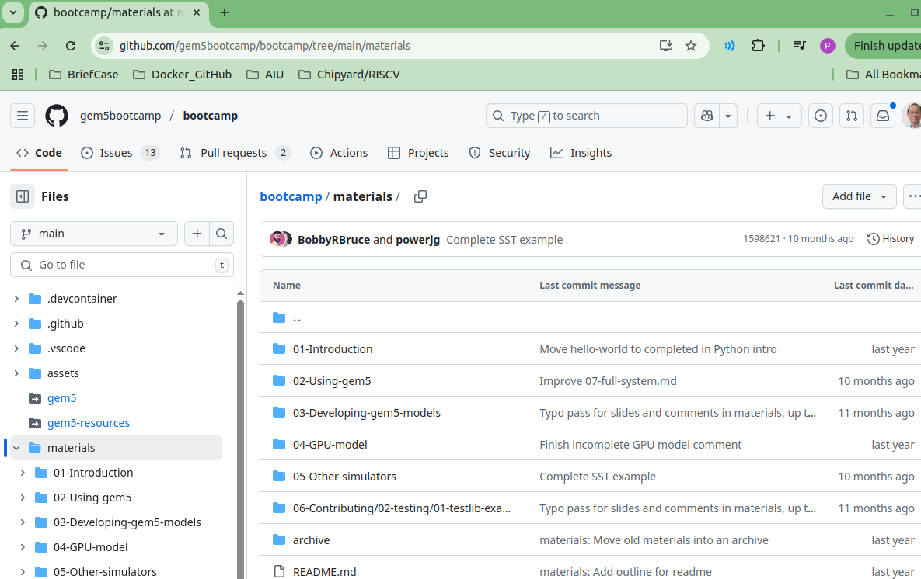
2.10 Materials Folder
https://www.youtube.com/watch?v=ExwHz4Z5bXc&list=PL_hVbFs_loVR_8ntTTmmG6YEq3Po_4snu&index=2
Materials Folder (6:31-7:00/18:47)
Materials folder contains the source code for corresponding Slides.
https://github.com/gem5bootcamp/bootcamp/tree/main/materials

Slide 21
2.11 Build Gem5

Slide 22
2.11 Build Gem5
https://www.youtube.com/watch?v=ExwHz4Z5bXc&list=PL_hVbFs_loVR_8ntTTmmG6YEq3Po_4snu&index=2
Materials Folder (7:01-7:02/18:47)
Q1. Can we download Gem5 prebuilt?
Ans: Download prebuilt Gem5 is not recommended. The easiest way I used is compile Gem5 (gem5.opt, gem5.fast, gem5.debug) under the Ubuntu and and run under Ubuntu.
Q2. How to download Gem5?
Ans: git clone https://github.com/gem5/gem5
Q3. How to compile Gem5?
After download gem5.
> cd gem5
> scons build/{ISA}/gem5.{variant} -j {cpus}
For example:
1. > scons build/ALL/gem5.opt -j8
# all architectures (X86/ARM/RISCV/AMD, etc), optimal version, 8 threads
2. > scons build/ALL/gem5.fast -j8 # basic version
3. > scons build/ALL/gem5.debug -j8
4. > scons build/RISCV/gem5.opt -j8
5. > scons build/X86/gem5.opt-j8
6. > scons build/ARM/gem5.opt -j8
7. > scons build/VEGA_X86/gem5.opt -j8 # AMD version
https://www.gem5.org/documentation/general_docs/building

Slide 23
2.11 Build Gem5
https://www.youtube.com/watch?v=ExwHz4Z5bXc&list=PL_hVbFs_loVR_8ntTTmmG6YEq3Po_4snu&index=2
Materials Folder (7:03-7:04/18:47)
Q4. How much memory required to compile?
Ans:
1. 8 GB RAM is good for X86 (gem5.opt, gem5.fast, gem5.debug) with -j8 (8 threads). Take long time (e.g., one night) to compile.
2. 16 GB RAM is good to compile all architectures (ALL/RISCV/X86/ARM/AMD, i.e., VEGA_X86, etc) with longer time (e.g., takes 2 hour) than 32 GB to compile.
3. 32 GB RAM is good to compile all architectures (ALL/RISCV/X86/ARM/AMD, i.e., VEGA_X86, etc) with less time (e.g., takes 1 hour) to compile.
https://www.gem5.org/documentation/general_docs/building

Slide 24
2.11 Build Gem5
https://www.youtube.com/watch?v=ExwHz4Z5bXc&list=PL_hVbFs_loVR_8ntTTmmG6YEq3Po_4snu&index=2
Materials Folder (7:05-7:44/18:47)
We have several gem5 binaries pre-built for users.
We don’t have to take the time to do that.
https://github.com/gem5bootcamp/bootcamp/tree/main/materials
Note:
Gem5 Compilation:

Slide 25
2.12 basic.py

Slide 26
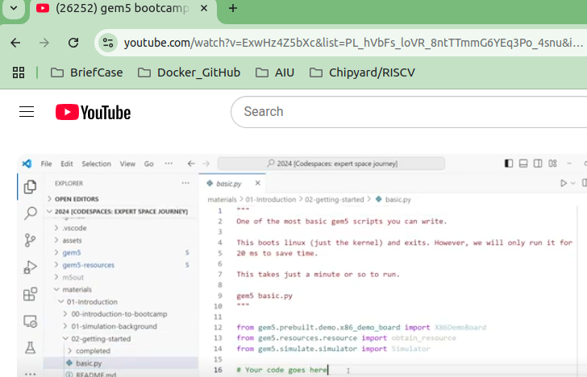
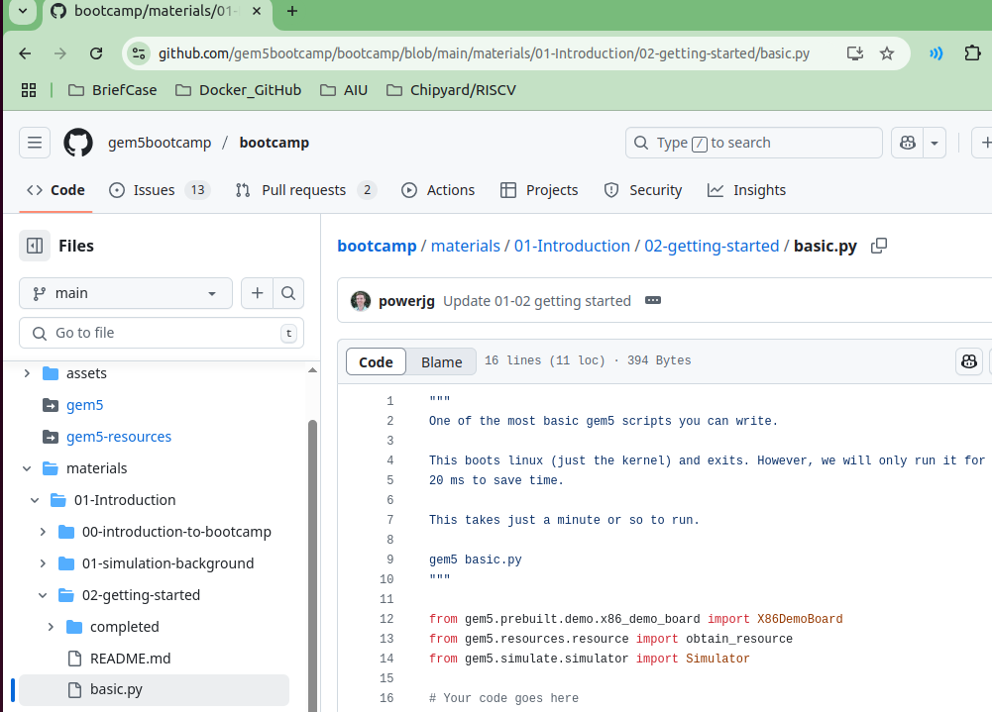
2.12 basic.py
https://www.youtube.com/watch?v=ExwHz4Z5bXc&list=PL_hVbFs_loVR_8ntTTmmG6YEq3Po_4snu&index=2
basic.py (7:01-8:59/18:47)
In Materials folder/01-Introduction/02-getting-started. There is a basic.py
The basic.py already imported the gem5 library for us.
We run 20ms to save time.
https://github.com/gem5bootcamp/bootcamp/blob/main/materials/01-Introduction/02-getting-started/basic.py

Slide 27
2.13 X86 Board

Slide 28
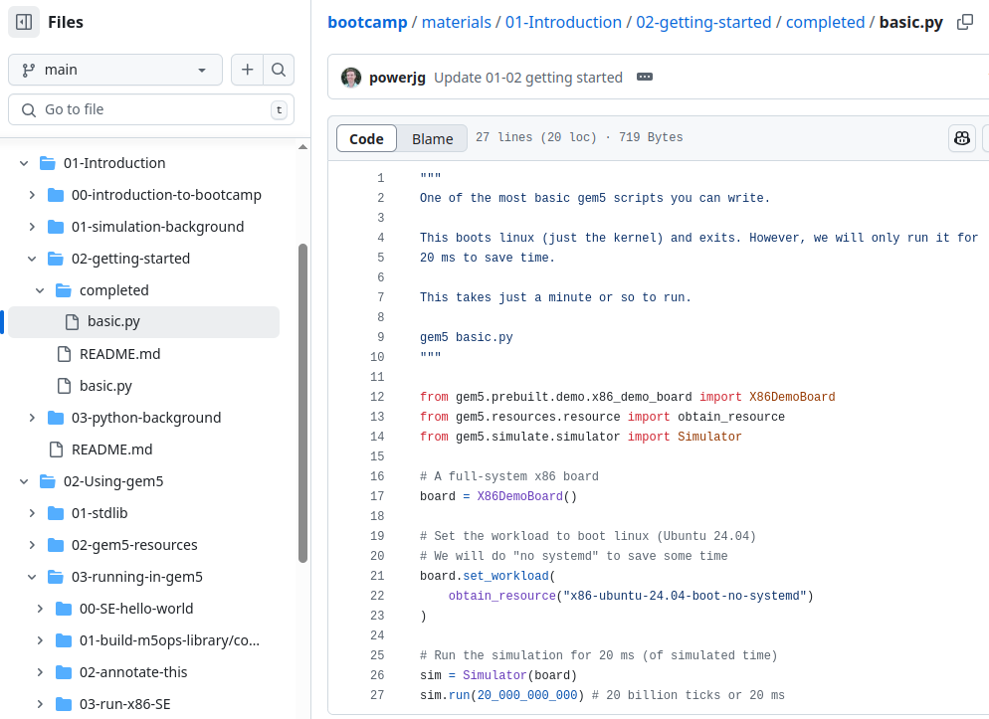
2.13 X86 Board
https://www.youtube.com/watch?v=ExwHz4Z5bXc&list=PL_hVbFs_loVR_8ntTTmmG6YEq3Po_4snu&index=2
X86 Board (9:00-9:32/18:47)
In the materials/01-Introduction/02-getting-ard()
> board = X86DemoBoard()
X86 Demo Board is for demo only, don't used it for your research:
  It has a single channel of a DDR3 memory and has a four cores, 3 GHz processor.
  It uses a very simple timing model, in-order model, from gem5.
  It has two-level cache hierarchy with first level: First level L1 is inside CPU core with L1i (Instruction) and L1d (Data). Second Level L2 and L3 are outside the CPU Core. L2 is larger and slower than L1. L3 cache is the largest and slowest.
  It runs in full system mode.
https://github.com/gem5bootcamp/bootcamp/blob/main/materials/01-Introduction/02-getting-started/completed/basic.py

Slide 29
2.14 X86 Board: Parameter

Slide 30
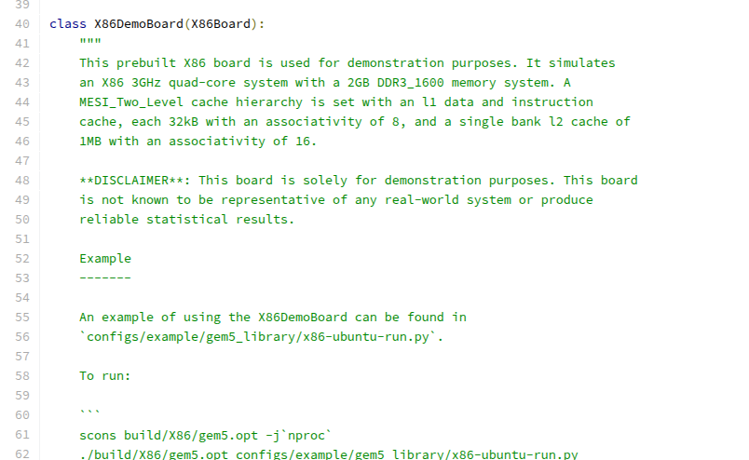
2.14 X86 Board: Parameter
https://www.youtube.com/watch?v=ExwHz4Z5bXc&list=PL_hVbFs_loVR_8ntTTmmG6YEq3Po_4snu&index=2
X86 Board: Parameter (9:33-9:47/18:47)
The class X86DemoBoard (X86Board) has passed in parameter X86Board.
https://gem5.googlesource.com/public/gem5/+/refs/tags/v21.2.0.0/src/python/gem5/prebuilt/demo/x86_demo_board.py

Slide 31
2.15 X86 Board: Set Workload

Slide 32
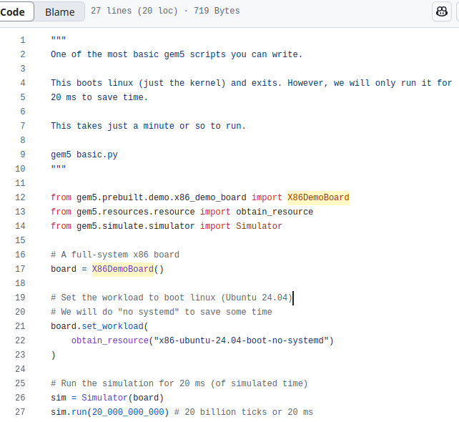
2.15 X86 Board: Set Workload
https://www.youtube.com/watch?v=ExwHz4Z5bXc&list=PL_hVbFs_loVR_8ntTTmmG6YEq3Po_4snu&index=2
X86 Board: Set Workload (9:48-10:40/18:47)
We set the workload for X86DemoBoard:
> board.set_workload (obtain_resource(“obtain_resource("x86-ubuntu-24.04-boot-no-systemd")
The resource name is “x86-ubuntu-24.04-boot-no-systemd”
https://github.com/gem5bootcamp/bootcamp/blob/main/materials/01-Introduction/02-getting-started/completed/basic.py

Slide 33
2.16 X86 Ubuntu Boot No Systemd

Slide 34
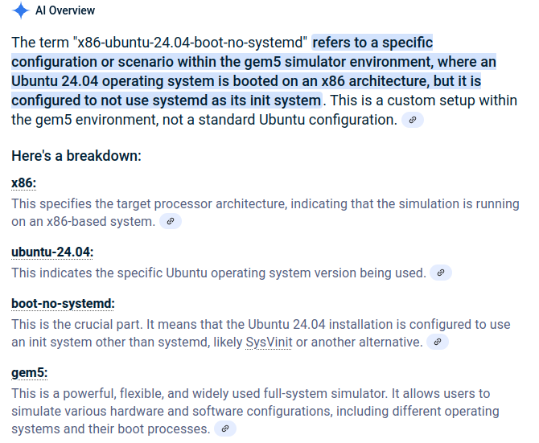
2.16 X86 Ubuntu Boot No Systemd
https://www.youtube.com/watch?v=ExwHz4Z5bXc&list=PL_hVbFs_loVR_8ntTTmmG6YEq3Po_4snu&index=2
X86 Board Ubuntu Boot No Systemd (9:48-11:17/18:47)
1. The "x86-ubuntu-24.04-boot-no-systemd" is a specific configuration within the gem5 simulator environment,
2. Ubuntu 24.04 operating system is booted on an x86 architecture. It is configured to not use systemd as its init system.
3. This is a custom setup within the gem5 environment, not a standard Ubuntu configuration.
Search for “x86-ubuntu-24.04-boot-no-systemd”

Slide 35
2.17 Create Simulator for Board

Slide 36
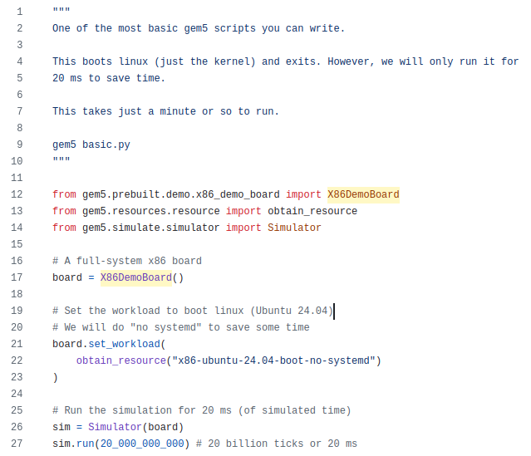
2.17 Create Simulator for Board
https://www.youtube.com/watch?v=ExwHz4Z5bXc&list=PL_hVbFs_loVR_8ntTTmmG6YEq3Po_4snu&index=2
Create Simulator for Board (11:18-11:27/18:47)
Create the simulator with the X86DemoBard.
> sim = Simulator (board)
https://github.com/gem5bootcamp/bootcamp/blob/main/materials/01-Introduction/02-getting-started/completed/basic.py

Slide 37
2.18 Run Simulator for Board

Slide 38
2.18 Run Simulator for Board
https://www.youtube.com/watch?v=ExwHz4Z5bXc&list=PL_hVbFs_loVR_8ntTTmmG6YEq3Po_4snu&index=2
Run Simulator for Board (11:28-12:10/18:47)
Run simulator with the X86DemoBard.
> sim.run (20_000_000_000)
Run 20 Billion ticks or 20 ms.
https://github.com/gem5bootcamp/bootcamp/blob/main/materials/01-Introduction/02-getting-started/completed/basic.py

Slide 39
2.19 Run Gem5 Simulator

Slide 40
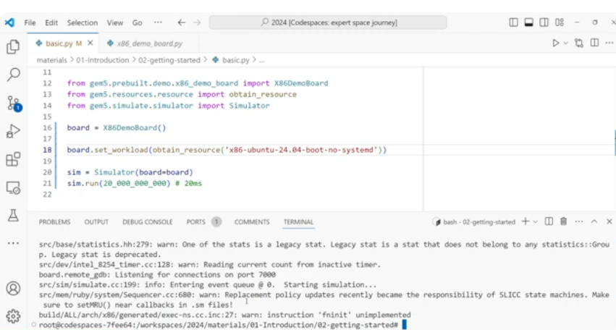
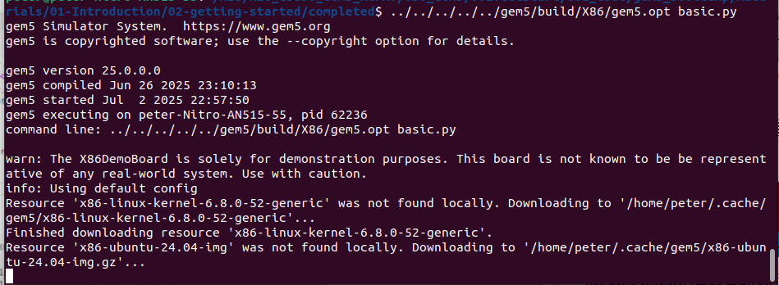
2.19 Run Gem5 Simulator
https://www.youtube.com/watch?v=ExwHz4Z5bXc&list=PL_hVbFs_loVR_8ntTTmmG6YEq3Po_4snu&index=2
Run Gem5 Simulator (12:11-14:27/18:47)
> cd materials.01_Introduction/02-getting-started/
We use compiled X86/gem5
> ../../../../../gem5/build/X86/gem5.opt basic.py
It takes 1 minute to run.

Slide 41
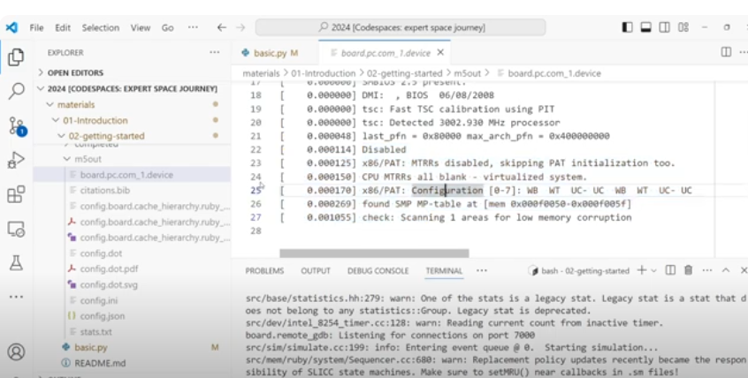
2.19 Run Gem5 Simulator
https://www.youtube.com/watch?v=ExwHz4Z5bXc&list=PL_hVbFs_loVR_8ntTTmmG6YEq3Po_4snu&index=2
Run Gem5 Simulator (15:28-16:27/18:47)
It generates several output files.

Slide 42
2.20 Gem5 Output: stats.txt

Slide 43
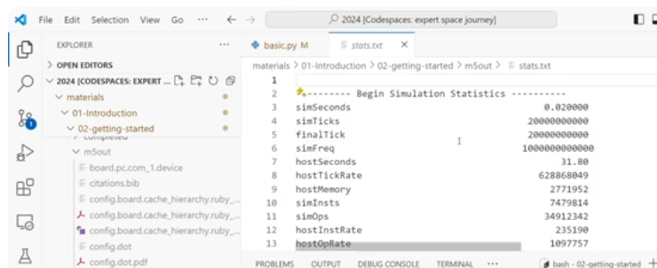
2.20 Gem5 Output: stats.txt
https://www.youtube.com/watch?v=ExwHz4Z5bXc&list=PL_hVbFs_loVR_8ntTTmmG6YEq3Po_4snu&index=2
Gem5 Output: stats.txt (16:28-16:58/18:47)
The output file is statistics output of gem5 simulation.
3. simSeconds: 0.02000 (20 mini-seconds)
7. hostSeconds 31.80 (The run time of the simulator is around 31.80 seconds)
10. simInsts: 7479814 (number of instruction, we have about 7 millions of instructions during this simulation)

Slide 44
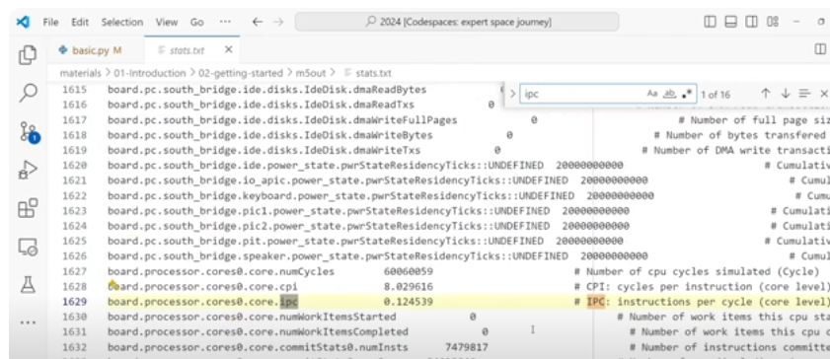
2.20 Gem5 Output: stats.txt
https://www.youtube.com/watch?v=ExwHz4Z5bXc&list=PL_hVbFs_loVR_8ntTTmmG6YEq3Po_4snu&index=2
Gem5 Output: stats.txt (16:59-17:44/18:47)
1629: Core.ipc: 0.124539 (The core interprocess communication is very low. It is a in order CPU. We do a bunch of memory accesses to boot up)

Slide 45
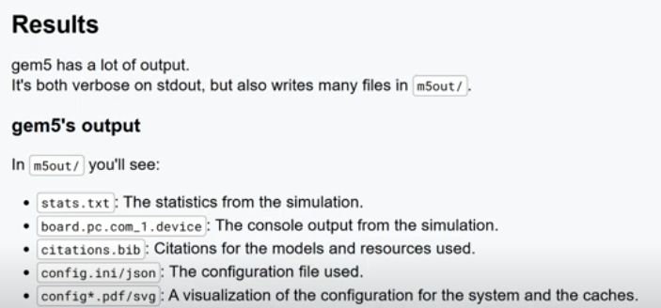
2.20 Gem5 Output: stats.txt
https://www.youtube.com/watch?v=ExwHz4Z5bXc&list=PL_hVbFs_loVR_8ntTTmmG6YEq3Po_4snu&index=2
Gem5 Output: stats.txt (17:45-17:48/18:47)
The Output files:
1. stats.txt
...

Slide 46
2.21 Summary

Slide 47
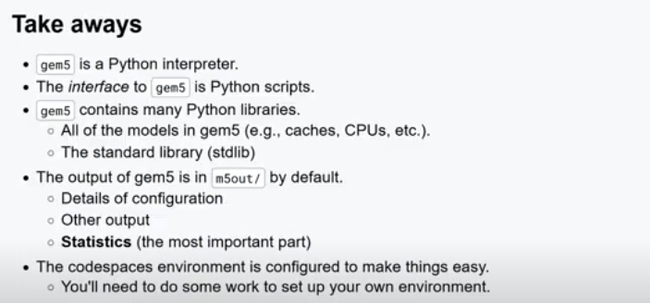
2.21 Summary
https://www.youtube.com/watch?v=ExwHz4Z5bXc&list=PL_hVbFs_loVR_8ntTTmmG6YEq3Po_4snu&index=2
Summary (17:49-18:47/18:47)
1. Gem5 is a Python interpreter
2. The Python script to interface gem5
3. Gem5 contains many Python Libraries: CPU Model, Cache Model, standard library
4. Output of Gem5 in folder m5out: Configuration, other outputs, Statistics output
5. We need to compile gem5 source code into gem5.opt (Optimized version) to run.

Slide 48
End

