Slide 1

11.1 Accelerate Gem5 Simulation: Slides
Peter H. Chen

Slide 2
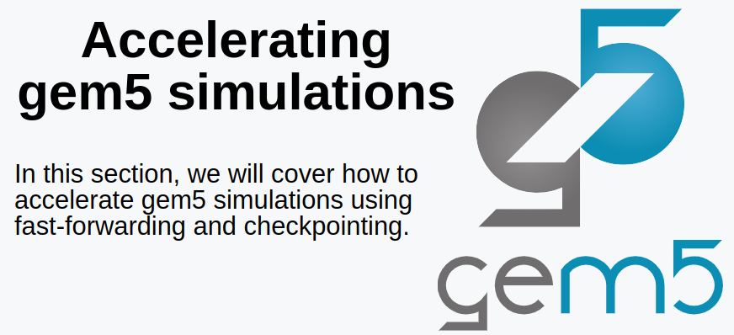
11.1 Accelerate Gem5 Simulation: Slides
https://gem5bootcamp.github.io/2024/#02-Using-gem5/08-accelerating-simulation
Accelerate Gem5 Simulation: Slides

Slide 3
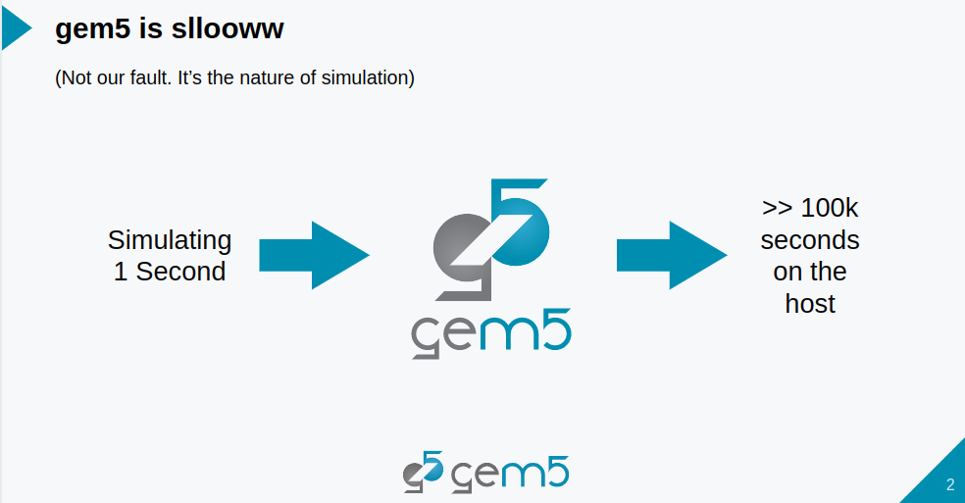
11.1 Accelerate Gem5 Simulation: Slides
https://gem5bootcamp.github.io/2024/#02-Using-gem5/08-accelerating-simulation
Accelerate Gem5 Simulation: Slides

Slide 4
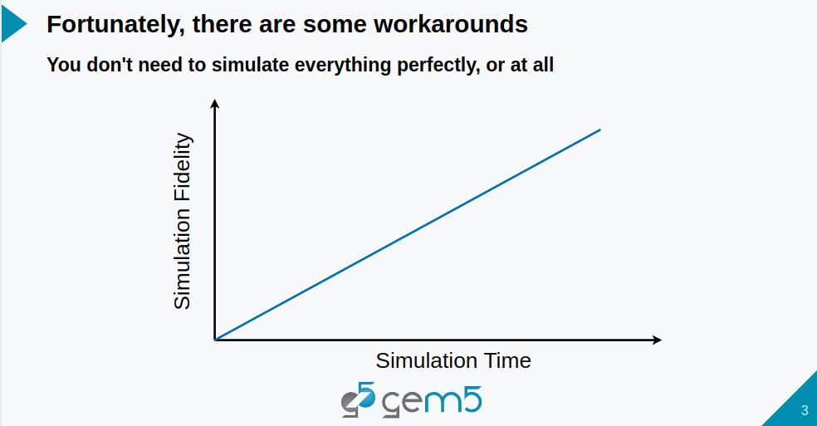
11.1 Accelerate Gem5 Simulation: Slides
https://gem5bootcamp.github.io/2024/#02-Using-gem5/08-accelerating-simulation
Accelerate Gem5 Simulation: Slides

Slide 5
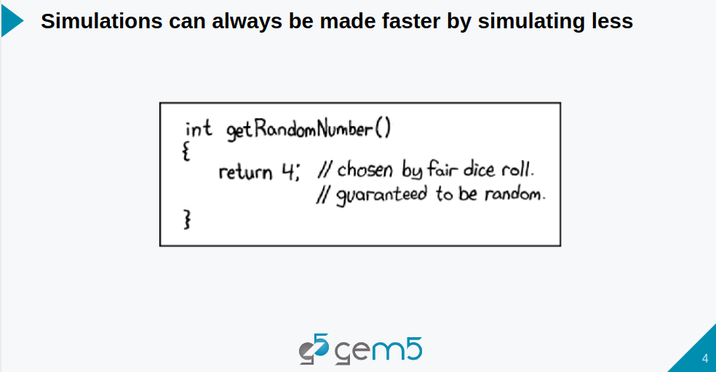
11.1 Accelerate Gem5 Simulation: Slides
https://gem5bootcamp.github.io/2024/#02-Using-gem5/08-accelerating-simulation
Accelerate Gem5 Simulation: Slides

Slide 6
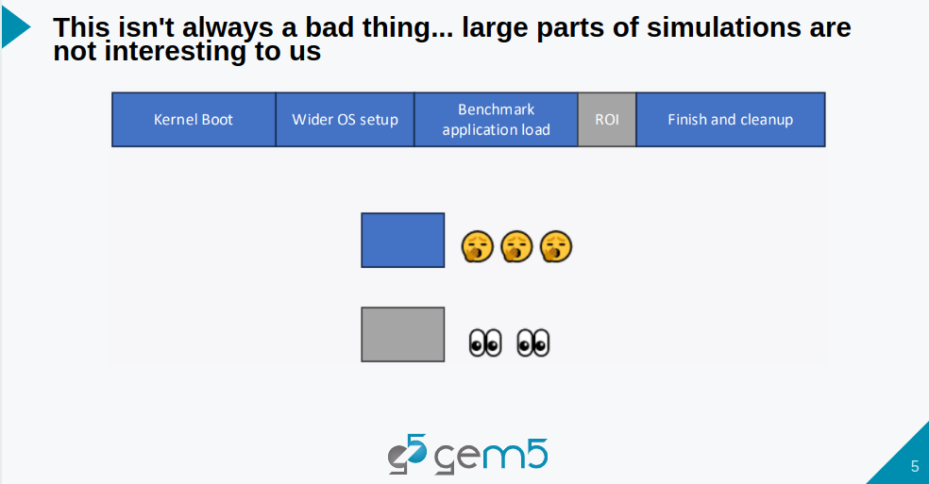
11.1 Accelerate Gem5 Simulation: Slides
https://gem5bootcamp.github.io/2024/#02-Using-gem5/08-accelerating-simulation
Accelerate Gem5 Simulation: Slides

Slide 7
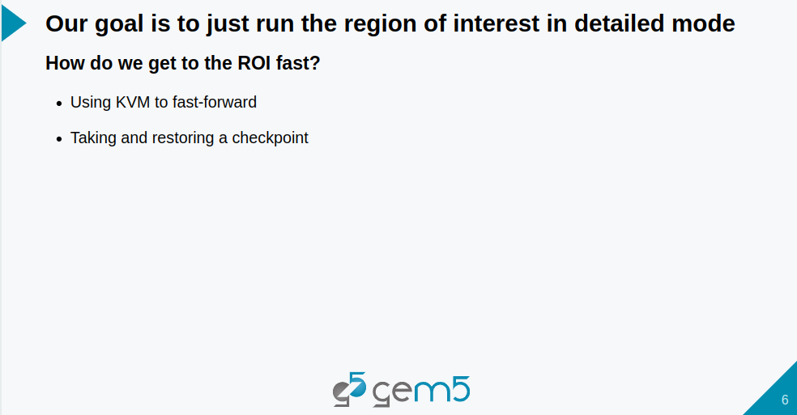
11.1 Accelerate Gem5 Simulation: Slides
https://gem5bootcamp.github.io/2024/#02-Using-gem5/08-accelerating-simulation
Accelerate Gem5 Simulation: Slides

Slide 8
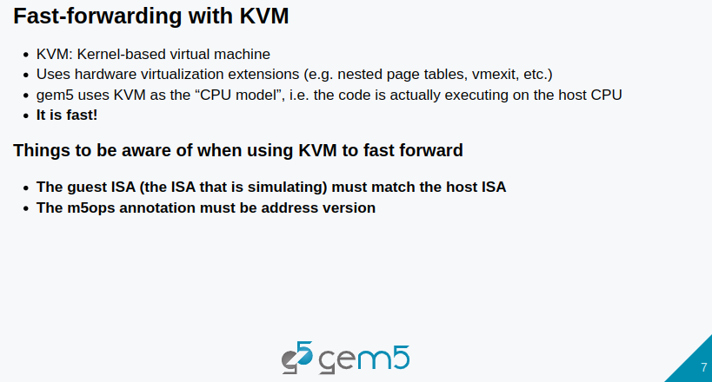
11.1 Accelerate Gem5 Simulation: Slides
https://gem5bootcamp.github.io/2024/#02-Using-gem5/08-accelerating-simulation
Accelerate Gem5 Simulation: Slides

Slide 9
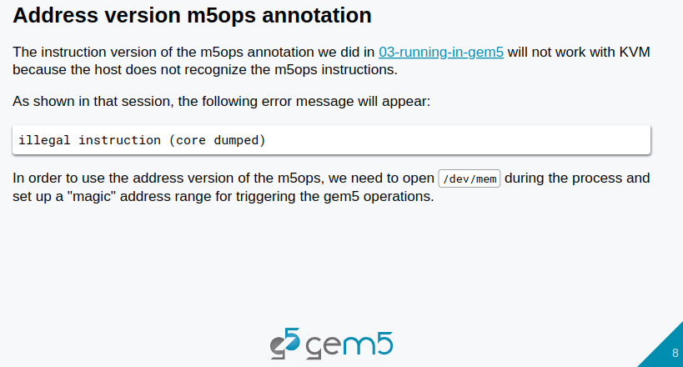
11.1 Accelerate Gem5 Simulation: Slides
https://gem5bootcamp.github.io/2024/#02-Using-gem5/08-accelerating-simulation
Accelerate Gem5 Simulation: Slides

Slide 10
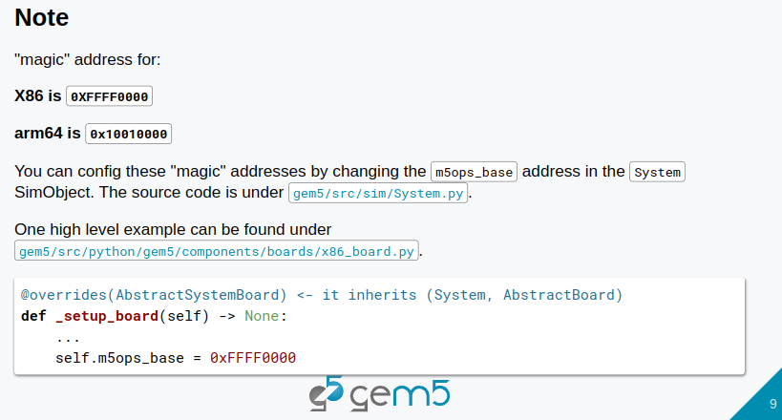
11.1 Accelerate Gem5 Simulation: Slides
https://gem5bootcamp.github.io/2024/#02-Using-gem5/08-accelerating-simulation
Accelerate Gem5 Simulation: Slides

Slide 11
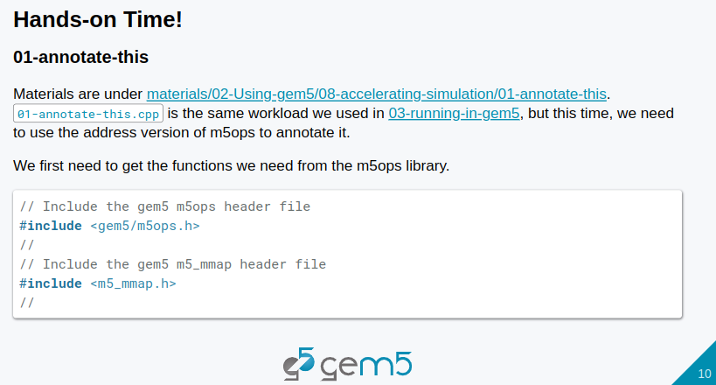
11.1 Accelerate Gem5 Simulation: Slides
https://gem5bootcamp.github.io/2024/#02-Using-gem5/08-accelerating-simulation
Accelerate Gem5 Simulation: Slides

Slide 12
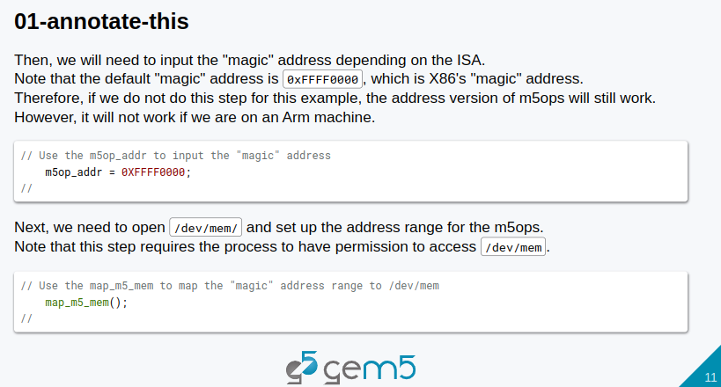
11.1 Accelerate Gem5 Simulation: Slides
https://gem5bootcamp.github.io/2024/#02-Using-gem5/08-accelerating-simulation
Accelerate Gem5 Simulation: Slides

Slide 13
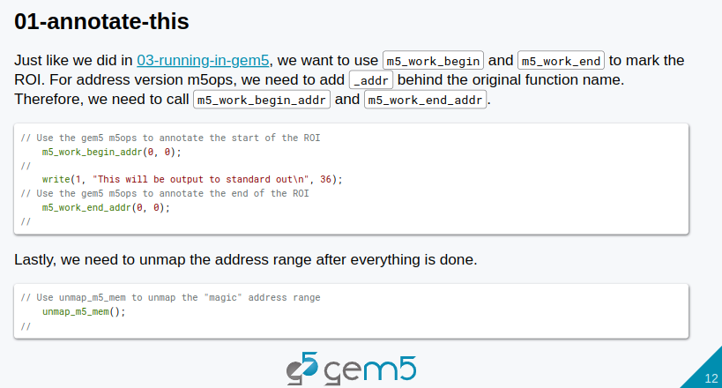
11.1 Accelerate Gem5 Simulation: Slides
https://gem5bootcamp.github.io/2024/#02-Using-gem5/08-accelerating-simulation
Accelerate Gem5 Simulation: Slides

Slide 14
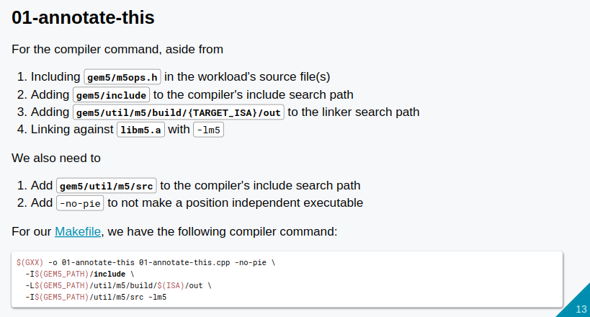
11.1 Accelerate Gem5 Simulation: Slides
https://gem5bootcamp.github.io/2024/#02-Using-gem5/08-accelerating-simulation
Accelerate Gem5 Simulation: Slides

Slide 15
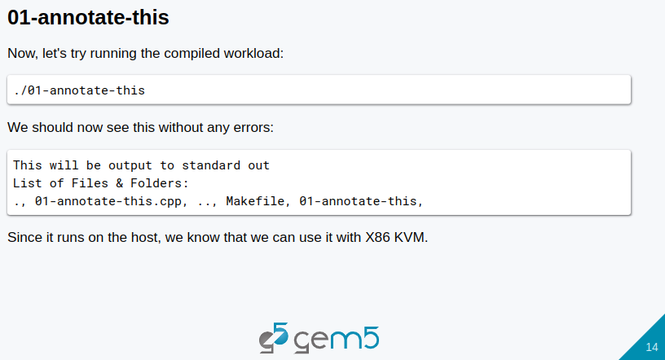
11.1 Accelerate Gem5 Simulation: Slides
https://gem5bootcamp.github.io/2024/#02-Using-gem5/08-accelerating-simulation
Accelerate Gem5 Simulation: Slides

Slide 16
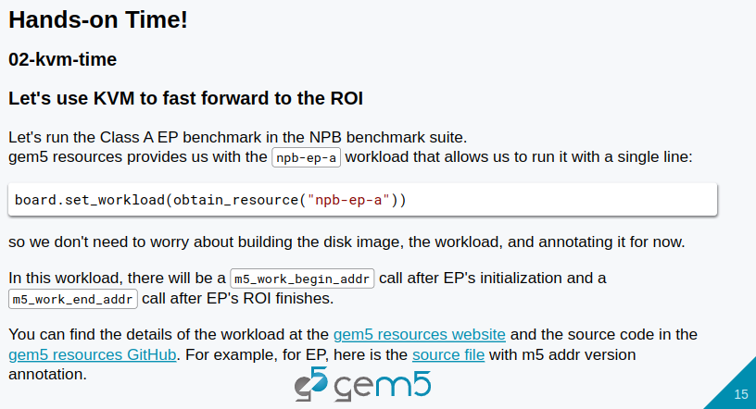
11.1 Accelerate Gem5 Simulation: Slides
https://gem5bootcamp.github.io/2024/#02-Using-gem5/08-accelerating-simulation
Accelerate Gem5 Simulation: Slides

Slide 17
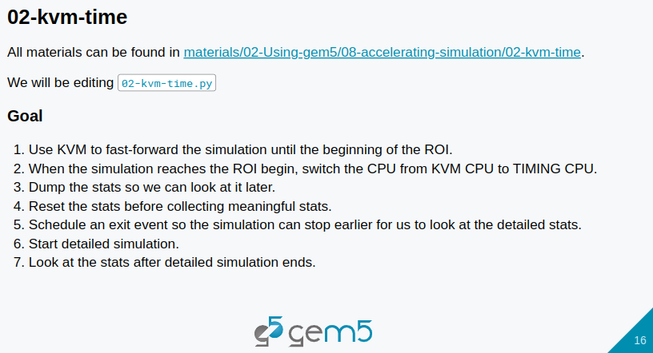
11.1 Accelerate Gem5 Simulation: Slides
https://gem5bootcamp.github.io/2024/#02-Using-gem5/08-accelerating-simulation
Accelerate Gem5 Simulation: Slides

Slide 18
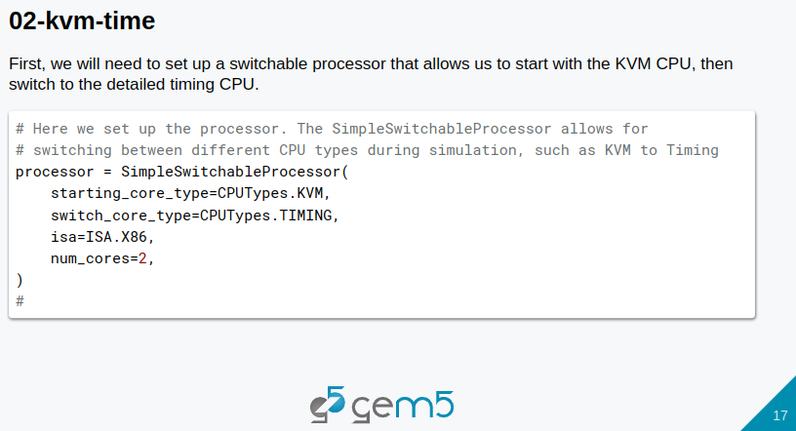
11.1 Accelerate Gem5 Simulation: Slides
https://gem5bootcamp.github.io/2024/#02-Using-gem5/08-accelerating-simulation
Accelerate Gem5 Simulation: Slides

Slide 19
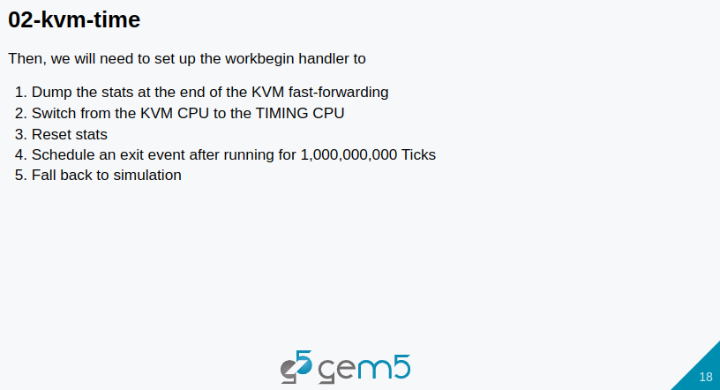
11.1 Accelerate Gem5 Simulation: Slides
https://gem5bootcamp.github.io/2024/#02-Using-gem5/08-accelerating-simulation
Accelerate Gem5 Simulation: Slides

Slide 20
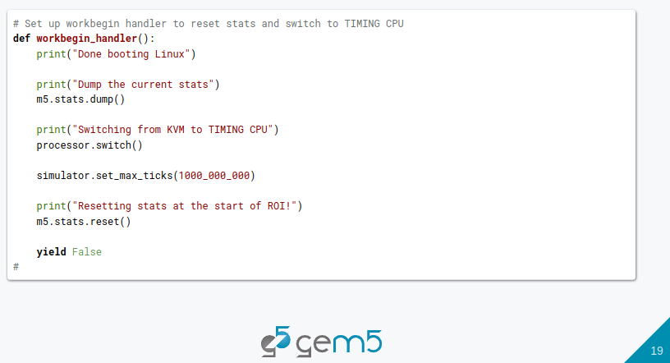
11.1 Accelerate Gem5 Simulation: Slides
https://gem5bootcamp.github.io/2024/#02-Using-gem5/08-accelerating-simulation
Accelerate Gem5 Simulation: Slides

Slide 21
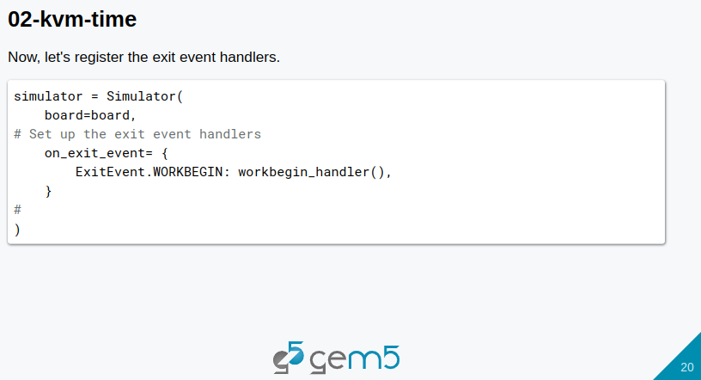
11.1 Accelerate Gem5 Simulation: Slides
https://gem5bootcamp.github.io/2024/#02-Using-gem5/08-accelerating-simulation
Accelerate Gem5 Simulation: Slides

Slide 22
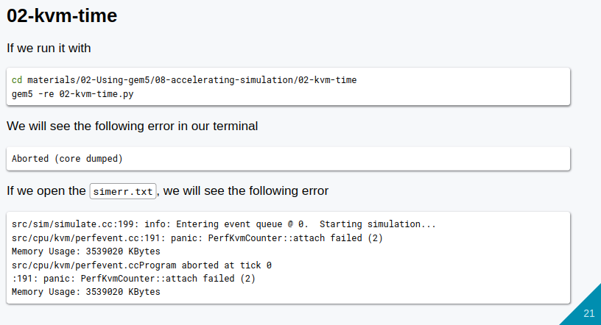
11.1 Accelerate Gem5 Simulation: Slides
https://gem5bootcamp.github.io/2024/#02-Using-gem5/08-accelerating-simulation
Accelerate Gem5 Simulation: Slides

Slide 23
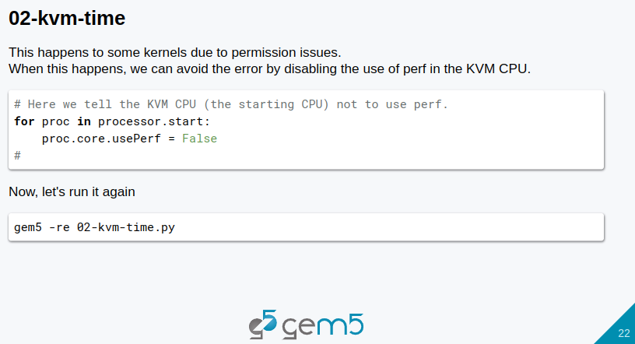
11.1 Accelerate Gem5 Simulation: Slides
https://gem5bootcamp.github.io/2024/#02-Using-gem5/08-accelerating-simulation
Accelerate Gem5 Simulation: Slides

Slide 24
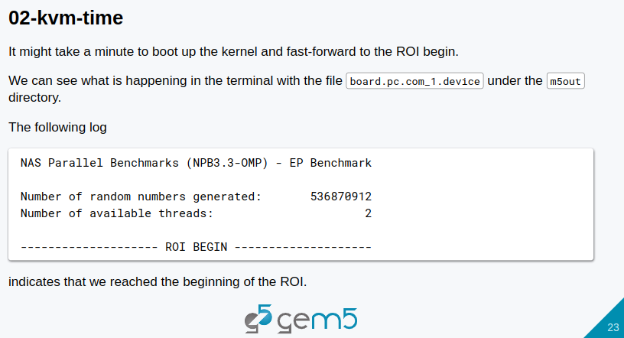
11.1 Accelerate Gem5 Simulation: Slides
https://gem5bootcamp.github.io/2024/#02-Using-gem5/08-accelerating-simulation
Accelerate Gem5 Simulation: Slides

Slide 25
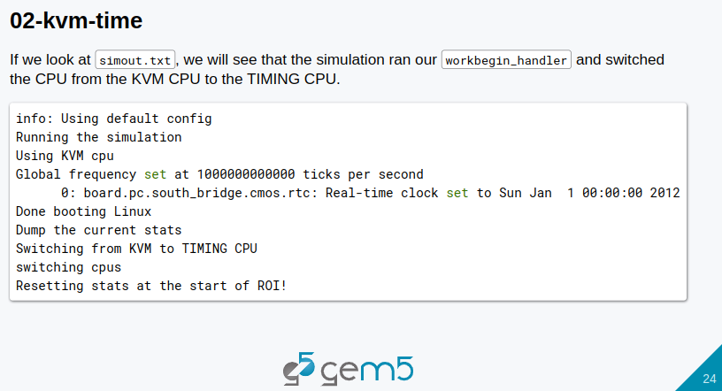
11.1 Accelerate Gem5 Simulation: Slides
https://gem5bootcamp.github.io/2024/#02-Using-gem5/08-accelerating-simulation
Accelerate Gem5 Simulation: Slides

Slide 26
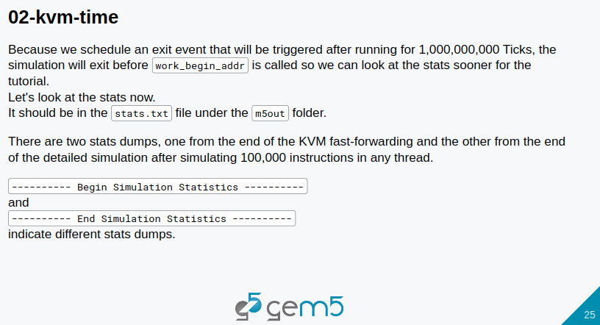
11.1 Accelerate Gem5 Simulation: Slides
https://gem5bootcamp.github.io/2024/#02-Using-gem5/08-accelerating-simulation
Accelerate Gem5 Simulation: Slides

Slide 27
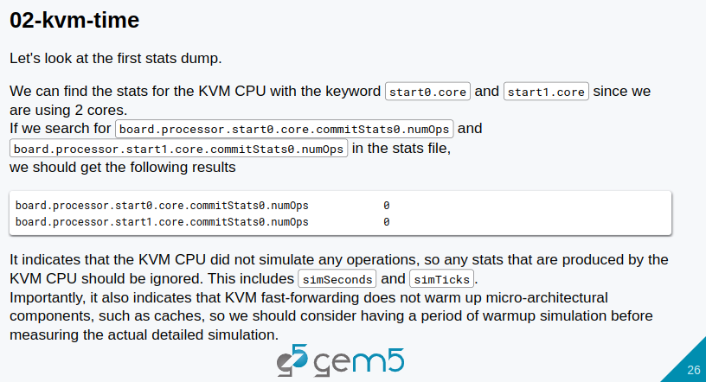
11.1 Accelerate Gem5 Simulation: Slides
https://gem5bootcamp.github.io/2024/#02-Using-gem5/08-accelerating-simulation
Accelerate Gem5 Simulation: Slides

Slide 28
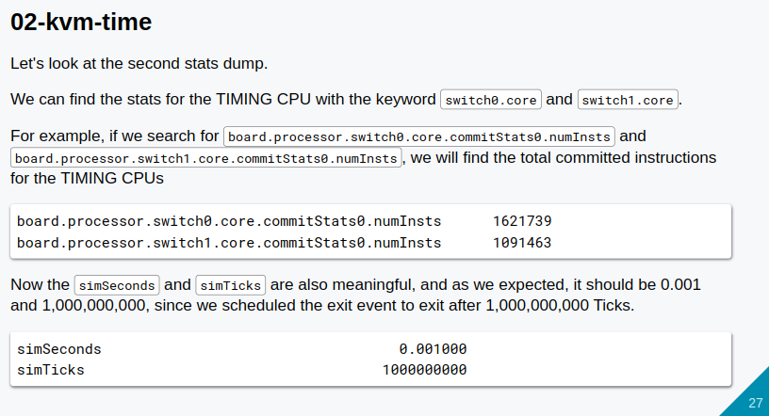
11.1 Accelerate Gem5 Simulation: Slides
https://gem5bootcamp.github.io/2024/#02-Using-gem5/08-accelerating-simulation
Accelerate Gem5 Simulation: Slides

Slide 29
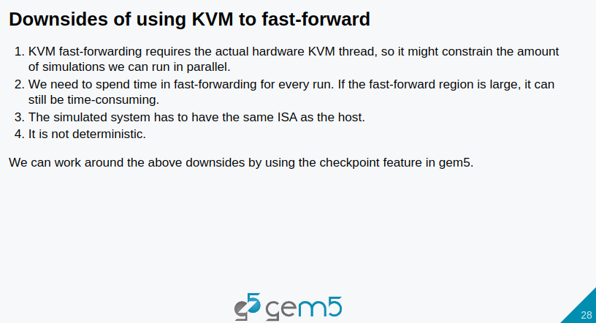
11.1 Accelerate Gem5 Simulation: Slides
https://gem5bootcamp.github.io/2024/#02-Using-gem5/08-accelerating-simulation
Accelerate Gem5 Simulation: Slides

Slide 30
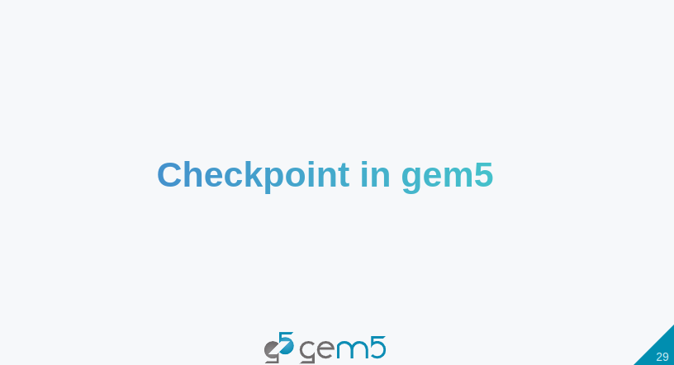
11.1 Accelerate Gem5 Simulation: Slides
https://gem5bootcamp.github.io/2024/#02-Using-gem5/08-accelerating-simulation
Accelerate Gem5 Simulation: Slides

Slide 31
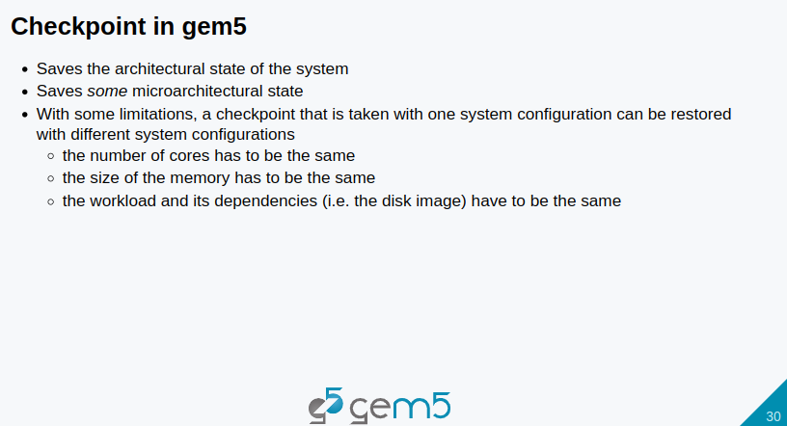
11.1 Accelerate Gem5 Simulation: Slides
https://gem5bootcamp.github.io/2024/#02-Using-gem5/08-accelerating-simulation
Accelerate Gem5 Simulation: Slides

Slide 32
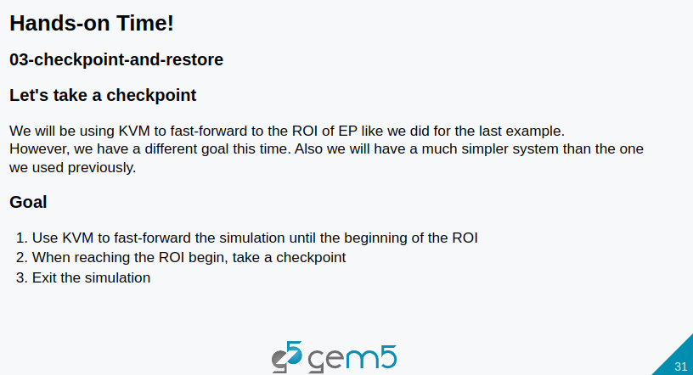
11.1 Accelerate Gem5 Simulation: Slides
https://gem5bootcamp.github.io/2024/#02-Using-gem5/08-accelerating-simulation
Accelerate Gem5 Simulation: Slides

Slide 33
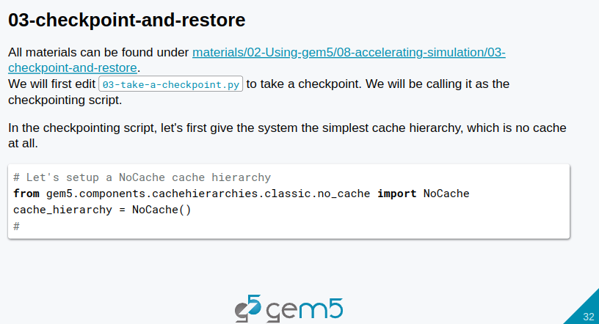
11.1 Accelerate Gem5 Simulation: Slides
https://gem5bootcamp.github.io/2024/#02-Using-gem5/08-accelerating-simulation
Accelerate Gem5 Simulation: Slides

Slide 34
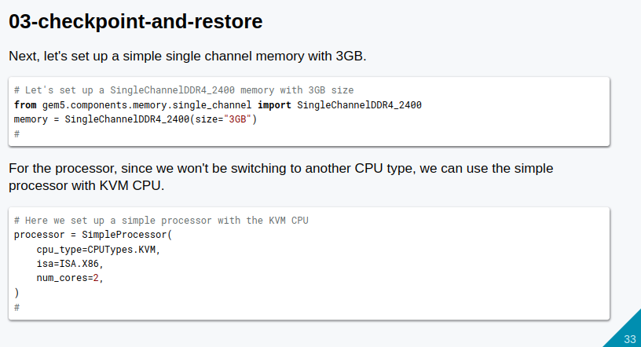
11.1 Accelerate Gem5 Simulation: Slides
https://gem5bootcamp.github.io/2024/#02-Using-gem5/08-accelerating-simulation
Accelerate Gem5 Simulation: Slides

Slide 35
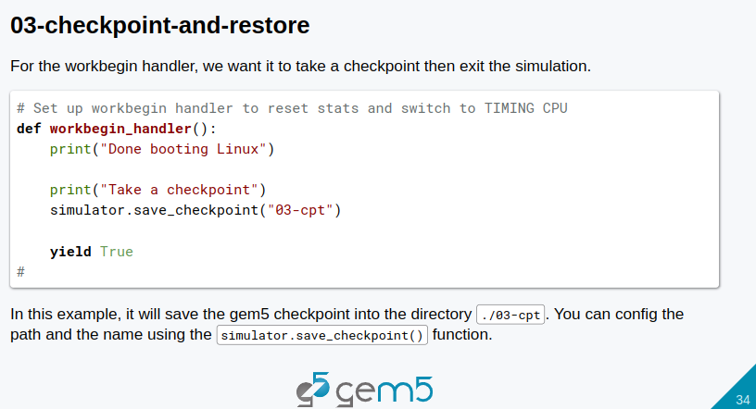
11.1 Accelerate Gem5 Simulation: Slides
https://gem5bootcamp.github.io/2024/#02-Using-gem5/08-accelerating-simulation
Accelerate Gem5 Simulation: Slides

Slide 36
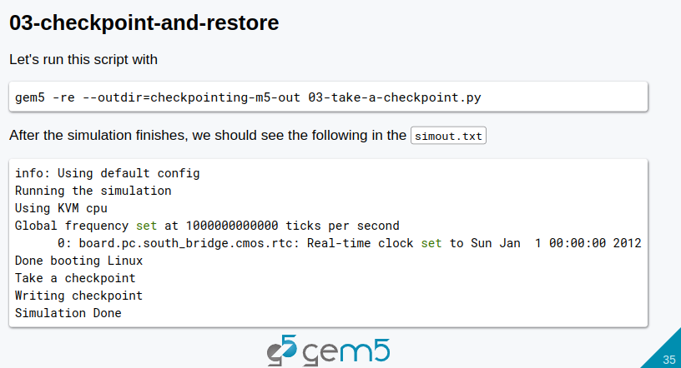
11.1 Accelerate Gem5 Simulation: Slides
https://gem5bootcamp.github.io/2024/#02-Using-gem5/08-accelerating-simulation
Accelerate Gem5 Simulation: Slides

Slide 37
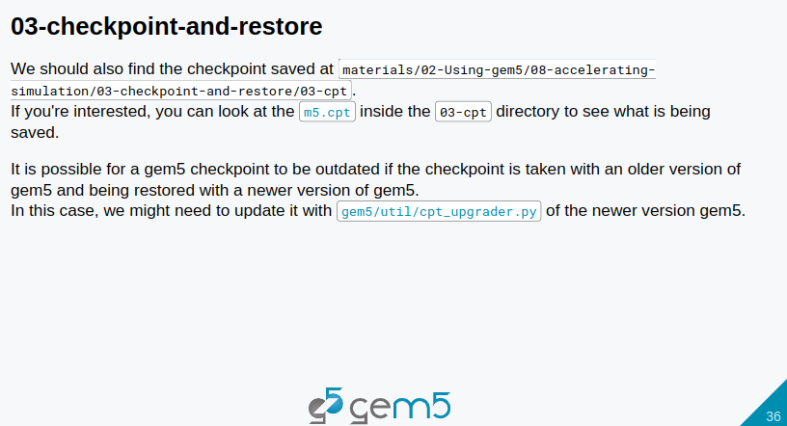
11.1 Accelerate Gem5 Simulation: Slides
https://gem5bootcamp.github.io/2024/#02-Using-gem5/08-accelerating-simulation
Accelerate Gem5 Simulation: Slides

Slide 38
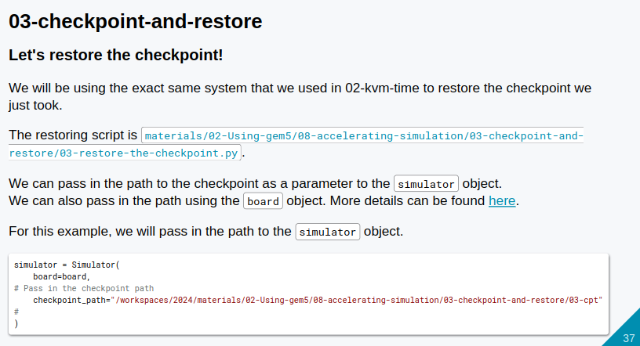
11.1 Accelerate Gem5 Simulation: Slides
https://gem5bootcamp.github.io/2024/#02-Using-gem5/08-accelerating-simulation
Accelerate Gem5 Simulation: Slides

Slide 39
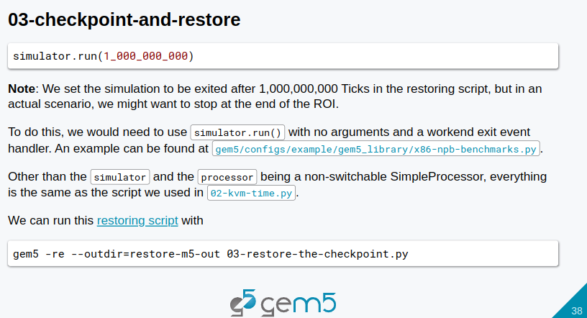
11.1 Accelerate Gem5 Simulation: Slides
https://gem5bootcamp.github.io/2024/#02-Using-gem5/08-accelerating-simulation
Accelerate Gem5 Simulation: Slides

Slide 40
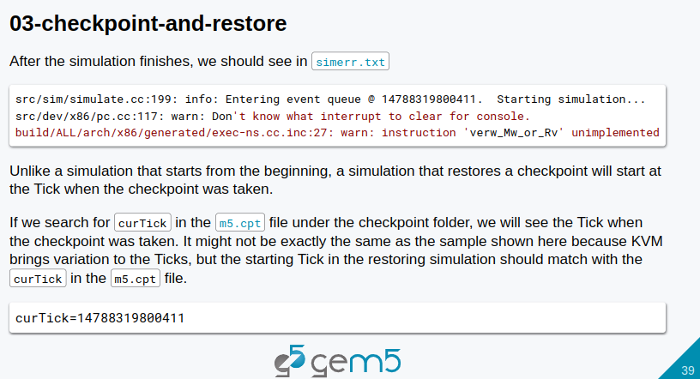
11.1 Accelerate Gem5 Simulation: Slides
https://gem5bootcamp.github.io/2024/#02-Using-gem5/08-accelerating-simulation
Accelerate Gem5 Simulation: Slides

Slide 41
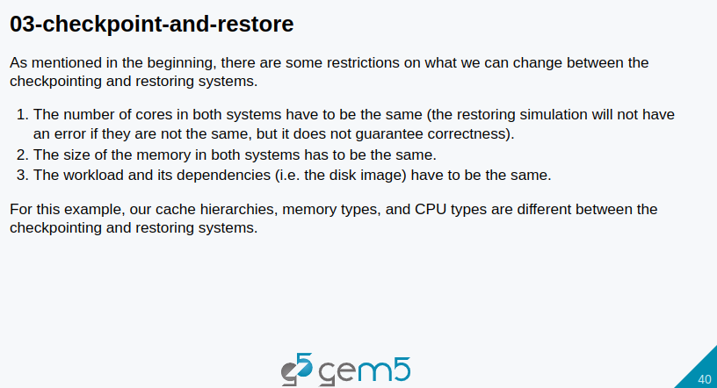
11.1 Accelerate Gem5 Simulation: Slides
https://gem5bootcamp.github.io/2024/#02-Using-gem5/08-accelerating-simulation
Accelerate Gem5 Simulation: Slides

Slide 42
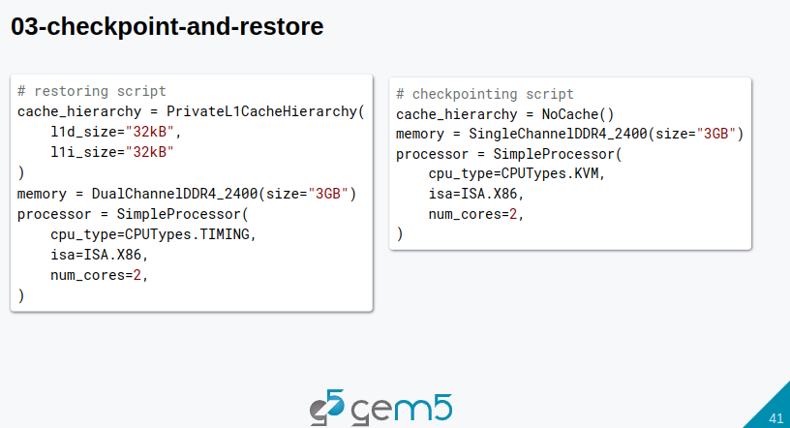
11.1 Accelerate Gem5 Simulation: Slides
https://gem5bootcamp.github.io/2024/#02-Using-gem5/08-accelerating-simulation
Accelerate Gem5 Simulation: Slides

Slide 43
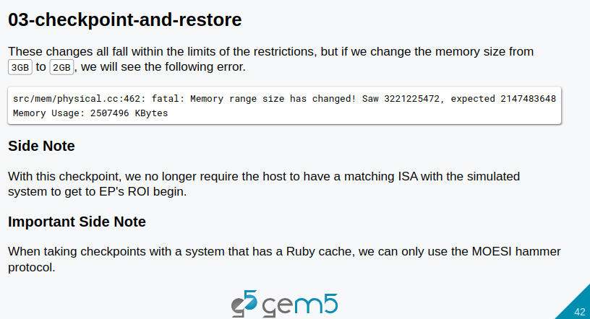
11.1 Accelerate Gem5 Simulation: Slides
https://gem5bootcamp.github.io/2024/#02-Using-gem5/08-accelerating-simulation
Accelerate Gem5 Simulation: Slides

Slide 44
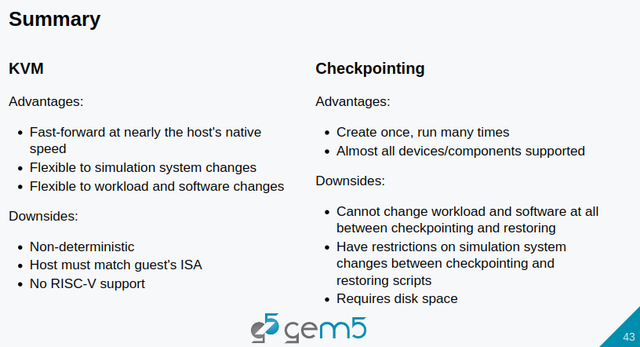
11.1 Accelerate Gem5 Simulation: Slides
https://gem5bootcamp.github.io/2024/#02-Using-gem5/08-accelerating-simulation
Accelerate Gem5 Simulation: Slides

Slide 45
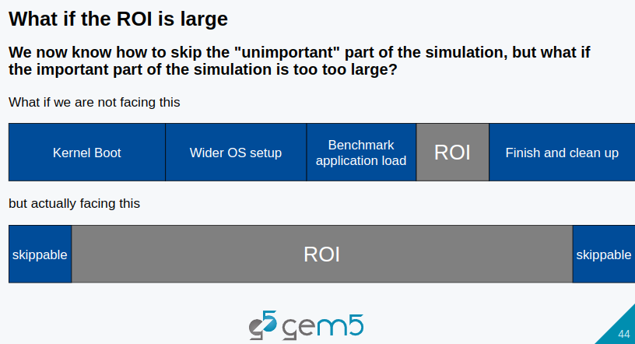
11.1 Accelerate Gem5 Simulation: Slides
https://gem5bootcamp.github.io/2024/#02-Using-gem5/08-accelerating-simulation
Accelerate Gem5 Simulation: Slides

Slide 46
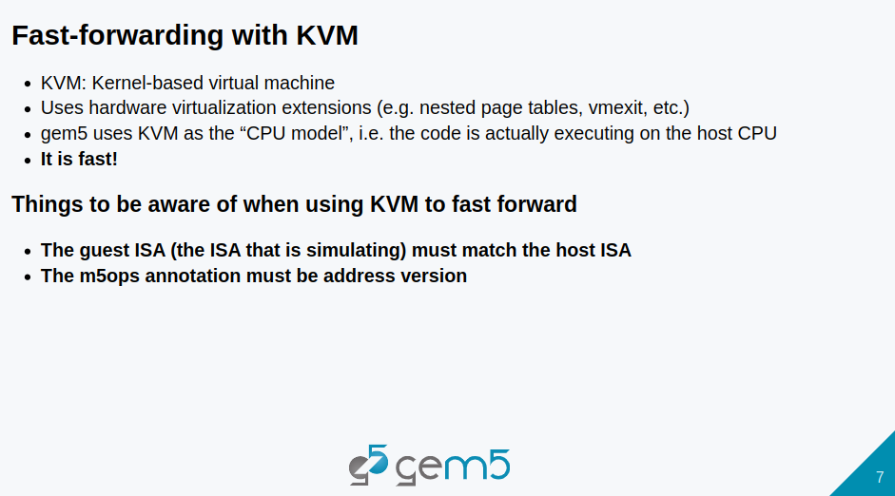
11.1 Accelerate Gem5 Simulation: Slides
https://gem5bootcamp.github.io/2024/#02-Using-gem5/08-accelerating-simulation
Accelerate Gem5 Simulation: Slides

Slide 47
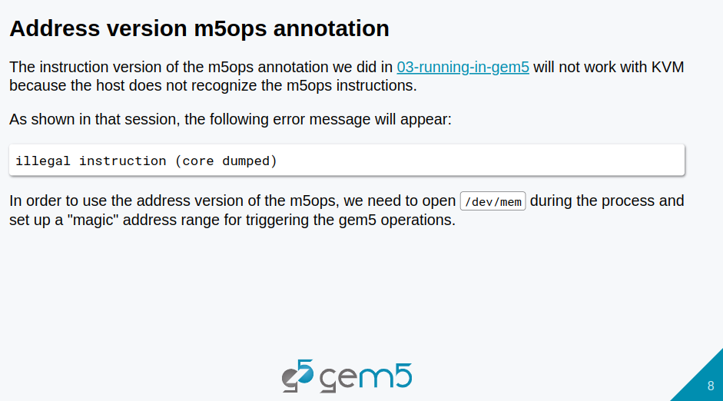
11.1 Accelerate Gem5 Simulation: Slides
https://gem5bootcamp.github.io/2024/#02-Using-gem5/08-accelerating-simulation
Accelerate Gem5 Simulation: Slides

Slide 48
End

