Slide 1

13 Gem5 Sample Simulation
Peter H. Chen

Slide 2
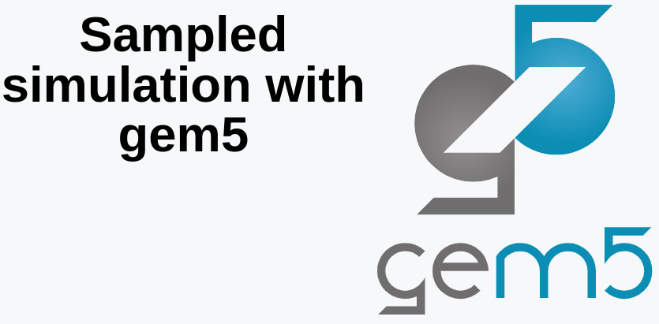
13 Gem5 Sample Simulation
https://www.youtube.com/watch?v=5V57XGFjUy8&list=PL_hVbFs_loVR_8ntTTmmG6YEq3Po_4snu&index=13
Gem5 Sample Simulation (0:00-0:05/39:44)
In this discussion, we are going to talk about the Gem5 Sample Simulation.

Slide 3
12.1 Topics

Slide 4
13.1 Topics
https://www.youtube.com/watch?v=5V57XGFjUy8&list=PL_hVbFs_loVR_8ntTTmmG6YEq3Po_4snu&index=13
Topics (0:06-0:07/39:44)
Topics:
1. Review of Question “What If ROI is too large?”
2. Sampling: Targeted Sampling and Statistical Sampling
3. Gem5 Targeted sampling
4. Gem5 SimPoint
5. simpoint example
6. Summary of simpoint
7. Gem5 LoopPoint and ELFies
8. LoopPoint and ELFies example
9. Summary of LoopPoint and ELFies
10. Gem5 Statistical Sampling Example
11. SMARTS (System-Level Memory Access Reporting, Tracking, and Simulation) example
12. Summary of Target Sampling and Statistical Sampling

Slide 5
12.2 What If ROI Is Too Large?

Slide 6
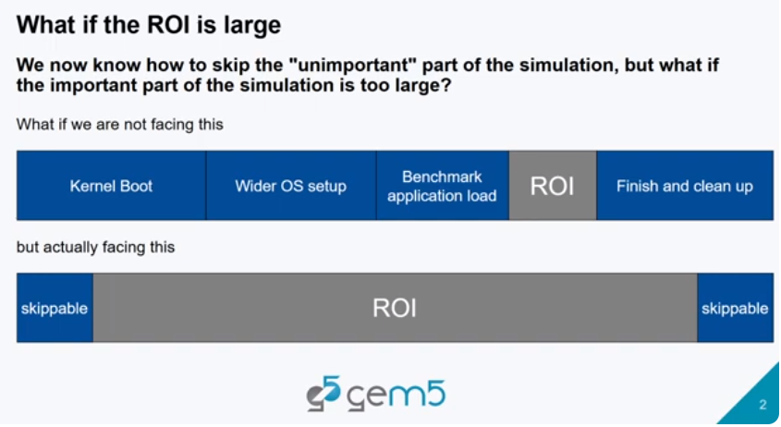
12.2 What If ROI Is Too Large?
https://www.youtube.com/watch?v=5V57XGFjUy8&list=PL_hVbFs_loVR_8ntTTmmG6YEq3Po_4snu&index=13
What If ROI Is Too Large? (0:08-0:16/39:44)
In the end of the last discussion, we raise the question about “What if our ROI is too large?”

Slide 7
End

