Slide 1

23 Cache
Peter H. Chen

Slide 2
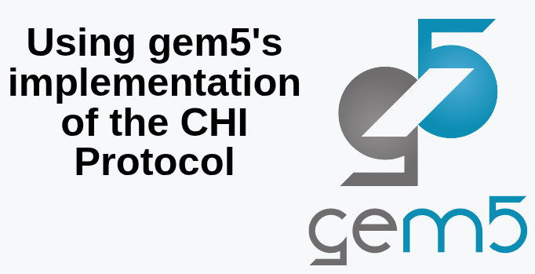
23 Cache
https://www.youtube.com/watch?v=FmaVcY8VyUk&list=PL_hVbFs_loVR_8ntTTmmG6YEq3Po_4snu&index=23
Cache (0:00-0:10/14:45)
We use AMBA/CHI (Advanced Micro-controller Bus Architecture/Coherence Hub Interface) Protocol for Gem5 Two Level Cache simulation.
The AMBA CHI protocol is implemented inside the gem5 Ruby memory subsystem.
Ruby is a gem5 module used for detailed, cycle-accurate simulation of caches, memory controllers, and interconnects.
AMBA CHI is built with SLICC (Specification Language for Implementing Cache Coherence) like other Ruby protocols, such as, MESI (Modified, Exclusive, Shared, Invalid) or MOESI (Modified, Owned, Exclusive, Shared, Invalid). SLICC defines the state machines, transitions, cache states, and network messages required to accurately simulate Arm's real-world hardware specifications.

Slide 3
23 Cache
https://www.youtube.com/watch?v=FmaVcY8VyUk&list=PL_hVbFs_loVR_8ntTTmmG6YEq3Po_4snu&index=23
Cache (0:11-1:30/14:45)
There are a lot of cache simulators which are not difficult to modeling: such as, on-chip network, bandwidth, or hierarchy model, hierarchy crossbar, etc.
Ruby is good and very flexible. A lot of Ruby protocols are accurate enough compared.
Among the Ruby protocol, AMBA/CHI (Advanced Micro-controller Bus Architecture/Coherence Hub Interface) Protocol is recommended to use for memory system simulation.

Slide 4
23.0 Topics

Slide 5
23.0 Topics
https://www.youtube.com/watch?v=FmaVcY8VyUk&list=PL_hVbFs_loVR_8ntTTmmG6YEq3Po_4snu&index=232
Cache (2:56-3:00/14:45)
1

Slide 6
End

