Slide 1

9 Gem5 Memory Model
Peter H. Chen

Slide 2
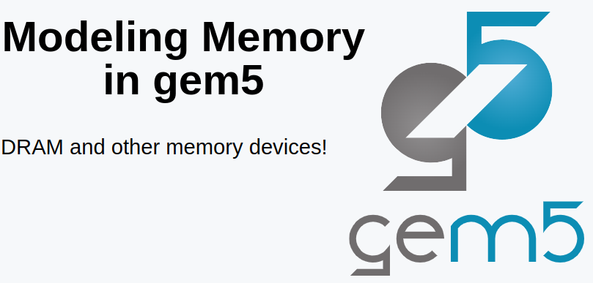
9 Gem5 Memory Model
https://www.youtube.com/watch?v=aw6RE0JU8RE&list=PL_hVbFs_loVR_8ntTTmmG6YEq3Po_4snu&index=9
Gem5 Memory Model (0:00-0:01/27:03)
We talk model of the Memory System in Gem5.

Slide 3
9.1 Topics

Slide 4
9.1 Topics
https://www.youtube.com/watch?v=aw6RE0JU8RE&list=PL_hVbFs_loVR_8ntTTmmG6YEq3Po_4snu&index=9
Topics (0:02-0:03/27:03)
Topics:
1. Gem5 Memory System: Gem5 Memory controller and Gem5 Memory interface
2. Gem5 Memory Controller
3. gem5 Memory Interface
4. Run example of Linear/Random generator and read/write percentage (50% or 100%):
> gem5.opt run-mem.py -c LinearGenerator -r 50
> gem5.opt run-mem.py -c RandomGenerator -r 100
5. Check the m5out/stats.txt: Memory Bandwidth/throughput
5. Simulation result:
a. The multi channel memory bandwidth is much higher that single channel memory.
b. Multi-channel memory bandwidth is much higher than Single Channel Memory. 100% read has higher bandwidth than 50% read/write.

Slide 5
9.2 Gem5 Memory System

Slide 6
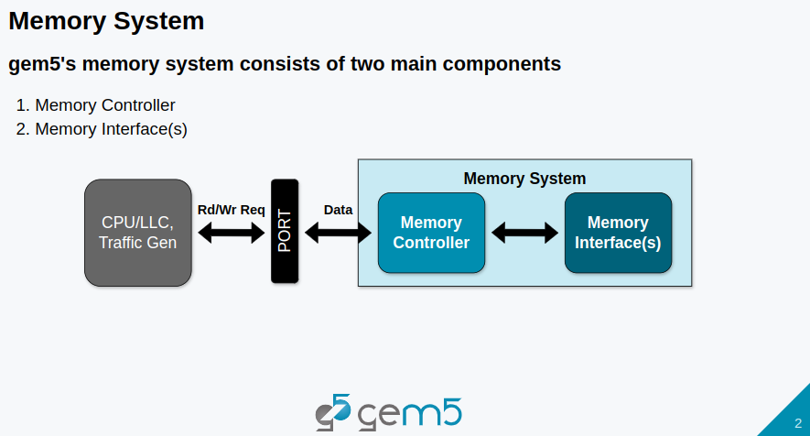
9.2 Gem5 Memory System
https://www.youtube.com/watch?v=aw6RE0JU8RE&list=PL_hVbFs_loVR_8ntTTmmG6YEq3Po_4snu&index=9
Gem5 Memory System (0:04-0:20/27:03)
Memory system in Gem5 break into two main components:
1. Memory controller: Interface of the port and receive all the read and write request through packets
2. Memory Interface.

Slide 7
9.3 Gem5 Memory Controller

Slide 8
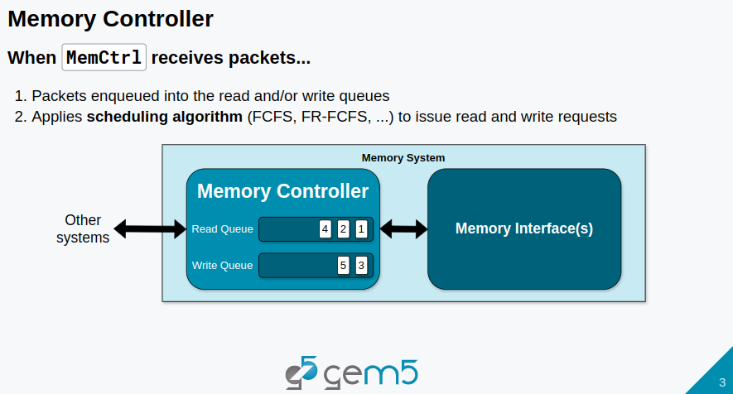
9.3 Gem5 Memory Controller
https://www.youtube.com/watch?v=aw6RE0JU8RE&list=PL_hVbFs_loVR_8ntTTmmG6YEq3Po_4snu&index=9
Gem5 Memory Controller (0:21-0:41/27:03)
When Memory Controller receives a packet from the port, the memory controller places the packet into read queue or write queue and then apply some Gem5 scheduling algorithm, such as, first come first server, i.e., first row come first serve.
The Memory controller will use the scheduling algorithm to figure out which request in the queue will be accessed next, etc.

Slide 9
9.4 Gem5 Memory Interface

Slide 10
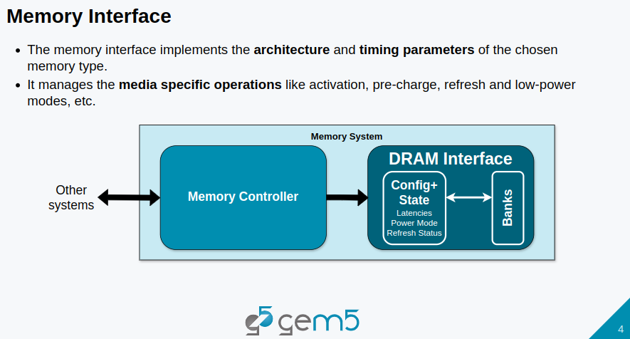
9.4 Gem5 Memory Interface
https://www.youtube.com/watch?v=aw6RE0JU8RE&list=PL_hVbFs_loVR_8ntTTmmG6YEq3Po_4snu&index=9
Gem5 Memory Interface (0:42-1:06/27:03)
At the same time, the memory interface implement all the architecture and timing parameters with the chosen memory type.
The memory interface manages the media specific operation, such as, activation, precharge, refresh, and low-power modes, etc.

Slide 11
9.5 Types of Gem5 Memory Controller

Slide 12
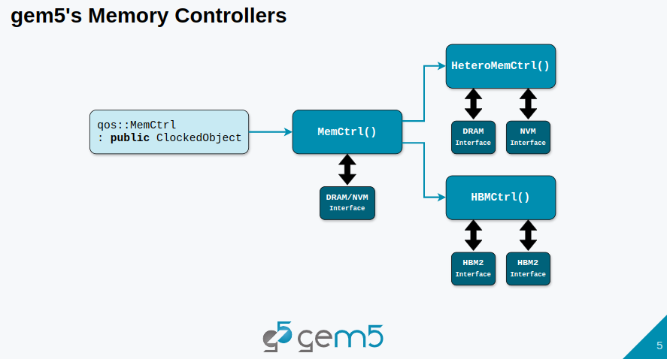
9.5 Types of Gem5 Memory Controller
https://www.youtube.com/watch?v=aw6RE0JU8RE&list=PL_hVbFs_loVR_8ntTTmmG6YEq3Po_4snu&index=9
Types of Gem5 Memory Controller (1:07-1:52/27:03)
All Gem5 Memory controller are defined in class qos (qos memory controller).
We have three main types of memory controllers.
1. Default memory controller (memCtrl). Interface is a DRAM Interface or NVM (Non-Volatile Memory)( Interface.
2. Heterogeneous Memory Controller: has two interfaces. one DRAM Interface and one NVM Interface for heterogeneous memory implementation.
3. HBMCtrl (High Bandwidth Memory Controller): have two two different HBM2 (High Bandwidth Memory Controller Generation 2) interfaces to model the pseudo channels of HBM2.

Slide 13
9.6 Types of Gem5 Memory Interface

Slide 14
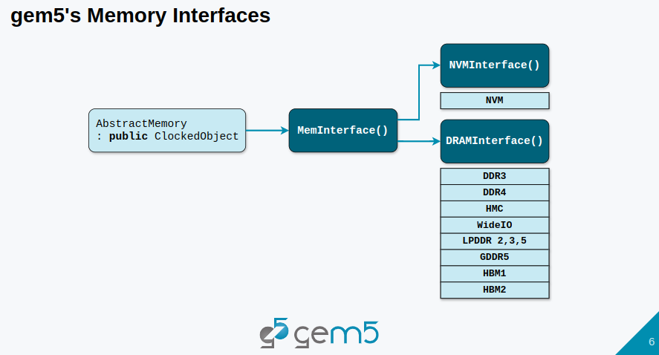
9.6 Types of Gem5 Memory Interface
https://www.youtube.com/watch?v=aw6RE0JU8RE&list=PL_hVbFs_loVR_8ntTTmmG6YEq3Po_4snu&index=9
Types of Gem5 Memory Interface (1:53-2:28/27:03)
Gem5 Memory Interface is defined in class AbstractMemory.
We can use two types of Interfaces:
1. NVMInterface(): NVM Model based on 3D cross point.
2. DRAMInterface(): DRAM Interface have DDR (Double Data Rate) memory, LPDDR (Low Power Double Data Rate) memory, GDDR (Graphic Double Data Rate), HMC (hybrid Memory Cube), WideIO (Memory Interface Standard for 3D IC), and HBM (High Bandwidth for AI/ML).

Slide 15
9.7 Timing Parameters of Memory Model

Slide 16
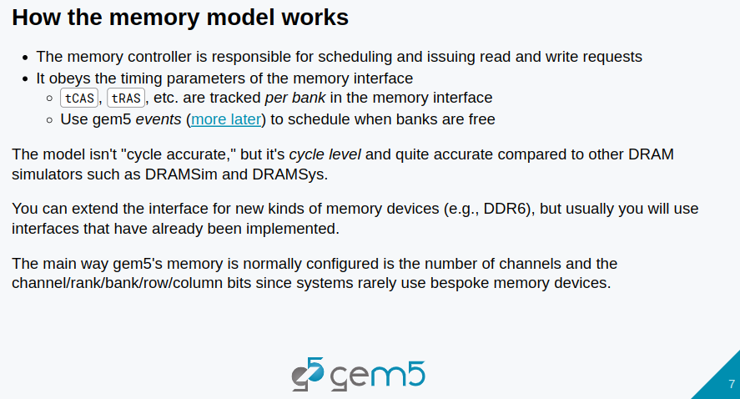
9.7 Timing Parameters of Memory Model
https://www.youtube.com/watch?v=aw6RE0JU8RE&list=PL_hVbFs_loVR_8ntTTmmG6YEq3Po_4snu&index=9
Timing Parameters of Memory Model (2:29-2:30/27:03)
We will look at the code for DRAM interface and timing parameters are implemented.

Slide 17
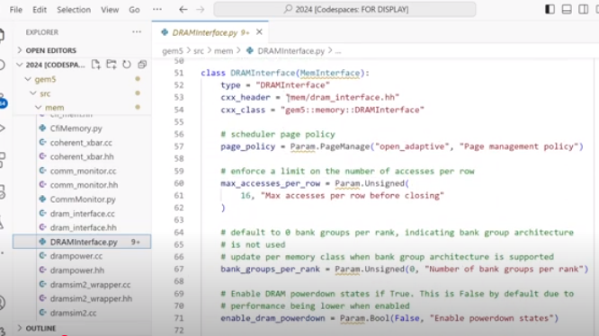
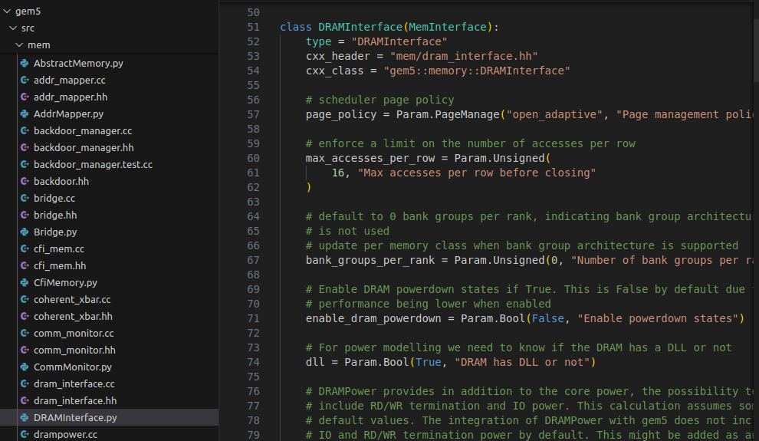
9.7 Timing Parameters of Memory Model
https://www.youtube.com/watch?v=aw6RE0JU8RE&list=PL_hVbFs_loVR_8ntTTmmG6YEq3Po_4snu&index=9
Timing Parameters of Memory Model (2:31-2:59/27:03)
> code gem5/src/mem/DRAMInterface.py
We look at the class DRAMInterface ()

Slide 18
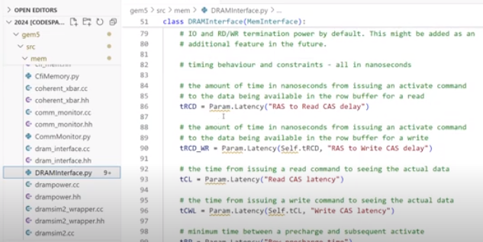
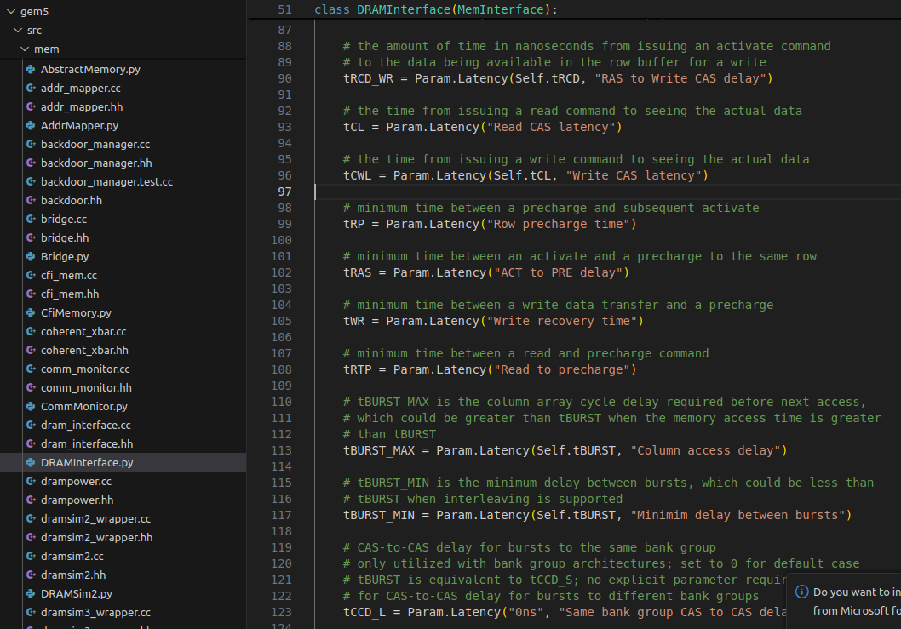
9.7 Timing Parameters of Memory Model
https://www.youtube.com/watch?v=aw6RE0JU8RE&list=PL_hVbFs_loVR_8ntTTmmG6YEq3Po_4snu&index=9
Timing Parameters of Memory Model (3:00-3:25/27:03)
> code gem5/src/mem/DRAMInterface.py
We can see a lot of timing variables, such as, tRCD [Time of RAS (Row Address Strobe) to Read CAS (Column Address Strobe) Delay], tRCD_WR [Time of RAS to Write CAS), tCL (Time of CAS Latency), tCWL (Time of CAS Write Latency), tRP (Time of Row Precharge), tRAS (Time of RAS), tWR (Time of Write Recovery), etc.

Slide 19
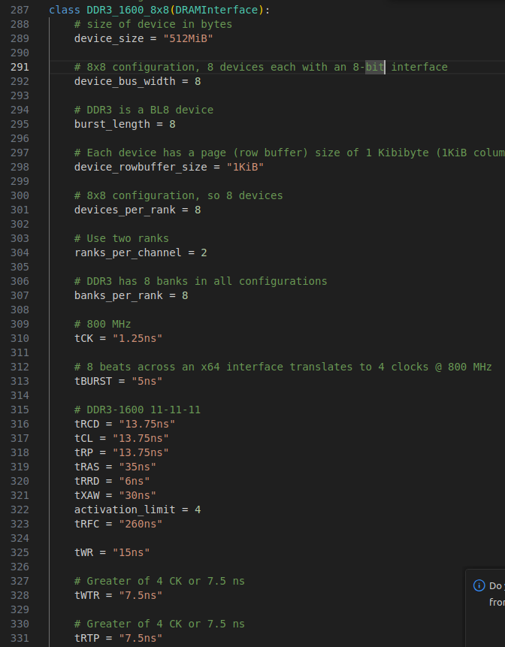
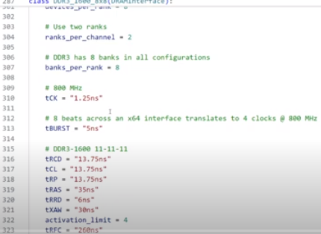
9.7 Timing Parameters of Memory Model
https://www.youtube.com/watch?v=aw6RE0JU8RE&list=PL_hVbFs_loVR_8ntTTmmG6YEq3Po_4snu&index=9
Timing Parameters of Memory Model (3:26-3:45/27:03)
> code gem5/src/mem/DRAMInterface.py
In Class DDR3_1600_8x8 (), we can see some of the timing variables already implemented with explanation by command, such as, “# 800 MHz” in line 309 and some with data come from data sheet

Slide 20
9.7 Timing Parameters of Memory Model
https://www.youtube.com/watch?v=aw6RE0JU8RE&list=PL_hVbFs_loVR_8ntTTmmG6YEq3Po_4snu&index=9
Timing Parameters of Memory Model (3:46-5:22/27:03)
So, the memory controller is responsible for scheduling and issue read/write request.
The timing parameters that it gets from the memory interface which connect to memory.
These timing parameters are tracked per bank. Each bank is tracked and accessed simultaneously.
We use gem5 events to schedule once a bank is complete accessing and free for the next access.
We talk more gem5 events later on.
The gem5 models are not 100% rise/fall cycle accurate as Verilog/Spice simulator but are almost accurate in cycle level. In Gem5, we concern the bank row and column bits activities and statistics.

Slide 21
9.8 Memory in Standard Library

Slide 22
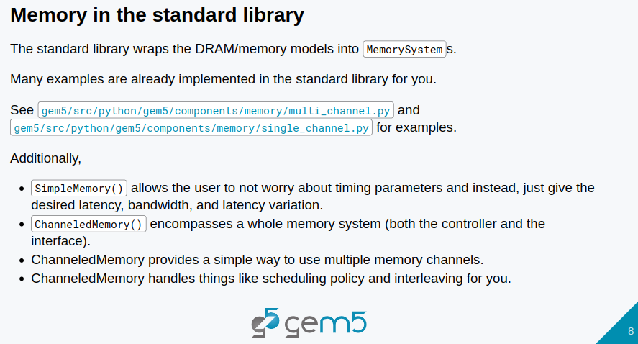
9.8 Memory in Standard Library
https://www.youtube.com/watch?v=aw6RE0JU8RE&list=PL_hVbFs_loVR_8ntTTmmG6YEq3Po_4snu&index=9
Memory in Standard Library (5:23-5:45/27:03)
Now, we are going to talk about memory in standard library.
Standard library wraps the memory model into Gem5 memory system.
Gem5 memory system contains the memory controller and memory interface.
Gem5 memory system already implemented many examples.

Slide 23
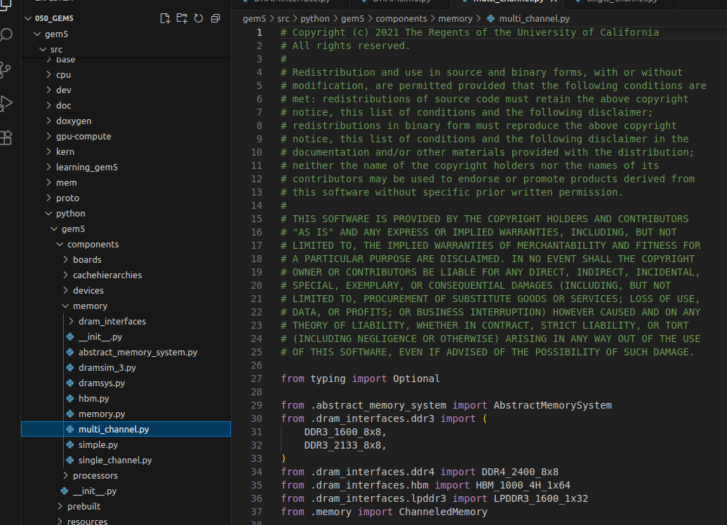
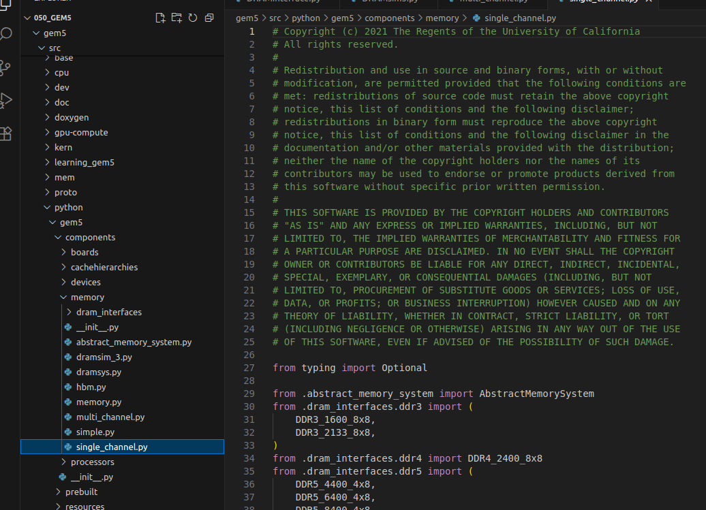
9.8 Memory in Standard Library
https://www.youtube.com/watch?v=aw6RE0JU8RE&list=PL_hVbFs_loVR_8ntTTmmG6YEq3Po_4snu&index=9
Memory in Standard Library (5:46-5:50/27:03)
We can check out the standard library section in multi-channel.py or single_channel.py
> code gem5/src/python/gem5/components/memory/[multi-channel.py, single_channel.py]
We will look these python files later on.

Slide 24
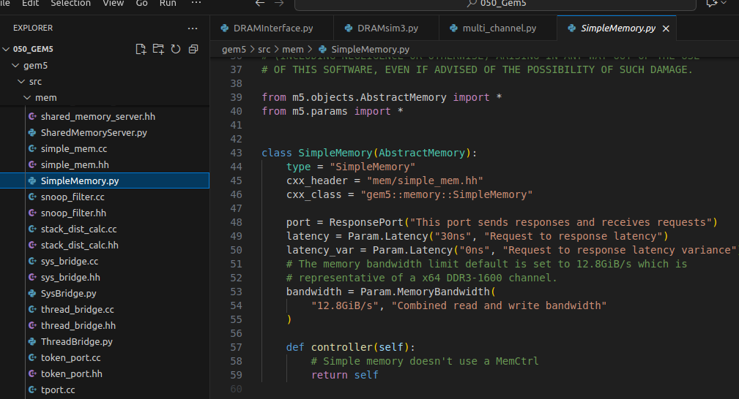
9.8 Memory in Standard Library
https://www.youtube.com/watch?v=aw6RE0JU8RE&list=PL_hVbFs_loVR_8ntTTmmG6YEq3Po_4snu&index=9
Memory in Standard Library (5:51-5:52/27:03)
We also have class SimpleMemory() and class single_channel.py
> code gem5/src/python/gem5/components/memory/[multi-channel.py, single_channel.py]
We will look these python files later on.

Slide 25
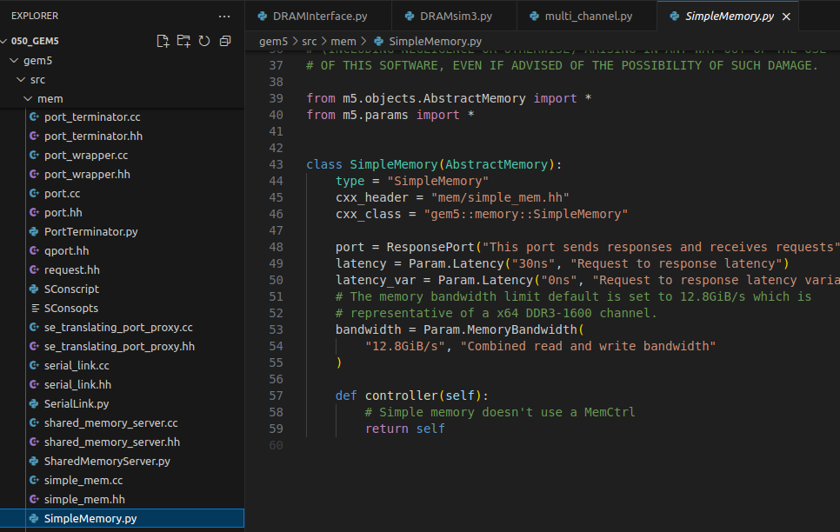
9.8 Memory in Standard Library
https://www.youtube.com/watch?v=aw6RE0JU8RE&list=PL_hVbFs_loVR_8ntTTmmG6YEq3Po_4snu&index=9
Memory in Standard Library (5:53-5:54/27:03)
In SimpleMemory.py, we can find class SimpleMemory()
> code gem5/src/mem/SimpleMemory.py
Class SimpleMemory () defines the parameters od single Memory.

Slide 26
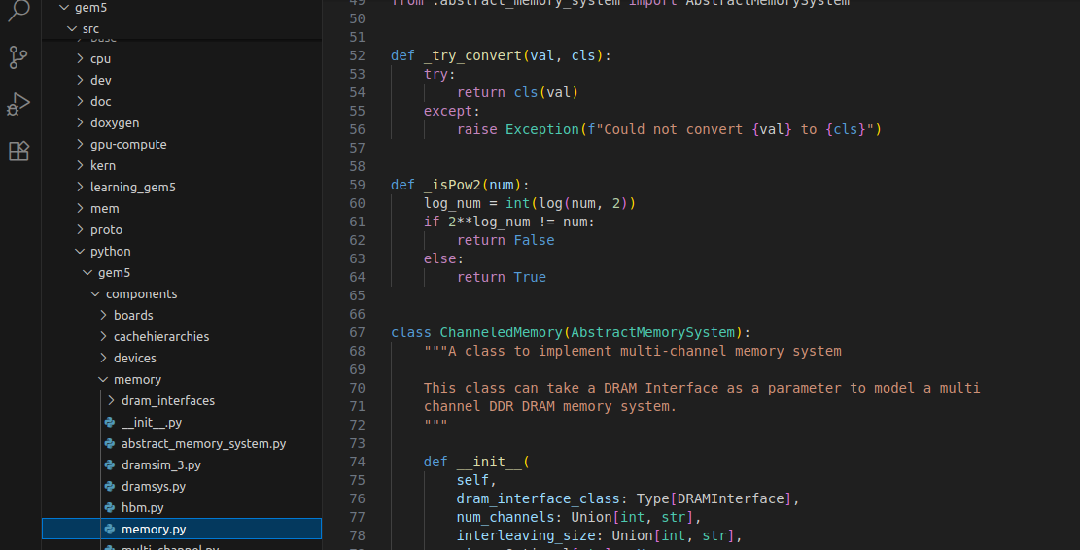
9.8 Memory in Standard Library
https://www.youtube.com/watch?v=aw6RE0JU8RE&list=PL_hVbFs_loVR_8ntTTmmG6YEq3Po_4snu&index=9
Memory in Standard Library (5:55-6:00/27:03)
In memory.py, we also can find class ChanneledMemory()
> code gem5/src/python/gem5/components/memory/memory.py
ChanneledMemory() contains the whole memory system.

Slide 27
9.8 Memory in Standard Library
https://www.youtube.com/watch?v=aw6RE0JU8RE&list=PL_hVbFs_loVR_8ntTTmmG6YEq3Po_4snu&index=9
Memory in Standard Library (6:01-6:57/27:03)
SimpleMemory() provides a simple way to parameters for all the memory system. We just need to passed in latency and bandwidth.
For the channeled memory, DDR, HBM, etc. Channeled memory provide simple way to use multiple memory channels and handles the scheduling policy and interleaving for us.
We will go over the interleaving later on.

Slide 28
9.9 Example: Run Standard Library Memory

Slide 29
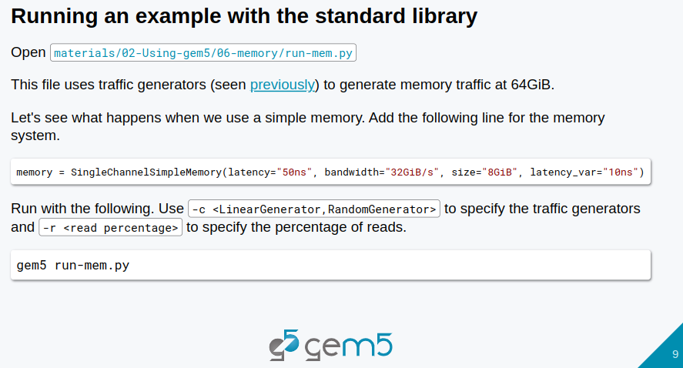
9.9 Example: Run Standard Library Memory
https://www.youtube.com/watch?v=aw6RE0JU8RE&list=PL_hVbFs_loVR_8ntTTmmG6YEq3Po_4snu&index=9
Example: Run Standard Library Memory (6:57-7:10/27:03)
We look at code.
> code bootcamp/materials/02-Using-gem5/06-memory/run-mem.py

Slide 30
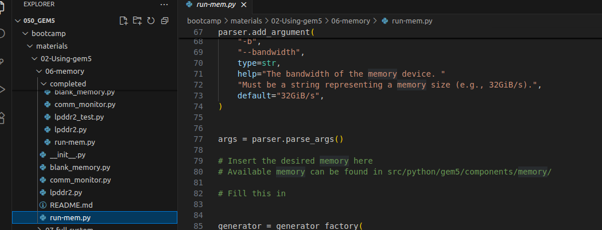
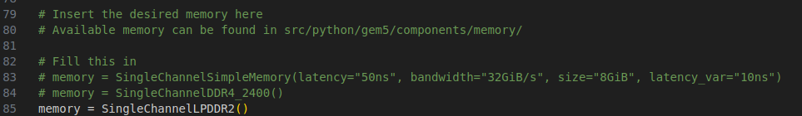
9.9 Example: Run Standard Library Memory
https://www.youtube.com/watch?v=aw6RE0JU8RE&list=PL_hVbFs_loVR_8ntTTmmG6YEq3Po_4snu&index=9
Example: Run Standard Library Memory (7:11-7:13/27:03)
We look at code.
> code bootcamp/materials/02-Using-gem5/06-memory/run-mem.py
In the below code example, we get the memory
1. SingleChannelSimpleMemory()
2. SingleChannelDDR4_2400()
3. SingleChannelLPDDR2()

Slide 31
9.9 Example: Run Standard Library Memory
https://www.youtube.com/watch?v=aw6RE0JU8RE&list=PL_hVbFs_loVR_8ntTTmmG6YEq3Po_4snu&index=9
Example: Run Standard Library Memory (7:14-7:25/27:03)
We look at code.
> code bootcamp/materials/02-Using-gem5/06-memory/run-mem.py
During the run time, we can use Linear traffic generator/Random traffic generator and specify the read percentage.
1. cd ../06-memory
2. ln -s <gem5_path>/build/ALL/gem5.opt .
3. > gem5.opt -c LinearGenerator -r 50 (50%) run-mem.py

Slide 32
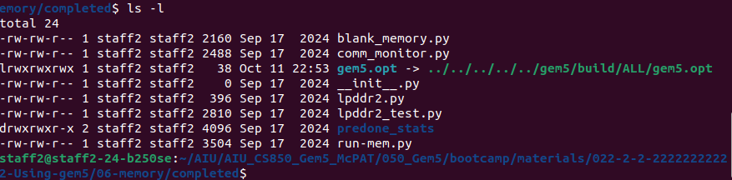
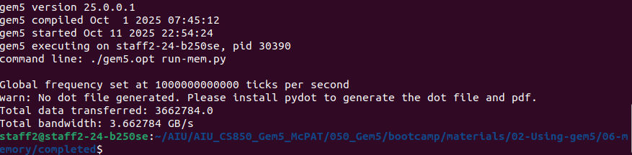
9.9 Example: Run Standard Library Memory
https://www.youtube.com/watch?v=aw6RE0JU8RE&list=PL_hVbFs_loVR_8ntTTmmG6YEq3Po_4snu&index=9
Example: Run Standard Library Memory (7:26-9:15/27:03)
We look at code.
> code bootcamp/materials/02-Using-gem5/06-memory/run-mem.py
1. cd ../06-memory
2. ln -s <gem5_path>/build/ALL/gem5.opt .
3. > gem5.opt run-mem.py

Slide 33
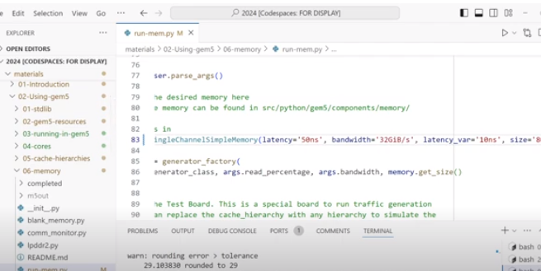
9.9 Example: Run Standard Library Memory
https://www.youtube.com/watch?v=aw6RE0JU8RE&list=PL_hVbFs_loVR_8ntTTmmG6YEq3Po_4snu&index=9
Example: Run Standard Library Memory (9:16-9:20/27:03)
We look at code.
> code bootcamp/materials/02-Using-gem5/06-memory/run-mem.py
Below is the simple memory example.
3. > gem5.opt run-mem.py

Slide 34
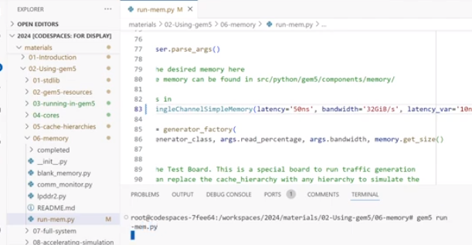
9.9 Example: Run Standard Library Memory
https://www.youtube.com/watch?v=aw6RE0JU8RE&list=PL_hVbFs_loVR_8ntTTmmG6YEq3Po_4snu&index=9
Example: Run Standard Library Memory (9:41-9:40/27:03)
We look at code.
> code bootcamp/materials/02-Using-gem5/06-memory/run-mem.py
Run simple memory simulation:
> gem5.opt run-mem.py

Slide 35
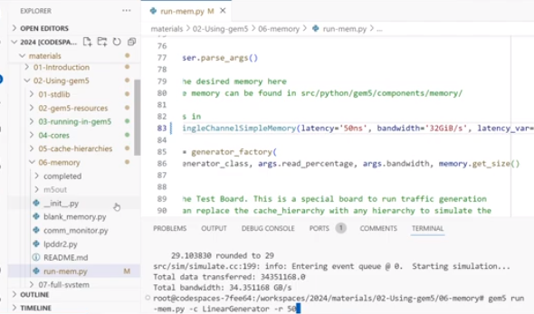
9.9 Example: Run Standard Library Memory
https://www.youtube.com/watch?v=aw6RE0JU8RE&list=PL_hVbFs_loVR_8ntTTmmG6YEq3Po_4snu&index=9
Example: Run Standard Library Memory (9:21-10:40/27:03)
We look at code.
> code bootcamp/materials/02-Using-gem5/06-memory/run-mem.py
Run simple memory simulation with linear generator and bandwidth 50
> ./gem5.opt run-mem.py -c LinearGenerator -r 50

Slide 36
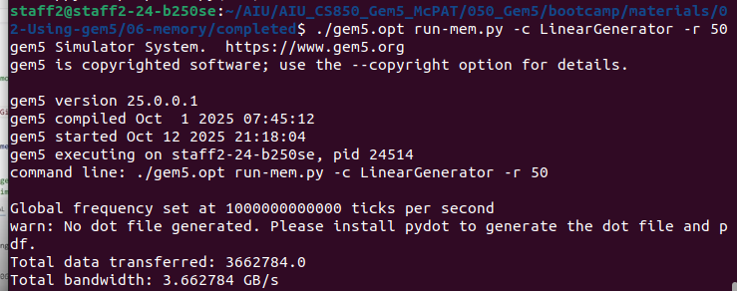
9.9 Example: Run Standard Library Memory
https://www.youtube.com/watch?v=aw6RE0JU8RE&list=PL_hVbFs_loVR_8ntTTmmG6YEq3Po_4snu&index=9
Example: Run Standard Library Memory (10:41-10:42/27:03)
> ./gem5.opt run-mem.py -c LinearGenerator -r 50
Note: “-c LinearGenerator -r 50” have to after “./gem5.opt run-mem,py”
Otherwise, we will get error message “LinearGenerator not defined”.
1. We run linear generator with read the percetage set to 50%.
2. We see the same kind of bandwidth 34 GB per second.

Slide 37
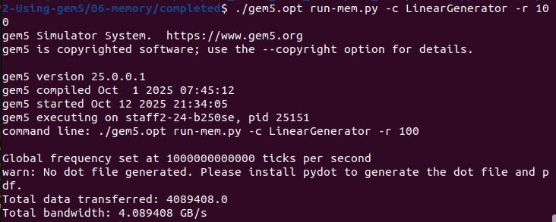
9.9 Example: Run Standard Library Memory
https://www.youtube.com/watch?v=aw6RE0JU8RE&list=PL_hVbFs_loVR_8ntTTmmG6YEq3Po_4snu&index=9
Example: Run Standard Library Memory (10:43-11:01/27:03)
> ./gem5.opt run-mem.py -c LinearGenerator -r 100
1. We re-run linear generator with read the percetage set to 100%.
2. Normally, read 100% is better than 50%
50% read: he memory workload consists of an equal mix of 50% read requests and 50% write requests.
100% reads: The memory workload consists exclusively of read requests. There are no write requests.

Slide 38
9.10 Generator, R/W % vs Bandwidth

Slide 39
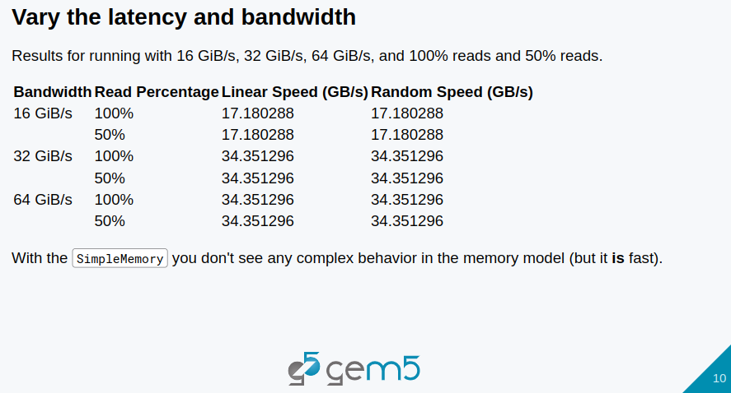
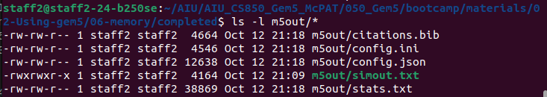
9.10 Generator, R/W % vs Bandwidth
https://www.youtube.com/watch?v=aw6RE0JU8RE&list=PL_hVbFs_loVR_8ntTTmmG6YEq3Po_4snu&index=9
Generator, R/W % vs Bandwidth (11:04-11:07/27:03)
1. We change different Generator and Read/Write Request Percentage, then check the results of Speed (Latency/Bandwidth) in m5out/stats.txt.
2. Check the date is updated.
3. Check the data are changed in m5out/stats.txt.
2
3

Slide 40
9.10 Generator, R/W % vs Bandwidth
https://www.youtube.com/watch?v=aw6RE0JU8RE&list=PL_hVbFs_loVR_8ntTTmmG6YEq3Po_4snu&index=9
Generator, R/W % vs Bandwidth (11:02-11:42/27:03)
Below is the summary of simulation.
1. Increase Linear/Random Generator speed increase the Latency/Bandwidth/Throughput.
2. Change Traffic (Linear or Random) Generator does not change the Latency/Bandwidth/Throughput.
3. Change Read/Write percentage does not change the Latency/Bandwidth/Throughput.

Slide 41
9.11 Run Channeled Memory

Slide 42
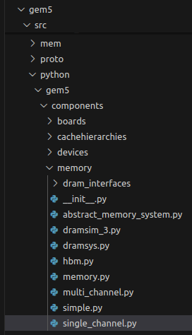
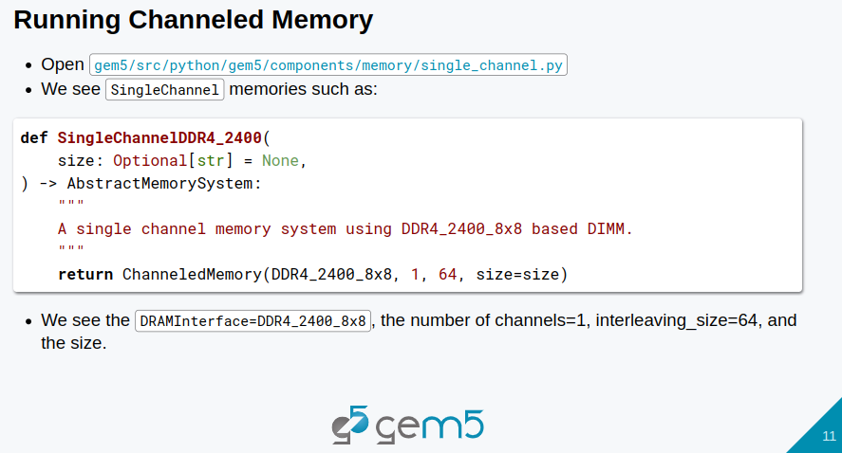
9.11 Run Channeled Memory
https://www.youtube.com/watch?v=aw6RE0JU8RE&list=PL_hVbFs_loVR_8ntTTmmG6YEq3Po_4snu&index=9
Run Channeled Memory (11:43-11:50/27:03)
Now, we are going to add more complex memory system.
In gem5/src/python/gem5/components/memory/shingle_channel.py or multi_channel.py], the memory system are single_channel.py or multi_channel.py.

Slide 43
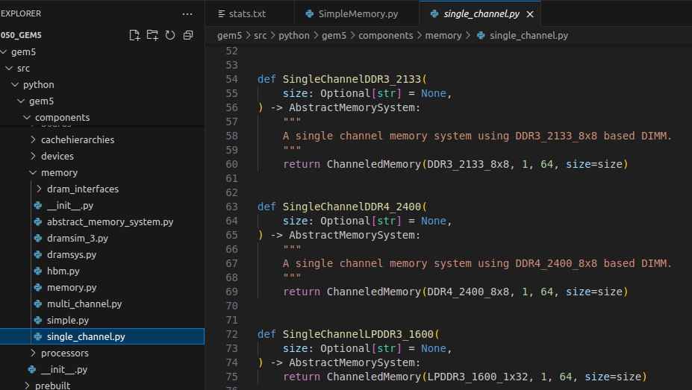
9.11 Run Channeled Memory
https://www.youtube.com/watch?v=aw6RE0JU8RE&list=PL_hVbFs_loVR_8ntTTmmG6YEq3Po_4snu&index=9
Run Channeled Memory (11:51-12:42/27:03)
> code ./gem5/src/python/gem5/components/memory/s[ingle_channel.py
We have defined function ShingleChannelDDR4_2400 ()

Slide 44
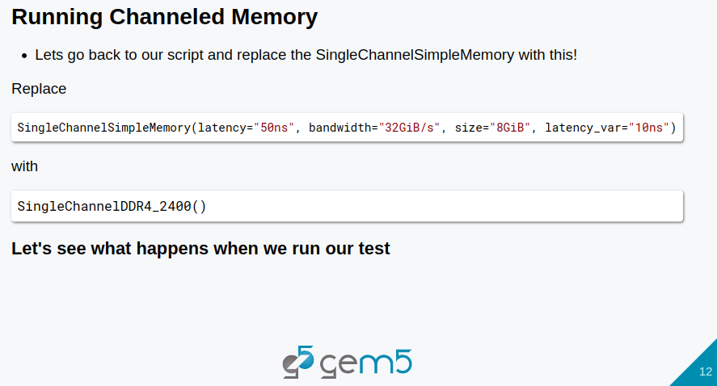
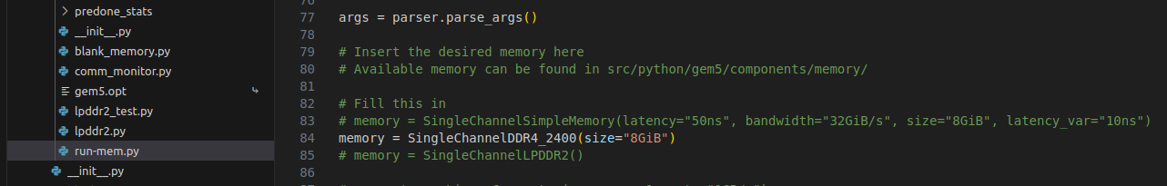
9.11 Run Channeled Memory
https://www.youtube.com/watch?v=aw6RE0JU8RE&list=PL_hVbFs_loVR_8ntTTmmG6YEq3Po_4snu&index=9
Run Channeled Memory (11:51-12:20/27:03)
> code ./gem5/src/python/gem5/components/memory/s[ingle_channel.py
We change Shingle Channel Simple Memory()
> # memory = SingleChannelSimpleMemory(latency="50ns", bandwidth="32GiB/s", size="8GiB", latency_var="10ns")
Into Shingle Channel DDR4, speed 2400 MHz with size 8GiB.
> ShingleChannelDDR4_2400 (size = “8GiB”))

Slide 45
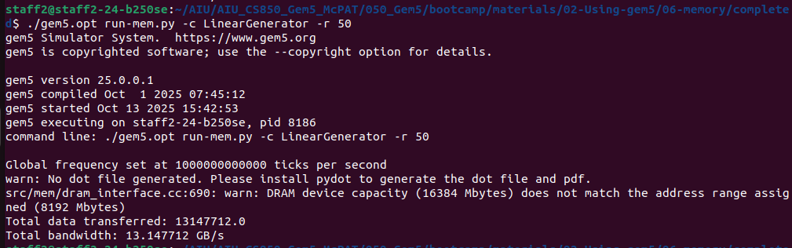
9.11 Run Channeled Memory
https://www.youtube.com/watch?v=aw6RE0JU8RE&list=PL_hVbFs_loVR_8ntTTmmG6YEq3Po_4snu&index=9
Run Channeled Memory (11:51-12:48/27:03)
> code ./gem5/src/python/gem5/components/memory/s[ingle_channel.py
Run again:
> ./gem5.opt run-mem.py -c LinearGenerator -r 50
We can see the bandwidth is 13 GB/s. Much higher than Simple memory.

Slide 46
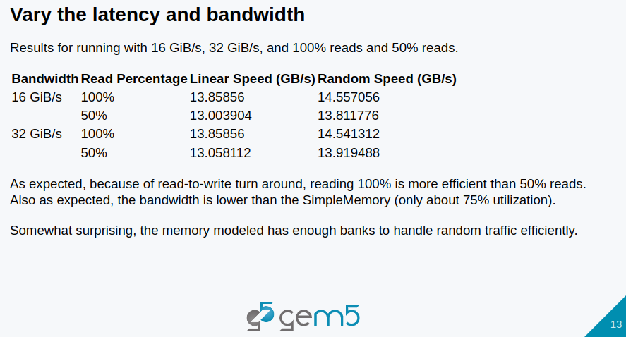
9.11 Run Channeled Memory
https://www.youtube.com/watch?v=aw6RE0JU8RE&list=PL_hVbFs_loVR_8ntTTmmG6YEq3Po_4snu&index=9
Run Channeled Memory (13:16-13:56/27:03)
Below is result of Channel Memory. They are similar to Simple memory.
Simulation result:
a. The multi channel memory bandwidth is much higher that single channel memory.
b. Multi-channel memory bandwidth is much higher than Single Channel Memory. 100% read has higher bandwidth than 50% read/write.

Slide 47
9.12 Add Channeled Memory

Slide 48
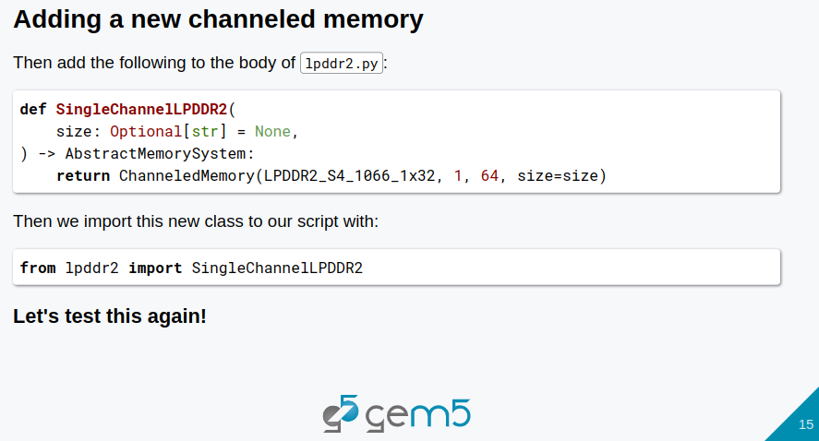
9.12 Add Channeled Memory
https://www.youtube.com/watch?v=aw6RE0JU8RE&list=PL_hVbFs_loVR_8ntTTmmG6YEq3Po_4snu&index=9
Add Channeled Memory (13:57-15:00/27:03)
We want to add a new channel memory LDDPR2, we cannot find channel memory in
> code ./gem5/src/python/gem5/components/memory/s[ingle_channel.py

Slide 49
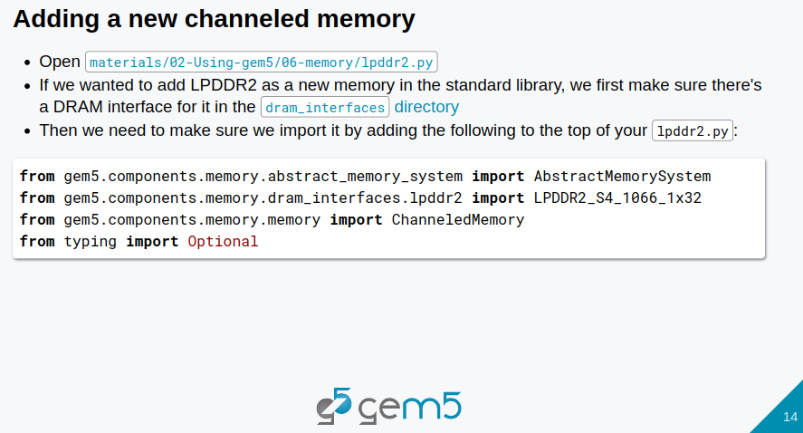
9.12 Add Channeled Memory
https://www.youtube.com/watch?v=aw6RE0JU8RE&list=PL_hVbFs_loVR_8ntTTmmG6YEq3Po_4snu&index=9
Add Channeled Memory (15:01-15:50/27:03)
First, we import library as below:

Slide 50
9.12 Add Channeled Memory
https://www.youtube.com/watch?v=aw6RE0JU8RE&list=PL_hVbFs_loVR_8ntTTmmG6YEq3Po_4snu&index=9
Add Channeled Memory (15:51-16:15/27:03)
Second, we
1. Import SingleChannleLDPPR2.
2. add ChanneledMemory (). Passing Parameter LPDDR2_S4_1066_1x32, 1 (‘1’ for Single Channel), 64, size)

Slide 51
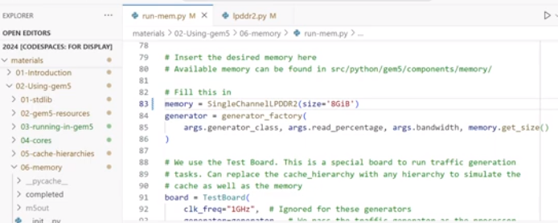
9.12 Add Channeled Memory
https://www.youtube.com/watch?v=aw6RE0JU8RE&list=PL_hVbFs_loVR_8ntTTmmG6YEq3Po_4snu&index=9
Add Channeled Memory (15:51-17:55/27:03)
Third, in run-mem.py
1. We add
Memory = SingleChannelLPDDR2(size = ‘8GiB’)
2. Run run-mem.py
> gem5.opt run-mem,py -c LinearGenerator/-c RandomGenerator -r 100/-r 50

Slide 52
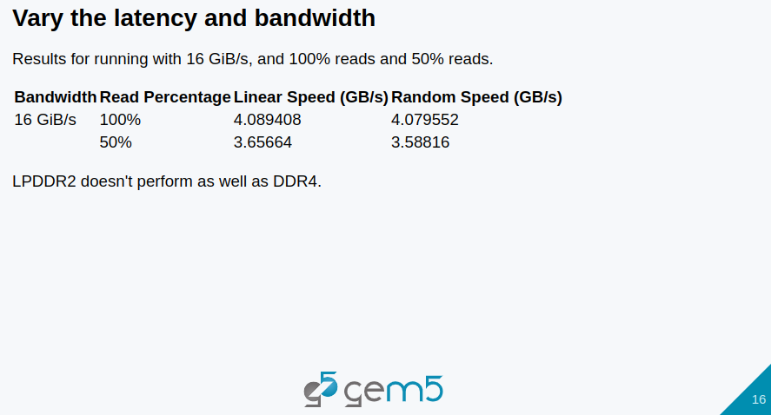
9.12 Add Channeled Memory
https://www.youtube.com/watch?v=aw6RE0JU8RE&list=PL_hVbFs_loVR_8ntTTmmG6YEq3Po_4snu&index=9
Add Channeled Memory (17:56-18:30/27:03)
Check results
100% read has much bigger Bandwidth then 50% read/write Bandwidth.

Slide 53
9.13 Common Monitor

Slide 54
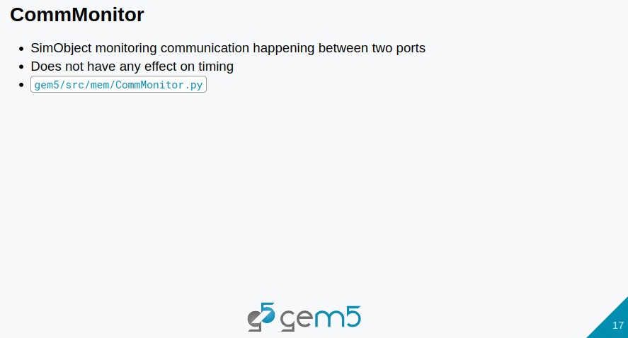
9.13 Common Monitor
https://www.youtube.com/watch?v=aw6RE0JU8RE&list=PL_hVbFs_loVR_8ntTTmmG6YEq3Po_4snu&index=9
Common Monitor (18:31-19:30/27:03)
Monitor communication between two ports.

Slide 55
End

