Slide 1

13 Gem5 Sample Simulation (1)
Peter H. Chen

Slide 2
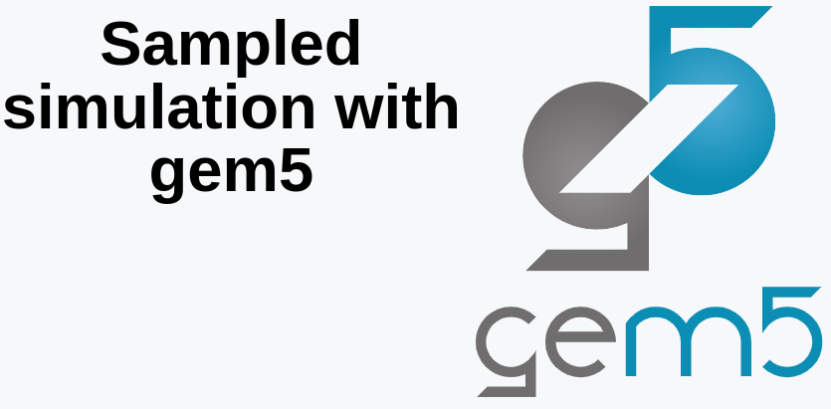
13 Gem5 Sample Simulation
https://www.youtube.com/watch?v=5V57XGFjUy8&list=PL_hVbFs_loVR_8ntTTmmG6YEq3Po_4snu&index=13
Gem5 Sample Simulation (0:00-0:05/39:44)
In this discussion, we are going to talk about the Gem5 Sample Simulation.

Slide 3
12.1 Topics

Slide 4
13.1 Topics
https://www.youtube.com/watch?v=5V57XGFjUy8&list=PL_hVbFs_loVR_8ntTTmmG6YEq3Po_4snu&index=13
Topics (0:06-0:07/39:44)
Topics:
1. Review of Question “What If ROI is too large?”
2. Sampling: Targeted Sampling and Statistical Sampling
3. Gem5 Targeted sampling
4. Gem5 SimPoint
5. simpoint example
6. Summary of simpoint
7. Gem5 LoopPoint and ELFies
8. LoopPoint and ELFies example
9. Summary of LoopPoint and ELFies
10. Gem5 Statistical Sampling Example
11. SMARTS (System-Level Memory Access Reporting, Tracking, and Simulation) example
12. Summary of Target Sampling and Statistical Sampling

Slide 5
12.2 What If ROI Is Too Large?

Slide 6
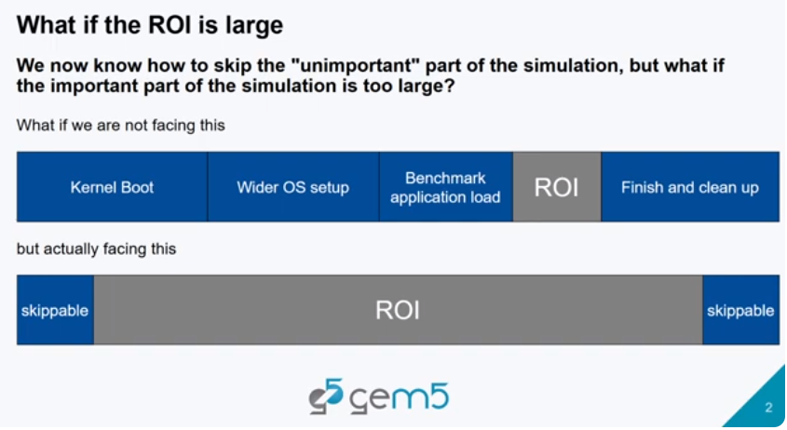
12.2 What If ROI Is Too Large?
https://www.youtube.com/watch?v=5V57XGFjUy8&list=PL_hVbFs_loVR_8ntTTmmG6YEq3Po_4snu&index=13
What If ROI Is Too Large? (0:08-0:16/39:44)
In the end of the last discussion, we raise the question about “What if our ROI is too large?”

Slide 7
12.3 Sampling

Slide 8
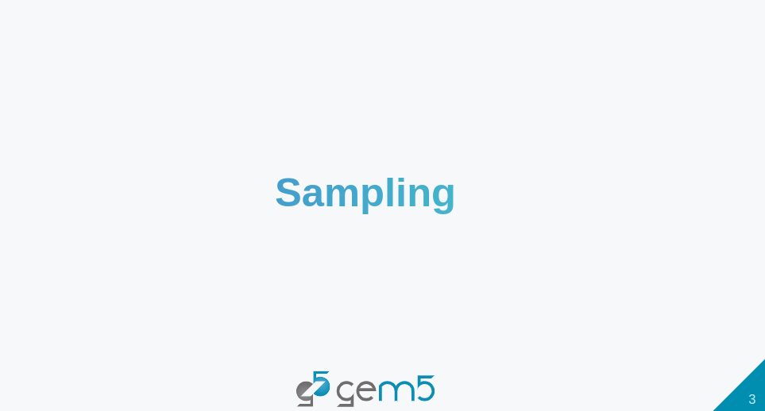
12.3 Sampling
https://www.youtube.com/watch?v=5V57XGFjUy8&list=PL_hVbFs_loVR_8ntTTmmG6YEq3Po_4snu&index=13
Sampling (0:17-0:20/39:44)
One of the solution to this problem (If the ROI is too large) is that we can do sample the simulation.

Slide 9
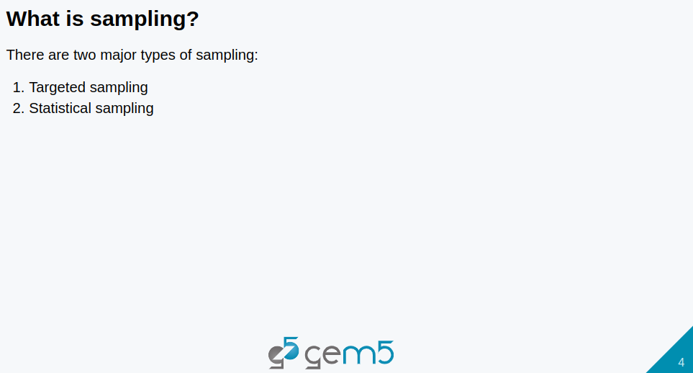
12.3 Sampling
https://www.youtube.com/watch?v=5V57XGFjUy8&list=PL_hVbFs_loVR_8ntTTmmG6YEq3Po_4snu&index=13
Sampling (0:21-0:33/39:44)
We can do sampling for very large ROI (Region of Interest).
There are two major types of sampling.
First one is targeted sampling
Second one is statistical code sampling.

Slide 10
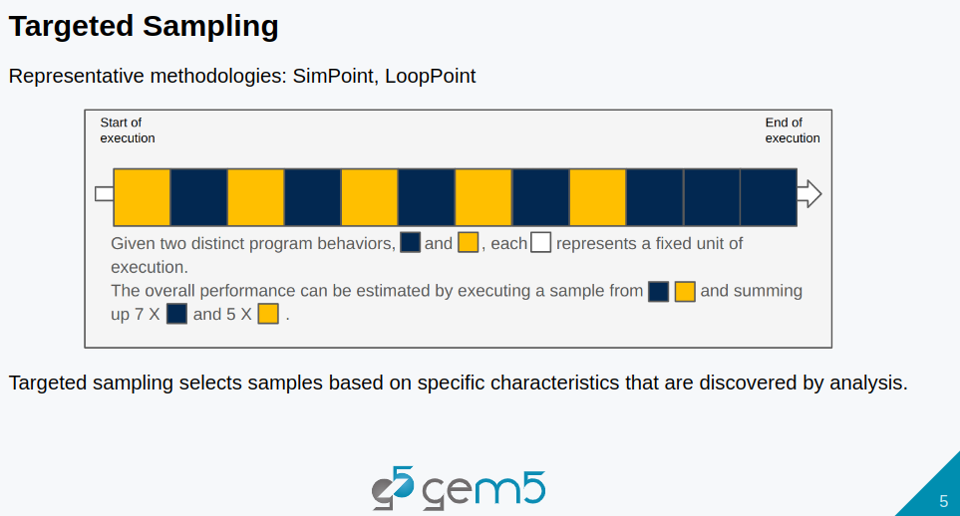
12.3 Sampling
https://www.youtube.com/watch?v=5V57XGFjUy8&list=PL_hVbFs_loVR_8ntTTmmG6YEq3Po_4snu&index=13
Gem5 Targeted Sampling (0:34-1:17/39:44)
What is Targeted Sampling?
Targeted Sampling selected the sample based on a specific characteristics that are discovered bu the analysis.
Below example is how Targeted Sampling works.
Given an execution as below, if there is two extinct program behaviors, the blue block and yellow block.
We can find out the this behavior through analysis and only simulate the blue block and yellow block.
Then, we multiple by the number of time it appear in the execution for the targeted sampling.

Slide 11
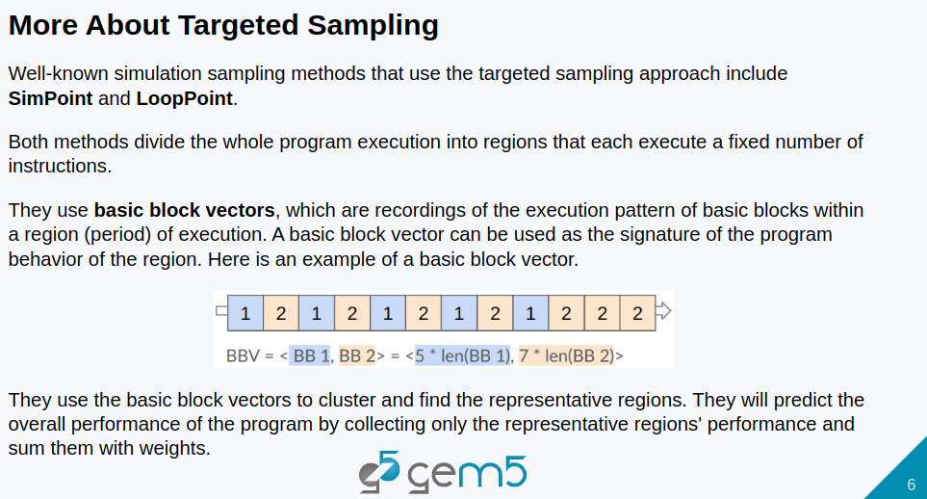
12.3 Sampling
https://www.youtube.com/watch?v=5V57XGFjUy8&list=PL_hVbFs_loVR_8ntTTmmG6YEq3Po_4snu&index=13
Gem5 Targeted Sampling (1:18-2:51/39:44)
There is two well-known targeted methods which are SimPoint and LoopPoint.
Both SimPoint and LoopPoint divide the whole program execution into regions that each execute a fixed number of instruction.
Below, we explain an oversimplified LoopPoint.
The LoopPoint uses a Basic Block Vector to classify the characteristic of the program behavior.
Assume the program only has two basic block. We execute some pattern here. We got a vector with 5 of block one and 7 of the block two. The vector does not record the order but record the frequency of block that has been executed.

Slide 12
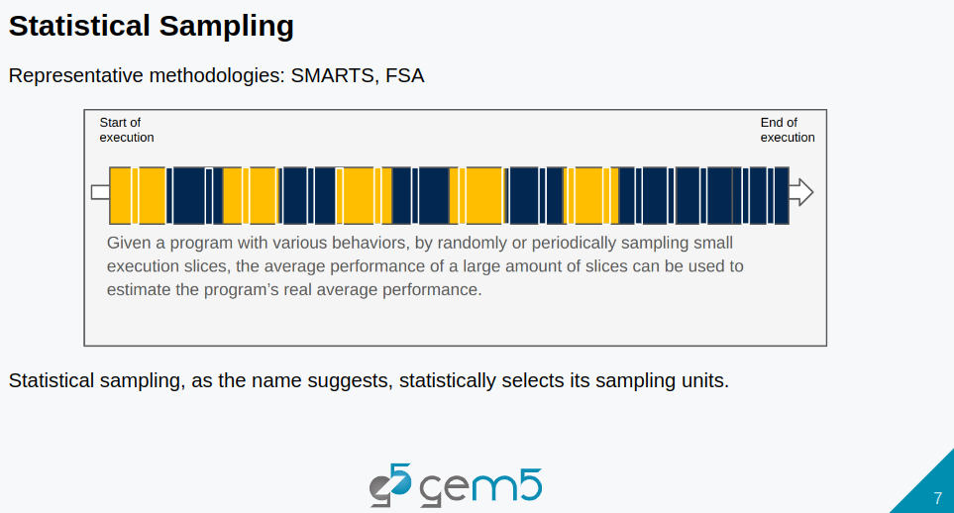
12.3 Sampling
https://www.youtube.com/watch?v=5V57XGFjUy8&list=PL_hVbFs_loVR_8ntTTmmG6YEq3Po_4snu&index=13
Gem5 Statistical Sampling (2:52-3:30/39:44)
The statistical sampling is the statistically select the sampling units. Below is the example of how it work.
When we have a program, we can slice into a small chunk of execution. We randomly select small chunk of slices and only do detailed simulation in this small chunk of execution instead of run the whole execution.
Then, we average the performance of the large amount of randomly selected slices. Between the selected slices (detailed simulation), we use Fast-Forward Simulation.
We predict the performance by average the results of randomly selected slices instead of run the whole program.

Slide 13
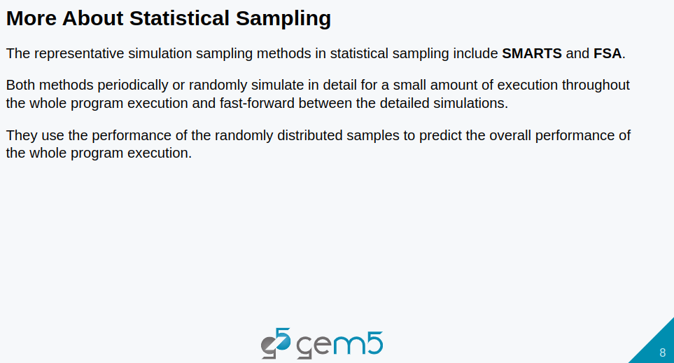
12.3 Sampling
https://www.youtube.com/watch?v=5V57XGFjUy8&list=PL_hVbFs_loVR_8ntTTmmG6YEq3Po_4snu&index=13
Gem5 Statistical Sampling (3:31-3:59/39:44)
The typical statistical sampling are SMARTS (Sampling Micro-Architecture Simulation) and FSA (Full Speed Ahead).
Both methods sampling periodically and randomly select for a small amount of execution (throughout a whole program execution) for detailed simulation.
Then, fast-forward between the detailed simulation.
Then, we use the performance of average the randomly distributed samples to predict the overall performance instead of the whole program execution.

Slide 14
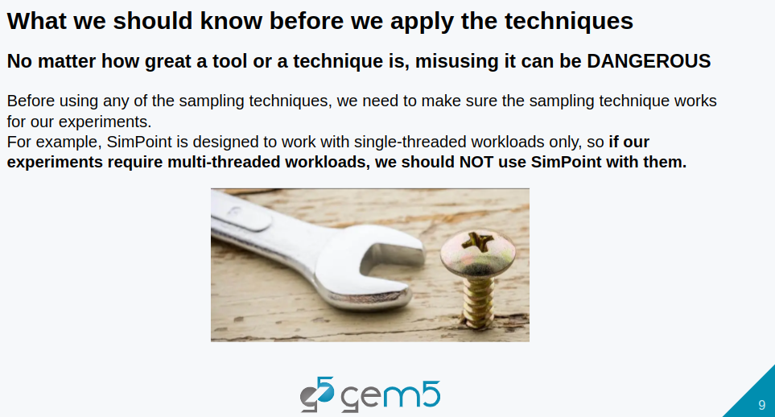
12.3 Sampling
https://www.youtube.com/watch?v=5V57XGFjUy8&list=PL_hVbFs_loVR_8ntTTmmG6YEq3Po_4snu&index=13
Gem5 Statistical Sampling (4:00-4:29/39:44)
No matter how great of the tool, misuse it can be dangerous.
Before we use any of the sampling techniques, we need to make sure the sampling technique works for our experiments.
For example, SimPoint os designed to work with single-threaded workload only.
So, if our experiment require multi-threaded workloads, we should not choose SimPoint as our sampling technique.

Slide 15
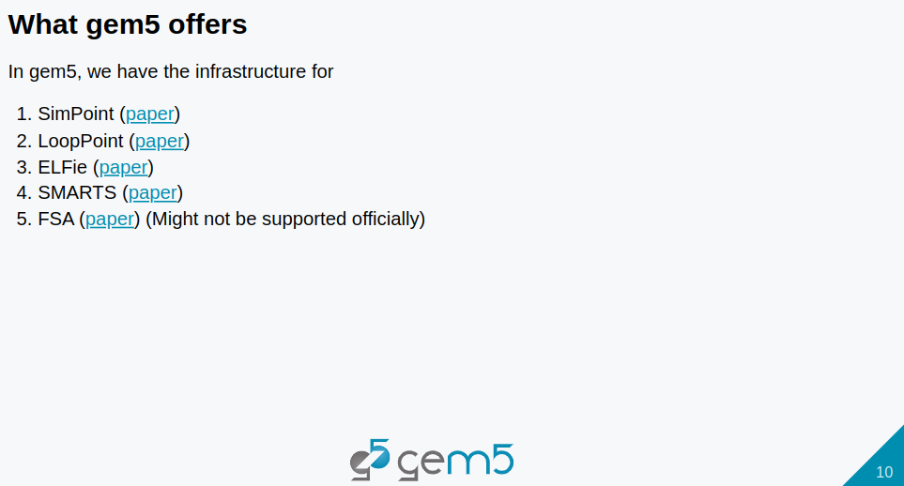
12.3 Sampling
https://www.youtube.com/watch?v=5V57XGFjUy8&list=PL_hVbFs_loVR_8ntTTmmG6YEq3Po_4snu&index=13
Gem5 Statistical Sampling (4:30-4:46/39:44)
In Gem5, we have infrastructure for
1. SimPoint
2. LoopPoint
3. ELFie (Executable and Link Format + fie: Specific Portion of Linked Binary of a large binary)
4. SMARTS (Sampling Micro-Architecture Simulation)
5. FSA(Full Speed Ahead): FSA is not support officially. Others, Gem5 supported.

Slide 16
12.4 Gem5 Targeted Sampling

Slide 17
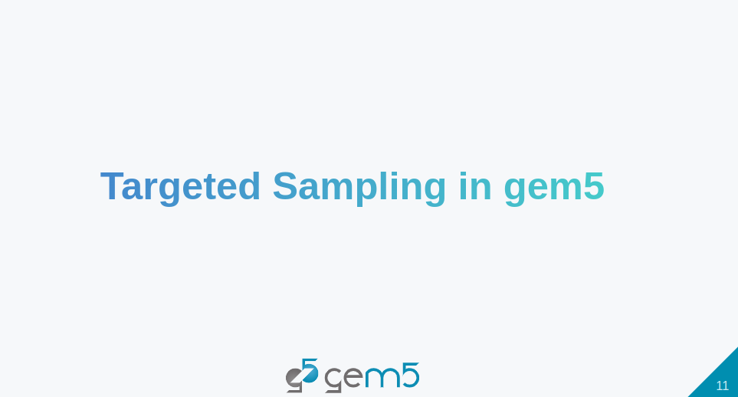
12.4 Gem5 Targeted Sampling
https://www.youtube.com/watch?v=5V57XGFjUy8&list=PL_hVbFs_loVR_8ntTTmmG6YEq3Po_4snu&index=13
Gem5 Targeted Sampling (4:47-4:49/39:44)
We start with Targeted Sampling in Gem5.

Slide 18
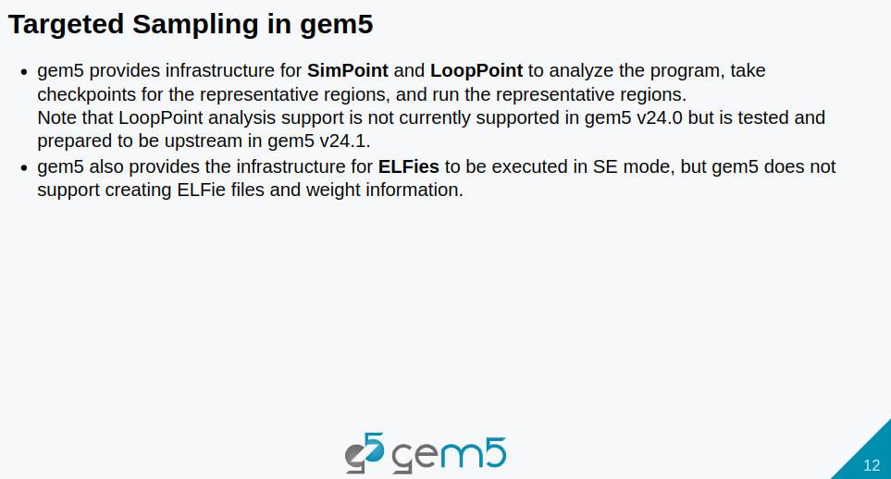
12.4 Gem5 Targeted Sampling
https://www.youtube.com/watch?v=5V57XGFjUy8&list=PL_hVbFs_loVR_8ntTTmmG6YEq3Po_4snu&index=13
Gem5 Targeted Sampling (4:50-5:28/39:44)
Gem5 provides infrastructure for SimPoint and LoopPoint to analyze the program, take checkpoint for the the representative regions, and run the representative regions.
LoopPoint is not in Gem5 24 version but will be in Gem5 24.1 version.
Gem5 also provide the infrastructure for ELFies (Executable and Link Format for smaller binary) to be executed in SE (System-call Emulation) Mode only. However, Gem5 integrates external tools, such as, intel/pinball2elf, to generate the ELFies. Gem5 internally does not support to generate the ELFie or associated weight information within gem5 framework.

Slide 19
End

