Slide 1

26 DRAM Integration
Peter H. Chen

Slide 2
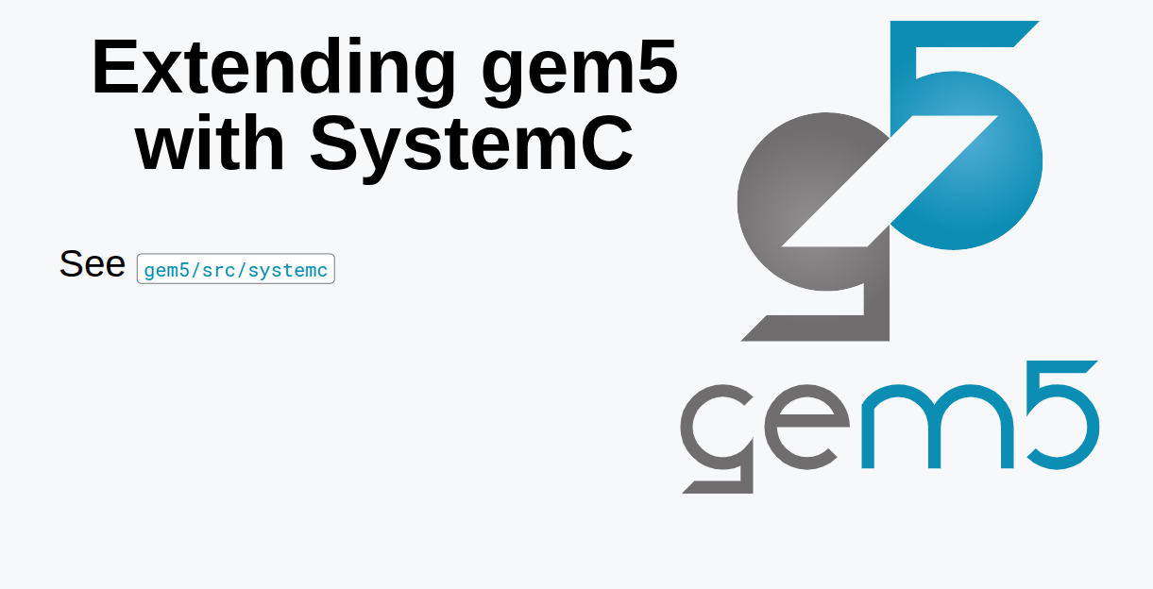
26 DRAM Integration
https://www.youtube.com/watch?v=ciSLhURk6OU&list=PL_hVbFs_loVR_8ntTTmmG6YEq3Po_4snu&index=26
DRAM Integration (18:16 - 18:17/20:37)
gem5 can integrate with System C.
We can integrate with System C Component into gem5 using TLM (Transaction-Level Modeling) bridge like CIS (Coherent Interconnect Subsystem) or we can take a System C Model and compile into gem5.
Gem5 has a full implementation of System C specification.

Slide 3
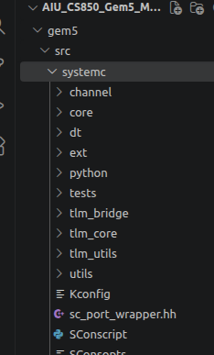
26 DRAM Integration
https://www.youtube.com/watch?v=ciSLhURk6OU&list=PL_hVbFs_loVR_8ntTTmmG6YEq3Po_4snu&index=26
DRAM Integration (19:01 – 20:37/20:37)
Any code written in compatible with System C, we can run the code in the gem5 simulator.
We can find the System C code example in the
> code ~gem5/src/systemc

Slide 4
End

