Slide 1

14 Gem5 Power Model
Peter H. Chen

Slide 2
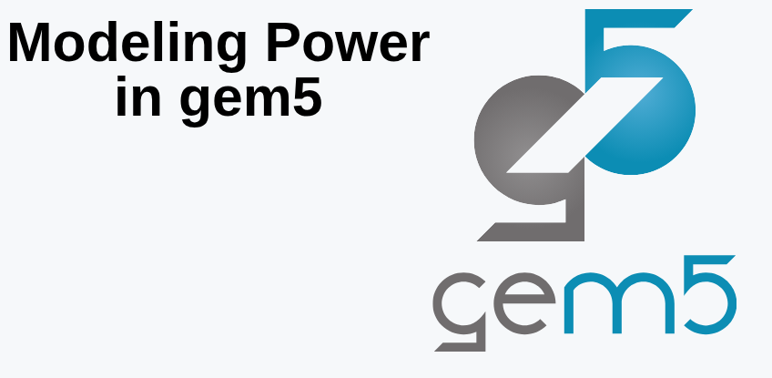
14 Gem5 Power Model
https://www.youtube.com/watch?v=Y-0mUyCoK_I&list=PL_hVbFs_loVR_8ntTTmmG6YEq3Po_4snu&index=14
Gem5 Power Model (0:00-0:45/11:59)
We talk about Power model for Gem5.

Slide 3
14.1 Topics

Slide 4
14.1 Topics
https://www.youtube.com/watch?v=Y-0mUyCoK_I&list=PL_hVbFs_loVR_8ntTTmmG6YEq3Po_4snu&index=14
Power Model Topic (0:46-0:50/11:59)
1. Power Modeling: We discuss the idea behind Power Model
2. Class MathExprPowerModel: We use Power Model in Gem5.
3. Example

Slide 5
14.2 Power Model

Slide 6
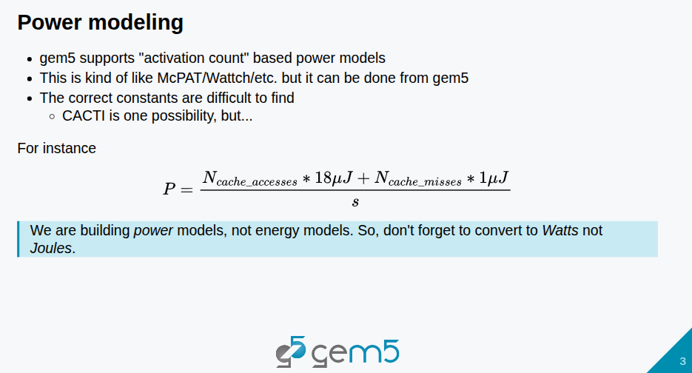
14.2 Power Model
https://www.youtube.com/watch?v=Y-0mUyCoK_I&list=PL_hVbFs_loVR_8ntTTmmG6YEq3Po_4snu&index=14
Power Model Topic (0:51-0:55/11:59)
1. Gem5 supports (internally within Gem5) activation count based power models.
2. In the past, a lot of people have used Power model, such as, McPAT with Gem5. First, we run Gem5 and get the Gem5 statistics, then feed the statistics into the McPAT.
3. We can do Gem5 statistics and McPAT in Gem5 as well.

Slide 7
14.2 Power Model
https://www.youtube.com/watch?v=Y-0mUyCoK_I&list=PL_hVbFs_loVR_8ntTTmmG6YEq3Po_4snu&index=14
Power Model Topic (0:56-2:35/11:59)
Q: For power model, how to get the power of each components in the system?
Ans: We can give the the number of activation, then we can get the power of that component.
1. Cache Access Energy (or cache activation energy): the number of cache was accessed to memory that costs some number of energy, e.g., 18uJ.
2. Cache Missing Energy [or MSHRs (Miss-Status Holding Registers)]: the number of times that cache was missed to access the memory that also cost some energy, e.g. 1uJ. ) that cost some energy.
3. Total energy: We add the energy of cache access memory and cache missed access memory.
4. We divide the total energy by time.
5. We can get the above power calculation by tool CACTI or McPAT.

Slide 8
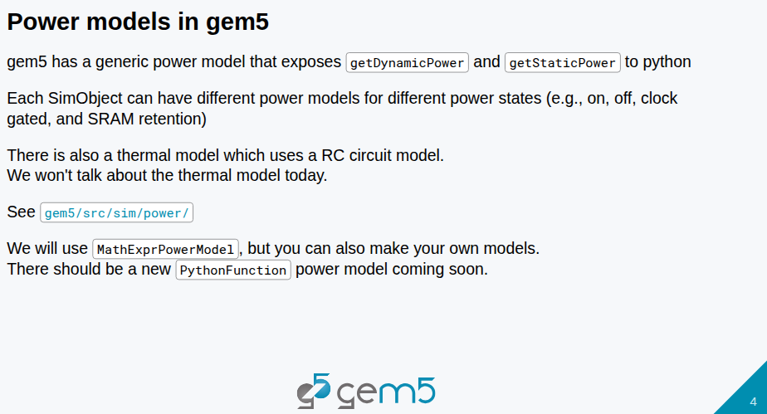
14.2 Power Model
https://www.youtube.com/watch?v=Y-0mUyCoK_I&list=PL_hVbFs_loVR_8ntTTmmG6YEq3Po_4snu&index=14
Power Model Topic (0:56-2:35/11:59)
Gem5 has a power model written in Python Functions: getDynamicPower () and getStaticPower ().

Slide 9
End

