Slide 1

7.1 CPU Model: Slides
Peter H. Chen

Slide 2
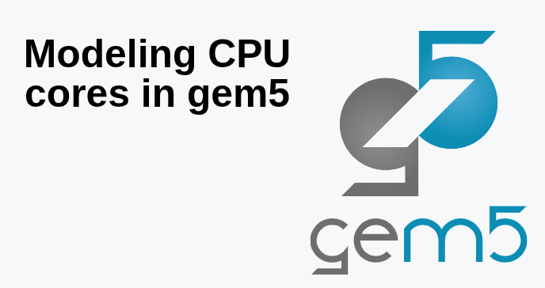
7.1 CPU Model: Slides
https://gem5bootcamp.github.io/2024/#02-Using-gem5/04-cores
CPU Model: Slides

Slide 3
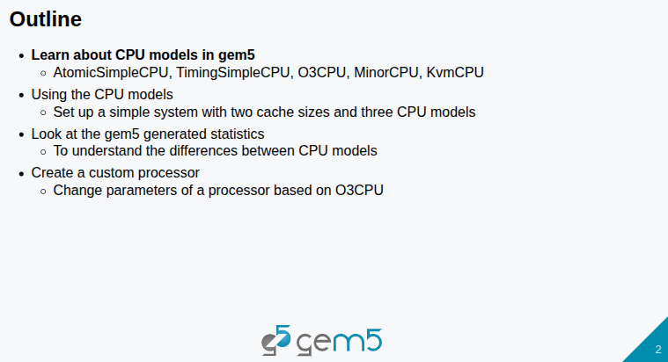
7.1 CPU Model: Slides
https://gem5bootcamp.github.io/2024/#02-Using-gem5/04-cores
CPU Model: Slides

Slide 4
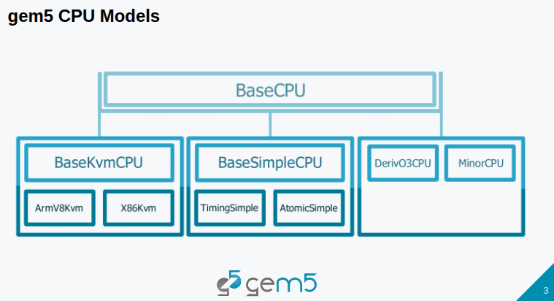
7.1 CPU Model: Slides
https://gem5bootcamp.github.io/2024/#02-Using-gem5/04-cores
CPU Model: Slides

Slide 5
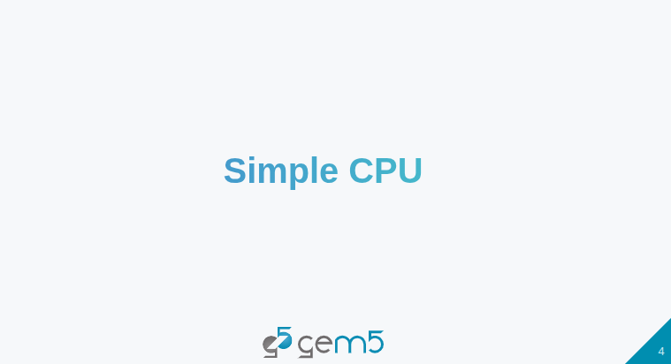
7.1 CPU Model: Slides
https://gem5bootcamp.github.io/2024/#02-Using-gem5/04-cores
CPU Model: Slides

Slide 6
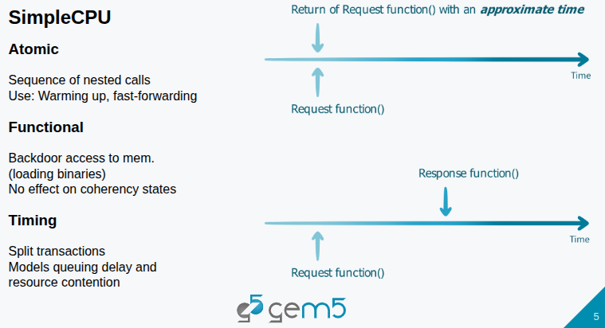
7.1 CPU Model: Slides
https://gem5bootcamp.github.io/2024/#02-Using-gem5/04-cores
CPU Model: Slides

Slide 7
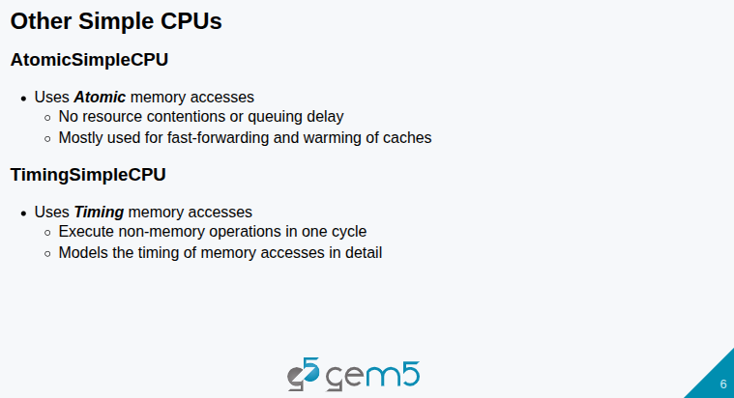
7.1 CPU Model: Slides
https://gem5bootcamp.github.io/2024/#02-Using-gem5/04-cores
CPU Model: Slides

Slide 8
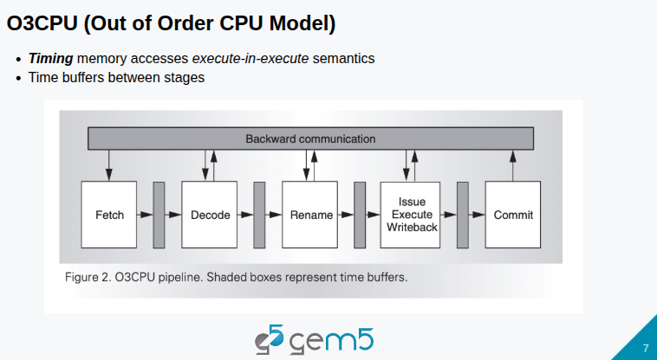
7.1 CPU Model: Slides
https://gem5bootcamp.github.io/2024/#02-Using-gem5/04-cores
CPU Model: Slides

Slide 9
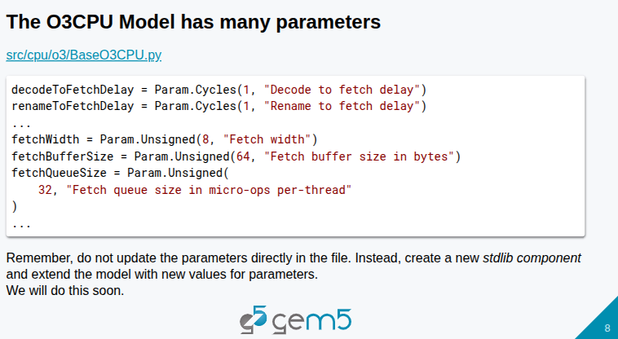
7.1 CPU Model: Slides
https://gem5bootcamp.github.io/2024/#02-Using-gem5/04-cores
CPU Model: Slides

Slide 10
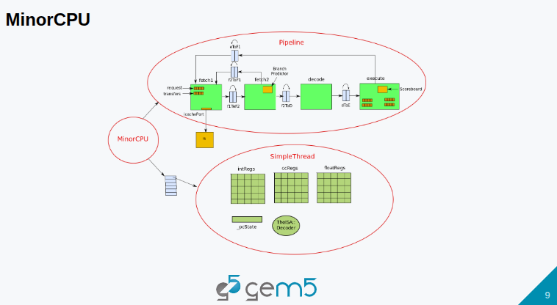
7.1 CPU Model: Slides
https://gem5bootcamp.github.io/2024/#02-Using-gem5/04-cores
CPU Model: Slides

Slide 11
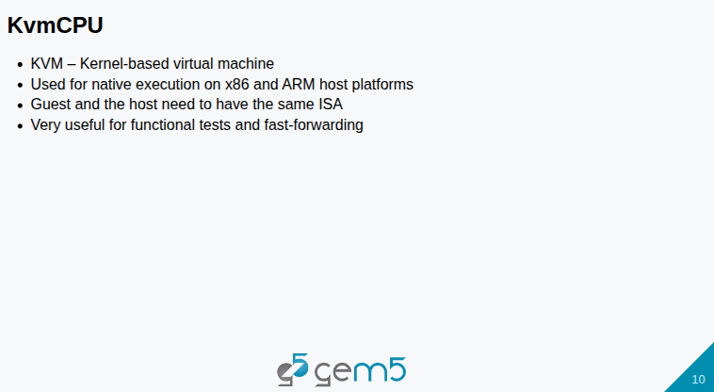
7.1 CPU Model: Slides
https://gem5bootcamp.github.io/2024/#02-Using-gem5/04-cores
CPU Model: Slides

Slide 12
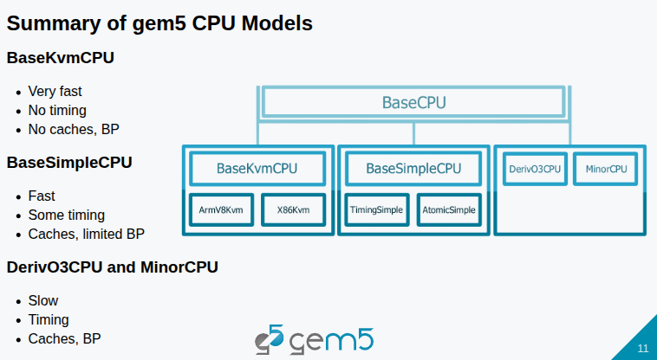
7.1 CPU Model: Slides
https://gem5bootcamp.github.io/2024/#02-Using-gem5/04-cores
CPU Model: Slides

Slide 13
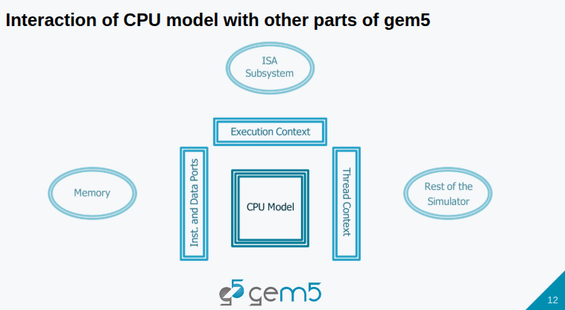
7.1 CPU Model: Slides
https://gem5bootcamp.github.io/2024/#02-Using-gem5/04-cores
CPU Model: Slides

Slide 14
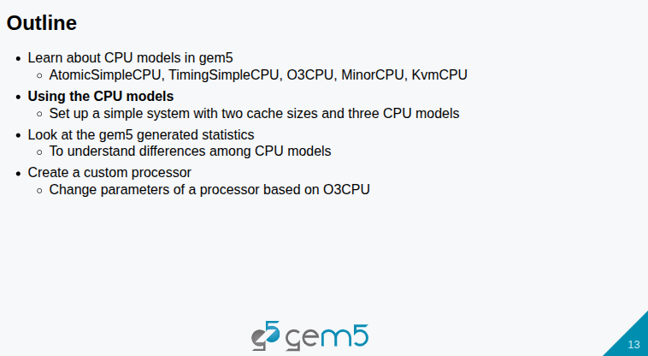
7.1 CPU Model: Slides
https://gem5bootcamp.github.io/2024/#02-Using-gem5/04-cores
CPU Model: Slides

Slide 15
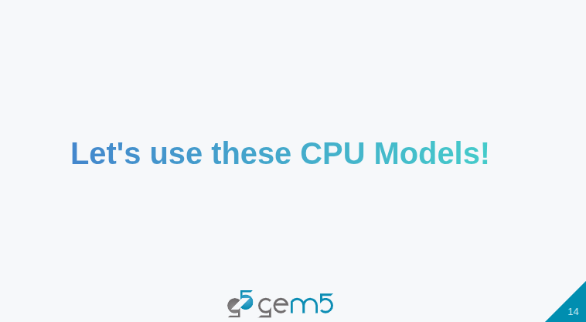
7.1 CPU Model: Slides
https://gem5bootcamp.github.io/2024/#02-Using-gem5/04-cores
CPU Model: Slides

Slide 16
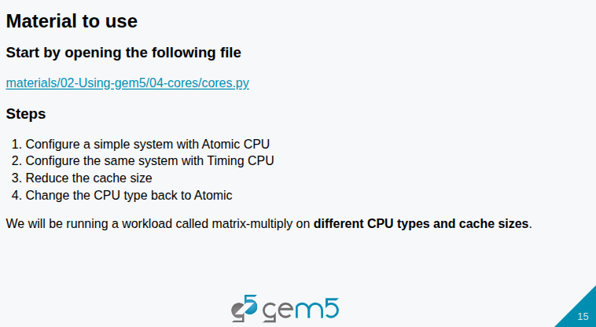
7.1 CPU Model: Slides
https://gem5bootcamp.github.io/2024/#02-Using-gem5/04-cores
CPU Model: Slides

Slide 17
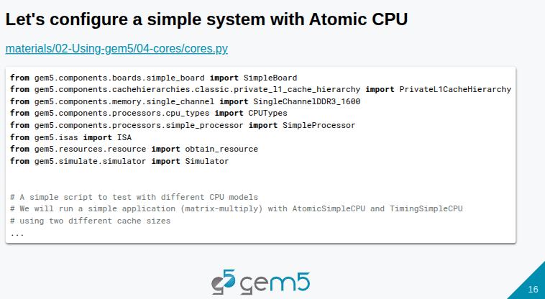
7.1 CPU Model: Slides
https://gem5bootcamp.github.io/2024/#02-Using-gem5/04-cores
CPU Model: Slides

Slide 18
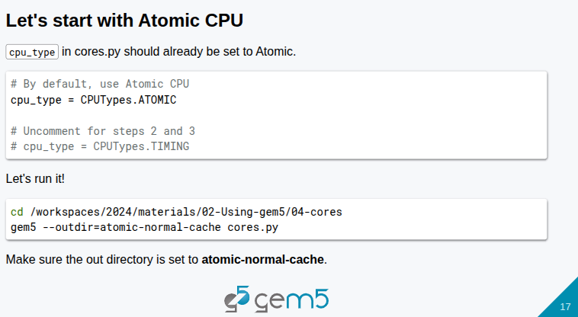
7.1 CPU Model: Slides
https://gem5bootcamp.github.io/2024/#02-Using-gem5/04-cores
CPU Model: Slides

Slide 19
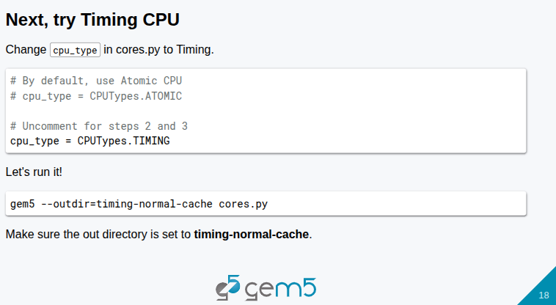
7.1 CPU Model: Slides
https://gem5bootcamp.github.io/2024/#02-Using-gem5/04-cores
CPU Model: Slides

Slide 20
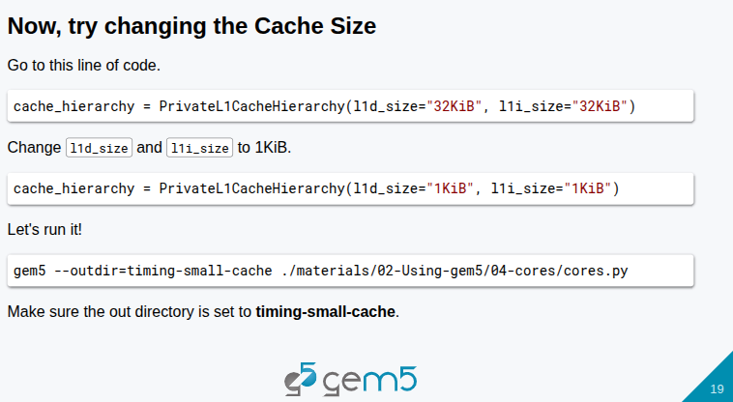
7.1 CPU Model: Slides
https://gem5bootcamp.github.io/2024/#02-Using-gem5/04-cores
CPU Model: Slides

Slide 21
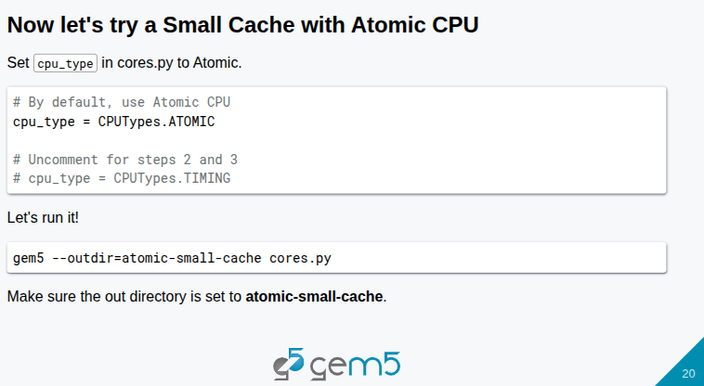
7.1 CPU Model: Slides
https://gem5bootcamp.github.io/2024/#02-Using-gem5/04-cores
CPU Model: Slides

Slide 22
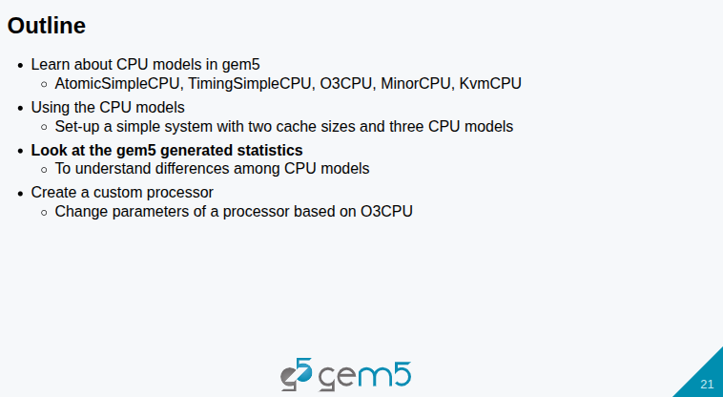
7.1 CPU Model: Slides
https://gem5bootcamp.github.io/2024/#02-Using-gem5/04-cores
CPU Model: Slides

Slide 23
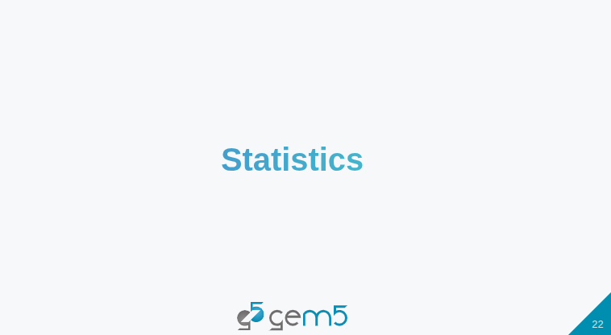
7.1 CPU Model: Slides
https://gem5bootcamp.github.io/2024/#02-Using-gem5/04-cores
CPU Model: Slides

Slide 24
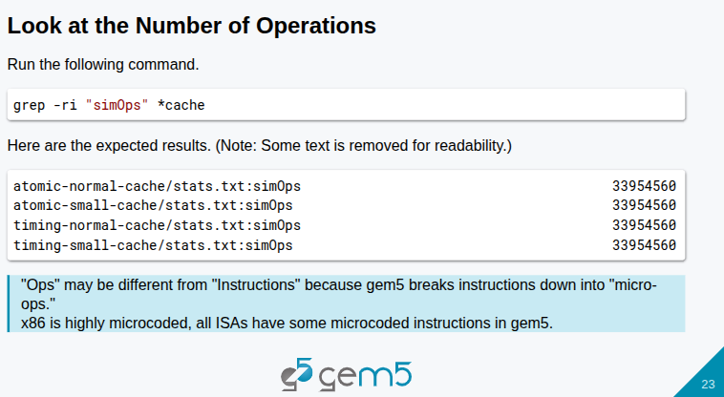
7.1 CPU Model: Slides
https://gem5bootcamp.github.io/2024/#02-Using-gem5/04-cores
CPU Model: Slides

Slide 25
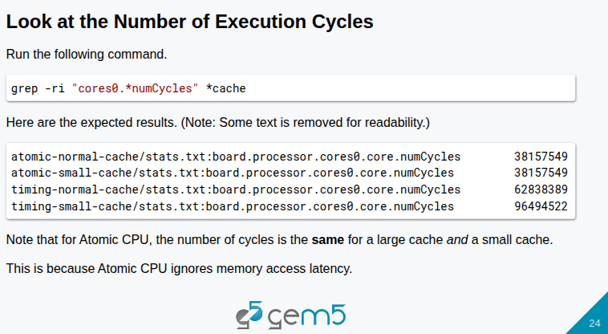
7.1 CPU Model: Slides
https://gem5bootcamp.github.io/2024/#02-Using-gem5/04-cores
CPU Model: Slides

Slide 26
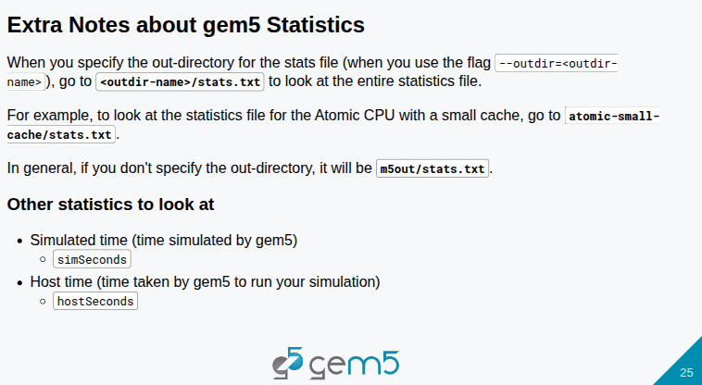
7.1 CPU Model: Slides
https://gem5bootcamp.github.io/2024/#02-Using-gem5/04-cores
CPU Model: Slides

Slide 27

7.1 CPU Model: Slides
https://gem5bootcamp.github.io/2024/#02-Using-gem5/04-cores
CPU Model: Slides

Slide 28
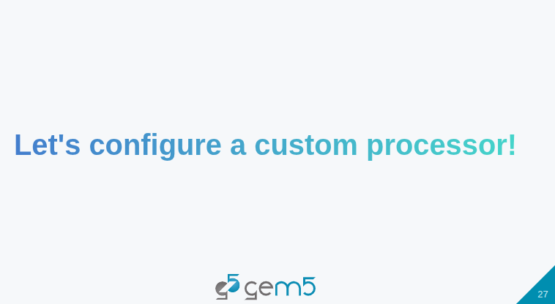
7.1 CPU Model: Slides
https://gem5bootcamp.github.io/2024/#02-Using-gem5/04-cores
CPU Model: Slides

Slide 29
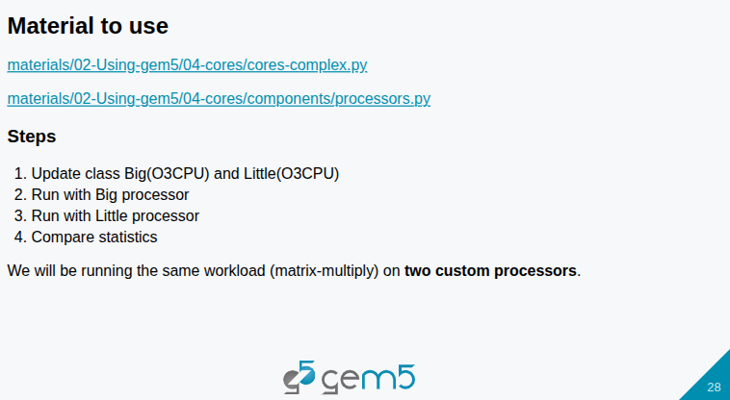
7.1 CPU Model: Slides
https://gem5bootcamp.github.io/2024/#02-Using-gem5/04-cores
CPU Model: Slides

Slide 30
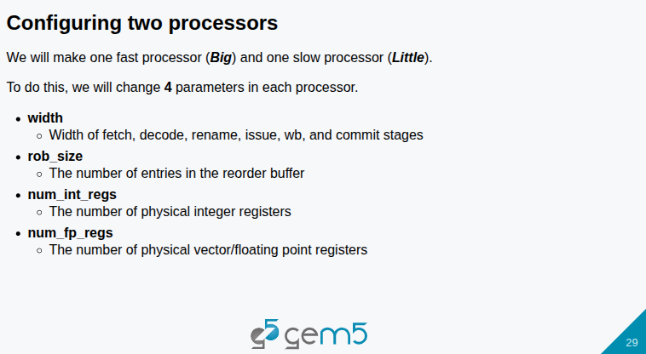
7.1 CPU Model: Slides
https://gem5bootcamp.github.io/2024/#02-Using-gem5/04-cores
CPU Model: Slides

Slide 31
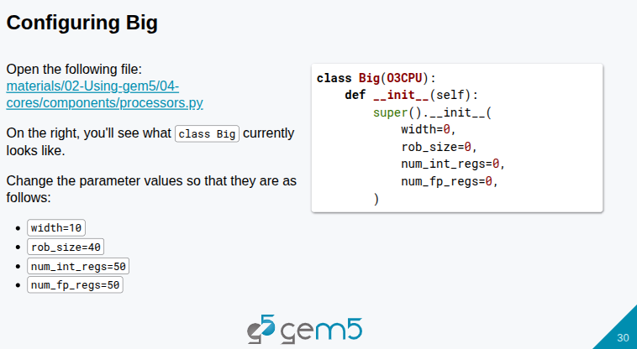
7.1 CPU Model: Slides
https://gem5bootcamp.github.io/2024/#02-Using-gem5/04-cores
CPU Model: Slides

Slide 32
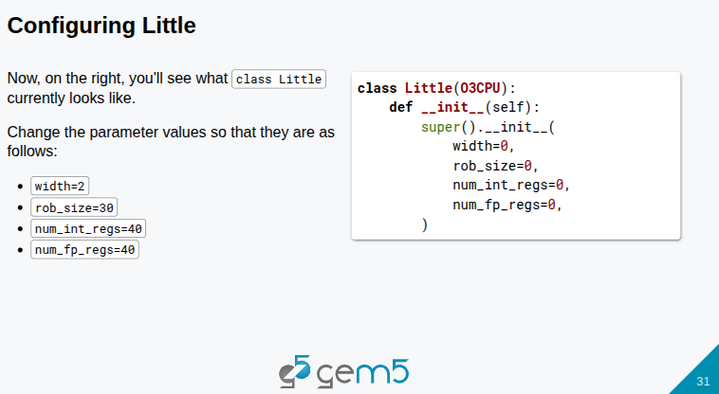
7.1 CPU Model: Slides
https://gem5bootcamp.github.io/2024/#02-Using-gem5/04-cores
CPU Model: Slides

Slide 33
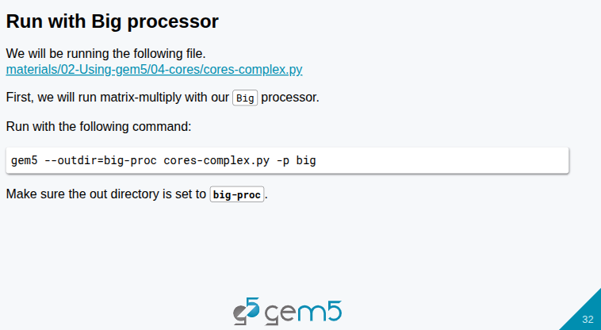
7.1 CPU Model: Slides
https://gem5bootcamp.github.io/2024/#02-Using-gem5/04-cores
CPU Model: Slides

Slide 34
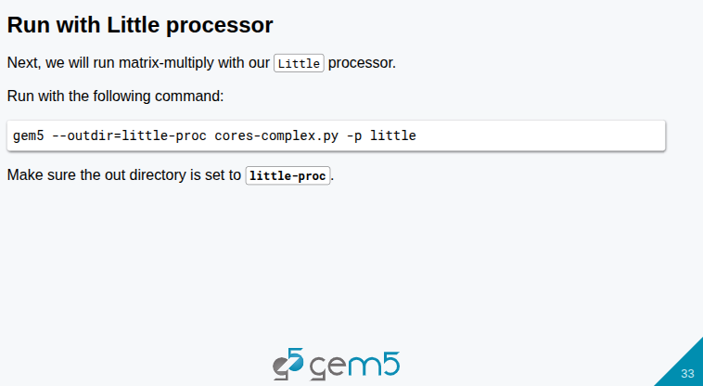
7.1 CPU Model: Slides
https://gem5bootcamp.github.io/2024/#02-Using-gem5/04-cores
CPU Model: Slides

Slide 35
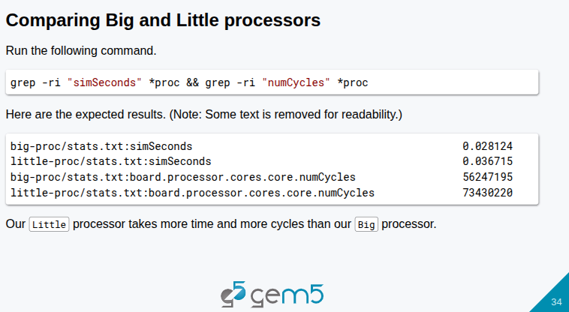
7.1 CPU Model: Slides
https://gem5bootcamp.github.io/2024/#02-Using-gem5/04-cores
CPU Model: Slides

Slide 36
End

