Slide 1

2.1 Get Started Lab
Peter H. Chen

Slide 2
2.1L Get Started Lab
https://www.gem5.org/getting_started/
Github Started Lab
We discuss how to install and run Gem5.

Slide 3
2.2L Github Repository

Slide 4
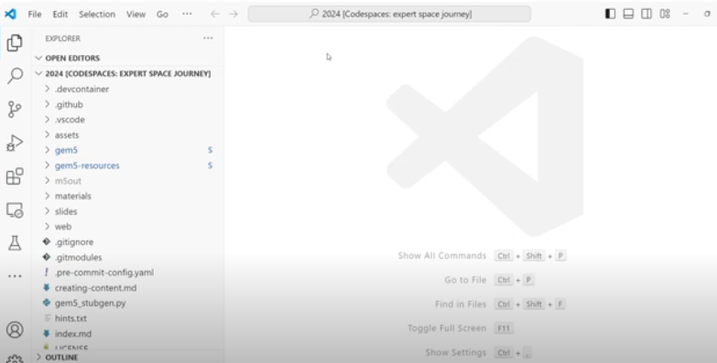
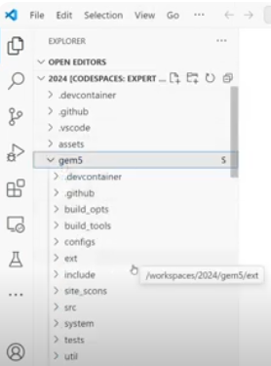
2.2L Github Repository
https://www.gem5.org/getting_started/
Github Repository
We have Visual Studio Environment on Github Codespace.
We see the “gem5” directory.

Slide 5
2.3L Download Gem5

Slide 6
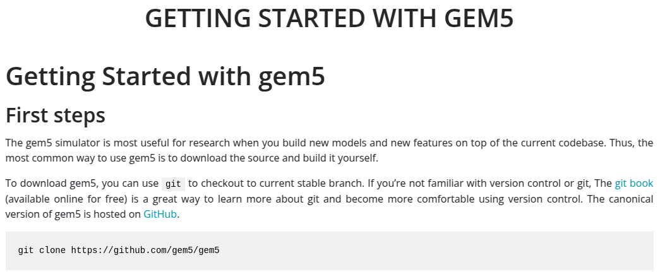
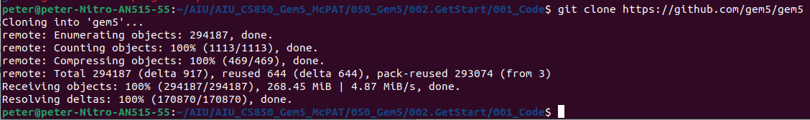
2.3L Download Gem5
https://www.gem5.org/getting_started/
Download Gem5
> git clone https://github.com/gem5/gem5

Slide 7
2.3 Download Gem5
https://www.gem5.org/getting_started/
Download Gem5

Slide 8
2.3 Download Gem5
https://www.gem5.org/getting_started/
Download Gem5
> cd gme5
> ls

Slide 9
2.4L Install SCONS

Slide 10
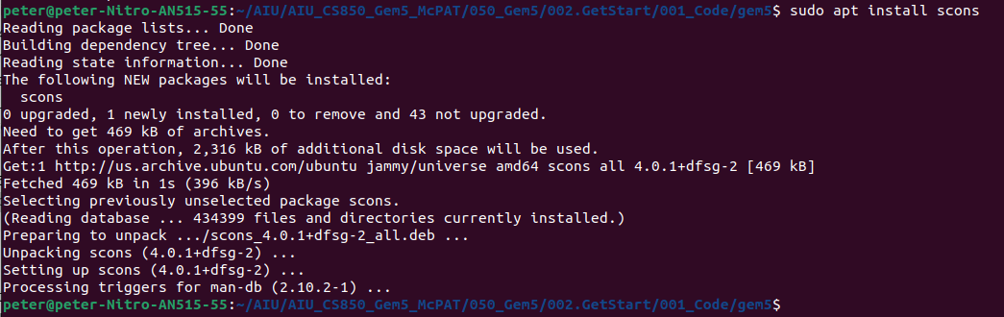
2.4L Install SCONS
https://www.gem5.org/getting_started/
Install SCONS
> sudo apt install scons # Install scons

Slide 11
2.5L Check Number of Processor

Slide 12
2.5L Check Number of Processor
https://www.gem5.org/getting_started/
Check Number of Processor
> nproc # Check how many CPU
>> 8 # CPU = 8

Slide 13
2.6L Install Requirement

Slide 14
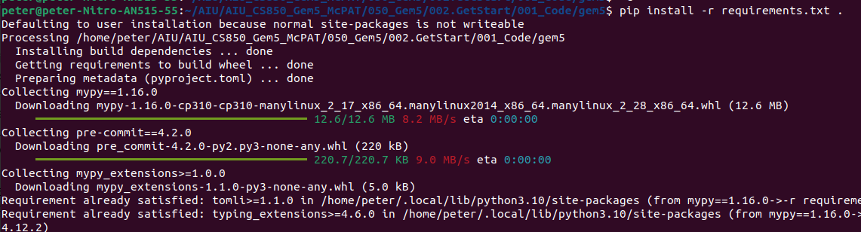
2.6L Install Requirement
https://www.gem5.org/getting_started/
Install Requirement
> pip install -r requirements.txt .

Slide 15
2.7L Install Macro Package m4

Slide 16
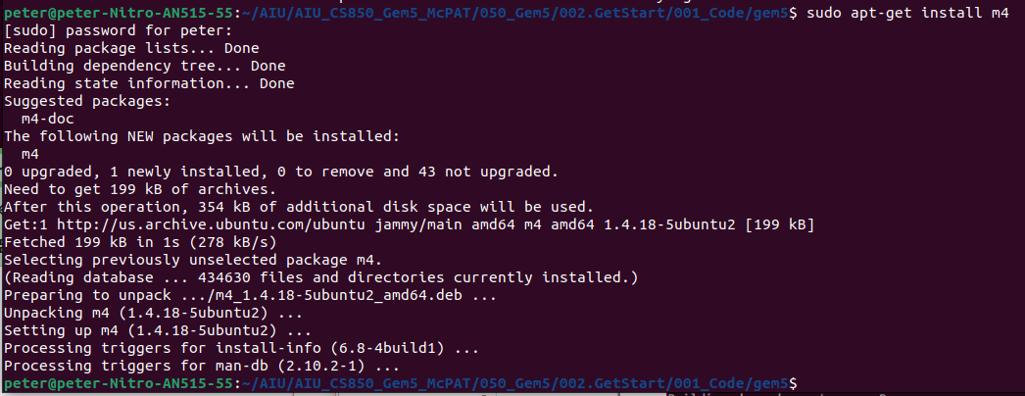
2.7L Install Macro Package m4
https://www.gem5.org/getting_started/
Install Macro Package m4
M4 is a Ubuntu macro package.
> pip apt-get install m4

Slide 17
2.8L Install Gem5

Slide 18
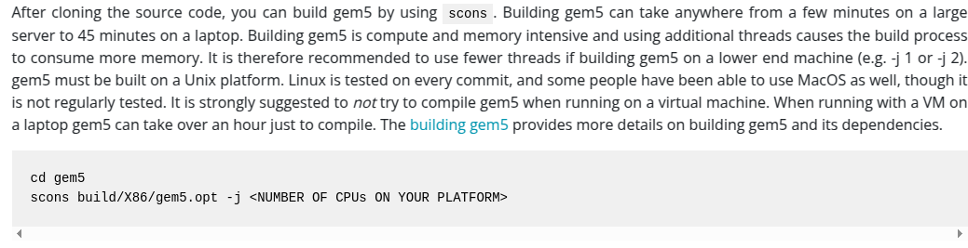
2.8L Install Gem5
https://www.gem5.org/getting_started/
Install Gem5
Scons (Software Construction) is a software construction tool.
> scons build/X86/gem5.opt -j 8 # <NUMBER OF CPUs ON YOUR PLATFORM>

Slide 19
2.9L Compile Gem5

Slide 20
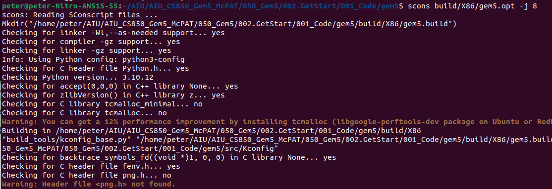
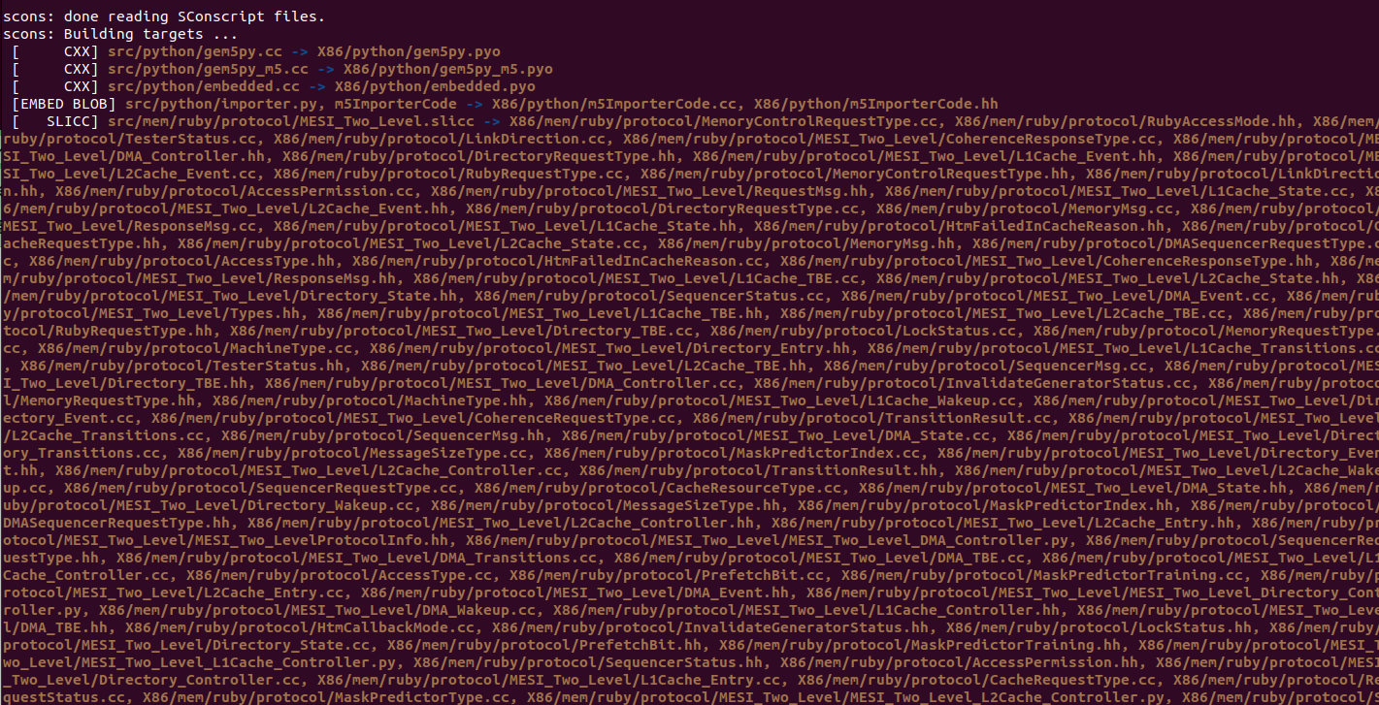
2.9L Compile Gem5
https://www.gem5.org/getting_started/
Compile Gem5
> scons build/X86/gem5.opt -j 8 # <NUMBER OF CPUs ON YOUR PLATFORM>

Slide 21
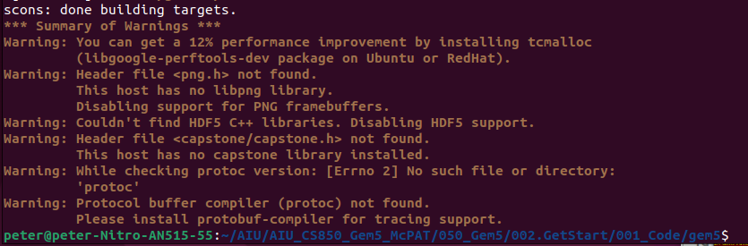
2.9L Compile Gem5
https://www.gem5.org/getting_started/
Compile Gem5
> scons build/X86/gem5.opt -j 8 # <NUMBER OF CPUs ON YOUR PLATFORM>

Slide 22
2.10L Run Gem5: Hello World

Slide 23
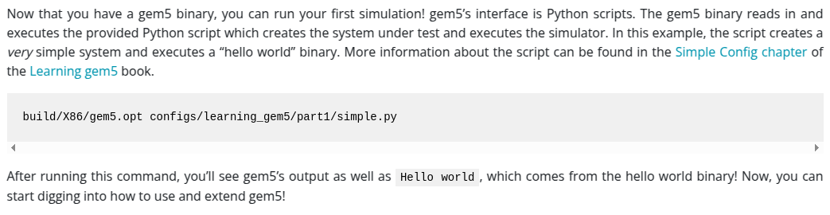
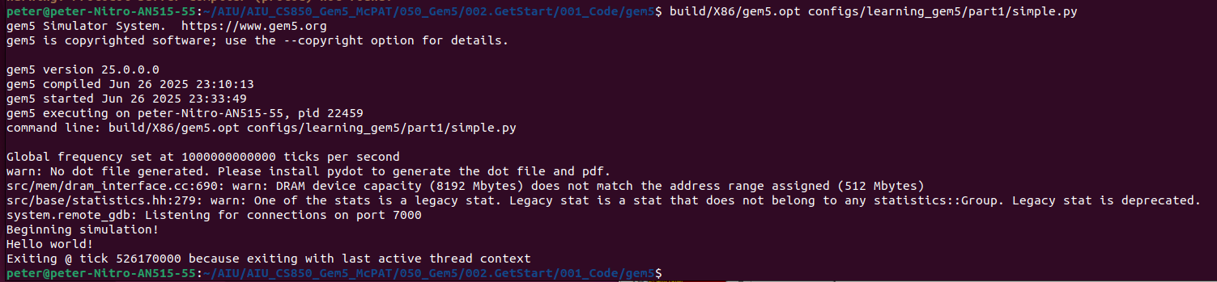
2.10L Run Gem5: Hello World
https://www.gem5.org/getting_started/
Run Gem5: Hello World
We have the Gem5 library
> build/X86/gem5.opt configs/learning_gem5/part1/simple.py

Slide 24
2.11L Build gem5 with Cache Architecture

Slide 25
2.11L Build gem5 with Cache Architecture
https://www.gem5.org/getting_started/
Build gem5 with Cache Architecture
Build gem5 with cache architecture, i.e., MESI (Modified, Exclusive, Shared, Invalid)
> scons build/ALL/gem5.opt
https://www.google.com/search?q=where+to+download+gem5-mesi&oq=where+to+download+gem5-mesi&gs_lcrp=EgZjaHJvbWUyBggAEEUYOdIBCTEzOTU2ajBqN6gCALACAA&sourceid=chrome&ie=UTF-8

Slide 26
End

