Slide 1

22 Model Port (02)
Peter H. Chen

Slide 2
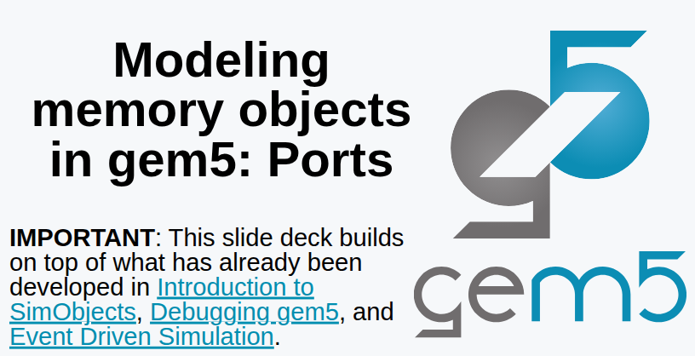
22 Model Port (02)
https://www.youtube.com/watch?v=IAPlbIZg518&list=PL_hVbFs_loVR_8ntTTmmG6YEq3Po_4snu&index=22
Model Port (02) (0:00-0:20/1:36:50)
Last time, we discussed a little bit about Ports.

Slide 3
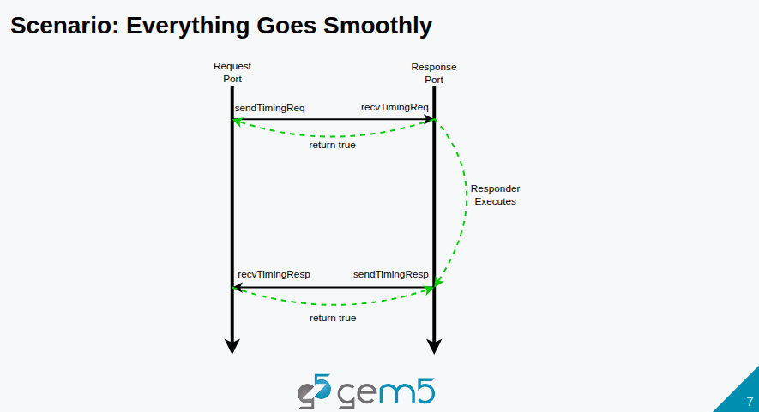
22 Model Port (02)
https://www.youtube.com/watch?v=IAPlbIZg518&list=PL_hVbFs_loVR_8ntTTmmG6YEq3Po_4snu&index=22
Model Port (02) (0:21-0:30/1:36:50)
We have below request, execution, and response diagram.
Gem5 has two types of ports: request port and response port.

Slide 4
22 Model Port (02)
https://www.youtube.com/watch?v=IAPlbIZg518&list=PL_hVbFs_loVR_8ntTTmmG6YEq3Po_4snu&index=22
Model Port (02) (0:31-1:40/1:36:50)
In Gem5, the concept of connected peers: Request port is connected to response port are always operated as connected peers.
The types of Ports are different. Usually, the SimObject has ports. We send the from the request port. The request and response ports are connected together. The signal propagates back from request to response port within the bandwidth.

Slide 5
22 Model Port (02)
https://www.youtube.com/watch?v=IAPlbIZg518&list=PL_hVbFs_loVR_8ntTTmmG6YEq3Po_4snu&index=22
Model Port (02) (1:41-2:20/1:36:50)
If cache is busy and cache is missing the status of handling registers. We get a miss and return False. Time continue to move on.
In some time, if cache is ready and port will return true. It is the responsibility of responder object to send the response back.
We call this is the timing response on the response port or receiving timing response on the request port.

Slide 6
22 Model Port (02)
https://www.youtube.com/watch?v=IAPlbIZg518&list=PL_hVbFs_loVR_8ntTTmmG6YEq3Po_4snu&index=22
Model Port (02) (2:21-2:55/1:36:50)
So, request ports send requests, receive responses. Response ports receive requests, send responses.
We will see in the code, the only functions that relate to receiving are pure virtual functions.
This means that response sending is very straightforward. We get the peer and ask peer to receive.

Slide 7
22.0 Topics

Slide 8
22.0 Topics
https://www.youtube.com/watch?v=IAPlbIZg518&list=PL_hVbFs_loVR_8ntTTmmG6YEq3Po_4snu&index=22
Model Port (02) (2:56-3:00/1:36:50)
1.

Slide 9
22.1 InspectorGadget

Slide 10
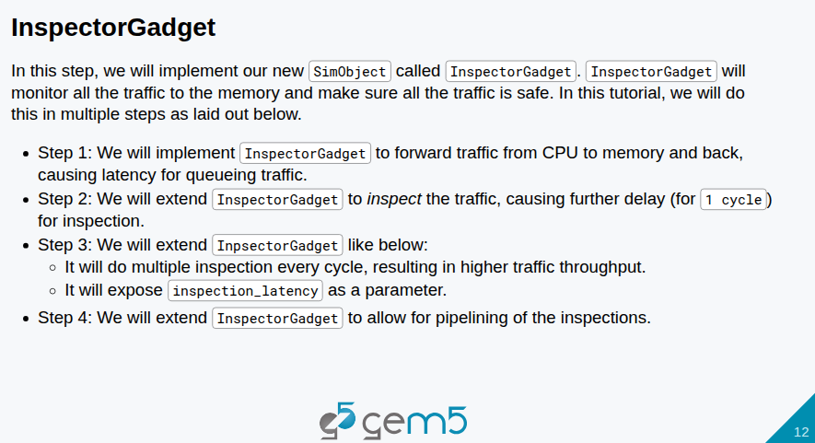
22.1 InspectorGadget
https://www.youtube.com/watch?v=IAPlbIZg518&list=PL_hVbFs_loVR_8ntTTmmG6YEq3Po_4snu&index=22
InspectorGadget (3:01-3:20/1:36:50)
1. Here, we implement InspectorGadget() in SimObject class.
2. InspectorGadget() will monitor all the traffic to the memory and make sure traffic is safe.
3. We will do this monitor in four steps.

Slide 11
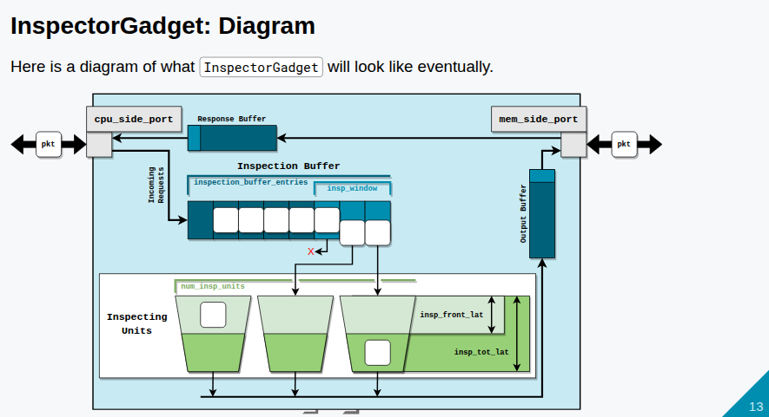
22.1 InspectorGadget
https://www.youtube.com/watch?v=IAPlbIZg518&list=PL_hVbFs_loVR_8ntTTmmG6YEq3Po_4snu&index=22
InspectorGadget (3:31-4:30/1:36:50)
Below is the diagram of high level view of InspectorGadget().
First step: At the left of the diagram, we have cpu_side_port. This is the model of the port on CPU side, a response port on CPU side. We have the buffer called Inspection Buffer. At the first step, we do not discuss the details of modeling any inspection.
Below describes how the protocol:
1. Create the inspection buffer.
2. Send inspection buffer through the memory side port to the memory.
3. Make a request
4. Get the responses
5. Forward the responses back.

Slide 12
22.1 InspectorGadget
https://www.youtube.com/watch?v=IAPlbIZg518&list=PL_hVbFs_loVR_8ntTTmmG6YEq3Po_4snu&index=22
InspectorGadget (4:31-4:45/1:36:50)
It seems to be easy, however, we have 73 slides to describe the protocol.
Because we cannot have infinite size of buffer in the hardware, we need to parameterize the size of memory buffers.

Slide 13
22.2 Step 1: Buffering Traffic

Slide 14
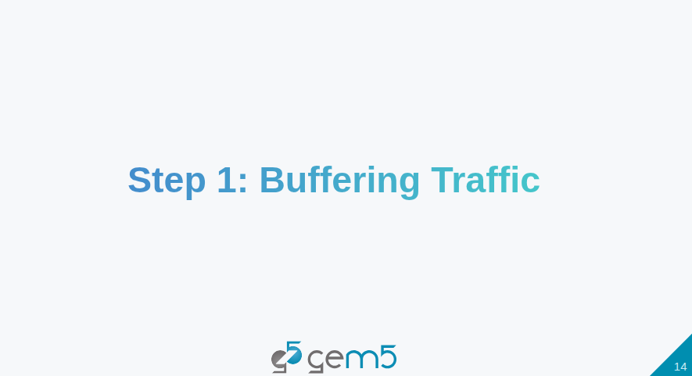
22.2 Step 1: Buffering Traffic
https://www.youtube.com/watch?v=IAPlbIZg518&list=PL_hVbFs_loVR_8ntTTmmG6YEq3Po_4snu&index=22
Step 1: Buffering Traffic (4:46-4:50/1:36:50)

Slide 15
22.3 ClockedObject

Slide 16
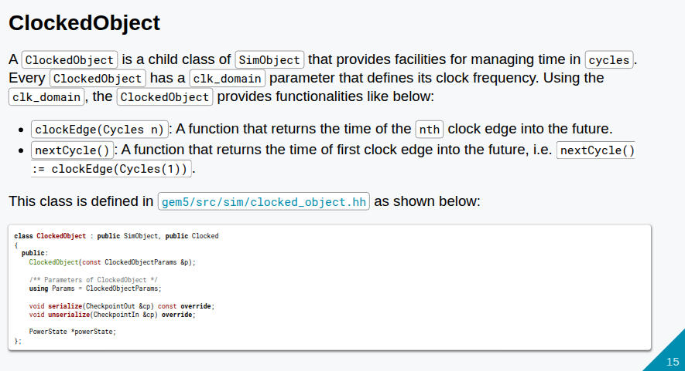
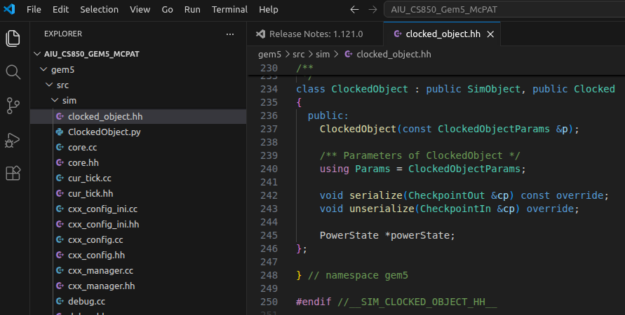
22.3 ClockedObject
https://www.youtube.com/watch?v=IAPlbIZg518&list=PL_hVbFs_loVR_8ntTTmmG6YEq3Po_4snu&index=22
ClockedObject (4:51-5:30/1:36:50)
> gem5/src/sim/clocked_object.hh
1. Before we write the code, we check the ClockedObject first.
2. The clocked_object.hh defines Clocked class and ClockedObject class.
3. The ClockedObject class inherited SimObject and Clocked class.
4. The ClockedObject will let us see the time in the concept of cycles, not tick.

Slide 17
22.3 ClockedObject
https://www.youtube.com/watch?v=IAPlbIZg518&list=PL_hVbFs_loVR_8ntTTmmG6YEq3Po_4snu&index=22
ClockedObject (5:31-5:40/1:36:50)
> gem5/src/sim/clocked_object.hh
5. The ClockedObject class has the function clockEdge(Cycle n) which returns tick of nth clock edge in the future.
6. The ClockedObject class also has nextCycle () function that return the first clock edge in the future, i.e., clockEdge(Cycle(1))
7. ClockedObject class gives you the time of next cycle in tick. It give you the time ticks and convert cycle to clock.

Slide 18
22.3 ClockedObject
https://www.youtube.com/watch?v=IAPlbIZg518&list=PL_hVbFs_loVR_8ntTTmmG6YEq3Po_4snu&index=22
ClockedObject (5:41-5:50/1:36:50)
> gem5/src/sim/clocked_object.hh
8. The ClockedObject has parameter (ClockedObjectParams) of Clock Domain. The clock frequency, rising, etc. are defined inside the parameters.
9. In C++, we cannot see the parameters. We only can see the next cycle, clock period, etc, We can get the all these in ticks.

Slide 19
22.4 InspectorGadget: Add File

Slide 20
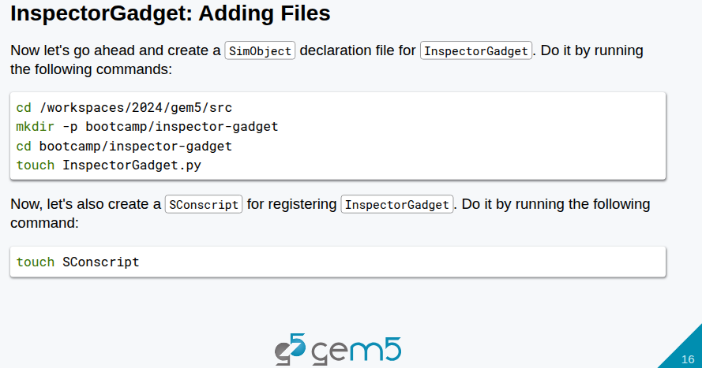
22.4 InspectorGadget: Add File
https://www.youtube.com/watch?v=IAPlbIZg518&list=PL_hVbFs_loVR_8ntTTmmG6YEq3Po_4snu&index=22
InspectorGadget: Add File (5:51-6:00/1:36:50)
> ~materials/03-Developing-gem5-models/04-ports/step-1/src/bootcamp/inspector-gadget/
Q: What is difference of ClockedObject and InspectorGadget?
Ans: In gem5,
1. ClockedObject is a Fundamental base class that governs simulation timing and clock domains.
2. “Inspector Gadget" is not a standard gem5 architectural class; it typically refers to specific debugging or tracing utilities within gem5, rather than a base object class.

Slide 21
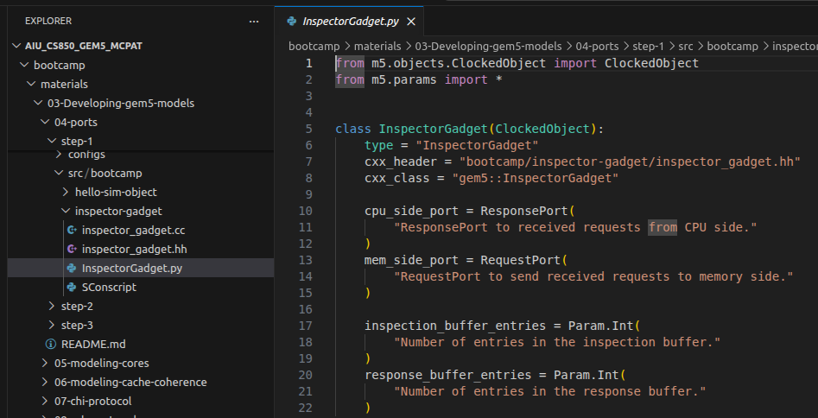
22.4 InspectorGadget: Add File
https://www.youtube.com/watch?v=IAPlbIZg518&list=PL_hVbFs_loVR_8ntTTmmG6YEq3Po_4snu&index=22
InspectorGadget: Add File (6:01-6:40/1:36:50)
> ~materials/03-Developing-gem5-models/04-ports/step-1/src/bootcamp/inspector-gadget/
> cd workspace/src
> mkdir bootcamp/inspector-gadget
> cd bootcamp/inspector-gadget
> touch InspectorGadget.py # Create SimObject declaration file
> touch SConscript # Scons builder

Slide 22
22.4 InspectorGadget: Add File
https://www.youtube.com/watch?v=IAPlbIZg518&list=PL_hVbFs_loVR_8ntTTmmG6YEq3Po_4snu&index=22
InspectorGadget: Add File (6:41-8:40/1:36:50)
> ~materials/03-Developing-gem5-models/04-ports/step-1/src/bootcamp/inspector-gadget/
Q: What is the relationship between the ClockedObject and SimObject?
Ans: In the gem5 simulator, ClockedObject is a direct subclass of SimObject that provides timing and clock management for hardware components.
A ClockedObject is a SimObject. The Clocked Object extends the class SimObject with one or more parameter. The ne parameter that we care about is clock domain.
Below, we create:
1. a directory called inspector-gadget under the bootcamp.
2. Under the inspector-gadget folder, we create the file
  2.1 InspectorGadget.py,
  2.2 inspector_gadget.hh
  2.3 inspector_gadget.cc

Slide 23
22.4 InspectorGadget: Add File
https://www.youtube.com/watch?v=IAPlbIZg518&list=PL_hVbFs_loVR_8ntTTmmG6YEq3Po_4snu&index=22
InspectorGadget: Add File (6:41-6:50/1:36:50)
> ~materials/03-Developing-gem5-models/04-ports/step-1/src/bootcamp/inspector-gadget/
Q: What is the relationship between the ClockedObject and SimObject?
Ans: In the gem5 simulator, ClockedObject is a direct subclass of SimObject that provides timing and clock management for hardware components.

Slide 24
End

