Slide 1

19 Event Driven Simulation
Peter H. Chen

Slide 2
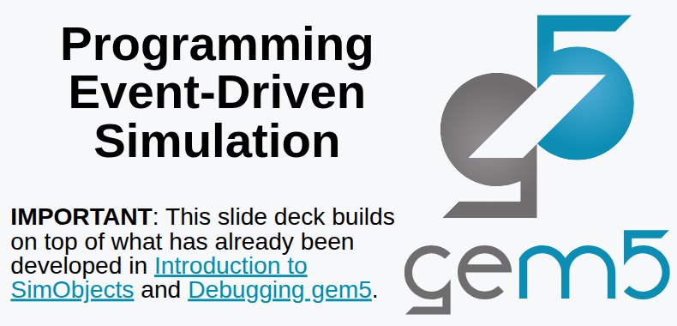
19 Event Driven Simulation
https://www.youtube.com/watch?v=n5RlOXumFyo&list=PL_hVbFs_loVR_8ntTTmmG6YEq3Po_4snu&index=19
Event Driven Simulation (0:00-0:01/52:51)
We talk about the Event Driven Simulation.

Slide 3
19.0 Topics

Slide 4
19.0 Topics
https://www.youtube.com/watch?v=n5RlOXumFyo&list=PL_hVbFs_loVR_8ntTTmmG6YEq3Po_4snu&index=19
Event Driven Simulation (0:01-0:02/52:51)
1. Review Event Driven Simulation

Slide 5
17.1 Review Event-Driven Simulation

Slide 6
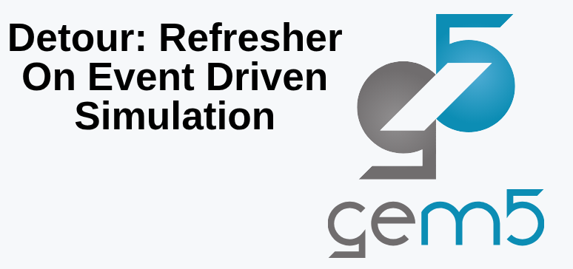
19.1 Review Event-Driven Simulation
https://www.youtube.com/watch?v=n5RlOXumFyo&list=PL_hVbFs_loVR_8ntTTmmG6YEq3Po_4snu&index=19
Review Event Driven Simulation (0:03-0:05/52:51)
First, we review Event Driven Simulation

Slide 7
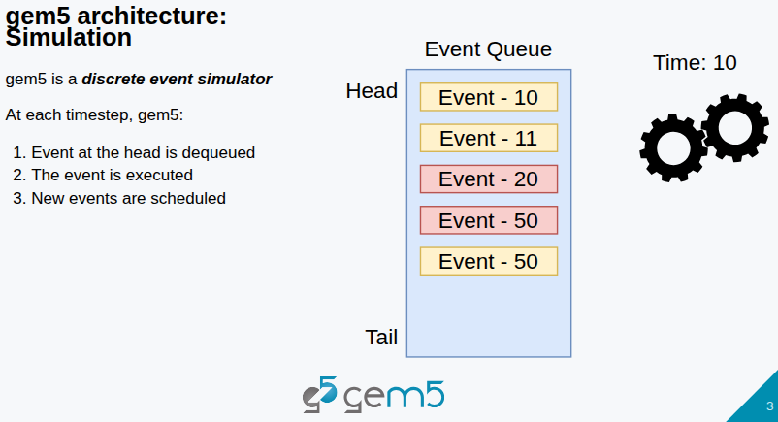
19.1 Review Event-Driven Simulation
https://www.youtube.com/watch?v=n5RlOXumFyo&list=PL_hVbFs_loVR_8ntTTmmG6YEq3Po_4snu&index=19
Review Event Driven Simulation (0:06-0:20/52:51)
As below, Gem5 has a global even queue.
The event queue is a priority queue. Events are ordered by the time which will be happened.

Slide 8
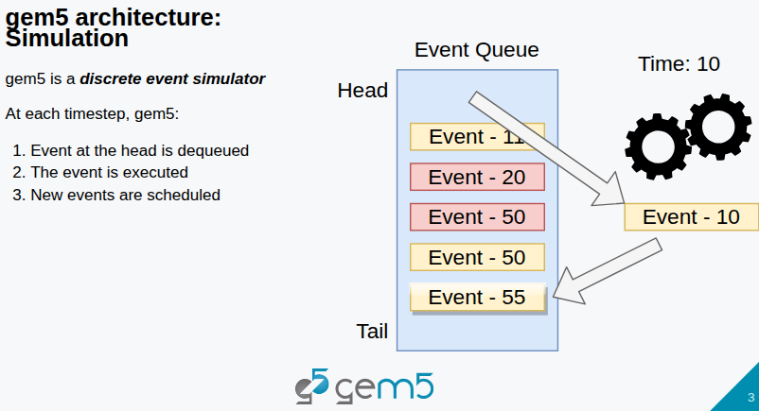
19.1 Review Event-Driven Simulation
https://www.youtube.com/watch?v=n5RlOXumFyo&list=PL_hVbFs_loVR_8ntTTmmG6YEq3Po_4snu&index=19
Review Event Driven Simulation (0:21-0:55/52:51)
First, event is popped off the queue.
The event gets executed. It may or may not generate other events.
If the events are generated, the events are inserted into the priority queue.
The event is not necessary appended to the back of the queue. The event can be inserted in the middle.
The queue is a priority queue.
Below, the event tick 10 can generate multiple events, one event, no event, etc.

Slide 9
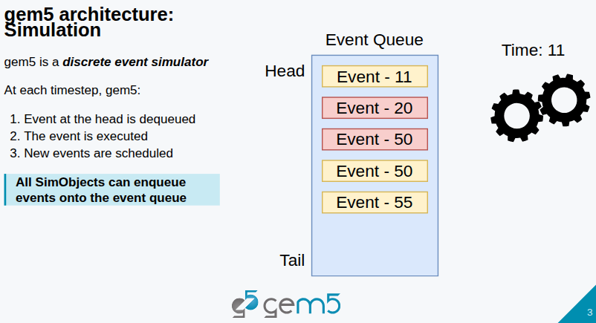
19.1 Review Event-Driven Simulation
https://www.youtube.com/watch?v=n5RlOXumFyo&list=PL_hVbFs_loVR_8ntTTmmG6YEq3Po_4snu&index=19
Review Event Driven Simulation (0:56-1:10/52:51)
Event itself can have different types.
Event is very very flexible.
Some objects are there for you to talk to the simulator to schedule events and make thing happen in the future.
All SimObjects can be put (enqueue) to the queue events.
We have to put task to the event queue of the simulator and let the simulator schedule the task.

Slide 10
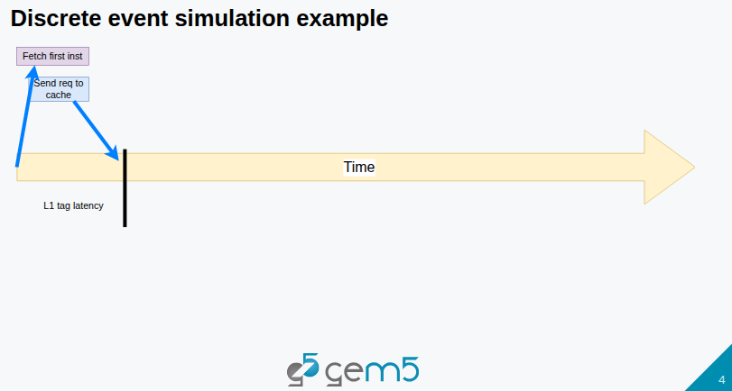
19.1 Review Event-Driven Simulation
https://www.youtube.com/watch?v=n5RlOXumFyo&list=PL_hVbFs_loVR_8ntTTmmG6YEq3Po_4snu&index=19
Review Event Driven Simulation (1:11-1:20/52:51)
In the below example, our CPU tries to fetch an instruction.

Slide 11
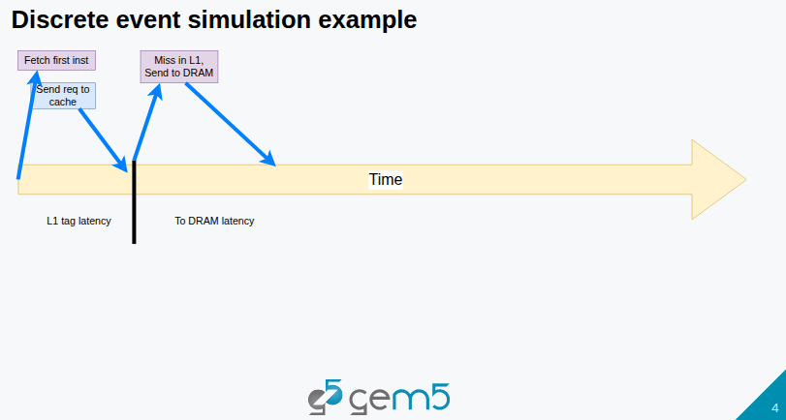
19.1 Review Event-Driven Simulation
https://www.youtube.com/watch?v=n5RlOXumFyo&list=PL_hVbFs_loVR_8ntTTmmG6YEq3Po_4snu&index=19
Review Event Driven Simulation (1:11-1:40/52:51)
Fetch instruction results in sending a request to the I-Cache (Instruction Cache).
Later on (In the future), to simulate the fetch latency and then to simulate the L1 Tag latency, the event to handle a miss in the L1 is scheduled if it is a miss.

Slide 12
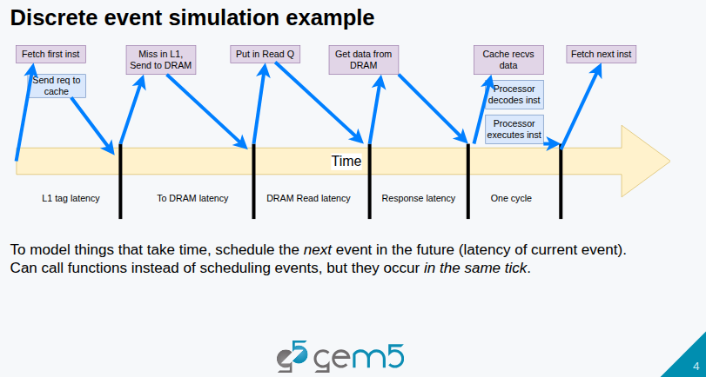
19.1 Review Event-Driven Simulation
https://www.youtube.com/watch?v=n5RlOXumFyo&list=PL_hVbFs_loVR_8ntTTmmG6YEq3Po_4snu&index=19
Review Event Driven Simulation (1:41-2:00/52:51)
If there is a latency to DRAM. We start to enqueue event based on latency.
Then, these function calls end up getting to a point where we don’t miss, we find the data that we are looking for, and then events are schedule to get the data back to the requester.

Slide 13
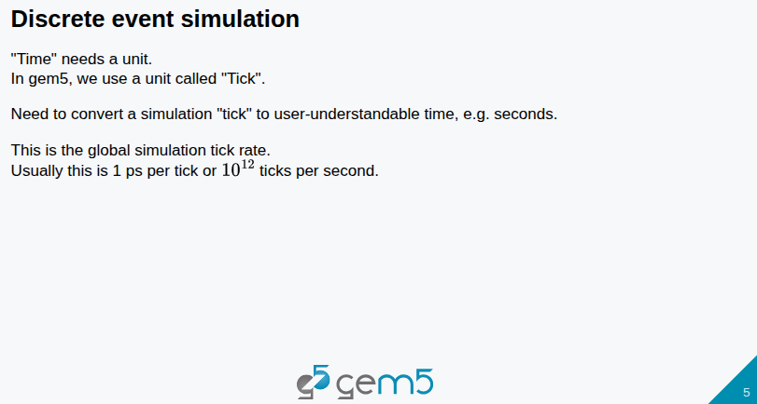
19.1 Review Event-Driven Simulation
https://www.youtube.com/watch?v=n5RlOXumFyo&list=PL_hVbFs_loVR_8ntTTmmG6YEq3Po_4snu&index=19
Review Event Driven Simulation (2:01-2:35/52:51)
Time need a unit. In Gem5, the unit of time is Tick.
We cannot have anything or any time that is smaller than one Tick.
So, it is like a quantum of time. Everything is described as number of ticks.
Click cycle periods, all of them are described as ticks. The global time is also described as number of ticks.
By default, number of ticks per second are 10 ^ 12. Another word, one tick is 1 ps (pico second).

Slide 14
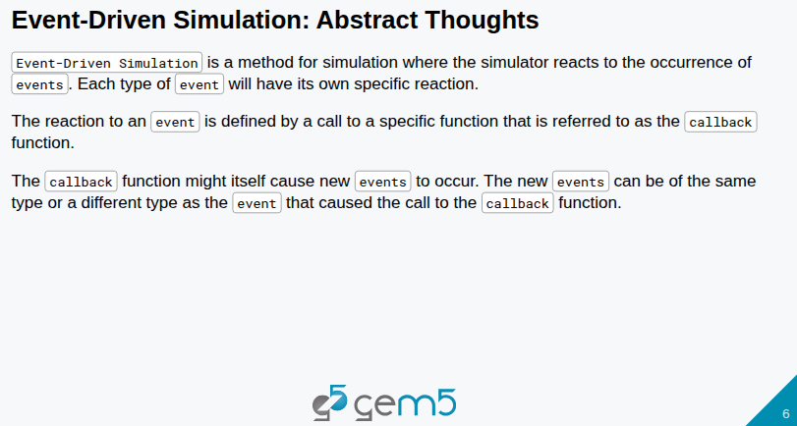
19.1 Review Event-Driven Simulation
https://www.youtube.com/watch?v=n5RlOXumFyo&list=PL_hVbFs_loVR_8ntTTmmG6YEq3Po_4snu&index=19
Review Event Driven Simulation (2:36-3:10/52:51)
Below is how we thought of Event-Driven Simulation.
Event-Driven simulation a method is that user tells simulator that something happen in the future.
And then, the simulator reacts to that thing occurring.
For user to have control over things that are happening. The user just specify a callback function, like we are telling the simulator to call me back when you get to a certain point and then that function simulates the functionality that you expect it to.

Slide 15
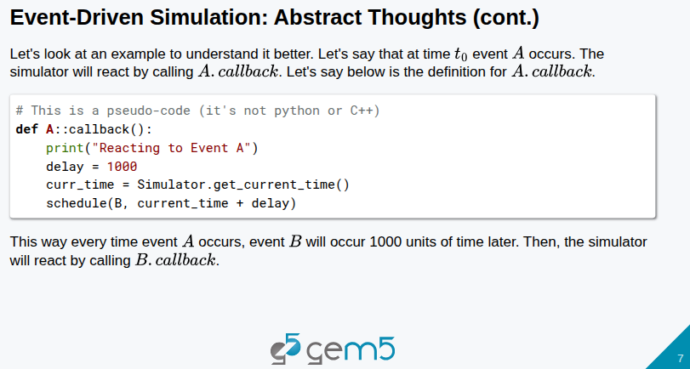
19.1 Review Event-Driven Simulation
https://www.youtube.com/watch?v=n5RlOXumFyo&list=PL_hVbFs_loVR_8ntTTmmG6YEq3Po_4snu&index=19
Review Event Driven Simulation (3:11-3:45/52:51)
Below is a pseudo-code.
If we have an event A, the event A has a callback function.
When the simulator gets to time that is equivalent to the time that A is scheduled, it will call A.callback().
A.callback() gets the current simulator time and schedule event B in 1000 unit of time in the future.

Slide 16
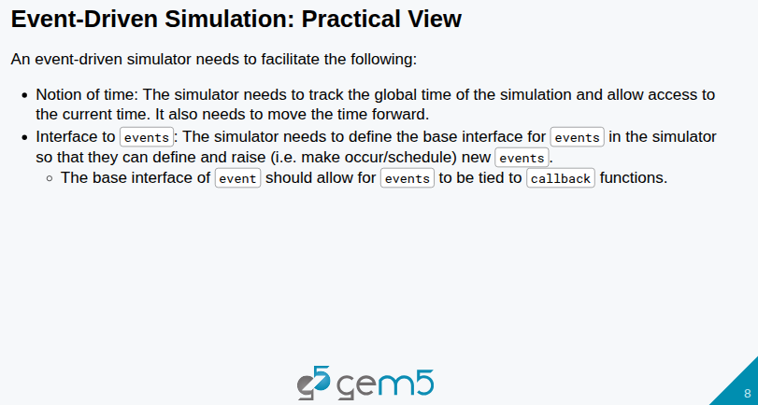
19.1 Review Event-Driven Simulation
https://www.youtube.com/watch?v=n5RlOXumFyo&list=PL_hVbFs_loVR_8ntTTmmG6YEq3Po_4snu&index=19
Review Event Driven Simulation (3:46-4:20/52:51)
The event-driven simulator needs to offers two things:
1. Notion of time: Gem5 offers time as tick.
2. Interface to schedule and process events: Gem5 offers events.
If we look at the SimObject class, we find SimObject class is inherited from EventManager class.
The SimObject can talk to simulator and make event happen at this time.

Slide 17
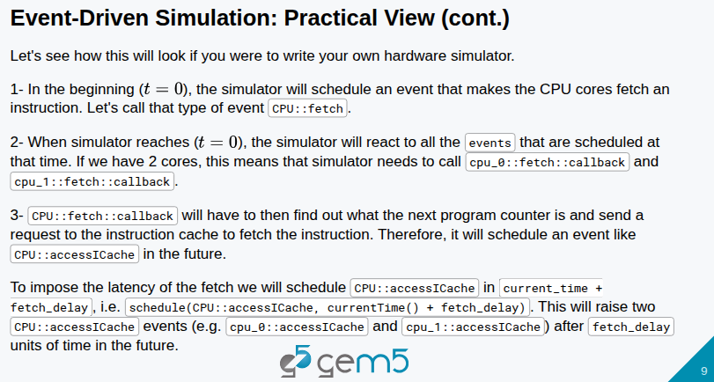
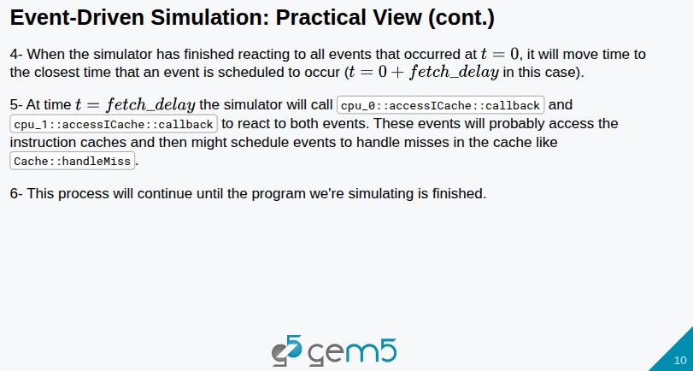
19.1 Review Event-Driven Simulation
https://www.youtube.com/watch?v=n5RlOXumFyo&list=PL_hVbFs_loVR_8ntTTmmG6YEq3Po_4snu&index=19
Review Event Driven Simulation (4:21-5:28/52:51)
We look at event-driven example.

Slide 18
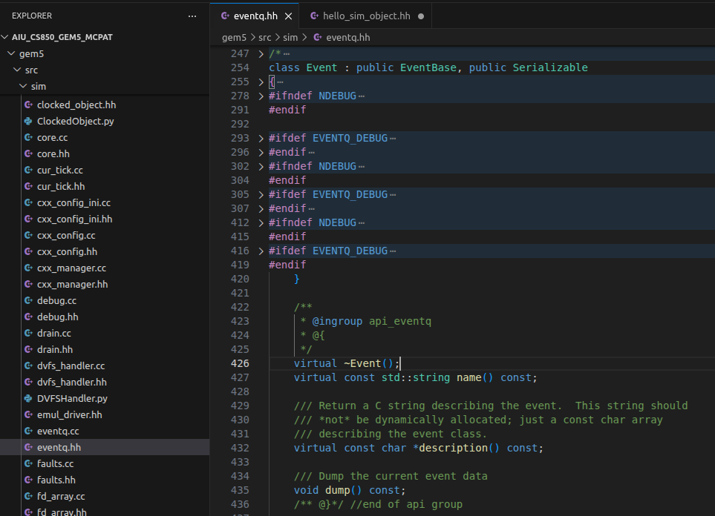
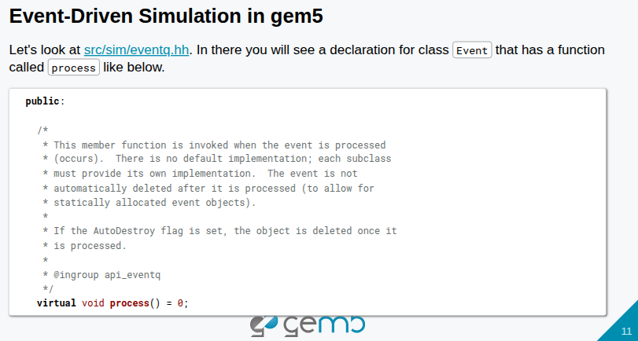
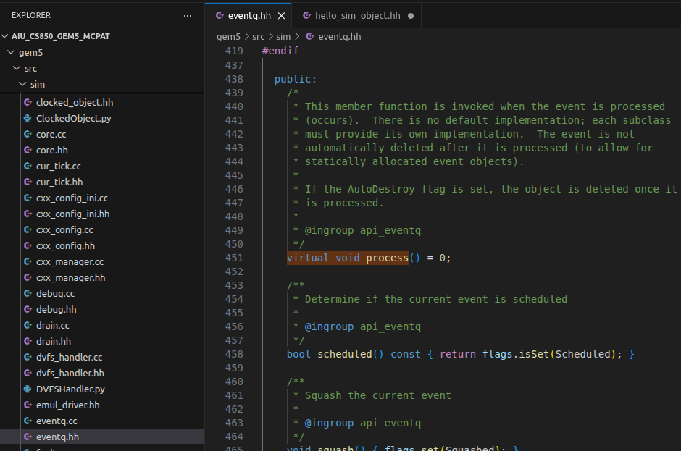
19.1 Review Event-Driven Simulation
https://www.youtube.com/watch?v=n5RlOXumFyo&list=PL_hVbFs_loVR_8ntTTmmG6YEq3Po_4snu&index=19
Review Event Driven Simulation (4:29-4:30/52:51)
In gem5/src/sim/eventq.hh, we can see process() is defined as the “true/pure virtual function” (manager handle) without any solid/concrete code inside.
> …
> virtual void process() = 0; /* Virtual pure function without any definition. */
> }

Slide 19
19.1 Review Event-Driven Simulation
https://www.youtube.com/watch?v=n5RlOXumFyo&list=PL_hVbFs_loVR_8ntTTmmG6YEq3Po_4snu&index=19
Review Event Driven Simulation (4:31-4:55/52:51)
This process() is a true virtual function which makes the event class an abstract class (i.e., no solid function inside, only management function).
Later on, in our application, we will need to inherit and class and function and re-define the virtual function process() into the solid function for our SimObject.

Slide 20
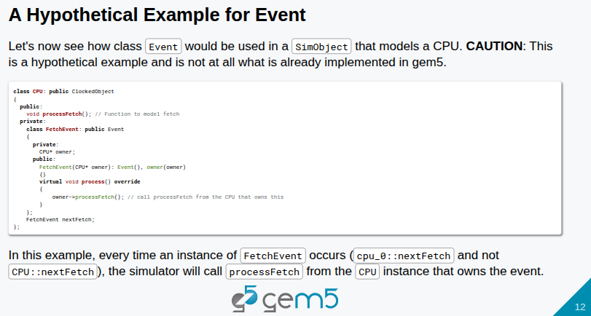
19.1 Review Event-Driven Simulation
https://www.youtube.com/watch?v=n5RlOXumFyo&list=PL_hVbFs_loVR_8ntTTmmG6YEq3Po_4snu&index=19
Review Event Driven Simulation (4:56-5:30/52:51)
Below, we have Event used in SimObject for CPU model.

Slide 21
End

