Slide 1

19.1 Event Driven Simulation: Slides
Peter H. Chen

Slide 2
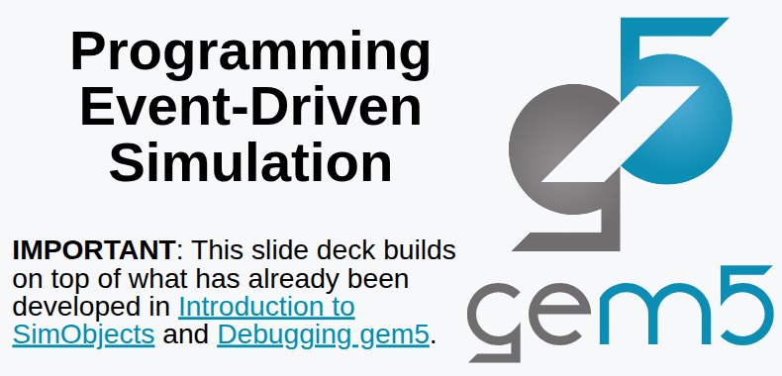
19.1 Event Driven Simulation: Slides
https://gem5bootcamp.github.io/2024/#03-Developing-gem5-models/03-event-driven-sim
Event Driven Simulation: Slides

Slide 3
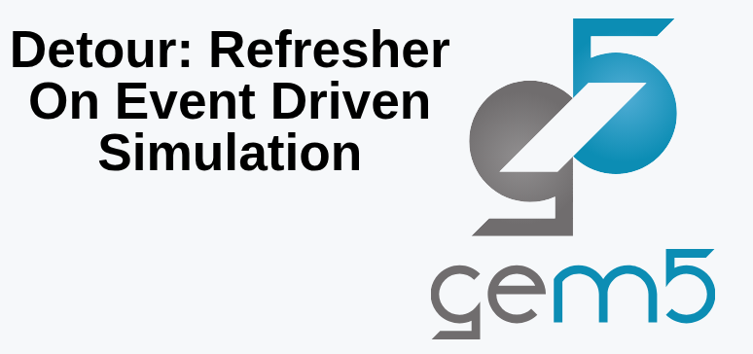
19.1 Event Driven Simulation: Slides
https://gem5bootcamp.github.io/2024/#03-Developing-gem5-models/03-event-driven-sim
Event Driven Simulation: Slides

Slide 4
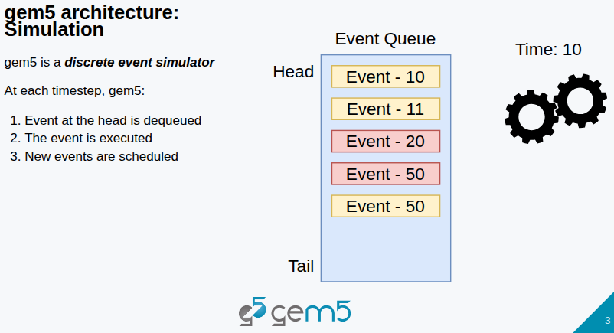
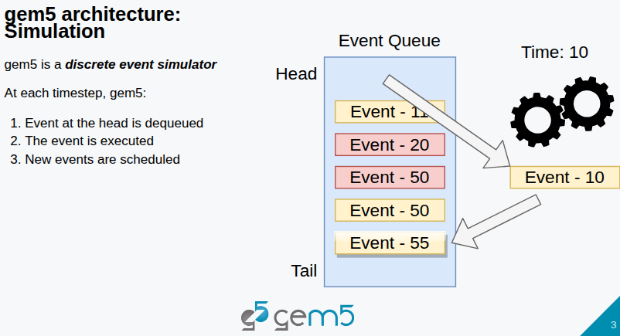
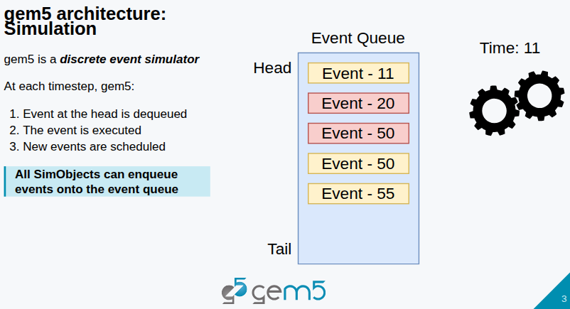
19.1 Event Driven Simulation: Slides
https://gem5bootcamp.github.io/2024/#03-Developing-gem5-models/03-event-driven-sim
Event Driven Simulation: Slides
1
2
3

Slide 5
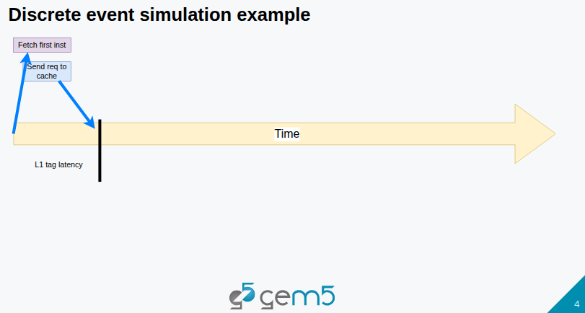
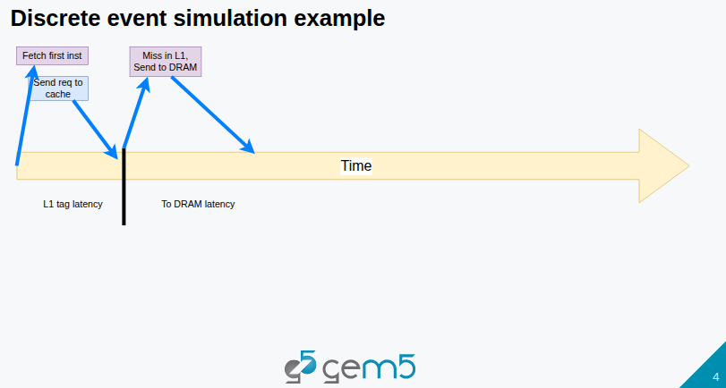
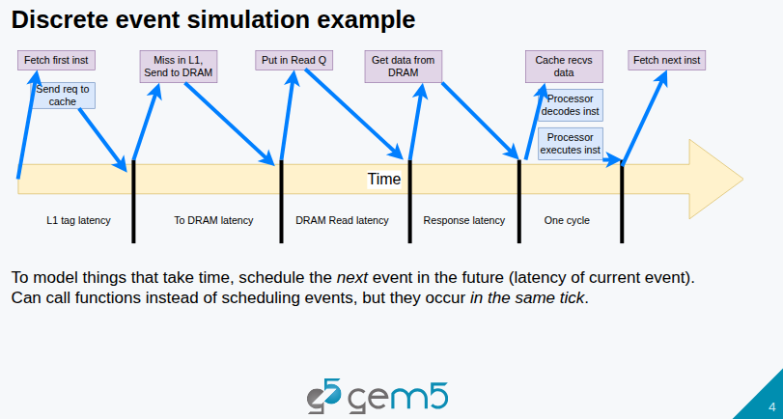
19.1 Event Driven Simulation: Slides
https://gem5bootcamp.github.io/2024/#03-Developing-gem5-models/03-event-driven-sim
Event Driven Simulation: Slides
1
2
3

Slide 6
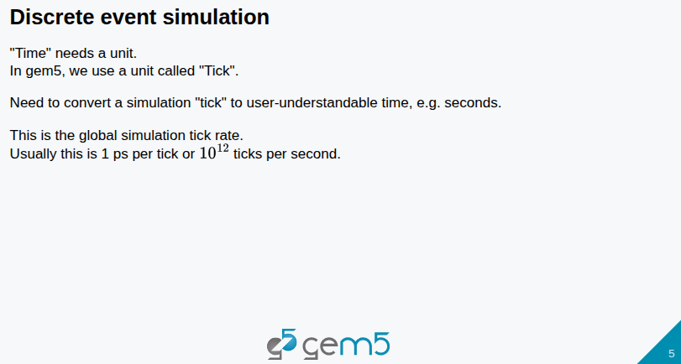
19.1 Event Driven Simulation: Slides
https://gem5bootcamp.github.io/2024/#03-Developing-gem5-models/03-event-driven-sim
Event Driven Simulation: Slides

Slide 7
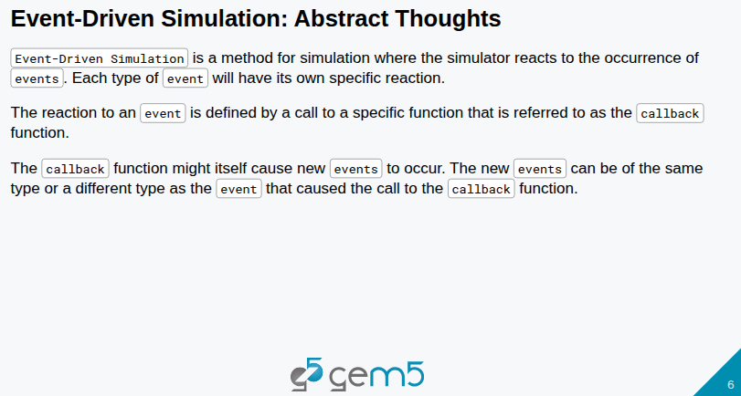
19.1 Event Driven Simulation: Slides
https://gem5bootcamp.github.io/2024/#03-Developing-gem5-models/03-event-driven-sim
Event Driven Simulation: Slides

Slide 8
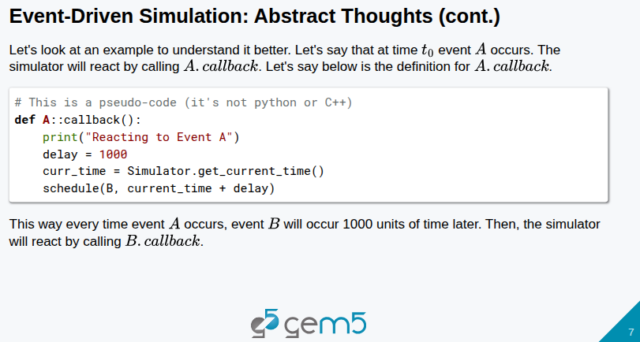
19.1 Event Driven Simulation: Slides
https://gem5bootcamp.github.io/2024/#03-Developing-gem5-models/03-event-driven-sim
Event Driven Simulation: Slides

Slide 9
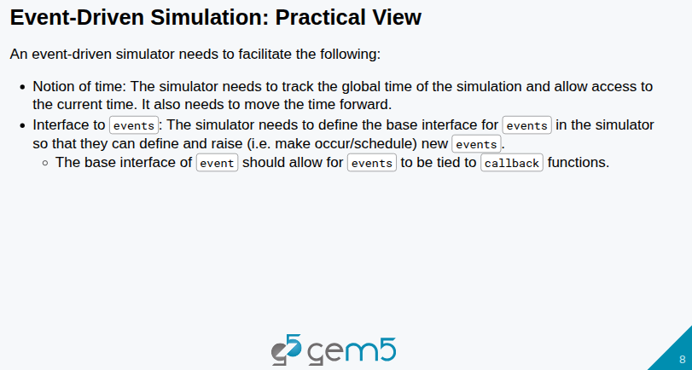
19.1 Event Driven Simulation: Slides
https://gem5bootcamp.github.io/2024/#03-Developing-gem5-models/03-event-driven-sim
Event Driven Simulation: Slides

Slide 10
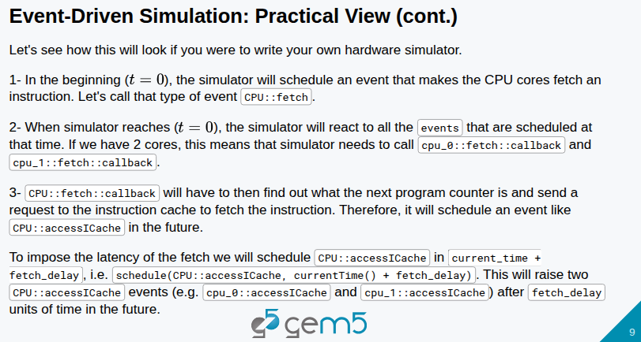
19.1 Event Driven Simulation: Slides
https://gem5bootcamp.github.io/2024/#03-Developing-gem5-models/03-event-driven-sim
Event Driven Simulation: Slides

Slide 11
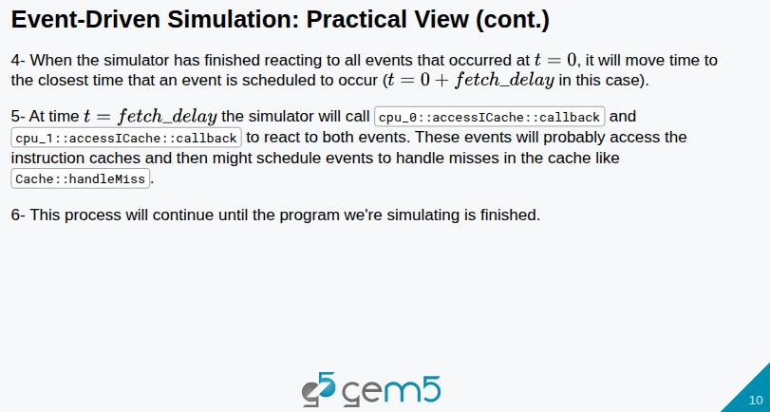
19.1 Event Driven Simulation: Slides
https://gem5bootcamp.github.io/2024/#03-Developing-gem5-models/03-event-driven-sim
Event Driven Simulation: Slides

Slide 12
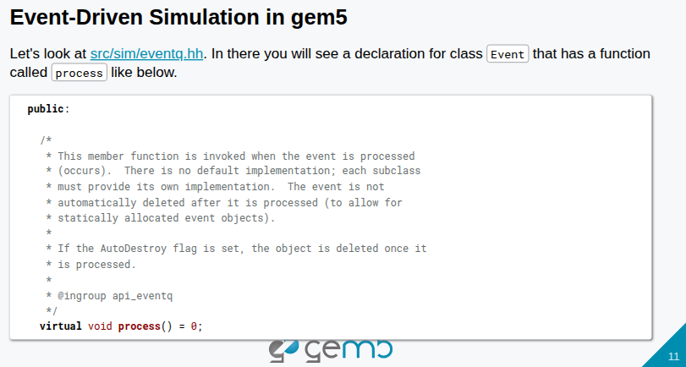
19.1 Event Driven Simulation: Slides
https://gem5bootcamp.github.io/2024/#03-Developing-gem5-models/03-event-driven-sim
Event Driven Simulation: Slides

Slide 13
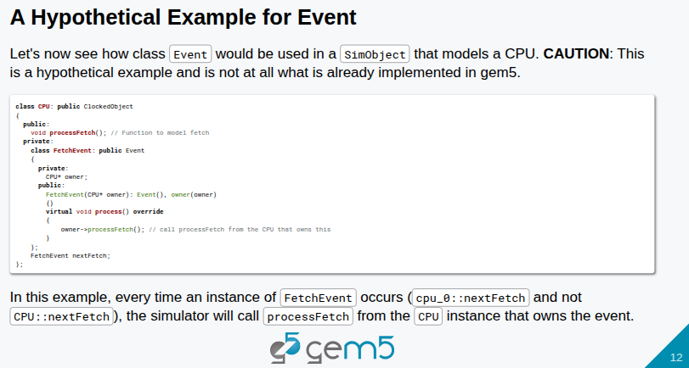
19.1 Event Driven Simulation: Slides
https://gem5bootcamp.github.io/2024/#03-Developing-gem5-models/03-event-driven-sim
Event Driven Simulation: Slides

Slide 14
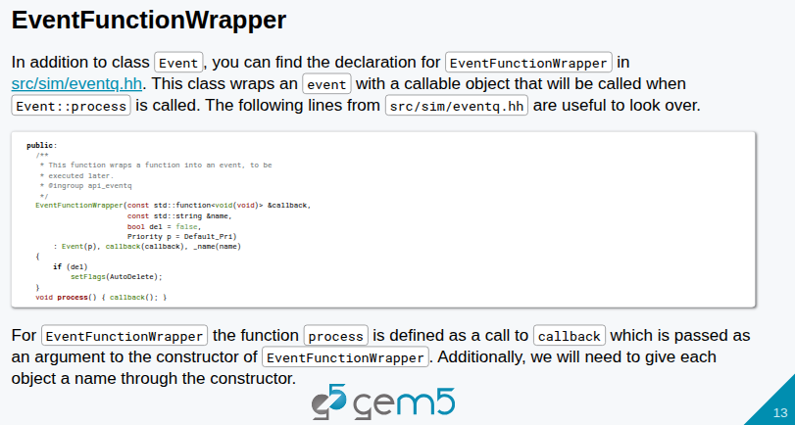
19.1 Event Driven Simulation: Slides
https://gem5bootcamp.github.io/2024/#03-Developing-gem5-models/03-event-driven-sim
Event Driven Simulation: Slides

Slide 15
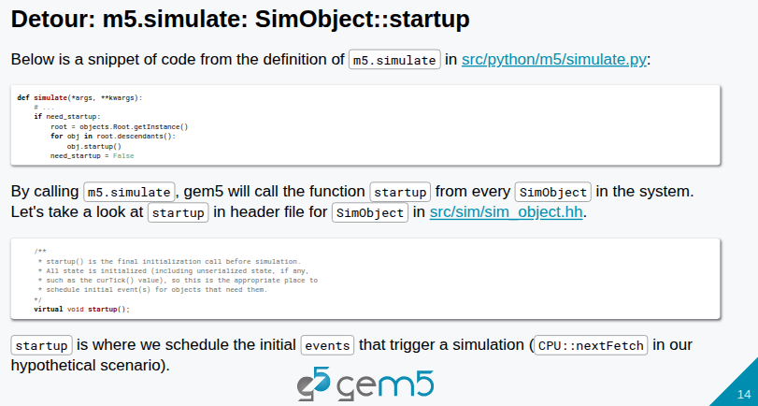
19.1 Event Driven Simulation: Slides
https://gem5bootcamp.github.io/2024/#03-Developing-gem5-models/03-event-driven-sim
Event Driven Simulation: Slides

Slide 16
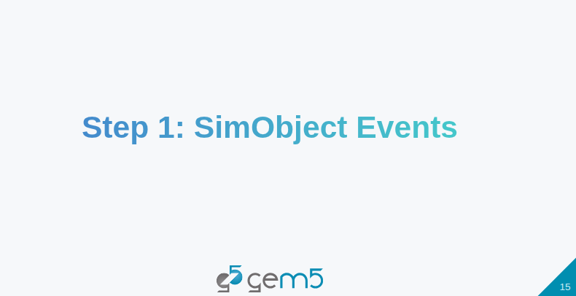
19.1 Event Driven Simulation: Slides
https://gem5bootcamp.github.io/2024/#03-Developing-gem5-models/03-event-driven-sim
Event Driven Simulation: Slides

Slide 17
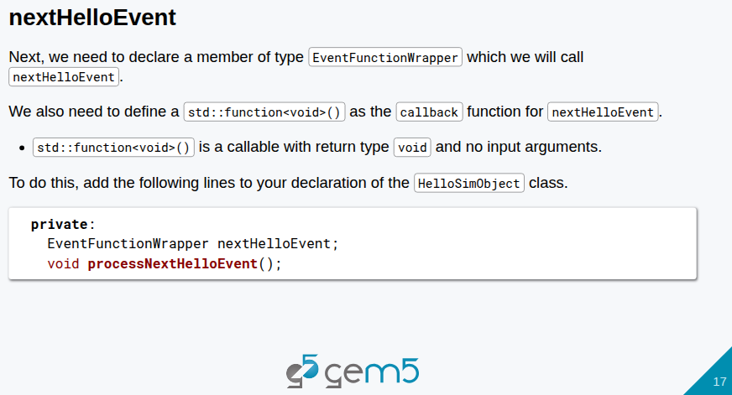
19.1 Event Driven Simulation: Slides
https://gem5bootcamp.github.io/2024/#03-Developing-gem5-models/03-event-driven-sim
Event Driven Simulation: Slides

Slide 18
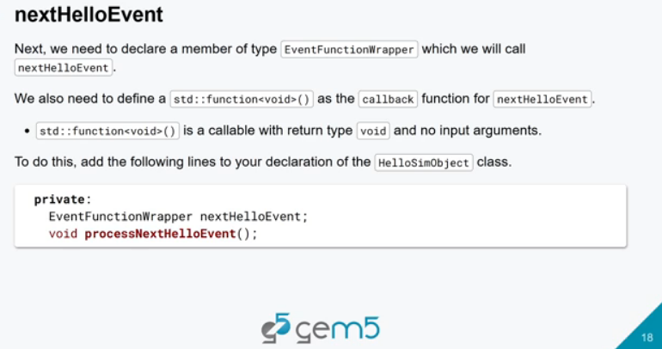
19.1 Event Driven Simulation: Slides
https://gem5bootcamp.github.io/2024/#03-Developing-gem5-models/03-event-driven-sim
Event Driven Simulation: Slides

Slide 19
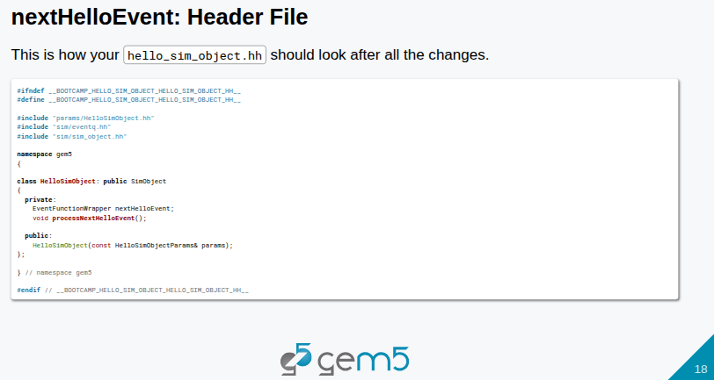
19.1 Event Driven Simulation: Slides
https://gem5bootcamp.github.io/2024/#03-Developing-gem5-models/03-event-driven-sim
Event Driven Simulation: Slides

Slide 20
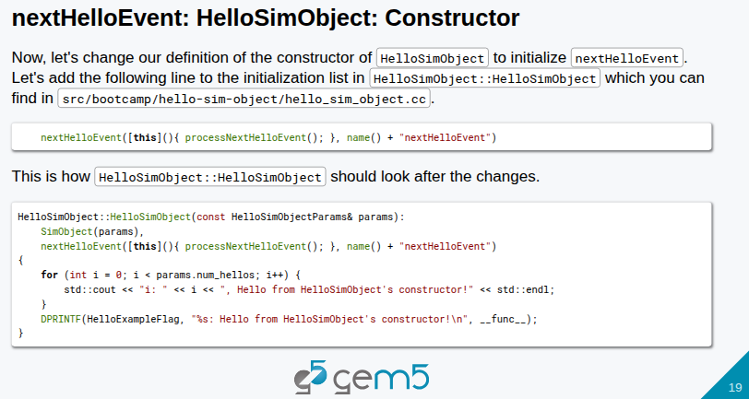
19.1 Event Driven Simulation: Slides
https://gem5bootcamp.github.io/2024/#03-Developing-gem5-models/03-event-driven-sim
Event Driven Simulation: Slides

Slide 21
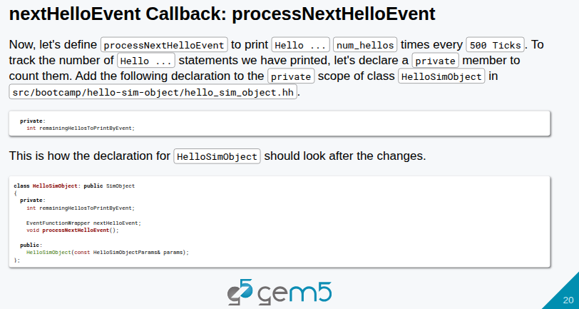
19.1 Event Driven Simulation: Slides
https://gem5bootcamp.github.io/2024/#03-Developing-gem5-models/03-event-driven-sim
Event Driven Simulation: Slides

Slide 22
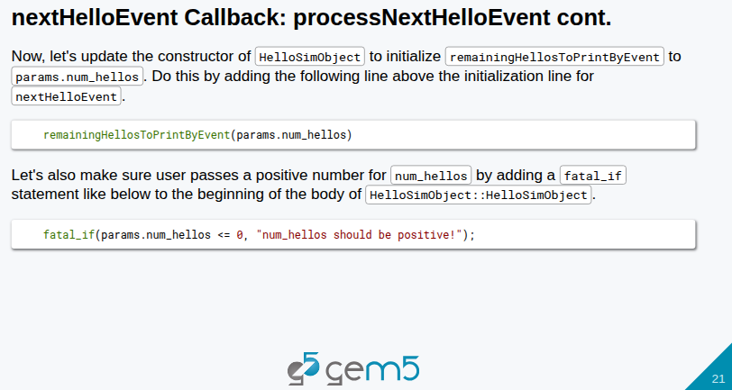
19.1 Event Driven Simulation: Slides
https://gem5bootcamp.github.io/2024/#03-Developing-gem5-models/03-event-driven-sim
Event Driven Simulation: Slides

Slide 23
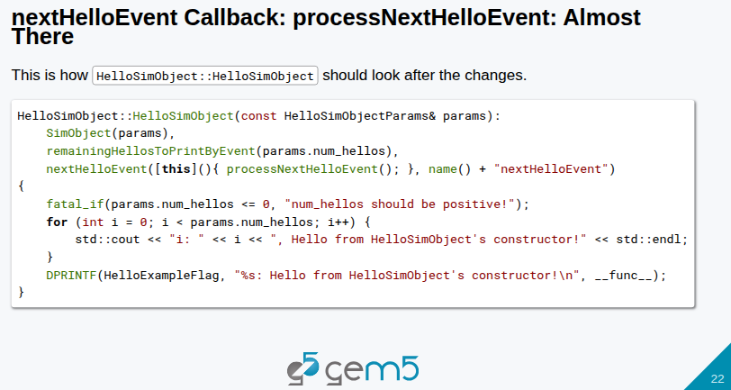
19.1 Event Driven Simulation: Slides
https://gem5bootcamp.github.io/2024/#03-Developing-gem5-models/03-event-driven-sim
Event Driven Simulation: Slides

Slide 24
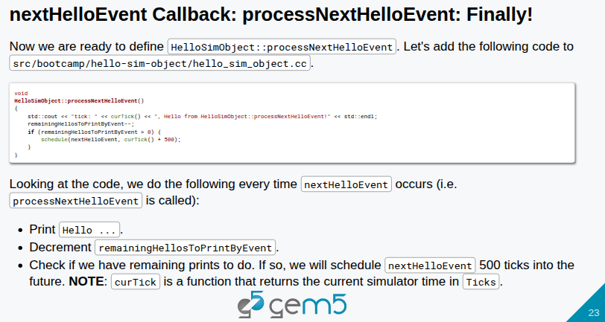
19.1 Event Driven Simulation: Slides
https://gem5bootcamp.github.io/2024/#03-Developing-gem5-models/03-event-driven-sim
Event Driven Simulation: Slides

Slide 25
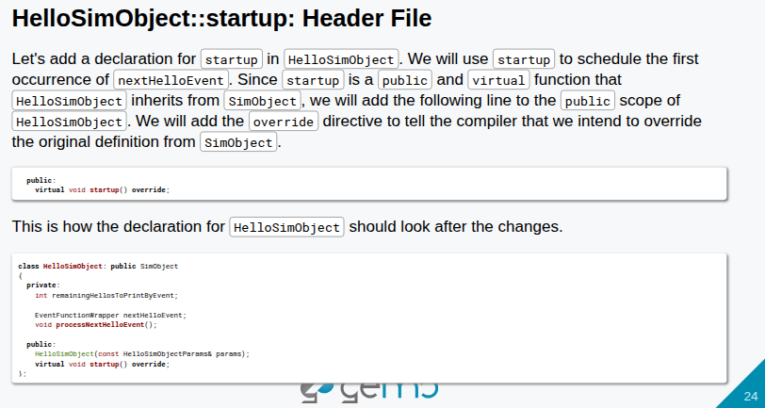
19.1 Event Driven Simulation: Slides
https://gem5bootcamp.github.io/2024/#03-Developing-gem5-models/03-event-driven-sim
Event Driven Simulation: Slides

Slide 26
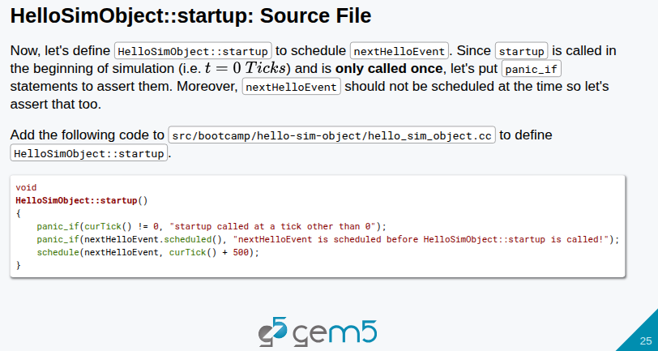
19.1 Event Driven Simulation: Slides
https://gem5bootcamp.github.io/2024/#03-Developing-gem5-models/03-event-driven-sim
Event Driven Simulation: Slides

Slide 27
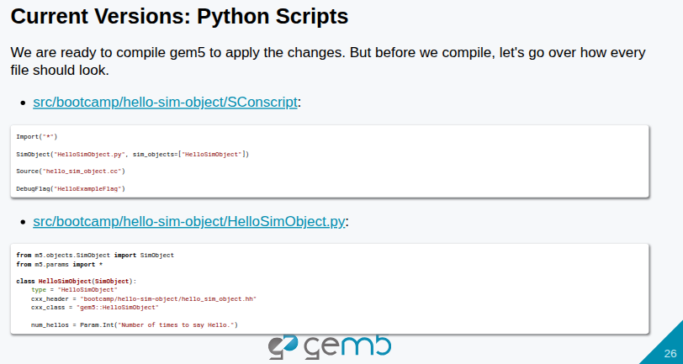
19.1 Event Driven Simulation: Slides
https://gem5bootcamp.github.io/2024/#03-Developing-gem5-models/03-event-driven-sim
Event Driven Simulation: Slides

Slide 28
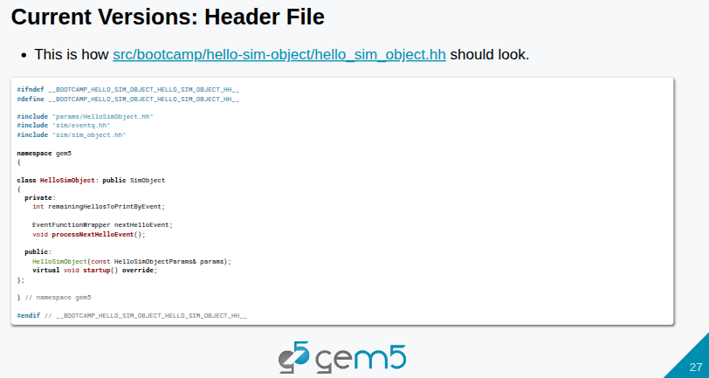
19.1 Event Driven Simulation: Slides
https://gem5bootcamp.github.io/2024/#03-Developing-gem5-models/03-event-driven-sim
Event Driven Simulation: Slides

Slide 29
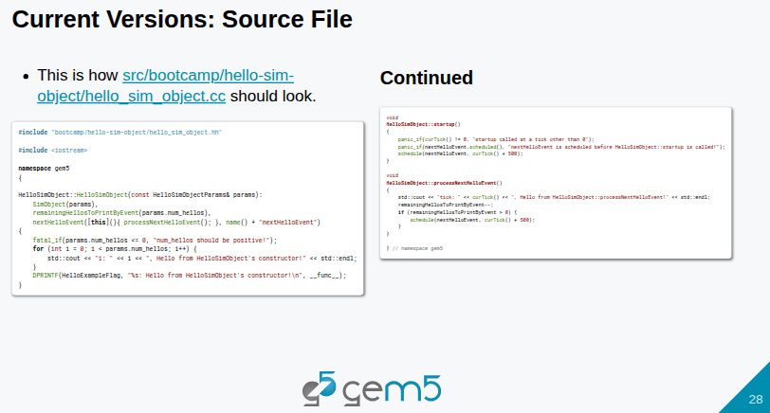
19.1 Event Driven Simulation: Slides
https://gem5bootcamp.github.io/2024/#03-Developing-gem5-models/03-event-driven-sim
Event Driven Simulation: Slides

Slide 30
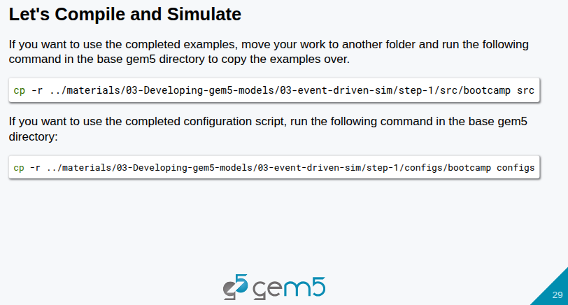
19.1 Event Driven Simulation: Slides
https://gem5bootcamp.github.io/2024/#03-Developing-gem5-models/03-event-driven-sim
Event Driven Simulation: Slides

Slide 31
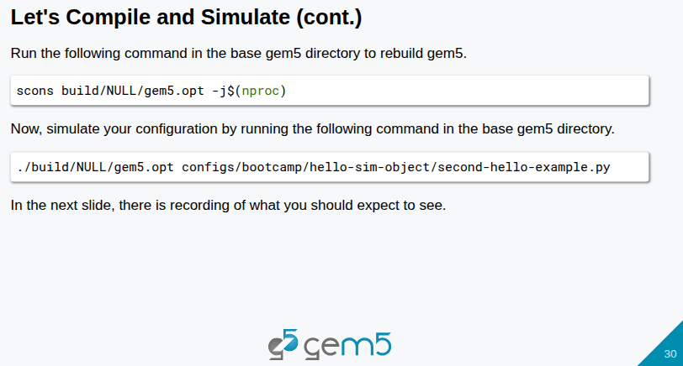
19.1 Event Driven Simulation: Slides
https://gem5bootcamp.github.io/2024/#03-Developing-gem5-models/03-event-driven-sim
Event Driven Simulation: Slides

Slide 32
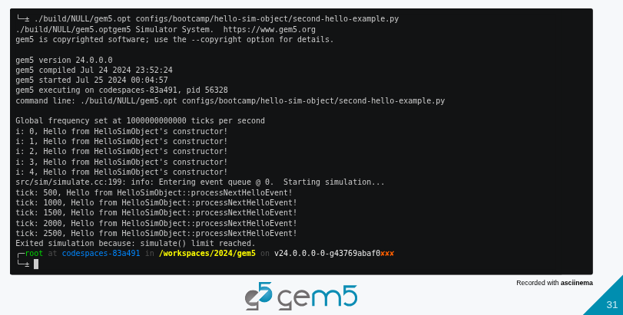
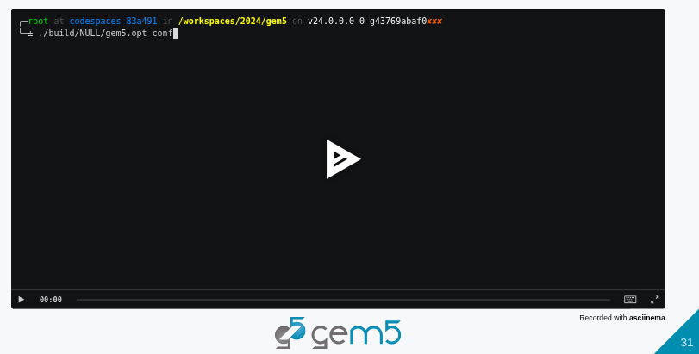

19.1 Event Driven Simulation: Slides
https://gem5bootcamp.github.io/2024/#03-Developing-gem5-models/03-event-driven-sim
Event Driven Simulation: Slides
1
2
3

Slide 33
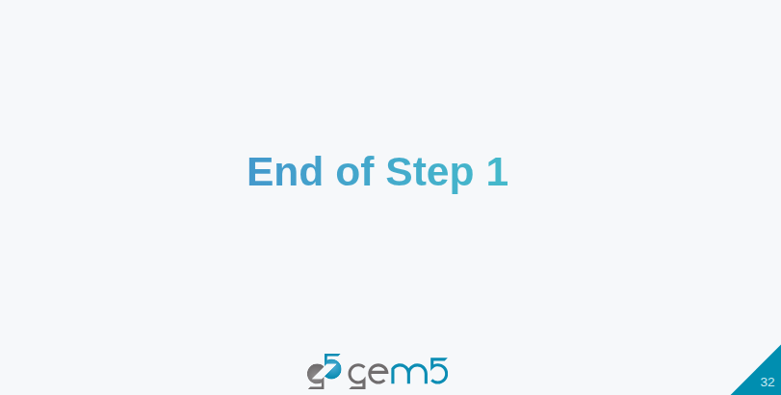
19.1 Event Driven Simulation: Slides
https://gem5bootcamp.github.io/2024/#03-Developing-gem5-models/03-event-driven-sim
Event Driven Simulation: Slides

Slide 34
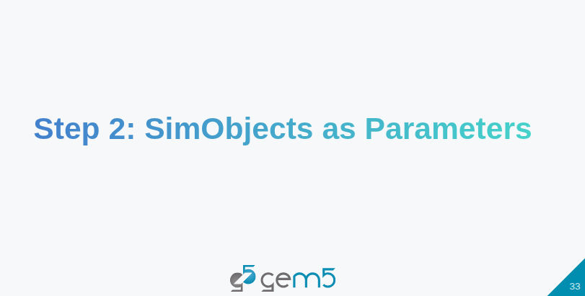
19.1 Event Driven Simulation: Slides
https://gem5bootcamp.github.io/2024/#03-Developing-gem5-models/03-event-driven-sim
Event Driven Simulation: Slides

Slide 35
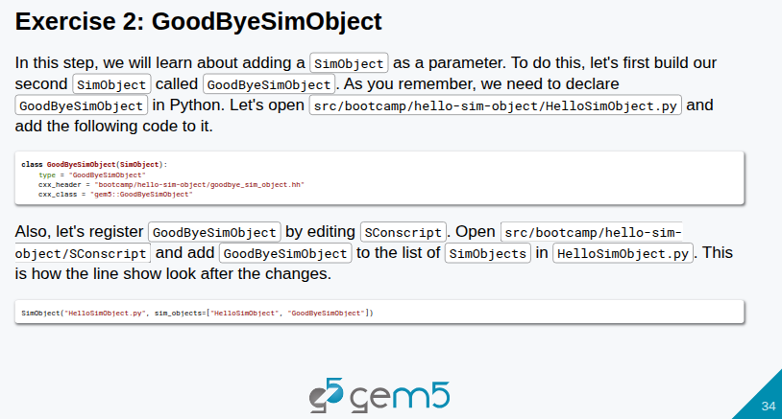
19.1 Event Driven Simulation: Slides
https://gem5bootcamp.github.io/2024/#03-Developing-gem5-models/03-event-driven-sim
Event Driven Simulation: Slides

Slide 36
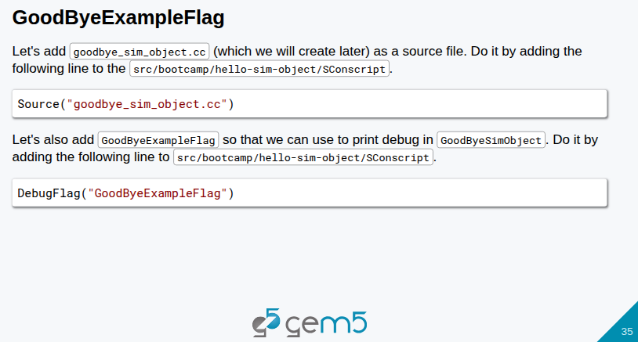
19.1 Event Driven Simulation: Slides
https://gem5bootcamp.github.io/2024/#03-Developing-gem5-models/03-event-driven-sim
Event Driven Simulation: Slides

Slide 37
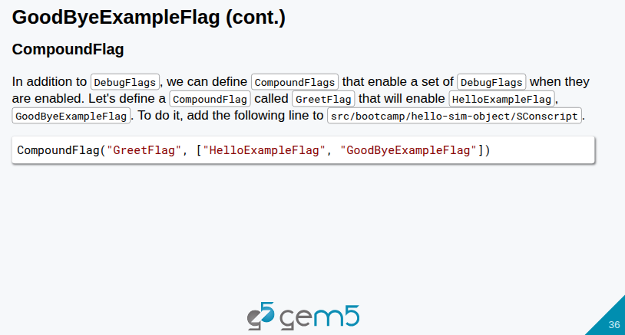
19.1 Event Driven Simulation: Slides
https://gem5bootcamp.github.io/2024/#03-Developing-gem5-models/03-event-driven-sim
Event Driven Simulation: Slides

Slide 38
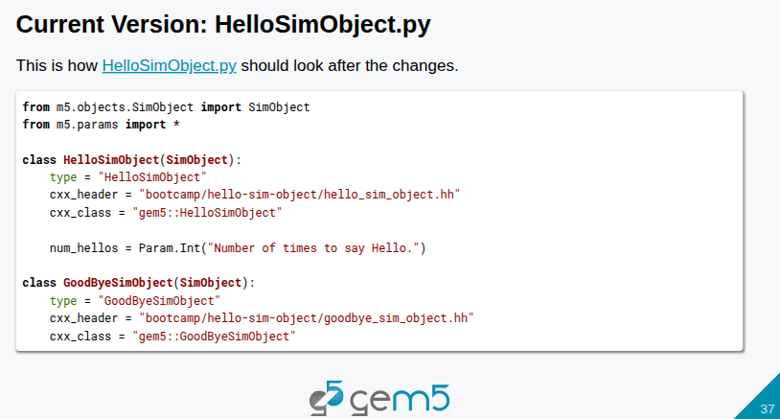
19.1 Event Driven Simulation: Slides
https://gem5bootcamp.github.io/2024/#03-Developing-gem5-models/03-event-driven-sim
Event Driven Simulation: Slides

Slide 39
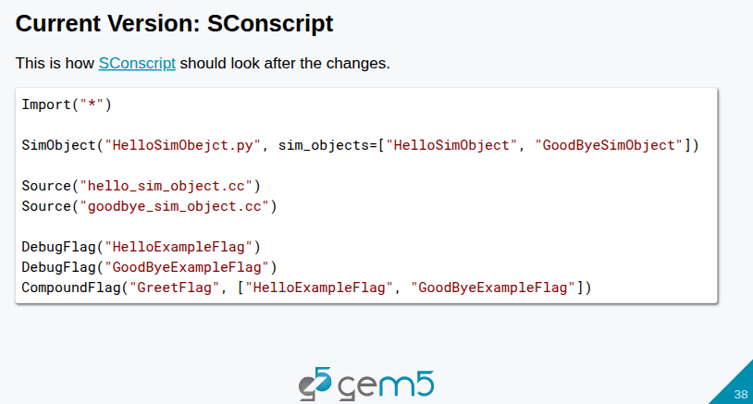
19.1 Event Driven Simulation: Slides
https://gem5bootcamp.github.io/2024/#03-Developing-gem5-models/03-event-driven-sim
Event Driven Simulation: Slides

Slide 40
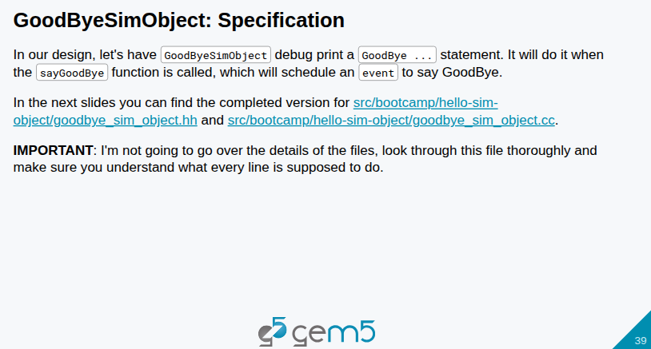
19.1 Event Driven Simulation: Slides
https://gem5bootcamp.github.io/2024/#03-Developing-gem5-models/03-event-driven-sim
Event Driven Simulation: Slides

Slide 41
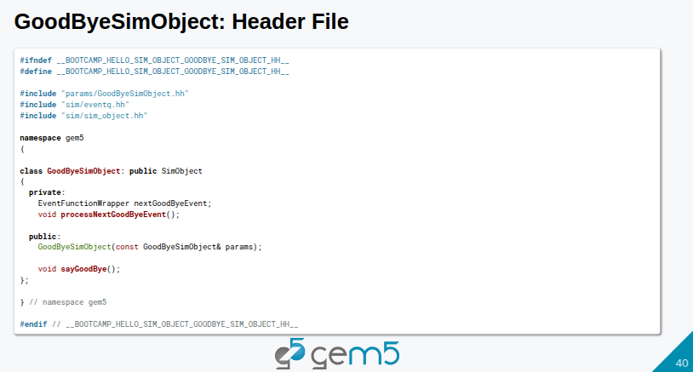
19.1 Event Driven Simulation: Slides
https://gem5bootcamp.github.io/2024/#03-Developing-gem5-models/03-event-driven-sim
Event Driven Simulation: Slides

Slide 42
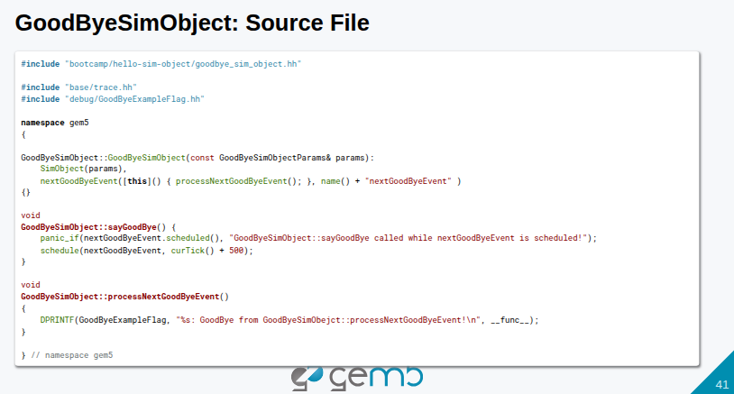
19.1 Event Driven Simulation: Slides
https://gem5bootcamp.github.io/2024/#03-Developing-gem5-models/03-event-driven-sim
Event Driven Simulation: Slides

Slide 43
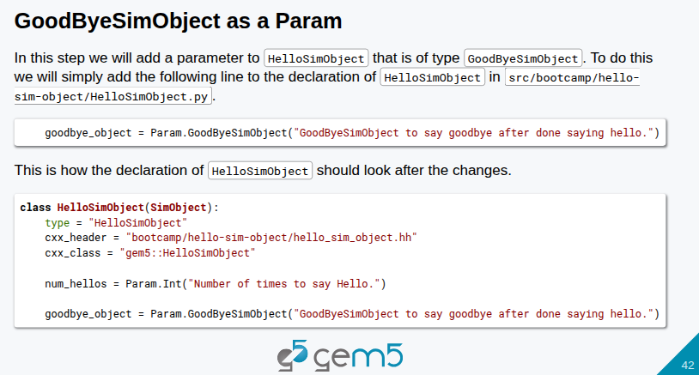
19.1 Event Driven Simulation: Slides
https://gem5bootcamp.github.io/2024/#03-Developing-gem5-models/03-event-driven-sim
Event Driven Simulation: Slides

Slide 44
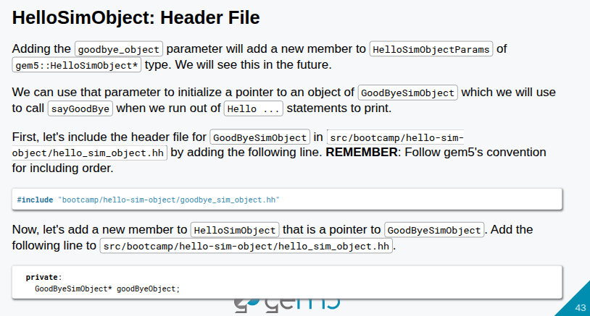
19.1 Event Driven Simulation: Slides
https://gem5bootcamp.github.io/2024/#03-Developing-gem5-models/03-event-driven-sim
Event Driven Simulation: Slides

Slide 45
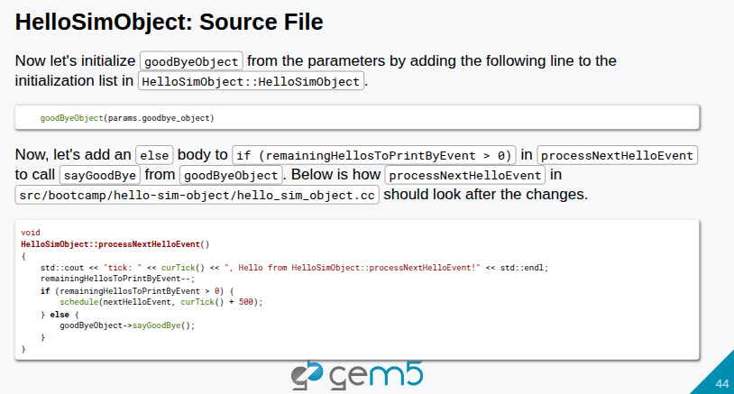
19.1 Event Driven Simulation: Slides
https://gem5bootcamp.github.io/2024/#03-Developing-gem5-models/03-event-driven-sim
Event Driven Simulation: Slides

Slide 46
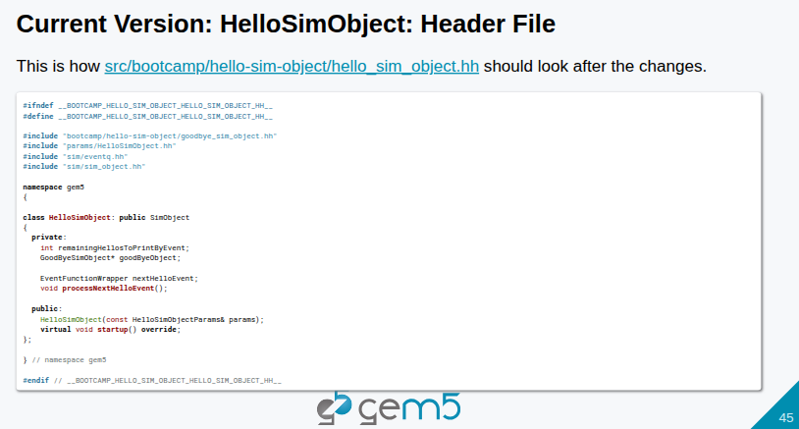
19.1 Event Driven Simulation: Slides
https://gem5bootcamp.github.io/2024/#03-Developing-gem5-models/03-event-driven-sim
Event Driven Simulation: Slides

Slide 47

19.1 Event Driven Simulation: Slides
https://gem5bootcamp.github.io/2024/#03-Developing-gem5-models/03-event-driven-sim
Event Driven Simulation: Slides

Slide 48

19.1 Event Driven Simulation: Slides
https://gem5bootcamp.github.io/2024/#03-Developing-gem5-models/03-event-driven-sim
Event Driven Simulation: Slides

Slide 49

19.1 Event Driven Simulation: Slides
https://gem5bootcamp.github.io/2024/#03-Developing-gem5-models/03-event-driven-sim
Event Driven Simulation: Slides

Slide 50

19.1 Event Driven Simulation: Slides
https://gem5bootcamp.github.io/2024/#03-Developing-gem5-models/03-event-driven-sim
Event Driven Simulation: Slides

Slide 51

19.1 Event Driven Simulation: Slides
https://gem5bootcamp.github.io/2024/#03-Developing-gem5-models/03-event-driven-sim
Event Driven Simulation: Slides

Slide 52

19.1 Event Driven Simulation: Slides
https://gem5bootcamp.github.io/2024/#03-Developing-gem5-models/03-event-driven-sim
Event Driven Simulation: Slides

Slide 53



19.1 Event Driven Simulation: Slides
https://gem5bootcamp.github.io/2024/#03-Developing-gem5-models/03-event-driven-sim
Event Driven Simulation: Slides
1
2
3

Slide 54

19.1 Event Driven Simulation: Slides
https://gem5bootcamp.github.io/2024/#03-Developing-gem5-models/03-event-driven-sim
Event Driven Simulation: Slides

Slide 55



19.1 Event Driven Simulation: Slides
https://gem5bootcamp.github.io/2024/#03-Developing-gem5-models/03-event-driven-sim
Event Driven Simulation: Slides
1
2
3

Slide 56

19.1 Event Driven Simulation: Slides
https://gem5bootcamp.github.io/2024/#03-Developing-gem5-models/03-event-driven-sim
Event Driven Simulation: Slides

Slide 57
End

