Slide 1

1.1 Gem5 vs. McPAT
Peter H. Chen

Slide 2
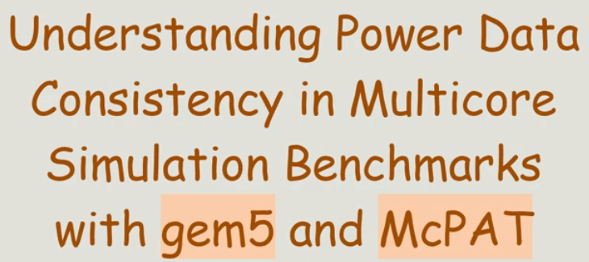
1.1 Gem5 vs. McPAT
https://www.youtube.com/watch?v=8eMvUNHiB30
Gem5 vs. McPAT (0:00-0:07/1:12)

Slide 3
1.2 Topic

Slide 4
1.2 Topic
https://www.youtube.com/watch?v=8eMvUNHiB30
Topic (0:08-0:52/1:12)
1. Introduction: Before CPU/GPU Design, we do not have any verilog code. How do we know the PAT (Power, Area, and Timing/Performance)?
We use McPAT (Multi Core Power/Area/Timing)-7nm for Power Model and Machine Learning with Feature Select and XGBoost Regression
Here, we discuss the ML (Machine Learning). We also can use Deep Learning/Neural Network for better accuracy.
2. Power Modeling Problem formulation: Static power and Dynamic Power
3. McPAT-Calib: McPAT-7nm power model and XGBoost Machine Learning
4. Evaluation: Boom (Berkeley Out-Of-Order Machine) Configuration and Benchmarks
5. Conclusion: Why McPAT-Calib is good?
5.1 McPAT-7nm is good power model.
5.2 Machine Learning: Feature selection, XGBoost regression
5.3 AL (Active Learning) Sampling: Select the diversity sample to reduce huge amount of sample.

Slide 5
End

