Slide 1

27.1 Contribution: Slides
Peter H. Chen

Slide 2

27.1 Contribution: Slides
https://gem5bootcamp.github.io/2024/#06-Contributing/01-contributing
Contribution: Slides

Slide 3
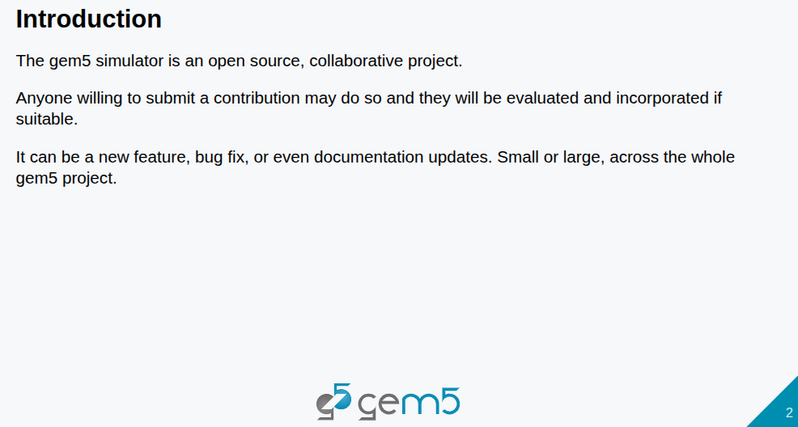
27.1 Contribution: Slides
https://gem5bootcamp.github.io/2024/#06-Contributing/01-contributing
Contribution: Slides

Slide 4
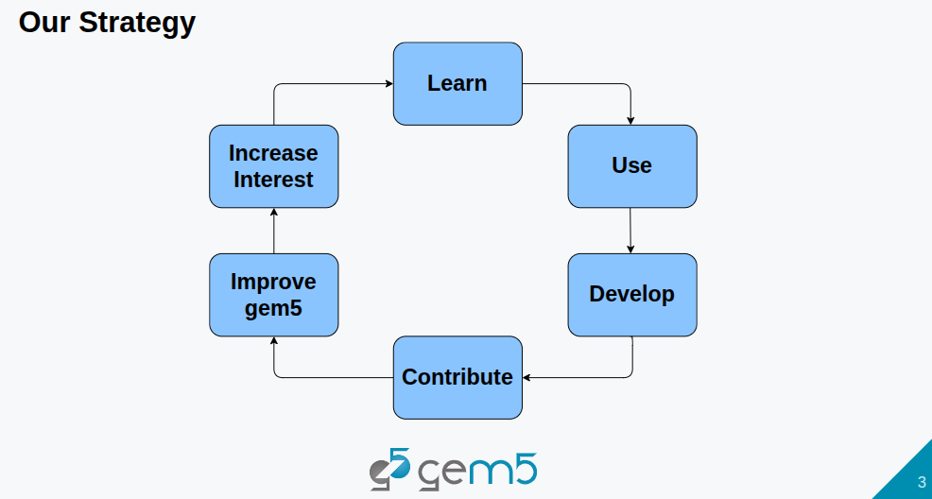
27.1 Contribution: Slides
https://gem5bootcamp.github.io/2024/#06-Contributing/01-contributing
Contribution: Slides

Slide 5
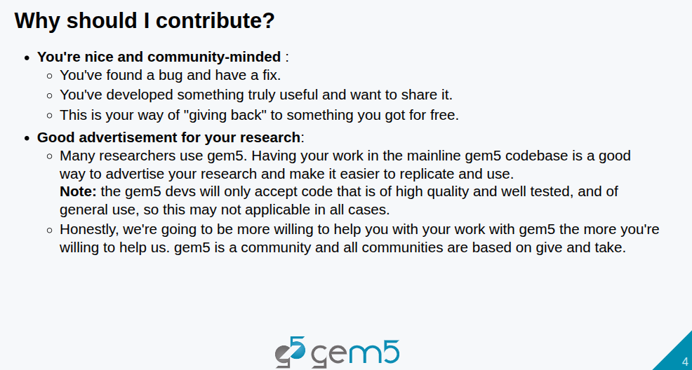
27.1 Contribution: Slides
https://gem5bootcamp.github.io/2024/#06-Contributing/01-contributing
Contribution: Slides

Slide 6
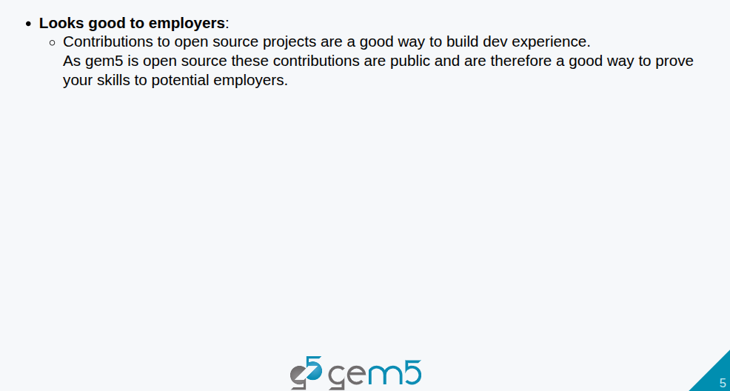
27.1 Contribution: Slides
https://gem5bootcamp.github.io/2024/#06-Contributing/01-contributing
Contribution: Slides

Slide 7
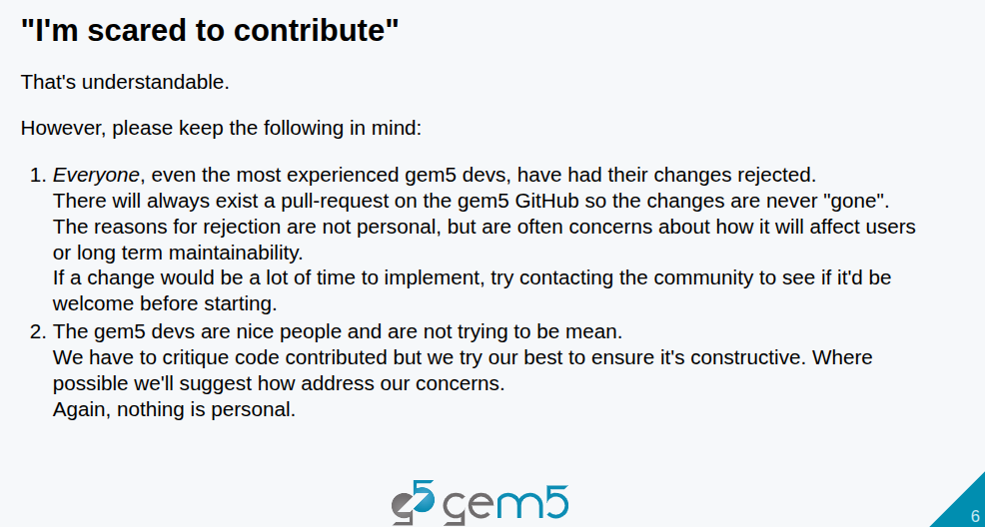
27.1 Contribution: Slides
https://gem5bootcamp.github.io/2024/#06-Contributing/01-contributing
Contribution: Slides

Slide 8
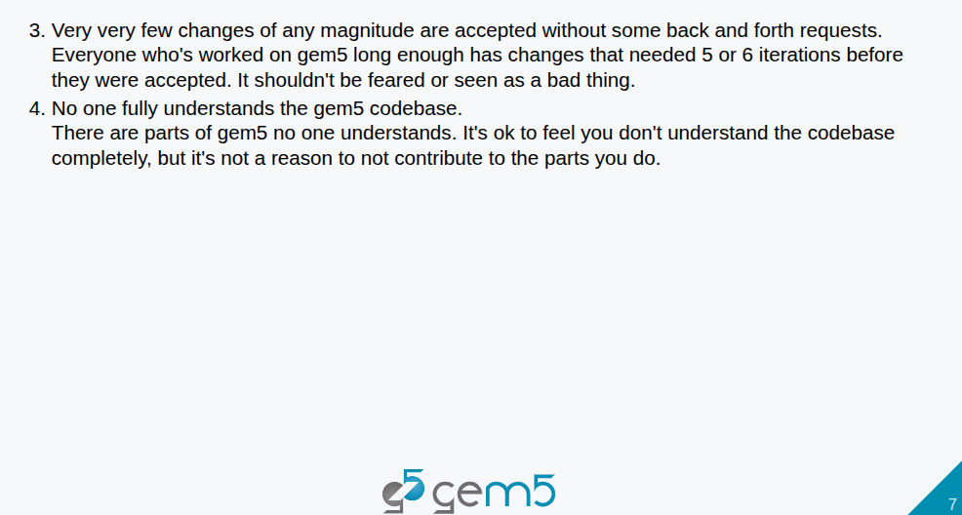
27.1 Contribution: Slides
https://gem5bootcamp.github.io/2024/#06-Contributing/01-contributing
Contribution: Slides

Slide 9
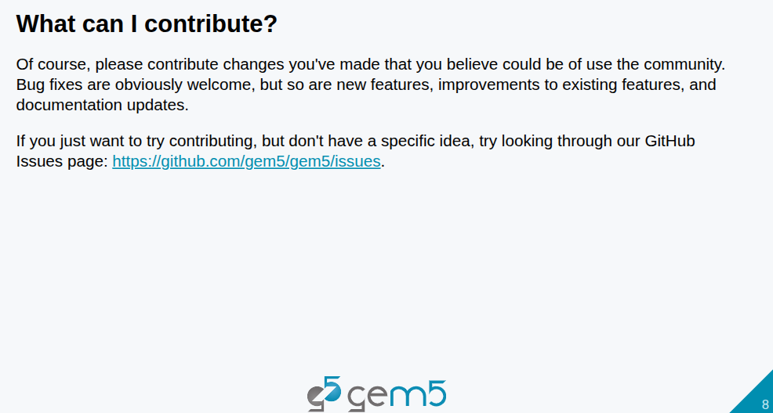
27.1 Contribution: Slides
https://gem5bootcamp.github.io/2024/#06-Contributing/01-contributing
Contribution: Slides

Slide 10
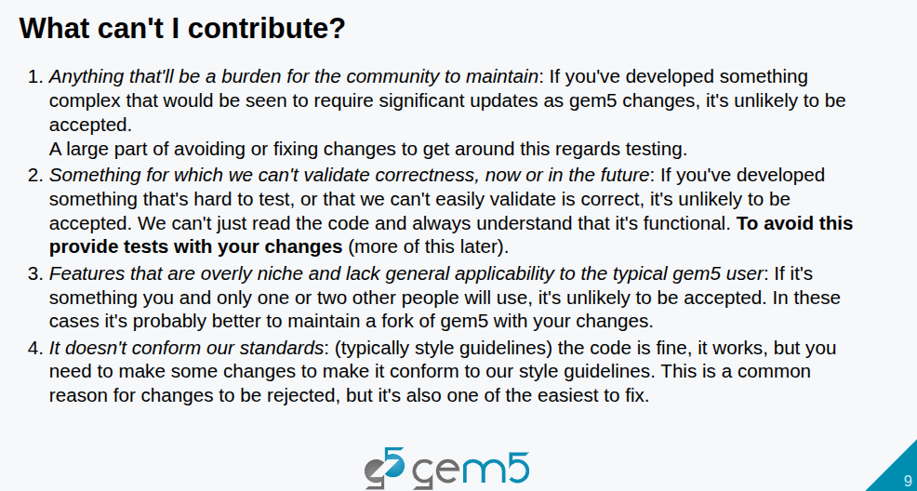
27.1 Contribution: Slides
https://gem5bootcamp.github.io/2024/#06-Contributing/01-contributing
Contribution: Slides

Slide 11
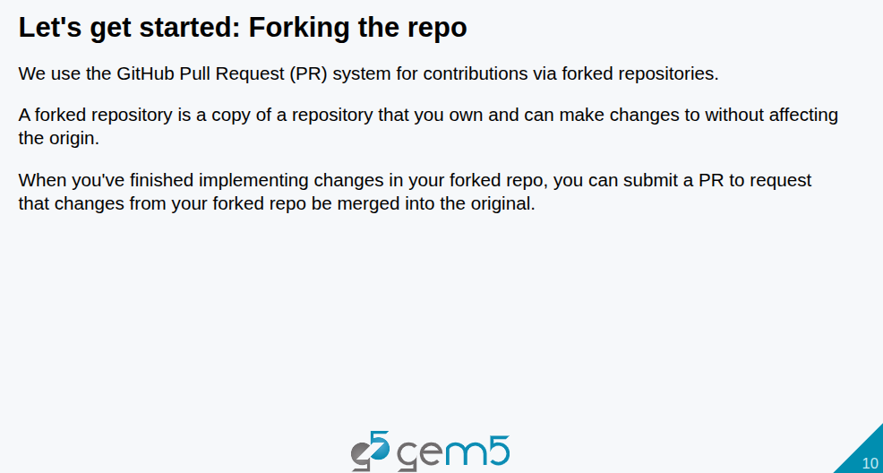
27.1 Contribution: Slides
https://gem5bootcamp.github.io/2024/#06-Contributing/01-contributing
Contribution: Slides

Slide 12
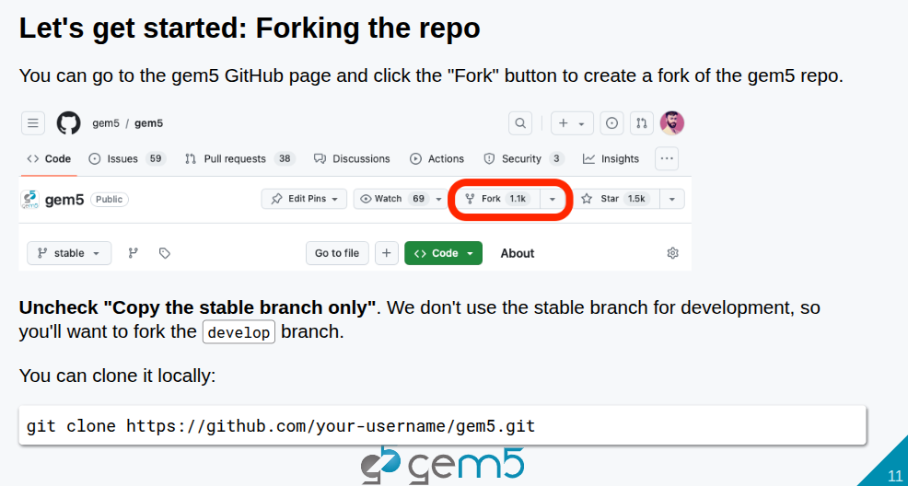
27.1 Contribution: Slides
https://gem5bootcamp.github.io/2024/#06-Contributing/01-contributing
Contribution: Slides

Slide 13
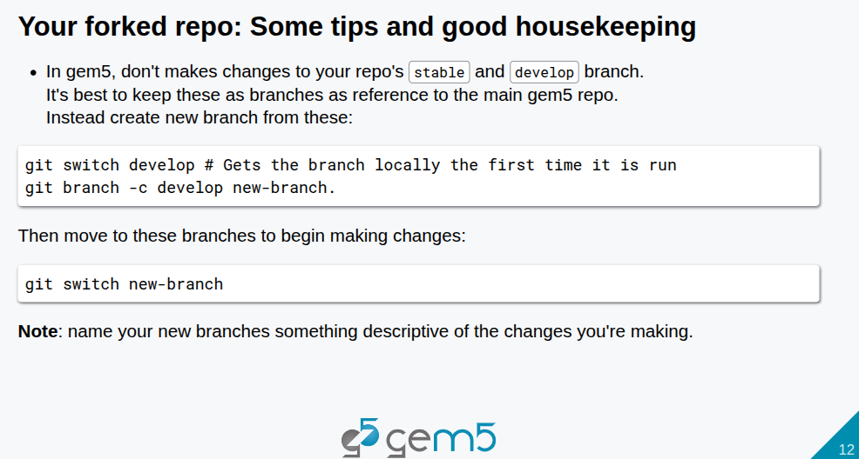
27.1 Contribution: Slides
https://gem5bootcamp.github.io/2024/#06-Contributing/01-contributing
Contribution: Slides

Slide 14
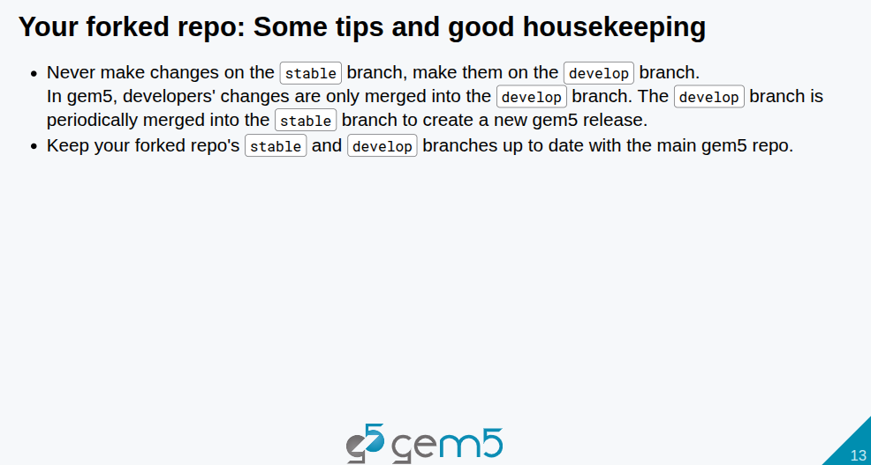
27.1 Contribution: Slides
https://gem5bootcamp.github.io/2024/#06-Contributing/01-contributing
Contribution: Slides

Slide 15
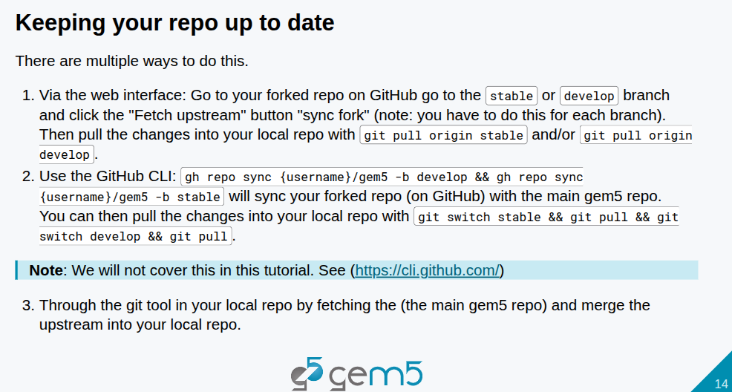
27.1 Contribution: Slides
https://gem5bootcamp.github.io/2024/#06-Contributing/01-contributing
Contribution: Slides

Slide 16
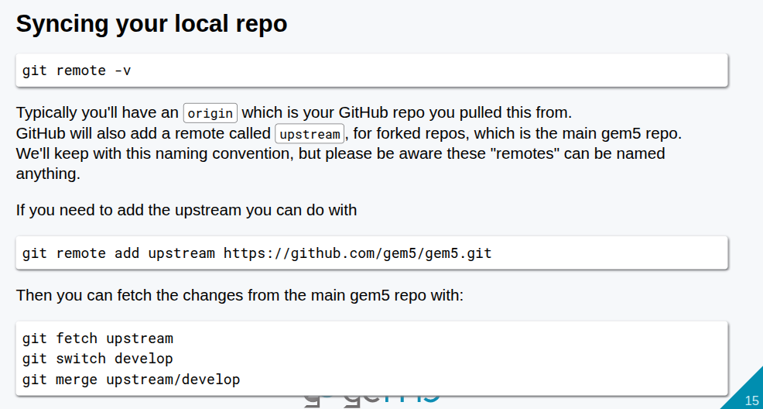
27.1 Contribution: Slides
https://gem5bootcamp.github.io/2024/#06-Contributing/01-contributing
Contribution: Slides

Slide 17
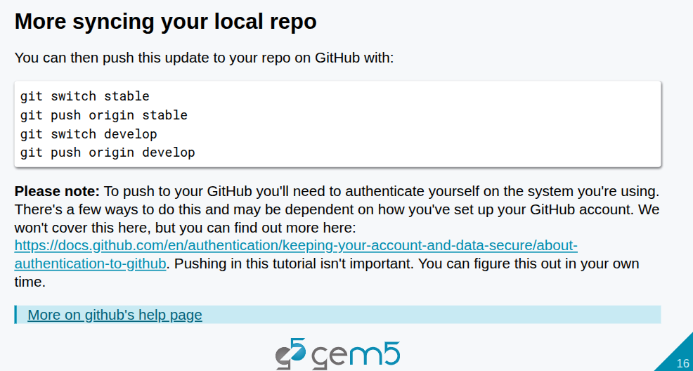
27.1 Contribution: Slides
https://gem5bootcamp.github.io/2024/#06-Contributing/01-contributing
Contribution: Slides

Slide 18
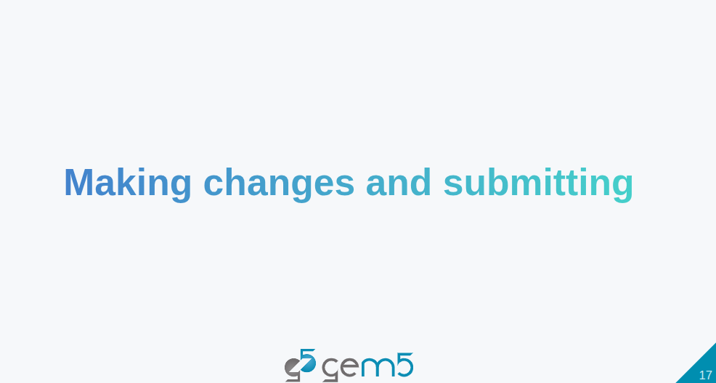
27.1 Contribution: Slides
https://gem5bootcamp.github.io/2024/#06-Contributing/01-contributing
Contribution: Slides

Slide 19
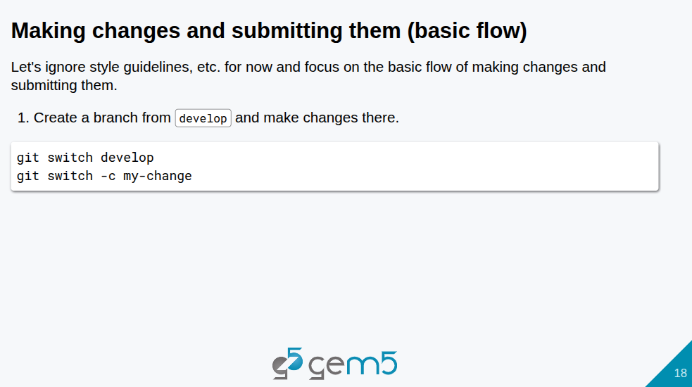
27.1 Contribution: Slides
https://gem5bootcamp.github.io/2024/#06-Contributing/01-contributing
Contribution: Slides

Slide 20
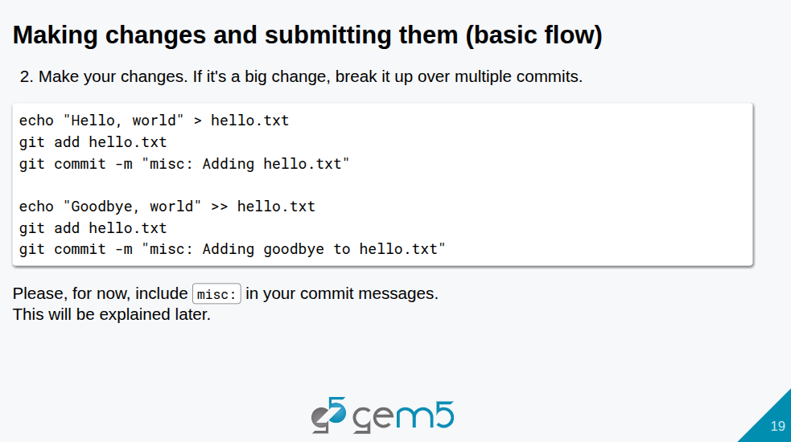
27.1 Contribution: Slides
https://gem5bootcamp.github.io/2024/#06-Contributing/01-contributing
Contribution: Slides

Slide 21
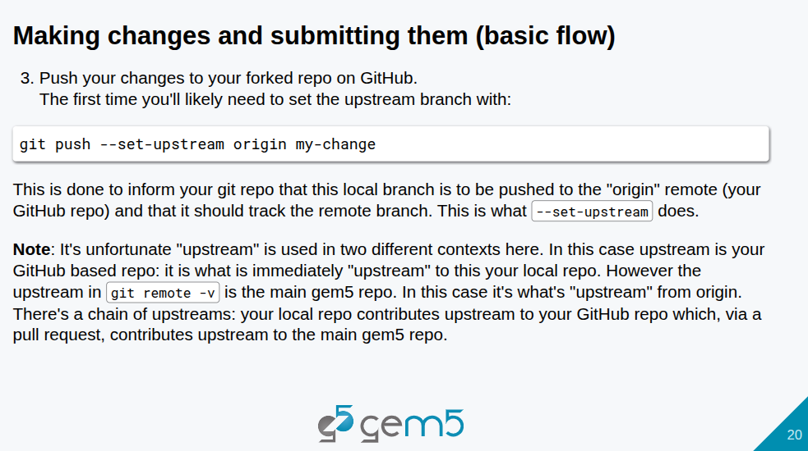
27.1 Contribution: Slides
https://gem5bootcamp.github.io/2024/#06-Contributing/01-contributing
Contribution: Slides

Slide 22
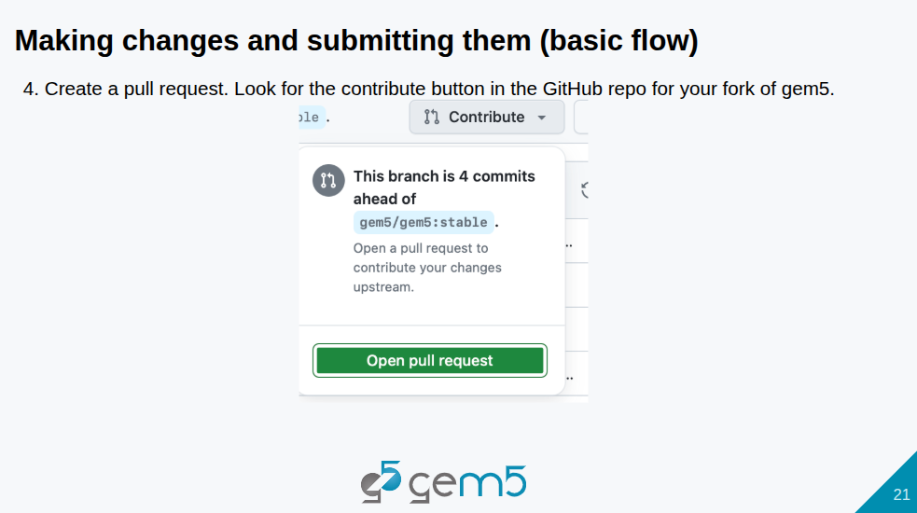
27.1 Contribution: Slides
https://gem5bootcamp.github.io/2024/#06-Contributing/01-contributing
Contribution: Slides

Slide 23
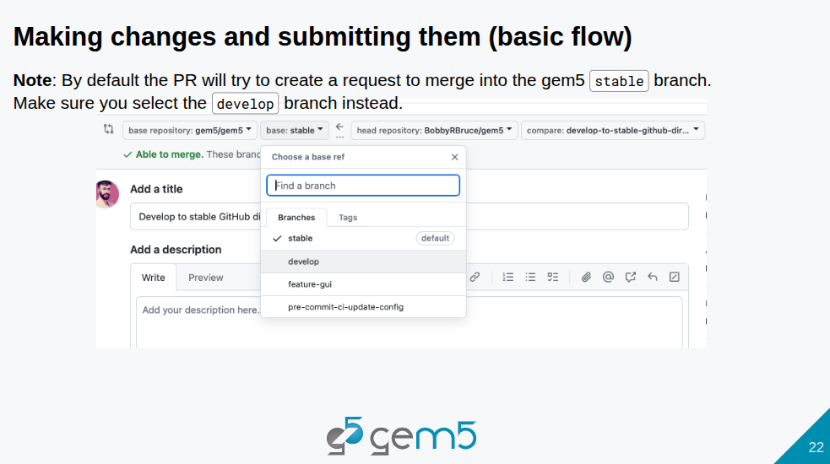
27.1 Contribution: Slides
https://gem5bootcamp.github.io/2024/#06-Contributing/01-contributing
Contribution: Slides

Slide 24
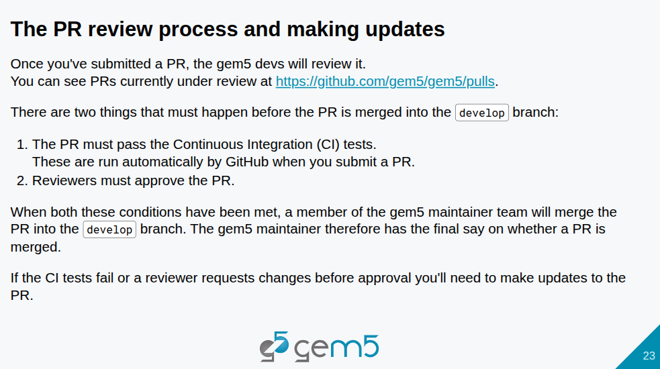
27.1 Contribution: Slides
https://gem5bootcamp.github.io/2024/#06-Contributing/01-contributing
Contribution: Slides

Slide 25
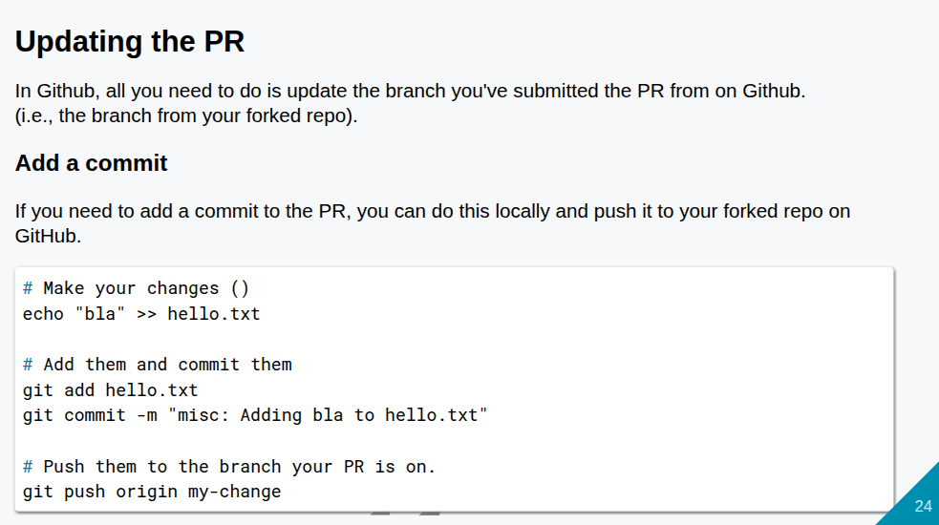
27.1 Contribution: Slides
https://gem5bootcamp.github.io/2024/#06-Contributing/01-contributing
Contribution: Slides

Slide 26
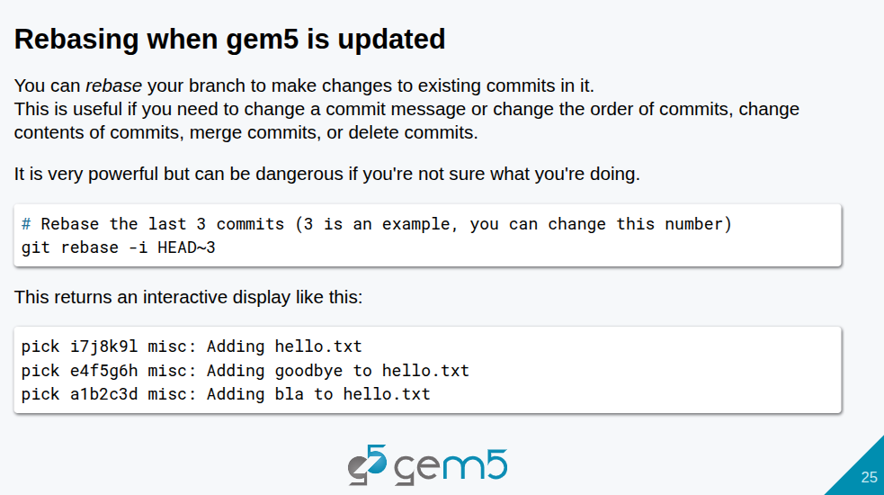
27.1 Contribution: Slides
https://gem5bootcamp.github.io/2024/#06-Contributing/01-contributing
Contribution: Slides

Slide 27
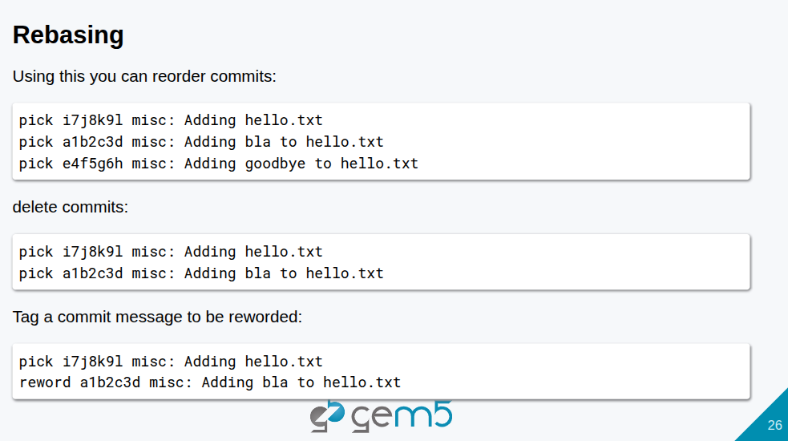
27.1 Contribution: Slides
https://gem5bootcamp.github.io/2024/#06-Contributing/01-contributing
Contribution: Slides

Slide 28
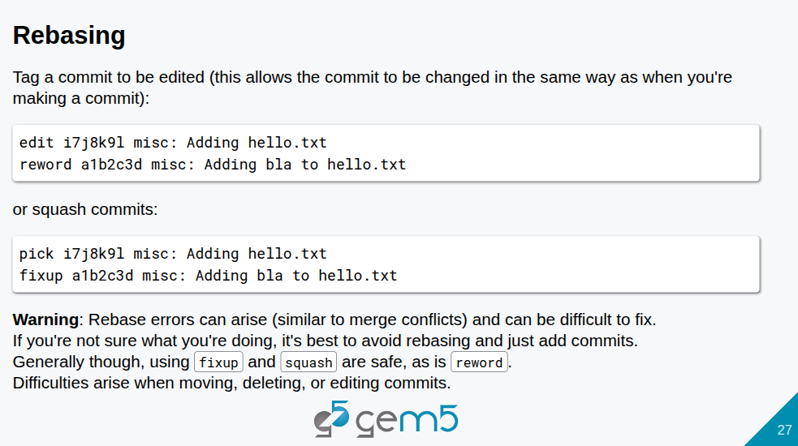
27.1 Contribution: Slides
https://gem5bootcamp.github.io/2024/#06-Contributing/01-contributing
Contribution: Slides

Slide 29
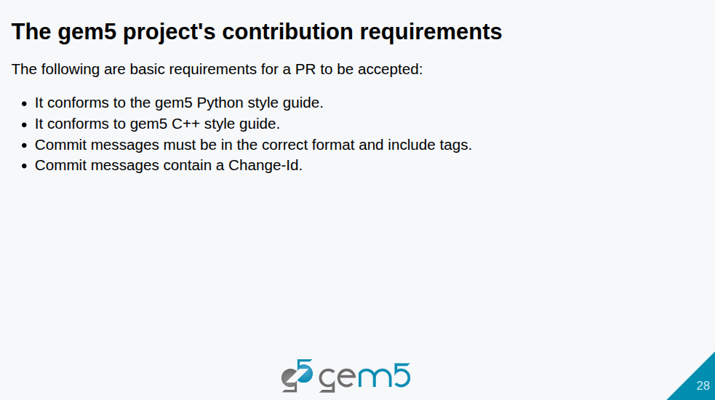
27.1 Contribution: Slides
https://gem5bootcamp.github.io/2024/#06-Contributing/01-contributing
Contribution: Slides

Slide 30
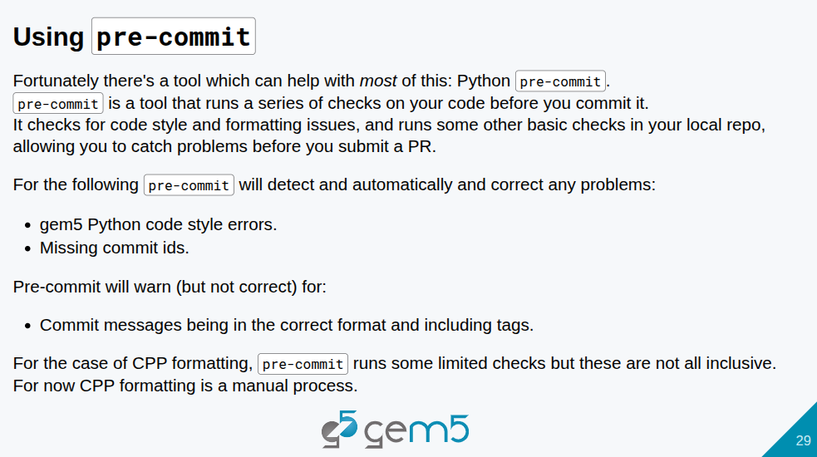
27.1 Contribution: Slides
https://gem5bootcamp.github.io/2024/#06-Contributing/01-contributing
Contribution: Slides

Slide 31
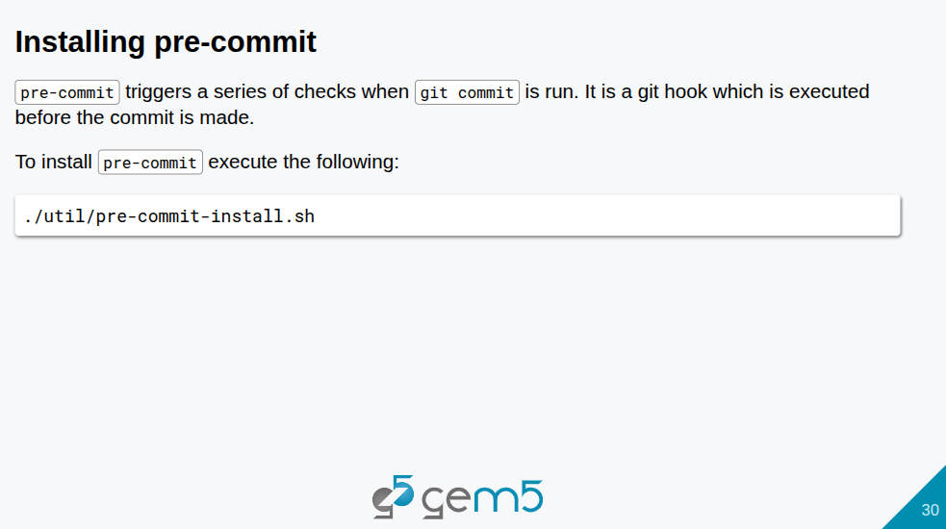
27.1 Contribution: Slides
https://gem5bootcamp.github.io/2024/#06-Contributing/01-contributing
Contribution: Slides

Slide 32
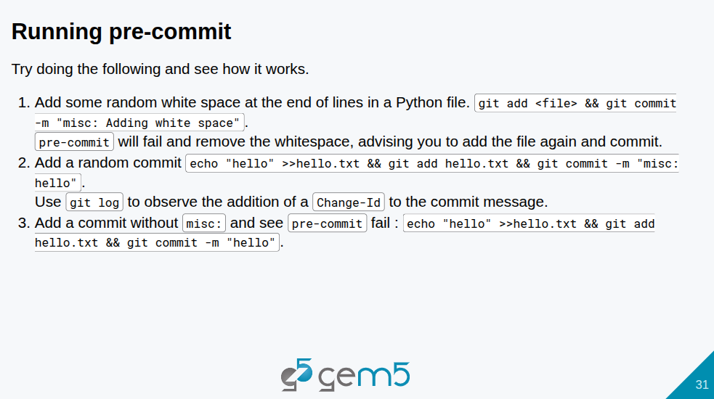
27.1 Contribution: Slides
https://gem5bootcamp.github.io/2024/#06-Contributing/01-contributing
Contribution: Slides

Slide 33
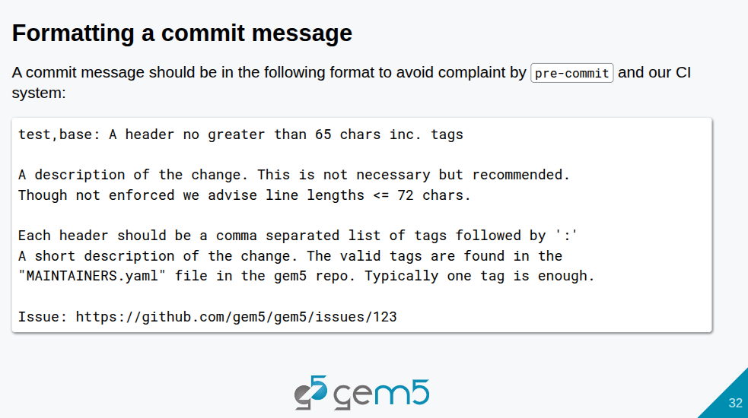
27.1 Contribution: Slides
https://gem5bootcamp.github.io/2024/#06-Contributing/01-contributing
Contribution: Slides

Slide 34
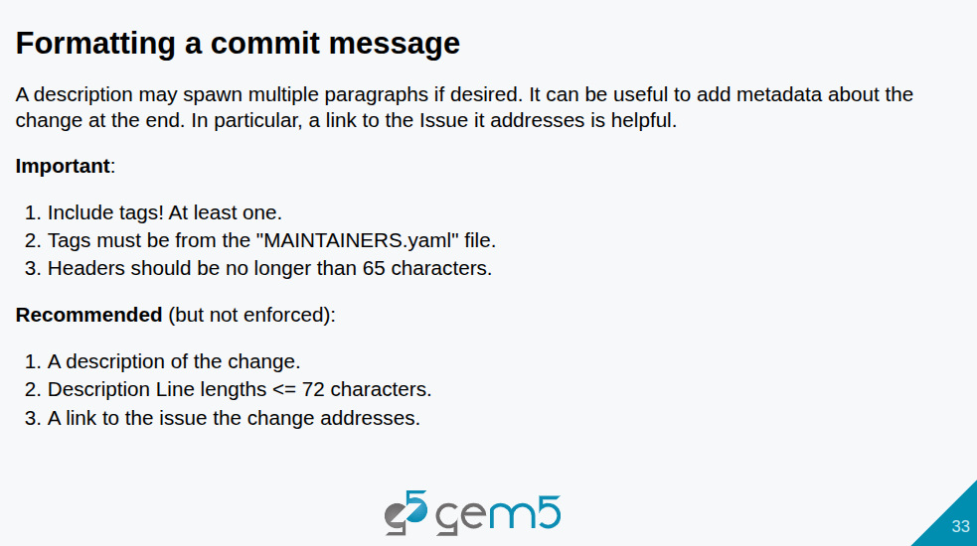
27.1 Contribution: Slides
https://gem5bootcamp.github.io/2024/#06-Contributing/01-contributing
Contribution: Slides

Slide 35
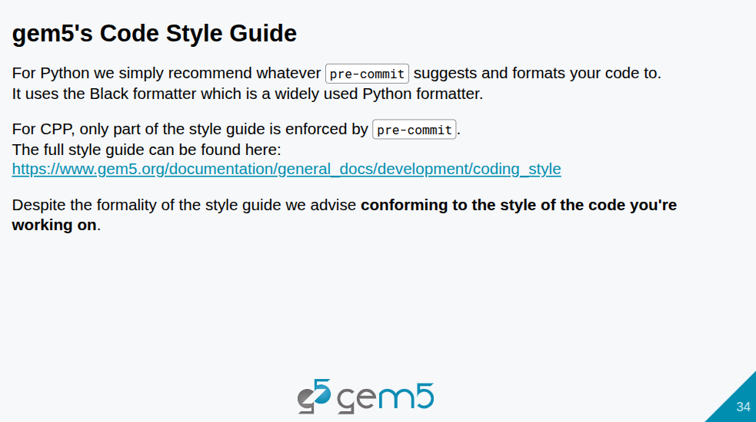
27.1 Contribution: Slides
https://gem5bootcamp.github.io/2024/#06-Contributing/01-contributing
Contribution: Slides

Slide 36
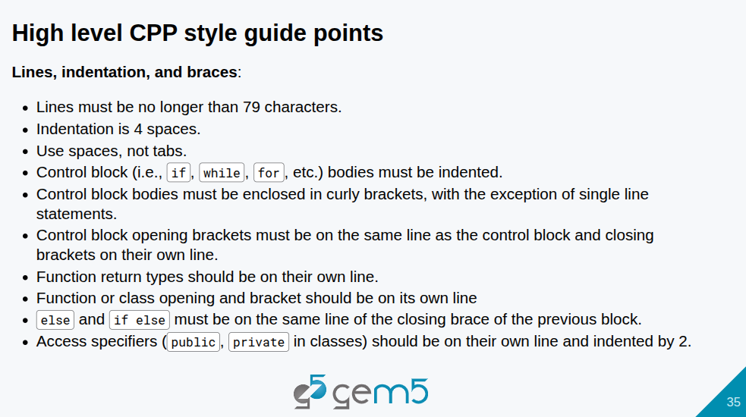
27.1 Contribution: Slides
https://gem5bootcamp.github.io/2024/#06-Contributing/01-contributing
Contribution: Slides

Slide 37
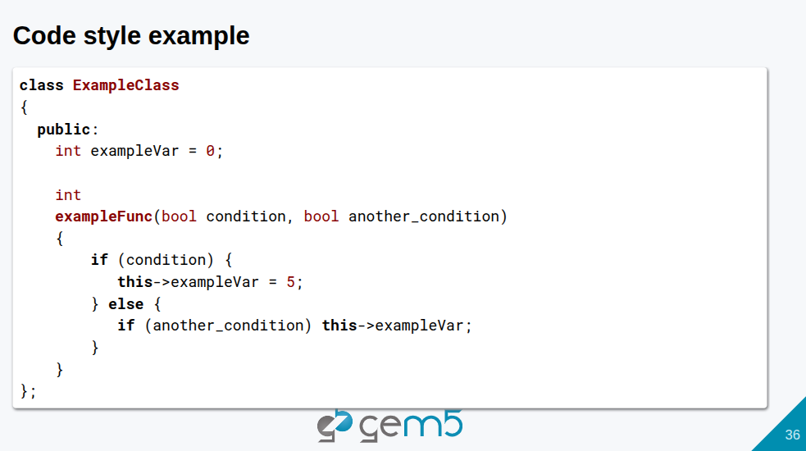
27.1 Contribution: Slides
https://gem5bootcamp.github.io/2024/#06-Contributing/01-contributing
Contribution: Slides

Slide 38
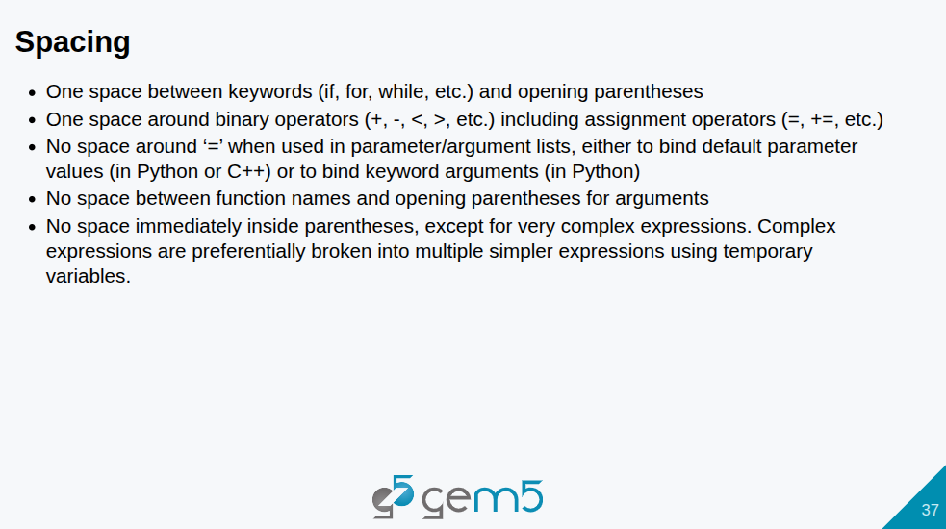
27.1 Contribution: Slides
https://gem5bootcamp.github.io/2024/#06-Contributing/01-contributing
Contribution: Slides

Slide 39
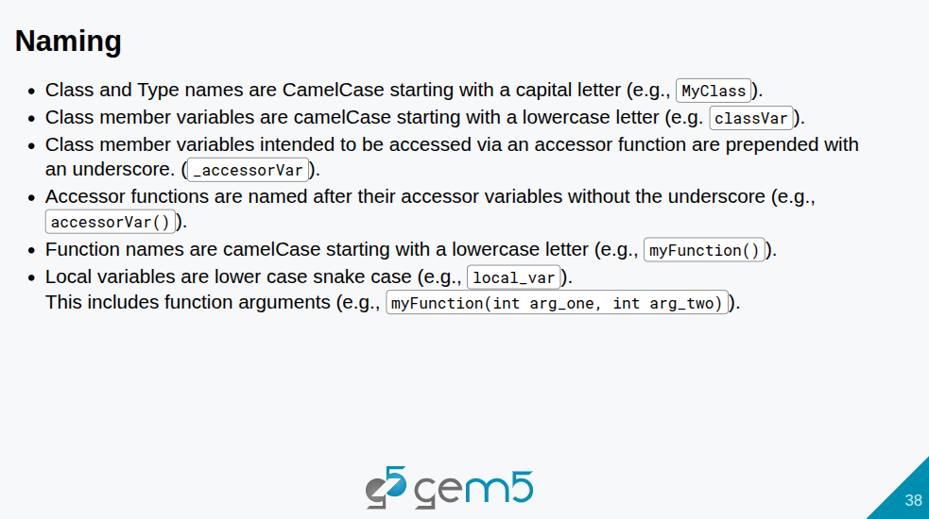
27.1 Contribution: Slides
https://gem5bootcamp.github.io/2024/#06-Contributing/01-contributing
Contribution: Slides

Slide 40
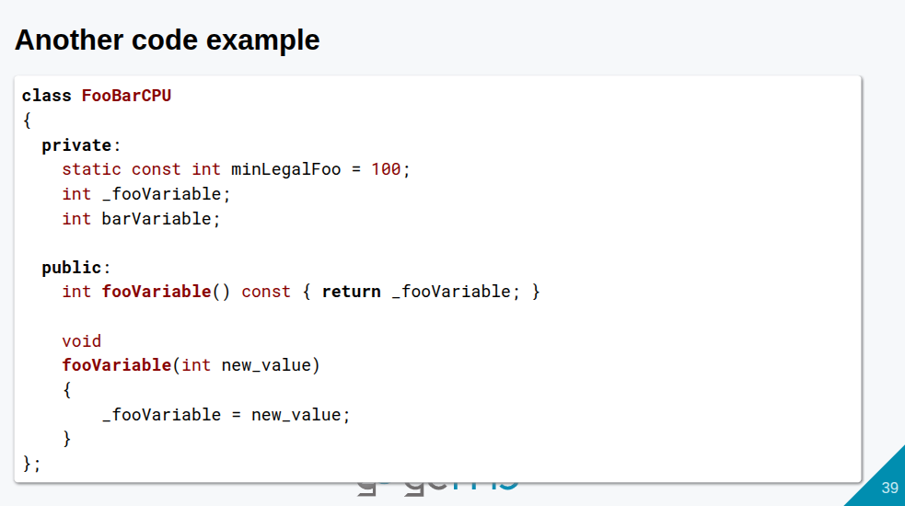
27.1 Contribution: Slides
https://gem5bootcamp.github.io/2024/#06-Contributing/01-contributing
Contribution: Slides

Slide 41
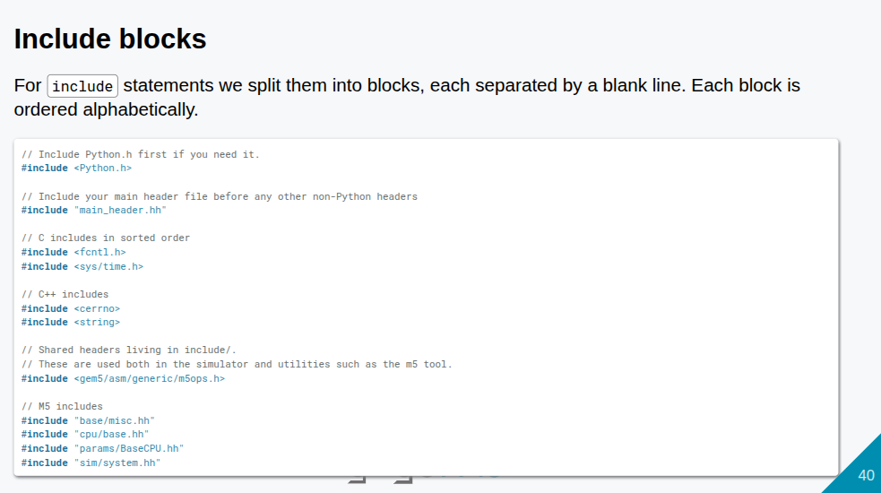
27.1 Contribution: Slides
https://gem5bootcamp.github.io/2024/#06-Contributing/01-contributing
Contribution: Slides

Slide 42
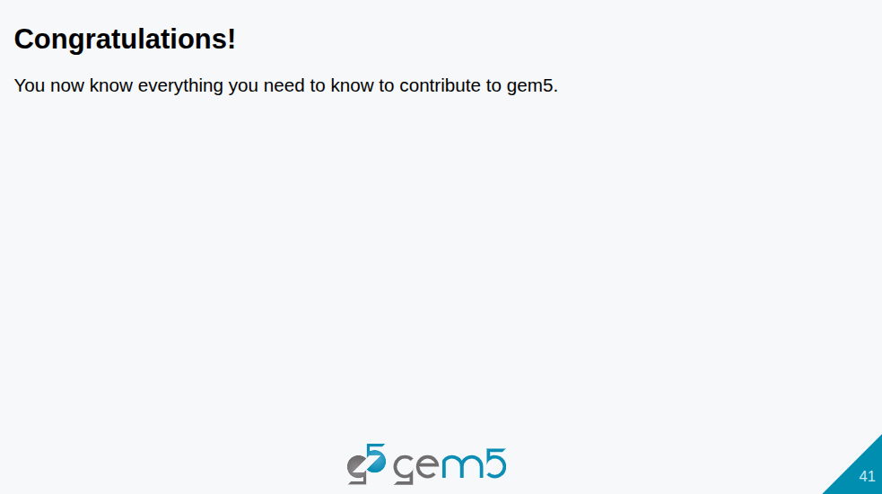
27.1 Contribution: Slides
https://gem5bootcamp.github.io/2024/#06-Contributing/01-contributing
Contribution: Slides

Slide 43
End

