Slide 1

24 Garnet On-Chip Network
Peter H. Chen

Slide 2
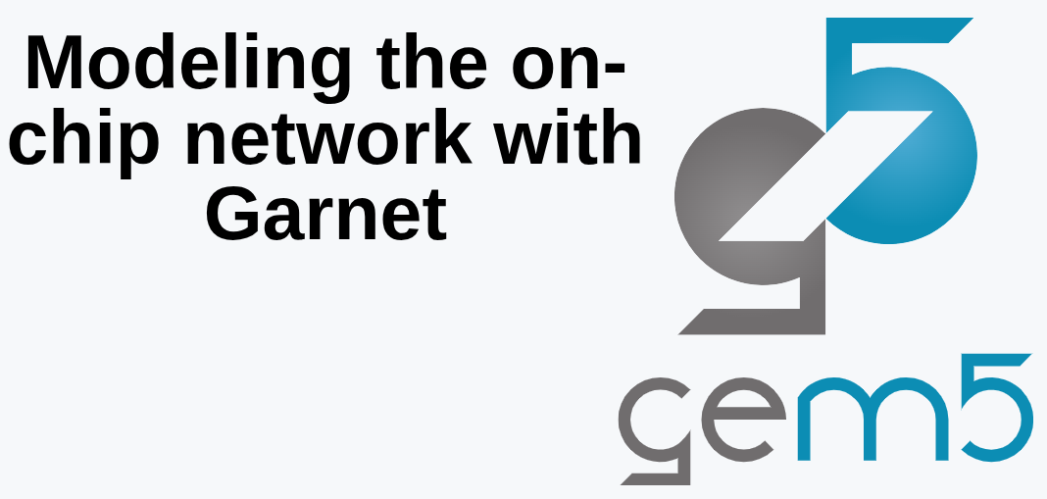
24 Garnet On-Chip Network
https://www.youtube.com/watch?v=XekmnJ9ayb0&list=PL_hVbFs_loVR_8ntTTmmG6YEq3Po_4snu&index=24
Garnet On-Chip Network (0:00-0:05/19:48)
We discuss how to model the chip network with Garnet.

Slide 3
24.0 Topics

Slide 4
24.0 Topics
https://www.youtube.com/watch?v=XekmnJ9ayb0&list=PL_hVbFs_loVR_8ntTTmmG6YEq3Po_4snu&index=24
Garnet On-Chip Network (2:10-2:14/19:48)
Topics:
1. Review Ruby
2. Network on Chip
3. Create Topology: Controller, Router, External Link, Internal Link.
4. Create Topology for CHI Protocol
5. Topology File

Slide 5
24.1 Review Ruby

Slide 6
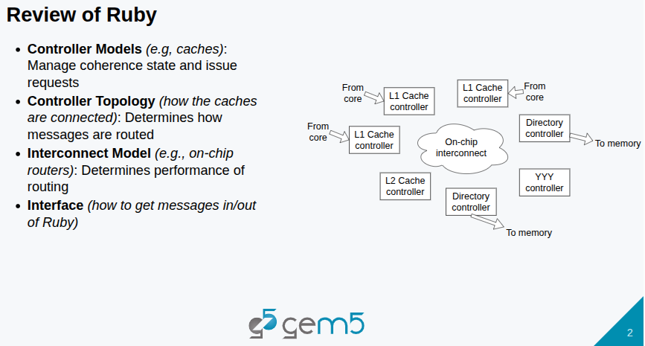
24.1 Review Ruby
https://www.youtube.com/watch?v=XekmnJ9ayb0&list=PL_hVbFs_loVR_8ntTTmmG6YEq3Po_4snu&index=24
Review Ruby (0:06-0:30/19:48)
Ruby includes a bunch of controller models. In the MSI (Modified, Shared, Invalid) of Cache Coherence Protocol, we have L1 cache controllers and directory controllers. In CHI (Coherence Hub Interface), we have a bunch of cache controllers that are configured in different ways.
Q: What is directory controller?
Ans: A cache directory is a map or "logbook" tracking with CPU cores. CPU cores contain many copy of data and state (read or modified).

Slide 7
24.1 Review Ruby
https://www.youtube.com/watch?v=XekmnJ9ayb0&list=PL_hVbFs_loVR_8ntTTmmG6YEq3Po_4snu&index=24
Review Ruby (0:36-0:40/19:48)
Once we have the controllers. We need the topology and interconnect model to connect the controllers together.
We have different controllers (Core to L1 Cache controllers, L2 Cache controllers, directory controller to memory, etc) and Interconnect Model.
We will dive into the on chip interconnect and see information about controller topology and interconnect topology.

Slide 8
24.2 Network On Chip

Slide 9
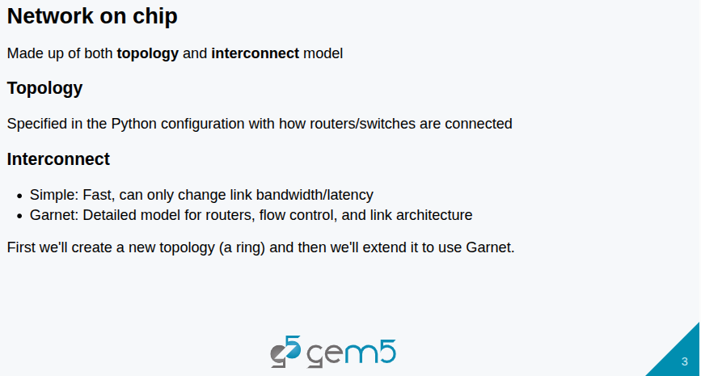
24.2 Network On Chip
https://www.youtube.com/watch?v=XekmnJ9ayb0&list=PL_hVbFs_loVR_8ntTTmmG6YEq3Po_4snu&index=24
Network On Chip (0:41-1:40/19:48)
Network on Chip made both topology and interconnect model.
The topology will be specified by Python configuration.
We will see how the routers and switches are connected together: Is it a mesh, a ring, crossbar, etc.
We have two different interconnect models (Simple and Garnet) in Gem5.
1) The Simple Interconnect Model is fast. We can only change link bandwidth and latency.
2) The Garnet Interconnect Model is a detailed model for routers. Garnet is is a cycle level model for routers. It is a three stage routers, flow control, and link architecture. Garnet also model serialization, deserialization, and clock domain crossing. Garnet can model 3D TSVs (Through-Silicon Vias) in the interconnect.

Slide 10
24.2 Network On Chip
https://www.youtube.com/watch?v=XekmnJ9ayb0&list=PL_hVbFs_loVR_8ntTTmmG6YEq3Po_4snu&index=24
Network On Chip (1:41-1:50/19:48)
First, we will create a simple ring topology.
Then, we will extend that ring topology to use Garnet instead of Simple Network.

Slide 11
24.3 Topology: Controller, Router, External/Internal Link

Slide 12
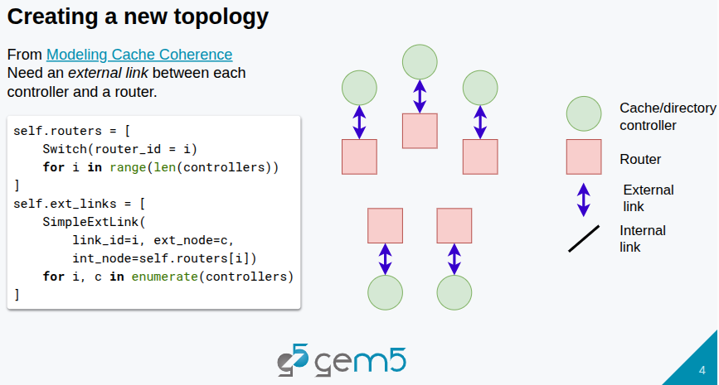
24.3 Topology: Controller, Router, External/Internal Link
https://www.youtube.com/watch?v=XekmnJ9ayb0&list=PL_hVbFs_loVR_8ntTTmmG6YEq3Po_4snu&index=24
Topology: Controller, Router, External/Internal Link (1:51-2:30/19:48)
We create the topology:
a. Create cache/directory controllers
b. Create routers. In simple network, the routers are just switches.
c. Create the external links from routers to the controllers.
d. Create the internal links between the routers.
These external links in the network are our message buffers. The external links are connected to the message buffers.
The message buffers in Ruby are used to send message into the network and receive messages from the network.
The send/receive messages to message buffers are done through the external links, from the side of the network.

Slide 13
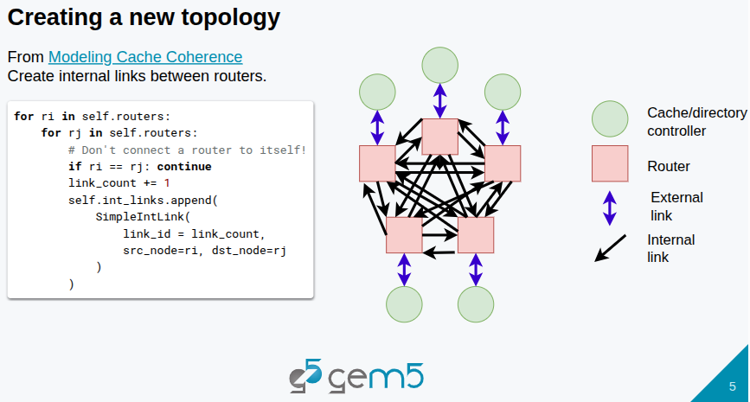
24.3 Topology: Controller, Router, External/Internal Link
https://www.youtube.com/watch?v=XekmnJ9ayb0&list=PL_hVbFs_loVR_8ntTTmmG6YEq3Po_4snu&index=24
Topology: Controller, Router, External/Internal Link (2:31-3:00/19:48)
The external links connect the cache/directory controllers and Router.
After we create the external links, we create the internal links between the Routers.
In the below diagram,
1. We have blue external link of every single pair of Router and Controller.
2. We also have the black arrows for the internal links between every Routers.

Slide 14
24.4 Ring Topology for CHI Protocol

Slide 15
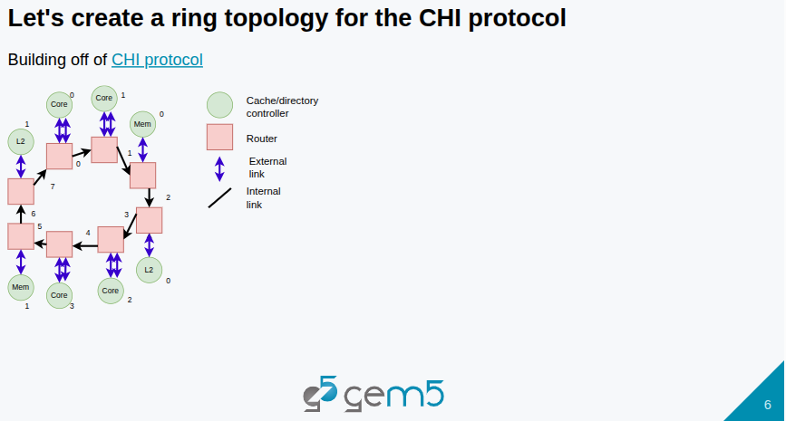
24.4 Ring Topology for CHI Protocol
https://www.youtube.com/watch?v=XekmnJ9ayb0&list=PL_hVbFs_loVR_8ntTTmmG6YEq3Po_4snu&index=24
Ring Topology for CHI Protocol (3:01-3:15/19:48)
Below diagram, we create Ring Topology for two groups of two cores, memory controller, L1 Cache.
On the top group, we have
1. Two cores are next to each other,
2. One memory controller,
3. L2 Cache.
On the bottom group, we have
1. Two cores are next to each other,
2. One memory controller,
3. L2 Cache.

Slide 16
24.5 Topology File: ring.py

Slide 17
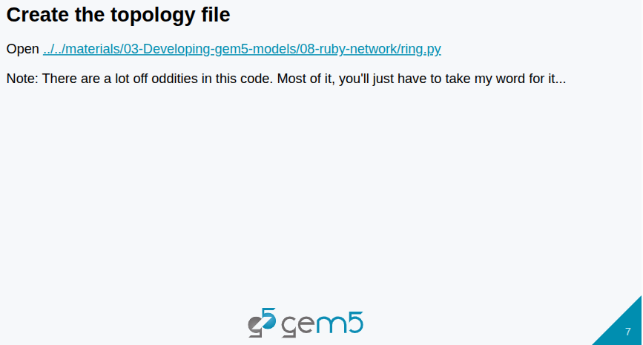
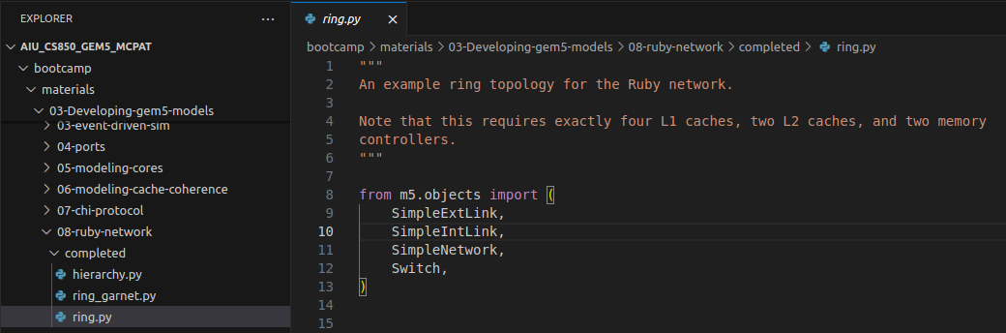
24.5 Topology File: ring.py
https://www.youtube.com/watch?v=XekmnJ9ayb0&list=PL_hVbFs_loVR_8ntTTmmG6YEq3Po_4snu&index=24
Topology File: ring.py (3:16-3:25/19:48)
> ~materials/03-Developing-gem5-models/08-ruby-network/ring.py
Now, we implement the simple topology.
For simple Topology, we import Simple External Link, Simple Internal Link, Simple Network, and Switch..

Slide 18
24.6 Class Ring

Slide 19
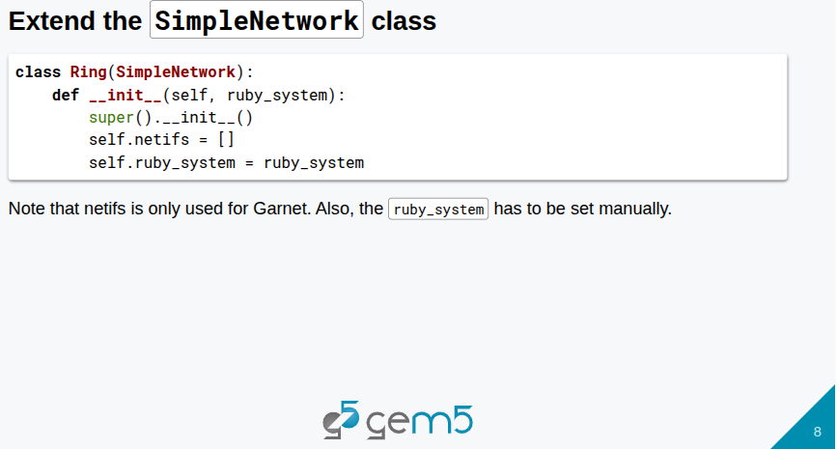
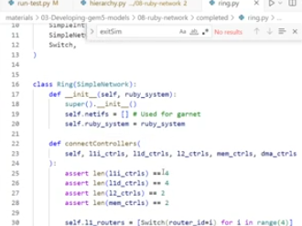
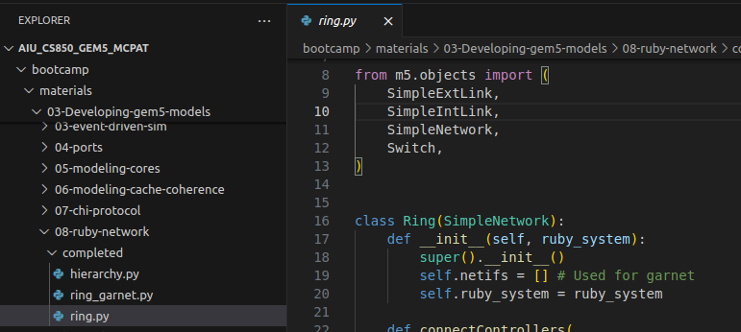
24.6 Class Ring
https://www.youtube.com/watch?v=XekmnJ9ayb0&list=PL_hVbFs_loVR_8ntTTmmG6YEq3Po_4snu&index=24
Class Ring (3:26-4:40/19:48)
> ~materials/03-Developing-gem5-models/08-ruby-network/ring.py
We implement the topology now.
We extend simple network class for class ring (pass class SimpleNetwork into class ring).

Slide 20
24.6 Class Ring
https://www.youtube.com/watch?v=XekmnJ9ayb0&list=PL_hVbFs_loVR_8ntTTmmG6YEq3Po_4snu&index=24
Class Ring (4:41-5:00/19:48)
> ~materials/03-Developing-gem5-models/08-ruby-network/ring.py
The __init__() is the Python constructor to set Ruby system (ruby_system) and simple network (self).
1. we inherit the parent class by super.__init__()
2. set self.netifs = [] to empty list.
3. set self.ruby_system = ruby_system

Slide 21
24.7 Main Function: connectController()

Slide 22
24.5 Topology File: ring.py
https://www.youtube.com/watch?v=XekmnJ9ayb0&list=PL_hVbFs_loVR_8ntTTmmG6YEq3Po_4snu&index=24
Topology File: ring.py (5:01-5:50/19:48)
> ~materials/03-Developing-gem5-models/08-ruby-network/ring.py
We are going to create ring topology for CHI protocol.
We want to layout four cores with particular order as below.

Slide 23
24.8 Specify Core, Cache, and Memory

Slide 24
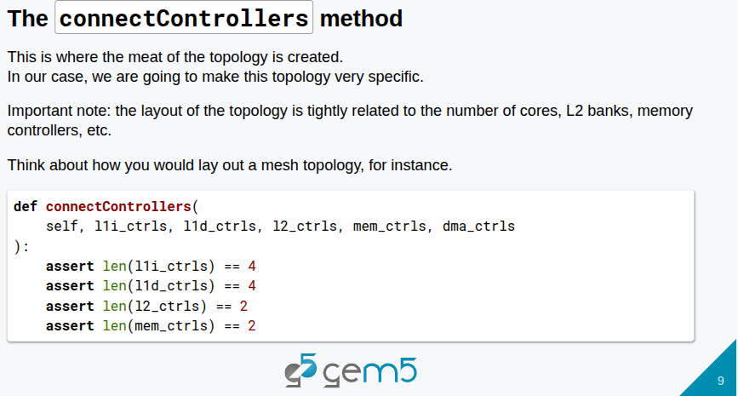
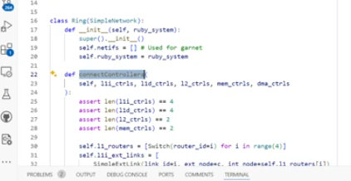
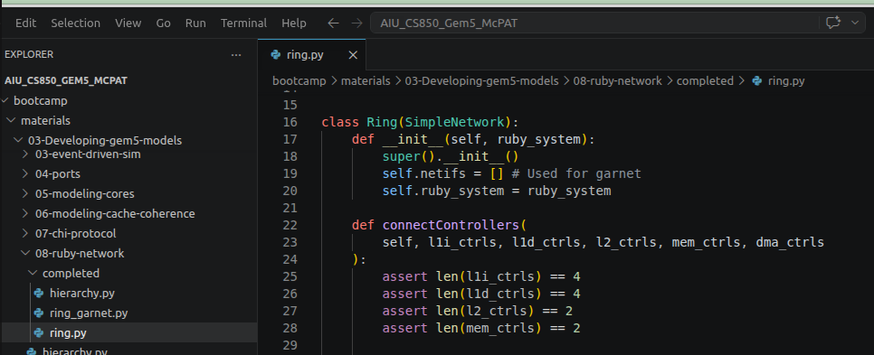
24.8 Specify Core, Cache, and Memory
https://www.youtube.com/watch?v=XekmnJ9ayb0&list=PL_hVbFs_loVR_8ntTTmmG6YEq3Po_4snu&index=24
Specify Code, Cache, and Memory (5:51-6:30/19:48)
> ~materials/03-Developing-gem5-models/08-ruby-network/ring.py
After the constructor, we do the main function: connectController()
In the connect controllers function, we have four L1 controllers (L1 Instruction, L1 Data), Two L2 controller, Two memory controller (DMA controllers).

Slide 25
24.9 Create Router for L1 Cache

Slide 26
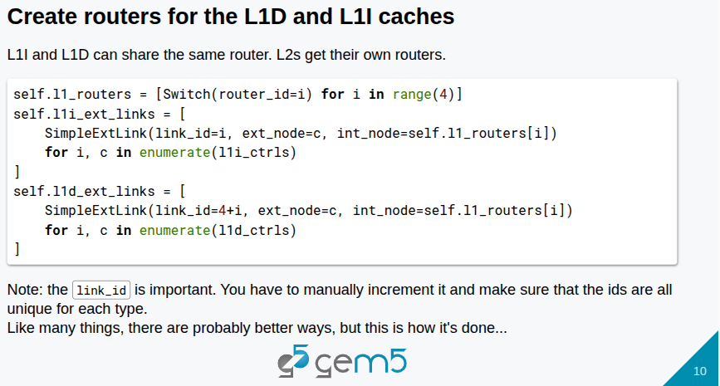
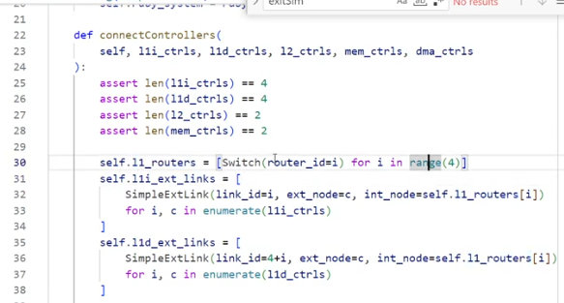
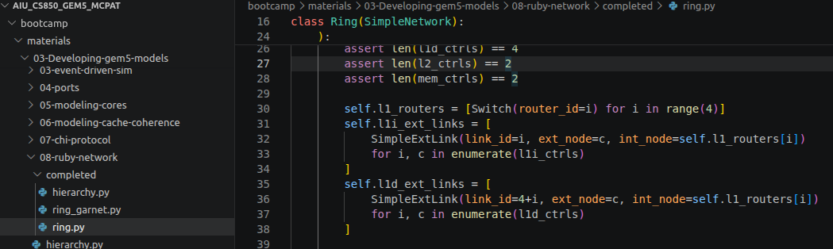
24.9 Create Router and Link for L1 Cache
https://www.youtube.com/watch?v=XekmnJ9ayb0&list=PL_hVbFs_loVR_8ntTTmmG6YEq3Po_4snu&index=24
Create Router and Link for L1 Cache (5:51-6:20/19:48)
> ~materials/03-Developing-gem5-models/08-ruby-network/ring.py
Create routers and for L1 cache.

Slide 27
24.10 Create Link for L2 Cache/Memory

Slide 28
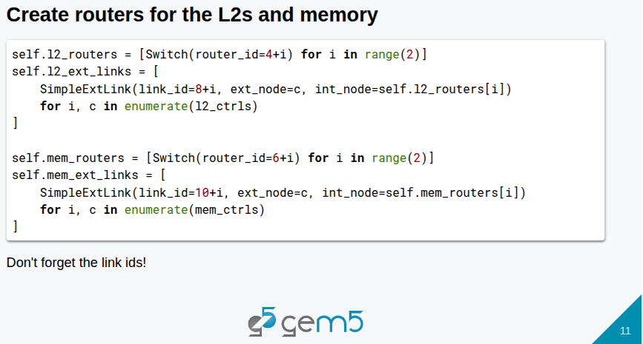
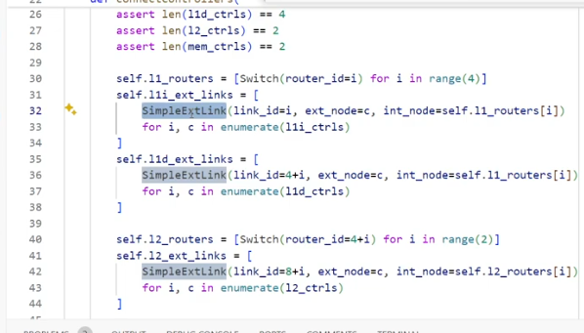
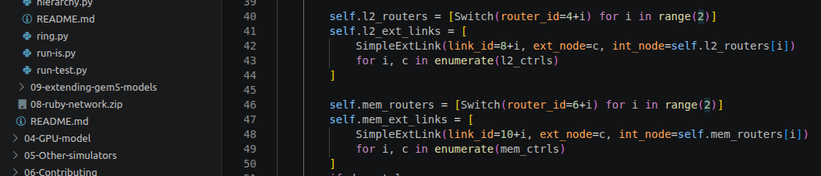
24.10 Create Link for L2 Cache/Memory
https://www.youtube.com/watch?v=XekmnJ9ayb0&list=PL_hVbFs_loVR_8ntTTmmG6YEq3Po_4snu&index=24
Create Link for L2 Cache/Memory (6:21-7:30/19:48)
> ~materials/03-Developing-gem5-models/08-ruby-network/ring.py
Create external Link for L1 Cache and L2 cache.

Slide 29
24.11 Create External Link for DMA

Slide 30
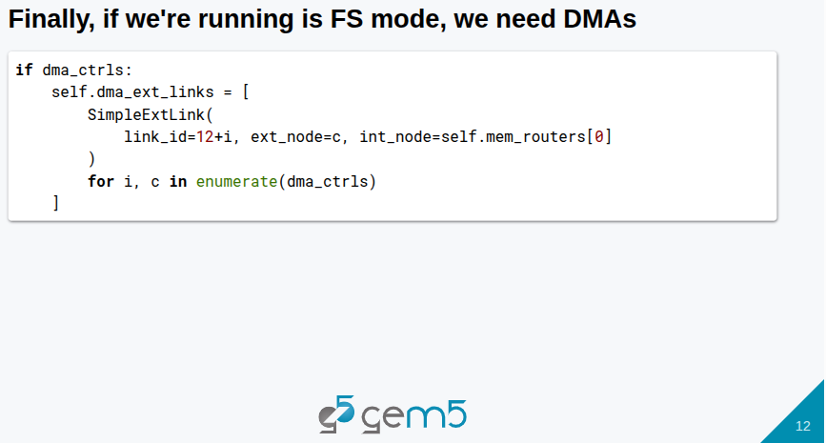
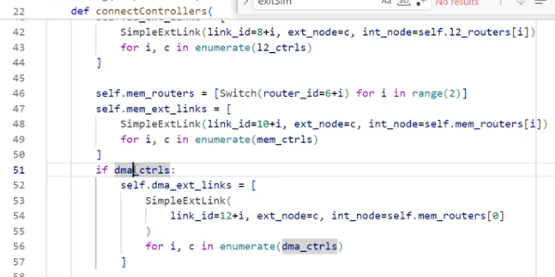
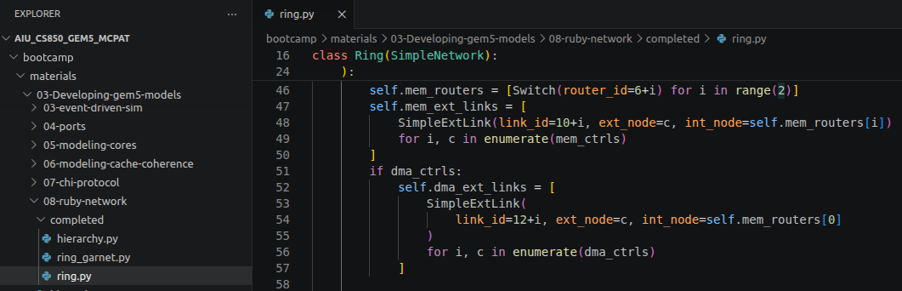
24.11 Create External Link for DMA
https://www.youtube.com/watch?v=XekmnJ9ayb0&list=PL_hVbFs_loVR_8ntTTmmG6YEq3Po_4snu&index=24
Create External Link for DMA (7:31-8:10/19:48)
> ~materials/03-Developing-gem5-models/08-ruby-network/ring.py
In full system mode simulation, we need DMA memory. DMA is a special memory router.
Below, we do DMA router which is the last router. We are done with all external links and routers,

Slide 31
24.12 Create Internal Link

Slide 32
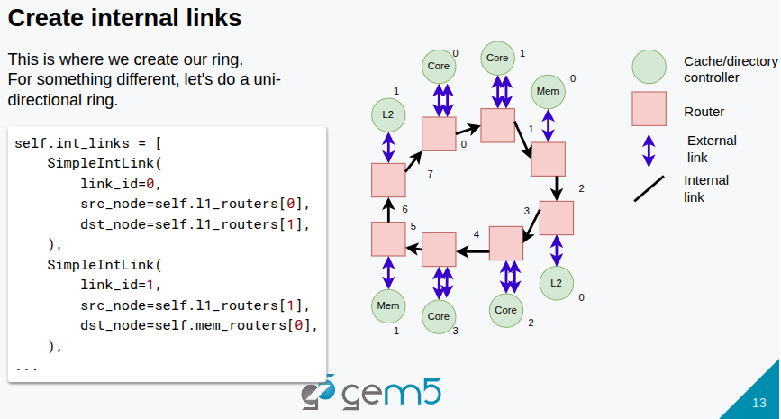
24.12 Create Internal Link
https://www.youtube.com/watch?v=XekmnJ9ayb0&list=PL_hVbFs_loVR_8ntTTmmG6YEq3Po_4snu&index=24
Create Internal Link (8:11-8:20/19:48)
> ~materials/03-Developing-gem5-models/08-ruby-network/ring.py
After we done with the external link, we create the internal link.

Slide 33
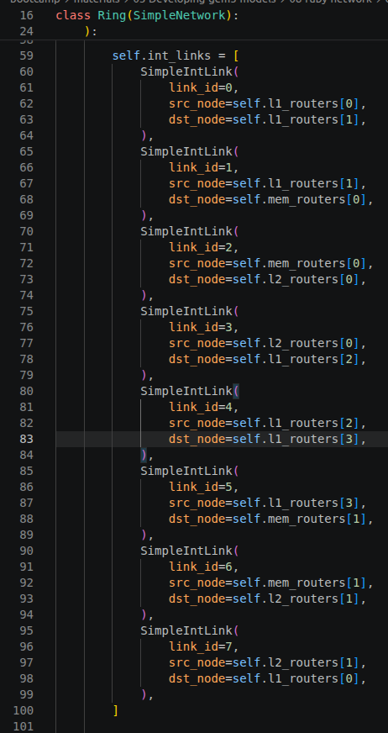
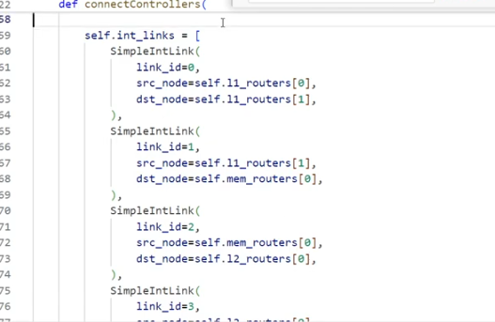
24.12 Create Internal Link
https://www.youtube.com/watch?v=XekmnJ9ayb0&list=PL_hVbFs_loVR_8ntTTmmG6YEq3Po_4snu&index=24
Create Internal Link (8:21-8:40/19:48)
> ~materials/03-Developing-gem5-models/08-ruby-network/ring.py
Below, we do internal link for core 0, core 1, core 2, and core 3.
1. Core 0 L1 router to core 1 L1 router
2. Core 1 L1 router to Core 0 memory router
3. Core 0 Core 0memory router to Core 0 L2 router,
...

Slide 34
24.13 Simple Network Structure: Ext Link/Router

Slide 35
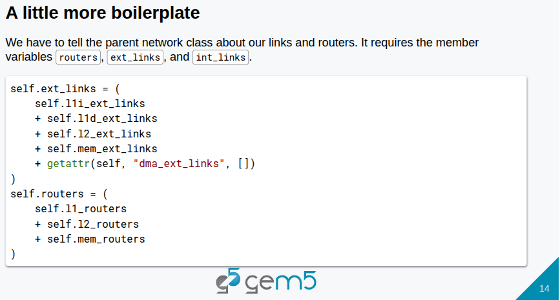
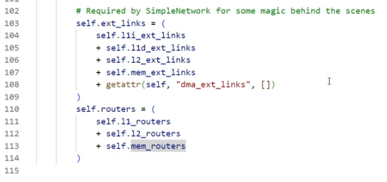
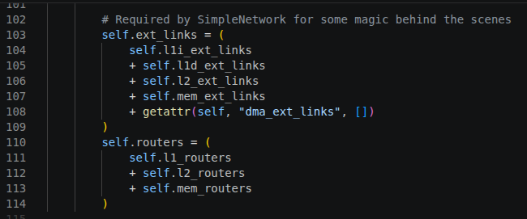
24.13 Simple Network Structure: Ext Link/Router
https://www.youtube.com/watch?v=XekmnJ9ayb0&list=PL_hVbFs_loVR_8ntTTmmG6YEq3Po_4snu&index=24
Simple Network Structure: Ext Link/Router (8:41-9:10/19:48)
> ~materials/03-Developing-gem5-models/08-ruby-network/ring.py
In Simple Network, we have data structures required for external Link and Router for object.
We have done all the specification for network ring topology.

Slide 36
24.14 Create Ring Topology for Ruby Network

Slide 37
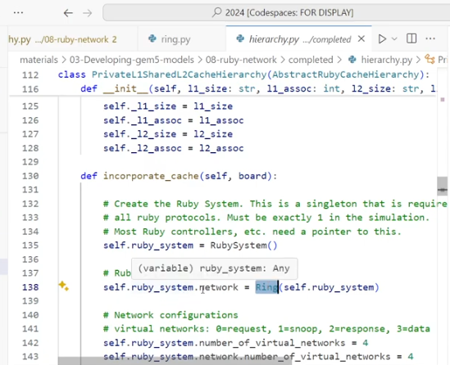
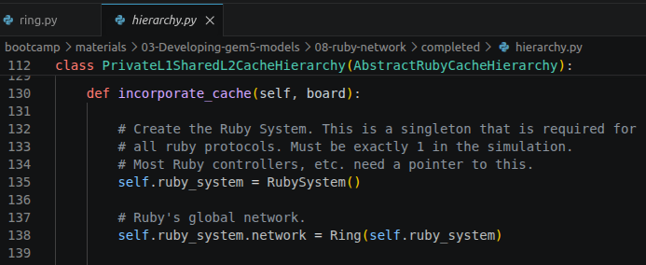
24.14 Create Ring Topology for Ruby Network
https://www.youtube.com/watch?v=XekmnJ9ayb0&list=PL_hVbFs_loVR_8ntTTmmG6YEq3Po_4snu&index=24
Create Ring Topology for Ruby Network (9:11-9:20/19:48)
> ~materials/03-Developing-gem5-models/08-ruby-network/hierarchy.py.
1. Create Ruby system
2. Create Ring topology for Ruby network

Slide 38
24.15 Connect Controller in Ruby Network

Slide 39
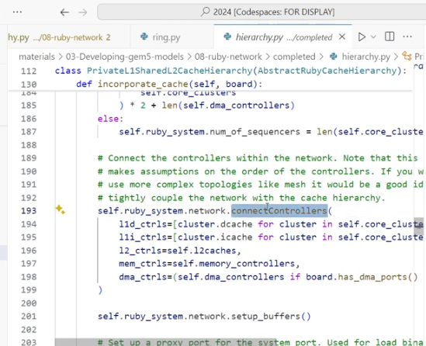
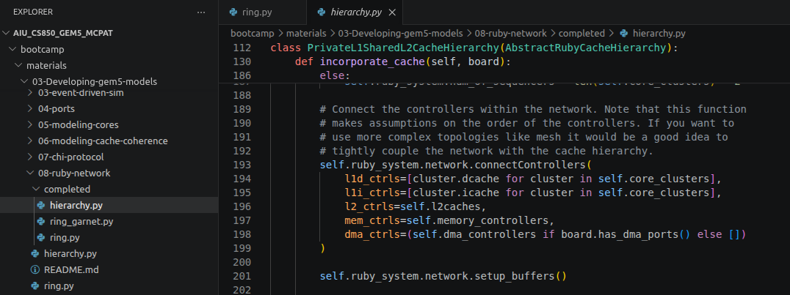
24.15 Connect Controller in Ruby Network
https://www.youtube.com/watch?v=XekmnJ9ayb0&list=PL_hVbFs_loVR_8ntTTmmG6YEq3Po_4snu&index=24
Connect Controller in Ruby Network (9:21-9:50/19:48)
> ~materials/03-Developing-gem5-models/08-ruby-network/hierarchy.py.
Below, we connect the Controller in Ruby Network.
We passed in all the controller into connectController (passed in all the controllers)

Slide 40
24.16 Create Two L2 Shared Cache

Slide 41
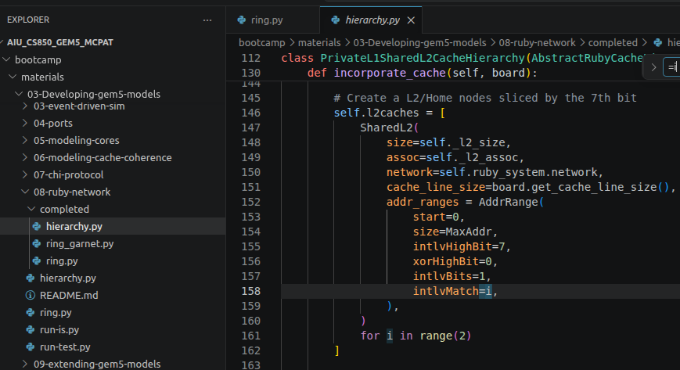
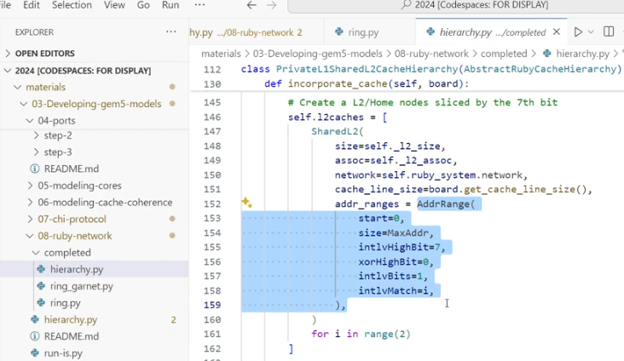
24.16 Create Two L2 Shared Cache
https://www.youtube.com/watch?v=XekmnJ9ayb0&list=PL_hVbFs_loVR_8ntTTmmG6YEq3Po_4snu&index=24
Create Two L2 Shared Cache (9:51-11:05/19:48)
> ~materials/03-Developing-gem5-models/08-ruby-network/hierarchy.py.
Below, we create two shared L2 caches/Home Nodes based on the 7th bit intlvMatch = i (0 or 1). One is intlvMatch = 0 and the other cache is intlvMatch = 1.
We will have The memory interleaved. It is similar to cache interleaved.

Slide 42
24.17 Run Test

Slide 43
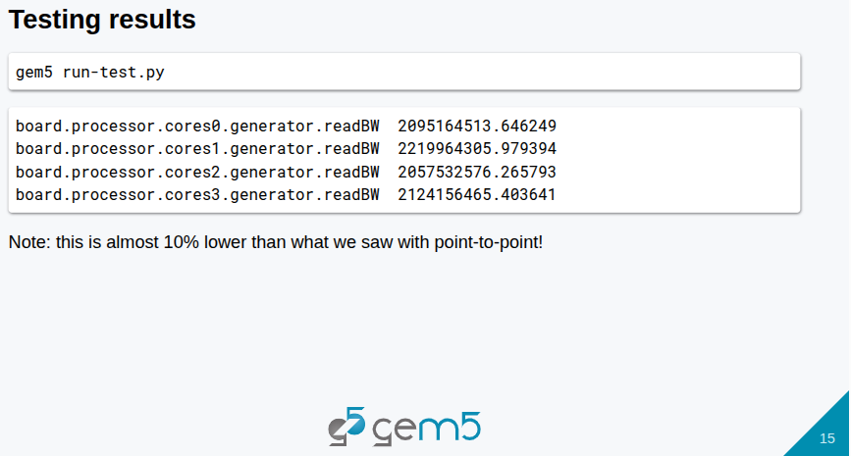
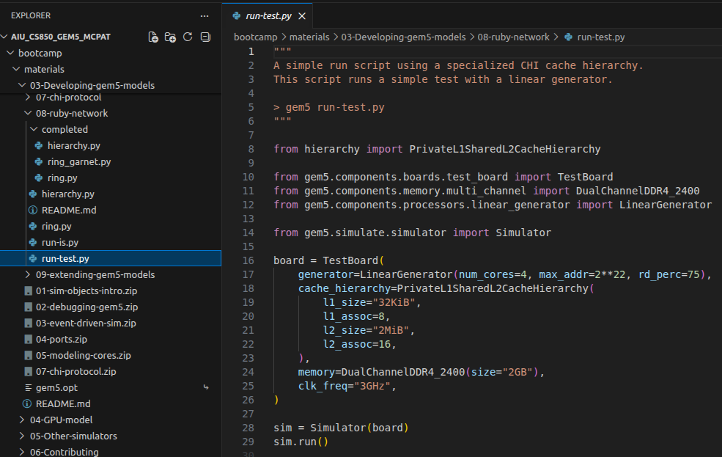
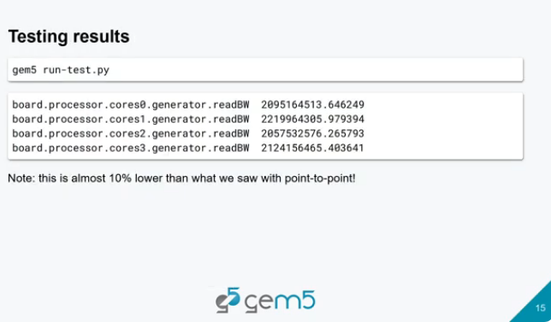
24.17 Run Test
https://www.youtube.com/watch?v=XekmnJ9ayb0&list=PL_hVbFs_loVR_8ntTTmmG6YEq3Po_4snu&index=24
Run Test (11:06-12:10/19:48)
> ~materials/03-Developing-gem5-models/08-ruby-network/run-test.py.
> gem5 run-test.py
The Ruby Ring type topology network bandwidth is 2.2 GB/sec.
In point-to-point type topology network, the bandwidth is 2.4 GB/sec.
Ruby Ring type network bandwidth is go down even we have two memory controllers.
Is (2.4 – 2.2)/2.2 = 10% slower than we saw before of point-to-point network result.

Slide 44
24.18 Swap L2 and Memory Order

Slide 45
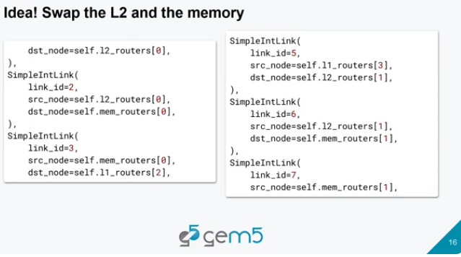
24.18 Swap L2 and Memory Order
https://www.youtube.com/watch?v=XekmnJ9ayb0&list=PL_hVbFs_loVR_8ntTTmmG6YEq3Po_4snu&index=24
Swap L2 and Memory Order (11:06-12:30/19:48)
> ~materials/03-Developing-gem5-models/08-ruby-network/run-test.py.
Why do we have idea of swapping the L2 and Memory?
Right now, we have CPU core, memory, and L2 Cache banks in order. This is a bad order since we need to send data from L1 Cache to the L2 Cache.
Note:
1. CPU, L2 cache, Memory are in public/shared loop.
2. There is no L1 cache in the public loop since L1 is private cache to CPU.
3. The CPU, L2 cache, and Memory are arranged in wrong order.

Slide 46
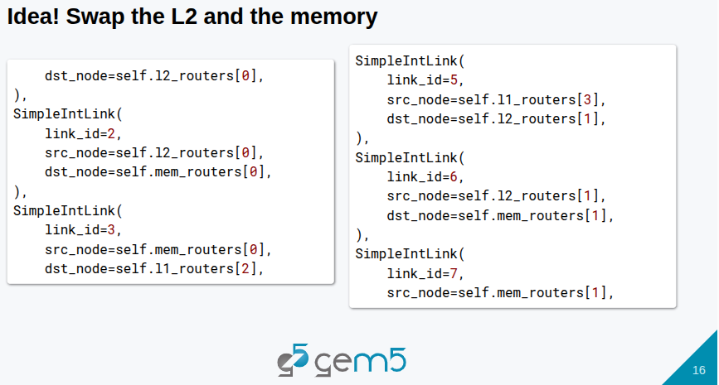
24.18 Swap L2 and Memory Order
https://www.youtube.com/watch?v=XekmnJ9ayb0&list=PL_hVbFs_loVR_8ntTTmmG6YEq3Po_4snu&index=24
Swap L1 and Memory Order (12:31-12:50/19:48)
> ~materials/03-Developing-gem5-models/08-ruby-network/run-test.py.
If we misses in the 2 Cache, then data will go to memory and data will take multiple trips around this ring. The better idea is to switch the L2 with memory.
When data go around the ring, the data go from L1 cache to L2 Cache to memory instead of L1 cache, memory, then L2 cache. We don’t have to go around the ring as many times. So, we switch L2 with memory.

Slide 47
24.19 Run Again with L2 and Memory Order

Slide 48
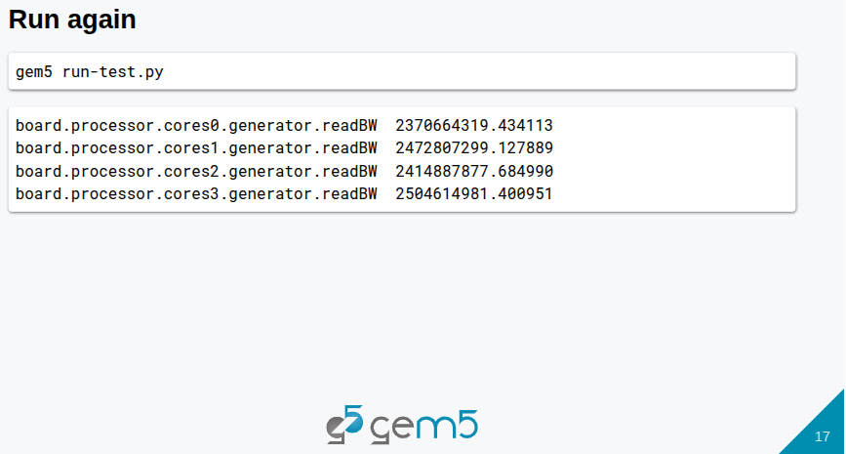
24.19 Run Again with L2 and Memory Order
https://www.youtube.com/watch?v=XekmnJ9ayb0&list=PL_hVbFs_loVR_8ntTTmmG6YEq3Po_4snu&index=24
Run Again with L1 and Memory Order (12:51-13:40/19:48)
> ~materials/03-Developing-gem5-models/08-ruby-network/run-test.py.
> gem5 run-test.py
We change the topology and improve the out of order bandwidth 2 GB/sec to in-order bandwidth 2.4 GB/sec.
We improve around 10% (= 2.4-2.2/2.2) bandwidth

Slide 49
24.20 Garnet

Slide 50
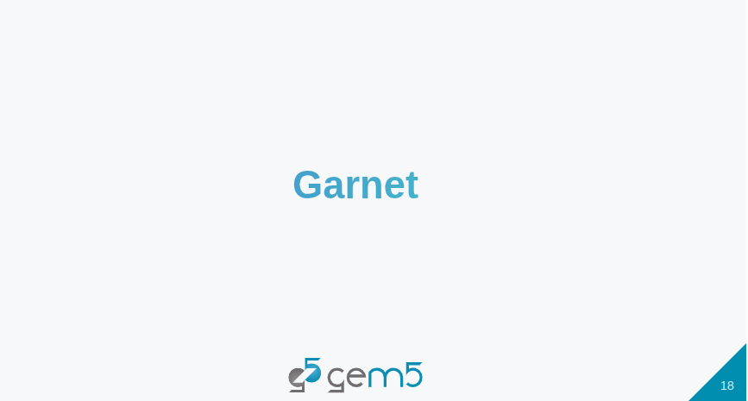
24.20 Garnet
https://www.youtube.com/watch?v=XekmnJ9ayb0&list=PL_hVbFs_loVR_8ntTTmmG6YEq3Po_4snu&index=24
Garnet (13:41-14:05/19:48)
> ~materials/03-Developing-gem5-models/08-ruby-network/run-test.py.
Now, we look at the Garnet network.

Slide 51
24.21 Simple Network vs Garnet

Slide 52
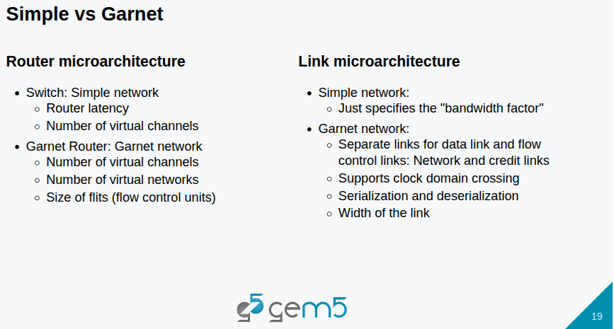
24.21 Simple Network vs Garnet
https://www.youtube.com/watch?v=XekmnJ9ayb0&list=PL_hVbFs_loVR_8ntTTmmG6YEq3Po_4snu&index=24
Simple Network vs Garnet (14:06-14:35/19:48)
> ~materials/03-Developing-gem5-models/08-ruby-network/run-test.py.
Here is some trade-off between the Simple Network and Garnet.
In Simple Network, the router micro-architecture is quite simple, all we can specify is the latency and number of virtual channels.
In the Garnet router, we can specify the number of virtual channels on our router, we can also specify the number of virtual networks, and size of flit (fly, flow control units) in the router

Slide 53
24.21 Simple Network vs Garnet
https://www.youtube.com/watch?v=XekmnJ9ayb0&list=PL_hVbFs_loVR_8ntTTmmG6YEq3Po_4snu&index=24
Simple Network vs Garnet (14:36-15:05/19:48)
> ~materials/03-Developing-gem5-models/08-ruby-network/run-test.py.
On the link side, the simple network can just specify the bandwidth factor.
In Garnet,
1. There is separate links for data and flow control. The network data and credit links are different.
2. It supports clock domain crossing, across links
3. It supports serialization and de-serialization
4. It supports a particular width of that link.
So we can have a flit size and a width of the link will be different.

Slide 54
24.22 Routing

Slide 55
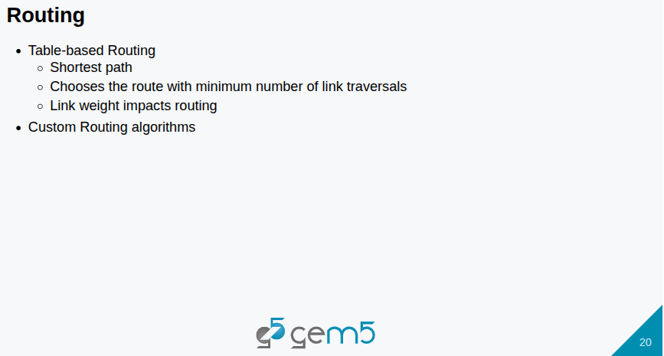
24.22 Routing
https://www.youtube.com/watch?v=XekmnJ9ayb0&list=PL_hVbFs_loVR_8ntTTmmG6YEq3Po_4snu&index=24
Routing (15:06-16:05/19:48)
> ~materials/03-Developing-gem5-models/08-ruby-network/run-test.py.
Routing is table-based.
1. Shortest path
2. Minimum number of link traversals
3. Link width impact routing
Custom Routing Algorithm

Slide 56
End

