Slide 1

26.2 DRAM: Slides
Peter H. Chen

Slide 2
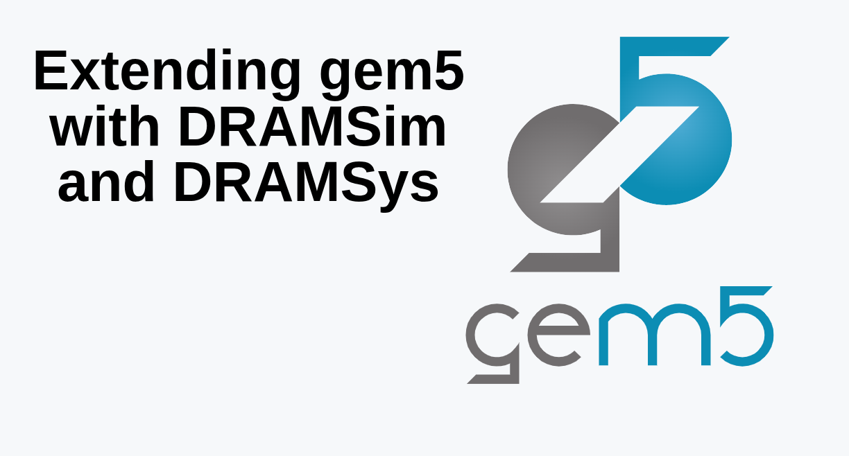
26.2 DRAM: Slides
https://gem5bootcamp.github.io/2024/#05-Other-simulators/01-sst
DRAM: Slides

Slide 3
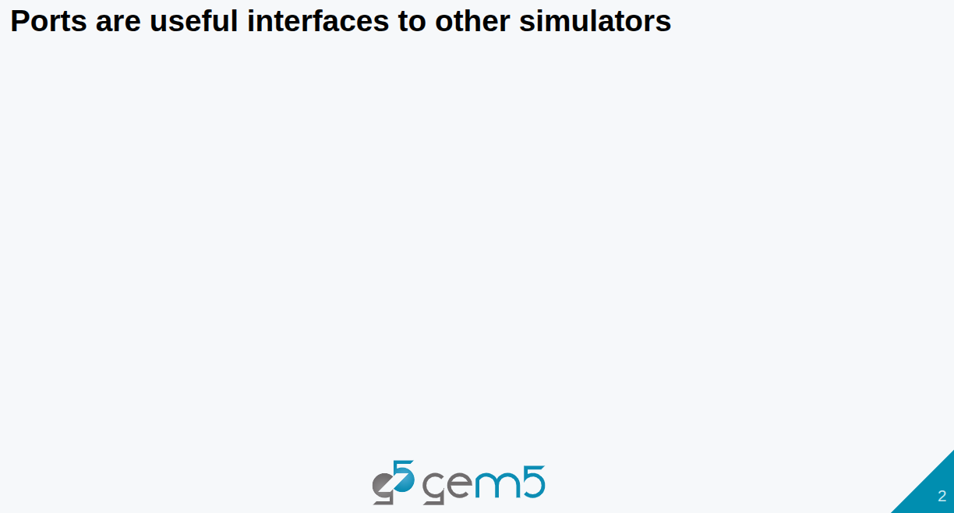
26.2 DRAM: Slides
https://gem5bootcamp.github.io/2024/#05-Other-simulators/01-sst
DRAM: Slides

Slide 4
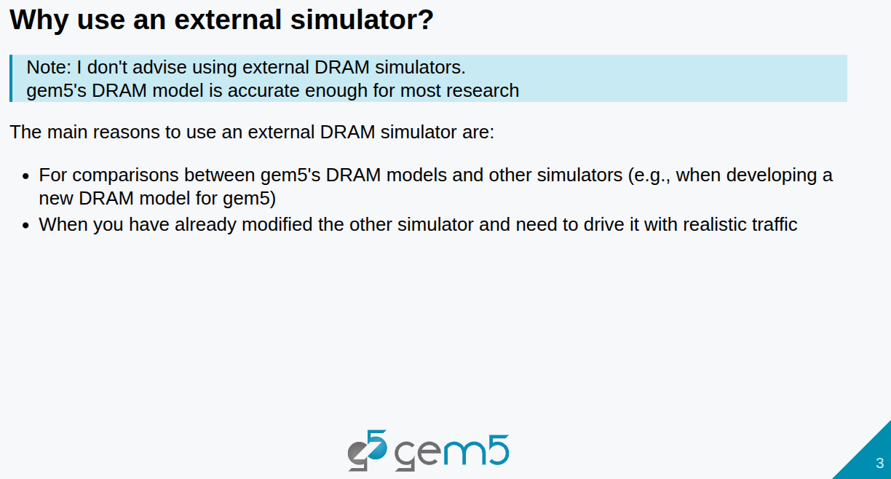
26.2 DRAM: Slides
https://gem5bootcamp.github.io/2024/#05-Other-simulators/01-sst
DRAM: Slides

Slide 5
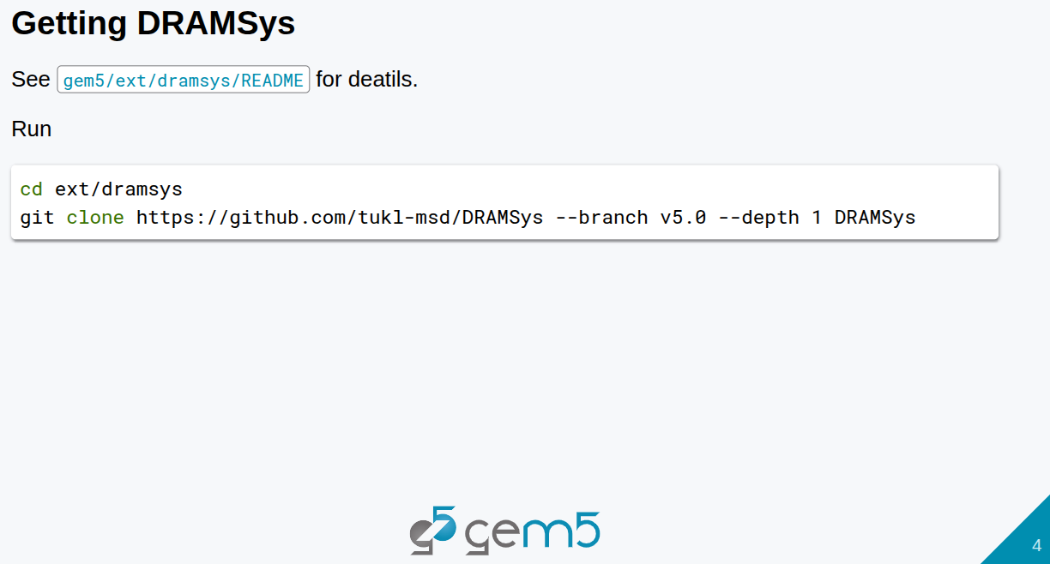
26.2 DRAM: Slides
https://gem5bootcamp.github.io/2024/#05-Other-simulators/01-sst
DRAM: Slides

Slide 6
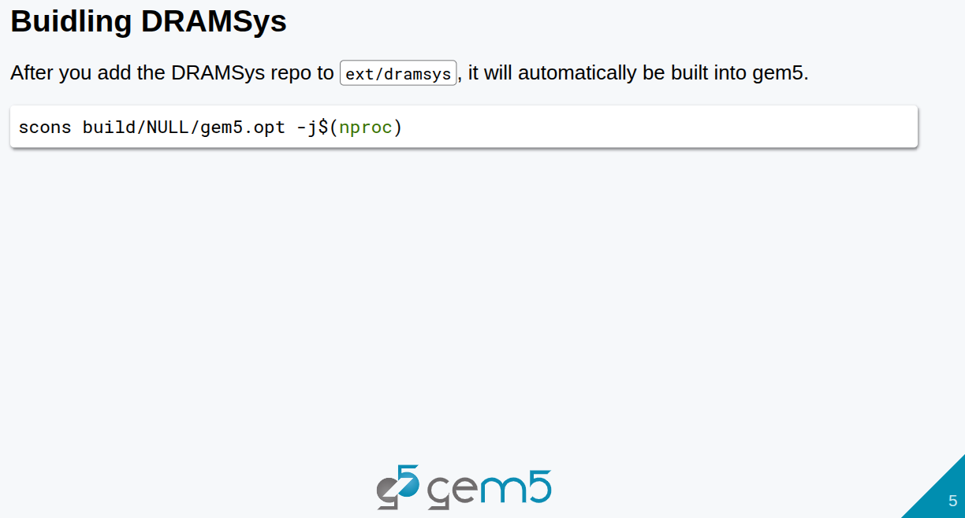
26.2 DRAM: Slides
https://gem5bootcamp.github.io/2024/#05-Other-simulators/01-sst
DRAM: Slides

Slide 7
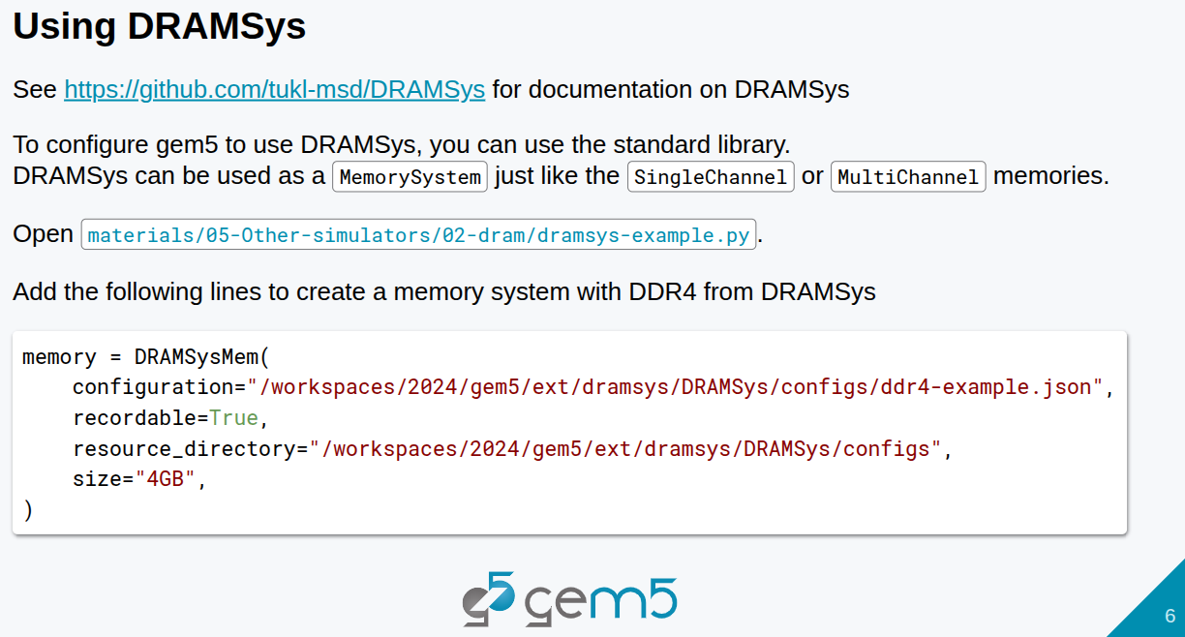
26.2 DRAM: Slides
https://gem5bootcamp.github.io/2024/#05-Other-simulators/01-sst
DRAM: Slides

Slide 8
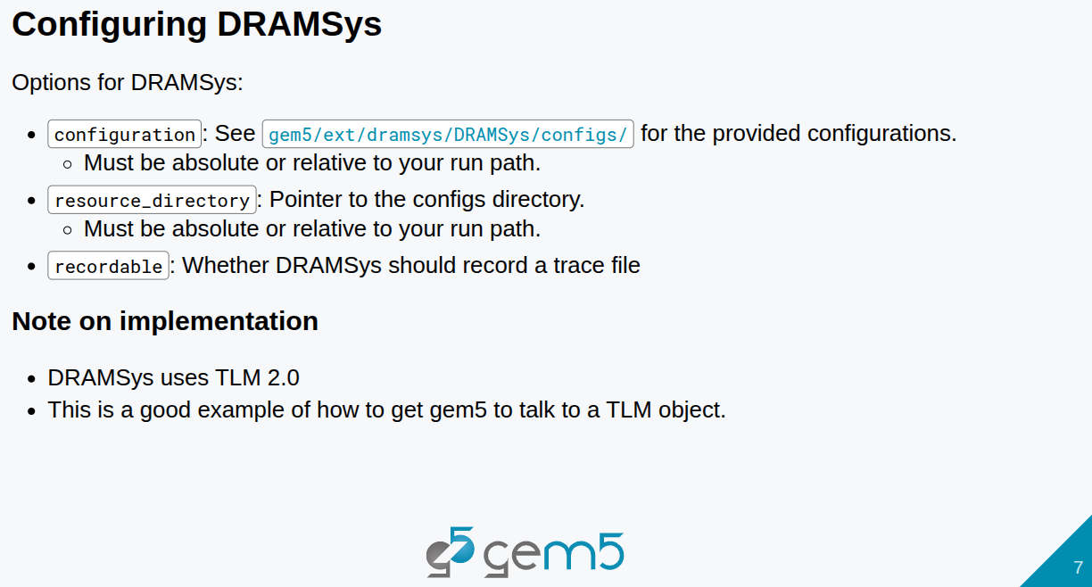
26.2 DRAM: Slides
https://gem5bootcamp.github.io/2024/#05-Other-simulators/01-sst
DRAM: Slides

Slide 9
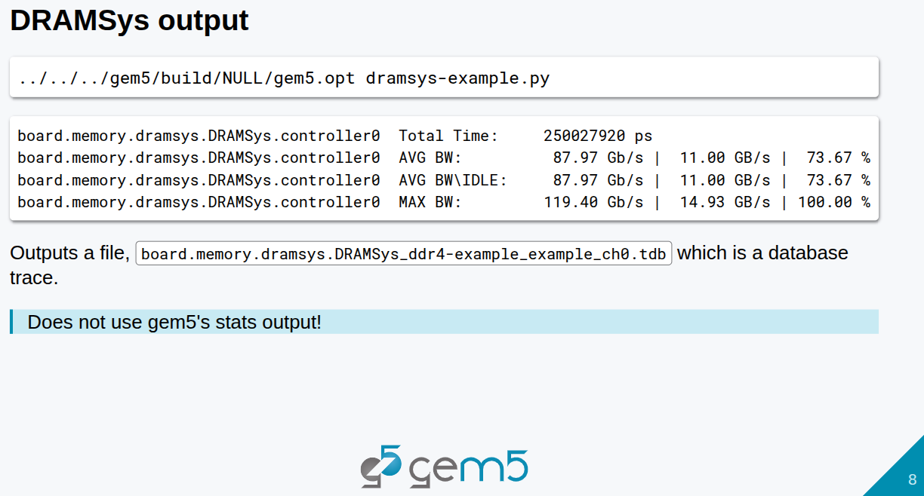
26.2 DRAM: Slides
https://gem5bootcamp.github.io/2024/#05-Other-simulators/01-sst
DRAM: Slides

Slide 10
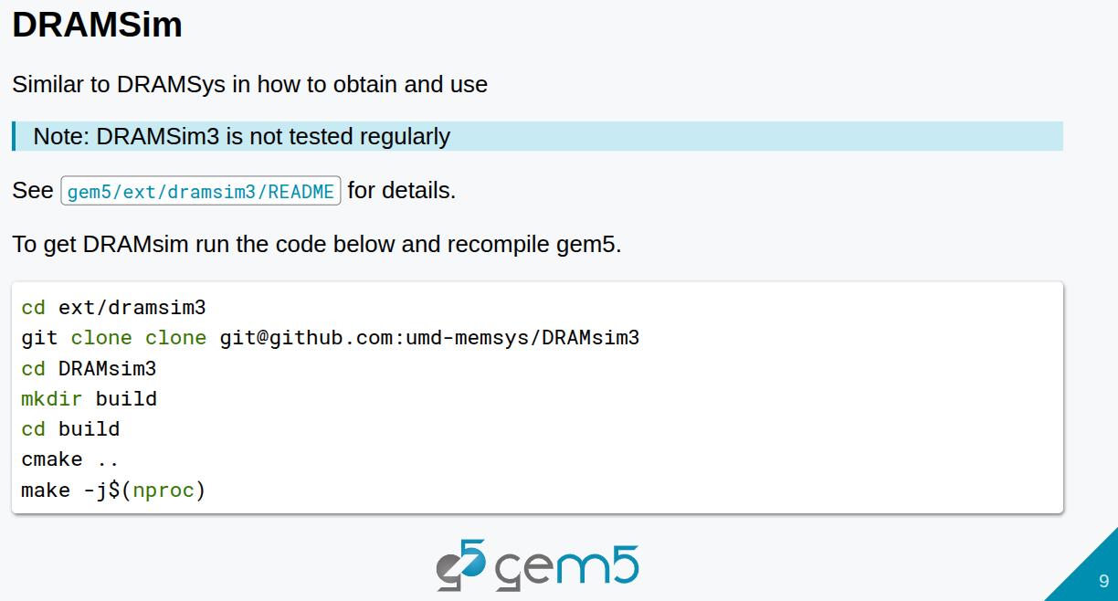
26.2 DRAM: Slides
https://gem5bootcamp.github.io/2024/#05-Other-simulators/01-sst
DRAM: Slides

Slide 11
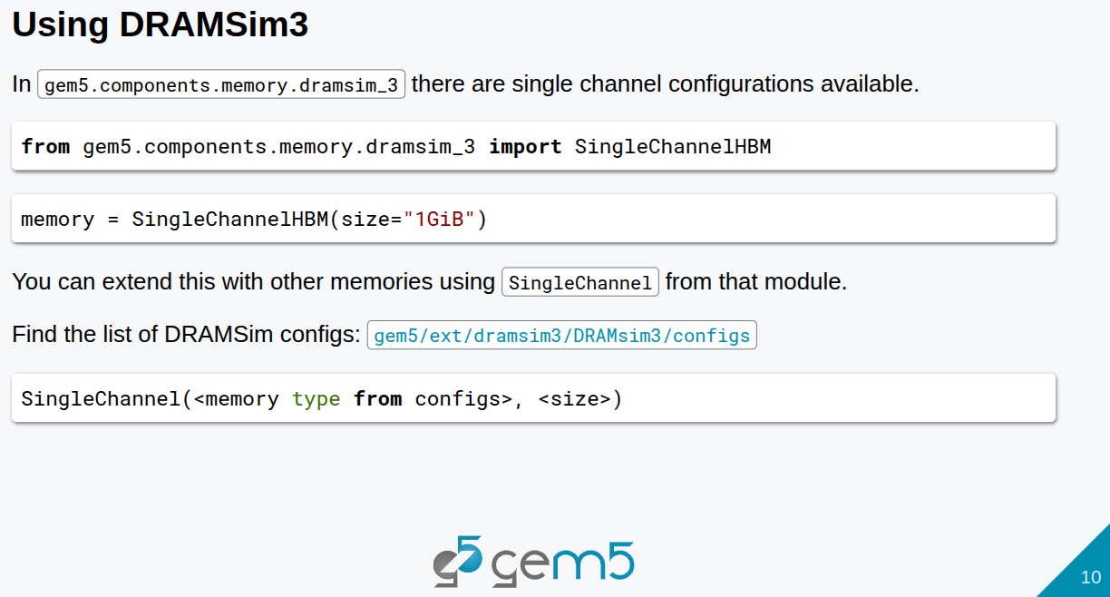
26.2 DRAM: Slides
https://gem5bootcamp.github.io/2024/#05-Other-simulators/01-sst
DRAM: Slides

Slide 12
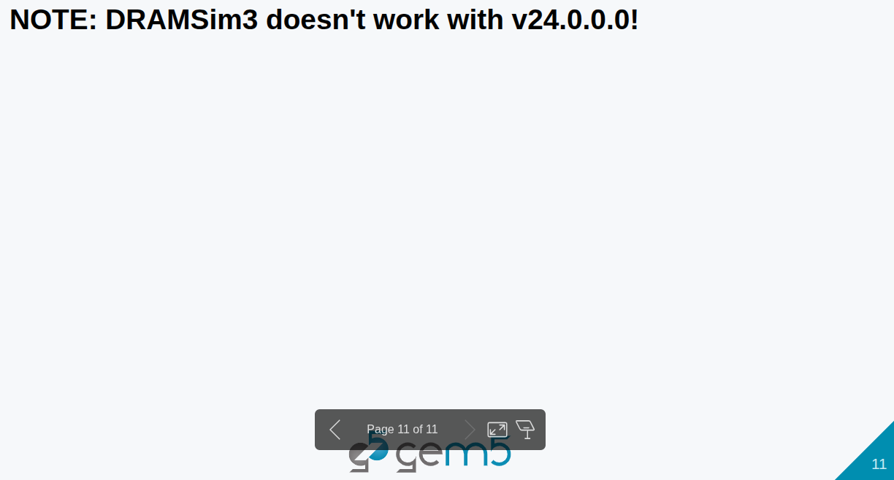
26.2 DRAM: Slides
https://gem5bootcamp.github.io/2024/#05-Other-simulators/01-sst
DRAM: Slides

Slide 13
26.2 DRAM: Slides
https://gem5bootcamp.github.io/2024/#05-Other-simulators/01-sst
DRAM: Slides

Slide 14
End

