Slide 1

26.1 SST (Structural Simulation Toolkit): Slides
Peter H. Chen

Slide 2

26.1 SST (Structural Simulation Toolkit): Slides
https://gem5bootcamp.github.io/2024/#05-Other-simulators/01-sst
SST: Slides

Slide 3
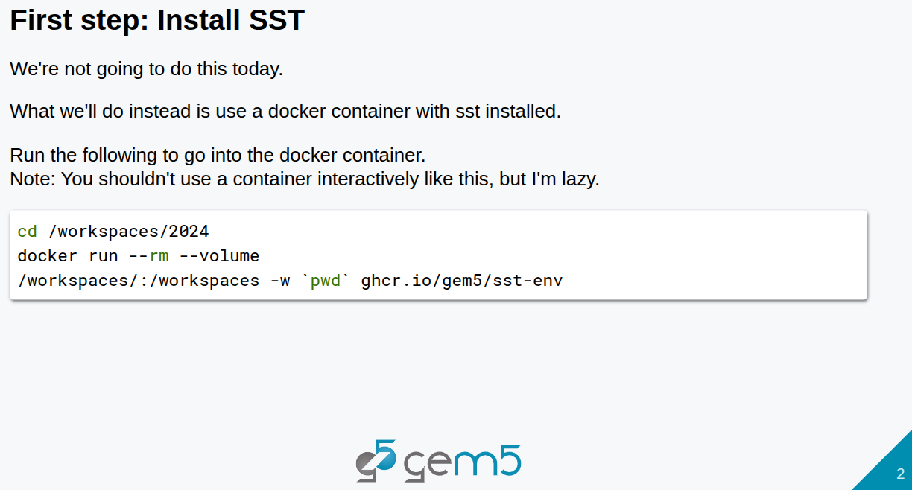
26.1 SST (Structural Simulation Toolkit): Slides
https://gem5bootcamp.github.io/2024/#05-Other-simulators/01-sst
SST: Slides

Slide 4
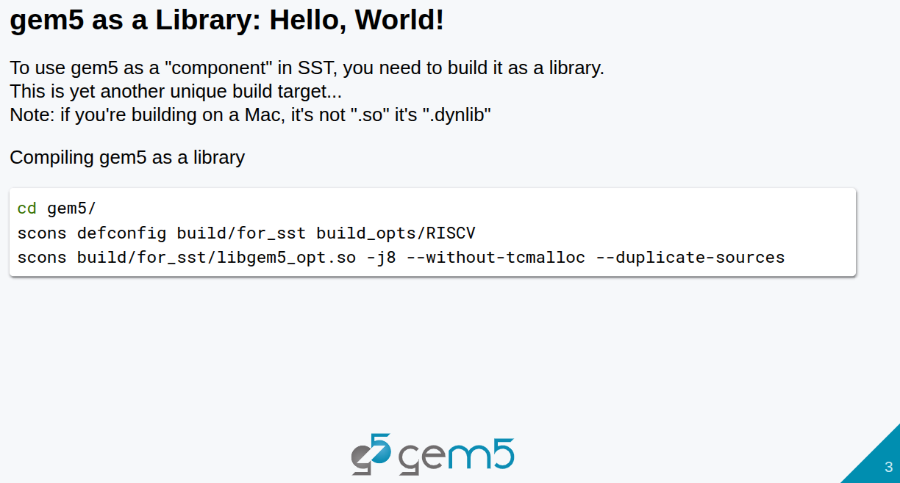
26.1 SST (Structural Simulation Toolkit): Slides
https://gem5bootcamp.github.io/2024/#05-Other-simulators/01-sst
SST: Slides

Slide 5
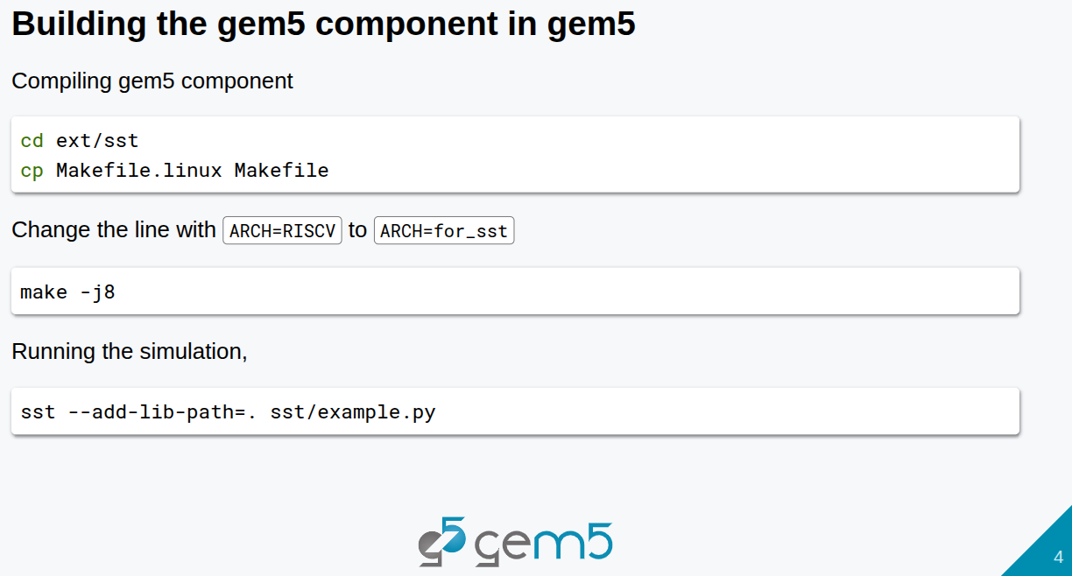
26.1 SST (Structural Simulation Toolkit): Slides
https://gem5bootcamp.github.io/2024/#05-Other-simulators/01-sst
SST: Slides

Slide 6
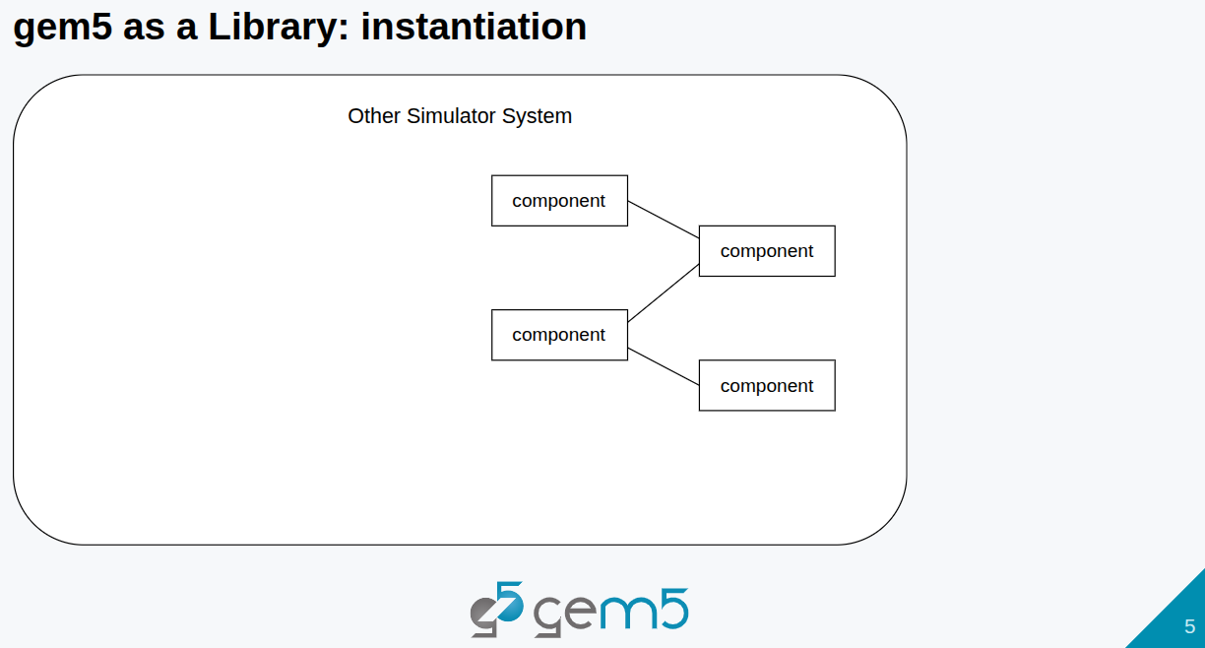
26.1 SST (Structural Simulation Toolkit): Slides
https://gem5bootcamp.github.io/2024/#05-Other-simulators/01-sst
SST: Slides

Slide 7
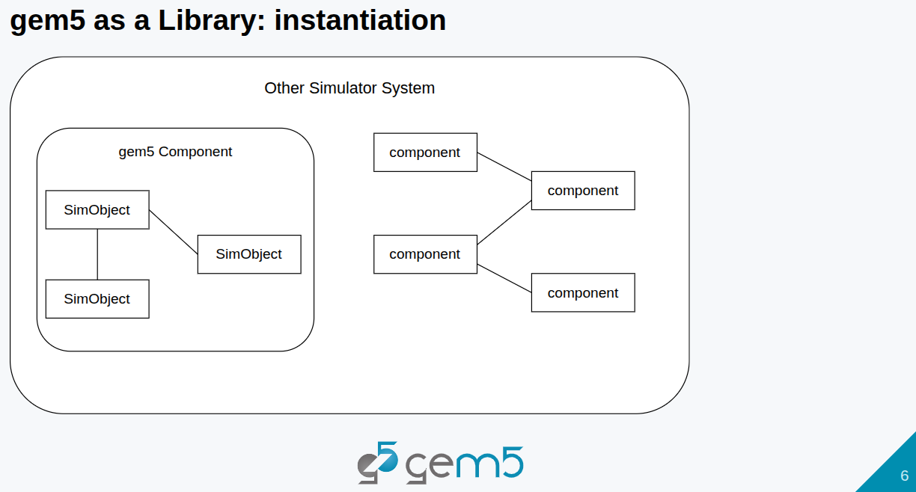
26.1 SST (Structural Simulation Toolkit): Slides
https://gem5bootcamp.github.io/2024/#05-Other-simulators/01-sst
SST: Slides

Slide 8

26.1 SST (Structural Simulation Toolkit): Slides
https://gem5bootcamp.github.io/2024/#05-Other-simulators/01-sst
SST: Slides

Slide 9
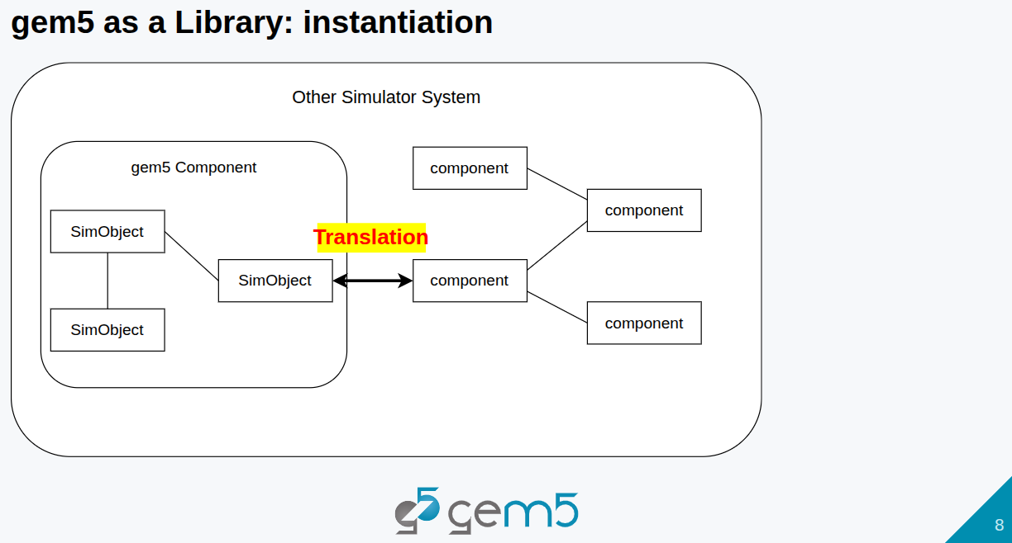
26.1 SST (Structural Simulation Toolkit): Slides
https://gem5bootcamp.github.io/2024/#05-Other-simulators/01-sst
SST: Slides

Slide 10
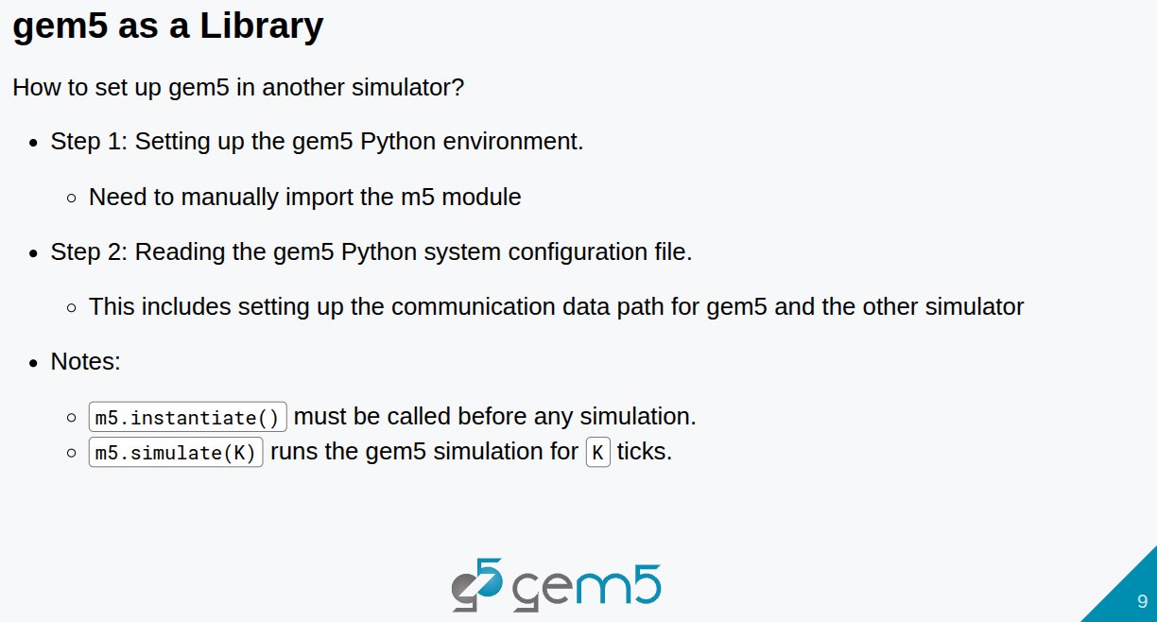
26.1 SST (Structural Simulation Toolkit): Slides
https://gem5bootcamp.github.io/2024/#05-Other-simulators/01-sst
SST: Slides

Slide 11
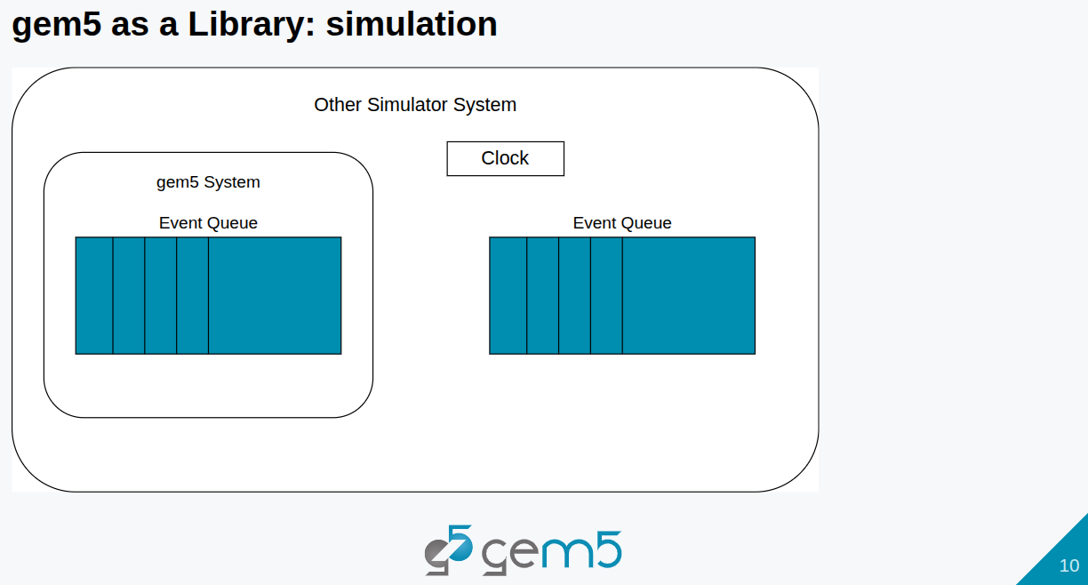
26.1 SST (Structural Simulation Toolkit): Slides
https://gem5bootcamp.github.io/2024/#05-Other-simulators/01-sst
SST: Slides

Slide 12
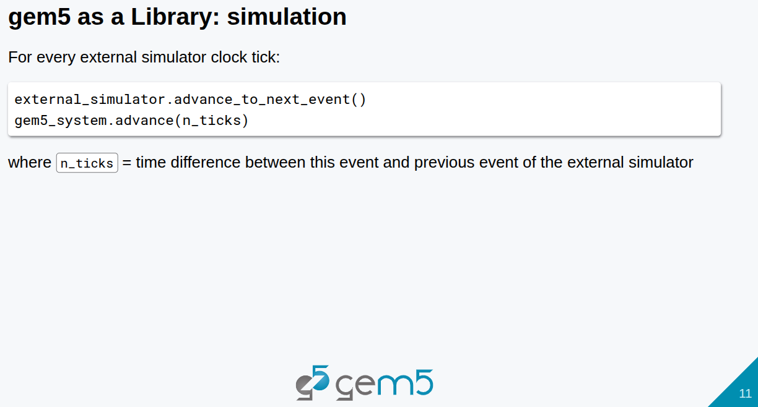
26.1 SST (Structural Simulation Toolkit): Slides
https://gem5bootcamp.github.io/2024/#05-Other-simulators/01-sst
SST: Slides

Slide 13
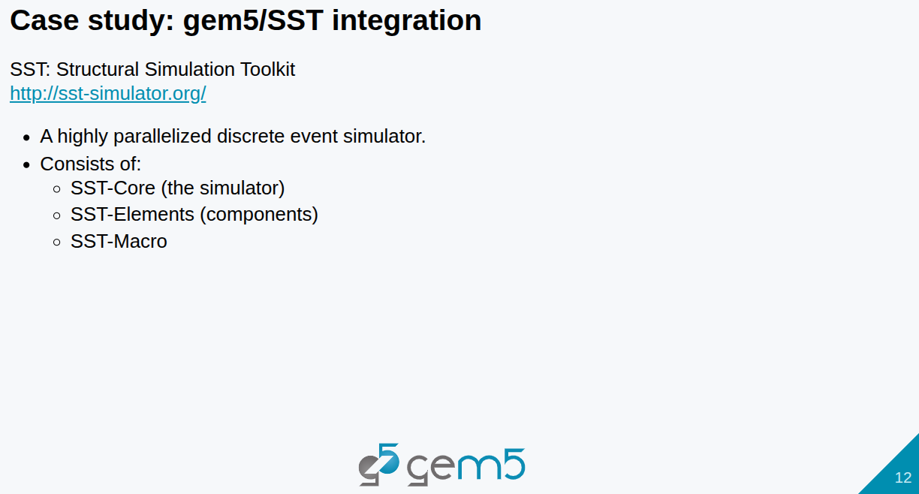
26.1 SST (Structural Simulation Toolkit): Slides
https://gem5bootcamp.github.io/2024/#05-Other-simulators/01-sst
SST: Slides

Slide 14
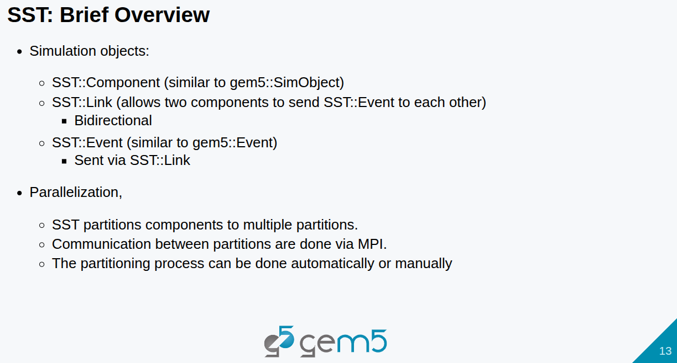
26.1 SST (Structural Simulation Toolkit): Slides
https://gem5bootcamp.github.io/2024/#05-Other-simulators/01-sst
SST: Slides

Slide 15
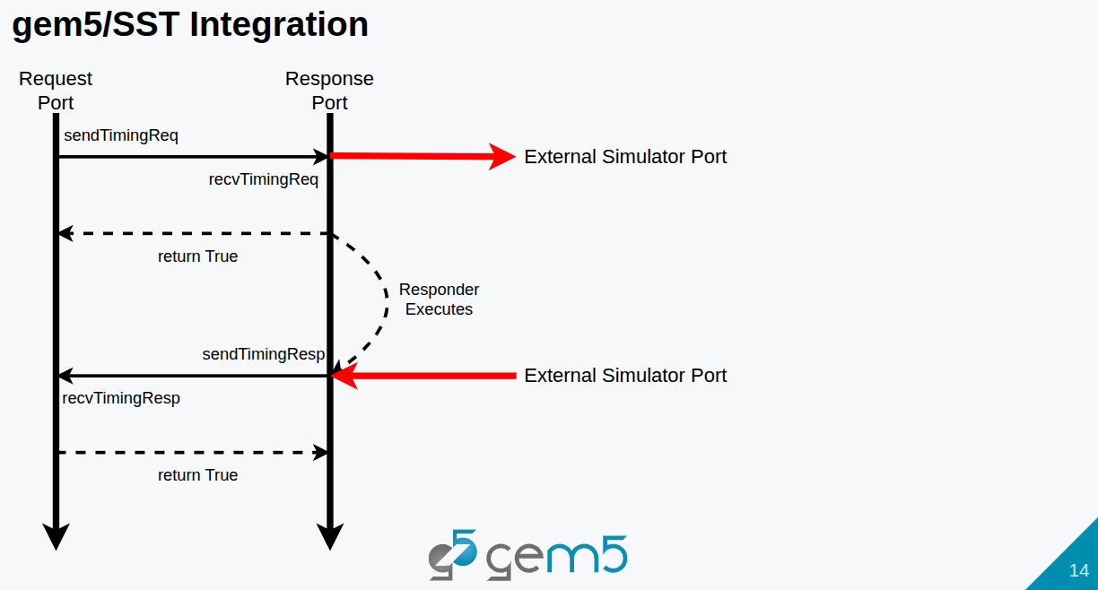
26.1 SST (Structural Simulation Toolkit): Slides
https://gem5bootcamp.github.io/2024/#05-Other-simulators/01-sst
SST: Slides

Slide 16
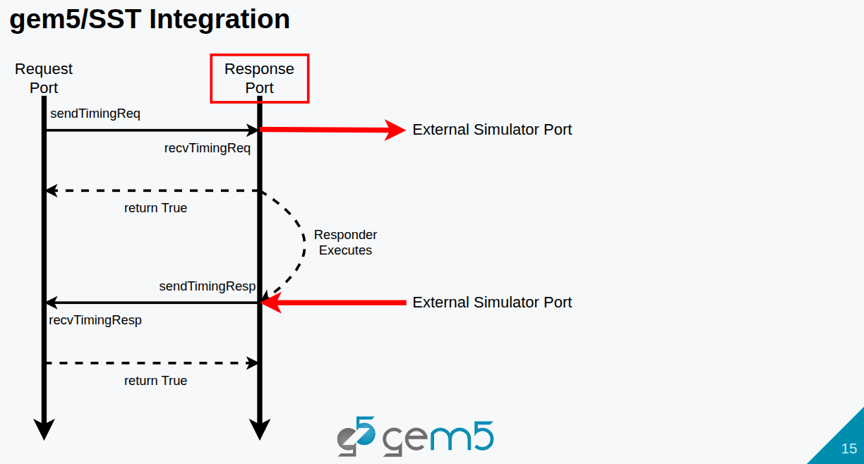
26.1 SST (Structural Simulation Toolkit): Slides
https://gem5bootcamp.github.io/2024/#05-Other-simulators/01-sst
SST: Slides

Slide 17
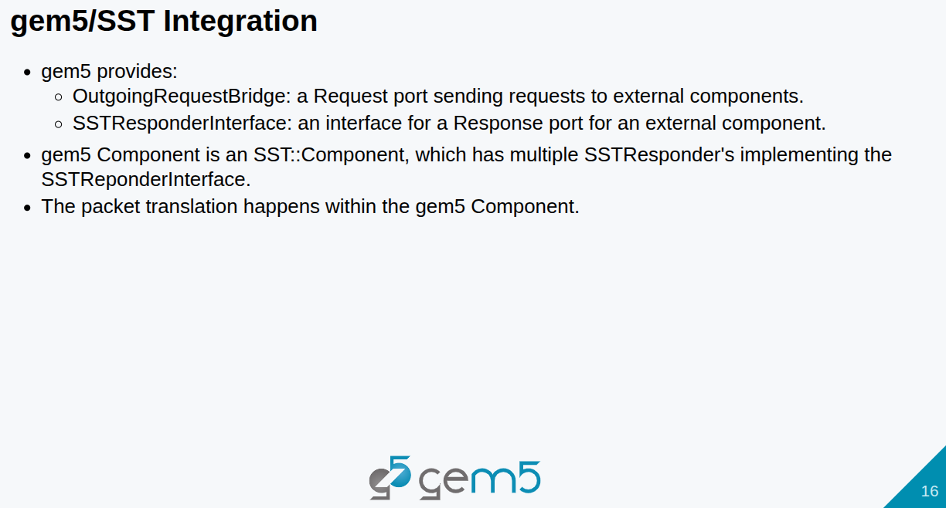
26.1 SST (Structural Simulation Toolkit): Slides
https://gem5bootcamp.github.io/2024/#05-Other-simulators/01-sst
SST: Slides

Slide 18
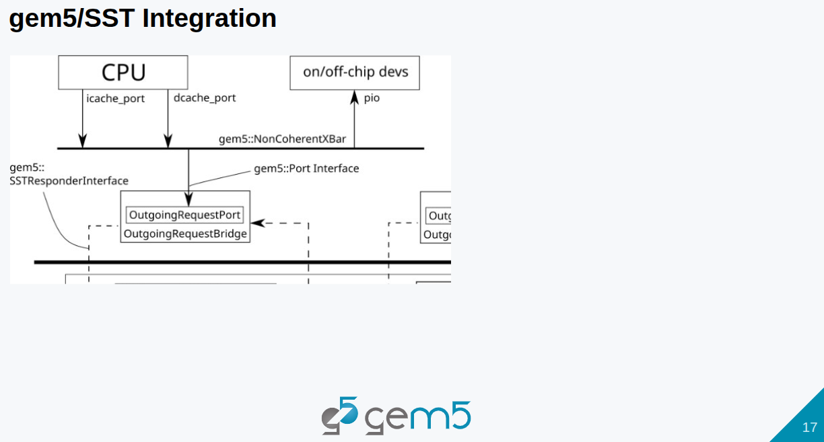
26.1 SST (Structural Simulation Toolkit): Slides
https://gem5bootcamp.github.io/2024/#05-Other-simulators/01-sst
SST: Slides

Slide 19
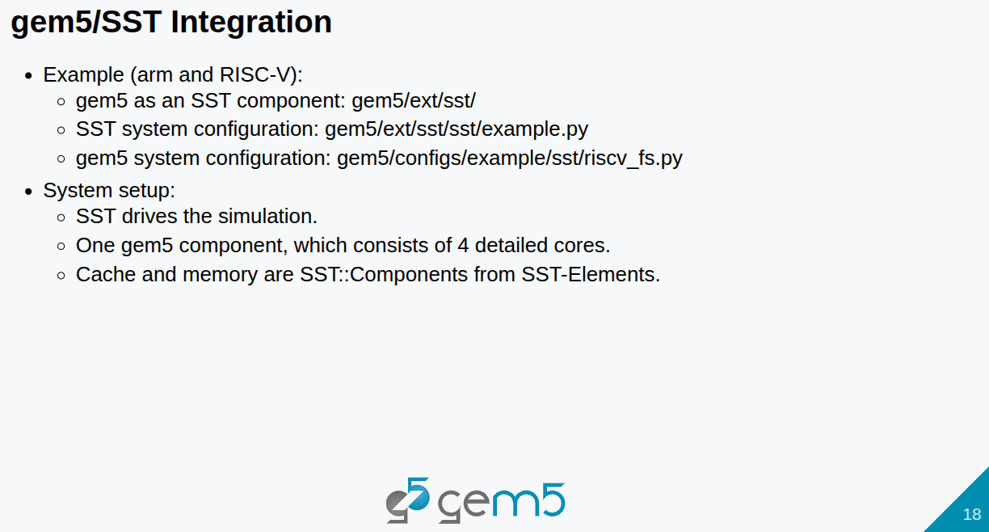
26.1 SST (Structural Simulation Toolkit): Slides
https://gem5bootcamp.github.io/2024/#05-Other-simulators/01-sst
SST: Slides

Slide 20
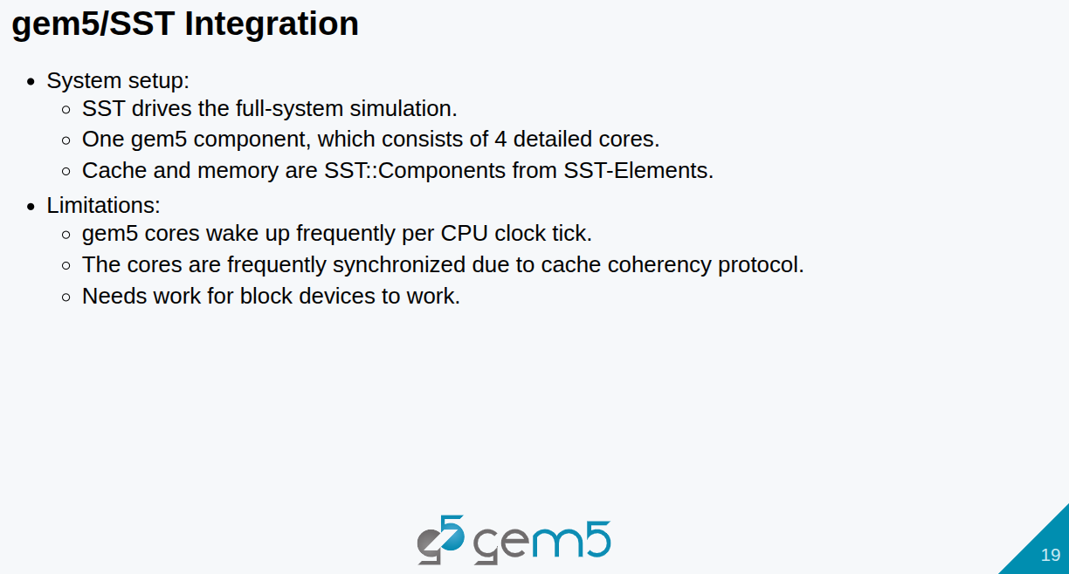
26.1 SST (Structural Simulation Toolkit): Slides
https://gem5bootcamp.github.io/2024/#05-Other-simulators/01-sst
SST: Slides

Slide 21
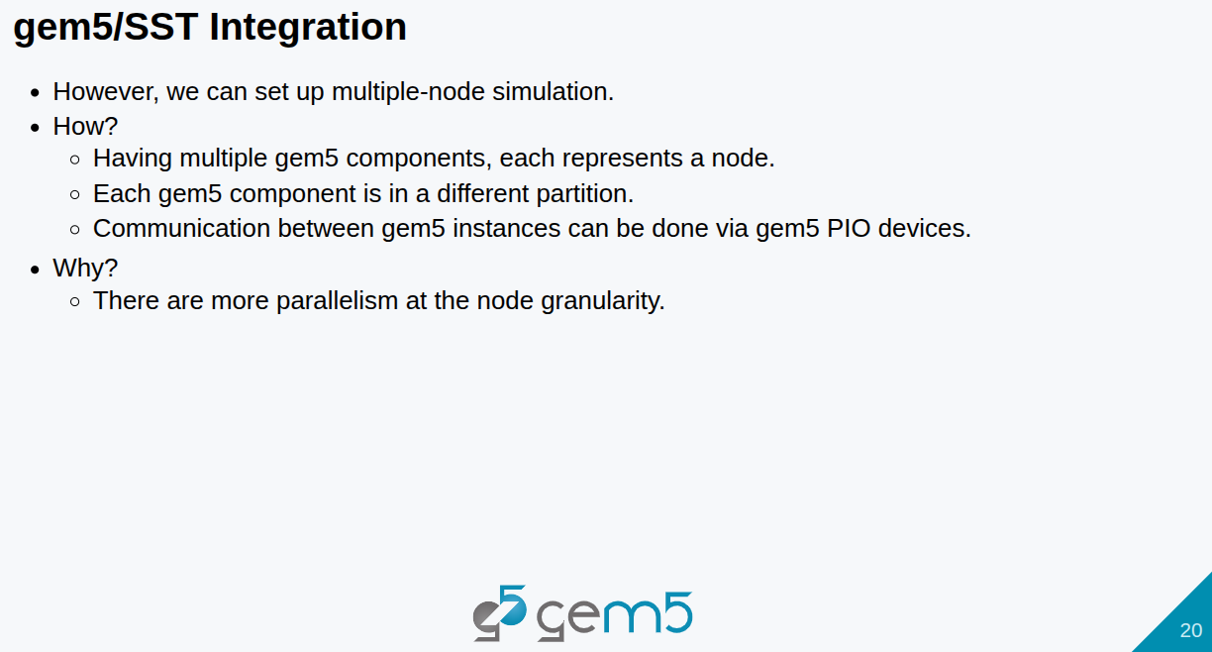
26.1 SST (Structural Simulation Toolkit): Slides
https://gem5bootcamp.github.io/2024/#05-Other-simulators/01-sst
SST: Slides

Slide 22
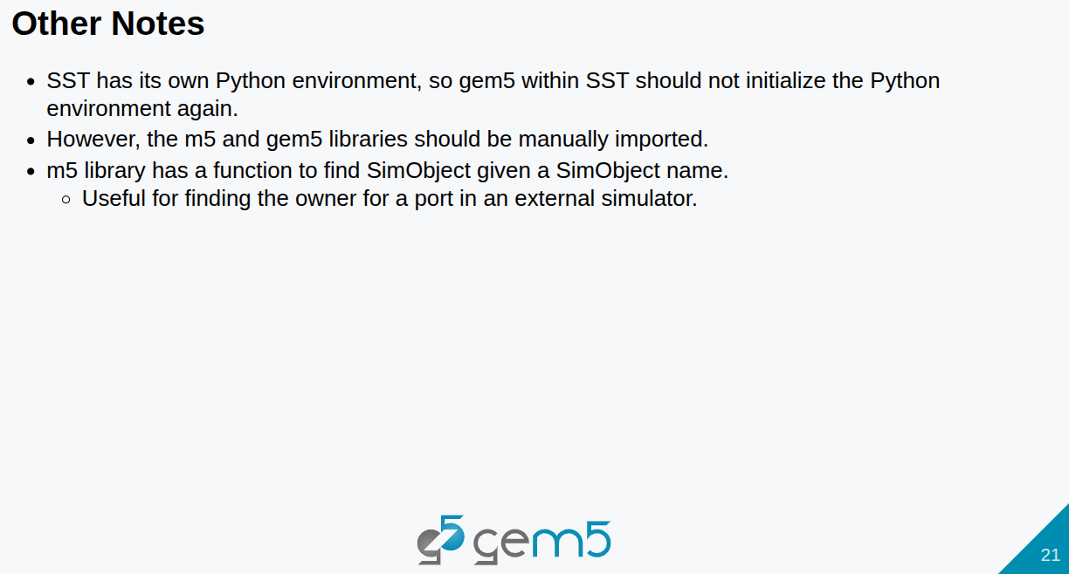
26.1 SST (Structural Simulation Toolkit): Slides
https://gem5bootcamp.github.io/2024/#05-Other-simulators/01-sst
SST: Slides

Slide 23
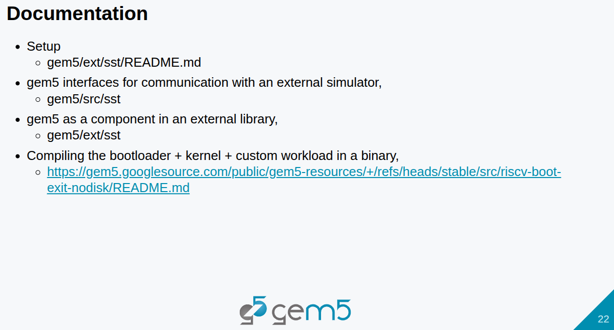
26.1 SST (Structural Simulation Toolkit): Slides
https://gem5bootcamp.github.io/2024/#05-Other-simulators/01-sst
SST: Slides

Slide 24
End

