Slide 1

1.1 Introduction of McPAT
Peter H. Chen

Slide 2
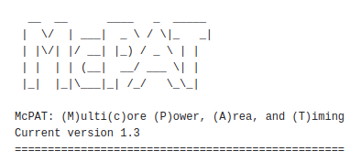
1.1 Introduction of McPAT
https://github.com/HewlettPackard/mcpat
Introduction of McPAT
McPAT (Multi-Core, Power, Area, Timing)
Current Version: 1.3
Before CPU, GPU IO, or any hardware design, i.e., in the architecture design period, we don’t have any Hardware Verilog or VHDL.
However, we want to know the roughly Power, Area, Timing before Verilog implementation with clock speed, nm technology, cache size, memory size, accelerator, etc.
How can we do that without Verilog/VHDL Hardware? McPAT is a framework which allowed architectural design for DSE (Design Space Exploration) without Verilog/VHDL Hardware design.

Slide 3
1.2 What is MCPAT?

Slide 4
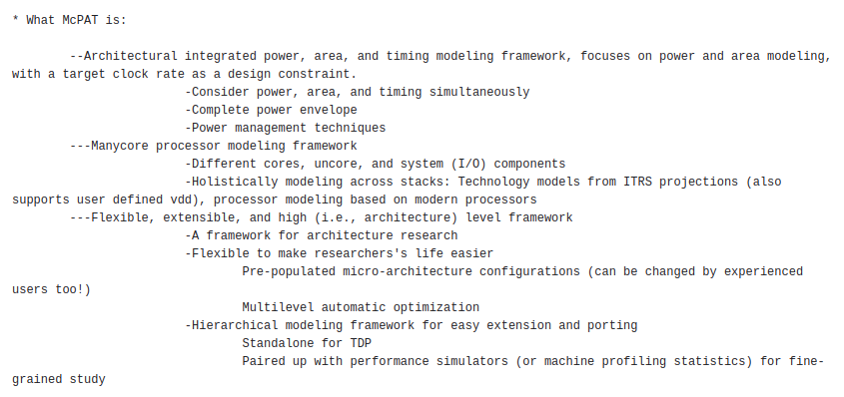
1.2 What is McPAT?
https://github.com/HewlettPackard/mcpat
What is McPAT?
1. McPAT is an integrated power, area, and timing modeling framework for architecture design (before Verilog implementation). McPAT mainly focuses on power and area modeling with a target clock rate as a design constraint.
1

Slide 5
1.2 What is McPAT?
https://github.com/HewlettPackard/mcpat
What is McPAT?
2. McPAT is used for multi-cores processor with external IO (Accelerator, such as, GPU) modeling framework. The technology models of McPAT come from ITRS (International Technology Roadmap Semiconductor) projects with user defined Vdd, processor modeling based on modern processors, such as, NVIDIA, AMD, ARM, Intel, etc.
2

Slide 6
1.2 What is McPAT?
https://github.com/HewlettPackard/mcpat
What is McPAT?
3. McPAT is a flexible, extensible, and high level (i.e., architectural level) framework. McPAT is a framework for architecture research. McPAT is flexible to make research easier. McPAT provides pre-defined micro-architecture configurations. The architecture can be changed by experienced users too and can be used in multilevel automatic optimization. McPAT hierarchical modeling framework for easy extension and porting standalone for TDP (Thermal Design Power). McPAT can be paired up with performance simulators (or machine profiling statistics) for fine-grained study.
3

Slide 7
1.3 McPAT Disadvantage

Slide 8
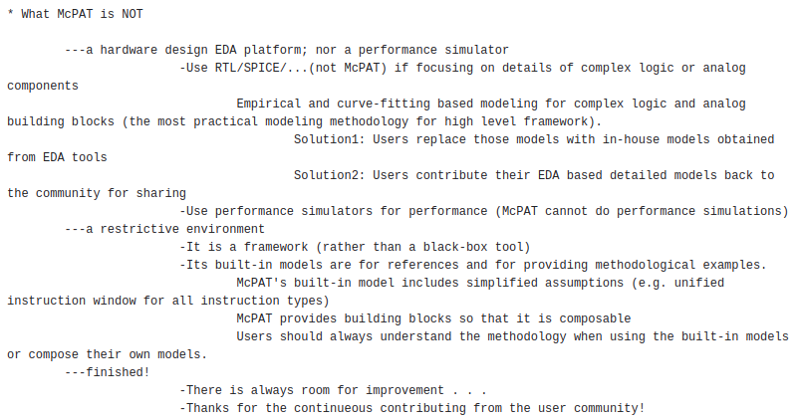
1.3 McPAT Disadvantage
https://github.com/HewlettPackard/mcpat
McPAT Disadvantage
1. McPAT is an EDA platform, McPAT cannot not do complicate logic/analog functional and timing simulation. We need to use RTL/SPICE, etc. for timing and functional simulation.
2. McPAT uses empirical and regression model for complex logic and analog building blocks. McPAT only provides the practical modeling methodology for high level framework. users need other in-house, EDA vendor, or community model to run

Slide 9
1.3 McPAT Disadvantage
https://github.com/HewlettPackard/mcpat
McPAT Disadvantage
3. McPAT is a framework. McPAT is not a black-box tool.
4. The McPAT built-in models are fixed and simplified with reference building blocks. Users need to understand the methodology when using the built-in models or compose their own models.
5. McPAT have room for improvement for nm technology.

Slide 10
1.4 McPAT Paper

Slide 11
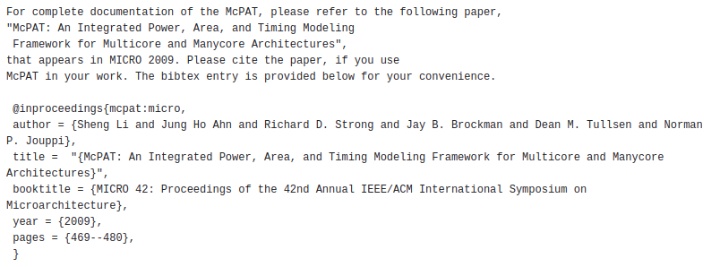
1.4 McPAT Paper
https://github.com/HewlettPackard/mcpat
McPAT Paper
1. “McPAT: An Integrated Power, Area, and Timing Modeling Framework for Multicore and Manycore Architecture”, MICRO 42: Proceedings of the 42nd Annual IEEE/ACM International Symposium on Microarchitecture.

Slide 12
1.5 McPAT Input/Output

Slide 13
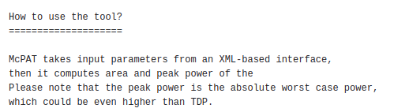
1.5 McPAT Input/Output
https://github.com/HewlettPackard/mcpat
McPAT Input/Output
1. McPAT input parameters of architectural design from XML file
2. McPAT output area and power of the architectural design.

Slide 14
1.6 Compile McPAT

Slide 15
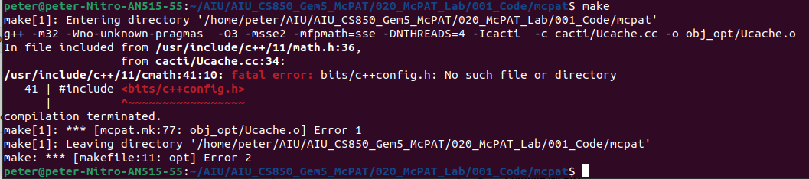
1.6 Compile McPAT
https://github.com/HewlettPackard/mcpat
Compile McPAT
> cd mcpat
> make
Or
> make -f makefile
>> /usr/include/c++/11/cmath:41:10: fatal error: bits/c++config.h: No such file or directory
>> 41 | #include <bits/c++config.h>
>> | ^~~~~~~~~~~~~~~~~~
https://stackoverflow.com/questions/4643197/missing-include-bits-cconfig-h-when-cross-compiling-64-bit-program-on-32-bit

Slide 16
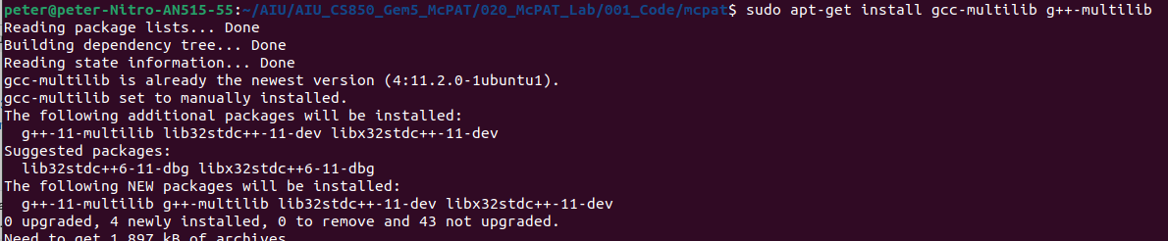
1.6 Compile McPAT
https://github.com/HewlettPackard/mcpat
Compile McPAT
Add gcc-multilib and g++-multilib
> sudo apt-get install gcc-multilib g++-multilib
https://stackoverflow.com/questions/4643197/missing-include-bits-cconfig-h-when-cross-compiling-64-bit-program-on-32-bit

Slide 17
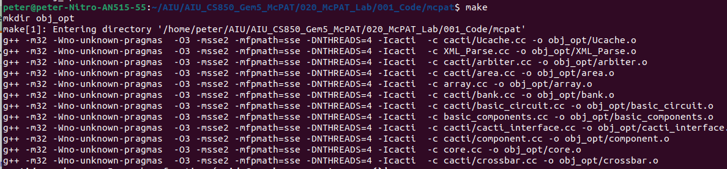
1.6 Compile McPAT
https://github.com/HewlettPackard/mcpat
Compile McPAT
Compile again
> make

Slide 18
1.7 Check Compiled mcpat

Slide 19
1.7 Check Compiled mcpat
https://github.com/HewlettPackard/mcpat
Check Compiled mcpat
> ./mcpat -h
>> How to use McPAT:
>> mcpat -infile <input file name> -print_level < level of details 0~5 > -opt_for_clk < 0 (optimize for ED^2P only)/1 (optimzed for target clock rate)>
Note:
1. There is a typo “optimed”. Should be “optimized”
2. -print_level <level>: This controls the amount of detail in the output. A higher <level> will provide more detailed results for each component of the processor.

Slide 20
1.8 Run McPAT

Slide 21
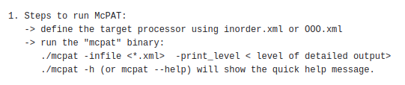
1.8 Run McPAT
https://github.com/HewlettPackard/mcpat
Run McPAT
1. define 000.xml
2. ./mcpat -infile <*.xml> -print_level <level>
3. ./mcpat -h (help)

Slide 22
1.9 Run McPAT ARM_A9_2GHz

Slide 23
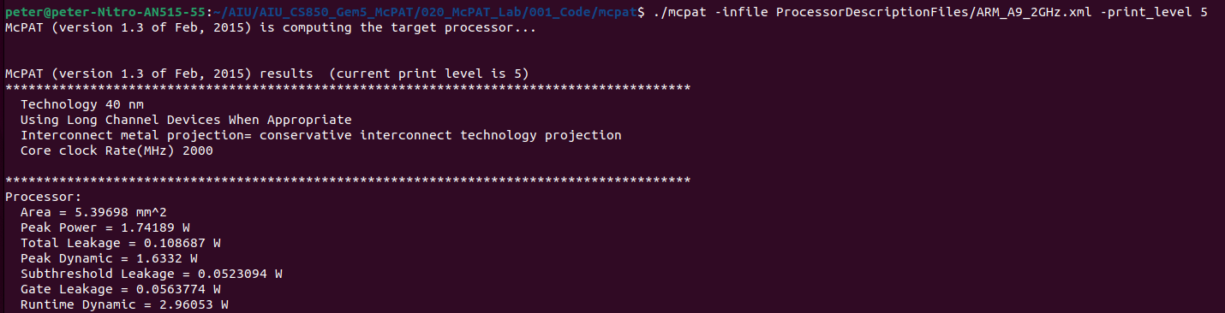
1.9 Run McPAT ARM_A9_2GHz
https://github.com/HewlettPackard/mcpat
Run McPAT ARM_A9_2GHz
1. ./mcpat -infile ProcessorDescriptionFiles/ARM_A9_2GHz.xml -print_level 5

Slide 24
1.10 Run McPAT ARM_A9_2GHz_withIOC

Slide 25
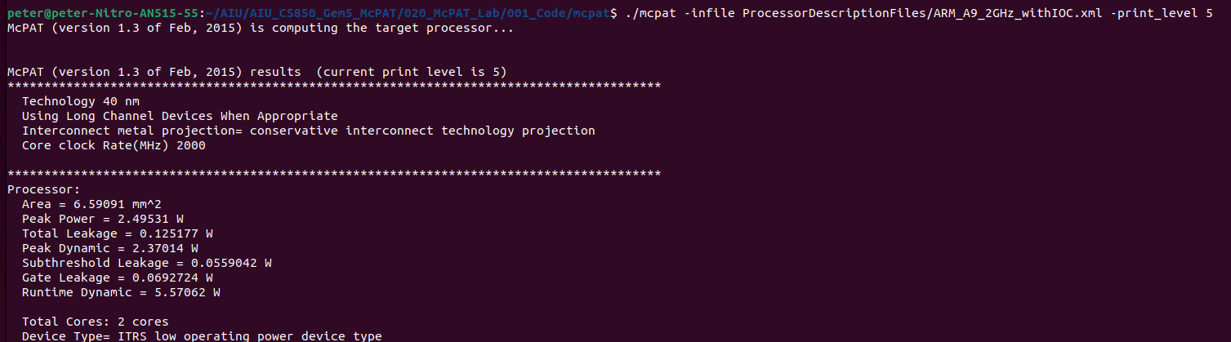
1.10 Run McPAT ARM_A9_2GHz_withIOC
https://github.com/HewlettPackard/mcpat
Run McPAT ARM_A9_2GHz with IOC
1. ./mcpat -infile ProcessorDescriptionFiles/ARM_A9_2GHz_withIOC.xml -print_level 5

Slide 26
1.11 Run McPAT Alpha21364

Slide 27
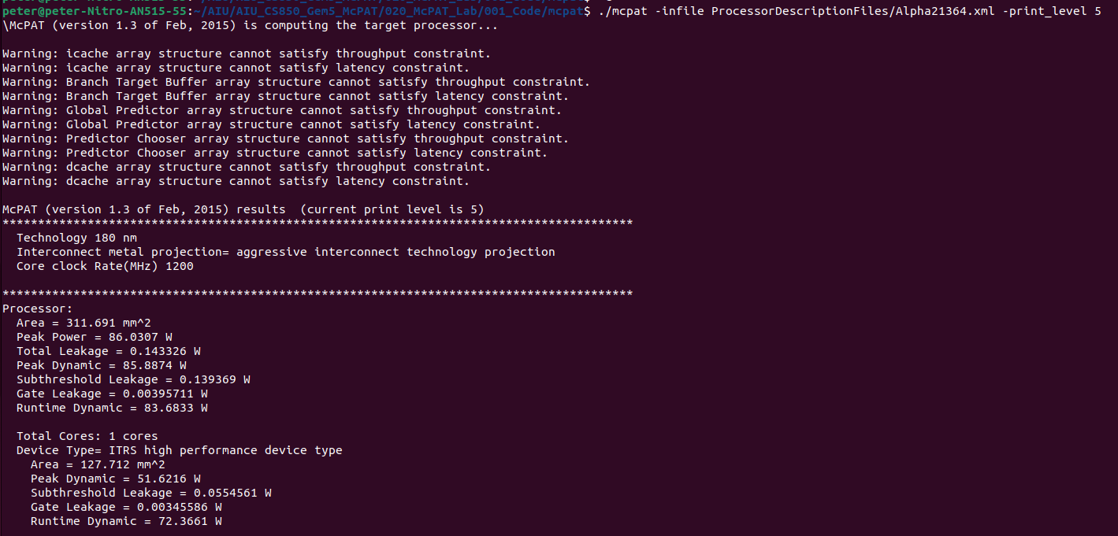
1.11 Run McPAT Alpha21364
https://github.com/HewlettPackard/mcpat
Run McPAT Alpha21365
1. ./mcpat -infile ProcessorDescriptionFiles/Alpha21364.xml -print_level 5
Wait for 1 minutes.

Slide 28
1.12 Run McPAT Xeon

Slide 29
1.12 Run McPAT Xeon
https://github.com/HewlettPackard/mcpat
Run McPAT Xeon
1. ./mcpat -infile ProcessorDescriptionFiles/Xeon.xml -print_level 5
Wait very long. No output.

Slide 30
End

