Slide 1

25 GPU Model (Part 02)
Peter H. Chen

Slide 2
25.23 Case 1: APU (Accelerated Process Unit)

Slide 3
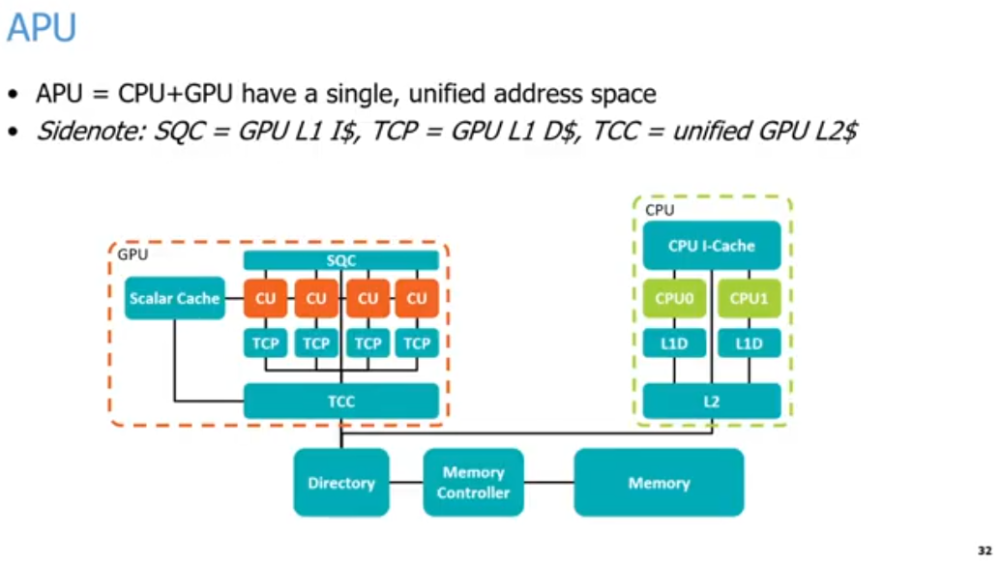
25.23 Case 1: APU (Accelerated Process Unit)
https://www.youtube.com/watch?v=Kjd1hTFOI44&list=PL_hVbFs_loVR_8ntTTmmG6YEq3Po_4snu&index=25
APU (Accelerated Process Unit) (47:16 - 47:17/2:01:30)
Chrome AI Summary:
1. APU (Accelerated Process Unit) = CPU + GPU
2. SQC (Sequencer Instruction Cache) = CPU L1 I$ (Instruction Cache), TCP (Texture Cache per Pipe) = GPU L1 D$ (Data Cache), TCC (Texture Cache per Channel) = unified GPU L2$ (Cache).
3. Cache Hierarchy Breakdown
  3.1. GPU Side (Left Orange Box)
    3.1.a. SQC (L1 I$): Shared across multiple Compute Units (CU) for instructions.
    3.1.b. Scalar Cache: Handles scalar data read-only operations for the CUs.
    3.1.c. TCP (L1 D$): Dedicated locally to individual Compute Units for data caching.
    3.1.d. TCC (Unified L2$): Aggregates data from the TCP caches and the Scalar Cache before communicating with the memory system
  3.2 CPU Side (Right Green Box)
    3.2.a. CPU I-Cache: Unified L1 Instruction Cache shared by the cores.
    3.2.b. L1D: Dedicated L1 Data Caches individual to each core (CPU0 and CPU1).
    3.2.c. L2: Shared L2 Cache supporting both CPU cores.
  3.3. Shared Memory System
    3.3.a. Directory: Manages cache coherence between the distinct CPU and GPU cache subsystems.
    3.2.b. Memory Controller: Controls data flow to and from the physical System Memory.
    3.3.c. Memory: The main unified memory storage pool shared by both processors.
1
2
3

Slide 4
25.23 Case 1: APU (Accelerated Process Unit)
https://www.youtube.com/watch?v=Kjd1hTFOI44&list=PL_hVbFs_loVR_8ntTTmmG6YEq3Po_4snu&index=25
Case 1: APU (Accelerated Process Unit) (47:18-47:19/2:01:30)
Chrome AI Mode Summary for case 1 use (APU):
Use Case 1: APU (Accelerated Processing Unit)
  a. Unified Memory Structure: The CPU and GPU share a single, unified address space and a single physical pool of system memory.
  b. No Copy Overhead: Because they share identical memory addresses, data does not need to be copied back and forth between separate CPU and GPU memory banks.
  c. Hardware Coherency: A dedicated Directory connects the CPU and GPU address spaces, maintaining cache coherency and allowing seamless data access between components.
  d. Shared Memory Controller: The directory routes requests through a unified memory controller directly into the main system memory.
1
2
3

Slide 5
25.23 Case 1: APU (Accelerated Process Unit)
https://www.youtube.com/watch?v=Kjd1hTFOI44&list=PL_hVbFs_loVR_8ntTTmmG6YEq3Po_4snu&index=25
Case 1: APU (Accelerated Process Unit) (47:20 - 47:21/2:01:30)
Chrome AI Mode Summary for case 1 use (APU):
AMD Cache Hierarchy & Nomenclature
  a. SQC (Sequencer Instruction Cache): Acts as the L1 Instruction Cache, shared across a group of Compute Units (CUs).
  b. TCP (Texture Cache per Pipe): Acts as the L1 Data Cache. Each individual Compute Unit gets its own separate TCP.
  c. TCC (Texture Cache per Channel): A unified L2 Cache handling both instruction (I) and data (D) lines for the GPU side.
  d. Scalar Cache: A specialized cache holding uniform constants or data. It supplies identical instructions/variables (like a universal bias term) to all threads in a warp or wavefront simultaneously.
1
2
3

Slide 6
25.23 Case 1: APU (Accelerated Process Unit)
https://www.youtube.com/watch?v=Kjd1hTFOI44&list=PL_hVbFs_loVR_8ntTTmmG6YEq3Po_4snu&index=25
Case 1: APU (Accelerated Process Unit) (47:22-48:00/2:01:30)
We will talk two common uses of GPUs with examples.
The first use is APU (Accelerated Processing Unit).
1. APU is CPU and GPU are used together in a single unified address space with coherent caches and a single set of memory. APU have the same address for CPU and GPU. APU don’t need to copy data back and forth between the CPU and GPU.
2. AMD Cache name: SQC (Sequencer Instruction Cache) = L1 Instruction Cache, TCP (Texture Cache per Pipe) = L1 Data Cache, TCC (Texture Cache per Channel) = Unified L2 Cache.
1
2
3

Slide 7
25.23 Case 1: APU (Accelerated Process Unit)
https://www.youtube.com/watch?v=Kjd1hTFOI44&list=PL_hVbFs_loVR_8ntTTmmG6YEq3Po_4snu&index=25
Case 1: APU (Accelerated Process Unit) (48:01 - 50:35/2:01:30)
3. Below is AMD APU diagram, GPU on the left and CPU on the right.
On the right, we have two CPU cores with two levels of cache (L1 and L2).We share caches between CPU and GPU. On the left, we have four CU (Compute Unit).
AMD uses weird name for their caches, SQC is the L1 Instruction Cache, TCP is L1 Data Cache. TCC is he unified L2 Cache. CPU and GPU share the caches across groups of our compute units.
Those compute units get a separate L1 data cache and they share a single unified L2 Cache for both I and D cache. AMD also have a specialized type of ache called a scaler cache. The scaler cache is for Vector operation, such as, multiple every thread by the same bias term for multiplication operations or normalize all the data into 0 to 1. All the warp or wavefront across all threads.
AMD’s APU use 2 level of cache and use a single unified address space. They have the directory to connect CPU and GPU address and allow us to access data back and forth between CPU and GPU.
The Directory connect to memory controller and finally in the memory.
The APU has only one system memory. There is no separate GPU memory and CPU memory.
1
2
3

Slide 8
25.24 Case 2: dGPU (Discrete GPU)

Slide 9
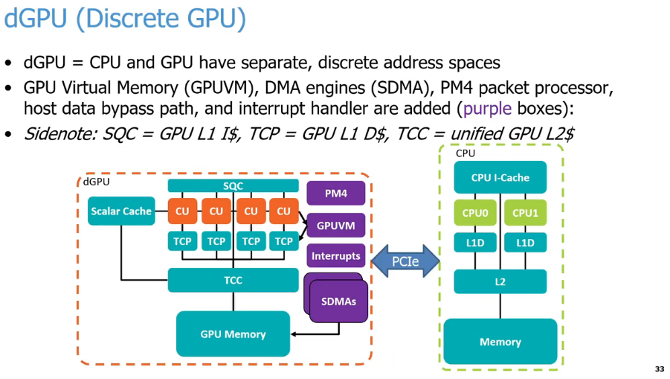
25.24 Case 2: dGPU (Discrete GPU)
https://www.youtube.com/watch?v=Kjd1hTFOI44&list=PL_hVbFs_loVR_8ntTTmmG6YEq3Po_4snu&index=25
Case 2: dGPU (Discrete GPU) (50:36 - 51:35/2:01:30)
Q: What is difference of dGPU (Discrete Process Unit) and APU (Accelerated Process Unit)?
Ans:
APU (Accelerated Processing Unit) combines both the CPU and GPU (Graphics process Unit) onto a single silicon chip, while a dGPU (Dedicated/Discrete Graphics Processing Unit) is a separate graphics IO card.
Description | APU (Accelerated Process Unit) | dGPU (Dedicated/Discrete GPU)
External Outlook | Combined on the CPU chip | Standalone PCIe expansion card
Video Memory (VRAM) | Share standard system DRAM | GPU has standalone/Dedicated very fast VRAM
Performance | Entry to mid level | Extremely fast
Price | Cheap | Very expensive
Power/Heat | High efficient, very cool | High power, require heavy cooling
Upgrade | Cannot upgrade | Easy to remove and add new graphic card

Slide 10
25.24 Case 2: dGPU (Discrete GPU)
https://www.youtube.com/watch?v=Kjd1hTFOI44&list=PL_hVbFs_loVR_8ntTTmmG6YEq3Po_4snu&index=25
Case 2: dGPU (Discrete GPU) (50:38 - 51:30/2:01:30)
1. APU (Accelerated Process Unit) have single/same address spaces on the mother board. dGPU (dedicated/discrete GPU) have separated address spaces external IO/PCIe card.
2. All the purple color boxes are extra components for GPU memory (Video RAM). GPU have its own Packet Processor PM4 (AMD Packet Mode 4), Virtual Memory GPUVM (GPU Virtual Memory), interrupt handlers, DMA/SDMA (Direct Memory Access/System Direct Memory Access), etc.
3. GPU uses the PCIe (Peripheral Component Interconnect Express) for discrete interface, such as, NVLink (NVIDIA Link) or XGM (ASUS Xtreme Graphics Mobile). In dGPU, we have to copy the data back and forth across the PCIe or other connection between the GPU memory and CPU memory. The bandwidth of the GPU memory and CPU memory are different.
1
2
3

Slide 11
25.25 Run GPU App in Gem5

Slide 12
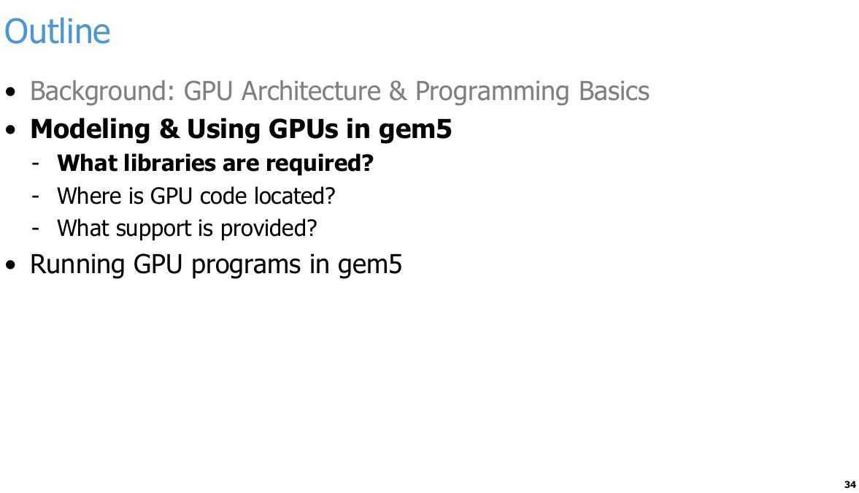
25.25 Run GPU App in Gem5
https://www.youtube.com/watch?v=Kjd1hTFOI44&list=PL_hVbFs_loVR_8ntTTmmG6YEq3Po_4snu&index=25
Run GPU App in Gem5 (51:31 - 51:32/2:01:30)

Slide 13
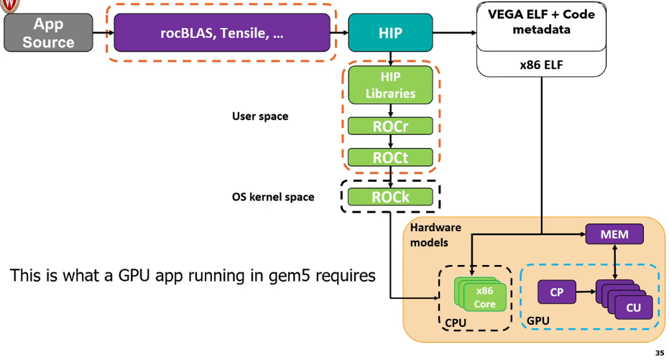
25.25 Run GPU App in Gem5
https://www.youtube.com/watch?v=Kjd1hTFOI44&list=PL_hVbFs_loVR_8ntTTmmG6YEq3Po_4snu&index=25
Run GPU App in Gem5 (51:33 - 51:34/2:01:30)
Chrome AI Mode Summary:
Below is AMD ROCm software stack and hardware components required to simulate a GPU application inside the gem5 architectural simulator.
1. Software Stack (User Space)
  a. App Source: The user-provided GPU application source code.
  b. Libraries: Core math and optimization libraries like rocBLAS and Tensile. HIP: AMD's portable C++ runtime and programming model interface.
  c. HIP Libraries: High-level libraries built on top of the runtime layer.
  d. ROCr (ROCm Runtime): Interacts directly with user-level software and manages system resources.
  e. ROCt (ROCm Thunk): The low-level user-space library interfacing directly with the kernel driver.
2. Driver & Kernel (OS Kernel Space)
  ROCk (ROCm Kernel): The open-source kernel driver (amdgpu) managing GPU hardware resources.
3. Hardware Simulation Models
  a. x86 Core (CPU): Simulates host CPU execution alongside binaries like x86 ELF.
  b. CP (Command Processor): Schedules and dispatches commands inside the simulated GPU.
  c. CU (Compute Units): Executes the actual parallel GPU compute workloads.
  d. MEM (Memory): Shared or dedicated memory hierarchy interconnecting the simulated CPU and GPU.
1
2
3
4
5
6
7

Slide 14
25.25 Run GPU App in Gem5
https://www.youtube.com/watch?v=Kjd1hTFOI44&list=PL_hVbFs_loVR_8ntTTmmG6YEq3Po_4snu&index=25
Run GPU App in Gem5 (51:35 - 54:15/2:01:30)
Below diagram shows Running a GPU app in Gem5.
1. We have a GPU application in the top/left in gray color of below diagram.
2. The application will go through multiple levels of user framework/libraries in purple color: rocBLAS (Basic Linear Algebra Subprogram) is math library for Linear Algebra and AMD Tensile (Open-source and code generator).
3. The application will go through the HIP (Heterogeneous-compute Interface for Portability) framework: HIP is the Runtime API Library and Kernel language.
4. The AMD Tensile will generate Vega (織女星, star name in Constellation Lyra) GPUs ELF (Executable and Link Format) code with meta data. GCC/Clang generates x86 ELF. They will be passed into the Gem5 simulator.
5. HIP framework runs in user space and OS kernel space. The user space includes HIP library, ROCr (Radeon Open Compute runtime), and ROCt (Thunk).
6. The OS kernel space includes ROCk (Kernel driver). ROCk is the Linux driver stack for GPU passed into the Hardware Models.
7. Hardware Models: contains x86 CPU cores and an AMD GPU architecture where the CP (Command Processor) receives commands from the CPU and dispatches them to the GPU's CUs (Compute Units).
Note: gem5 has AMD and ARM GPU but not NVIDIA GPU.
1
2
3
4
5
6
7

Slide 15
25.26 AMD ROCm Stack

Slide 16
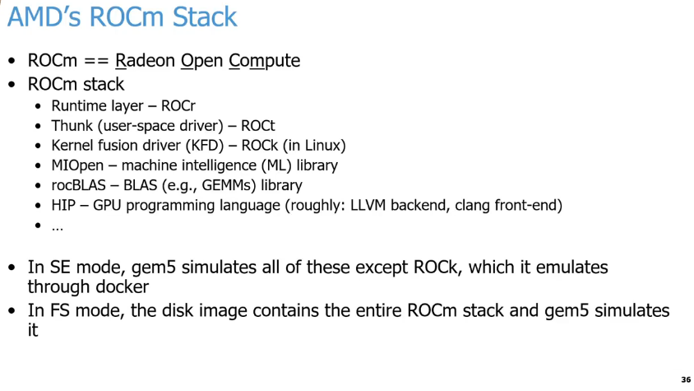
25.26 AMD ROCm Stack
https://www.youtube.com/watch?v=Kjd1hTFOI44&list=PL_hVbFs_loVR_8ntTTmmG6YEq3Po_4snu&index=25
AMD ROCm Stack (54:16 - 54:17/2:01:30)
Chrome AI Mode Summary:
gem5 handles AMD's ROCm (Radeon Open Compute) stack in its two main simulation modes:
1. SE Mode (Syscall Emulation)
  a. Partial simulation: gem5 directly simulates almost all layers of the ROCm stack (ROCr, ROCt, MIOpen, rocBLAS, and HIP).
  b. Exception (ROCk): It does not simulate the Kernel fusion driver (ROCK).
  c. Docker workaround: The ROCk driver is instead emulated through a Docker container.
2. FS Mode (Full System)
  a. Complete simulation: The simulation relies on a full disk image containing the entire, intact ROCm stack.
  b. Hardware-level handling: gem5 simulates the entire stack end-to-end without bypassing any layers.

Slide 17
25.26 AMD ROCm Stack
https://www.youtube.com/watch?v=Kjd1hTFOI44&list=PL_hVbFs_loVR_8ntTTmmG6YEq3Po_4snu&index=25
AMD ROCm Stack (54:18 - 56:00/2:01:30)
1. AMD provides the ROCm (Radeon Open Compute) stack for gem5.
2. ROCm stands for Radeon Open Compute. Radeon is an AMD brand name derived from "radio + electron".
3. AMD ROCm supports all layers of software:
a. ROCr (ROCm runtime): Runtime layer
b. ROCt (ROC thunk): User-space driver
c. ROCk (ROC Linux kernel): KFD (Kernel Fusion Driver) integrated into the Linux kernel.
d. MIOpen (Machine Intelligence Open Library): Machine Learning library
e. rocBLAS (ROC Basic Linear Algebra Subprograms): Linear Algebra library
f. HIP (Heterogeneous-compute Interface for Portability): GPGPU programming language, compilers with LLVM (Low Level Virtual Machine) backend, and Clang frontend for AMD GPGPU.
5. In SE (System-call Emulation) mode, gem5 supports all ROCm layers for simulation except ROCk. ROCk is emulated through Docker.
6. In FS (Full System) mode, the gem5 disk image contains the entire ROCm stack, and gem5 simulates it entirely, including system commands and syscalls (system calls).
1
2
3
4
5

Slide 18
25.27 GPU Programming

Slide 19
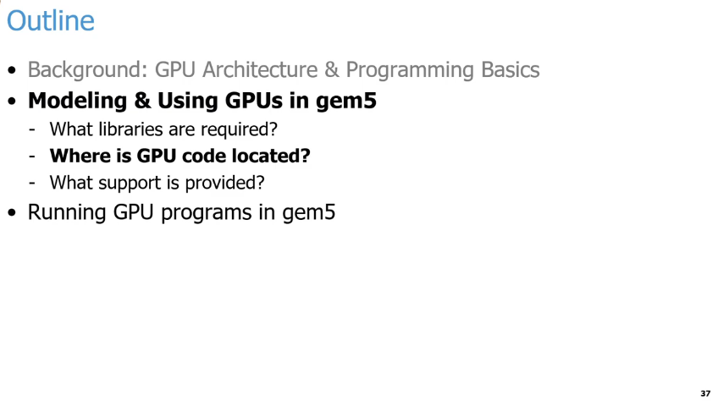
25.27 GPU Programming
https://www.youtube.com/watch?v=Kjd1hTFOI44&list=PL_hVbFs_loVR_8ntTTmmG6YEq3Po_4snu&index=25
GPU Programming (56:01 - 56:05/2:01:30)
Below is the outline of GPU Programming Basics:
1. gem5 GPU Model:
  a. GPU Libraries
  b. gem5 GPU Code location
  c. gem5 support
2. Run GPU program in gem5.

Slide 20
25.28 GPU Model Codebase

Slide 21
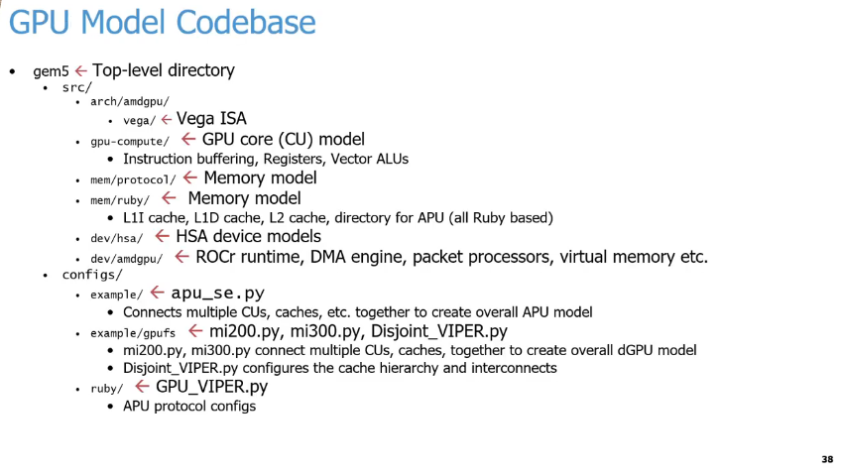
25.28 GPU Model Codebase
https://www.youtube.com/watch?v=Kjd1hTFOI44&list=PL_hVbFs_loVR_8ntTTmmG6YEq3Po_4snu&index=25
GPU Model Codebase (56:06 - 56:07/2:01:30)
Below is a structured summary of the GPU Model Codebase directories and configurations:
1. Source Directory (src/)
  a. arch/amdgpu/vega/: Contains the Vega (織女星) Instruction Set Architecture (ISA).
  b. gpu-compute/: Houses the GPU core (Compute Unit) model, managing instruction buffering, registers, and vector ALUs.
  c. mem/protocol/: Handles part of the memory model implementation.
  d. mem/ruby/: Implements the Ruby-based memory model, including L1I, L1D, and L2 caches, as well as the APU directory.
  e. dev/hsa/: Contains the Heterogeneous System Architecture (HSA) device models.
  f. dev/amdgpu/: Manages ROCr runtime simulation, DMA engines, packet processors, and virtual memory.
2. Configuration Files (configs/)
  a. example/apu_se.py: Connects multiple CUs and caches to assemble the overall APU model.
  b. example/gpufs/: Contains scripts for discrete GPU (dGPU) and interconnect configuration.
    b.1. mi200.py, mi300.py: Connects CUs and caches together for full dGPU models.
    b.2 Disjoint_VIPER.py: Configures the cache hierarchy and system interconnects.
  c. ruby/GPU_VIPER.py: Defines the cache coherence protocol configurations for the APU.

Slide 22
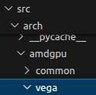
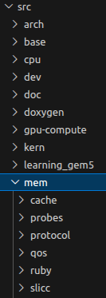
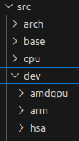
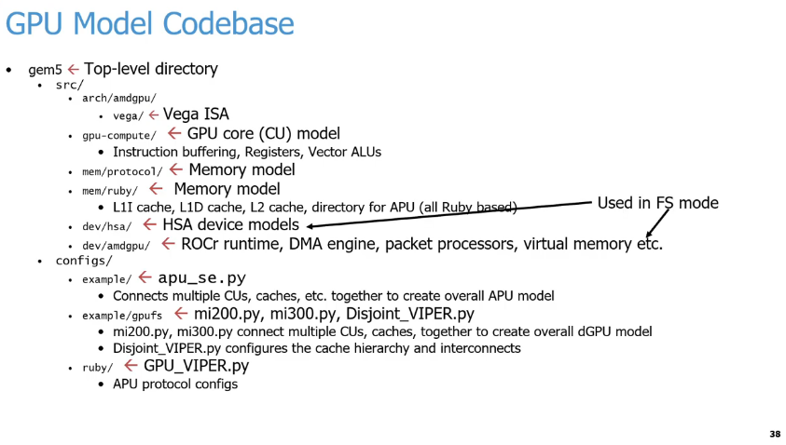
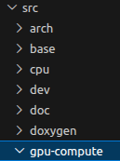
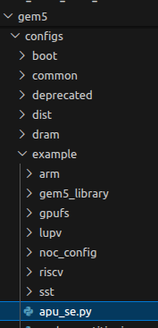
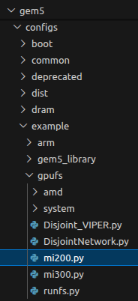
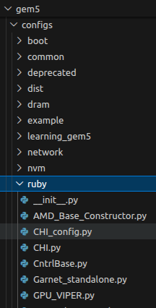
25.28 GPU Model Codebase
https://www.youtube.com/watch?v=Kjd1hTFOI44&list=PL_hVbFs_loVR_8ntTTmmG6YEq3Po_4snu&index=25
GPU Model Codebase (56:08 - 56:55/2:01:30)
Below are the libraries required by AMD GPU in gem5. The codes are located under gem5/src folder.
1.a: arch/amdgpu/vega: Contains the AMD GPU ISA (Instruction Set Architecture)
1.b: gpu-cpmpute: Contains the GPU core CU (Compute Unit) model, including instruction buffer, register, and Vector ALUs.
1.c, 1.d: mem/protocol and mem/ruby: contains the ruby based protocol for memory coherence and memory consistency.
1.e dev/hsa contains HSA (Heterogeneous System Architecture) device model.
1.f dev/amdgpu contains ROCr runtime, DMA engine, packet processors, virtual memory, etc.
1.a
1.f
1.e
1
1.a
1.b
1.c
1.c
1.d
1.d
1.e
1.b
1.f
2
2.a
2.b
2.c
2.b
2.a
2.c

Slide 23
25.28 GPU Model Codebase
https://www.youtube.com/watch?v=Kjd1hTFOI44&list=PL_hVbFs_loVR_8ntTTmmG6YEq3Po_4snu&index=25
GPU Model Codebase (56:56 - 57:10/2:01:30)
In the configs side, we have configurations for SE (System Call Emulation) mode and FS (Full system) mode.
The files in dev/hsa and dev/amdgpu are used in FS mode only.
2.a example: apu_se.py contains the connection of multiple CUs (Compute Units) and caches to create the APU (Accelerate Processing Unit) model.
2.b example/gpufs: mi200.py and mi300.py connect multiple CUs and caches to create dGPU (Discrete GPU) model. Disjoint_VIPER.py configures the cache hierarchy and interconnects (VIPER name is a poison snake).
2.c ruby: GPU_VIPER.py configure APU protocol.
1.a
1.f
1.e
1
1.a
1.b
1.c
1.c
1.d
1.d
1.e
1.b
1.f
2
2.a
2.b
2.c
2.b
2.a
2.c

Slide 24
25.29 GPU Kernel

Slide 25
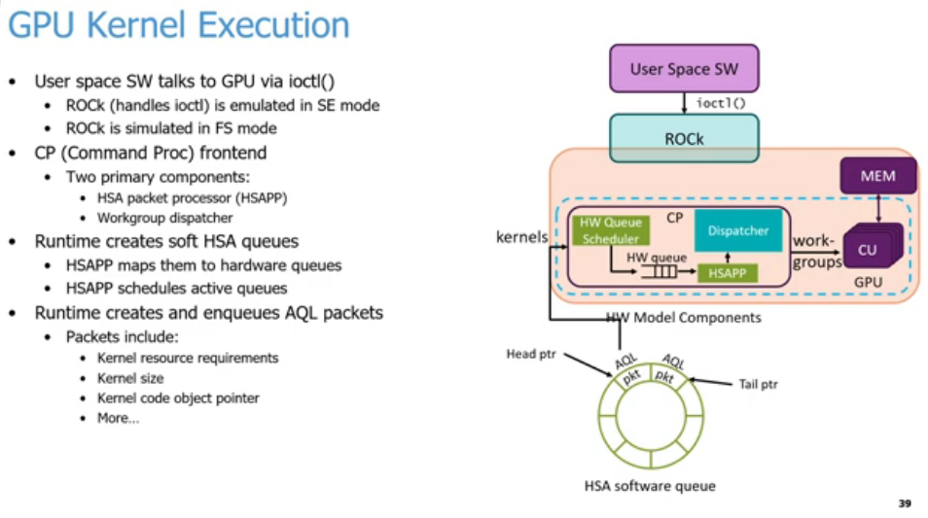
25.29 GPU Kernel
https://www.youtube.com/watch?v=Kjd1hTFOI44&list=PL_hVbFs_loVR_8ntTTmmG6YEq3Po_4snu&index=25
GPU Kernel (57:11 - 57:12/2:01:30)
Summary of the GPU kernel execution process shown in the slide:
1. Driver Communication: User Space Interaction: User space software communicates with the GPU using ioctl().
  1.1. SE Mode Emulation: The ROCK driver handles ioctl() and is emulated in Syscall Emulation mode.
  1.1. FS Mode Simulation: The ROCK driver is simulated in Full System mode.
2. CP Frontend Components: Two Core Components: The Command Processor frontend consists of an HSAPP and a Workgroup dispatcher.
3. Queue & Packet Lifecycle: Soft Queue Creation: The runtime creates soft HSA queues.
  3.1 Hardware Queue Mapping: The HSAPP (Heterogeneous System Architecture Packet Processor) maps these soft HSA queues to hardware queues.
  3.2 Active Queue Scheduling: The HSAPP handles the scheduling of active queues.
4. Packet Generation: The runtime creates and enqueues AQL packets.
  4.1 Packet Contents: These packets include kernel resource requirements, kernel size, and the kernel code object pointer.
5
1
2
6
7
3
4
9
8

Slide 26
25.29 GPU Kernel
https://www.youtube.com/watch?v=Kjd1hTFOI44&list=PL_hVbFs_loVR_8ntTTmmG6YEq3Po_4snu&index=25
GPU Kernel (57:13 - 57:14/2:01:30)
Explained the Diagram:
5.User Space SW initiates a GPU command.
6. Driver Communication: User Space SW sends an ioctl() command down to the kernel-level driver (ROCK).
7. Command Processor (CP) Frontend:
  7.1 Gatekeeper: The CP acts as the gatekeeper inside the GPU (the light orange box).
  7.2 Scheduling: It contains the HW Queue Scheduler, which manages incoming tasks.
  7.3 Queueing: Commands move from the scheduler into a hardware queue (HW queue).
8. Queue Management
  8.1 HSA Queue: The circular ring represents the HSA software queue.
  8.2 Packet Generation: The runtime environment generates and enqueues AQL packets (Architected Queue Language) packets containing kernel data.
  8.3 Head Pointer: Points to the execution start.
  8.4 Tail Pointer: Points to where new packets are added.
  8.5 Feedback Loop: These packets feed directly back into the hardware model components (kernels).
9. Hardware Processing & Execution
  9.1 Queue Processing: The HSAPP (HSA Packet Processor) processes the active queues.
  9.2 Work-Group Release: The CP signals the Dispatcher to release the work-groups.
  9.3 Parallel Dispatch: The Dispatcher sends these work-groups to the CU (Compute Unit) for parallel execution.
  9.4 Memory Access: The CU interacts directly with the GPU memory (MEM) to read and write data during execution.
5
1
2
6
7
3
4
9
8

Slide 27
25.29 GPU Kernel
https://www.youtube.com/watch?v=Kjd1hTFOI44&list=PL_hVbFs_loVR_8ntTTmmG6YEq3Po_4snu&index=25
GPU Kernel (57:15 - 59:20/2:01:30)
1. If we have some code (user space software) offload the Linux kernel and run on GPU, we need to use ioctl(). We need the ROCk comes in to do that.
We emulate that in SE mode or FS mode. We use the command processor in frontend to offload our kernel to the GPU command processor.
Execution Step-by-Step Flow
1. User space software communicates with the GPU driver via ioctl() system calls.
2. The Radeon Open Compute Kernel (ROCK) driver handles these calls (emulated in SE mode or simulated in FS mode).
3. The Command Processor (CP) frontend manages the offloading using two main components:HSAPP (Heterogeneous System Processor Packet Processor):
  3.1 Maps software queues to hardware queues.
  3.2 Workgroup Dispatcher: Dispatches workgroups to the Compute Units.
4. The runtime creates soft HSA queues (64K circular queues in memory heap).
5. The runtime creates and enqueues AQL Packets (Architected Queue Language) containing:
  5.1 Kernel resource requirements
  5.2 Kernel dimensions and sizes
  5.3 Kernel code object pointers
1
1
2
2
3
3
4
4
5
5

Slide 28
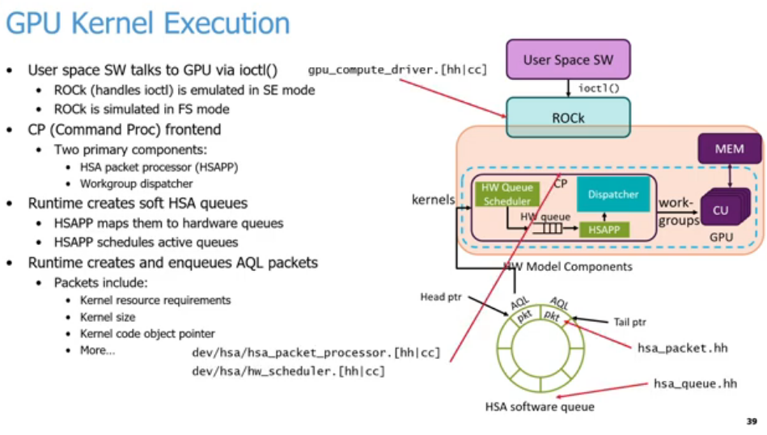
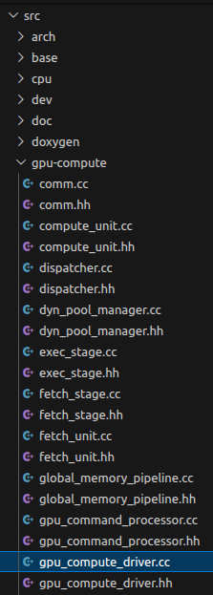
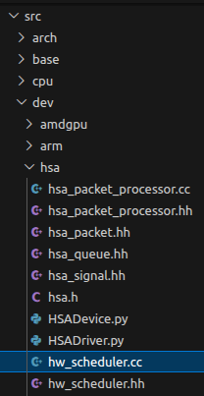
25.29 GPU Kernel
https://www.youtube.com/watch?v=Kjd1hTFOI44&list=PL_hVbFs_loVR_8ntTTmmG6YEq3Po_4snu&index=25
GPU Kernel (59:20 - 59:30/2:01:30)
We have five places to look at gem5 AMD/GPU.
1. src/gpu-compute/gpu_compute_driver.{hh|cc}:
  1.1. Implements the ROCK (Radeon Open Compute Kernel) driver emulation.
  1.2. Handles the ioctl() system calls initiated by User Space SW.
2. dev/hsa/hsa_packet_processor.{hh|cc}:
  2.1. Implements the HSAPP (Heterogeneous System Processor Packet Processor) logic.
  2.2. Responsible for mapping software HSA queues to hardware queues.
3. src/dev/hsa/hw_scheduler.{hh|cc}:
  3.1 Implements the HW Queue Scheduler component within the Command Processor (CP).
  3.2 Schedules active queues onto the execution hardware.
4. src/dev/hsa/hsa_packet.hh: Defines the structures and layouts for AQL packets (Architected Queue Language).
5. src/dev/hsa/hsa_queue.hh: Defines the structure and management of the HSA software queue (the ring buffer with head and tail pointers).
1
2
4
5
2
4
3
3
5
1

Slide 29
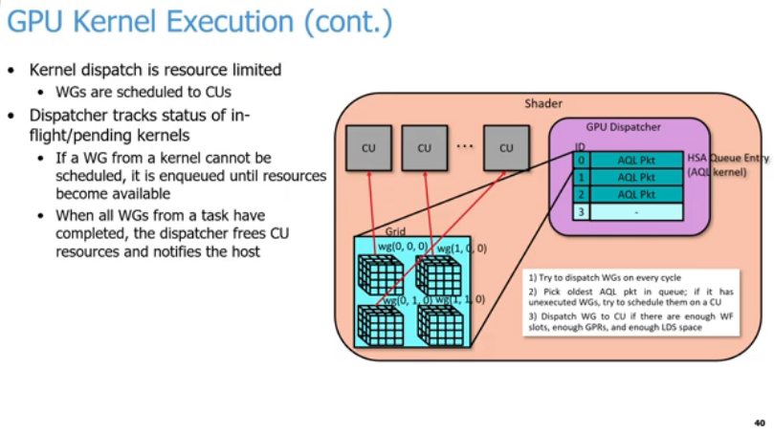
25.29 GPU Kernel
https://www.youtube.com/watch?v=Kjd1hTFOI44&list=PL_hVbFs_loVR_8ntTTmmG6YEq3Po_4snu&index=25
GPU Kernel (59:31 - 59:33/2:01:30)
Summary (Skip below slide because these came up in the questions before execution pipeline)
GPU Dispatcher schedules work-groups (WGs) to Compute Units (CUs) during kernel execution.
1. Core Concepts
  1.1. Resource Limits: Work-groups are mapped directly to hardware Compute Units based on availability.
  1.2 Status Tracking: The dispatcher tracks all running or pending kernels.
  1.3. Queueing: If resources are full, unmapped WGs wait in a queue.
  1.4. Host Notification: The dispatcher frees resources and alerts the host CPU once all WGs finish.
2. Dispatcher Workflow
  2.1. Continuous Check: Attempts to dispatch WGs on every hardware cycle.
  2.2. FIFO Selection: Selects the oldest AQL packet with remaining unexecuted WGs.
  2.3. Resource Verification: Dispatches WGs only if three conditions are met:
    2.3.1. Available Wavefront (WF) slots.
    2.3.2. Sufficient GPRs (General Purpose Registers).
    2.3.3. Adequate LDS (Local Data Share) space.

Slide 30
25.30 GPU Execution Pipeline

Slide 31
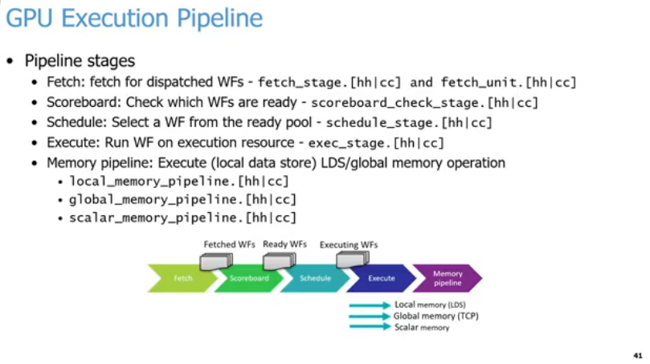
25.30 GPU Execution Pipeline
https://www.youtube.com/watch?v=Kjd1hTFOI44&list=PL_hVbFs_loVR_8ntTTmmG6YEq3Po_4snu&index=25
GPU Execution Pipeline (59:34 - 59:35/2:01:30)
Summary
structural pipeline stages of a GPU hardware simulator, breaking down how Wavefronts (WFs) flow through execution and memory stages.
1. Core Pipeline Stages
  1.1. Fetch: Retrieves instructions for dispatched WFs.
  1.2 Scoreboard: Checks dependencies to determine which WFs are ready.
  1.3. Schedule: Selects an execution-ready WF from the available pool.
  1.4. Execute: Runs the selected WF on the hardware execution resources.
2. Memory Pipeline Subsystems: The memory stage handles three distinct operations:
  2.1. Local Memory (LDS): Data operations utilizing the Local Data Share.
  2.2. Global Memory (TCP): Main GPU memory operations.
  2.3. Scalar Memory: Specialized handling for uniform scalar data.

Slide 32
25.30 GPU Execution Pipeline
https://www.youtube.com/watch?v=Kjd1hTFOI44&list=PL_hVbFs_loVR_8ntTTmmG6YEq3Po_4snu&index=25
GPU Execution Pipeline (59:36 - 1:00:55/2:01:30)
In gem5, we have roughly five pipeline stages. There is more in a real GPU. In gem5, this is how we model it.
1. Fetch: We fetch the WFs (Wavefronts) that we dispatched to the GPU which are implemented in the fetch stage and fetch unit.
2. Scoreboard: We check which Wavefronts are ready.
3. Schedule: Select a Wavefront from the ones that are ready. In every cycle, we keep track of Schedule and Scoreboard information. For example, Is wavefront 0 get ready to go, wavefront 1 get ready to go, etc. Whatever the wavefronts are ready to go, schedule grabs those and starts sending that work out to the later stages in the pipeline.
4. Execute: Execute is the most important. Execute can be ALU operations and different memory operations.
5. Memory Pipeline: When we execute the ALU operations and memory pipeline, the operations can be local memory operation, global memory operation, or scalar memory operation.
1
2
3
4
5

Slide 33
25.31 AMD/GPU Support

Slide 34
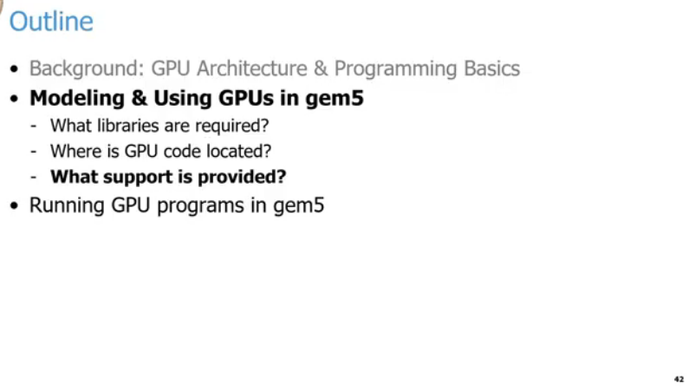
25.31 AMD/GPU Support
https://www.youtube.com/watch?v=Kjd1hTFOI44&list=PL_hVbFs_loVR_8ntTTmmG6YEq3Po_4snu&index=25
AMD/GPU Support (1:00:56 - 1:00:57/2:01:30)
The last topic before we do the GPU example: “What is AMD/GPU Support gem5?”

Slide 35
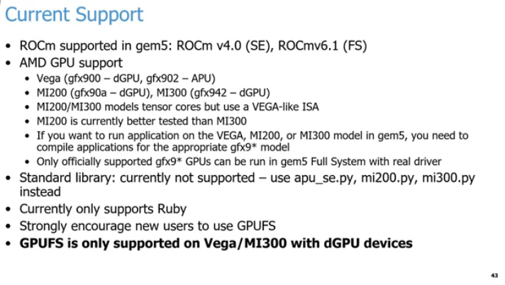
25.31 AMD/GPU Support
https://www.youtube.com/watch?v=Kjd1hTFOI44&list=PL_hVbFs_loVR_8ntTTmmG6YEq3Po_4snu&index=25
AMD/GPU Support (1:00:57 - 1:03:40/2:01:30)
1. ROCm supports gem5: In FS mode, gem5 supports the latest version ROCm v6.1. In SE Mode, gem5 support ROCm v4.0.
2. gem5 supports a number of AMD/GPUs:
  a. gem5 supports AMD Vega class GPUs for dGPU (discrete GPUs) with library gfx (Graphics) 900 and APU (Accelerated Processing Unit = CPU + GPU) with library gfx 902. Vega are used in gaming.
  b. gem5 supports AMD GPUs MI200 (gfx90a) and MI300 (gfx942). These MI (Machine Intelligence) products are all dGPUs and used for generative AI. In AMD gfx9xx, gfx is Graphics, 9 is the series number and xx is the version ID.
  c. In MI200 and MI300, gem5 supports the Matrix Core Engines. These tensor cores were introduced when shifting from Vega ISA to CDNA (Compute DNA).
  d. Currently, MI200 is better tested than MI300.
1
2
a
b
c
d
e
f
3
4
5
6

Slide 36
25.31 AMD/GPU Support
https://www.youtube.com/watch?v=Kjd1hTFOI44&list=PL_hVbFs_loVR_8ntTTmmG6YEq3Po_4snu&index=25
AMD/GPU Support (1:03:41 - 1:05:50/2:01:30)
2. gem5 supports a number of AMD/GPUs (Cont):
  e. If we want to run Vega, MI200, or MI300 in gem5, we need to compile applications for appropriate gfx9* model, for example, if we want to run code for MI200 model, we need to compile the code for gfx90a. If we want to run code for MI300, we need to compile the code for gfx942, etc. If we do not compile with the right architecture, the compilation will fail.
  f. Only official gfx9* GPUs can be run on gem5 Full System mode with real driver.
3. Currently, gem5 does not support GPU standard library yet. Right now, gem5 only use apu_se.py, mi200.py, mi300.py for testing instead.
4. Currently, gem5 only supports Ruby GPU.
5. For APU, gem5 strongly recommends use GPU FS mode instead of GPU SE mode.
6. When AMD releases new ROCm (Radeon Open Compute) Libraries, AMD only fully supports GPU FS mode and does not provide full testing for the gfx libraries in Vega/MI300 for GPU SE Mode.
1
2
a
b
c
d
e
f
3
4
5
6

Slide 37
25.32 GPU Full System Simulation

Slide 38
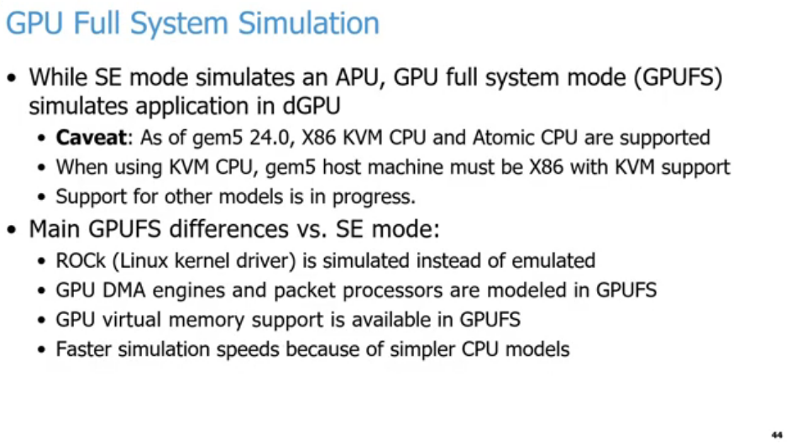
25.32 GPU Full System Simulation
https://www.youtube.com/watch?v=Kjd1hTFOI44&list=PL_hVbFs_loVR_8ntTTmmG6YEq3Po_4snu&index=25
GPU Full System Simulation (1:05:51 - 1:05:52/2:01:30)
Summary
1. Core Definitions
  a. SE Mode: Simulates an Accelerated Processing Unit (APU).
  b. GPUFS Mode: Simulates applications running on a discrete GPU (dGPU).
2. Caveats & Constraints (as of gem5 24.0)
  a. Supported CPUs: Only X86 KVM CPU and Atomic CPU are supported.
  b. Host Requirement: Using KVM CPU requires an X86 host machine with KVM support.
  c. Future Work: Support for other hardware models is currently in progress.
3. Main Differences (GPUFS vs. SE Mode)
  a. Driver Handling: ROCk (Linux kernel driver) is fully simulated rather than emulated.
  b. Hardware Modeling: GPU DMA engines and packet processors are actively modeled in GPUFS.
  c. Memory: GPU virtual memory support is fully available in GPUFS.
  d. Performance: Simulation speeds are faster due to the use of simpler CPU models.
1
2
3

Slide 39
25.32 GPU Full System Simulation
https://www.youtube.com/watch?v=Kjd1hTFOI44&list=PL_hVbFs_loVR_8ntTTmmG6YEq3Po_4snu&index=25
GPU Full System Simulation (1:05:53 - 1:07:25/2:01:30)
1. The gem5 SE (System call Emulation) mode simulates application in the APU (= CPU + GPU).
The gem5 FS (Full system) mode simulates application in both APU (= CPU + GPU) and dGPU (Discrete GPU).
2. gem5 24.0 only supports x86 KVM (Kernel-based Virtual Machine) CPU and Atomic Mode (原子模式, an atomic action/one single, uninterrupted function call) CPU with GPU FS Mode.
  When using KVM CPU, the host machine must have X86 with KVM support.
  In all the demo examples, we use a flag to disable the host X86 requirement that allow gem5 to run AMD, multi-GPU, Multi-chipset devices.
3. The main differences between GPU FS and GPU SE Mode:
  In GPU FS Mode, ROCk (Radeon Open Compute Kernel Driver) performs Full System Simulation. GPU SE mode uses System Call Emulation.
  In GPU FS mode, GPU DMA engines and packet processor are modeled. GPU SE mode does not model DMA engine and packet processor.
  In GPU FS mode, GPU Virtual memory is modeled. GPU SE mode does not model GPU Virtual Memory.
  In GPU FS mode, we have simpler CU model for fast simulation through phases of the program. GPU SE mode is slower.
1
2
3

Slide 40
25.33 gem5 Docker

Slide 41
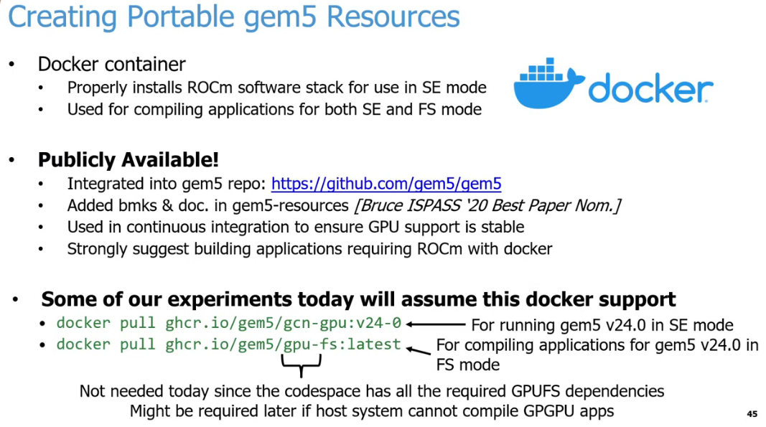
25.33 gem5 Docker
https://www.youtube.com/watch?v=Kjd1hTFOI44&list=PL_hVbFs_loVR_8ntTTmmG6YEq3Po_4snu&index=25
gem5 Docker (1:07:26 - 1:07:27/2:01:30)
Summary:
The Docker containers provide reliable, portable environments for gem5 simulator workflows involving AMD ROCm software stacks.
Core Infrastructure
  Docker Containers: Handle the proper installation of the ROCm software stack.
  Dual-Mode Compilation: The environments support compiling target applications for both System Call Emulation (SE) mode and Full System (FS) mode.
Availability & Integration
  Official Repository: Integrated directly into the main gem5 repository.
  Resource Inclusion: Benchmarks and documentation are added to the gem5-resources repository.
  CI/CD Integration: Utilized in continuous integration pipelines to enforce stable GPU support.
  Recommended Practice: Developers are strongly encouraged to use Docker for building ROCm-dependent applications.
Hands-On Experiment Support
  gcn-gpu:v24-0: Image used for executing gem5 v24.0 in SE mode.
  gpu-fs:latest: Image used to compile applications for gem5 v24.0 in FS mode.
  Workshop Note: These local Docker pulls are unnecessary for the current session because the provided cloud Codespace already comes pre-configured with all required GPUFS dependencies.
1
2
3

Slide 42
25.33 gem5 Docker
https://www.youtube.com/watch?v=Kjd1hTFOI44&list=PL_hVbFs_loVR_8ntTTmmG6YEq3Po_4snu&index=25
gem5 Docker (1:07:28 – 1:08:55/2:01:30)
1. To compile/link different with different versions of AMD/GPUs library, and setting up driver stacks for running are very complicated and challenging.
To avoid complication of compiling, linking, and setting, we do all of these through the Docker support, i.e., Docker has done these for us.
Docker use “docker pull” command to download the docker image and “docker run” to run the downloaded image.
2. Docker hub is a public web server that collect different versions of pre-built images for us to download (docker pull).
3. Below, we have two different docker pull commands for download SE Mode image and FS Mode image, respectively.
a. For gem5 SE mode (v24.0)
> docker pull ghcr.io/gem5/gcn-gpu:v24-0
b. For gem5 FS Mode (v24.0)
> docker pull ghcr.io/gem5/gpu-fs:latest
Note: The command “gpu-fs” is not explicitly needed since Docker puts all of them together.
1
2
3

Slide 43
25.34 Run GPU/SE Mode

Slide 44
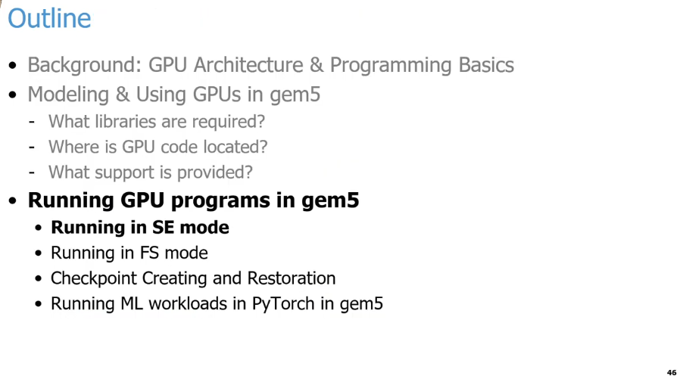
25.34 Run GPU/SE Mode
https://www.youtube.com/watch?v=Kjd1hTFOI44&list=PL_hVbFs_loVR_8ntTTmmG6YEq3Po_4snu&index=25
Run GPU/SE Mode (1:08:56 – 1:10:30/2:01:30)
We will go through four types of example
1. GPU in SE Mode
2. GPU in FS Mode
3. GPU checkpoint and restoration
4. How do we run PyTorch in gem5?
5. How do we run ML (Machine Learning) workloads in PyTorch in gem5?
6. How do we create and checkpoints to make gem5 run faster?

Slide 45
25.35 Running Square: GPU Vector Addition

Slide 46
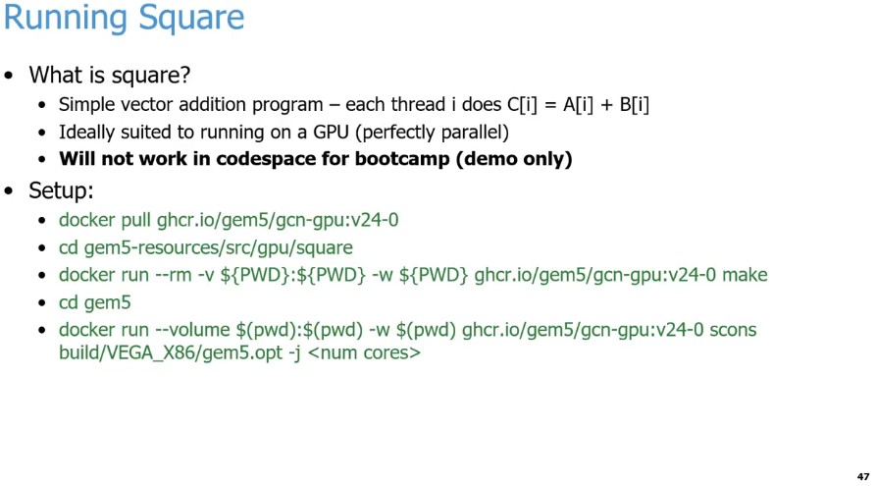
25.35 Running Square: GPU Vector Addition
https://www.youtube.com/watch?v=Kjd1hTFOI44&list=PL_hVbFs_loVR_8ntTTmmG6YEq3Po_4snu&index=25
Running Square: GPU Vector Addition (1:10:31 – 1:12:05/2:01:30)
1. What is the Square program?
  a. Square is a simple vector addition program where each thread calculates C[i] = A[i] + B[i].
  b. Hardware: It is a perfectly parallel application designed to run on a GPU.
  c. This demo will not work inside a standard bootcamp codespace environment.
The example below shows how to pull the Docker image and compile the gem5 binary with AMD/GPU libraries.
2. Pull the Docker image:
> docker pull ghcr.io/gem5/gcn-gpu:v24-0
3. Go to the work directory.
> cd gem5-resources/src/gpu/square
4. Clean up the work directory and compile the Square program.
> docker run --rm -v ${PWD}:${PWD} -w ${PWD} ghcr.io/gem5/gcn-gpu:v24-0 make
5. Go to the gem5 directory.
> cd gem5
6. Build gem5 with AMD X86/VEGA libraries.
> docker run --volume $(pwd):$(pwd) -w $(pwd) ghcr.io/gem5/gcn-gpu:v24-0 scons build/VEGA_X86/gem5.opt -j <num cores>
1
2
3
4
5
6

Slide 47
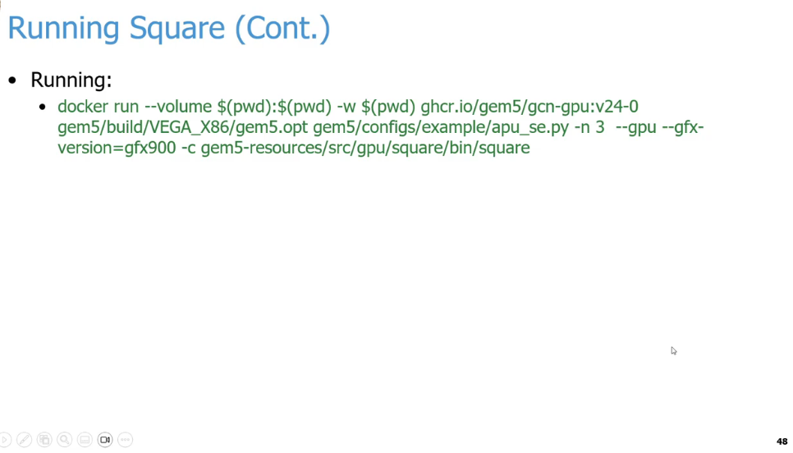
25.35 Running Square: GPU Vector Addition
https://www.youtube.com/watch?v=Kjd1hTFOI44&list=PL_hVbFs_loVR_8ntTTmmG6YEq3Po_4snu&index=25
Running Square: GPU Vector Addition (1:12:06 – 1:12:30/2:01:30)
We have built gem5 with AMD/GPUs. How do we get AMD/GPU gem5 to run square? Below is the command to run AMD/GPU gem5:
> docker run --volume $(pwd):$(pwd) -w $(pwd) ghcr.io/gem5/gcn-gpu:v24-0 gem5/build/VEGA_X86/gem5.opt gem5/configs/example/apu_se.py -n 3 --gpu --gfx-version=gfx900 -c gem5-resources/src/gpu/square/bin/square
Command Flags Explanation:
1. Docker Flags
  a. run: Creates and starts a new container instance from the specified image.
  b. --volume $(pwd):$(pwd): Mounts your current working directory ($(pwd)) from your host machine into the exact same path inside the container. This allows the container to access and save files directly to your host machine.
  c. -w $(pwd): Sets the working directory inside the container to your current host directory path, ensuring the command executes from that folder.
  d. ghcr.io/gem5/gcn-gpu:v24-0: The specific Docker container image being downloaded and run, which comes pre-configured with a gem5 GPU development environment.
2. gem5 Binary & Configuration
  a. gem5/build/VEGA_X86/gem5.opt: The compiled gem5 simulator executable, optimized for performance (.opt), simulating an AMD Vega x86 architecture.
  b. gem5/configs/example/apu_se.py: The Python configuration script that defines the hardware layout (Accelerated Processing Unit) to run in Syscall Emulation (se) mode.
3. gem5 Simulation Flags
  a. -n 3: Configures the simulation to use 3 CPU cores.
  b. --gpu: Enables the simulation of the GPU component within the system architecture.
  c. --gfx-version=gfx900: Specifies the exact AMD GPU instruction set architecture version to simulate (gfx900 corresponds to AMD Vega 10 / MI25).
  d. -c gem5-resources/src/gpu/square/bin/square: Specifies the path to the compiled workload/binary (square) that the simulated system will execute.

Slide 48
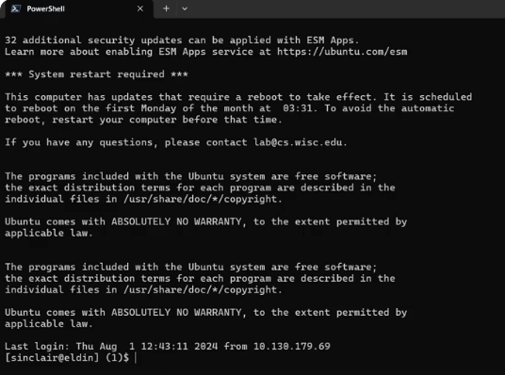
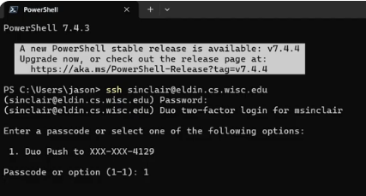
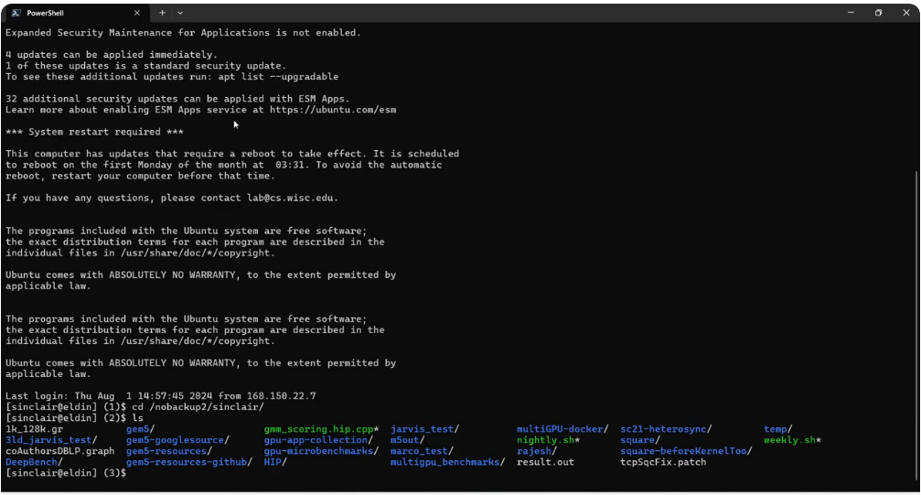
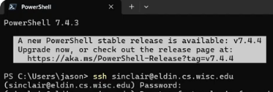
25.35 Running Square: GPU Vector Addition
https://www.youtube.com/watch?v=Kjd1hTFOI44&list=PL_hVbFs_loVR_8ntTTmmG6YEq3Po_4snu&index=25
Running Square: GPU Vector Addition (1:12:31 – 1:13:00/2:01:30)
Below image shows Professor Sinclair commands:
1. open power shell
2. remote connect with secure shell
> ssh sinclair@eldin.cs.wisc.edu
3. push Docker image
4. Change to his working directory
> cd /nobackup2/sinclair
3
1
4
2

Slide 49
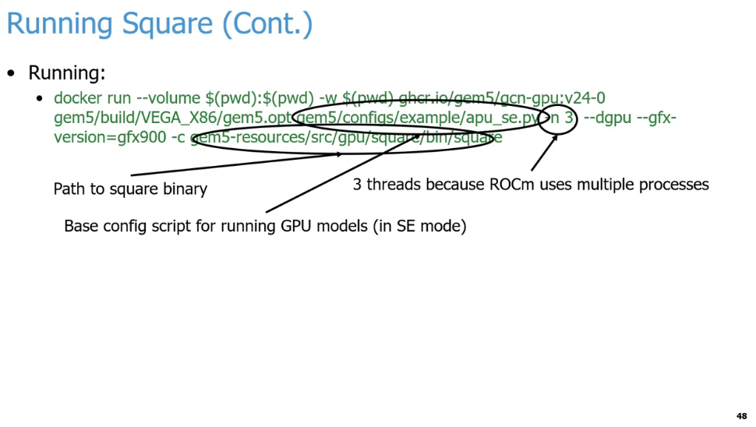
25.35 Running Square: GPU Vector Addition
https://www.youtube.com/watch?v=Kjd1hTFOI44&list=PL_hVbFs_loVR_8ntTTmmG6YEq3Po_4snu&index=25
Running Square: GPU Vector Addition (1:13:01 – 1:15:50/2:01:30)
After compilation finishes in the Docker environment, we are ready to run the Square binary under the Docker environment.
1. --volume $(pwd):$(pwd): Mounts your current working directory ($(pwd)) from your host machine into the exact same path inside the container. This allows the container to access and save files directly to your host machine.
2. -w $(pwd): Sets the working directory inside the container to your current host directory path, ensuring the command executes from that folder.
3. ghcr.io/gem5/gcn-gpu:v24-0: The specific Docker container image being downloaded and run, which comes pre-configured with a gem5 GPU development environment.
4. gem5/build/VEGA_X86/gem5.opt: The compiled gem5 simulator in AMD Vega/X86 Architecture. It is an opt (optimized for performance) binary.
5. gem5/configs/example/apu_se.py: The Python configuration script that defines the hardware layout (Accelerated Processing Unit) to run in SE (Syscall Emulation) mode.
6. -n 3: Specifies 3 threads for ROCm (Radeon Open Compute) for the multiprocessors to run the program.
7. --dgpu: Enables the simulation of the GPU component within the system architecture.
8. --gfx-version=gfx900: Specifies the AMD GPU gfx (Graphics) instruction set architecture version to simulate (gfx900 corresponds to AMD Vega 10 / MI25). This model is for AMD discrete GPU.
9. -c <path>: Passes the binary of the square program.
1
2
3
4
6
7
8
9
5

Slide 50
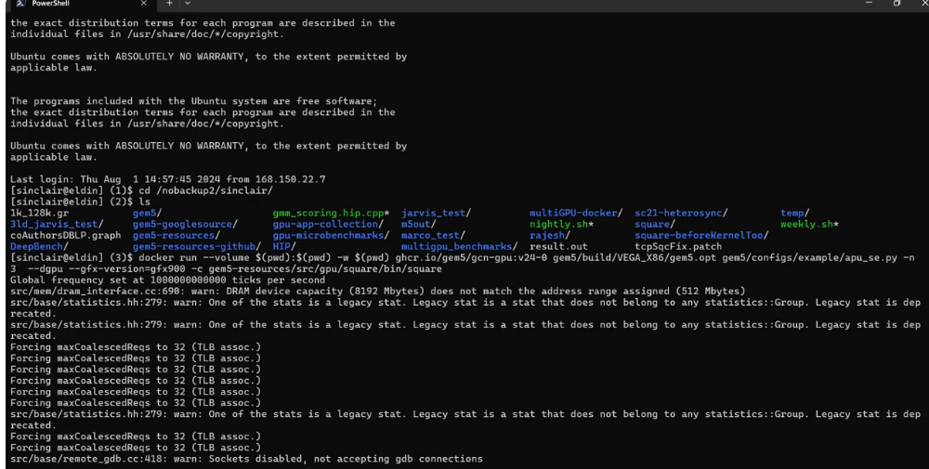
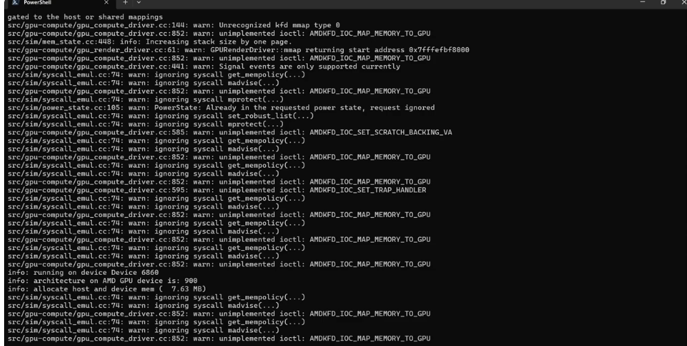
25.35 Running Square: GPU Vector Addition
https://www.youtube.com/watch?v=Kjd1hTFOI44&list=PL_hVbFs_loVR_8ntTTmmG6YEq3Po_4snu&index=25
Running Square: GPU Vector Addition (1:13:01 – 1:18:10/2:01:30)
Under the work directory, type command:
> docker run --volume $(pwd):$(pwd) -w $(pwd) ghcr.io/gem5/gcn-gpu:v24-0 gem5/build/VEGA_X86/gem5.opt gem5/configs/example/apu_se.py -n 3 --gpu --gfx-version=gfx900 -c gem5-resources/src/gpu/square/bin/square
> … <running now>
If we passed the wrong version of gfs, we will get the execution error.

Slide 51
25.36 Running Square: Output Statistics

Slide 52
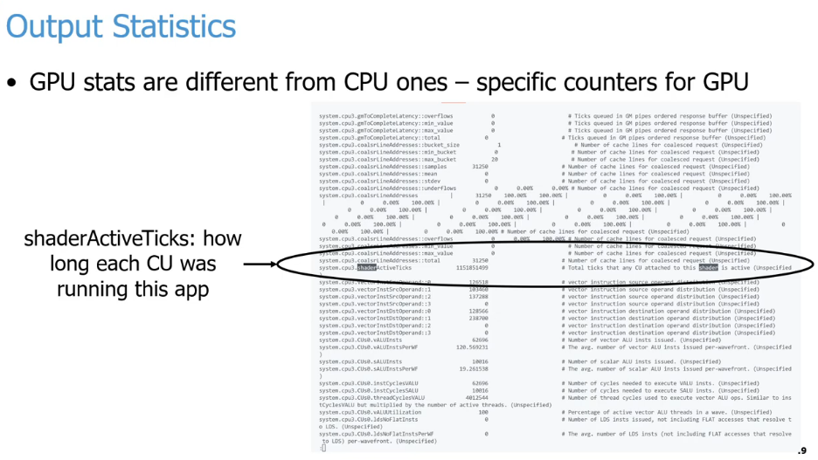
25.36 Running Square: Output Statistics
https://www.youtube.com/watch?v=Kjd1hTFOI44&list=PL_hVbFs_loVR_8ntTTmmG6YEq3Po_4snu&index=25
Running Square: Output Statistics (1:18:11 – 1:18:12/2:01:30)
The primary statistical differences between CPUs and GPUs stem from their architectural goals: CPUs track sequential latency, while GPUs track parallel throughput.
Performance Metric | CPU Counters | GPU Counters
Execution Focus | Latency minimization | Throughput maximization
Instruction Tracking | Instructions Per Cycle (IPC) | Thread/Wavefront Occupancy
Core Activity | Active clock cycles | shaderActiveTicks / Execution time
Memory Monitoring | L1/L2/L3 cache hit/miss rates | Memory coalescing (coalsrLineAddresses)
Control Flow | Branch mispredictions | Predicated threads / Masked lanes
Arithmetic Type | Scalar / SIMD instructions | Vector (VALU) vs. Scalar (SALU) tracking
Key Differences Explained
Core Tracking: CPU stats measure individual core efficiency. GPU stats track collective compute unit activation across thousands of smaller processing cores.
Memory Architecture: CPU metrics focus on caching hierarchy latency. GPU metrics focus on memory bandwidth utilization and memory instruction coalescing.
Branch Handling: CPUs aggressively monitor branch predictors. GPUs monitor thread diverging where masking registers temporarily disable execution lanes.

Slide 53
25.36 Running Square: Output Statistics
https://www.youtube.com/watch?v=Kjd1hTFOI44&list=PL_hVbFs_loVR_8ntTTmmG6YEq3Po_4snu&index=25
Running Square: Output Statistics (1:18:13 – 1:19:12/2:01:30)
The highlighted on the screen is shaderActiveTicks. shaderActiveTicks tells us how many ticks in the compute unit in the program. This case takes 1.1 Billion ticks.
Metric Name: system.cpu3.shaderActiveTicksValue: 1,151,851,409
Description: # Total ticks that any CU attached to this shader is active (Unspecified)
In gem5, a "tick" is usually measured in picoseconds (ps) by default (1 tick = 10^(-12) seconds).
1,151,851,409 ticks = 1,151,851,409 x 10^(-12) second = 1,151,851 x 10^(-9) second = 1,151,851 nanoseconds = 1,151.85 us = 1.15ms about of active Compute Unit runtime.

Slide 54
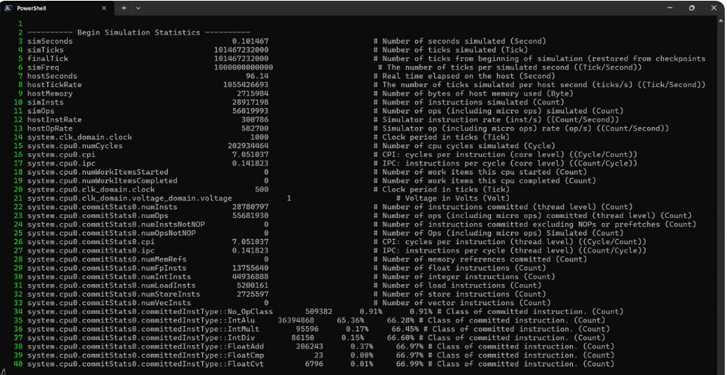
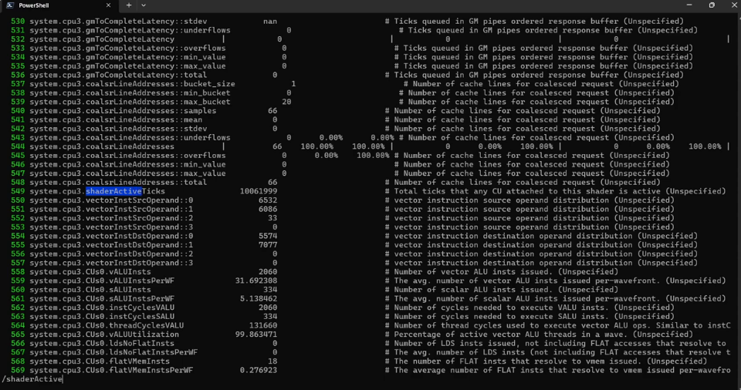
25.36 Running Square: Output Statistics
https://www.youtube.com/watch?v=Kjd1hTFOI44&list=PL_hVbFs_loVR_8ntTTmmG6YEq3Po_4snu&index=25
Running Square: Output Statistics (1:18:13 – 1:20:10/2:01:30)
Below highlight is the shaderActiveTicks 10,061,999 tick = 10,061,999 ps = 10,061.999 ns = 10 us = 0.01 ms = 0.00001 sec
CU takes 10 million ticks.
So, different program running results are different.

Slide 55
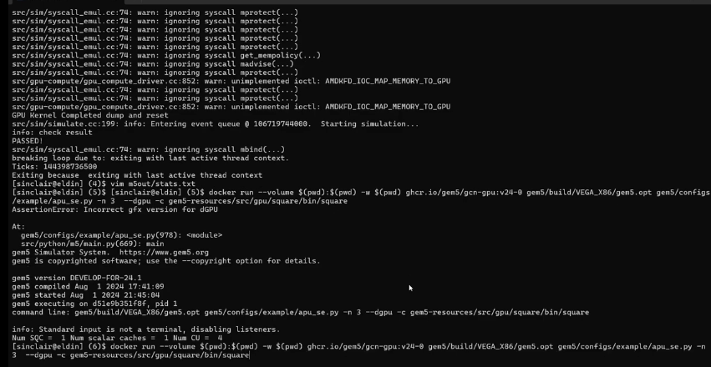
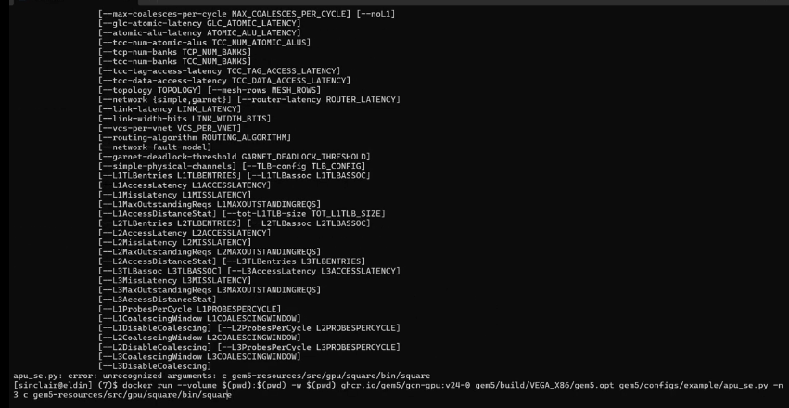
25.36 Running Square: Output Statistics
https://www.youtube.com/watch?v=Kjd1hTFOI44&list=PL_hVbFs_loVR_8ntTTmmG6YEq3Po_4snu&index=25
Running Square: Output Statistics (1:20:11 – 1:20:25/2:01:30)
If we remove the gfx900 (discrete GPU) flags and run again.
Then, we can see it runs failed.

Slide 56
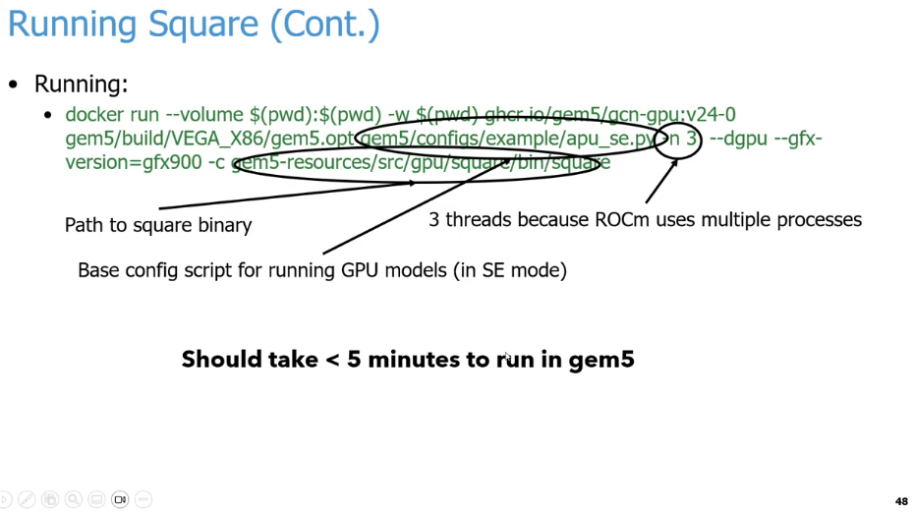
25.36 Running Square: Output Statistics
https://www.youtube.com/watch?v=Kjd1hTFOI44&list=PL_hVbFs_loVR_8ntTTmmG6YEq3Po_4snu&index=25
Running Square: Output Statistics (1:20:26 – 1:21:20/2:01:30)
We need –dgpu and --gfx-version=gfx900 discrete GPU library to run it.
It should take less 5 minutes to run gem5 discrete GPU mode.

Slide 57
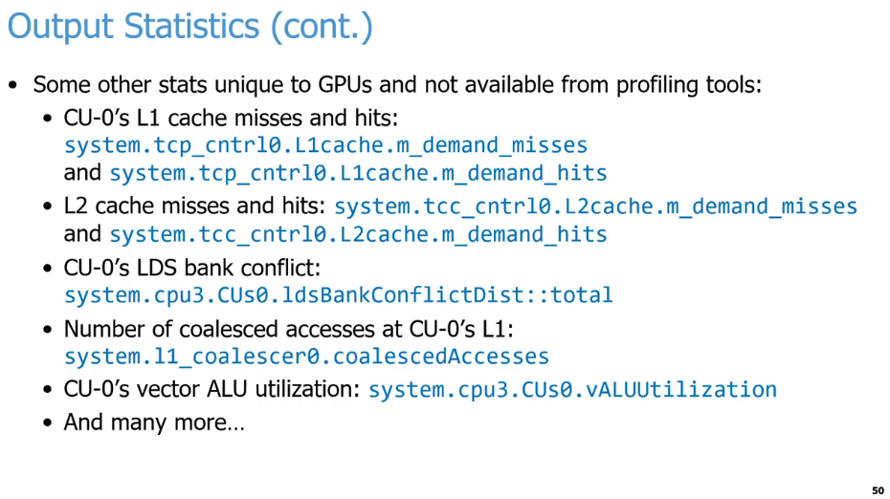
25.36 Running Square: Output Statistics
https://www.youtube.com/watch?v=Kjd1hTFOI44&list=PL_hVbFs_loVR_8ntTTmmG6YEq3Po_4snu&index=25
Running Square: Output Statistics (1:21:21 – 1:21:40/2:01:30)
Below is the GPU example of CU (Compute Unit).
1. For L1 Cache. we can see there are
  a. Cache hits and misses.
  b. tcp_cntrli (TCP Controller I): Here, i is the Compute Unit number.
  c. m_demand_misses/m-demand_hits: Here, m Demand Hits and m Demand missed under the L1 Cache.
2. For L2 Cache, we can look at the tcc m_demand_hits and misses
1
2
3

Slide 58
25.36 Running Square: Output Statistics
https://www.youtube.com/watch?v=Kjd1hTFOI44&list=PL_hVbFs_loVR_8ntTTmmG6YEq3Po_4snu&index=25
Running Square: Output Statistics (1:21:41 – 1:22:20/2:01:30)
3. For the scratchpads or LDS (Local Data Share), AMD calls the scratchpad LDS. We can look at the Bank Conflicts and how many accesses are coalesced using “Number of coalesced accesses.”
Q1. What is LDS?
Ans:
  a. LDS (Local Data Share) is a fast, on-chip scratchpad memory located inside each compute unit.
  b. LDS allows threads in the same workgroup or block to share data quickly.
  c. LDS offers much lower latency than global device memory (DRAM).
  d. LDS is managed by the programmer to optimize high-performance kernels.
Q2: What is LDS Bank Conflict?
An LDS bank conflict occurs when multiple threads in a wavefront (or warp) try to access different data addresses that reside within the same memory bank at the exact same time.
To achieve high bandwidth, Local Data Share (LDS) is divided into equally sized memory modules called banks (typically 32 banks). Each bank can service only one request per clock cycle.
  a. No Conflict: If 32 threads access 32 different banks, the requests are processed simultaneously (1 cycle).
  b. Bank Conflict: If two or more threads try to access different memory addresses within the same bank, the hardware must serialize the requests. This causes a stall, degrading performance.
1
2
3

Slide 59
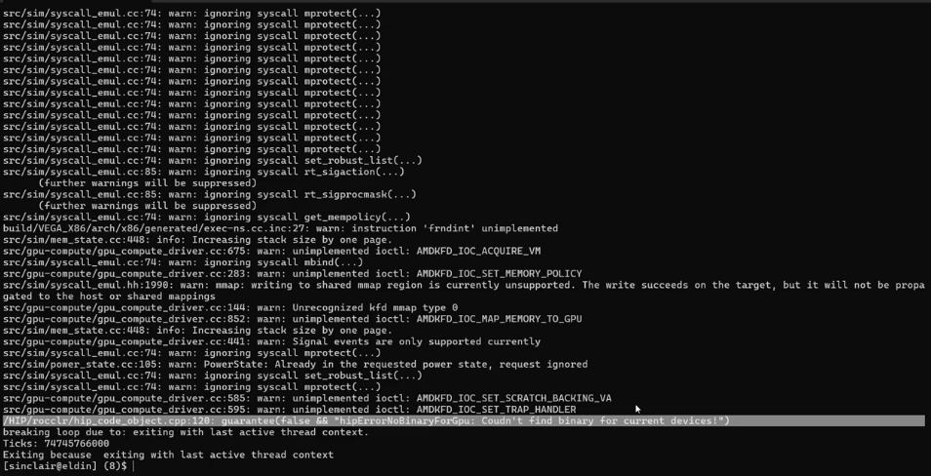
25.36 Running Square: Output Statistics
https://www.youtube.com/watch?v=Kjd1hTFOI44&list=PL_hVbFs_loVR_8ntTTmmG6YEq3Po_4snu&index=25
Running Square: Output Statistics (1:22:21 – 1:22:40/2:01:30)
Below are the compiled error messages:
> /HIP/rocclr/hip_code_object.cpp:120: guarantee(false && "hipErrorNoBinaryForGpu: Coudn't find binary for current devices!")
>> “Couldn’t” is a typo of “Couldn’t”
This error tells us the ROCm/HIP (Heterogeneous-compute Interface for Portability) application was compiled for a different GPU architecture than the one being simulated or used.

Slide 60
25.37 GPU Configuration Parameters

Slide 61
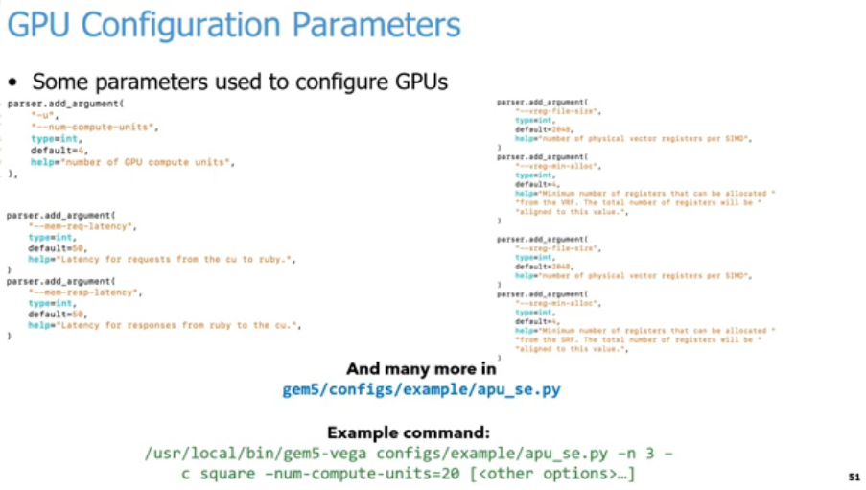
25.37 GPU Configuration Parameters
https://www.youtube.com/watch?v=Kjd1hTFOI44&list=PL_hVbFs_loVR_8ntTTmmG6YEq3Po_4snu&index=25
GPU Configuration Parameters (1:22:41 – 1:22:42/2:01:30)
Left column code:
> parser.add_argument ( "-u", "--num-compute-units",
> type=int, default=4, help="number of GPU compute units", ),
>
> parser.add_argument ("--mem-req-latency", type=int, default=50,
> help="Latency for requests from the cu to ruby.", )
>
> parser.add_argument ("--mem-resp-latency", type=int, default=50,
> help="Latency for responses from ruby to the cu.",)
Right column Codes:
> parser.add_argument ("--vreg-file-size", type=int, default=2048,
> help="number of physical vector registers per SIMD",)
>
> parser.add_argument ("--vreg-min-alloc", type=int, default=4,
> help="Minimum number of registers that can be allocated "
> "from the VRF. The total number of registers will be "
> "aligned to this value.",)
>
> parser.add_argument ("--sreg-file-size", type=int, default=2048,
> help="number of physical vector registers per SIMD",)
>
> parser.add_argument ("--sreg-min-alloc", type=int, default=4,
> help="Minimum number of registers that can be allocated "
> "from the SRF. The total number of registers will be "
> "aligned to this value.",)
1
4
5
2
6
3
7

Slide 62
25.37 GPU Configuration Parameters
https://www.youtube.com/watch?v=Kjd1hTFOI44&list=PL_hVbFs_loVR_8ntTTmmG6YEq3Po_4snu&index=25
GPU Configuration Parameters (1:22:43 – 1:23:00/2:01:30)
In GPUs SE (Syscall Emulation) Mode, gem5 has a large number of parameters to setup, for example, we can control:
1. the number of compute-units of GPUs,
2. the amount of latency of memory requests, the latency unit is “ticks”;
3. the amount of latency of requests and responses of memory, the latency unit is “tick”;
4. how big of register per SIMD (Single Instruction, Multiple Data) unit, the unit is the total number of vector registers (physical entry per SIMD unit); the size of each register is = 64 lanes x 4 bytes = 256 bytes;
5. the minimum number of registers allocated from VRF (Vector Register File), the VRF handles independent data for every single lane/thread in a wavefront;
6. the number of scalar registers per SIMD,
7. the minimum number of registers allocated from SRF (Scalar Register File), the SRF handles data that is uniform across the entire wavefront.
1
4
5
2
6
3
7

Slide 63
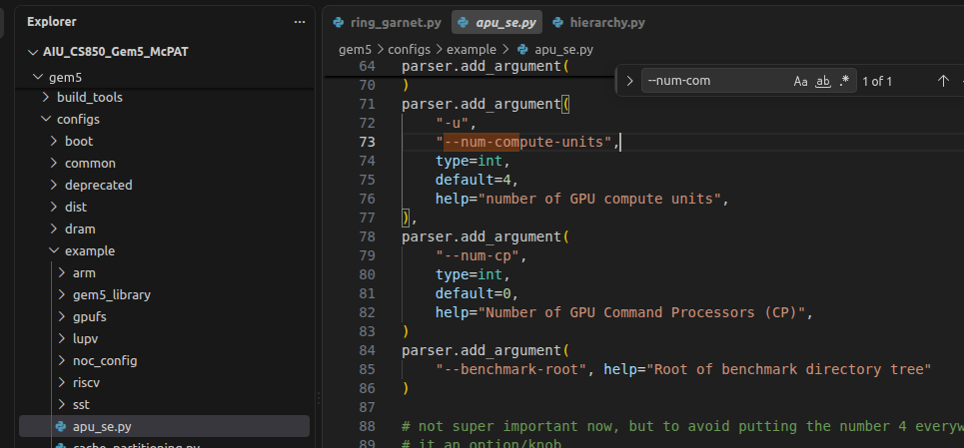
25.37 GPU Configuration Parameters
https://www.youtube.com/watch?v=Kjd1hTFOI44&list=PL_hVbFs_loVR_8ntTTmmG6YEq3Po_4snu&index=25
GPU Configuration Parameters (1:23:01 – 1:23:15/2:01:30)
8. We can look at the example in
> gem5/configs/example/apu_se.py
For example, the code on the right is to use the num-compute-units, we can call parser.add_argument (…) as below:
> parser.add_argument ("-u", "--num-compute-units", type=int, default=4,
> help="number of GPU compute units",),
Here the compute unit is set to default = 4.
9. We can change to 20 compute units with Linux Shell command.
1
4
5
2
6
3
7
8
9

Slide 64
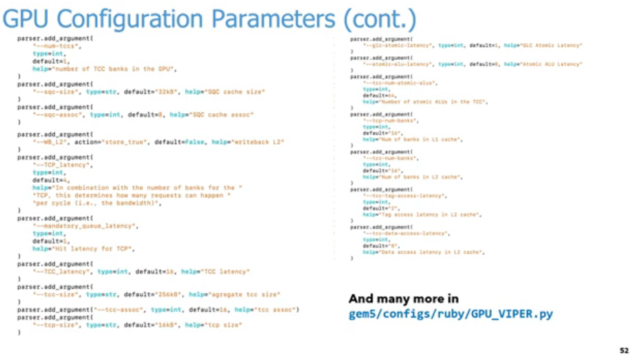
25.37 GPU Configuration Parameters
https://www.youtube.com/watch?v=Kjd1hTFOI44&list=PL_hVbFs_loVR_8ntTTmmG6YEq3Po_4snu&index=25
GPU Configuration Parameters (1:23:16 – 1:23:16/2:01:30)
Left Column Code:
> parser.add_argument ("--num-tccs", type=int,default=1, help="number of TCC banks in the GPU",)
> parser.add_argument ("--sqc-size", type=str, default="32kB", help="SQC cache size")
> parser.add_argument ("--sqc-assoc", type=int, default=8, help="SQC cache assoc")
> parser.add_argument ("--WB_L2", action="store_true", default=False, help="writeback L2")
> parser.add_argument ("--TCP_latency", type=int, default=4, help="In combination with the number of banks for the "
"TCP, this determines how many requests can happen " "per cycle (i.e., the bandwidth)",)
> parser.add_argument ("--mandatory_queue_latency", type=int,default=1,help="Hit latency for TCP",)
> parser.add_argument ("--TCC_latency", type=int, default=16, help="TCC latency")
> parser.add_argument("--tcc-size", type=str, default="256kB", help="aggregate tcc size")
> parser.add_argument("--tcc-assoc", type=int, default=16, help="tcc assoc")
> parser.add_argument("--tcp-size", type=str, default="16kB", help="tcp size")

Slide 65
25.37 GPU Configuration Parameters
https://www.youtube.com/watch?v=Kjd1hTFOI44&list=PL_hVbFs_loVR_8ntTTmmG6YEq3Po_4snu&index=25
GPU Configuration Parameters (1:23:17 – 1:23:17/2:01:30)
Right Column Code:
> parser.add_argument ("--glc-atomic-latency", type=int, default=1, help="GLC Atomic Latency")
> parser.add_argument("--atomic-alu-latency", type=int, default=8, help="Atomic ALU Latency")
> parser.add_argument("--tcc-num-atomic-alus", type=int,default=64, help="Number of atomic ALUs in the TCC",)
> parser.add_argument("--tcc-num-banks", type=int,default=16, help="Num of banks in l1 cache",)
> parser.add_argument("--tcc-num-banks", type=int,default=16,help="Num of banks in l2 cache",)
> parser.add_argument("--tcc-tag-access-latency", type=int,default=2, help="Tag access latency in L2 cache",)
> parser.add_argument("--tcc-data-access-latency", type=int,default=8,help="Data access latency in L2 cache",)
Bottom Right Note:
And many more ingem5/configs/ruby/GPU_VIPER.py

Slide 66
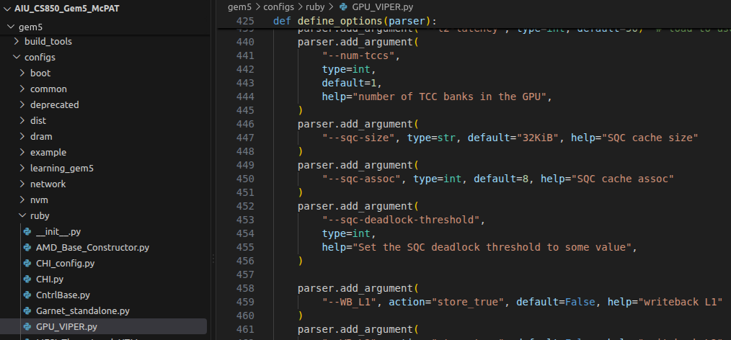
25.37 GPU Configuration Parameters
https://www.youtube.com/watch?v=Kjd1hTFOI44&list=PL_hVbFs_loVR_8ntTTmmG6YEq3Po_4snu&index=25
GPU Configuration Parameters (1:23:18 – 1:23:20/2:01:30)
Below, in ruby/GPU_VIPER.py, we have the configurations for the GPU cache and memory protocol.
Q. What is the difference between apu_se.py and GPU_VIPER.py?
Ans:
1. apu_se.py is a top-level system configuration script. It configures HIP (Heterogeneous-compute Interface for Portability) for a heterogeneous APU (Accelerated Processing Unit) simulation environment, managing high-level orchestration, such as Compute Units (CUs), setting up the ROCm parameters, and orchestrating overall simulation options in Syscall Emulation (SE) mode.
2. GPU_VIPER.py is a subsystem-specific cache protocol script. It configures detailed cache hierarchy and memory coherence mechanisms in the GPU Viper Protocol.

Slide 67
25.38 Run GPU in FS Mode

Slide 68
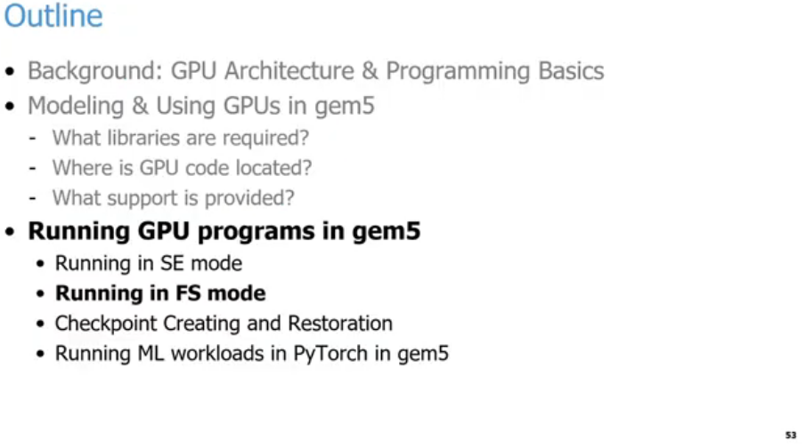
25.38 Run GPU in FS Mode
https://www.youtube.com/watch?v=Kjd1hTFOI44&list=PL_hVbFs_loVR_8ntTTmmG6YEq3Po_4snu&index=25
Run GPU in FS Mode (1:23:21 – 1:23:22/2:01:30)

Slide 69
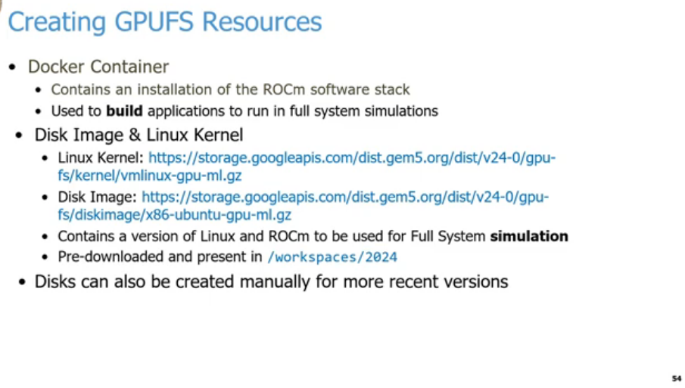
25.38 Run GPU in FS Mode
https://www.youtube.com/watch?v=Kjd1hTFOI44&list=PL_hVbFs_loVR_8ntTTmmG6YEq3Po_4snu&index=25
Run GPU in FS Mode (1:23:23 – 1:23:25/2:01:30)
This slide outlines the necessary steps and file links for Creating GPUFS (GPU Full System) Resources when setting up gem5 Full System GPU models. It breaks down the environments needed to build and execute machine learning or GPU workloads under architectural simulation.
1. Docker Container
  a. Contains a complete installation of the AMD ROCm software stack.
  b. Acts as the development environment used to build applications and compile binaries before deploying them into the simulator.
2. Disk Image & Linux Kernel: To run a Full System (FS) simulation, gem5 requires an isolated virtual kernel and OS filesystem:
  a. Linux Kernel: Downloadable via vmlinux-gpu-ml.gz.
  b. Disk Image: Downloadable via x86-ubuntu-gpu-ml.gz.
  c. Purpose: Provides a packaged version of Linux and ROCm tailored natively to execute target machine learning binaries during simulation.
  d. Environment: These files are pre-downloaded inside the /workspaces/2024 directory for bootcamp/tutorial environments.🛠
3. Manual Configuration
  a. Custom disk images can be built manually to test newer kernel versions or updated ROCm software stacks.01

Slide 70
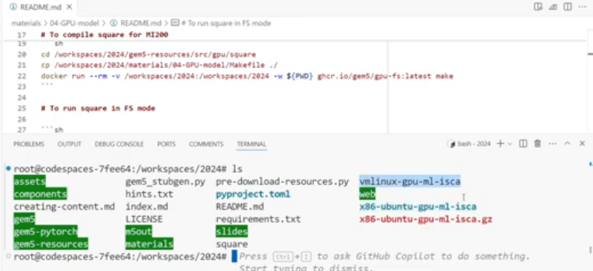
25.38 Run GPU in FS Mode
https://www.youtube.com/watch?v=Kjd1hTFOI44&list=PL_hVbFs_loVR_8ntTTmmG6YEq3Po_4snu&index=25
Run GPU in FS Mode (1:23:26 – 1:24:45/2:01:30)
1. Gem5 support ROCm 6.1 and Simulate ROCm stack. The Docker container contains an installation of ROCm software stack. We can use ROCm Stack to build the application that we are going to run our GPUFS simulation.
2. There are two important parts: Linux Kernel and disk image. We can download the disk image or Linux kernel
  a. Linux Kernel: Downloadable via vmlinux-gpu-ml.gz.
  b. Disk Image: Downloadable via x86-ubuntu-gpu-ml.gz.
  c. There are version of Linux and ROCm for full simulation.
  d. In the gem5-resource and material. There are GPU examples run and make GPU model.
  > bootcamp/gem5-resources/src/gpu/square
  > bootcamp/materials/04-GPU-model/Makefile
1
2

Slide 71
25.39 Build Square for GPU-FS

Slide 72

25.39 Build Square for GPU-FS
https://www.youtube.com/watch?v=Kjd1hTFOI44&list=PL_hVbFs_loVR_8ntTTmmG6YEq3Po_4snu&index=25
Run GPU in FS Mode (1:24:46 – 1:25:47/2:01:30)
2. Build GPU-FS”
a. Go to Square work director
> cd gem5-resource/src/gpu/square
b. Copy Makefile to wok directory
> cp materials/04-GPU-model/Makefile .
c. Remove previous docker run environment in workspace-path and re-recreate latest docker run environment.
Note:
a. ghcr (GitHub Container Register) store the latest Gem5’s image.
b. The command ghcr.io/gem5/gpu-fs:latest compile applications for gem5’s pre-built Docker container image to run in GPU Full-System (GPUFS)
> docker run --rm -v <workspace-path> -w ${PWD} ghcr.io/gem5/gpu-fs:latest make
1
2

Slide 73



25.39 Build Square for GPU-FS
https://www.youtube.com/watch?v=Kjd1hTFOI44&list=PL_hVbFs_loVR_8ntTTmmG6YEq3Po_4snu&index=25
Run GPU in FS Mode (1:24:48 – 1:26:00/2:01:30)
Now, we take the exact same application Square that we run in GPU-SE (Syscall Emulation).
We will run it in GPU-FS (Full System).
1. Compile the m5ops (m5/gem5 opcodes) binary for gem5 from m5 project (FS Mode has different binary from SE mode.
> cd gem5/util/m5
> scons build/x86/out/m5 # build the gem5/util/build/x86/out/[libm5.a, m5] binary
> cd build/x86/out
> ls -l
>> libm5.a # m5 binary library compiled for C++ static C library
>> m5 # m5 binary for command utility, such as, m5 exit, m5 checkpoint in guest terminal
1
2

Slide 74
25.39 Build Square for GPU-FS
https://www.youtube.com/watch?v=Kjd1hTFOI44&list=PL_hVbFs_loVR_8ntTTmmG6YEq3Po_4snu&index=25
Run GPU in FS Mode (1:24:48 – 1:25:30/2:01:30)
2. We run square in gem5-resources/src/gpu/square with docker run
a. change to working directory (gem5-resources/src/gpu/square)
> cd ~/gem5-resources/src/gpu/square
b. Copy GPU-FS Makefile from bootcamp directory (~bootcamp/materials/04-GPU-model/Makefile) to working directory (cd ~/gem5-resources/src/gpu/square)
> cp ~bootcamp/materials/04-GPU-model/Makefile .
c. Use docker run command to generate and run
> docker run --rm -v <workspace-path> -w ${PWD} ghcr.io/gem5/gpu-fs:latest make
Note:
c.1 --rm -v <workspace-path>: Remove previous docker run environment in workspace-path
c.2 ghcr.io (GitHub Container Registry): Get the latest gem5 image from GitHub.
c.3 make: Recreate the new docker environment
1
2

Slide 75


25.39 Build Square for GPU-FS
https://www.youtube.com/watch?v=Kjd1hTFOI44&list=PL_hVbFs_loVR_8ntTTmmG6YEq3Po_4snu&index=25
Run GPU in FS Mode (1:25:31 – 1:25:50/2:01:30)
1. Modify README.md file
2. Generate m5ops
1
2

Slide 76


25.39 Build Square for GPU-FS
https://www.youtube.com/watch?v=Kjd1hTFOI44&list=PL_hVbFs_loVR_8ntTTmmG6YEq3Po_4snu&index=25
Run GPU in FS Mode (1:25:51 – 1:27:50/2:01:30)
4. Change to gpu square application working directory
5. Copy Makefile to working directory
6. Use “docker run” command to run application.
7. Running.,.,
4
5
6
7

Slide 77
25.40 Run GPU-FS Without Docker

Slide 78

25.40 Run GPU-FS Without Docker
https://www.youtube.com/watch?v=Kjd1hTFOI44&list=PL_hVbFs_loVR_8ntTTmmG6YEq3Po_4snu&index=25
Run GPU-FS Without Docker (1:27:51 – 1:27:52/2:01:30)
Docker environment is easier for user to run gem5. This is the recommended way.
If we compile without error, we can run GPU-FS without docker.
Parameter Breakdown:
a. --app: Path to the target binary application.
b. --disk-image: Simulated operating system storage image file.
c. --kernel: Pre-built Linux kernel vmlinux file.
d. --no-kvm-perf: Performance tracking flag configuration.

Slide 79
25.40 Run GPU-FS Without Docker
https://www.youtube.com/watch?v=Kjd1hTFOI44&list=PL_hVbFs_loVR_8ntTTmmG6YEq3Po_4snu&index=25
Run GPU-FS Without Docker (1:27:53 – 1:28:00/2:01:30)
1. In GPU-SE mode, we technically can only use Docker pre-built image due to complicated ROCm stack.
2. In GPU-FS mode, can run both without and with Docker pre-built image. The user most likely compiles the benchmark by himself. The libraries are part of the disk image.
> /usr/local/bin/gem5-vega gem5/configs/example/gpufs/mi200.py --app ./gem5-resources/src/gpu/square/bin/square --disk-image ./x86-ubuntu-gpu-ml-isca --kernel ./vmlinux-gpu-ml-isca --no-kvm-perf

Slide 80
25.40 Run GPU-FS Without Docker
https://www.youtube.com/watch?v=Kjd1hTFOI44&list=PL_hVbFs_loVR_8ntTTmmG6YEq3Po_4snu&index=25
Run GPU-FS Without Docker (1:28:01 – 1:28:20/2:01:30)
For GPU-FS mode,
a. Once we download the disk image, we can run the following in the command line without any Docker.
b. We just need to download the disk image before we run.
c. We have pre-built Vega, therefore, we do not need to run scons to build. gem5-Vega is in the user/local/bin.
d. We have config file mi200.py.
e. We are still running application Square which is compiled previously.
> /usr/local/bin/gem5-vega gem5/configs/example/gpufs/mi200.py --app ./gem5-resources/src/gpu/square/bin/square --disk-image ./x86-ubuntu-gpu-ml-isca --kernel ./vmlinux-gpu-ml-isca --no-kvm-perf

Slide 81
25.40 Run GPU-FS Without Docker
https://www.youtube.com/watch?v=Kjd1hTFOI44&list=PL_hVbFs_loVR_8ntTTmmG6YEq3Po_4snu&index=25
Run GPU-FS Without Docker (1:28:21 – 1:29:25/2:01:30)
f. Now, we have flags for disk image and kernel. These two files are used to run container. The kernel will bring in ROCm 6.1 stack.
g. The last flag is “--no-kvm-perf”. This flag does decouple the application from host machine with KVM support. We don’t need to update the KVM hardware.
> /usr/local/bin/gem5-vega gem5/configs/example/gpufs/mi200.py --app ./gem5-resources/src/gpu/square/bin/square --disk-image ./x86-ubuntu-gpu-ml-isca --kernel ./vmlinux-gpu-ml-isca --no-kvm-perf

Slide 82


25.40 Run GPU-FS Without Docker
https://www.youtube.com/watch?v=Kjd1hTFOI44&list=PL_hVbFs_loVR_8ntTTmmG6YEq3Po_4snu&index=25
Run GPU-FS Without Docker (1:29:26 – 1:30:40/2:01:30)
Below
> cd <work directory>
Run command:
> /usr/local/bin/gem5-vega gem5/configs/example/gpufs/mi200.py --app ./gem5-resources/src/gpu/square/bin/square --disk-image ./x86-ubuntu-gpu-ml-isca --kernel ./vmlinux-gpu-ml-isca –no-kvm-perf
It takes a couple of minutes to run.

Slide 83

25.40 Run GPU-FS Without Docker
https://www.youtube.com/watch?v=Kjd1hTFOI44&list=PL_hVbFs_loVR_8ntTTmmG6YEq3Po_4snu&index=25
Run GPU-FS Without Docker (1:30:41 – 1:31:15/2:01:30)
The results are in m5out/system.pc.com_1.device

Slide 84
25.41 Compile MFMA Operations in GPUFS

Slide 85


25.41 Compile MFMA Operations in GPUFS
https://www.youtube.com/watch?v=Kjd1hTFOI44&list=PL_hVbFs_loVR_8ntTTmmG6YEq3Po_4snu&index=25
Compile MFMA Operations in GPUFS (1:31:16 – 1:31:17/2:01:30)
Q. What is difference between the Square and MFMA (Matrix Fused Multiply-Add)
Ans: Square only do C = A x B. MFMA does D = A x B + C.

Slide 86
25.41 Compile MFMA Operations in GPUFS
https://www.youtube.com/watch?v=Kjd1hTFOI44&list=PL_hVbFs_loVR_8ntTTmmG6YEq3Po_4snu&index=25
Compile MFMA Operations in GPUFS (1:31:16 – 1:32:35/2:01:30)
Run MFMA (Matrix Fused Multiply-Add) operations in the gem5 GPU Full-System simulation.
Below, we use mi200.py to do MFMA (D = A x B + C) calculation for 32 bits operation. Everything else are very similar to Square before.
1. Navigate to the working directory
> cd /workspaces/2024/
2. Copy the source materials into the gem5-resources directory
> cp -r materials/04-GPU-model/mfma_fp32/ gem5-resources/src/gpu/mfma_fp32
3. Move into the copied directory
> cd gem5-resources/src/gpu/mfma_fp32
4. Compile the MFMA source code using the gem5 GPU Docker container
> docker run --rm -v /workspaces/2024:/workspaces/2024 -w ${PWD} ghcr.io/gem5/gpu-fs:latest make
5. Return to the main workspace root
> cd /workspaces/2024/
6. Run the gem5 full-system simulation targeting an AMD MI200 GPU
> /usr/local/bin/gem5-vega -d mfma_out1 gem5/configs/example/gpufs/mi200.py
> --kernel ./vmlinux-gpu-ml-isca --disk-image ./x86-ubuntu-gpu-ml-isca
> --app ./gem5-resources/src/gpu/mfma_fp32/mfma_fp32_32x32x2fp32 --no-kvm-perf

Slide 87


25.41 Compile MFMA Operations in GPUFS
https://www.youtube.com/watch?v=Kjd1hTFOI44&list=PL_hVbFs_loVR_8ntTTmmG6YEq3Po_4snu&index=25
Compile MFMA Operations in GPUFS (1:31:16 – 1:32:30/2:01:30)
In mfma_fp32_32x32x2fp32.cp, we call __builtin_amdgcn_mfma_f32_32x32x2f32(a, b, d, 0, 0, 0)
Amdgcn (AMD Graphic Core Next) is software tool to generate code for AMD GPUs (Graphic Processing Units).
> ~materials/04-GPU-model/mfma_f32/src/mfma_f32_32x32x2fp32.cpp

Slide 88

25.41 Compile MFMA Operations in GPUFS
https://www.youtube.com/watch?v=Kjd1hTFOI44&list=PL_hVbFs_loVR_8ntTTmmG6YEq3Po_4snu&index=25
Compile MFMA Operations in GPUFS (1:32:31 - 1:32:50/2:01:30)
In the massive “N x M problem” (N programming languages and M types of hardware chips, we need LLVM (Low Level Virtual machine).
LLVM is a universal, modular middle man. LLVM shared a universal language called LLVM IR (Intermediate Representation). LLVM translates the IR into machine code for any hardware chip.

Slide 89

25.41 Compile MFMA Operations in GPUFS
https://www.youtube.com/watch?v=Kjd1hTFOI44&list=PL_hVbFs_loVR_8ntTTmmG6YEq3Po_4snu&index=25
Compile MFMA Operations in GPUFS (1:32:51 - 1:33:30/2:01:30)
Here, we are using the __built_amdgcn_mfma_f32_32x32x2f32() function to perform the LLVM (Low Level Virtual Machine) for matrix calculation for different machines.
This call is for AMD GCN (Graphic Core Next), MFMA (Matrix Fused Multiply-Add), f32 (Accumulator/Output, Floating point 32 bits), 32 x 32 x 2 (M x N x K, A = 32 x2 , B = 2 x 32, C = 32 x 32), f32 (Input 32 bit floating point)

Slide 90


25.41 Compile MFMA Operations in GPUFS
https://www.youtube.com/watch?v=Kjd1hTFOI44&list=PL_hVbFs_loVR_8ntTTmmG6YEq3Po_4snu&index=25
Compile MFMA Operations in GPUFS (1:33:31 - 1:36:25/2:01:30)
> cd <work directory>
> cp -r <code> # Copy code from materials to gem5-resources/gpu/mfma_fp32
> cd <mfma_fp32> # Change to mfma_fp32 directory
> docker run … make # Compile mi200 for MFMA (Matrix Fused Multiply-Add)

Slide 91
25.42 Run MFMA Operations in GPUFS

Slide 92



25.42 Run MFMA Operations in GPUFS
https://www.youtube.com/watch?v=Kjd1hTFOI44&list=PL_hVbFs_loVR_8ntTTmmG6YEq3Po_4snu&index=25
Run MFMA Operations in GPUFS (1:36:26 - 1:37:15/2:01:30)
GPU model has a wide variety of different configuration operations.
Below are the commands for simple register allocation (run one wavefront at a time on a given computer unit) and dynamic register allocation (that uses all the resource at the same time).
1. The left slide image,
2. Right top (video images README.md, line 57 to 58), and
3. Right bottom (MS-code image README.md, line 41 to 42).
1
2
3

Slide 93
25.42 Run MFMA Operations in GPUFS
https://www.youtube.com/watch?v=Kjd1hTFOI44&list=PL_hVbFs_loVR_8ntTTmmG6YEq3Po_4snu&index=25
Run MFMA Operations in GPUFS (1:37:26 - 1:37:55/2:01:30)
1. The “-d” flag is to specify different output directory for output simple and output.
2. The “--reg-alloc-policy” specifies the register allocation policy.

Slide 94

25.42 Run MFMA Operations in GPUFS
https://www.youtube.com/watch?v=Kjd1hTFOI44&list=PL_hVbFs_loVR_8ntTTmmG6YEq3Po_4snu&index=25
Run MFMA Operations in GPUFS (1:37:56 - 1:38:05/2:01:30)
After we run the simple register allocation and dynamic register allocation, we should have two directories, mfma-outsimple and mfma-outdyn.

Slide 95

25.42 Run MFMA Operations in GPUFS
https://www.youtube.com/watch?v=Kjd1hTFOI44&list=PL_hVbFs_loVR_8ntTTmmG6YEq3Po_4snu&index=25
Run MFMA Operations in GPUFS (1:38:06 - 1:39:20/2:01:30)
> grep “shaderActiveTicks” mfma-outdyn/stats.txt
>> shaderActiveTicks 34798997
> grep “shaderActiveTicks” mfma-outsimple/stats.txt
>> shaderActiveTicks 63451997
Run time formulas: Execution time = Total Tick x Tick Frequency
If we run dynamic register allocator (tick = 34798997) which is less than a simple register allocator (tick = 63451997).
We get about half of the run time or double the performance for the same application MFMA.

Slide 96
End

